Slide 1
Particle Accelerators and Beam Dynamics
Accelerator & Technology Sector
Beams Department
Accelerator Beam Physics Group
F. Asvesta & T. Prebibaj
Eurolabs 2025

Slide 2
Disclaimer
Based on:
K. Schindl: “Space charge”
S. Albright: “Longitudinal Optimisations for Space Charge Reduction in the CERN PSB”
Y. Papaphilippou : “Introduction to Accelerators”
Summer student lectures:
  B. Holzer, V. Kain, and M. Schaumann
CERN accelerator school (CAS):
  F. Tecker: “Longitudinal beam dynamics”
  G. Rumolo, K.Li : “Instabilities Part I: Introduction – multiparticle systems, macroparticle models and wake functions”
  X. Buffat and T. Pieloni: “Beam-beam effects”
Joint Universities Accelerator School (JUAS):
  F. Antoniou, H. Bartosik and Y. Papaphilippou: “Linear imperfections” and “nonlinear dynamics”
Books:
  K. Wille: “The Physics of Particle Accelerators”
  S.Y. Lee: “Accelerator Physics”
  A. Wolski: “Beam Dynamics in High Energy Particle Accelerators”
  H. Wiedemann: “Particle Accelerator Physics”
Images: cds.cern.ch

Slide 3
Overview
Introduction/Reminder
  Transverse beam dynamics
CERN accelerator complex
  Proton Synchrotron Booster
    Space charge
  Proton Synchrotron
    Tailoring of bunches
  Super Proton Synchrotron
    Instabilities
  Large Hadron Collider
    Beam-beam effects

Slide 4
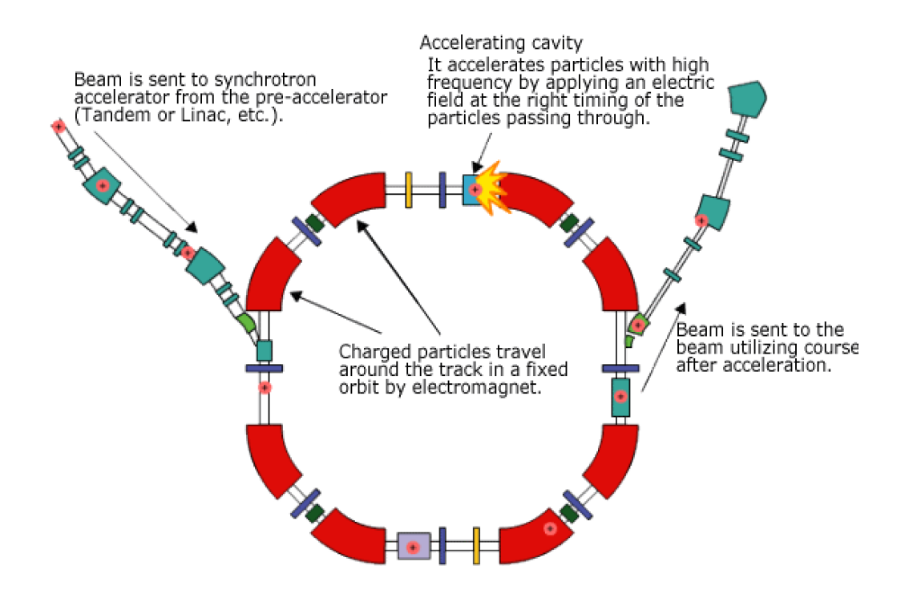
Synchrotron
The most common accelerator
Fixed beam trajectory | magnetic field changes synchronous to the energy
Magnets around the beam path to control the motion | bending (dipoles) & focusing (quadrupoles)
Electric fields used to accelerate (RF cavity) the beam

Slide 5

Transverse motion – Field expansion
y
In a synchrotron we want to study particles on the design orbit
Magnetic fields are present all along s
The magnetic field at the vicinity of the particle can be expanded as:
x
s
design orbit
ρ
$$\frac{e}{p}B_{y}\left(x\right)={\frac{e}{p}B}_{y0}+\frac{e}{p}\frac{{dB}_{y}}{dx}x+\frac{1}{2!}\frac{e}{p}\frac{d^{2}B_{y}}{{dx}^{2}}x^{2}+\frac{1}{3!}\frac{e}{p}\frac{d^{3}B_{y}}{{dx}^{3}}x^{3}+…=\frac{1}{r}+kx+\frac{1}{2!}mx^{2}+\frac{1}{3!}ox^{3}+…$$
Linear terms
Higher order terms
Dipole
Quadrupole
Sextupole
Octupole
$$…$$
Sufficient terms for a synchrotron

Slide 6
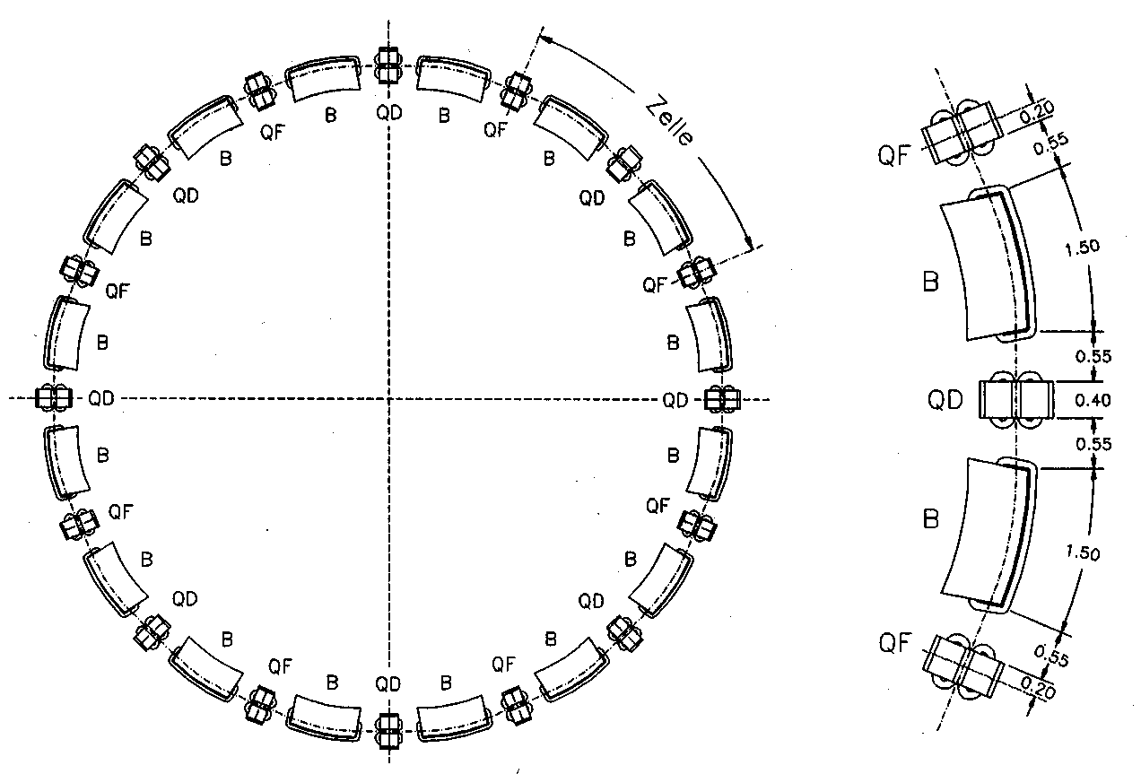
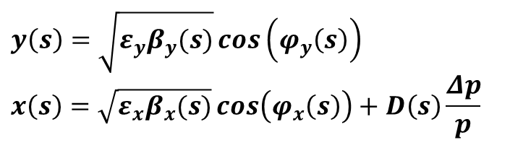
Transverse motion – FODO
The equations of motion moving along the FODO structure:
Dispersive contribution
Quadrupole contribution
(strong focusing)
Dipole contribution (weak focusing)
Setting and we obtain Hill’s equations, with K_{x,y}(s) depending on the position s and K_{x,y}(s+L) = K_{x,y}(s) periodic functions, where L is the periodicity
Solutions describe a quasi harmonic oscillation, where amplitude, phase (and dispersion) depend on the position s in the ring
$$y\left(s\right)=\sqrt{ε_{y}β_{y}(s)}\cos\left(φ_{y}\left(s\right)\right)$$
$$x\left(s\right)=\sqrt{ε_{x}β_{x}(s)}\cos\left(φ_{x}\left(s\right)\right)+D\left(s\right)\frac{Δp}{p}$$

Slide 7
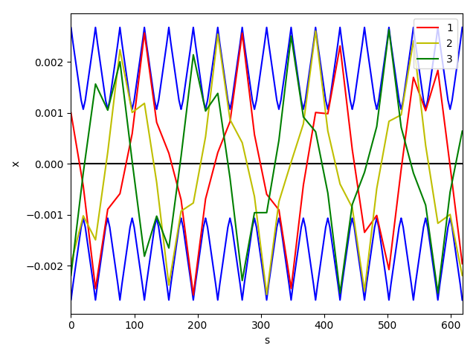
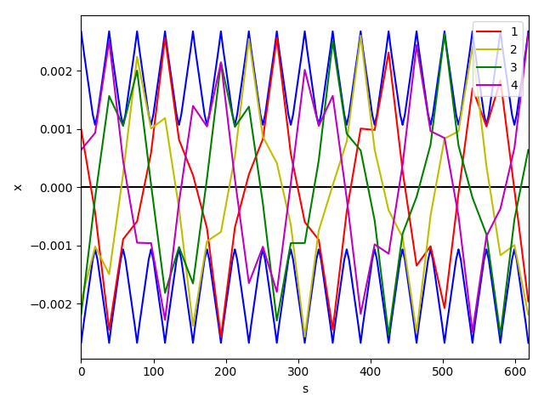
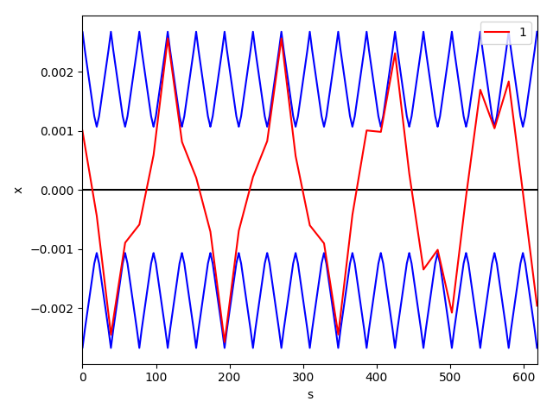
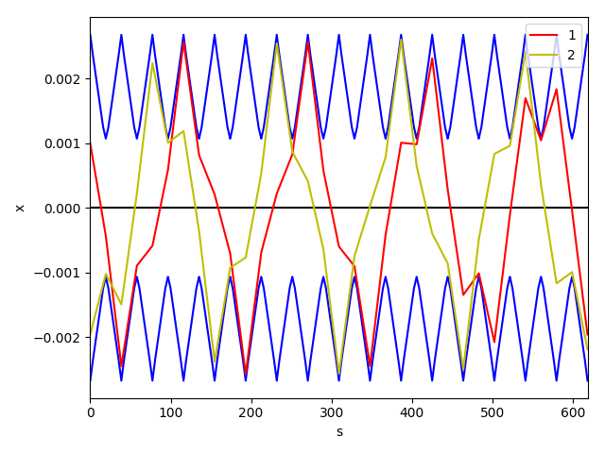
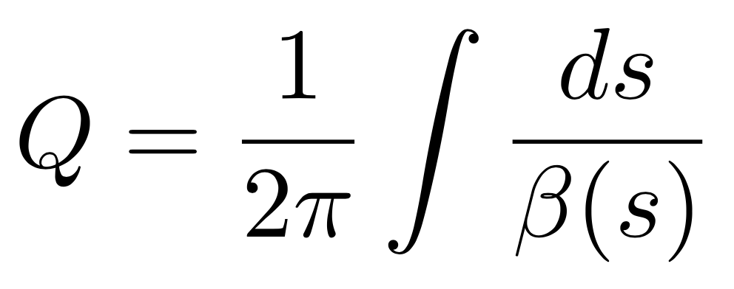
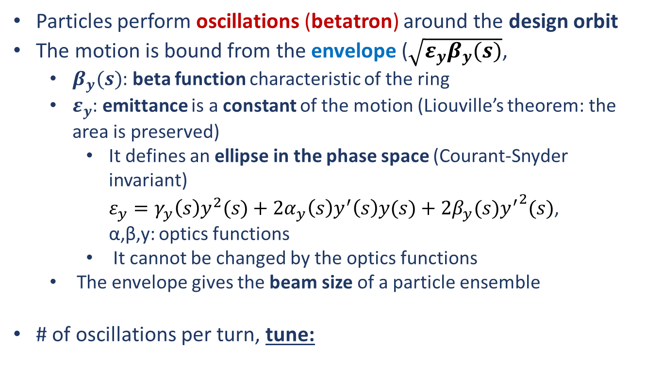
Transverse motion – betatron oscillations
Particles perform oscillations (betatron) around the design orbit
The motion is bound from the envelope ($\sqrt{ε_{y}β_{y}(s)}$,
  $β_{y}(s)$: beta function characteristic of the ring
  $ε_{y}$: emittance is a constant of the motion (Liouville’s theorem: the area is preserved)
    It defines an ellipse in the phase space (Courant-Snyder invariant)
    $ε_{y}=γ_{y}{\left(s\right)y}^{2}(s)+2α_{y}\left(s\right)y^{′}\left(s\right)y(s)+2β_{y}(s){y^{′}}^{2}(s)$,
  α,β,y: optics functions
    It cannot be changed by the optics functions
  The envelope gives the beam size of a particle ensemble
# of oscillations per turn, tune:
y[m]
s [m]

Slide 8
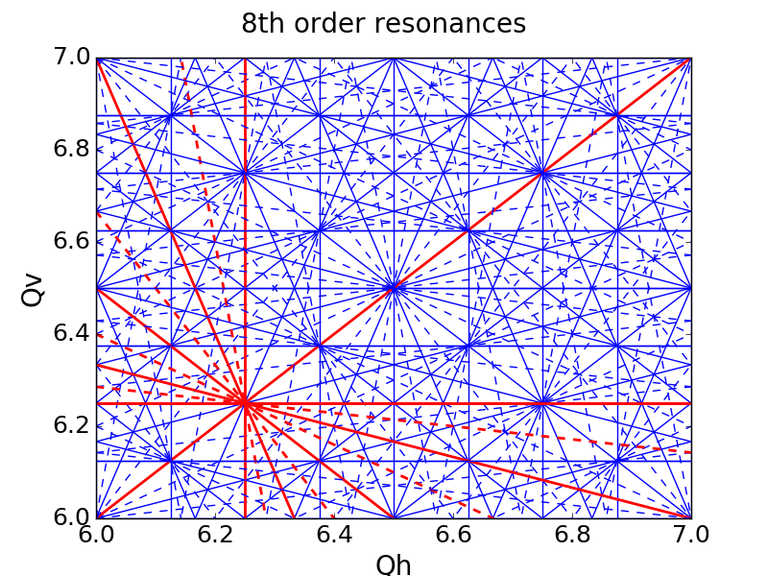
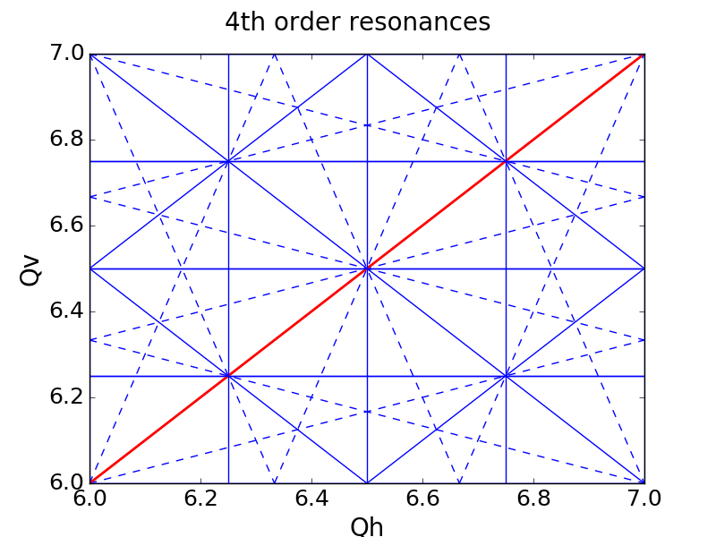
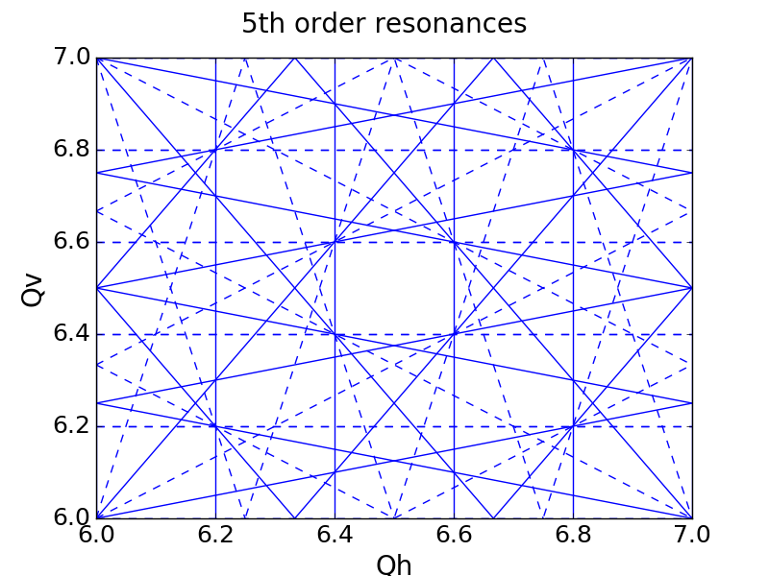
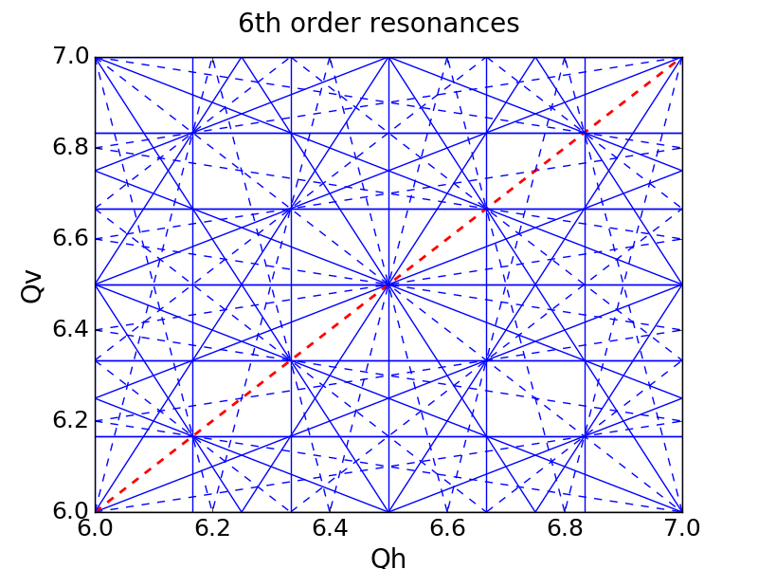
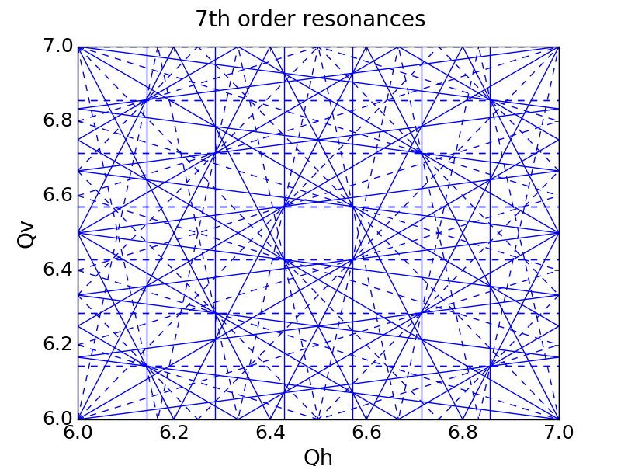
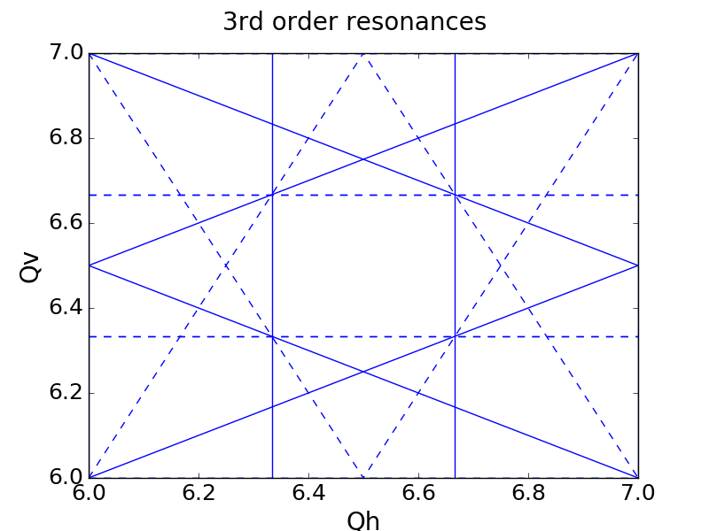
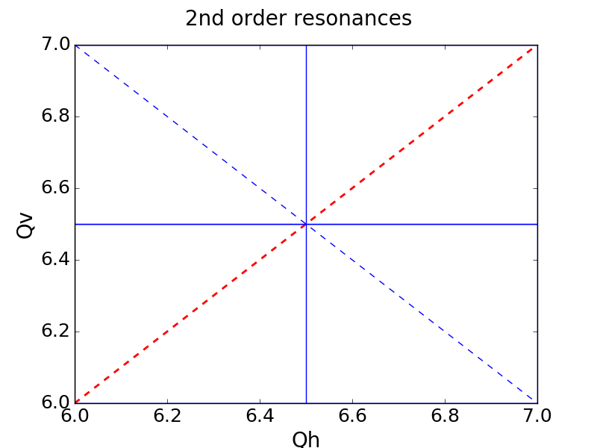
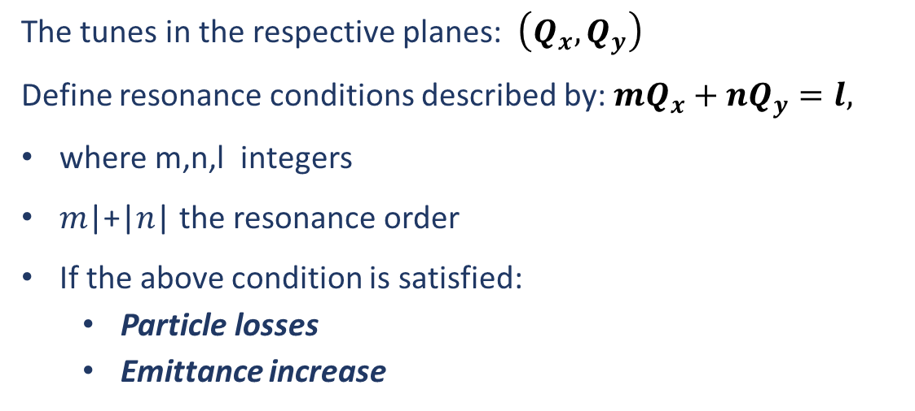
Resonances
The tunes in the respective planes: $\left(Q_{x},Q_{y}\right)$
Define resonance conditions described by: $mQ_{x}+nQ_{y}=l,$
where m,n,l integers
𝑚|+|𝑛| the resonance order
If the above condition is satisfied:
  Particle losses
  Emittance increase
Resonances | Machine Periodicity
Magnetic Field Component
 | Systematic | Non Systematic
Skew
Normal

Slide 9


Magnetic Field Component
Normal components become skew when rotated by half the rotation symmetry
Normal Quadrupole
$45°$ Rotation
Skew Quadrupole
Normal Sextupole
$30°$ Rotation
Skew Sextupole
Plots from:
T. Satogata et al., "Magnets and Magnet Technology", USPAS2013

Slide 10
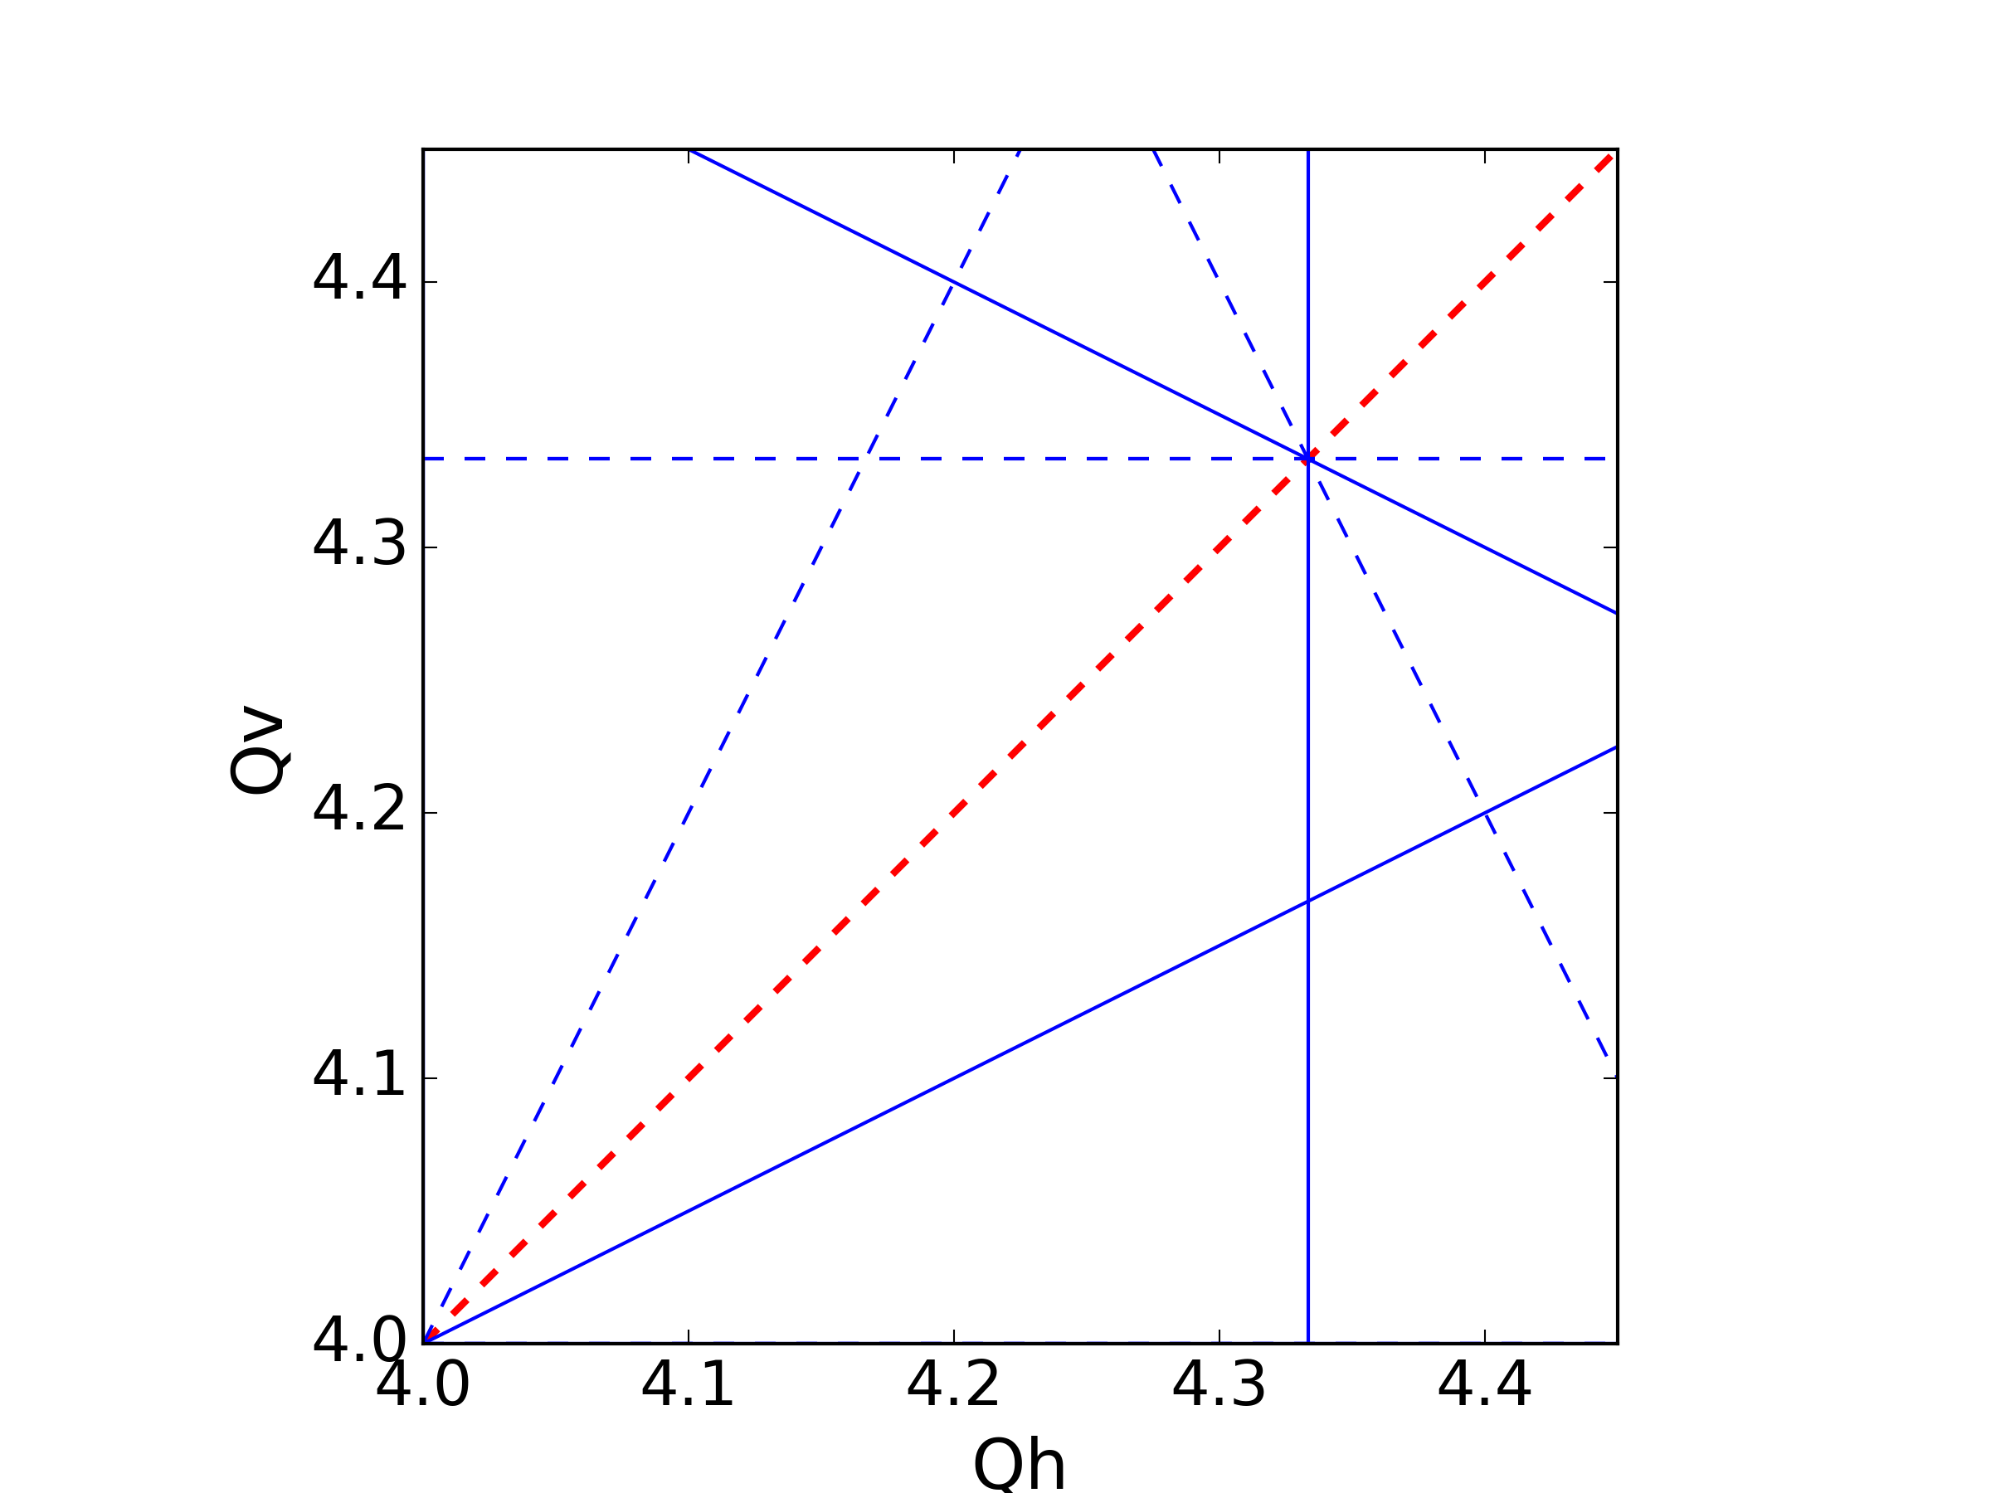
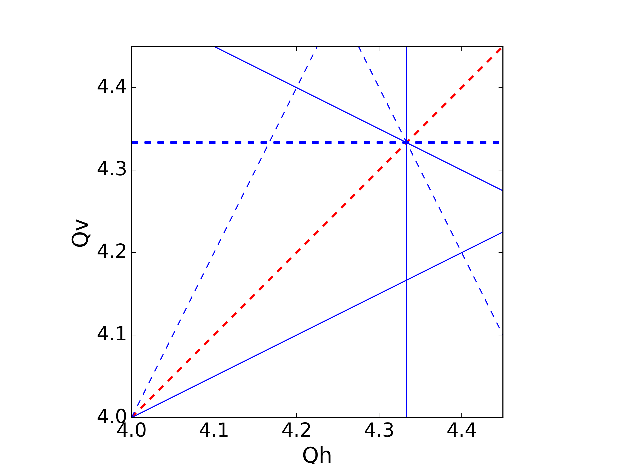
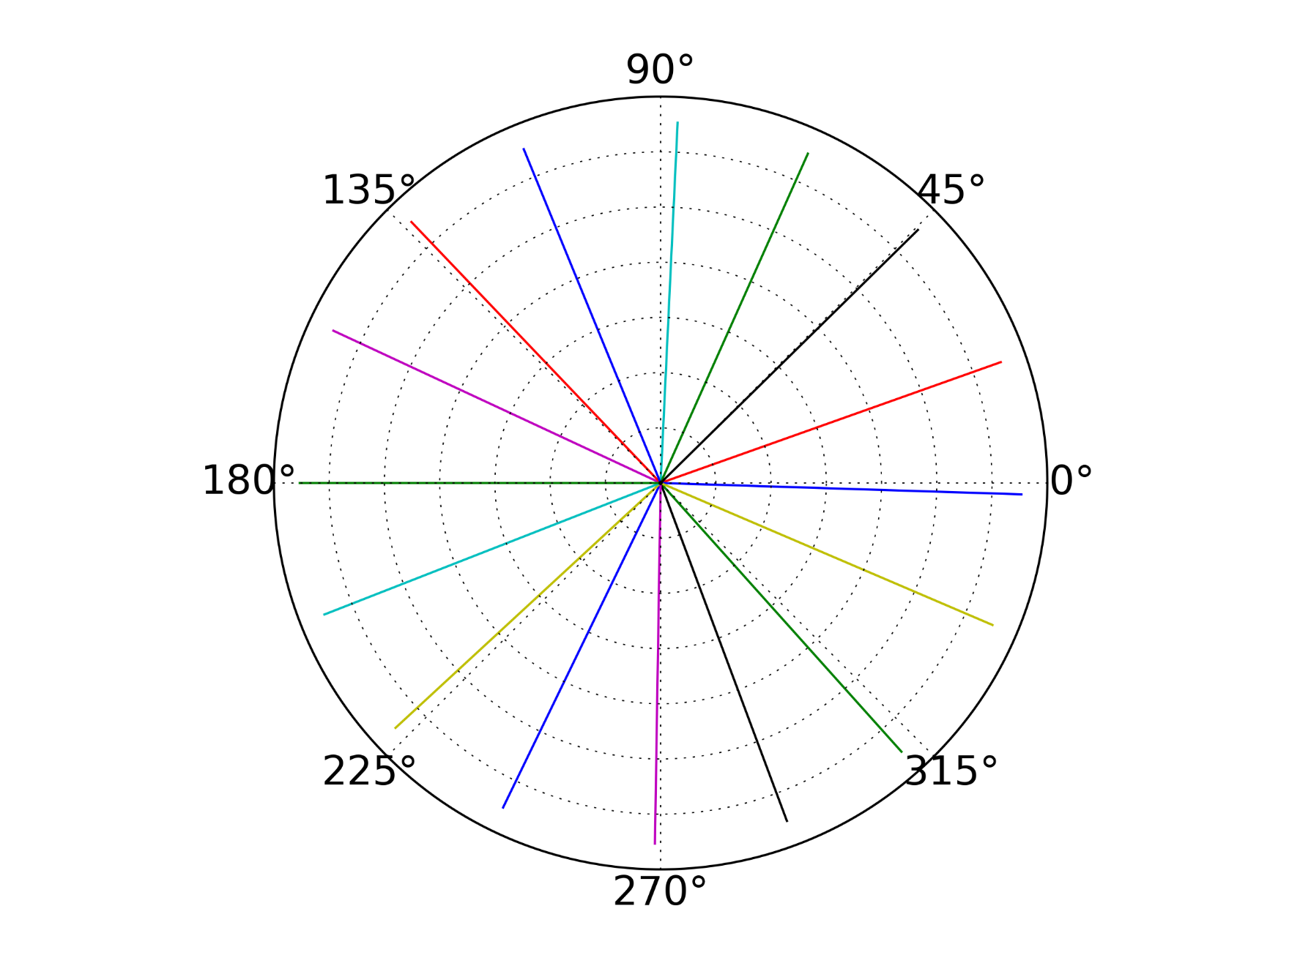


Machine Periodicity
Non-Systematic Resonance
$$3Q_{v}=13$$
$16$ cells
The errors cancel out due to the periodicity

Slide 11
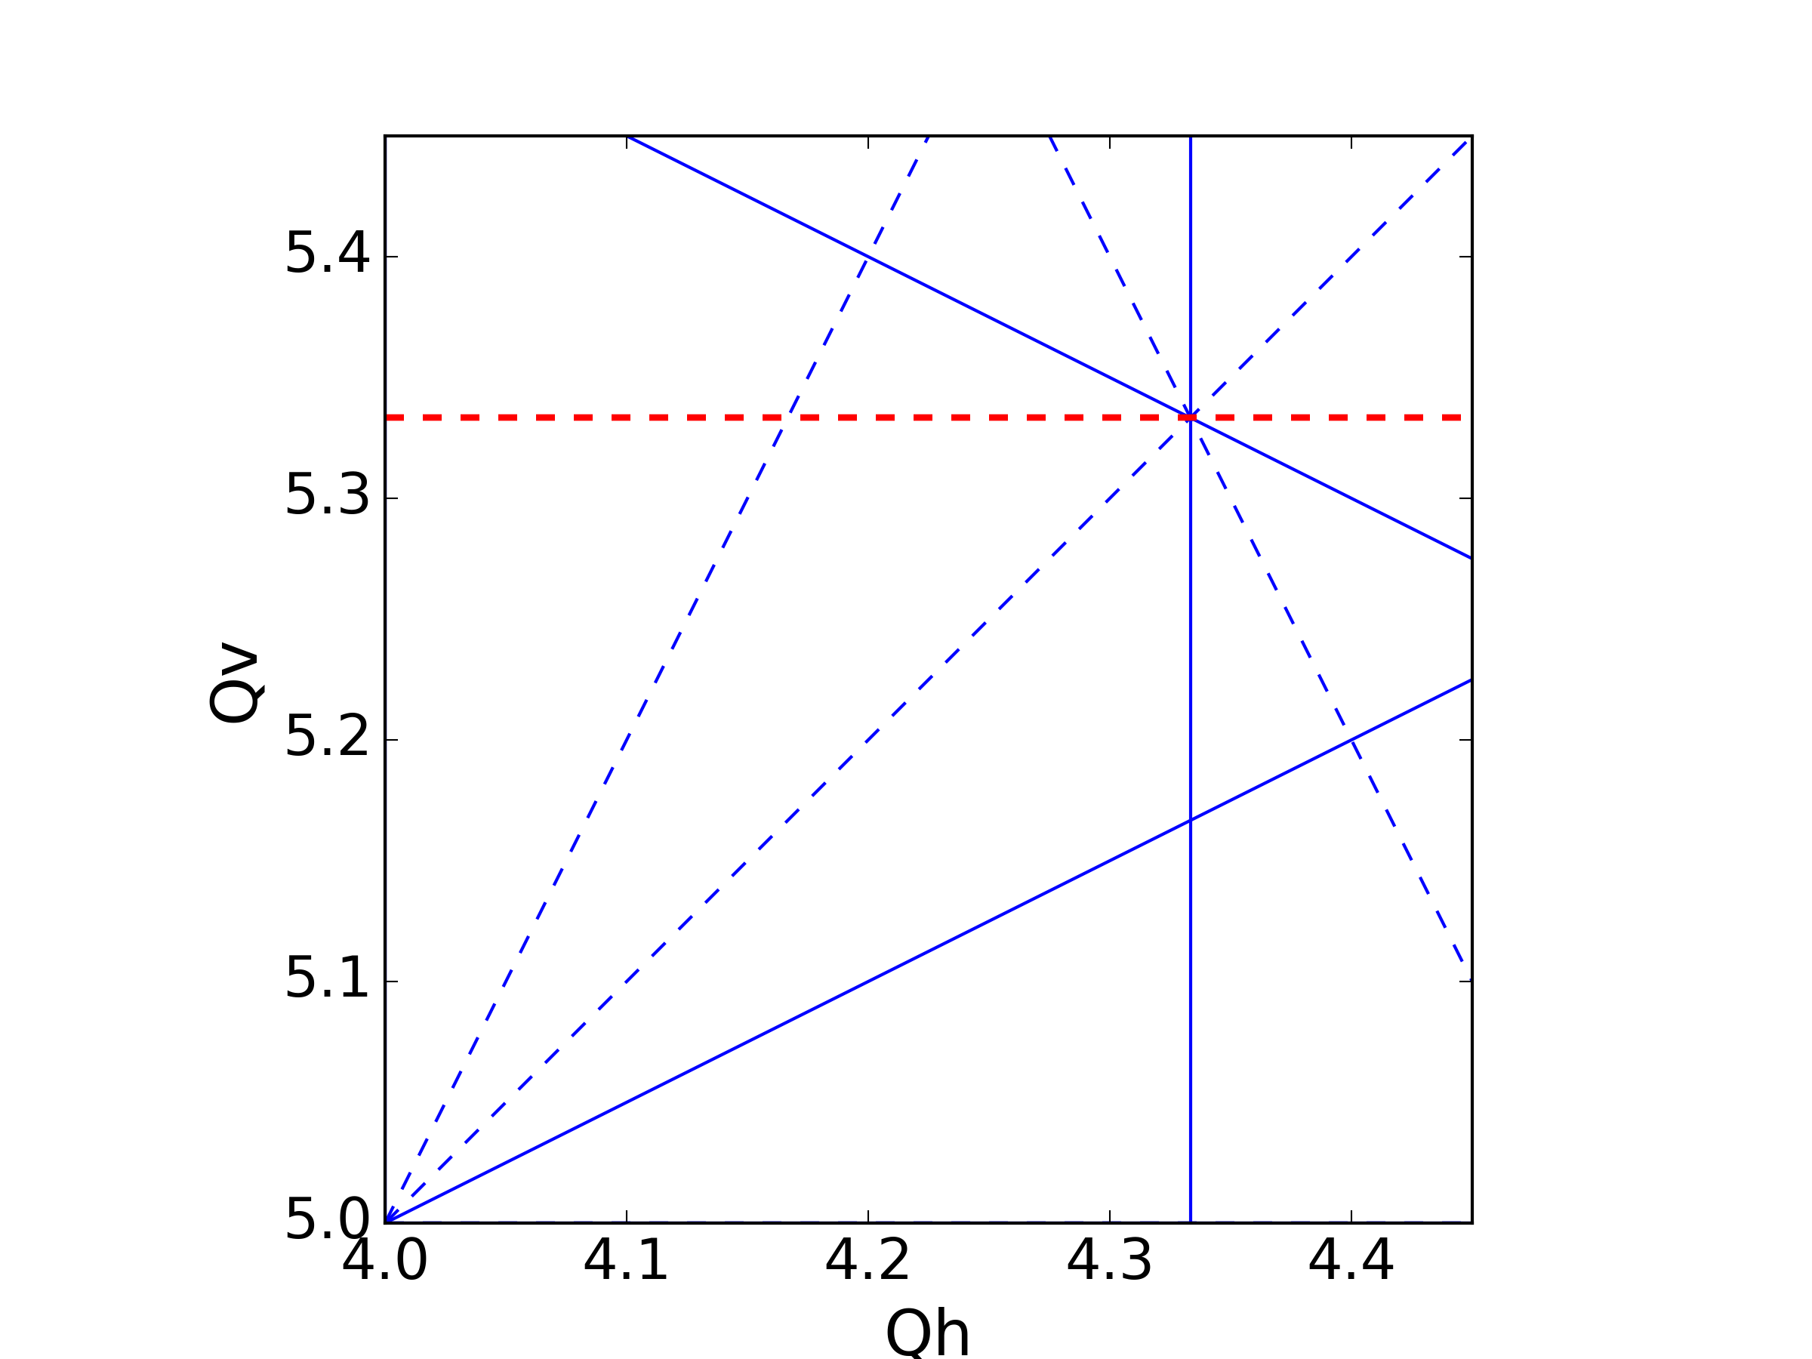
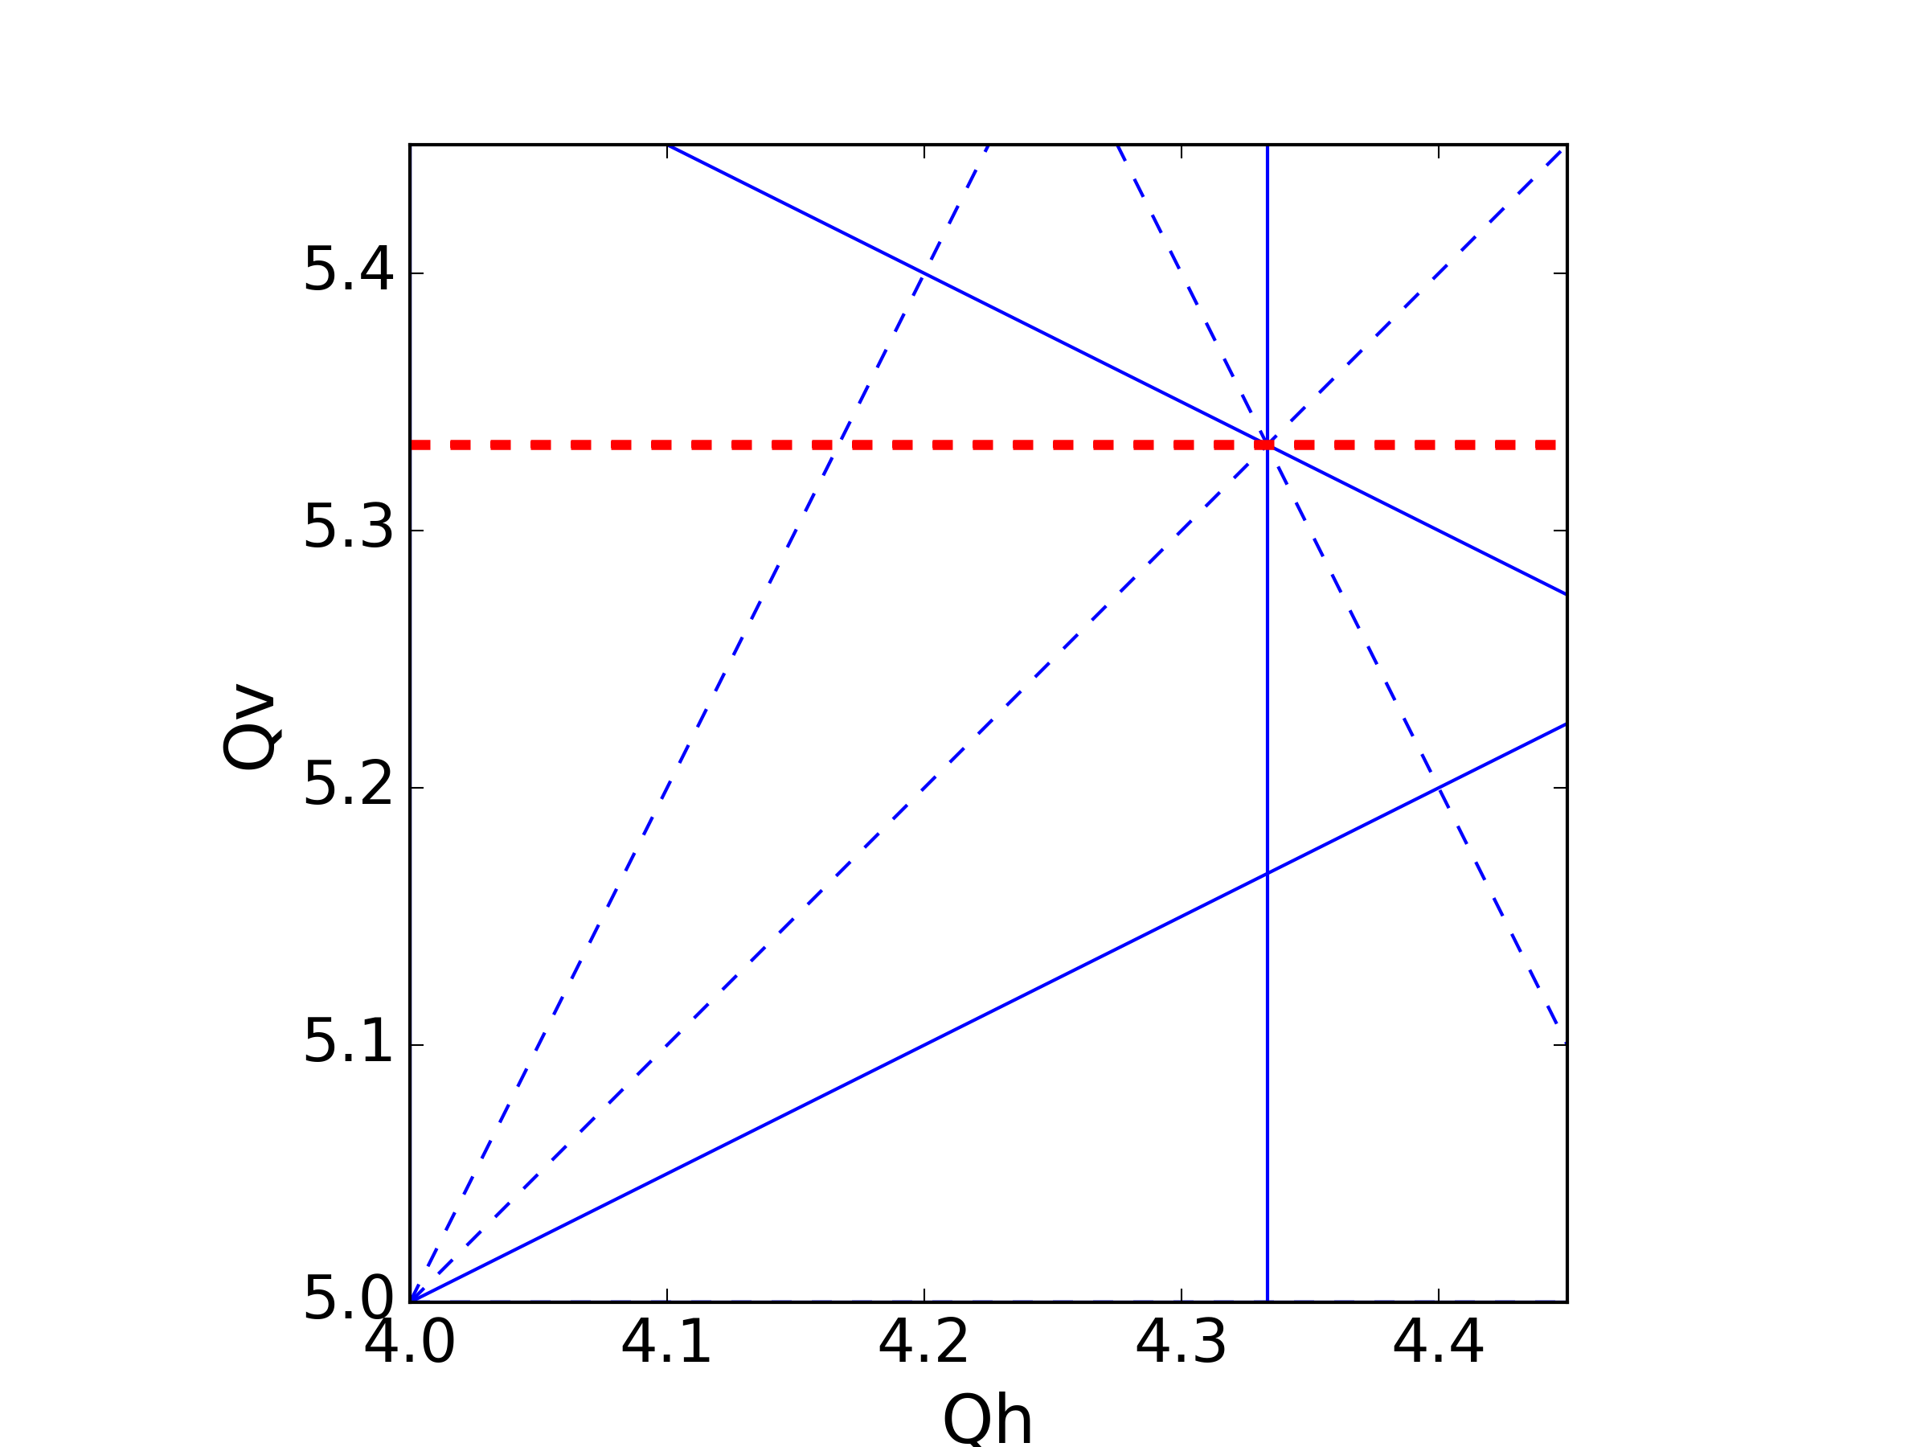
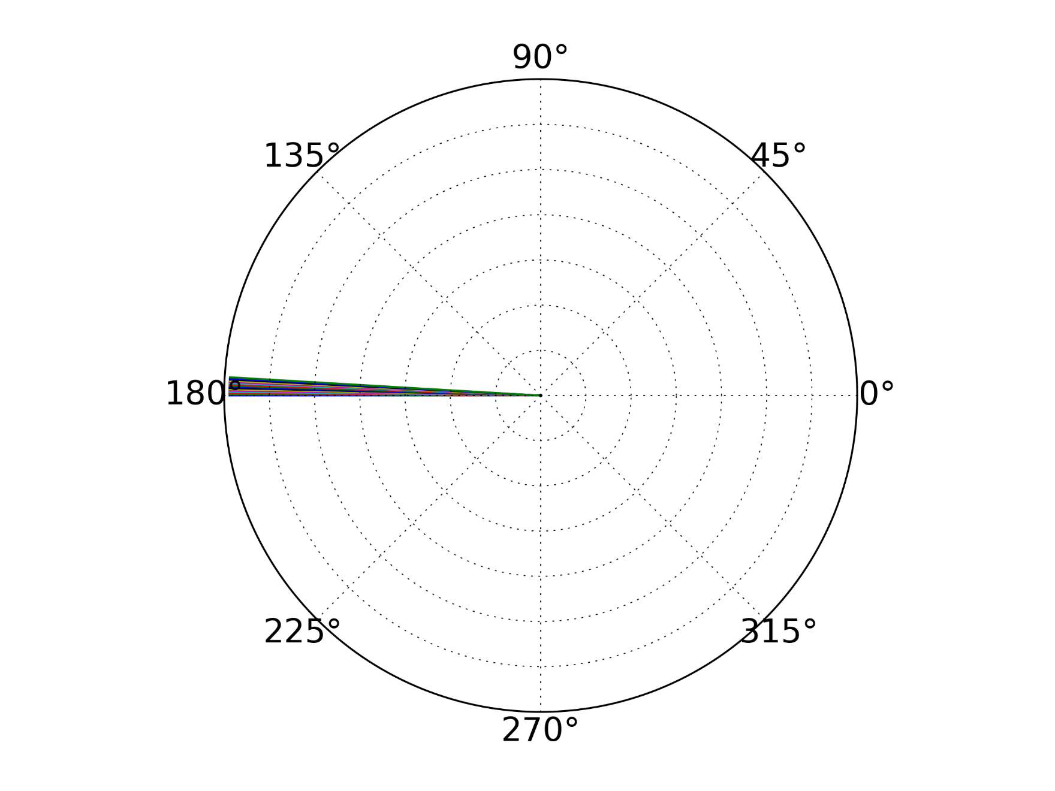


Machine Periodicity
Systematic Resonance
$16$ cells
$$3Q_{v}=16$$
The errors sum up – strong resonance

Slide 12
Transverse motion – betatron resonances
Under normal conditions the emittance is preserved turn after turn:
Observing the phase space turn-by-turn we get the emittance ellipse
In the presence of a strong resonance:
Emittance of a particle on the 1st turn
Emittance increases on the 2nd turn
Emittance increases further on the 3rd turn
Emittance (and amplitude) will keep increasing until the particle is lost
x’
x
Mitigation measures:
Careful tune choice – avoid resonance condition
Higher order elements – corrections to cancel the effect of the resonance

Slide 13
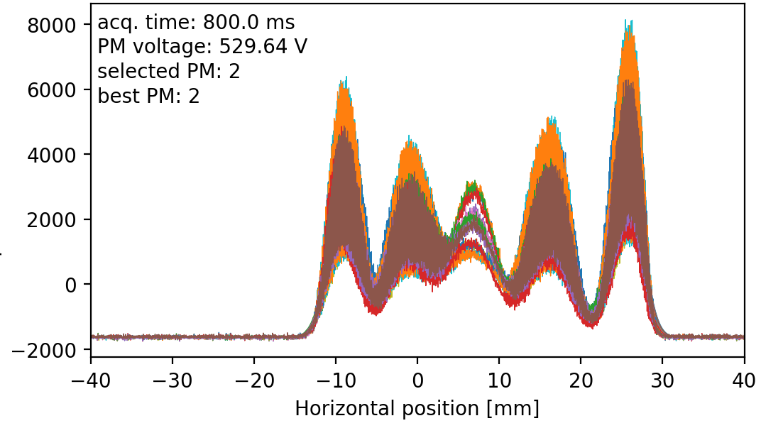
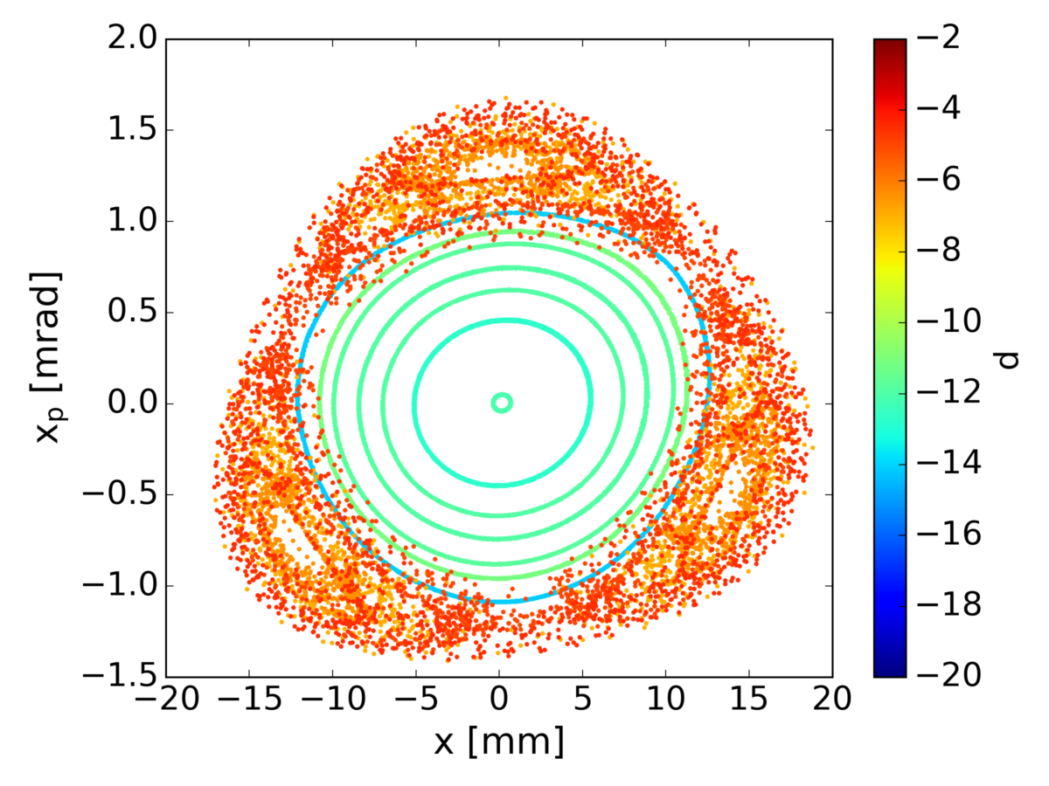
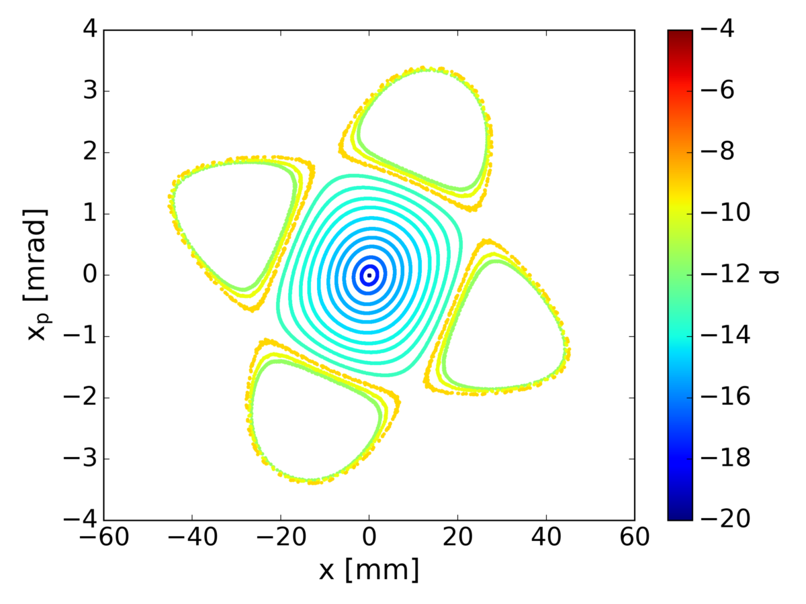
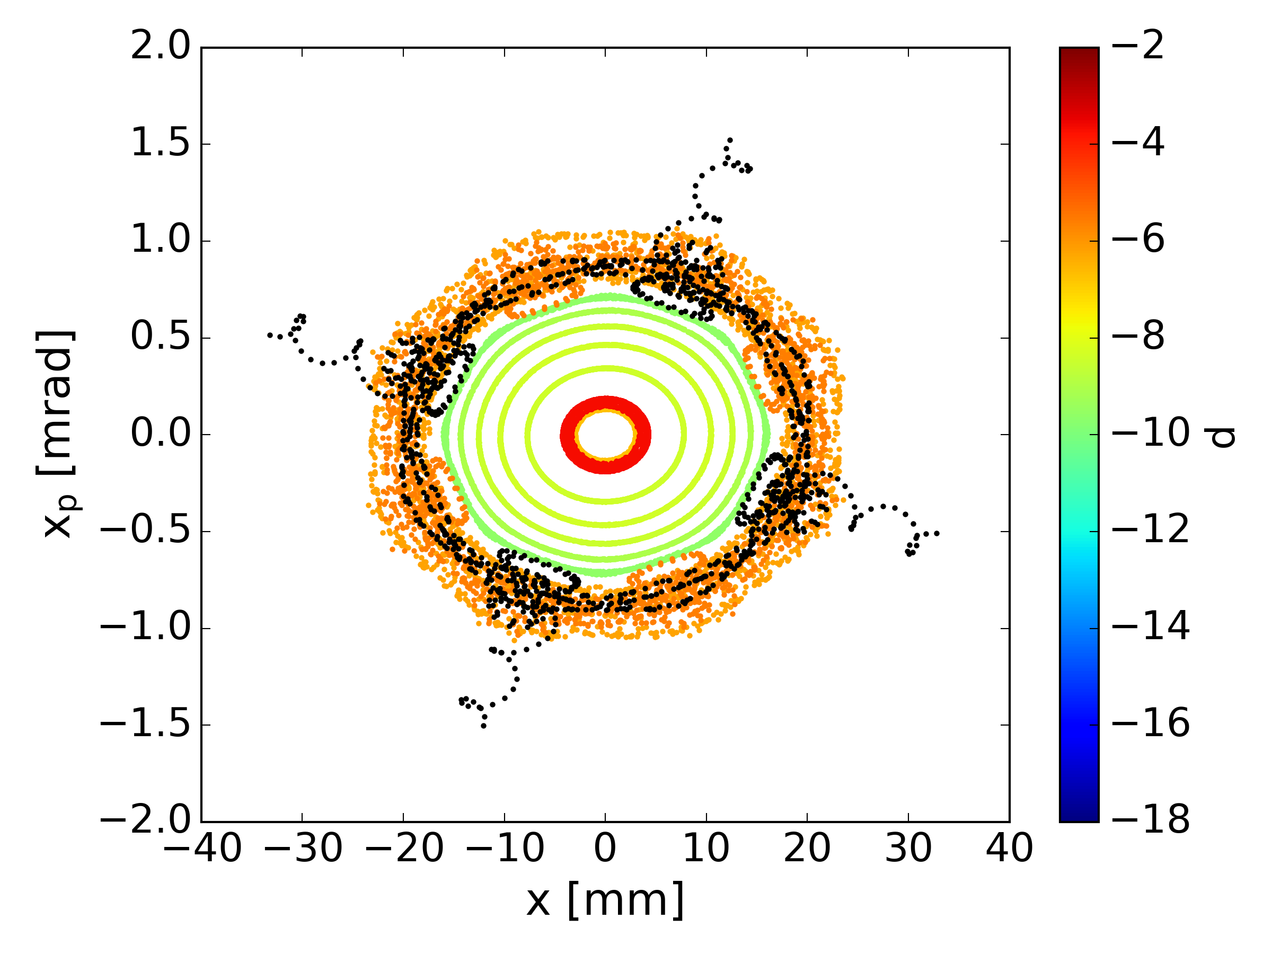
Transverse motion – phase space
Used in PS Multi-Turn-Extraction
The phase space gets distorted in the vicinity of driven resonances
Changing our tune to approach a resonance:
  Starting with well defined ellipses
  Approaching the resonances – forming islands depending on the resonance order
Profile (projection in x) measurements
3rd Order
4th Order
8th Order

Slide 14
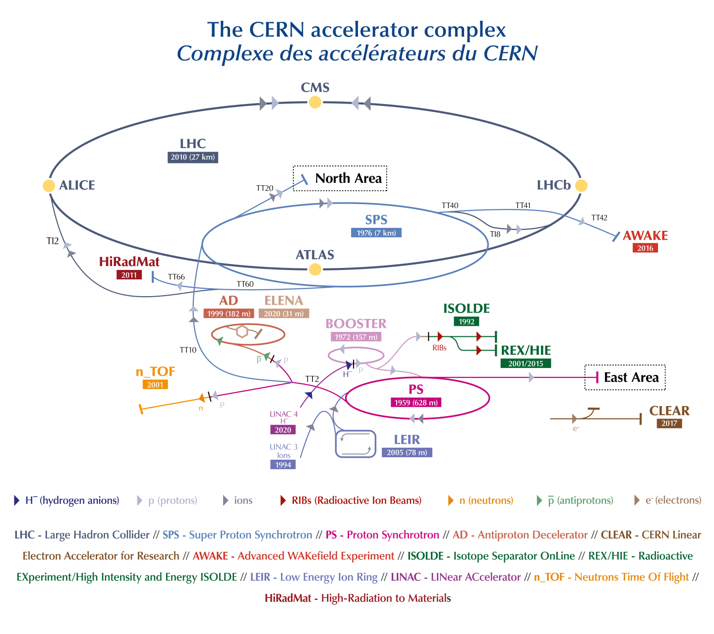
CERN Accelerator Complex
CERN Proton chain
LINAC-4 160MeV (H-)
Proton Synchrotron Booster 2GeV
Proton Synchtrotron 26GeV
Super Proton Synchrotron 450 GeV
Large Hadron Collider 7Tev
CERN Ion chain
LINAC-3
Low Energy Ion Ring
Proton Synchtrotron
Super Proton Synchrotron
Large Hadron Collider
Other facilities & experiments: n_TOF, ISOLDE, East Area, North Area, HiRadMat, AWAKE, CLEAR (electrons), AD & ELENA (Antiprotons)
CERN Proton chain
LINAC-4 160MeV (H-)
Proton Synchrotron Booster 2GeV
Proton Synchtrotron 26GeV
Super Proton Synchrotron 450 GeV
Large Hadron Collider 7Tev
CERN Ion chain
LINAC-3
Low Energy Ion Ring
Proton Synchtrotron
Super Proton Synchrotron
Large Hadron Collider
Other facilities & experiments: n_TOF, ISOLDE, East Area, North Area, HiRadMat, AWAKE, CLEAR (electrons), AD & ELENA (Antiprotons)
We’ll focus on the proton beams towards the LHC

Slide 15
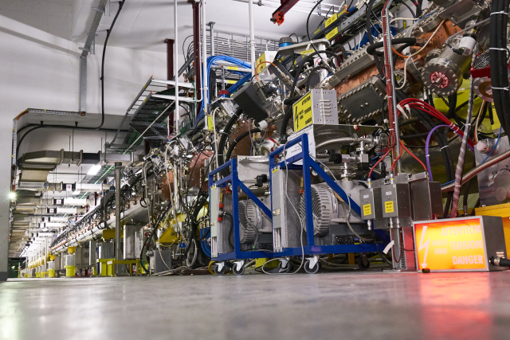
CERN Accelerator Complex – Linac 4
Linac 4
Linac 4: Linear Accelerator 4
CERN’s newest accelerator
1st run: 2019
Main purpose: to increase the injection energy of the PSB to 160 MeV.

Slide 16
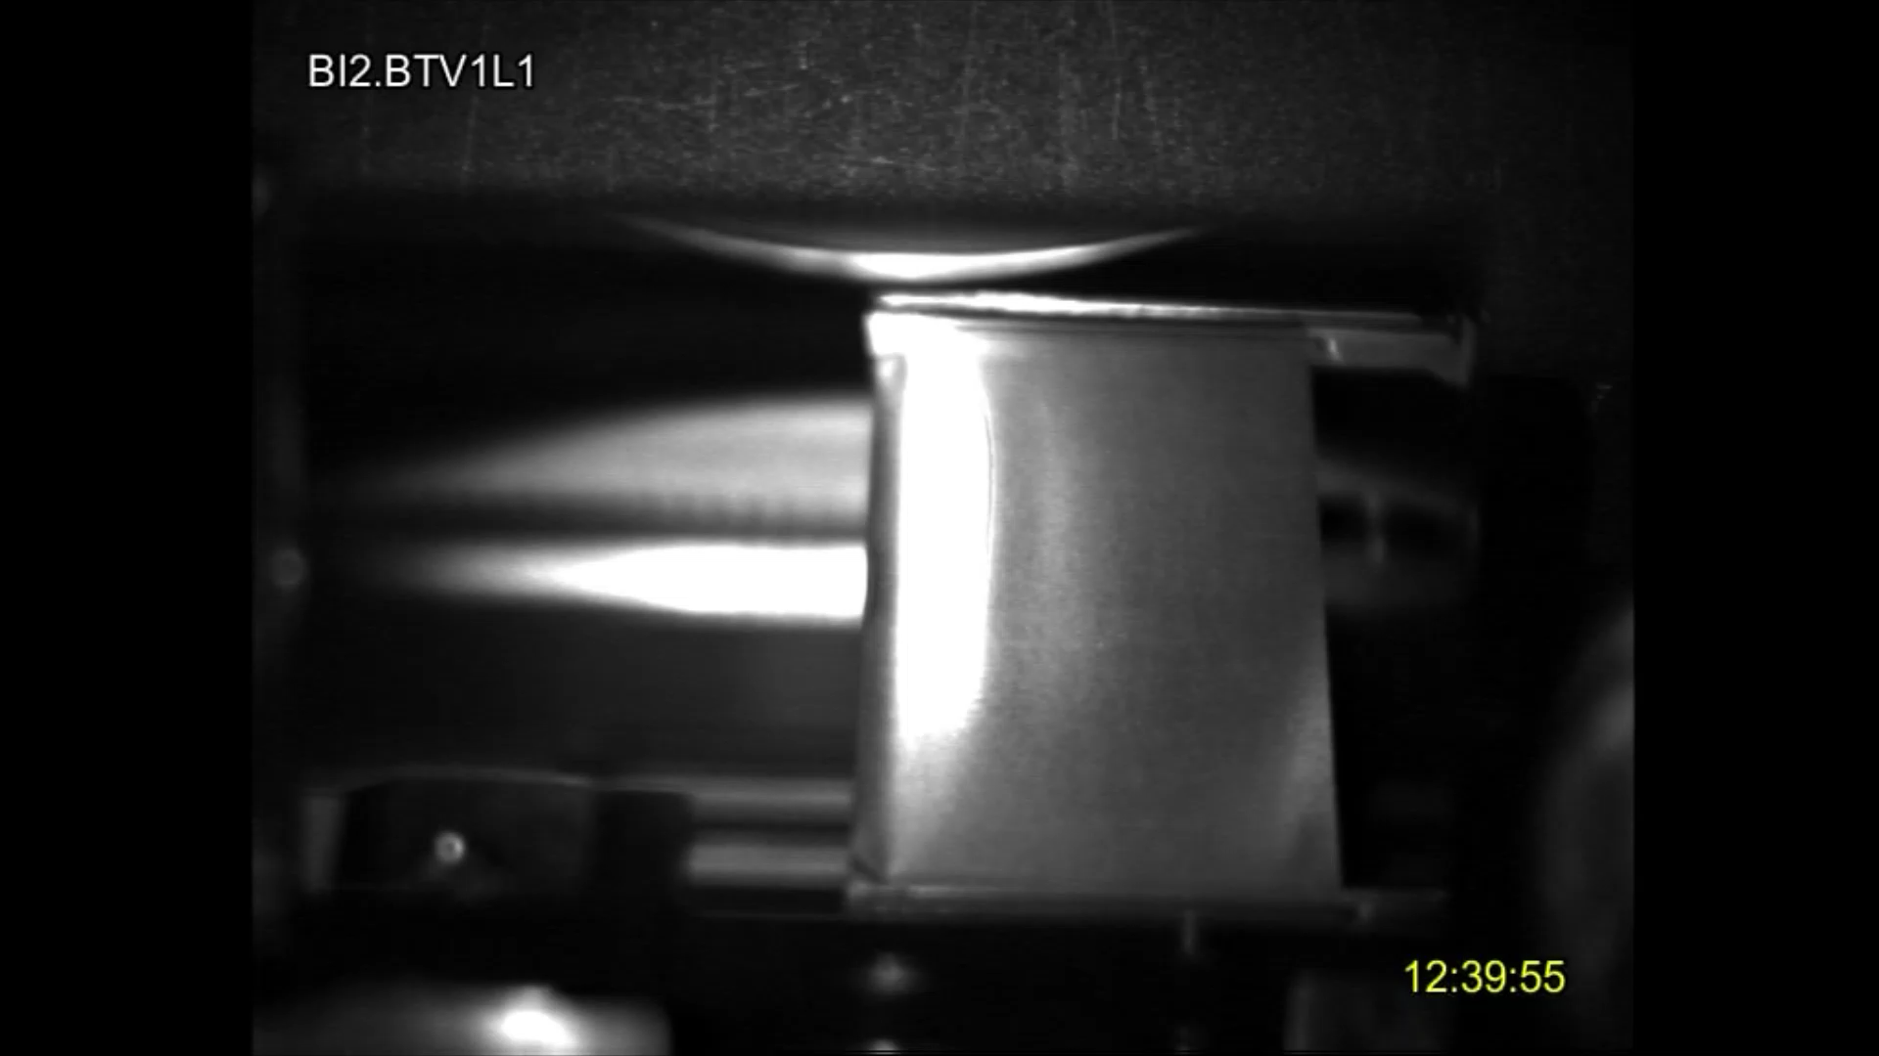
CERN Accelerator Complex – Linac 4
Linac 4
Linac 4: Linear Accelerator 4
CERN’s newest accelerator
1st run: 2019
Main purpose: to increase the injection energy of the PSB to 160 MeV.
It accelerates negative hydrogen ions, H⁻, to 160 MeV.
H⁻ beam guided through a stripping foil at PSB injection to produce the protons: “Charge exchange injection”.

Slide 17
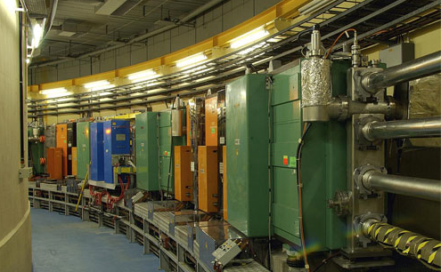
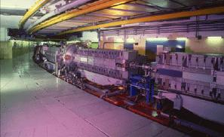
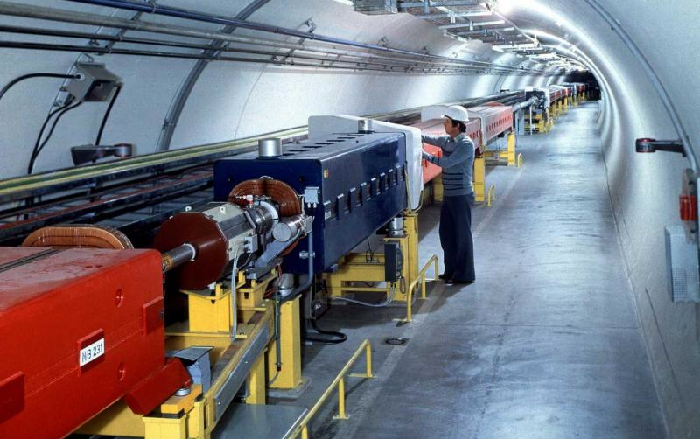

CERN Accelerator Complex
PSB
PS
SPS
LHC

Slide 18
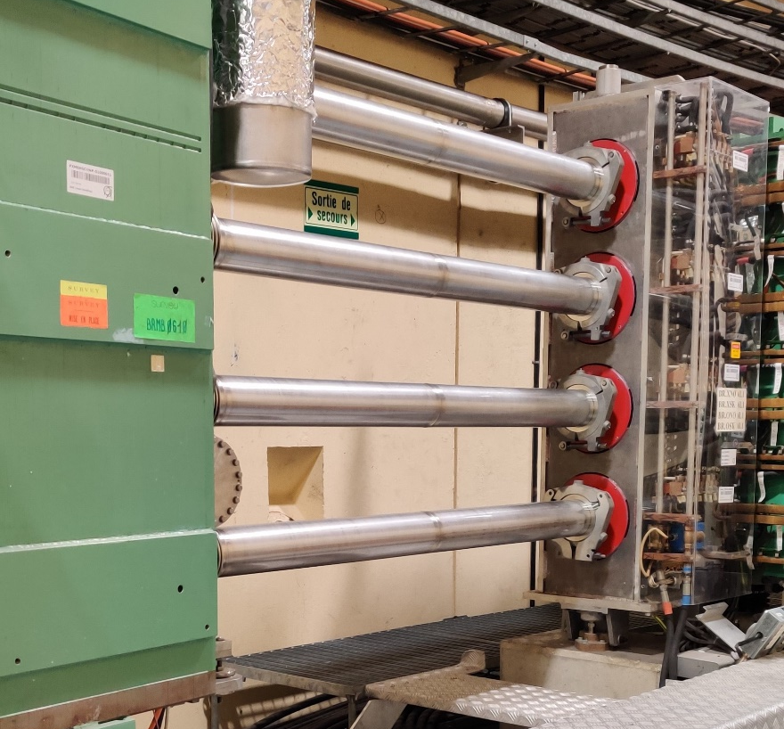
CERN Accelerator Complex – PSB
PSB
PSΒ: Proton Synchrotron Booster
The first circular accelerator of the Complex
1st run: 1972
Main purpose: to increase the number of protons that PS can accelerate.
It comprises 4 superposed rings
Essentially, they are 4 different synchrotrons with common characteristics (magnets, etc.)

Slide 19
PSB – Space Charge
PSB
PSΒ: Proton Synchrotron Booster
The first circular accelerator of the Complex
Main purpose: to increase the number of protons that PS can accelerate.
Why did we need a new accelerator to increase the number of protons???
We wanted to increase the number of protons while maintaining a small emittance
  Emittance defines the beam size – larger emittance would require a larger aperture
  Emittance cannot decrease along the chain – luminosity depends on the emittance “set” in the injectors
At low energies, the coulomb forces developing within the bunch dominate the dynamics – SPACE CHARGE

Slide 20

PSB – Space Charge
SPACE CHARGE
Coulomb forces between the moving particles
Non-Linear continuous kick
Self-fields that move with the beam
The frequency of the betatron motion changes
Different particles in the same bunch will have a different tune
Incoherent tune spread
Gaussian Distributions: $V_{sc}\left(x,y\right)=\frac{r_{o}N_{B}}{β^{2}γ^{3}\sqrt{2π}σ_{s}}\int_{0}^{∞}{\frac{−1+e^{−\frac{x^{2}}{2σ_{x}^{2}+t}−\frac{y^{2}}{2σ_{y}^{2}+t}}}{\sqrt{\left(2σ_{x}^{2}+t\right)\left(2σ_{y}^{2}+t\right)}}dt}$
Transverse Amplitude
Energy
Transverse Beam Size
Bunch Intensity
Longitudinal Parameters

Slide 21
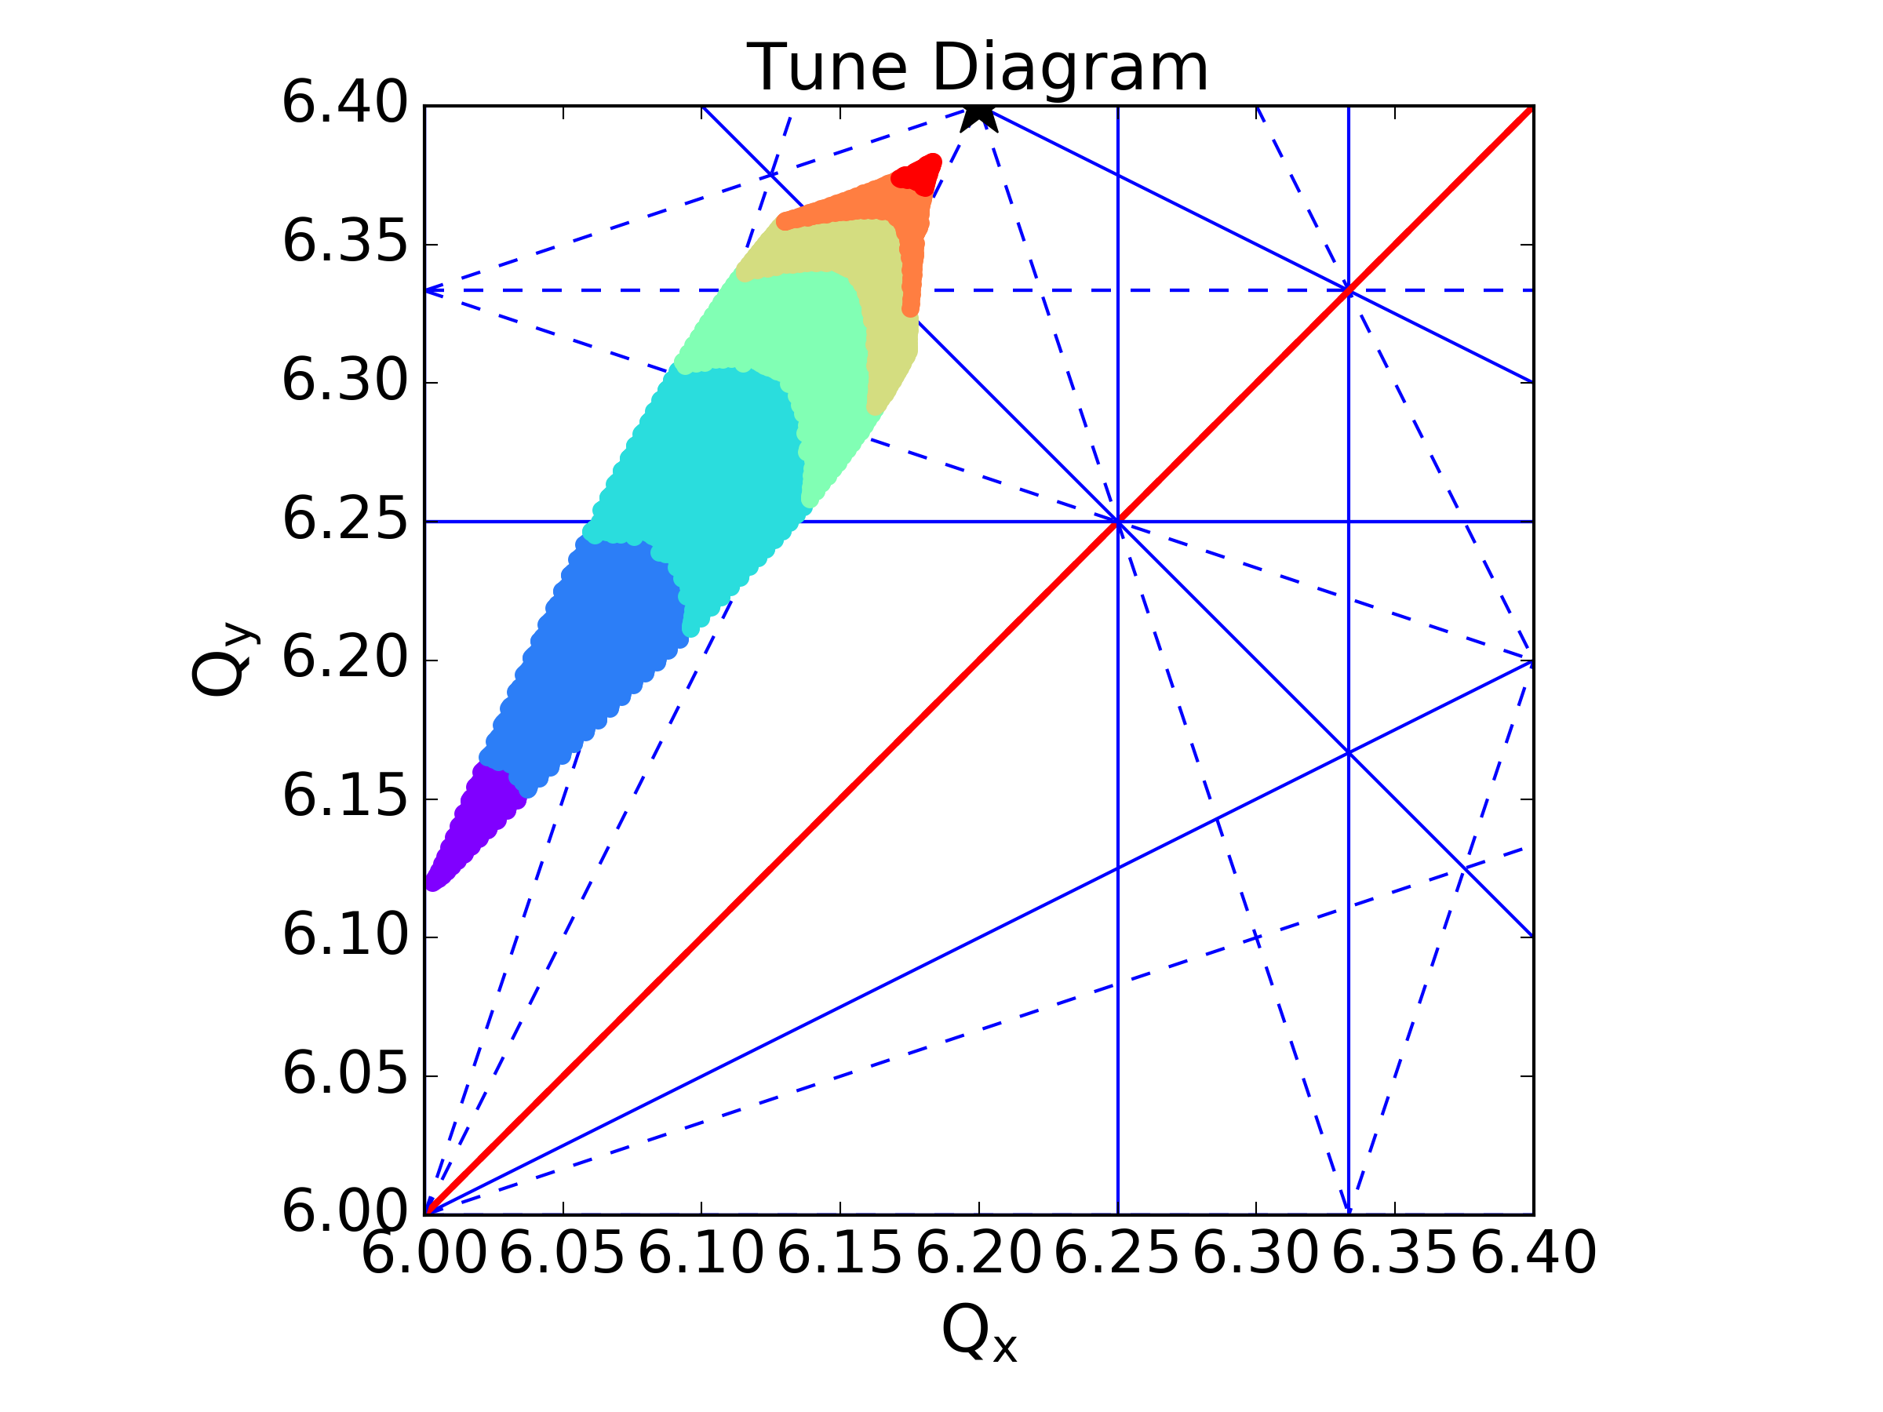
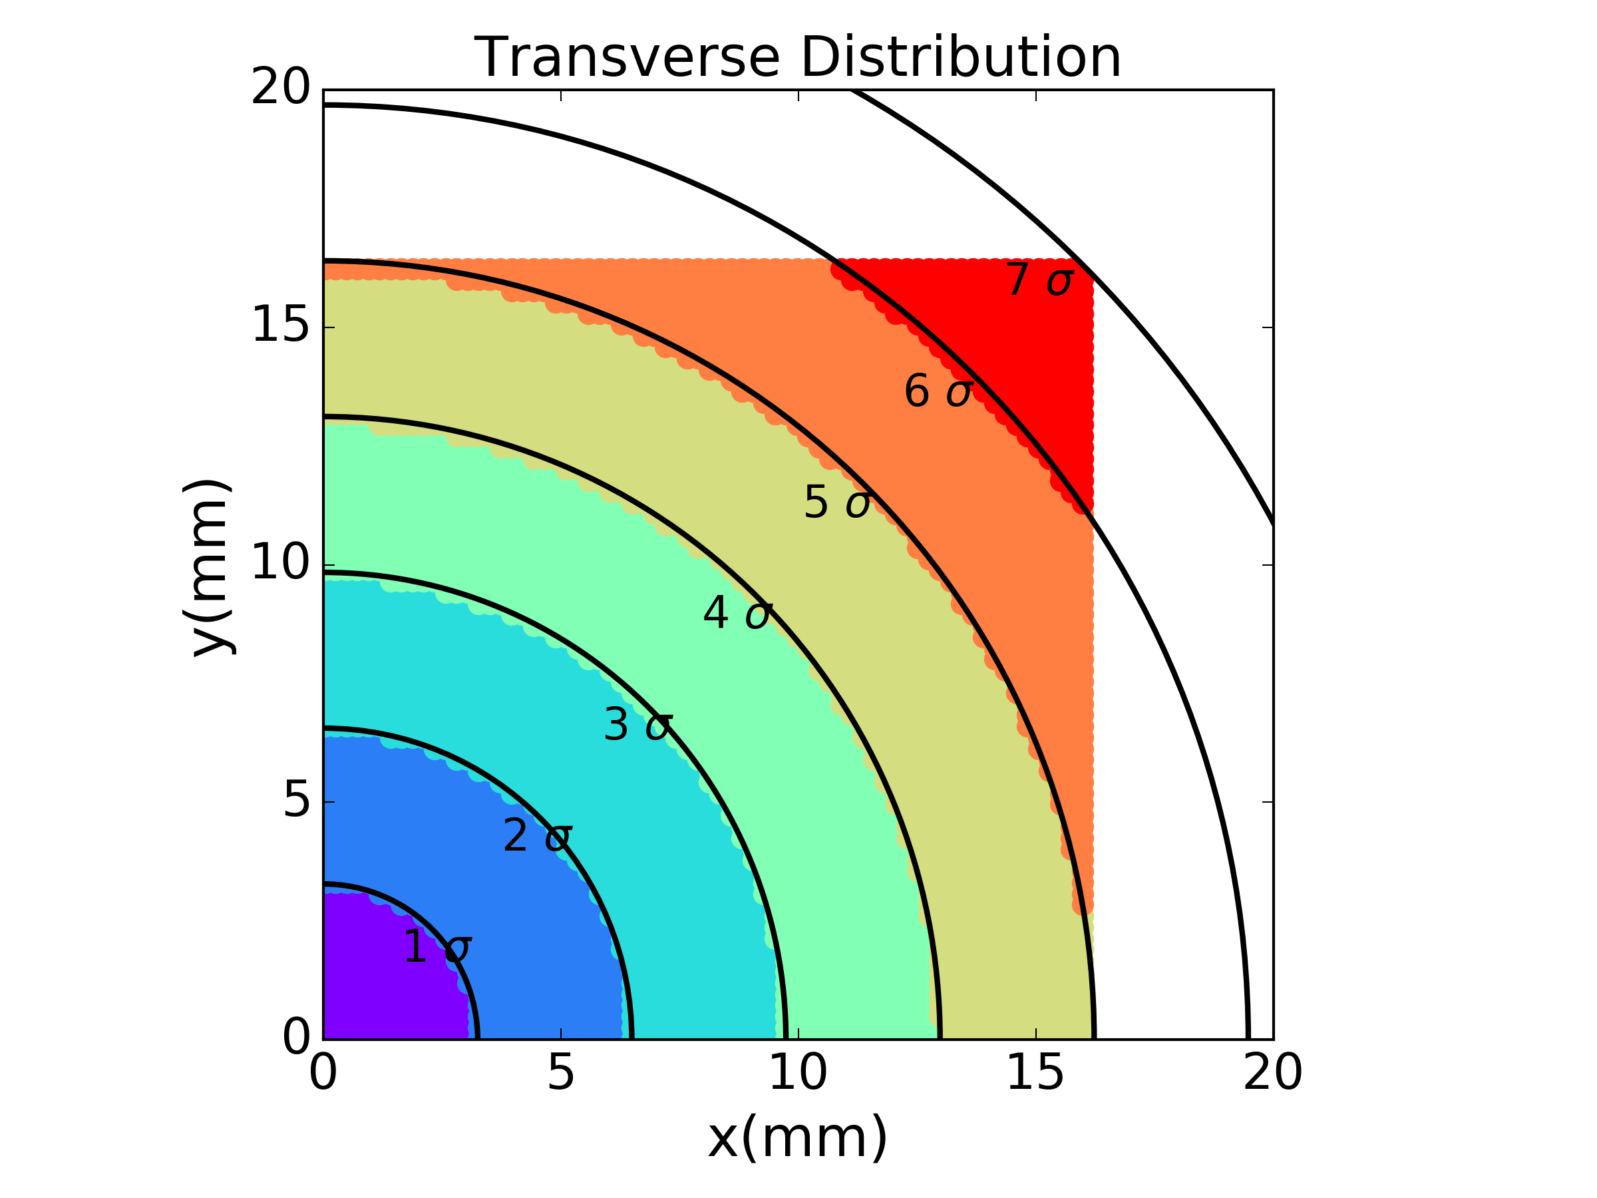
PSB – Space Charge
Transverse Amplitude
The closer to the center of the bunch
the larger the detuning

Slide 22
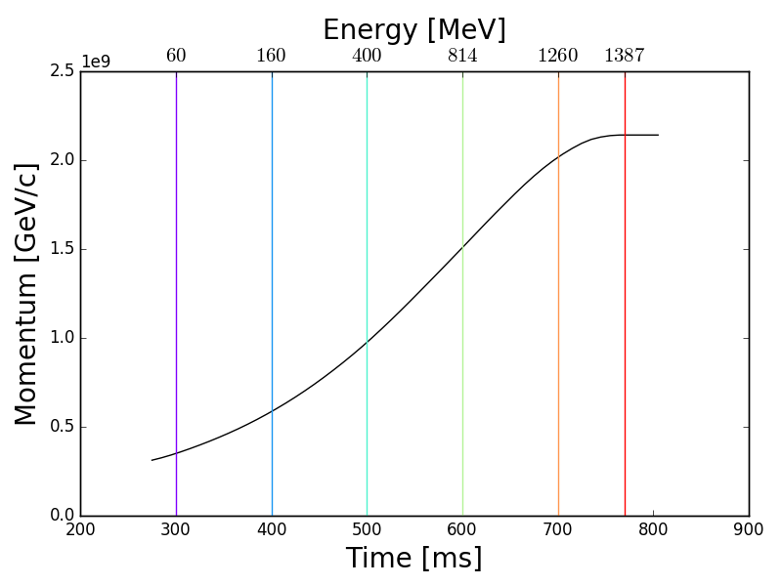
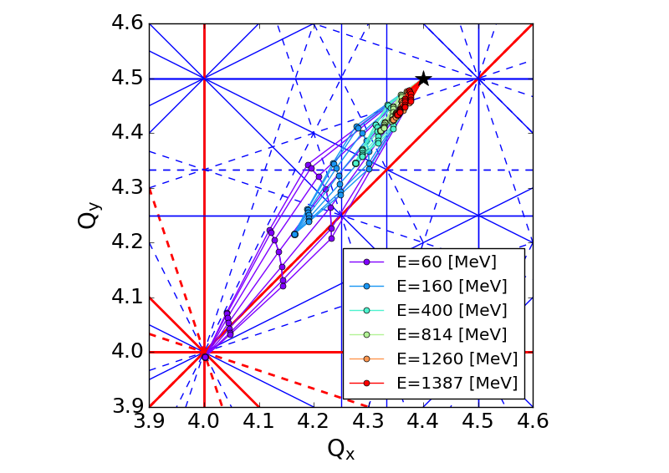
PSB – Space Charge
The lower the energy
the larger the detuning
Energy

Slide 23
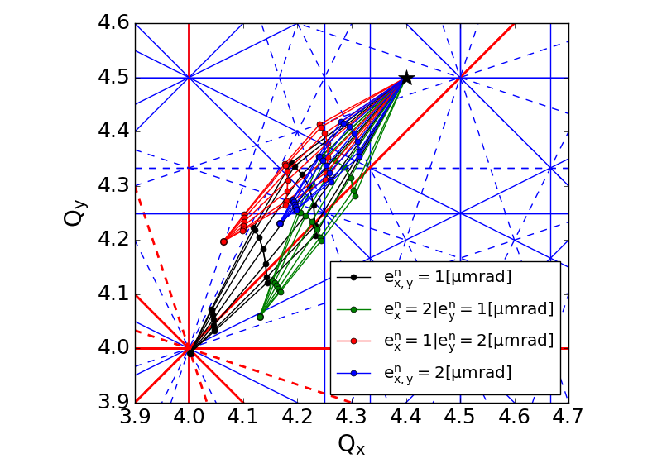
PSB – Space Charge
Transverse Beam Size
The smaller the emittance
the larger the detuning
Emittance x (mm mrad) | Emittance y (mm mrad)
1 | 1
2 | 1
1 | 2
2 | 2

Slide 24
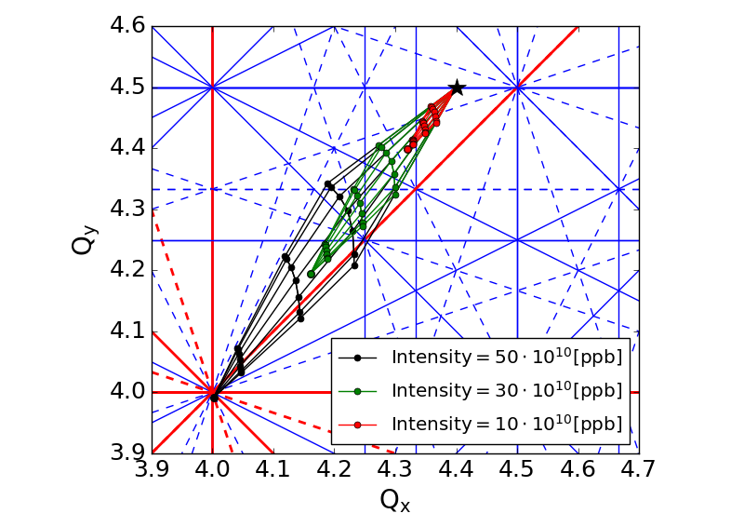
PSB – Space Charge
Bunch Intensity
The larger the intensity
the larger the detuning
Intensity (10¹⁰ ppb)
50
30
10

Slide 25
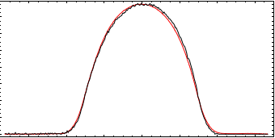
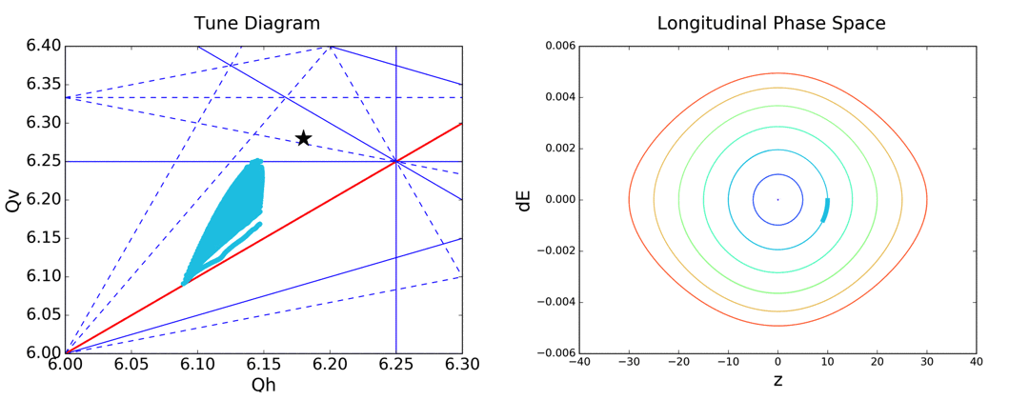
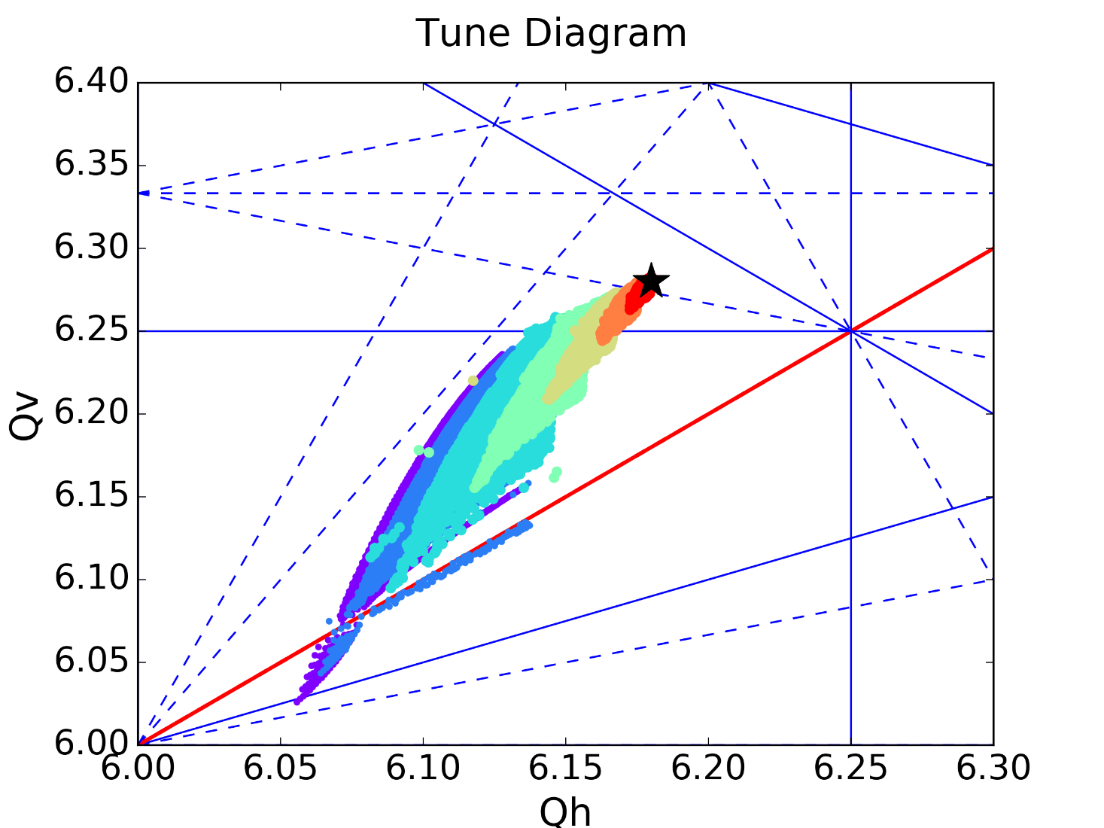
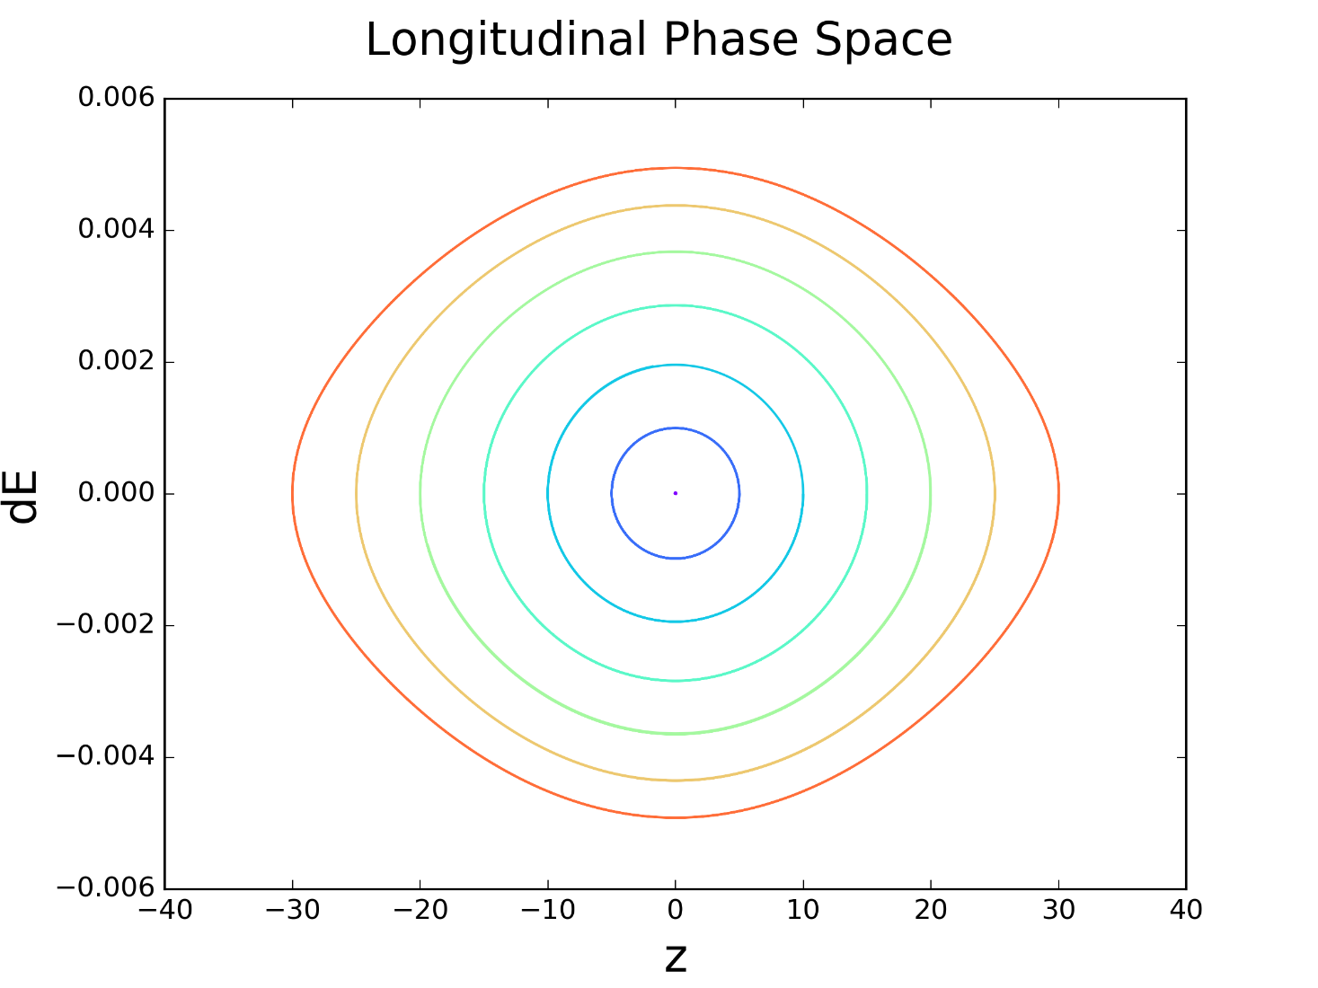
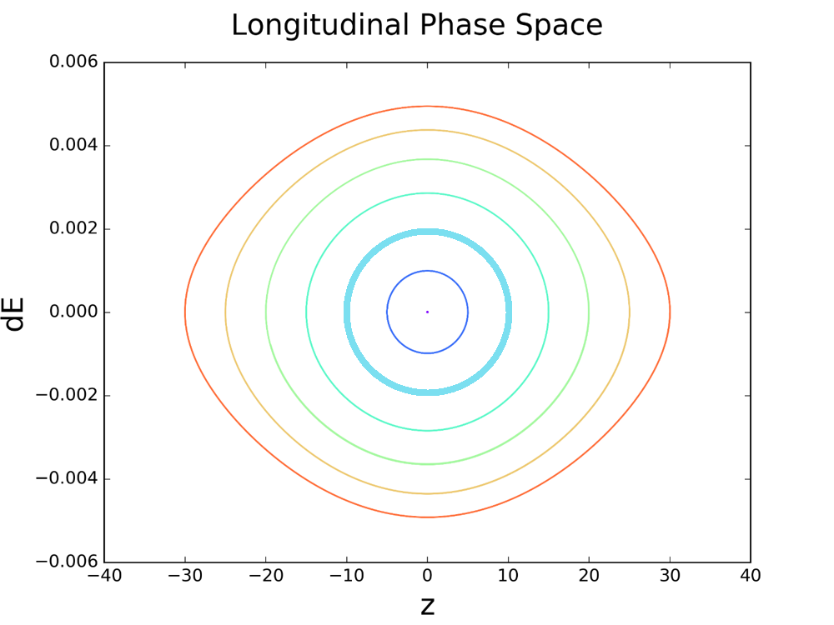
PSB – Space Charge
Longitudinal profile
Longitudinal Settings
Smaller bunch length – larger detuning
Detuning changes with the synchrotron motion

Slide 26
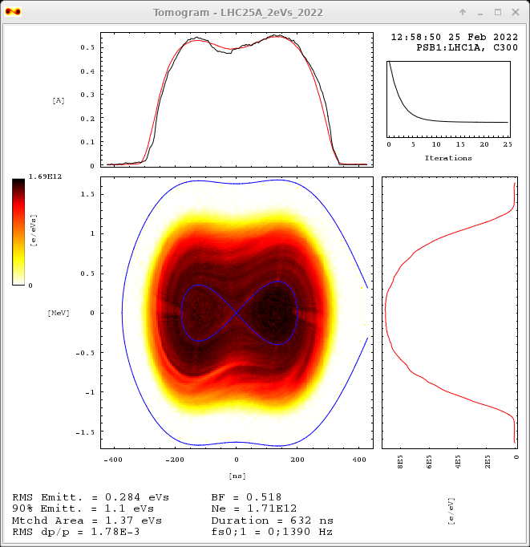
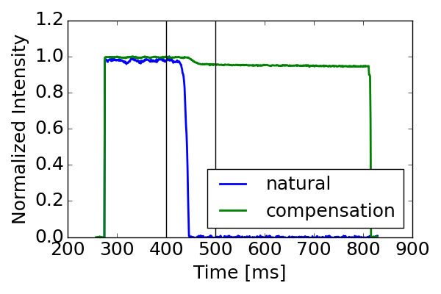
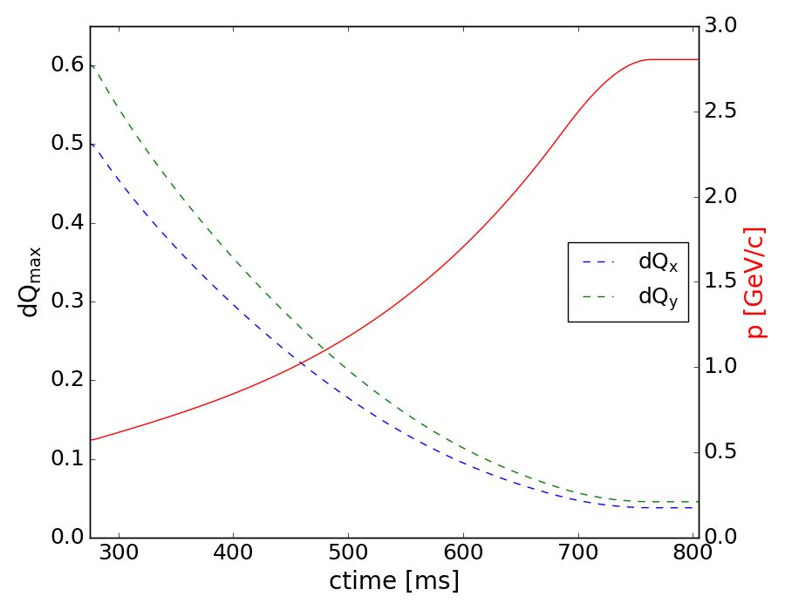
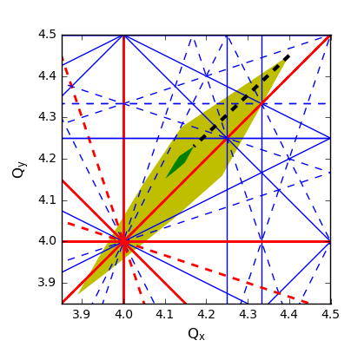
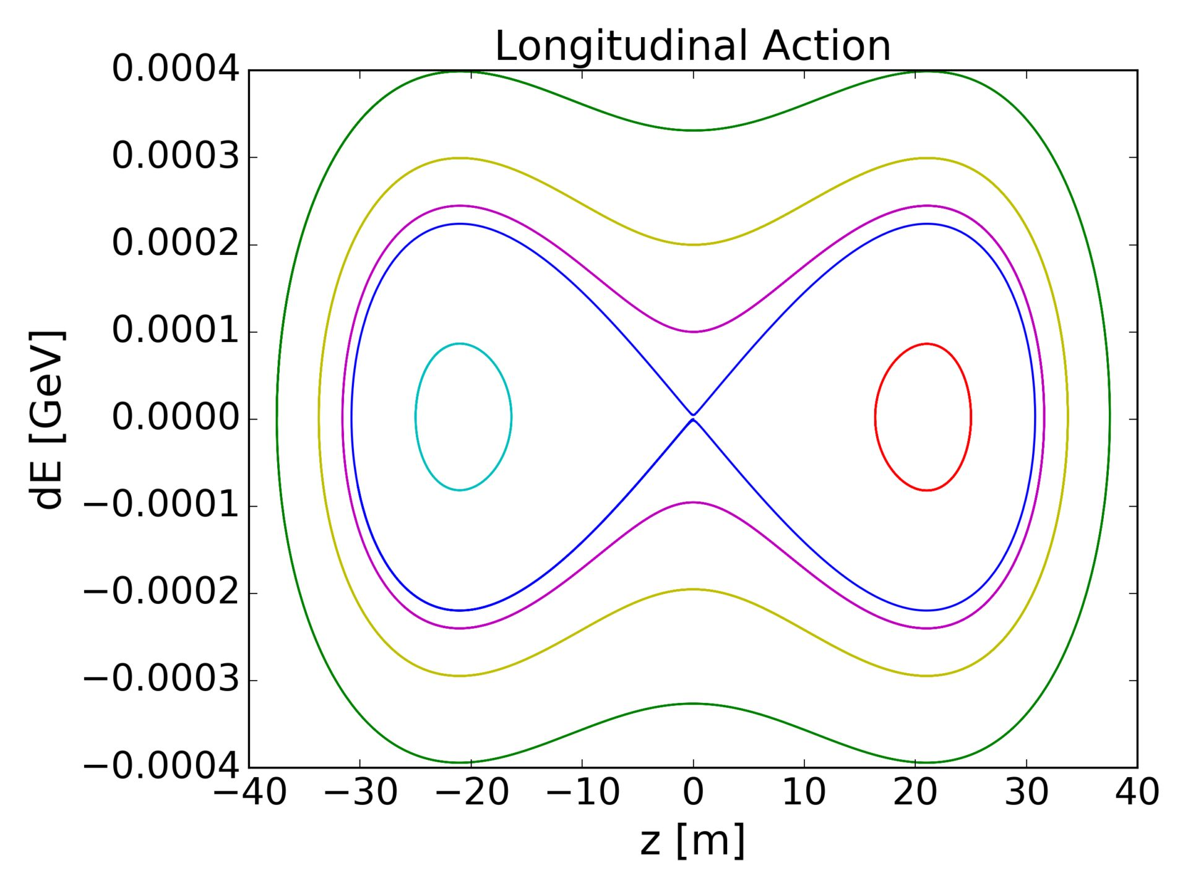

PSB – Space Charge
Since space charge is caused by the beam itself it cannot be avoided
Some “mitigation” strategies:
  Starting the acceleration right after injecting the beam – minimize the time at low energy
  Use nonlinear magnets (sextupoles & octupoles) to mitigate resonances – minimize effects on losses & emittance blow-up
  Use an additional RF system pulsing on a higher harmonic to reduce the longitudinal line density & elongate the bunches
Extra magnets

Slide 27

CERN Accelerator Complex – PS
PS: Proton Synchrotron
CERN’s first accelerator
1st run: 1959
Even today it accelerates beams (protons and ions) for the LHC and other CERN experiments
The bunches and their spacing is defined in the PS
PS
Consists of 100 combined function magnets
The same magnet bends and focuses the beam!

Slide 28
PS – Tailoring of bunches
PS: Proton Synchrotron
The bunches and their spacing is defined in the PS
PS
How can we change the number of bunches & the space between them?
We need more RF systems so that we can have additional “harmonics” (similar to the PSB case shown before)
  Changing the voltage ratios and the phase of the different systems:
    Merge bunches
    Split bunches
    Rotate bunches

Slide 29





PS – Tailoring of bunches
Changing the voltage ratios (also adjusting phases etc) of the different systems we can change the shape of the bunch (& the longitudinal profile)
We start with a single RF system
We include a second RF system at h₂=2h₁ and we start changing the contribution of the 2 systems (voltage)
If we keep changing the contributions of the two systems we can fully separate the bunches!

Slide 30




PS – Tailoring of bunches
1. Inject four bunches (h=7)
LHC bunches in the PS
The PSB can provide up to 4 bunches per injection (one out of each ring)
Two injections in the PS (4+2)
One bucket is kept empty
Each bucket is split in three after the second injection
Wait 1.2 s for second injection
2. Inject two more bunches (h=7)
3. Triple split after second injection (h=21)
F. Tecker: “Longitudinal beam dynamics” (CAS)

Slide 31



PS – Tailoring of bunches
LHC bunches in the PS
The PSB can provide up to 4 bunches per injection (one out of each ring)
Two injections in the PS (4+2)
One bucket is kept empty
Each bucket is split in three after the second injection
Two times a double splitting
Bunch rotation before extraction
6. Double split (h42)
7. Double split (h42 → h84)
F. Tecker: “Longitudinal beam dynamics” (CAS)

Slide 32

PS – Tailoring of bunches
h=14
h=21
h=7
Triple splitting
F. Tecker: “Longitudinal beam dynamics” (CAS)

Slide 33

PS – Tailoring of bunches
h=84
h=21
h=42
Two times double splitting and bunch rotation
F. Tecker: “Longitudinal beam dynamics” (CAS)

Slide 34

CERN Accelerator Complex – SPS
SPS: Super Proton Synchrotron
The 2nd larger accelerator at CERN with a circumference of 7km
1st run: 1976
Discovery of the W and Z bosons during its operation as a collider
Today it operates as an accelerator producing beams (protons and ions) for the LHC and other CERN experiments
For the LHC, it accumulates short high intensity bunches for several injections
SPS

Slide 35

SPS – Instabilities
SPS: Super Proton Synchrotron
For the LHC, it accumulates short high intensity bunches for several injections
Injecting 4 * 72 bunches in the SPS we start observing beam losses
Looking more carefully in the intensity evolution of each bunch – losses mainly for the later bunches
SPS
Could we have an effect from the first bunches to the other ones?
G. Rumolo, K.Li : “Instabilities Part I: Introduction – multiparticle systems, macroparticle models and wake functions”

Slide 36

CERN Accelerator Complex – LHC
LHC: Large Hadron Collider
The largest accelerator at CERN with a circumference of 26.7km
1st run: 2008
Two beams circulate in opposite directions driven by 1232 superconducting dipoles, 14.3m long with up to 8T field in temperatures of 1.9 K
Operates with protons and ions
LHC

Slide 37

SPS – Instabilities
In fact, the bunches can interact with the environment in the accelerator (vacuum pipe, cavities, instrumentation devices etc)
As the bunches move on the s direction, they can create fields: “Wakefield”
The wakefield depends on the distribution of our bunches and can cause a collective response
SPS
G. Rumolo, K.Li : “Instabilities Part I: Introduction – multiparticle systems, macroparticle models and wake functions”

Slide 38



SPS – Instabilities
This collective response can result in “intra-bunch” motion
The amplitude of this motion can increase in time leading to large losses
In case of multiple bunches in a ring, “bunch-by-bunch” motion, some of them can be affected more than others
I. Mases et al.: “Transverse beam stability and MKP-S heating test”
H. Bartosik: “Beam dynamics and optics studies for the LHC injectors upgrade”
E. Koukovini-Platia et al.: “Source of horizontal instability at the CERN Proton Synchrotron Booster”

Slide 39



SPS – Instabilities
Curing Instabilities
Careful modelling of the electromagnetic properties of our equipment allows for predictions of certain instabilities
  Changes in the design or the materials of a piece of equipment could suppress this response
  Changes in our working conditions (WP) to avoid the instability
Feedback systems – observe the bunch motion and apply “kicks” to cancel any deviations from the desired state
Introduce nonlinear elements – they can change the incoherent tune spread and help damping the coherent instability
SPS
octupoles
Sextupoles
C. Antuono et al: “PSB impedance and stability studies”
E. Koukovini-Platia et al: “Source of horizontal instability at the CERN Proton Synchrotron Booster”
C. Zannini et al: “The SPS transverse instabilities at injection”

Slide 40


CERN Accelerator Complex – LHC
There are 8 interaction points, in 4 of which the detectors of the main experiments (ATLAS, CMS, ALICE, LHC-B) are placed
The main purpose: the production, detection and study of Higgs bosons
Ongoing works for its upgrade until 2029
High Luminosity LHC (HL-LHC) to increase LHC performance (~x10)
LHC

Slide 41

LHC – Beam-beam
LHC: Large Hadron Collides
Two beams circulate in opposite directions
There are 8 interaction points (4 collision points)
LHC
Does the interaction affect the dynamics of the system?

Slide 42

LHC – Beam-beam
Does the interaction affect the dynamics of the system?
Of course!
Even the optics change drastically to accommodate the need for squeezing down the beamsize!
  To minimize the beta functions for the collision – huge increase of the beta functions in the close vicinity of the interaction point
The interaction of the two beams is the strongest nonlinearity in the accelerator
We will only consider part of these effects
F. Soubelet et al: “Rigid waist shift: A new method for local coupling corrections in the LHC interaction regions”

Slide 43
LHC – Beam-beam
We can define two different regimes for the beam-beam force
The interaction for the colliding bunches – Head On
The interaction for the non-colliding bunches – Long Range
Both strongly nonlinear
→ Tune spread!

Slide 44

LHC – Beam-beam
The contribution of the Head On to the tune spread is much larger than the Long Range.
Reminder: the tune spread coming from space charge looks very similar to the head-on!
In reality, during collisions, the two contributions are combined!
→ Dangerous resonances are overlapped!
S. Fartoukh et al., PRSTAB, 2015

Slide 45

LHC – Beam-beam
Mitigation strategies:
The contribution of the long-range interaction is very similar to that of a wire in the vicinity of the beam
  Attempting compensation with a wire – tunespread shape dominated by the head on contribution
To avoid losses from strong resonances
  careful tune choice
  apply corrections using dedicated elements (up to dodecapole correctors installed in the LHC!)
S. Fartoukh et al., PRSTAB, 2015
P. Belanger et al., HL LHC collaboration meeting 2023

Slide 46
Summary
Delivering high Luminosity for the LHC experiments can be very challenging
The various accelerators at CERN work together to produce high quality beams
  Some since 1959!
Each accelerator has different characteristics that can lead to very different dynamics!
We tried giving a single (partial!) example of some effects, but In most cases multiple of these are co-existing!
  PSB: space charge + instabilities + bunch splitting (not for LHC)
  PS: bunch tailoring + space charge + instabilities + transition crossing
  SPS: instabilities + space charge + transition crossing (not for LHC)
  LHC: beam-beam + instabilities + optics perturbations …
In our continuous efforts to improve our beams for all the CERN experiments we end up with more challenges that we need to overcome!

