Slide 1
CAS Program Committee Meeting
“Beam Instrumentation”
11.12.2024

Slide 2
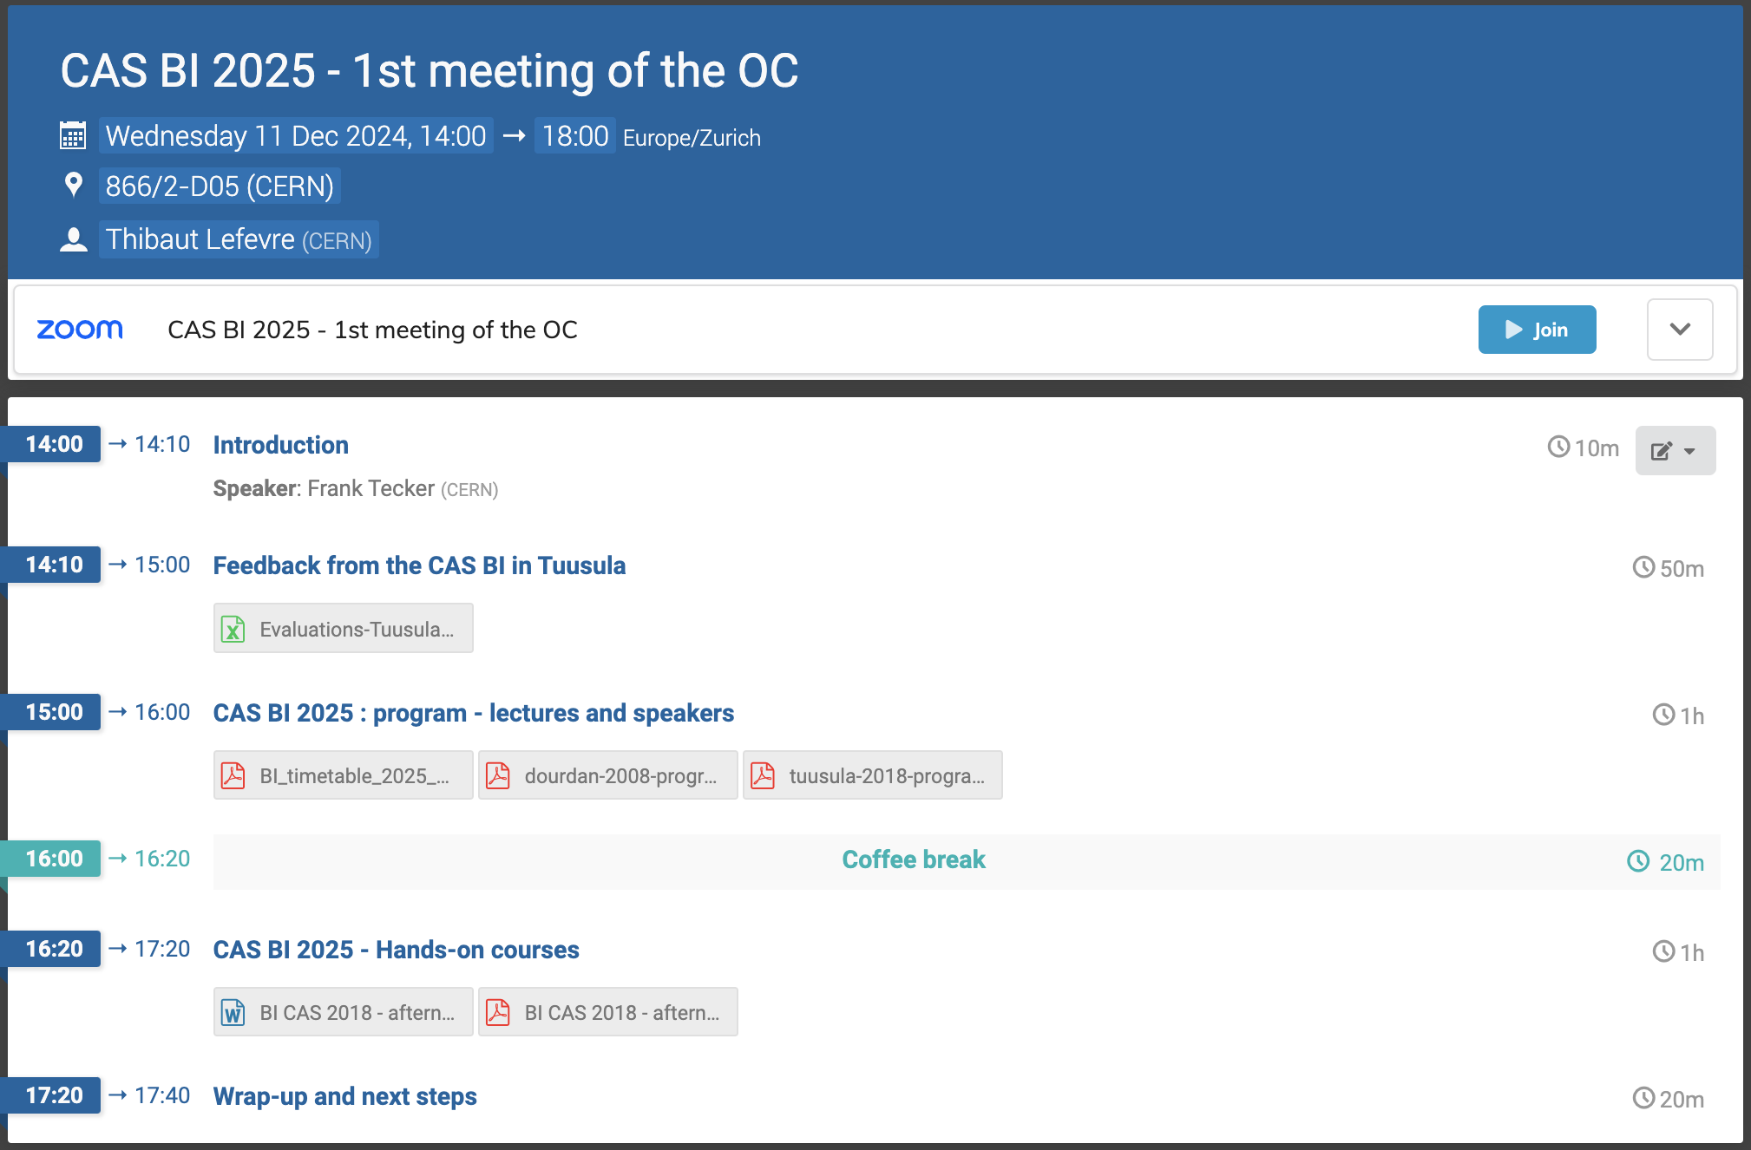
Program Committee Meeting - Schedule
Many thanks for participating as Program Committee Member!

Slide 3
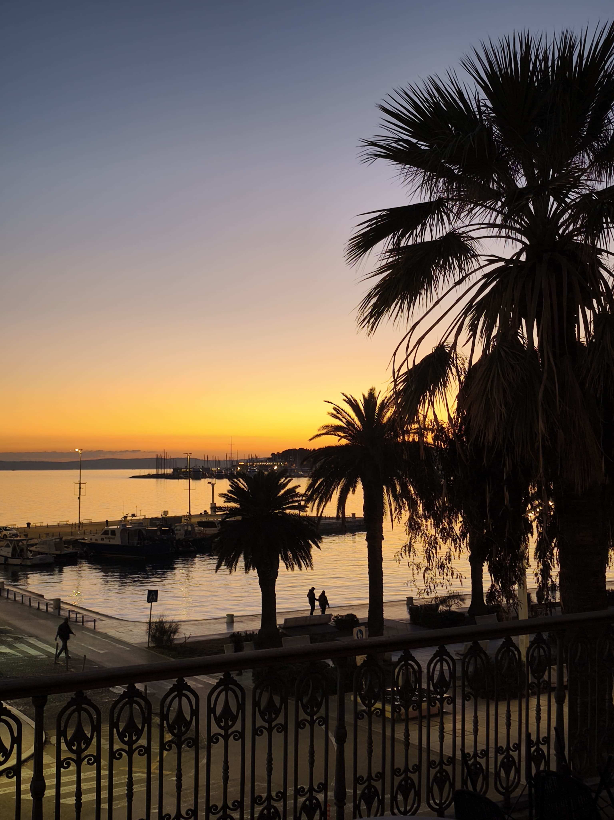
Course venue
The foreseen venue is Split, Croatia
Local organizer: Toni Sculac
Many Thanks!!!
We visited three hotels last week
all would be suitable
Right now: follow-up with the hotels
Dates foreseen: 16 – 29 November 2025
(13 nights)

Slide 4
2008 – Schedule: 39 lectures – 3 discussion/interactive session

Slide 5
2018 – Schedule: 41 lectures – 3 discussion sessions

Slide 6
2025 – Schedule: 43 lectures / discussion sessions

Slide 7
2025 – Schedule: 43 lectures / discussion sessions

Slide 8
2018 Evaluation - Comments
Overall, very positive comments: awesome, great!, excellent quality
Only criticism:
  lectures too long, should be 45 min + 15 min discussion – we ask lecturers
  Frequent overlap of basic concepts, where lecturers were not aware
Hands-on: Best part of the school!, The best courses in the world, Excellent, Exceptionally good, …
  Some people prefer more instructions, others prefer to play more themselves
  RF: very much praised, not much time to well understand, material not provided,
  initially more time for setup needed, time reduced later
  Profiles: good, but felt overprepared with spreadsheets

Slide 9
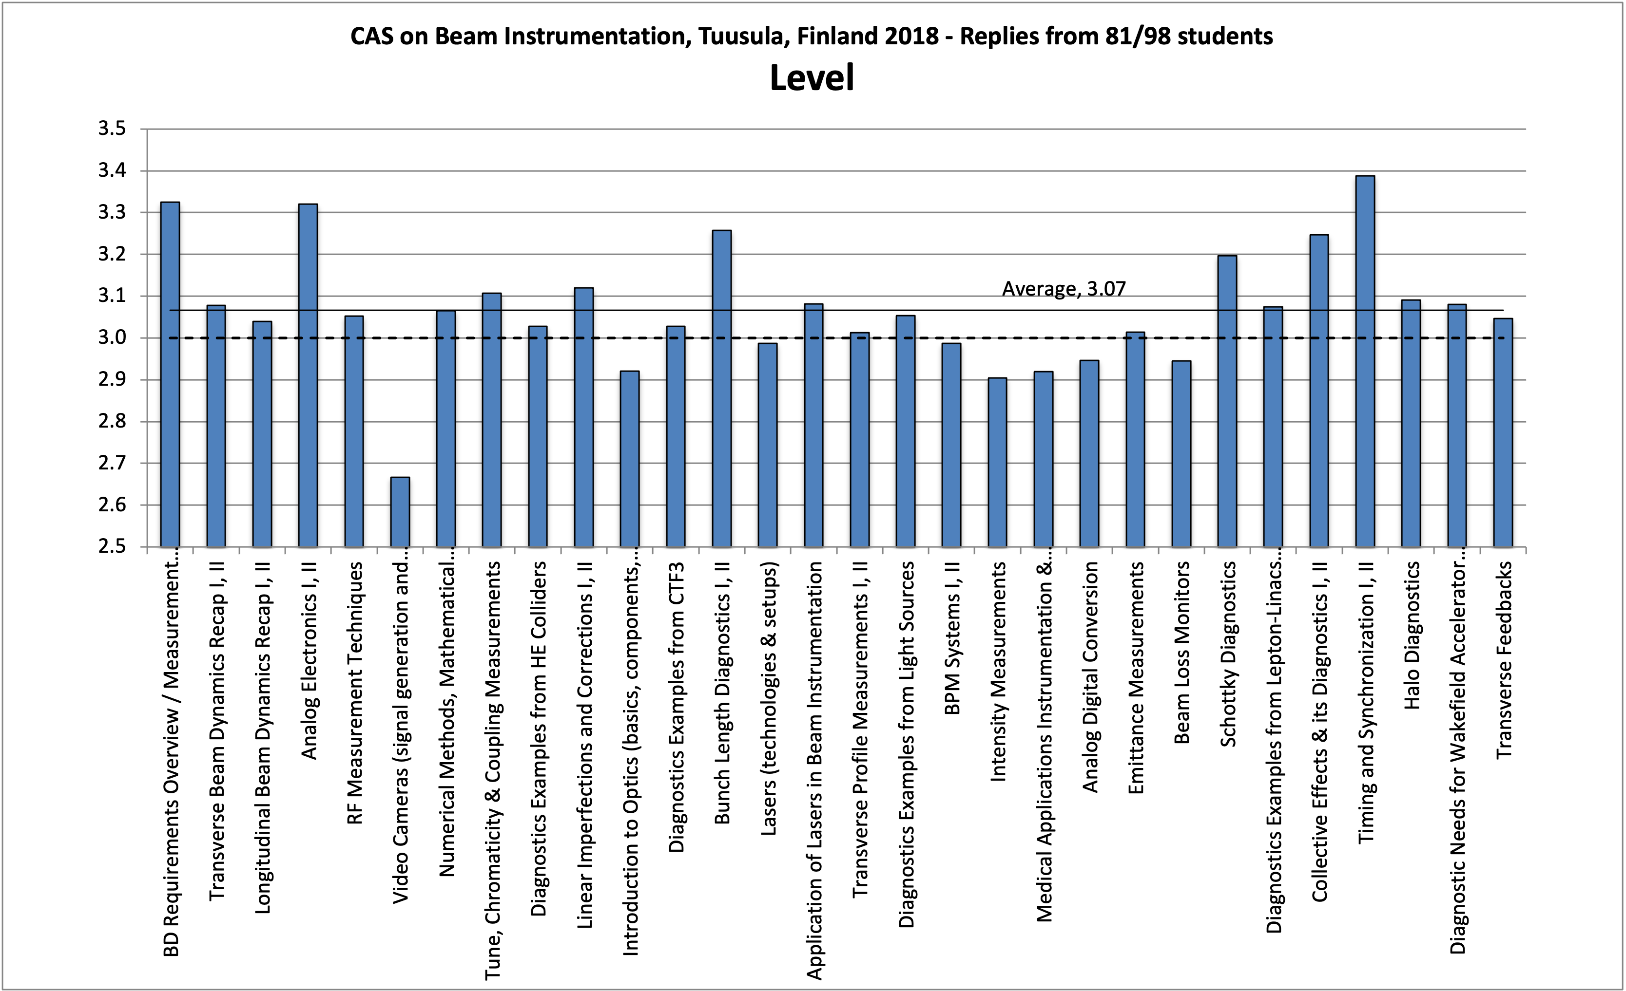
2018 Evaluation - Level

Slide 10
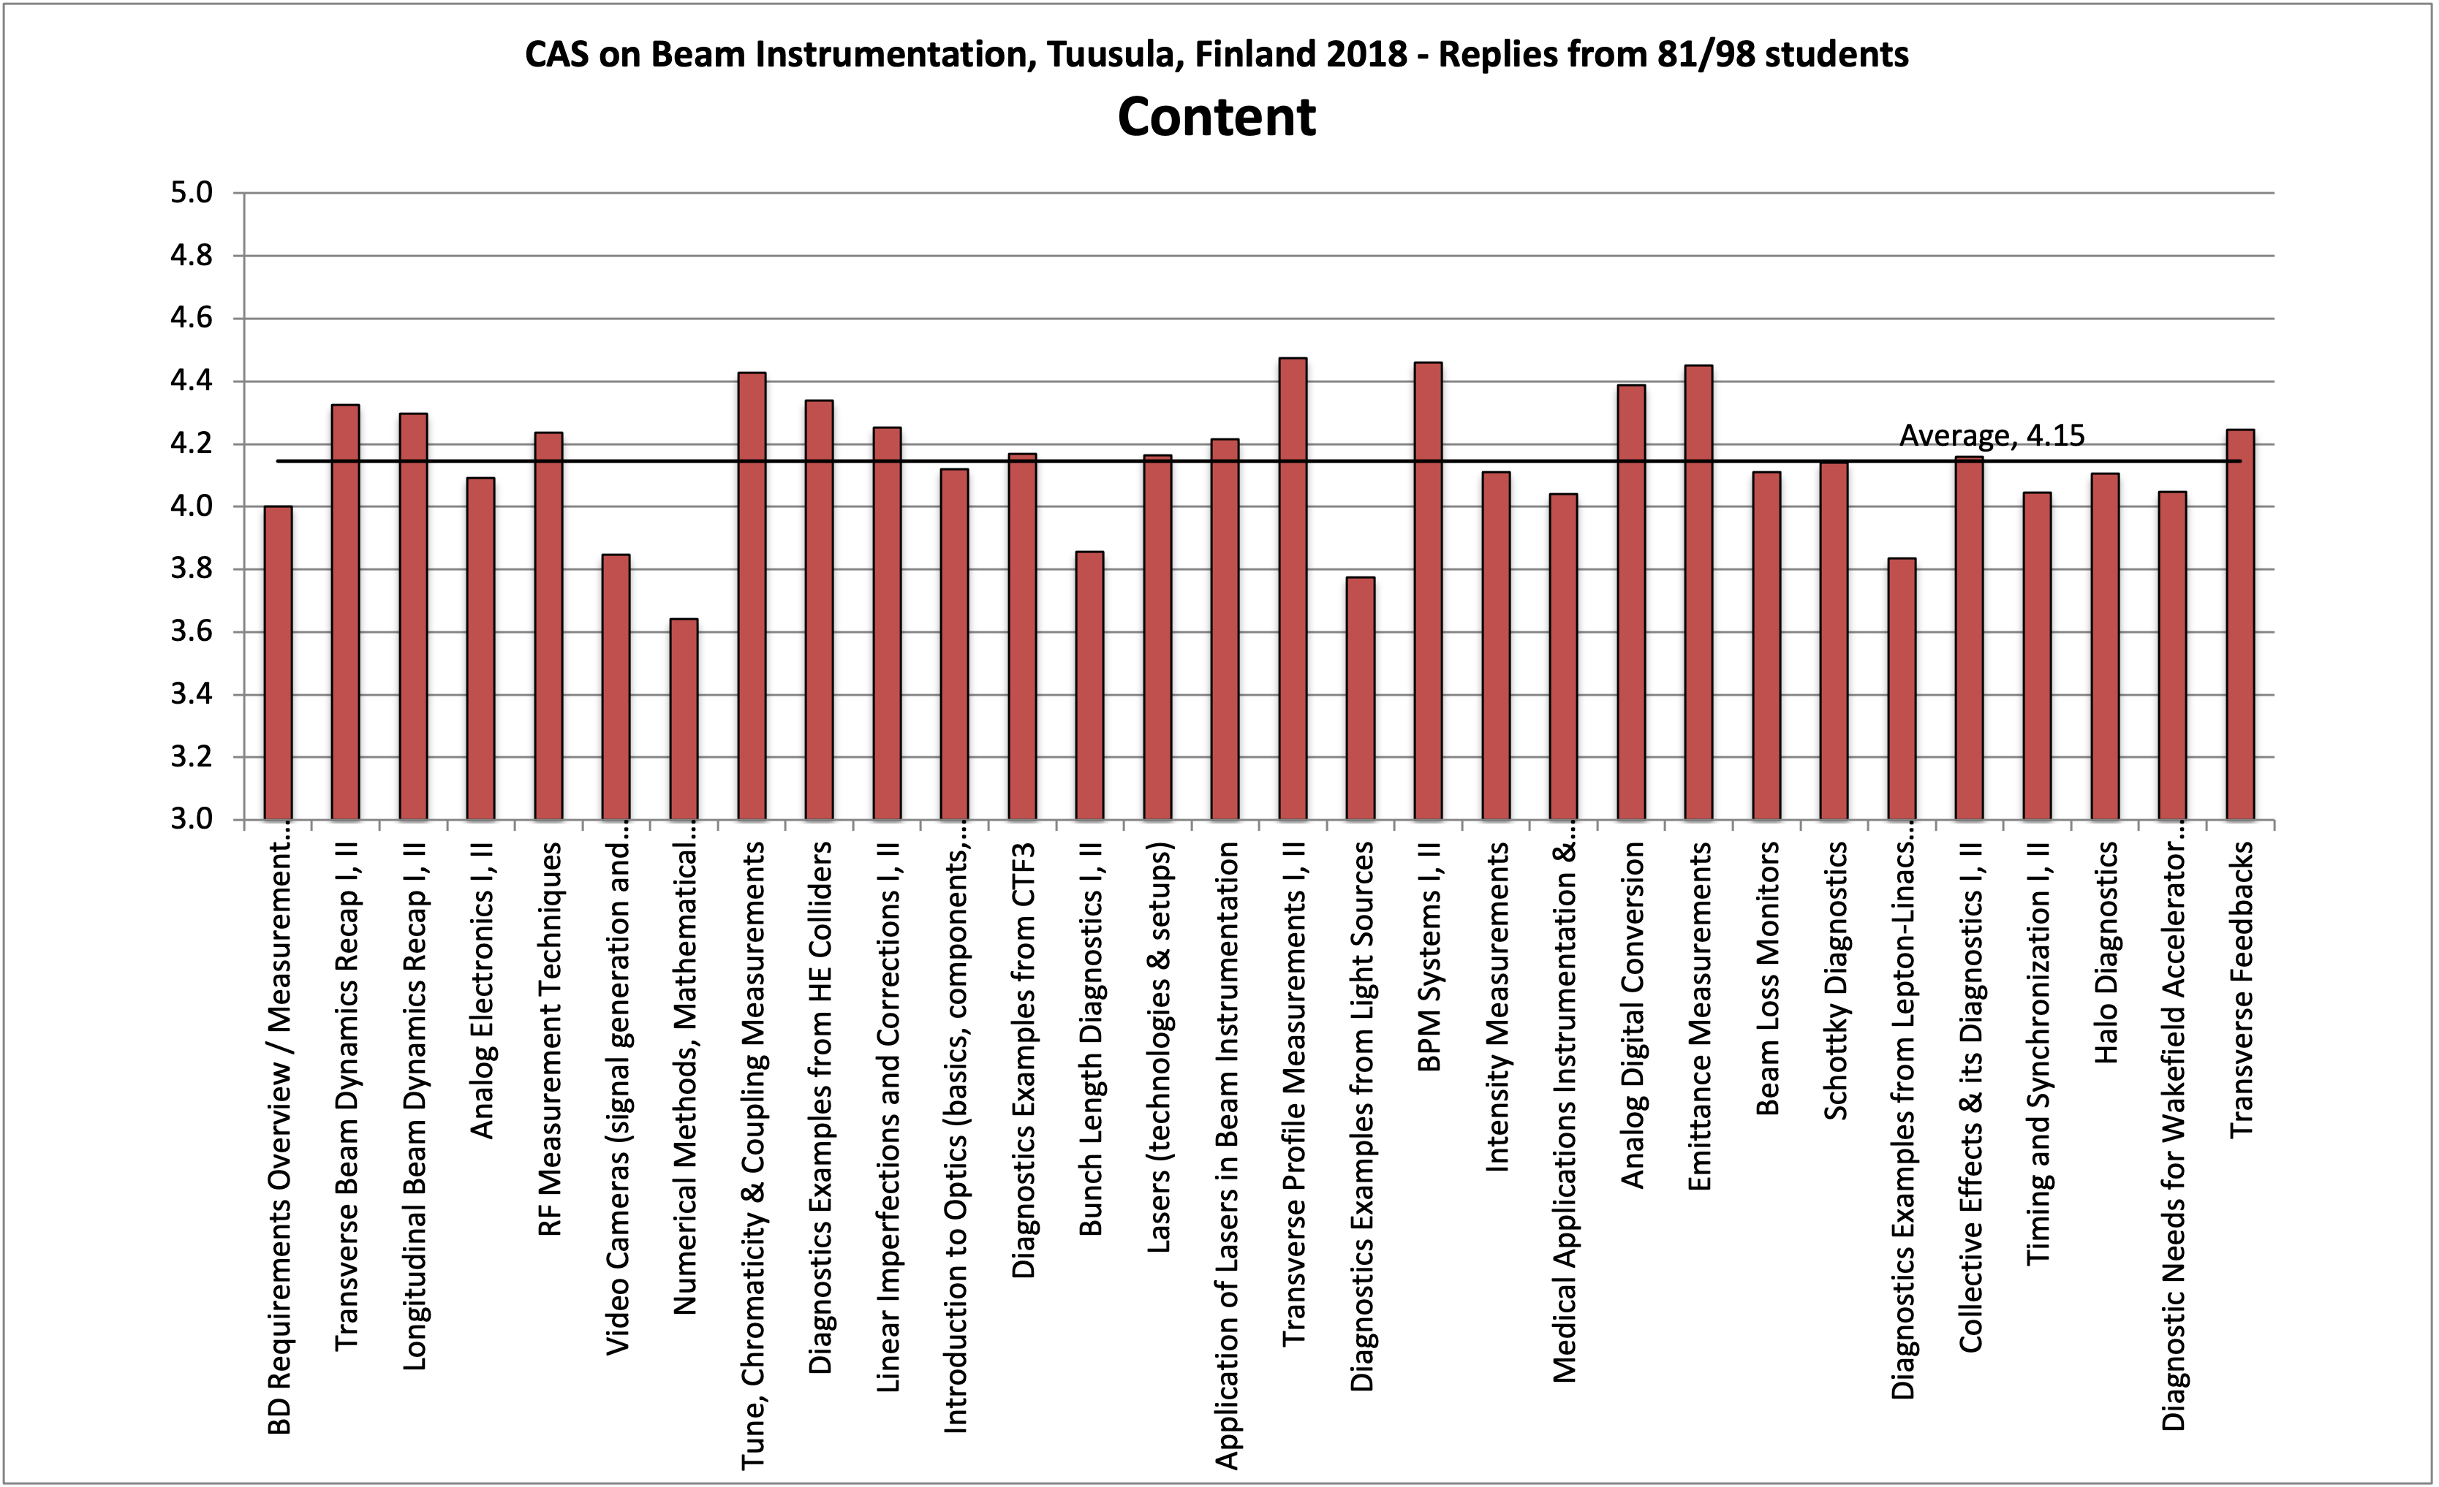
2018 Evaluation - Content

Slide 11
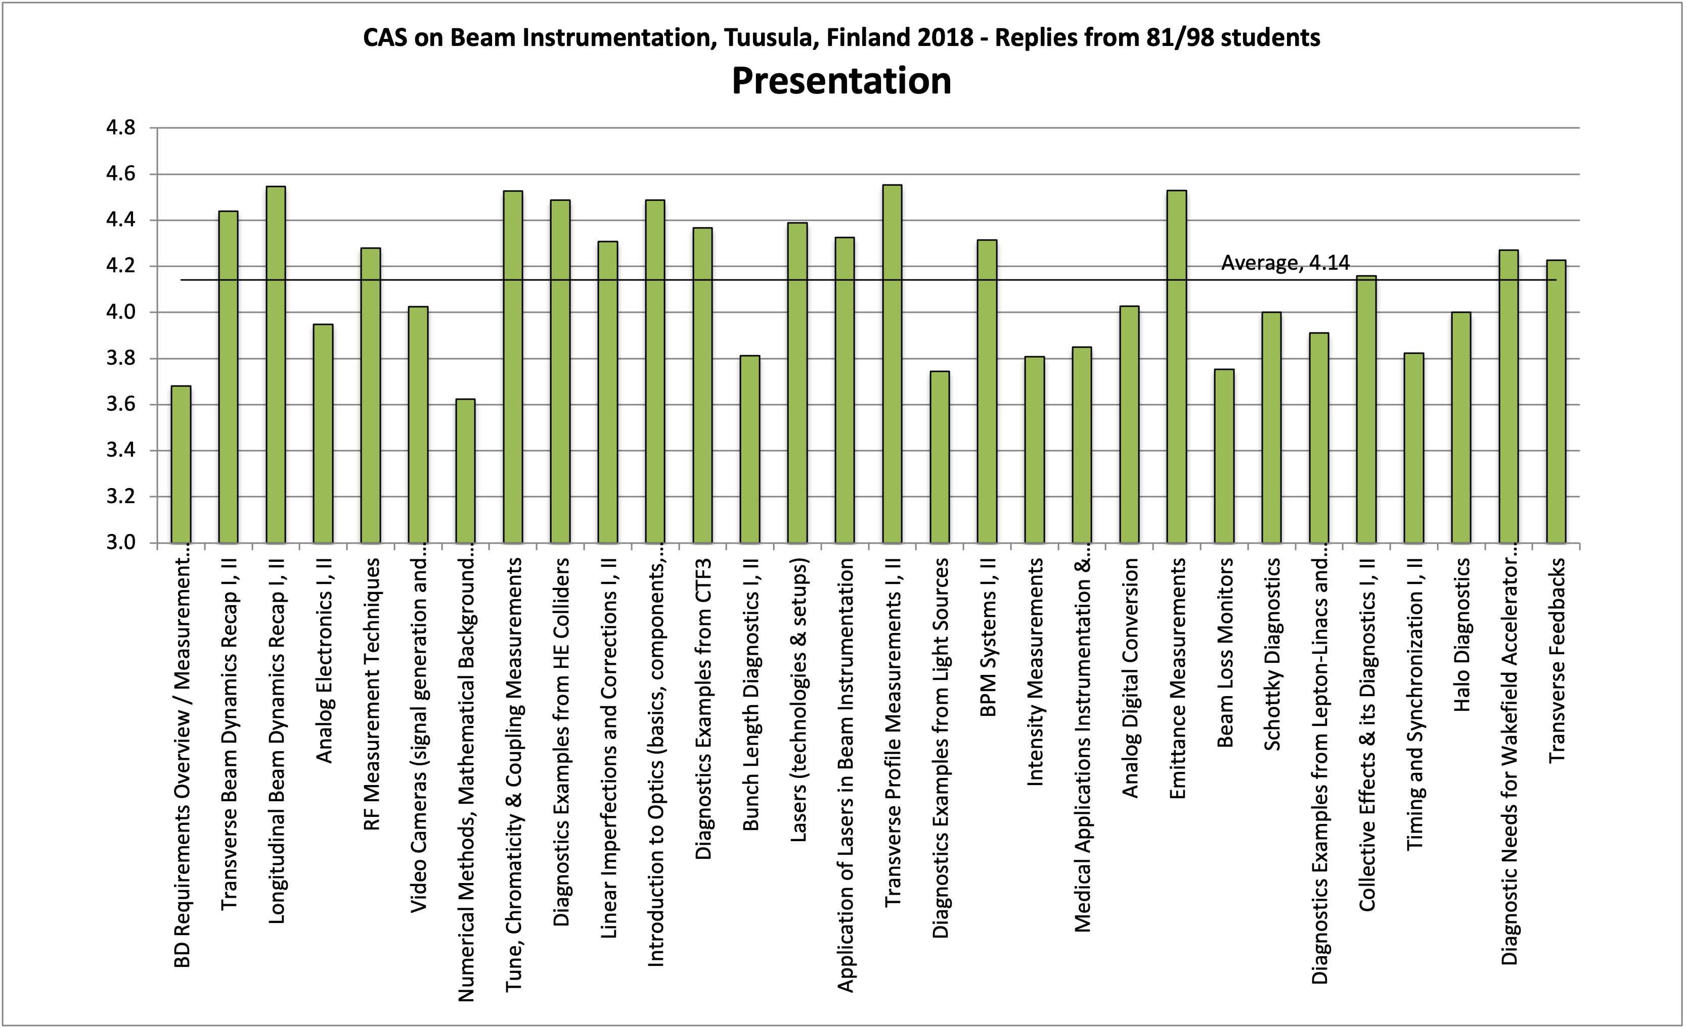
2018 Evaluation - Presentation

Slide 12
2018 Hands-on
RF measurements
  Manfred Wendt, Piotr Kowina, Christine Vollinger
DSP / tunes
  Sergey Sadovich, Diogo Alves, Markus Aicheler, (Hermann Schmickler)
Profiles
  Enrico Bravin, Thibaut Lefevre, Stephen Gibson, Beata Walasek-Hoehne, Kay Wittenburg
BPMs
  Rhodri Jones, Jeroen Belleman, Alessandro Gallo, Marek Gasior, (Hermann Schmickler)

