Slide 1
Tapering and energy compensation
Delphine Domange, Cédric Hernalsteens
FCC-ee Accelerator Design Meeting
2024-11-27

Slide 2
Tapering and energy compensation
Synchrotron radiation energy losses over one turn is significant, even at the z-pole energy (45.6 GeV) and becomes critical at the ttbar energy
  Rf phase (energy compensation) and magnet relative strengths (tapering) must be
  self-consistently adjusted
    Energy loss and energy compensation (gain from cavities) impacts tapering and vice-versa
    Need to find a fixed-point in an extended parameter space
Tapering schemes must be devised to accomadate
  Practical considerations: powering scheme, cabling, cost
  Beam dynamics considerations: orbit shift, beta-beating, chromatic correction, dynamical and momentum apertures
  Ideal tapering: each element is adjusted to match exactly the beam momentum at that location
  Realistic tapering: magnets are adjusted in groups (mean rigidity) within magnet families

Slide 3
Outline
Powering schemes and considered tapering schemes
Self-consistent algorithm to find a fixed-point in the rf phase / tapering / closed-orbit correction space
  Present implementation in xsuite
  Required extensions
  Implementation
Results for multiple tapering schemes
  ttbar
  Z

Slide 4
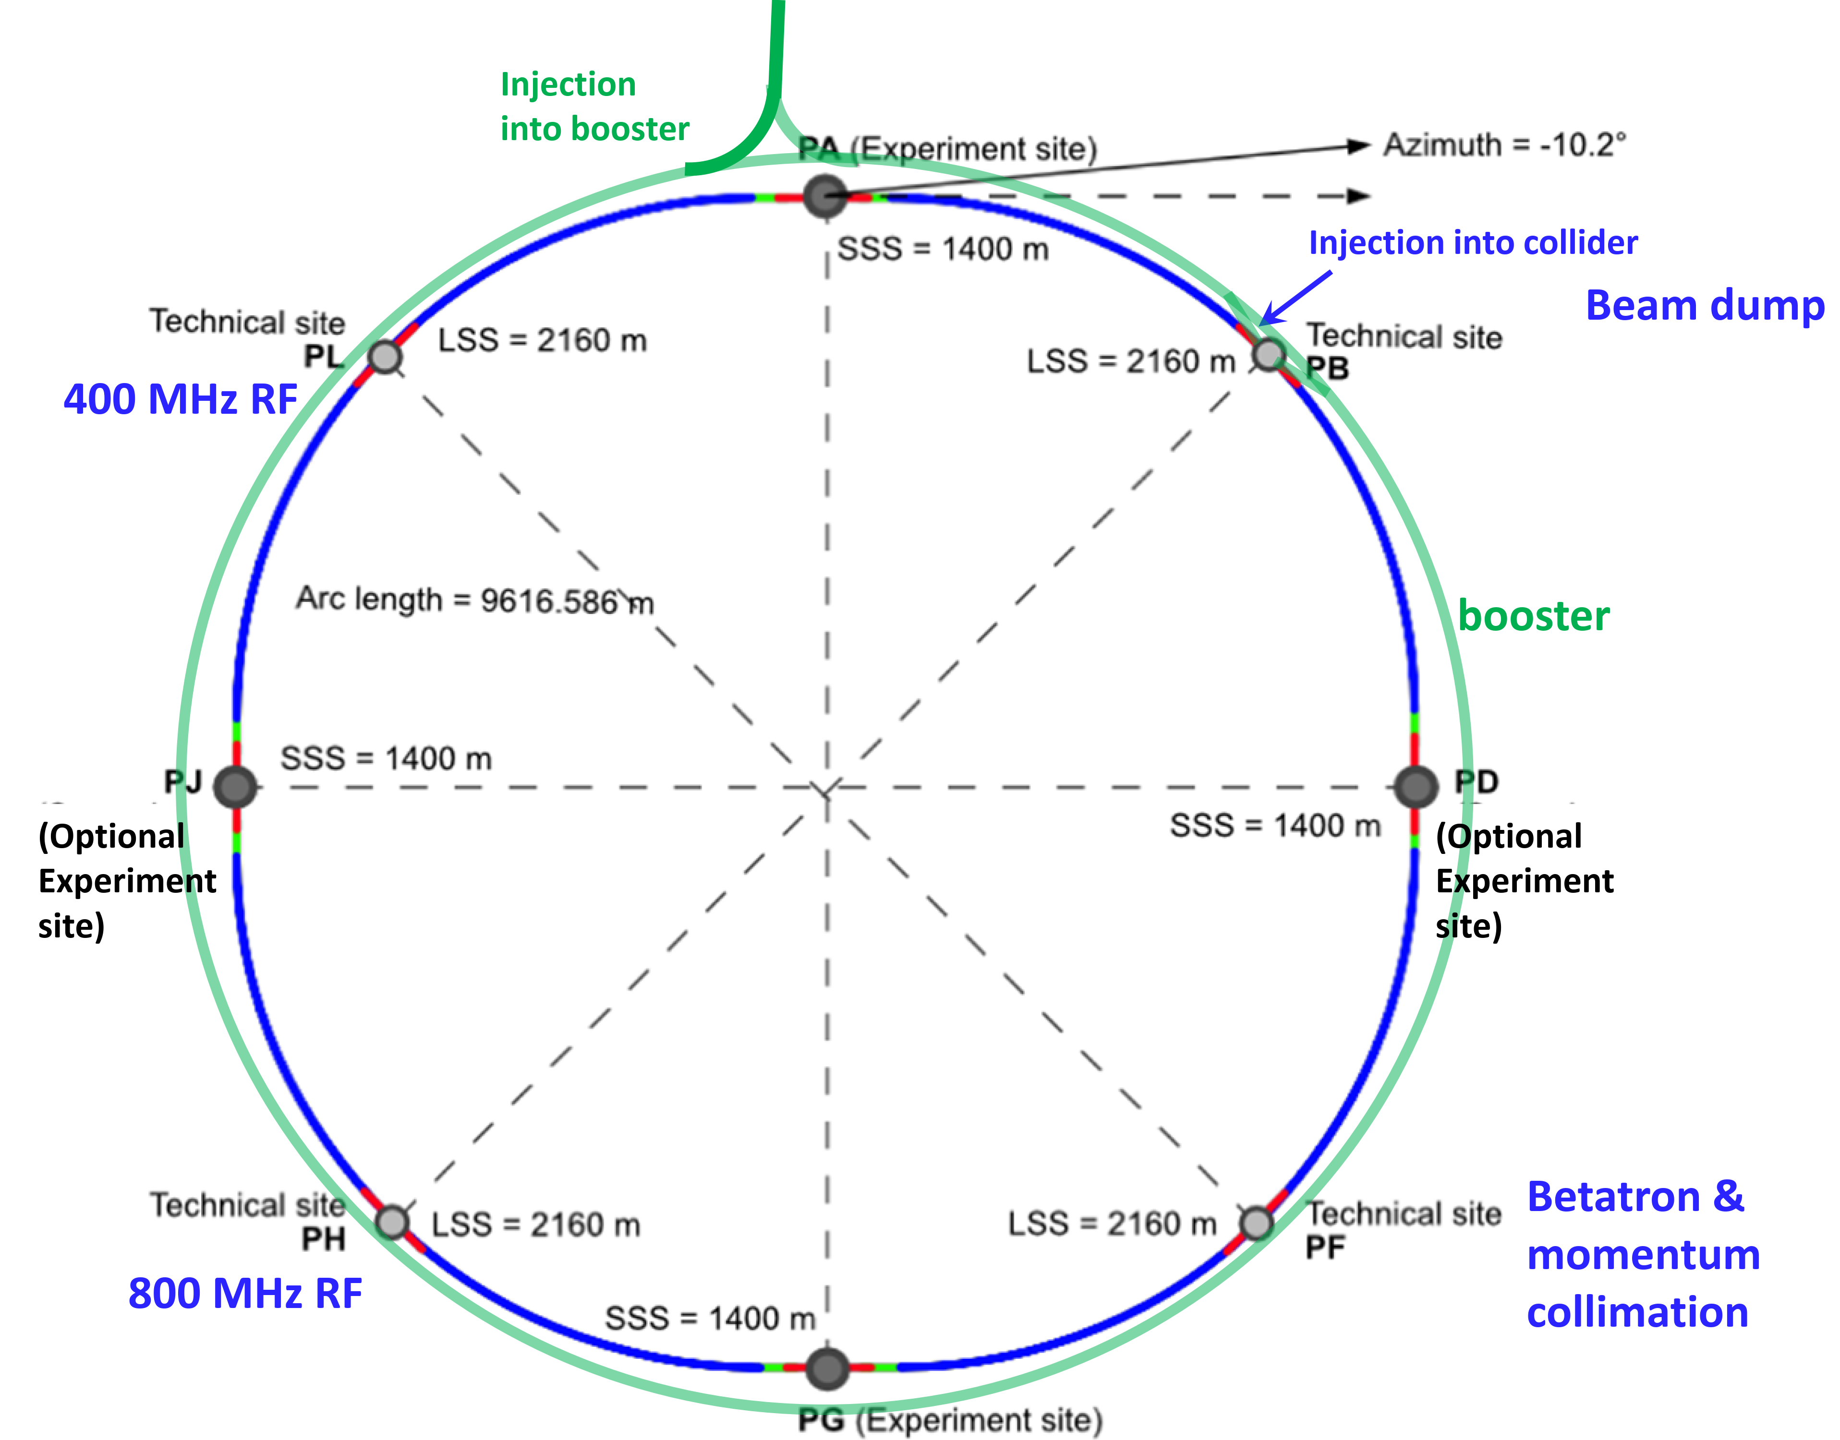
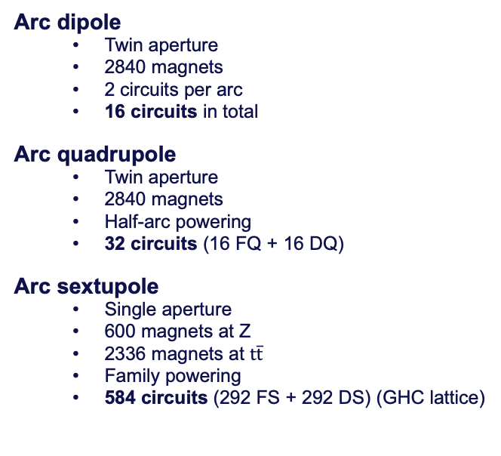
Powering schemes for the arc magnets
Arc dipole
  Twin aperture
  2840 magnets
  2 circuits per arc
  16 circuits in total
Arc quadrupole
  Twin aperture
  2840 magnets
  Half-arc powering
  32 circuits (16 FQ + 16 DQ)
Arc sextupole
  Single aperture
  600 magnets at Z
  2336 magnets at $t\overline{t}$
  Family powering
  584 circuits (292 FS + 292 DS) (GHC lattice)
All other magnets considered individually powered in this study.

Slide 5
Tapering schemes
Tapering scheme | Dipoles | Quadrupoles | Sextupoles
D#_Q#_S#_M# | Individual | Individual | Individual
D8_Q0_SC_M# | Arc | 8 | No tapering | Circuit | 2 x 292
D8_Q8_SC_M# |  | Arc | 2 x 8
D8_Q16_SC_M# |  | Half arc | 2 x 16
D16_Q0_SC_M# | Half arc | 16 | No tapering
D16_Q8_SC_M# |  | Arc | 2 x 8
D16_Q16_SC_M# |  | Half arc | 2 x 16
D32_Q0_SC_M# | Quarter arc | 32 | No tapering
D32_Q8_SC_M# |  | Arc | 2 x 8
D32_Q16_SC_M# |  | Half arc | 2 x 16
D64_Q0_SC_M# | Eigth arc | 64 | No tapering
D64_Q8_SC_M# |  | Arc | 2 x 8
D64_Q16_SC_M# |  | Half arc | 2 x 16
Naming convention:
DX_QY_SZ_MW
X: number of dipole tapering families
Y: number of quadrupole tapering families
Z: number of sextupole tapering families
W: number of tapering families for other magnets
#: individually tapered
0: no tapering applied

Slide 6
Self-consistent tapering algorithm
Current implementation
  Limited to ideal tapering
  Assumes that an initial closed-orbit can be found
  Self-consistency implied by the ideal tapering, no closed-orbit search (initial guess without synchrotron radiation is used and tracked throughout)
Improvements for self-consistent grouped tapering
  Must rely on closed-orbit search
    If closed-orbit not available at the start, ”SR threading” is needed
  Takes tapering groups as input
    Indicates what to do with the groups: no tapering, ideal tapering, mean rigidity tapering, etc.
  Perform closed-orbit correction at the groups boundaries (crucial for the straight sections, also crucial at boundaries in the arcs – see later)

Slide 7
Implementation in xsuite
Relies on usual 6D closed-orbit search
If no closed-orbit can be found without tapering
  Perform “threading”: track through single element, obtain energy loss, taper the element, re-start tracking (leap-frog), after a full turn re-phase the cavities to compensate for energy loop; iterate as required
Tapering
  Find closed-orbit
  Taper elements
  Perform closed-orbit correction
  Re-phase rf
  Iterate until fixed-point found

Slide 8
Find closed-orbit
Successful?
Yes
No
Δeloss < Tol ?
“Threading”
Yes
No
N_ iterations
Fixed point find
Taper elements
Perform closed-orbit correction
Re-phase RF

Slide 9
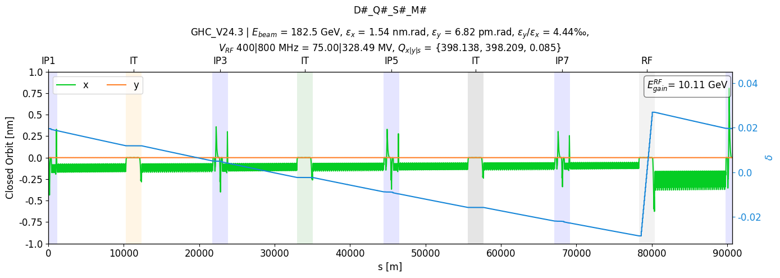
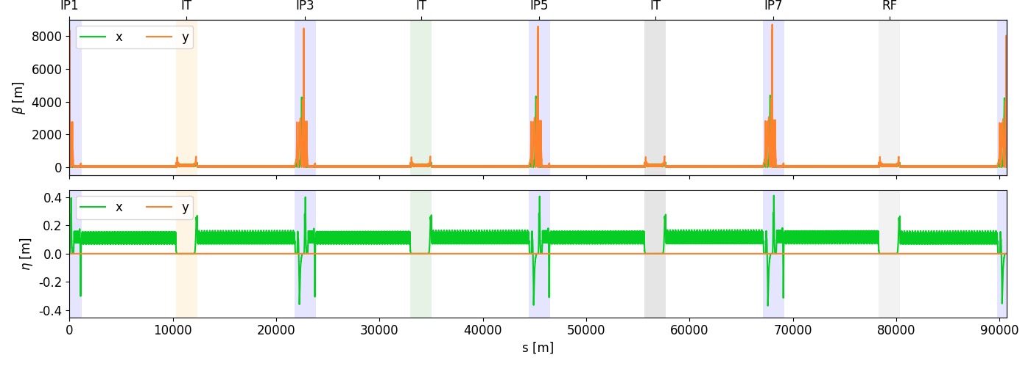
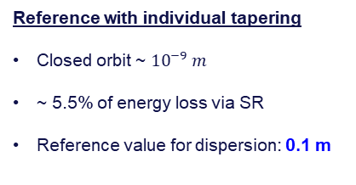
Results – ttbar energy
Reference with individual tapering
Closed orbit ~ ${10}^{−9} m$
~ 5.5% of energy loss via SR
Reference value for dispersion: 0.1 m

Slide 10
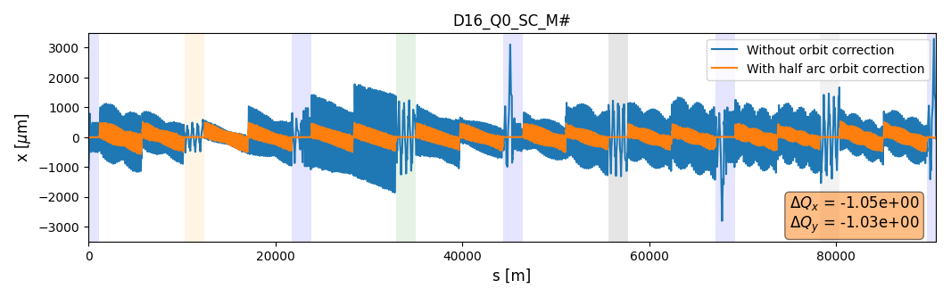
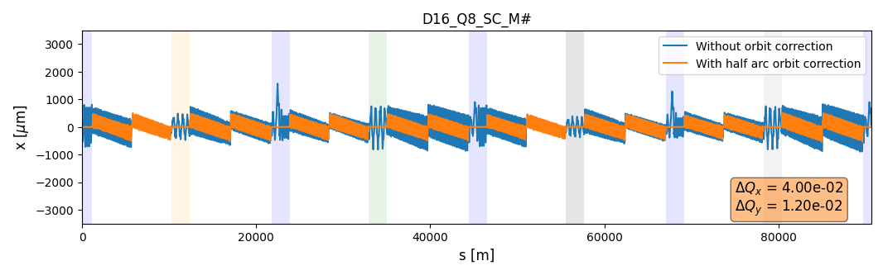
Results – ttbar energy
Impact of the orbit correction
Reduction of the orbit oscillations
  Cancelled at the IP
Better symmetry along the machine
Impact of the quadrupoles tapering
Relatively limited on the closed orbit
Larger impact on the tune shift

Slide 11
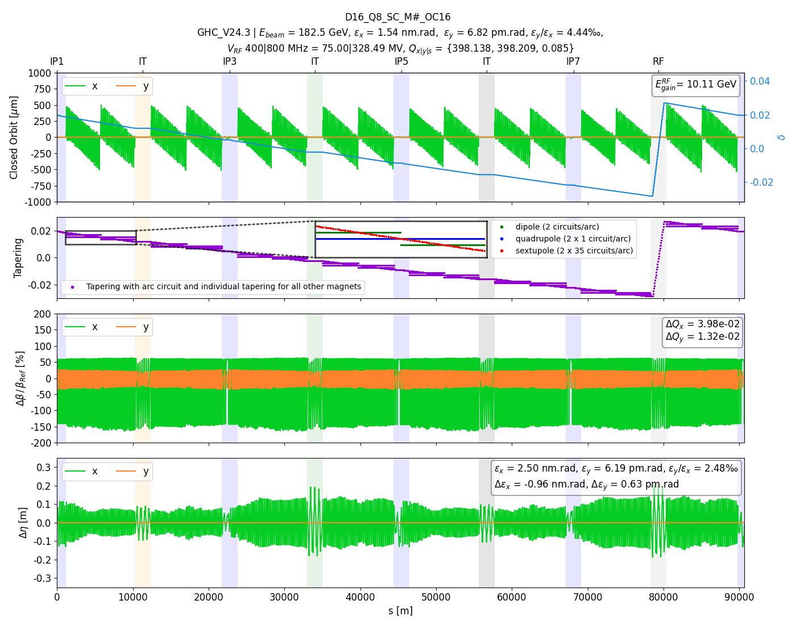
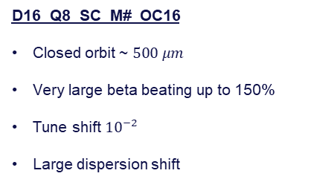
Results – ttbar energy
D16_Q8_SC_M#_OC16
Closed orbit ~ $500 μm$
Very large beta beating up to 150%
Tune shift ${10}^{−2}$
Large dispersion shift

Slide 12
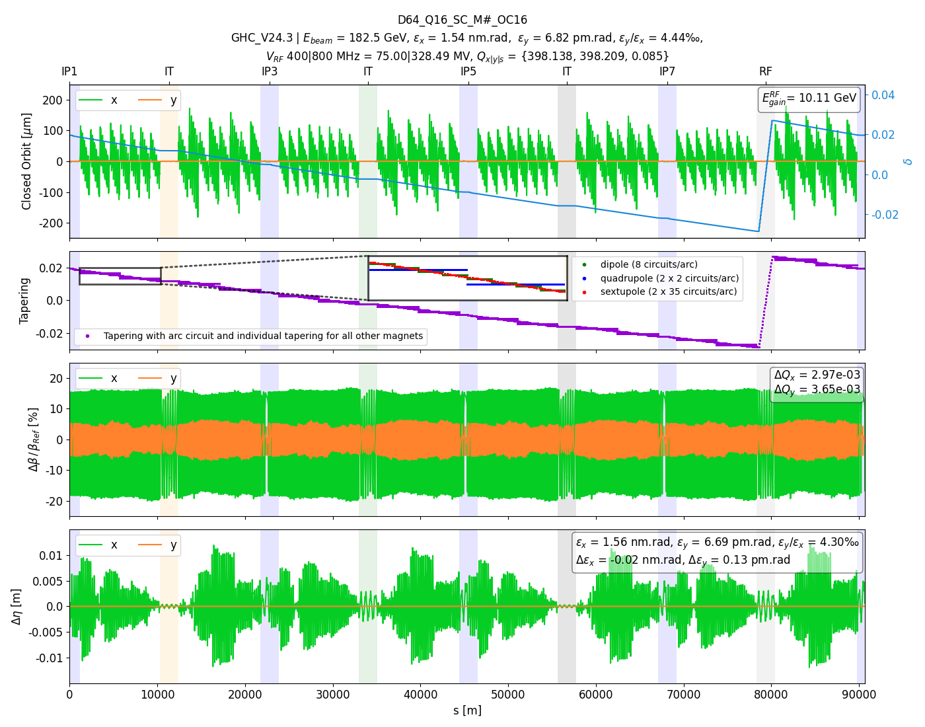
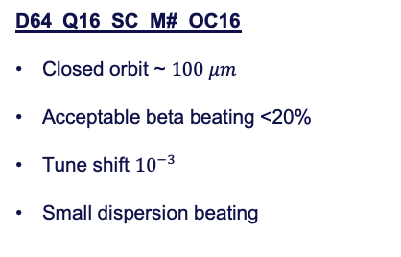
Results – ttbar energy
D64_Q16_SC_M#_OC16
Closed orbit ~ $100 μm$
Acceptable beta beating <20%
Tune shift ${10}^{−3}$
Small dispersion beating
Closed-orbit correction performed self-consistently in the fixed-point search. Do we need more? User-provided function or matching routine to self-consistently rematch tune, optics, etc. ?

Slide 13
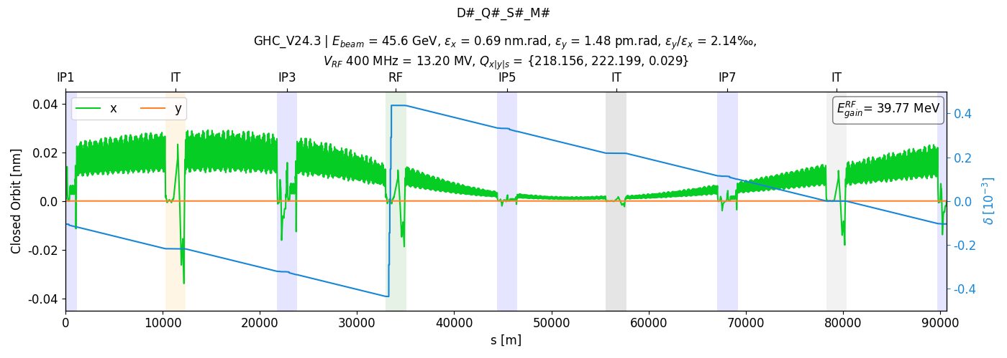
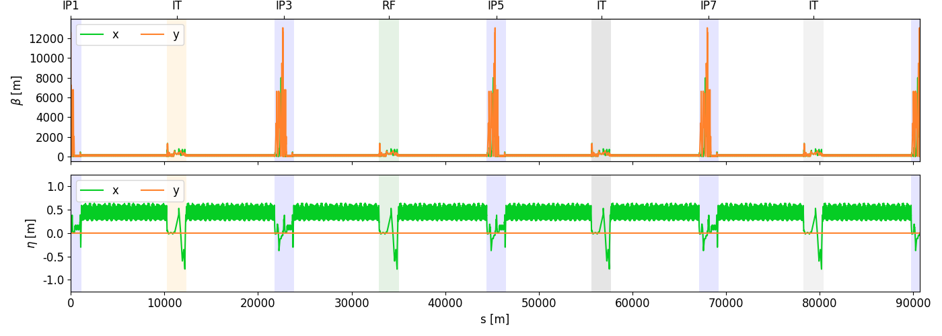
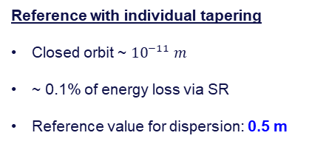
Results – Z-pole energy
Reference with individual tapering
Closed orbit ~ ${10}^{−11} m$
~ 0.1% of energy loss via SR
Reference value for dispersion: 0.5 m

Slide 14
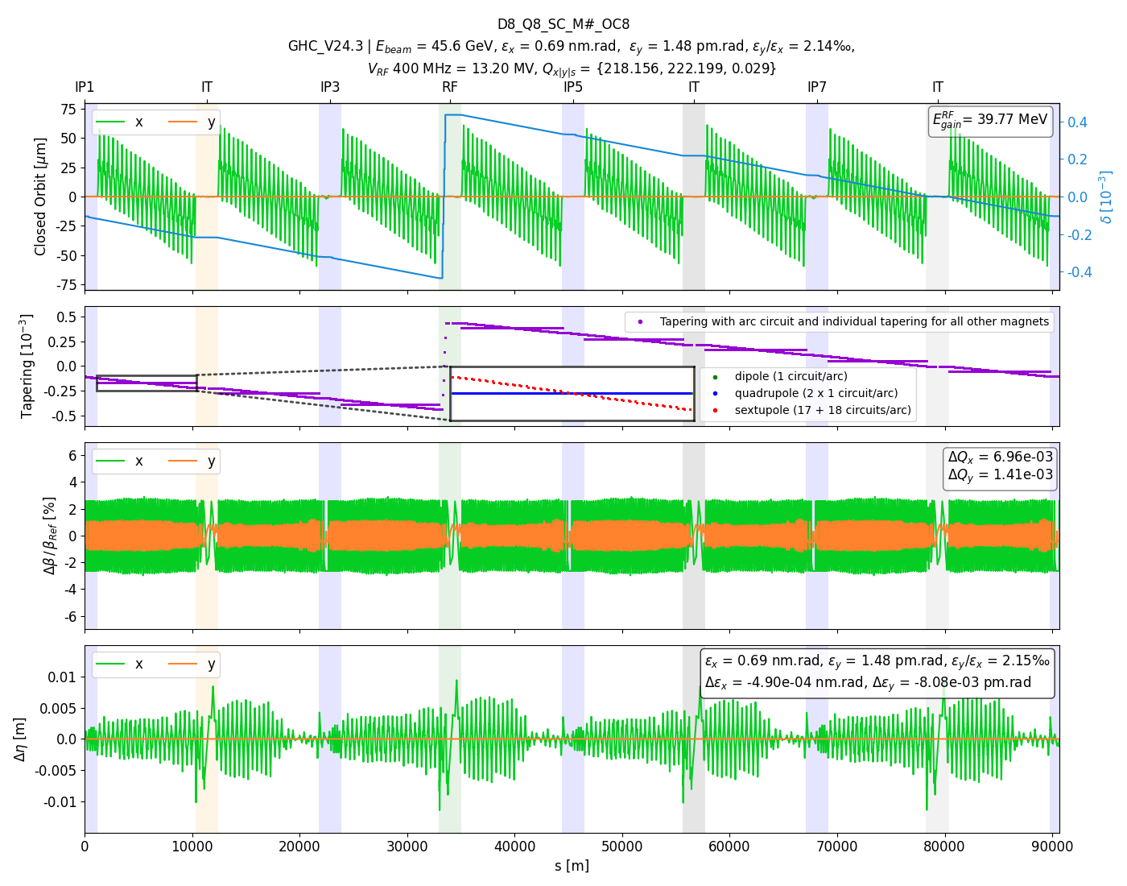
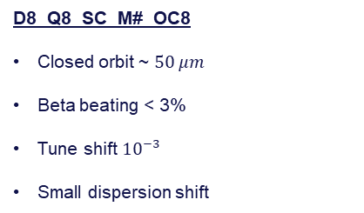
Results – Z-pole energy
D8_Q8_SC_M#_OC8
Closed orbit ~ $50 μm$
Beta beating < 3%
Tune shift ${10}^{−3}$
Small dispersion shift

Slide 15
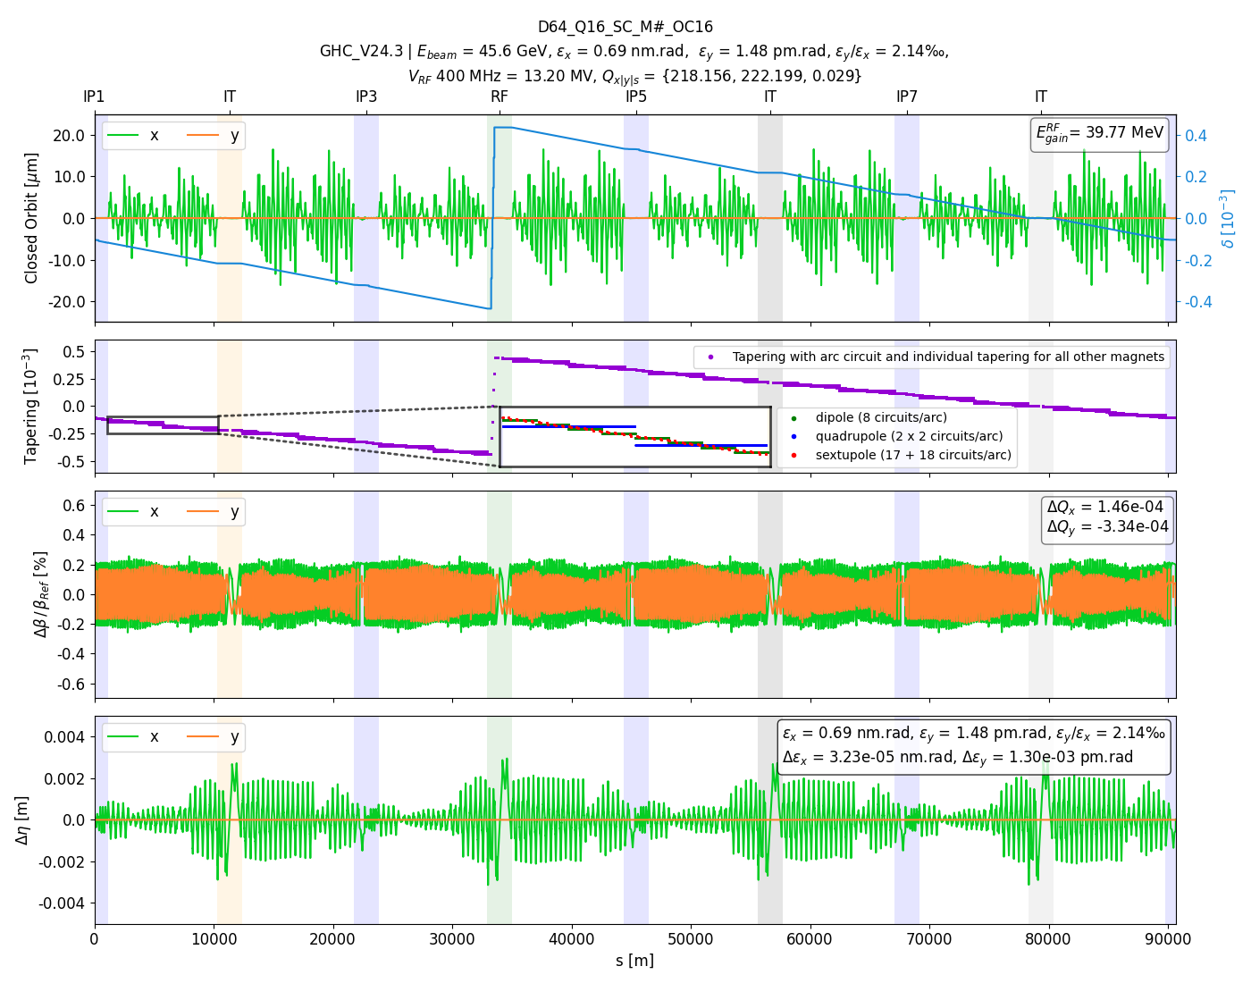
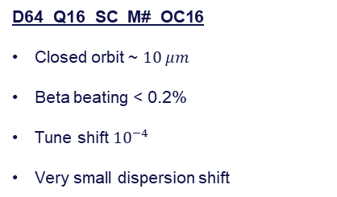
Results – Z-pole energy
D64_Q16_SC_M#_OC16
Closed orbit ~ $10 μm$
Beta beating < 0.2%
Tune shift ${10}^{−4}$
Very small dispersion shift

Slide 16
Results comparison
Z-pole energy
ttbar energy

Slide 17
Thank you for your attention.
17

