Slide 1
Bond
Reaction mold update
&
Impgregnation mold concept
N.Peray
13/12/2024

Slide 2
Reaction mold
Impregnation mold

Slide 3

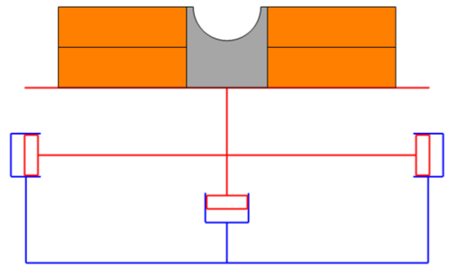
Reaction mold : ball bearing option
https://www.smbbearings.com/products/si3n4-ceramic-bearings.html
ZrO2 or Si3N4 ball bearing
ST2408362_01

Slide 5
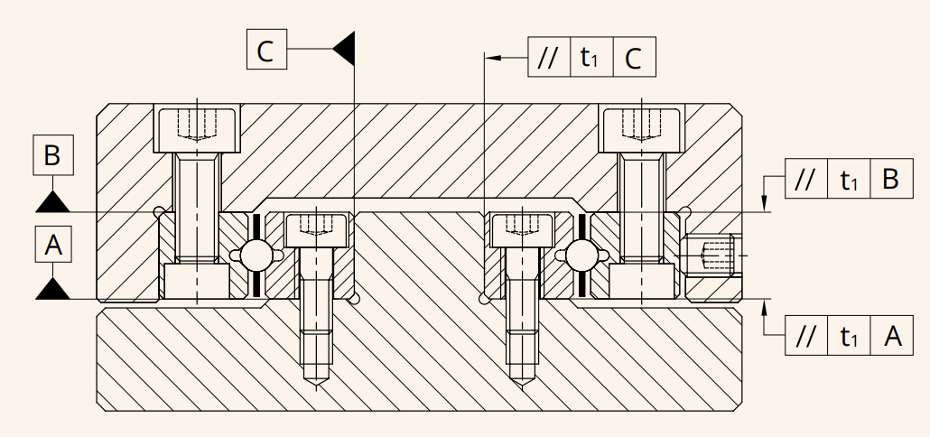
Differential thermal expension
Guiding rail test station
Thermal expansion coefficient :
ZrO2 ≈ 12.2 10⁻⁶/K
Si3N4 ≈ 3 10⁻⁶/K
Ti Ta6V ≈ 10.6 10⁻⁶/K
1.4404 (316L) ≈ 19.5 10⁻⁶/K
1.4301 (304) ≈ 18.5 10⁻⁶/K
ZrO2
Si3N4

Slide 6
Nb3Sn reaction behavior test proposal
Does the hard way bend create a fixed-point during reaction heat treatment ?
Two configuration test layout :
With hard way bend head (close to the Bond geometry)
Straight head
Single layer
Few turns
Simplified central post
Big gap (few millimeters)

Slide 7
Reaction mold
Impregnation mold

Slide 8
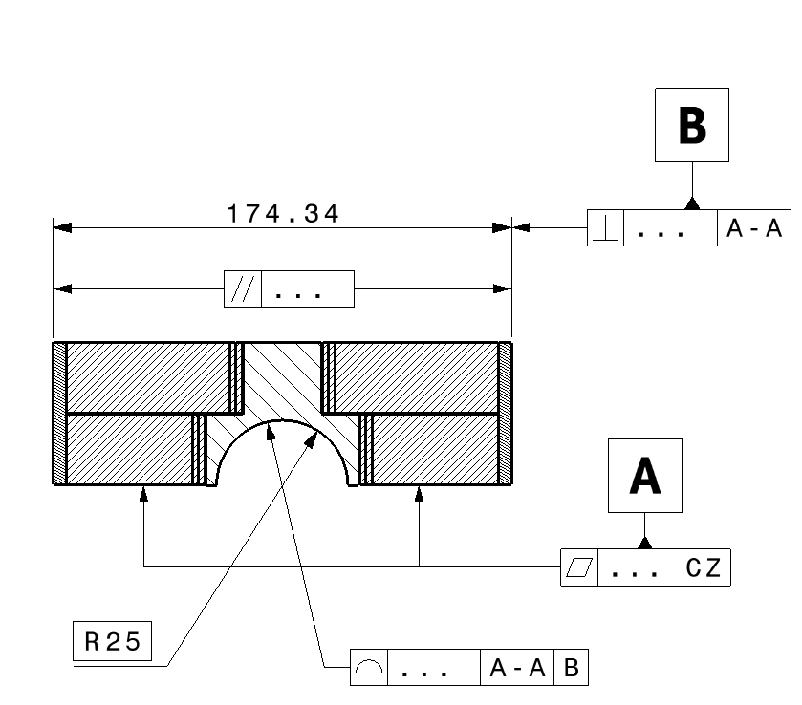
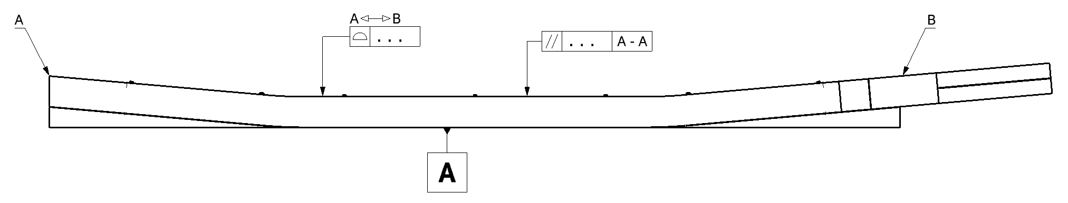
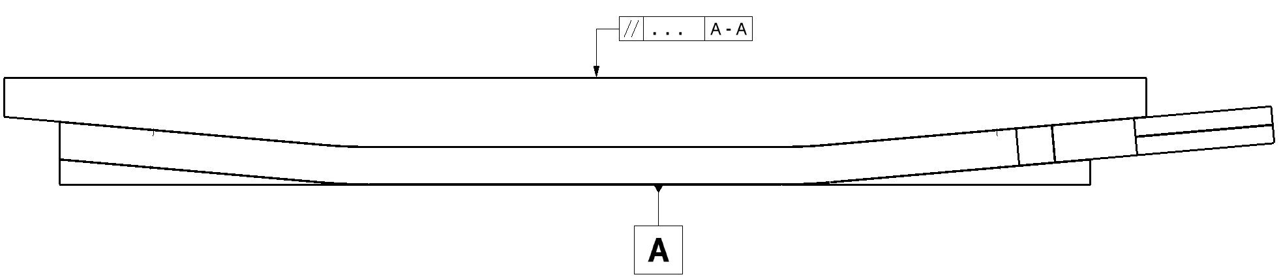
What are we waiting from a good impregnation mold ?
Main criteria :
Flatness of the midplane surface
Shape on the pad side to fit the pad without shimming
Parallelism of the key/bladder track to the midplane
Secondary criteria (a bit less critic as they can be easily shimmed):
4) Parallelism of the sides
5) Perpendicularrity of the sides to the midplane
6) Aperture shape and localisation
5
4
1
6
2
3
Length and ends location don’t need to be very accurate as we can easily have a fine tunning system for the axial preload.

Slide 9
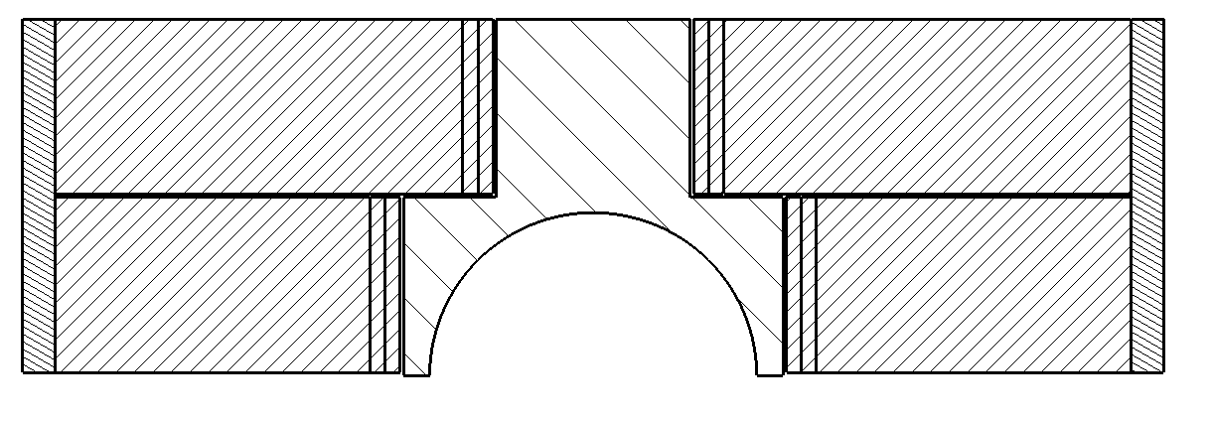

Custom filler

Slide 10
In the case where the pole gaps don’t close and the coil is overlength,
fiberglass layer can be added here to fill the gap

Slide 11
Seal web overview

Slide 13
Thanks for your attention

