Slide 1
Bond
Mock-up design of sliding reaction tooling
N. Lusa and J. Ferradas Troitino
Acknowledgements to B. Pellet and N. Peray
13/12/2024

Slide 2
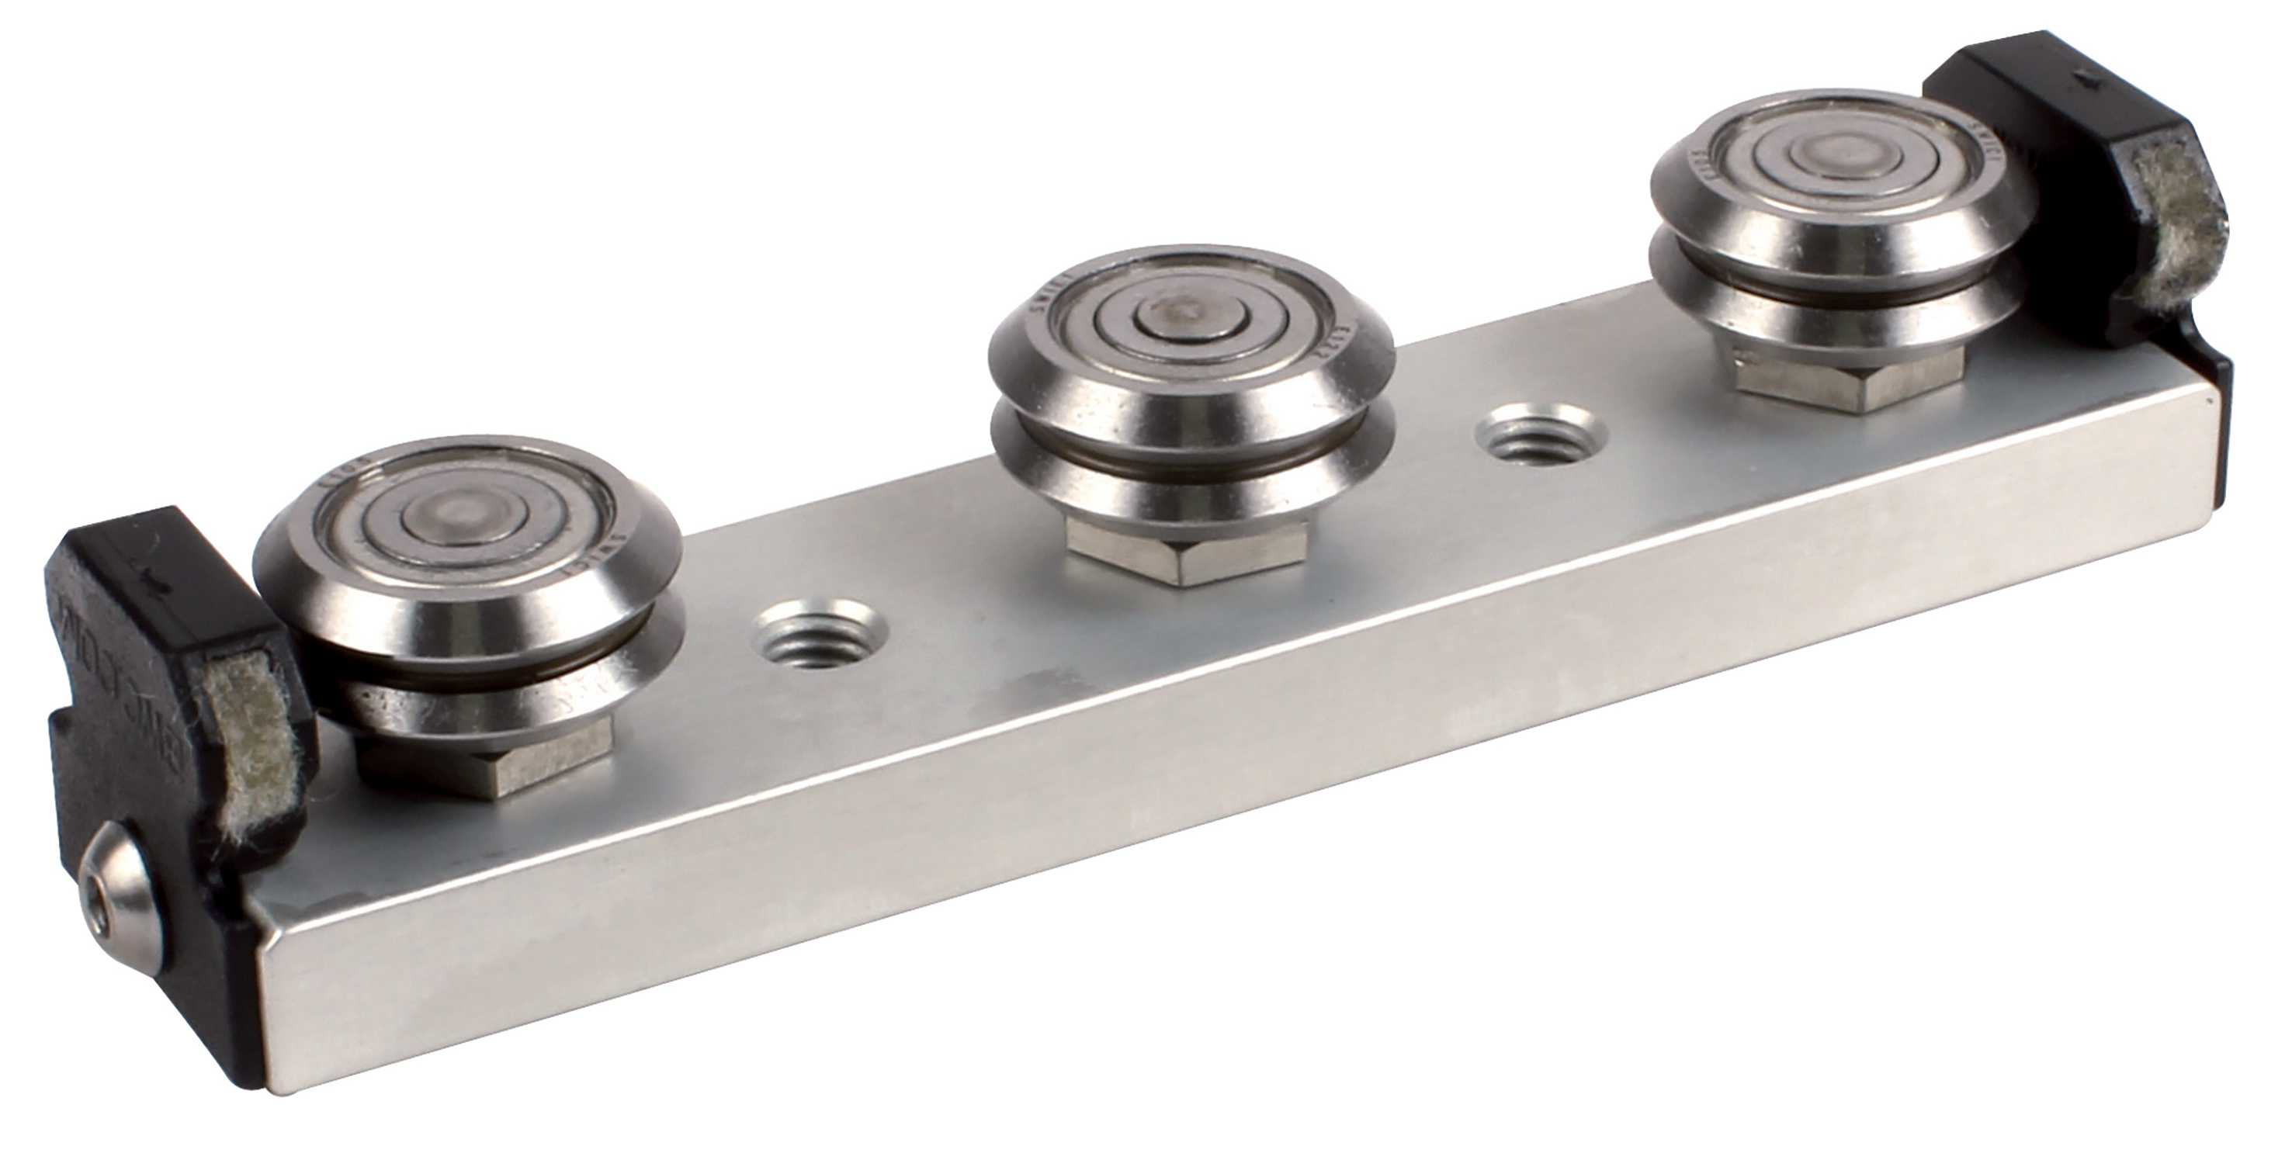
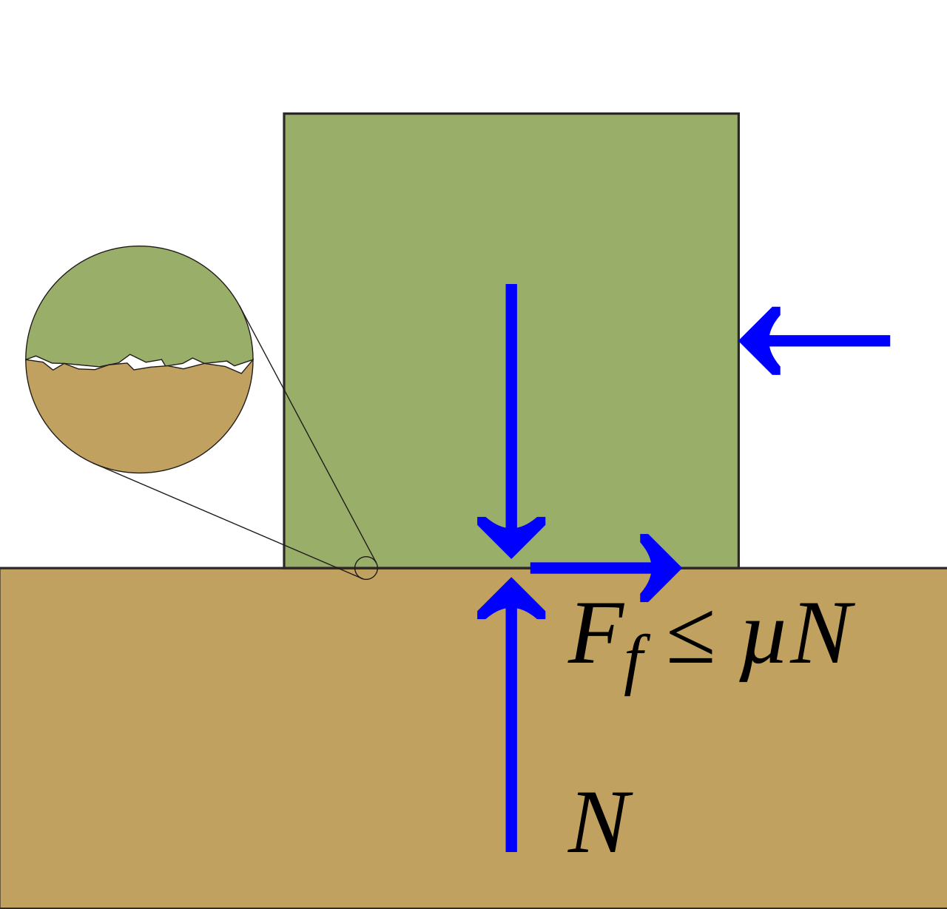
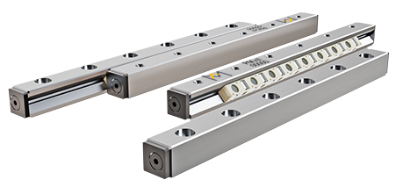
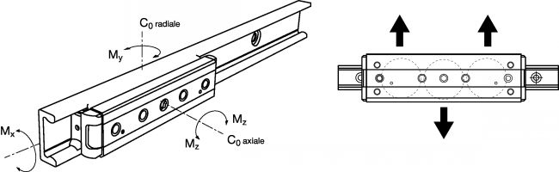
Reaction mold – Head sliding solution
 | Sliding surface (Stainless steel against mica or ceramic) | Circular ceramic bearing (Si₃N₄) | Linear ceramic bearing (Si₃N₄)
+ | Easy to set up and adjust, cheap | Rolling element (instead of friction), no risk of buckling, easy to adjust | High strength, high guiding precision, rolling element, no risk of buckling, easy to design and set up
- | Friction, risk of stick slip effect, risk of buckling | Complex system (on a design point of view) | Can be expensive, need precise machined part

Slide 3
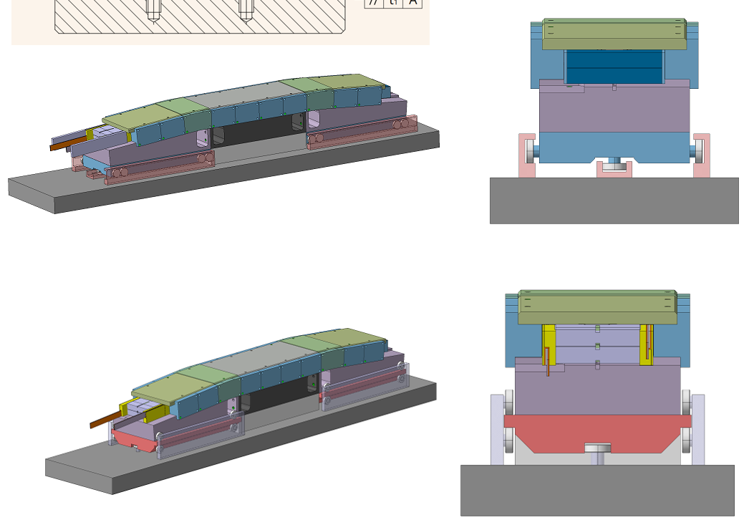
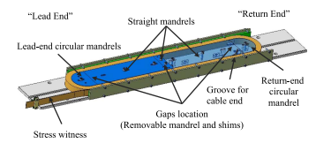
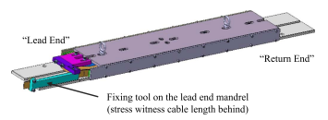
Test set-up
Updates based on last meeting comments (19/11/24) and latest reaction mold design input
  Base length from 1300 mm → 750 mm to be able to use even the smaller oven in B.927
  Better definition of the mock-up with linear ceramic bearings
  Displacement measurement based on high temperature capacitive sensors or other measurement device
    Meeting with EN-MME on 03/12/2024 to activate a collaboration aiming at finding the appropriate measuring device for our case
    We expect to have a reply by the end of the year with a tentative timeline for
      Feasibility study
      Purchasing of one or more measurement systems
      Calibration
      Implementation and integration of the measurement system in a dedicated mock-up
  Mock-up version using circular ceramic bearings (SMB Bearing supplier)
  Next step: Very preliminary design of the set-up with a coil mock-up ongoing
    Among the main the goals
      Test the sliding solution with a “coil” instead of a rigid bar
      Test the gap measurement system
    Set-up design may change based on tests already performed in the past for Fresca2 (M. Durante et al., "Geometrical Behavior of Nb3Sn Rutherford Cables During Heat Treatment," in IEEE Transactions on Applied Superconductivity, vol. 26, no. 4, pp. 1-5, June 2016, Art no. 4802705, doi: 10.1109/TASC.2016.2530166)
      Ok for the gap measurement
      A flat mock-up, would it give us valuable insights of the sliding phenomena of a coil with flared ends?
    Could be interesting to develop a mock-up with a flared end (not yet done)
Courtesy of N. Peray

Slide 4

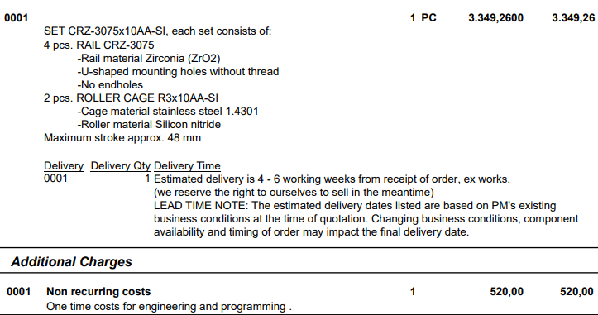
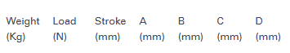
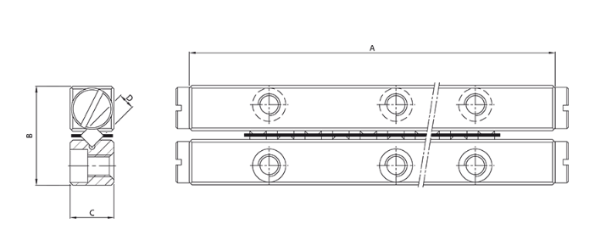
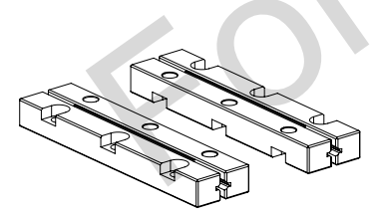
1st option
Linear ceramic bearing
Purchasing of 1 set CRZ-3075x10AA-SI:
  4 pcs ZrO₂ rails (Si₃N₄ rails available upon request and for a MOQ)
  2 pcs stainless steel roller cage and Si₃N₄ rollers

Slide 5
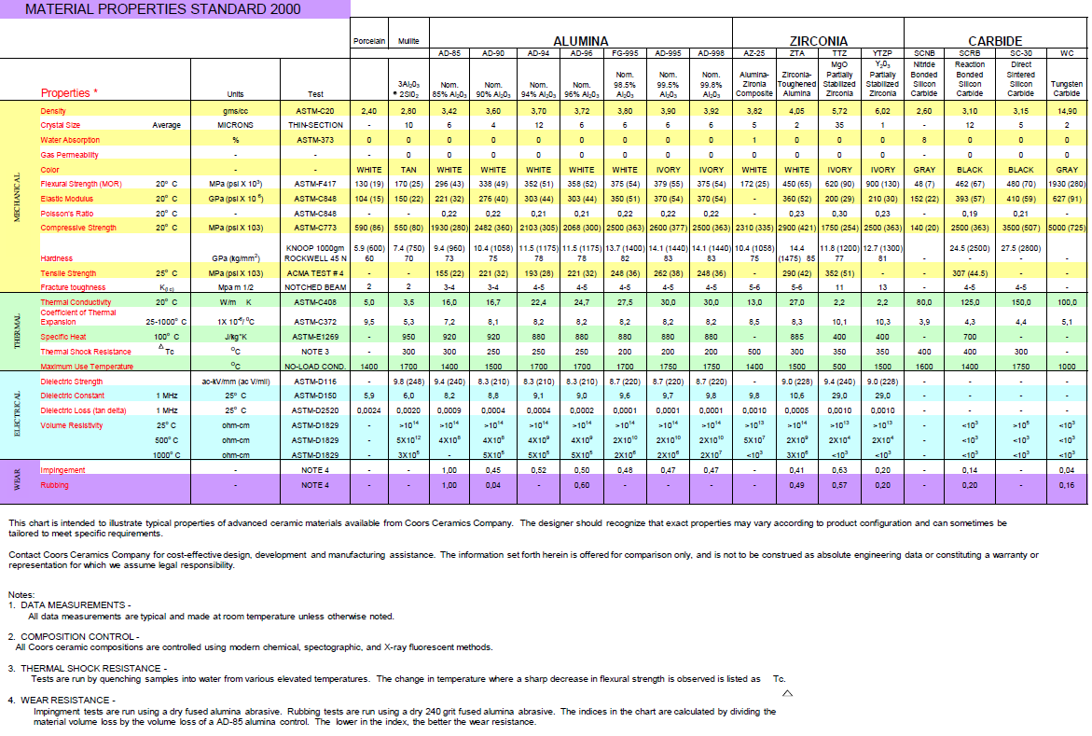
ZrO₂ properties (supplier datasheet)

Slide 6
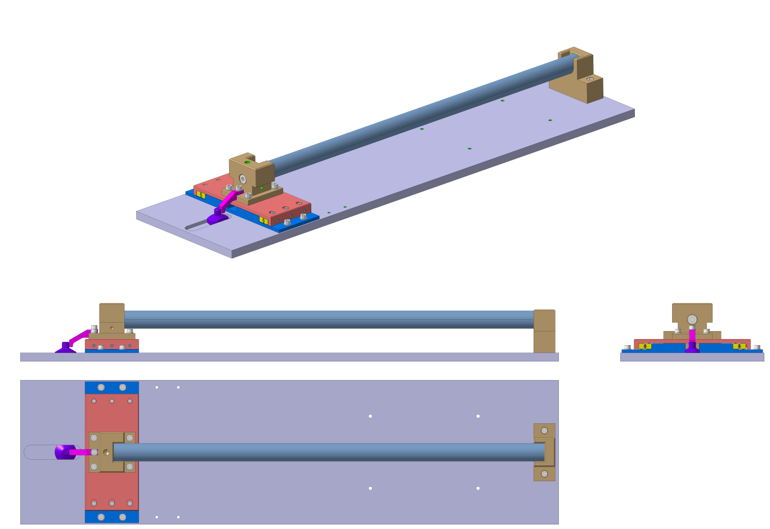
Test set-up

Slide 7
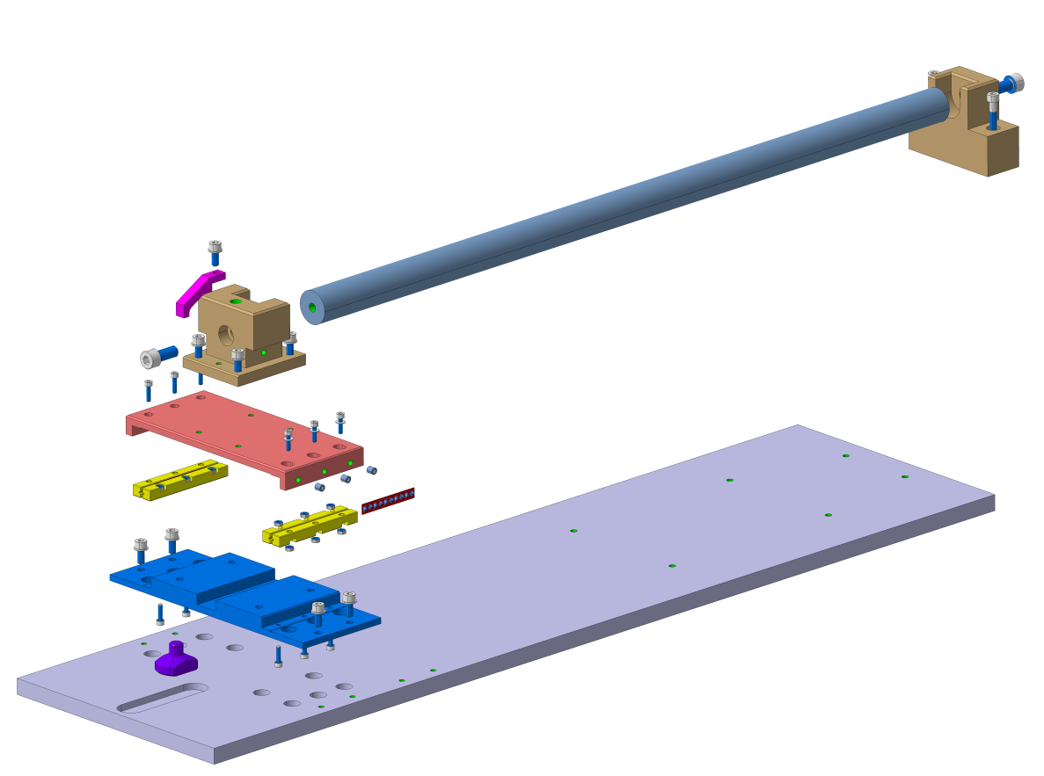
Test set-up
Ti or SS304?
Titanium grade 2
Stainless steel 304

Slide 8

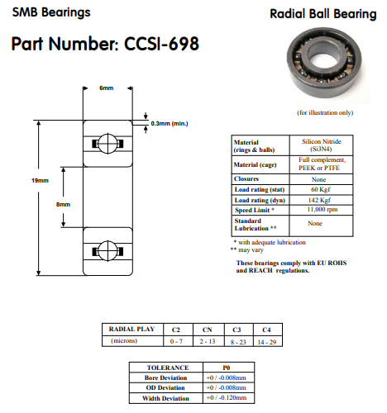
2nd option
Circular ceramic bearing
Based on actual full Si₃N₄ bearing stock, they can propose us only bearings without cage
  In principle for temperatures between 500-900°C a GH4099 nickel-based alloy cage could be used
Price for 6 bearings CCSI-698 (chosen randomly for the mock-up manufacturing)
  32.10 £/piece (36.30 CHF/piece)
  12 bearings in stock
COMMENT: The use of this type of bearing could be more challenging w.r.t. another system
  Fitting shaft/bearing must be careful check both at ambient and high temperatures to
    Ensure the alignment of the mold parts during the whole reaction cycle
    Make sure that interference fits due to differential thermal expansions do not reduce the radial play of the bearing to an unacceptable level (or shaft and housing fits should always accommodate differences in expansion coefficients)

Slide 9
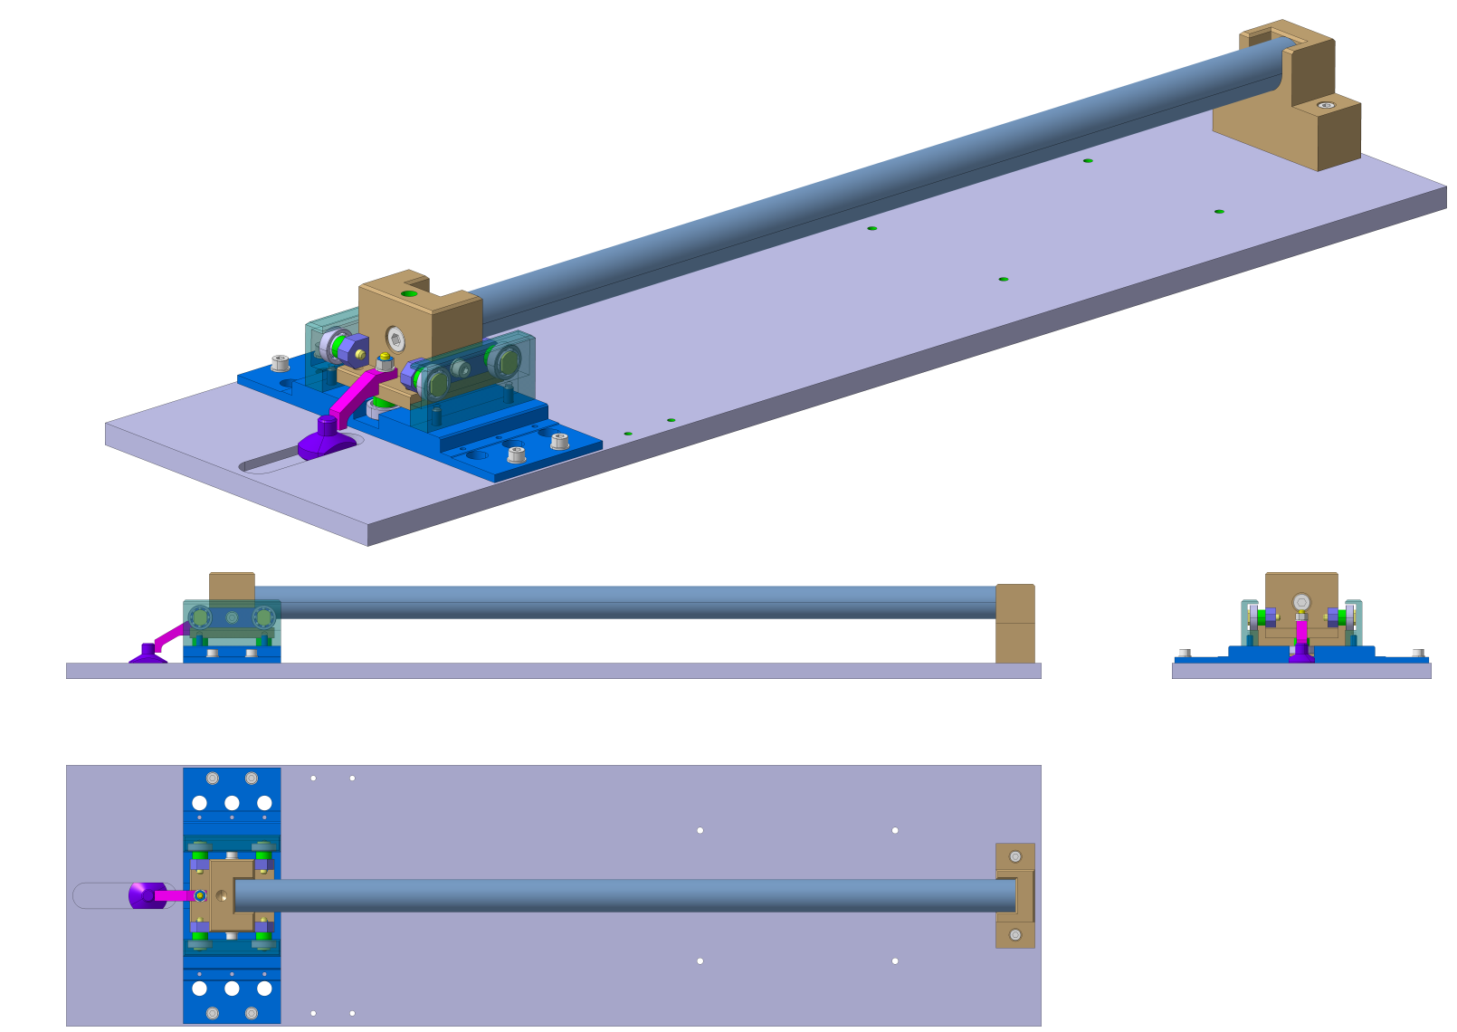
Test set-up

Slide 10
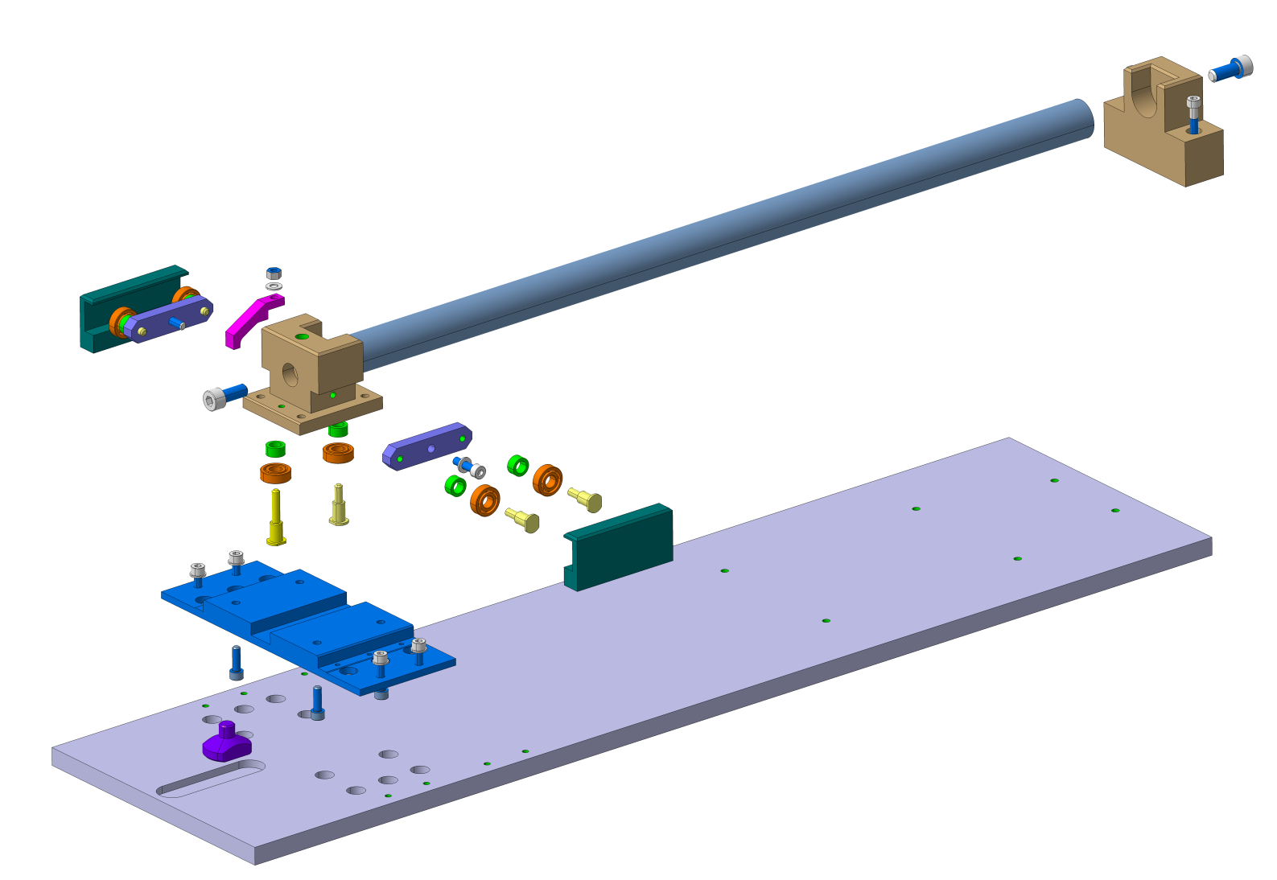
Test set-up
Ti or SS304?
Titanium grade 2
Stainless steel 304

Slide 11
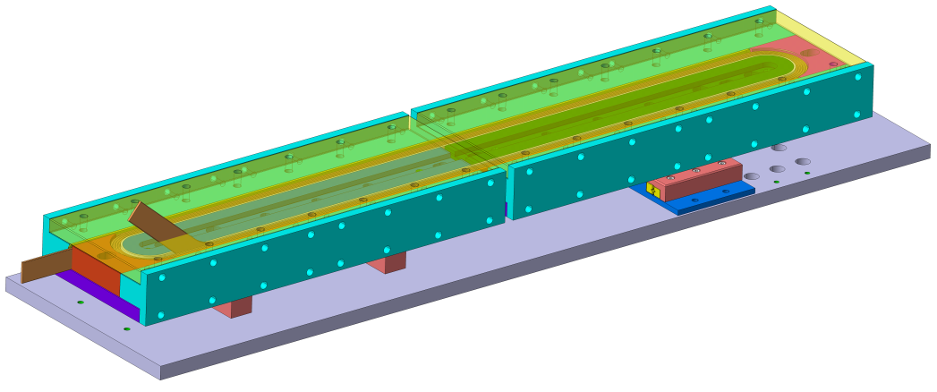
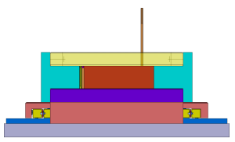
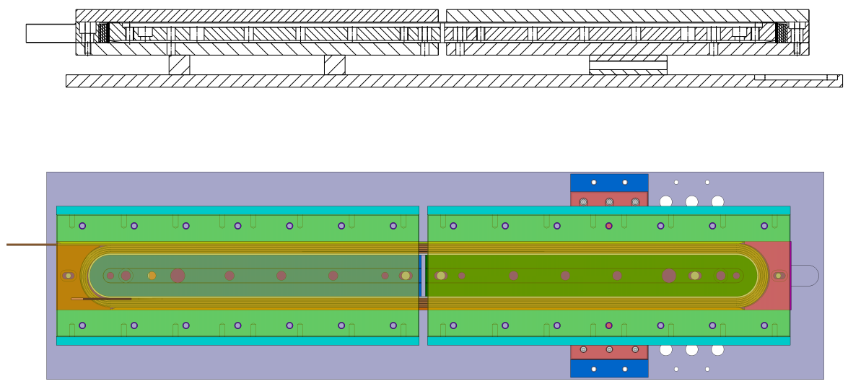
Coil test set-up
Free extremity
Very preliminary
Sliding device
Fixed extremity
Coil
Gap measurement system

Slide 12
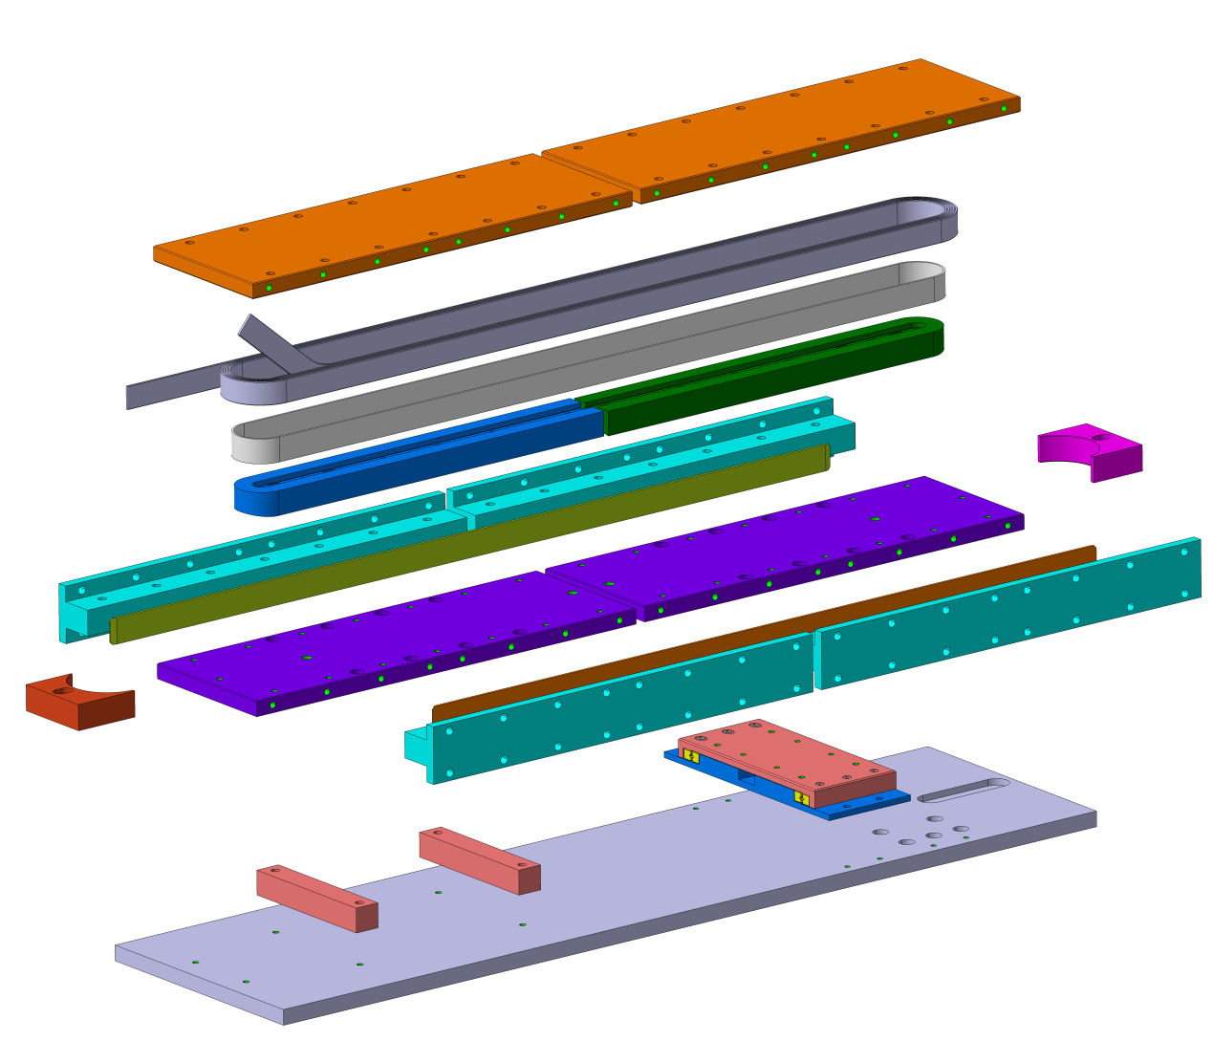
Coil test set-up
Very preliminary

Slide 13
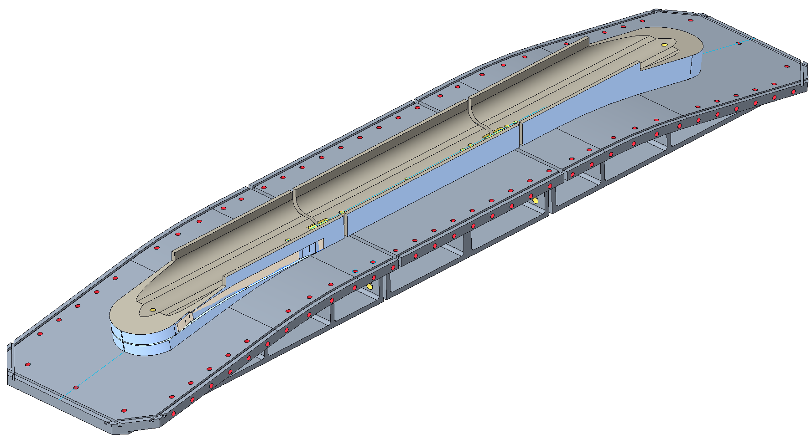




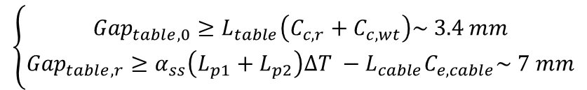
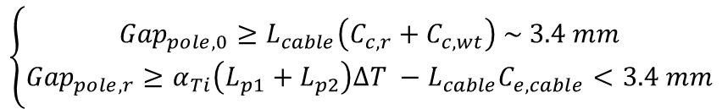

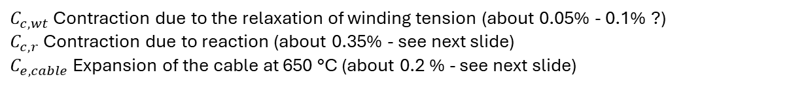


Some comments on gaps
For the first-order assessment of the required gaps, we follow a similar logic than for TFD (see J.L. Rudeiros presentation).
$$L_{p2}$$
$${Gap}_{pole}$$
$$L_{p1}$$
Central plane
Main parameters
Pole extremity
Pole center
$C_{c,wt}$ Contraction due to the relaxation of winding tension (about 0.05% - 0.1% ?)
$C_{c,r}$ Contraction due to reaction (about 0.35% - see next slide)
$C_{e,cable}$ Expansion of the cable at 650 °C (about 0.2 % - see next slide)
Cable
$$L_{cable}$$
Table extremity
Table center
$$L_{t2}$$
$${Gap}_{table}$$
$$L_{t1}$$
$$\left\{\begin{aligned}{Gap}_{pole,0}≥L_{cable}\left(C_{c,r}+C_{c,wt}\right) \sim 3.4 mm \\ {Gap}_{pole,r}≥α_{Ti}\left(L_{p1}+L_{p2}\right)∆T −L_{cable}C_{e,cable}<3.4 mm\end{aligned}\right.$$
Pole
Central plane
$$\left\{\begin{aligned}{Gap}_{table,0}≥L_{table}\left(C_{c,r}+C_{c,wt}\right)\sim 3.4 mm \\ {Gap}_{table,r}≥α_{ss}\left(L_{p1}+L_{p2}\right)∆T −L_{cable}C_{e,cable}\sim 7 mm\end{aligned}\right.$$
Table
Assuming SS 316
** Without considering the change in coil length after releasing winding tension
* Courtesy of Jose Luis Rudeiros

Slide 14
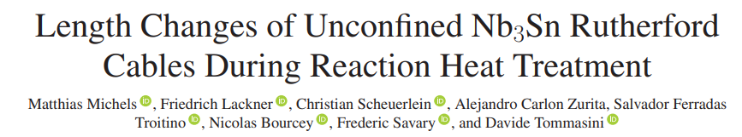
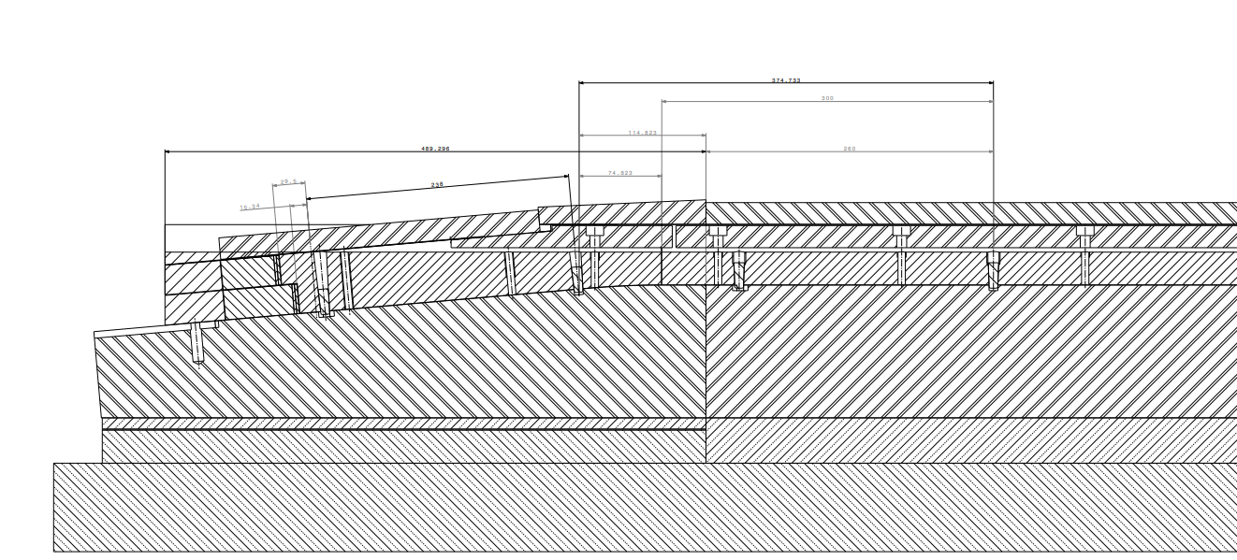
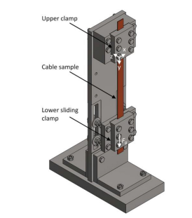
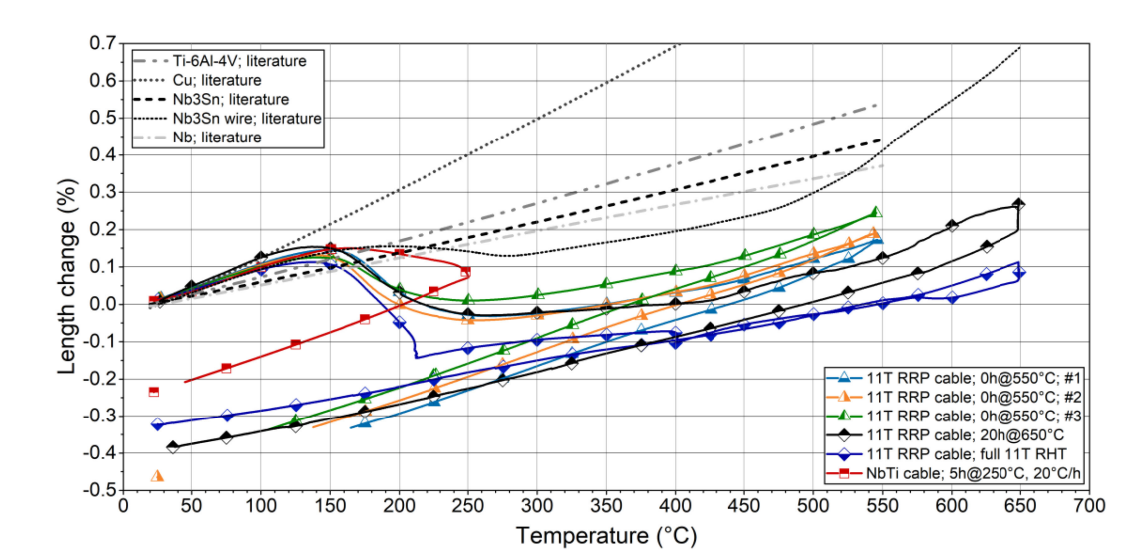
Some comments on gaps

Slide 15
Reaction mold – Motion during reaction cycle
Because of non homogenized material choice in coil/mold component, relative movement will occur during the reaction process.
For transverse dimension change, the mold will expand more than the pole and the conductor. And the cavity is design with the reacted cable dimension to anticipate its growth during reaction.
For the longitudinal direction it is a different story. The “angle” between the straight section and the head creates a kind of fixed point that restrain the straight section to live its life freely.
* Slide from N. Peray

Slide 16
Reaction mold – Central pole fixed point
Pins or part of it might be removed during reaction
Fixed point
Nice, but what happen with the layerjump ?
Screwed cap
Conical section
Pin interface in the mold
Cylindrical section
* Slide from N. Peray

Slide 17
Reaction mold – Motion during reaction cycle
A way of looking at it is to assume that the ends are kind of a SMC/RMC case,
If we assume that the end-pole is fixed to the tooling and the curvature imposes a fixed point as well to the cable…
All displacement is then happening in the head. Would we need to cut the end region to introduce a gap (magenta dashed line) as well?

Slide 18
Spare slides

Slide 19
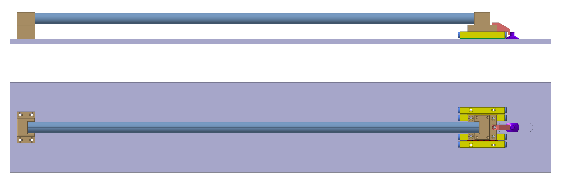
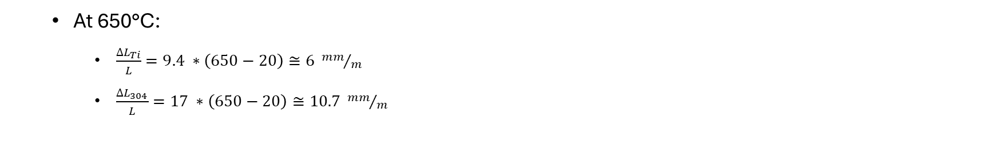
Test set-up
0.6m long bar
(SS 304)
  At 650°C:
    $\frac{{∆L}_{Ti}}{L}=9.4 ∗\left(650−20\right)≅6 {mm}/m$
    $\frac{{∆L}_{304}}{L}=17 ∗\left(650−20\right)≅10.7 {mm}/m$
A 0.6m long bar of SS 304 is enough to have a differential displacement of about 2.8 mm
Ti grade 2 (grade 5) cost:
15x200x1300 mm → 1230 CHF (1633 CHF)
Ø100x500mm → 771 CHF (951 CHF)

