Slide 1

CERN Basketball Club
General Assembly
06th December 2024

Slide 2
Agenda
Last season report (President)
Financial state of the club (Treasurer)
Planning for the current season (President)
Discussion

Slide 3
2023-2024 Committee
Borja Fernandez Adiego – President
George Iakovidis – Vice President
Pedro Felix Lopez Macia – CERN1R
Jeronimo Ortola Vidal – Treasurer/CERN2R
Manuel Gonzalez Berges – Secretary/CERN2R
Nikolaos Kasioumis – CERN2R
Francois Boyer – Member
Roberto Muriel Maurino – CERN1R

Slide 4
2023-2024 Status
Members
  CERN 1: 11 players
  CERN 2: 17 players
  Only trainings: 5 person paid
Gyms
  Tuesdays: Chavanne
  Wednesdays: Bude
  Thursdays: Saint Genis Diamanterie
Competitions – GAB
    CERN 1 - League A / Cup
    CERN 2 - League C / Cup

Slide 5
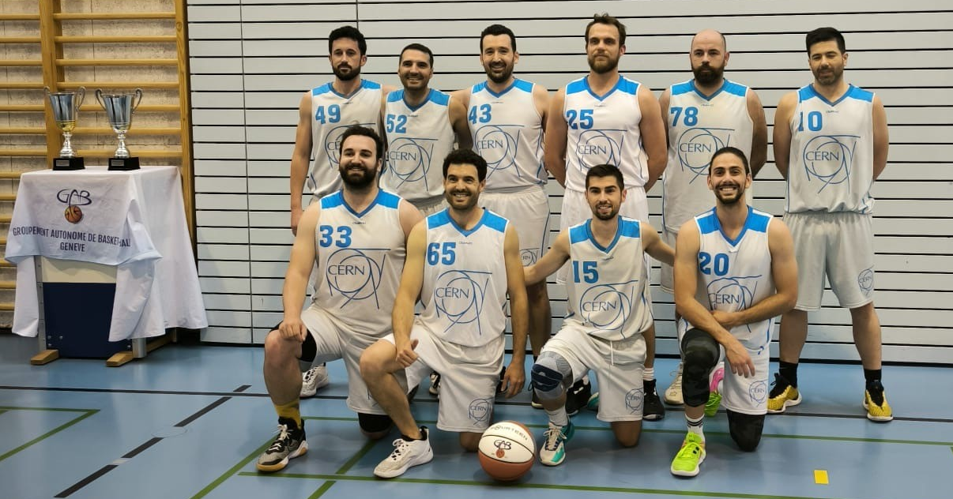

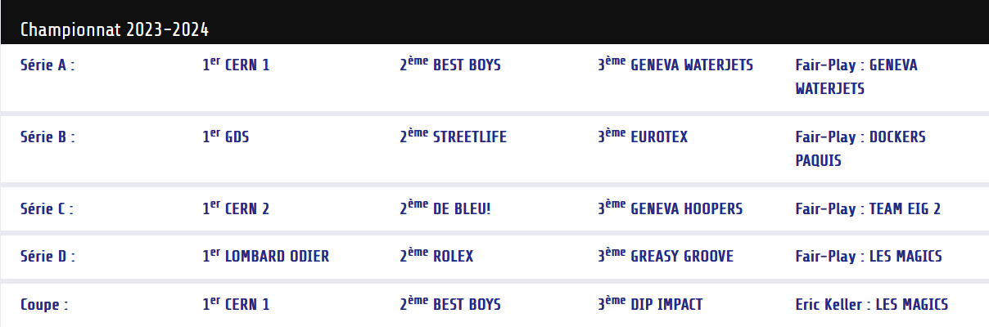
CERN1 2023/24 Championship
https://gabasket.ch/palmares-du-gab/

Slide 6
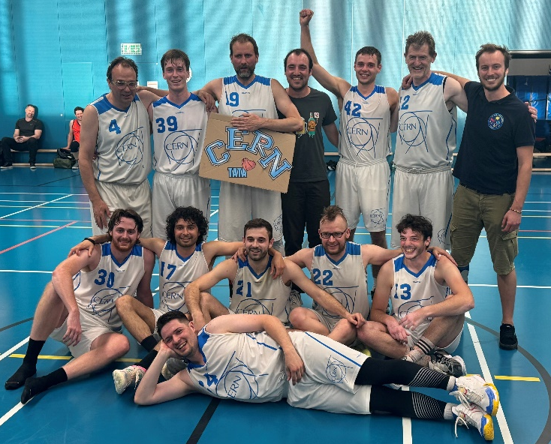

CERN2 2023/24 Championship
https://gabasket.ch/palmares-du-gab/

Slide 7
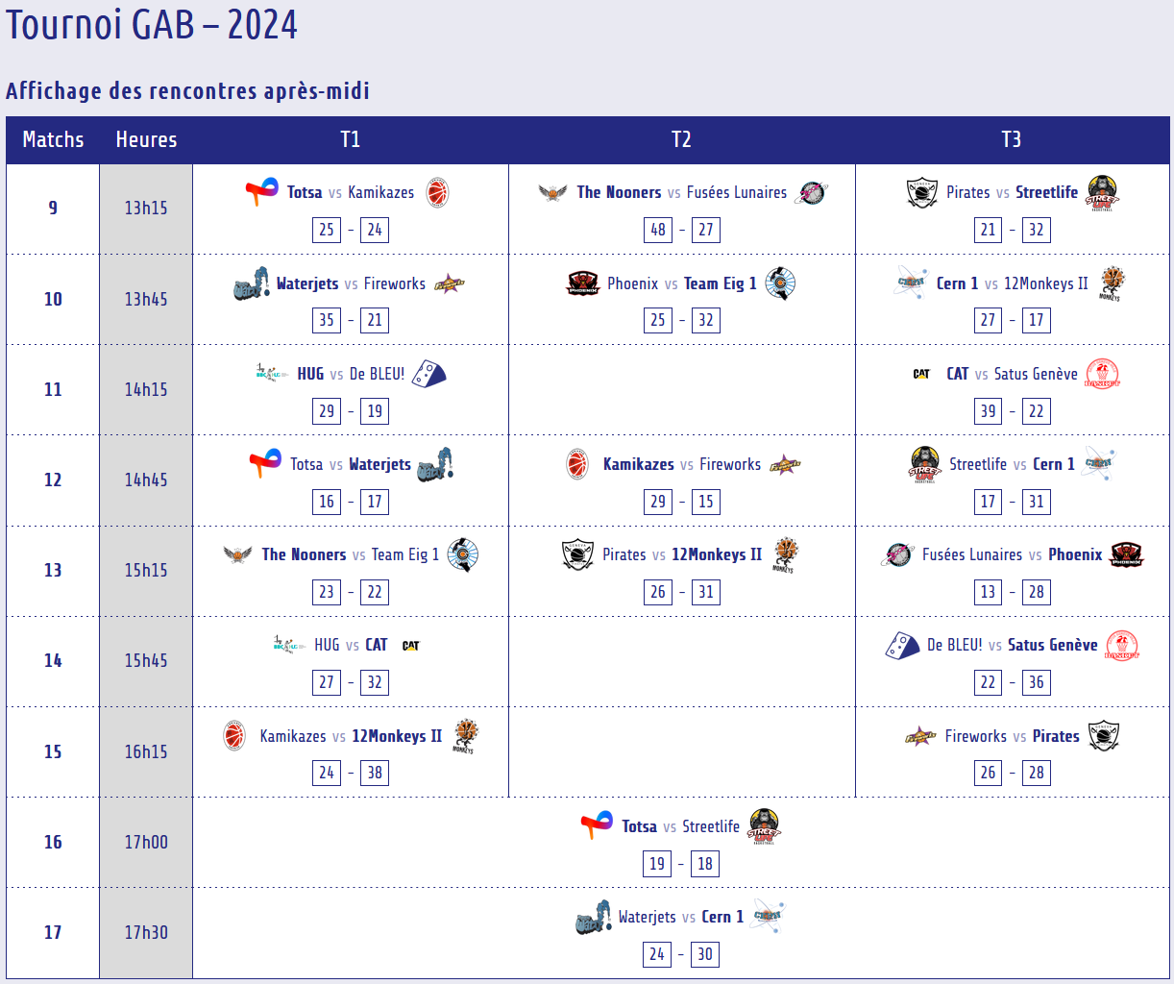
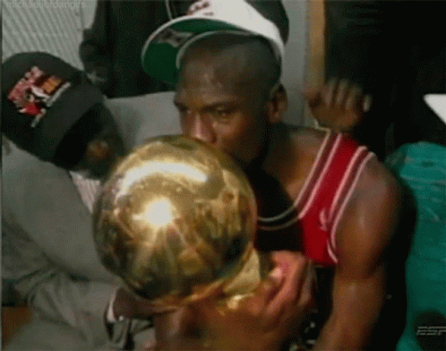
GAB tournament
https://gabasket.ch/tournoi-gab-2024/

Slide 8
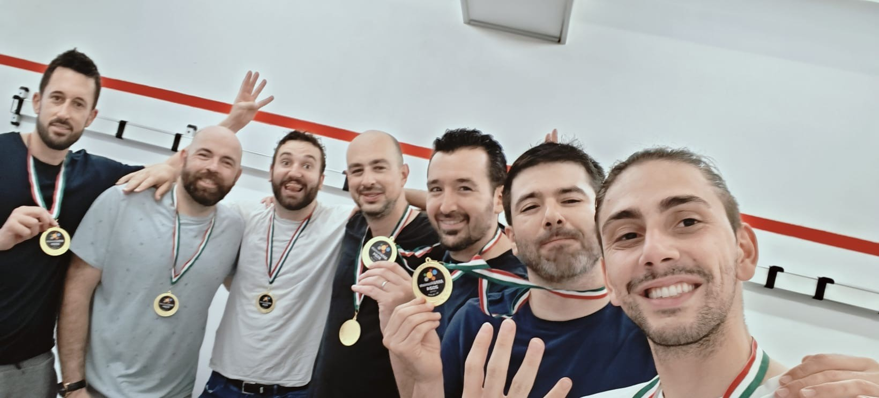
Mini Atomiades
Don’t have enough GIF !!! ☺☺

Slide 9

Congratulations !!!!
Congratulations for both teams for this perfect year !!
Same results are expected next season ☺ ☺

Slide 10
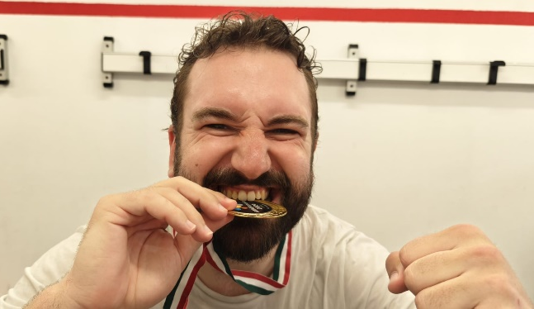
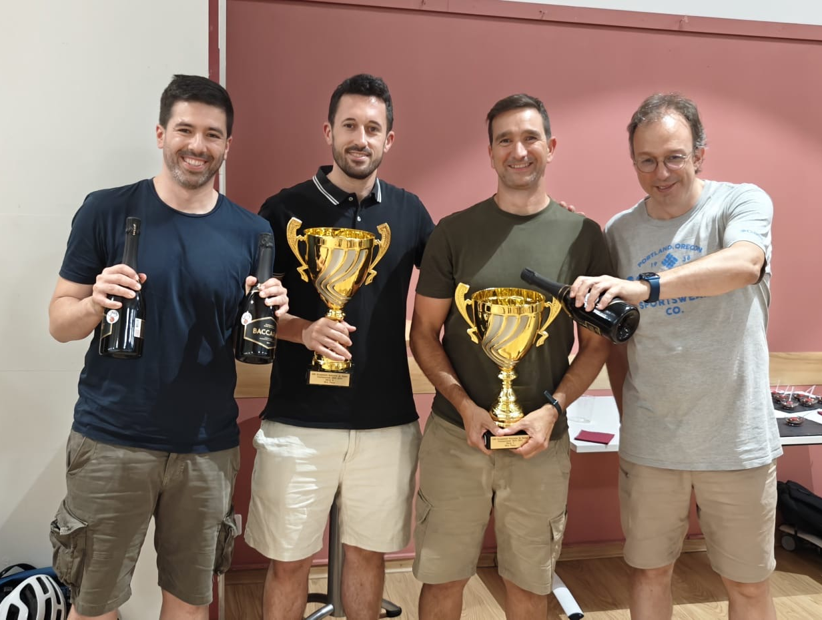
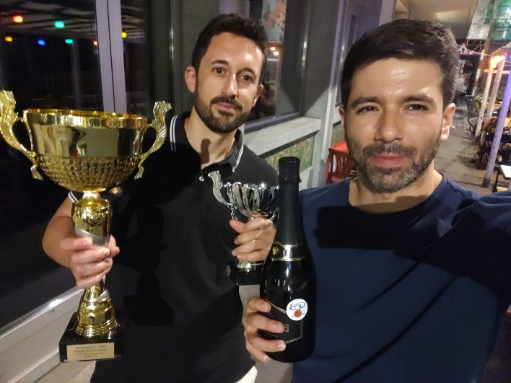
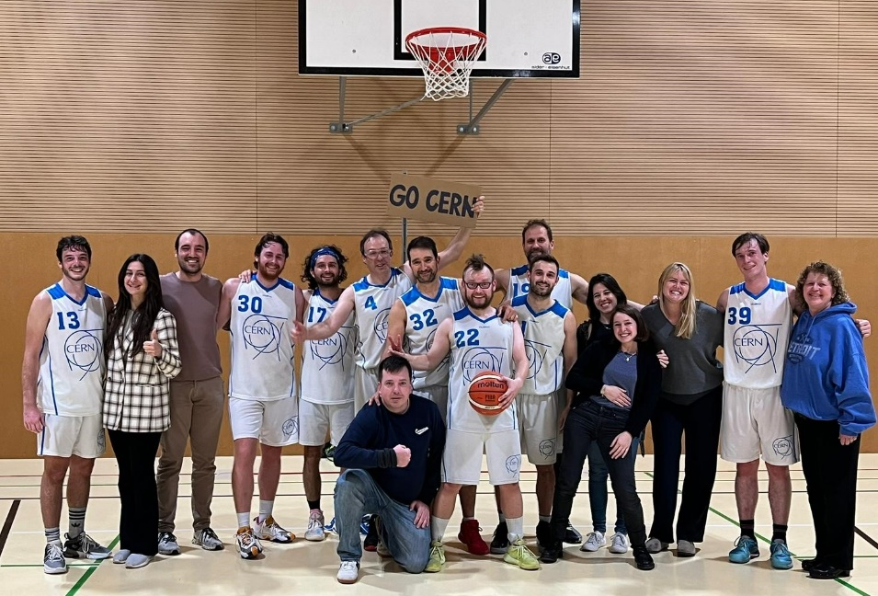

Some photos

Slide 11
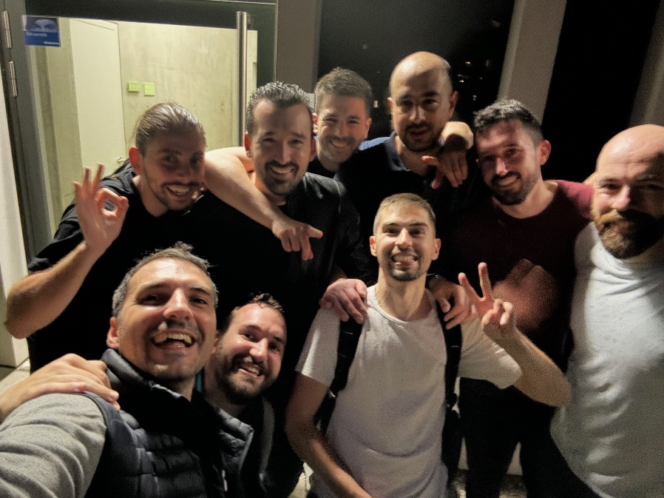
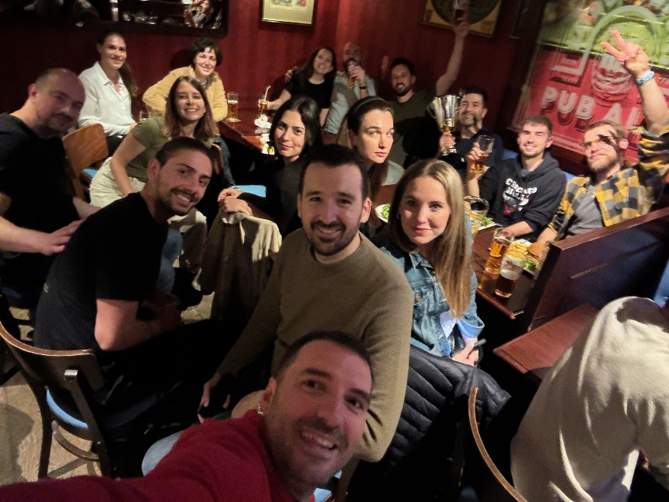
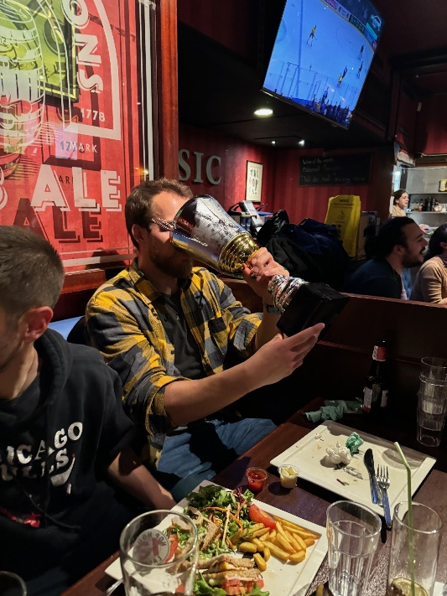
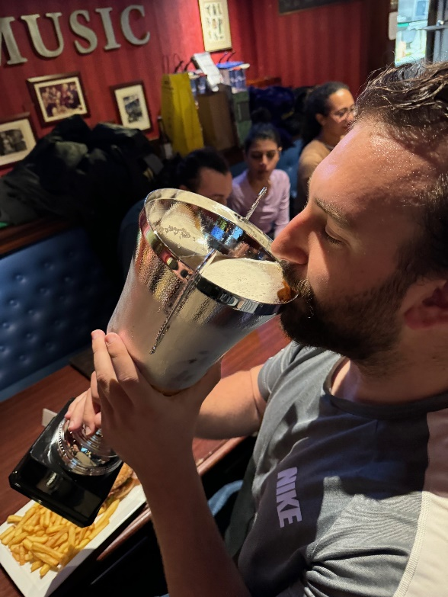
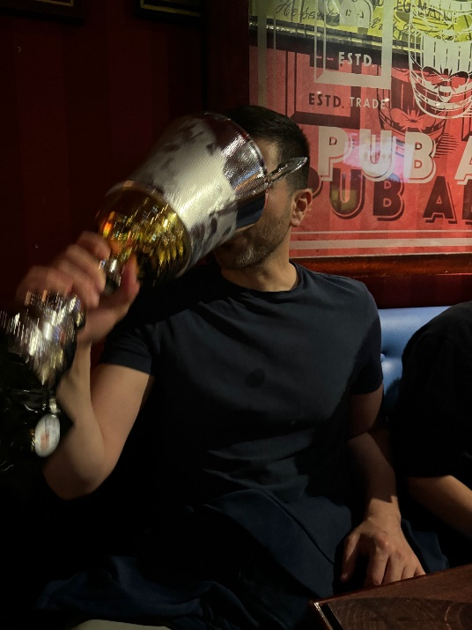
Some photos

Slide 12
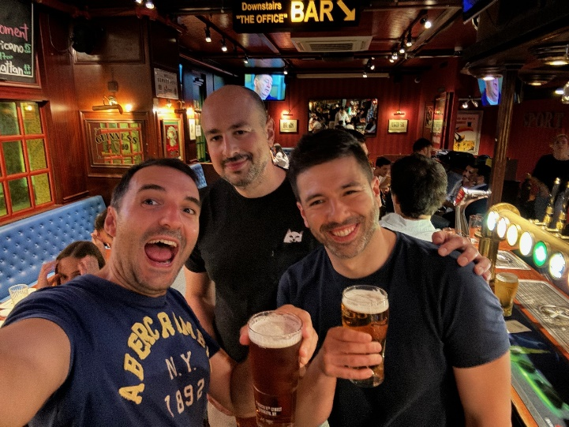
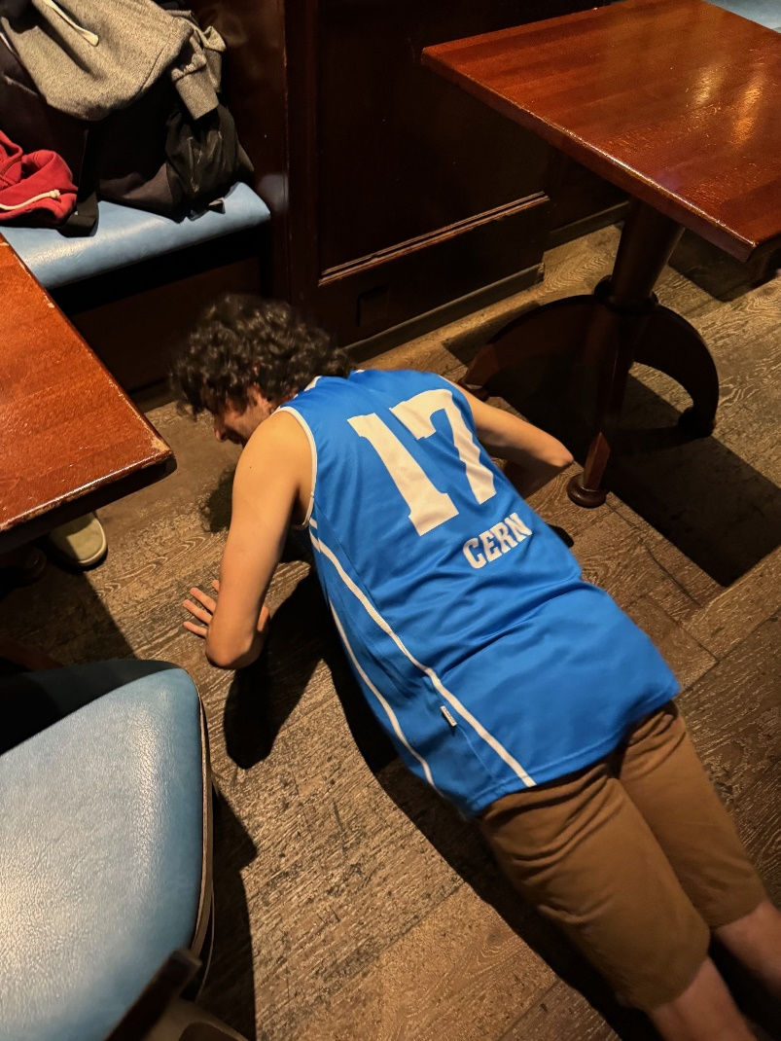
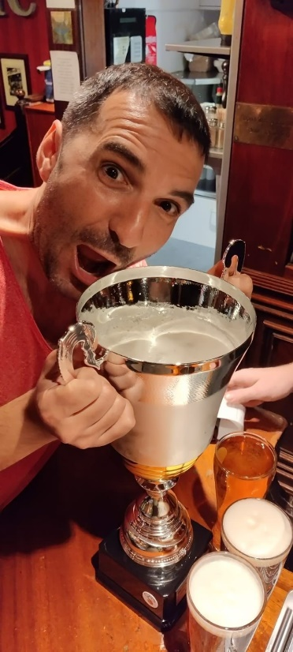
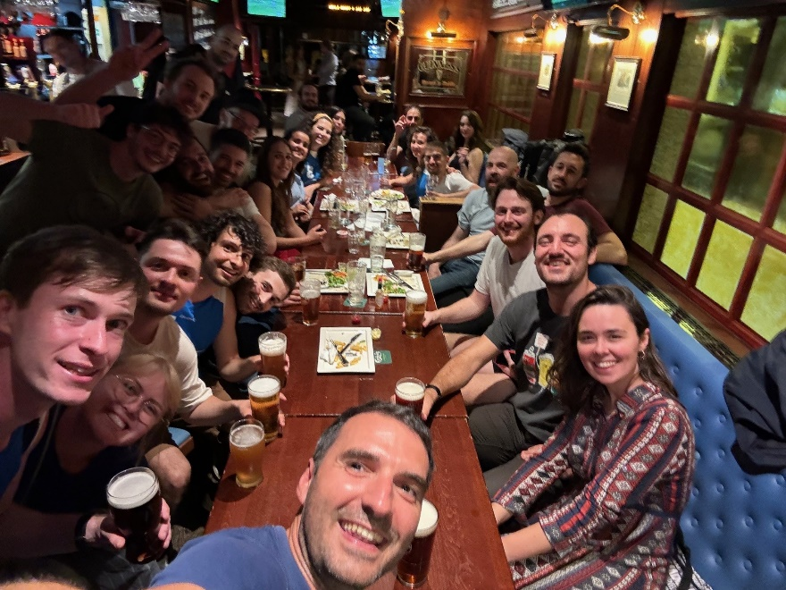
Some photos

Slide 13
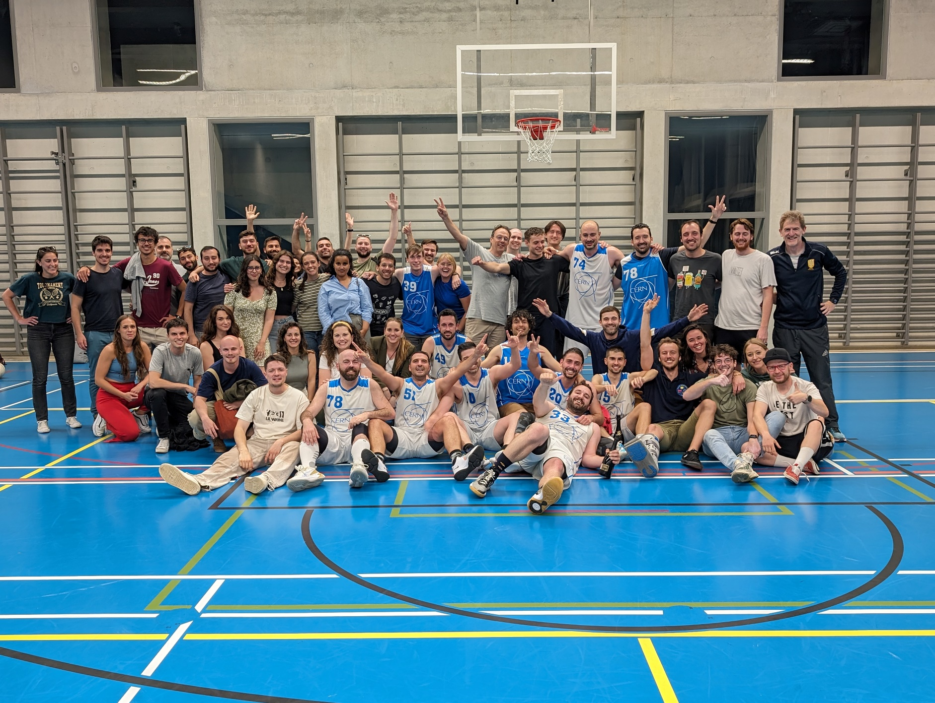
Thanks to all the people in the committee and everyone in the club

