Slide 1

CERN Basketball Club
General Assembly
06th December 2024

Slide 2
Season 2024-2025
The committee announced the CERN1 and CERN2 players
This is the criteria that we have followed for the selection:
  Members of the teams from last year have been given preference
  Attendance to the trainings and/or pickup games
  Basketball level / Team needs
CERN2 roster
1. Jeronimo ORTOLA
2. MANUEL GONZALEZ BERGES
3. GIUSEPPE MAZZOLA
4. Emanuele VILLA
5. STEFANO SAROGLIA Responsible CERN2
6. BABEL PAWEL
7. Krzysztof Nienartowicz
8. Jakub Gajownik
9. William WARNER
10. Marcos VAZQUEZ
11. Mihailo Lukovic
12. Francisco Moreira Huhn
CERN1 roster
1. Miguel Gil Costa
2. Francois Boyer
3. Pedro Felix Lopez Macia
4. Georgios Voutsinas
5. Dario Soriano Guillen
6. Roberto Muriel Mauriño
7. Jose Rodriguez Nogueira
8. Alexandros Petridis
9. Alvaro Perez
10. Borja Fernandez Adiego

Slide 3
Season 2024-2025
Gyms
  Tuesdays: Chavanne
  Wednesdays: Bude
  Thursdays: Saint Genis - Diamanterie
All info can be found here: https://twiki.cern.ch/twiki/bin/view/SocialActivities/BasketballClub

Slide 4
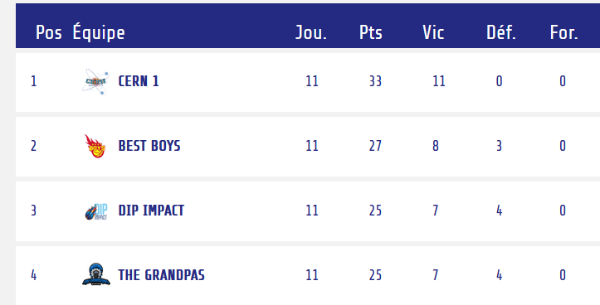
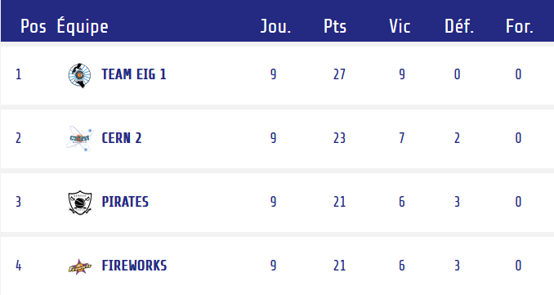
Season 2024-2025
Competitions – GAB
  CERN 1
    https://gabasket.ch/team/cern_1
    League A
    Cup
  CERN 2
    https://gabasket.ch/team/cern_2
    League B
    Cup

Slide 5
2024-2025 Committee
François Boyer– President
Borja Fernandez Adiego– Vice President
Pedro Felix Lopez Macia – CERN1R
Jeronimo Ortola Vidal – Treasurer/CERN2R
Manuel Gonzalez Berges – Secretary/CERN2R
Roberto Muriel Maurino– CERN1R
George Iakovidis– Member
Pepe Rodriguez – Social event, marketing and communication manager !!
Anyone else interested?

Slide 6
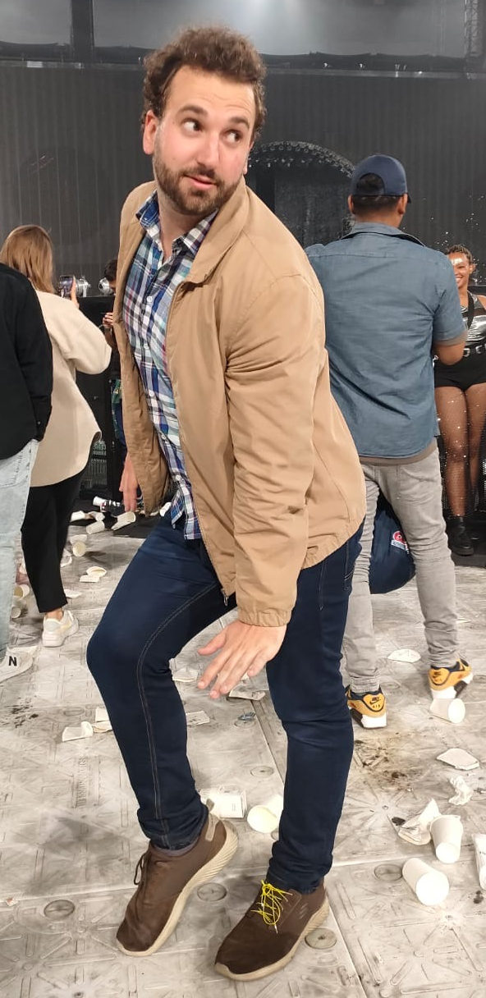
2024-2025 committee
New Member: Pepe Rodriguez!

Slide 7


New sponsoring
The Pickwick pub has kindly offered to sponsor the club by purchasing warm-up over-shirts.
Order will be done ideally before Xmas. Both team will be equipped, and a stock of T-shirts will be made available for sale to members and non-members of the club. Please contact us if you are interested

Slide 8
2024-2025 activities
Xmas dinner tonight !! (Pedro and Roberto)
Basket tournament ?
Summer BBQ, Spring BBQ, Just a BBQ (?)
Data privacy (?)
New website (Pepe and Alex)
…
Any other volunteer?

Slide 9
Any suggestion, complain?

