Slide 1
Use of AI AT THE EPO
Diego eguidazu | Cio

Slide 2
A responsible use of AI...
  To enhance the quality, consistency, and efficiency of our services
  We also see potential to improve legal clarity and accessibility for our users
  Our human-centric approach ensures that AI is used as a tool to support our staff
  We leverage our knowledge of patents to ensure that AI is used appropriately in the PGP
  An agile approach allows to adapt quickly and effectively to new developments in AI technology

Slide 3
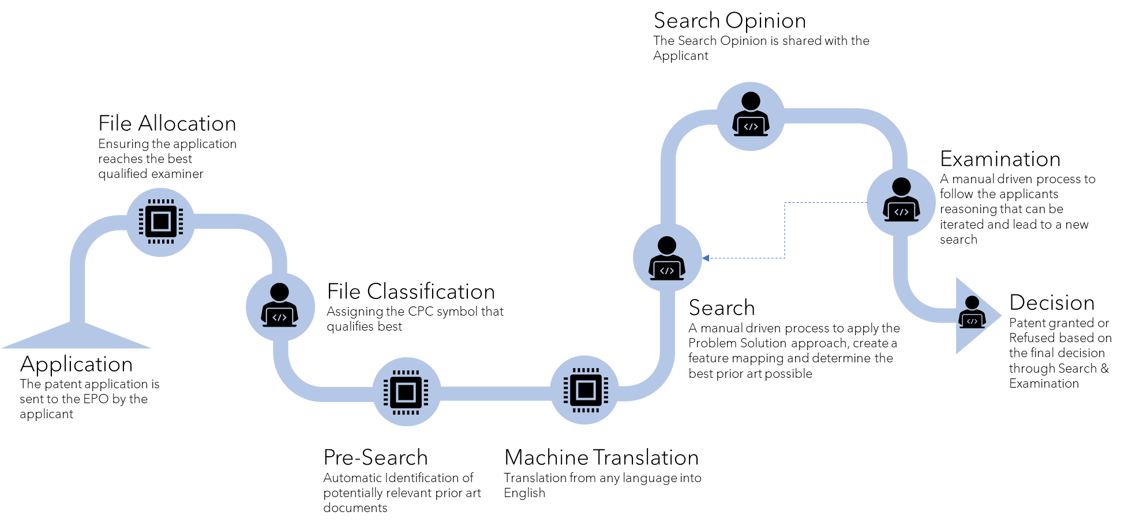
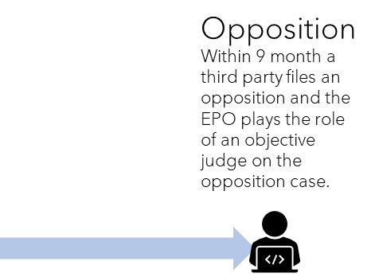
The simplified PGP
NLP/CV
NLP
Future
MT
NLP
1
2
CV/NLP
MT
3
Dissemination
Patent information and case law is made available online

Slide 4

watch, assess and adopt gradually
  Proofs of concept based on non-confidential content. Processing our body of knowledge to exploit it in our operations.
  Integration of LLM into the Microsoft Office suite. It remains core to our administrative work. Low risk in terms of confidentiality and purpose (administrative efficiency, enhanced collaboration). Joined the Early Adopters programme.
  Strong uptake by staff. Gradual expansion of use cases to more and more complex needs. Adoption remains driven by expected benefits. Measures in place for usage.

Slide 5
One last stop: The non-technical challenges
Knowledge
Learning and adapting
Data Protection
Security
Cost

Slide 6

We have confirmed that human + AI provides a better result in terms of quality and efficiency than either of them alone and, therefore, its adoption should remain human-centric
EPO Strategic Plan 2028

Slide 7
Thank you for your attention

