Slide 1
Inputs to CERN Environmental Report 2023-24
Enrico Chesta
IPT/KT
December 2024

Slide 2
Reminder:
Inputs to CERN Environmental Report 2021-22

Slide 3
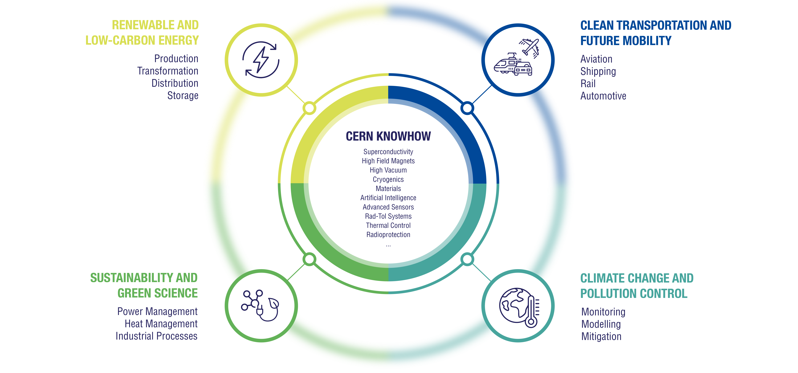
Highlight 1: CERN/KT preliminary strategy on Environmental Applications defined in 2021

Slide 4

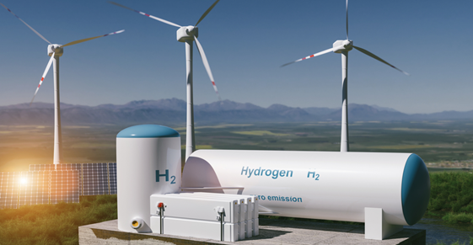

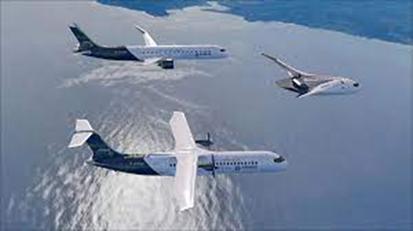



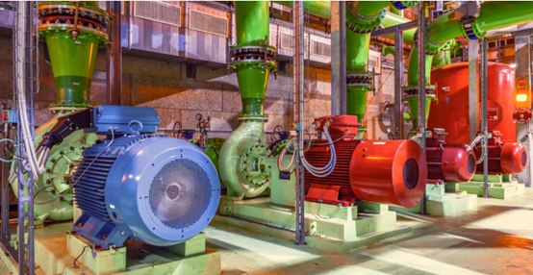
Highlight 2: examples of projects signed in 2021-22 and under implementation in the 4 areas of focus
RENEWABLE AND LOW-CARBON ENERGY | Helping a company in Spain (Applus+) to develop cryogenic testing facilities to support the development of systems for green hydrogen storage and transportation
CLEAN TRANSPORTATION AND FUTURE MOBILITY | Supporting civil aviation (Airbus) to assess the feasibility and interest of using superconducting power distribution systems in future electric/hybrid airplanes
CLIMATE CHANGE AND POLLUTION CONTROL | Collaborating with the European Space Agency (ESA) to develop Artificial Intelligence algorithms to analyse Earth Observation images for climate monitoring
SUSTAINABILITY AND GREEN SCIENCE | Partnering with industry (ABB) to improve energy efficiency of CERN cooling and ventilation infrastructure by up to 15% using smart sensors and digital twins
Enrico Chesta | KT Inputs to CERN Environmental Report 2021-22

Slide 5

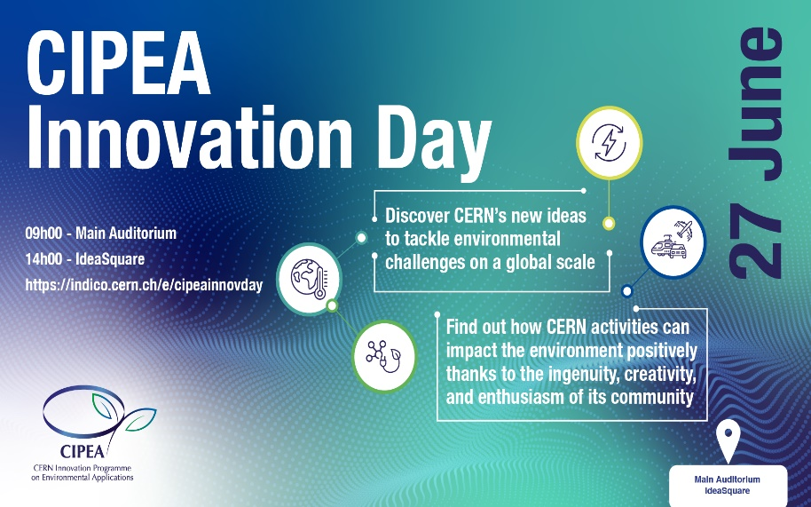
Highlight 3: CIPEA (CERN Innovation Programme on Environmental Applications) launch and results in 2022
In March 2022, CERN launched the CIPEA programme to encourage CERN experts to come up with new ideas for environmental applications.
In June 2022, the CIPEA Innovation Day welcomed 15 innovative project proposals, such as:
  Accelerator systems for improving clean-techs production and reducing polluting emissions;
  Vacuum and RF technologies for renewable energy large-scale distribution and new industrial heating;
  Machine-learning algorithms for climate modelling;
  Innovative systems for reducing greenhouse gas emissions at CERN and beyond.
In September 2022, 7 CIPEA projects were selected to receive support from the KT Fund
Enrico Chesta | KT Inputs to CERN Environmental Report 2021-22

Slide 6
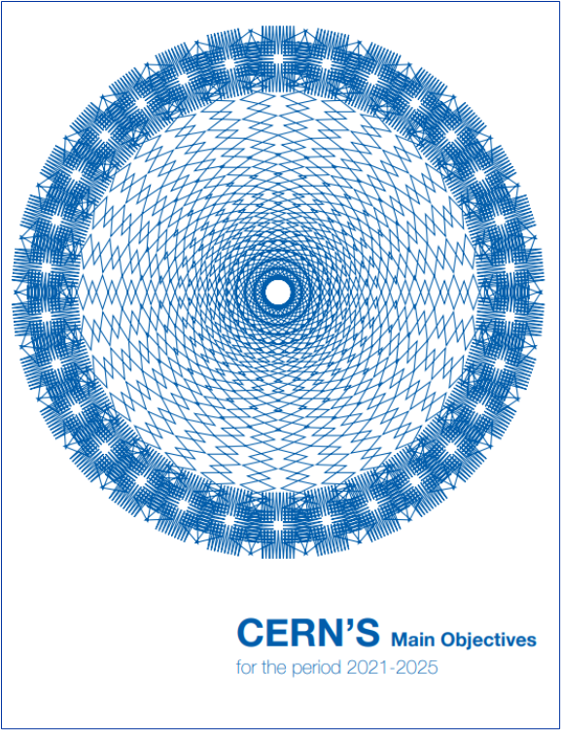
Inputs to CERN Environmental Report 2023-24
Identify and develop CERN’s technologies that may contribute to mitigating the impact of society on the environment
Minimise the Laboratory’s impact on the environment
Pursue actions and technologies aiming at energy saving

Slide 7

CIPEA – Concept Evolution
CIPEA today is a label for all CERN projects (supported by KT) aiming at achieving positive environmental impact beyond CERN (global level)
Currently counting 30 projects in total - Classification
Origin:
  10 issued from internal proposals
  20 issued from external requests
Funding:
  9 supported by the KT Fund
  (out of which 4 supported also by external funding)
  10 supported only via external funding (companies)
  2 supported by external public funding (EU, ESA)
  9 currently in negotiation with external companies
PRL (Project Readiness Level): Classification in 6 different levels - see next slide
Key areas distribution:
  Renewable and Low Carbon Energy: 15
  Clean Transportation and Future Mobility: 6
  Climate Change and Pollution Control: 5
  Sustainability and Green Science: 4
  All subcategories covered

Slide 8
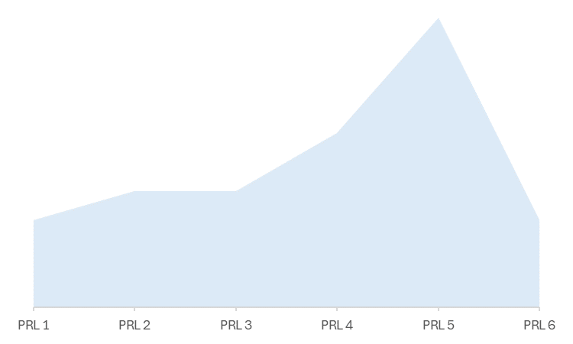
CIPEA – Project Readiness Levels
Projects in exploration phase
Kobold
SMC
Thea Energy
…
Projects in early definition phase
Proxima Fusion
UKAEA
Beta-NMR for solid state batteries
ENEA
Projects in advanced definition phase
Statnett
Cryotank
Sohyytech
Projects in early implementation phase
ENI
META
Gauss Fusion
Transmutex
UTMOST CLEEN / Atlas Copco
WebEnergy
EcoChiller
Edge SpAIce
Projects in advanced implementation phase
SCALE / Airbus UpNext
LH2 tanker / GTT
IVAC-RED / SuperNode
Steels for tokamaks / Rolf Kind
MagWatts / SolidWatts
ALPHA / Lightricity
VULCAN / DAES
SF6-free circulator / AFT
Projects nearing completion
EMP2
MotorSense / ABB
LH2 testing / Applus
QUAI4EO
1- External partner and CERN expertise/ technology identified
2- Negotiations with external partner initiated or KT Fund allocated
3- Draft collaboration agreement defined and iterated
4-Final agreement signed and project started
5- First tangible results delivered
6- Consolidated results available

Slide 9

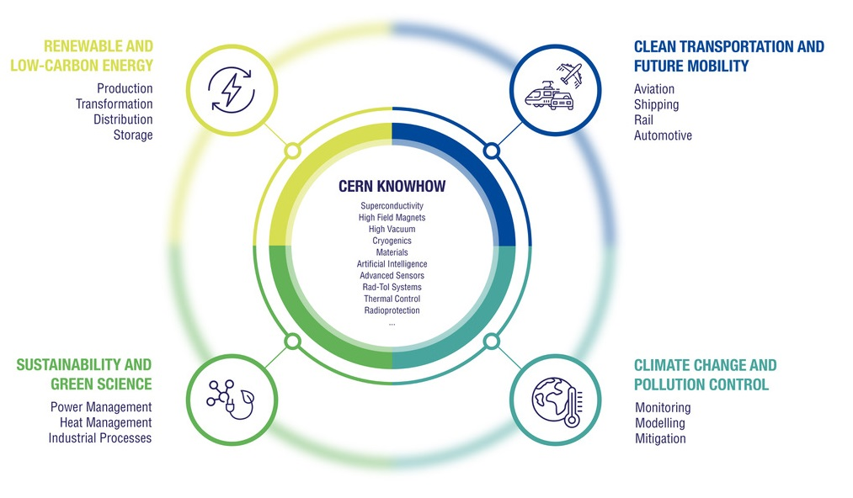






























CIPEA Projects in Environmental Key Areas
With sub-categories tentative distribution

Slide 10
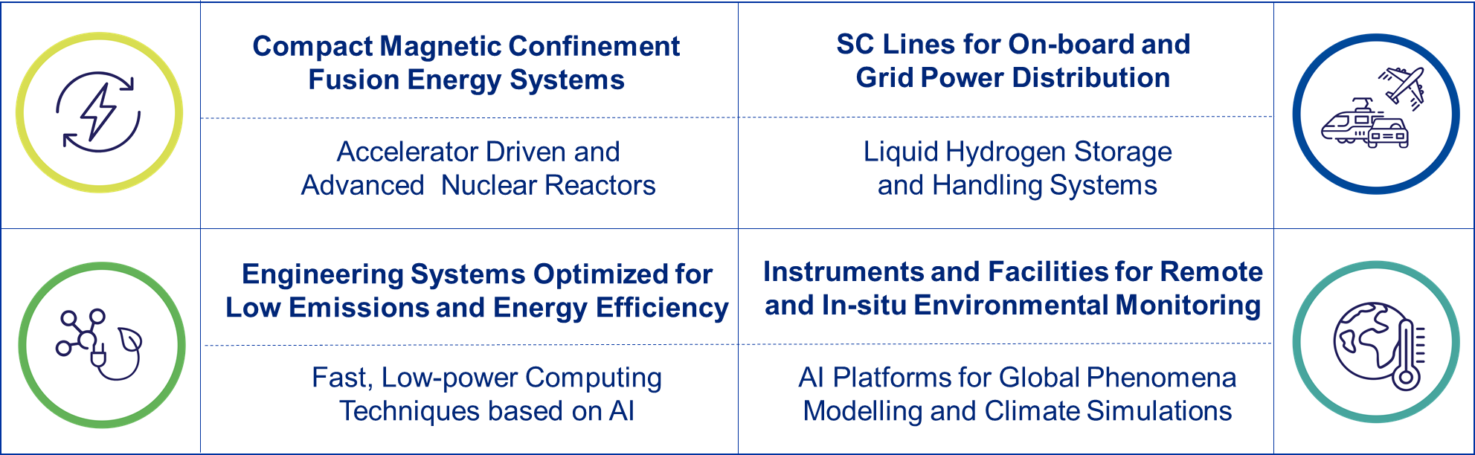
CIPEA - Poles of Competence in Environmental Applications

Slide 11
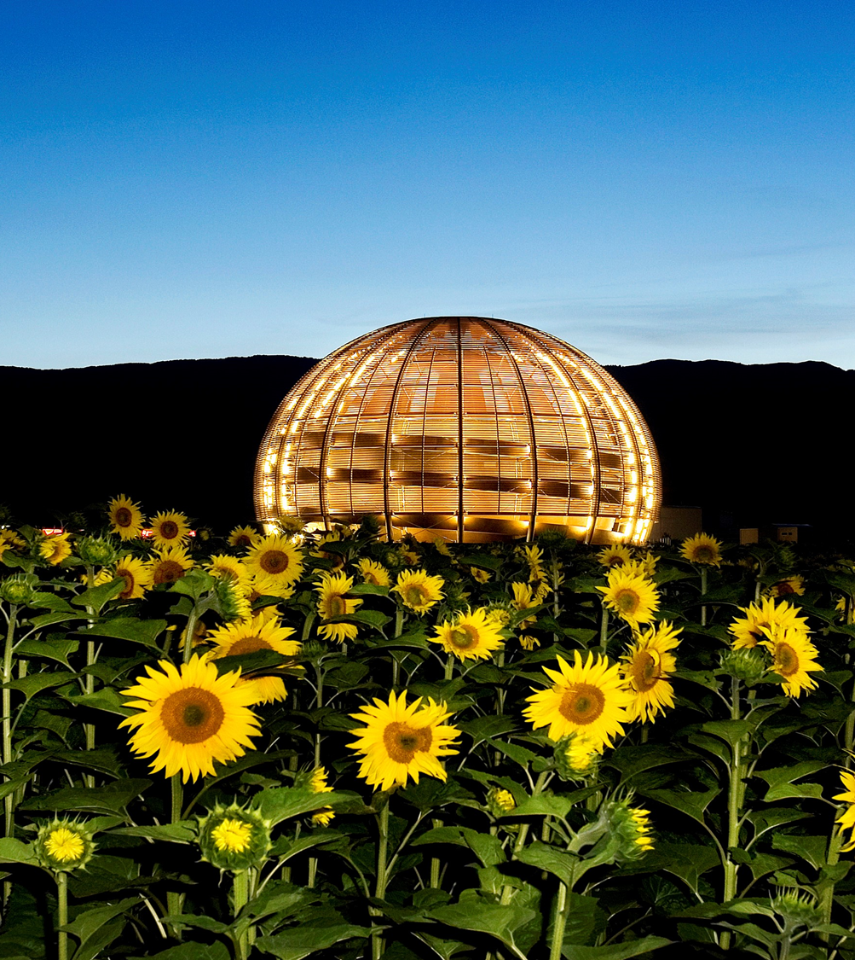
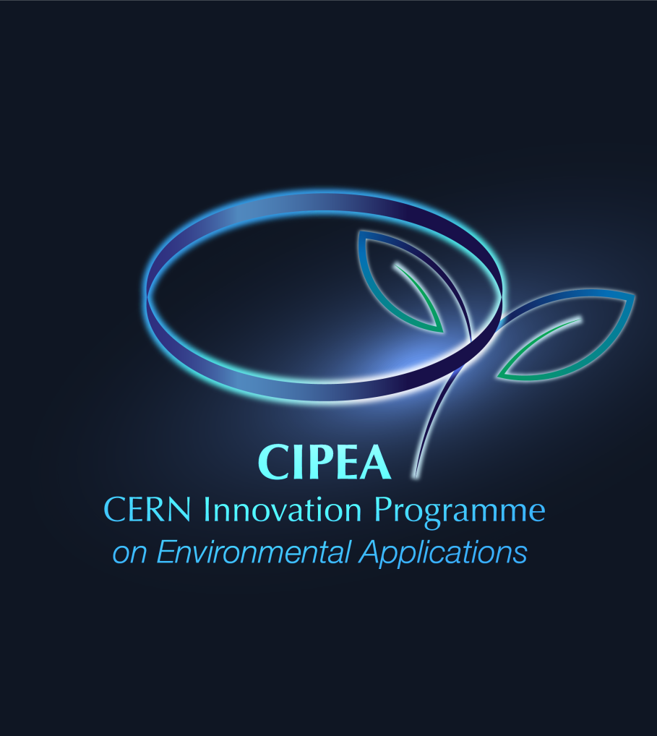
CIPEA On-going Projects Examples

Slide 12
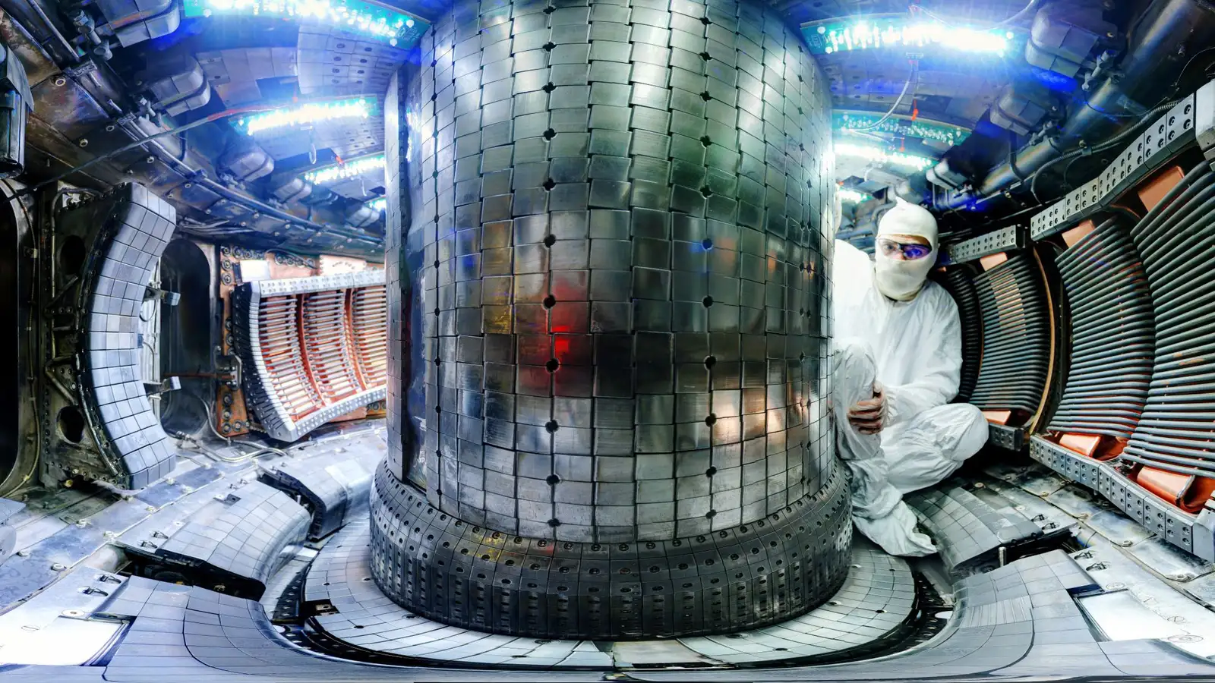
RENEWABLE AND
LOW-CARBON ENERGY
Production
Fusion Systems
Magnetic confinement fusion devices –
System design and components testing

Slide 13

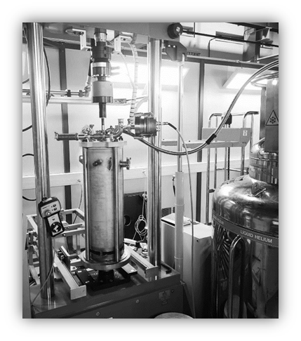
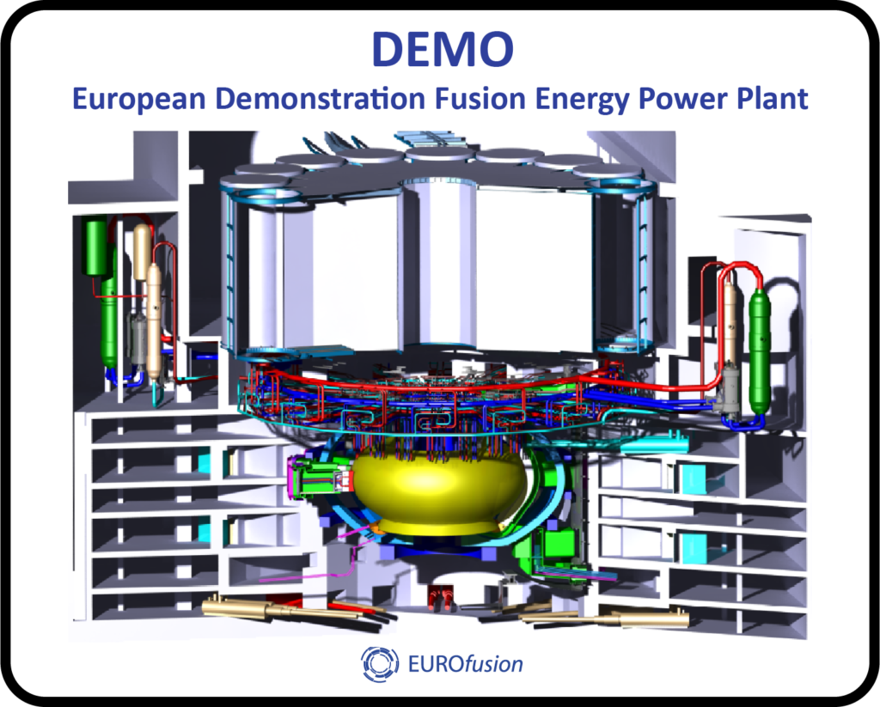
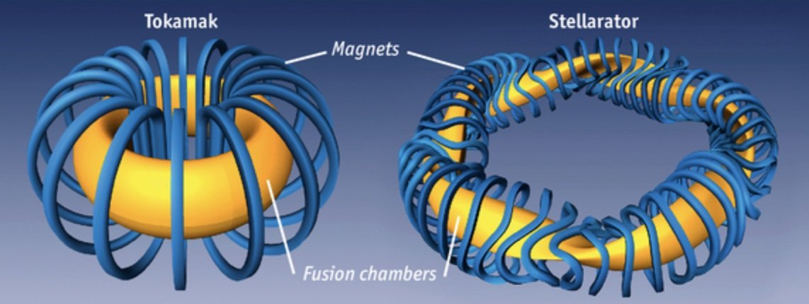
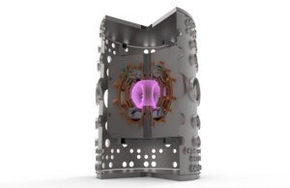
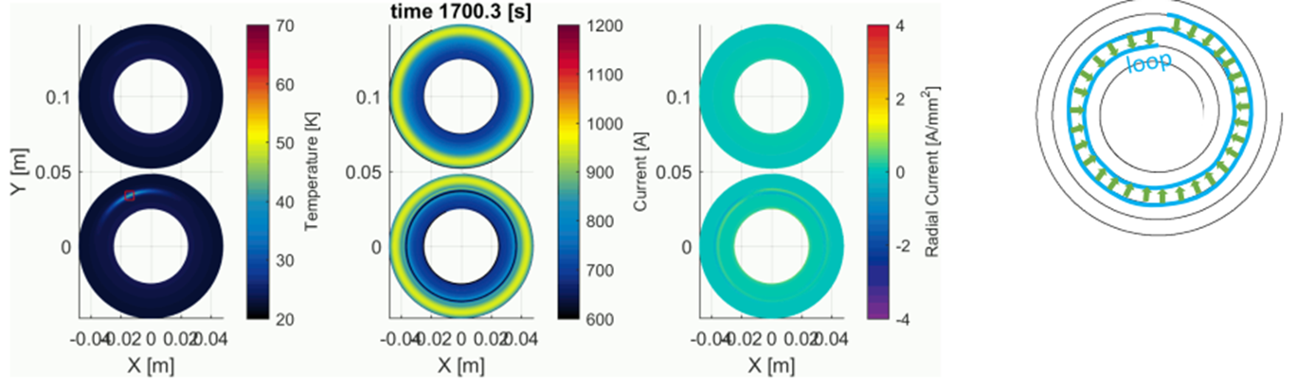







Supporting system level R&D and component testing for fusion systems
EMP2
Design, modelling and testing of critical components for magnetic confinement fusion devices
Assessing the mechanical properties of steels for tokamaks casing at cryogenic temperatures
Impact: Accelerating availability of unlimited affordable low-carbon fusion energy
https://home.cern/news/news/knowledge-sharing/future-colliders-and-fusion-reactors

Slide 14
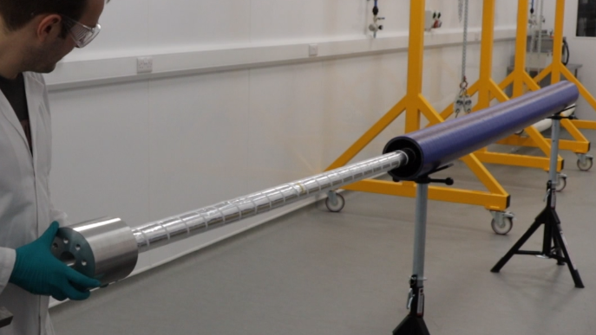
RENEWABLE AND
LOW-CARBON ENERGY
Distribution
Cryostats for SC powerlines
IVAC-RED: Insulation VACuum of superconducting cables for Renewable Energy Distribution

Slide 15
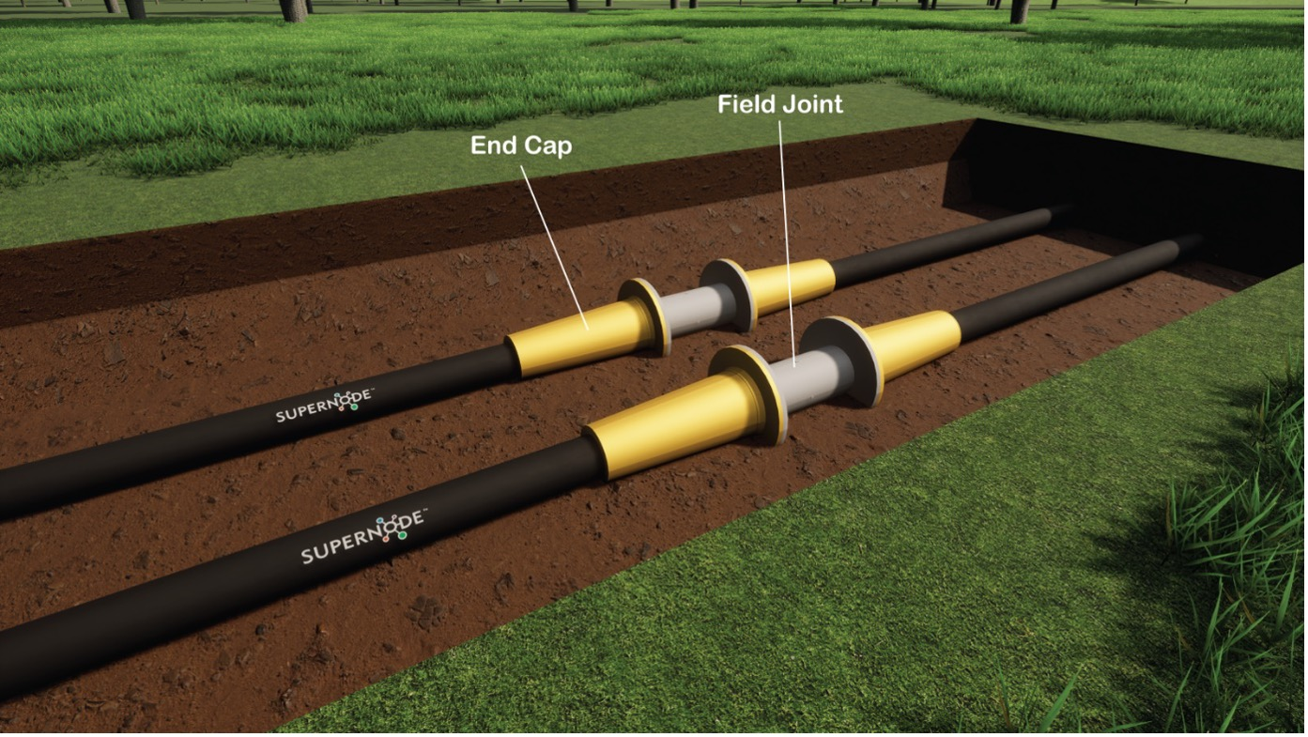

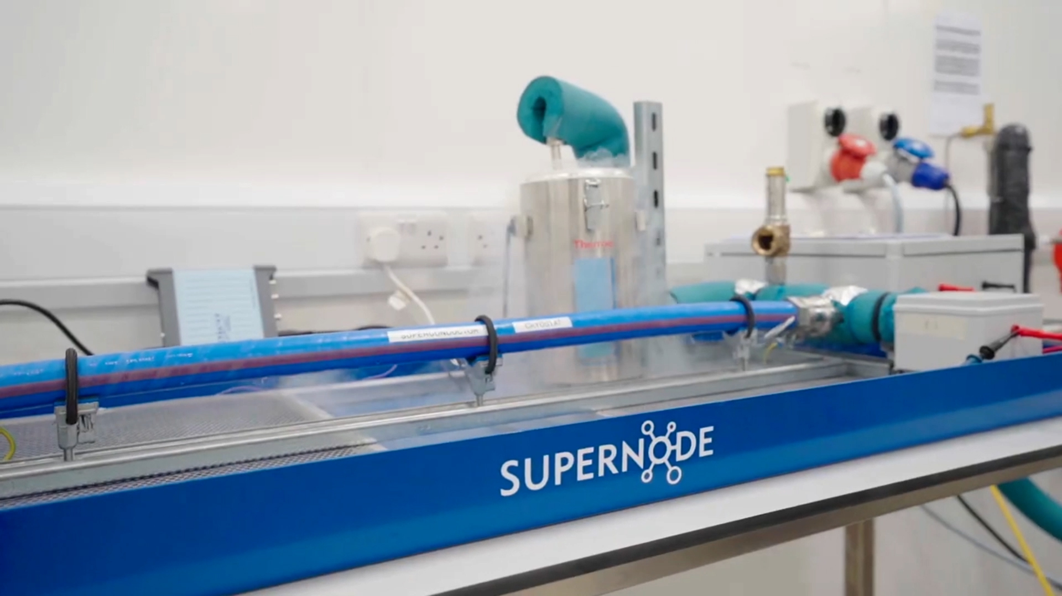
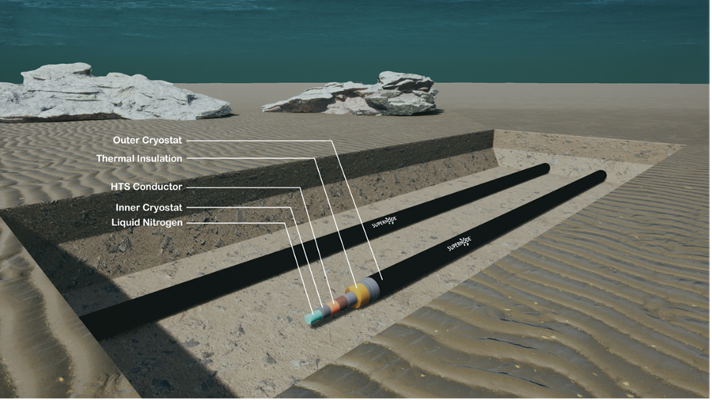

Vacuum compatibility of materials for long-range superconducting cables
EMP2
Permeability and outgassing measurements of candidate materials for the insulating system of superconducting cables
Development of dedicated test rig
Impact: Minimizing losses, cost and footprint of long-range renewable energy power transmission, for both terrestrial and submarine applications
https://home.web.cern.ch/news/news/knowledge-sharing/supernode-and-cern-collaborate-new-solutions-renewable-energy

Slide 16

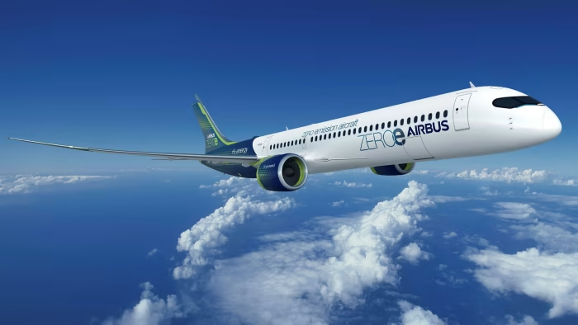
CLEAN TRANSPORTATION
AND FUTURE MOBILITY
Aviation
HTS for Electric Planes
SCALE: Super-Conductors for Aviation with Low Emissions

Slide 17
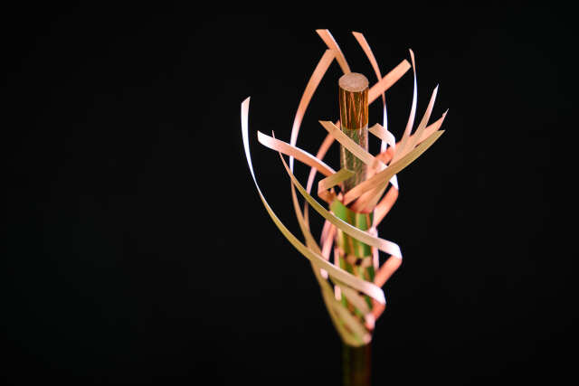

SCALE: Demonstration of SC power distribution systems for future LH₂ planes
SCALE aims to promote the adaptation and adoption of superconducting technologies in airborne electrical distribution systems
The demonstrator consists of a DC link (cable and cryostat) with two current leads. The cooling system is based on gaseous helium.
Impact: Support critical decisions on advanced technologies for clean aviation with the ambition to:
  Halve weight and volume of components
  Reduce voltage to below 500V
  Increase system efficiency (+5-10%)
https://kt.cern/news/press-release/knowledge-sharing/cern-and-airbus-partnership-future-clean-aviation
Joint press release

Slide 18
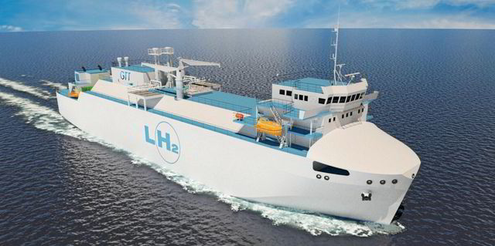
CLEAN TRANSPORTATION
AND FUTURE MOBILITY
Shipping
Liquid Hydrogen storage
Development of large LH₂ tanks for maritime transportation

Slide 19
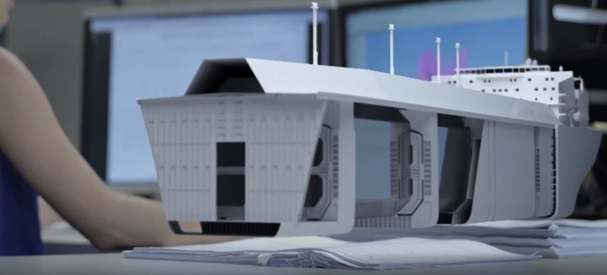
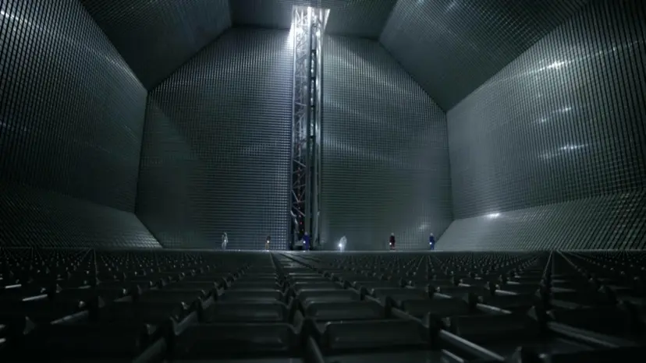

Supporting the development of tanks for long-range maritime transport of LH₂
EMP2
Project to help GTT adapting procedures/designs for LNG to innovative LH2 tanks related to:
Materials specifications and quality control
Welding procedures to ensure leak-tightness
Materials test for vacuum insulation layer
Impact: Develop technologies to enable the maritime transport of liquid hydrogen to connect producers and consumers across the world enabling a green hydrogen economy.
CERN and GTT enabling liquid hydrogen maritime transportation - Video

Slide 20

CLIMATE CHANGE AND
POLLUTION CONTROL
Modelling
EMP2
Environmental Modelling and Prediction Platform

Slide 21
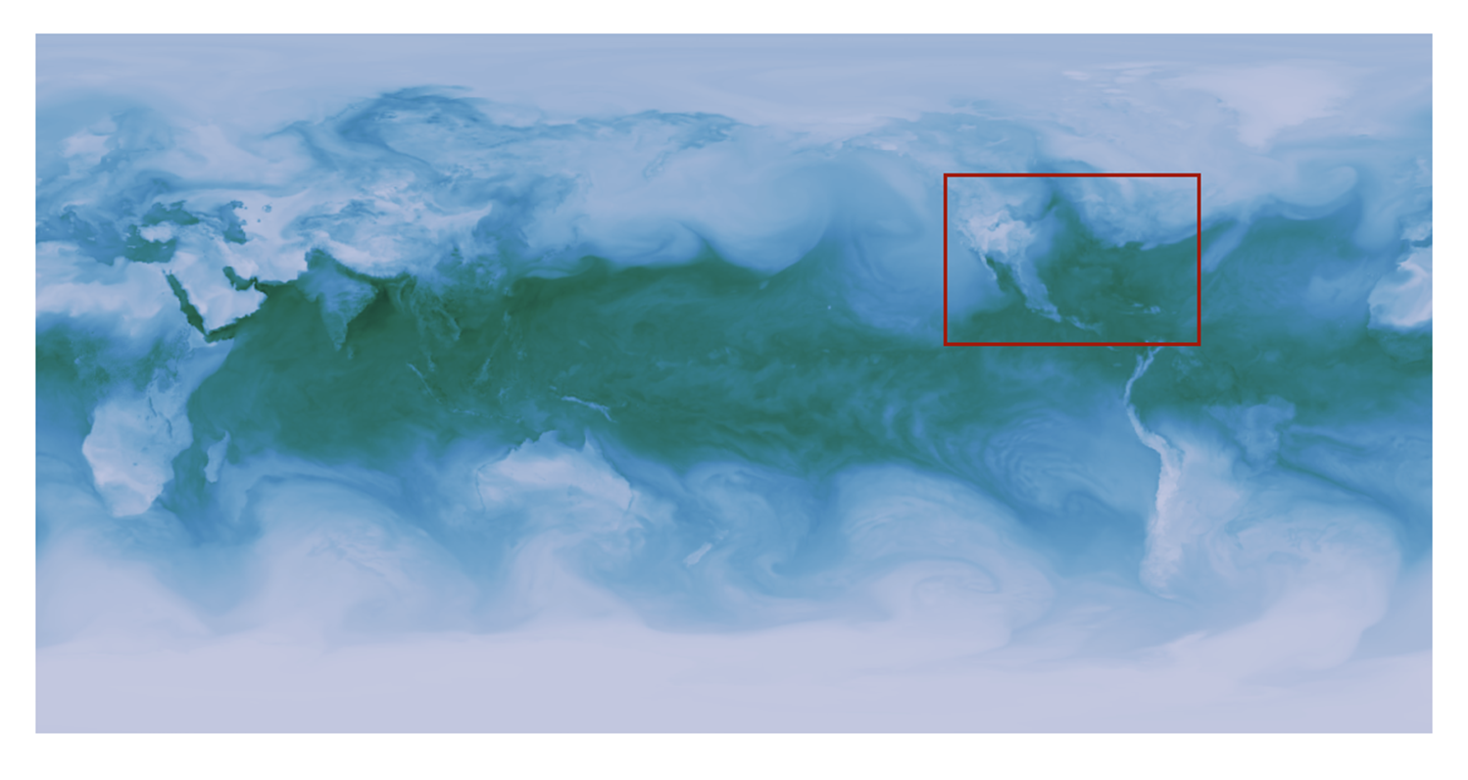


Environmental Modelling and Prediction Platform
EMP2
Development of a proof-of-concept Machine Learning digital twin of the dynamics of the atmosphere
Trained on hourly data over 40 years from Copernicus (Wind, Temperature, Humidity & Precipitation)
Impact: Very robust predictions that can improve traditional numerical weather modelling, specifically:
  Nowcasting (weather forecast up to 6h)
  Downscaling of (extreme) weather phenomena (32km → 6km)
  Correction of precipitation measurements bias

Slide 22

CLIMATE CHANGE AND
POLLUTION CONTROL
Mitigation
UTMOST CLEEN / CLEER
Electron Beam Flue Gas Treatment System

Slide 23
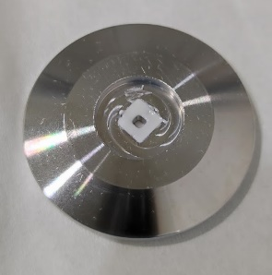
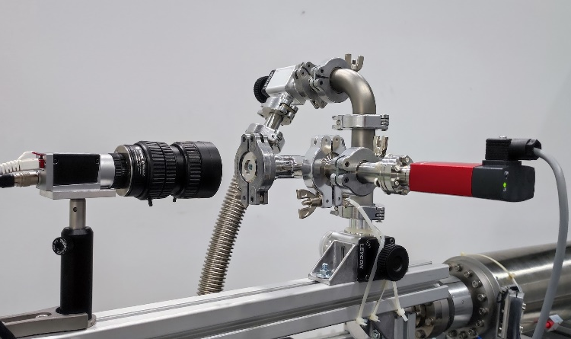
Development of Electron-Beam-Flue Gas-Treatment
UTMOST CLEEN: Ultra-Thin Membrane Overlay STacks to Channel Low Energy ElectroNs to Atmosphere
Development of a compact and durable Electron Beam Flue Gas Treatment (EBFGT) technology
Phase 1: UTMOST CLEEN: Development of key components such as ultrathin beam windows
Phase 2: UTMOST CLEER: Development of Demonstrator System for specific application
Impact: Significant cut in greenhouse gas emissions from hard-to-abate transportation systems (ships) and industries (semiconductors) through pre-release exhaust gas purification.
Reduce SOx emission by up to 95%
Reduce NOx emission by up to 80%
Strategic Partnership Negotiation On-going

Slide 24
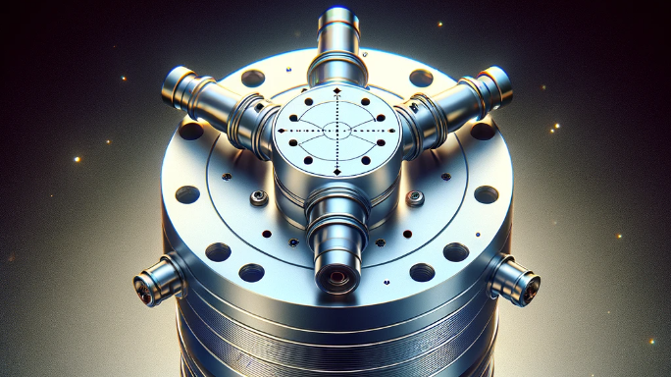
Development of a vacuum-compatible high-power waveguide circulator
SUSTAINABILITY AND
GREEN SCIENCE
Industrial processes - Emissions management
SF6-free RF circulator for photo injectors

Slide 25
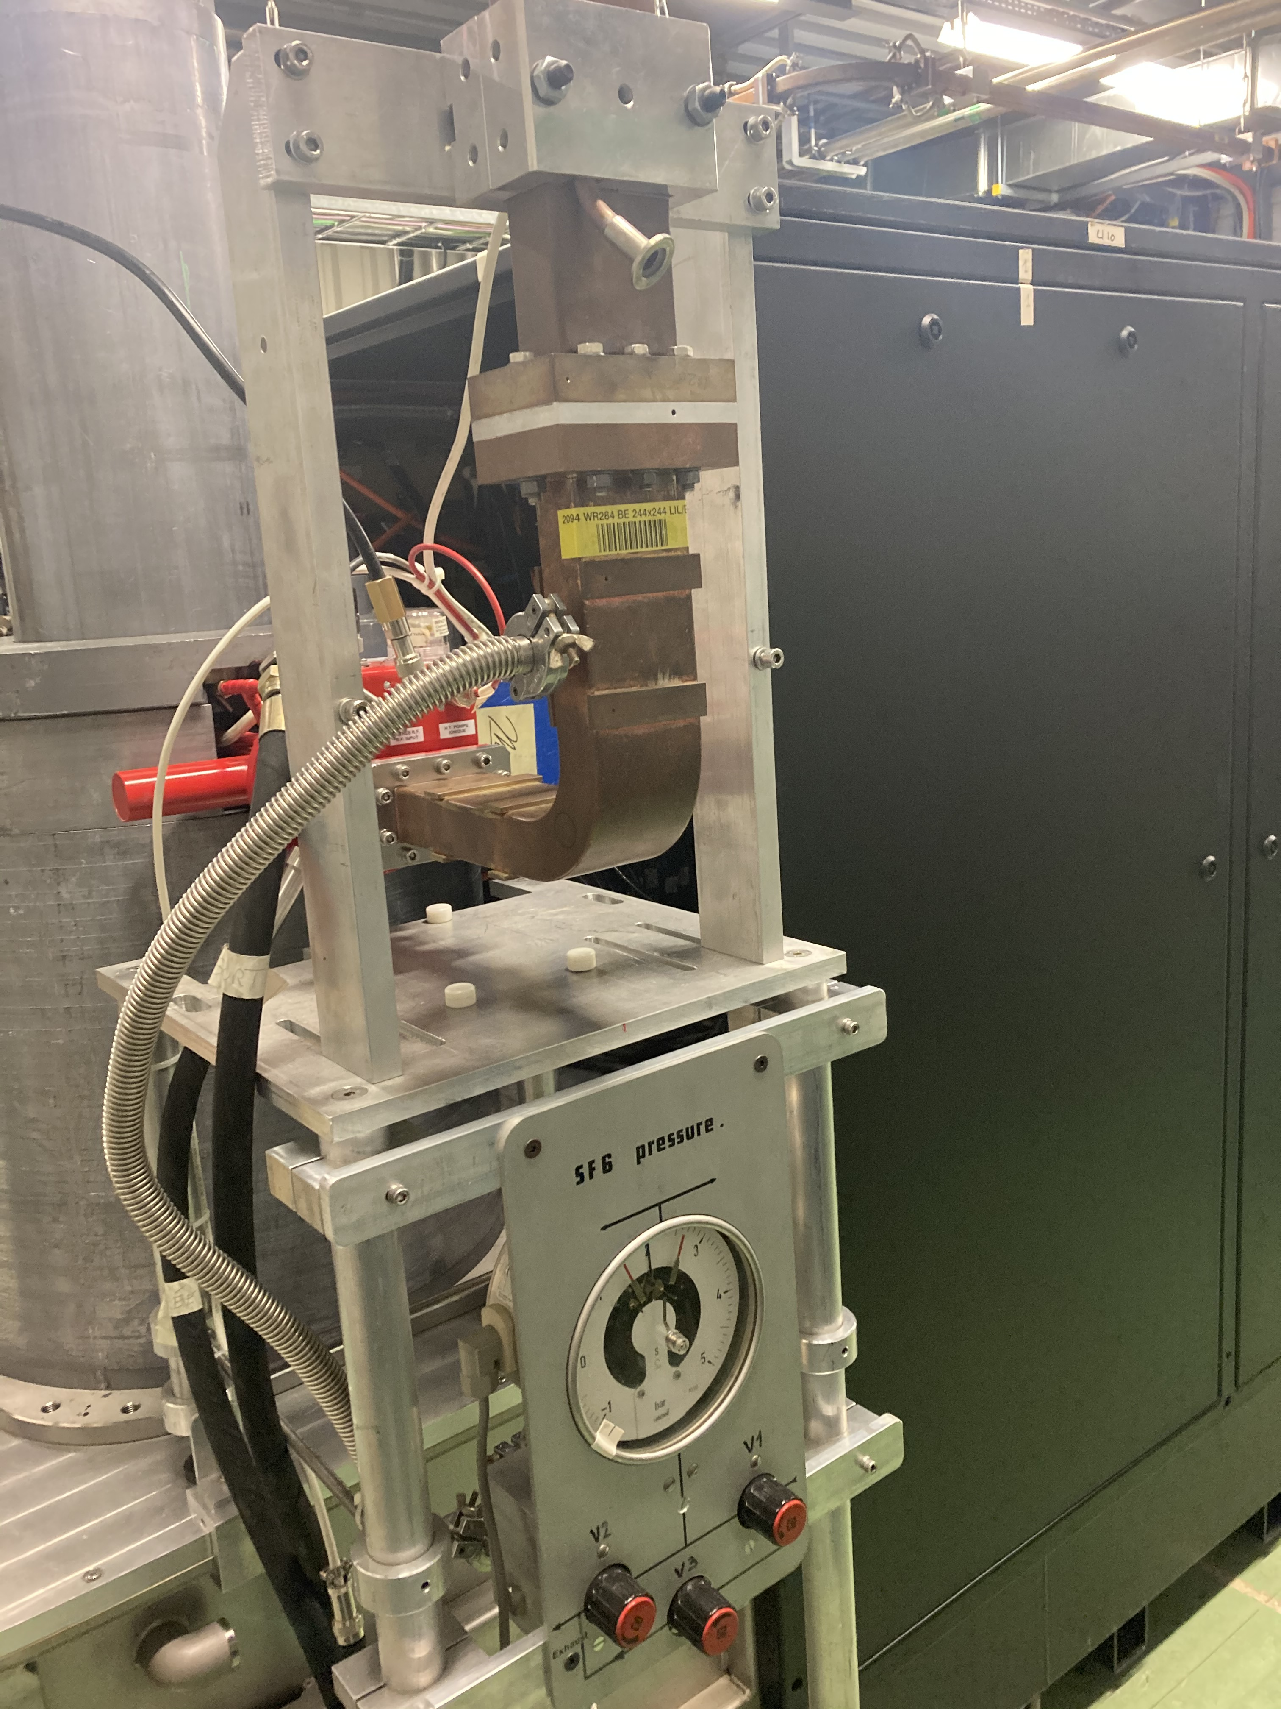
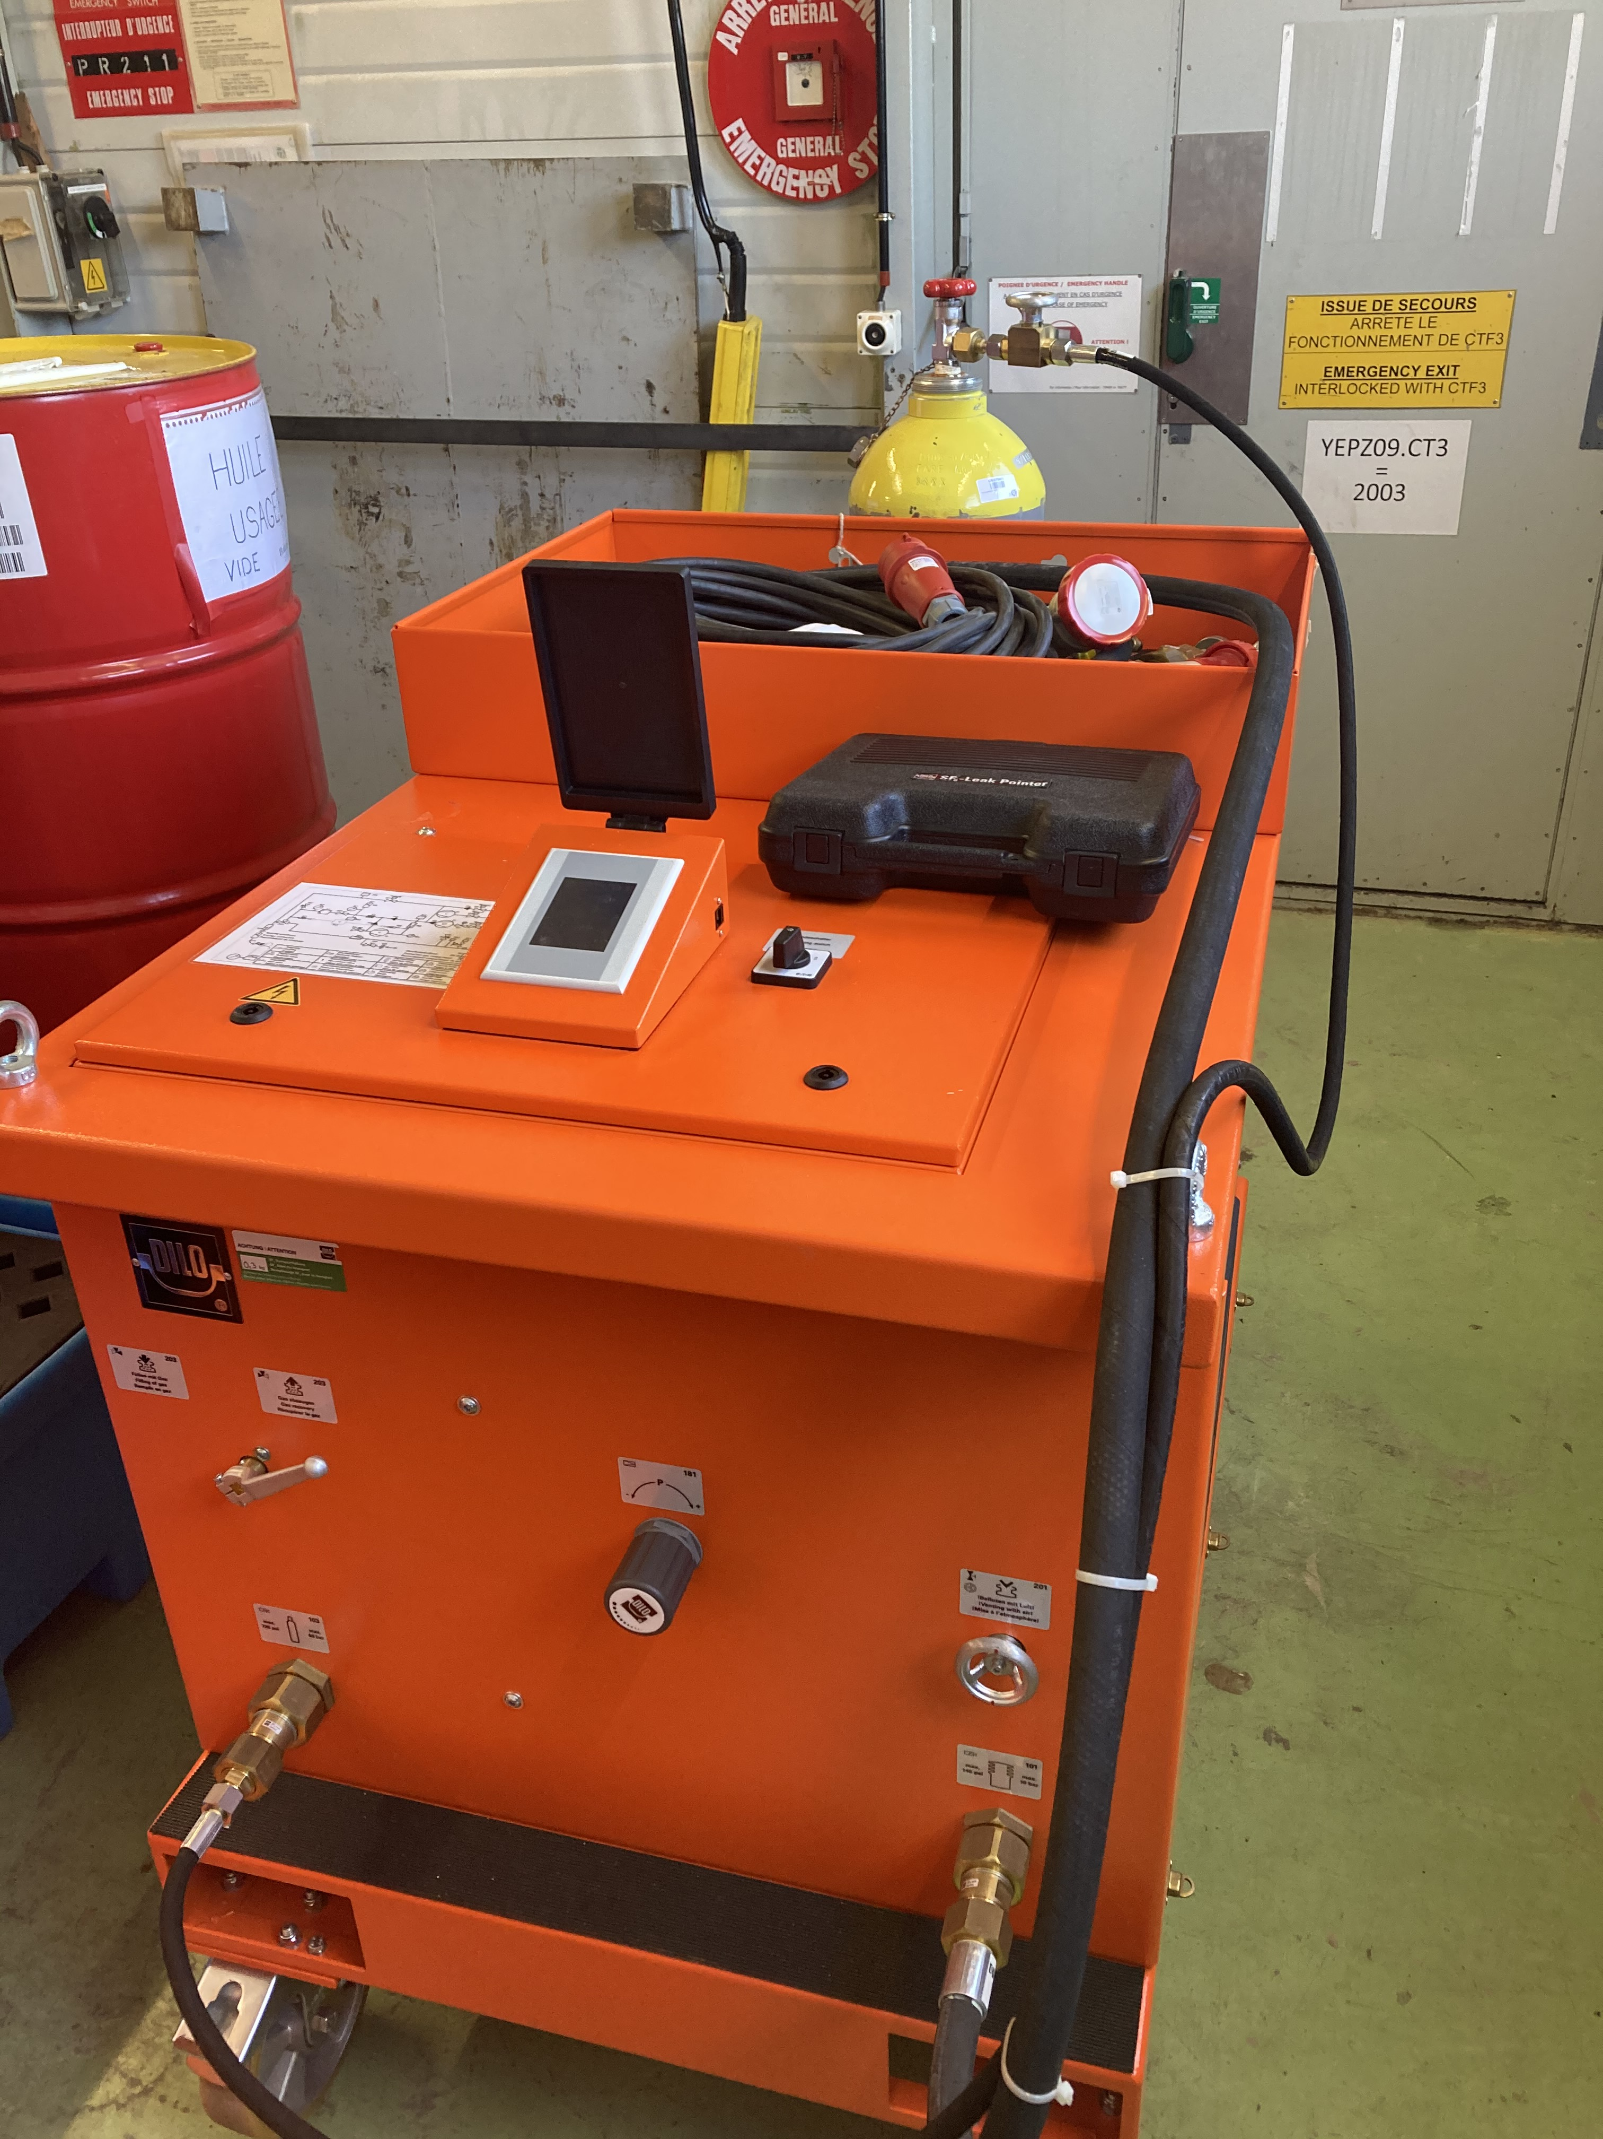

SF6-free RF circulator for photo injectors
Development of a vacuum-compatible high-power waveguide circulator operable without SF6
Performing outgassing and brazing studies to identify suitable vacuum-compatible ferrite
Testing existing circulators with eco-friendly alternative gases
Impact: Eliminate need of SF6 gas (Global warming potential: 23’500) in all accelerator applications requiring RF circulators (including medical hadron facilities).
CERN’s need: 3 units.
Potential benefits also for circuit breakers industry.

Slide 26
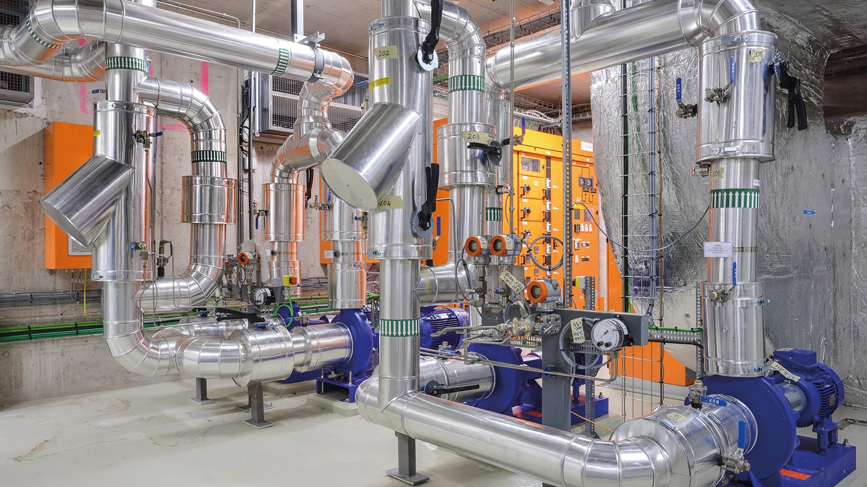
SUSTAINABILITY AND
GREEN SCIENCE
Industrial processes - Power management
MotorSENSE
Reducing electricity consumption in cooling and ventilation using smart sensors and digital twins

Slide 27
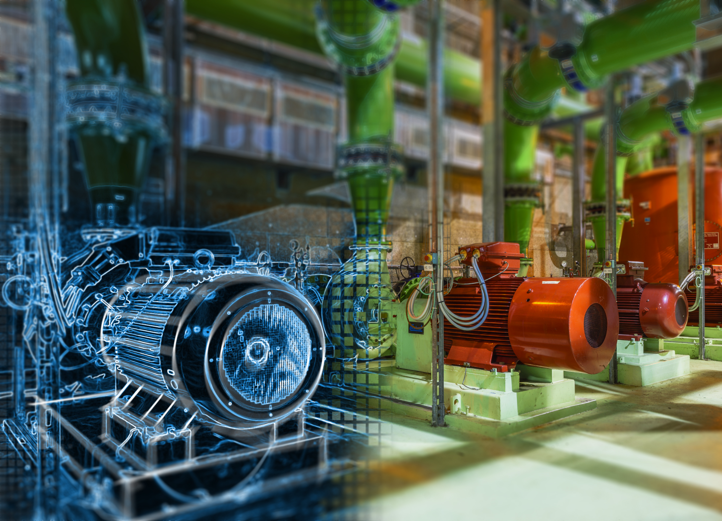

Energy savings in driven pumps and fans using smart sensors and digital twins
EMP2
Reducing electricity consumption in cooling and ventilation using smart sensors and digital twins
Selection of >800 low-voltage motors and installation of >100 smart sensors
Measurement of output power, speed, vibration levels and estimation of operating efficiency
Improvement and optimisation of smart sensors algorithms
Development of digital twins
Recommendations for energy saving
Impact: Identification of 17.4% energy-saving opportunities at CERN (up to 31 GWh). Same approach can be applied to any infrastructure with similar cooling and ventilation requirements.
https://home.cern/news/news/knowledge-sharing/abb-and-cern-identify-174-energy-saving-opportunity-laboratorys-cooling

Slide 28
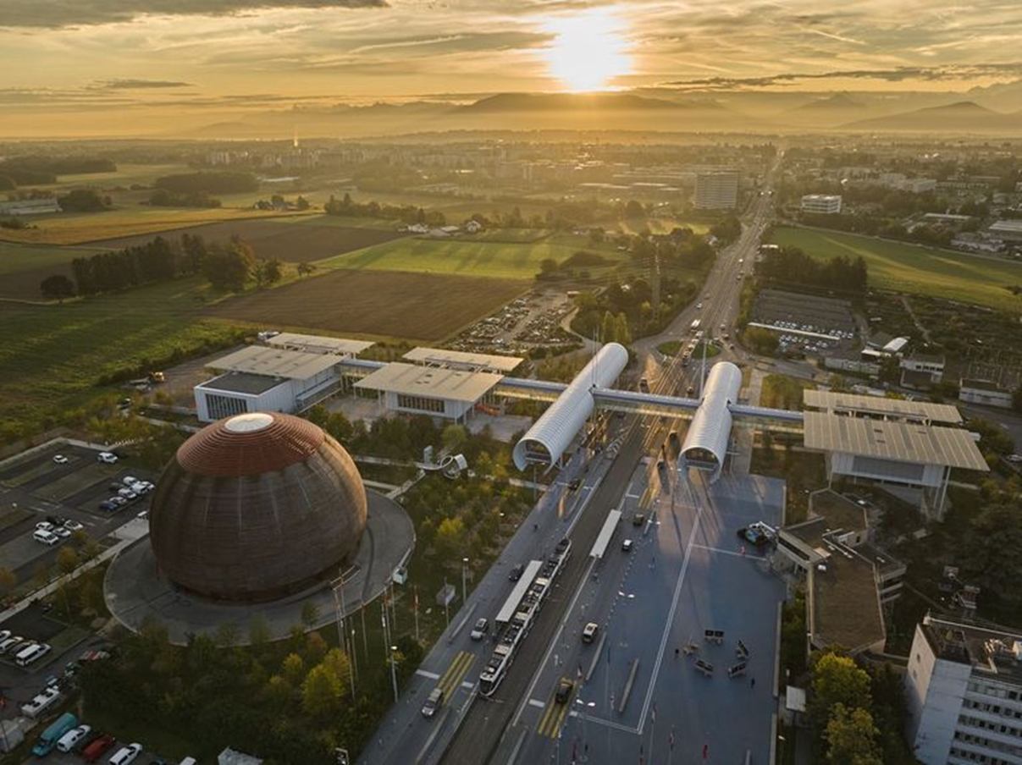

Thanks for your attention!
Enrico Chesta
enrico.chesta@cern.ch
www.cern.ch/kt

