Slide 1

LHC - Beam Wire Scanner
Impedance Study Update
SY-RF-BR
18/02/2025
H. Bursali, C. Vollinger, W. Andreazza, C. Pasquino, H. Sullivan
96th IWG Meeting

Slide 2
Outline
Legacy Model
Improvements on the Model
  Follow up
  RF Absorber Usage
  Studied Models
  Updated Model
  Previous vs Updated Model
Beam-induced RF Power Loss
Conclusion & Future Work
96th IWG Meeting
1

Slide 3
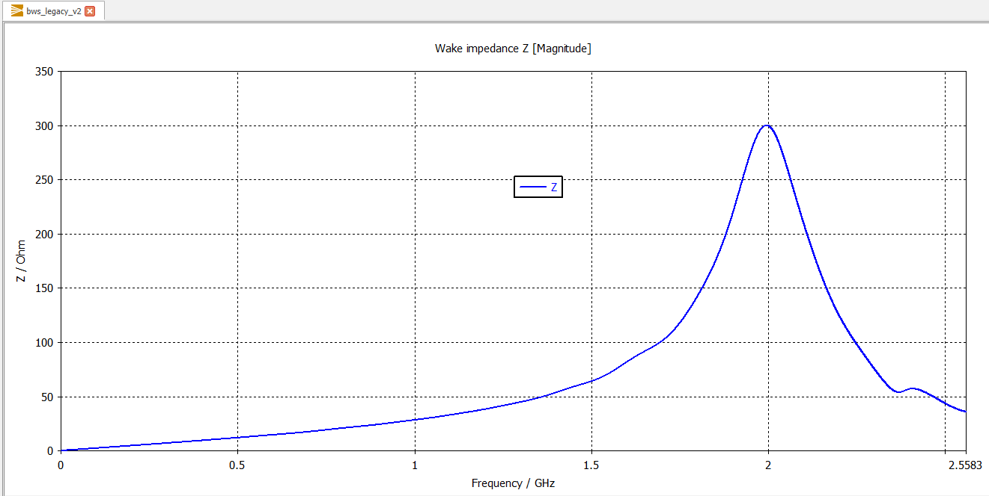
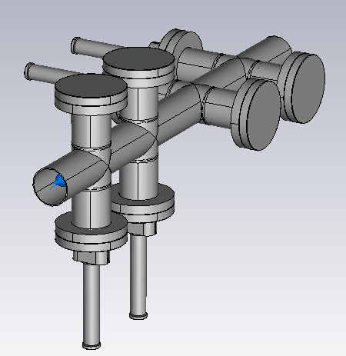
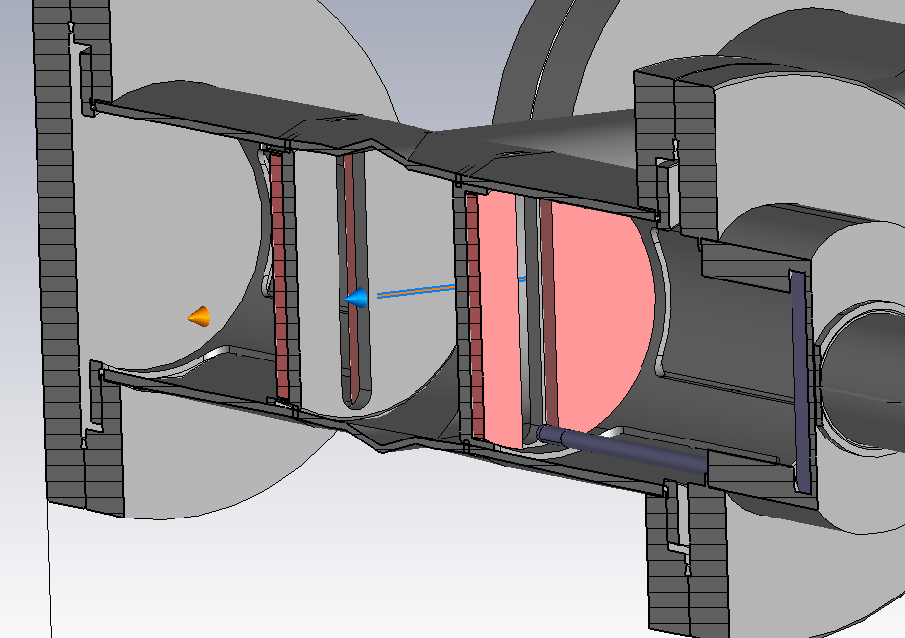
Legacy Model
Ferrites (TT2-111 R)
4 wire scanners
Wire Scanner
Wire is located behind the ferrites!
96th IWG Meeting
2

Slide 4
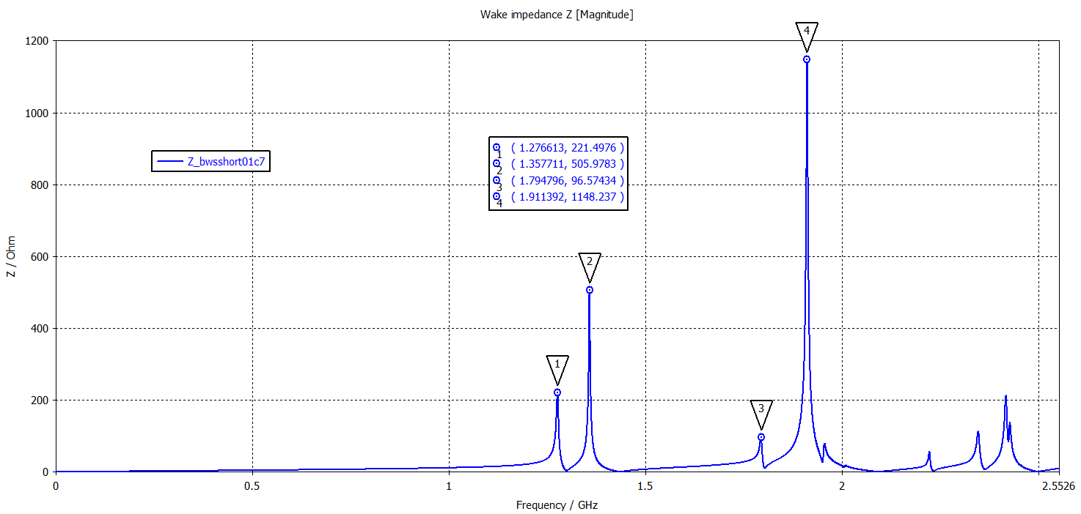
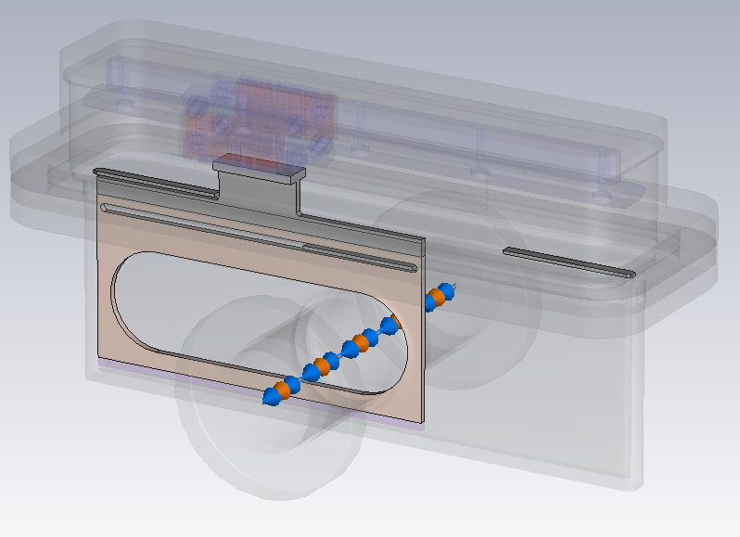
Follow up
For more info: ‘LHC BWS Impedance Study’, 93rd IWG Meeting
96th IWG Meeting
3

Slide 5
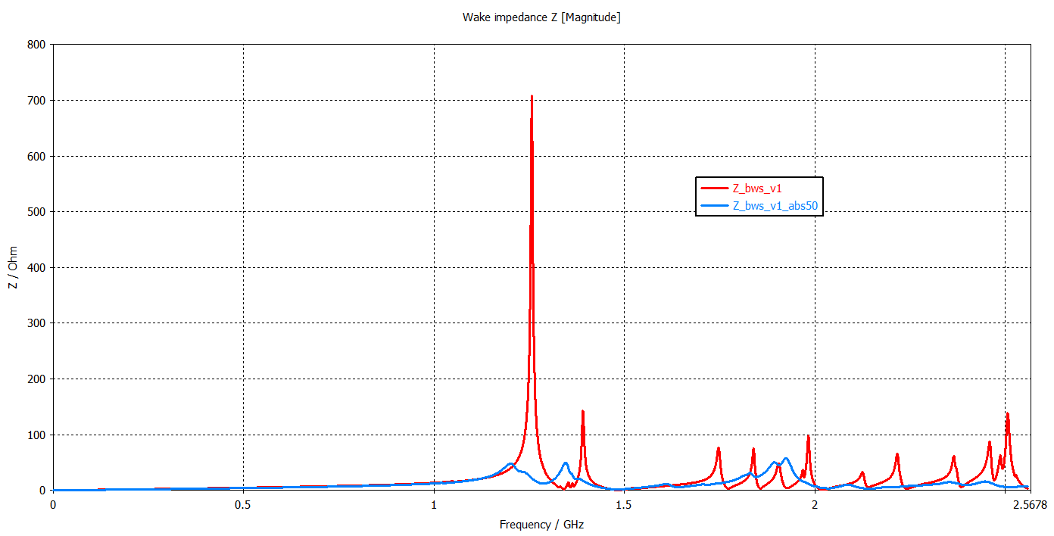
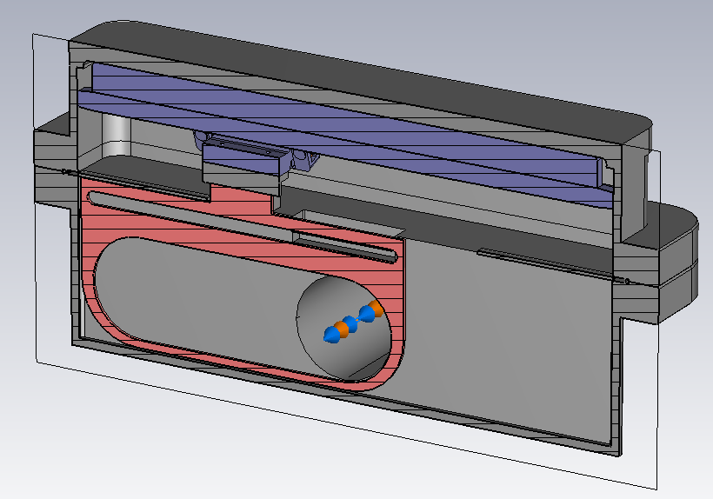
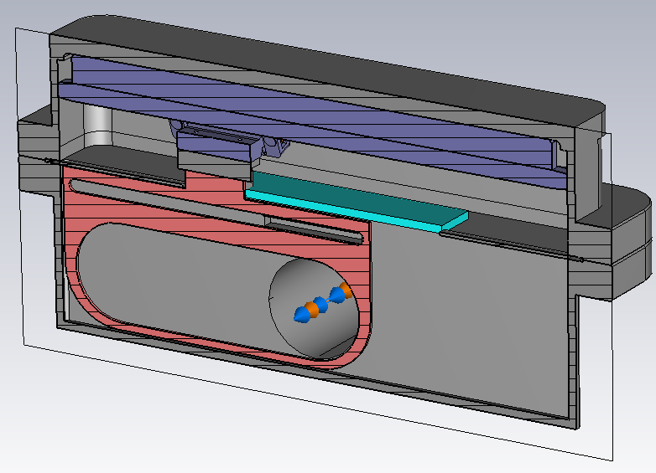
RF Absorber Usage
No RF absorber
With RF absorber
50 Ω NEG coated ceramic (macor)
96th IWG Meeting
4

Slide 6
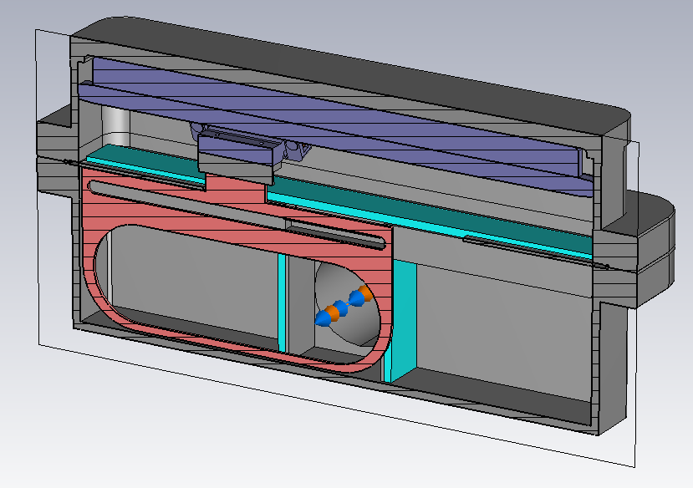
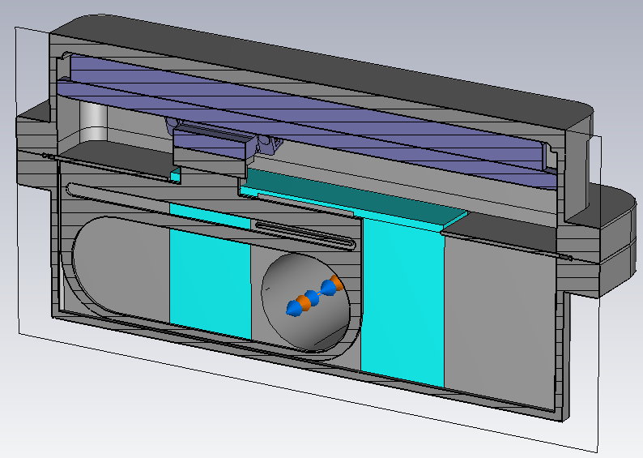
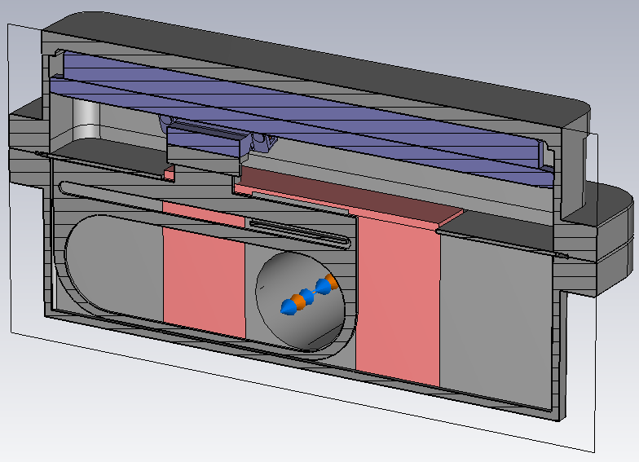
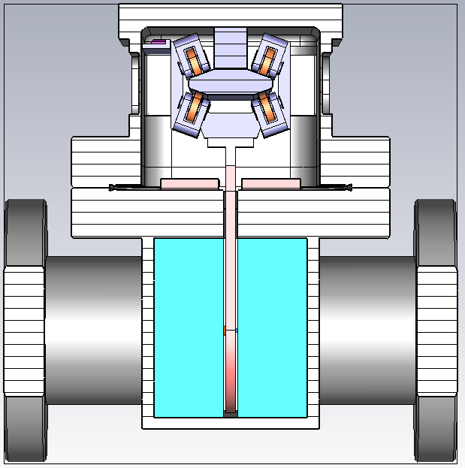
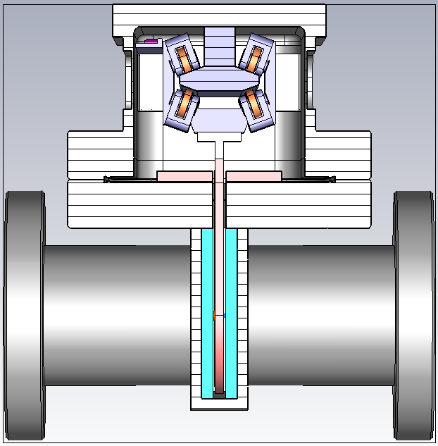

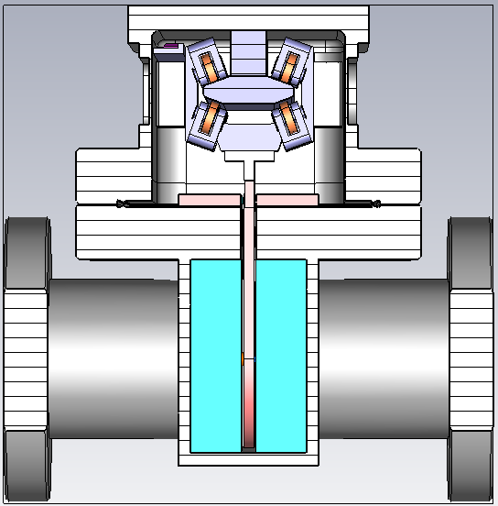
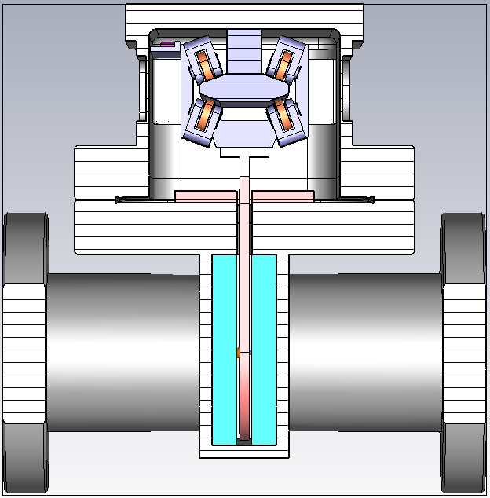
Studied Models
RF absorbers with different lengths on bottom chamber
Models with different absorber configurations
30 mm
5 mm
50 Ω NEG coated ceramic (macor)
20 mm
10 mm
Absorber -> 50 Ω NEG coated ceramic (macor)
Ferrites (TT2-111 R)
96th IWG Meeting
5

Slide 7
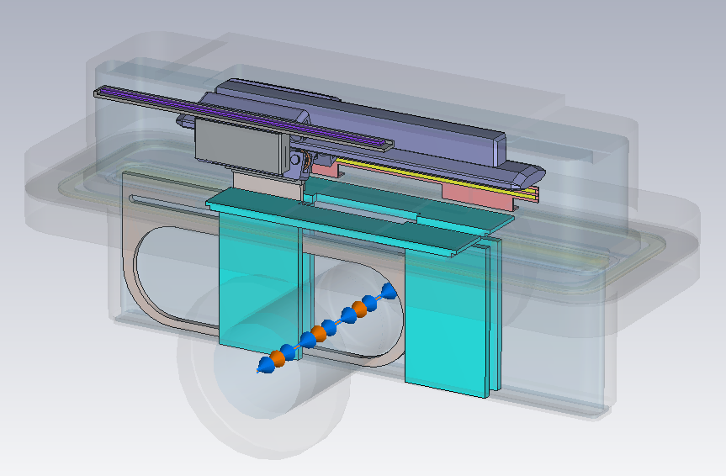
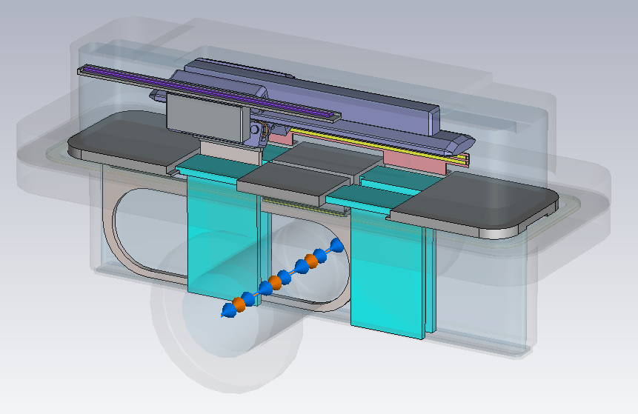
Updated Model
RF Absorber Locations
RF Absorber and Panel Locations
Panels
50 Ω NEG coated ceramic (macor)
96th IWG Meeting
6

Slide 8
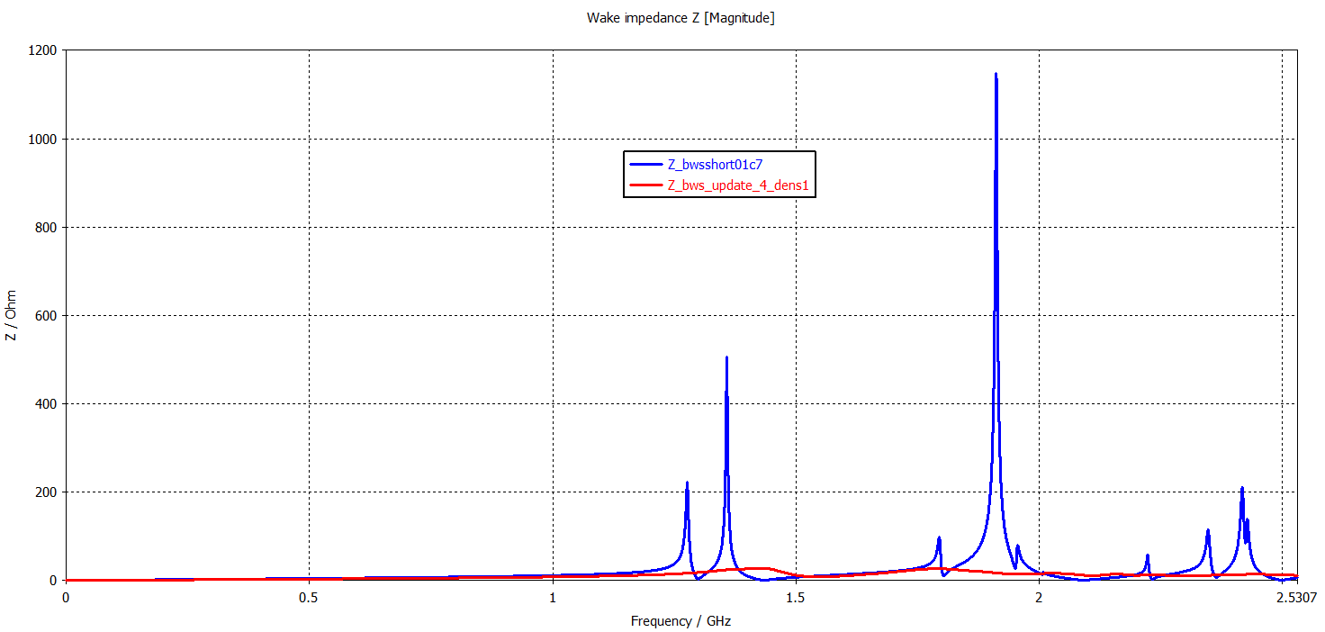
Previous vs Updated Model
Previous Model (93rd IWG)
Updated Model
96th IWG Meeting
7

Slide 9
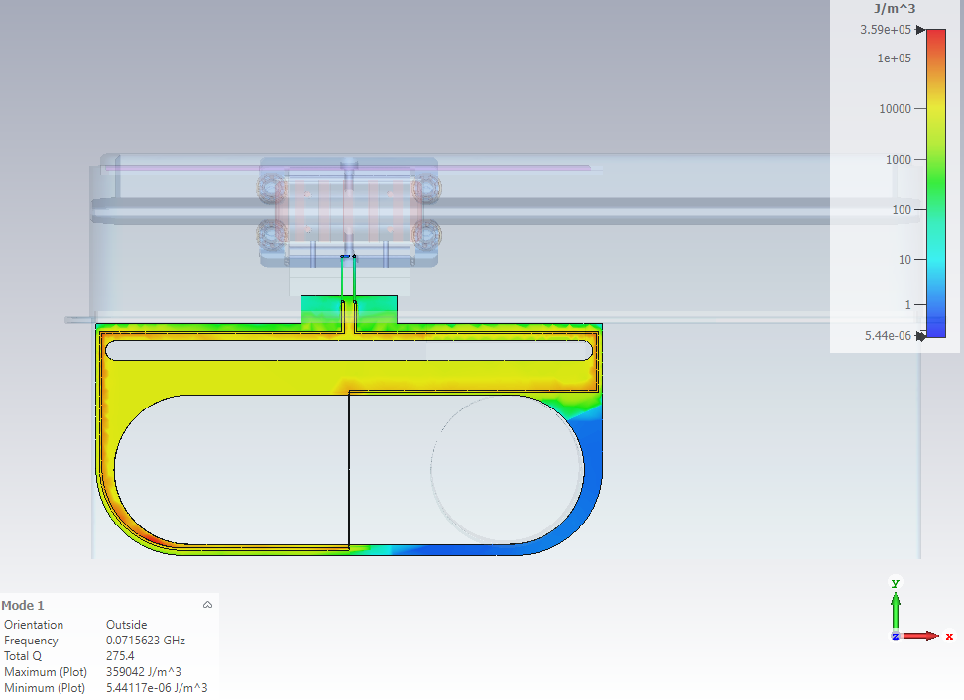
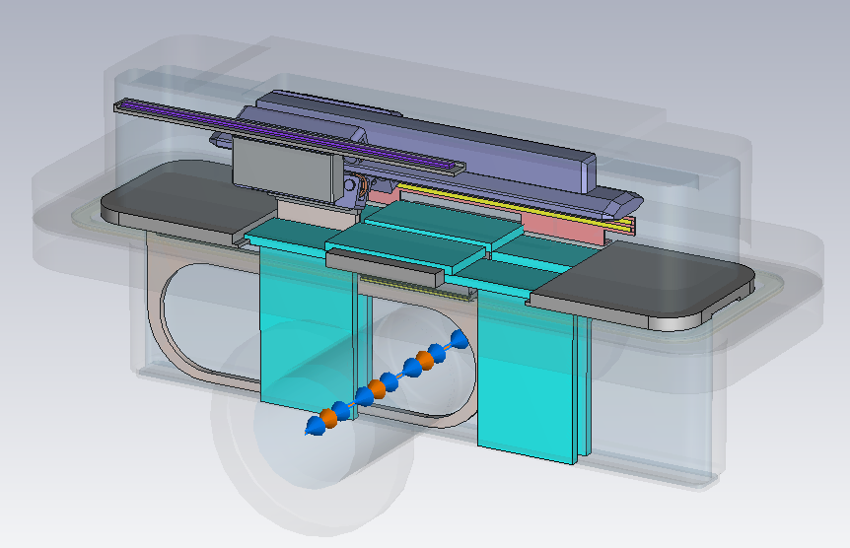
Remark (1)
Current Design
Current Design + Absorbers on the middle panel
There will be wire with copper track on the card. -> Loop!
96th IWG Meeting
8

Slide 10
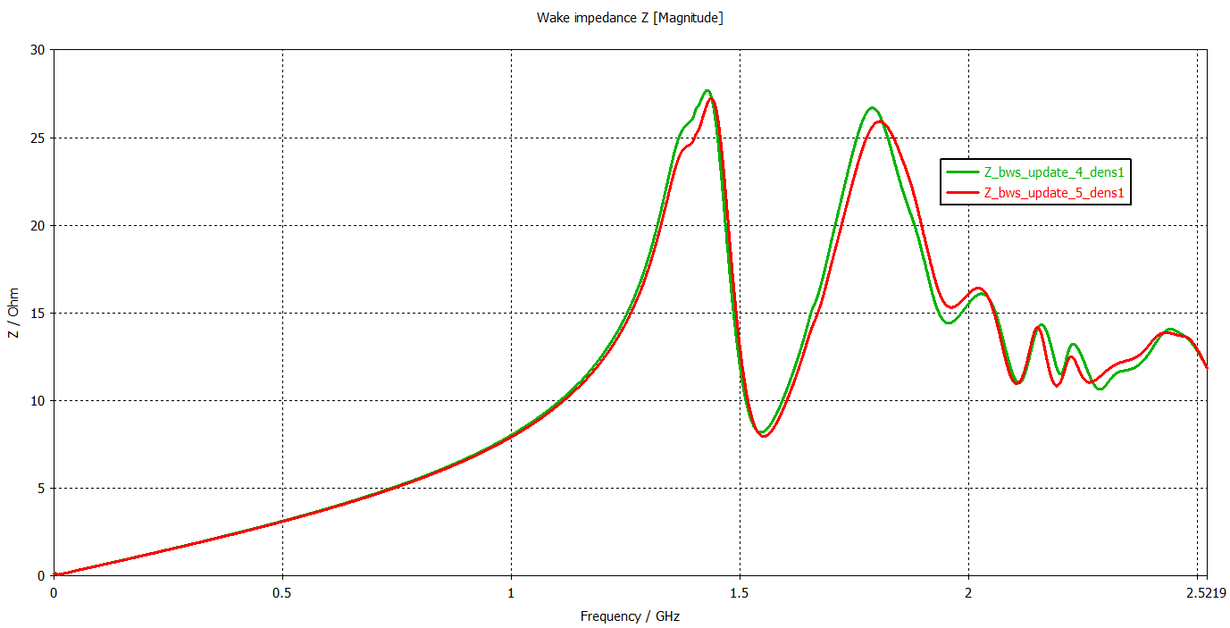
Remark (2)
Current model
Additional absorbers
96th IWG Meeting
9

Slide 11
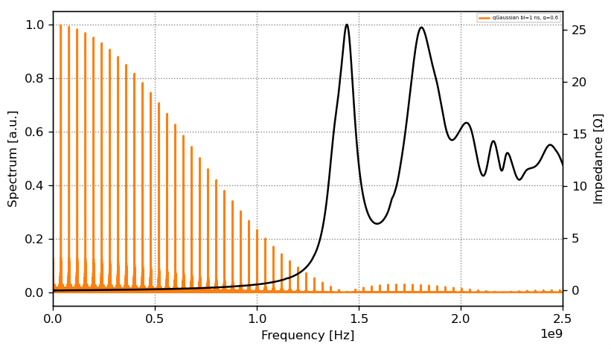
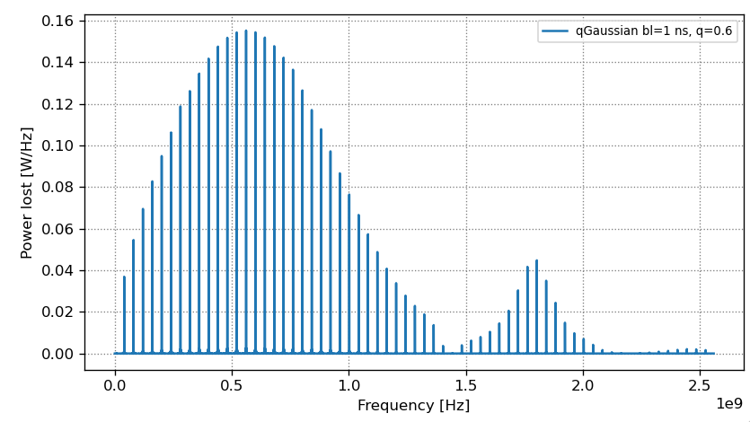
Beam-Induced RF Power Loss
Power Loss
Power Spectral Density over Frequency
q-Gaussian Distribution
Power Loss -> 4.59 W
Max. Power Loss -> 5.03 W
Bunch length -> 1 ns
Number of particles/bunch -> 2.2e11
Beam Induced Heating Computation code – BIHC
96th IWG Meeting
10

Slide 12
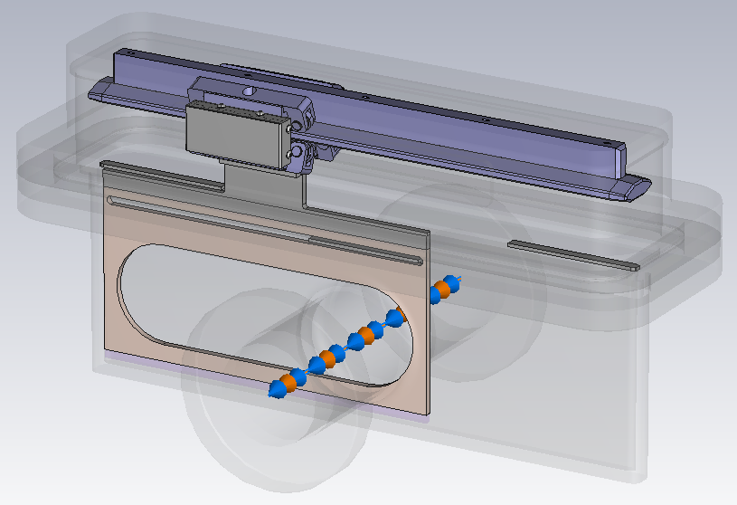
Conclusion & Future Work
Previous Model
The BWS model is equipped with RF absorbers both in the lower and upper chambers. All the peaks in the previous model (presented in 93rd IWG meeting) has mitigated.
The panels are updated for better mechanical assembly and RF contact.
Calculated beam-induced RF power loss is ~5 W for q-Gaussian beam distribution with 1 ns bunch length and 2.2e11 p/b intensity.
Integration model and transverse impedance simulations will be performed.
Updated Model
96th IWG Meeting
11

Slide 13
Thanks for your attention!
SY-RF-BR
Special thanks to Leonardo Sito for the help on the BIHC code.
96th IWG Meeting

Slide 14
Backup Slides

Slide 15
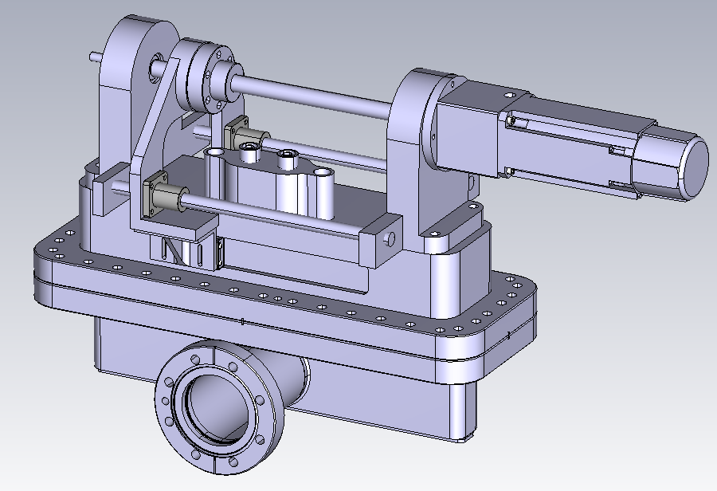
BWS Model
Mechanical Model
Simplified CST Model

Slide 16
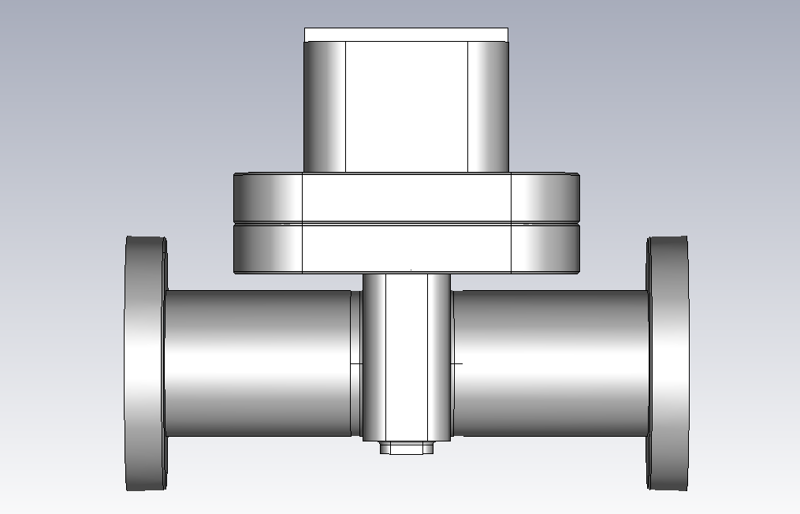
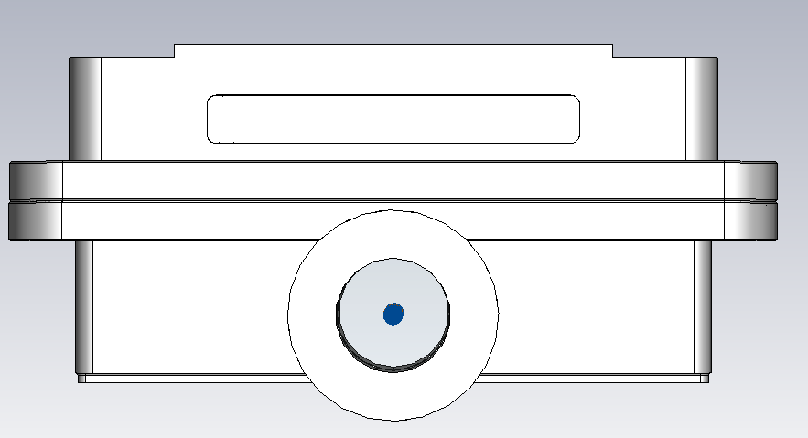
BWS Model - Dimensions
185 mm
62 mm
350 mm
250 mm

Slide 17
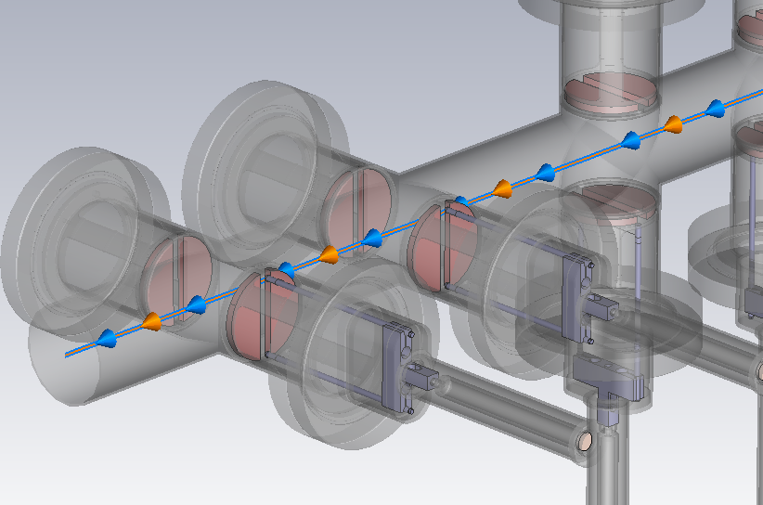
BWS Legacy Model

Slide 18
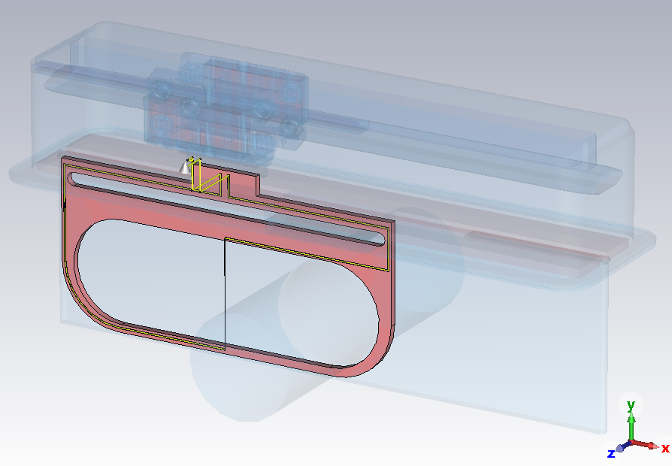
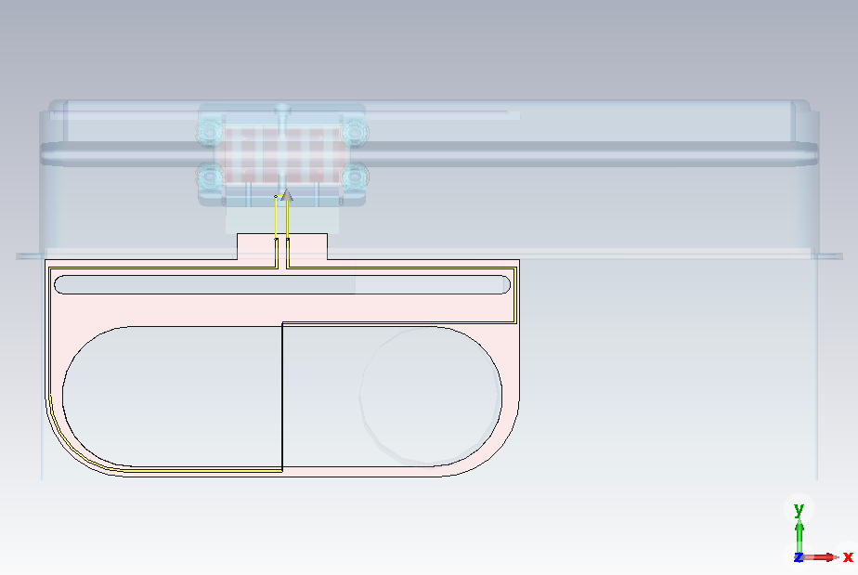
BWS Model Trial with Wire (1)
CST Model with Wire & Feedtrough
Front View
Eigen Solver
Mode # | Frequency (MHz)
1 | 71
2 | 75
3 | 338
4 | 446
5 | 532

Slide 19
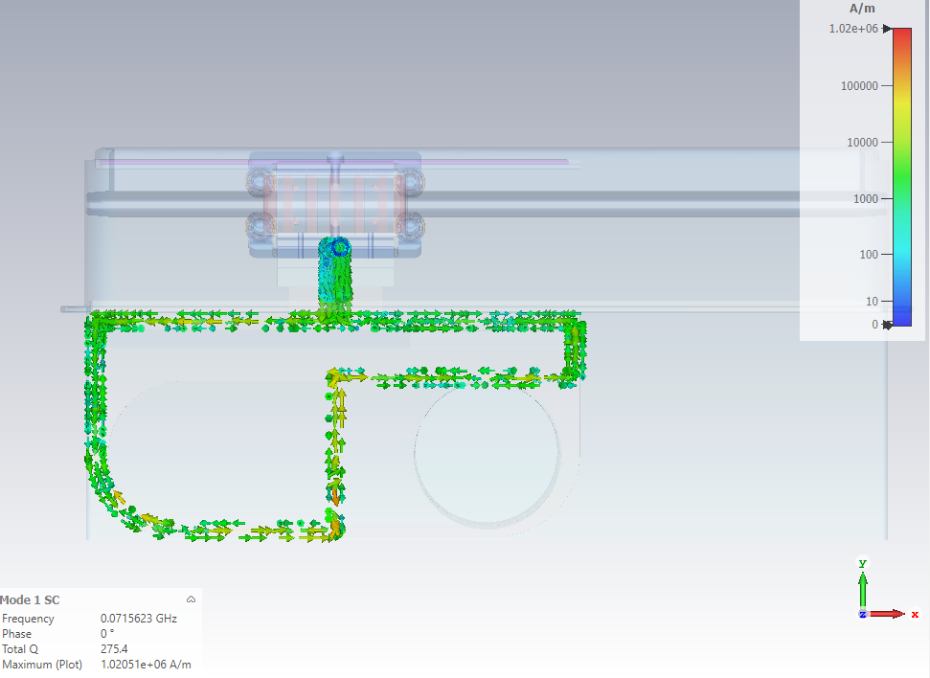
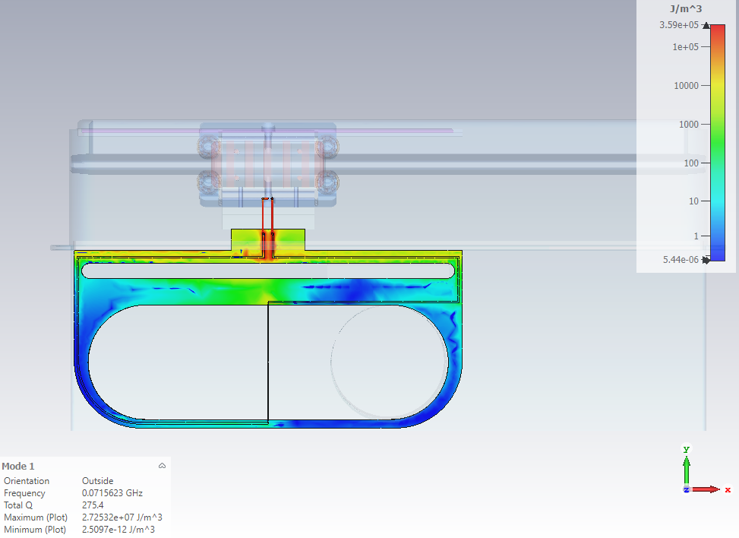
BWS Model Trial with Wire (2)
Mode #1 -> 71 MHz
Surface Current
Electric Field
Magnetic Field

Slide 20
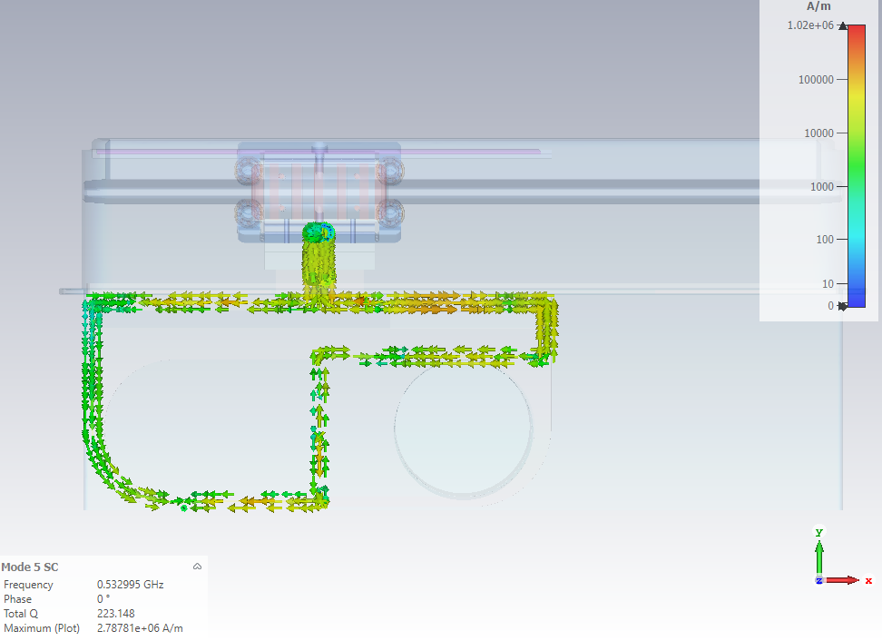
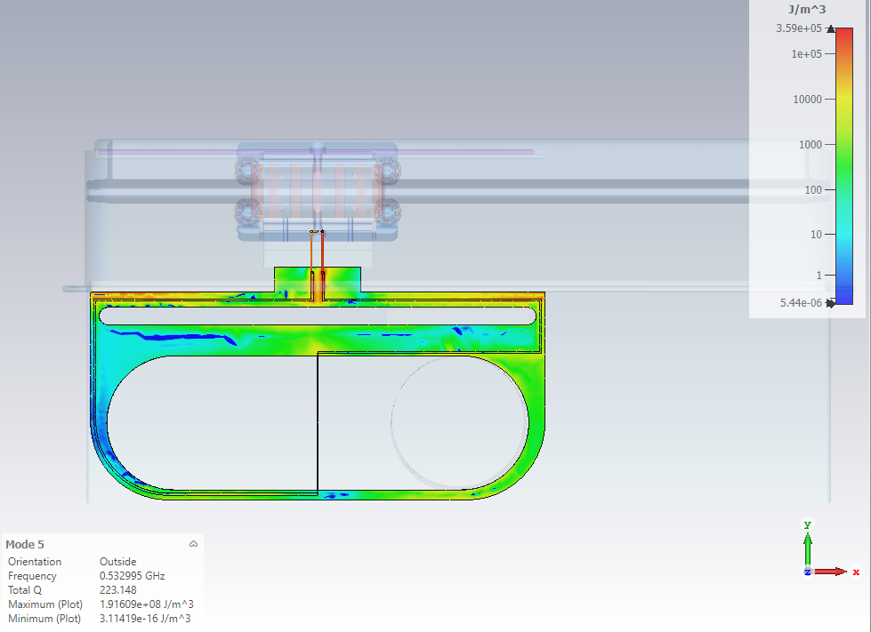
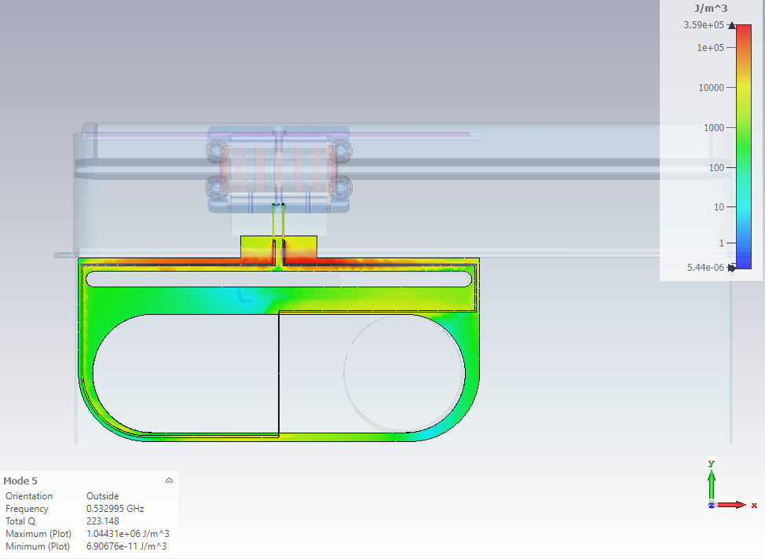
BWS Model Trial with Wire (3)
Mode #5 –> 532 MHz
Surface Current
Electric Field
Magnetic Field

Slide 21
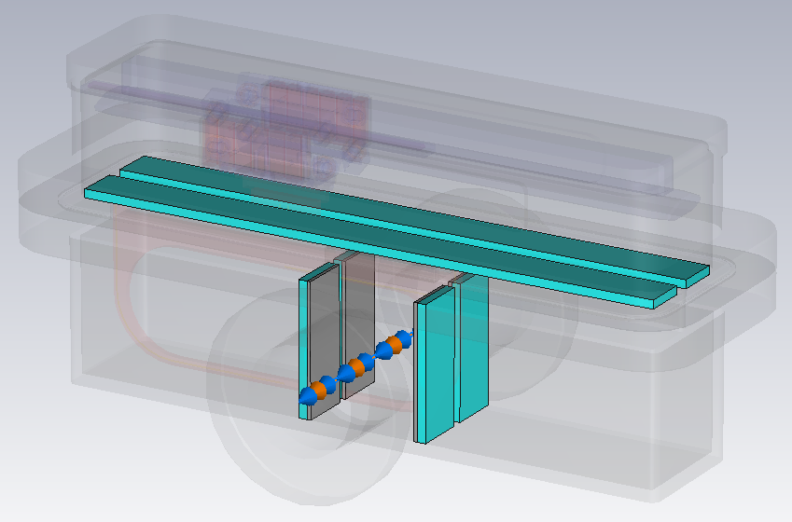
Models with Absorbers at Bottom Chamber (1)
RF absorber -> 50 Ω NEG coated ceramic (5 mm thickness)

Slide 22
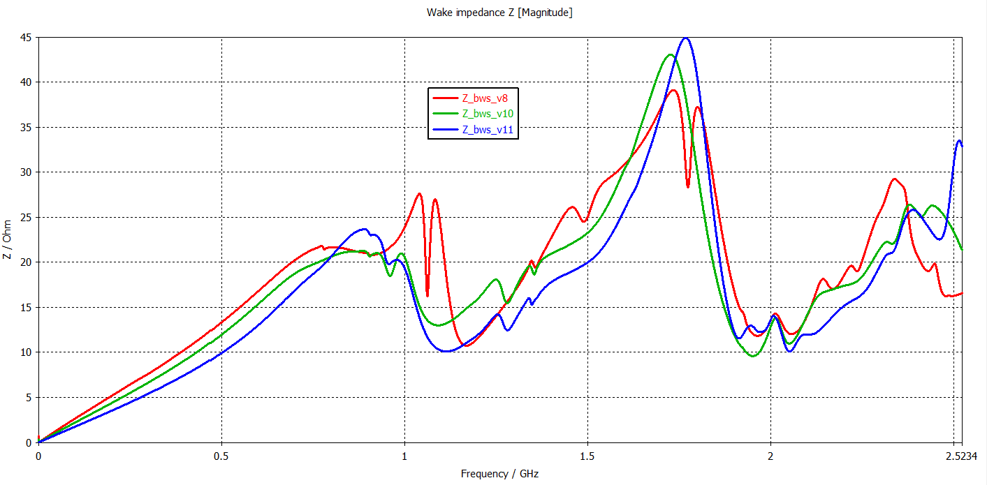
Models with Absorbers at Bottom Chamber (2)
Absorber width
30 mm
20 mm
10 mm

Slide 23
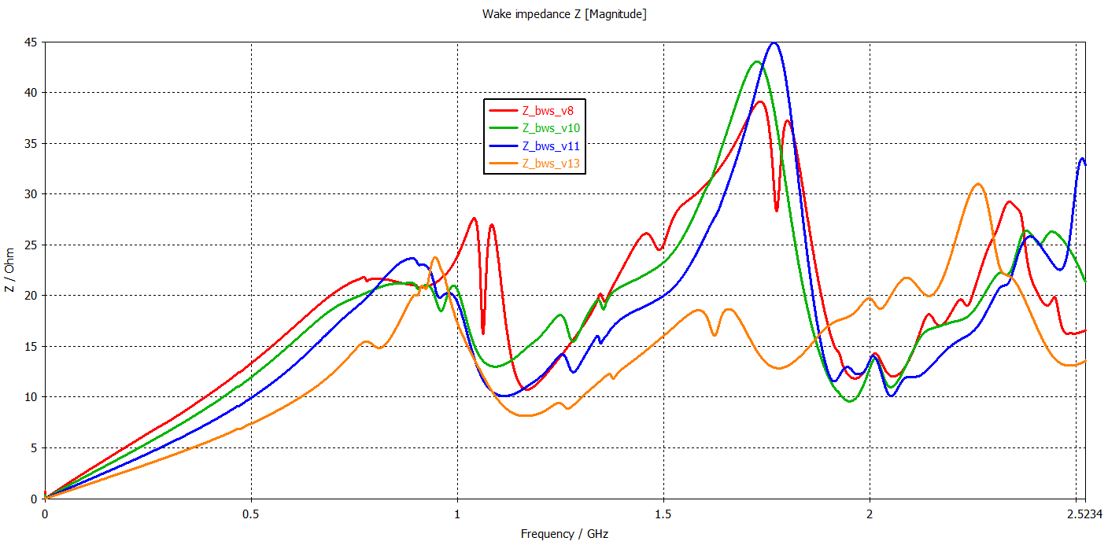
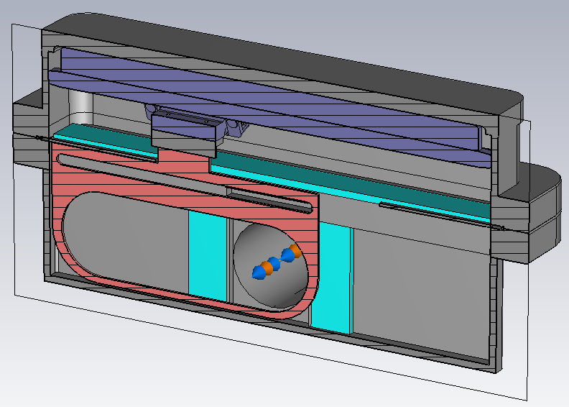
Models with Absorbers at Bottom Chamber (3)
30 mm
20 mm
10 mm
5 mm

Slide 24
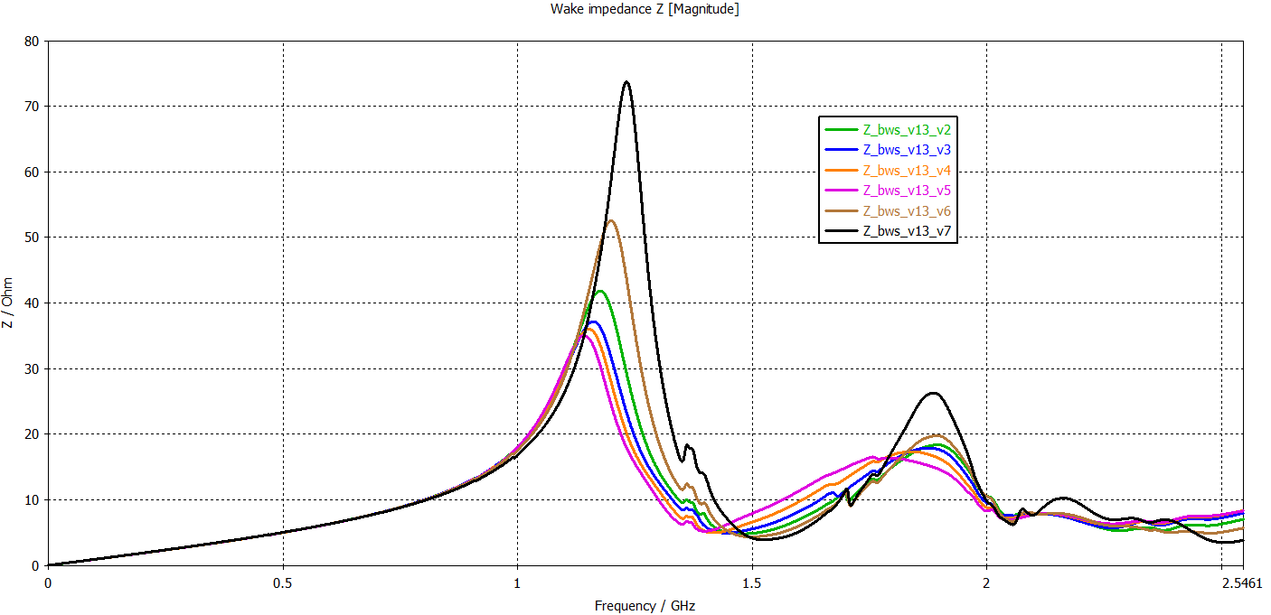
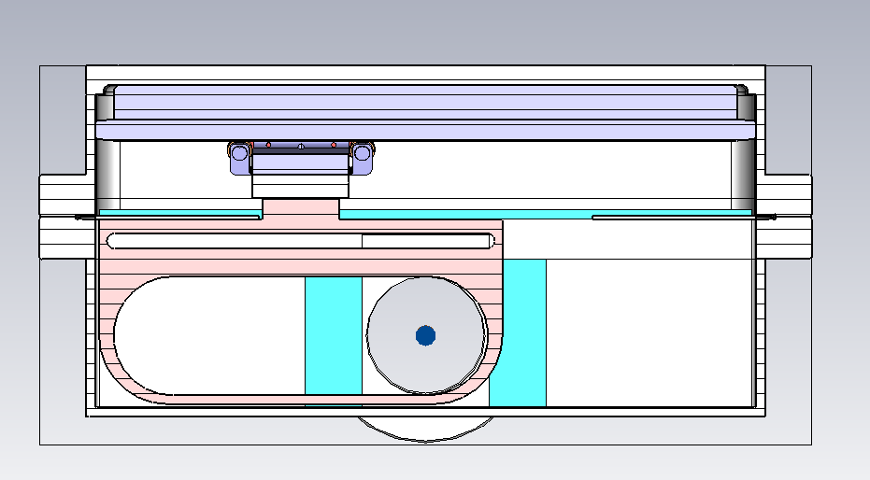
Absorber Width Change
Absorber width
10 mm
20 mm
30 mm
40 mm
50 mm
60 mm

Slide 25
Modified Bottom Chamber (1)
Impedance responses of modified model with different absorbers
Model with NEG coated absorbers
Model with ferrites
Model with combined absorbers
50 Ω NEG coated ceramic (macor)
50 Ω NEG coated ceramic (macor)
Ferrites (TT2-111 R)
Ferrites (TT2-111 R)

Slide 26
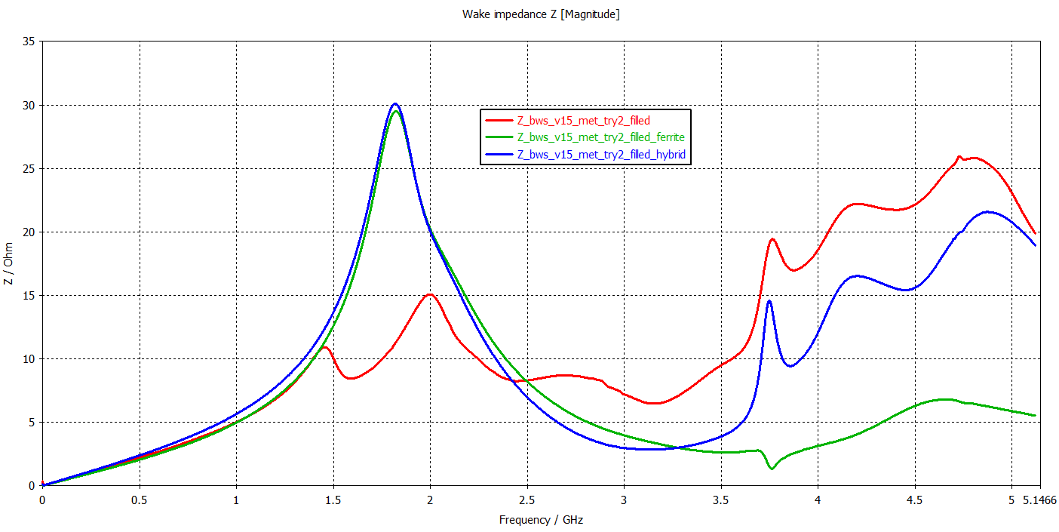
Modified Bottom Chamber (2)
Impedance responses of modified model with different absorbers
Model with NEG coated absorbers
Model with ferrites
Model with combined absorbers

Slide 27
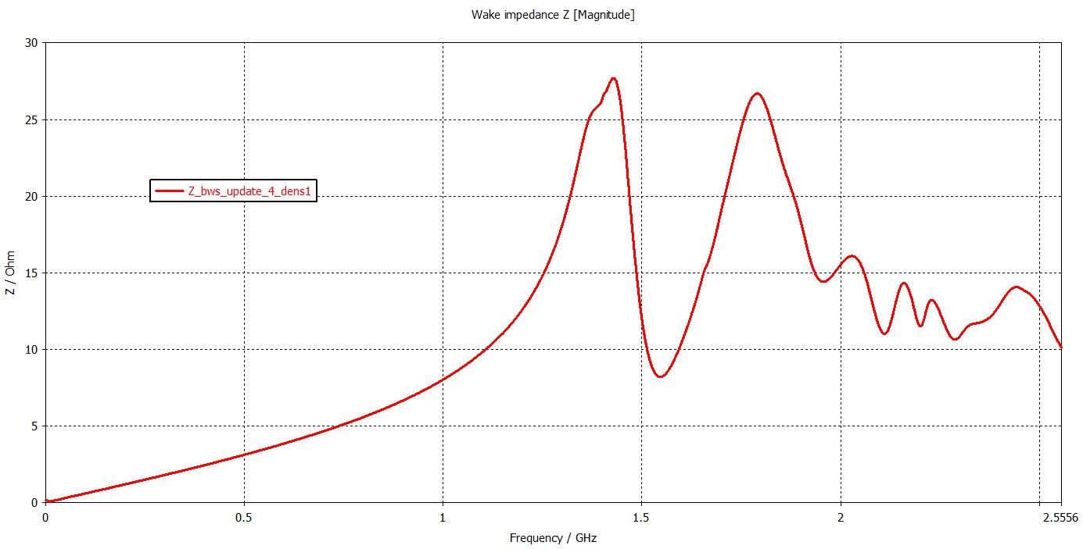
Updated Model

