Slide 1
AOBs, 96th IWG meeting
C. Vollinger, C. Zannini

Slide 2
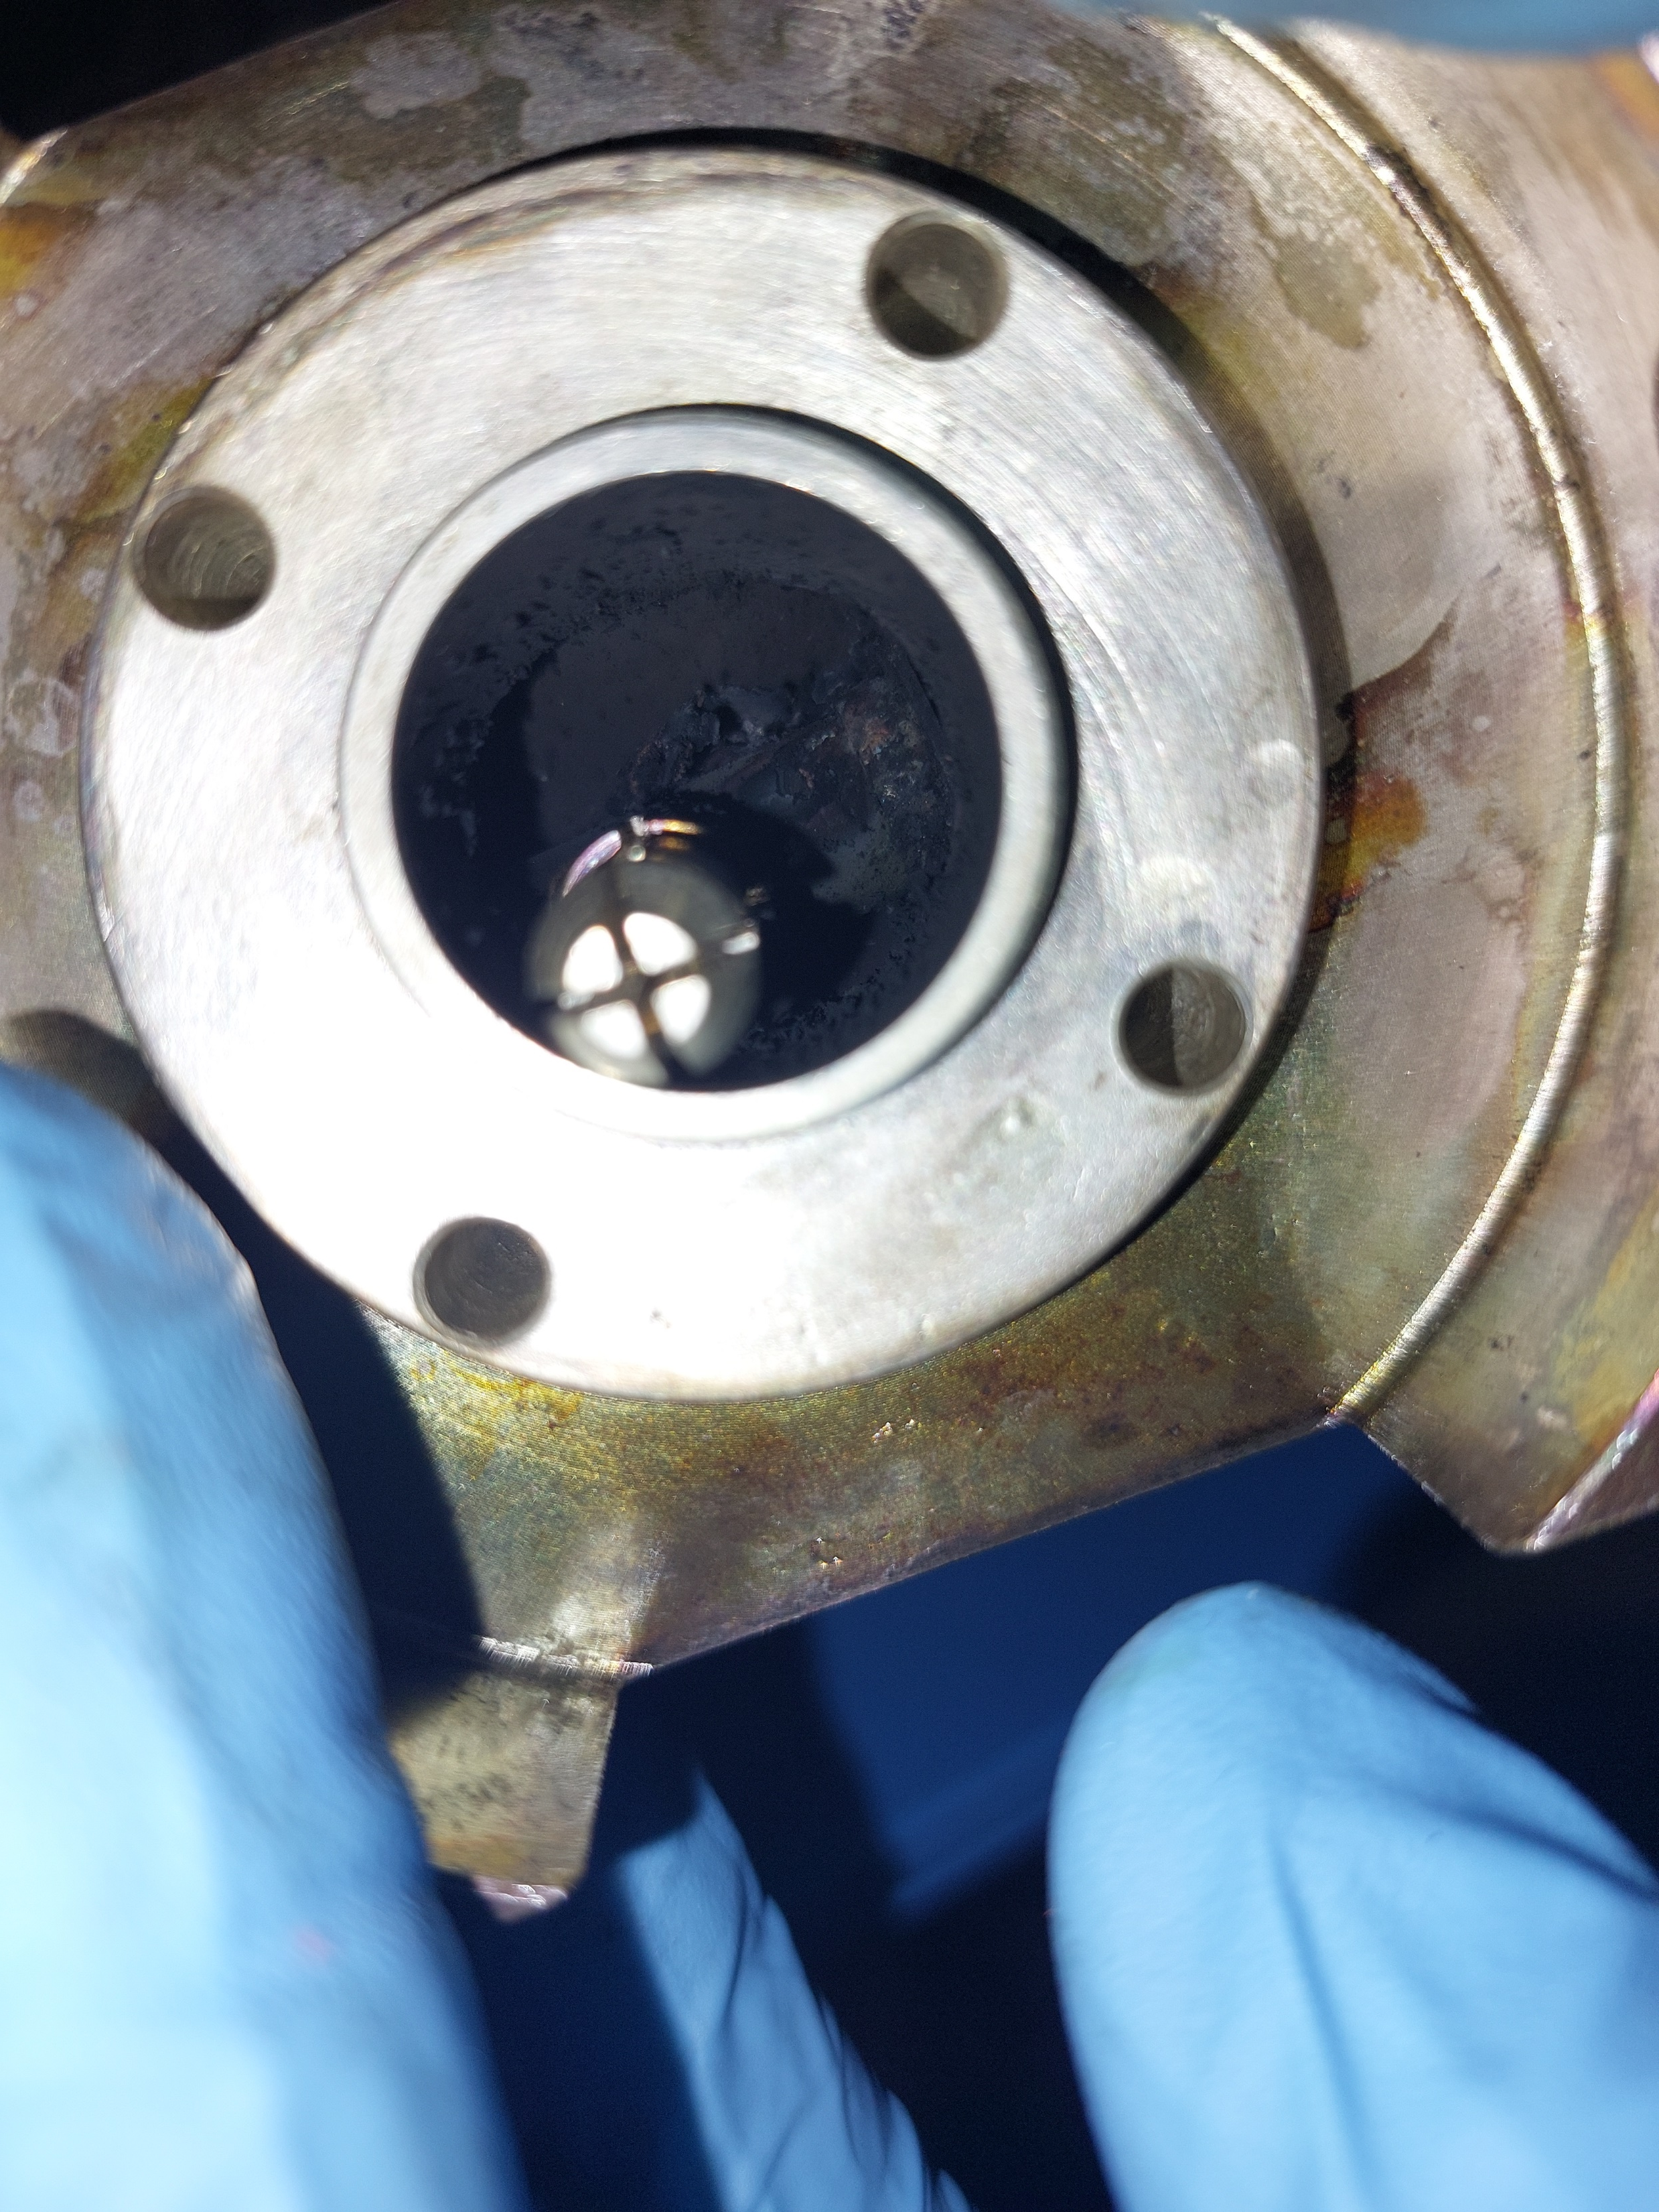

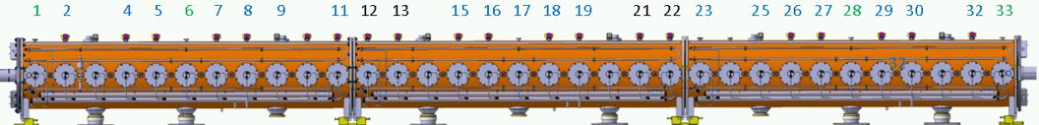
938 MHz HOM failure in SPS 200 MHz TWC
First one (11/07/2024) with vacuum problem due to crack in ceramic window during LHC filling preparation with 1.6e11 ppb
However, just before, we had 2.4e11 ppb at injection.
For details, see Giulia’s talk at IPP meeting: https://indico.cern.ch/event/1434561/contributions/6036246/attachments/2900059/5091949/20240719_IPP.pdf
Now (17/01/2025, again cavity 3):
no damage to the ceramic, but Teflon burned.
Pictures & illustrations from SY-RF-AC team

Slide 3
Measurement Requests/ Pending Requests/ Next IWG Topics
SY-ABT:
measurement of the MKP-L (spare magnet), after re-assembly.
MKDH status?
SY-BI:
Possibility to install the SPS-BGI into the LHC during YETS 25/26 for study purposes.
Next IWG(s):
Presentation of TCPC goniometer stabilities during 2024 Pb run (D. Mirarchi, re-scheduled);
Surface resistance and impedance effects of LESS processing for Q5 magnets (M. Himmerlich);
PSB Bypass Measurements and Status (J. Bento).

