Slide 1
ET Civil Engineering Roadmap for Phase 1 Context
Maria Marsella
Jonathan Bratanata

Slide 2
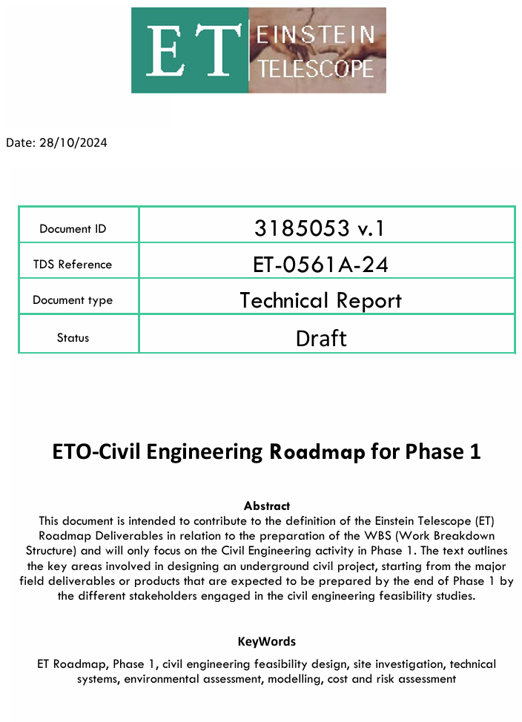
Objectives
Contribute to the overall ET roadmap
Identifying potential gaps and defining responsibility roles for (civil engineering related) deliverables
Assisting in coordinating activities with local teams involved in the site studies.
To be agreed upon not just by ETO, but also with the 2 (3?) local teams bidding for ET, both for the deliverables and also the non-aligned schedules of ETO, LTs & ET-PP
Clarification on the approach of ETO-ED with local teams is also needed.
https://edms.cern.ch/document/3185053/1

Slide 3
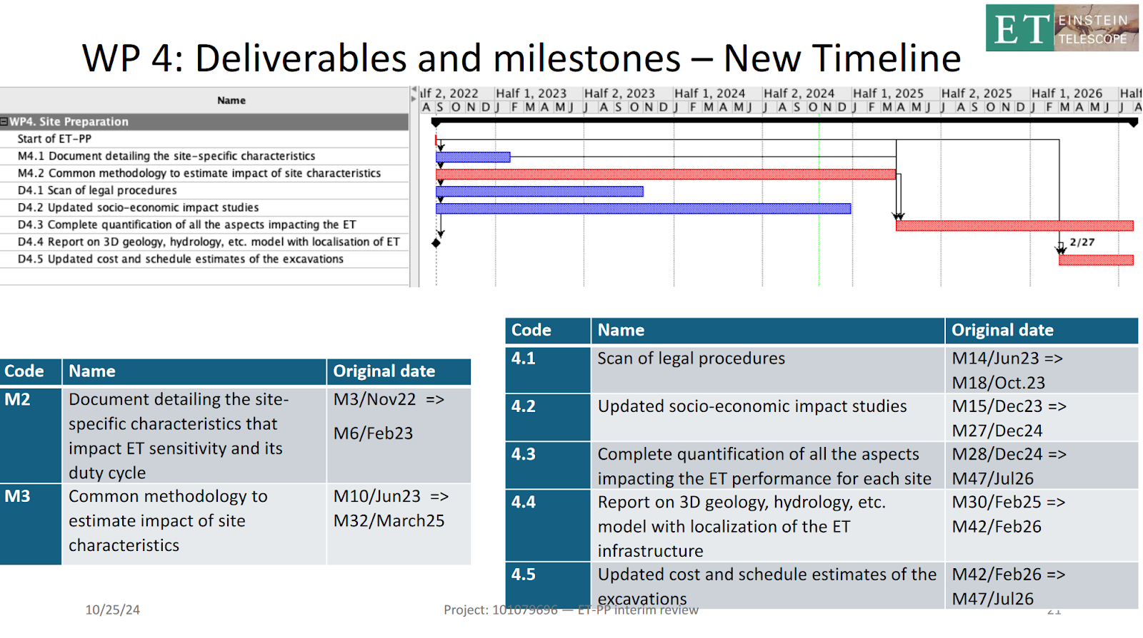
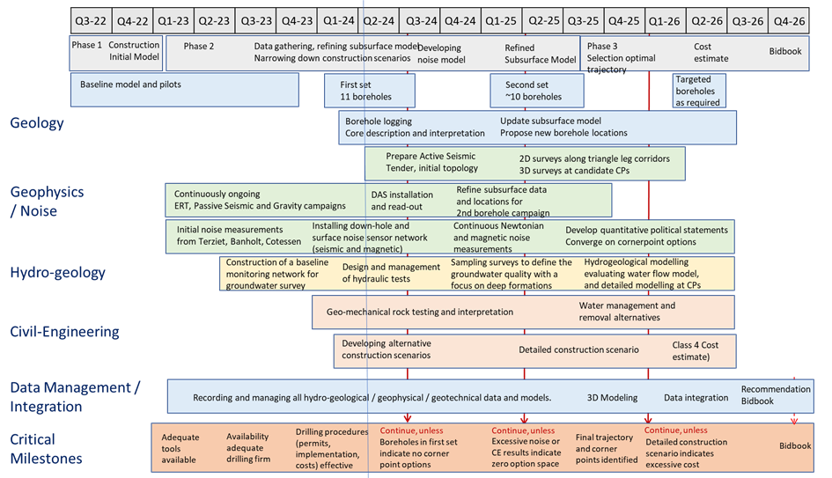
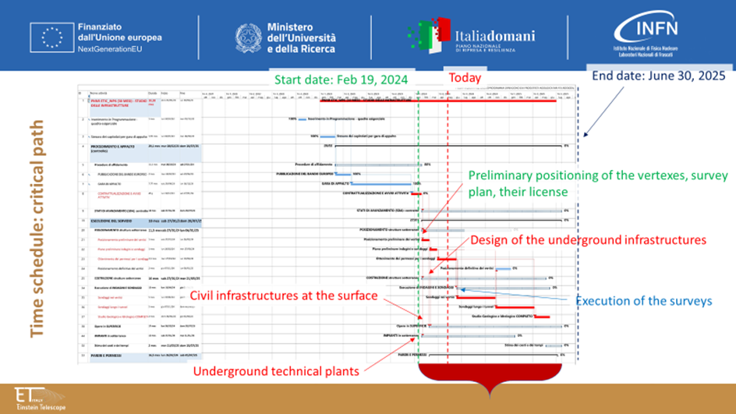
Timeline Discrepencies
Timeline |  | Dur (m) | 2022 |  | 2023 |  |  |  | 2024 |  |  |  | 2025 |  |  |  | 2026
Activities |  |  | Q3 | Q4 | Q1 | Q2 | Q3 | Q4 | Q1 | Q2 | Q3 | Q4 | Q1 | Q2 | Q3 | Q4 | Q1 | Q2 | Q3 | Q4
EMR (Update May 2024)
 | Construction Initial Model
 | Data gathering, refining subsurface model
 | Narrowing down construction scenarios
 | Developing noise model
 | Refined subsurface model
 | Selection optimal trajectory
 | Cost estimate
 | Bidbook defined
TETI (Update May 2024)
 | PNNR ETIC_WP6 (30 MONTHS) - INFRASTRUCTURE STUDY | 22 |  |  |  |  |  |  |  |  |  |  |  |  | Extend
 | Programming - Requirements Framework | 1
 | Drafting of Tender Documents | 2
 | PROCEDURE AND PROCUREMENT (control) | 31 |  |  |  |  |  |  |  |  |  |  |  |  | Extend
 | Assignment Procedures | 12
 | STATES OF PROGRESS (SDA): contract | 19 |  |  |  |  |  |  |  |  |  |  |  |  | Extend
 | EXECUTION OF THE SERVICE | 19 |  |  |  |  |  |  |  |  |  |  |  |  | Extend
 | POSITIONING underground structures | 12
 | CONSTRUCTION underground structures | 17
 | Carrying out INVESTIGATIONS AND SURVEYS | 13
 | SURFACE Works | 18 |  |  |  |  |  |  |  |  |  |  |  |  | Extend
 | Underground SYSTEMS | 13
 | Estimation of Costs and Schedule | 2 |  |  |  |  |  |  |  |  |  |  |  |  | Extend
 | OPINIONS AND PERMISSIONS | 18 |  |  |  |  |  |  |  |  |  |  |  |  | Extend
End Jul 2026
Initially intended to have a better understanding of the current plan of events and deadlines tied to civil engineering activities for ET.
Then to agree upon deadlines of civil engineering related activities and deliverables.
Master schedule possible to be made?
EMR: End date 2026
Lusatsia: ?
TETI: End date Jun 2025 (now Oct 2025)

Slide 4
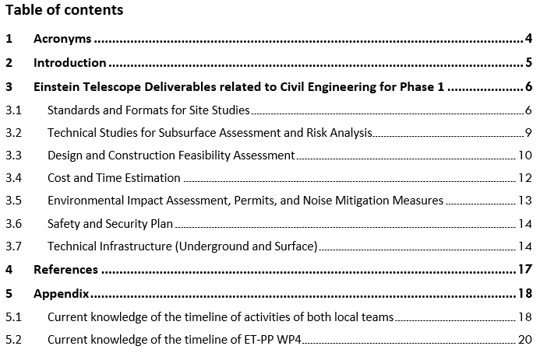
Logic behind the organization of the document
Grouping of the deliverables, partially work package/working group-based division, but subject to change if necessary, as many aspects are interrelated:
Standards and formats for site studies
Technical studies for subsurface assessment and risk analysis
Design and construction feasibility assessment
Cost and time estimation
Environmental impact assessment, permits, and noise mitigation measures
Safety and security plan
Technical Infrastructure (underground and surface)

Slide 5
Logic behind the organization of the document
Each deliverable is linked to key information, including
The responsible unit for tasks or WPs,
Target delivery dates, which are not final and subject to change as new information regarding the timelines of ETO, ET-PP, and the local teams are agreed upon and inconsistencies are sorted out
Necessary intermediate actions,
prerequisites/required inputs, and
its correspondence with the potential WBS element (work in progress in ETO-PO).
Standards and Formats for Site Studies
Deliverable |  | Responsible Unit-Dept | Target Delivery Date | Intermediate actions | Prerequisite/ Input | Corresponding WBS Element
3.1.1 | Standards for data exchange formats, BIM Modelling guidelines, and ET Modelling Coordination including process for model changes and updates | ETO-CE | Q4 2024 | Consultation with ET-PP WP8 | Confirmed alignment with ET-PP WP8 | 3
… | … | … | … | … | … | …

Slide 6
Standards and formats for site studies
Standards and Formats for Site Studies
Deliverable |  | Responsible Unit-Dept | Target Delivery Date | Intermediate actions | Prerequisite / Input | Corresponding WBS Element
3.1.1 | Standards for data exchange formats, BIM Modelling guidelines, and ET Modelling Coordination including process for model changes and updates | ETO-CE, ETO-PO-QA | Q1 2025 | Consultation with ET-PP WP8 | Confirmed alignment with ET-PP WP8 | 3
3.1.2 | Model-based analysis methods (Cost estimation/verification, GIS-BIM combination, Take offs, …) | ETO-CE | Q1 2025? | ? | ? | 2.2
3.1.3 | Validation procedures/review procedures | ETO-PO, ETC (science case) | Q2 2025? | Consultation and approval from ETO needed before delivering any docs | ETO approval and ETC | 3
3.1.4 | Cost standards and validation methodology (CE related only) | ETO-CE | Q4 2024 | Ref.doc on methodology | CERN-CE MOU alignment with ETO-PO | 7
3.1.5 | Risk standards and validation methodology (CE related only) | ETO-PO and ETO-CE | Q2 2025? | Ref.doc on methodology; has to be integrated in the general methodology | CERN-CE MoU specifically for geohazards? local & intl. code compliant | 10, 5
3.1.6 | Preliminary TDR CE underground infrastructure (from PBS ?) | ETO- CE | Q4 2026 | Overall agreement on the methodology is needed | PBS is fully reviewed sept. 24 CERN-MOU | 2.2
3.1.7 | Reference schedule for preparation, construction, and implementation of CE works (ROADMAP) | ETO-PO and ETO-CE | Q1 2025 | Alignment with LTs schedules. | LT acceptance | 3
3.1.8 | Process for changes request of detector configuration | ETO-PO | Q4 2024 | On-going informally | ETC-ISB approval | 3
3.1.9 | ET reference detector layout(s) | ETC and ETO | Ref. detector layout - triangle: Q4 2024? 2L: Q1 2025? | Ref. Detector layout in collaboration with ETC | Ref. optical layout, ETC collaboration | 2.2, 9
3.1.10 | ET baseline civil infrastructure layout | ETO | Baseline civil infrastructure layout Q4 2026? | Ref. Technical Infrastructure layout | ETC input, configuration decision has been made | 2.2, 9
Standardize the modelling work methodology for the ET engineering group and to prevent issues related to model compatibility and coordination
With the initial aim to aid the ET taskforce work
High priority/urgency, since it is a bottleneck in the delivery process of any other document from ETO
Common methodology for attributing the maturity level of the CE design and subsequent cost estimation
Connected to risk campaign conducted by ETO-PO
To include (among other things) the comparison of the design of all bidding sites. Timeline to be discussed further
Overall ET roadmap related to civil engineering deliverables
Currently “taken over” by ET Taskforce?
Timeline to be discussed further
Timeline to be discussed further

Slide 7
Technical studies for subsurface assessment and risk analysis
Technical Studies for Subsurface Assessment and Risk Analysis
Deliverable |  | Responsible Unit | Target Delivery Date | Intermediate actions | Prerequisite/ Input | Corresponding WBS Element
3.2.1 | Data collection & surface surveying | LT | Q4 2025(TETI) / Q4 2026(EMR) | Conducted by LTs with WP4 coordination | Input from WP4 | 8.2
3.2.2 | Borehole campaigns at potential vertex locations | LT | Q4 2025(TETI) / Q4 2026(EMR) | Conducted by LTs with WP4 coordination | Input from WP4 | 8.2
3.2.3 | Borehole campaigns at potential tunnel locations | LT | Q4 2025(TETI) / Q4 2026(EMR) | Conducted by LTs with WP4 coordination | Input from WP4 | 8.2
3.2.4 | Prospection and laboratory testing report | LT | Q4 2025(TETI) / Q4 2026(EMR) | Conducted by LTs with WP4 coordination | Input from WP4 | 8.2
3.2.5 | 3D geological and hydrogeological model | LT | Q4 2025(TETI) / Q4 2026(EMR), 02/2026 (WP4) | Conducted by LTs with WP4 coordination | Input from WP4 | 8.2
3.2.6 | Geotechnical Interpretive Report | LT | Q4 2025(TETI) / Q4 2026(EMR) | Conducted by LTs with WP4 coordination | Input from WP4 General ET layout Reviewed by CERN (CE MOU) | 8.2
Separate activities usually with/without their own separate reports, leading to the end product of the site characterization chapter in the “bidbook” and/or a GIR (or equivalent) for engineering purposes
Geotechnical Interpretive Report (GIR) or equivalent: A factual report on geophysical and geotechnical site investigation along with the data interpretation, and the associated field investigations and laboratory tests. In this case, it acts as a summary and conclusion of the previous deliverables within this section.

Slide 8
Design and construction feasibility assessment
Design and Construction Feasibility Assessment
Deliverable |  | Responsible Unit | Target Delivery Date | Intermediate actions | Prerequisite/Input | Corresponding WBS Element
3.3.1 | Report on positioning/Location Scenarios of underground design (Triangle and 2L) | LT | Q4 2025(TETI) / Q4 2026(EMR) | Conducted by LTs | Requirements, General ET layout | 2.2, 9
3.3.2 | Drawings and conceptual design of underground structure (including resulting surface structures) for: 1. Caverns, 2. Tunnels, 3. Intersurface connections (access tunnels/shafts, boreholes, etc.), 4. Technical rooms, 5. Dewatering, 6. Emergency exits, 7. Monitoring systems, 8. Other auxiliary structures | LT | Q4 2025(TETI) / Q4 2026(EMR) | Conducted by LTs | Requirements, ET reference layout, defined requested minimum level of detail | 2.2, 9
3.3.3 | Report on optimised construction solutions for the underground facility | LT, in consultation with ETO-ETC | Q4 2025(TETI) / Q4 2026(EMR) | Conducted by LTs | Requirements, General ET layout | 2.2, 9
3.3.4 | Logistics plan during construction including: 1. Layout of the construction site(s), 2. Personnel, 3. Flow of equipment and material, 4. Transportation of structural components from surface to underground site level | LT | Q4 2025(TETI) / Q4 2026(EMR) | Conducted by LTs | ED input needed | 2.2, 9
3.3.5 | Construction risk assessment | LT | Q4 2025(TETI) / Q4 2026(EMR) | Conducted by LTs | ETO inputs | 2.2, 3.5, 9, 10
3.3.6 | Specific reports on the feasibility of construction solutions able to mitigate level of noise | LT, in consultation with ETO-ETC | Q4 2025(TETI) / Q4 2026(EMR) | Conducted by LTs | ISB input needed, ET-PP WP4/SCB | 2.2, 9
Report on positioning, including showing the compliance with all the needed local requirements to host and strategy to build ET at the location
Level of detail according to the specified maturity level.
Compliant with all relevant local/international standards/best practices
Explanation and justification for changes made to the reference layouts released by ETC/ETO. Tied to 3.3.1.
Any during construction plans which are tied to the local studies are the responsibility of the local teams (phase 1)
Any specific alterations done to meet the required sensitivity/noise budget, tied to 3.3.1 and 3.3.3

Slide 9
Cost and time estimation
Cost and Time Estimation
Deliverable |  | Responsible Unit | Target Delivery Date | Intermediate actions | Prerequisite/Input | Corresponding WBS Element
3.4.1 | Cost estimation report for the construction of underground and surface facilities | LT, ET-PP WP4, in consultation with ETO | Q4 2025(TETI) / Q4 2026(EMR), 07/2026 (ET-PP WP4) | Conducted by LTs with ET-PP WP4 coordination | Defined requested minimal level of detail | 7.4
3.42. | Scheduling for construction underground and surface facilities (preparation, construction and implementation) | LT, ET-PP WP4, in consultation with ETO | Q4 2025(TETI) / Q4 2026(EMR), 07/2026 (ET-PP WP4) | Conducted by LTs with ET-PP WP4 coordination |  | 3
3.4.3 | Scheduling for civil works permitting (authorizations, expropriations, and easements) | LT, ET-PP WP4, in consultation with ETO | Q4 2025(TETI) / Q4 2026(EMR), 07/2026 (ET-PP WP4) | Conducted by LTs withET-PP WP4 coordination | Ref. ET-PP WP4 | 3
Cost estimation based/compliant with a common methodology for a minimal level of maturity level of the CE design
Estimated scheduling of construction works

Slide 10
Environmental impact assessment, permits, and noise mitigation measures
Environmental Impact Assessment, Permits, and Noise Mitigation Measures
Deliverable |  | Responsible Unit | Target Delivery Date | Intermediate actions | Prerequisite/Input | Corresponding WBS Element
3.5.1 | Land development strategy accomplishing local urban planning and land use/zoning | LT | Q4 2025(TETI) / Q4 2026(EMR) | Conducted by LTs | Bid book defined | 6
3.5.2 | Excavation material treatment and management plan (feasibility) | LT | Q4 2025(TETI) / Q4 2026(EMR) | Conducted by LTs | ET-PP WP9 strategy | 6
3.5.3 | Cultural heritage preservation report | LT | Q4 2025(TETI) / Q4 2026(EMR) | Conducted by LTs | Bid book defined | 6
3.5.4 | Assessment of noise levels and mitigation strategy (e.g. construction typologies, buffer zones) | LT | Q4 2025(TETI) / Q4 2026(EMR) | Conducted by LTs | SCB input | 6
3.5.5 | Environmental impact assessment and management (water treatment, gas emission, habitats, and ecosystems protection) | LT | Q4 2025(TETI) / Q4 2026(EMR) | Conducted by LTs | ET-PP WP9 strategy | 6
3.5.6 | Strategy for connections to public networks & utilities | LT | Q4 2025(TETI) / Q4 2026(EMR) | Conducted by LTs |  | 6
3.5.7 | Environmental risk assessment | LT/ETO | Q4 2025(TETI) / Q4 2026(EMR) | Conducted by LTs & ETO | ET-PP WP9 strategy | 6
3.5.8 | Legal studies for site construction permitting | LT | Q4 2025(TETI) / Q4 2026(EMR) | Conducted by LTs | ET-PP WP4 | 6
3.5.9 | Long term assessment and sustainability plans, including: 1. Lifespan evaluation, 2. Resilience and Climate Adaptation, 3. Maintenance costs analysis (structural), 4. Plan to accommodate potential future upgrades | ETO | Q4 2025(TETI) / Q4 2026(EMR) | CERN model | ET-PP WP9 | 6
Related to 3.3.1, showing the compliance with all the needed local requirements to host and strategy to build ET at the location
Site independent and site specific aspects
Tied to ET-PP WP9 deliverable. Certain aspects might be connected to LTs’ responsibilities

Slide 11
Safety and security plan
Safety and Security Plan
Deliverable |  | Responsible Unit | Target Delivery Date | Intermediate actions | Prerequisite/Input | Corresponding WBS Element
3.6.1 | Strategy on safety and security during construction | LT, eventually a separate dedicated department within ETO | Q4 2025(TETI) / Q4 2026(EMR) | LT prepare site-dep. plan | ED defines standards | 5
3.6.2 | Strategy on safety and security during operation | ETO-ED, eventually a separate dedicated department within ETO | Q4 2026 | LT prepare site-dep. plan (if necessary) | Acquisition of required expertise | 5
3.6.3 | Risk assessment and mitigation (impact on performance, cost, schedule) | LT, ETO | Q4 2025(TETI) / Q4 2026(EMR) | LT prepare site-dep. plan | ED defines standards | 10
3.6.4 | Planning of mitigating measures | LT, ETO | Q4 2025(TETI) / Q4 2026(EMR) | LT prepare site-dep. plan | ED defines standards | 5, 10
Concerning activities during construction, tied to local/international safety regulations/standards
Concerning activities during operation; ETO to set the safety standards for operation (in addition to local/international safety regulations/standards

Slide 12
Technical Infrastructure (underground and surface)
Technical Infrastructure (Underground and Surface)
Deliverable |  | Responsible Unit | Target Delivery Date | Intermediate actions | Prerequisite/Input | Corresponding WBS Element
3.7.1 | Cooling and ventilation: Design and integration – technical reports and drawings Design technical solution for HVAC of surface and underground; Design technical solution for (water) cooling of surface and underground; Integration with the infrastructure design; Underground installation plan; CFD simulations and fluid flow analysis. | ETO | Q4 2026? Q3 2027 | LTs to coordinate and adjust for site specific solution/layout | CERN MOU | 2.2
3.7.2 | Electrical Engineering: Design and integration – technical reports and drawings: First Single Line Diagram design (HV / MV / LV distribution); Develop AC grid solution, evaluation DC option (if necessary); Study compact surface sub-stations; Study connection to public HV grid; Study energy storage requirements regarding renewable energy supply and networks stability; First integration model for underground and surface areas; Cabling and FO routing; CAPEX / OPEX modelling. | ETO | Q4 2026? Q3 2027 | LTs to coordinate and adjust for site specific solution/layout | CERN MOU | 2.2
3.7.3 | Access and Alarms: Design and integration – technical reports: Identify all the prevention and mitigation barriers or systems to be implemented; Document safety requirements; Document safety solutions. | ETO-ED | Q4 2026? Q3 2027 | LTs to coordinate and adjust for site specific solution/layout | CERN MOU | 2.2, 3.5, 5.3, 10
3.7.4 | Occupational Health and Safety: Design and integration – technical reports: Underground risk assessment Fire Safety Concept report: Partitioning and smoke extraction; Smoke / leak detection report Evacuation concept report; Implosion risk assessment report. | ETO-ED | Q4 2026? Q3 2027 | LTs to coordinate and simultaneously work on (for site specific aspects)/adjust for site specific solution/layout | CERN MOU | 2.2
3.7.5 | Evaluation of requirements related to technical infrastructure technical report | ETO-ED | Q4 2026? Q3 2027 |  | CERN MOU | 2.2
3.7.6 | Validation of cost, planning, and risks for technical infrastructure technical report | ETO-ED | Q4 2026? Q3 2027 |  | CERN MOU | 3.5, 5, 7.4, 10
3.7.7 | Preliminary Technical Infrastructure TDR, including (but not limited to): HVAC chapter Electrical chapter Access and Alarms chapter Safety chapter | ETO-ED | Q4 2026? Q3 2027 |  | CERN MOU | 2.2
Tied to MOU with CERN regarding technical infrastructure.
Timeline and plan moving forward to be discussed further

Slide 13
Thanks!

Slide 14
Discussion points (tbc)
  Identify a reference person from CERN, ETO, EMR, and TETI for each deliverable.
  How to further develop the document
  Understand how to define the level of details
  Address content and timeline inconsistencies and possible solutions
  Establish a tool for tracking the status of documents
  Agree on the method for effective information sharing among team members
  Define the procedure for submitting and handling change requests
Identify and internal review Board
Assign responsibilities and schedule follow-up meetings to monitor progress.

