Slide 1
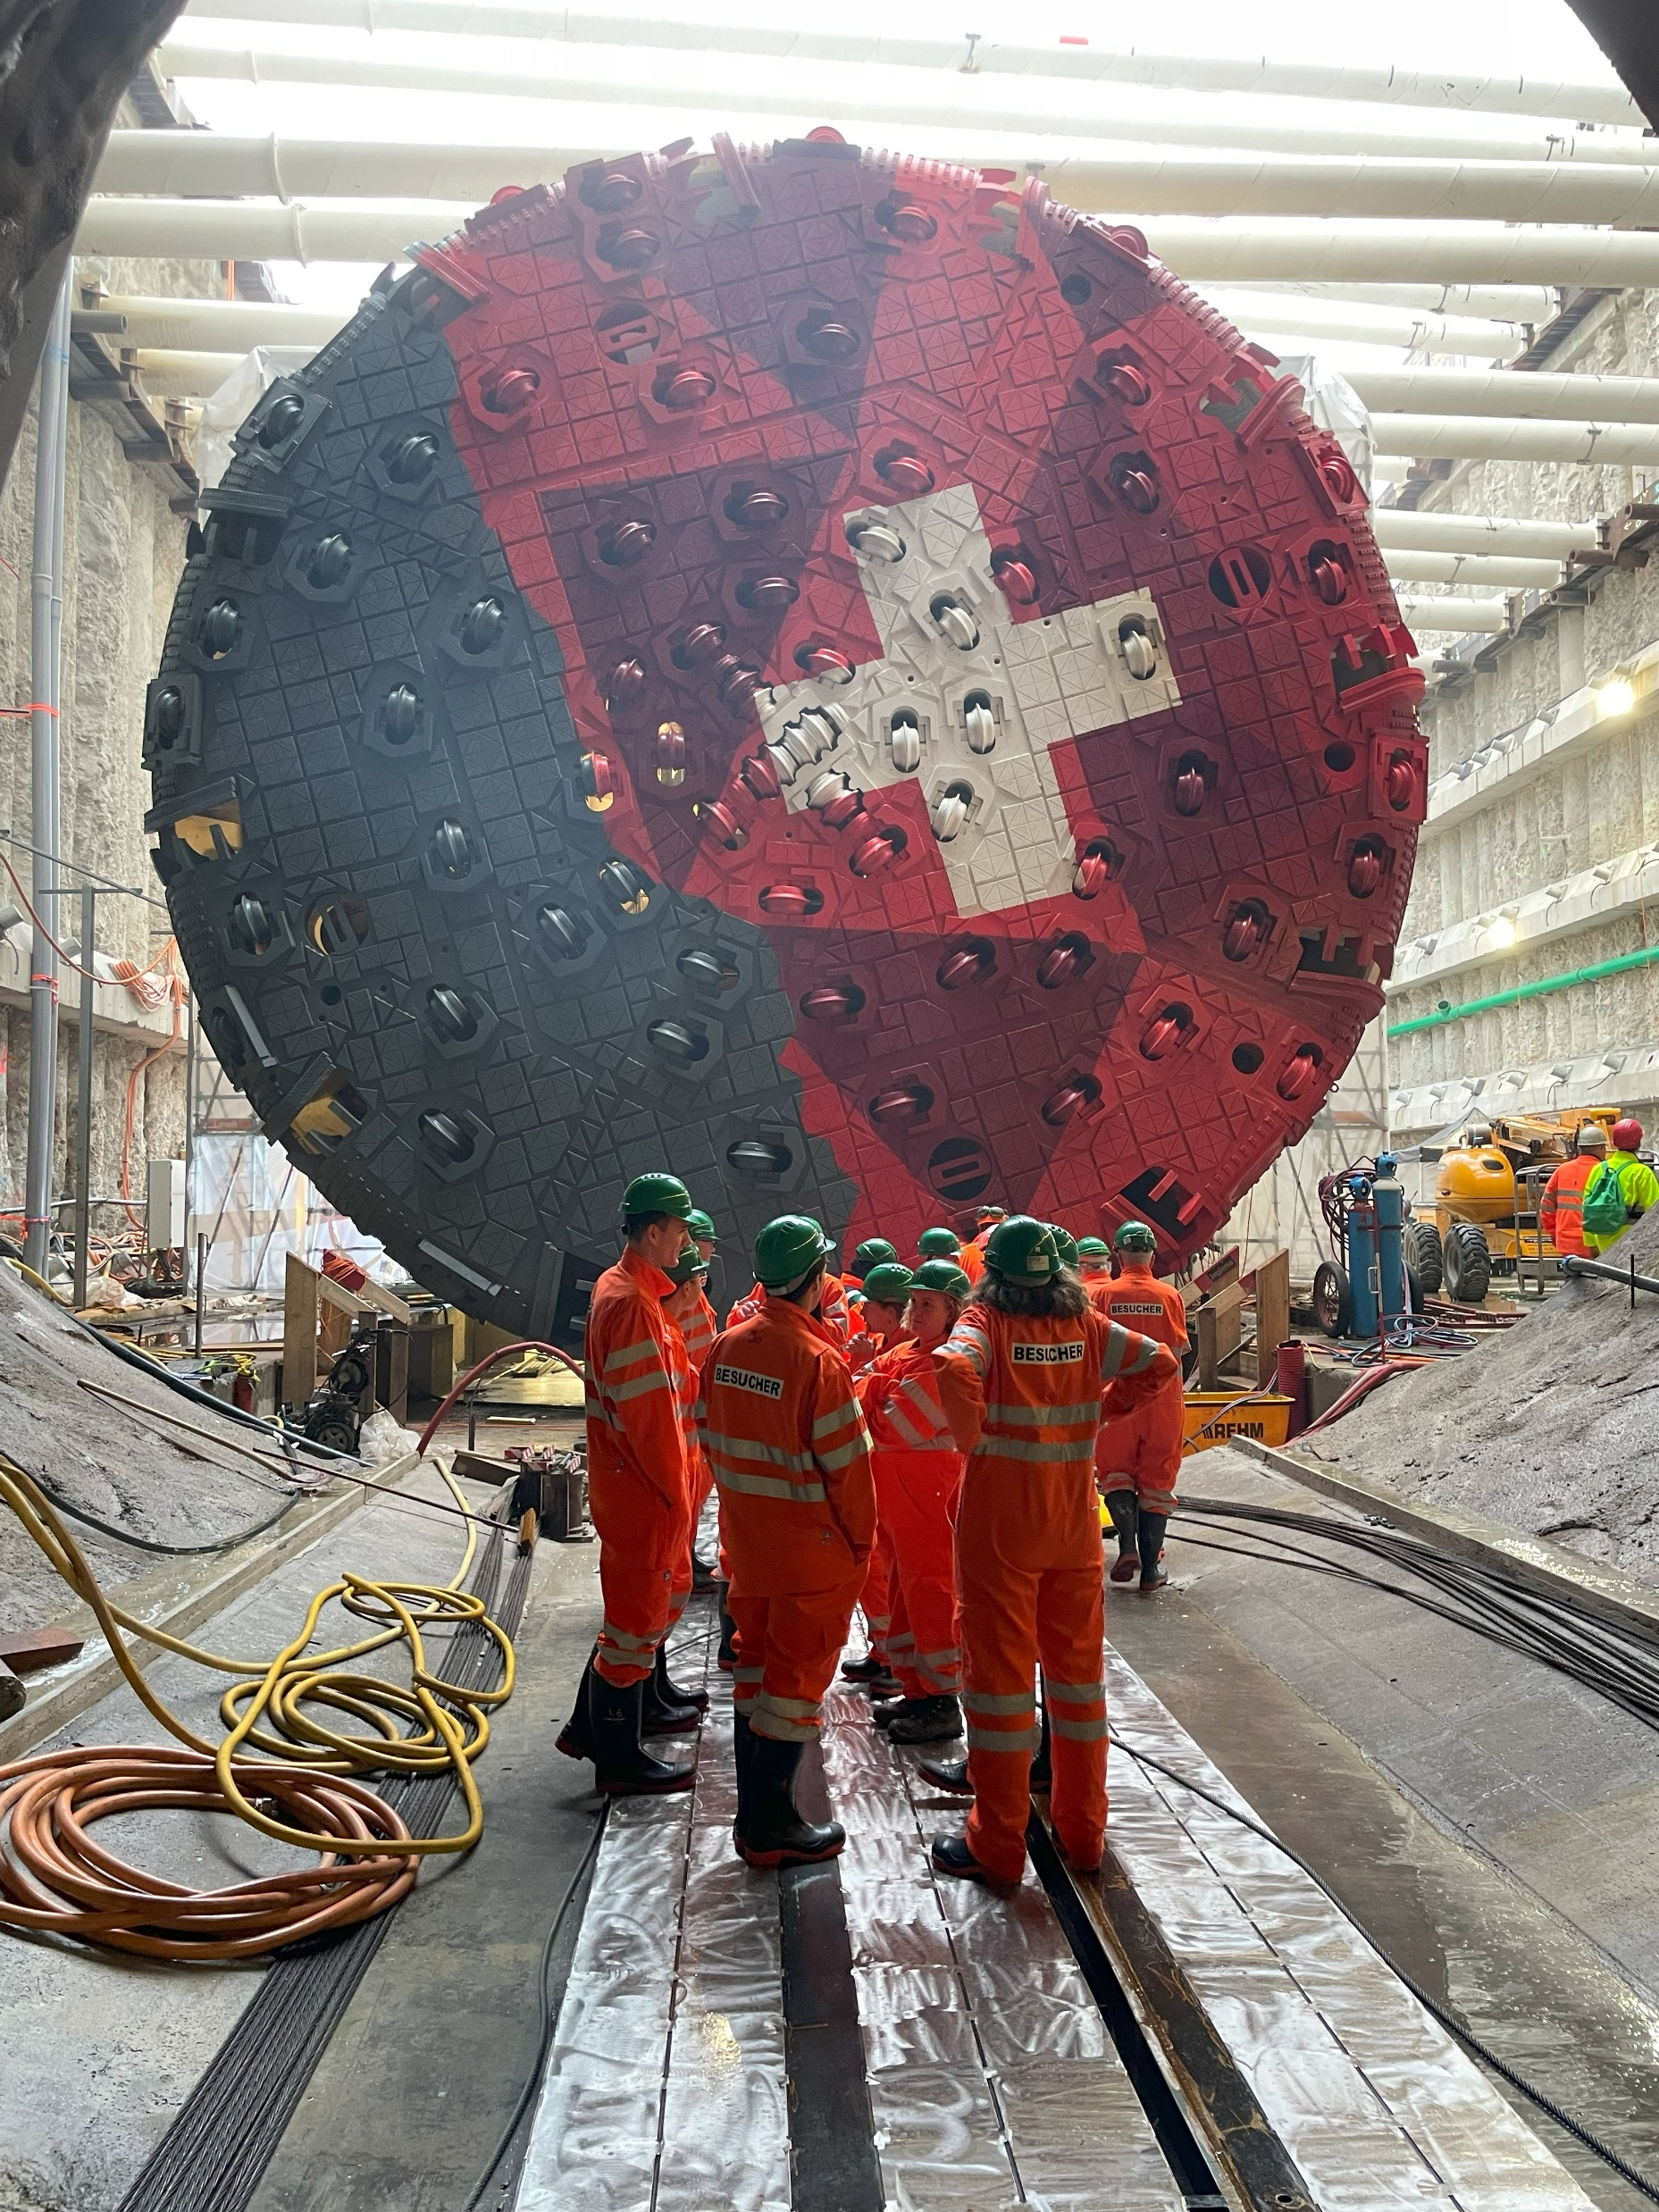

Einstein Telescope
ET-PP WP5 - December 19, 2024
Comments/Links and inconsistencies on Roadmap Phase 1 vs Technical Infrastructure and Safety
Patrick Werneke
ETO-TETO-EMR-CERN Civil Engineering Meeting
CERN, January 14, 2025

Slide 2
Einstein Telescope
ET-PP WP5 - December 14, 2024
Comments/Links and inconsistencies vs Technical Infrastructure
“Issue on 'master planning' (planning across all institutions and responsibilities).” (EMR):
In order to create parts 3.3 to 3.6 as a Local Team, prerequisites/input are needed from the deliverables of part 3.1.1 and 3.7. Deliverables from 3.1.1 and 3.7 must be ahead in time. The Target Delivery Date for 3.7 should be no later than Q3 2025 and actually as soon as possible from today.
In this draft version, the Delivery Date is at the same time as sections 3.3 through 3.6. This inconsistency leads to an unfeasible ‘master planning’. If – as an example - ET baseline civil infra layout from ETO is 2026, then bid book EMR should be somewhere in 2027 to allow modifications on ETO baseline in Q4 2026.
This also requires that the ambition from §3.7.7 should be concept design instead of preliminary design.
Another not unimportant point in that regard is that in the opinion of the EMR, the Target Delivery Date of 07/2026 for cost estimation and scheduling leaves no more room for adjustments in the TETI and EMR documents

Slide 3
Einstein Telescope
ET-PP WP5 - December 14, 2024
Comments/Links and inconsistencies vs Technical Infrastructure
“Issue on level of detail for a feasibility phase.” (EMR)
In order to create parts 3.3 to 3.6 as a Local Team, prerequisites/input are needed from the deliverables of part 3.1.1 and 3.7. Deliverables from 3.1.1 and 3.7 must be ahead in time. The Target Delivery Date for 3.7 should be no later than Q3 2025 and actually as soon as possible from today.
Central question is: why delivering so many drawings and models for a feasibility study? It costs a lot of money and brings a very limited added value for the feasibility phase.
Examples:
  3.7.1 Cooling and ventilation: description is very detailed for a feasibility study. What is the point? CFD simulations! Some demands are typical for detailed design.
  §3.7.2 Electrical engineering: description is very detailed for a feasibility study. What is the point? Some demands are typical for detailed design, not for a concept design.

Slide 4
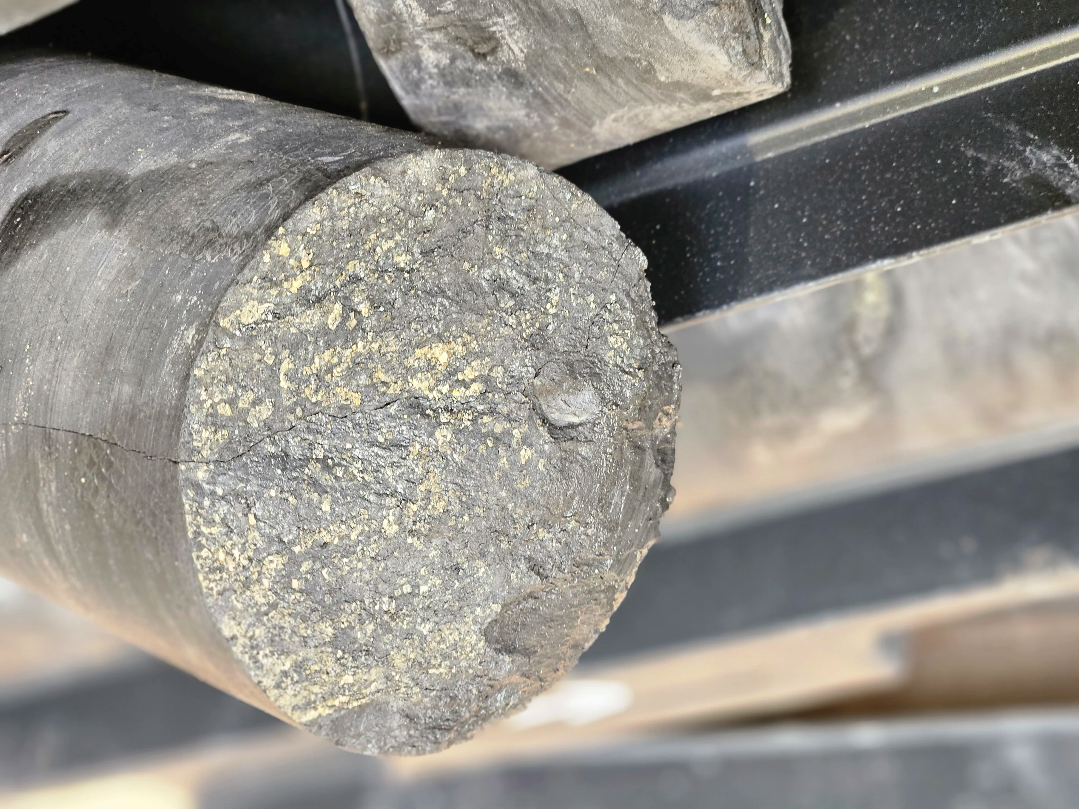
Einstein Telescope
ET-PP WP5 - December 14, 2024
Comments/Links and inconsistencies vs Technical Infrastructure
“Issue on 'master planning' (planning across all institutions and responsibilities).”
The Civil Engineering and Technical Infrastructure are on different timelines due to two different collaboration agreements with CERN:
  ETO Civil Engineering pre-TDR: Q4 2026
  ETO Technical Infrastructure and Safety pre-TDR: Q3 2027
Technical Infrastructure and Safety agreement finalized and will be
signed soon: start will be April 1st. :i.e. hiring the persons
Consequences of the different timelines are not yet discussed
with ETO directors.

Slide 5
Einstein Telescope
ET-PP WP5 - December 14, 2024
Comments/Links and inconsistencies vs Technical Infrastructure
“Issue on 'master planning' (planning across all institutions and responsibilities).”
What should we do?
Forget about the implications of Technical Infrastructure for now. Assume will be no problem for the civil infrastructure: assume we have enough space for cables and piping.
A very low level basic concept design be presented Q2/Q3 2026 may be possible?
  Will this be helpful for LT’s?
  Do we expect major changes due to TI and Safety?
    Issues could be: escape routes, additional shafts, sizes, at the surface?

Slide 6
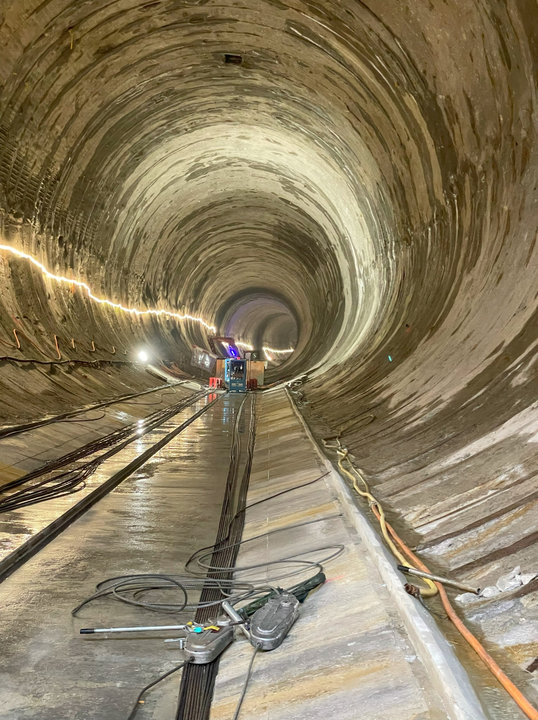
Einstein Telescope
ET-PP WP5 - December 14, 2024
Comments/Links and inconsistencies vs Technical Infrastructure
“Issue on level of detail for a feasibility phase.” (From EMR)
Cooling and ventilation: source of noise (acoustic, thermal, Newtonian)
Have to follow the CERN standard program for hiring flexible personnel (fellows)
CERN will provide help writing pre-TDR chapters
Uncertainty if the contract can be extended after 2027/2028: HL-LHC – FCC
Safety may have a large impact on the civil infrastructure
We have the person power: FTE’s hired inside the CERN departments
  These persons could be working for ETO in the future

Slide 7
Einstein Telescope
ET-PP WP5 - December 14, 2024
Comments/Links and inconsistencies vs Technical Infrastructure
“Issue on safety and security.” (EMR)
ETO seems to see safety and security as a site dependent aspect while it probably will be site independent. ETO should formulate demands in relationship with these topics that should be followed by both EMR as TETI.
NOTE:
By formulating ‘LTs to adjust for local solution/layout’ it seems that issues as §3.7.3 Access and alarms / §3.7.4 Health & Safety are presented as an site dependent aspect. It should be posed as a requirement or starting point from ETO towards EMR and TETI.
3.7.3: please confirm that the expressions Document safety requirements and solutions is intended as a request to provide evidence of specific, local requirements that LTs will use as a reference. (TETI)

Slide 8
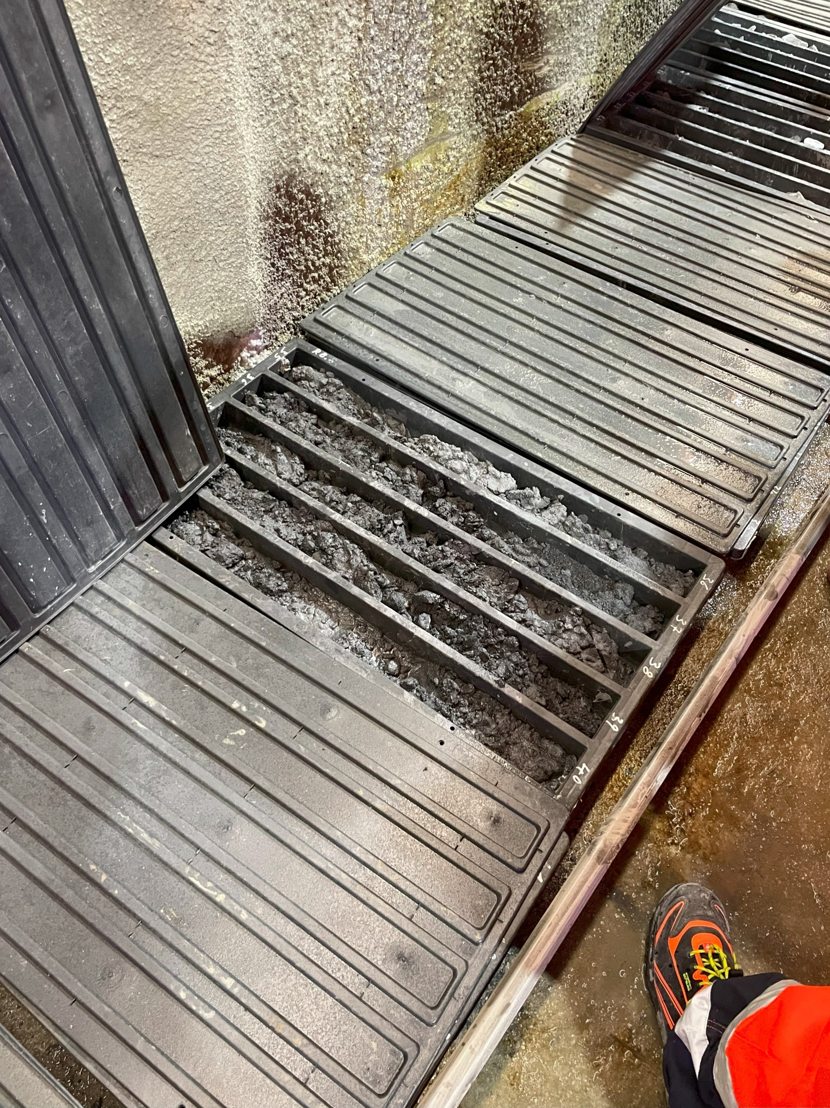
Einstein Telescope
ET-PP WP5 - December 14, 2024
Comments/Links and inconsistencies vs Technical Infrastructure
“Issue on safety and security.” (EMR)
“11) Page 11. Tasks 3.3.4 and 3.3.6. I do not believe in LT addressing these points alone.” Responsibilities for the correlated aspects must be identified in ETO-ETC (Variola EDMS)
Logistics plan during construction including: 1. Layout of the construction site(s), 2. Personnel, 3. Flow of equipment and material, 4. Transportation of structural components from surface to underground site level
“16) Page15. Task 3.7.4. Who will do it? This should be included in the
LT studies.”
Occupational Health and Safety

Slide 9
Einstein Telescope
ET-PP WP5 - December 14, 2024
Comments/Links and inconsistencies vs Technical Infrastructure
“Issue on safety and security.”
Responsible for Health and Safety at the construction site & environment: LT’s
  Follow EU Directives (92/57 and more)
Responsible for Health and Safety during installation and operation: ETO
  No ETO Occupational Health and Safety officer yet!
  Access and Alarms: solution for safety issues that cannot be mitigated!
  CERN safety agreement: fire safety, smoke and leak detection, evacuation, implosion
  Risk manager (ETO-PO)

Slide 10
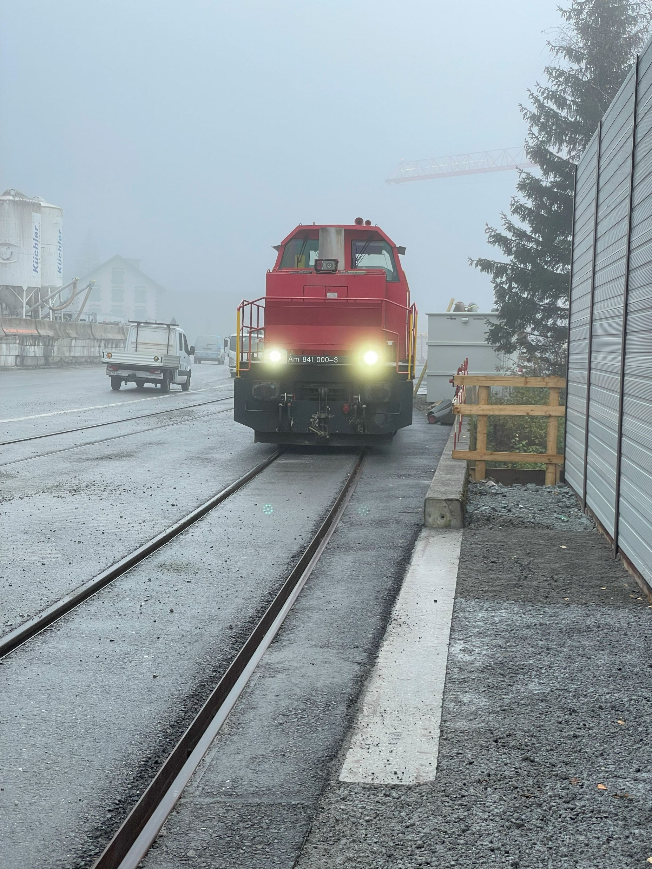
Einstein Telescope
ET-PP WP5 - December 14, 2024
Comments/Links and inconsistencies vs Technical Infrastructure
Conclusion:
Pre-TDR of the Technical infrastructure will be ready in Q3 2027!
What are the consequences of this delay and what information is
needed for LT’s?
Responsible for Health and Safety at the construction site & environment: LT’s
Responsible for Health and Safety during installation and operation: ETO

