Slide 1
EMR organization & progress
Facility Infrastructure & civil engineering
CERN - 14/01/2025

Slide 2
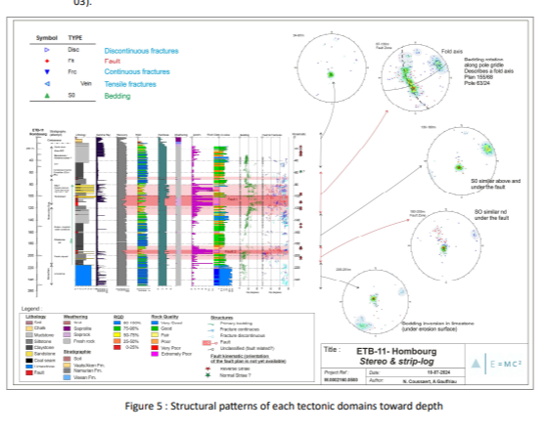
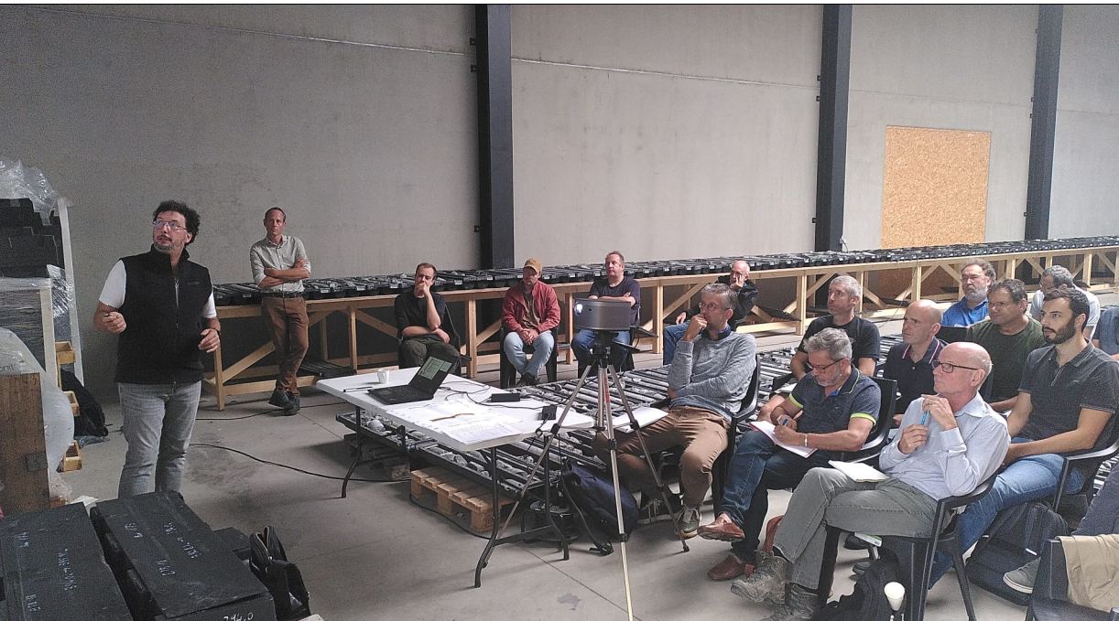
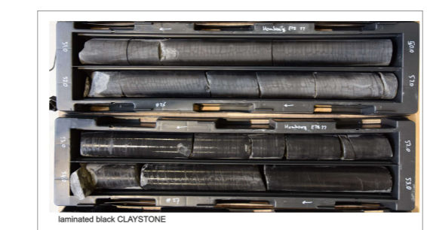
Defining subsoil conditions
First drilling campaign: Geotechnical core logging, still ongoing (7 from 11 reports ready)
Establish geotechnical criteria methodology
Launching seismic/noise campaign
Launching second drilling campaign

Slide 3
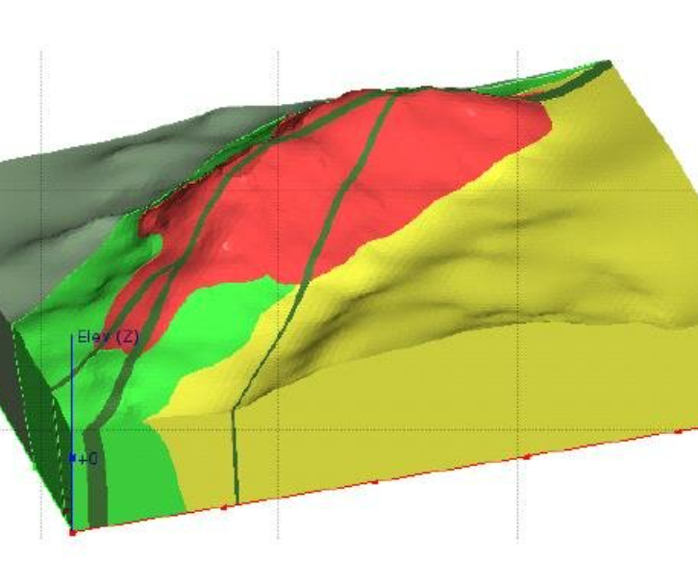
Evaluating subsoil conditions = basis for civil
Converting data into a geotechnical model, data from first boreholes used = ongoing
Starting with a comprehensive 3D model in LEAPFROG, incorporating data from hydro-geological, geological and studies on noise

Slide 4
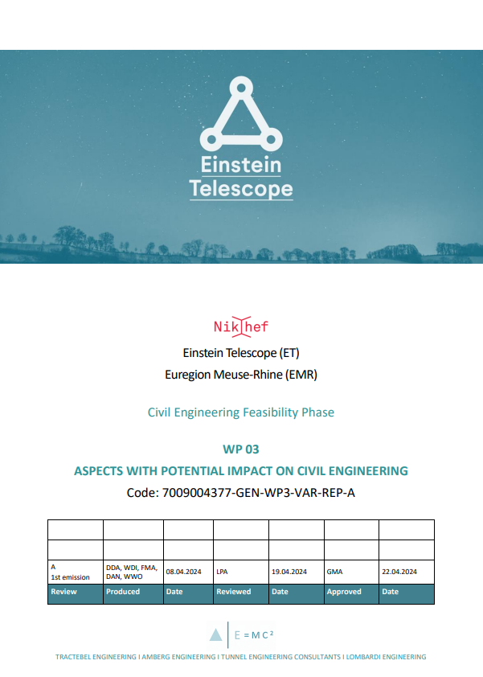
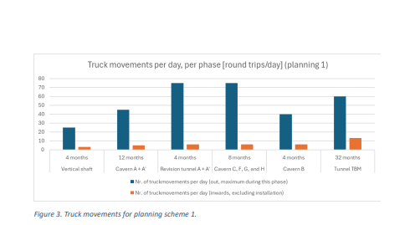
First steps – Facility Infrastructure & civil eng.
Defining activities necessary for feasibility & bid book
Establish risk management / mitigation approach and introduction into systems engineering
Review of the available geological and geotechnical data
Preliminary survey on construction logistics and impact on the region
Identifying aspects having potential impact on civil engineering
Establish contacts with stakeholders and coordinating alignment with ETO → basis of design

Slide 5
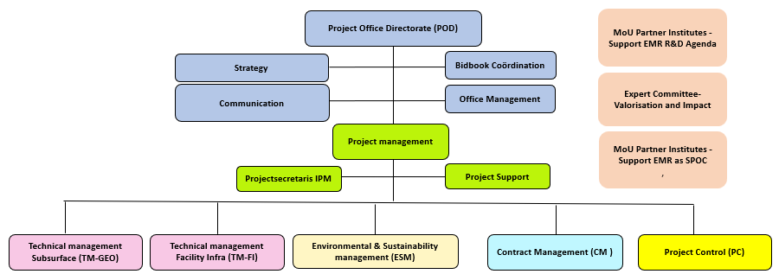
September 2024
Full IPM project organization established → addition of manager environment, manager Facility Infrastructure (civil engineering) and office manager
  Theo Reinders replaces Guid Bartholomée as Project Manager
Theo Reinders
Jacqueline ter Linden
Wim Walk
Joseph Ickmans
Johan Rutten
John Kerstjens
John Kerstjens

Slide 6
Approach Facility Infrastructure (civil eng.)
Focus on:
  Alignment with ETO/ETC and stakeholders → fixation starting points & criteria (alignment with detector specialists & minimize rework)
  Organize feasibility studies & necessary input for bid book
3 phases:
  Concept phase: Currently in finalization: establish roadmap (showstoppers/cost drivers/risks → priorities) & mobilizing full team on all relevant disciplines
  Assessment phase: 2 parallel actions resulting in a basis for bid book
    Design concept scenarios (expert judgement) for the relevant disciplines → modular approach
    Converging design criteria together with ETO/ETC and other stakeholders (local)
  Concept design phase: after fixation of main starting points (ETO & stakeholders), finalize concept design and provide input on bid book

Slide 7
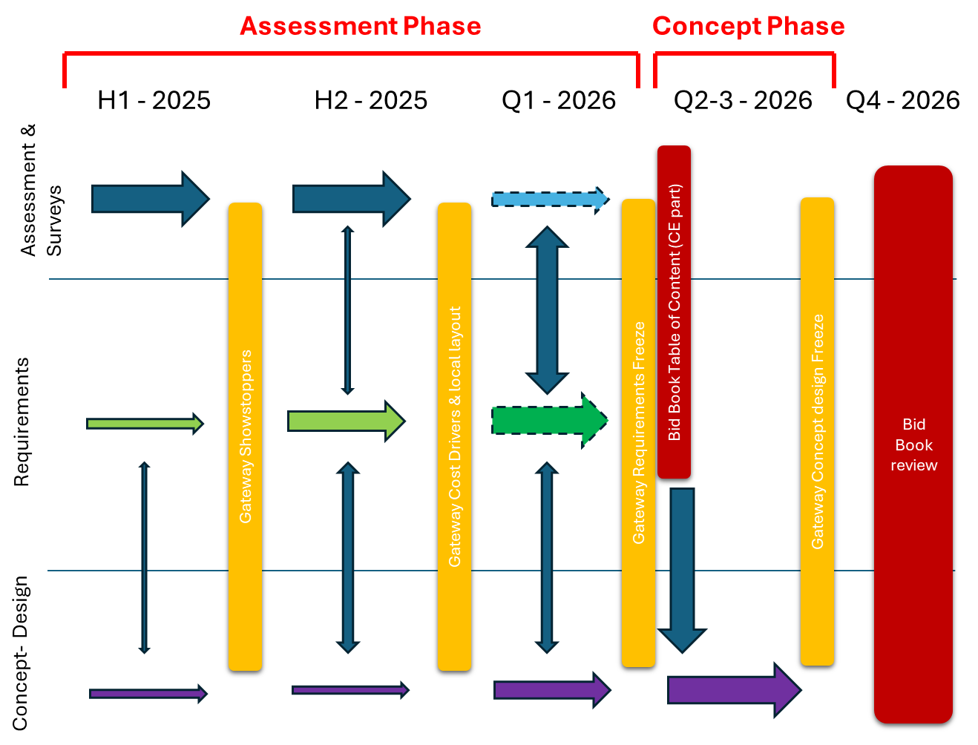
Timing Facility Infrastructure (only triangle)
Assumed time frame for internal review EMR

Slide 8
