Slide 1
Status and Progress since the last Meeting
Pablo Garcia Tello
7.3.2025, ISAB Meeting

Slide 2
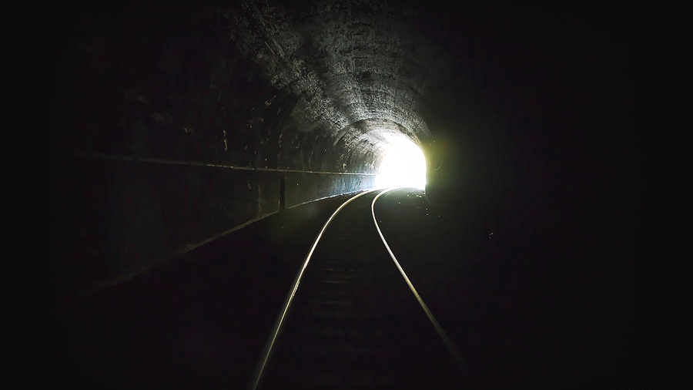

Slide 3
Three key aspects
The budget situation has improved.
We are better known among the Council Delegates.
Hard work led to an increasing demand for what we do.

Slide 4
Budget situation
The EC is relaunching in brief the call for ATTRACT 1B.
IPT is temporarily offering a little help.
More EU grant applications have been submitted.
We expect a sizable extra income form underspending at the end of ATTRACT Phase 2.

Slide 5
Council Delegates
Several Council Delegates have been invited and visited IdeaSquare (e.g. Spain, Estonia) and they are speaking about our added value in the CERN Council meetings.
The next CERN DG has visited IdeaSquare.
Along this year we will increase our efforts to bring more (e.g. NL, Germany is work in progress).
We have also good connections with the CERN ILO community which is passing the messages to our added value to the Council Delegates.

Slide 6
Increasing demand for what we do (1)
Our calendar for Educational activities 2025 is fully booked.
We are starting to book activities for 2026.
Since in 2024 we operated at 82% building occupation, we are offering to run our educational activities at the external organization’s premises as long as they afford our travelling expenses. This demand is increasing too.

Slide 7
Increasing demand for what we do (2)
NASA is fully interested in our education program IdeaSquare Planet (i2P). They are already collaborating with us.
The demand for prototyping and training courses is ramping up.
CIJ, among other achievements, has started the publication of the socio-economic studies coming from ATTRACT.
The number of followers in social media and their testimonials of our added value is increasing.

Slide 8



Some 2024 highlights
(more in the upcoming Activity Report)
Prototyping
Training for 68 CERN Personnel (3D printing and laser cutting).
Departments EP, SY, TE, IT, BE, EN.
Prototyping expertise offered to CMS, ALICE, LHCb, ISOLDE, ATLAS and ProtoDUNE.
2 FPGA courses (20 participants in total)
1 MediPix workshop with 18 participants.
Social Media
10k followers (18% growth in 2024).
5 social media platforms.
145 social media posts.
23 articles on the website.
3 issues of CIJ Journal (29 contributions published).
2 Books contributions (Springer and OUP).
4 delivered talks at the UN about social innovation.
4 Workshops/tours with Science Gateway.
Education and Training
488, students 13% increase from 2023.
19 Educational workshops on innovation.
21 weeks of students in house.
35 Innovation related events.
31 organizations sent students.
82% building occupation rate.

Slide 9
What about the future?
We have reached a period of relative budget stability; however, we need more EU projects than just ATTRACT 1B to consolidate this trend.
Will we get anything from the MTP?
It is reassuring that the demand for who we are, what we do, and how we do it, is on highly increasing demand.
Will the new management agree upon the fact that we already deliver value added to CERN and CERN MS?

Slide 10
Thanks and Questions

