Slide 1
IdeaSquare Educational Programmes
ISAB-G March 2025
Ole Werner, Catarina Batista, Laura Wirtavuori

Slide 2
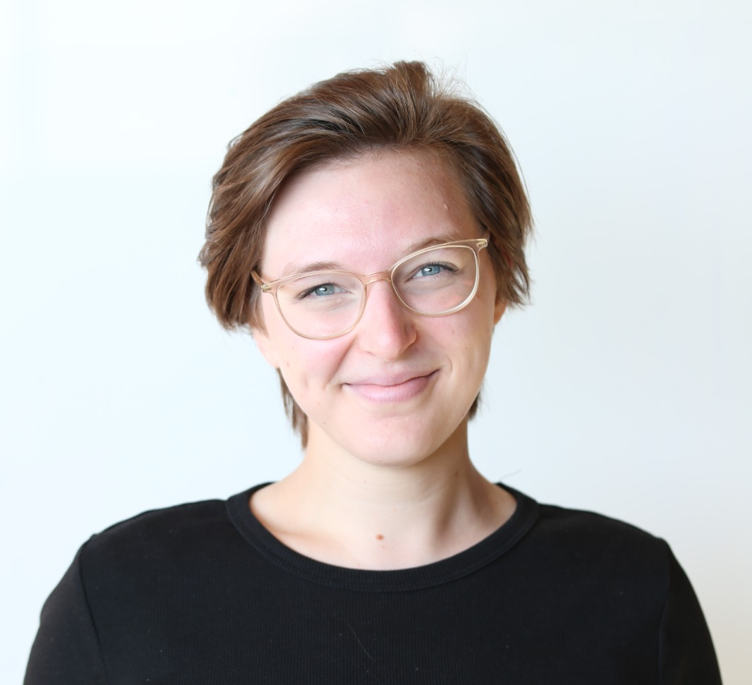
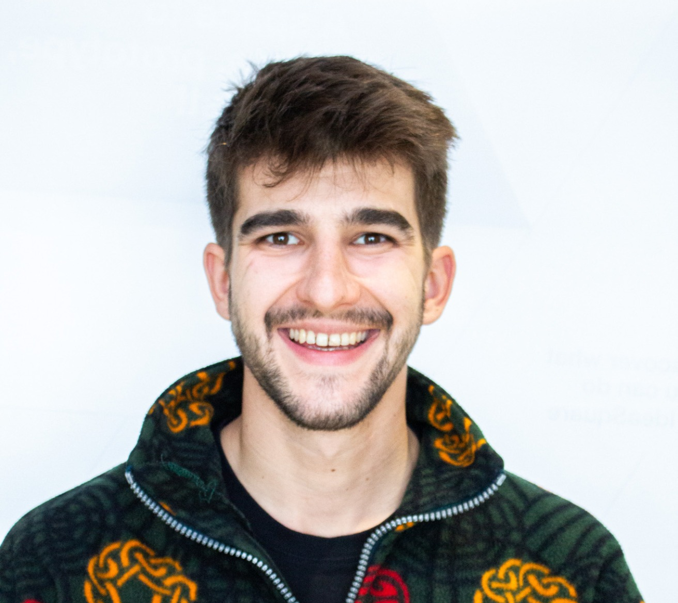
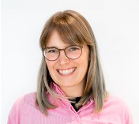
Catarina Batista
Mindset Accelerator at CERN IdeaSquare
BA Communication, Post-grad Product and Service Innovation, MSc Psychology.
Passionate about education and humanitarian challenges.
Ole Werner
Galactic Firefighter at CERN IdeaSquare
BSc Psychology, MSc Behavior Change
Passionate about understanding individual cognitions and behaviors in teams.
Laura Wirtavuori
Activity manager at CERN IdeaSquare
MSc Industrial Engineering and Management
Passionate about sustainability and systemic change.

Slide 3
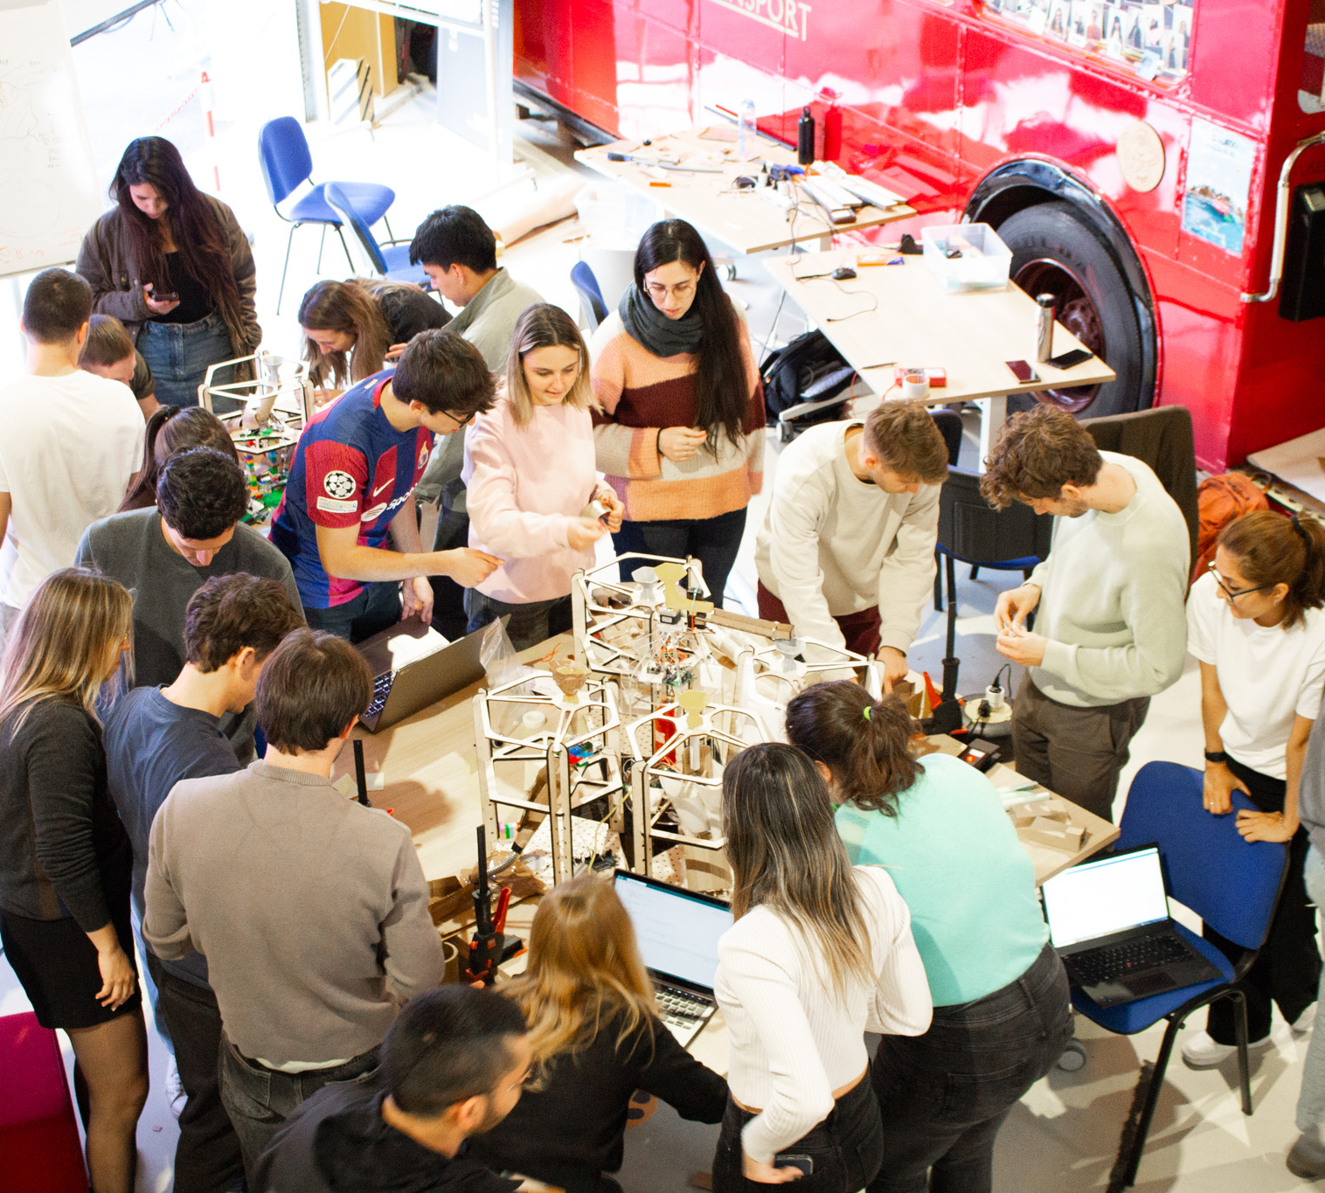
Our responsibilities and tasks
Educating and Training Future Generations
Training of young minds to become thought leaders.
Delivering experiential learning fostering analytical and creative and systemic thinking, curiosity, self-awareness, resilience and flexibility.
Co-designing the programs embedded in the curricula in several universities worldwide, with the following building blocks:
Facilitating 22+ programs/year by coaching multidisciplinary teams of students through futuristic interplanetary innovation processes.
Make-a-thon at IdeaSquare
Notes:
CERN as an inspirational and immersive space, to take lessons on collaboration and breakthrough thinking.

Slide 4
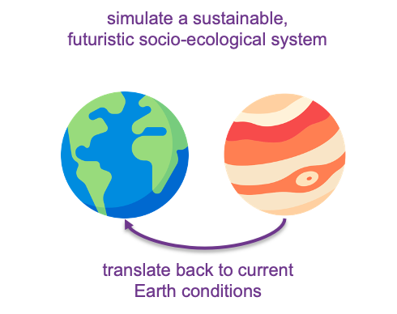

I2-Planet Flagship is Sailing!
Educating and Training Future Generations
Training of young minds to become thought leaders.
Delivering experiential learning fostering analytical and creative and systemic thinking, curiosity, self-awareness, resilience and flexibility.
Co-designing the programs embedded in the curricula in several universities worldwide, with the following building blocks:
Facilitating 22+ programs/year by coaching multidisciplinary teams of students through futuristic interplanetary innovation processes.

Slide 5
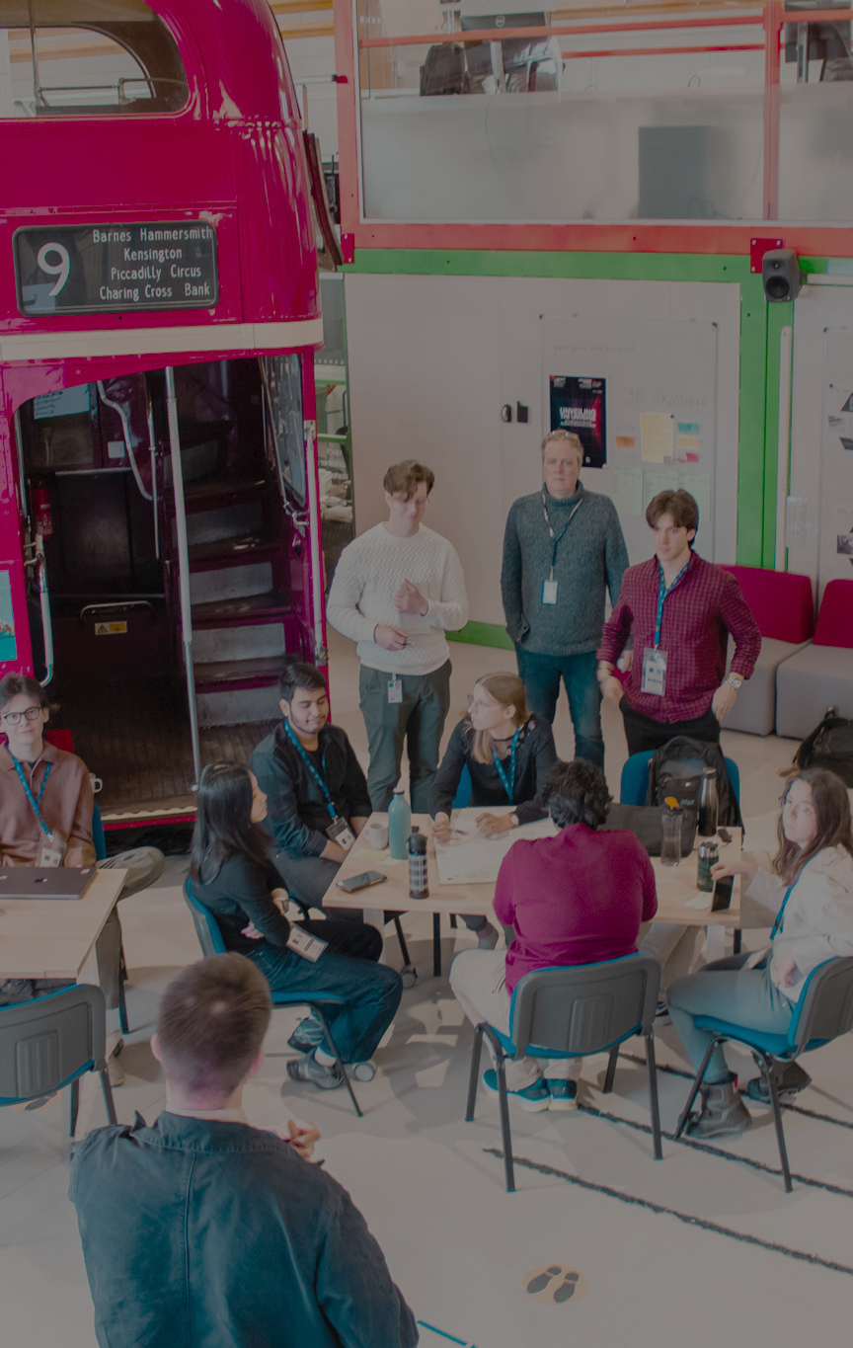
Educational programmes – what is changing
In 2024:
488 students (431 in 2023)
35+ different institutions
17% Design, 18% Business, 42% Engineering, 22% Other
40% female students (almost x2 of CERN’s goal for 2025)
45/52 weeks booked in the space
What is different in 2025:
All Educational programmes are IdeaSquare Planet programmes.
External expertise: Collaboration with NASA and Klang Games start to take shape.
20 programs already booked, some with multiple week visits
48/52 weeks booked in the space already, we’ve reached full capacity.
More programs are taught online (Melbourne, DOMUS, Singapore). Reason being budget & calendar availability.
Notes:
Gender balance
9 ATTRACT programs
{Number of conversation = n° Coffee/3}

Slide 6
The New Normal?
2024 was about diverging and experimenting around i2P, 2025 will be about making the programme more robust.
How?
Revisiting existing content, iterating, improving and reusing it.
Going deeper into the topics and tools we use to design the programs, develop stronger frameworks.
Learning from research team and from feedback meetings with partners how to improve the experience. Including Prototying and Holodeck.
Document progress, learnings, prototypes and results more consistently.
Buddying up with people/organisations with credible expertise (NASA, Klang, external researchers, etc).
i2Planet has been a successful program and remains as an avenue for new consortiums for funding proposals.
We are now able to have clearer guidelines and processes as to how i2P can run and we might already have our first spin-off (Space Science Unit in Swinburne University of Technology).

Slide 7
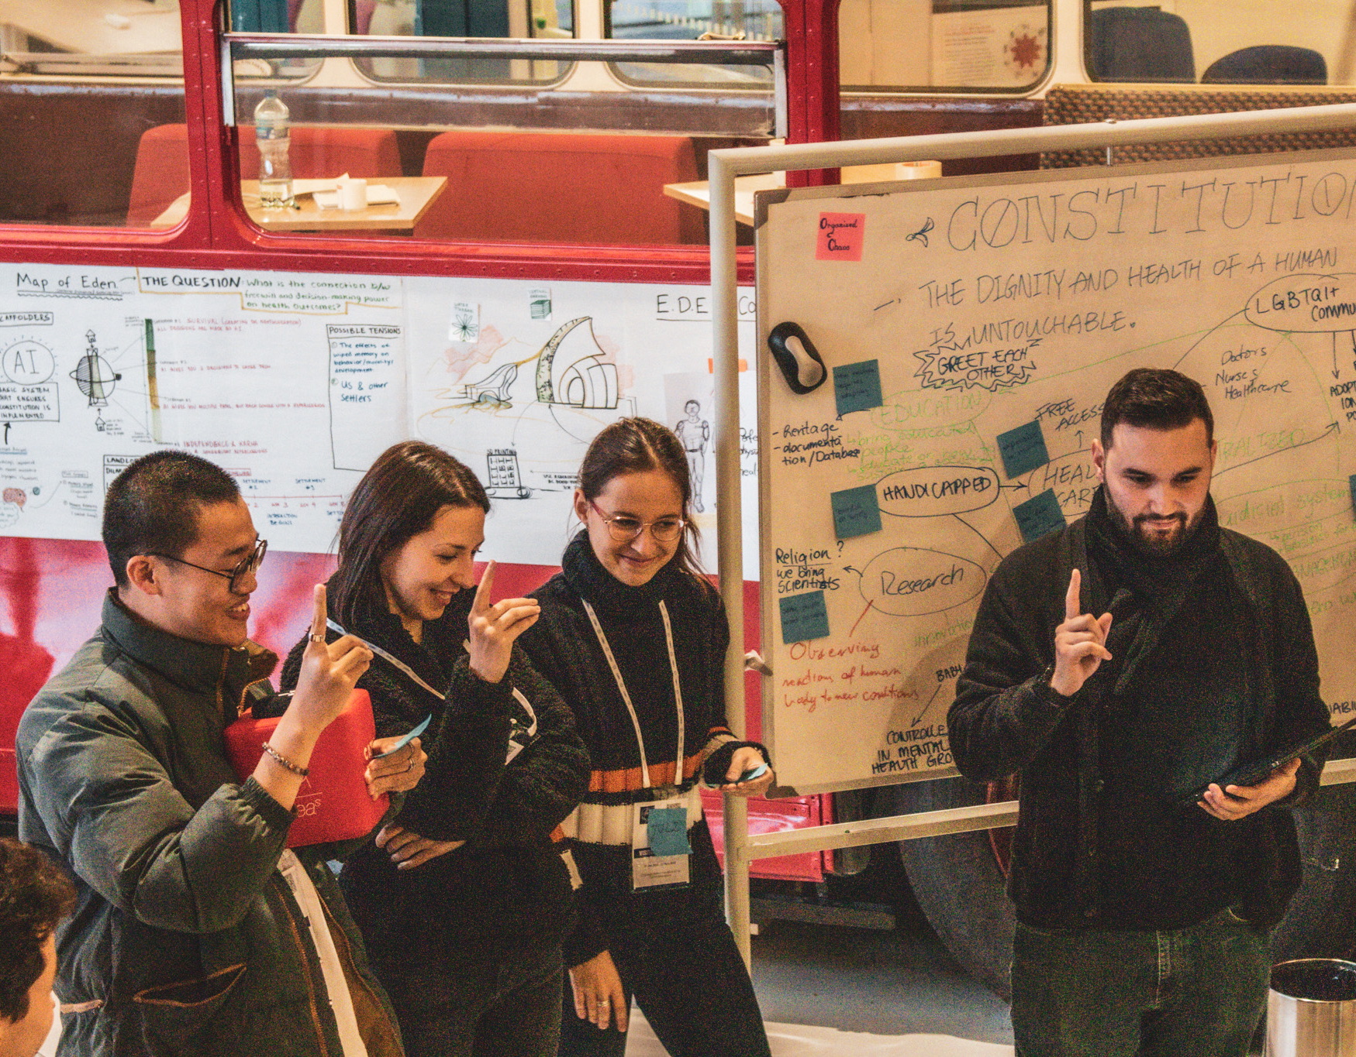
Thank you!
Questions?

