Slide 1
Contactor’s Control Board
Reliability Study – kick-off meeting

Slide 2
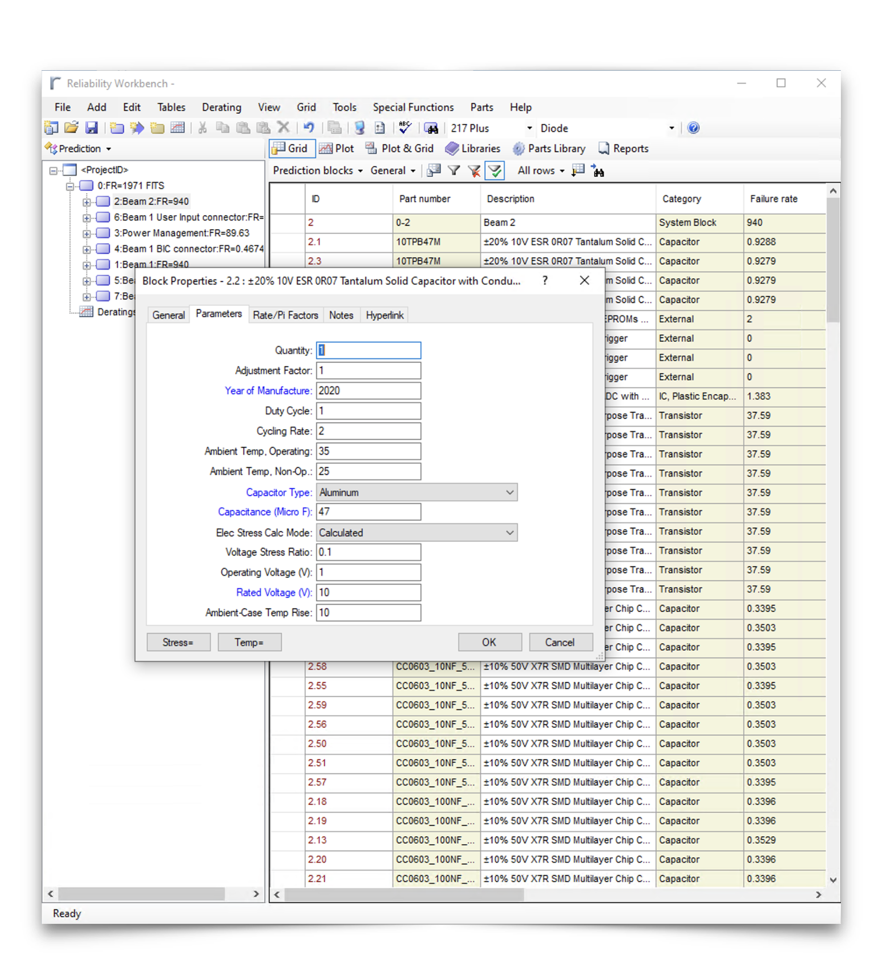
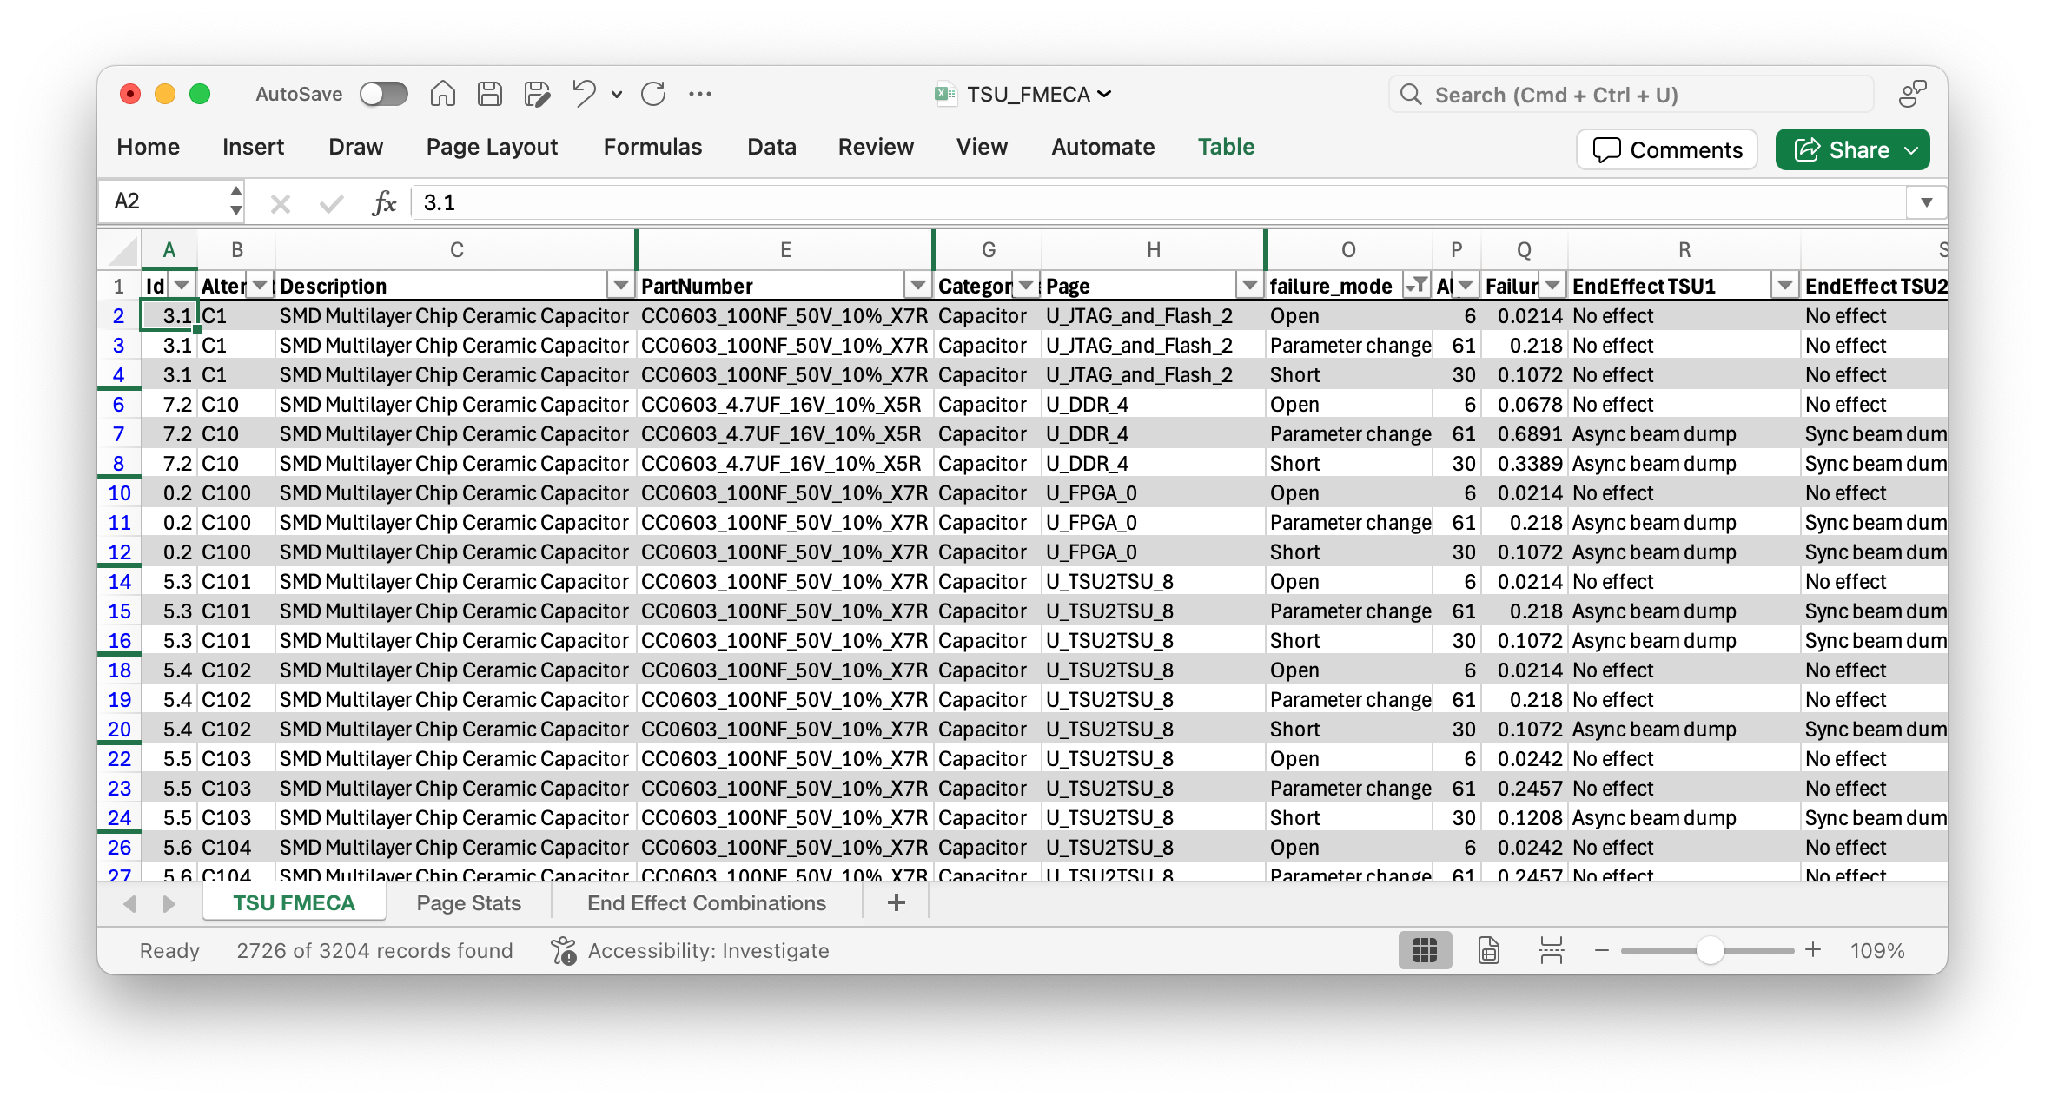
Component-level FMECA
Failure rates, modes & end-effects
Component failure modelling
Use library of component failure models, parametrized by mission profile and operating conditions
End-effects assignment
Together with expert, assign system-level effect of each component failure mode
Outcomes:
Template of all component failure modes and estimation of their likelihood.
Outcomes:
Establishing probability for each failure end-effect (on system level).
This considers only the first order failures, components being used according to specifications and defined operating scenarios & during useful life.

Slide 3
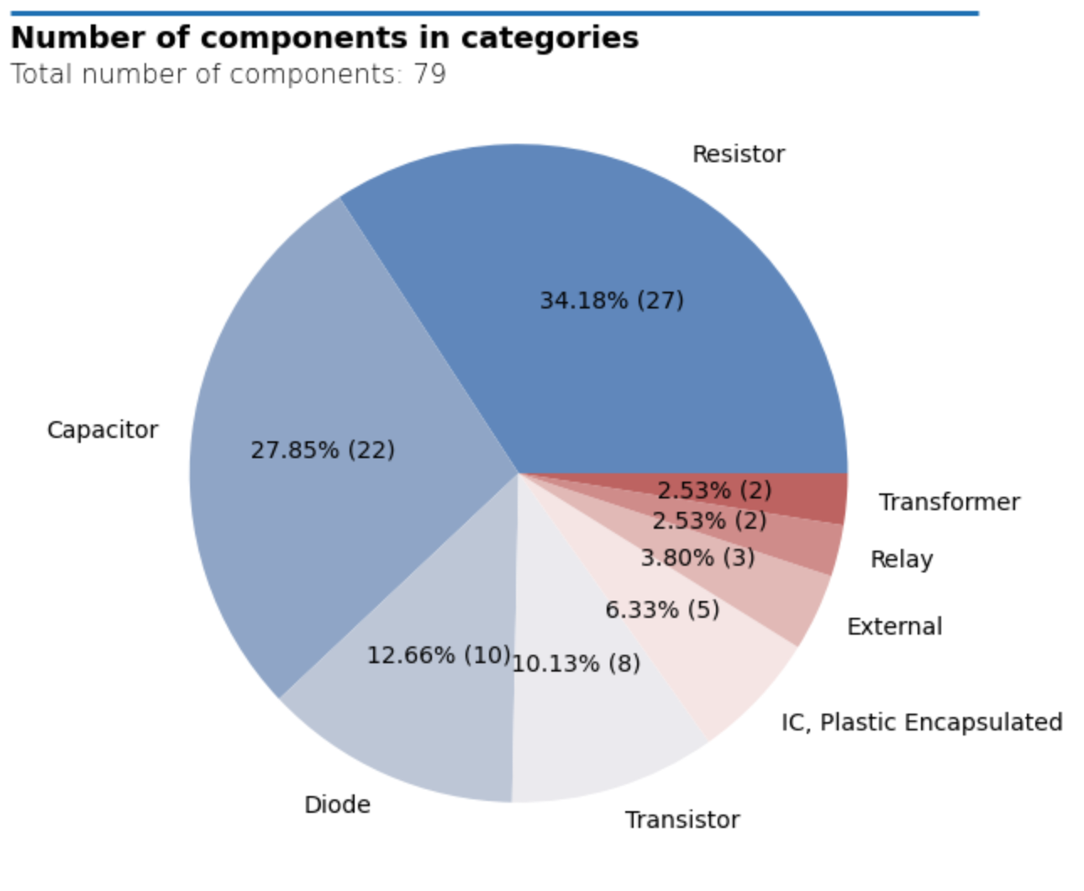
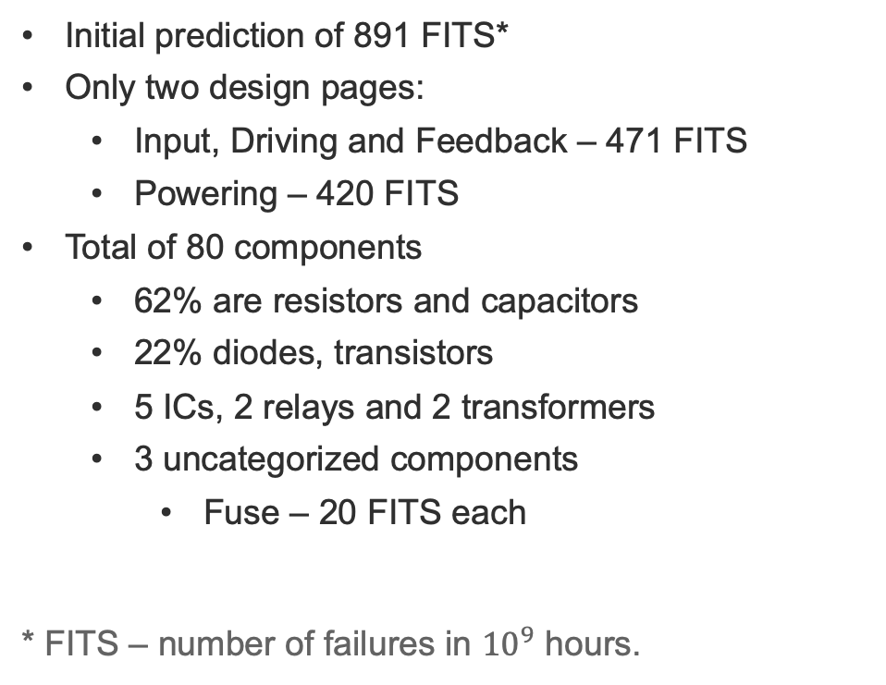
General statistics
Initial prediction of 891 FITS*
Only two design pages:
  Input, Driving and Feedback – 471 FITS
  Powering – 420 FITS
Total of 80 components
  62% are resistors and capacitors
  22% diodes, transistors
  5 ICs, 2 relays and 2 transformers
  3 uncategorized components
    Fuse – 20 FITS each
* FITS – number of failures in ${10}^{9}$ hours.

Slide 4
Mission profile & other assumptions
Operating temperature: 35℃.
Non-operating temperature: 25℃.
Default component parameters:
  Year of manufacture: 2020
  Ambient case rise (where applicable): 10℃.
  Duty cycle: 1 (i.e., always on).
  Cycling rate 2 (i.e., two power cycles in a year).
Relative humidity: 0.5
Parts assumed to be used within their ratings, no modifications made to quality and process factors (217Plus standard assumed).

Slide 5
Functional Context
Mains Board
CCB
Contactor
Powering
24 V
P COIL
Control Card
Close, open, zero&pulse release
Interlock Card
Input, Driving and Feedback
N COIL, AUX MICRO SWITCH
Feedback

Slide 6
Special components
Miniature High Capacity Relays, SPST – 80 FITS
Gate Driver – Transistor?
NPN/PNP General Purpose transistors vs OptiMOS Power MOSFET and PNP Complementary Silicon Power Transistor
Two analog optocouplers
Power Metal Strip, High Power
Professional MELF Resistor
Aluminium Electrolytic Capacitor, High Reliability for Switching Power Supplies
Encapsulated Transformer and Moulded Transformer

Slide 7
Other problems
How many instances of the CCB will be deployed? What is the criticallity of a single contactor not opening?
  There seems to be three contactor relays in series – can it be considered triple redundancy?
End-effects assignment

Slide 9
Other problems
Galvanic isolation:
  matters of insulation degradation, thermal stress and other environmental factors,
  mitigation: through design (creepage, clearance, layout), materials, inspections; also conformal coatings, sealing
    How to Meet the Higher Isolation Creepage & Clearance Needs in Automotive Applications
How many instances of the CCB will be deployed? What is the criticallity of a single contactor not opening?
  There seems to be three contactor relays in series – can it be considered triple redundancy?
End-effects assignment

