Slide 1
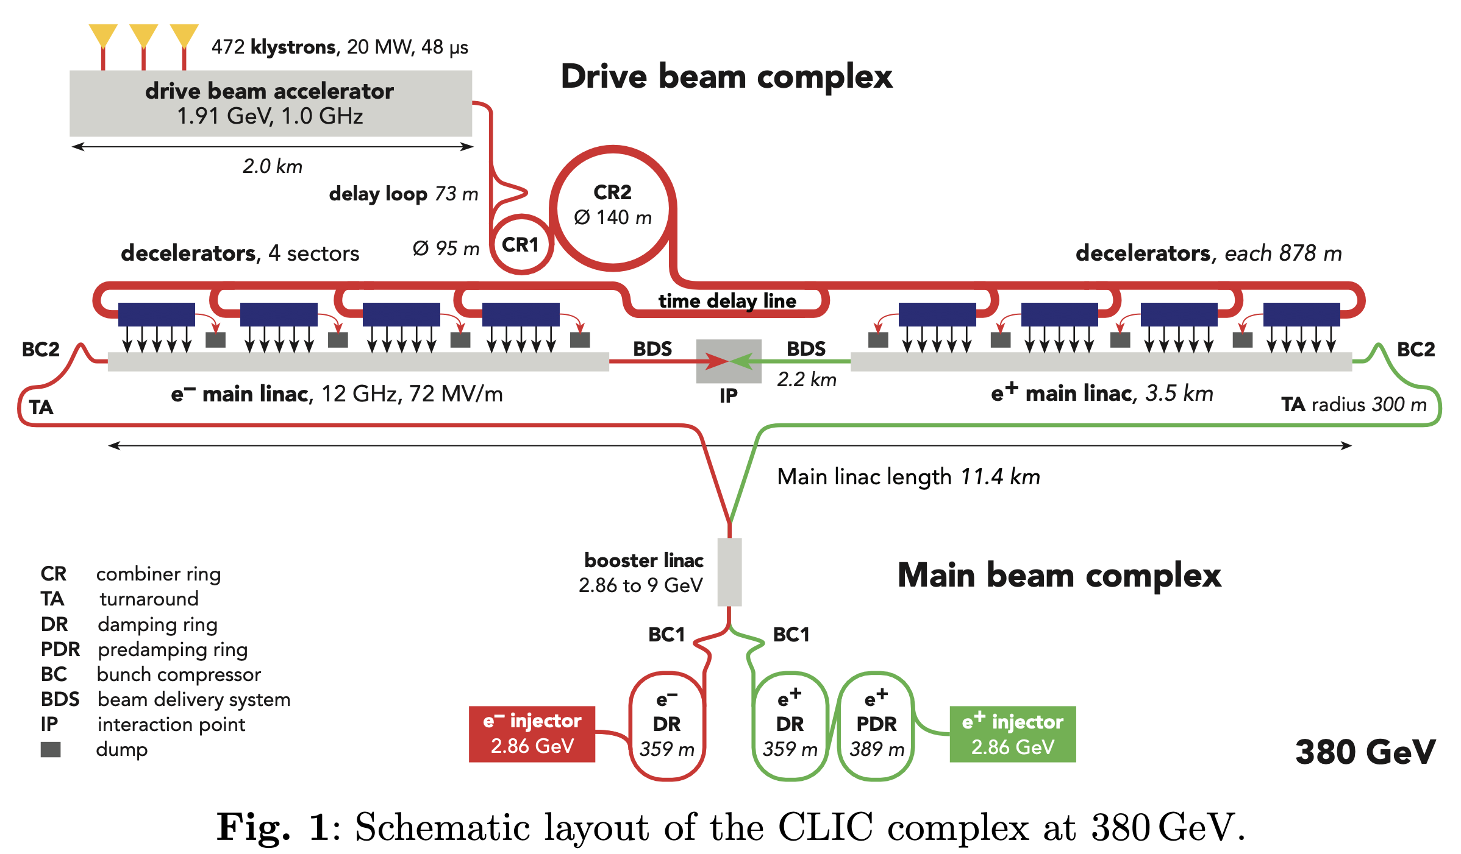

Slide 2
Baseline: 380 GeV
Baseline: 380 GeV drive-beam machine - “low-energy machine”
  Main parameters, system overview and technology details will primarly refer to 380 GeV
  Keep details on klystron options
  L = 2.25 x 10³⁴/cm²/s
Option: 100 Hz, with 65% higher power
  L = 4.5 x 10³⁴/cm²/s
For 100 Hz running, option(?): two BDS and IPs
  L = 2.25 x 10³⁴/cm²/s per IP

Slide 3
Option: 250 GeV
Proposed implementation: missing module scheme, shorter DBA
Less cost than simply reducing sectors from 4 to 3
Tunnel same as 380 GeV, for easy upgrade
L = 1.3 x 10³⁴/cm²/s, 2.6 x 10³⁴/cm²/s for 50 Hz and 100 Hz

Slide 4
High-energy machine: 1.5 TeV
L = 1.3 x 10³⁴/cm²/s. Only 50 Hz, one BDS considered
Mention that one can reach 2 TeV with a single drive-beam
No special mention of 3 TeV machine

Slide 5
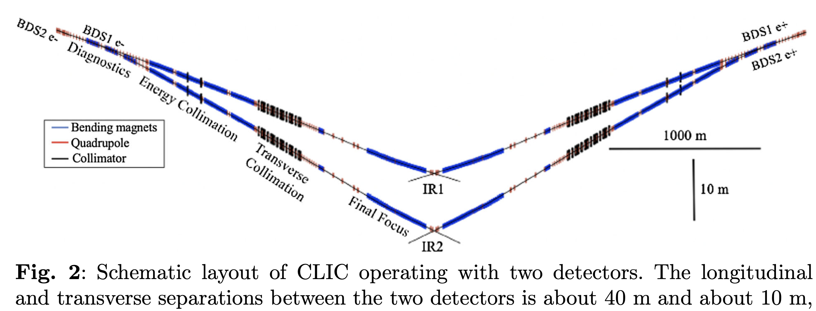
Two BDS/IP

