Slide 1
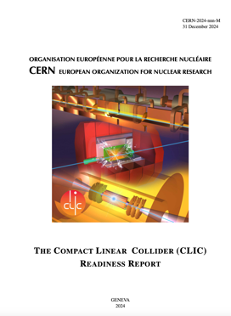
The CLIC ESPP update – I
Guidelines:
Preparing “Project Readiness Report” as a step toward a TDR
Assuming ESPP in ~ 2025-6, Project Approval ~ 2028, Project (tunnel) construction can start in ~ 2030.
Project summary for Snowmass already include some of these changes, i.e. luminosity improvements, 100 Hz study, power update for 380 GeV: LINK
However, several important changes:
Energy scales: 380 GeV and 1.5 TeV with one drivebeam
Consider also 100 Hz running at 250 GeV and 380 GeV (i.e. two parallel experiments, two BDSs)
Several updates on parameters (injectors, damping rings, drive-beam) based on new designs, results and prototyping (e.g. klystrons, magnets) - however no fundamental changes beyond staying at one drivebeam
Technology results updates, including more on use of them in other projects (e.g. alignment, instrumentation, X-band RF is small linacs)
Update costing and power – interplay between inflation and CHF
Life Cycle Assessments
More detailed prep phase planning (next 5-7 years)

Slide 2
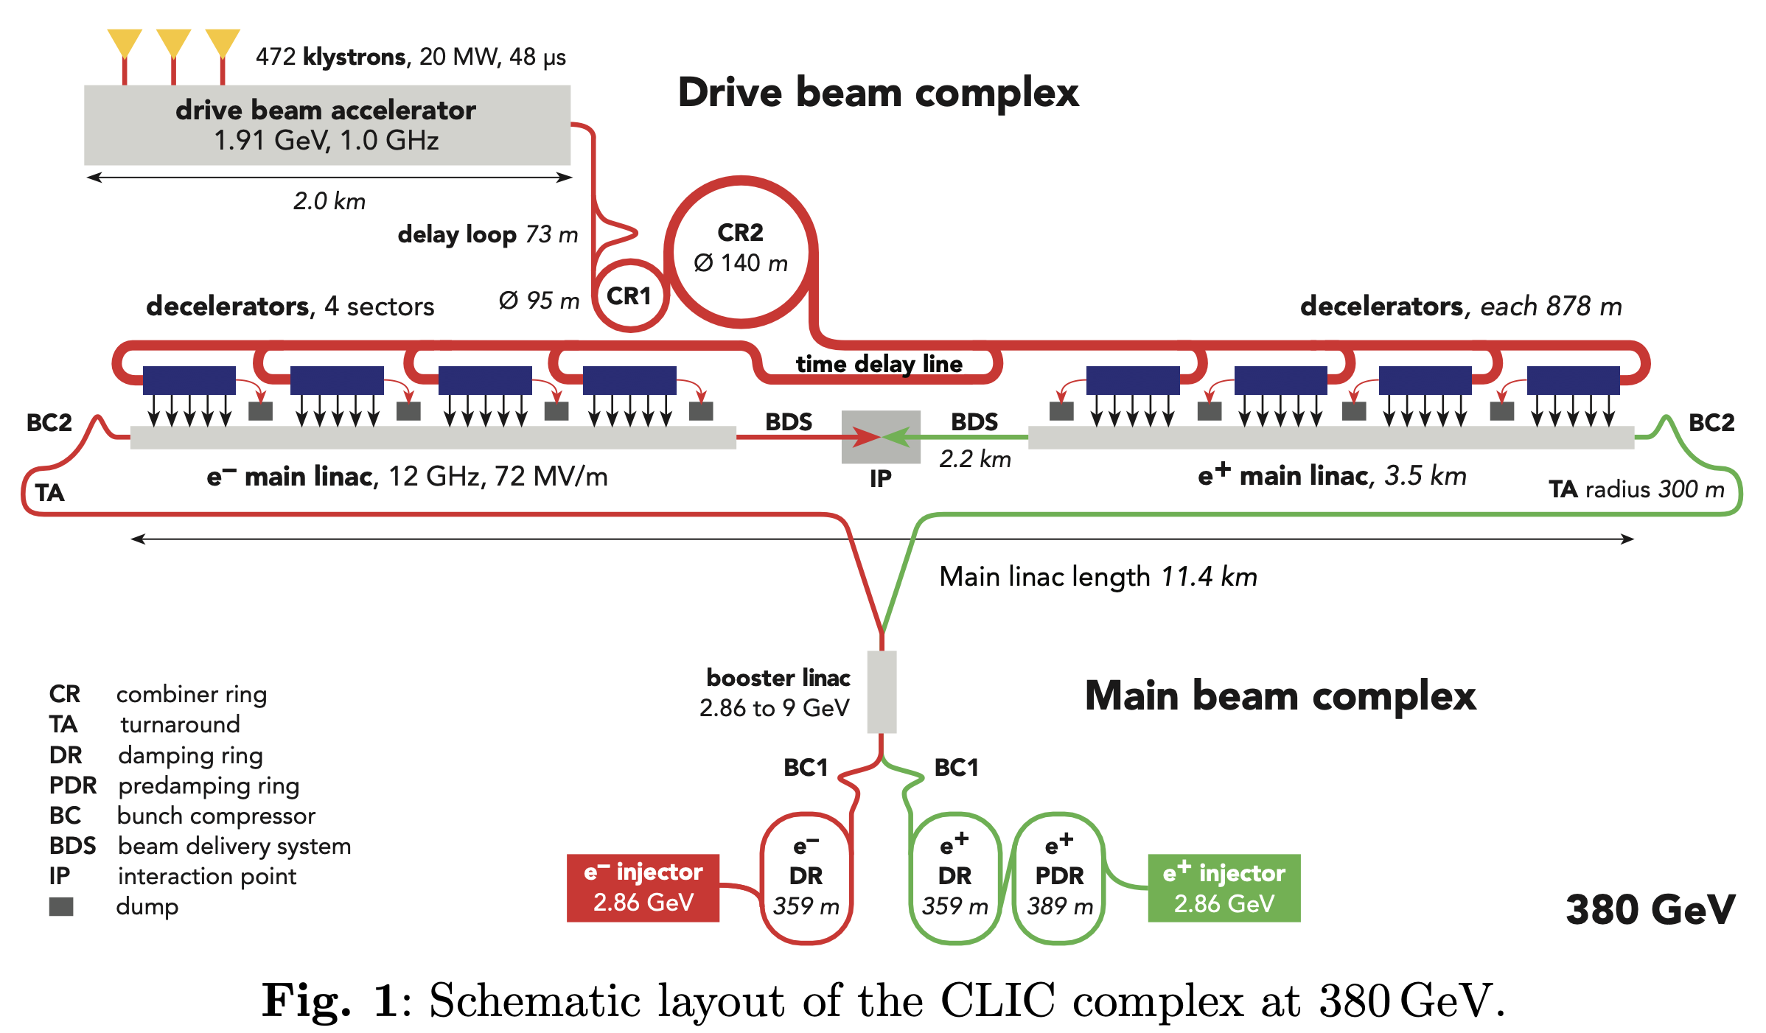

Slide 3
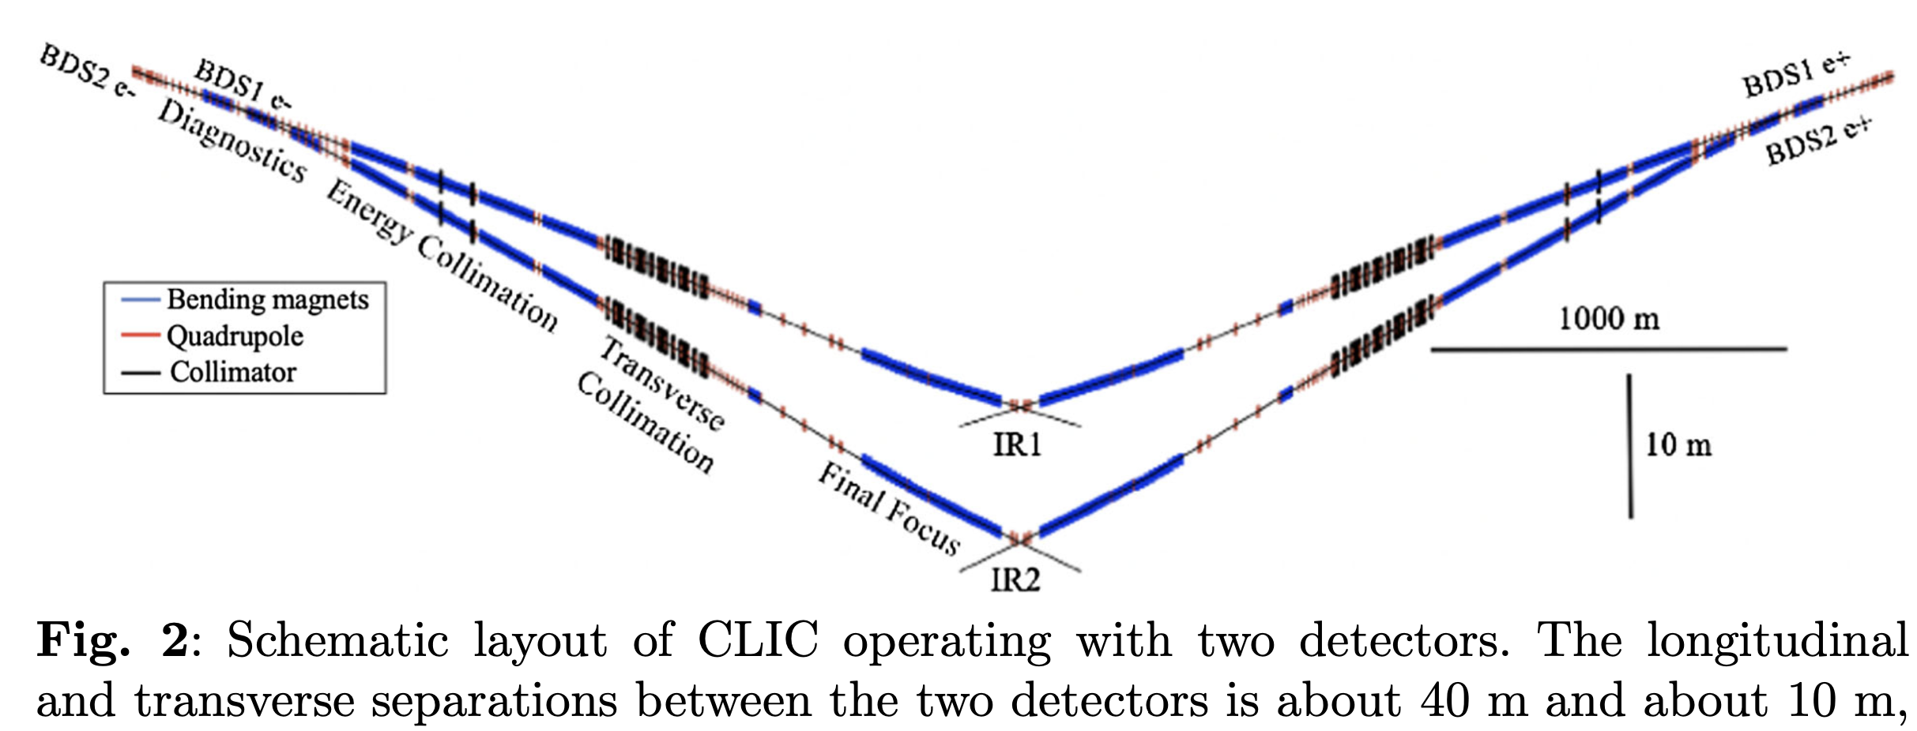
Two BDS/IP

Slide 4
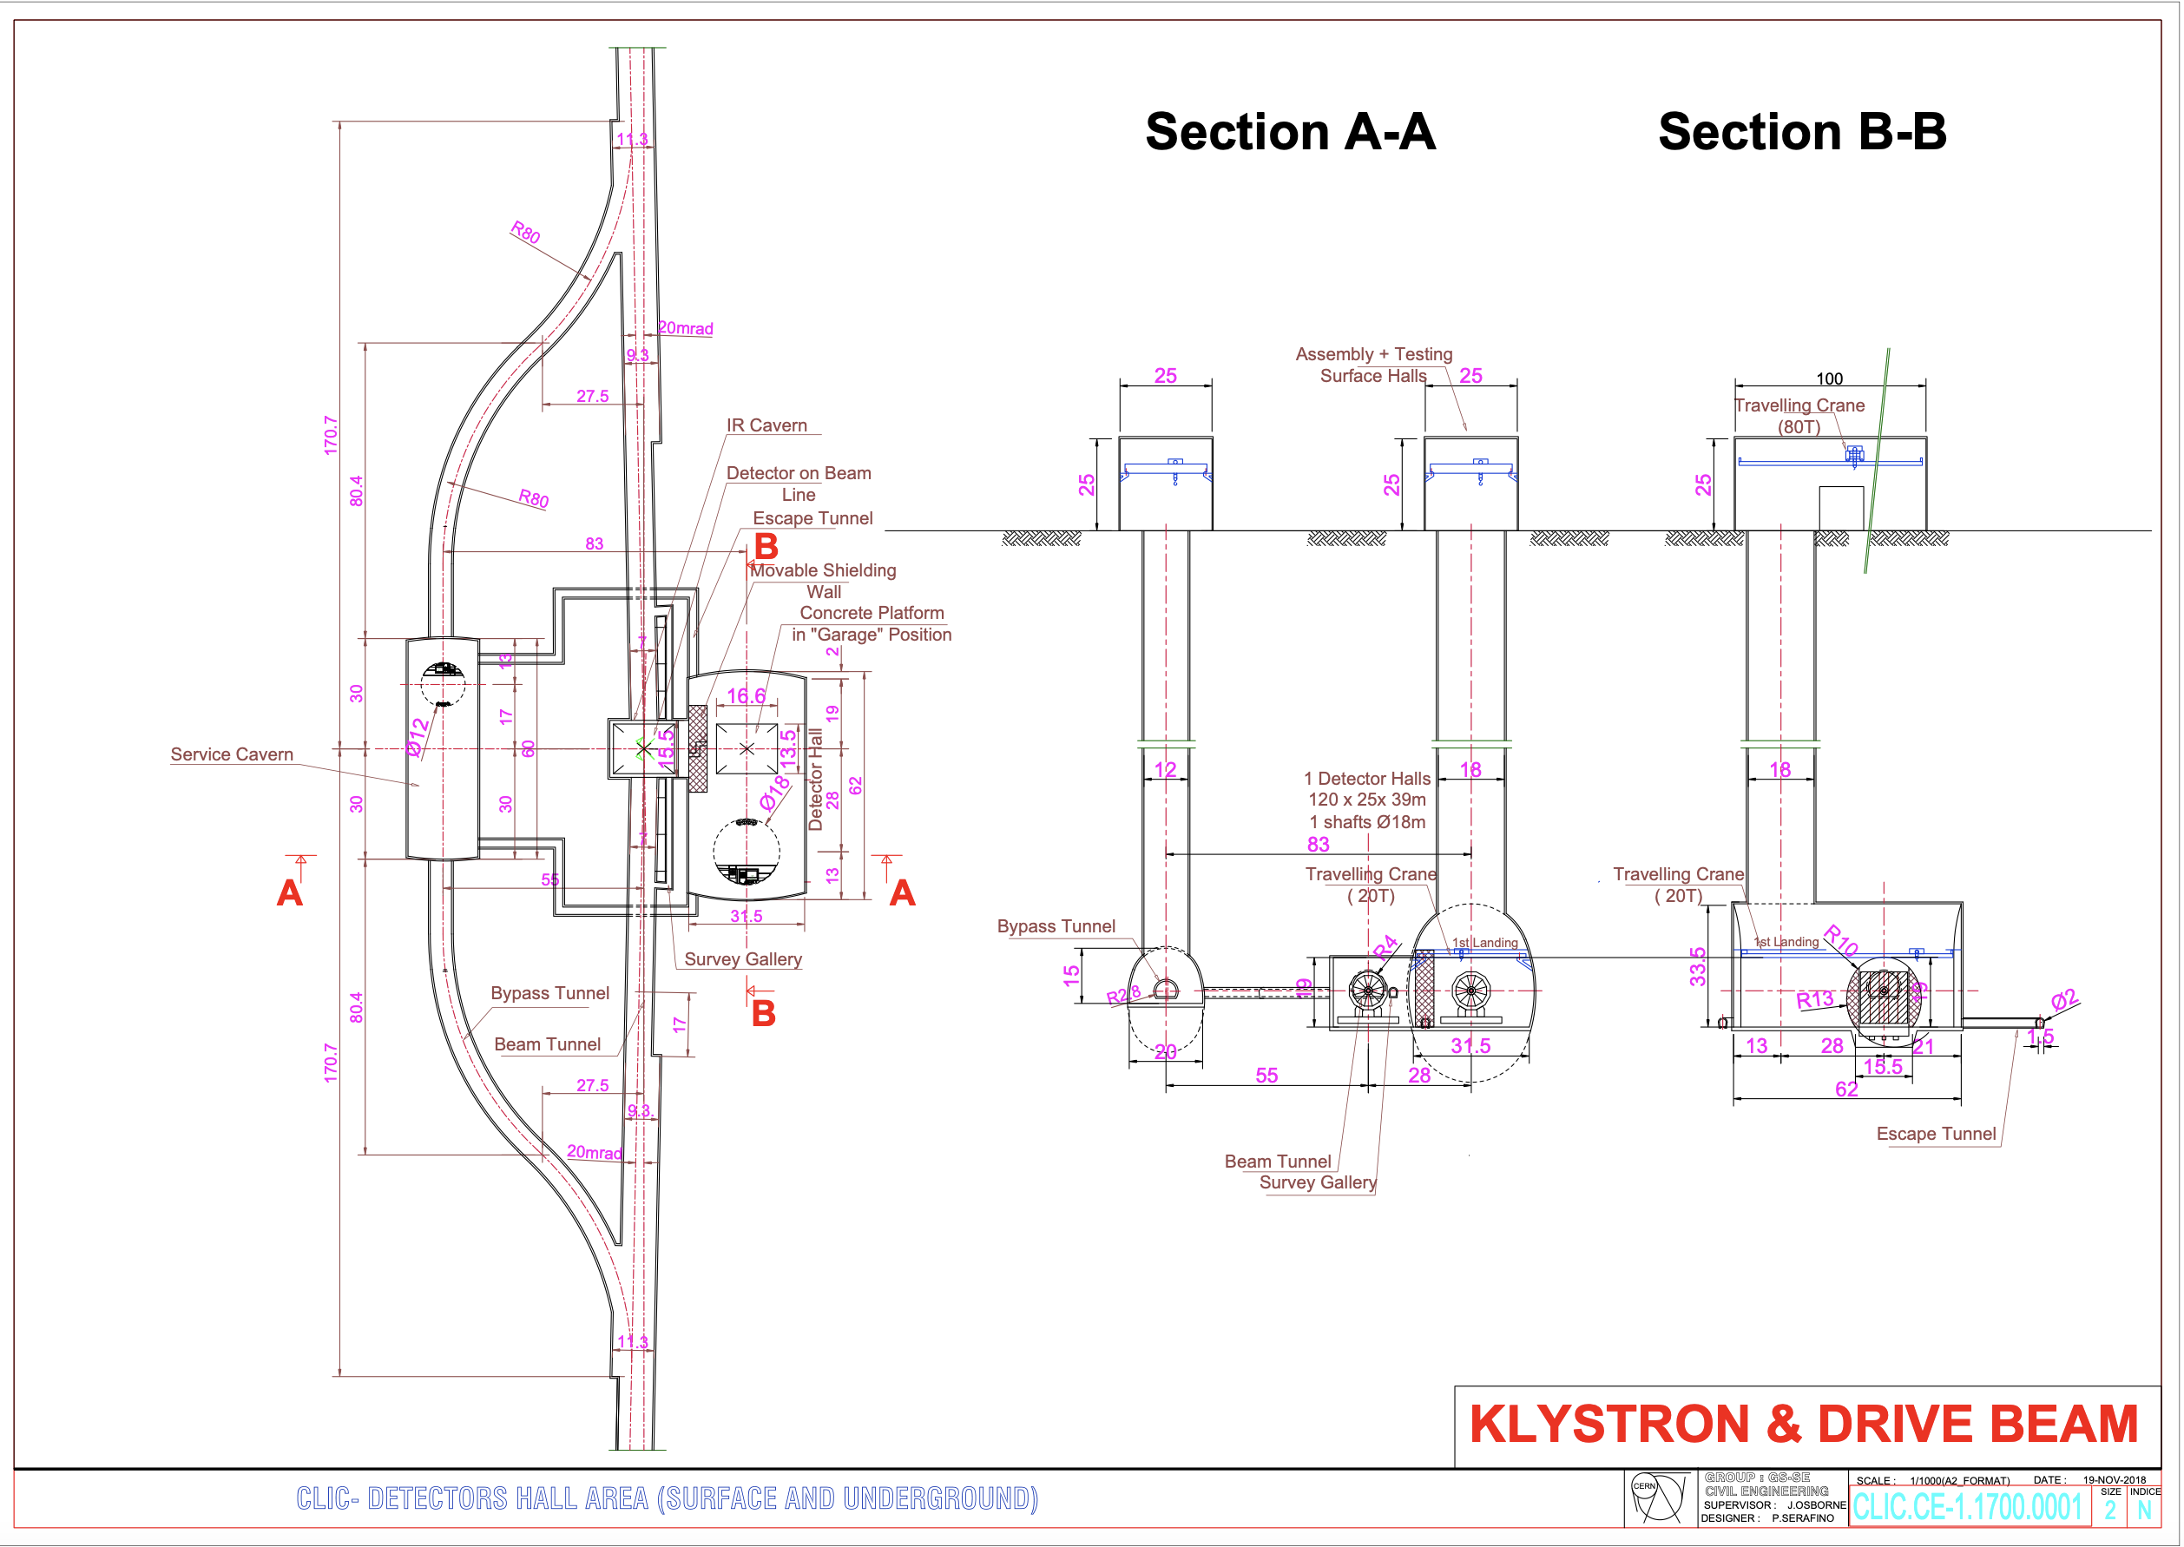

Slide 5
Baseline: 380 GeV
Baseline: 380 GeV drive-beam machine - “low-energy machine”
  Main parameters, system overview and technology details will primarly refer to 380 GeV
  Keep details on klystron options
  L = 2.25 x 10³⁴/cm²/s
Option: 100 Hz, with ~65% higher power
  L = 4.5 x 10³⁴/cm²/s
For 100 Hz running, option: two BDS and IPs
  L = 2.25 x 10³⁴/cm²/s per IP

Slide 6
Option: 250 GeV
Proposed implementation: missing module scheme, shorter DBA
Less cost than simply reducing sectors from 4 to 3
Tunnel same as 380 GeV, for easy upgrade
L = 1.5 x 10³⁴/cm²/s, 3.0 x 10³⁴/cm²/s for 50 Hz and 100 Hz

Slide 7
High-energy machine: 1.5 TeV
L = 3.7 x 10³⁴/cm²/s. Only 50 Hz, one BDS considered
Mention that one can reach 2 TeV with a single drive-beam
No special discussion of 3 TeV machine expect reference to CDR

Slide 8
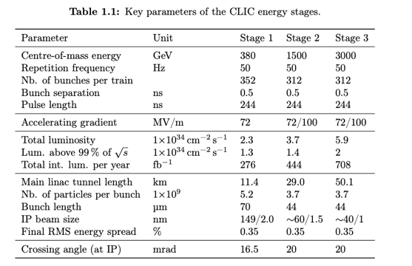
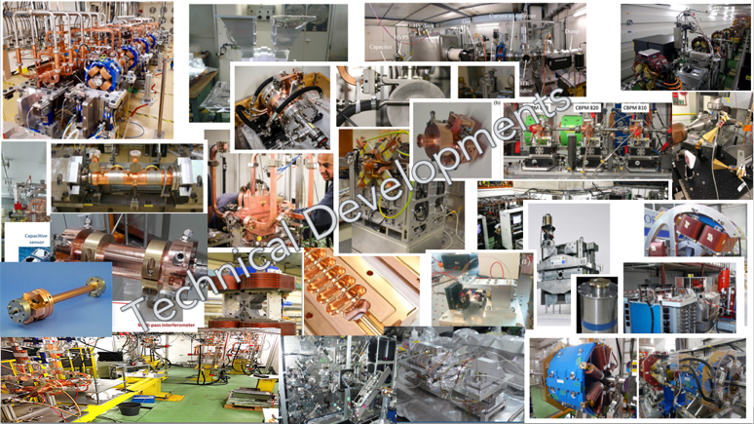
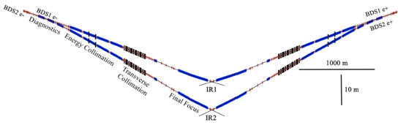
The CLIC ESPP update - II

Slide 9
Run plan and integrated luminosities
250
50/100 Hz
10 years with ramp, i.e. 8 years
1.5/3.0
1.4/2.9 at-1
1500
50 Hz
3.7 10^34
10 with ramp up, i.e. 9 years
4 at-1
At 380 we are at 2.25 10^34 with 50 Hz, the double at 100 Hz
At 250 it is reduced to 1.5 and 3.0.
At 1.5 we assume only 50 Hz (due to power), 3.7 10^34
We have a ramp up at 10, 30, 60% the first 3 years for 380 (or 250), 25, 75% for second stage
So 10 years at 250 or 380 is 8 x 1.2 10^7s, 10 years at 1.5 is 9 x 1.2 10^7s
380
50/100 Hz
10 years with ramp up, i.e 8 years
2.25/4.5
Integrated 10 years: 2.2/4.3 at-1

Slide 10
ESPP inputs – I
General goals for LCs :
See physics opportunities on page 5
Lower cost to get to Higgs and top than a circular machine
Power similar to LHC, or lower
Footprint similar to LHC, CE cost risks therefore manageable
Does not determine footprint of future energy frontier machines (hadrons and muon), and it has its own upgrade opportunities.
Higgs factory focussed studies | Project input (the traditional way) See earlier slides
ILC | ILC in Japan (JAHEP/ILC-Japan and IDT)
CLIC | CLIC at CERN
C3 | Project study, focus on next phase
HALHF | Project concept, pre-CDR
Energy recovery | Project concepts and plans

Slide 11
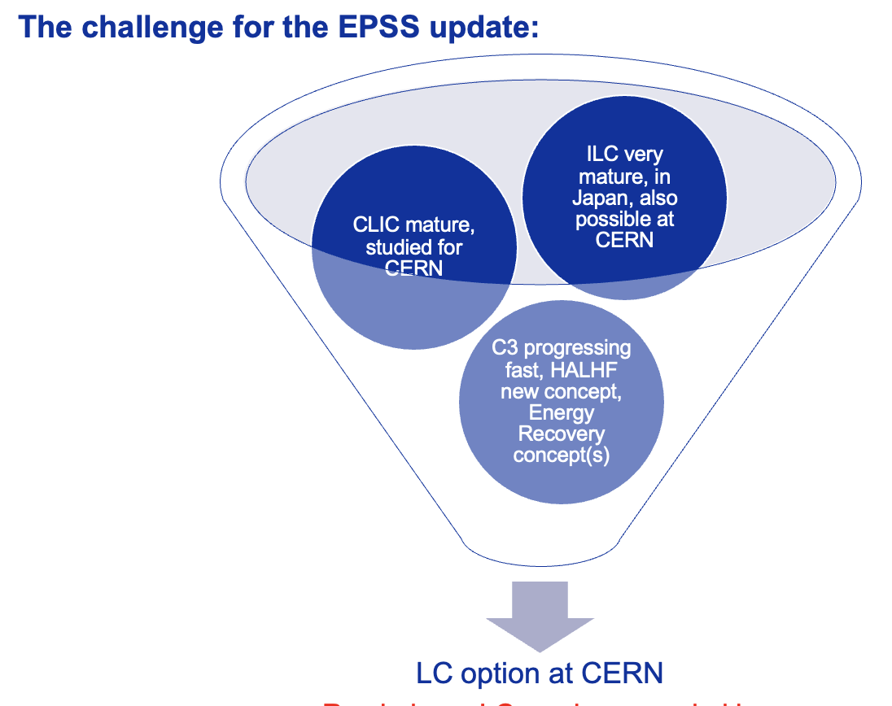
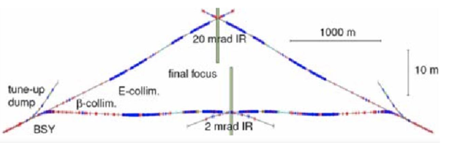
ESPP inputs – II
For a LC at CERN, what would be favoured option to start with – keeping in mind technology changes can be envisaged ?
New approach for this ESPP (facility and community approach) – with three key inputs to the ESPP
Common LC physics paper covering from 90 GeV to 1000 GeV or even above. Include also non collider programme (see slide 5). Serves also the projects on previous page.
Starting with ILC technology, look at energy and luminosity extension options with improved SFR, or CLIC, C3, plasma and Energy Recovery technologies
Implementation of the above at CERN in footprint studied for CLIC (and ILC back in the TDR days), with two BDS, and experimental area at Prevessin, and considerations of upgrade options.

Slide 12
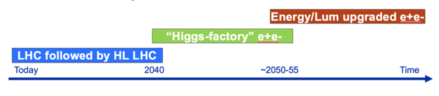
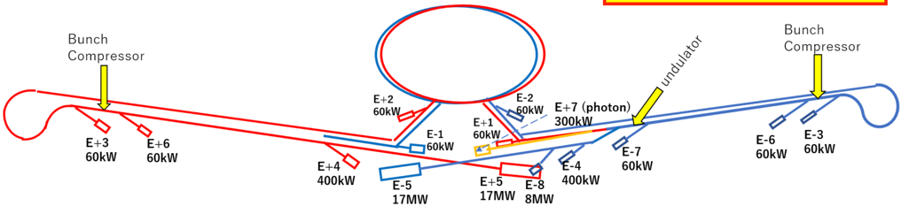
A physics-driven, polarised operating scenario for a Linear Collider
250 GeV, ~2ab-1:
  precision Higgs mass and total ZH cross-section
  Higgs -> invisible (Dark Sector portal)
  basic ffbar and WW program
  optional: WW threshold scan
Z pole, few billion Z’s: EWPOs 10-100x better than today
350 GeV, 200 fb-1:
  precision top mass from threshold scan
500…600 GeV, 4 ab-1:
  Higgs self-coupling in ZHH
  top quark ew couplings
  top Yukawa coupling incl CP structure
  improved Higgs, WW and ffbar
  probe Higgsinos up to ~300 GeV
  probe Heavy Neutral Leptons up to ~600 GeV
800…1000 GeV, 8 ab-1:
  Higgs self-coupling in VBF
  further improvements in tt, ff, WW, ….
  probe Higgsinos up to ~500 GeV
  probe Heavy Neutral Leptons up to ~1000 GeV
  searches, searches, searches, …
Beyond collider:
ILCX – e.g. beam-dump experiments, dark sector physics, light dark matter, strong QED (ILCX workshop)
Test and R&D beams for detector and accelerator studies
From J.List/M.Peskin

Slide 13
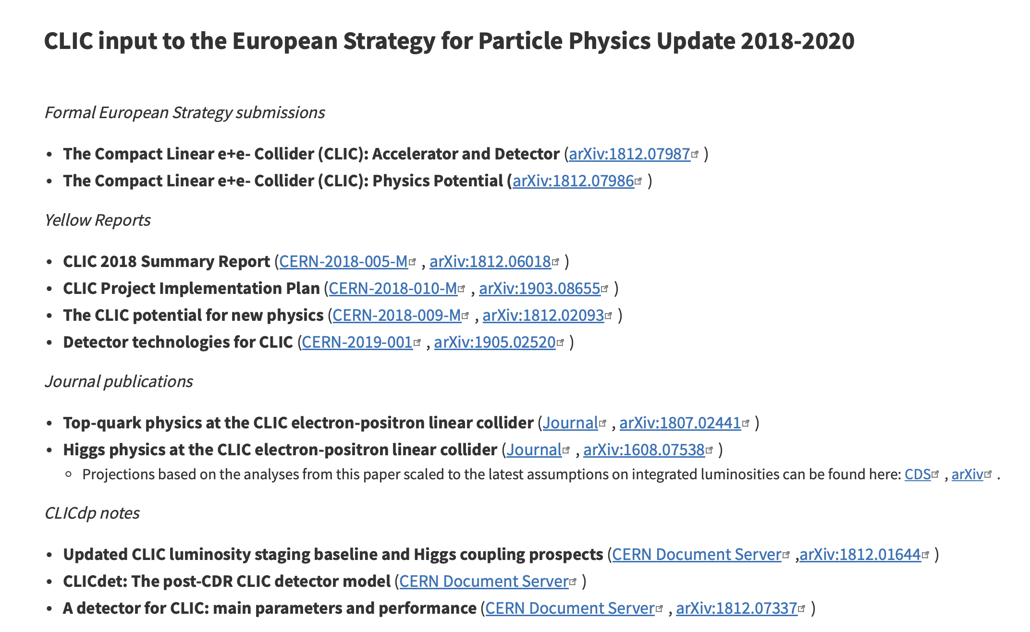

Slide 14
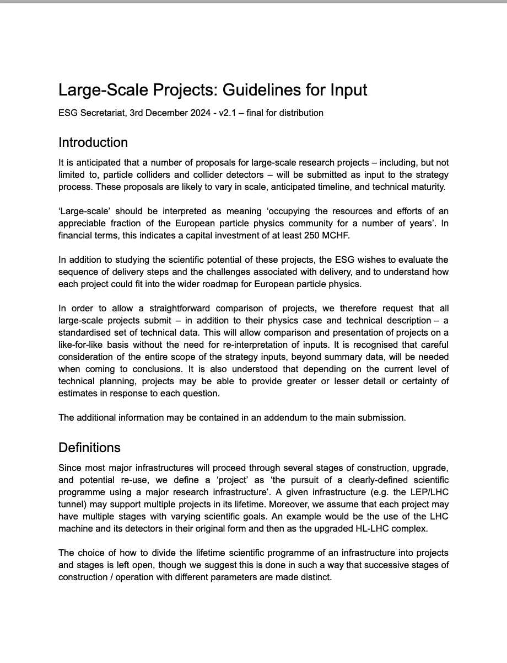
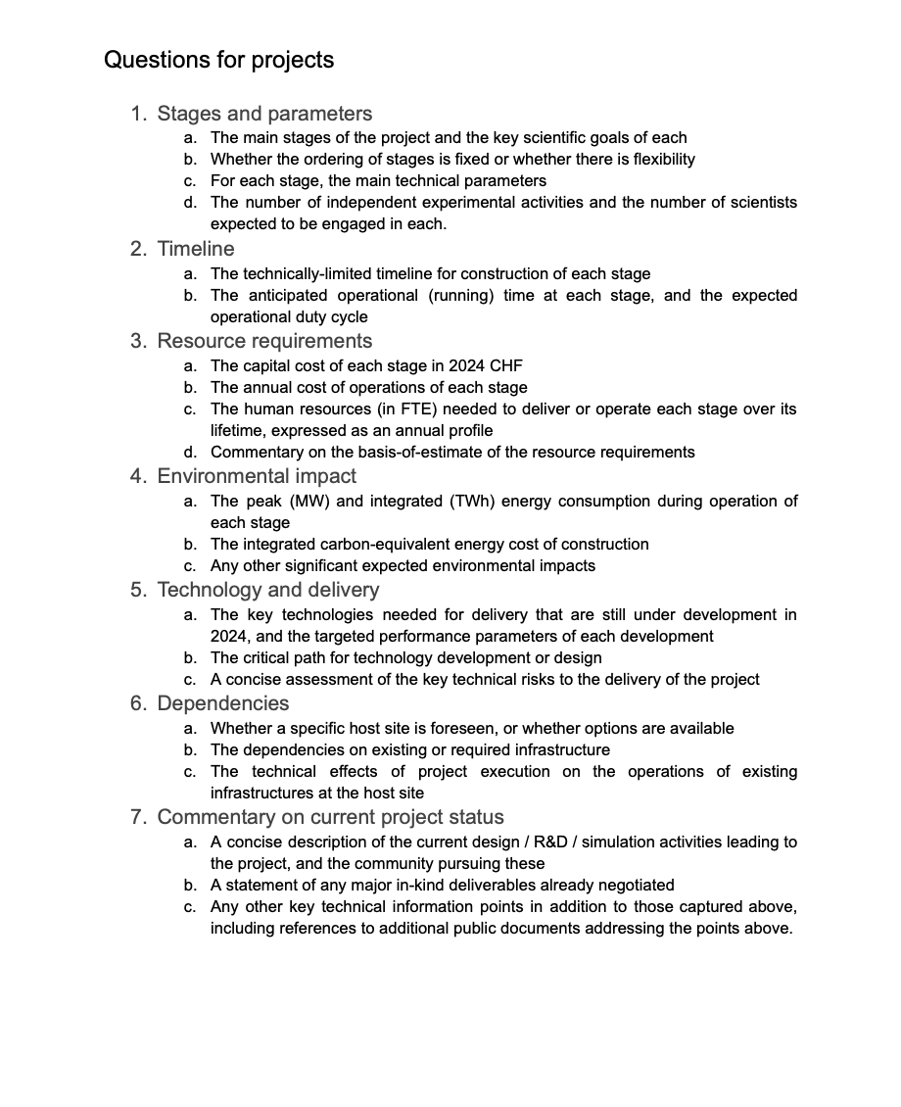

Slide 15
