Slide 1

Intro to the
9th Control System
Cyber-Security
Workshop
(CS)²/HEP

Slide 2
Before starting: A word on Safety
Emergency Assembly Point (e.g. in case of evacuation):
Use Stairwell 4 left of women’s restrooms leading to holding space at 55 E. Wabash
Emergency Reporting: 66 or 5565 for Hotel Security. …and general 911 emergency
Non-Emergency:
Contact me or any conference staff: “See something, say something!”
Respect the ICALPECS Code of Conduct: https://indico.jacow.org/event/86/page/241-code-of-conduct
Note that this is a smoke & drug free event. Workplace violence policy is in place.
…and as this is an open conference, watch your belongings.
Finally: Enjoy, learn, exchange & have fun!

Slide 3
Two Mantras
“Freedom, security, convenience
ꟷ choose two”
(Dan Geer)
“Security will always be exactly as bad as it can possibly be while allowing everything to still function.”
(Nat Howard)

Slide 4
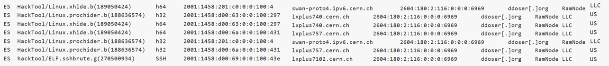
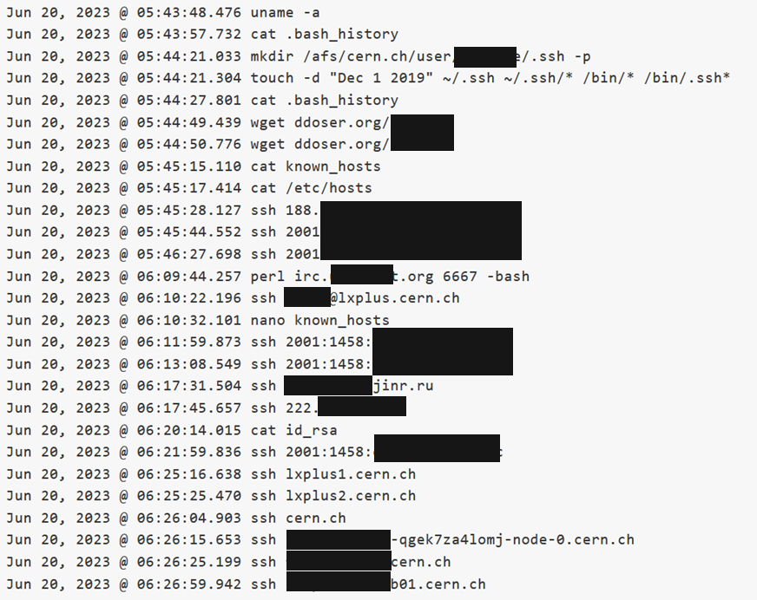
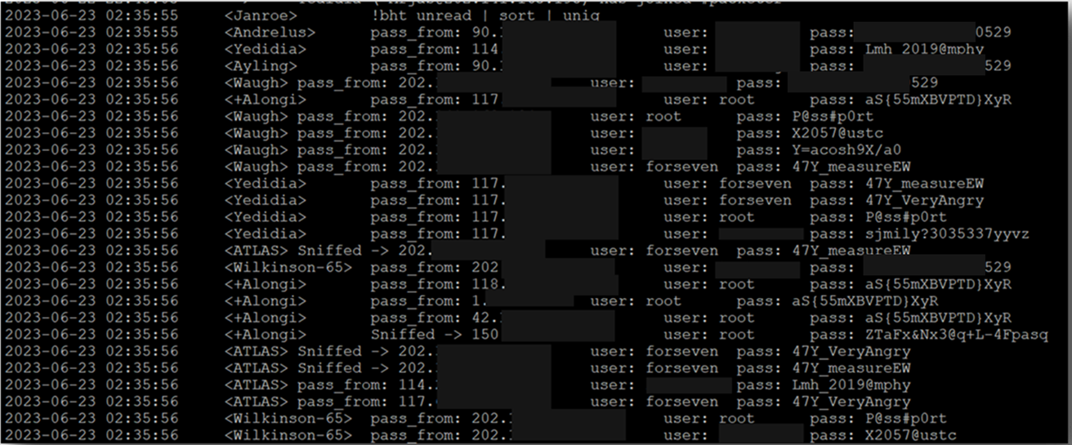
Anatomy of an attack
Reconnaissance
Screw up dates
Get rootkit & IRC
IRC for C&C
Lateral movement
 foreach(host)

Slide 5

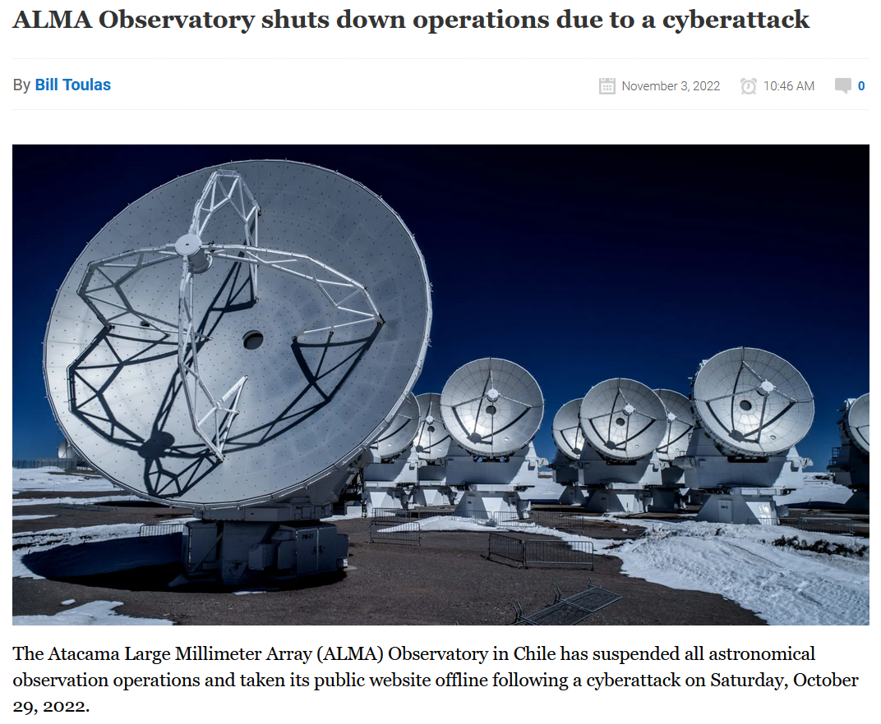
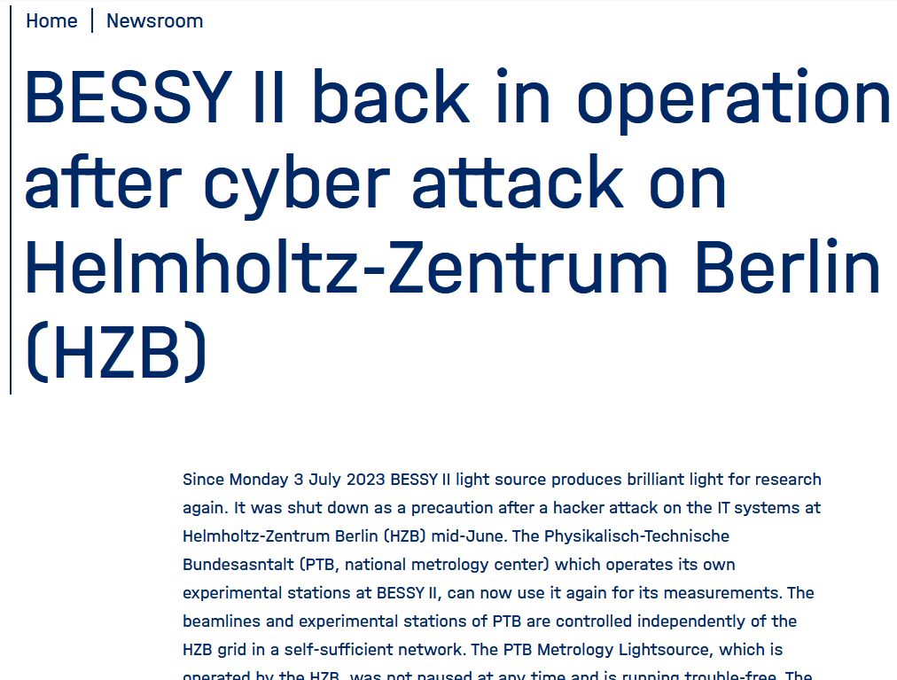
ICALEPCS 2023
The Elephant has arrived…
What do you do
to protect your operations ?

Slide 6
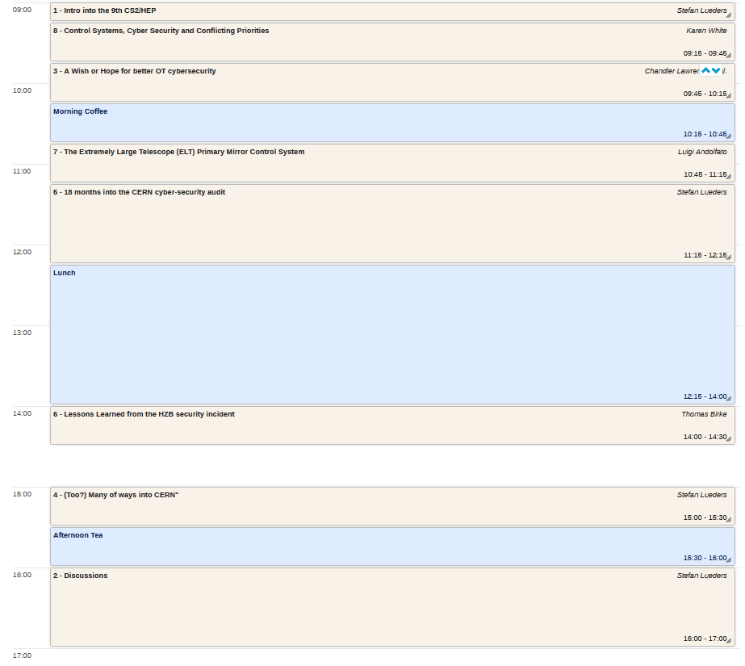
indico.cern.ch/event/1487380/timetable

