Slide 1
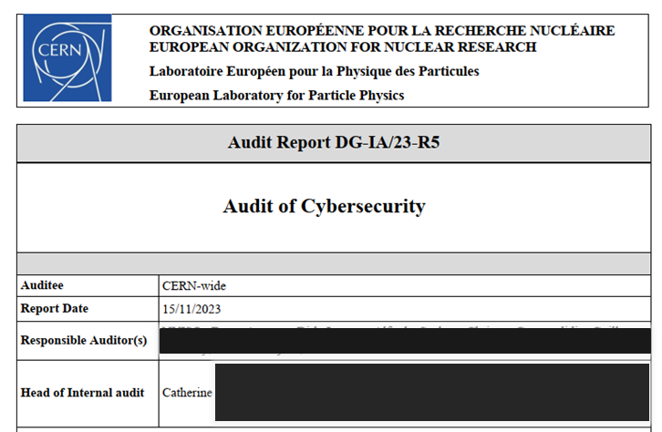
18 Months into the 2023
Cyber-Security Audit

Slide 2
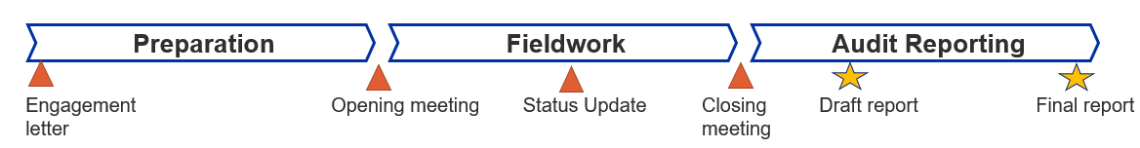
About CERN Audits
CERN’s Internal Audit service provides independent assurance
3-year rolling audit plan with input from management, external auditors & audit committee (i.e. representatives from all member states)
Some audits contracted to external company
Here: Contracted in Q1 2023 to a company from Belgium
Q2 Q2/3: 100h+ of interviews Q4: Approval
Company did a good job, but under-estimated CERN’s complexity…
…of course, an audit can be friend or foe.

Slide 3
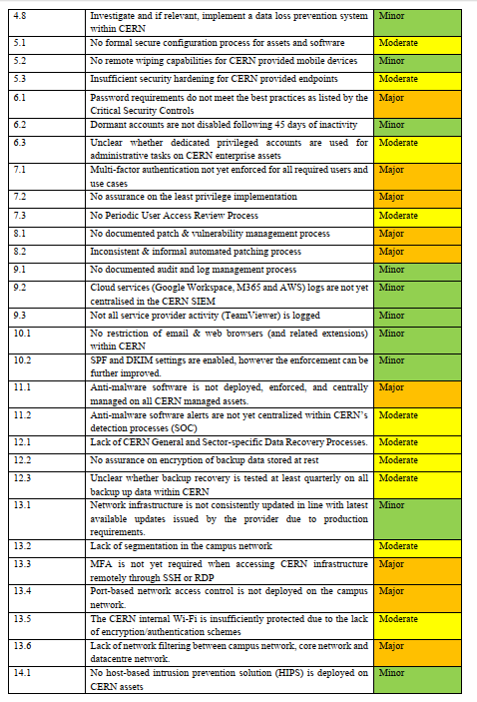
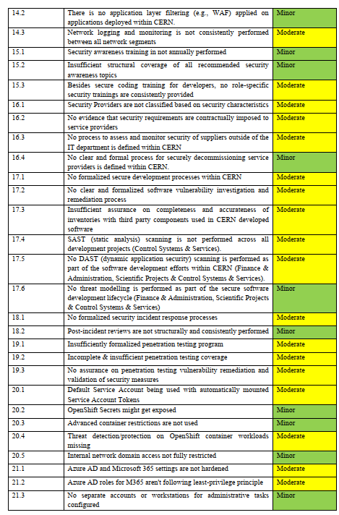
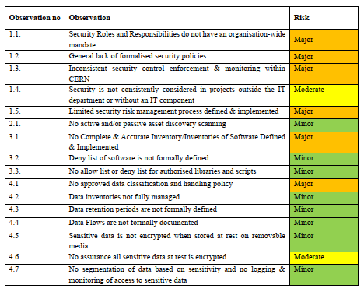
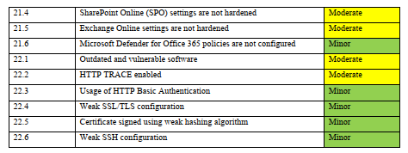
Cyber-Security Audit Findings
Following CISv8 standard
selected by CSO; alternative: ISO27k
http://www.cisecurity.org/controls/v8
82 findings, but NO SURPRISES!
0 crit./15 major/34 moderate/33 minor
This translated into 95 work packages for 2024-2026
9 findings rejected as BS/irrelevant
18 risk accepted as implementation
costs were too high/impossible
For many, work already started well before audit ☺☺☺

Slide 4
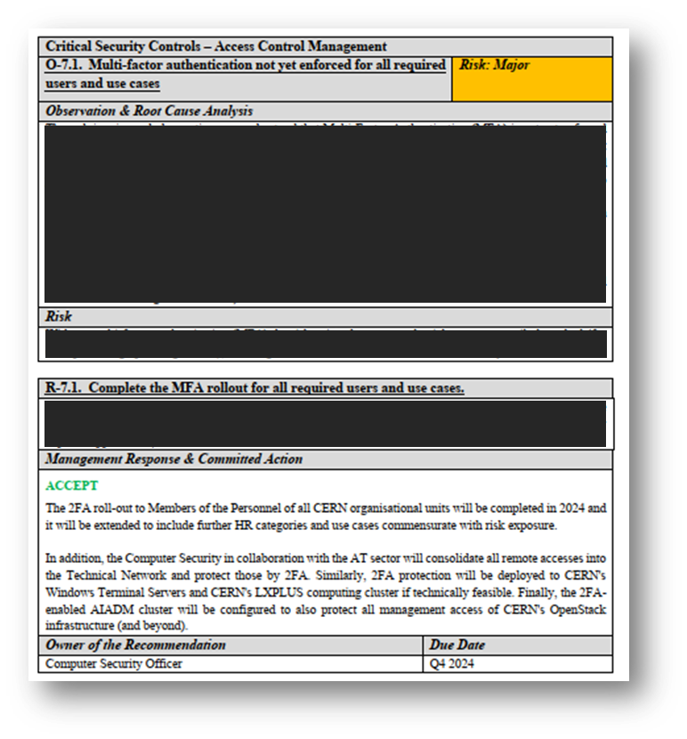
CERN Internal Audit Report Format
Risk level:
Critical, Major, Moderate, Minor
Observation numbered O-m.n
where m is 1+CISv8 chapter
Contractor’s finding(s)
Contractor’s recommendation(s) R-m.n
CERN’s response and commitment. Accepted (or rejected) by CERN’s DG
Internal Audit requires implementation for Critical, Major, Moderate by that deadline

Slide 5
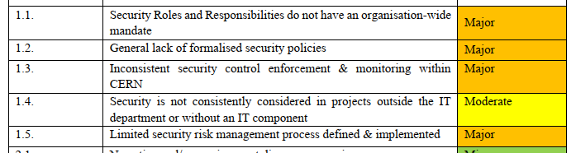
Extra: Governance



 Done/established
In the work plan 2024/2025
!? Challenging


1.1 Approved new Cyber-Security Policy as well as Mandate of CSO
  → https://cern.ch/ComputingRules
1.2/3 Created “Computer Security Board” discussing Subsidiary Policies with liaisons from sectors/departments/units & major experiments
1.4 Approved a Subsidiary Policy to require security reviews for all CERN
1.5 Integrated cyber-risks into ERM + IT department’s risk register

Slide 6

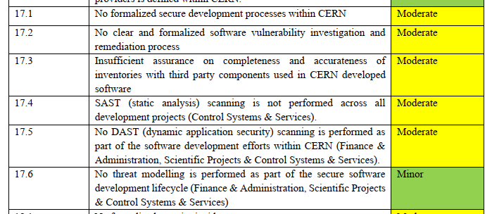
CIS#1&2 Inventory & Control of Assets

Rejected


Risk
registered


Identified all stakeholders (i.e. beams, business computing, IT services, physics software, Open-Source Program Office)
Engaged external consultant (from Gartner) for input and guidance
Assigned authority (“STEPS”, a CIO-in-disguise) to drive this forward,
but missing a good driver
Eventually requiring a (light-weight) SBOM for “critical” services?

Slide 7
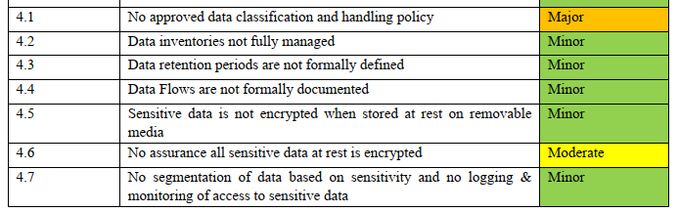
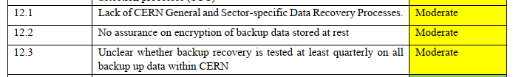
CIS#3&11 Data Protection & Recovery







Quasi-approved new (old) policies. Now performing DHP gap analysis
Created “Data Governance Officer” role

Slide 8


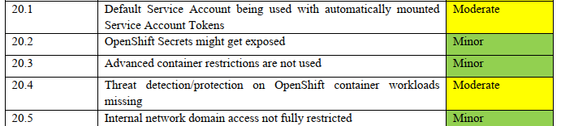
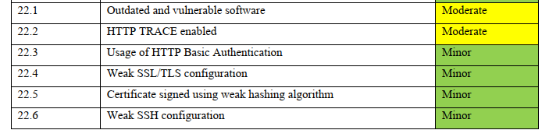
CIS#4&7 Secure Config & Vuln’s












Slide 9
CIS#4&7 Secure Config & Vuln’s
5.1/20-22.x Deployed “Security Principles” for containers, web applications, … → https://cern.ch/ComputingRules
5.1 Hardening Openstack (~30k VMs):
2026: Enforcing “Golden” images. Profit eventually Harbor SBOM?
5.1 & 22.1/6 Hardening “Puppet”:
Reviewed firewall defaults, “auditd” everywhere,
Now deploying “Vault” secrets management (e.g. w/r SSH ciphers)
5.2 & 22.1 Hardening Windows & AD infrastructure:
Killed LLMNR/NTLMv1/SMBv1; deployed Bitlocker; upcoming AD pentest
14.2 & 22.2/4/5 Hardened Websphere (~15k websites):
Module curation on “WordPress”; WAF deployment;
2026: Enforcing “Security Principles” (TLS, certificates, cookie policy, …)
20.x Hardened Openshift (~4k PaaS containers / ~10k for web hosting):
2026: Enforcing “Golden”/”distroless” and/or minimal containers

Slide 10
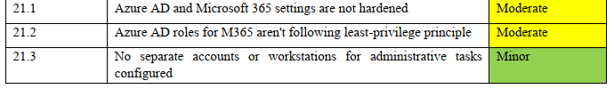

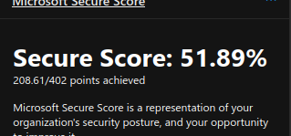
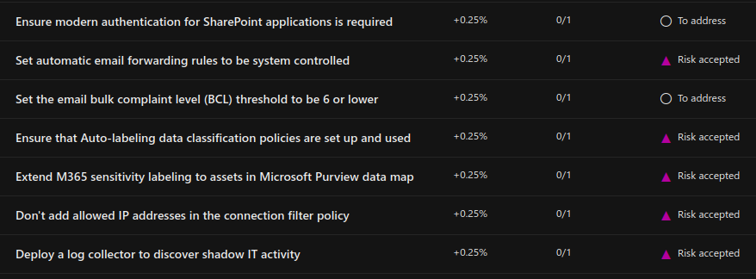
CIS#4&7 Secure Config & Vuln’s





Conquered MS tools to reduce security risk.
MS put up lots of (license) hurdles

Slide 11
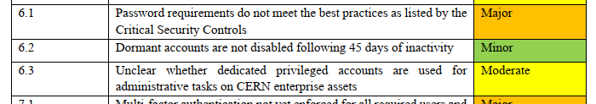
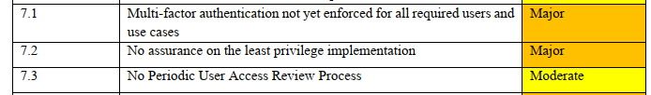
CIS#5&6 Accounts & Access Control



6.1 Enforce 15+ chars password length / no complexity (NIST 800-63b)
6.3 Reviewed admin accounts; reduced usage of ~9k Service Accounts
7.1 Finished 2FA roll-out (~42k accounts in total done for CERN SSO). Now deploying to LXPLUS/SSH & Windows/RDP; VPN service Q4
7.2/3 Reviewed AuthZ groups: AIS roles, e-groups, RBAC. Needing GMS…
Plus: Terminated ~100 local logins exposed to Internet and old SSO

Slide 12
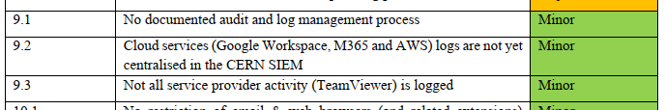
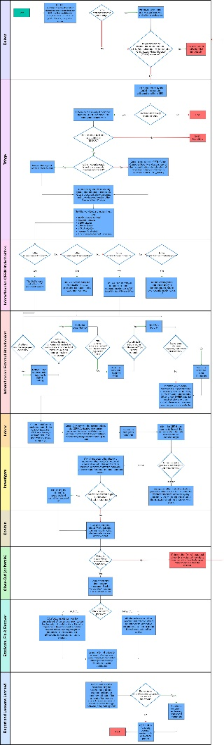
CIS#8,13&17 Logging & Incident Response




9.1 Improved CERN SOC documentation
9.2 Integrating new “cloud” data sources (MS, Google)
14.3 Ingesting traffic from DC/Experiment’s networks (2026)
18.x Revised incident response procedure.
Included process for (critical) vulnerability management

Slide 13


CIS#9&10 Email, Web & EDR




10.2 Deployed SPF/DKIM and tightened DMARC settings (“reject”)
11.1 Rolled out “ESET” EDR to ~10k CERN-managed Windows plus
CERN-owned Windows/macOS devices
14.1 Ongoing roll-out of “ESET” to Windows Terminal Servers

Slide 14
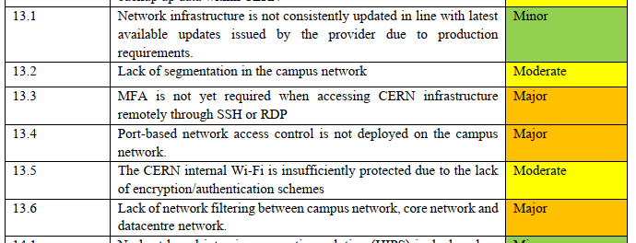
CIS#12 Network Infrastructure




13.2 Improving protection of DC against Campus (→ “DMZ”; 2026)
13.5 Now deploying WPA3 on Campus network
13.6 Redesigning DC & TN inter-network filtering (2025)
2026: Installation & testing; LS3: Deployment together with ATS

Slide 15



CIS#12 New Network Infrastructure
External Network (Internet)
Campus
Campus Network
IoT VLANs
Technical Network (TN)
BB1
BB2
External sites
Experiment pits
WLCG Tier1/2/3s
Experiment Networks (EN)
Meyrin Data Centre
Prévessin DC
IPMI
IPMI
DAQ
(main experiments)
ITS
ITS
LHCONE/LHCOPN
(Tier1/2s)
DAQ
(small experiments)
LCG
LCG

Slide 16
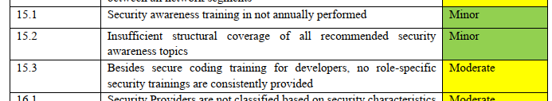
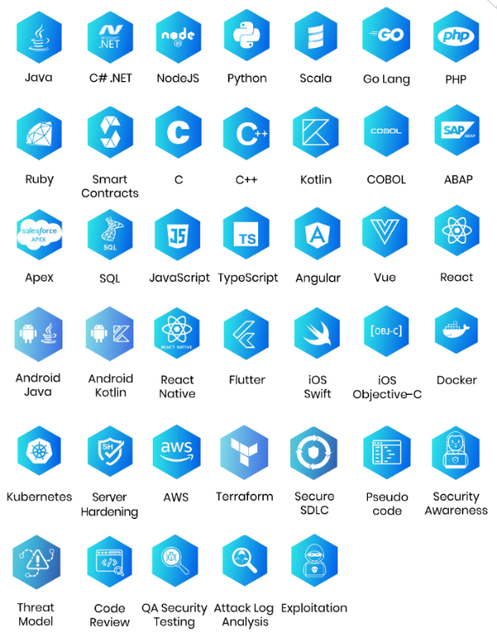
CIS#14 Awareness & Training



Contracted new training courses
to “SecureFlag” on-line platform
Integrated into the annual interview process for all software developers, architects, IT-service managers, …; Enforcing in 2026

Slide 17
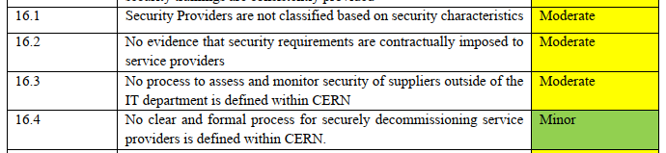
CIS#15 Service Providers




16.1 Modified “Supplier database” to add link to security/GDPR reviews of all tenders/purchases
16.2/4 Adapted tender documents for every purchase with IT-component
(i.e. technical specification and supplier questionnaire)
16.3 Correlating our Supplied DB entries with DarkWeb intelligence

Slide 18
CIS#16 Application Software Security



17.1 Using OWASP’s “Cheat-Sheets” as “Security Principles” for devs.
17.2 → Incident Response & Vulnerability Remediation Procedure (18.x)
17.4 Readied Git SAST & “Secrets scanning”.
Now enforcing both to a subset of 135k repos
17.6 Covered by review process and risk register (1.x)

Slide 19
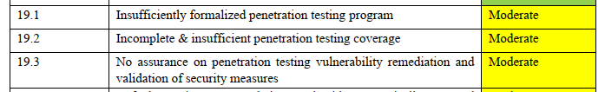
CIS#18 Penetration Testing



19.1 Formalized pentesting program together with
general review/assessment program
19.2 Concluded one-off vuln. scan of 7k websites & 3k webservers.
No catastrophes, but several XSS and other “standard” vulnerabilities
19.2 Deployed “canaries”, SOC monitored
19.2 Running Bug Bounty Program pilot
19.3 → Incident Response & Vulnerability Remediation Procedure (18.x)

Slide 20
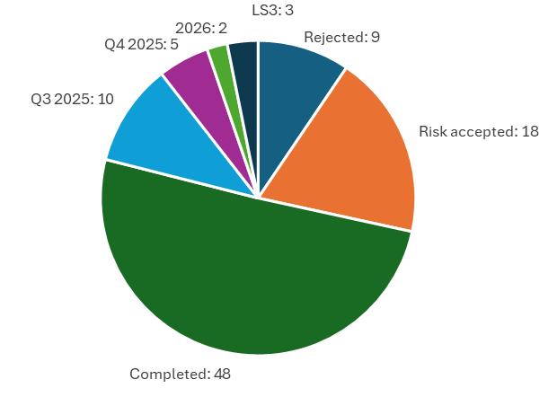
Cyber-Security Audit Status
A long and intense journey
82 findings, 64 committed actions,
95 work packages in total
Aim to have most implemented by Q4 2024 & accepted by Internal Audit
Recall the
“NO
SURPRISES!”
Many
well on track
Still, some
very hard nuts
left…

Slide 21
Many thanks to
Adam, Ale, Aleksandra, Alex I, Alex L, Alexandros, Carles, Edoardo, Hannah, Igor, Ismaël, Jean-Yves, Joao, Jose, Liviu, Luna, Marc VdE, Mario, Michal, Nilo, Pablo, Pau, Paul, Robin, Roman, Sebastien, Sebastian, Steve, Tim, Vincent B, Vincent D, Wayne
…and everyone else helping to further securing CERN!!!
Resources:
https://cern.ch/ComputingRules
https://home.cern/tags/computer-security
…or ping me at Stefan.Lueders@cern.ch

