Slide 1
FTI Group Meeting
December 2024
Alberto Di Meglio

Slide 2
Welcome to the FTI Group
This is the first Group Meeting of FTI
  ... an opportunity to explain what the Group is about
  ... the ambitions, mandate, objectives, expected results
  ... and meet each other
Group meetings don’t have to be boring!!
  ... how do we make them...
    Useful
    Informative
    Fun!!
Ideas, suggestions, proposals are welcome, this is not about me, it’s about everybody

Slide 3
Let’s start from...
What the hell does FTI means??
It stands for Frontier Technologies and Initiatives
Well... It’s even less clear than before...
Fine, let me ask the source of all true knowledge...

Slide 4
ChatGPT, what does “Frontier Technologies” mean?
"Frontier technologies" refer to cutting-edge, innovative technologies that are at the forefront of scientific and technological advancement. These are typically emerging or breakthrough technologies that have the potential to disrupt industries, solve complex global challenges, or transform how people live and work.
They are often in early stages of development or adoption but hold significant promise for the future. Some examples of frontier technologies include:
Artificial Intelligence (AI) and Machine Learning
Quantum Computing
Big Data
Metaverse and Digital Twins
Next-Generation Connectivity
…

Slide 5
Now it’s clear, thanks!
But why Communications and Education?
Well, innovation and frontier technologies strongly rely on explaining, showing, educating, training, connecting, participating, co-developing, etc. etc.
Understanding how to talk to people of all ages and backgrounds and designing new ways of doing so is also part of living on the frontier
But there is much more, so let’s dive into some more details

Slide 6
Organisational structure
A high-level organigram provides a simplified view of where key capabilities will sit across the department in the future state. The structure has also been designed to increase collaboration across IT, enabling innovation to flourish in-line with the IT Strategy.
Department Head
Computing Security
Technical Coordination
Frontier Technologies and Initiatives
Resource Management
Capacity Planning
Governance, Risk and Compliance
OQI
Architecture
FinOps
Technical Capability Delivery & Development
Technical Capacity Planning & Management
Business Engagement
Service Management
Change Management
Collaborations and Partnerships
New Technologies Programmes and Projects
Communication & Outreach
Learning and Education
Portfolio Management
Supplier & Contract Management
Talent Management
Finance & Accounting
Vendor Management
Facilities Management

Slide 7






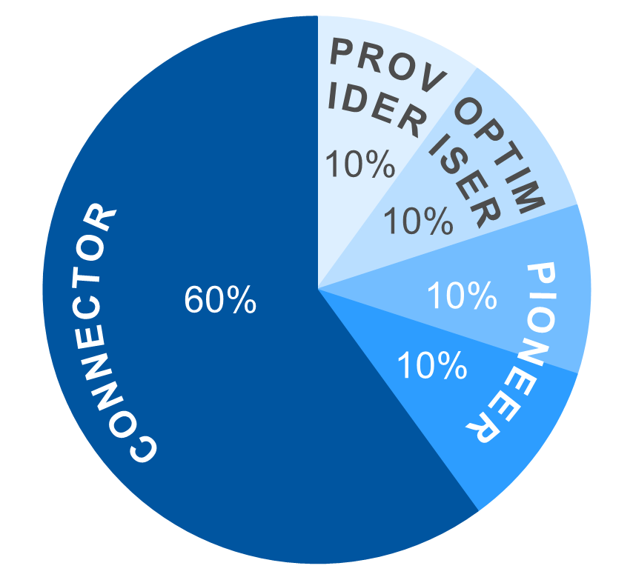
Frontier Technologies and Initiatives: Functional overview
The Frontier Technologies Initiatives Group (IT-FT) is responsible to identify, support and where appropriate execute joint development projects on frontier technologies in collaboration with the IT Technical Delivery experts, the CERN community, other scientific communities and industry. It is also responsible to oversee the communication, outreach and education activities to support the execution of the IT strategy, develop skills in emerging technologies, and maximise the visibility and impact of the IT Department on science and society.
Frontier Technologies
and Initiatives
Collaborations and Partnerships
Physics Software Engineering
Computing and Data Science
Communications
and Outreach
Learning and Education
Technology
Infrastructures
Section
NextGen
Function
KEY ROLES & RESPONSIBILITIES
MEASURES OF SUCCESS
Promote, define, and support the establishment of collaborations and partnerships with the scientific communities, industry and other international organisations
Support the CERN and HEP community in the assessment of new technologies like AI, HPC and Quantum, and the development of efficient, sustainable physics computing applications
Oversee the development and execution of the IT communication strategy, ensuring alignment to CERN’s overall mission and objectives and maximisation of impact
Define, oversee and execute education and skills development programmes and initiatives
Increased intra- and inter-departmental collaboration on new technologies development
Improved efficiency and transparency of joint activities and their impact
Improved clarity on the role of IT Department in the CERN innovation objectives
Increased engagement across CERN as a result of effective socialisation of objectives
Increased visibility and impact of IT Department as a result of effective communications
Increased impact and reach of education and skills development within and outside the CERN community
KEY
CAPABILITIES
ROLES
FRAMEWORK
GOVERNANCE STRUCTURES
PAIN POINTS ADDRESSED
Quarterly Group meetings
Bi-weekly Section Leaders meeting
Weekly one-to-one meetings with Section/Function leads
Attendance by representation at IRB, ITSC, STDF and other bodies as required
Communicating the role CERN IT plays in fostering a culture of continuous improvement and cutting-edge solutions more clearly
Provide better alignment of partnerships, communication, and education with the IT Dep. strategic objectives
Technology Assessment
Collaboration
Innovation
Education and Outreach
Communication
Impact on society

Slide 8
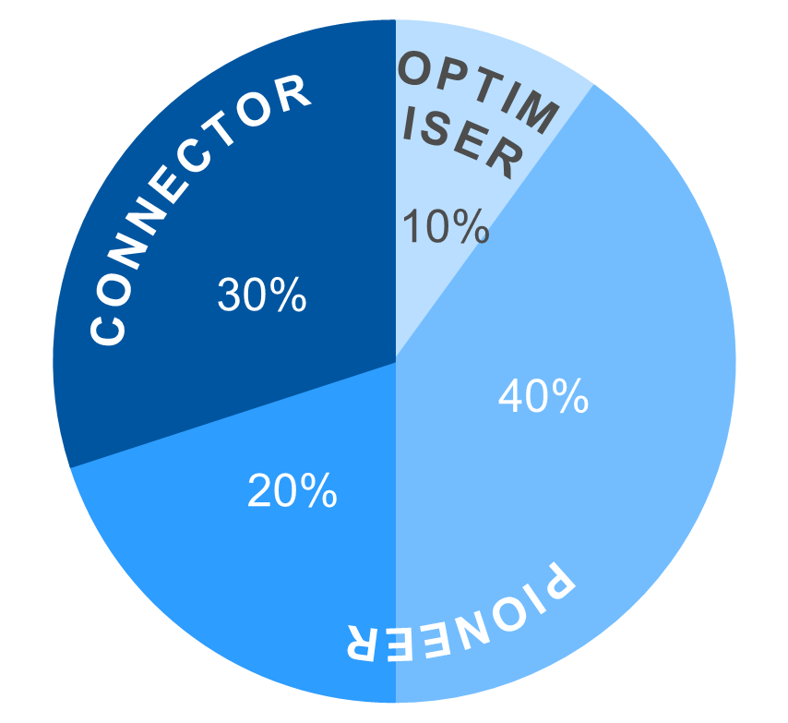
Collaborations and Partnerships: Functional overview
The Collaborations and Partnership section fosters strategic alliances to drive technical innovation and support CERN's mission. The section is responsible for promoting and developing collaborations with scientific communities, the HPC community, industry leaders, European initiatives, and other international organizations. By engaging with key internal and external stakeholders, the section advances the co-development oftechnologies and techniques for the benefit of the IT Department, CERN experiments and CERN activities at large.
Frontier Technologies
and Initiatives
Collaborations and Partnerships
Physics Software Engineering
Computing and Data Science
Communications
and Outreach
Learning and Education
Technology
Infrastructures
KEY ROLES & RESPONSIBILITIES
MEASURES OF SUCCESS
Promote and support collaborations by facilitating the establishment and growth of partnerships with scientific and technical communities, industry leaders, infrastructures providers, international organizations, ensuring alignment with CERN's strategic objectives.
Develop and strengthen relationships with EuroHPC-JU and national HPC providers, participate in HPC user and access fora and publicize and coordinate HPC access opportunities..
Drive technical innovation by initiating and executing joint projects with industry, research communities and infrastructure providers (i.e. HPC) to position CERN at the forefront of scientific and technological advancements.
Engage with external stakeholders such as the European Commission, the CERN computing community, and other stakeholders to develop and execute programmes that attract external support, drive innovation, and foster CERN's mission.
Foster international collaboration by iidentifying and developing opportunities for international collaboration across diverse scientific domains, fostering a global network of partnerships that contribute to CERN’s long-term vision.
Engage new industries and strategic partners: successfully attract new industry and research partners for exploratory and strategic projects, expanding CERN's collaborative network.
Revitalize existing projects: refresh and sustain existing collaborative projects, maintaining a focus on cutting-edge innovation and ensuring continued relevance and impact.
Enhance dissemination activities (scientific publications, annual reports, presentations at conferences, strategy documents) to promote joint activities, while increasing participation in external opportunities.
Increase project visibility: elevate the visibility and recognition of CERN’s collaborative projects, showcasing their contribution to advancing CERN’s mission and their broader impact on the scientific community.
KEY
CAPABILITIES
ROLES
FRAMEWORK
GOVERNANCE STRUCTURES
PAIN POINTS ADDRESSED
Bi-monthly Section leaders meetings
Weekly section meetings to assess technical progress, status and plans
Regular meetings as required by projects and collaborations (Internal and external technical meetings, CERN openlab partnerships, EC office, PMO, KT)
Provide better alignment of partnerships, communication, and education with the IT Dep. strategic objectives
Technology Assessment and R&D
Collaboration
Knowledge Sharing
Partnership
Management
Innovation

Slide 9
Physics Software Engineering: Functional overview
The Physics Software Engineering Section works on novel software engineering concepts and computing hardware performance aspects of commonly used algorithmic data processing applications in high energy physics (HEP) and provides support and opportunities for skills development and visibility of software engineers and computing experts in relevant activities.
Frontier Technologies
and Initiatives
Collaborations and Partnerships
Physics Software Engineering
Computing and Data Science
Communications
and Outreach
Learning and Education
Technology
Infrastructures
KEY ROLES & RESPONSIBILITIES
MEASURES OF SUCCESS
Improve the performance of software applications commonly used in the HEP community by adopting new computing hardware architectures and engineering techniques
Investigate and evaluate innovative computing architectures and software engineering concepts for their usability in the domain of physics data processing
Measure and enhance the sustainability of HEP software at the level of the individual application on current and future heterogeneous computing architectures
Boost the career paths of research software engineers and scientists via specialised training and recognition of their work in the field
Adoption of software packages within the HEP community, in particular the LHC experiments and their usage on novel computing hardware platforms
Improvements in data processing challenges of forthcoming data taking periods based on solutions provided by the Section
Increased adoption of novel software engineering techniques, tools and platforms within the physics software engineering community
Improved skills development, especially students and early career researchers, training resources and recognition mechanisms
KEY
CAPABILITIES
ROLES
FRAMEWORK
GOVERNANCE STRUCTURES
PAIN POINTS ADDRESSED
Bi-weekly Section leaders meetings
Weekly section meetings to assess status and plans
Regular meetings with projects and collaborations (CERN EP + TH, NGT, LHC MC WG, MCNet, HSF, ICFA, JENA, EIROforum, EVERSE, SYCLOPS, …)
Communicating the role CERN IT plays in fostering a culture of continuous improvement and cutting-edge solutions more clearly
Improve integration and exchanges across the RCS sector on software engineering and code development for physics
Technology Assessment
Collaboration
Innovation
Training and Recognition
Impact on physics data processing

Slide 10
Computing and Data Science: Functional overview
The Computing and Data Science Section will study the impact of cutting-edge technologies like Quantum Computing and Artificial Intelligence on the development of future computing models for fundamental scientific research by developing proof of concepts and co-development activities with IT Dep. experts, CERN and experiments experts, and researchers in industry and other relevant scientific communities.
Frontier Technologies
and Initiatives
Collaborations and Partnerships
Physics Software Engineering
Computing and Data Science
Communications
and Outreach
Learning and Education
Technology
Infrastructures
KEY ROLES & RESPONSIBILITIES
MEASURES OF SUCCESS
Work closely with IT Department experts and the CERN and experiments community to identify areas of interests to introduce or expand the use of emerging technologies, such as AI and Quantum
Design, develop, test, and assess technology proofs of concept in real-world scenarios
Design and execute joint research projects with academia, industry, and international research organizations within and beyond HEP
Contribute to Education, Communication and the further development of technical competences maximising the impact of the activities on CERN and society
Number and impact on CERN activities of new prototypes and demonstrators showcasing new technology on realistic use case
Number quality of scientific publications
Increased impact of education and skills development in IT, CERN and beyond through support for internships and student projects (Master, PhD)
KEY
CAPABILITIES
ROLES
FRAMEWORK
GOVERNANCE STRUCTURES
PAIN POINTS ADDRESSED
Bi-monthly Section leaders meetings
Weekly Section meetings
Weekly journal club (dedicated to new tech scouting and knowledge sharing)
Project meetings as necessary
Communicating the role CERN IT plays in fostering a culture of continuous improvement and cutting-edge solutions more clearly
Improve integration and exchanges among teams working on different techs (i.e. HPC, QC, AI, …) across IT Dep. and the Organization
Technology R&D
Proof of Concept
Innovation
Collaboration

Slide 11
Technology Infrastructures: Functional overview
The Technology Infrastructures function provides general coordination of access to resources and capabilities from external providers to FTI activities. It also develops expertise in efficient and sustainable management and use of heterogenous computing services such as public clouds, quantum services and HPC, keeping close integration with the IT Architecture function and a direct relationship with IT Capacity Planning and the Technical Coordination teams.
Frontier Technologies
and Initiatives
Collaborations and Partnerships
Physics Software Engineering
Computing and Data Science
Communications
and Outreach
Learning and Education
Technology
Infrastructures
KEY ROLES & RESPONSIBILITIES
MEASURES OF SUCCESS
Manage agreements between the FTI Group and external resource providers to support the technical needs of IT Dept. flagship projects
Develop data analytics tooling to monitor the technology resources usage including costing, manage risks, and contribute to the Department planning and sustainability efforts
Exploit strategic partnerships in heterogeneous computing services to co-design use cases for future technologies and capabilities
Establish a direct link to IT Capacity Planning and IT Architecture functions and contribute to the transition of the experience of the FTI projects into Technical Delivery
Successful provisioning of resources to FTI projects and initiatives
Improved understanding of cost management of new architectures in the IT services lifecycle
Operational access model for quantum services in the CERN Quantum Hub
Consolidated synergies between the activities of FTI , ARB, Capacity Planning and TC
Better understanding of areas for future strategic collaborations with external providers
KEY
CAPABILITIES
ROLES
FRAMEWORK
GOVERNANCE STRUCTURES
PAIN POINTS ADDRESSED
Weekly Report meetings
Project meetings with the QTI and NGT
ARB meetings
Capacity Planning meetings
Project meetings with industrial partners
Standardisation of metrics for seamless access across diverse computing resources
Provision of advanced analytics capabilities with increased cost-effectiveness
Tangible impact of innovation in service operations
Strategic Planning
Resource Usage
Sustainability
Co-Development

Slide 12
Communications and Outreach: Functional overview
The Communications and Outreach team is responsible to define and implement the IT Department Communications and Outreach strategy in close collaboration with the Department Management and technical experts to maximise the visibility and awareness of the IT Department objectives, activities, and competences across a diverse range of audiences through appropriate channels, and support its impact on the advancement of science and society
Frontier Technologies
and Initiatives
Collaborations and Partnerships
Physics Software Engineering
Computing and Data Science
Communications
and Outreach
Learning and Education
Technology
Infrastructures
KEY ROLES & RESPONSIBILITIES
MEASURES OF SUCCESS
Oversee all internal and external IT communications, ensuring its messaging is consistent and engaging
Promote the IT Department’s mission in supporting the CERN research programmes and open science
Create communications initiatives to foster motivation, engagement, and attractiveness
Prepare detailed reports, press releases, and other materials as necessary
Increased number of readers of published articles
Increased number of profiles following the social media (positive growing trend)
Improved number and sentiment of the impressions and reactions to posts
Attract spontaneous feedback, improved number and sentiment of reactions to published articles
KEY
CAPABILITIES
ROLES
FRAMEWORK
GOVERNANCE STRUCTURES
PAIN POINTS ADDRESSED
Weekly meeting with all IT comms officers involved with the various projects (Editorial team meetings)
Weekly reporting to Group leader
Weekly meeting with IR-ECO
Communicating the role CERN IT plays in fostering a culture of continuous improvement and cutting-edge solutions more clearly
Communicating technical topics
Strategic planning
Audience analysis
Storytelling
Internal culture sensitivity

Slide 13
Learning and Education: Functional overview
The Learning and Education team is responsible to define and execute the processes and mechanisms through which the IT Department builds and transmits knowledge to support its current and future strategic objectives. This includes supporting the internal evolution of skills and behaviours, collecting and organising learning resources, and contributing to wider knowledge creation for science and society via initiatives like the CERN School of Computing and the CERN openlab Summer Student programme.
Frontier Technologies
and Initiatives
Collaborations and Partnerships
Physics Software Engineering
Computing and Data Science
Communications
and Outreach
Learning and Education
Technology
Infrastructures
KEY ROLES & RESPONSIBILITIES
MEASURES OF SUCCESS
Deliver and monitor learning and education opportunities for members of the CERN IT department to support the evolution of skills in technical, communication and management domains
Ensure that members of the IT Department receive continuous education in relevant technologies to keep their competencies updated and increase motivation
Deliver education programmes on IT technologies on topics relevant to CERN and to scientific research and applications and based on IT Department competences and values
Increased skills, competencies and overall motivation of IT Department members
Increased number of education opportunities in the Department, including Master & PhD students
Increased number of educators among IT Department experts on relevant topics
Increased recognition of people able to educate and transfer knowledge
Increased visibility and impact of IT Dep expertise via participation and feedback on CERN School(s) of Computing and other programmes
KEY
CAPABILITIES
ROLES
FRAMEWORK
GOVERNANCE STRUCTURES
PAIN POINTS ADDRESSED
As the Connector: 40%
As the Pioneer: 30%
As the provider: 20%
As the Optimiser: 10%
Participation in bi-weekly Group management meeting
Chairing of the IT Department Learning and Education Steering Board
Chairing and participation in the CSC Board and other similar bodies as needed
Fragmentation of activities and initiatives across groups, departments, and sectors.
Lack of a clear place in the IT department to discuss IT education matters
Diminishing attractiveness of IT Department as employee in IT domains
Digital Literacy
Knowledge Sharing
Talent growth
Programme
management

Slide 14
So what’s next
We will (try to) have a Group meeting per month
  Share information and discuss about topics of broad interests (not necessarily technical)
  Get to know each other, welcome new people as they join, say good-bye to people moving on through their lives
I’m collecting ideas about what to do in 2025
  Pizza is always an option...
  ... But so is skiing, go-karting, sailing, playing Magic the Gathering, curling, ...
Let’s help each other make the most of the time we spend together, it’s normal and even constructive to have different opinions, it’s less easy to find ways of sharing them in a safe environment
  Beyond the technical aspects, it is a high-priority mission for me to make sure everybody and anybody has a way of expressing themselves and feeling great about doing it
  My door is always open

Slide 15
Let’s Glögg!!
And Secret Santa!!

