Slide 1


IT-FTI-CAP
Collaborations & Partnerships
Maria Girone, Section Leader

Slide 2
IT-FTI-CAP
Functional Overview
Collaborations and Partnerships
The Collaborations and Partnership Section fosters strategic alliances to drive technical innovation and support CERN's mission. The section is responsible for promoting collaborations with scientific communities, industry leaders, European initiatives, and other international organizations. By engaging with key internal and external stakeholders, the section facilitates the co-development of technologies and techniques for the benefit of the IT Department, CERN experiments and CERN activities at large.
IT-FTI Group Meeting – December 2024

Slide 3






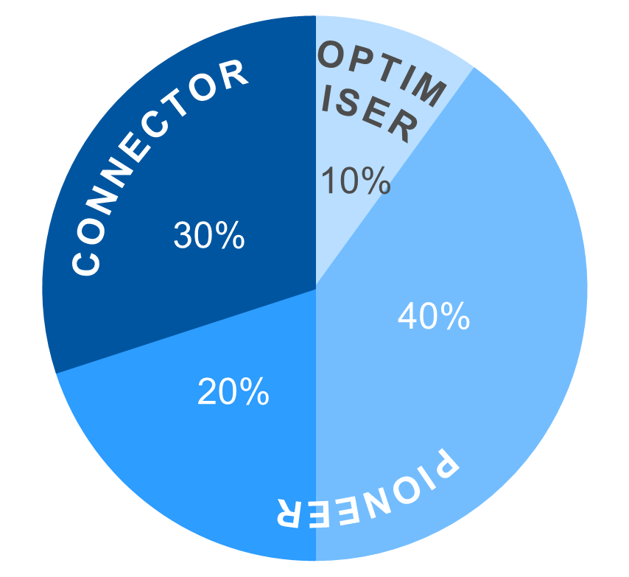
Frontier Technologies
and Initiatives
Collaborations and Partnerships
Physics Software Engineering
Computing and Data Science
Communications
and Outreach
Learning and Education
Technology
Infrastructures
KEY ROLES & RESPONSIBILITIES
MEASURES OF SUCCESS
Promote and support collaborations by facilitating the establishment and growth of partnerships with scientific and technical communities, industry leaders, infrastructures providers, international organizations, ensuring alignment with CERN's strategic objectives.
Develop and strengthen relationships with EuroHPC-JU and national HPC providers, participate in HPC user and access fora and publicize and coordinate HPC access opportunities.
Drive technical innovation by initiating and executing joint projects with industry, research communities and infrastructure providers (i.e. HPC) to position CERN at the forefront of scientific and technological advancements.
Engage with external stakeholders such as the European Commission, the CERN computing community, and other stakeholders to develop and execute programmes that attract external support, drive innovation, and foster CERN's mission.
Foster international collaboration by identifying and developing opportunities for international collaboration across diverse scientific domains, fostering a global network of partnerships that contribute to CERN’s long-term vision.
Engage new industries and strategic partners: successfully attract new industry and research partners for exploratory and strategic projects, expanding CERN's collaborative network.
Revitalize existing projects: refresh and sustain existing collaborative projects, maintaining a focus on cutting-edge innovation and ensuring continued relevance and impact.
Enhance dissemination activities (scientific publications, annual reports, presentations at conferences, strategy documents) to promote joint activities, while increasing participation in external opportunities.
Increase project visibility: elevate the visibility and recognition of CERN’s collaborative projects, showcasing their contribution to advancing CERN’s mission and their broader impact on the scientific community.
KEY
CAPABILITIES
ROLES
FRAMEWORK
GOVERNANCE STRUCTURES
PAIN POINTS ADDRESSED
Bi-monthly Section leaders meetings
Weekly section meetings to assess technical progress, status and plans
Regular meetings as required by projects and collaborations (Internal and external technical meetings, CERN openlab partnerships, EC office, PMO, KT)
Provide better alignment of partnerships, communication, and education with the IT Dep. strategic objectives
Technology Assessment and R&D
Collaboration
Knowledge Sharing
Partnership
Management
Innovation
IT-FTI Group Meeting – December 2024

Slide 4



















CERN openlab – Phase VIII (2024-2026)
Strategic Directions
Enhance industry and research partnerships, in particular within Europe, leveraging on CERN ILOs.
CERN openlab as incubator for strategic partnerships.
Established Industry and Research Members
R&D Directions
Sustainable Infrastructures
Industry and Research Members in
Pre-agreement Stage
Heterogenous Computing, Platforms and HPC Systems
Computing Architectures and Software Engineering
Advanced Storage, Data Management and Networks
Infrastructures and Techniques for Artificial Intelligence
Applications for Society and Environment
Prospective Industry/Research Members
Emerging Technologies
New Materials for Long-Term Digital Storage
Digital Twins
Quantum Computing and Networks
Europe (8)
DE
IT
FR
CH
FI
Structured Three-year Phase Cycles
Systematically Assess Technological Evolution
Anticipate future needs
Delineate overarching thematic priorities
U.S. (5)
IT-FTI Group Meeting – December 2024

Slide 5
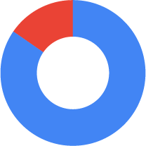


Project
Status
OSCARS
Ongoing
EC
Projects
IT-FTI
EVERSE
Ongoing
Approved Projects by Pillar
EOSC Beyond
Ongoing
Pillar 2 (15.4%)
Horizon-ZEN
Ongoing
Pillar 1 (84.6%)
IT-FTI
SPECTRUM
Ongoing
AARC3
Ongoing
IT-FTI
SYCLOPS
Ongoing
FAIRCORE4EOSC
Ongoing
Approved Projects by Pillar
IT-FTI
interTwin
Ongoing
Horizon Europe Pillars:
Coordination and Support Action (23.1%)
Research and Innovation Action (76.9%)
OpenWebSearch.EU
Ongoing
1
Scientific Excellence
EOSC EDEN
Not Started
2
EOSC Data Commons
Not Started
Global Challenges and European Industrial Competitiveness
IT-FTI
ODISSEE
Not Started
3
Innovative Europe
IT-FTI
TURING
Submitted Proposals
*Submitted proposals are not included in the charts
IT-FTI
QUARK
Submitted Proposals
IT-FTI Group Meeting – December 2024

Slide 6






Matteo Bunino
Mariana Velho
Kalliopi Tsolaki
Killian Verder
Anna Elisa Lappe
Jarl Saether
Maria Girone
Stravos Portokalidis
Eric Wulff
David Southwick
IT-FTI Group Meeting – December 2024

Slide 7

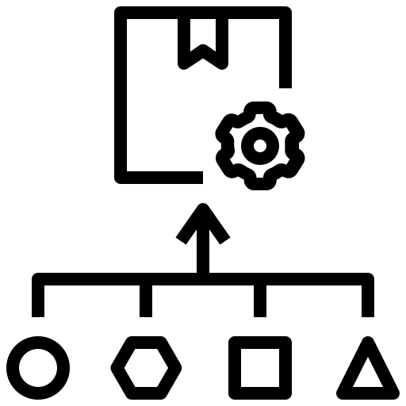









EC Collaborations and R&D on HPC
New Techniques and Technologies
New Challenges and Opportunities
Enables Machine Learning and AI algorithms and processing techniques
New resources for processing
Requires technology migration and redesigning of applications
Opens the possibility for real-time interactive simulations (Digital Twins)
Encourages stronger engagement with industry, other science communities and the HPC community
Burst/elastic resource scheduling
Requires strategic planning between CERN, WLCG, and HPC
A path to optimize energy usage
ODISSEE
Online Data Intensive Solutions for Science in the Exabyte Era
Requires common solutions to overcome technical challenges, leveraging on externally funded initiatives (EuroHPC JU, EC funded projects, industry,…)
IT-FTI Group Meeting – December 2024

Slide 8


Questions

Slide 9
Heterogeneous Architecture Testbed: Hardware
x86
(Euro)HPC Development access
Intel Xeon: Sierra Forest, Emerald Rapids, Sapphire Rapids
LUMI, Leonardo, Deucalion, Vega, Henri, etc..
AMD EPYC*: Genoa, Milan
100+ users & 290+ accounts
Public Cloud Development access
Arm
~95 systems, mostly bare-metal
CERN Cloud Operating Model
Ampere, NVIDIA Grace, Fujitsu A64FX**
RISC-V *
Used by ATLAS, CMS, LHCb, QTI, openlab, CERN EP, IT, ATS
IBM Power (8 and 9)
Networking Switches
~200 tickets handled p/a
InfiniBand
GPU
NVIDIA T4 and L4
Omni-Path
NVIDIA V100, A100, H100**
AI Specialized Hardware*
AMD MI100, MI210x**
GraphCore, Cerabras
Intel GPU Flex 140 and 170, Max 1100
FPGA
*Remote access via E4
Xilinx U200
**Remote access via Simons Foundation
IT-FTI Group Meeting – December 2024

Slide 10
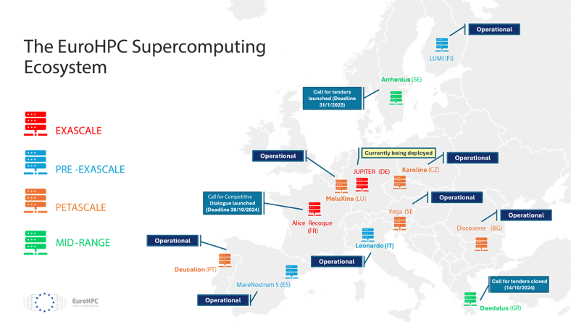
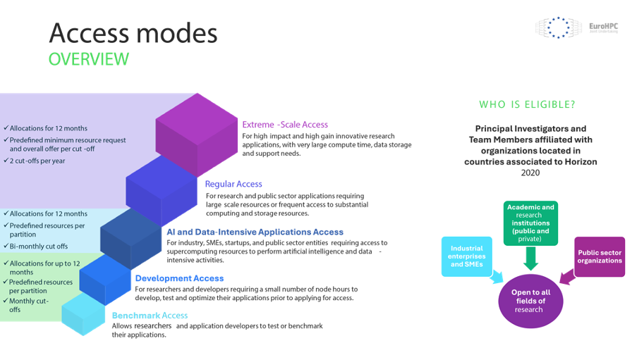
EuroHPC JU
EuroHPC JU is a joint initiative between the EU, European countries and private partners to develop a World Class Supercomputing Ecosystem in Europe
EuroHPC JU manage the access time (from 35% for petascale systems up to 50% of pre-exascale systems total capacity) of EuroHPC supercomputers
Researchers from academia, research institutes, public authorities, and industry can apply for access to computing time on EuroHPC supercomputers.
IT-FTI Group Meeting – December 2024

