Slide 1
Technology Infrastructures Function
João Fernandes
IT
IT-FTI Group Meeting – 10.12.2024

Slide 2
Outline
  Context
  Strategy for External Computing Resources
  Cloud Resources Operating Model
  Q&A
Notes:
time saved in completing a project and avoiding costly overruns. It also should mean that the same type of mistakes are not made

Slide 3






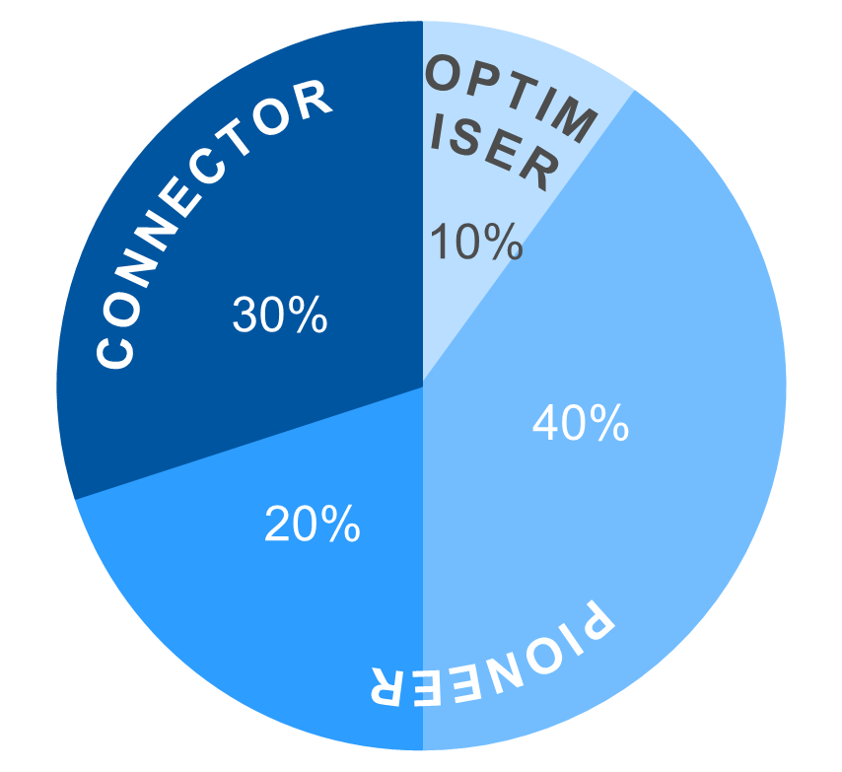
Technology Infrastructures: Functional overview
The Technology Infrastructures function provides general coordination of access to resources and capabilities from external providers to FTI activities. It also develops expertise in efficient and sustainable management and use of heterogenous computing services such as public clouds, quantum services and HPC, keeping close integration with the IT Architecture function and a direct relationship with IT Capacity Planning and the Technical Coordination teams.
Frontier Technologies
and Initiatives
Collaborations and Partnerships
Physics Software Engineering
Computing and Data Science
Communications
and Outreach
Learning and Education
Technology
Infrastructures
KEY ROLES & RESPONSIBILITIES
MEASURES OF SUCCESS
Manage agreements between the FTI Group and external resource providers to support the technical needs of IT Dept. flagship projects
Develop data analytics tooling to monitor the technology resources usage including costing, manage risks, and contribute to the Department planning and sustainability efforts
Exploit strategic partnerships in heterogeneous computing services to co-design use cases for future technologies and capabilities
Establish a direct link to IT Capacity Planning and IT Architecture functions and contribute to the transition of the experience of the FTI projects into Technical Delivery
Successful provisioning of resources to FTI projects and initiatives
Improved understanding of cost management of new architectures in the IT services lifecycle
Operational access model for quantum services in the CERN Quantum Hub
Consolidated synergies between the activities of FTI , ARB, Capacity Planning and TC
Better understanding of areas for future strategic collaborations with external providers
KEY
CAPABILITIES
ROLES
FRAMEWORK
GOVERNANCE STRUCTURES
PAIN POINTS ADDRESSED
Weekly Report meetings
Project meetings with the QTI and NGT
ARB meetings
Capacity Planning meetings
Project meetings with industrial partners
Standardisation of metrics for seamless access across diverse computing resources
Provision of advanced analytics capabilities with increased cost-effectiveness
Tangible impact of innovation in service operations
Strategic Planning
Resource Usage
Sustainability
Co-Development

Slide 4
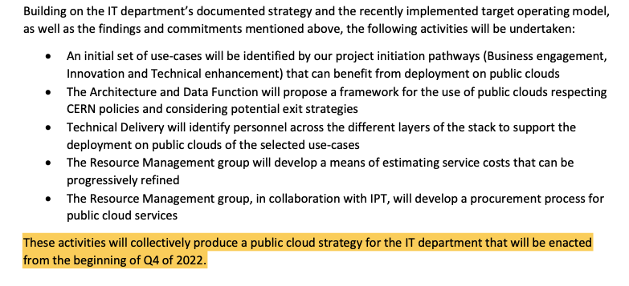
IT Cloud Strategy
  The IT Department established the need to create a Public Cloud Strategy
Published on the 6th May 2022: https://cds.cern.ch/record/2809609
Notes:
time saved in completing a project and avoiding costly overruns. It also should mean that the same type of mistakes are not made

Slide 5

Objectives
Complement on-premise capacity with public cloud services (IaaS/PaaS/SaaS)
Prepare the Department to meet the increasing computing needs of CERN
  Support future classical computing needs (e.g. NextGen)
  Equip the QTI2 with access to multiple quantum technologies to ensure its R&D objectives
Result in 2024: Final Cloud “Package” with 3 elements:
  1) Updated Cloud Policy;
  “The usage of external cloud services is overseen by the “Steering Group on Externally Provided Software, Systems, Hardware and Services (STEPS).“
    Finalised; To be endorsed CERN wide via STEPS
  2) 2 Separate blanket contracts (Cloud and Quantum) with a total of 3+2 vendors
    Results submitted to the FC 25th of September 2024 and unanimously approved;
  3) Multi-staged and Multi-Governance cloud operating model (2025)

Slide 6
Operating Model Implemented in 3 phases
Initiation Phase (now)
  Initial deployment of the Resource Operating Model and its Governance
  Top-level elements of the Governance are all in place, it is possible to make the transition to the Pilot Phase.
    Estimated timeline: Ready by January 2025

Slide 7

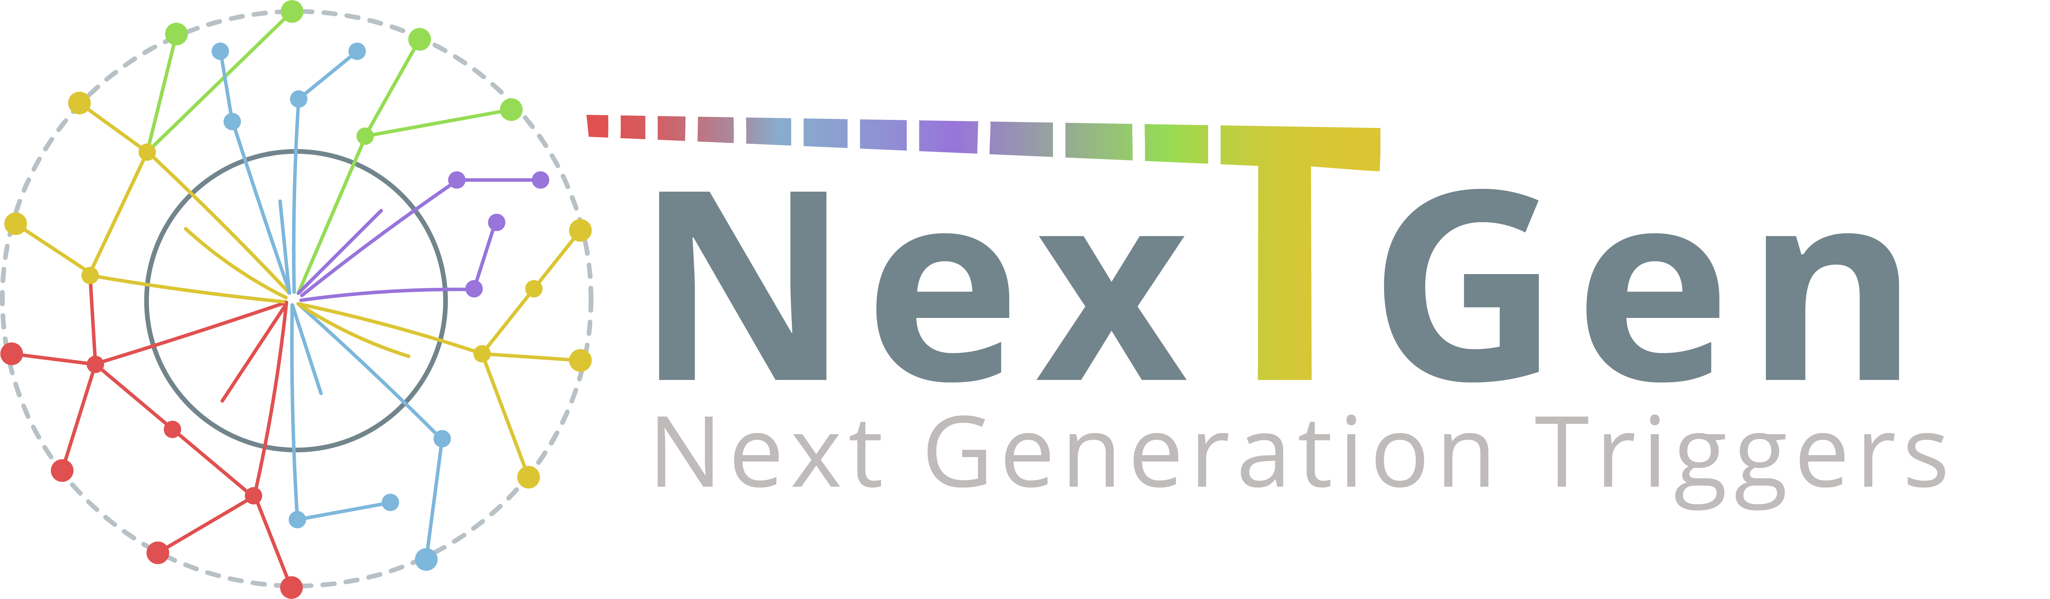

Pilot Phase 2025
  Deployment of 3 initial Pilot Use Cases to build expertise, validate the model and associated processes
  Minimum Viable Product (MVP):
    QTI2 to decide access via sub-licensing to Quantum vendors
      Access to be only provided to QTI approved R&D projects
    NextGen: NGT decides access to vendors, timings and amount of resources
      Technical effort allocated by NGT to operate and develop their own projects
        Effort allocation already in the Kubernetes Team and IT-CA
    CERN IT Pilot: Heterogenous Architectures Testbed (HAT)
      Subscription managed by the Capacity Planning function
      Minimal testing access for checking a particular technology for suitability purposes
      Limited in budget, resources and access time

Slide 8

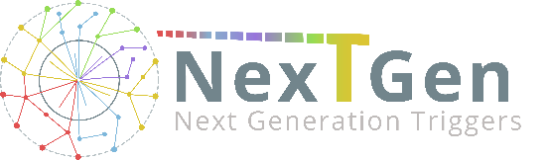
Governance - Pilot Phase 2025
Finance & Resource Management
Business Engagement
Cloud Enablement Team
IT Chief Architect
FinOps
Manager
IT Consulting Lead
Procurement & Vendor Management
Training & Upskilling
Security
IT Data Privacy Coordinator
Heterogeneous Architecture Testbed
Cloud Task Force
FinOps, TD technical experts, Capacity Planning, Resource Management, QTI and NextGen reps./technical experts, Engagement reps.
2.0
Other use cases

Slide 9
From 2026: Scaling Phase
An updated governance model for cloud and associated processes will be a deliverable from the Pilot phase by Dec 2025
The scaling phase will onboard all the lessons learned and evolution of use cases
A refined, generalised model to access external heterogeneous resources will be produced
The Scaling Phase aims to start in January 2026

Slide 10
FTI Tech Infra Function in a Nutshell
Provision of computing resources not available on-premise
  Starting by NextGen and QTI
Provide advanced analytics on resource usage, cost and optimisation
Generalise a model for heterogenous off-prem resources provisioning
Establish a direct relationship between FTI, IT Architecture and IT Capacity Planning functions

Slide 11
One More Thing…

Slide 12

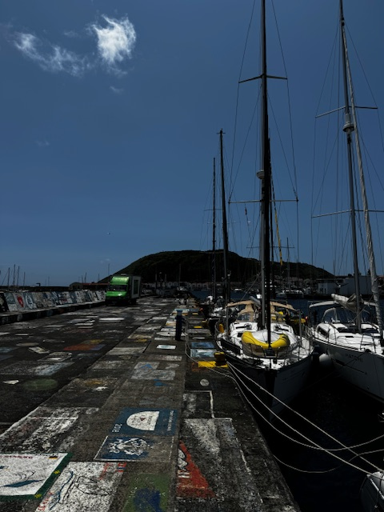

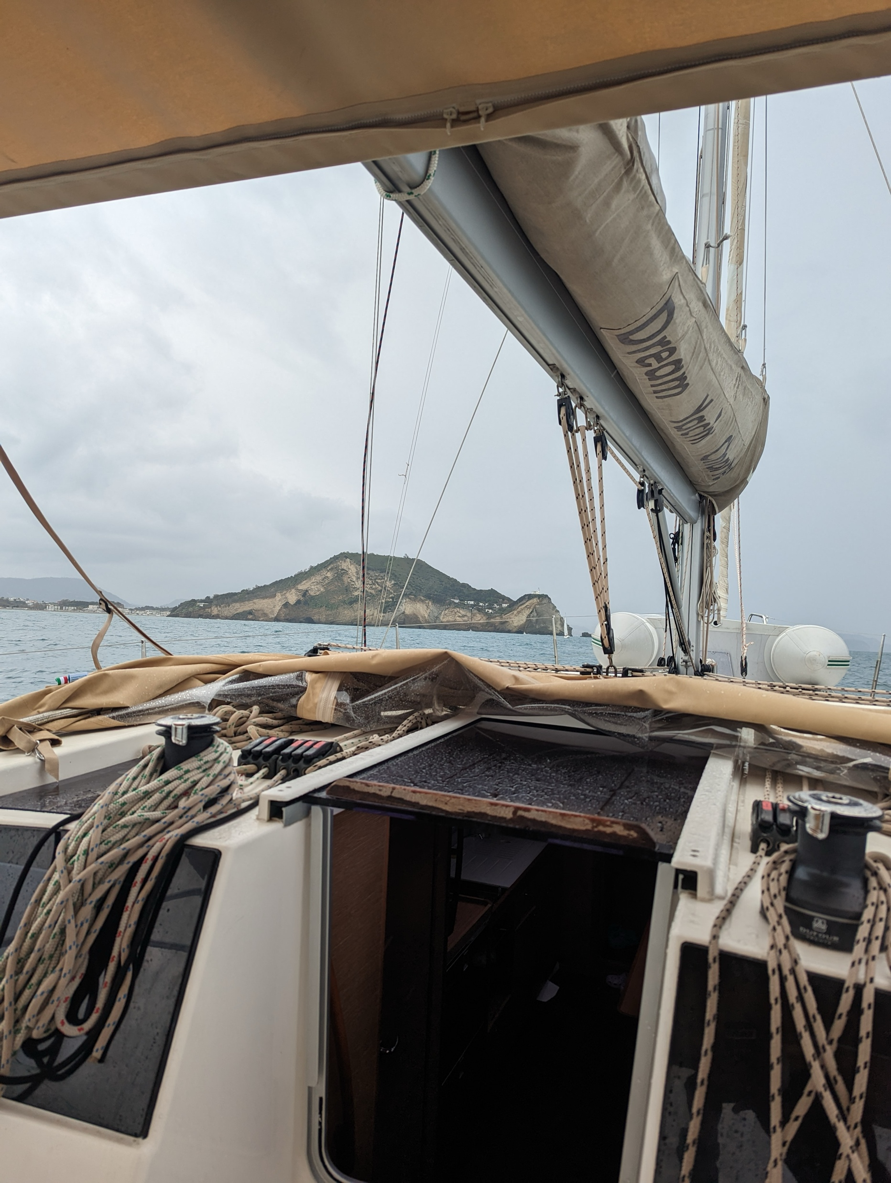
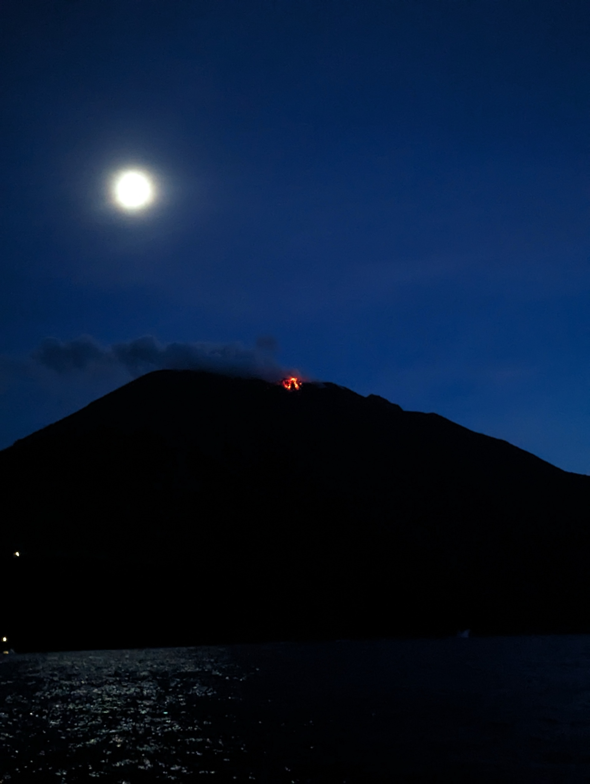
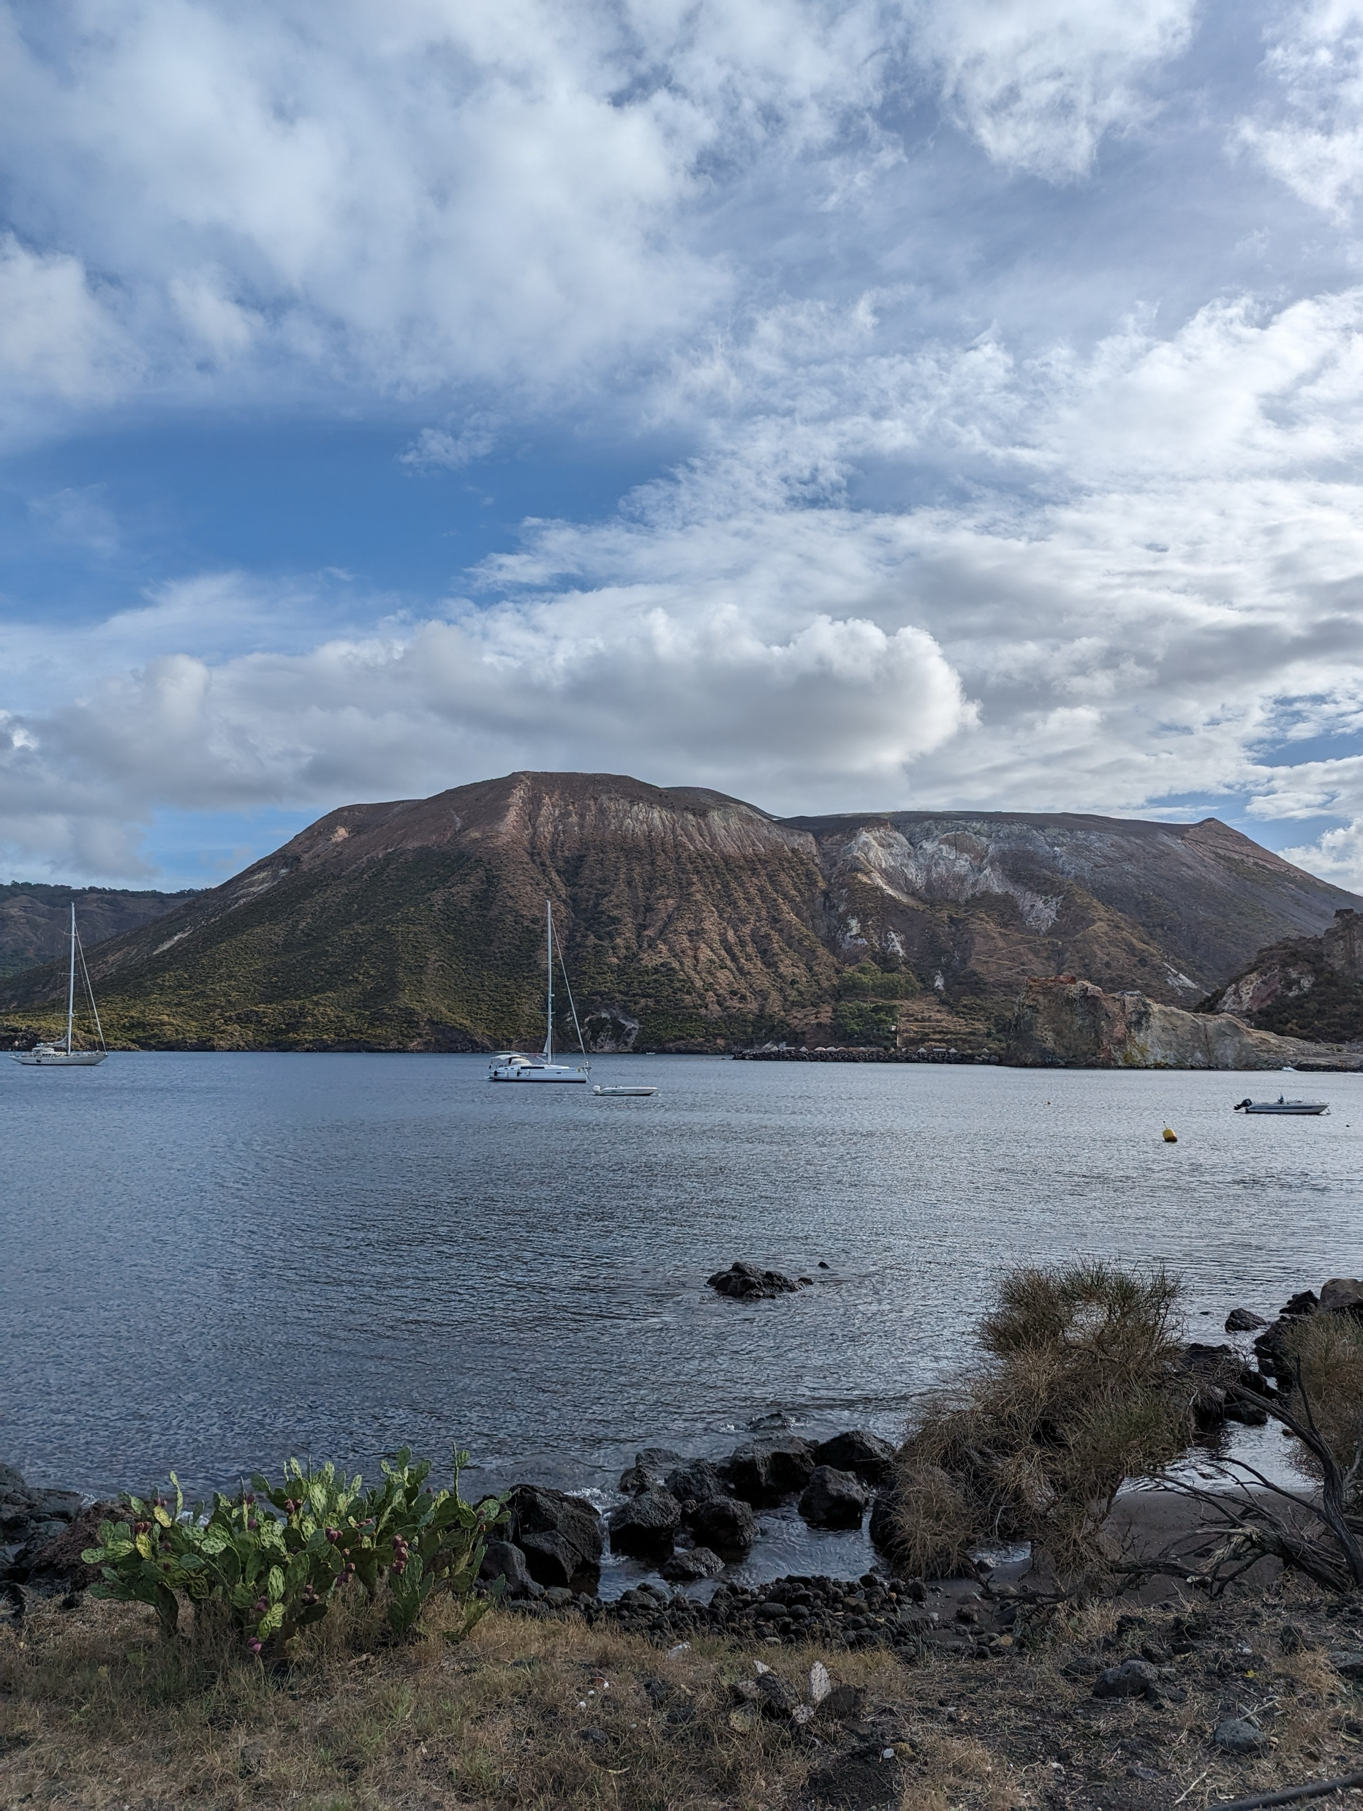
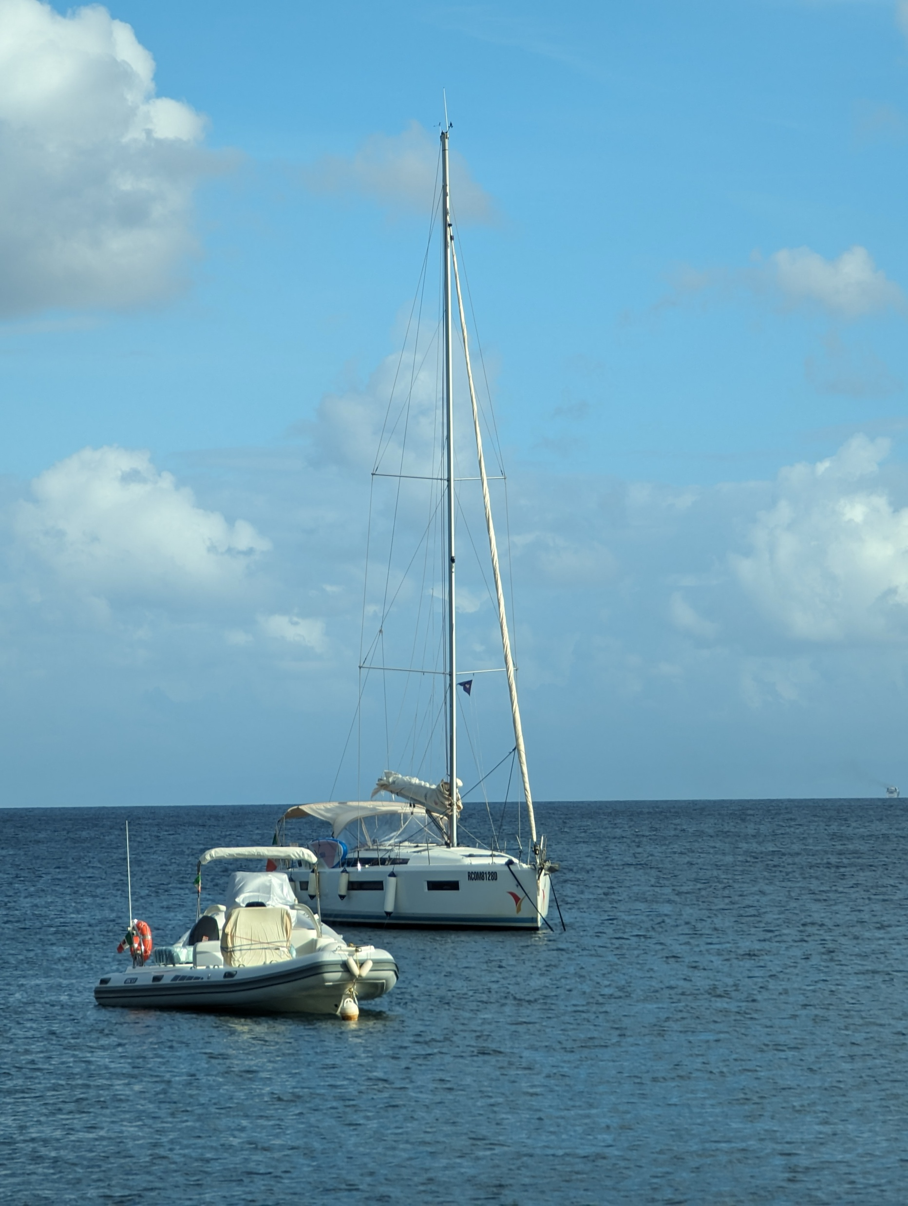

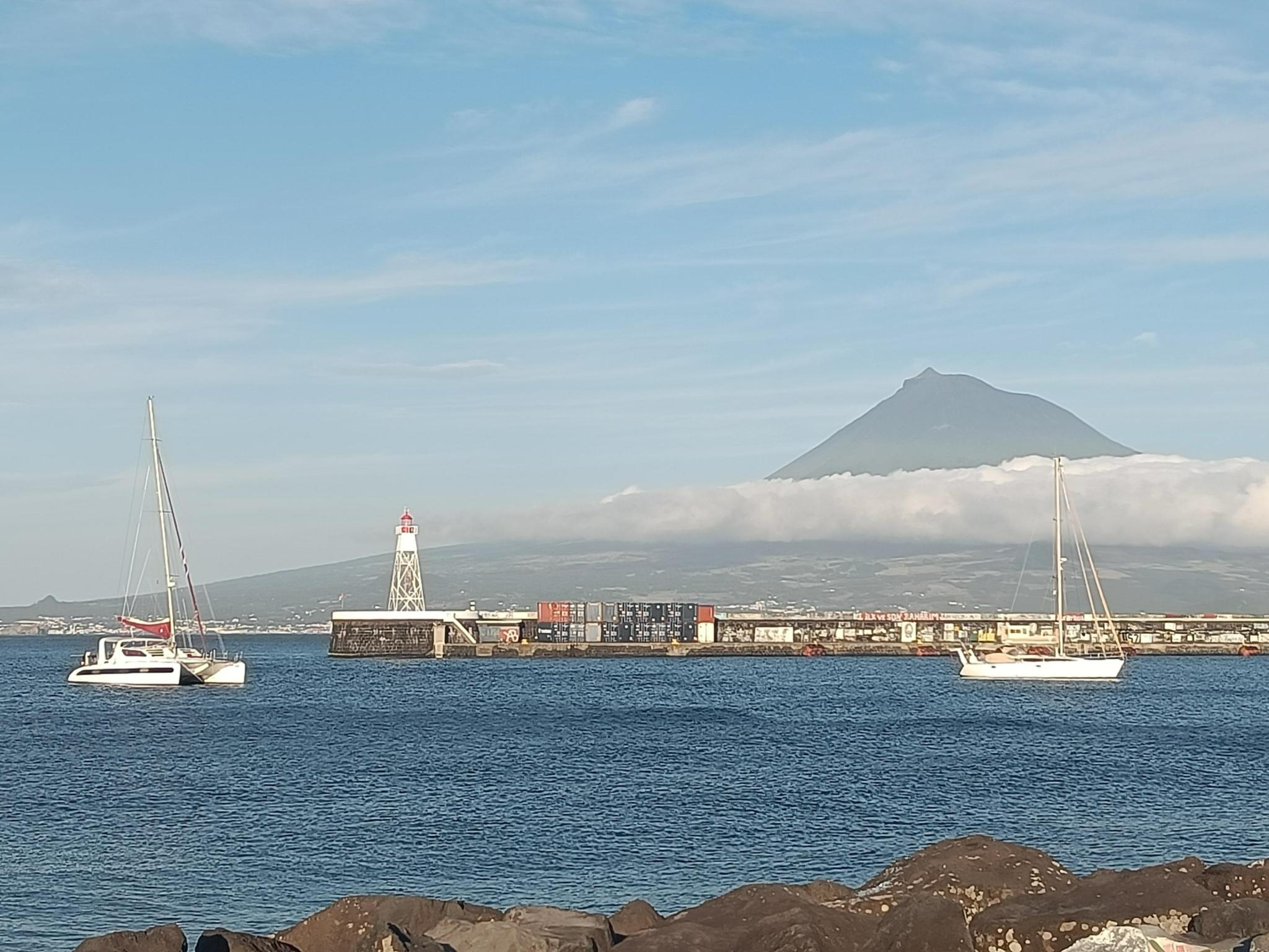

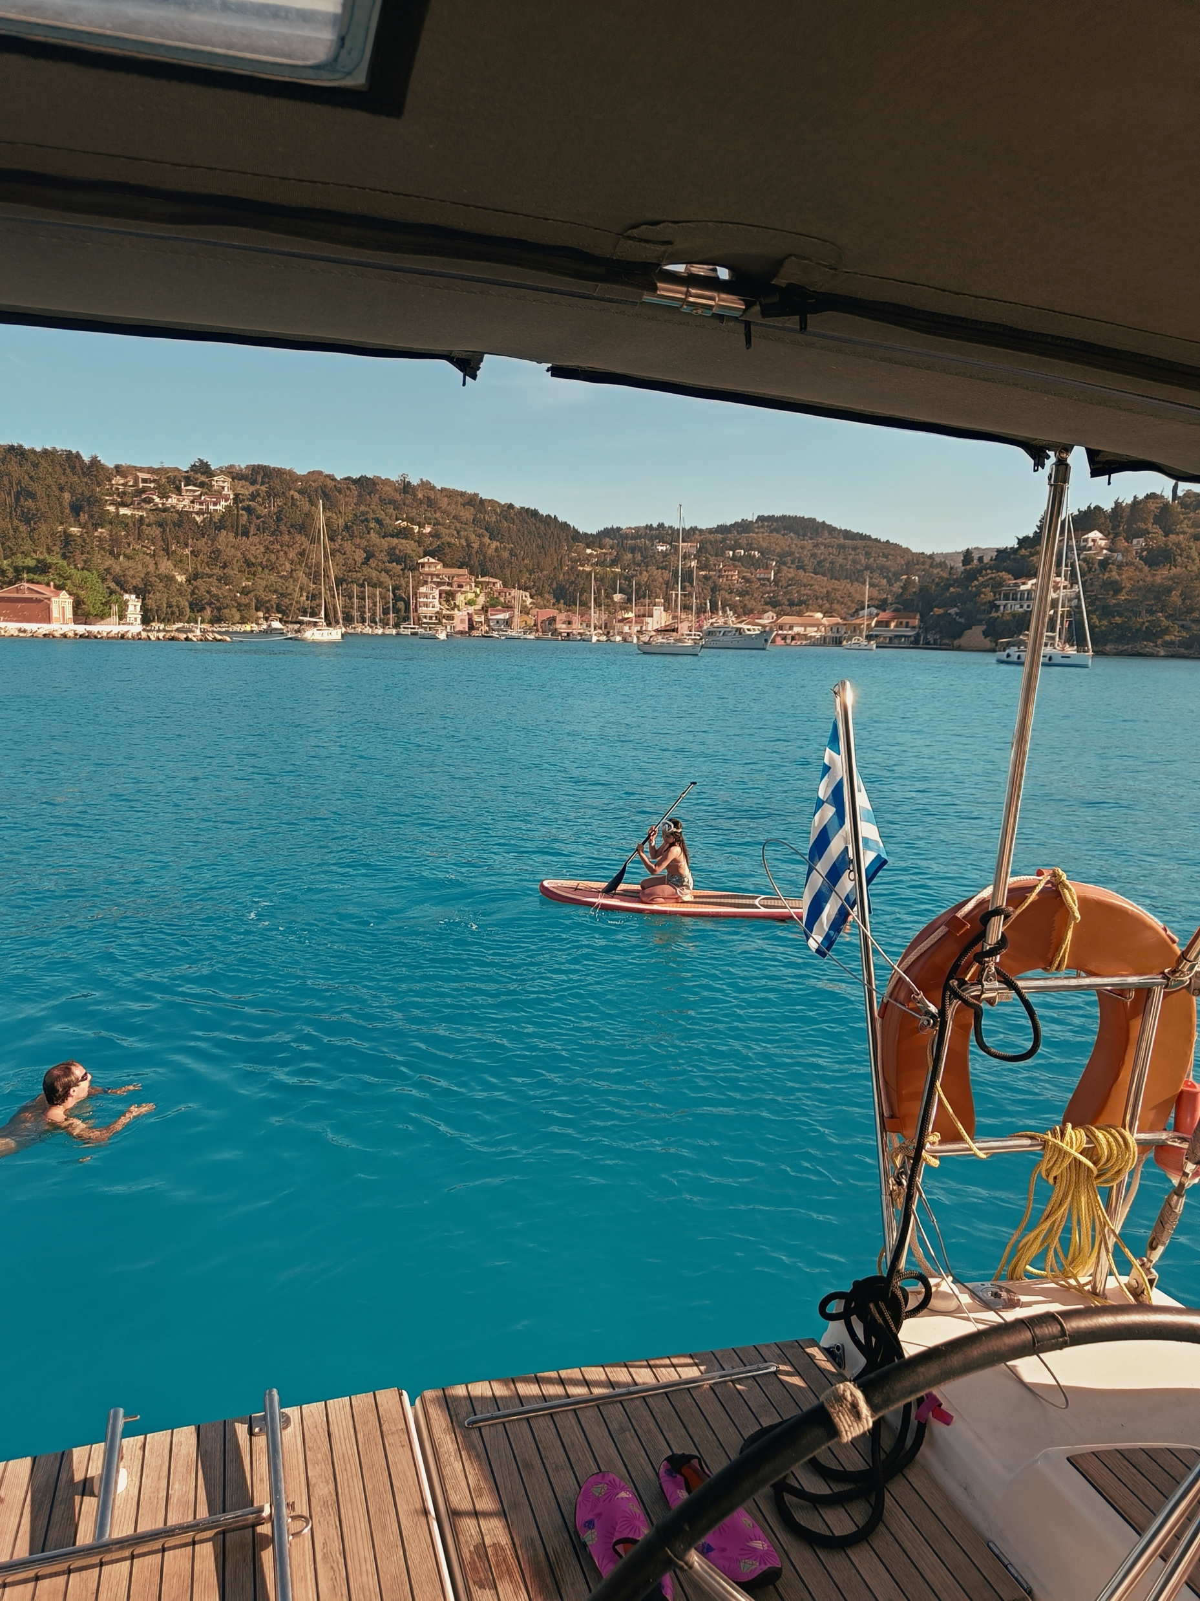

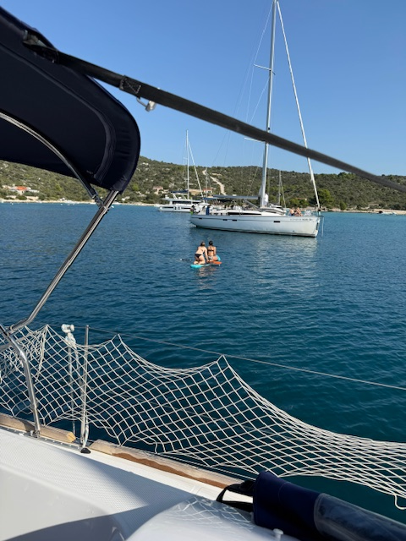
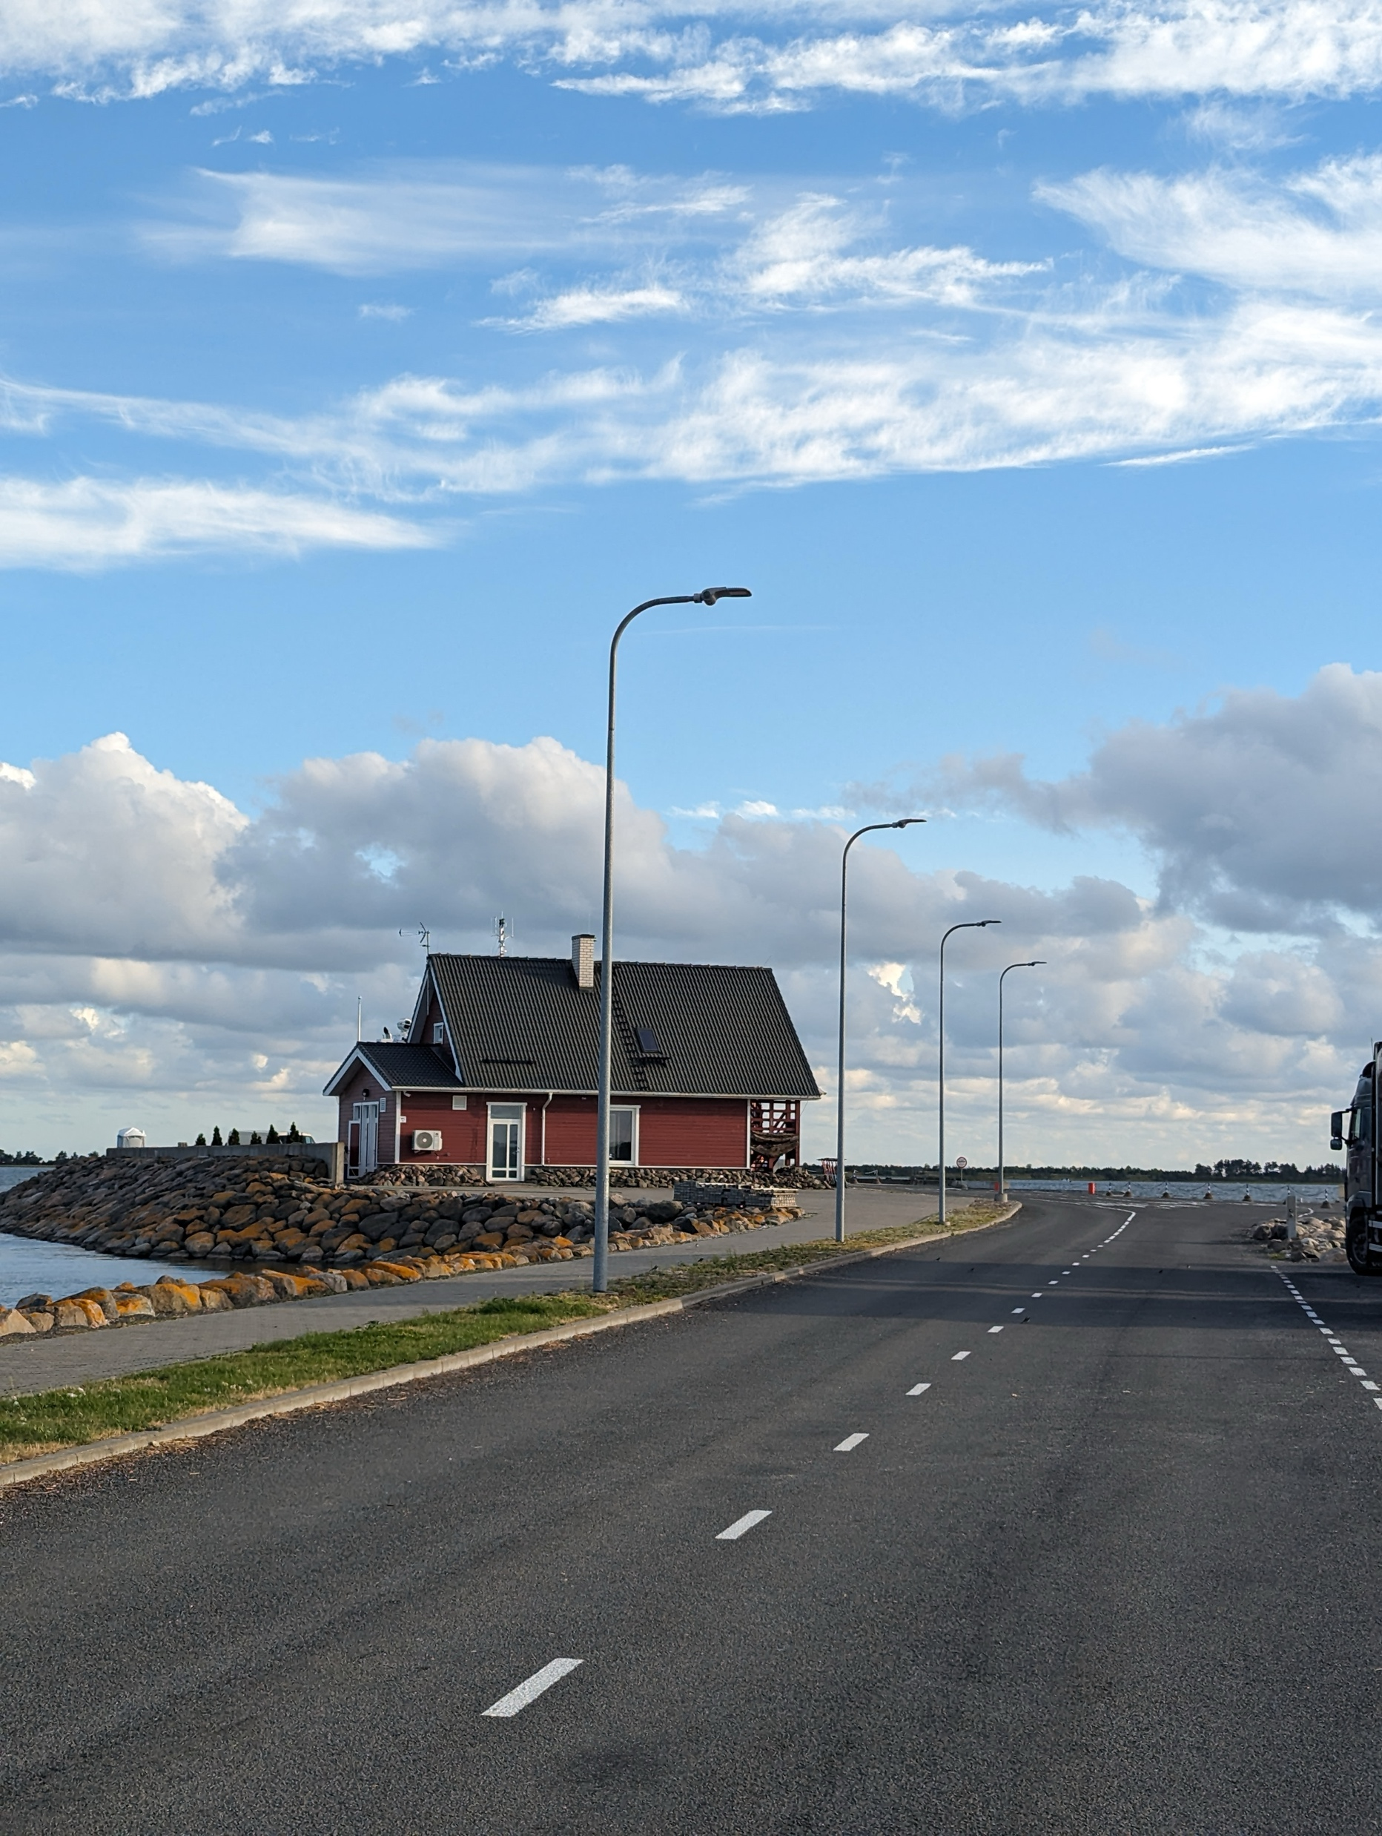
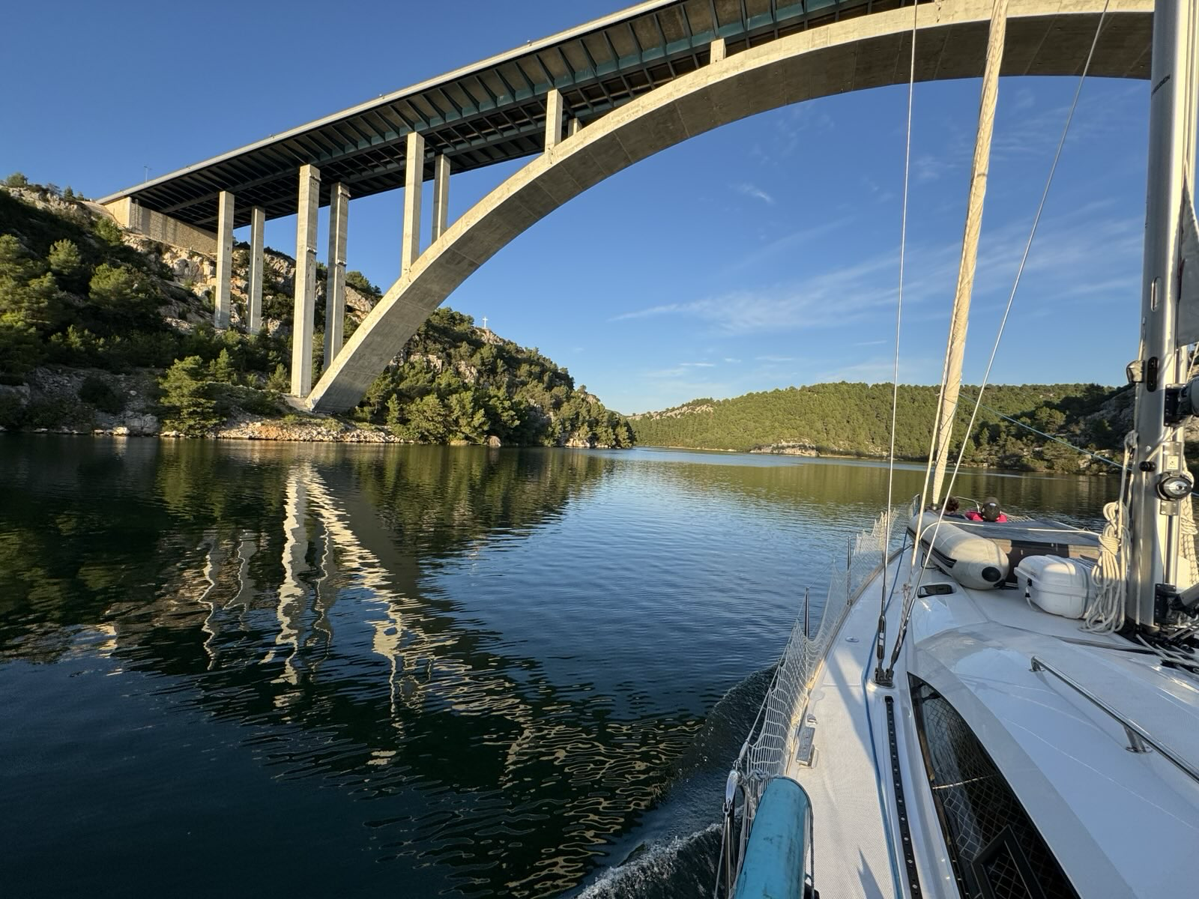
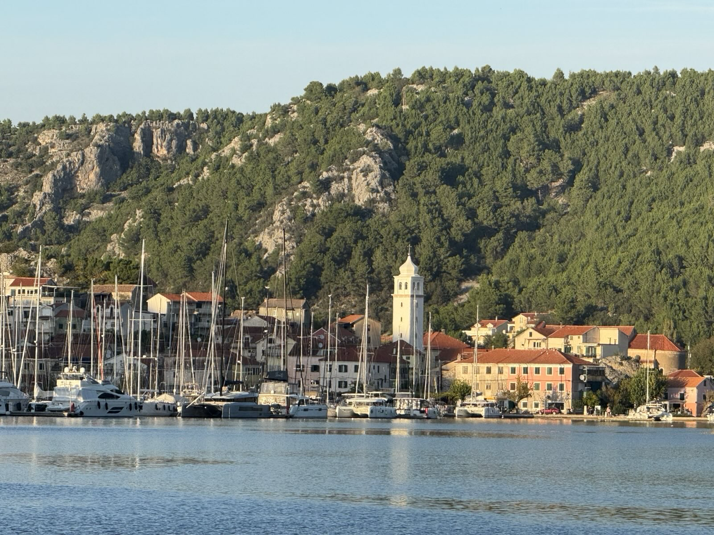


Frontier Technology Sailing
Someone called it once ”Quantum Sailing”, but I think now it can be renamed ”Frontier Tech Sailing” ☺
Normally happens twice per year: April and October
We will fill another boat in our next outing in April 2025: the Netherlands
  If interested, please let me know. ☺
Below, some pictures from the last outings…
Azores, July 2024
Naples, April 2022
Sicily, October 2023
Corfu, October 2022
Estonia, April 2023
Croatia, October 2024

Slide 13
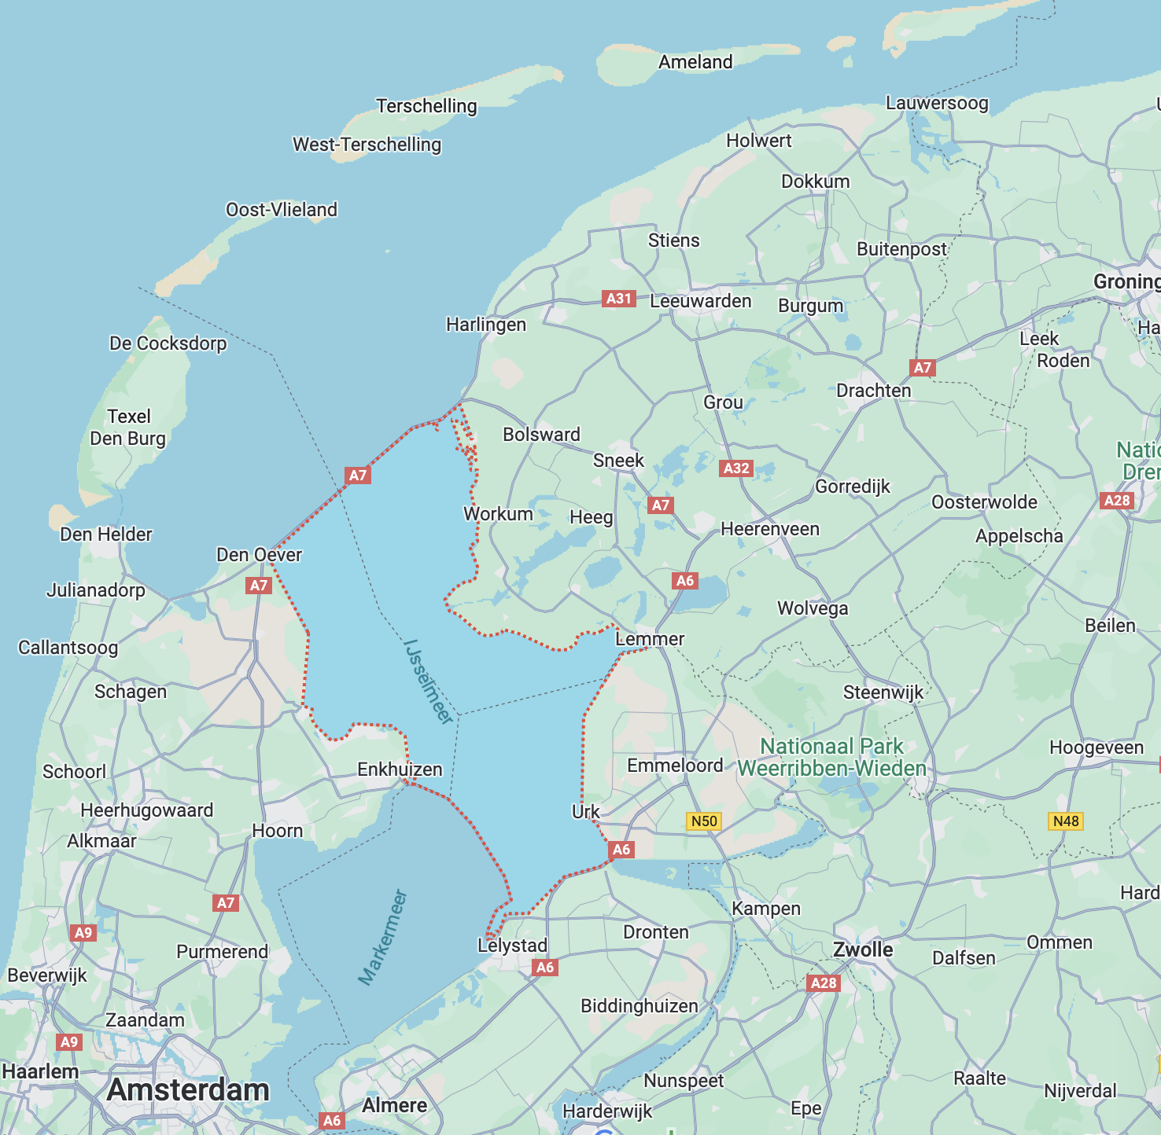


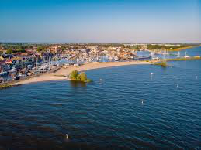
Sailing Netherlands in April
We take the boat here

Slide 14


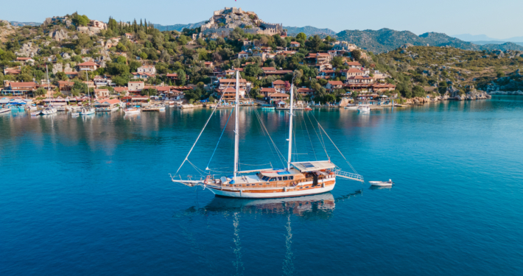

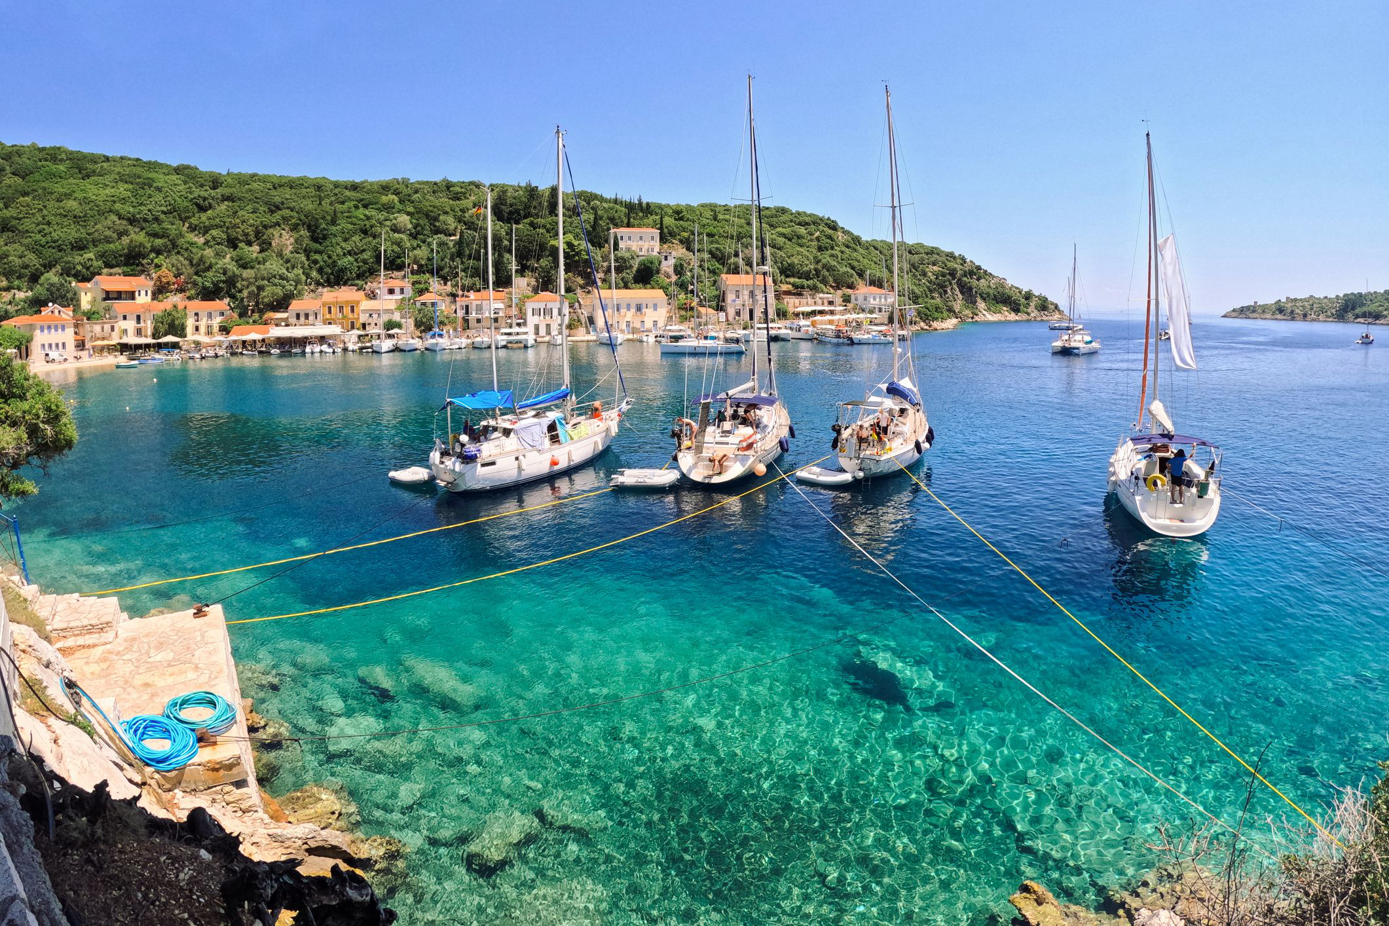

Frontier Technology Sailing Roadmap
Finland
Lofoten Islands
Turkey
Greece (again) this time Sporades
Denmark
Azores again (cross to Flores)
…

Slide 15
Questions?

