Slide 1

Dear FTI group members,
I am really sorry to be missing our first group meeting and, above all, the Secret Santa.
I would like to thank you very much for the continuos support that you let me feel everyday and the very nice ambience that you contribute to create in our work environment!
Thank you and see you soon!

Slide 2

FTI Group Meeting
Antonella Del Rosso
IT Comms

Slide 3
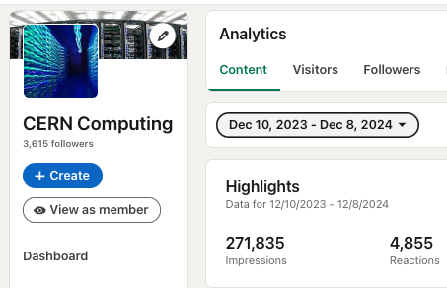
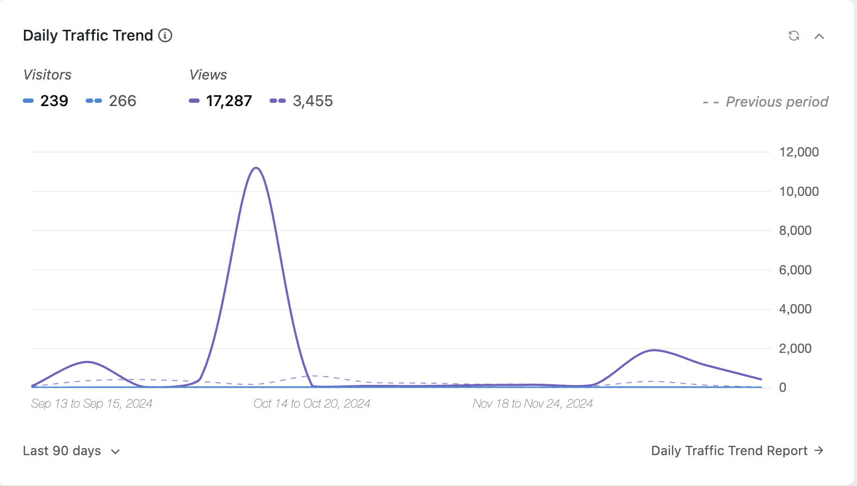
One year on…
IT Readme
DCVP upgrade started
Fluidic Data now in standard operating mode
Design completed around the artwork
Concept of new “heritage” exhibition shared
Article
CERN Computing
Visit experience

Slide 4
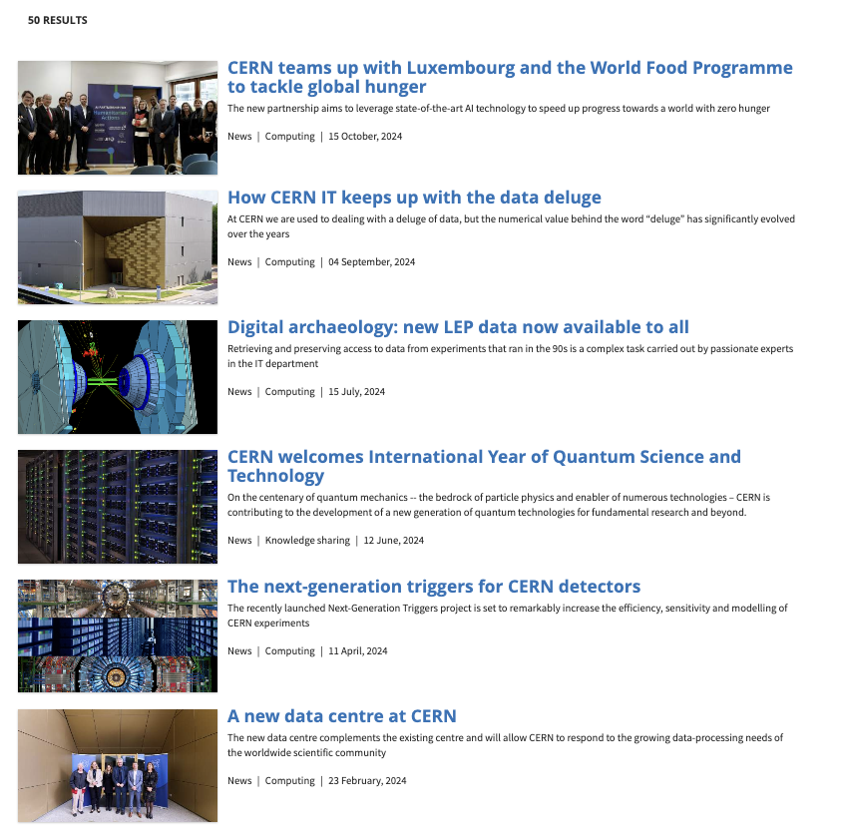
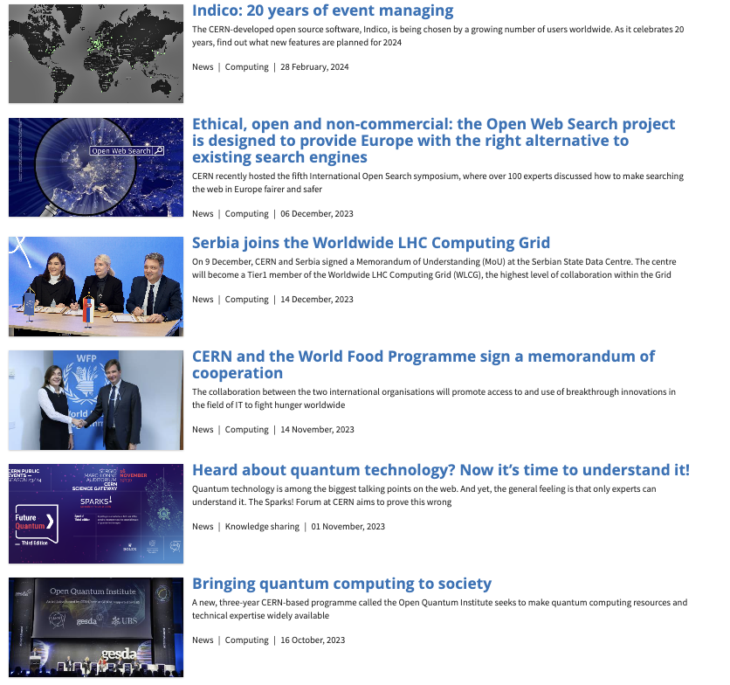
And more…

Slide 5
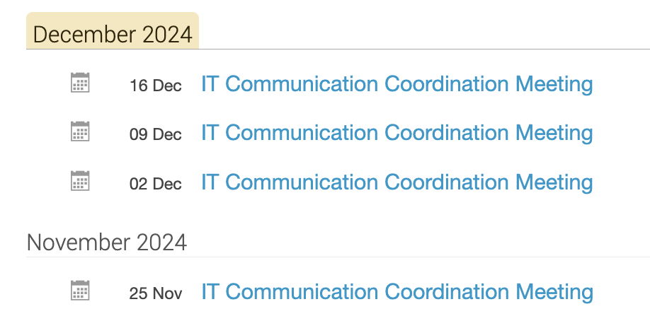
..and more…
Other meetings for new exhibit in Science Gateway…
other meetings for Events in 2025…
other meetings….
…and meetings…
….and meetings
And documents…
and presentations (Council, Enrica’s)…
and other documents….
…and documents…

Slide 6
Exciting 2025 ahead!
This will happen:
Complete upgrade of the IT Visit experience
IT Standard presentation
Ensure readership stats improve
Ensure regular coverage of IT content
Will the following happen?
IT New website
New exhibit(s) on Quantum in SG finalised
New exhibition installed

Slide 7
More to come…
This was short!
I will be happy to share more detailed news and updates at the next group meeting, which I am looking forward to!
Thank you for your understanding.

