Slide 1
Education
Alberto Pace

Slide 2



Education
Innovation
Education
CERN
Mission: uniting people
Research
?
Discovery
Accelerating beams
(accelerators)
Detecting particles
(experiments)
Large-scale computing (Analysis)

Slide 3






Learning and Education: Functional overview
The Learning and Education team is responsible to define and execute the processes and mechanisms through which the IT Department builds and transmits knowledge to support its current and future strategic objectives. This includes supporting the internal evolution of skills and behaviours, collecting and organising learning resources, and contributing to wider knowledge creation for science and society via initiatives like the CERN School of Computing and the CERN openlab Summer Student programme.
Frontier Technologies
and Initiatives
Collaborations and Partnerships
Physics Software Engineering
Computing and Data Science
Communications
and Outreach
Learning and Education
Technology
Infrastructures
KEY ROLES & RESPONSIBILITIES
MEASURES OF SUCCESS
Deliver and monitor learning and education opportunities for members of the CERN IT department to support the evolution of skills in technical, communication and management domains
Ensure that members of the IT Department receive continuous education in relevant technologies to keep their competencies updated and increase motivation
Deliver education programmes on IT technologies on topics relevant to CERN and to scientific research and applications and based on IT Department competences and values
Increased skills, competencies and overall motivation of IT Department members
Increased number of education opportunities in the Department, including Master & PhD students
Increased number of educators among IT Department experts on relevant topics
Increased recognition of people able to educate and transfer knowledge
Increased visibility and impact of IT Dep expertise via participation and feedback on CERN School(s) of Computing and other programmes
KEY
CAPABILITIES
ROLES
FRAMEWORK
GOVERNANCE STRUCTURES
PAIN POINTS ADDRESSED
As the Connector: 40%
As the Pioneer: 30%
As the provider: 20%
As the Optimiser: 10%
Participation in bi-weekly Group management meeting
Chairing of the IT Department Learning and Education Steering Board
Chairing and participation in the CSC Board and other similar bodies as needed
Fragmentation of activities and initiatives across groups, departments, and sectors.
Lack of a clear place in the IT department to discuss IT education matters
Diminishing attractiveness of IT Department as employee in IT domains
Digital Literacy
Knowledge Sharing
Talent growth
Programme
management

Slide 4
Education in IT-FTI
3 activities
  IT Education
  CERN School of Computing
  NextGen WP4

Slide 5
IT Education

Slide 6
Vision
Ensure all CERN personnel maintain or enhance their IT competencies throughout their tenure.
Deliver IT education relevant to CERN’s research and CERN unique technologies.
Promote mentorship and teaching within the IT department, recognizing contributors to education.

Slide 7
To be created (proposal):
Learning and Education Steering Committee
Strategic oversight:
  Define/Implement the strategic vision and priorities for IT education within the department (or organization).
  Align educational initiatives with the department's mission and organizational goals.
Educational offerings:
  Review and approve education and training programs for IT personnel.
  Evaluate the relevance and quality of new and existing initiatives (e.g., workshops, seminars, academic partnerships).
  Integrate emerging technologies and methodologies into educational programs.
Establish policies for continuous learning, professional development requirements for staff involved in IT technologies
Monitoring and Evaluation
  Define frameworks for assessing educational initiatives impact. Track the effectiveness and reach of educational initiatives.

Slide 8
IT education may include
Technical training activities (DTO)
Communication training activities (DTO)
Leadership and Management training (DTO)
Academic Training (https://academictraining.cern.ch/)
Post-conferences workshops and support to workshop where IT technology is disseminated
IT Seminars
IT Education Catalogue (https://it-edu.web.cern.ch/)
Online Training (Udemy, Linkedin Training, Youtube, …)
Students programmes
  Summet / Technical / Doctoral

Slide 9
Priorities for IT education (to be approved)
Should focus on beginners and Intermediate education levels
  Ensure onboarding of newcomers
  Avoid leaving people behind at technology changes
  Advanced training organized on-demand for specific cases
Areas where improved education is needed
  Technologies developed at CERN
  Advanced technologies relevant to CERN research
Increase the lecturers from the IT department
Increase the level of projects offered to students by the IT department
  Applies to both technical and doctoral students
  Ensure that the investment is not lost when the student leaves

Slide 10
Targets of Information Technology education
IT department personnel
CERN Employees and associates (MPEs and MPAs)
Member of CERN Collaborations
Persons affiliated with institutes having CERN collaboration agreements
External with no affiliation with CERN, HEP or Academia.
  Industry
  Teachers
  General public
Covered through the CERN School of Computing

Slide 11
CERN School of Computing
Kristina Gunne, Andrzej Nowicki, Alberto Pace

Slide 12
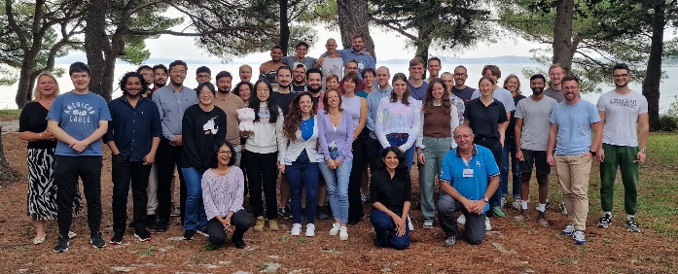
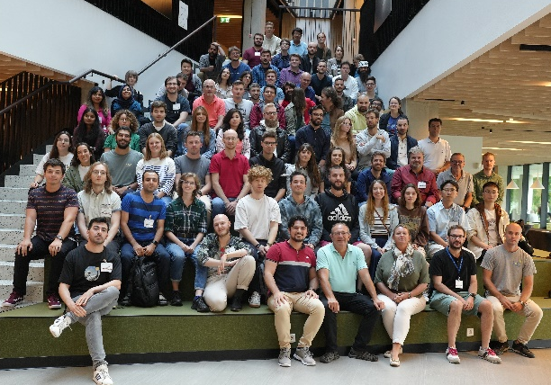
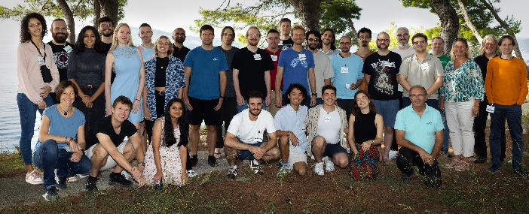
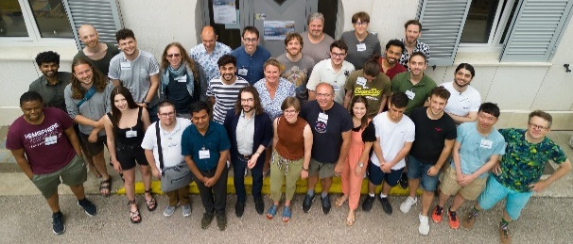
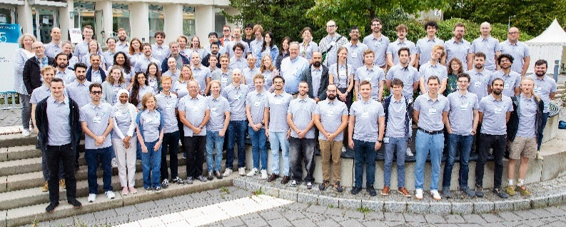
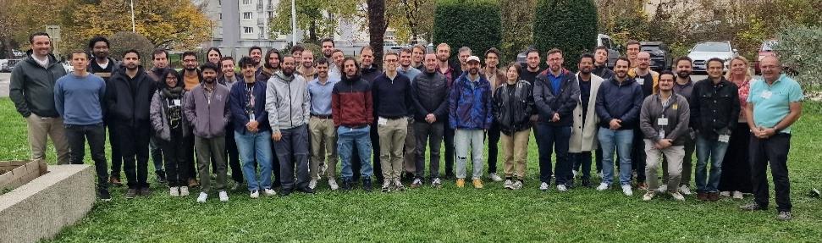
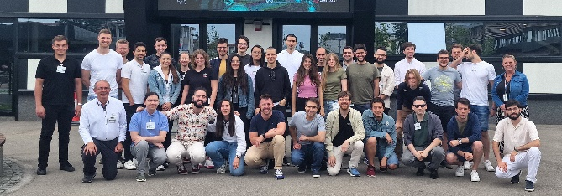
CERN School of Computing
https://csc.web.cern.ch/
9 schools organized in 2023 - 24
  Inverted School (March 23), Heterogeneous Computing (June 23), Main school in Estonia (Aug 23), Computer Security (Oct 23), Inverted School (April 24), Heterogeneous Computing (June 24), Main school in Germany (Sep 24), Machine Learning (Oct 24), IT Services (Nov 24)
Potential schools for 2025 - 26
  Inverted School (March 25), Computer Security (April 25), Machine Learning (June 25), Main school in Sweden (July 25), Heterogeneous Computing (Oct 25), IT Services (Nov 25), Regional School in Latin America (Chile, early 26), …

Slide 13
School vision, strategy, and plans
Attract the best PhD and Master students worldwide
Deliver education on Scientific Computing topics relevant to CERN research and on specific IT technologies developed at CERN
Create a network of lifetime links of participants across all scientific research laboratories, institutes and universities
  Including those not directly involved in CERN research programs
Tactical directions:
  Increase education on emerging and innovative technologies that will play majors roles in scientific research in future years (Machine Learning, Quantum Computing, AI, Heterogeneous Architectures, Datacenter technologies)
  Increase geographical coverage (schools in Latin America in 2026, Asia, Middle-East)

Slide 14
Overall Evaluation CSC 2024 (excerpts)
The school was excellent, one of the best experiences of my life. I learnt a lot of new things, or at least I have now the instruments to study them alone. I appreciated the heterogenous environment, and the networking possibilities. I met so many amazing people, both within the students and the lecturers.
It has been the best work-related event I ever had in my life.
One of the best, if not the best, two weeks of my life! And I'm not exaggerating. Thank you to all the organizers, instructors, and the attendees!
Honestly one of the best experiences I have ever had, certainly in terms of academic events. The school itself was amazing, all the activities were perfect.
Organisation was brilliant. Lectures were brilliant. Social events were brilliant. All-in-all I hope I can come back to another version of the CSC in the future

Slide 15
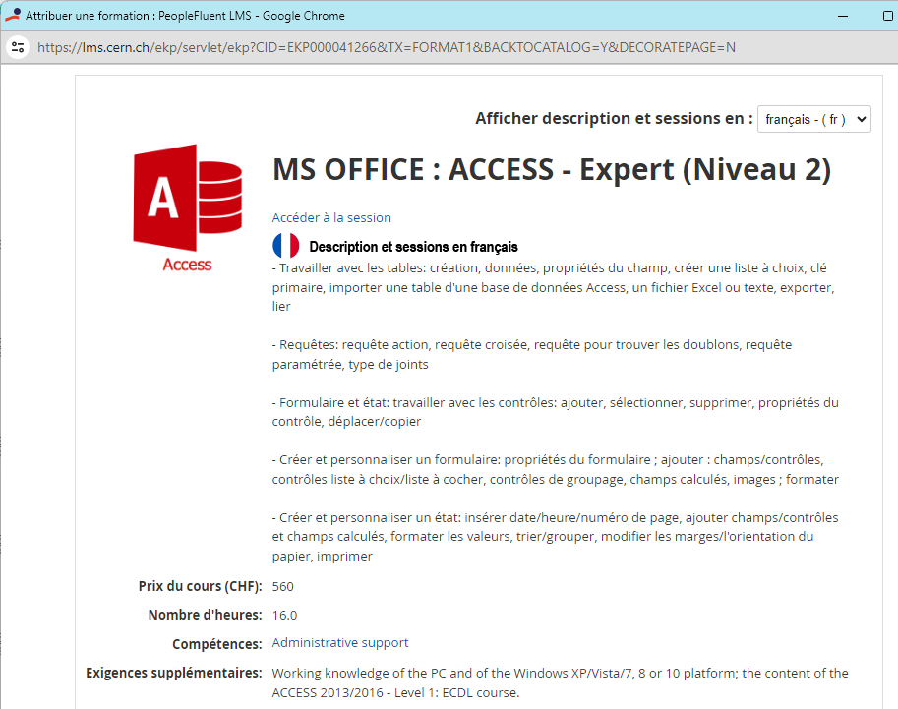
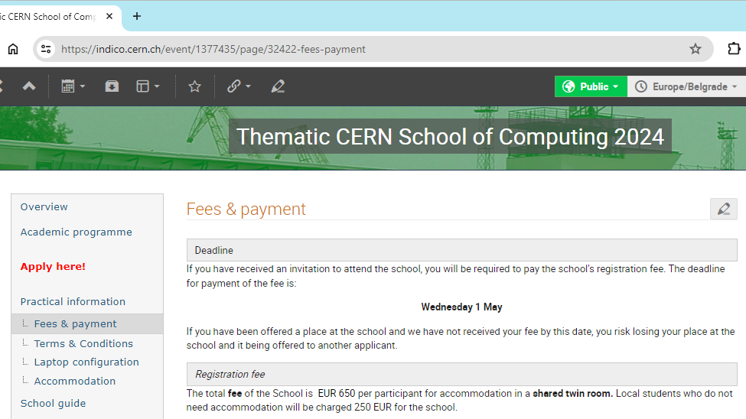
Comparative advertisement
637 CHF for a full week + lodging, meals, excursions
560 CHF for 16 hours
School on IT services: 420 CHF for a full week

Slide 16
NextGen Work Package 4
4.1 Outreach, 4.2 Education

Slide 17
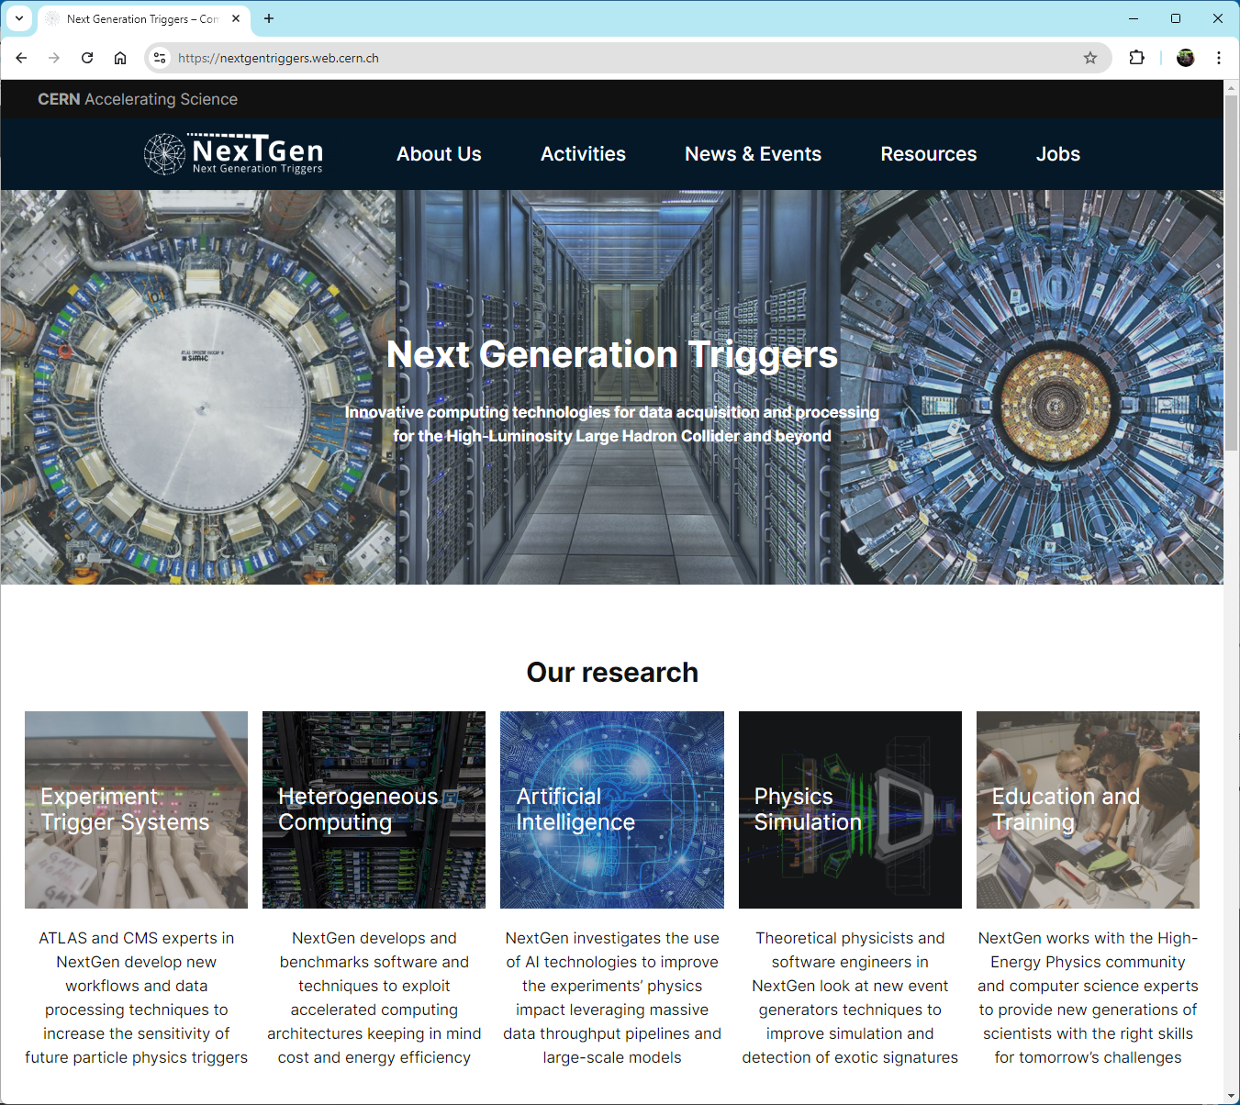
Outreach (WP 4.1) in 2024
Articles and social media presence
Web site
  https://nextgentriggers.web.cern.ch/
Events:
  NextGen All Hands meeting, 24 September 2024 https://indico.cern.ch/event/1421591/
  NextGen Technical Workshop, 25-27 November 2024 https://indico.cern.ch/event/1421629/
Exchange programme
Team:
  Alex Lasa Lamarca and the IT-FTI Communication (Antonella del Rosso, Jana Fiserova)

Slide 18
Education Programmes (WP 4.2) in 2024
Participation in several schools
  International School of Triggers and Data Acquisition (ISOTDAQ) – June
  CERN School of Computing – September
  Smarthep Edge Machine Learning School – September
  School on “Artificial intelligence and modern physics” – Sep-Oct
  Efficient Scientific School of INFN - October
  Thematic School of Computing on Machine Learning – October
Advanced training courses on various technologies (at CERN or in industry)
  Parallel, High-performance, High-throughput Computing, C++, Python, Data handling, Machine Learning, CUDA, FPGA programming, VHDL, Networking, Neural Networks …
Team:
  Felice Pantaleo, Vicky Batsari

Slide 19
Conclusion: Your role
Ensure you maintain or enhance your IT competencies through time.
Be an expert in technologies necessary to CERN’s research and the unique technologies developed at CERN
  Become an expert in a specific field
  Understand other fields
Ensure that you mentor and teach within every opportunity available in the IT department and in CERN Schools.

