Slide 1



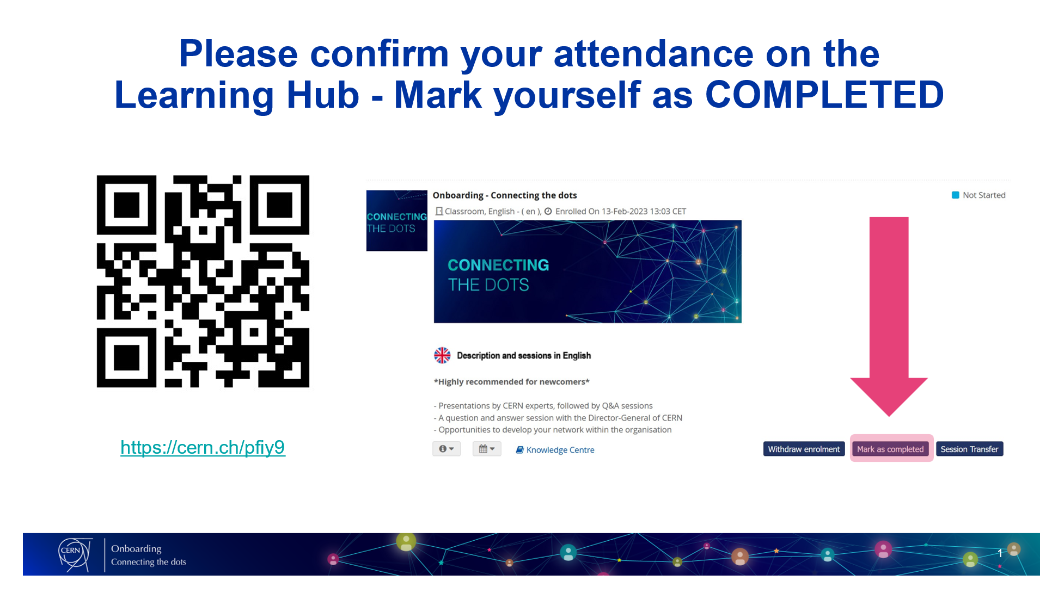
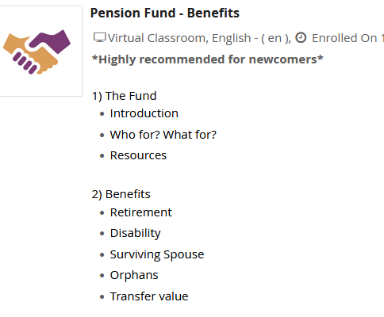

Please confirm your attendance on the Learning Hub
1
2
3
Scan the
QR Code
Go to
‘My Learning’
Click on
‘Mark as Completed’

Slide 2
PENSION FUND
Information for new members
Garance Louvin – Benefits Service 17 February 2025

Slide 3
Agenda for today
1
The purpose of the CERN Pension Fund
Transfers from other schemes
End of contract options
Member and member’s family benefits
How your membership works
What communication will you receive from the Fund
Find out more about the Pension Fund
Benefits Service
2
3
4
5
6
7
8

Slide 4
The purpose of the CERN Pension Fund
Our purpose is to insure our members and beneficiaries, together with their families, against the financial consequences of disability, old age and death.
(Article I 1.01)
As an international organisation, CERN and ESO operate their own social security system, including a pension scheme, the CERN Pension Fund
Defined benefits
CERN Pension Fund
Benefits paid are based on your reference salary
No member has an individual balance, and all benefits are paid from a common fund
A solidarity scheme

Slide 5
How your membership works
Becoming a Member
Membership is automatic and mandatory for CERN/ESO Staff, Fellow and Graduate
The Benefits Service is the point of contact for pension queries
Transfers
Provisions apply for transfers from and to other pension funds to allow continuity of your pension during your working life
At the end of your contract
Accept a transfer value (non-optional below 5 years of service)
Become a deferred beneficiary (and take benefits later)
Become a beneficiary (if you reach the applicable retirement age)
If you become a Beneficiary
Monthly pension benefits are payable until your death
Benefits reviewed each year for indexation
Insurance against death or disability
Benefits payable to you or your survivors for eligible family scenarios

Slide 6


How your contributions work
Your monthly contributions are 12.64% of your reference salary
Monthly contributions from and

Slide 7
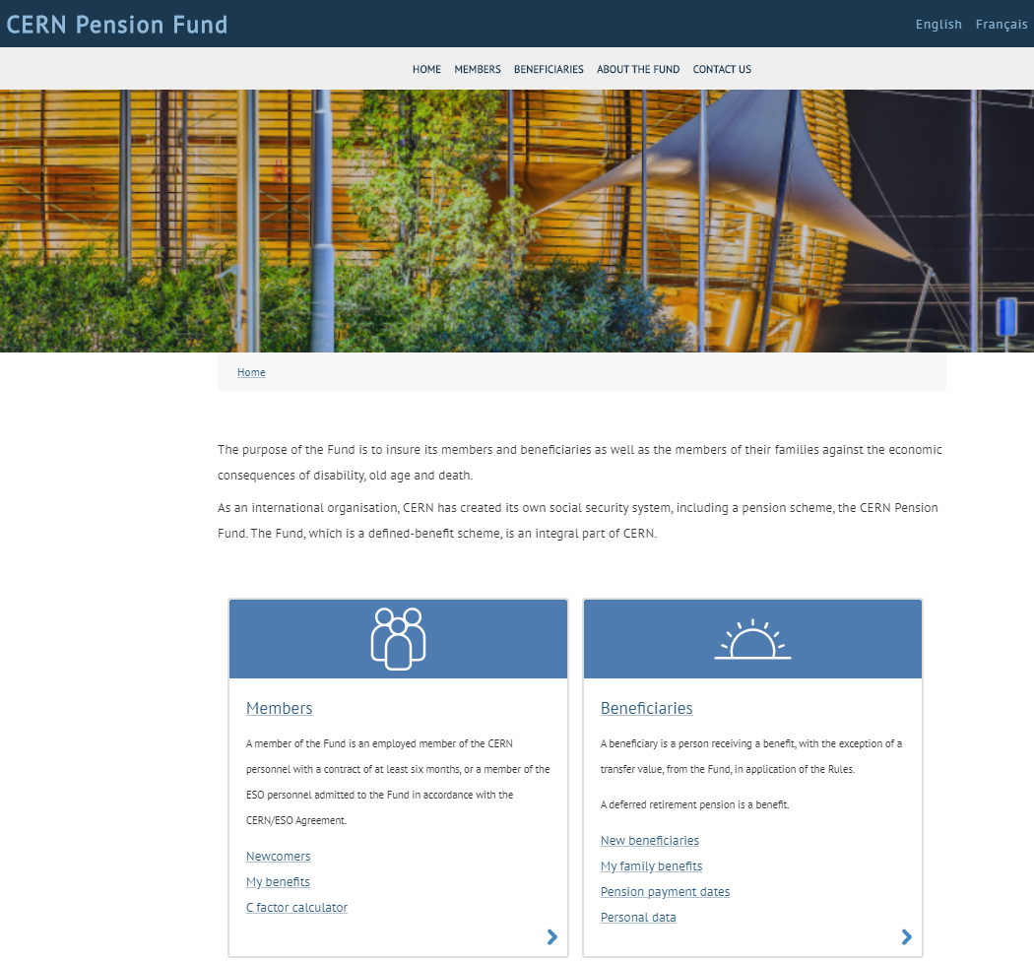
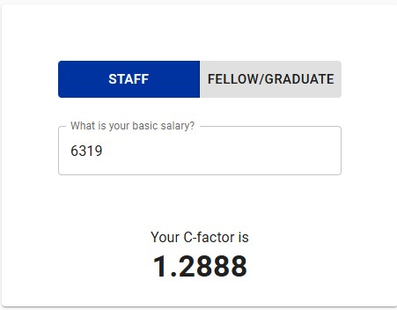
How to calculate your reference salary
Staff members
Reference Salary = Basic salary * Coefficient C
  Basic salary: percentage of a midpoint of a grade
  Coefficient C: factor based on the basic salary

Slide 8
How much is a Graduate reference salary
Graduates
A unique reference salary
5 748 CHF

Slide 9
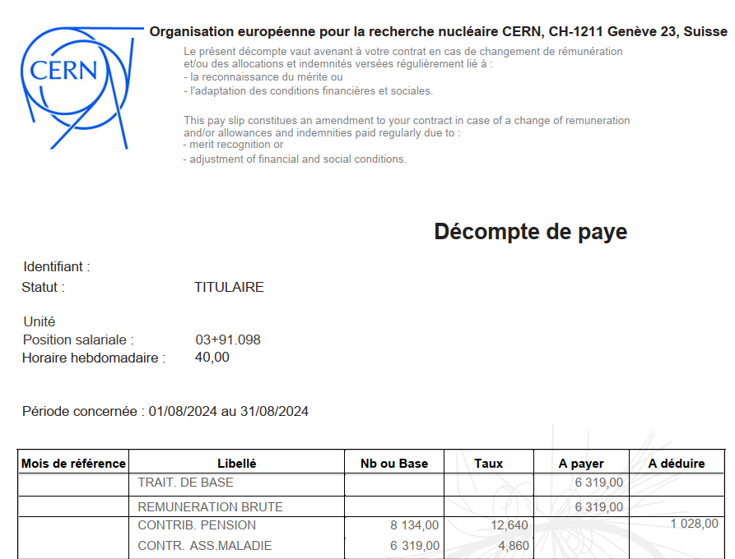
How do I know what my reference salary is
Your reference salary is shown on your monthly pay slip

Slide 10
What communication will I receive
Arrival
Annually
End of contract
Arrival letter and factsheet
A letter confirming your membership of the Fund
Departure formalities
Two months before the end of your contract
Annual Report and Annual Information meeting
Individual breakdown of pension rights
This will give you an estimate of your benefits at the end of your contract
Provide members and beneficiaries with an update on the benefits, governance matters and investment performance.
Key information for members
Contact details for the Benefits Service
A link to our website
Departure form to be completed and returned to the Benefits Service
Opportunity to ask questions during the Annual Information meeting

Slide 11
Transfers from other schemes
Why?
Provide continuity of your pension savings
Increase your benefits at the end of your contract
What?
Transfers are accepted from employer pension schemes
When?
Can be made at any time during your contract
Become entitled to a pension (if at least 5 years of service)
Calculation?
Must be received before the end of your contract
Reference salary on the date of application
Transfer rates depend on your age on the date of application

Slide 12
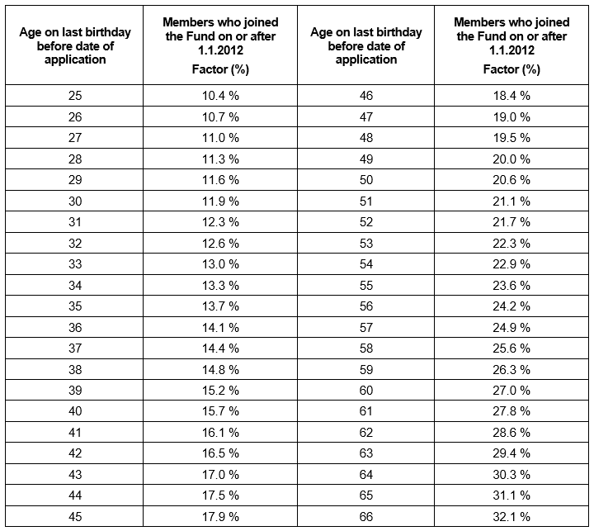
What are the transfer-in rates
The transfer-in rates depend on your age on the date of application.
More information is available on our website

Slide 13
What are my end of contract options
Transfer Value
Compulsory for less than 5 years of service
Deferred Retirement Pension
At least 5 years of service required
Postponement of decision
No matter the duration of service
Defer payment of pension until retirement age of 67
Payment in Swiss francs to your personal bank account (if relevant)
Early retirement option available from age of 52
Tax treatment depends on your country of residence
Transfer to another pension scheme
End of contract before the age of 67
Possibility to postpone your decision for up to 12 months

Slide 14
What about the transfer value
Amount
14.7% of the last reference salary for the first 10 years of service
22% of the last reference salary for each further year of service
Payment
The month following your contract end date
In Swiss francs
To another private pension scheme (if they agree)
Into your personal bank account (if you have less than 10 years of service)
Tax
Tax treatment depends on your country of residence

Slide 15
Transfer value – example calculation
Basic salary = 6 319 CHF
C factor = 1.2888
Reference salary = 8 144 CHF
Service duration = 60 months*
Ratio for full time contribution = 1
➔8 144 CHF x 60 x 14.7% x 1 = 71 830 CHF
*In case of resignation, the duration of service is adjusted accordingly

Slide 16
What about the deferred retirement pension
Entitlement
At least 5 years of service
Contract end before the applicable retirement age (67) for a reason other than death or total disability
Payment deferred until the applicable retirement age at the latest
Early retirement option available from age of 52
Amount
1.85% of the average of the last 3 years’ reference salary* per year of membership
*based on the salary scale at the end of the contract

Slide 17
Leaving CERN < 5 years
the transfer value can be paid into another private pension scheme
(in CHF in any country)
the transfer value can be paid to the member (in CHF)

Slide 18
5 years ≤ Leaving CERN < 10 years
the transfer value can be paid into another private pension scheme
(in CHF in any country)
the transfer value can be paid to the member
(in CHF)
the member is entitled to a deferred retirement pension
Please note: periods of Unpaid Leave (without contributions to the Fund) are not considered as periods of service

Slide 19
Leaving CERN ≥ 10 years
the member is entitled
to a deferred retirement pension
the transfer value can be paid into another private pension scheme (in CHF in any country)

Slide 20
What about the retirement pension
Entitlement
At least 5 years of service is required to be entitled to a retirement pension
Applicable age of retirement is 67
Early retirement option is available from 52 years old
Amount
Calculated on the basis of 1.85% of the average of the last 3 years’ reference salary* per year of membership (maximum 37 years and 10 months)
Tax
Tax treatement depends on your country of residence
*based on the salary scale at the end of the contract

Slide 21
Will my spouse/partner receive a pension
Entitlement
Surviving spouse’s pension payable to the spouse/partner of a member if the marriage/legally registered partnership dates from at least 1 year prior to the death
Amount
1.1% of the last reference salary of the deceased member per year of membership he would have had until the applicable retirement age (no matter the initial contract duration)
Duration
From the 1st day following the member’s death
Until the death or remarriage of the spouse/partner

Slide 22
What about my children
Entitlement
Orphan’s pension paid to dependent children recognised by CERN
Up to the age of 20 if unmarried and not in a full-time employment
Between 20 and 25 years of age if in full-time education, unemployed and unmarried
Amount
Percentage of the last reference salary of the deceased member:
  24% for 1 orphan
  34% for 2 orphans, etc.

Slide 23
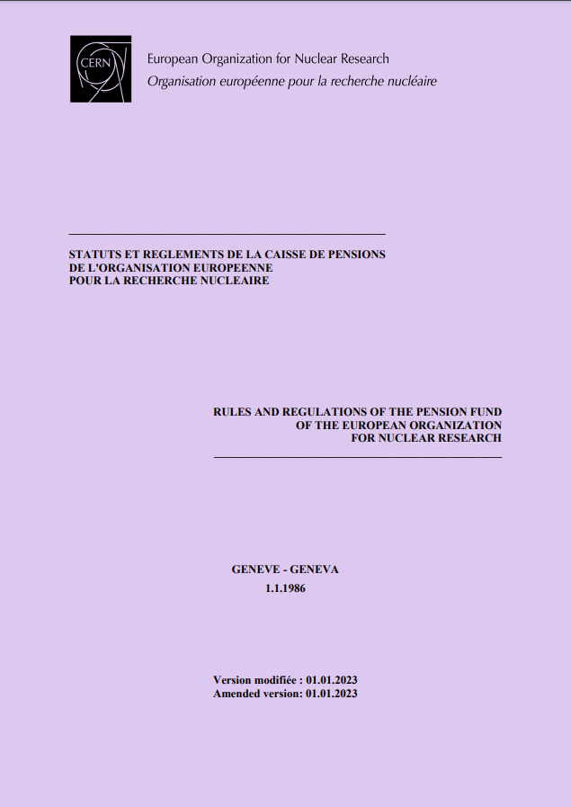
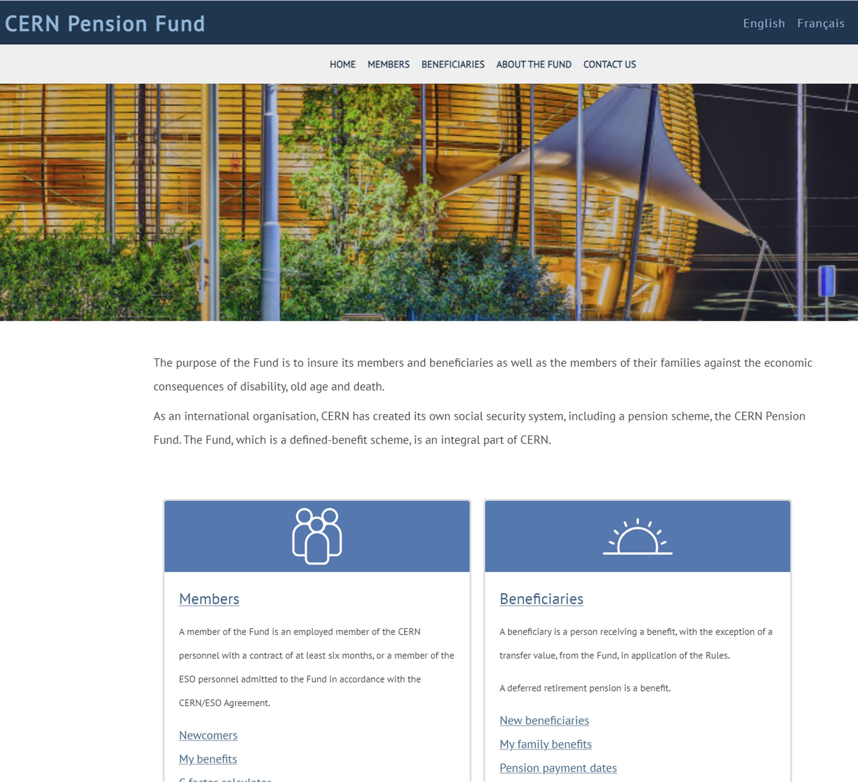
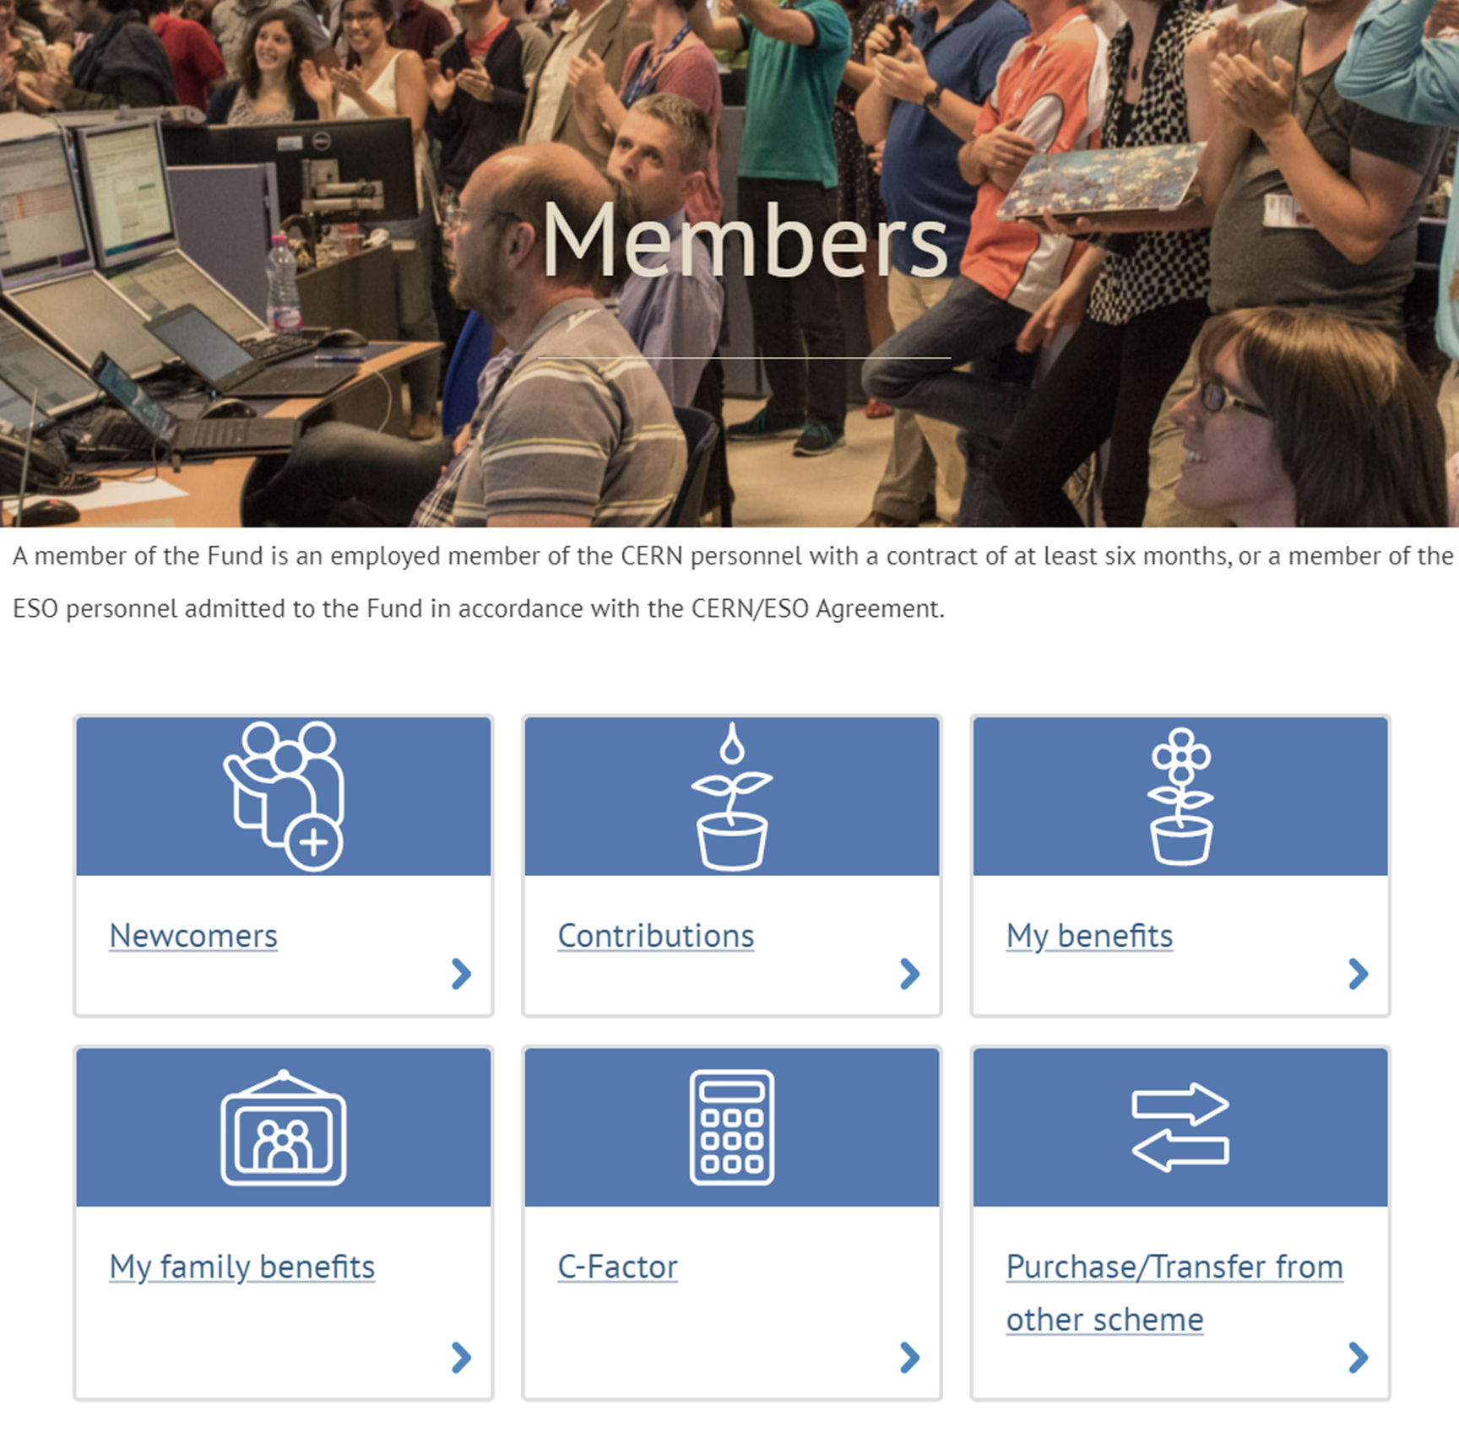
Where can I find out more about my benefits
Our website has a section dedicated for members
Pension Fund Rules & Regulations

Slide 24
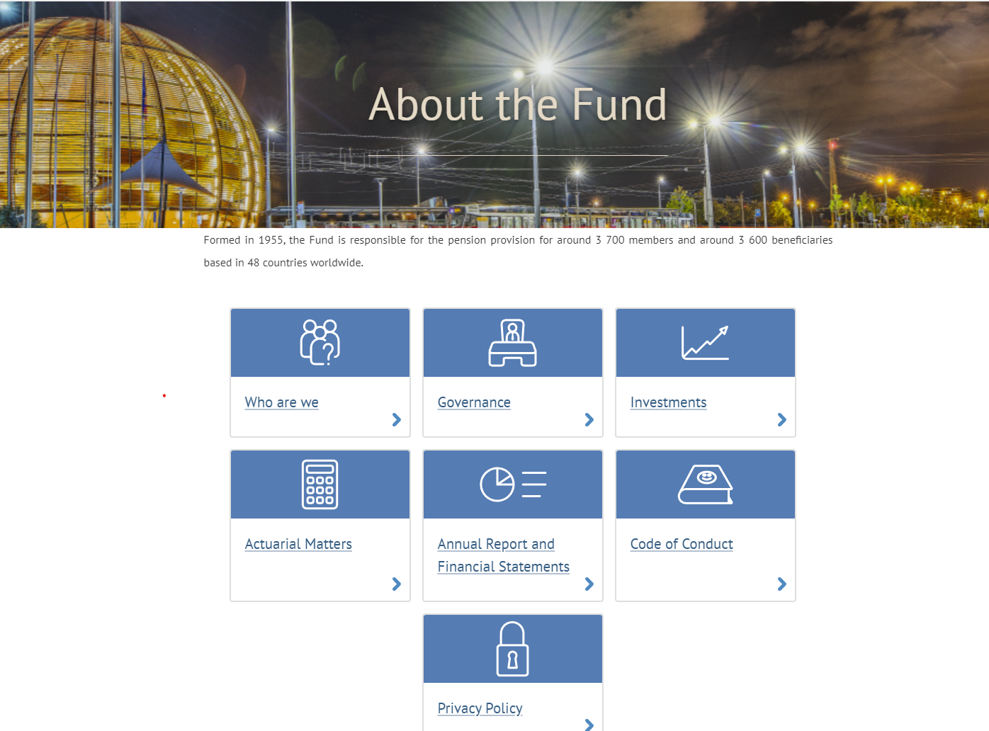


Where can I find out more about the Pension Fund?
Our website has general information on the Pension Fund
Our Annual Report and Financial Statements includes updates from the year
Annual Information Meeting
14 October 2025
Council Chamber

Slide 25
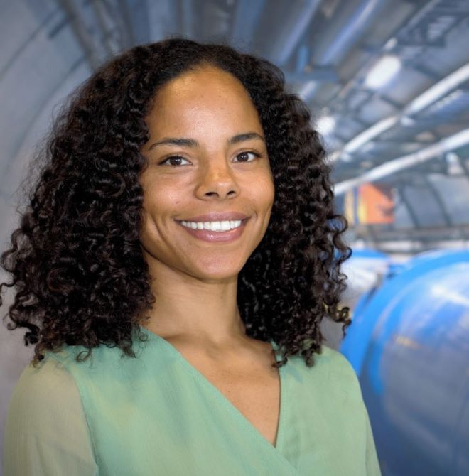


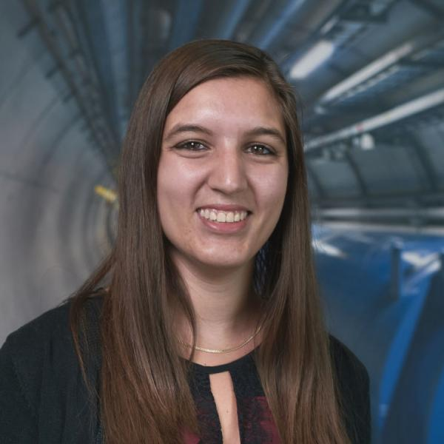
Benefits Service
Aïsha Bankolé
Emilie Clerc
Pilar Herguedas
Garance Louvin
pension-benefits@cern.ch
+41 22 767 88 11
http://pensionfund.cern.ch
Building 5/5 (Meyrin)

Slide 27
Please confirm your attendance on the Learning Hub
1
2
3
Scan the
QR Code
Go to
‘My Learning’
Click on
‘Mark as Completed’

