Slide 1
ALICE GAS SYSTEMS
  2024 Activities
  03 February 2025
  ED/DT/FS – Gas Group
  Louis-Philippe De Menezes

Slide 2
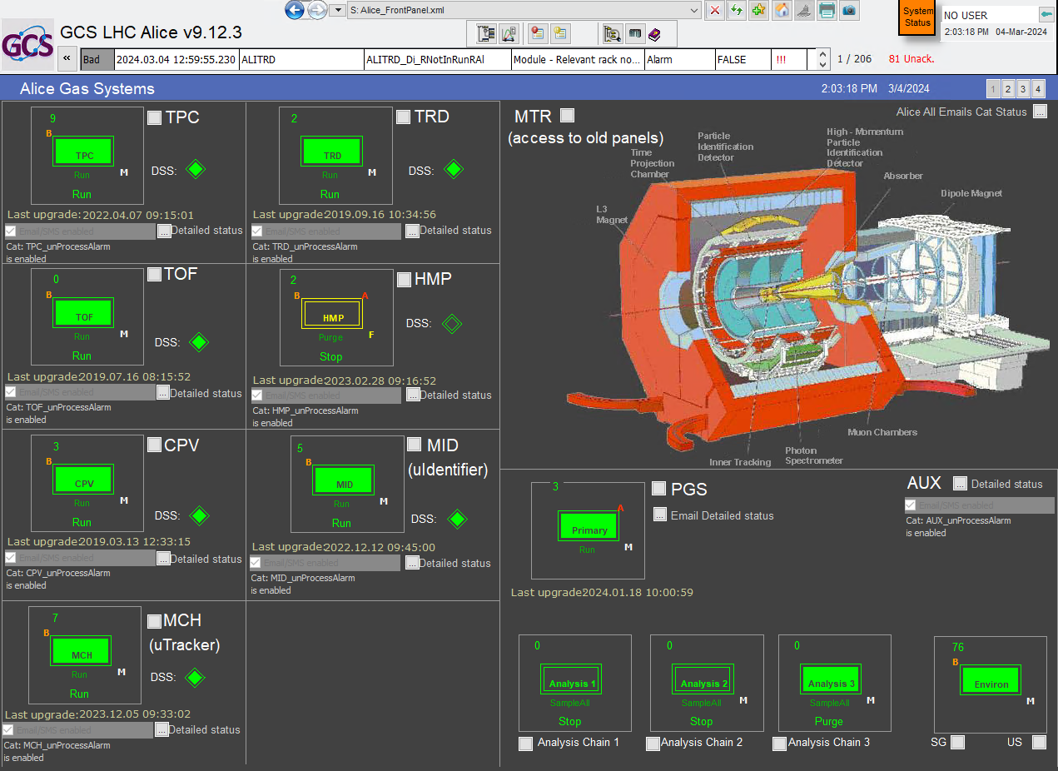
TOPICS
  * Piquet Interventions
  * M&O interventions
  * One specific intervention
  * On going activities
  ED/DT/FS – Gas Group
  Louis-Philippe De Menezes

Slide 3
Piquet interventions
MID
TPC
87 piquet interventions in 2023
82% / 18%
5.5h00 of stop
  ED/DT/FS – Gas Group
60.5 of direct work
  Louis-Philippe De Menezes

Slide 4
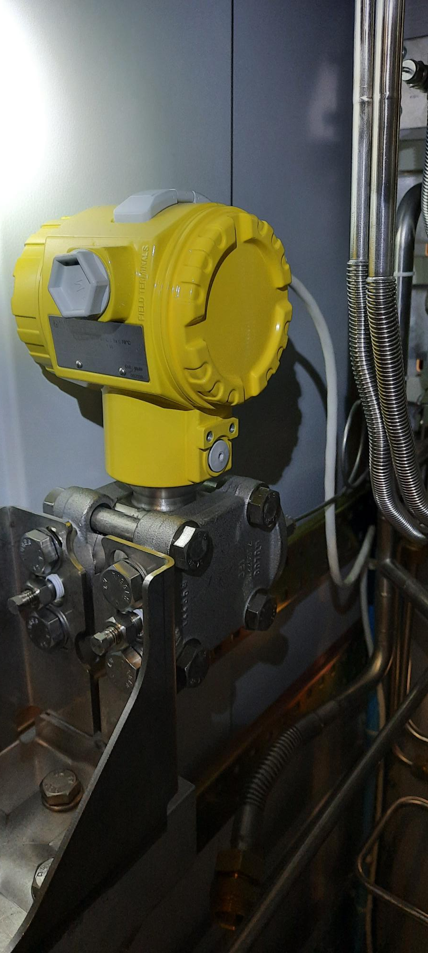
Piquet interventions
Example of intervention on MID
The system stopped due to the fact that the pressure sensor had a strange behavior and suddenly went to the minimum of the scale (-15 mbars). We swopped the regulation from this chamber sensor to the output distribution sensor. It was running like this before the installation of the chamber sensor.
  ED/DT/FS – Gas Group
  Louis-Philippe De Menezes

Slide 5
M&O interventions
130 M&O interventions
  ED/DT/FS – Gas Group
  Louis-Philippe De Menezes

Slide 6
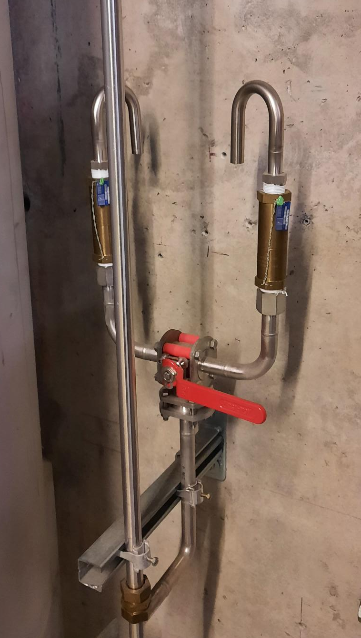
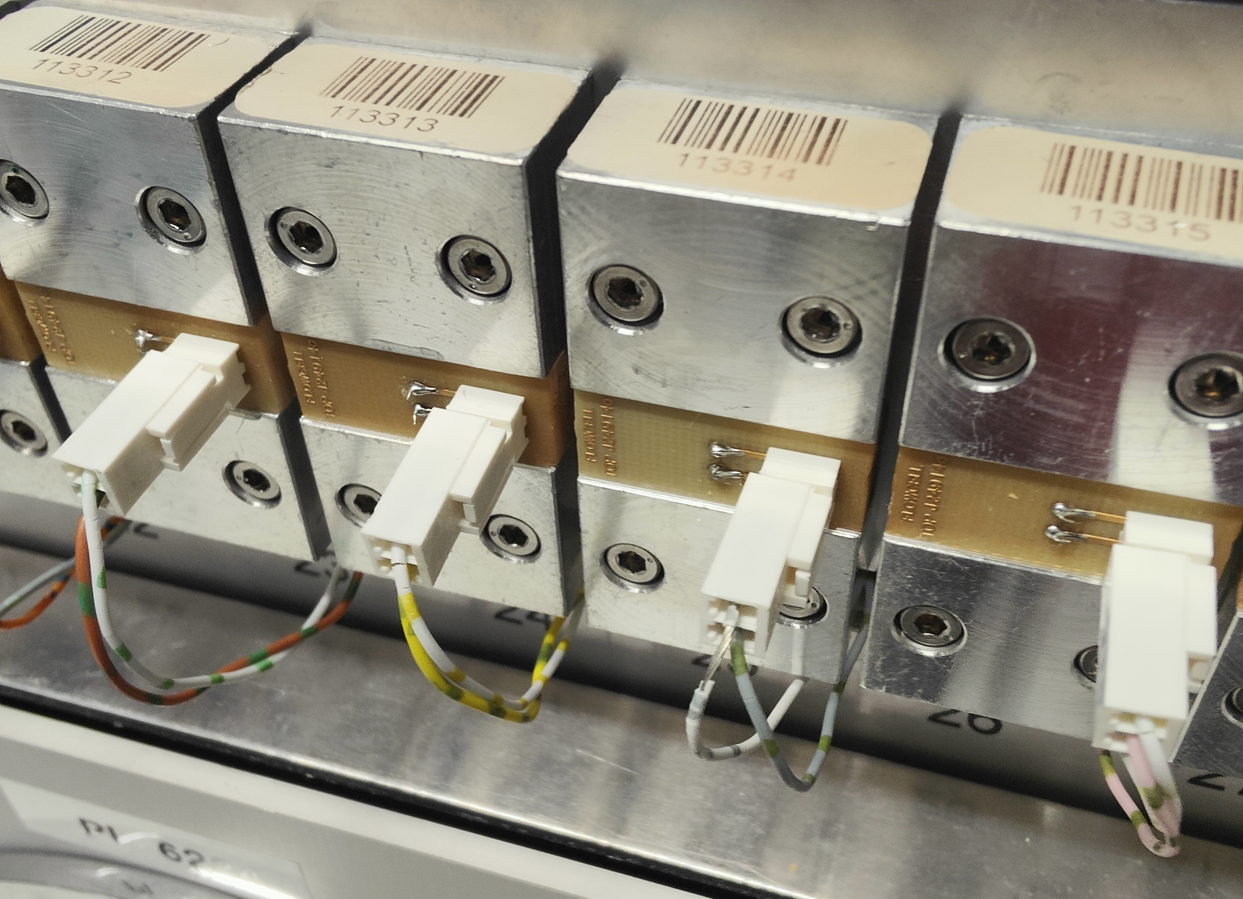
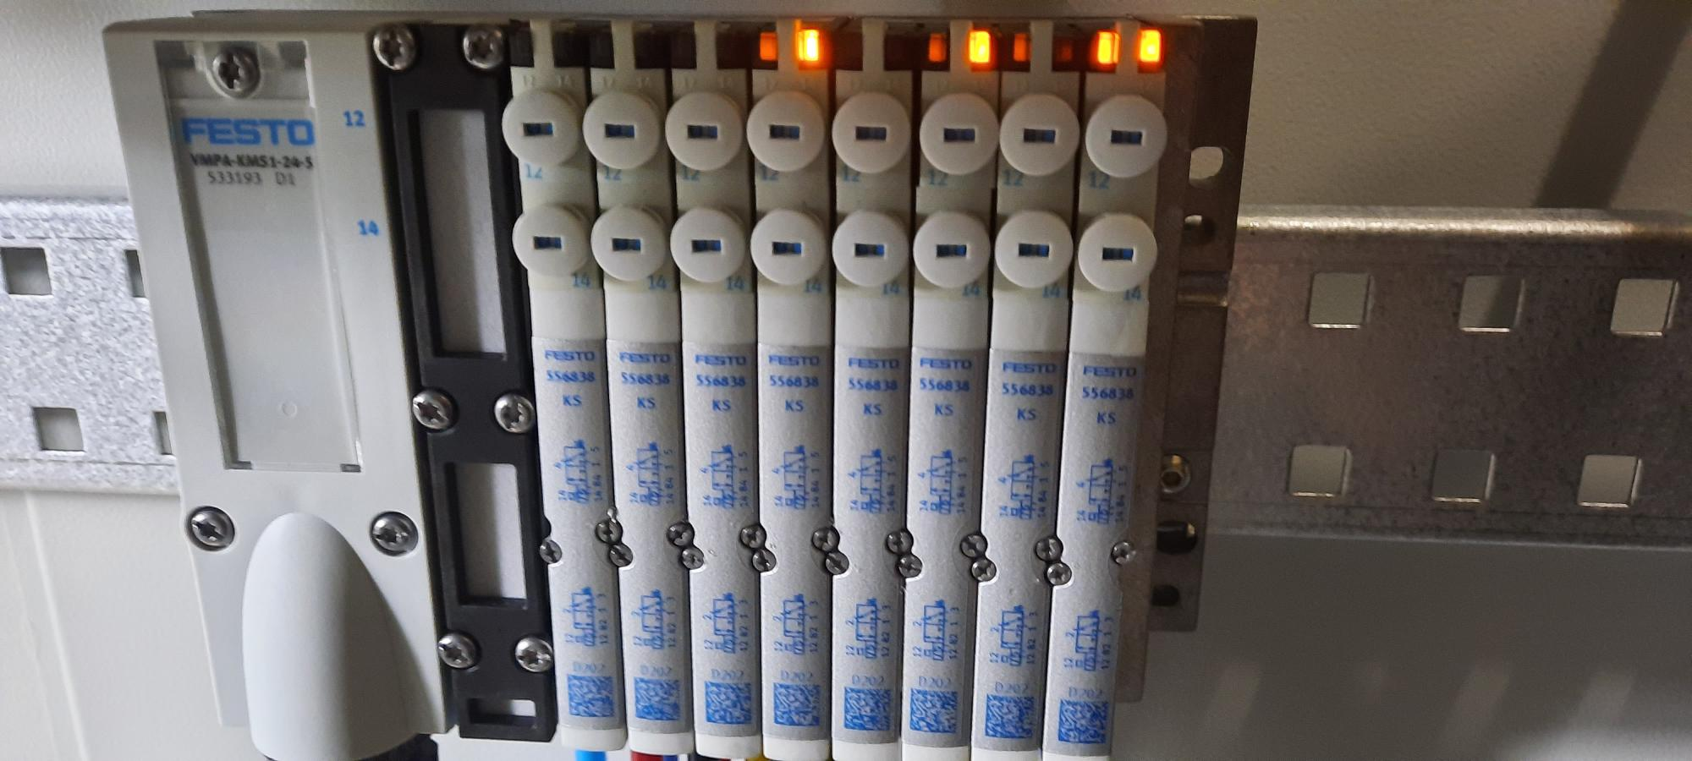
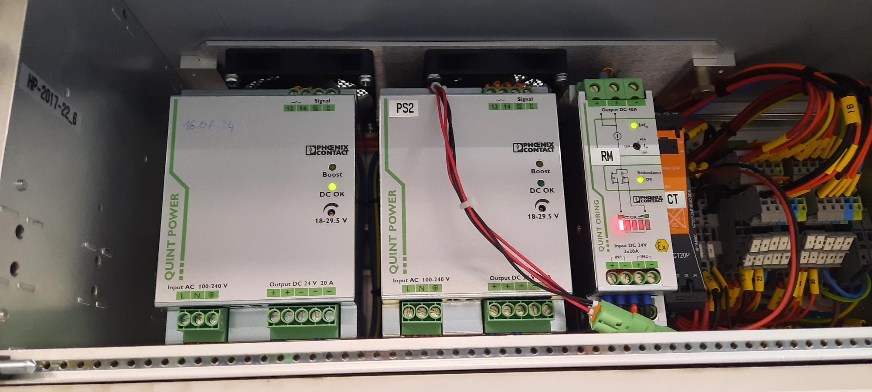
M&O interventions
Safety valves checks
Example of activities
Safety valves checks
Analyzers checks calibration / cells changes or calibration
Pump membranes changes
Filters change / cleaning
Power supply change MCH
Periodic checks
Festo changes
FESTO Modules
replacement
  ED/DT/FS – Gas Group
TOF Exhaust filter
  Louis-Philippe De Menezes

Slide 7
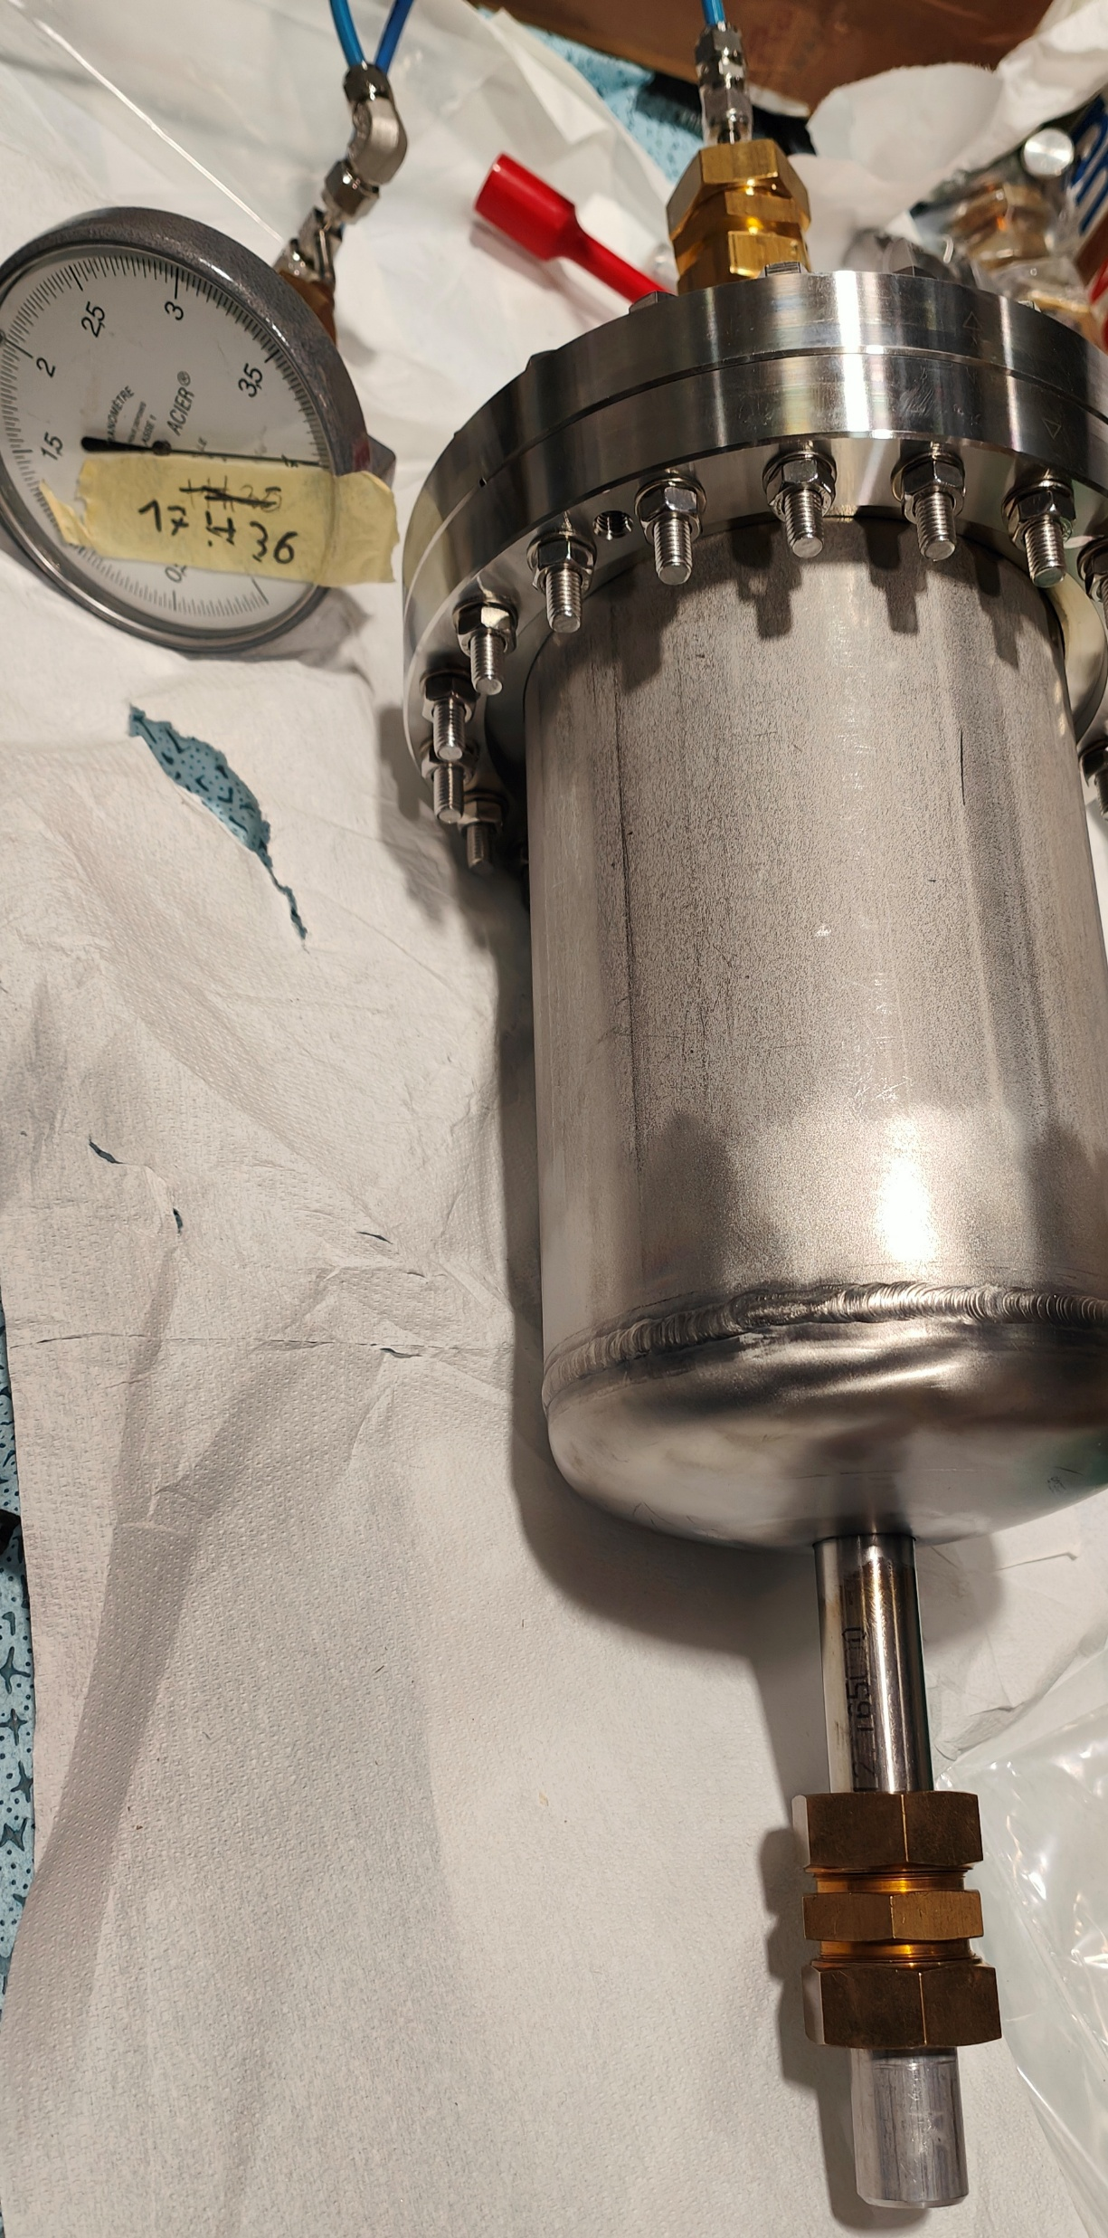
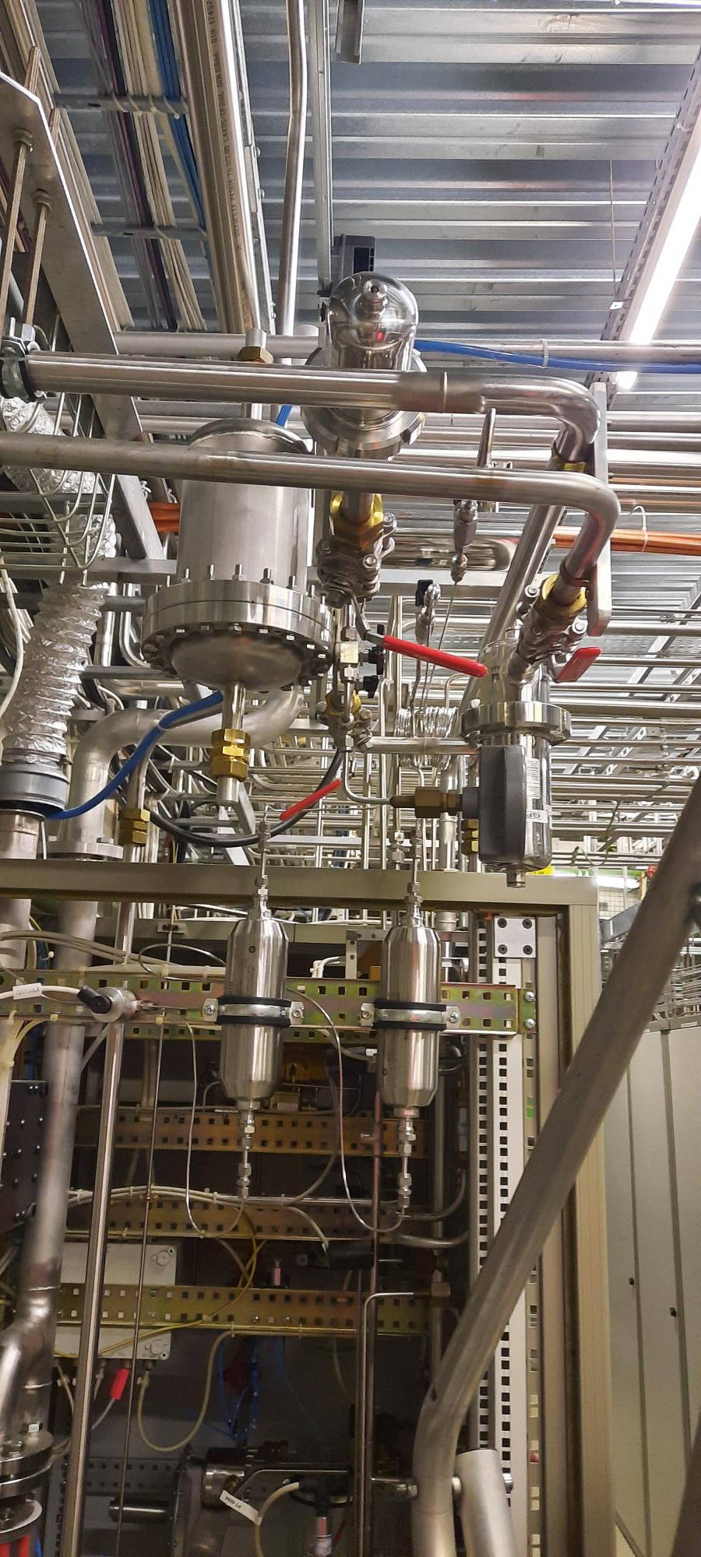
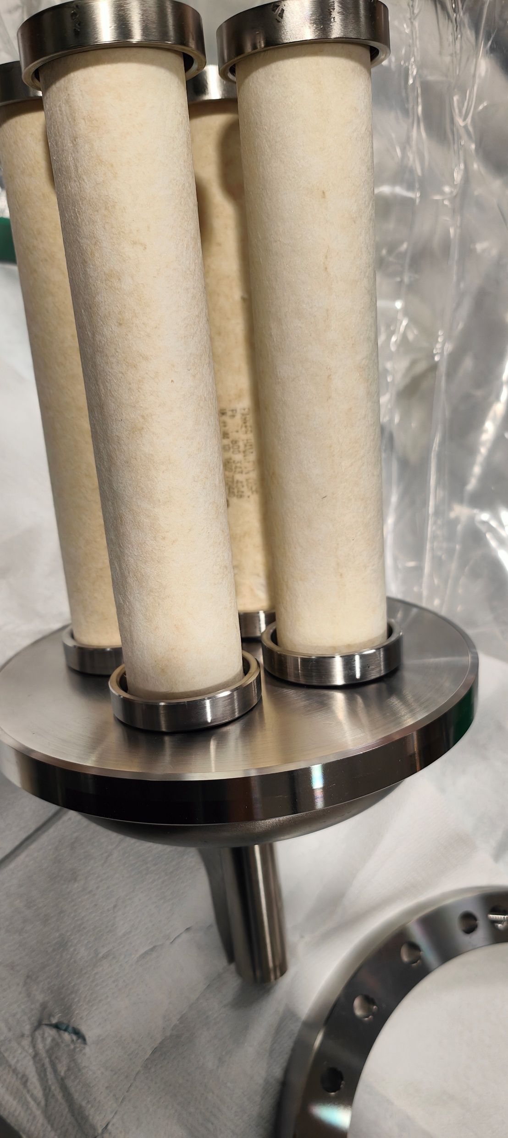
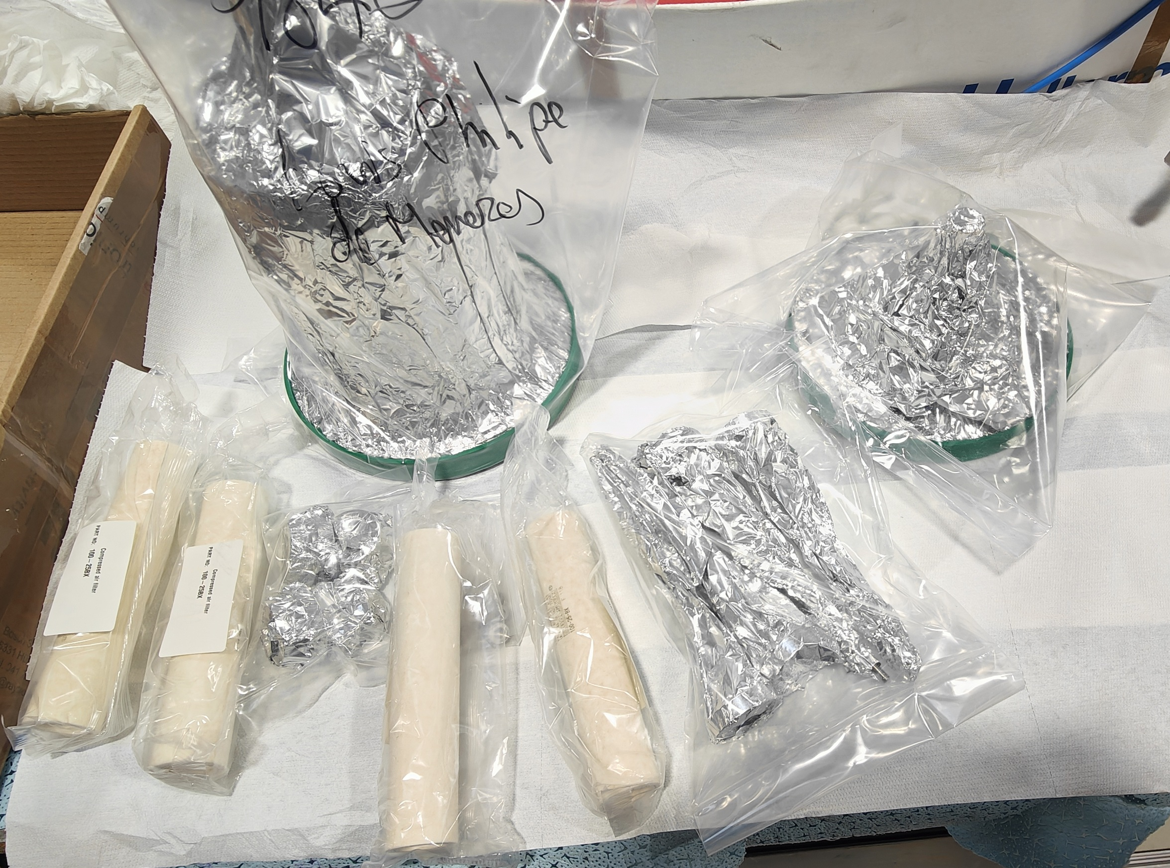
Specific intervention
Example of intervention on TPC
Construction and installation of a new small filtration low delta P filter ( 0.02 microns and 20mbars)
  ED/DT/FS – Gas Group
  Louis-Philippe De Menezes

Slide 8
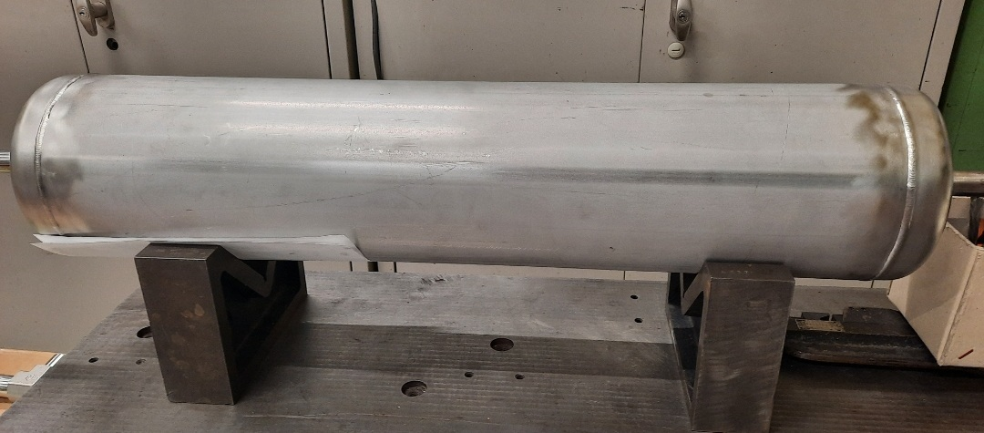
Activities 2025 ( On going)
TRD Leak search
TPC pump dumper
  ED/DT/FS – Gas Group
  Louis-Philippe De Menezes

Slide 9
ThANK you

