Slide 1
The Gas Team and the LHC gas systems:
introduction

Slide 2
Outlook
Gas Systems Team organization
Experiment/detectors contact persons, egroups
M&O Budget update
Other ALICE projects/activities
Conclusions

Slide 3
Gas Systems Team organization
First level contacts for non urgent matters:
Gas system sites responsible:
ALICE: Louis-Philippe De Menezes
ATLAS: Mattia Busato
CMS: Andrea D’Auria
LHCb: Patrick Carriè
They are your first contact for any gas system issue
If you write an email, please put in cc gassystems.support@cern.ch :
we will treat your email in case of absence of the site responsible
your email will create a jira ticket that will allow (you and us) to follow the issue reported
Second level contacts for non urgent matters:
M&O contact persons: Beatrice Mandelli, Gianluca Rigoletti
Project leader: Roberto Guida
1st contact for any urgent issue: gas piquet 162516

Slide 4
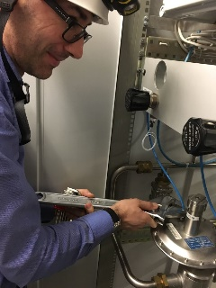
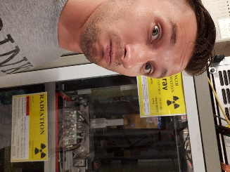
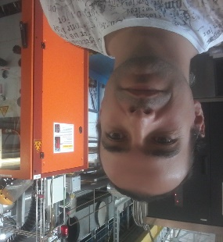
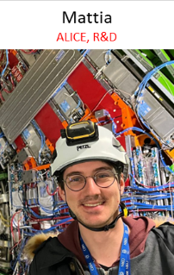
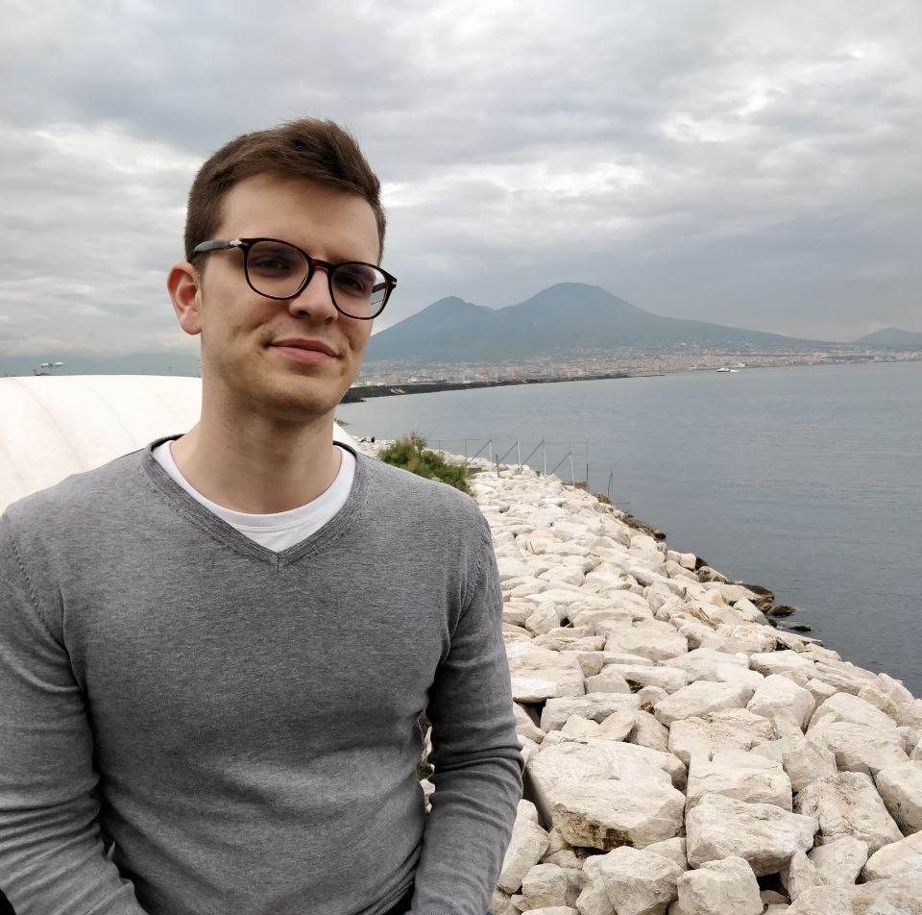
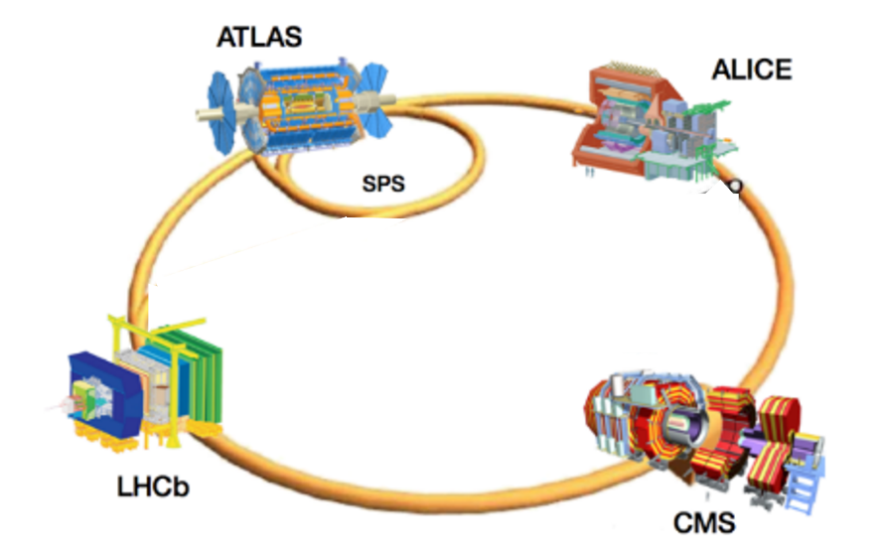
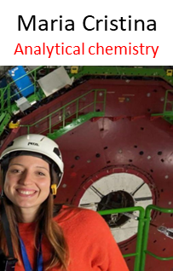
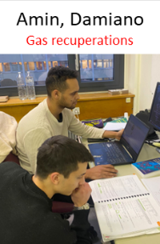
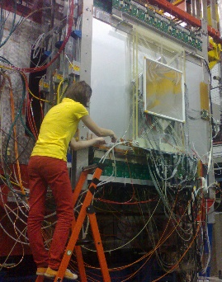
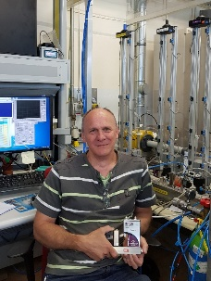
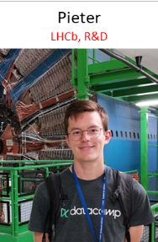
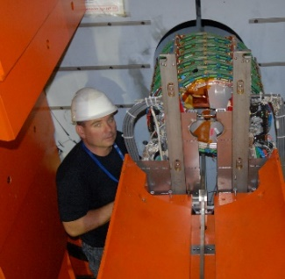
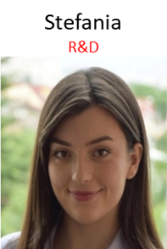
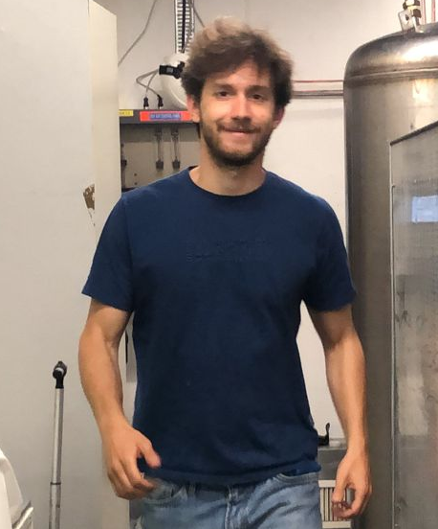
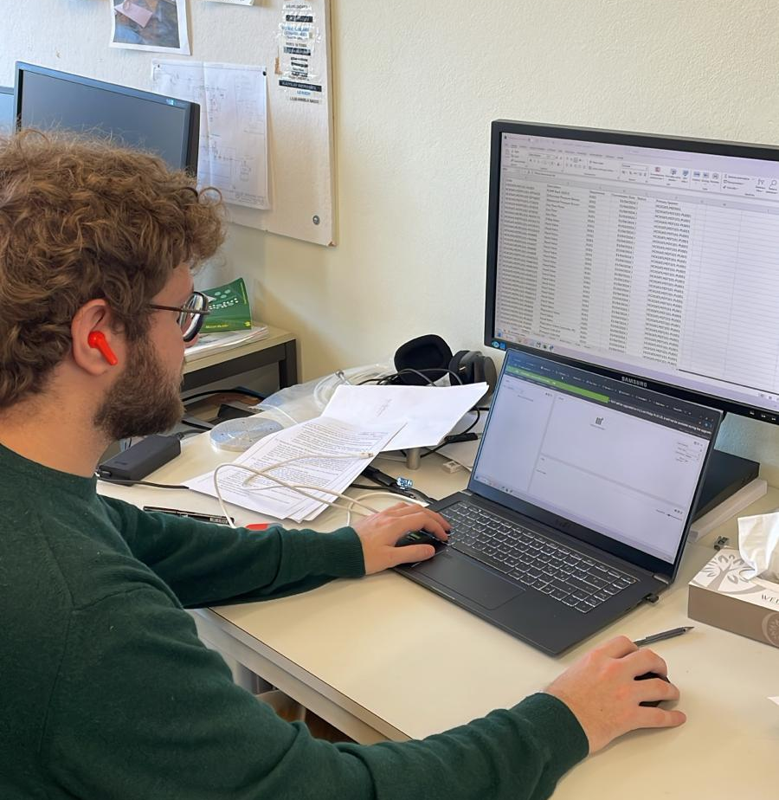
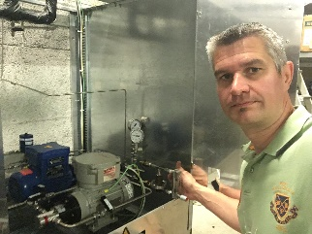
Gas Systems Team organization
Roberto
Project leader
Kacper
ATLAS and Pumps
Gianluca
Software, LHC-M&O, ATLAS and R&D
Louis-Philippe
ALICE, CLOUD
Gianluca
Software, LHC-M&O, ATLAS and R&D
V.
Students: Doct, Tech, Trainee
Beatrice
R&D and LHC-M&O
Patrick
LHCb and electrical
Spare parts (electrical)
Andrea
CMS
Mattia B.
CMS, CLOUD and R&D
Bonaventura
Maintenance analysis,
EAM/Infor and Pumps
Frederic
Gas & Cooling workshop
Spare parts (mechanical)

Slide 5
Gas Systems Team organization
Roberto
Project leader
Gianluca
Software, LHC-M&O, ATLAS and R&D
Louis-Philippe
ALICE, CLOUD
Mattia B.
ATLAS, CLOUD and R&D
Gianluca
Software, LHC-M&O, ATLAS and R&D
V.
Fellow, Doct, Tech, Trainee
Maria Cristina
gas analysis,
and CMS
Beatrice
R&D and LHC-M&O
Patrick
LHCb and electrical
Spare parts (electrical)
Andrea
CMS and
workshop
Maria Cristina
gas analysis
and CMS
Bonaventura
Maintenance analysis,
EAM/Infor and Pumps

Slide 6
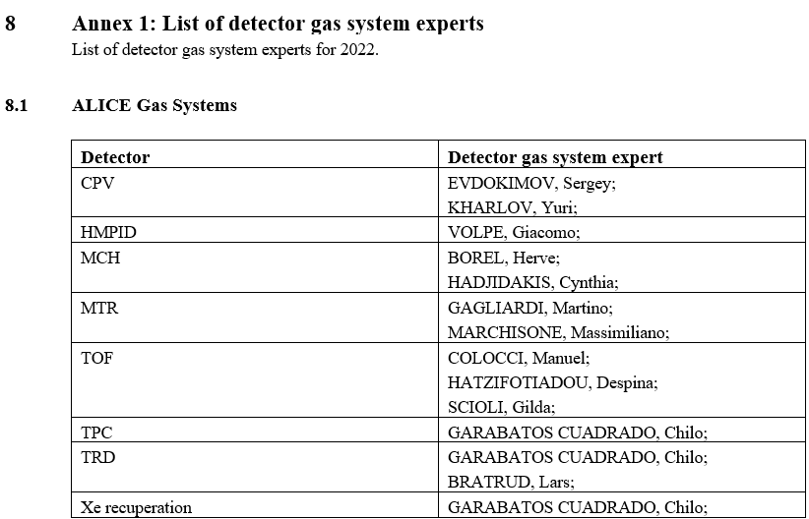
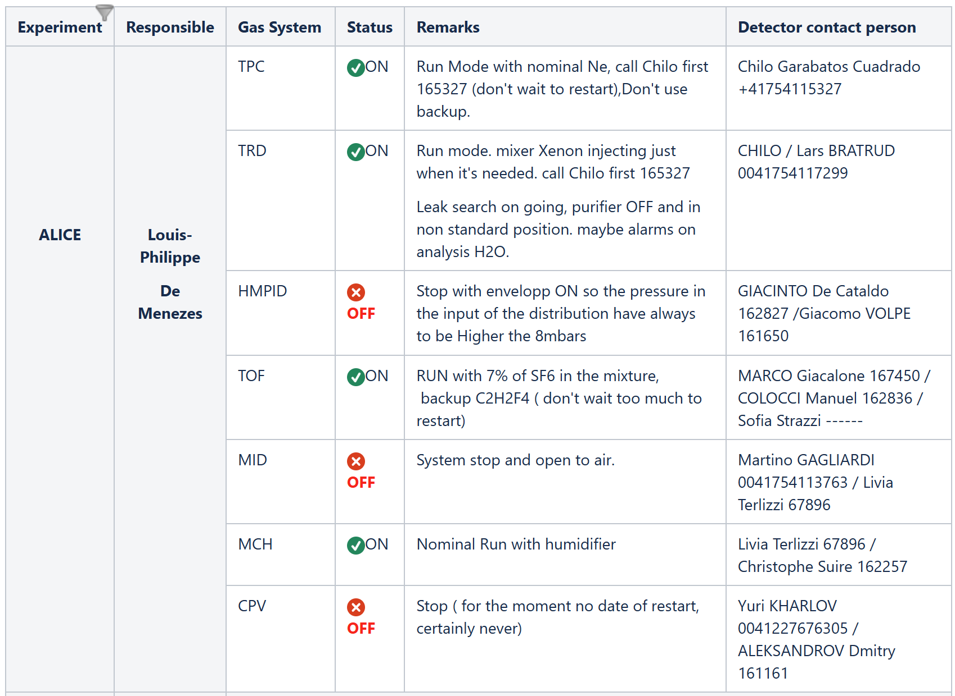
Detector contact persons
M&O Workpackage Run3 (EDMS 2779718)
Knowledge base for Gas Systems Home - Knowledge base for Gas Systems - Global Site

Slide 7
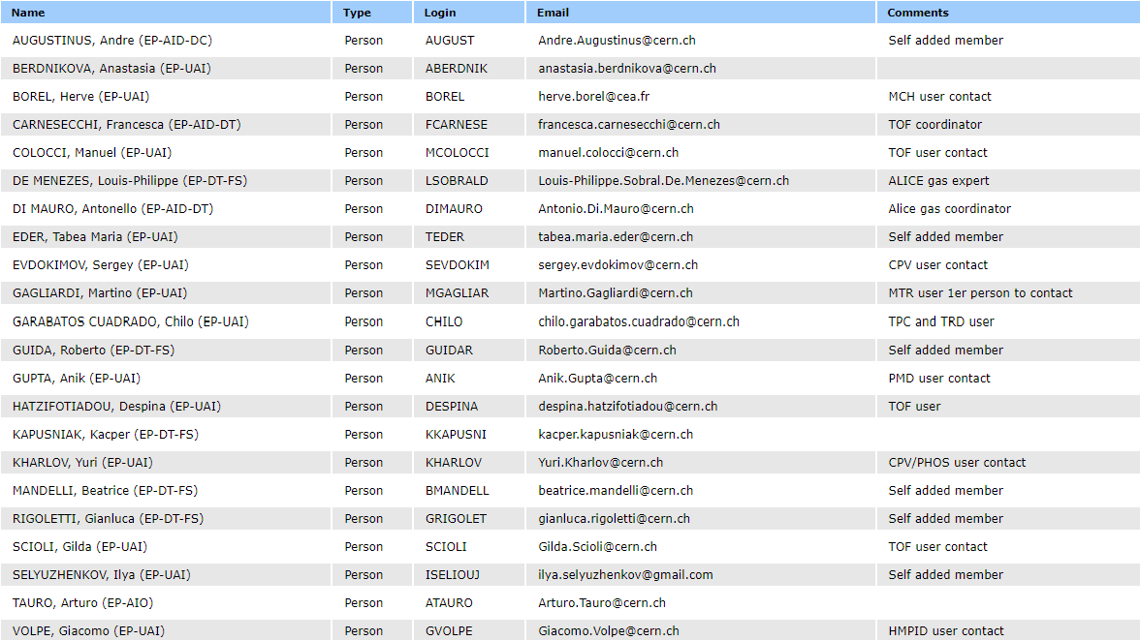
Detector contact persons
Egroup for communications between gas team and experiments.
Free subscription and unsubscription (to facilitate the detector contact persons in keeping the list updated)
For ALICE:
gas-users-ALICE
Members are:
To facilitate communication add:
detector
On-call numbers
names to add/remove?

Slide 8
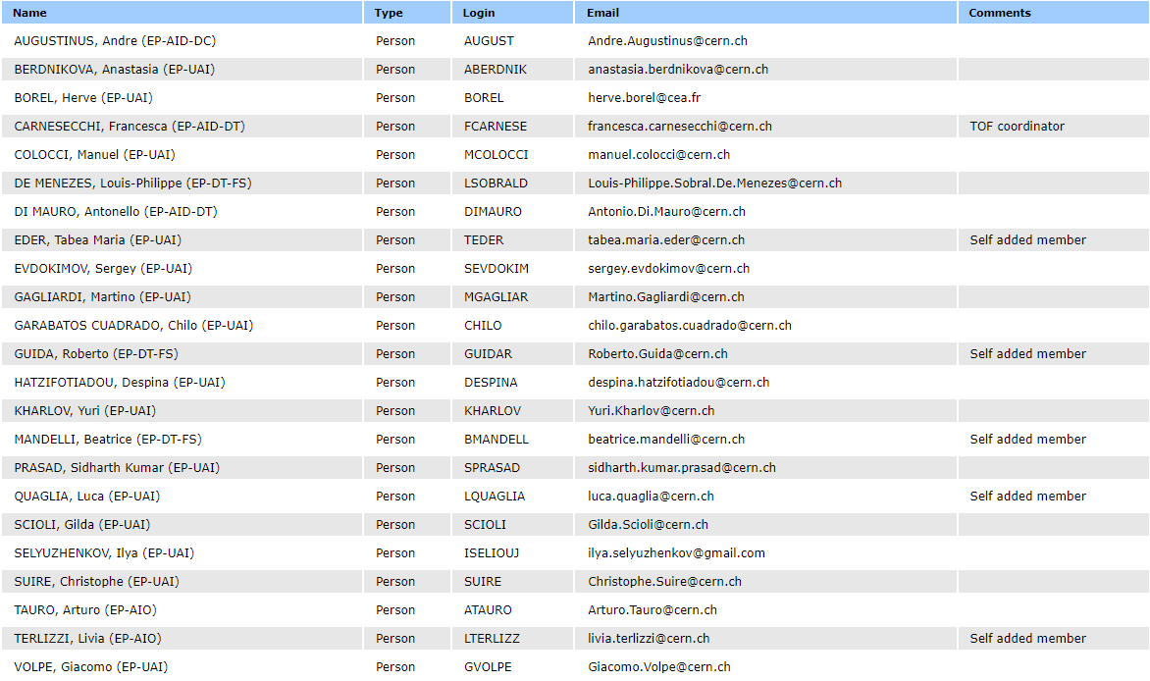
Gas systems elog
Egroup for elog notification
Free subscription and unsubscription (to facilitate the detector contact persons in keeping the list updated)
For ALICE:
gas-users-ALICE-ELOG
Members are:

Slide 9
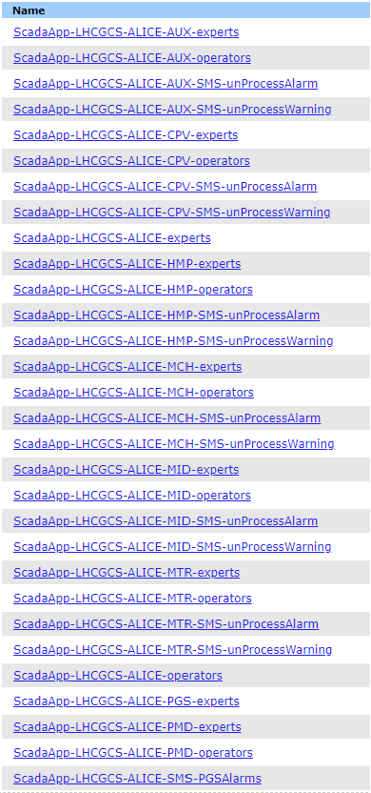

Gas systems notifications
New egroup for alarms/warning notifications specific for each detector:
Introduced for users that would like to receive only notifications concerning their detector
Example for CPV

Slide 10
M&O budget
M&O budget (EDMS 2779718):
Material and personnel costs covered by the M&O agreement
MFCs maintenance
Consumables (lab, tools, connectors, …)
Gas analysis (calibration gases, materials, O2 cells, maintenance, …)
Pump maintenance 2000h & 30000 h
Purifier maintenance
Safety valve maintenance
Pneumatic controls
PLC & Power Supply
Pressure sensors (radiation tolerant)
-
Maintenance organization (procedures, reports, …)
Analysis modules and operation
R&D for upgrade/consolidation
For ALICE:
Up to 2024
→ 133.2 kCHF
From 2025
→ 161.2 kCHF (Update to M&O Workpackage (EDMS 3088231))

Slide 11
M&O budget
For ALICE: 133.2 kCHF. How it is calculated:
It reflects:
For 580 k over the four experiments:
Complexity of the installations
  Weights table:
  Open 1
  Closed 2
  Closed complex 3
  Recuperation New 2
  Recuperation Old 1
  Flushing 1
  Analysis 0.2
  Analysis valves 0.1
Piquet elogs (2016-2021)
M&O elogs (2016-2021)
For 140 k over the four experiments:
30% operation of complex gas analysis modules
  ALICE 15%
  ATLAS 10%
  CMS 50%
  LHCb 25%
35% Consolidation and developments
  50% Common part (pressure sensors, controls, monitoring interface, …)
  50% Specific to experiment (- ATL-RPC, CMS-RPC, CF4 (CMS, LHCb), C4F10 (LHCb))
35% Support for above activities

Slide 12
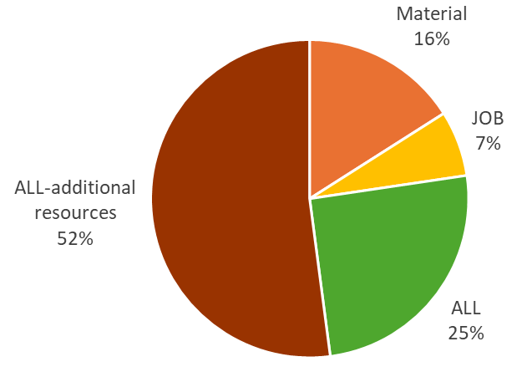
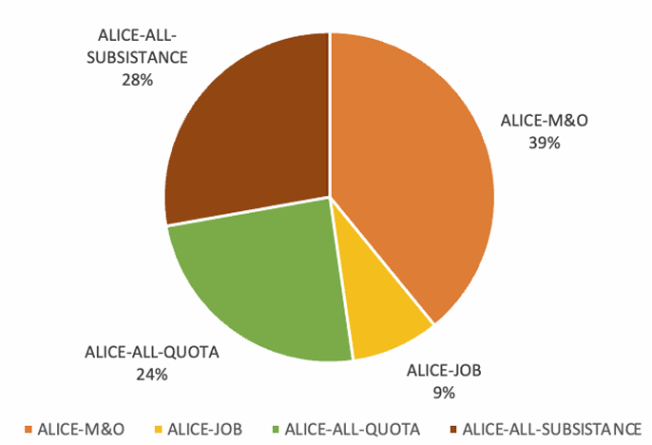
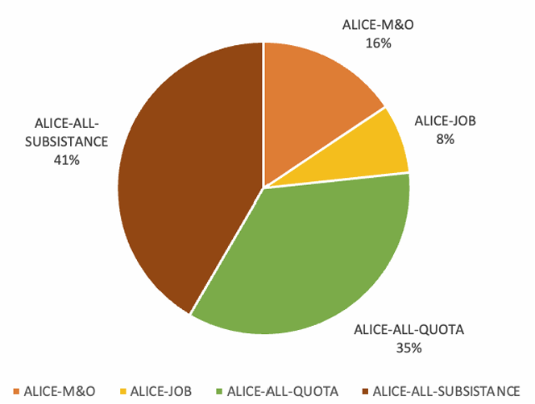
M&O budget 2022 and 2023
2022
93% budget used
2023
118% budget used
2024
118% budget used
-1 staff (controls) paid on EP budget (from 2025 back to EP budget thanks to a new LD)
+1 fellow (controls) paid on M&O (same as above, from 2025 back to EP budget thanks to a new LD)
+1/3 fellow (3D drawings) paid on M&O
+1 fellow for gas systems operation and flowcells
+1/2 fellow for gas systems operation and gas recuperation
+1 tech. student/Doctoral for EAM/Infor, risk assessment and reliability analysis
-1.5 staff technical (opening of a new LD technical under discussion)

Slide 13
Other ALICE projects/activities
Consolidation/upgrade:
Material and manpower costs not covered by the M&O agreement
CPV humidifier (EDMS 1953961)
  Material 11 k (TID 7809588)
  Human resources: tbc → LPh
MCH humidifier (EDMS 3017496)
  Material ~23 k (TID to be issued → LPh)
  Human resources: tbc → LPh
https://its.cern.ch/jira/browse/GASSYSTEMS-246

Slide 14
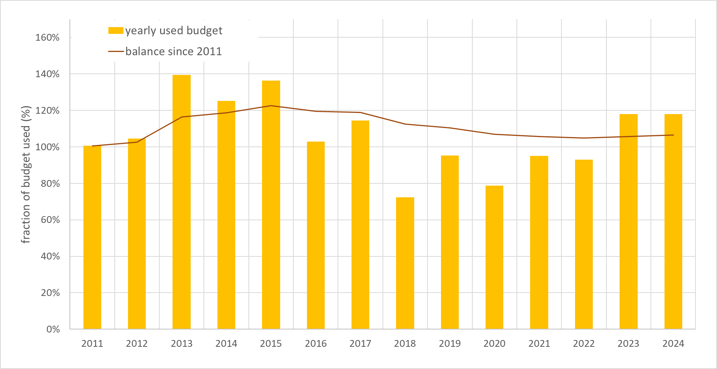
Budget history since 2011
ALICE gas system budget status since 2011:
M&O only
130 k
M&O + Addendum
130 k + 31 k
New WP
133 k

Slide 15
Conclusions
LHC M&O
LHC M&O activities are well defined and supported by the M&O agreement.
budget situation will normalize from 2025 thanks to “update” to M&O workpakage and 1 LD (controls) replacing a fellow
~5 fellow, doctoral, technical for new competencies needed:
  3D drawings
  EAM/Infor, maintenance and spare parts organization
  Flowcells
  Operation of gas systems and gas recuperation
Other ALICE projects/activities
CPV, MCH humidifiers
Others? New needs?
Beyond M&O budget
CEPS budget for R&D on new system to optimize GHG usage (examples: improvement of gas systems to cope with new detector needs and R134a, CF4, SF6, C4F10 recuperation plants)
HostLab for construction of R134a recuperation plants for ATLAS and CMS
LS3
We need to collect detector needs asap: to anticipate any potential resource issue

