Slide 1
ALICE GAS SYSTEMS
  Activities to be done in 2025
  03 February 2025
  ED/DT/FS – Gas Group
  Louis-Philippe De Menezes

Slide 2
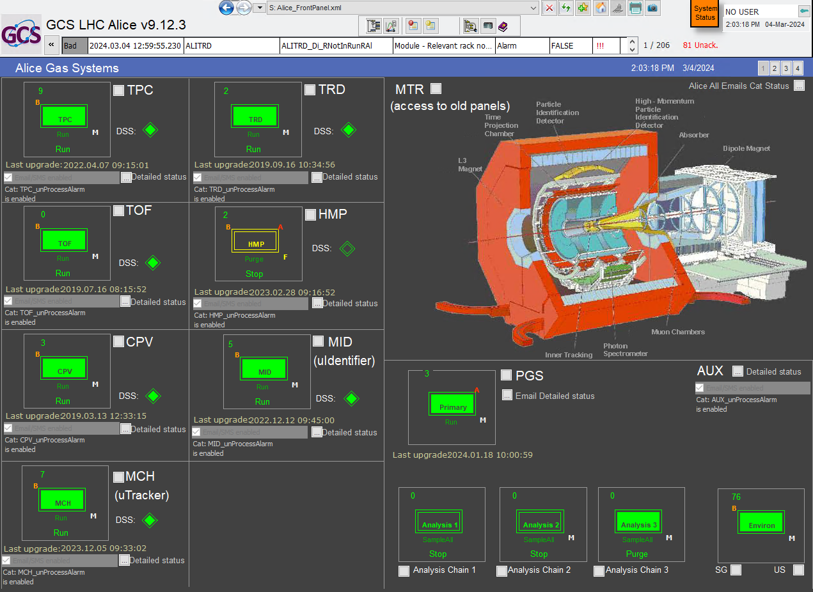
Activities for 2025
  * TPC Pump dumper
  * Big volume to remove
  * TRD pumps
  * TRD recovery insulation
  * TOF gas mixture recuperation
  ED/DT/FS – Gas Group
  Louis-Philippe De Menezs

Slide 3
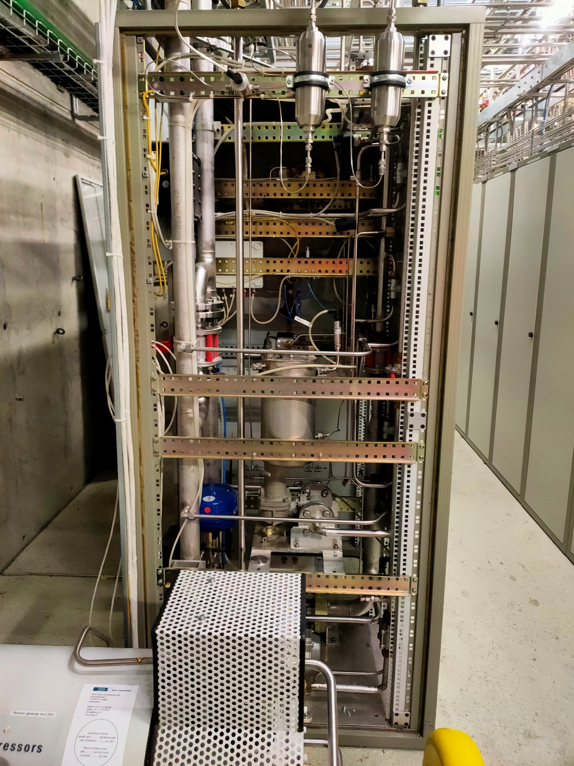
Activities in 2025
TPC pump dumper in low pressure side
Request made by Chilo to have one volumes with compartment to reduce the impact of the pump variation transmitted by the
  Louis-Philippe De Menezes

Slide 4
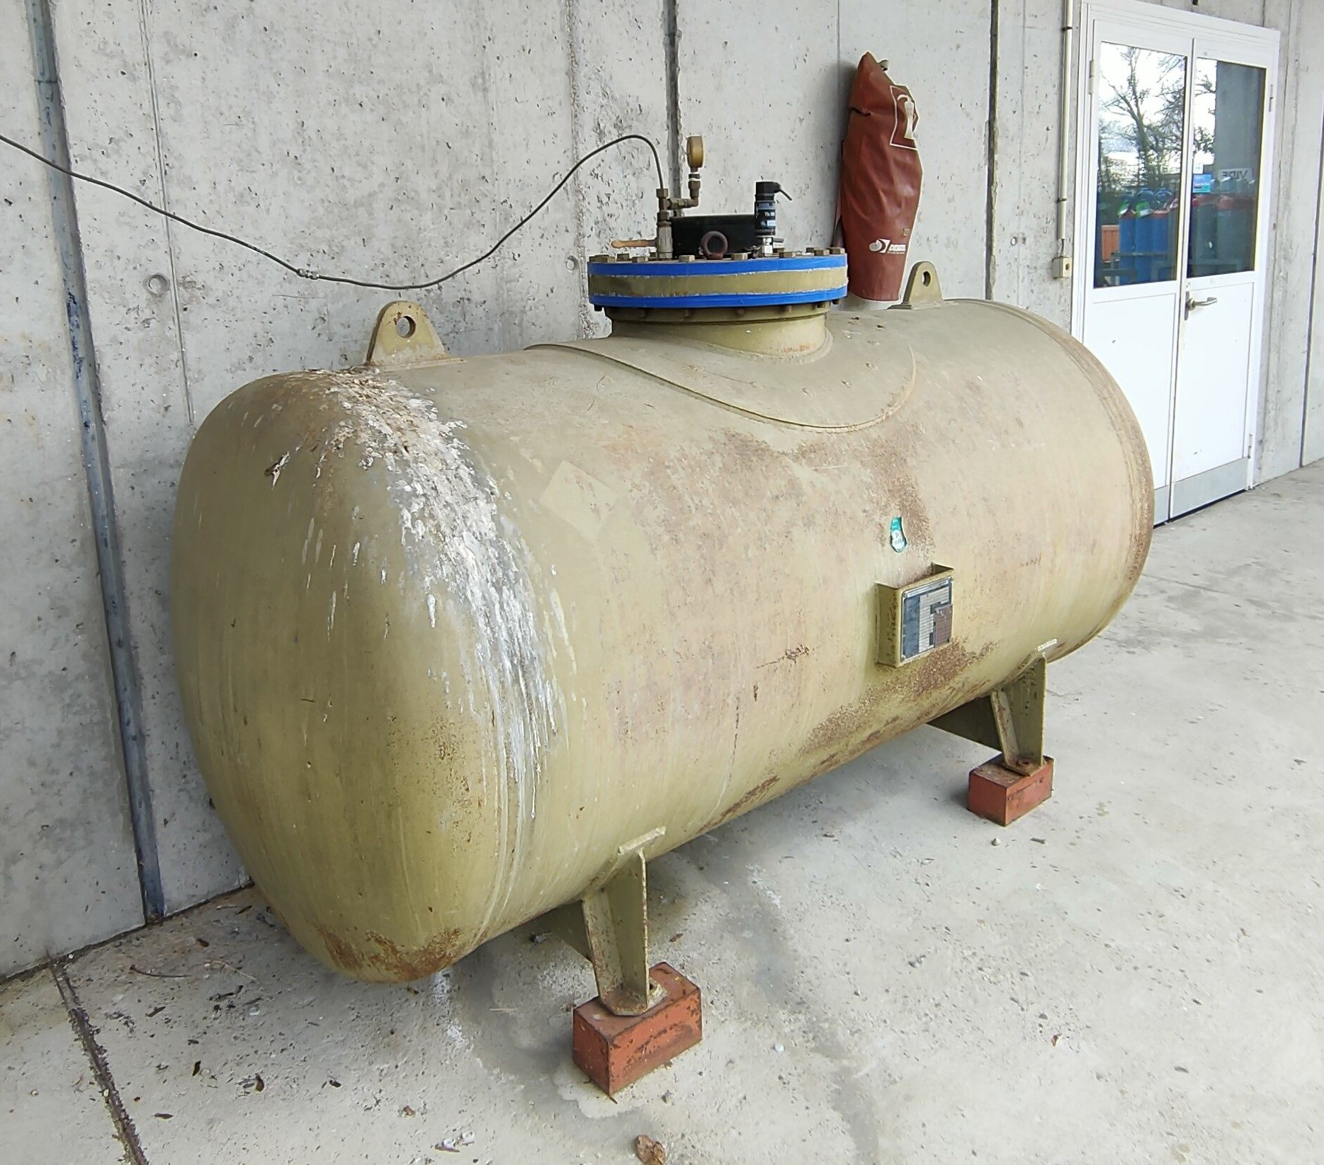
Activities in 2025
Big braun volume
CERN safety requested the pressure test ( every 10 years)
  Louis-Philippe De Menezes

Slide 5
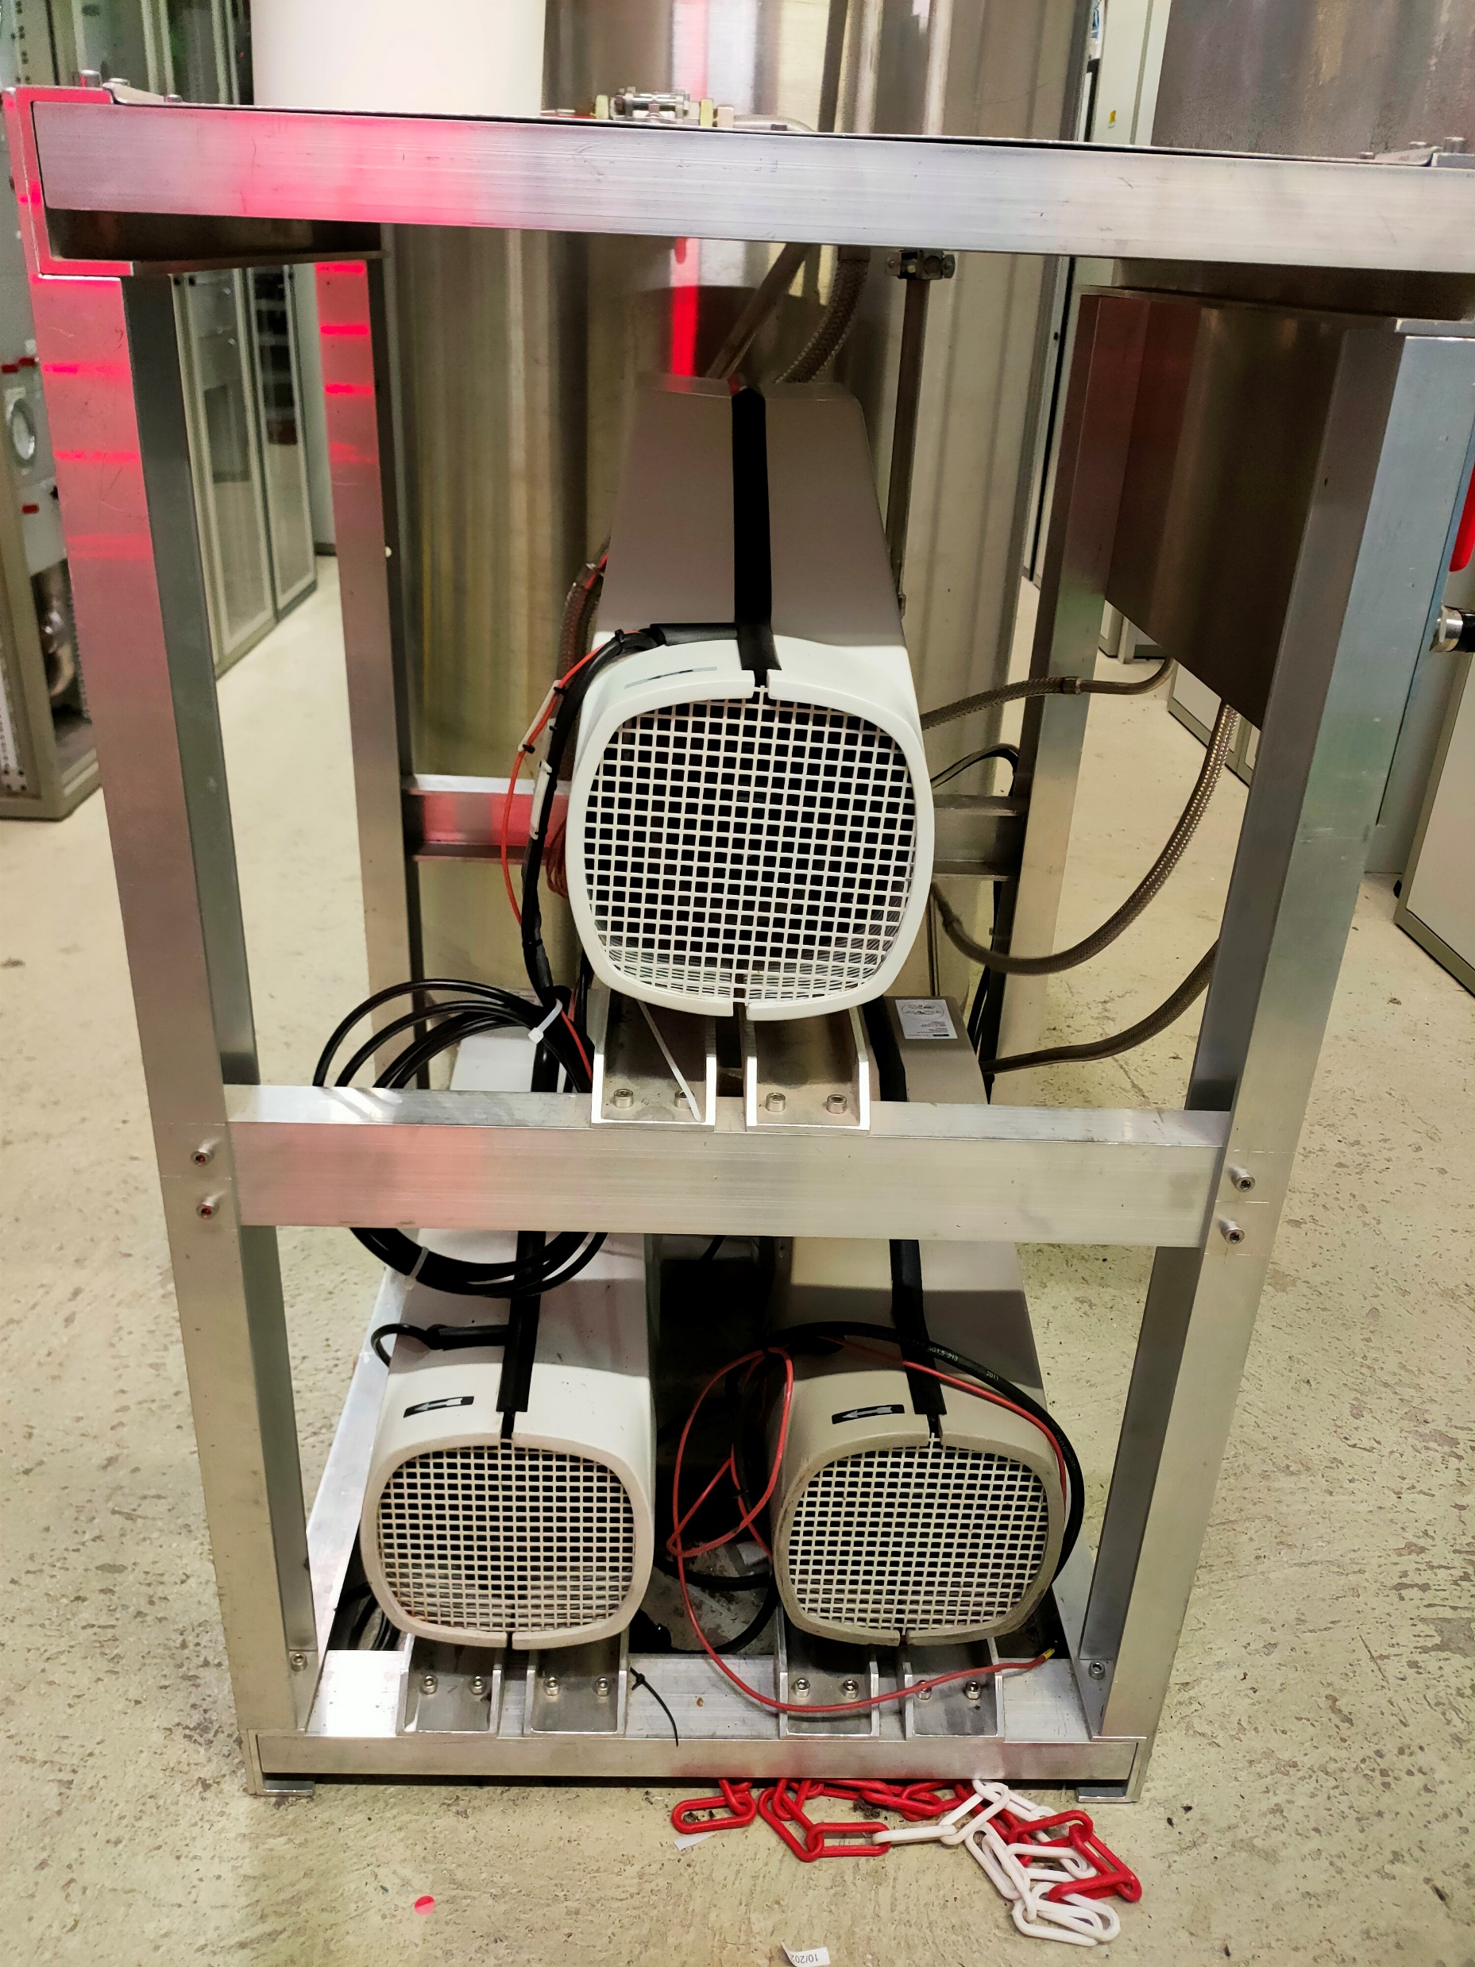
Activities in 2025
TRD Pumps to change
Requested by the standard gas system maintenance plan
  Louis-Philippe De Menezes

Slide 6
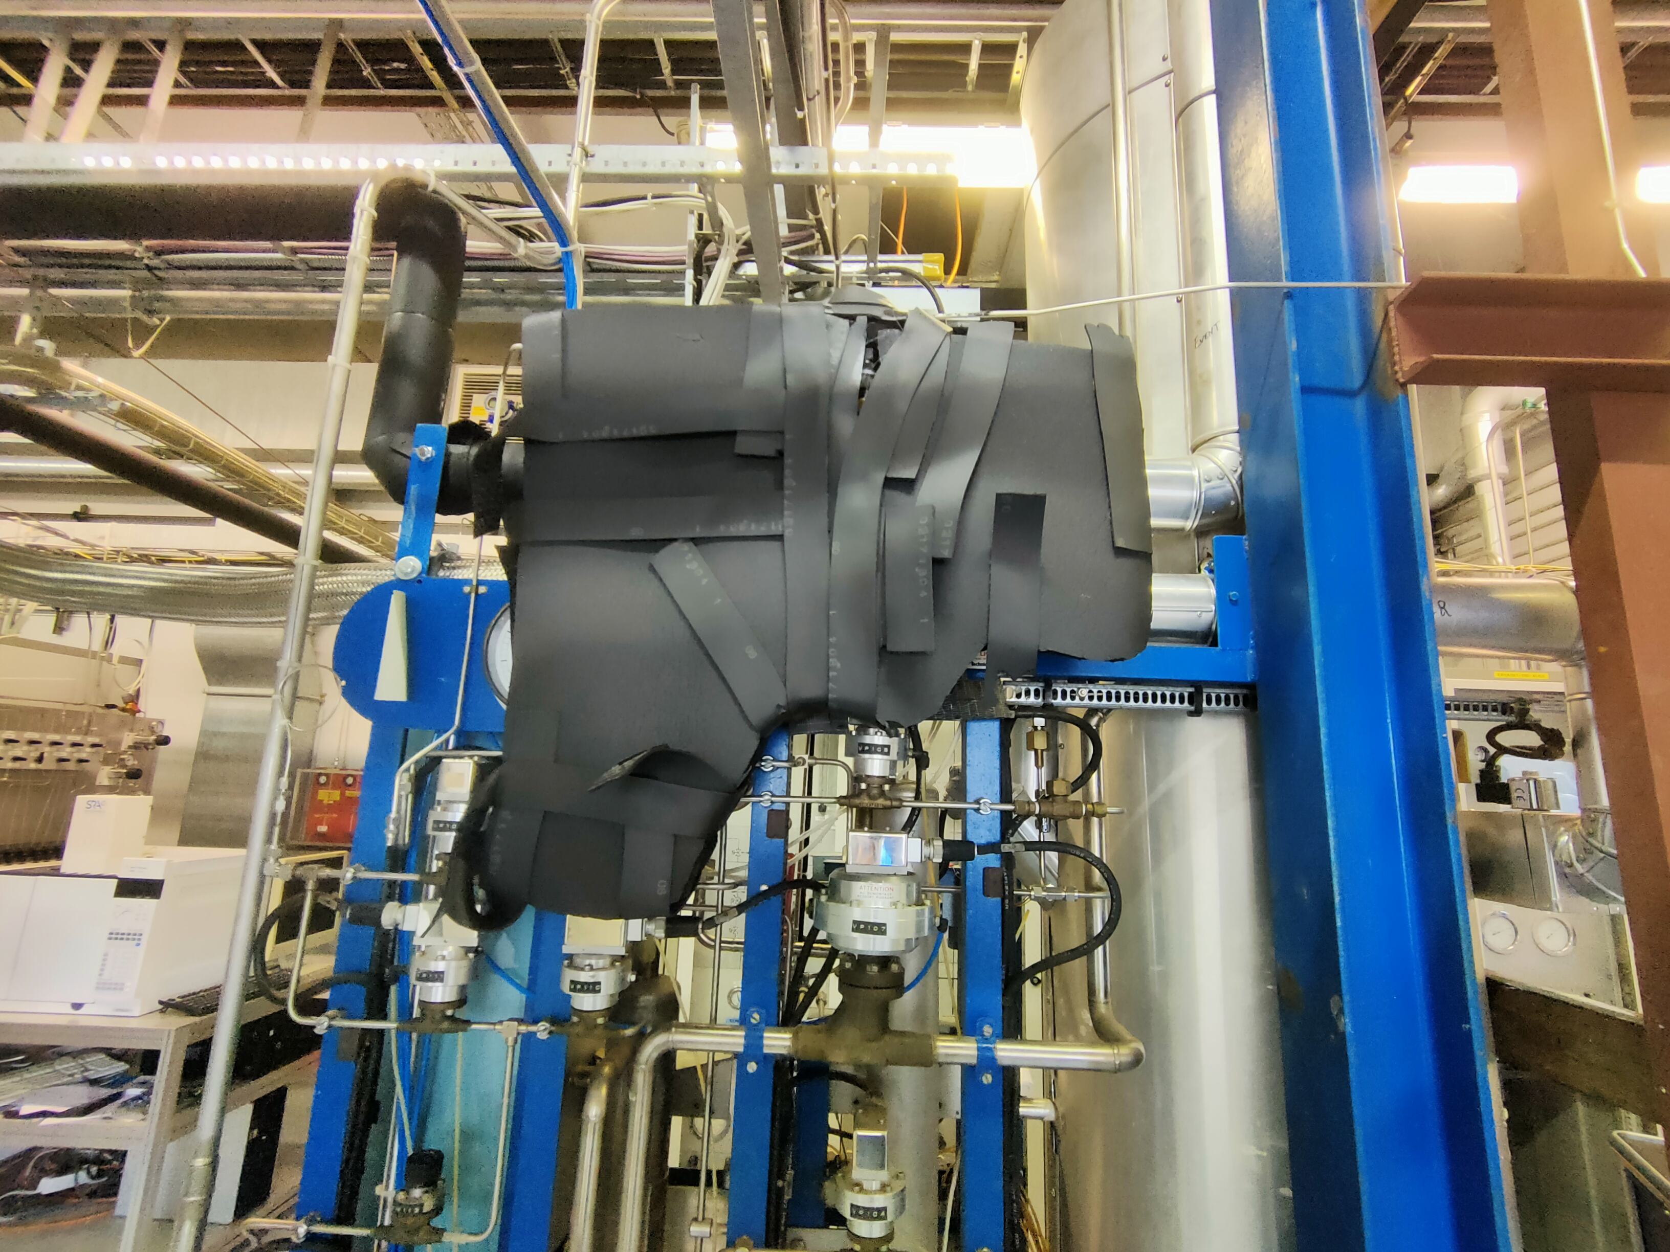
Activities in 2025
TRD recovery insulation to be redone
Requested by Me
  Louis-Philippe De Menezes

Slide 7
Activities in 2025
TOF gas mixture recuperation to prepare for LS
  Louis-Philippe De Menezes

Slide 8
ThANK you

