Slide 1
Jet modification in cold and hot QCD medium
CERN Theory Institute: High energy probes of the initial stages
CERN, March 31- April 4 2025
Xin-Nian Wang
Central China Normal University

Slide 2
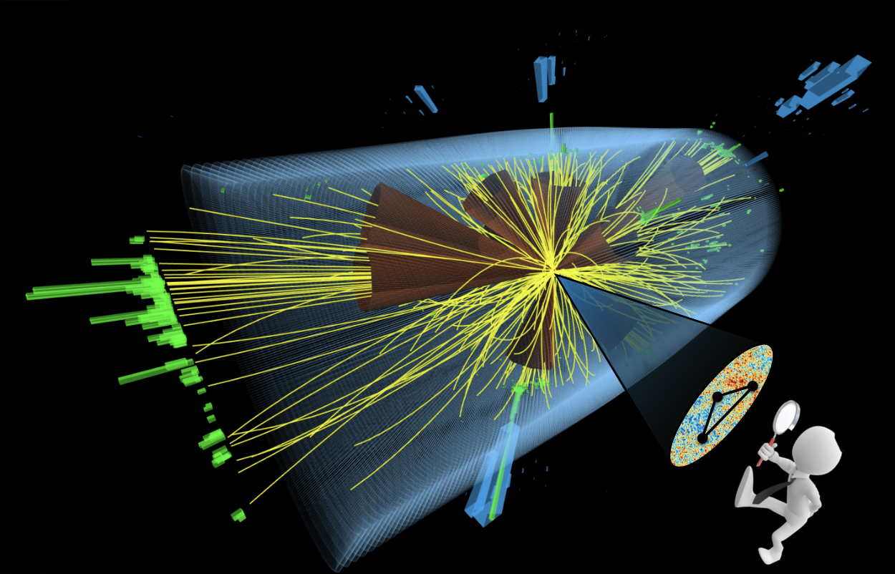
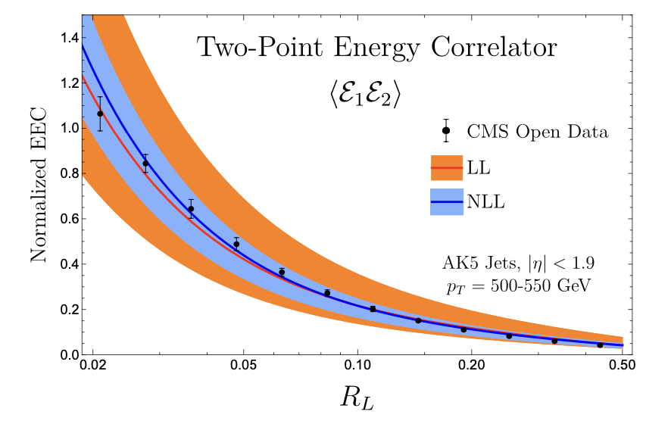
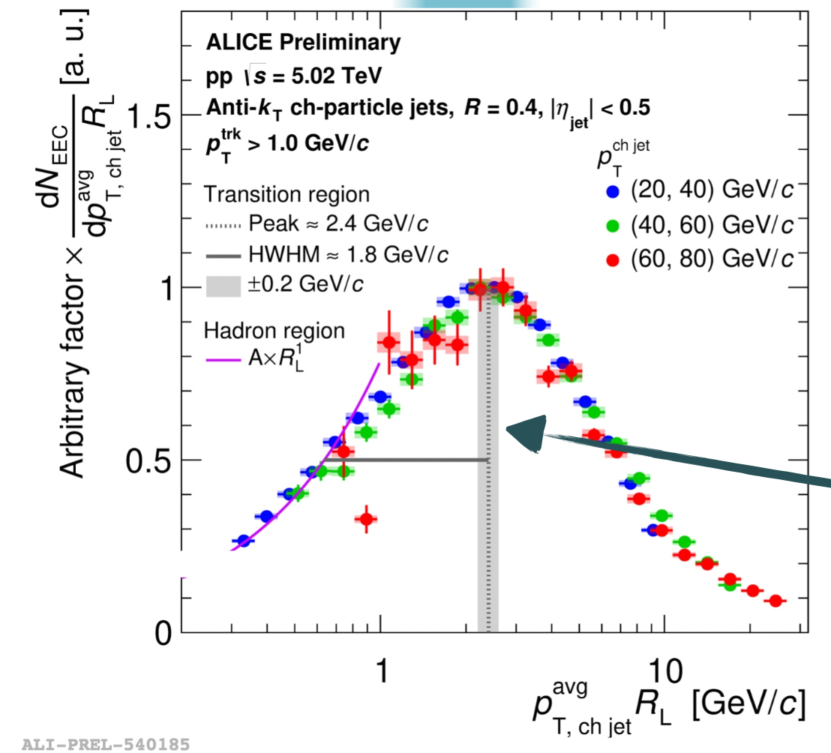
Energy-energy correlator (EEC)
A new jet substructure observable:
(1) Energy flux calculable in pQCD
(2) Clear transition from perturbative to non-perturbative: hadronization scale
Moult, et al
Fan, QM23
Notes:
\frac{d\Sigma^{(n)}}{d\theta}=\frac{1}{\sigma}\sum_{i\neq j}\int d \vec n_{i,j} \frac{d\sigma_{ij}}{d\vec n_{i,j}} \frac{E_i^n E_j^n}{Q^{2n}} \delta(\vec n_1\cdot \vec n_2 -\cos\theta)

Slide 3
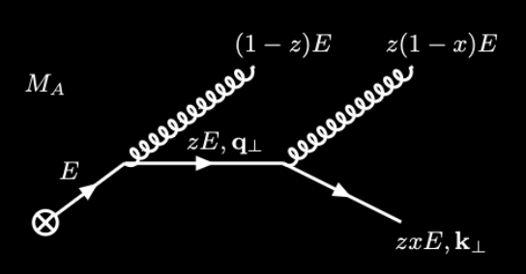
Jet EEC in Vacuum: LO
LO emission:
(1) same power-behavior for quark and gluon at LO
(2) Uncorrelated emission at small angle
Notes:
\frac{d\Sigma_q^{\rm vac}}{d\theta} \approx \frac{\alpha_s}{2\pi} C_F
\int_0^1 dz~ z(1-z) P_{qg}(z) \int_{\mu_0^2}^{Q^2} \frac{d{\bf \ell}_\perp^2}{\ell_\perp^2} \delta \left(\theta - \frac{\ell_\perp}{z(1-z)E}\right)
\approx \frac{\alpha_s}{2\pi}\frac{C_F}{2\theta} \left(3-\frac{2\mu_0}{E\theta}\right)\sqrt{1-\frac{4\mu_0}{E\theta}}
\frac{\partial \Sigma_q}{\partial \ln \mu^2} = \frac{\alpha_s(\mu^2)}{2\pi}\left[\gamma_{qq}(3)\Sigma_q +\cdots\right]
\frac{\partial }{\partial t}
\begin{bmatrix}
\Sigma_q\\
\Sigma_g\\
\end{bmatrix}
=
\begin{bmatrix}
\gamma_{qq}(3) & \gamma_{gq}(3) \\
2N_f\gamma_{qg}(3) & \gamma_{gg}(3)
\end{bmatrix}
\begin{bmatrix}
\Sigma_q\\
\Sigma_g
\end{bmatrix}

Slide 4
Jet EEC in Vacuum: Evolution
Leading Log evolution:
….
Different EEC for quarks and gluons
Notes:
second Mellin moments
\frac{d\Sigma_q^{\rm vac}}{d\theta} \approx \frac{\alpha_s}{2\pi} C_F
\int_0^1 dz~ z(1-z) P_{qg}(z) \int_{\mu_0^2}^{Q^2} \frac{d{\bf \ell}_\perp^2}{\ell_\perp^2} \delta \left(\theta - \frac{\ell_\perp}{z(1-z)E}\right)
\approx \frac{\alpha_s}{2\pi}\frac{C_F}{2\theta} \left(3-\frac{2\mu_0}{E\theta}\right)\sqrt{1-\frac{4\mu_0}{E\theta}}
\frac{\partial \Sigma_q}{\partial \ln \mu^2} = \frac{\alpha_s(\mu^2)}{2\pi}\left[\gamma_{qq}(3)\Sigma_q +\cdots\right]
\frac{\partial }{\partial t}
\begin{bmatrix}
\Sigma_q\\
\Sigma_g\\
\end{bmatrix}
=
\begin{bmatrix}
\gamma_{qq}(3) & \gamma_{gq}(3) \\
2N_f\gamma_{qg}(3) & \gamma_{gg}(3)
\end{bmatrix}
\begin{bmatrix}
\Sigma_q\\
\Sigma_g
\end{bmatrix}

Slide 5
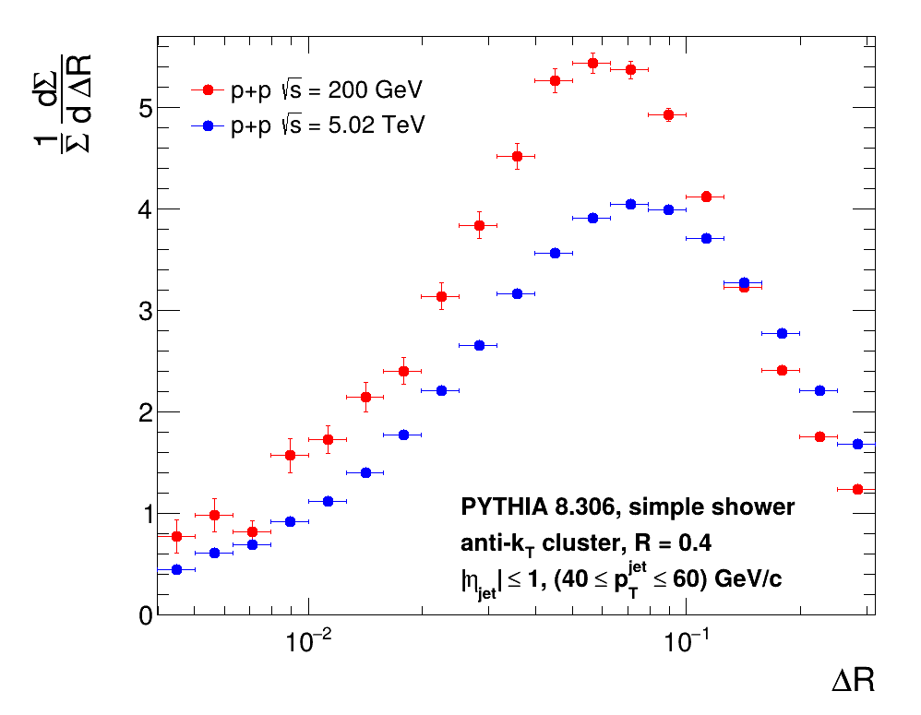
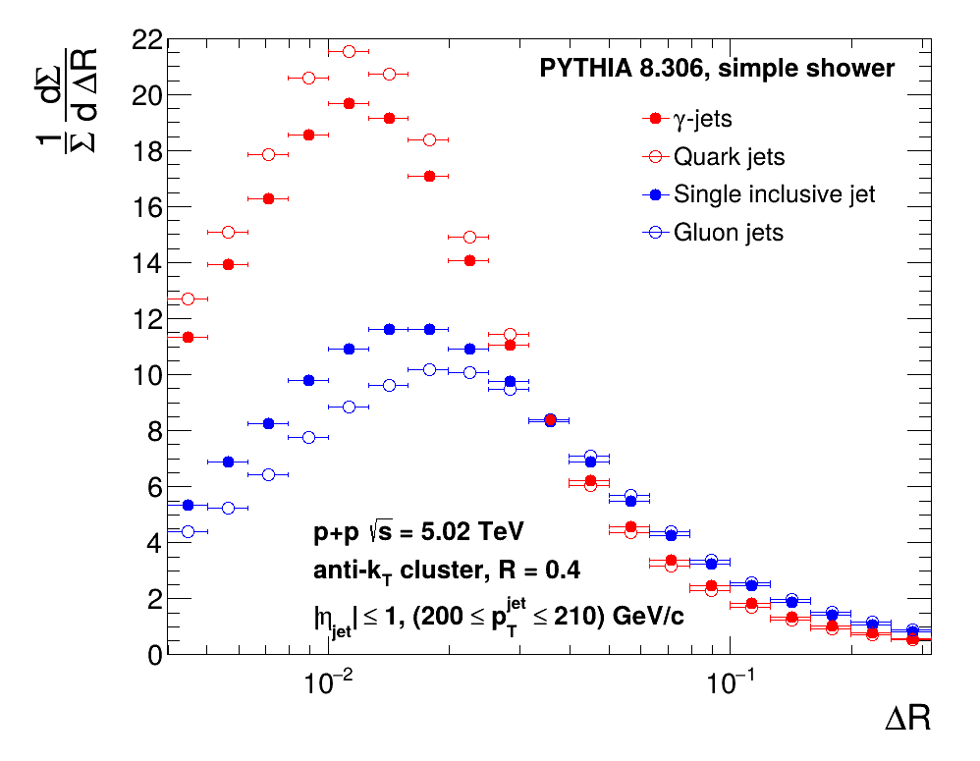
Consequences of flavor dependence of EEC
γ-jets vs. single inclusive jets
-dependence
of EEC
p_{T} – dependence of single
inclusive jet EEC
L. Apolinari, Z. Yang, et al, 2502.11406

Slide 6
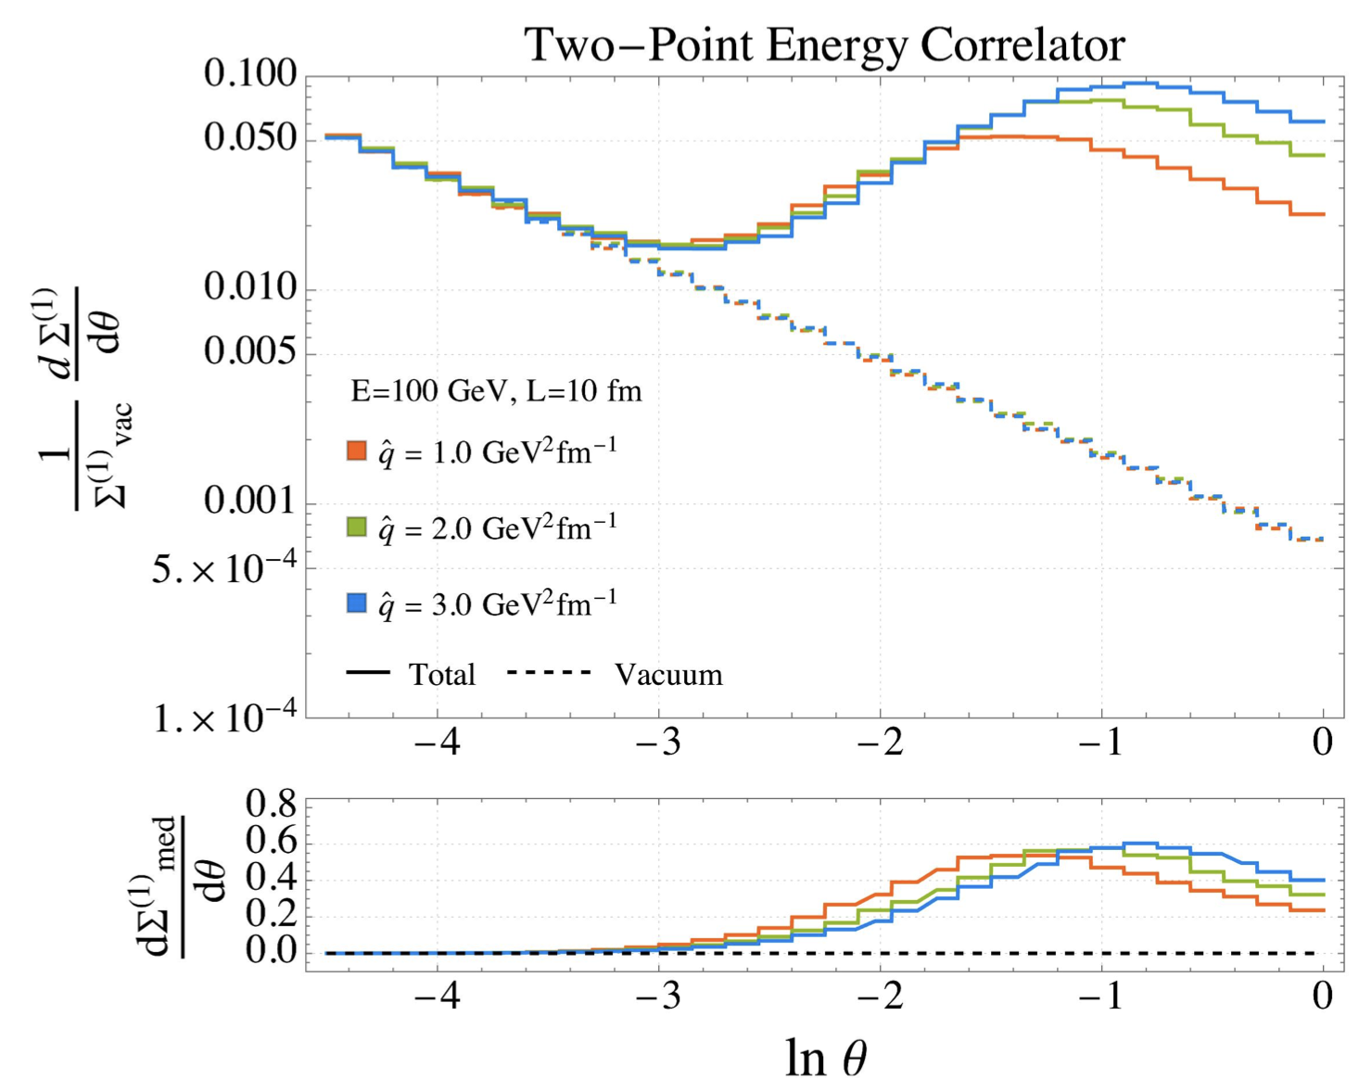
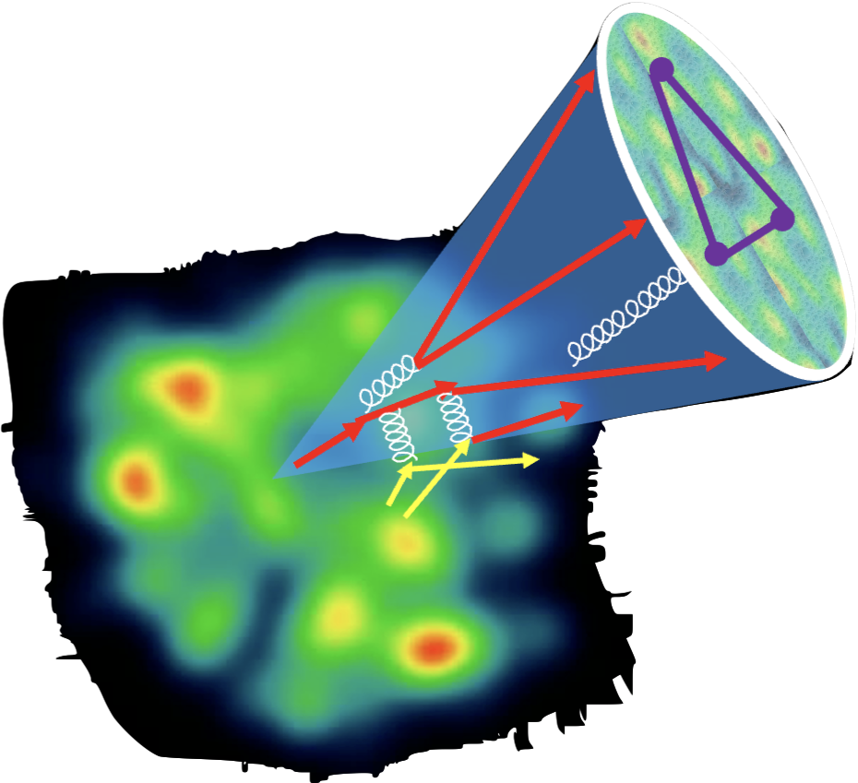
Resolving QGP scales with EEC
Andres, et al , PRL 130 (2023) 26, 262301 (2209.11236)

Slide 7
Resolving QGP scales with EEC
Can EEC resolve the induced gluon emission in EIC and heavy-ion collisions?
Can EEC resolve momentum broadening of leading partons and recoil partons (medium response)?
Can EEC resolve the angular scale of in-medium parton collisions in EIC and heavy-ion collisions

Slide 8
Gluon spectrum from single emission in GHT
Generalized HT induced emission in a QCD brick medium:
g(2)
a
l
a(1)
k
A simple saturation model for gluon TMD PDF
Notes:
\frac{dN_{g}^{a({\rm GHT})}}{dz d\ell^2_\perp}
= \frac{C_AC_2(R)}{N_c^2-1} \frac{\alpha_s}{2\pi} P_{ag}^{(0)}(z)
\int dy \rho_A(y) \int_0^{Q^2} d^2{\bf k}_\perp \frac{\alpha_s \phi_{g}(x_g, {\bf k}_\perp^2)}{k_\perp^2} \frac{2{\bf k}_\perp \cdot {\bf \ell}}{\ell_\perp^2({\bf \ell}_\perp-{\bf k}_\perp)^2}
\left[1-\cos\frac{y}{\tau_f}\right]
\tau_f =\frac{2z(1-z)E}{(\bf \ell_\perp-\bf k_\perp)^2}
\ell_\perp \ll zE, |\bf k_\perp-\bf \ell_\perp| \ll (1-z)E
\theta_{12}^2\approx 4\frac{(\bf \ell_\perp- z\bf k_\perp)^2}{z^2(1-z)^2E^2} \approx 4\frac{(\bf \ell_\perp- \bf k_\perp)^2}{z^2(1-z)^2E^2}
\int_0^{2\pi} d\phi \frac{\bf k_\perp\cdot\bf \ell_\perp+\bf k_\perp^2}{(\bf \ell+\bf k_\perp)^2}=2\pi \Theta(k_\perp^2-\ell_\perp^2)
\bf \ell_\perp -\bf k_\perp \rightarrow \bf \ell_\perp
\theta_{12} \approx \frac{2 \ell_\perp}{z(1-z)E}
\frac{d\Sigma^{\rm med}_q}{d\theta} =\frac{{L}^{5/2} \hat{q}}{\pi\sqrt{E}} \frac{8\alpha_\mathrm{s} C_A}{(\sqrt{EL}\theta)^3}
\int dz \frac{P_{qg}(z)}{z(1-z)} \left[1-\frac{\sin ELz(1-z)\theta^2/8}{ELz(1-z)\theta^2/8}\right]
\frac{d\Sigma^{\rm med}_q}{d\theta} \approx
\frac{ L^{2} \hat{q}}{2 E} \frac{\alpha_\mathrm{s} C_A}{\theta}, \theta> \sqrt{8\pi/EL}
\frac{d\Sigma^{\rm med}_q}{d\theta} \approx \frac{L^3 \hat{q} \alpha_\mathrm{s} C_A \theta}{64\pi}, \theta < \sqrt{8\pi/EL}
\hat q_R= \int d^2k_\perp \frac{\alpha_s C_2(R)}{N_c^2-1} \rho_A \phi(x_g, \vec{k}_{\perp}) =\frac{\pi C_2(R)}{N_c^2-1} \rho_A K\ln(1+\frac{Q^2}{x_B Q_s^2}).

Slide 9
EEC from single emission in e+Pb
l
k
GHT induced emission in e+Pb
Y. Ke, XNW and W. Zhao in preparation
Notes:
\frac{d\Sigma^{\rm med}_q}{d\theta} \approx
\frac{ L^{2} \hat{q}}{2 E} \frac{\alpha_\mathrm{s} C_A}{\theta}, \theta> \sqrt{8\pi/EL}
\frac{d\Sigma^{\rm med}_q}{d\theta} \approx \frac{L^3 \hat{q} \alpha_\mathrm{s} C_A \theta}{64\pi}, \theta < \sqrt{8\pi/EL}

Slide 10
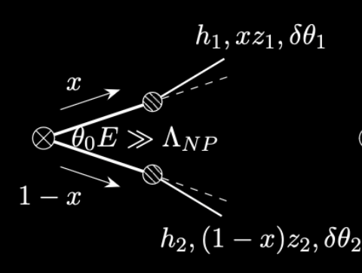
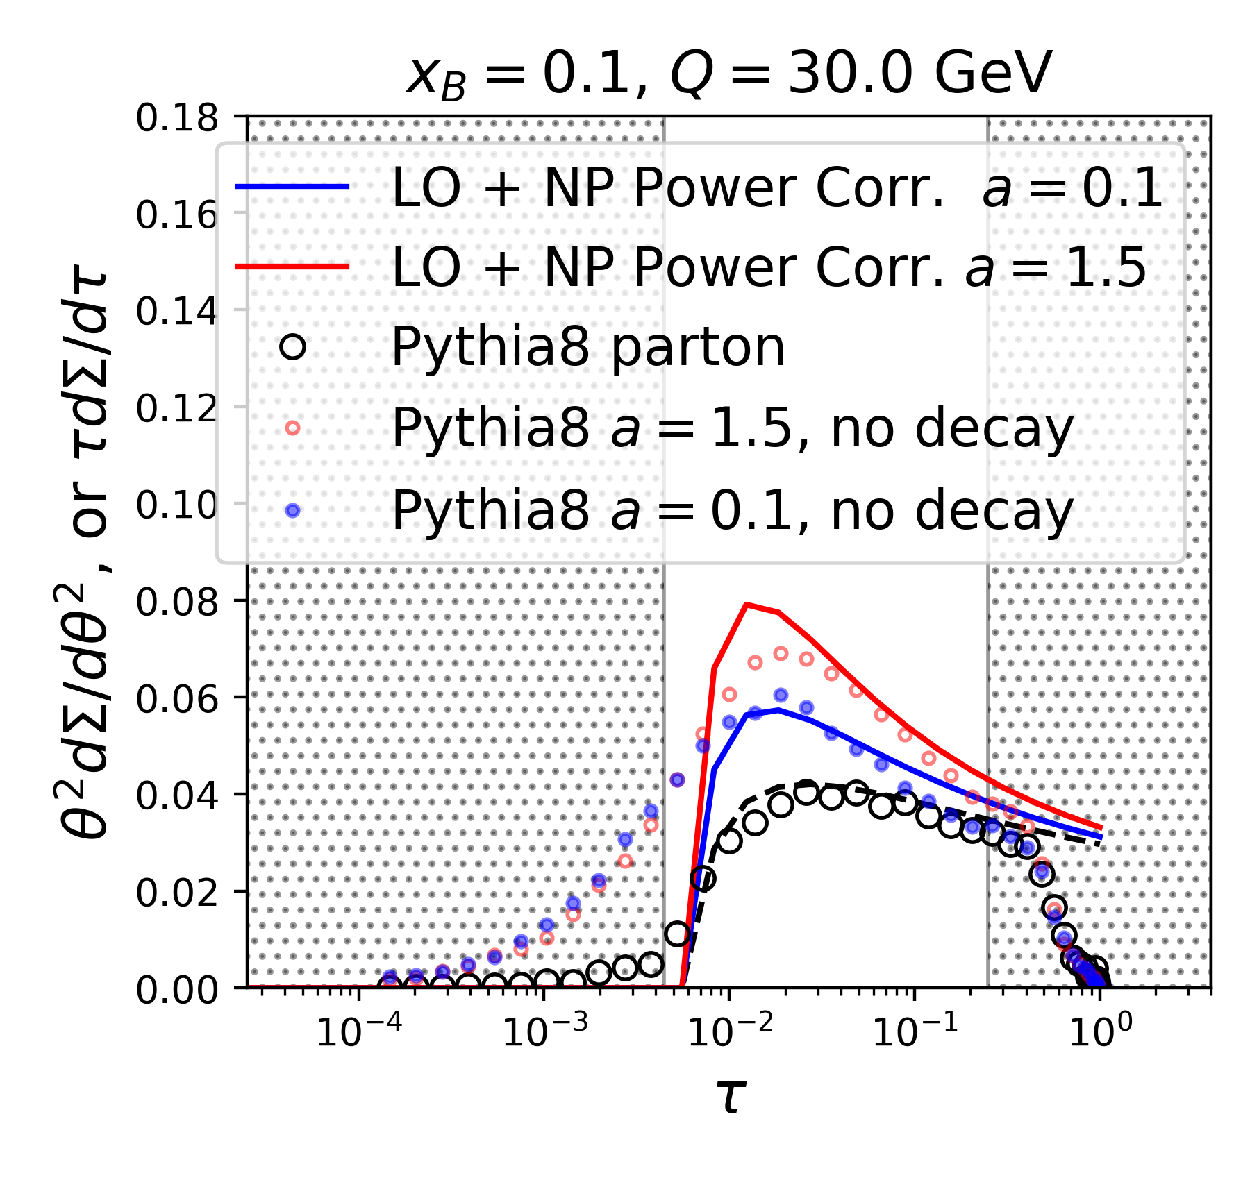
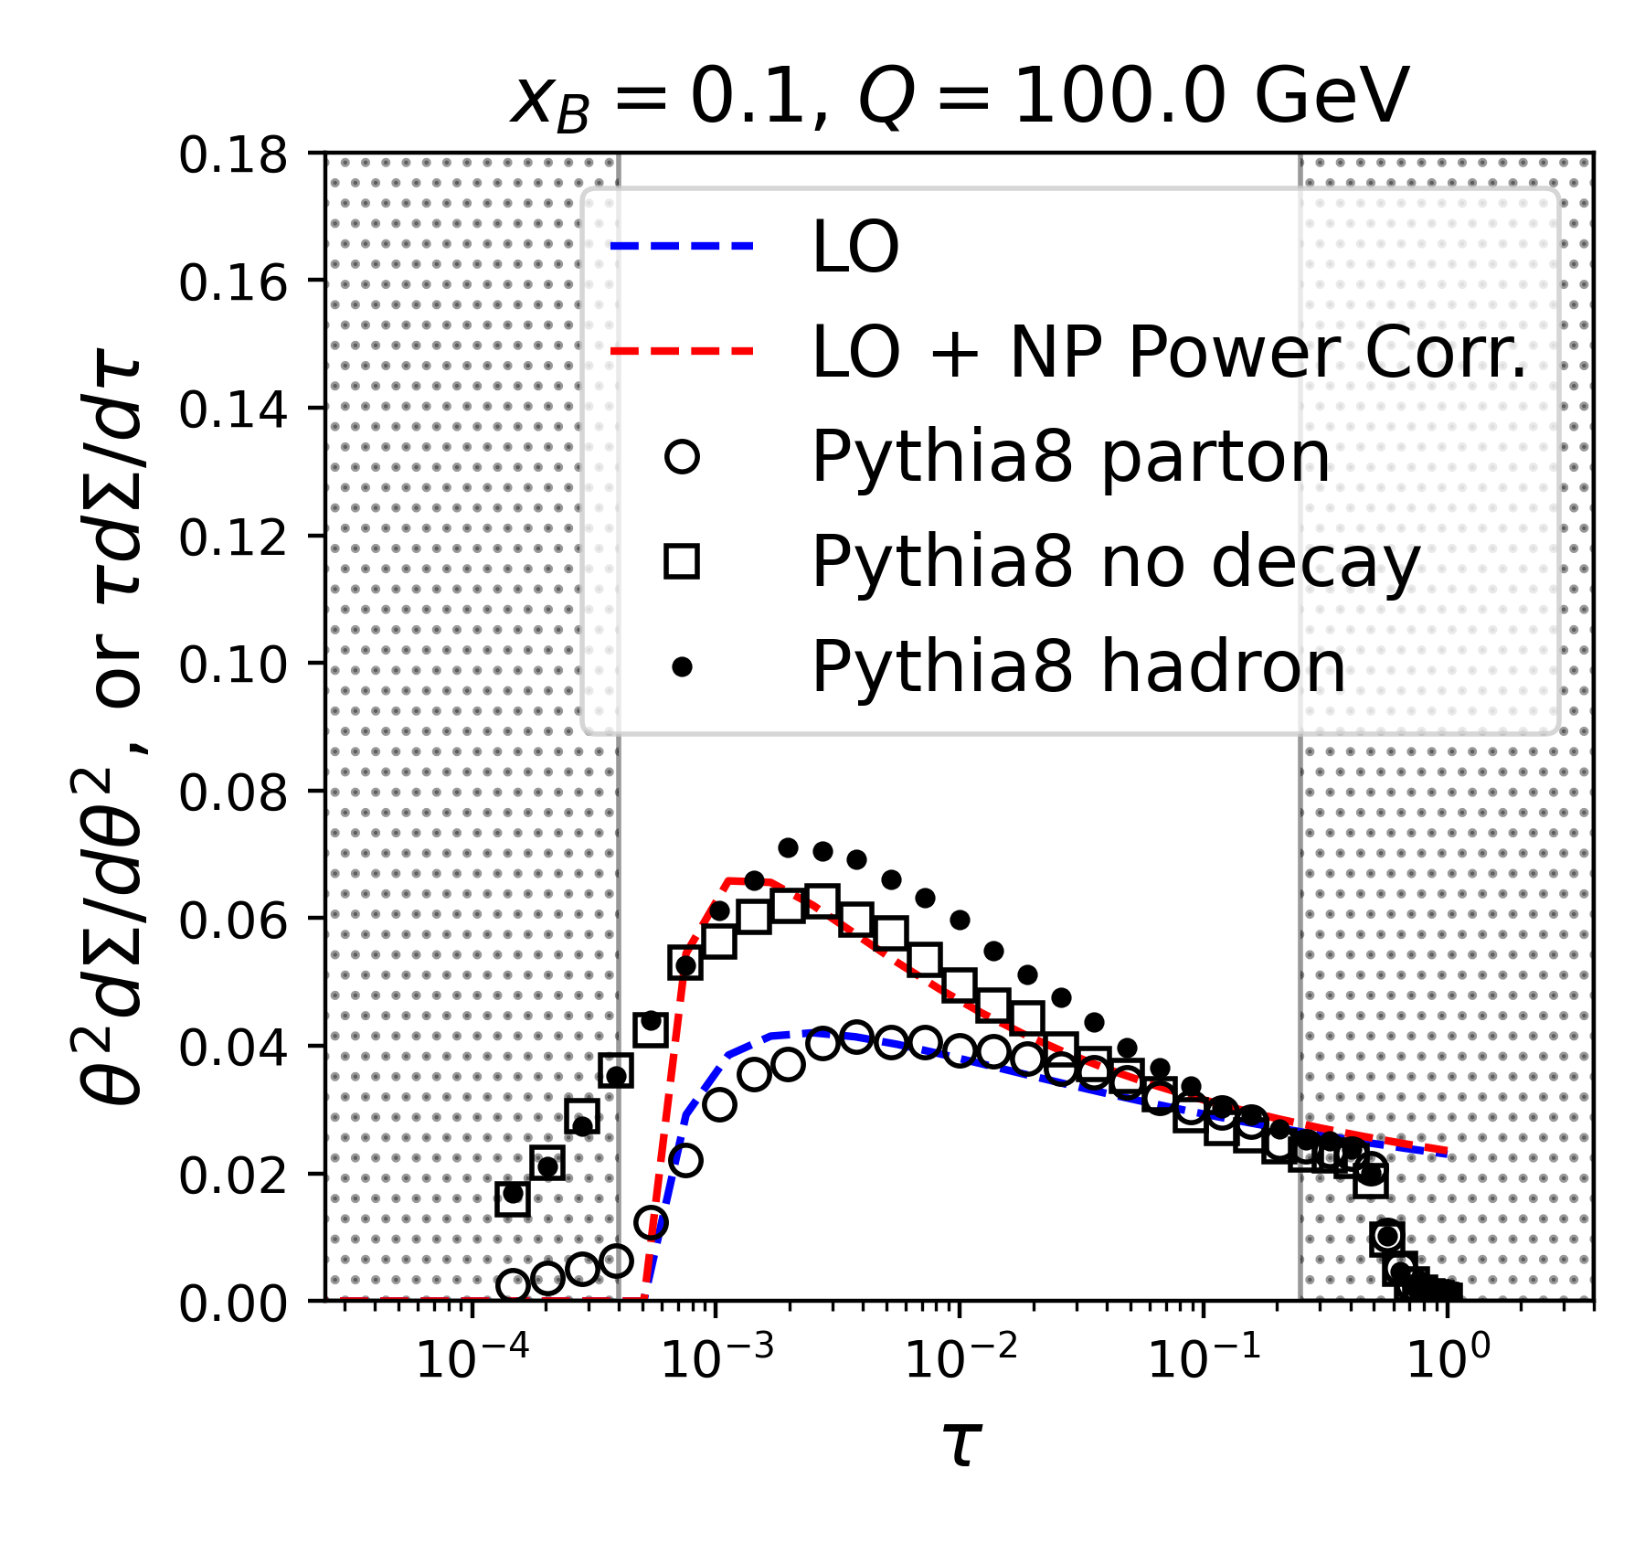
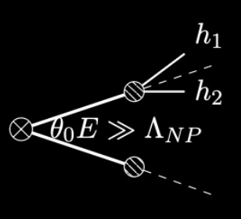
Effects of hadronization: TMD Fragmentation
Power corrections at large angle
Y. Ke, XNW and W. Zhao in preparation
Random correlation at small angle
EEC should be sensitive to momentum broadening in medium
Notes:
f_{h/i}(z_h,{\bf k})= f_{h/i}(z_h) \frac{e^{-{\bf k}^2/2\sigma^2}}{2\pi \sigma^2 }
f_{h/i}(z_h) \propto \frac{(1-z)^a z^b}{z}
\frac{dN}{d\theta^2} &=& \frac{\alpha_s(\mu^2) C_F}{2\pi}\frac{3}{4}\left\{ 1 + \left[\frac{2\sigma^2}{\theta^2 E^2}\right]^{\frac{1}{2}} \frac{(1+a)\sqrt{\pi}}{3} \left[\log^2\frac{\mu^2}{\theta^2E^2} + \mathcal{O}(\log\frac{\mu^2}{\theta^2E^2})\right] \right\}

Slide 11
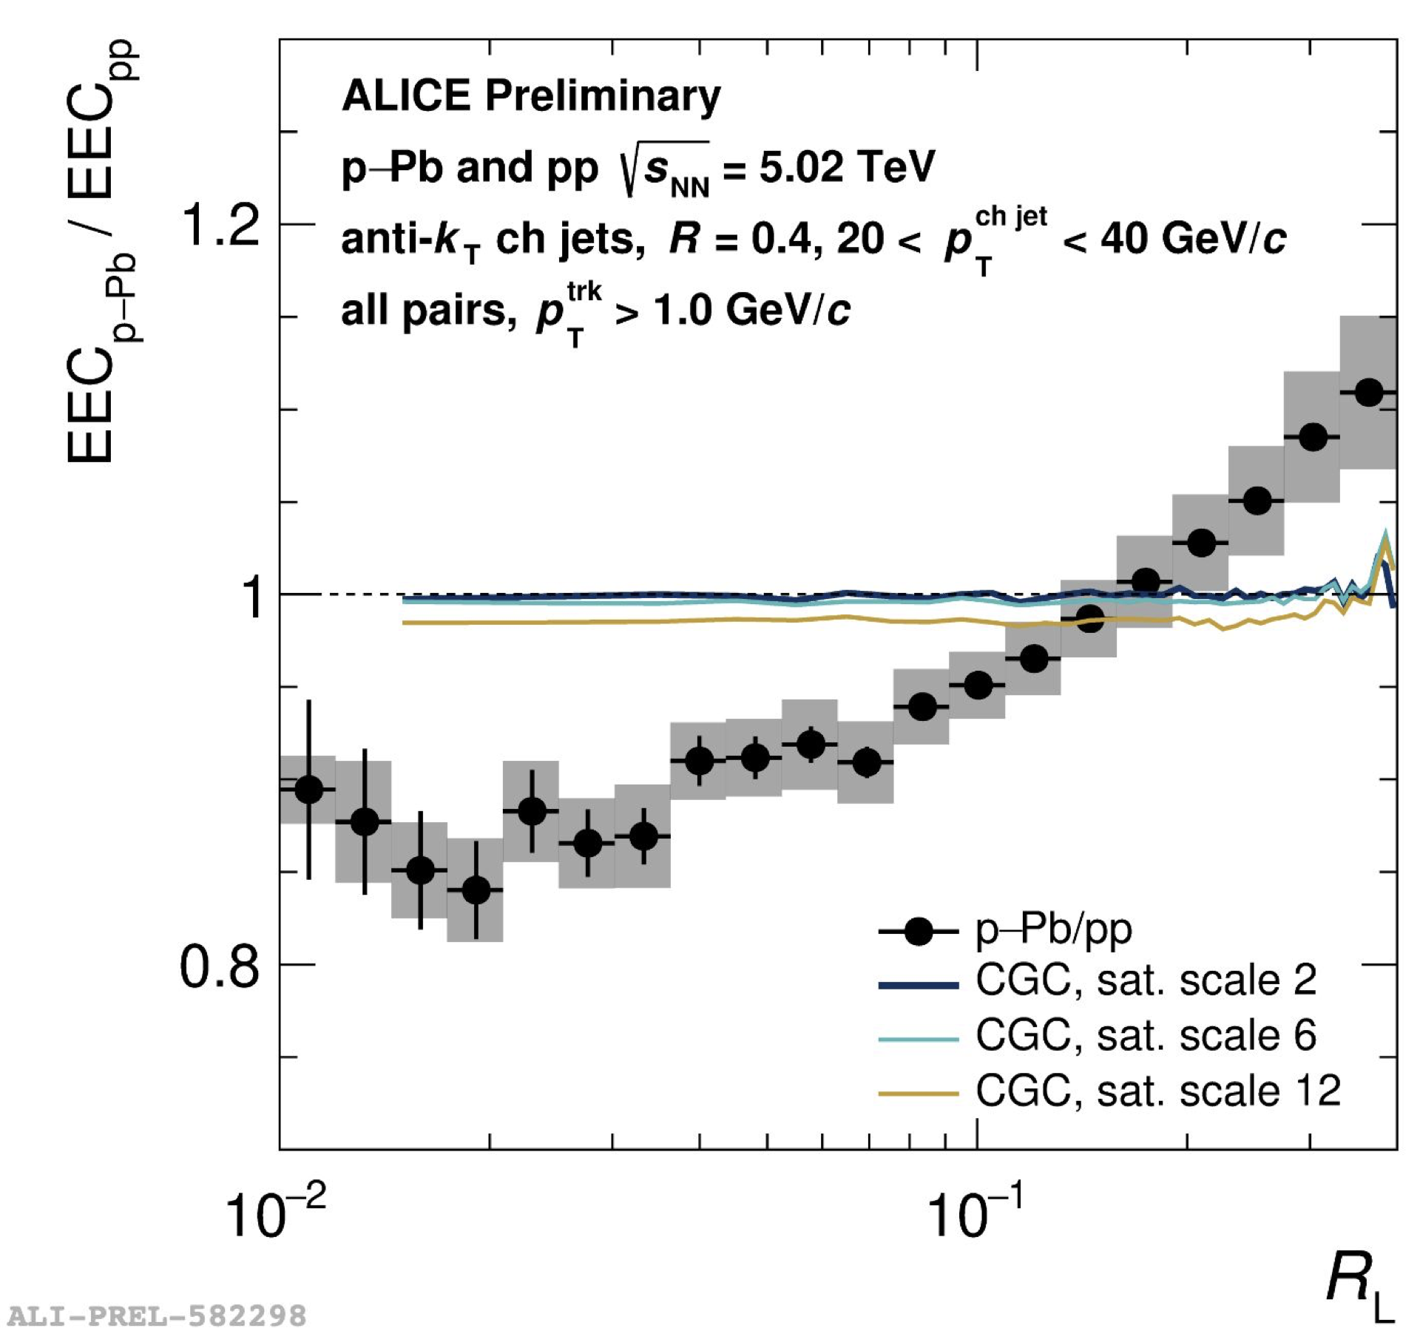

Medium modification of ECC in EIC
Modification mainly caused by momentum broadening
e+A
p + Pb
Y. Ke, XNW and W. Zhao in preparation
Nambrath for ALICE at HP2024

Slide 12
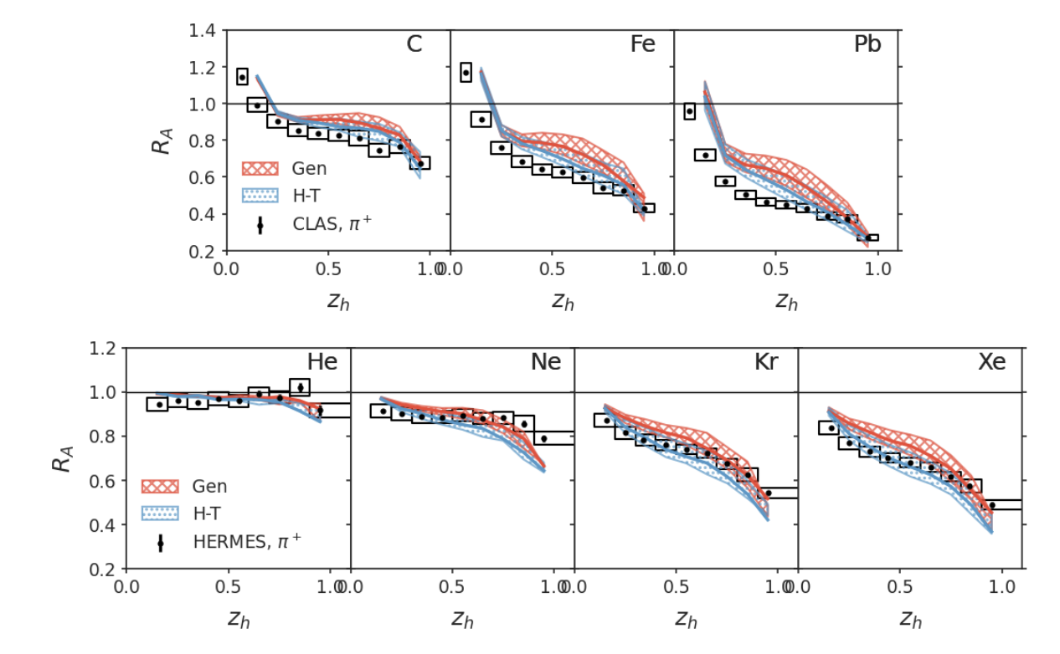
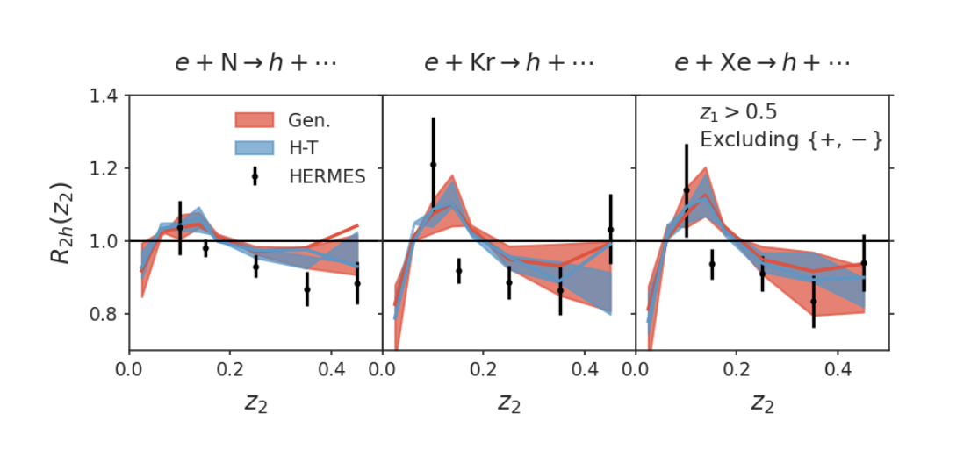
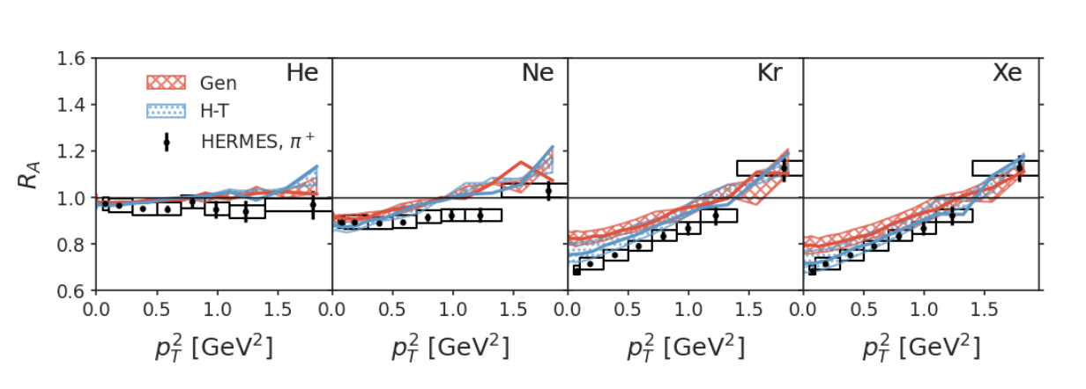
Modification of single and dihadron spectra in EIC
Leading hadron spectra
di-hadron spectra
Leading hadron spectra
Ke, Zhang, Xing and XNW, Phys. Rev. D 110, 034001 (2024)

Slide 13
Nuclear modification of dijets & TMD pdf at EIC
l_{qT}=v_{T}+k_{T}-l_{T}
l_{T}
v_{T}
k_{T}
p
Yuanyuan Zhang & XNW 2104.04520
Notes:
\frac{d \hat{\sigma}_D}{dx_B dQ^2 dz d^2l_{\perp}d^2l_{q\perp}} = \sigma_0 \frac{1+z^{2}}{1-z} \frac{\alpha_s^2}{ N_c} \int dy_1^- \rho(y_1^-,\vec{y}_{N\perp})
\otimes \int d^2 \vec{v}_{\perp} \int \frac{d^2 \vec{k}_{\perp}}{(2\pi)^2} {\color{magenta}f_{q}^{A}(x_B,\vec{v}_{\perp})}{\color{yellow}\frac{\phi(0,\vec{k}_{\perp})}{{k}_{\perp}^2}} \mathcal{N}_g(\vec l_\perp, \vec l_{q\perp},\vec k_\perp,\vec v_\perp)
\vec l_\perp+\vec l_{q\perp}=\vec k_\perp+\vec v_\perp
\frac{\Delta\sigma_{e+A}}{A\sigma_{e+p}}\propto A^{2/3}
\sigma_{e+Pb}/A\sigma_{e+p}

Slide 14
EEC from single emission in QGP
l
k
HT induced emission in a QGP brick:
Yang, He, Moult & XNW, PRL 132 (2024) 1, 011901
Notes:
\frac{d\Sigma^{\rm med}_q}{d\theta} \approx
\frac{ L^{2} \hat{q}}{2 E} \frac{\alpha_\mathrm{s} C_A}{\theta}, \theta> \sqrt{8\pi/EL}
\frac{d\Sigma^{\rm med}_q}{d\theta} \approx \frac{L^3 \hat{q} \alpha_\mathrm{s} C_A \theta}{64\pi}, \theta < \sqrt{8\pi/EL}

Slide 15
Jet-induced medium response
CoLBT-hydro
Before
After hydro background subtraction

Slide 16
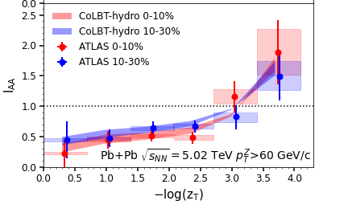
Modification of jets and medium response
r
CoLBT
e-Print: 2101.05422
Notes:
In order to Simultaneous description of hadron and jet RAA need to include jet-induced medium response

Slide 17
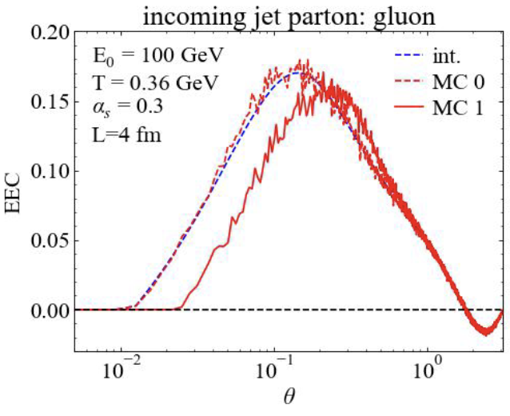
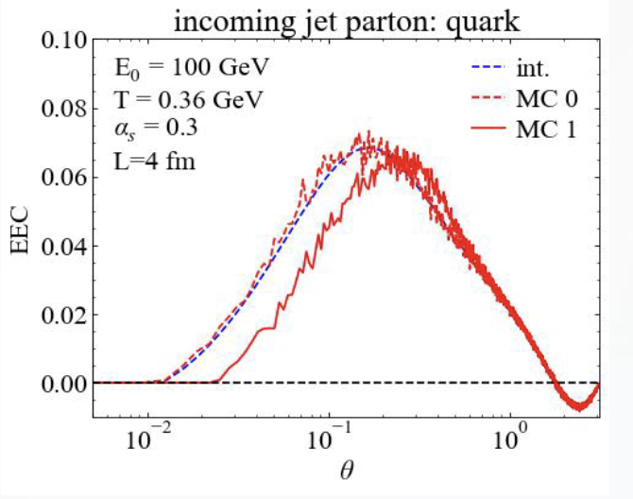
Contributions from medium response
2→ 2 elastic collisions:
1(a)
2(c)
recoil and back-reaction (“negative partons”)
k
3 (d)
(b)
μ_{D} -- angular scale of
parton-medium scattering
θ₁₃
θ₂₃
θ₁₃
θ₂₃
Notes:
\frac{d\Sigma^{\rm med}_a}{d\theta}\hspace{-6pt} = \hspace{-6pt}\int dx \sum_{b,(cd)} \int \prod_{i=b,c,d}d[p_i] \times \left[\int d\vec n_{c,d}\delta(\vec n_c\cdot \vec n_d -\cos\theta)E_d f_b(1\pm f_c)(1\pm f_d)\right.\\
\left. - {\color{red} \int d\vec n_{c,b}\delta(\vec n_c\cdot \vec n_b -\cos\theta) E_b f_c(1\pm f_a)(1\pm f_b)}\right] \frac{E_c}{E_a^2}\\
\times \frac{\gamma_b}{2E_a} (2\pi)^4\delta^4(p_a+p_b-p_c-p_d) \left|\mathcal{M}_{ab\rightarrow cd}\right|^2,

Slide 18
EEC of a jet shower in a QGP brick
A jet shower in a brick in LBT
Debye mass:
Energy loss and momentum
broadening lead to suppression
at small angles
Radiated gluon and medium response dominate at large angles
Yang, He, Moult & XNW, PRL 132 (2024) 1, 011901

Slide 19
EEC of γ-jets in Pb+Pb Collisions
CoLBT simulations:
Enhancement at large angles by soft hadrons from radiated gluons and medium response, sensitive to pT cuts
EEC by energetic hadrons from leading shower partons at small angles are suppressed, not affected by pT cuts
Yang, He, Moult & XNW, PRL 132 (2024) 1, 011901

Slide 20
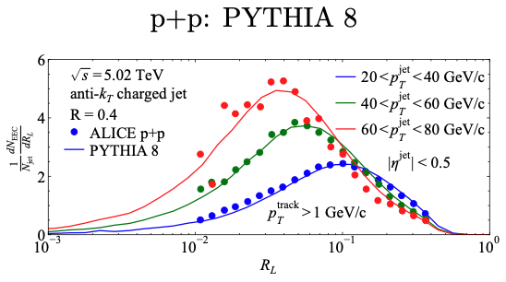
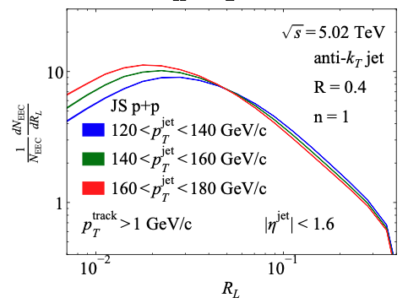
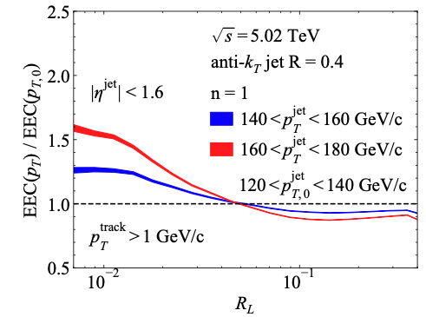
EEC of Single inclusive jets
If 120 GeV jets come from vacuum fragmentation of jets with energy loss from initial 140 or 160 GeV

Slide 21
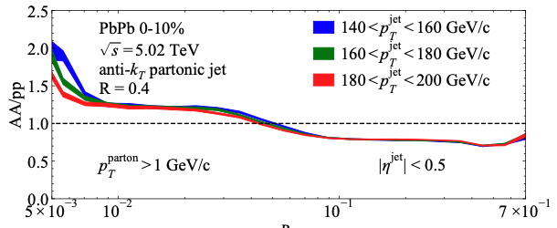
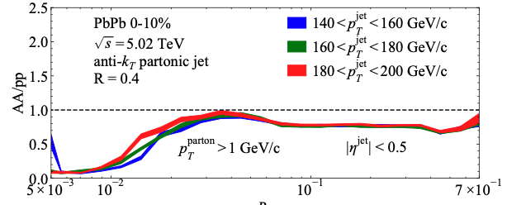
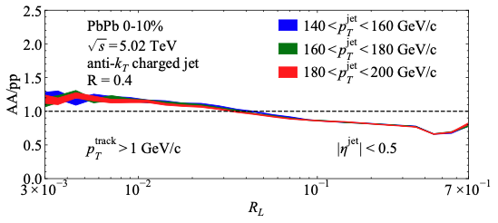
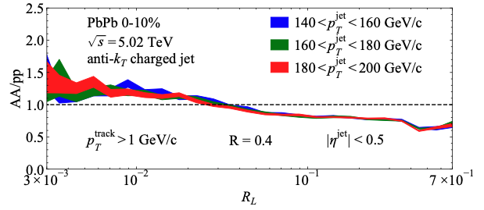
Enhancement due to jets with reduced energy?
With jet splitting outside medium
No jet splitting outside medium
partons
hadrons
Preliminary JETSCAPE
Preliminary JETSCAPE
Effect of hadronization dominates at small angle !

Slide 22
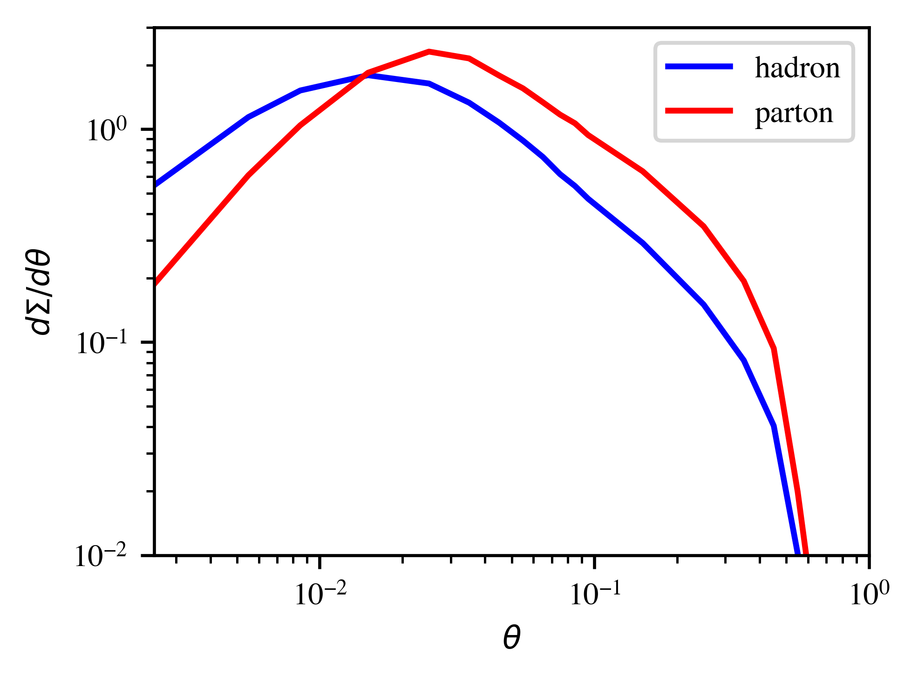
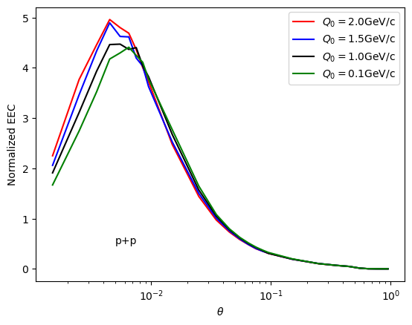
Effects of hadronization
Parton EEC at small angle due to random correlation
Hadron EEC sensitive to hadronization
Pythia γ-jet
p_{T}^{γ}>100 GeV/c
p_{T}^{jet}> 50 GeV/c, R=0.5
JETSCAPE: increase of the hadronization scale Q₀

Slide 23
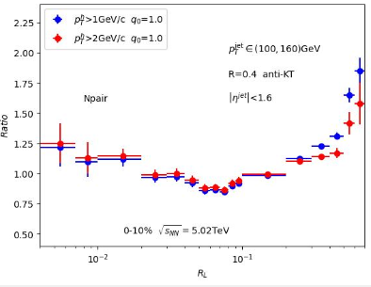
Single jet EEC from CoLBT
Increased virtuality scale in medium leads to enhancement of EEC at small angle
Medium response leads to enhancement at large angle R_{L}>0.3

Slide 24
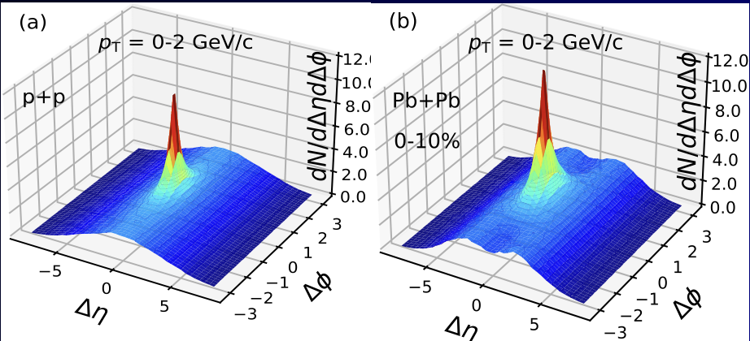
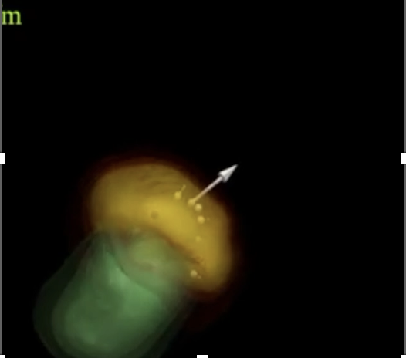
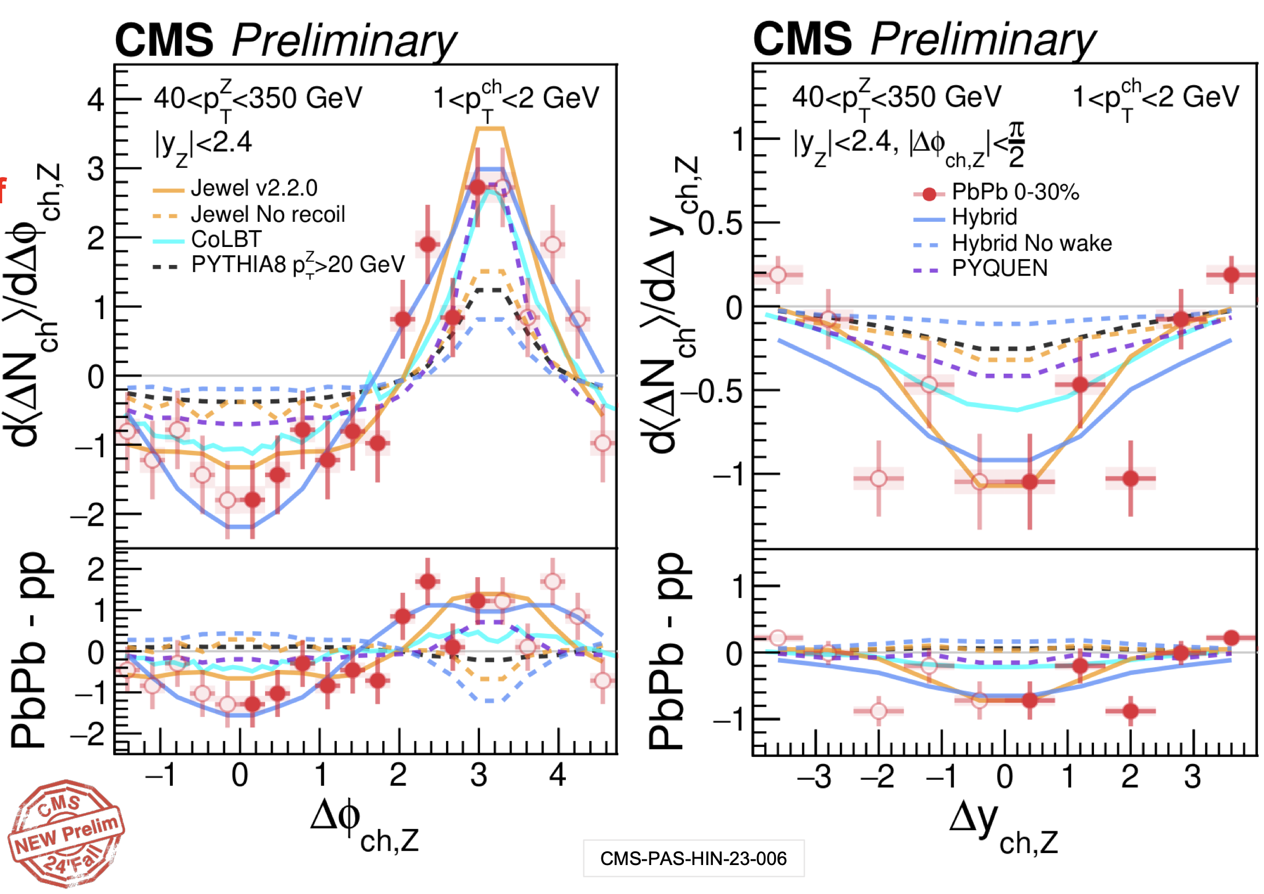
3D structure of diffusion wake
Jet-hadron correlation in γ/jet events
Diffusion wake → rapidity valley
on top of the MPI ridge
Yang, Luo, Chen, Pang and XNW, PRL 130, 052301 (2023)
Y. Lee
talk at
HP2024

Slide 25
Diffusion wake and jet energy loss
Longitudinal tomography
γ-jet asymmetry p_{T}^{jet}/p_{T}^{γ} : proxy of jet energy loss
p_{T}=1-2 GeV/c
Yang, Luo, Chen, Pang and XNW, PRL 130, 052301 (2023)
Zhang, Owens, Wang and XNW, PRL 103, 032302 (2009)

Slide 26
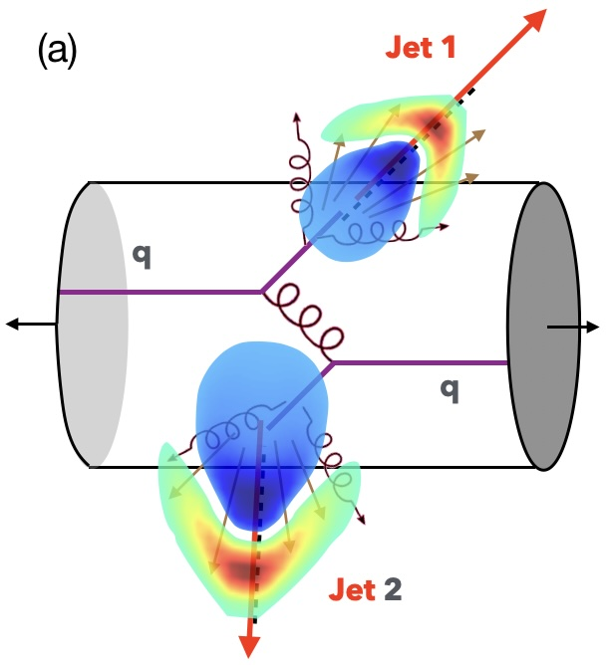
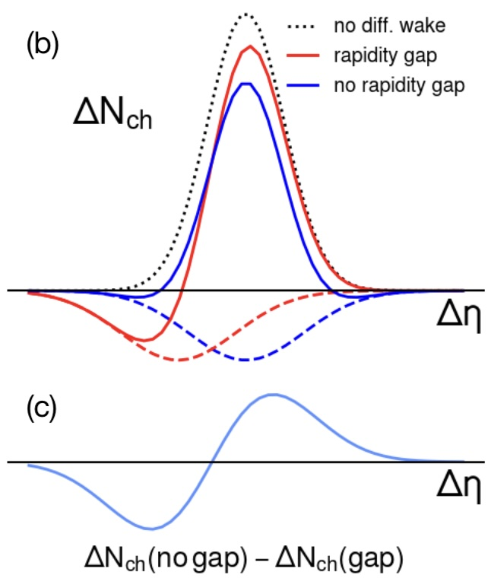
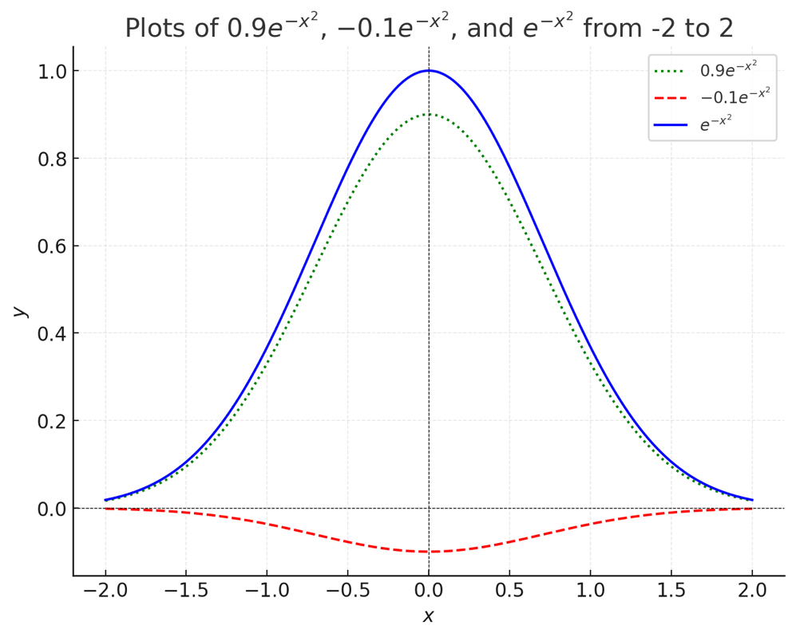
Diffusion wake in di-jets
Jet-hadron correlation in di-jets with rapidity gap
Rapidity ordering convention:

Slide 27
Rapidity asymmetry as robust signal of diffusion wake
Medium modification of jet-hadron correlation
Rapidity Asymmetry
No background subtraction needed !
Zhong Yang and XNW, 2501.03419
Notes:
\Delta N_{\rm AA}=\int d\Delta\phi\left[\frac{dN_{\rm AA}}{d\Delta\phi d\Delta\eta} - \frac{dN_{\rm pp}}{d\Delta\phi d\Delta\eta}\right]

Slide 28
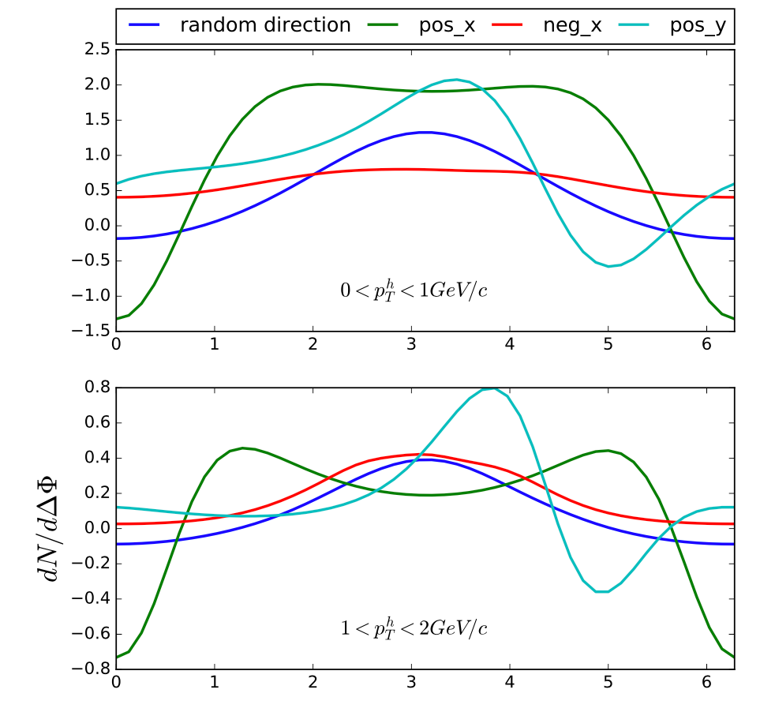
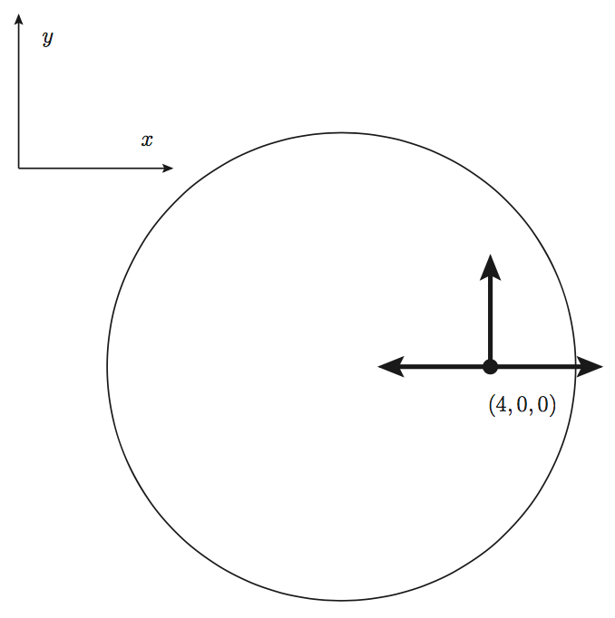
Initial position & azimuthal correlation
γ-hadron correlation
W Chen & XNW (2018)
Li, Liu, Ma, XNW and Zhu, Phys. Rev. Lett. 106, 012301 (2011)
ΔΦ
Tachibana, Shen & Majumder 2001.08321 (2020)

Slide 29
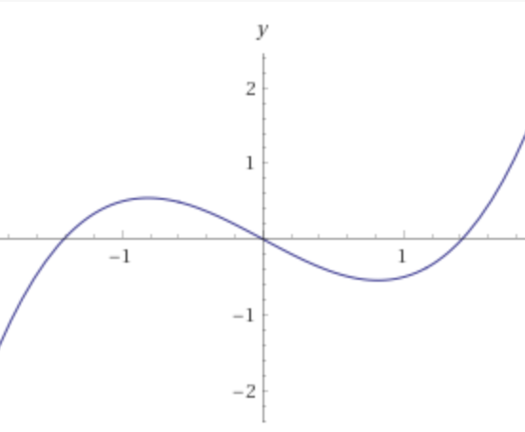
Asymmetric p_{T} broadening in non-uniform medium
y
Deflection due
to transverse
gradient along y
γ
jet
Momentum asymmetry
x

Slide 30
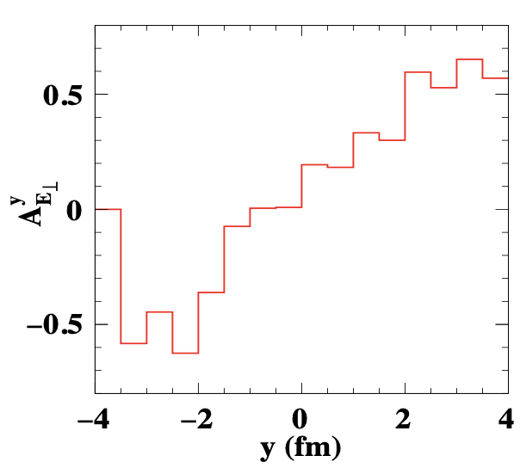
Transverse gradient tomography
(p_{T}>3 GeV/c)
drift due
to transverse
gradient along y
y
γ
jet
x
He, Pang & XNW, PRL 125 (2020) 12, 122301
Jet energy loss → propagation length → initial jet position in x: Longitudinal tomography
Notes:
A_{E_\perp}^{\vec n}=\frac{\int d^3rd^3pf_a(\vec p,\vec r) \vec p_T\cdot \vec n}{\int d^3rd^3pf_a(\vec p,\vec r)}

Slide 31
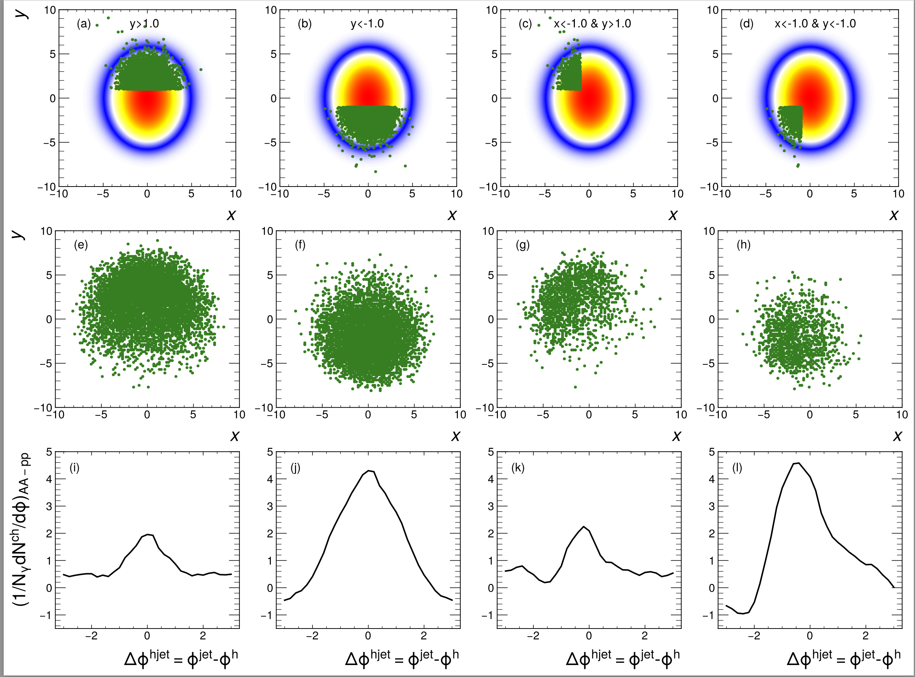
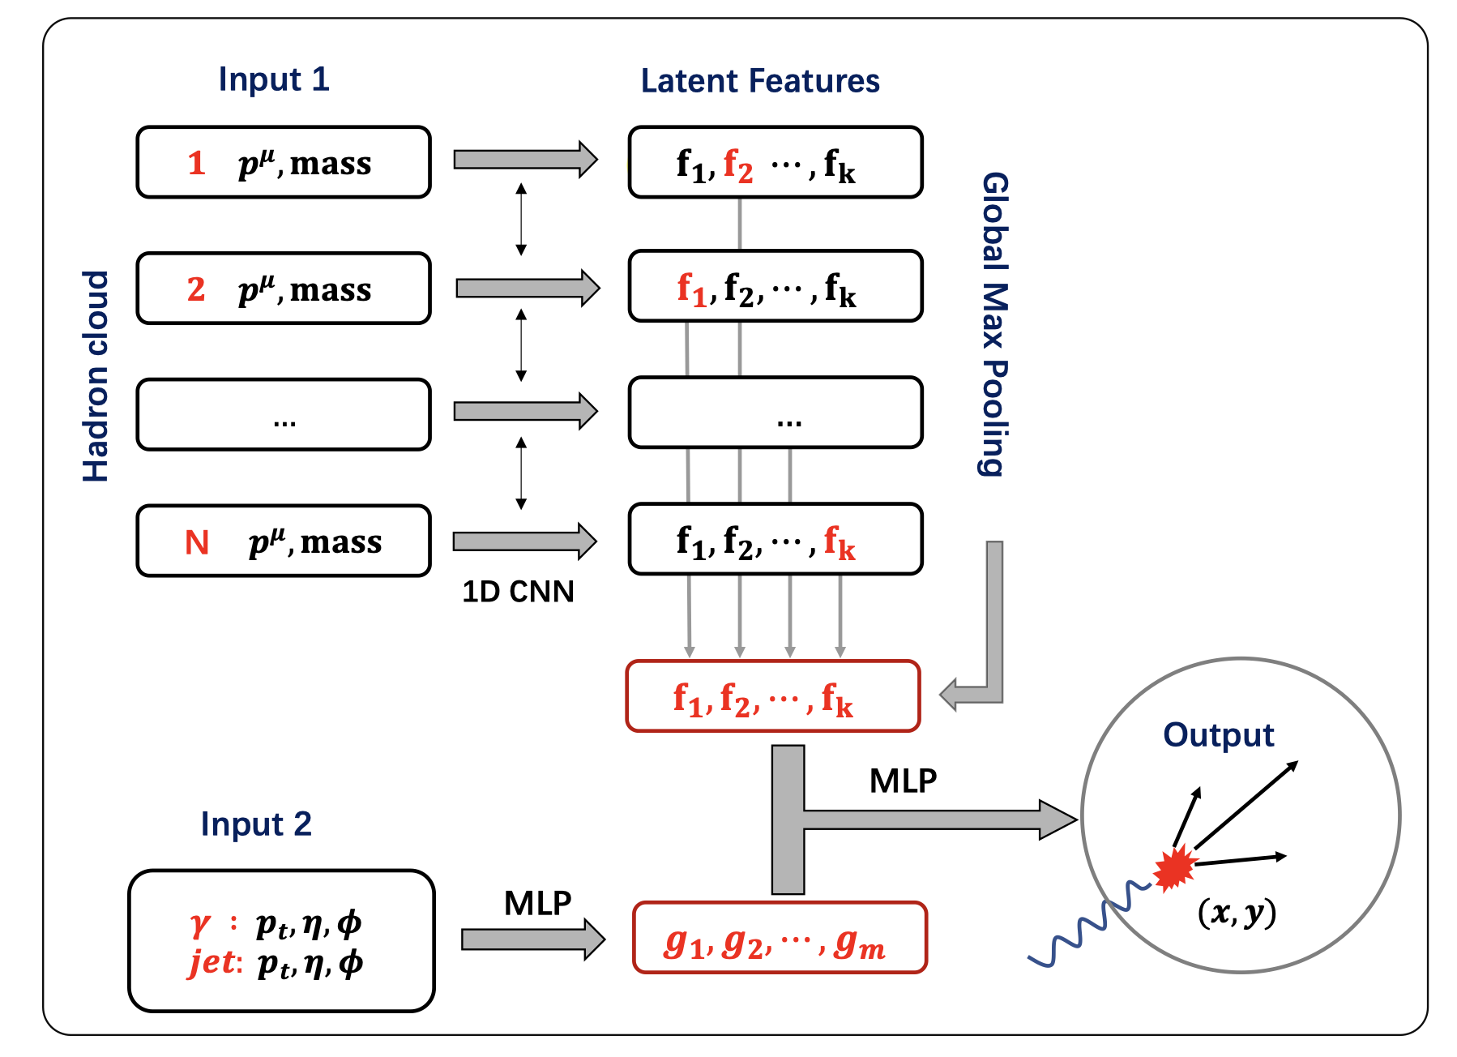
Deep learning assisted jet tomography
PCN (point cloud network)
DL network selection
Actual distribution
Eur.Phys.J.C 83 (2023) 7, 652
γ-soft hadron correlation
Yang, He，Chen，Ke，Pang & XNW
Notes:
Recently, the point could network as been applied to predict the transverse position of the initial jet production vertices

Slide 32
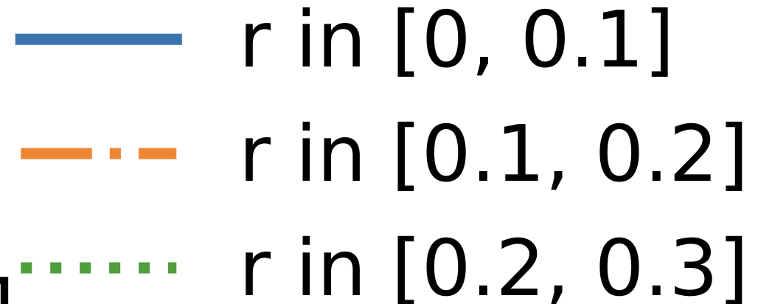
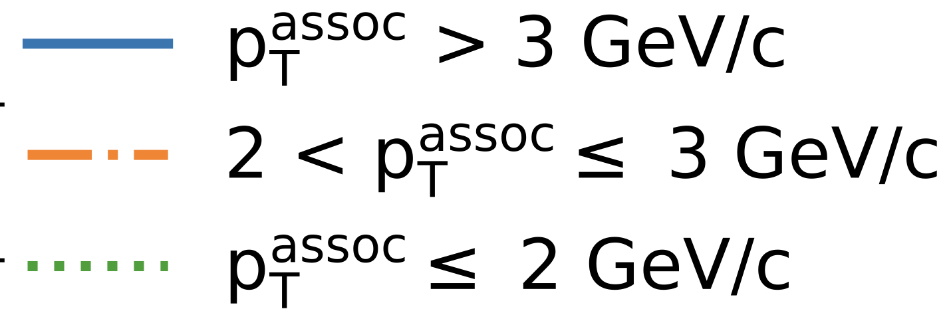
Asymmetric jet shape: azimuthal dependent
Energetic hadrons at the core of jet are deflected away from center
Soft hadrons from medium response at large angle flow into center
φ
r
Xiao, He, Pang, Zhang and XNW PRC 109 (2024) 5, 054906

Slide 33
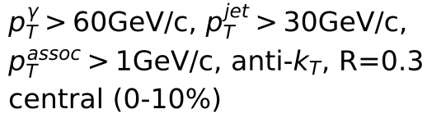
Asymmetric jet shape at finite rapidity
Jet and longitudinal-flow coupling
φ
r
η
Xiao, Zhang and XNW to be published
1.0
1.0
Against the longitudinal flow
Along the longitudinal flow

Slide 34
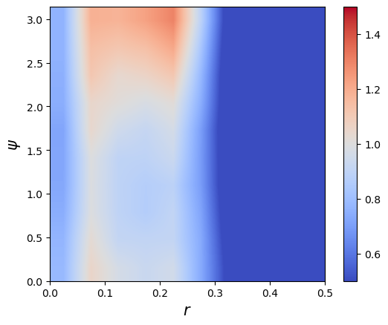
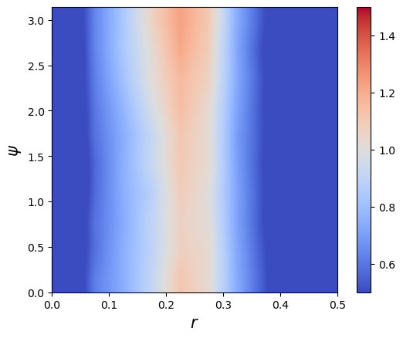
Seeing Mach-cone through 3p Azimuthal Correlation
p+p (γ+jet) p_{T}>40 GeV/c
0-10%Pb+Pb (γ+jet)
ψ
r
)
Back-to-back correlation due to momentum conservation of parton splitting
Azimuthal uniform correlation due to medium-response: Mach-cone – sound velocity?
r=(r1+r2)/2

Slide 35
Summary
Medium modification of EEC in EIC by pt broadening
Medium-response dominates enhancement of EEC at large angles in heavy-ion collisions which is sensitive to interaction scale in medium
Use 2D jet tomography to reveal the angular structure of Mach-cone excitation
Rapidity asymmetry as a robust signal of diffusion wake
Future studies: ML improved 2D tomography and constraint on EoS, transport coefficients

