Slide 1
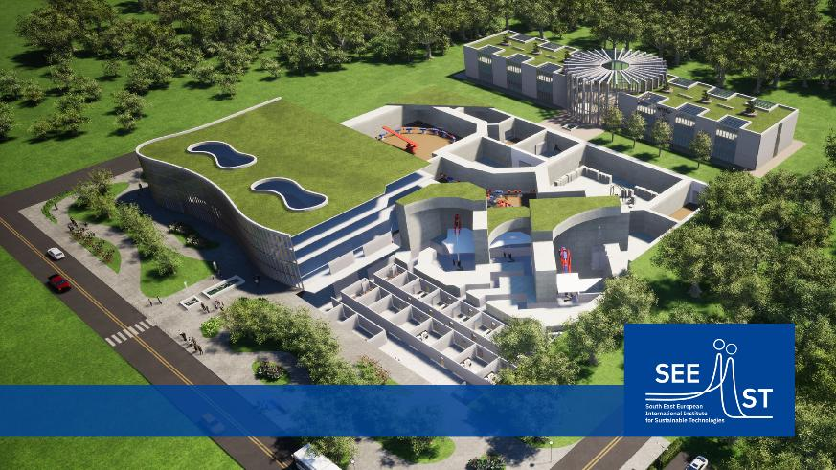
The SEEIIST Project
Peter Grübling

Slide 2
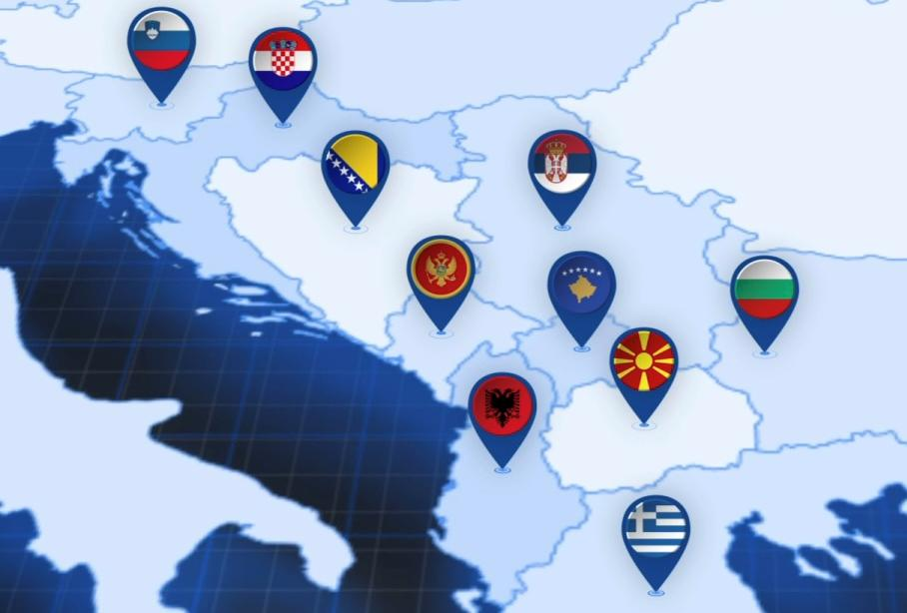
History and Vision
SEEIIST:
South East European International Institute for Sustainable Technologies
Initiative launched in 2017 as
Science for Peace project
10 participating countries
Focus on ion beam therapy related research
Closing gap in European Research Landscape
Making SEE region attractive for researchers
Capacity building for SEE and EU wide
Enlarging excellence of Hadron Therapy Network in Europe (MedAustron, CNAO, HIT Heidelberg)
Participating Countries:
Republic of Slovenia
Republic of Croatia
Bosnia and Herzegovina
Montenegro
Republic of Albania
Republic of Serbia
Kosovo*
Republic of Bulgaria
Republic of North Macedonia
Hellenic Republic
* This designation is without prejudice to positions on status, and is in line with UNSC 1244 and the ICJ Opinion on the Kosovo Declaration of Independence.

Slide 3

History and Vision
SEEIIST:
South East European International Institute for Sustainable Technologies
Initiative launched in 2017 as
Science for Peace project
10 participating countries
Focus on ion beam therapy related research
Closing gap in European Research
Strengthen research landscape in SEE region
Capacity building for SEE and EU wide
Enlarging excellence of Hadron Therapy Network in Europe (MedAustron, CNAO, HIT Heidelberg)
SEEIIST Research Infrastructure:
Main scientific Instrument:
Synchrotron based Ion Beam Accelerator
Research Fields:
Non-clinical Research
Clinical Research, incl. Treatment
Distributed RI:
Main Facility
Technology Hubs
Research Hubs
Clinical Hubs

Slide 4
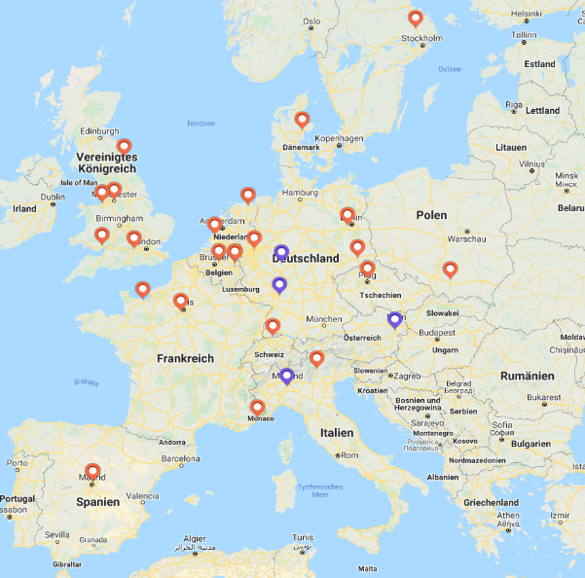

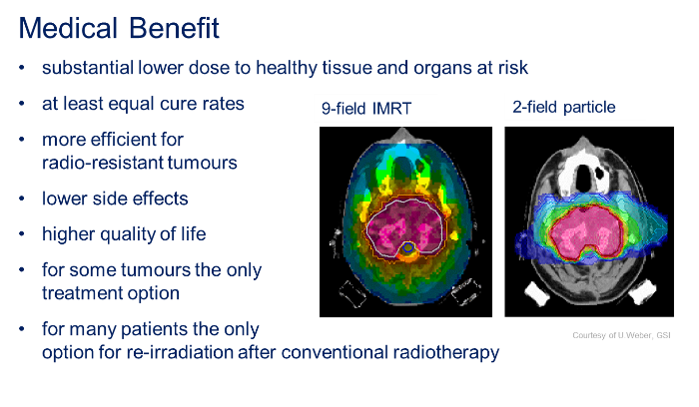
The Rational for an Ion Beam Therapy Research Institute
Inverse Dose Profile - The Bragg Peak
Situation in Europe
Population in Europe:
746,4 Mio
Population SEE Region:
44,3 Mio
IBT Centers Europe:
34 (20 p⁺; 4 p⁺ and C¹²)
IBT Patients Europe:
total: ca. 150.000
SEE: ca. 10.500
but only 34 centers
with 10.600 p in 2021
depth dose distribution of x-rays used in conventional radiotherapy
Tumour
Proton/Ion Therapy Centers
SOBP
Ion beam Bragg-Peak:
depth dose distribution of proton beam at single energy
absorbed dose
entrance dose
exit dose
penetration depth
Rational
→ Make Ion Beam Therapy is available for patients in SEE
→ Accelerator based RI: seed for a wide range of science
→ Close lack of human capacities and knowledge on fields in SEE

Slide 5
The Rational for an Ion Beam Therapy Research Institute
SEEIIST
Targets and Values:
bring IBT to the region
establish a major European research institute in SEE
counteract the brain drain
retract researchers to their home countries
give young scientists a perspective
develop a research eco-system in SEE
Follow the spirit
“Science for Peace”
SEEIIST
Economic Net Present Value
European Investment Bank and University of Milan analysed cost benefit ratio for CNAO, that is comparable to SEEIIST
Benefit-Cost Ratio of 4.5
ENPV of 1.5 billion Euro
Similar socio-economic leverage effects can be assumed for SEEIIST and for the participating countries hosting hubs.
SEEIIST
Project Perspectives – Spinoffs
beam characteristics suitable for a wide range of research in radiobiology, radiopharmaceuticals, material sciences and space sciences
SEEIIST know how as incubator for further developments like an synchrotron light source or compact, cost optimized machines and technologies and their commercialization
Business spinoffs: radiopharmaceuticals, detector technology, material characterization and development, artificial intelligence and big data computing in medicine, green engineering, etc.

Slide 6
Basic Concept for the Future Institute
SEEIIST research – European Research Infrastructure Consortium (ERIC)
Responsible for establishment and operation of the SEEIIST infrastructure
Owner of the SEEIIST facility
Responsible for non-clinical research programme
Legal manufacturer of the Treatment Accelerator
Service provider for clinical and non-clinical users
SEEIIST clinics (research and clinical trials)
Separate legal entity
User of the SEEIIST infrastructure
Permit holder for clinical trials and treatment
Legal responsibility for clinical trials and treatment
Takes financial risks for clinical operation
SEEIIST external research users
Researchers from Europe and SEE region
Executing own research programmes
Collaboration and proposal based
Considering excellence and capacity building
Potential industrial users

Slide 7
SEEIIST - Project: Key Factors for Success
Equipment
Performance
Patient
Pool
Finances
Organization
Performance

Slide 8
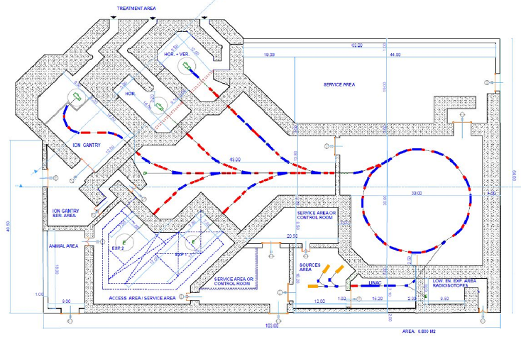
Key Factor: Equipment Performance (see HITRIplus WP7)
Particle Beam Therapy equipment is required to
have high performance in sense of
patient throughput and parallel research
be professionally integrated with
auxiliary equipment and IT systems
provide state-of-the-art PBT incl. image guided PBT
Equipment
Performance
Equipment
Performance
Patient
Pool
Payment
Organization
Performance
→ Accelerator:
Synchrotron based, providing ion beams from helium up to neon with energy up to 450 MeV/u (carbon ions)
ions per spill up to 2 * 10¹⁰ (20 times higher than provided by existing treatment machines)
in fast extraction mode, up to 1000 times larger dose rates capable for FLASH therapy
fast cycling mode for parallel clinical and non-clinical use: switching times in the order of 1 second
dedicated isotope production beam line
3 medical beamlines
2 expandable research beamlines

Slide 9
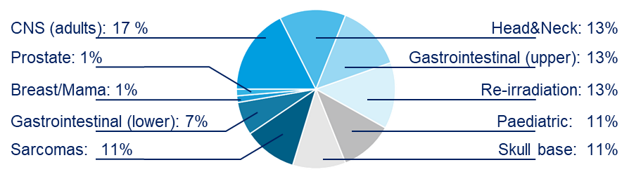
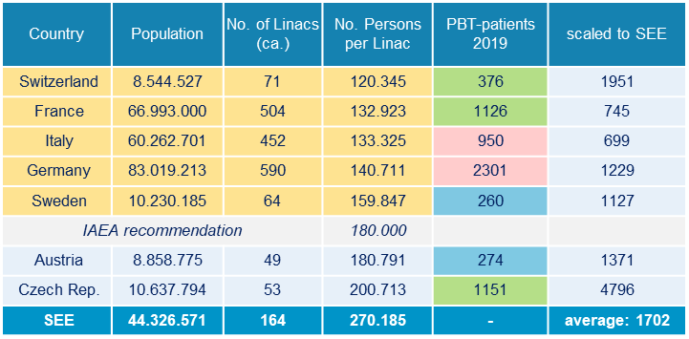
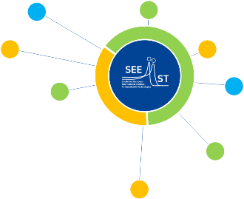
Key Factor: Patient Pool
Potential Number of Patients (indication based)
Indications for treatment with photon therapy
include a number of approximately
20.000 for every ten million populations per year,
including 12% (2.400) of proton therapy*.
Europe: 179.000 PBT Patients per year
SEE: 10.560 PBT Patients per year
Reality Check: Europe in 2021 – 10.600 only !!
Realistic achievable numbers:
MedAustron expects realistically 750+ patients/a
PBT cases per 10 million of population – in total 835
scaled to SEE: ca. 3700 patients/a
achievable via SEEIIST clinical hubs !!
Equipment
Performance
Patient
Pool
Patient
Pool
Payment
Organization
Performance
* Nunes Marcos d’Ávila.
Protontherapy versus carbon ion therapy: advantages, disadvantages and similarities.
Cham et al.: Springer, 2015.

Slide 10
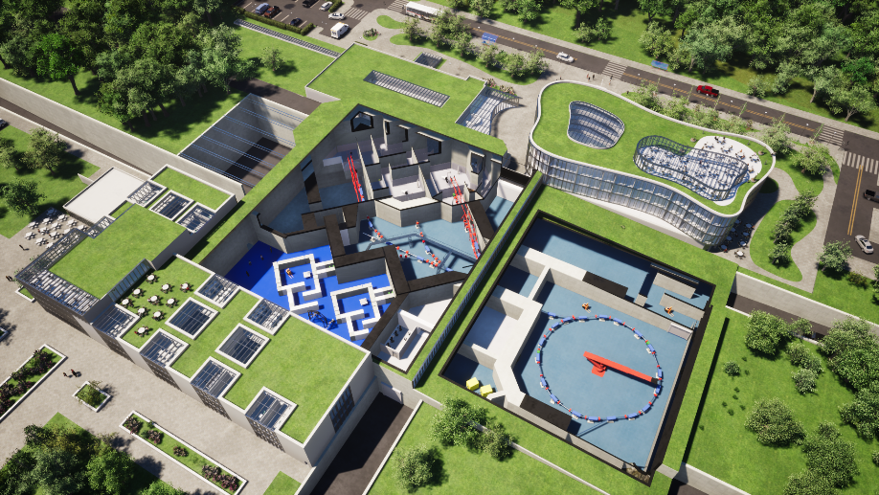
Key Factor: Organizational Performance
Influencing aspects:
Clinical concept and clinical protocols
Impact on indication mix, number of fractions per
patient and consequently the total number of patients
Research concept
Impact on user and experiment management
Impact on funding and costs
Quasi-parallel Research and Clinical operation
Impact on beam time management
Impact on reimbursement, funding and costs
Workflow performance
Impact on machine idle time (should be as low as possible !!)
to be tackled by:
Workflow and organizational optimization
Training
Appropriate planning
Optimized facility and appropriate accelerator design
clinical research /treatment
Equipment
Performance
Patient
Pool
Organization
Performance
Payment
Organization
Performance
Non-clinical research

Slide 11
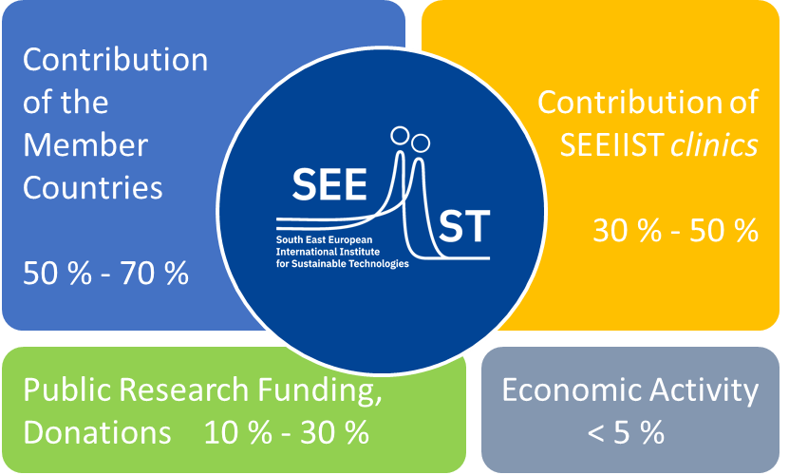
Key Factor: Coverage of Operational Costs
Funding of Research
Adequate calculation of costs per hour of beam time
Competitive research programme addressing European
needs for EU funding
Regional educational and research programme for
SEEIIST member funding
Basic operational Costs and Maintenance
Sustainable financing concept by SEEIIST members
Reimbursement of Clinical Research and Treatment
Adequate contracts with health care insurances are mandatory
Reimbursement per patient should be calculated to cover costs for the worst case of patient numbers (patient pool and performance)
National factors are to be considered
Collaboration with Industrial partners
Competitive costs and reimbursement scheme
Equipment
Performance
Patient
Pool
Finances
Organization
Performance
Payment

Slide 12
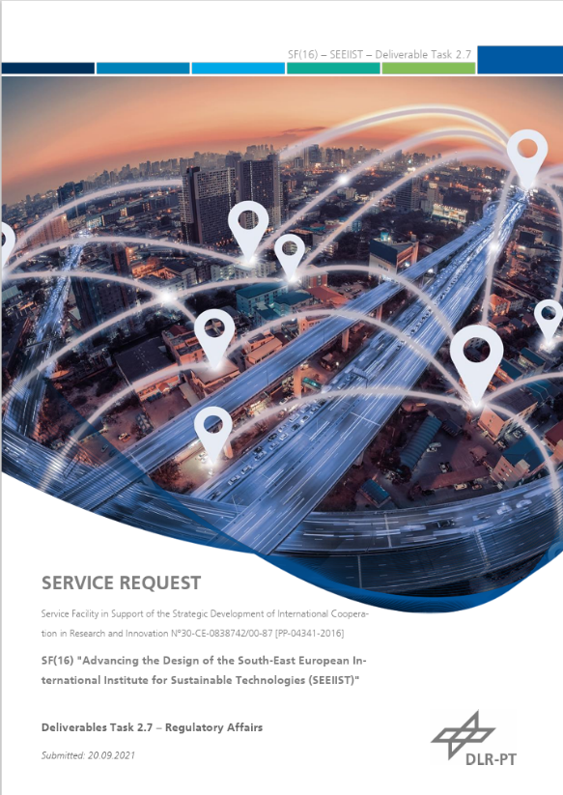
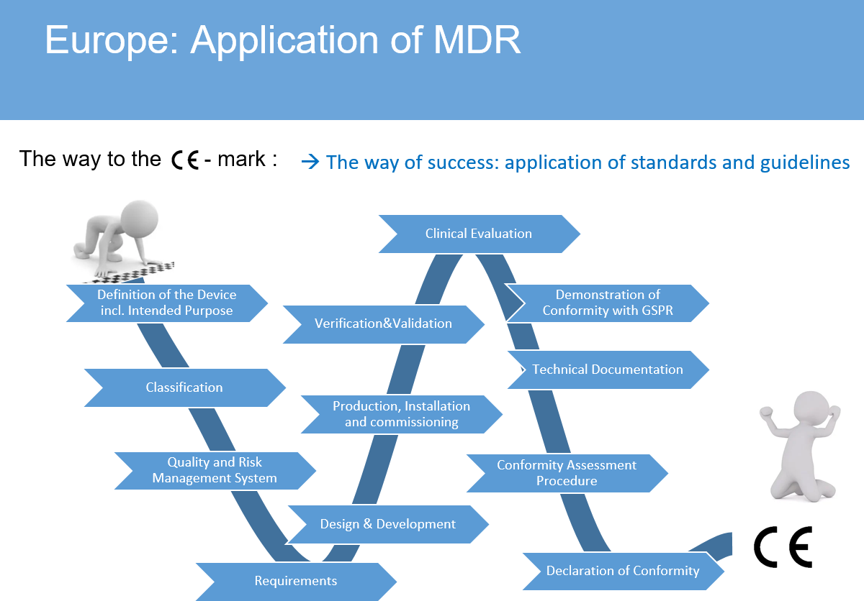
Accelerator - “Licence” for Treatment
Concept for licencing the SEEIIST Accelerator as Medical Device

Slide 13
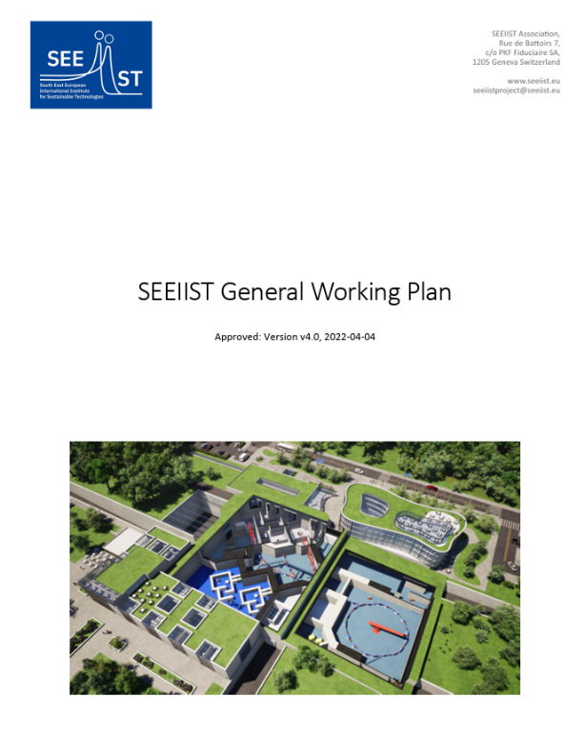

SEEIIST - Project: Work Plan
Equipment
Performance
Patient
Pool
Approved by SEEIIST -SC
Finance
Organization
Performance

Slide 14
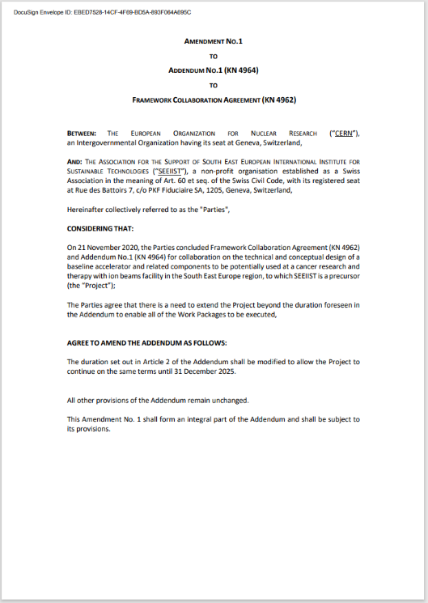

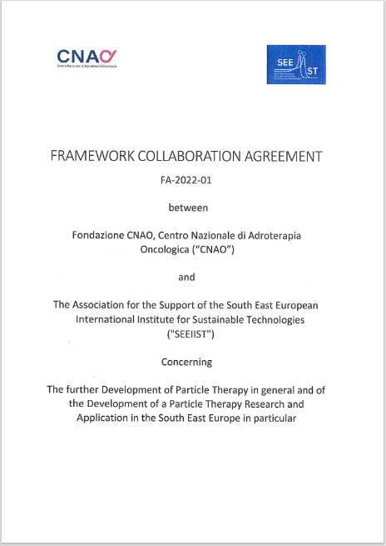
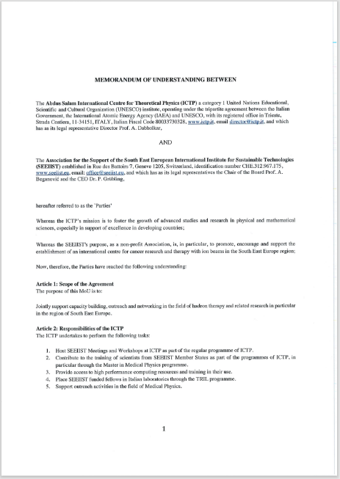

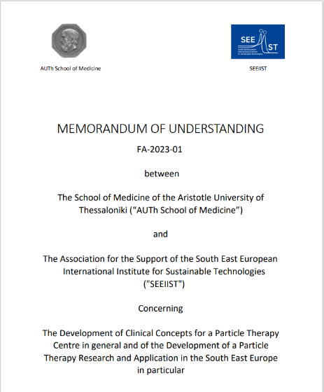
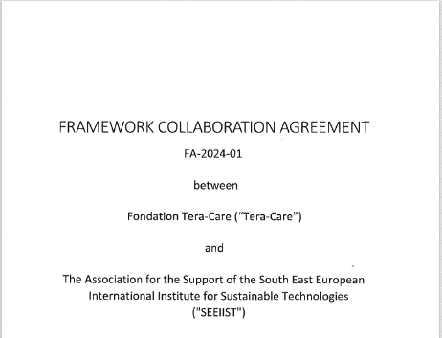

International Collaborations
CERN
  Established 11.2020
  Content: accelerator design, HITRIplus and NIMMS activities
CNAO
  Established 07.2022
  2 IAEA follows to work at CNAO
ICTP
  Established 03.2023
  1 project: Hadron Therapy School for professionals
  in medical physics (Trieste, 04/2024)
School of Medicine Aristotle University of Thessaloniki
  Established 12.2023
  1 project: Workshop/Training course (Thessaloniki, 10/2024)
Tera-Care
  Established 01.2024
  1 project: Collaboration in HITRIplus, accelerator design

Slide 15
SEEIIST: Time Line
Foundation of the SEEIIST ERIC
Preparatory and Design Phase
Site Preparation and Construction of the Building
Equipment Installation and Commissioning (Stage 1)
Start non-clinical Research
Delayed by ca. 2 years
Start clinical Research and Treatment of Patients
Installation, Commissioning and Use for Research of Stage 2 and subsequent
2024
2025
2026
2027
2028
2029
2030
2031

Slide 16




Thank you for your attention.
Contact:
Peter Grübling, CEO SEEIIST Association
+49 169 939 08359
peter.gruebling@gmx.de
Stay tuned …
www.seeiist.eu
https://www.facebook.com/SEEIIST/
https://ch.linkedin.com/company/seeiist
Architectural design by Kaprinis Architects

