Slide 1
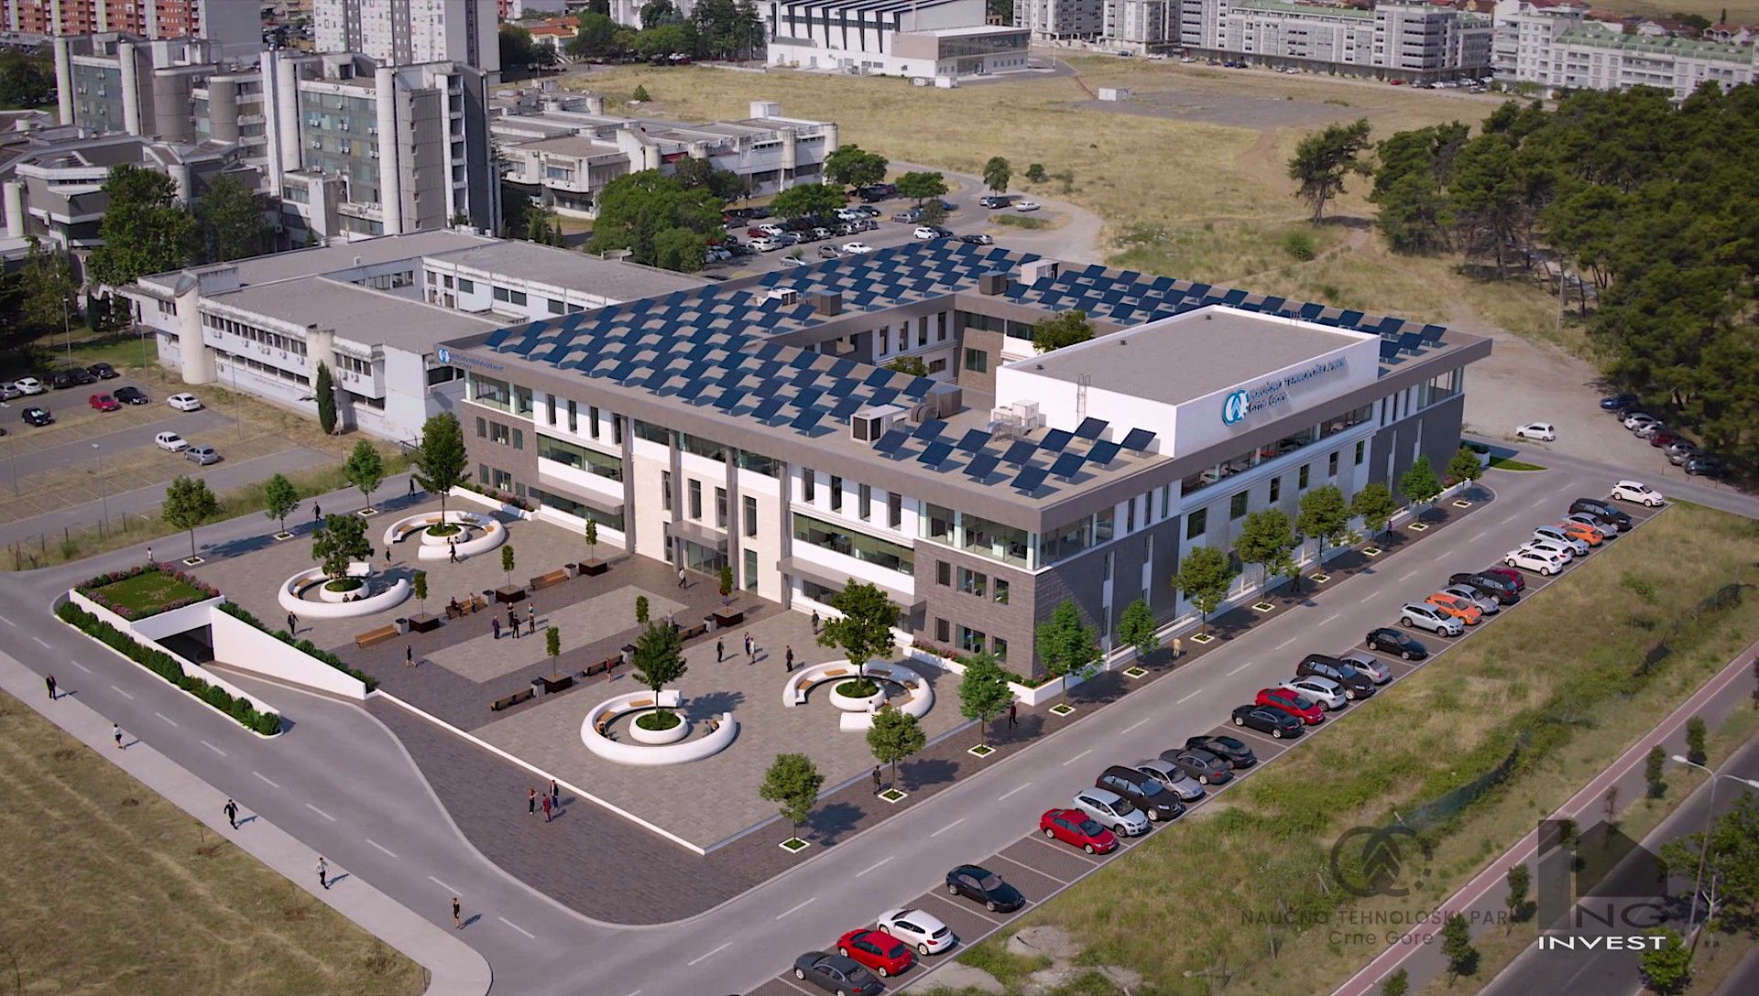
Project Overview
Sandro Rossi
Coordinator
Project Meeting and Hadrontherapy Workshop
From Innovation to Implementation
Podgorica, March 24th-25th, 2025
SCIENCE AND TECHNOLOGY PARK OF MONTENEGRO, PODGORICA

Slide 2
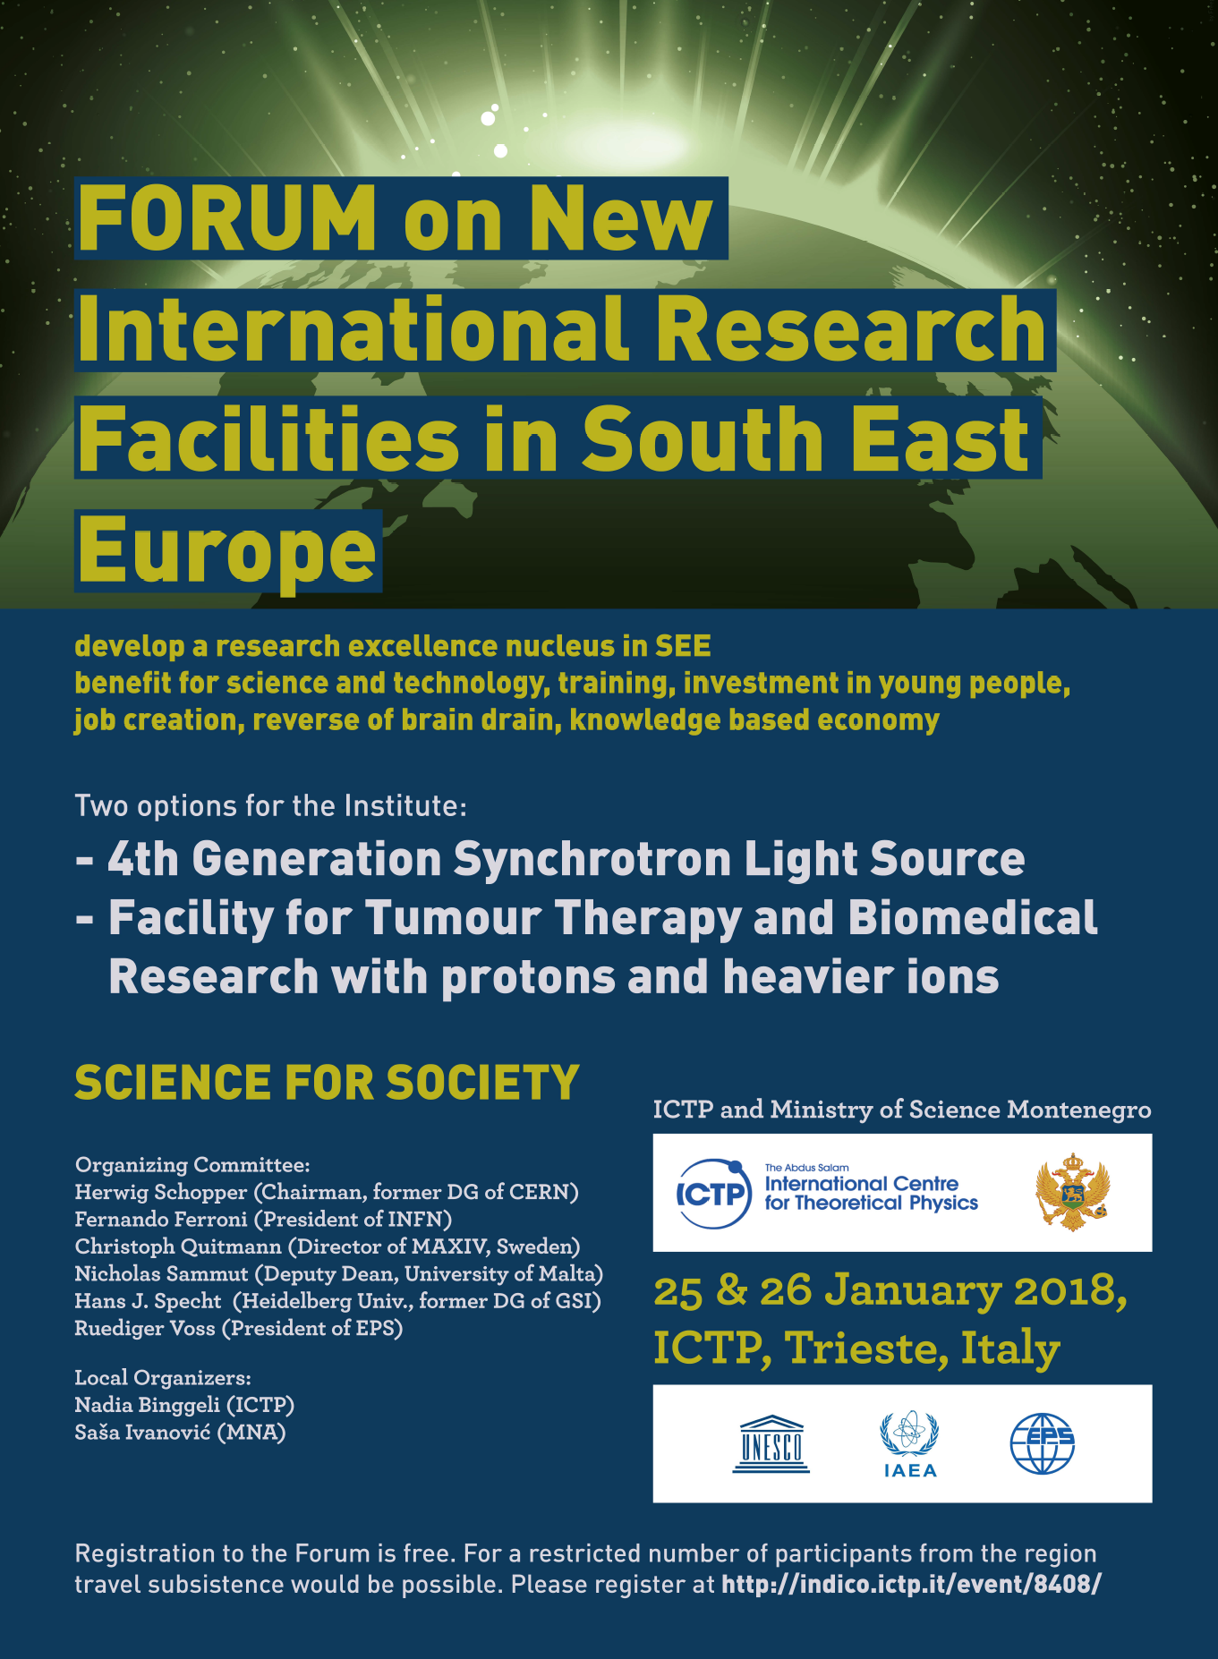
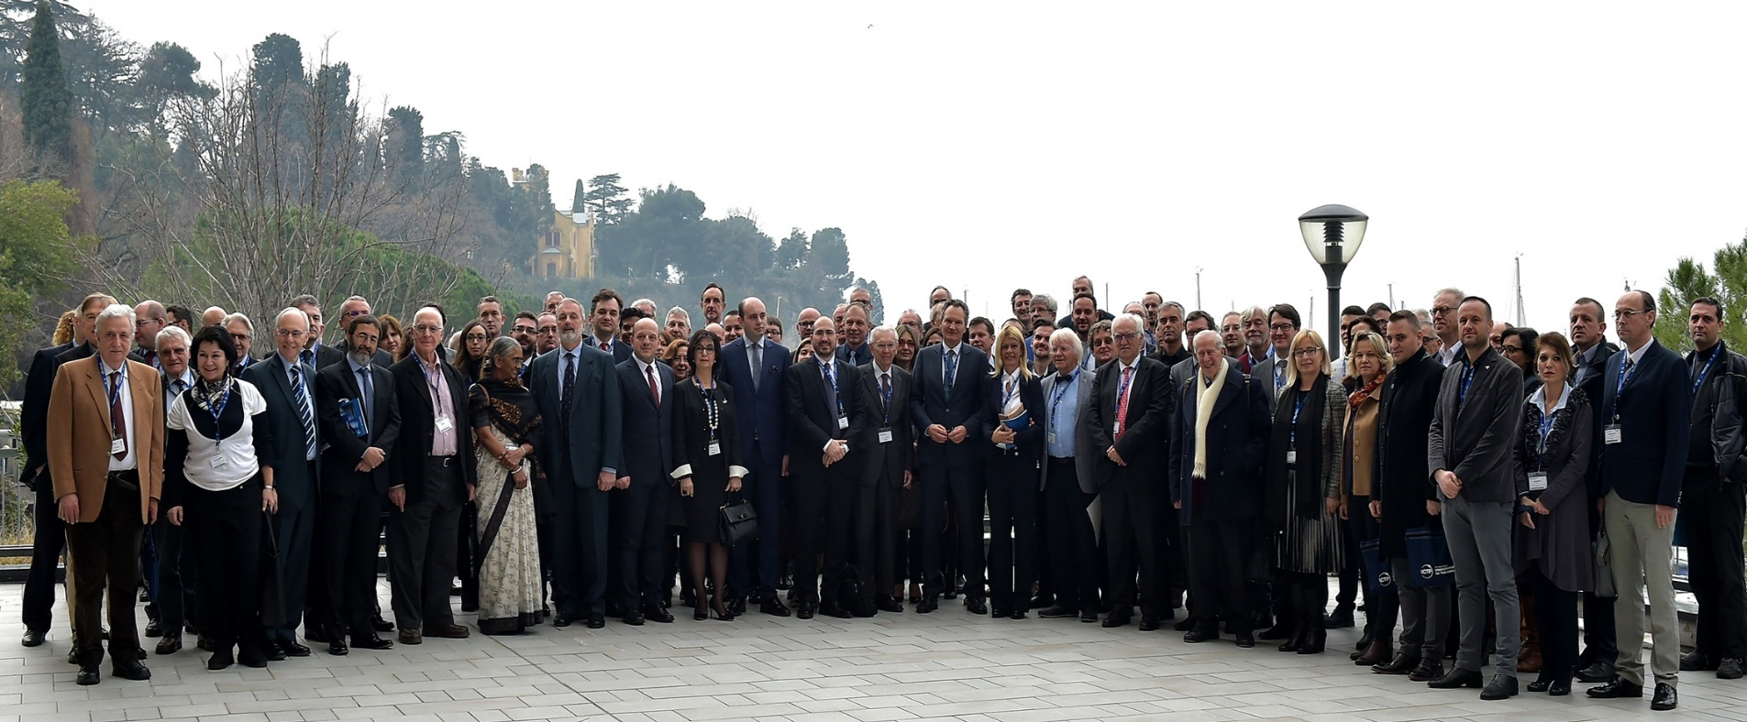
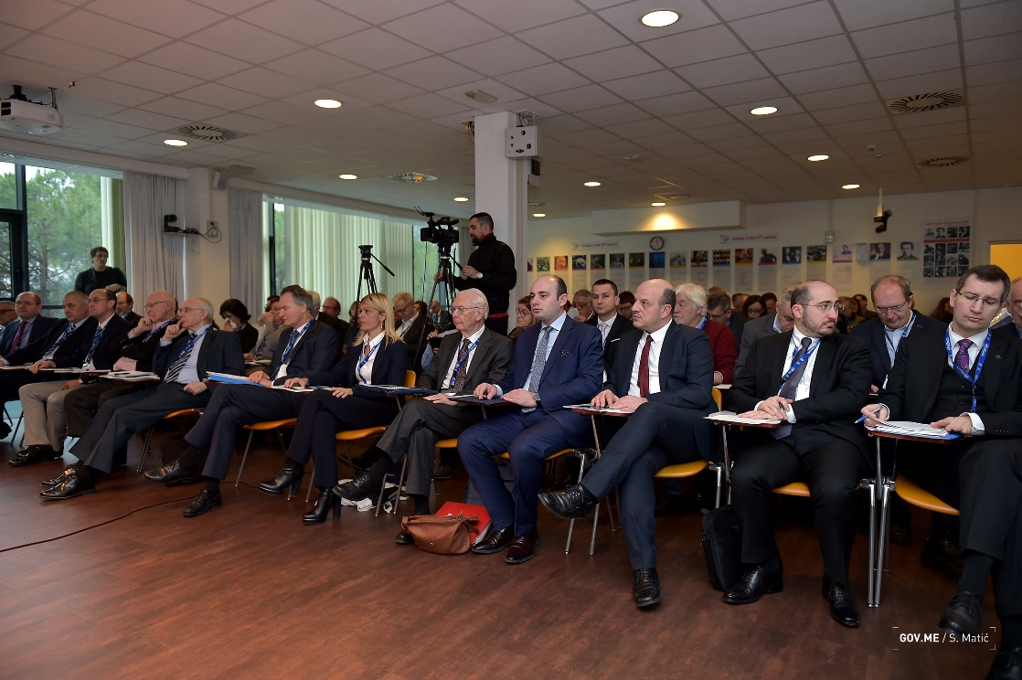
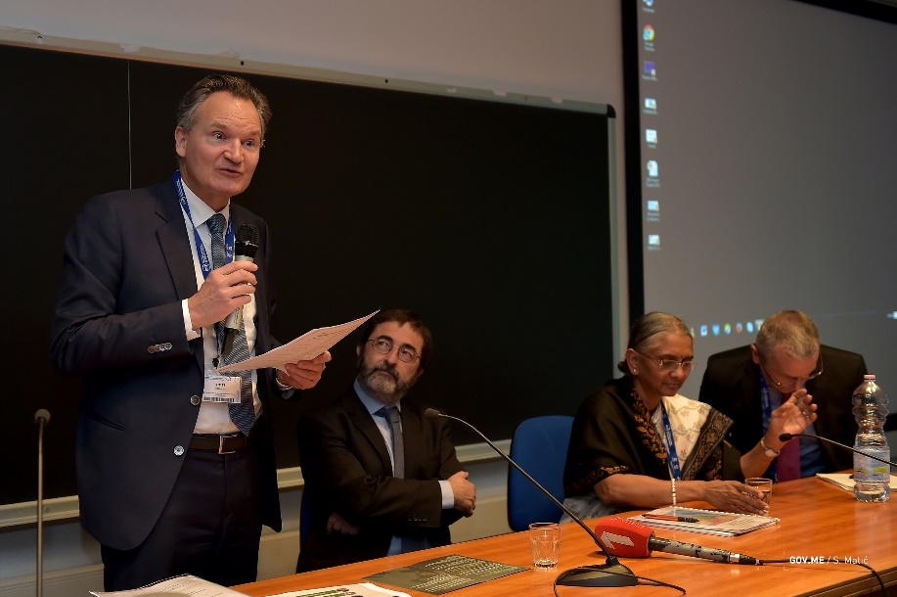

Slide 3





















SEEIIST
(Courtesy of Sanja Damjanovic – Budva 18/9/2019)
HITRI – Hadron Ion Therapy Research Infrastructure
Design Study Proposal – EU H2020 INFRADEV-01-2019-2020 call
TIARA prepared
to give advice
HITRI Consortium
Several beneficiaries from SEE Region through SEEIIST

Slide 4
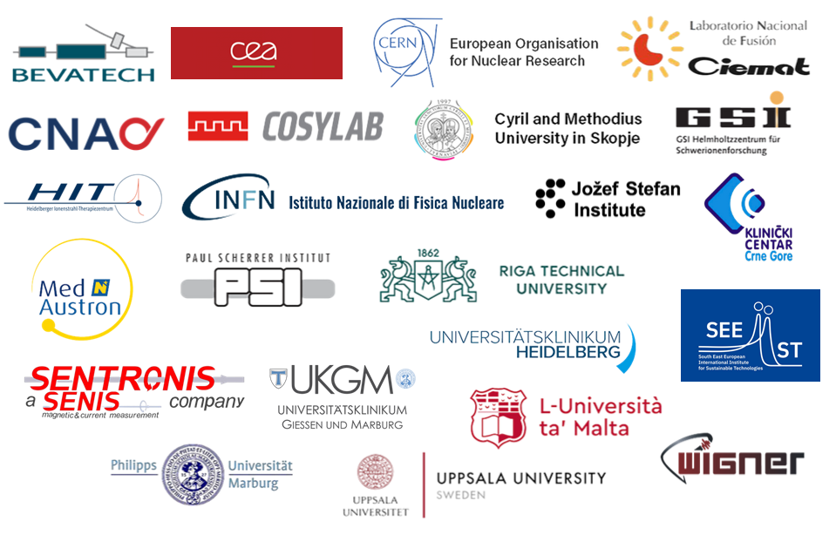




HITRIplus Consortium (started April 2021)
H2020-INFRAIA-2018-2020
23 Institutes
(4 CIRT centres, 11 research institutions, 5 universities, 3 SMEs)
14 European Countries
4.5 years Project
(1st April 2021 – 30th September 2025)
Total budget: 5 MEuro

Slide 5

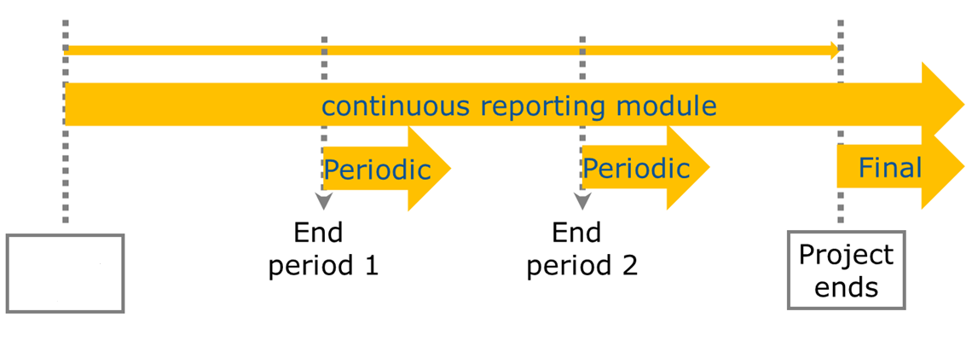

Where are we?
1 April 2021
30 September 2025
Month 18
Month 36
Project start
Project end
30 September 2022
31 March 2024
March 2025
Extension to March 2026 requested

Slide 6
HITRIplus Objectives
1. To integrate, open up and broaden the leading European Research Infrastructure for the treatment of cancer with beams of ions, ranging from helium to carbon and to heavier ions.
2. To coordinate and strengthen the research programmes on heavy ion therapy of different European institutions, by promoting synergies, collaborations, innovation, knowledge transfer, new initiatives and sharing of tools and data.
3. To develop in a joint and coordinated way novel technologies to improve the accelerators and their ancillary systems that provide particle beams to this scientific community. These technologies will improve the present generation of facilities and will be the foundation for a next generation European design for ion therapy facilities.
4. To establish a European multidisciplinary community for heavy ion therapy research, aiming at improving treatment strategies and modalities by connecting physics and engineering with medicine, biology and biophysics, and to extend this community towards emerging European regions, addressing in particular new initiatives in South East Europe.
5. To define the main technical features and the scientific programme of a future pan-European Research Infrastructure for medical and radiobiological research with heavy ion beams, to be built in South East Europe or in another European region.

Slide 7
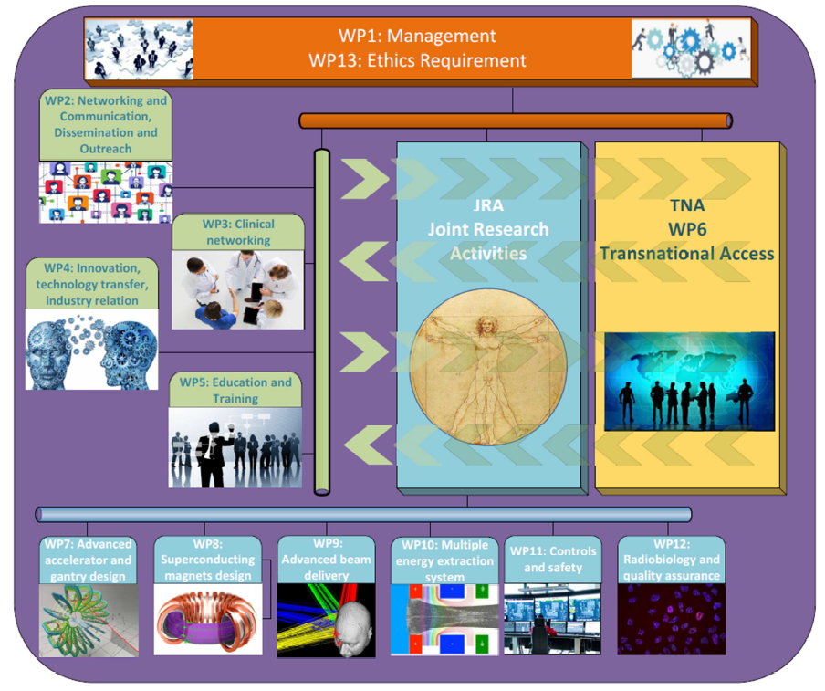
1 General Assembly
2 Advisory Boards
3 Pillars
13 Work Packages

Slide 8
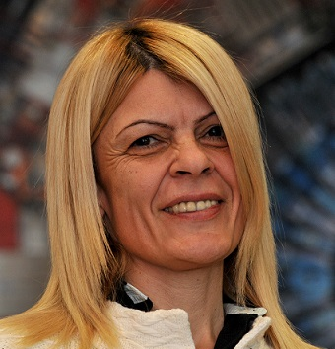
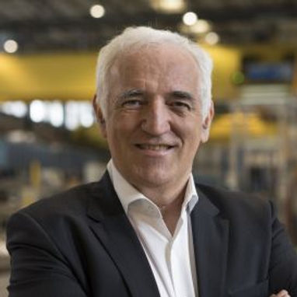

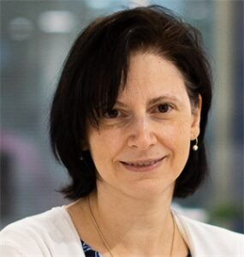
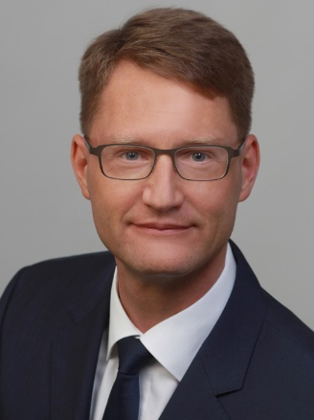
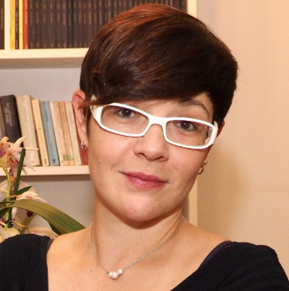
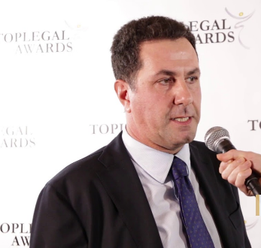
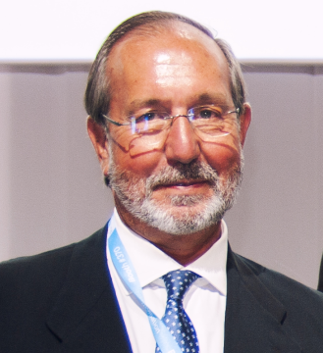
HITRIplus Governance
General Assembly
1 representative per Party
Sanja Damjanovic, SEEIIST
Sanja.Damjanovic@cern.ch
Frederick Bordry
External Scientific Advisory Board
Giovanni Anelli
Advisory Board for ethical/legal/
industrial issues
Katia Parodi
Jens Habermann
Chiara Delaini
Paolo De Carlo
Felipe Calvo

Slide 9
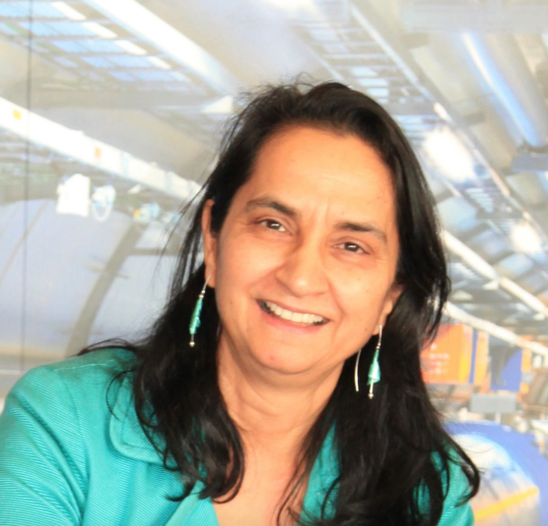
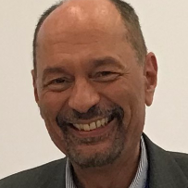

The Pillars
Networking Activities NA
Trans National Access TNA
Joint Research Activities JRA
Manjit Dosanjh
Senior Advisor for Medical Applications at CERN and visiting professor at University of Oxford.
Manjit.Dosanjh@cern.ch
Marco Durante
Director of the Biophysics Department of GSI and full Professor of Physics at the Technical University of Darmstadt, Germany.
M.Durante@gsi.de
.
Maurizio Vretenar
Senior physicist and project manager at CERN.
(HITRIplus Deputy Project Coordinator)
Maurizio.Vretenar@cern.ch
.

Slide 10
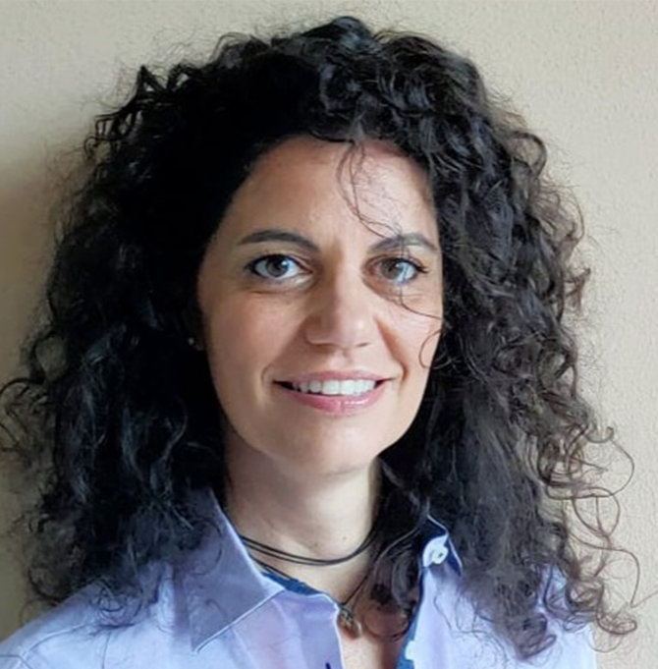
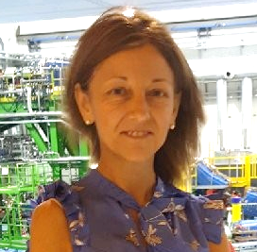


WP1 Managment: ‘the Angels’
‘Actual’ Deputy
Administration & Finance
Communication
Organization
Angelica Facoetti, CNAO
Angelica.Facoetti@cnao.it
Maria Vittoria Livraga , CNAO
mariavittoria.livraga@cnao.it
Silvia Meneghello , CNAO
Silvia.Meneghello@cnao.it
Chiara Marazzi , CNAO
Chiara.Marazzi@cnao.it

Slide 11
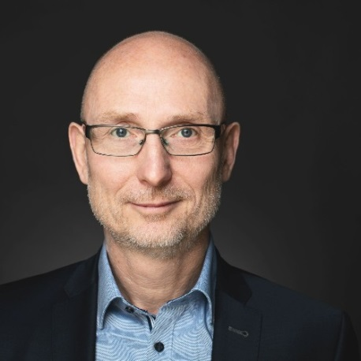
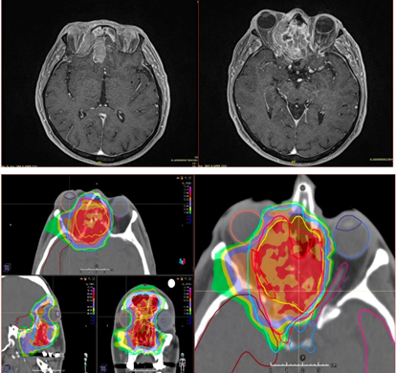

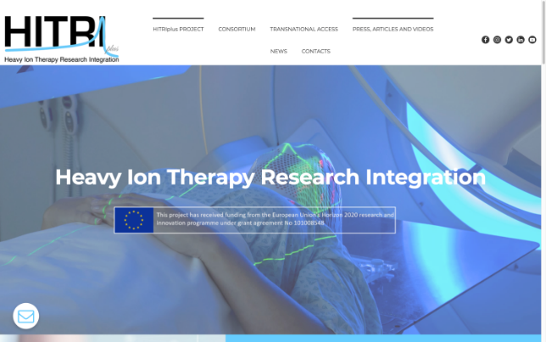
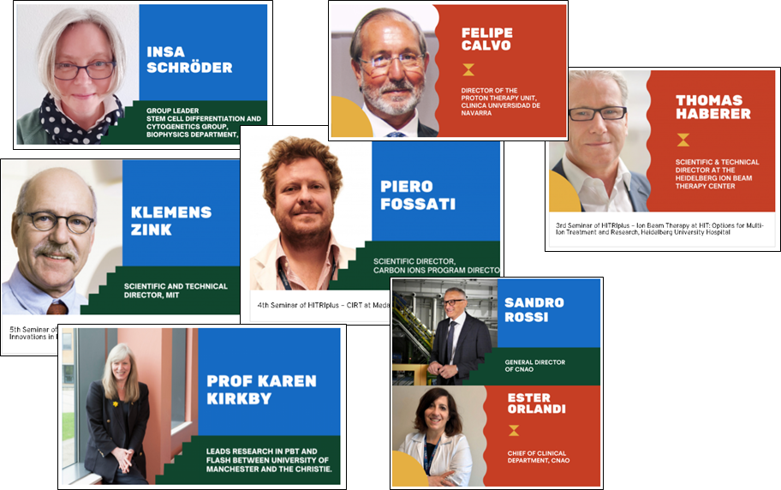
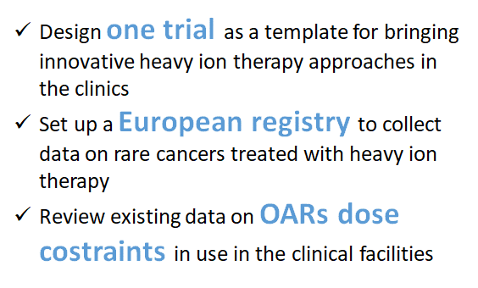
NA: Networking Activities
WP2
Networking and Communication, Dissemination and Outreach
WP3
Clinical Networking
Peter Grübling, SEEIIST
Piero Fossati, MEDA

Slide 12
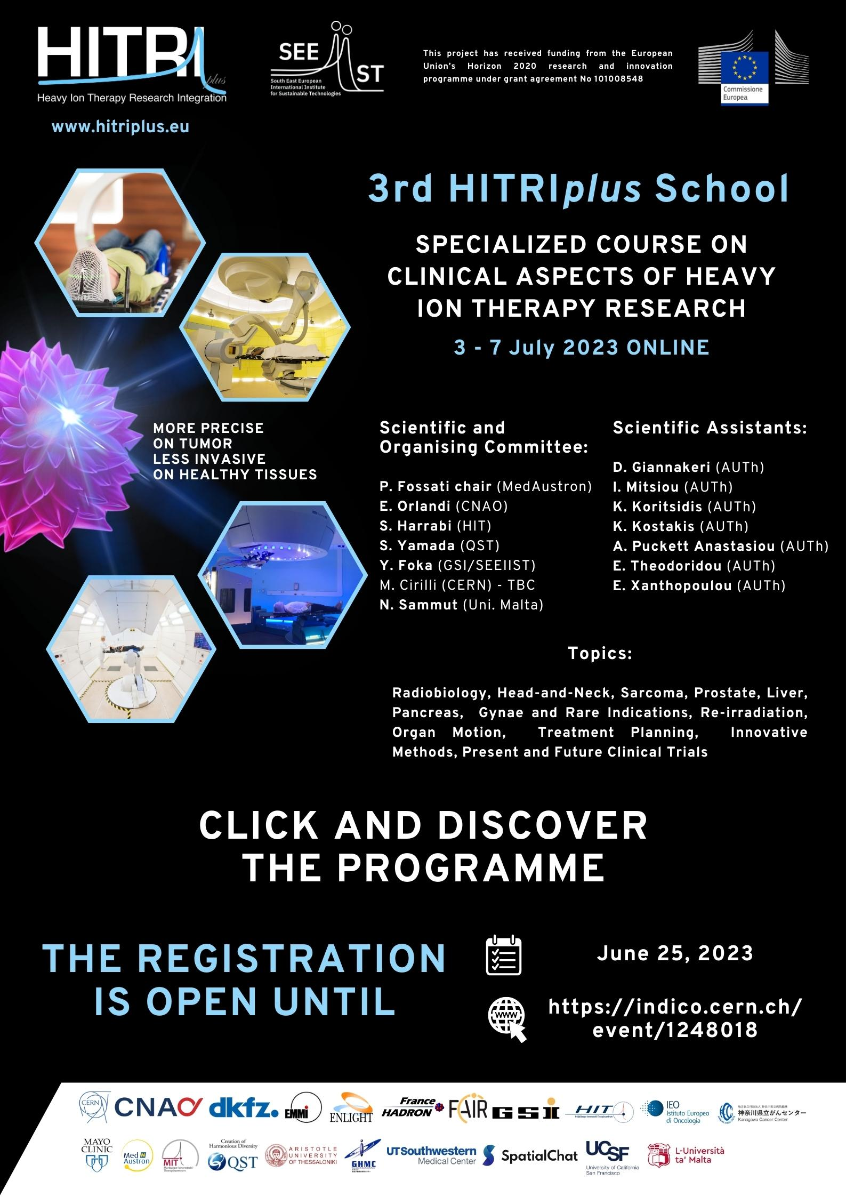

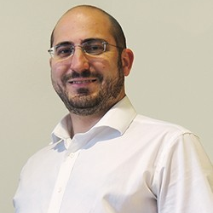
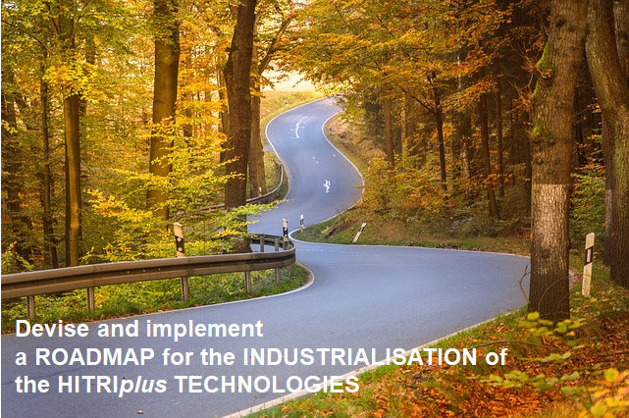
NA: Networking Activities
WP4
Innovation, technology transfer, industry relation
WP5
Education and training
Manuela Cirilli, CERN
Nicholas Sammut, UM

Slide 13
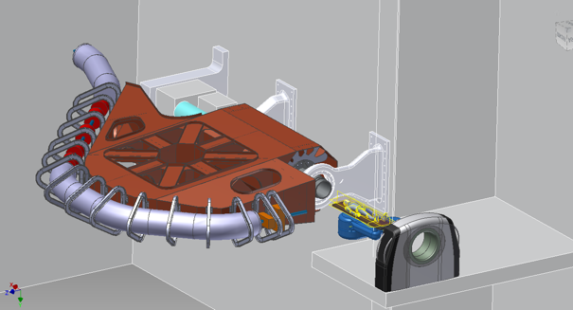
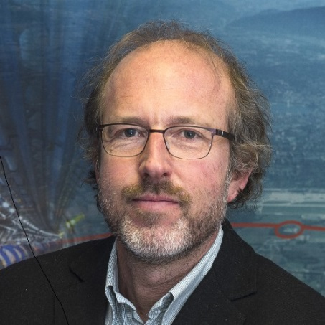
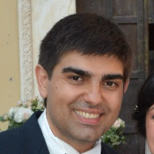
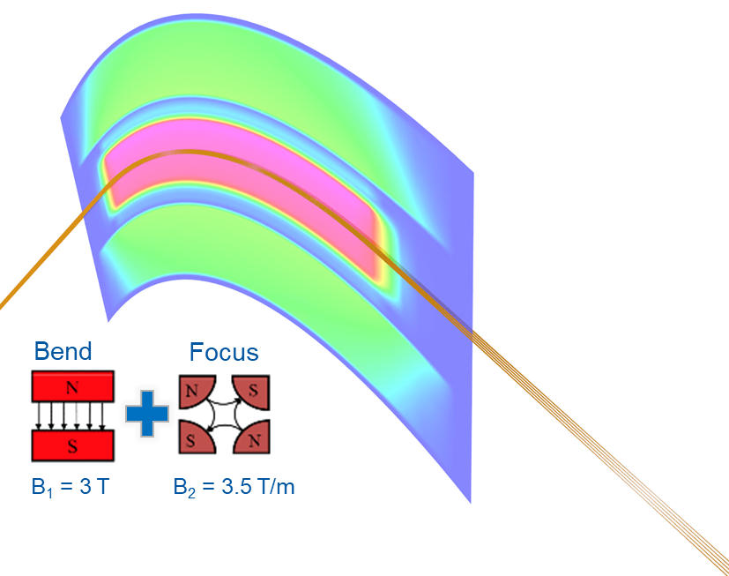
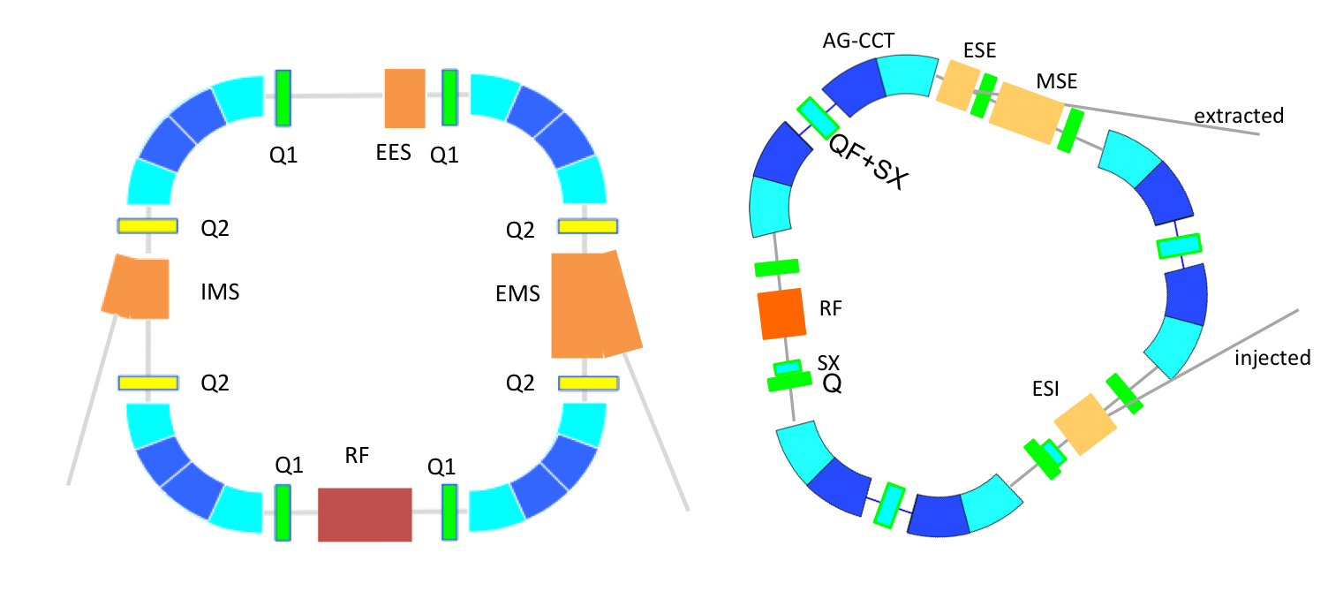
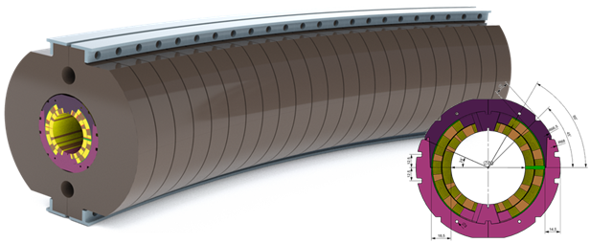
JRA: Joint Research Activities
WP7
Advanced accelerator and gantry design
WP8
Superconducting magnet design
Maurizio Vretenar, CERN
Ernesto De Matteis, INFN

Slide 14
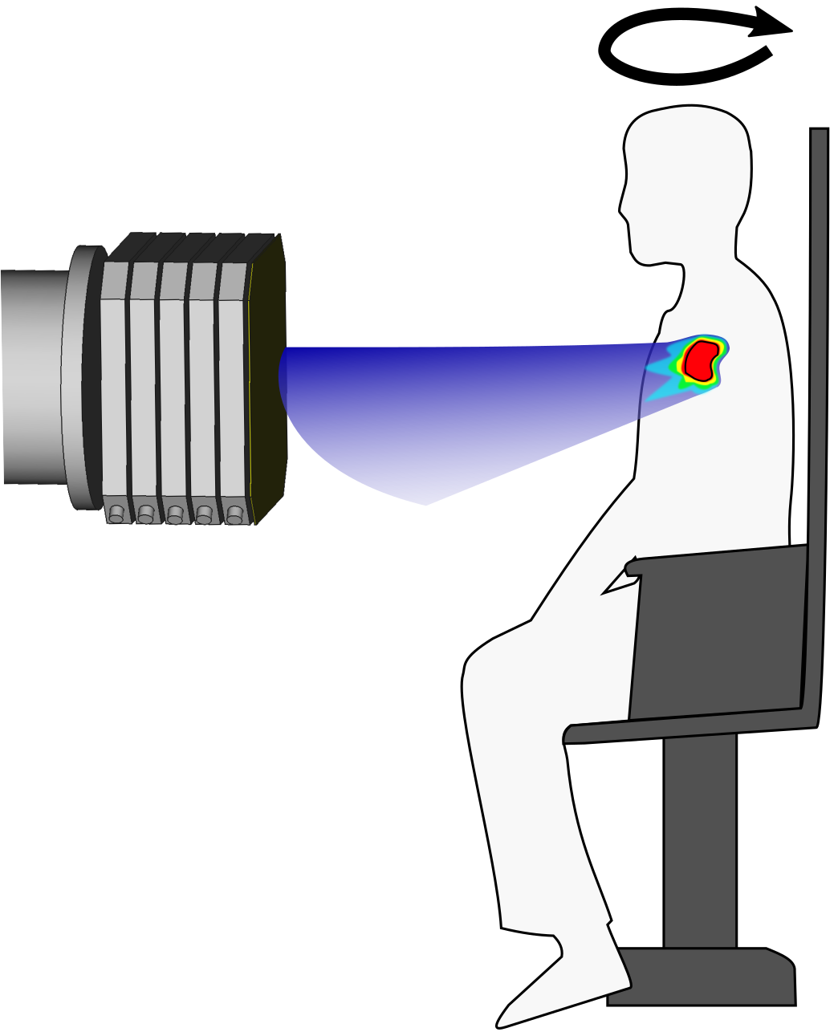
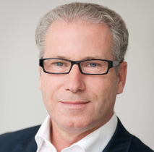
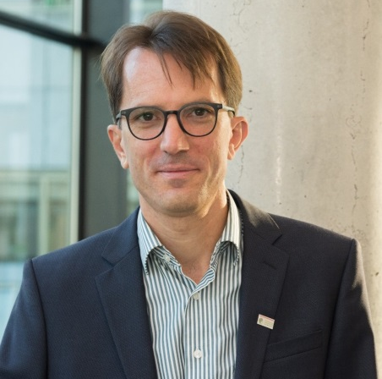
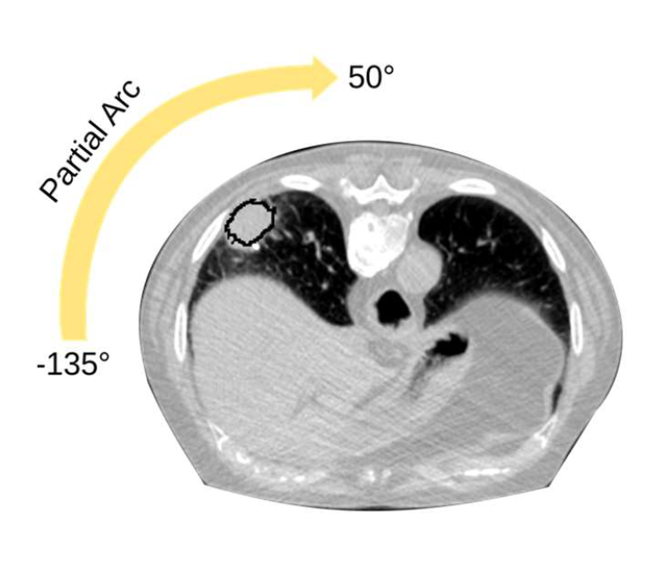
JRA: Joint Research Activities
WP10
Multiple energy
extraction system
WP9
Advanced
beam delivery
Thomas Haberer, UKHD/HIT
Christian Graeff, GSI
Arc - Therapy

Slide 15

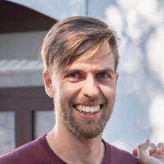
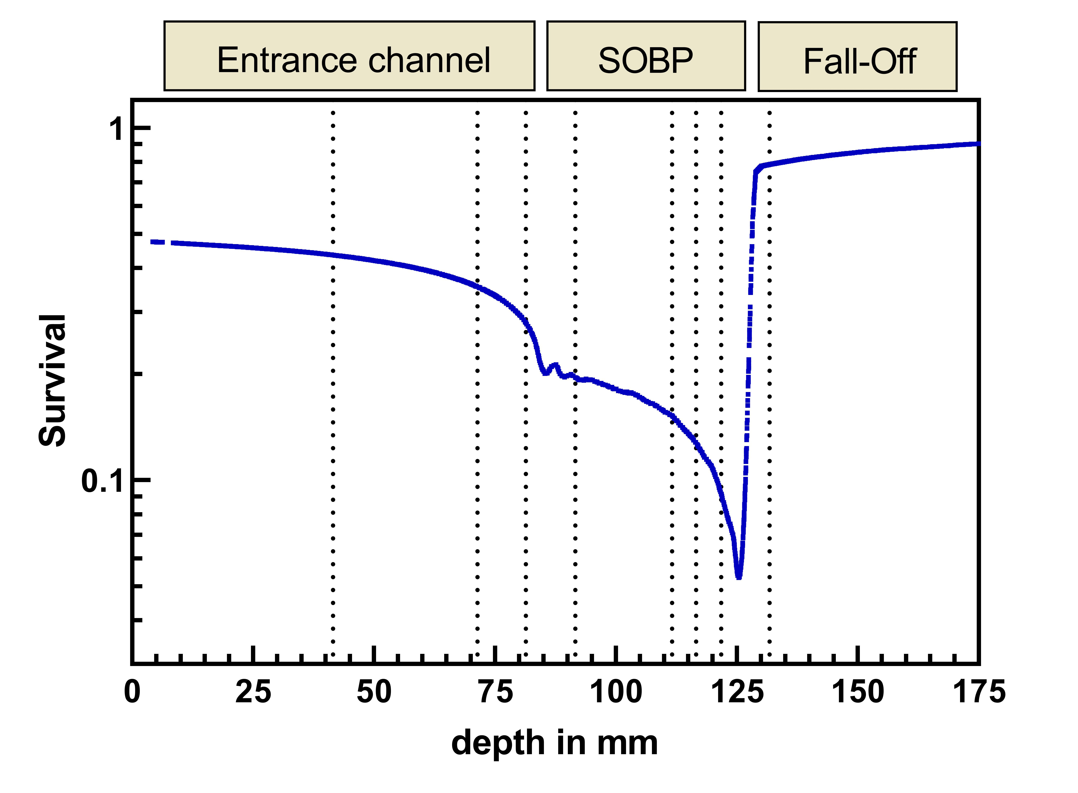
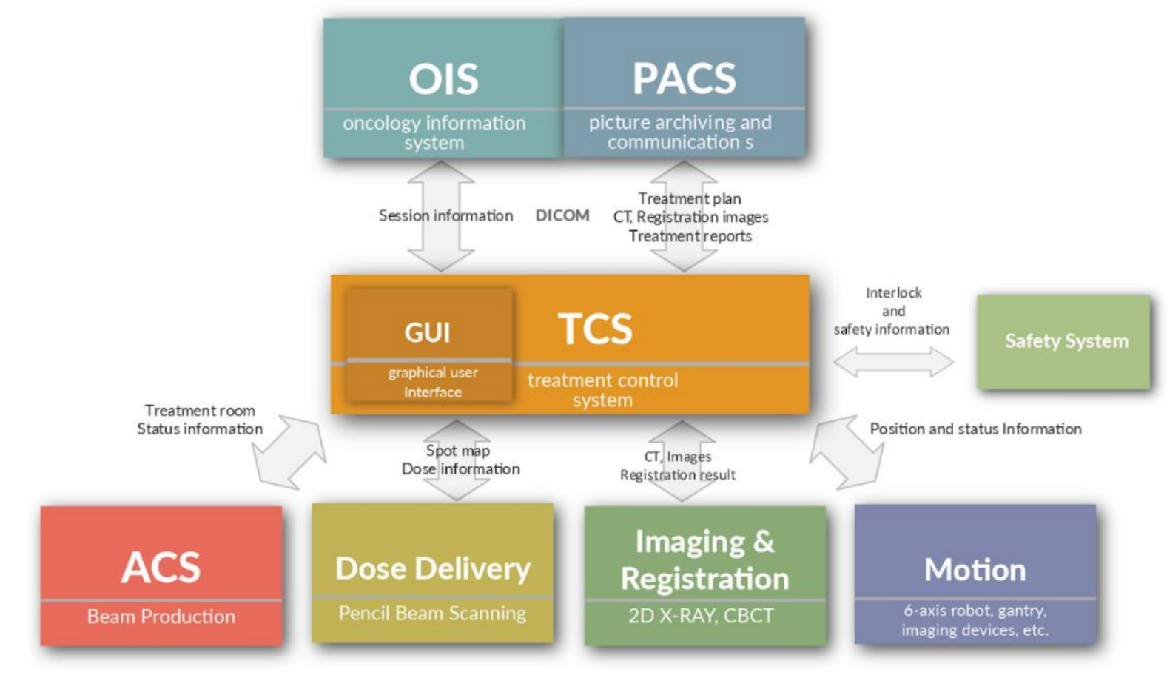
JRA: Joint Research Activities
WP12
Radiobiological Dosimetry
and QA
WP11
Controls and Safety
Ulrike Schötz, UMR
Dominik Perusko, CSL

Slide 16
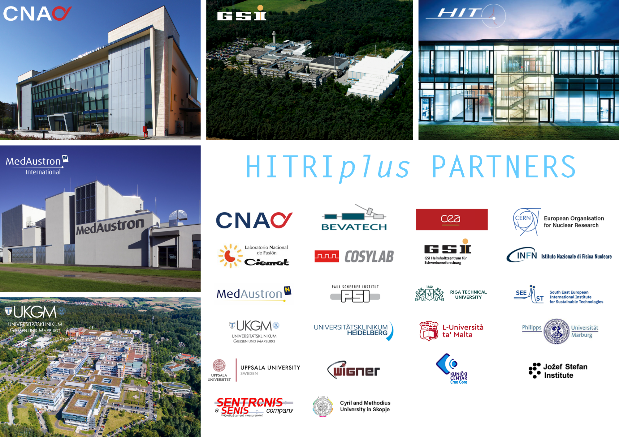
TNA: Trans National Access
The Clinical Research Access gives the opportunity to clinicians/medical physicists/technicians to join clinical research in hadron therapy through the submission of a clinical case for C-ion treatment, the comparison of treatment plans (photons, C-ions, protons), the discussion for C-ion eligibility of clinical cases or for clinical research trials in Hadrontherapy, and actively participate in the workflow of hadron treatment. .
The Research Access will attract universities, research centres, and hospitals, which will connect all the groups to perform research activities with carbon ion beams. Industrial partners are also encouraged to take part in the research programme, to be involved in the development of new clinical procedures and new medical devices.

Slide 17





WP6 - TNA
Research
RESEARCH
Clinical
March 2024
RESEARCH | Total [h] | Done [h] | Available [h]
CNAO | 80 | 45 | 35
GSI | 296 | 39 | 257
UKHD/HIT | 72 | 107 | -35
 | 448 | 191 | 257
March 2025
RESEARCH | Total [h] | Done and booked [h] | Available [h]
CNAO | 200 (80 + 120) | 183 | 17
GSI | 55 (296-241) | 47 | 8
UKHD/HIT | 193 (72 + 121) | 215 | - 22
 | 448 | 445 | 3

Slide 18
Research TNA – 20+ research topics
FragmentatiOn Of Target @ HIT
Feasibility of real-time PET range verification in proton, He and C therapy using short-lived nuclides
SIRMIO (Small Animal Proton Irradiator for Research in Molecular Image-guided Radiation-Oncology)
Heavy ion spatially fractionated radiotherapy
Assessing radiosensitivity of higher plants and mechanisms for radioresistance at different phenological stages
Measurements of damages to biomolecules in solution induced by carbon ions and their secondary fragments
Assessing space like radiation dose exposure and long-term risks in humans by using real-time differential gene expression sequencing analysis
Stopping power ratio measurements of electron density phantom
Silver atomic Quantum Clusters of five atoms (Ag5-AQCs), radiosensitizer for heavy-ion particle therapy
SiFi-CC – commissioning of a setup for prompt-gamma imaging
Spectral Fibre Dosimetry for Heavy Ion Radiotherapy
Mixed beam image guidance for particle therapy applications
Spot scanning proton arc therapy for head and neck cancer patients
Test of TIARA detector with protons from synchrotron and carbon ions
Angular distribution measurements of neutron fields generated with a typical clinical ion beams (proton and carbon) applied to anthropomorphic phantom
An online, high-resolution, microfabricated beam transverse profiler
Biophysical investigation of clinical helium ion beams for treatment of breast cancer
Characterization of a novel diamond-based detection system for dosimetry and microdosimetry in ion beam therapy using He and O ions
Multiscale and comprehensive assessment of the effects of hadrontherapy in head and neck tumors – Stealth-Bomber Paradigm
PEPITES: toward an ultra-thin distant beam monitor used during patient treatment
Direct comparison of water calorimetry and ionization chambers in carbon ion and helium ion beams in terms of absorbed dose-to-water

Slide 19
WP6 - TNA
Research
CLINICAL
Clinical
March 2024
CLINICAL | Total [h] | Requested [h] | Available [h]
CNAO | 12 | 6 | 6
UKHD/HIT | 10 | 0 | 10
MEDA | 12 | 3 | 9
MIT | 16 | 2 | 14
 | 50 | 11 | 39
March 2025
CLINICAL | Total [h] | Requested [h] | Available [h]
CNAO | 12 | 12 | -
UKHD/HIT | 10 | 3 | -
MEDA | 12 | 12 | -
MIT | 16 | 2 | -
 | 50 | 29 | 21

Slide 20
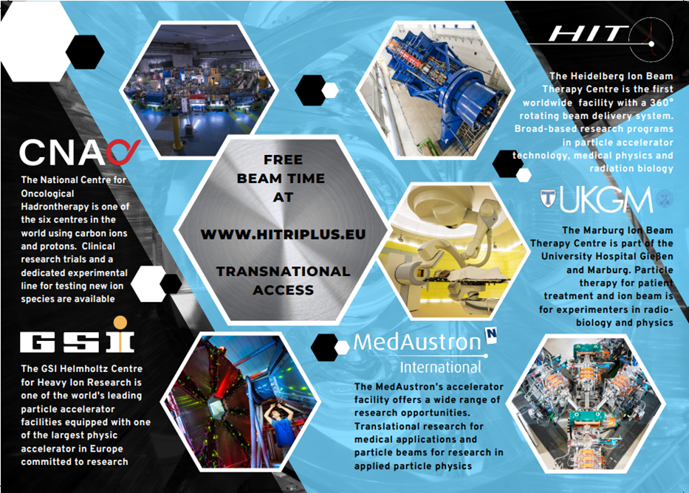
Clinical TNA
Affiliation | Country
Thessaloniki | Greece
AEPROT | Spain
Hospital of Lithuanian University of Health Sciences | Lithuania
Amethyst Radiotherapy | Romania
Papageorgiou General Hospital | Greece
University of Babes Bolyai Cluj Napoca | Romania
Centre Baclesse | France
Veszprém County Hospital | Hungary
National Institute of Children's Diseases | Slovakia
Institute of Oncology Ljubljana | Slovenia
University Szeged, Department Oncotherapy | Hungary
Mayo Clinic Florida | USA
Rambam Health Care Campus | Israel
Erasmus MC, University Medical Center Rotterdam | Netherlands
Wollongong University | Australia
Tel Aviv University | Israel
Východoslovenský onkologický ústav a.s. | Slovakia
Proton Therapy Centre Czech | Czech Republic
DR MGR Medical University | India

Slide 21
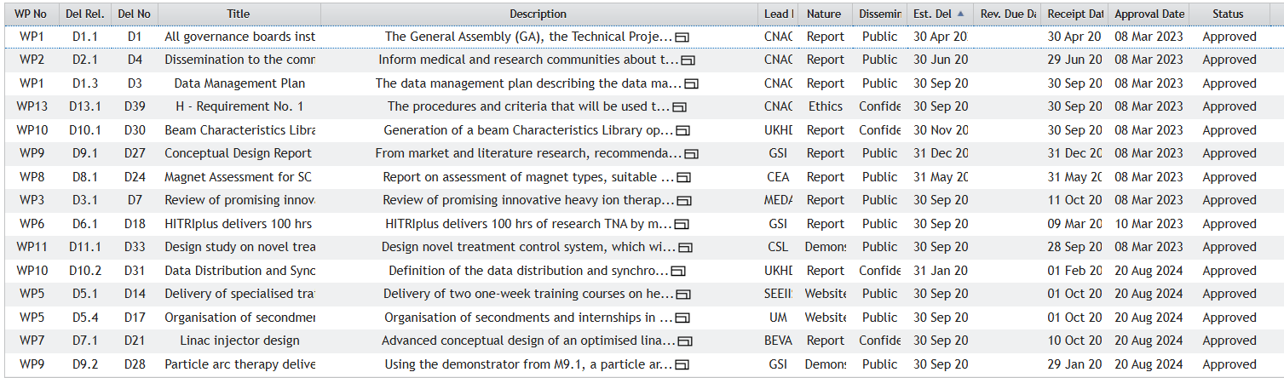

Deliverables
118/18 Deliverables APPROVED

Slide 22
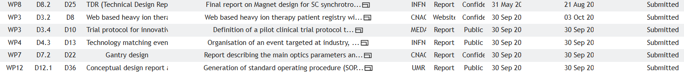
Deliverables submitted during the 3 RP (since 31 March 2024)
7 Deliverables SUBMITTED

Slide 23

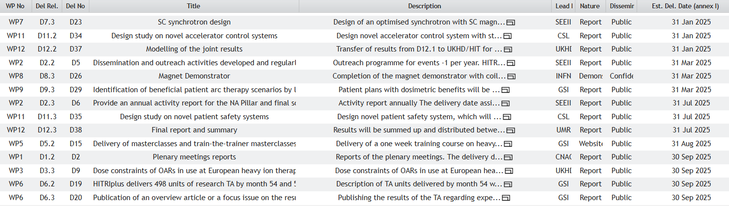
Deliverables: 14 to go

Slide 24
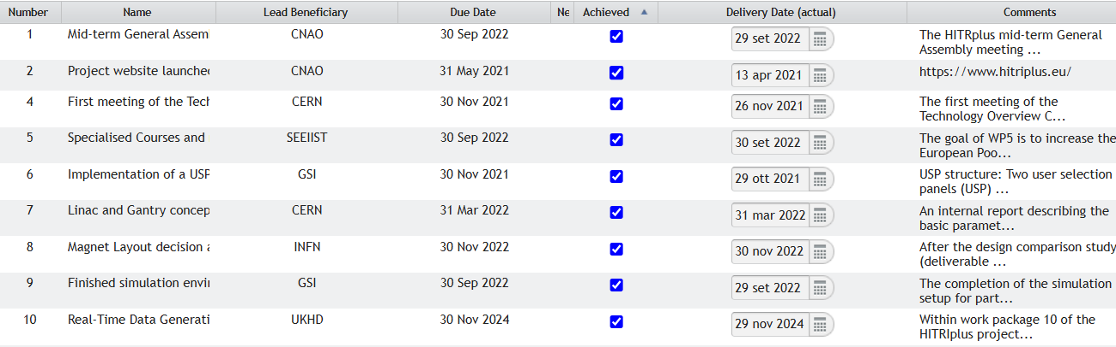
Milestones
12 Milestones completed

Slide 25
2 Milestones to go

Slide 26
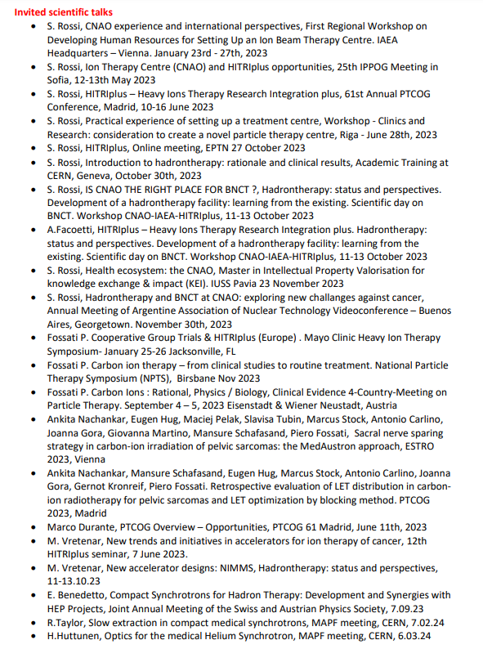
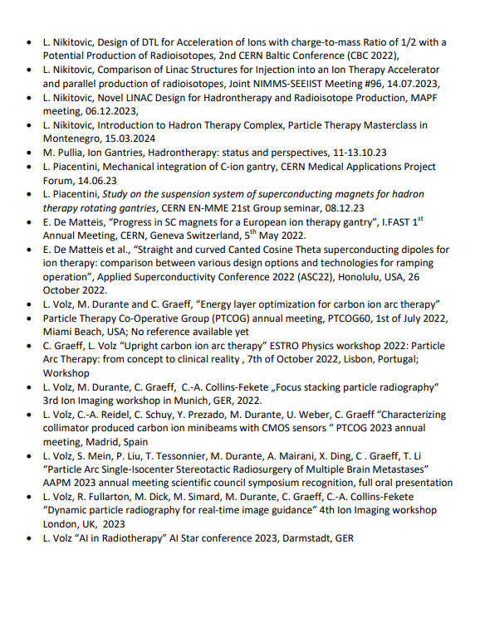
Scientific contributions
Scientific Talks
(78 speeches)
Public talks
(40 events)
Webinars
(19 events)
Lectures
(21 events)

Slide 27
Publications
More than 50 publications in extenso
Last ones
Mamaras A et al 2024 J. Phys.: Conf. Ser. 2687 052010DOI 10.1088/1742 6596/2687/5/052010
Toral F et al., "Status of Nb-Ti CCT Magnet EU Programs for Hadron Therapy," in IEEE Transactions on Applied Superconductivity, vol. 34, no. 5, pp. 1-5, Aug. 2024, Art no. 4401705, doi: 10.1109/TASC.2023.3349252.
Pullia MG et al 2023 J. Phys.: Conf. Ser. 2420 012099
Rossi L et al 2024 J. Phys.: Conf. Ser. 2687 092009DOI 10.1088/1742-6596/2687/9/092009
Benedetto E and Vretenar M 2024 J. Phys.: Conf. Ser. 2687 092003DOI 10.1088/1742-6596/2687/9/092003
Benedetto E et al 2024 J. Phys.: Conf. Ser. 2687 062007DOI 10.1088/1742-6596/2687/6/062007
Sorti S et al., "Electromagnetic Losses in Fast-Ramped Canted-Cosine-Theta Magnets," in IEEE Transactions on Applied Superconductivity, 2024, Art no. 4003506, doi: 10.1109/TASC.2024.3360933.
Nikitovic L et al 2024 J. Phys.: Conf. Ser. 2687 052011DOI 10.1088/1742-6596/2687/5/052011
Prioli M et al 2024. First Winding Trial for the Superconducting Ion Gantry (SIG) Dipole Demonstrator Magnet., doi: 10.1109/TASC.2024.3361440.
Georgieva P. and Dosanjh, M. ENLIGHT (European Network for Light Ion Hadron Therapy) and its role in Hadron therapy. Health Technol. 2024. https://doi.org/10.1007/s12553-024-00837-8
Volz L et al. Focus stacking single-event particle radiography for high spatial resolution images and 3D feature localization. Phys Med Biol. 2024. doi: 10.1088/1361-6560/ad131a.
Volz L. Focus stacking single-event particle radiography for high spatial resolution images and 3D feature localization. Phys Med Biol. 2024. doi: 10.1088/1361-6560/ad131a.
Bertho A et al. Carbon minibeam radiation therapy results in tumor growth delay in an osteosarcoma murine model. Sci Rep. 2025 Mar 1;15(1):7305. doi: 10.1038/s41598-025-91872-6.

Slide 28



THANK YOU!
https://www.hitriplus.eu/
@HITRIplus - Heavy Ion Therapy Research Integration
HITRIplus
@heavy_ion
HITRIplus

