Slide 1
WP6: Transnational Access
Prof. Marco durante, Ph.d.
Dr. konrad lehmann, ph.d.
GSI helmholtzzentrum für schwerionenforschung

Slide 2
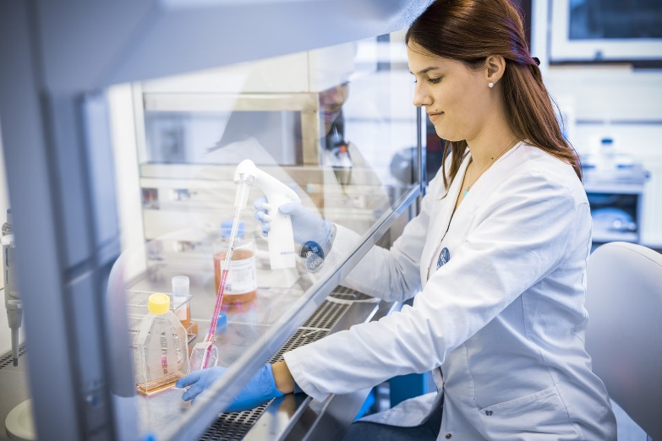
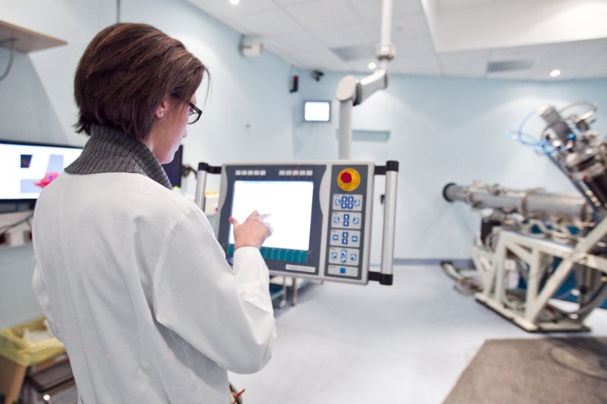
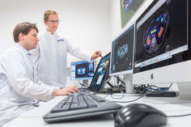


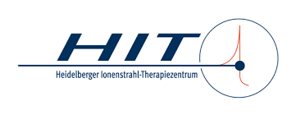
Research TNA
(clivial chordoma)

Slide 3
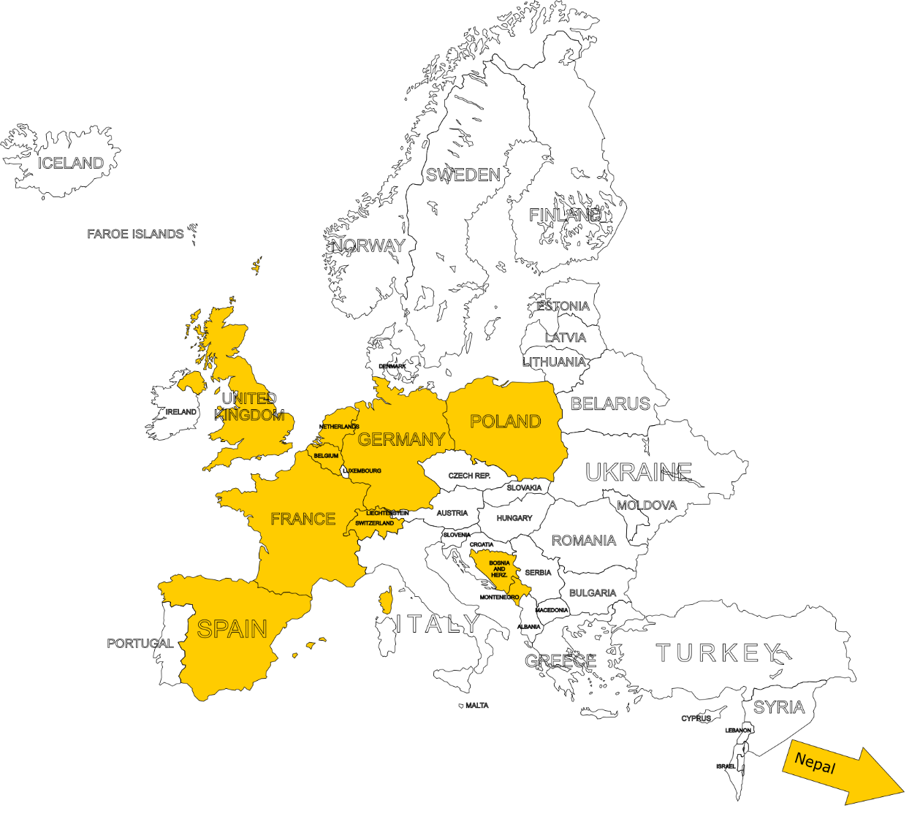
Countries of origin for applications

Slide 4
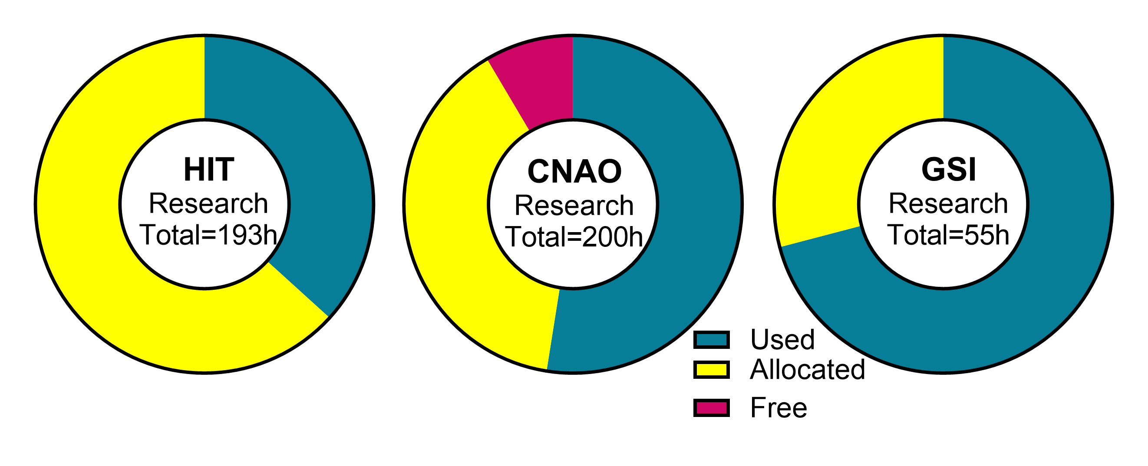
Research beamtime provided by facilities

Slide 5
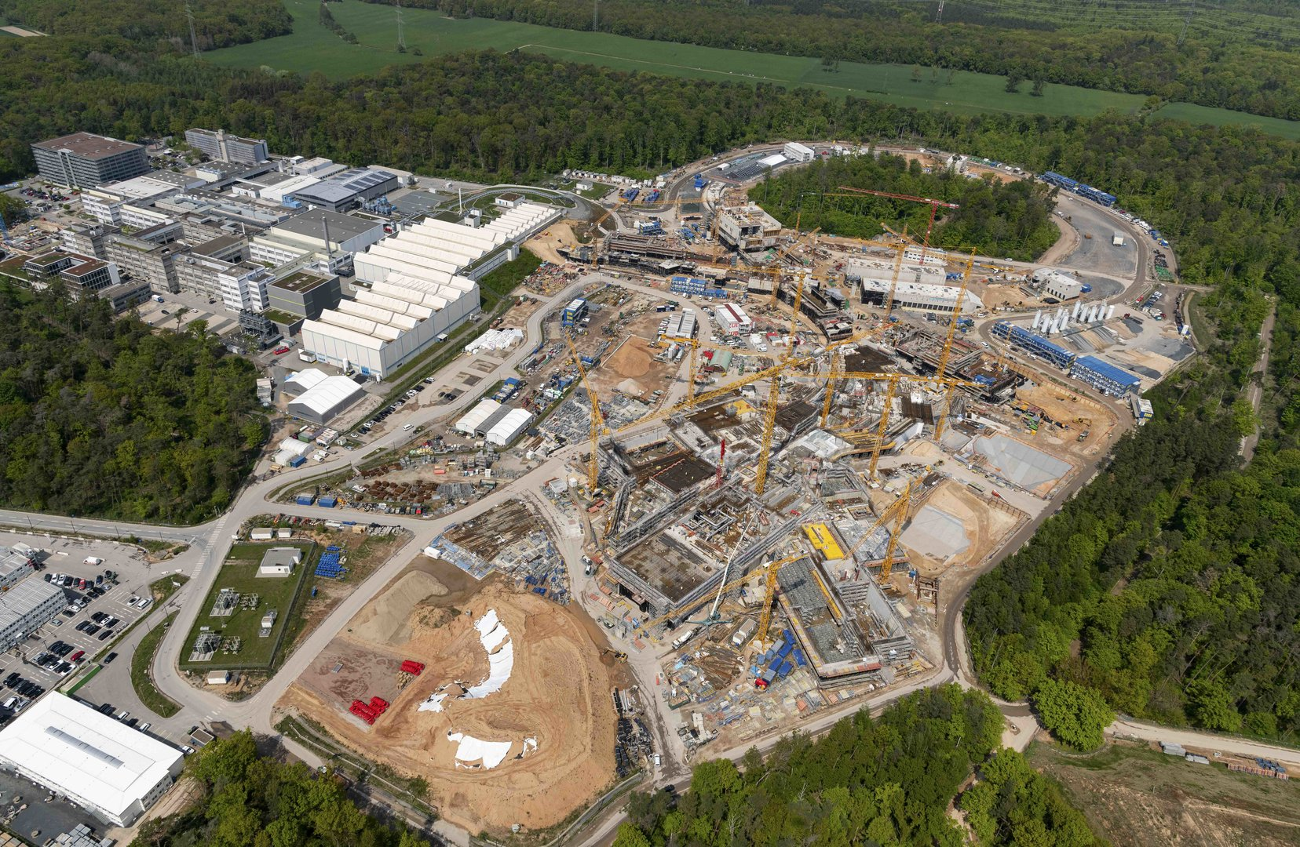
Beamtime situation at GSI
High energy prizes led to complete cancelling of beamtime in 2023.
Ongoing construction of FAIR centre drains available means and interferes with accelerator availability.
=> shortage in beam time; only few days / year
=> reassignment of TNA hours to HIT and CNAO has been necessary

Slide 6
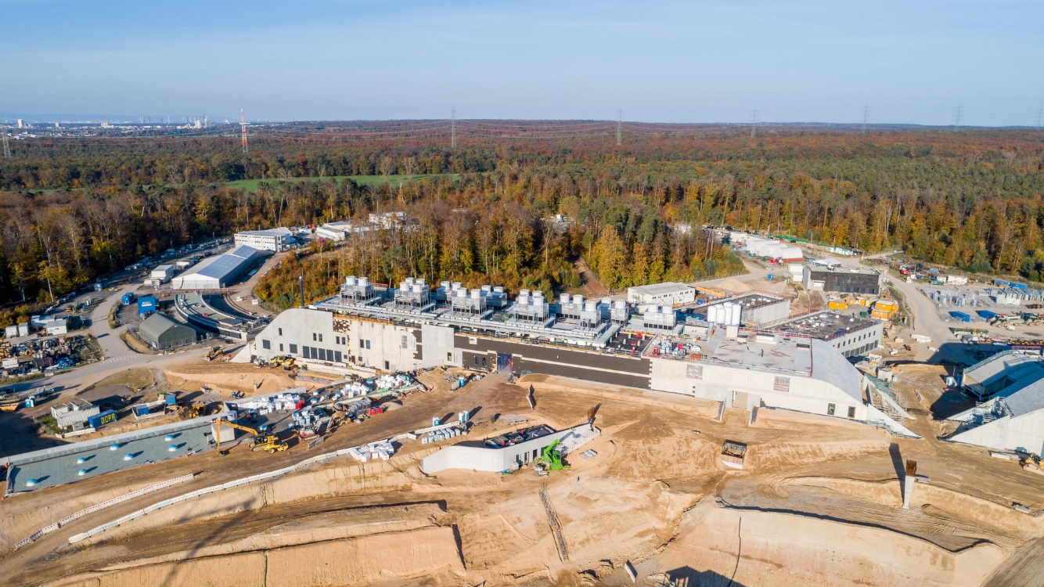
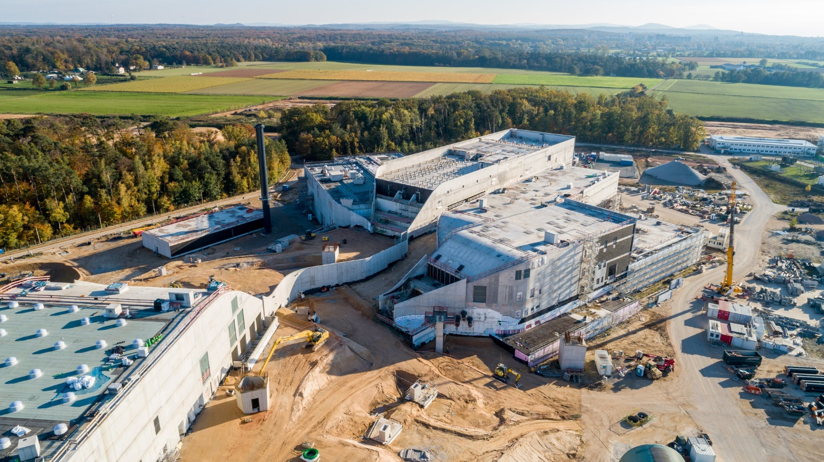
But at least we go ahead.

Slide 7



Contributors to TNA
Research
Clinic
 | Res. [h] | Clin. [P] | Total
CNAO | 80 | 12 | 92
GSI | 296 | - | 296
UKHD/HIT | 72 | 10 | 82
MEDA | - | 12 | 12
MIT | - | 16 | 16
 | 448 | 50 | 498
 | Res. [h] | Clin. [P] | Total
CNAO | 200 | 12 | 212
GSI | 55 | - | 55
UKHD/HIT | 193 | 10 | 203
MEDA | - | 12 | 12
MIT | - | 16 | 16
 | 448 | 50 | 498
120h
121h

Slide 8
Research TNA applications – 1st & 2nd reporting period
Applicant | Affiliation | Proposal title | h requested | h used | Host | Period
Marie Vanstalle | Institut Pluridisciplinaire Hubert Curien (IPHC), Strasbourg | Measurements of damages to biomolecules in solution induced by carbon ions and their secondary fragments | 24 + 16 (2025) | 40 | CNAO | April 14/15 & May 26/27, 2023 April 16, 2025 June 14/15, 2025
Christophe Badie | UK Health Security Agency | Assessing space like radiation dose exposure and long-term risks in humans by using real-time differential gene expression sequencing analysis | 6 | 8 | CNAO | May 13, 2023
Ilaria Rinaldi | MAASTRO | Stopping power ratio measurements of electron density phantom | 5 | 5 | HIT | December 20, 2022
Fernando Dominguez | USC Spain | Silver atomic Quantum Clusters of five atoms (Ag5-AQCs), radiosensitizer for heavy-ion particle therapy. | 8 | 6 | GSI | February 11th & April 18th, 2024
Aleksandra Wronská | Jagiellonian University in Kraków | SiFi-CC – commissioning of a setup for prompt-gamma imaging | 12 | 16 | HIT | January 12/13, 16/17, 2023
Anne Klimpel | TU Dresden | Spectral Fibre Dosimetry for Heavy Ion Radiotherapy | 8 | 7 | CNAO | March 6, 2023
Charles-Antoine Collins-Fekete | University College London | Mixed beam image guidance for particle therapy applications | 8 | 4 | GSI | December 18/19, 2023
Krishna Prasad Subedi | Nepal | Spot scanning proton arc therapy for head and neck cancer patients | - | - | HIT | declined
Notes:
The animated bars highlight the two projects that are presented in more detail on the next slide. I chose FOOT, because it is your project, and Prezado, because she came to GSI.

Slide 9
Research TNA applications – 3rd reporting period
Applicant | Affiliation | Proposal title | h req. | h used | Host | Period
Sara Marcatili | CNRS/IN2P3, Grenoble, France | Test of TIARA detector with protons from synchrotron and carbon ions | 40 | 40 | CNAO | 2024 & March 22/23, 2025
Armin Durakovic | Cantonal hospital Zenica, Bosnia and Herzegovina | Angular distribution measurements of neutron fields generated with a typical clinical ion beams (proton and carbon) applied to anthropomorphic phantom | 16 | 16 | CNAO | May 10/11, 2024
Michele Caldara | Switzerland | An online, high-resolution, microfabricated beam transverse profiler | 16 | 28 | CNAO | July30/31, 2024 April 5/6, 2025
Vladimir Petrović | Montenegro | [none] | [none] |  | CNAO
Lorenzo Manti | Universitá di Napoli, Italy | Biophysical investigation of clinical helium ion beams for treatment of breast cancer | 64 |  | HIT
Claudio Verona | Roma, Italy | Characterization of a novel diamond-based detection system for dosimetry and microdosimetry in ion beam therapy using He and O ions | 32 |  | HIT
Claire Rodriguez-Lafrasse | University of Lyon, France | Multiscale and comprehensive assessment of the effects of hadrontherapy in head and neck tumors – Stealth-Bomber Paradigm | 32 | 14 | CNAO | 2024 & April 3rd, 2025
Marc Verderi | Institut National de Physique Nucléaire et de Physique des Particules, France | PEPITES for CNAO : toward an ultra-thin distant beam monitor used during patient treatment | 48 | 16 | CNAO | April 11-13, 2025
Lies Verpoest | Belgium | Direct comparison of water calorimetry and ionization chambers in carbon ion and helium ion beams in terms of absorbed dose-to-water | 24 |  | HIT
Magdalena Kołodziej | Polen | Testing beam-activated tumour tracers for online proton therapy monitoring | 16 |  | HIT
Isabelle Allemand | Frankreich | Heavy Ions and Adult Stem Cells | 8 |  | GSI
Notes:
The animated bars highlight the two projects that are presented in more detail on the next slide. I chose FOOT, because it is your project, and Prezado, because she came to GSI.

Slide 10
Research access to HIT
Original TNA obligation (72h) was almost fulfilled in 2024.
=> assignment of 121h from GSI in 2025
New guests in 2025:
  Biophysical investigation of clinical helium ion beams for treatment of breast cancer, Lorenzo Manti, Universitá di Napoli, Italy
  Characterization of a novel diamond-based detection system for dosimetry and microdosimetry in ion beam therapy using He and O ions, Claudio Verona, Roma, Italy
  Direct comparison of water calorimetry and ionization chambers in carbon ion and helium ion beams in terms of absorbed dose-to-water, Lies Verpoest, Belgium
  Testing beam-activated tumour tracers for online proton therapy monitoring, Magdalena Kołodziej, Poland

Slide 11
Research access to CNAO
Measurements of damages to biomolecules in solution induced by carbon ions and their secondary fragments, IPHC Strasbourg, Vanstalle, April-May 2023, April / June 2025
Test of TIARA detector with protons from synchrotron and carbon ions, CNRS Grenoble, Marcatili, 2024, March 2025
Angular distribution measurements of neutron fields generated with a typical clinical ion beams (proton and carbon) applied to anthropomorphic phantom, Cantonal hospital Zenica, Durakovic, May 2024
An online, high-resolution, microfabricated beam transverse profiler, Michele Caldara, Switzerland, July 2024 & April 2025
Multiscale and comprehensive assessment of the effects of hadrontherapy in head and neck tumors – Stealth-Bomber Paradigm, Claire Rodriguez-Lafrasse, University of Lyon, France, 2024 & April 2025
PEPITES for CNAO : toward an ultra-thin distant beam monitor used during patient treatment, Marc Verderi, Institut National de Physique Nucléaire et de Physique des Particules, France, April 2025

Slide 12
Research access to GSI
Silver atomic Quantum Clusters of five atoms (Ag5-AQCs), radiosensitizer for heavy-ion particle therapy. USC, Domínguez, February 11th & April 18th, 2024
Mixed beam image guidance for particle therapy applications, University College London, Collins-Fekete, February 2024, April 2025
Heavy Ions and Adult Stem Cells, Isabelle Allemand, Paris, May 2025
Molecular mechanisms of torpor-induced radioprotection, Matteo Cerri, May 2025

Slide 13
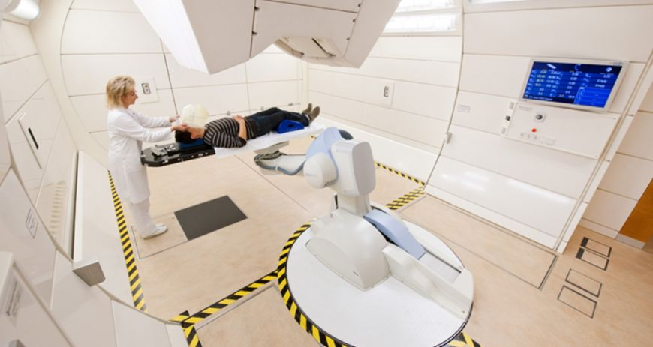
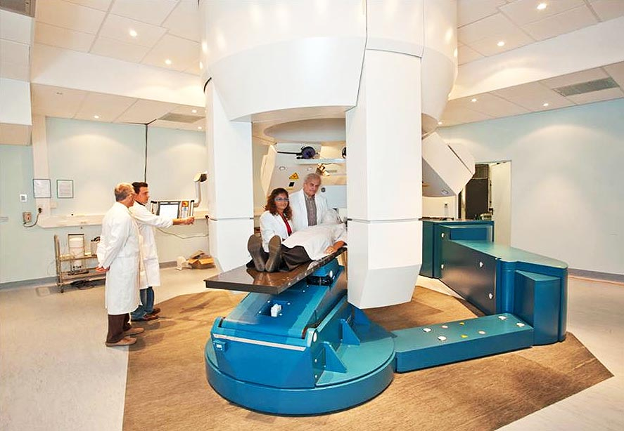
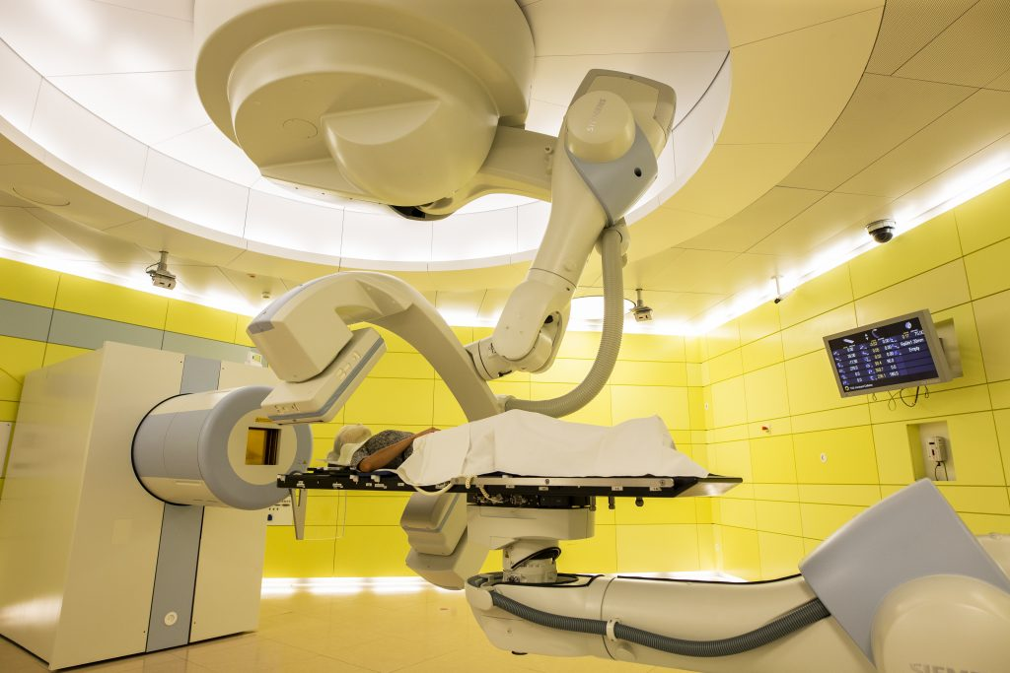
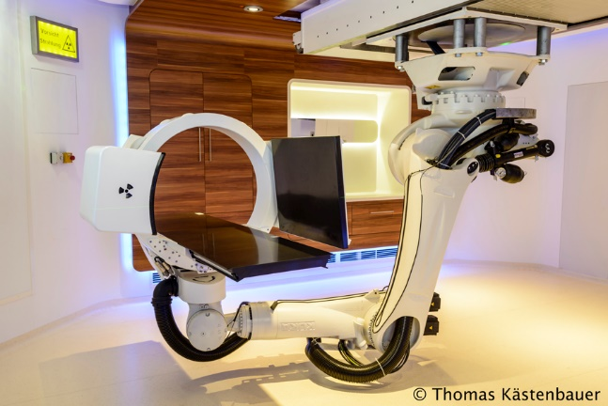
Specific TA to clinical activities

Slide 14
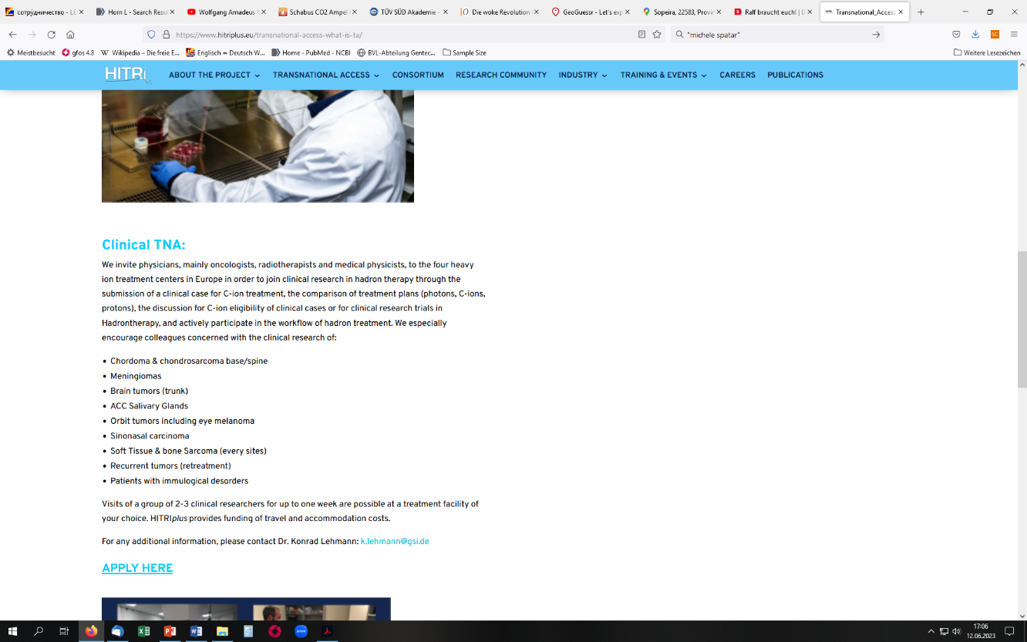
New modality of clinical research TNA
Following the suggestions of the advisory committee, as of February 2023:
Call for applications by radiotherapists / oncologists
Visits to radiotherapy facilities by teams of physicians
Getting acquainted with treatment planning, work flow, potential of hadron therapy
No patient required, only submission of clinical case for discussion

Slide 15
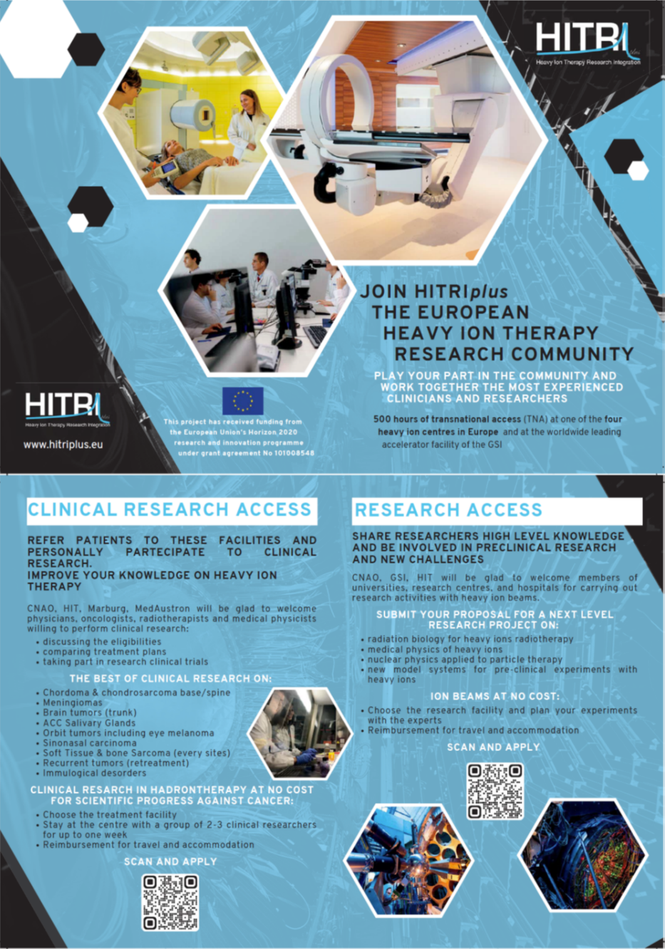
Dissemination
New flyer distributed at conferences
Active recruitment by staff physicians through personal contact
Call published on HITRI+ website

Slide 16
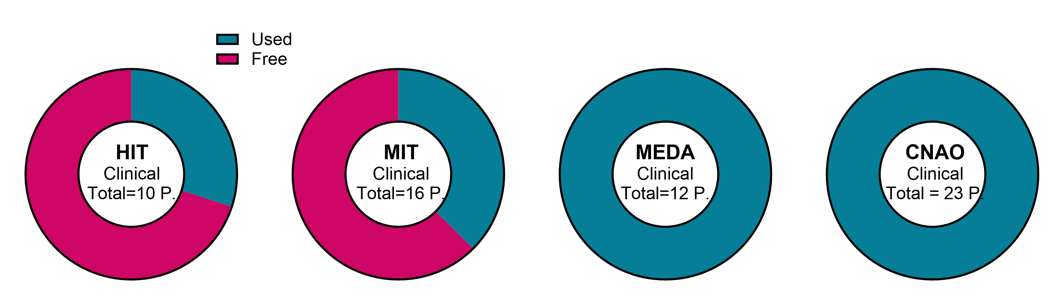
Clinical TNA use

Slide 17
Clinical research TNA applications
Applicant | Affiliation | Country | Host | Decision | # visitors
Ioannis Boukovinas | Thessaloniki | Greece |  | no | patient
Rogelio Robaina Escobar | AEPROT | Spain | CNAO | yes | 1
Erika Korobeinikova | Hospital of Lithuanian University of Health Sciences | Lithuania | CNAO | yes | 3
Renata Zahu | Amethyst Radiotherapy | Romania | CNAO | yes | 2
Maria Topalidou | Papageorgiou General Hospital | Greece | CNAO | yes | 3
Ghizela Ana Maria Salagean | University of Babes Bolyai Cluj Napoca | Romania | CNAO | yes | 2
Juliette Thariat | Centre Baclesse | France | CNAO | yes | 1
Zsolt Cselik | Veszprém County Hospital | Hungary | MedAustron | yes | 1
Alexandra Kolenova | National Institute of Children's Diseases | Slovakia | MedAustron | yes | 1
Ana Perpar | Institute of Oncology Ljubljana | Slovenia | MedAustron | yes | 2
Katalin Hideghety | University Szeged, Department Oncotherapy | Hungary | MedAustron | yes | 1
Daniel Koffler | Mayo Clinic Florida | USA | MedAustron | yes | 1
Roy Holland | Rambam Health Care Campus | Israel | MedAustron | yes | 2
Remi Nout | Erasmus MC, University Medical Center Rotterdam | Netherlands | CNAO | yes | 3
Linh Tran | Wollongong University | Australia | MedAustron | yes | 1

Slide 18
Clinical research TNA applications
Applicant | Affiliation | Country | Host | Decision | # visitors
Edib Avdic | Cantonal hospital Zenica, Bosnia and Herzegovina | Bosnia-Herzegovina | CNAO | yes | 2
Patient 1 (clivial chordoma) | - | Greece | MIT | yes | 3
Patient 2 (clivial chordoma) | - | Greece | MIT | yes | 3
Leor Zach | Tel Aviv University | Israel | CNAO | yes | 1
Sarah Al-Hamami | Proton Therapy Centre Czech | Czech Republic | CNAO | yes | 3
Divya Khosla | Postgraduate Institute of Medical Education and Research (PGIMER), Chandigarh | India | CNAO | yes | 1
Subrat Kumar Giri | DR MGR Medical University | India | CNAO | yes | 1
Petra Stefková | Východoslovenský onkologický ústav a.s. | Slovakia | MedAustron | yes | 1
Eyal Fenig | Davidoff Comprehensive Cancer Center, Rabin Medical Center, Beilinson | Israel | MedAustron | yes | 1
Eneida Mataj | Università degli Studi di Brescia | Italy | HIT | yes | 1
Federica Piciche | IRCCS Ospedale Policlinico San Martino - Universita´ degli Studi di Genova (DISSAL) | Italy | HIT | yes | 1
Sajal Kakkar | Max Super Speciality Hospital | India | MedAustron | yes | 1

Slide 19
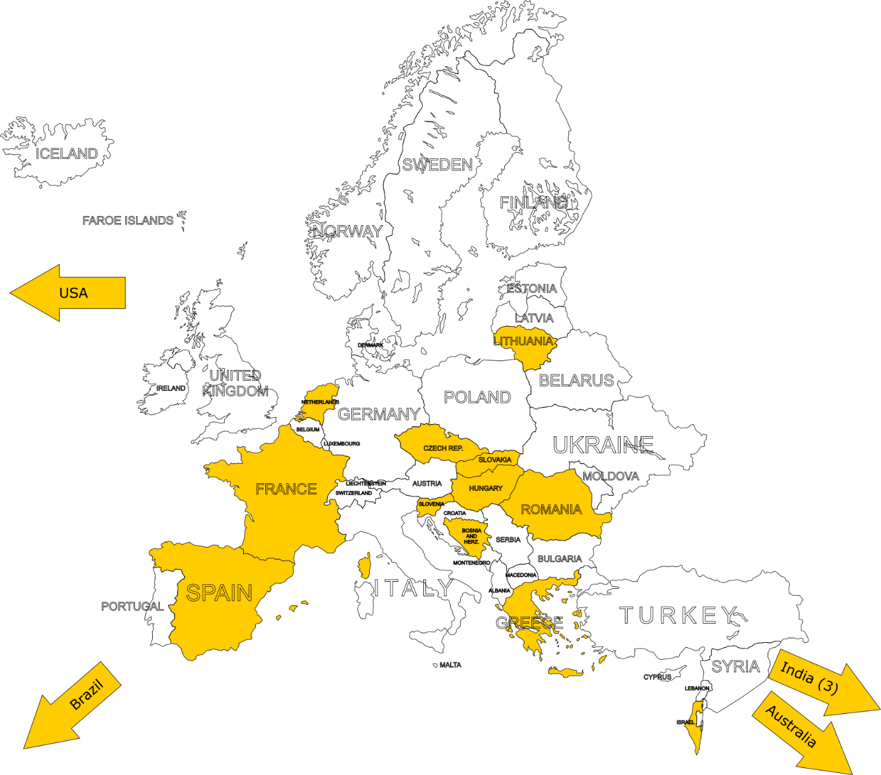
Countries of origin for clinical research TNA
14 applications from 12 different countries
Notable focal point on SEE:
Czech Republic
Slovakia
Hungary
Slovenia
Romania
Greece
(Lithuania)

Slide 20
Summary
Research TNA:
  High demand, which generally exceeds offer.
  Redistribution of hours from GSI to HIT and CNAO was a flexible and efficient solution to problems with beamtime availability at GSI.
  Applications reflect a very multifaceted research field.
Clinical research TNA:
  New modality of informative visits has met with great success.
  28 applications with a total of 44 visitors have been accepted during the reporting period.
  Personal commitment and communication by local staff plays a central role.
General:
  TNA is a successful tool for research promotion, networking and integration of the field.
  Constant reflections and adaptations are necessary.

Slide 21
THANK YOU VERY MUCH!

