Slide 1
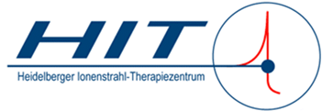
Hadrontherapy Workshop - From Innovation to Implementation
Particle Therapy Experience on Central Nervous System Tumors
Tanja Eichkorn
Heidelberg Ion Beam Therapy Center (HIT)
University Hospital Heidelberg
Dept. of Radiation Oncology

Slide 2
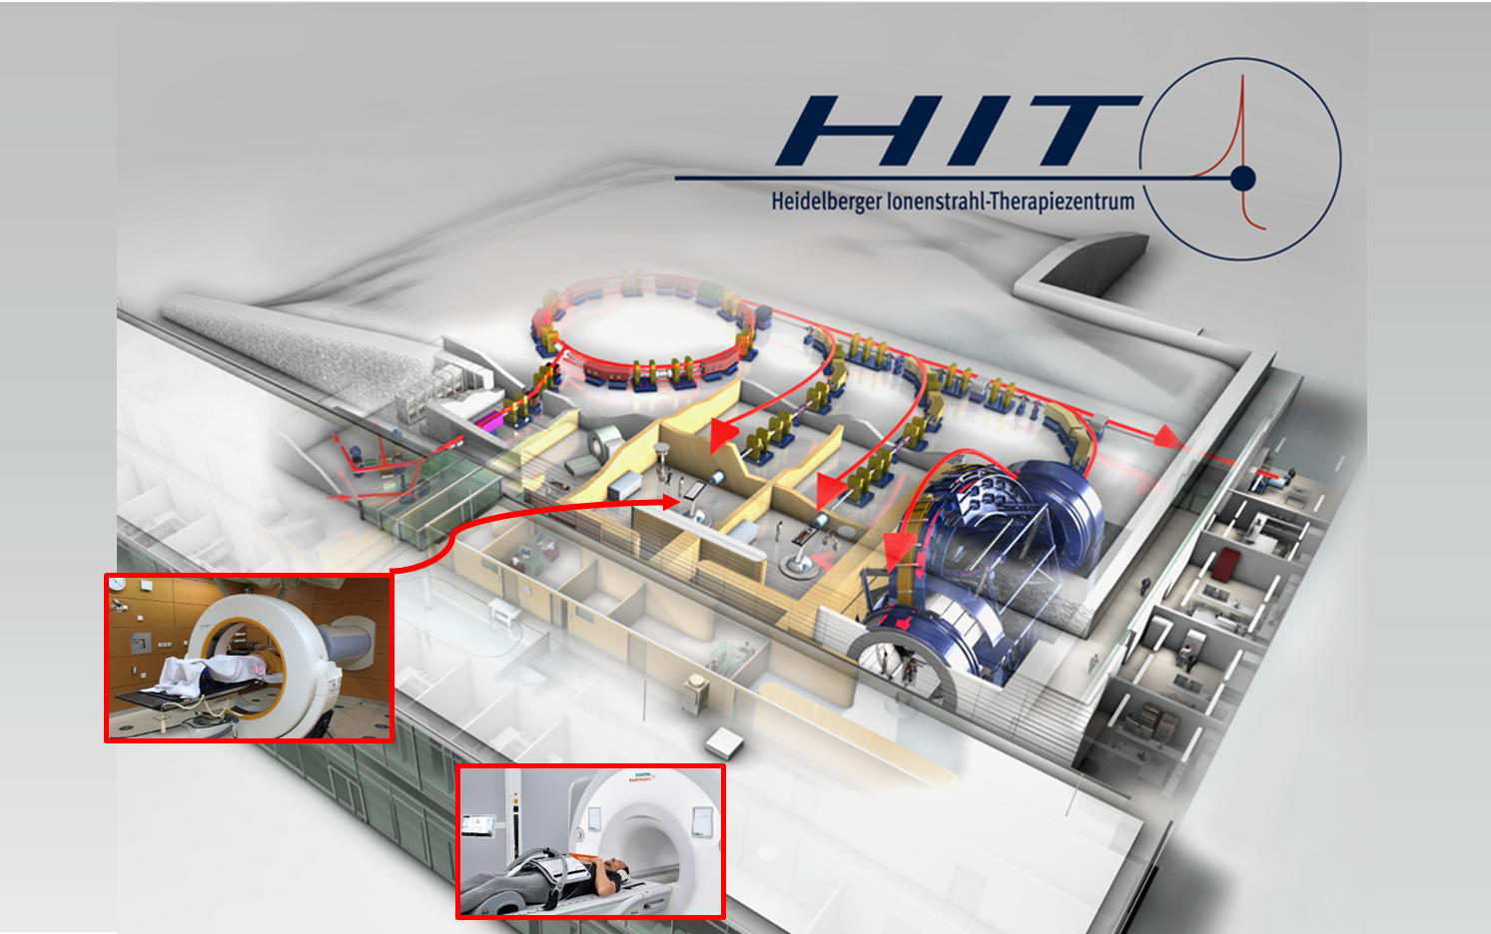
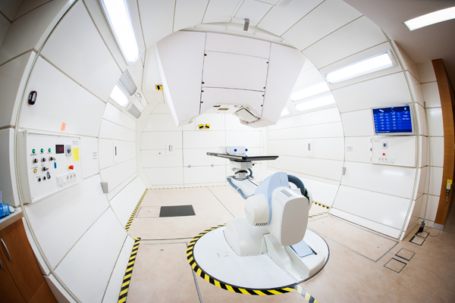
Ion sources:
Protons
Carbon ions
Helium ions
experimental:
Oxygen ions
Ion type change: ~10 sec
Synchrotron
Experimental Beam and Laboratories
In room CT
2 treatment rooms
horizontal beam
1,5 T MRT
Research
Gantry treatment room since 2012
360° rotatable
670 tons weight
©HIT
Notes:
Integrierter Arbeitsablauf mit konventioneller RT: Protokolle, Akte
H1 und C12 am Horizontalstrahl seit 11/2009; Gantry seit 10/2012
Biophysikalisch etabliert – klinische Evidenz?
2

Slide 3

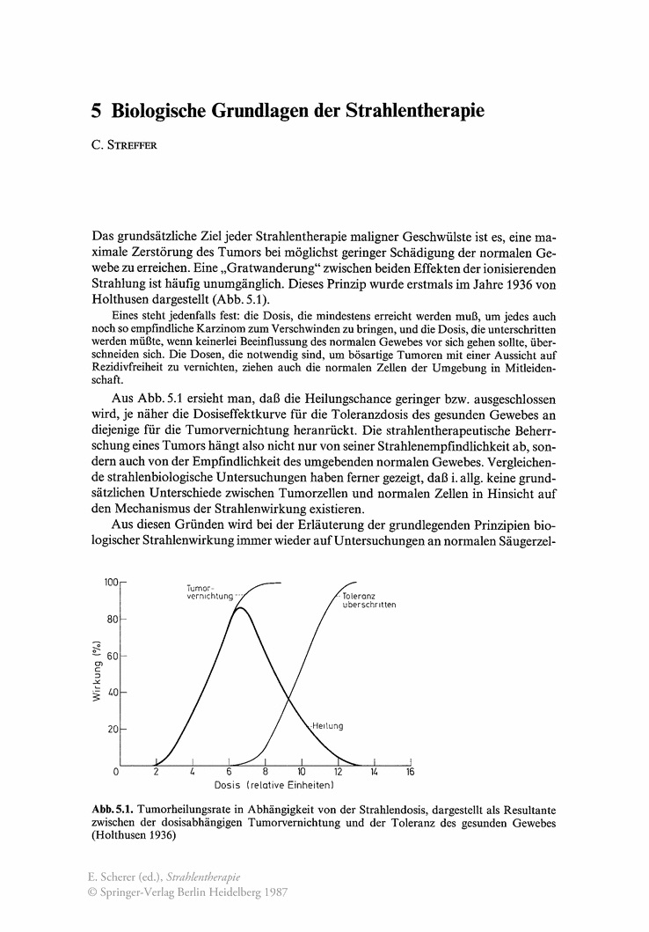
dilemma in oncology
TUMOR
NORMAL
TISSUE
-> eradication of
all tumor cells
-> achieving local control
-> improving survival
-> protection of surrounding
healthy tissue
-> organ preservation
-> reducing late sequelae

Slide 4
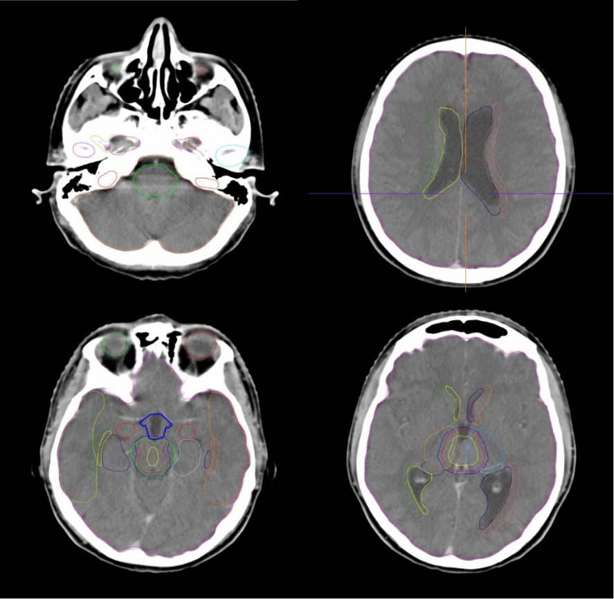

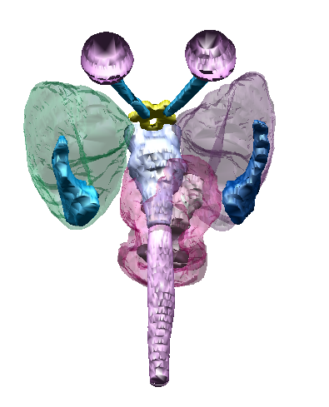
rationale of hadron therapy for brain tumors
potential sequelae
Secondary malignancies
Visual impairment / loss of hearing
Quality of life ↓
Hypopituitarisms
neurocognitive function ↓

Slide 5
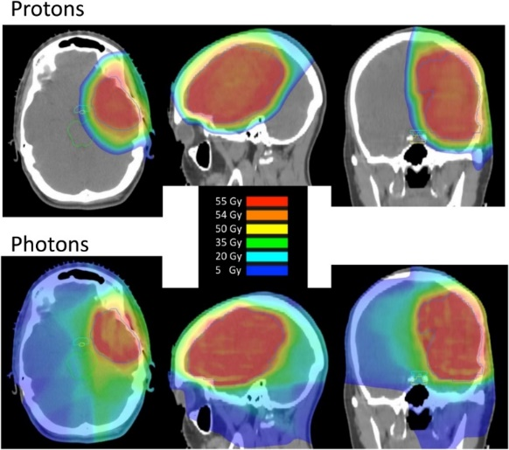
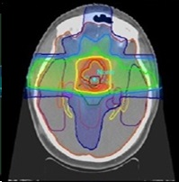
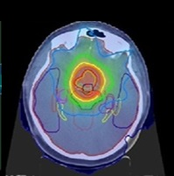
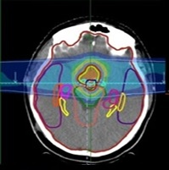
quantification of the dosimetric potential
C
C
C
3D-CRT
VMAT
protons
Shih et al Cancer (2015) 121(10):1712-9

Slide 6
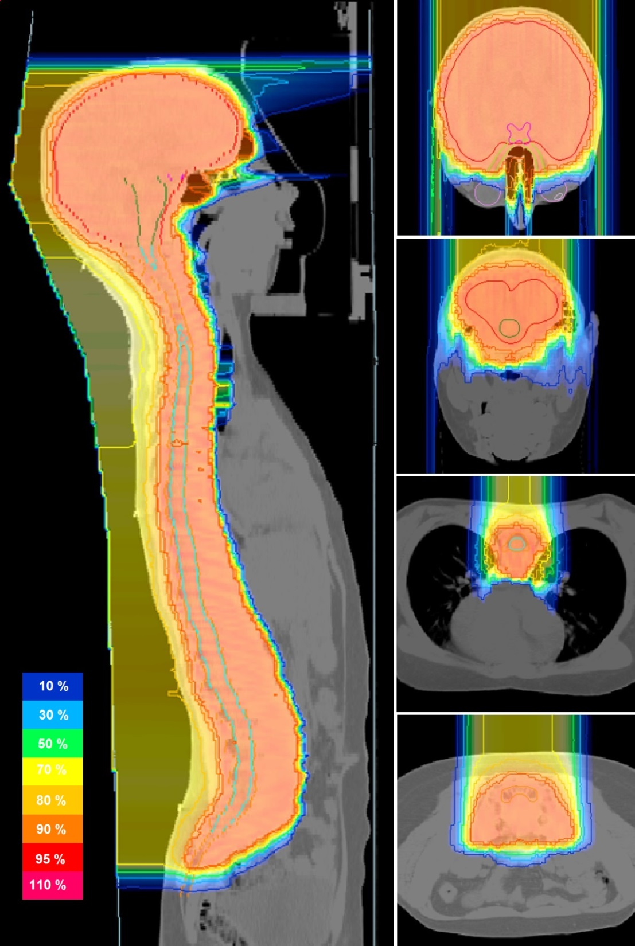
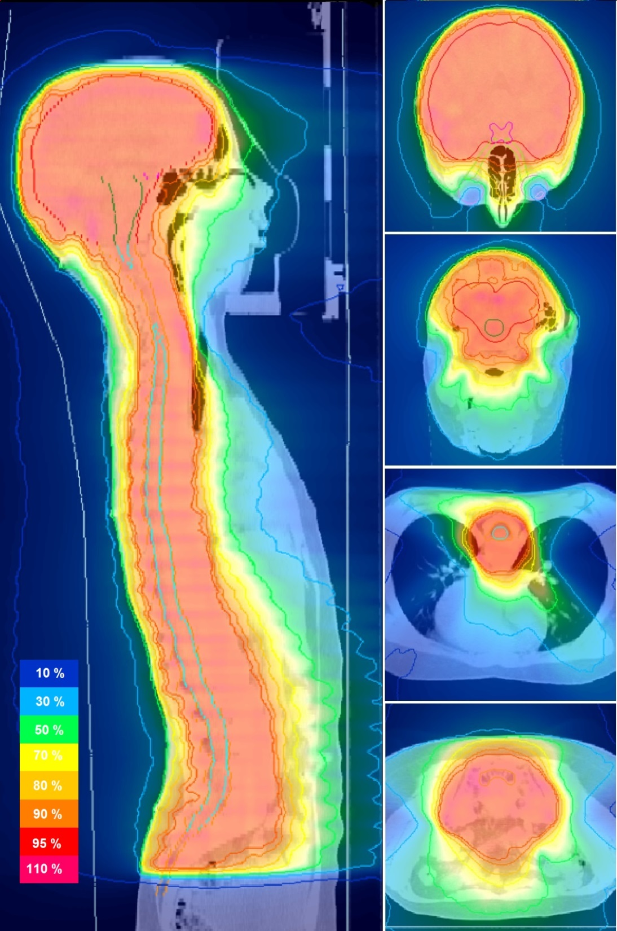
protonen
photons

Slide 7
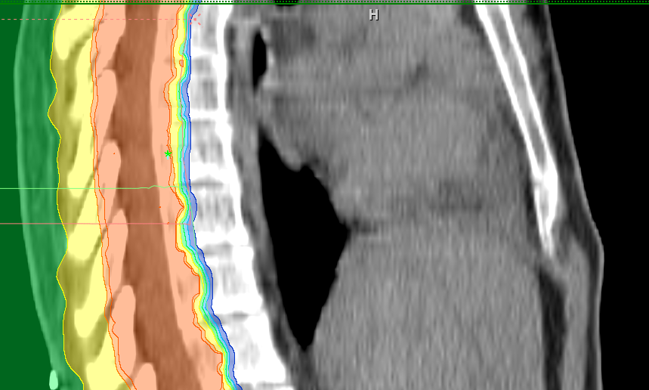
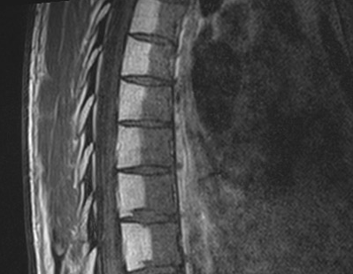
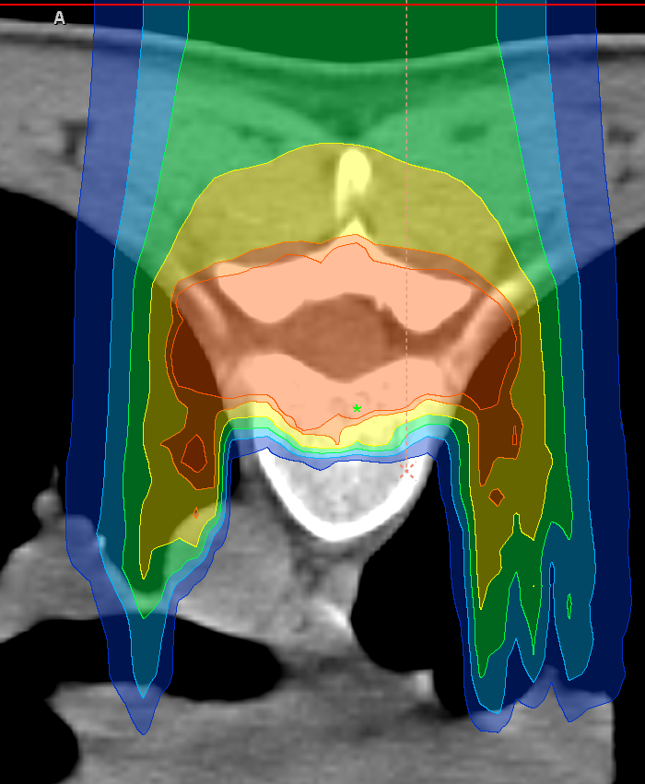
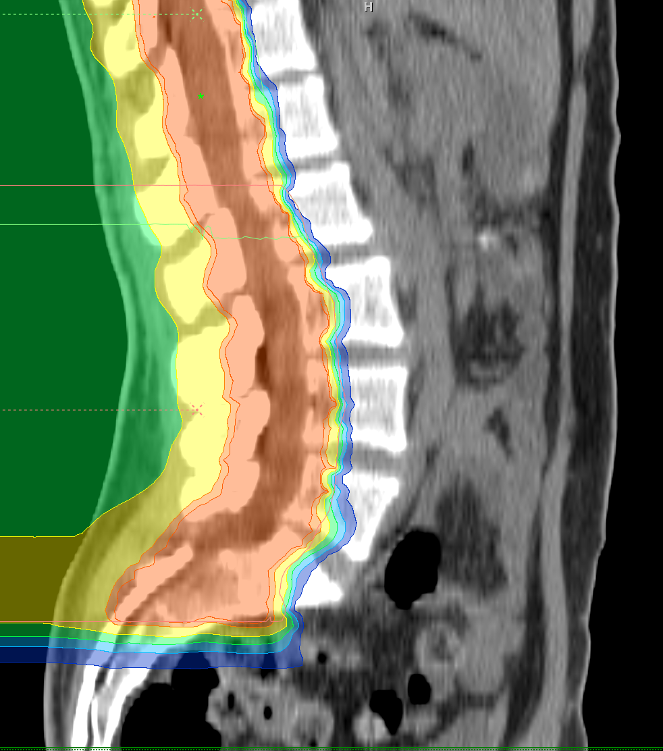
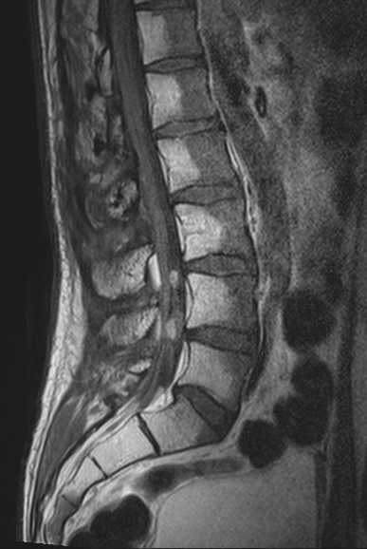
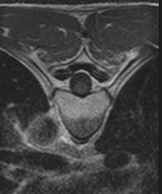
clinical outcome
Treatment plan dose distribution
T1-weighted MRI
Fatty changes
in irradiated part
of vertebral bodies
~6 month
after
Proton RT
Proves entire treatment chain, incl. patient positioning, beam application

Slide 8
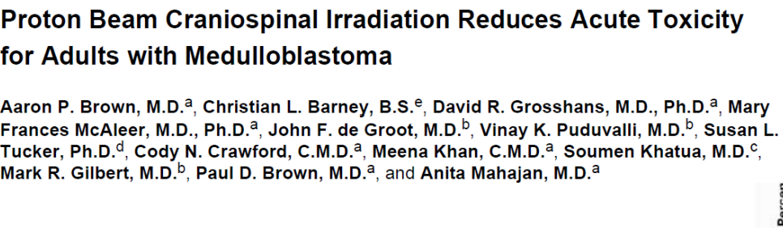
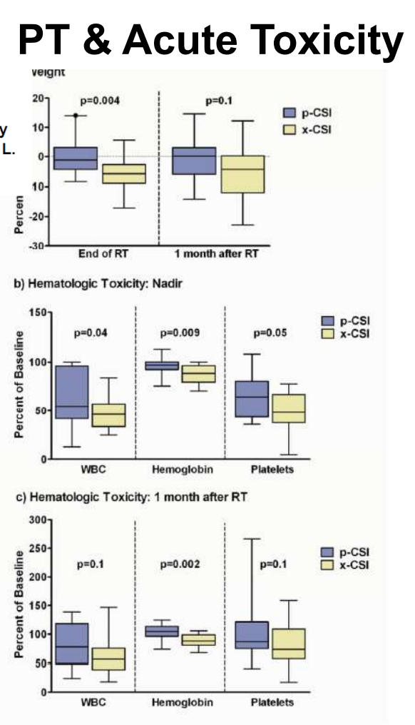
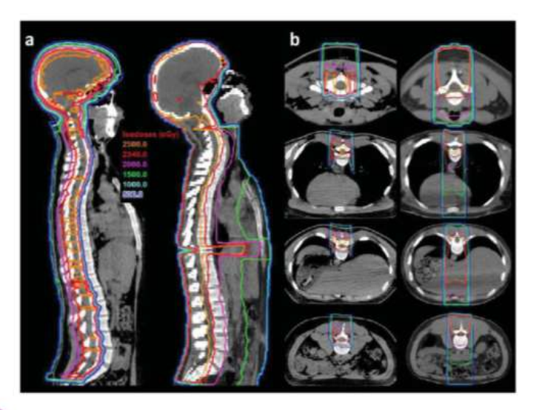
clinical outcome

Slide 9
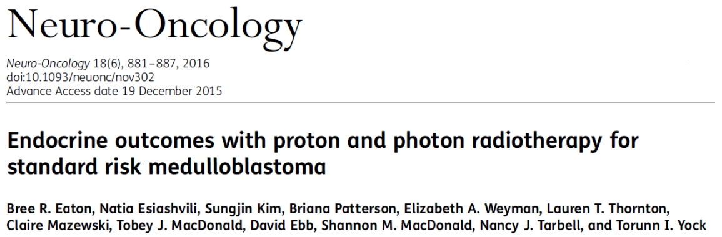
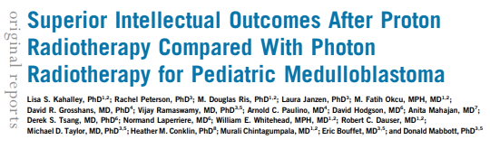
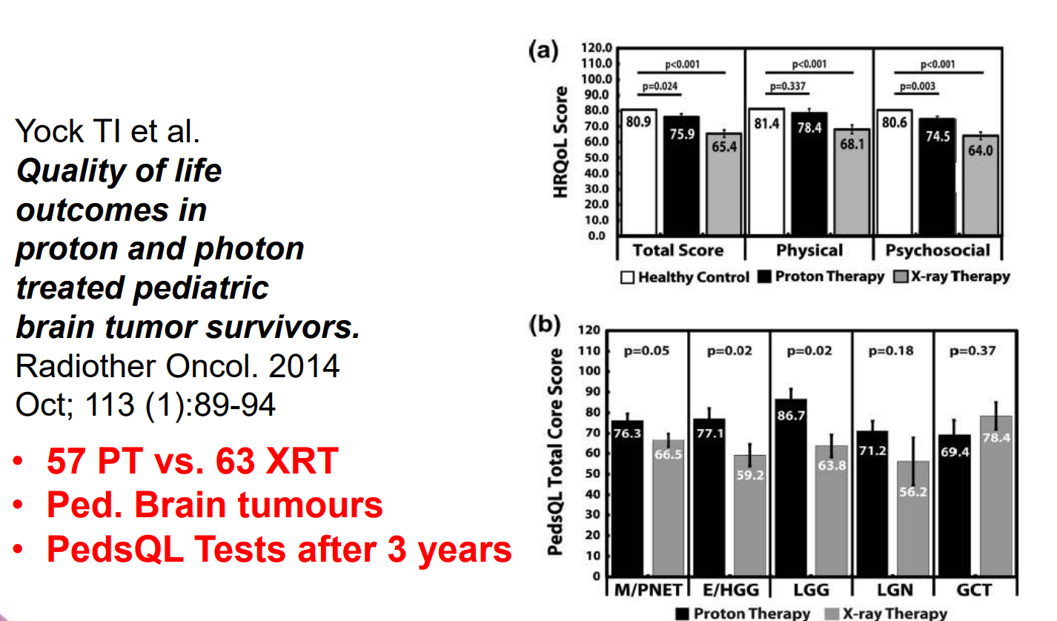
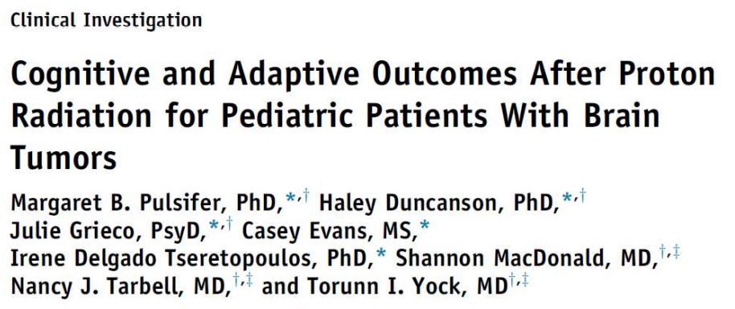
clinical outcome

Slide 10
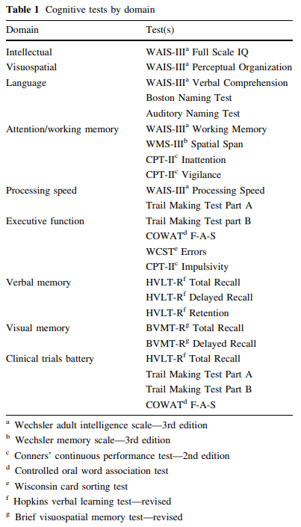
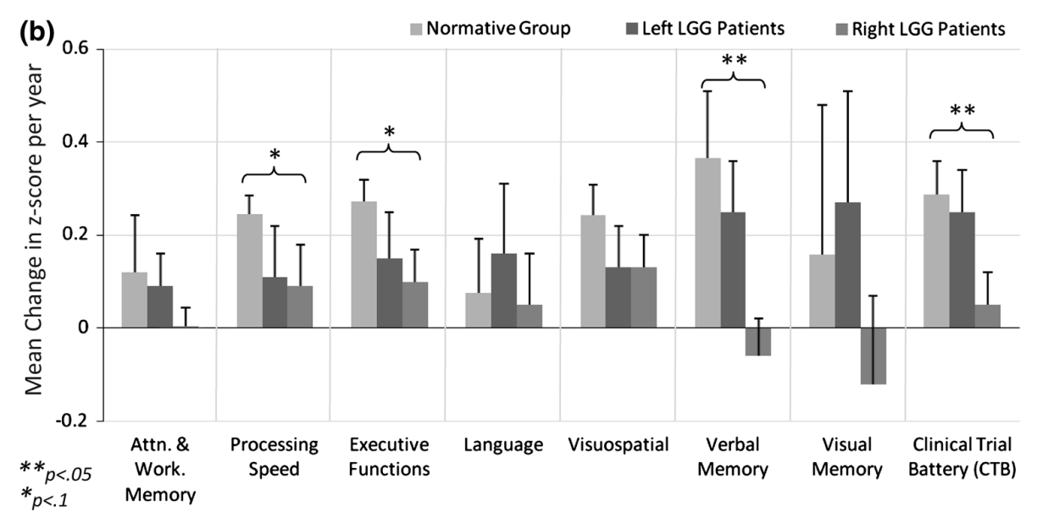
Neurocognitive effects of proton radiation therapy in adults
with low-grade glioma
20 adult patients with LGG, median f/u 5 years, 5-year OS 84%
Indication for PBT: age > 40 years, GTV > 6 cm, progression
54 Gy RBE in 30 fractions, CTV-margin 15 mm
stable cognitive function
Shermann 2016
Notes:
MGH, left sided tumors more baseline impairment but also more improvement

Slide 11
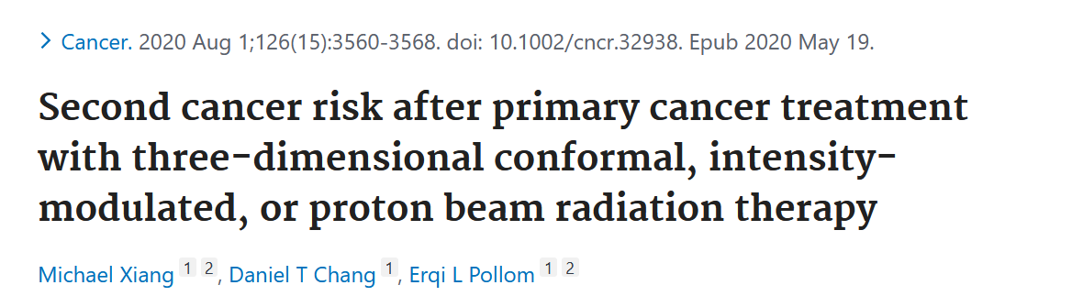
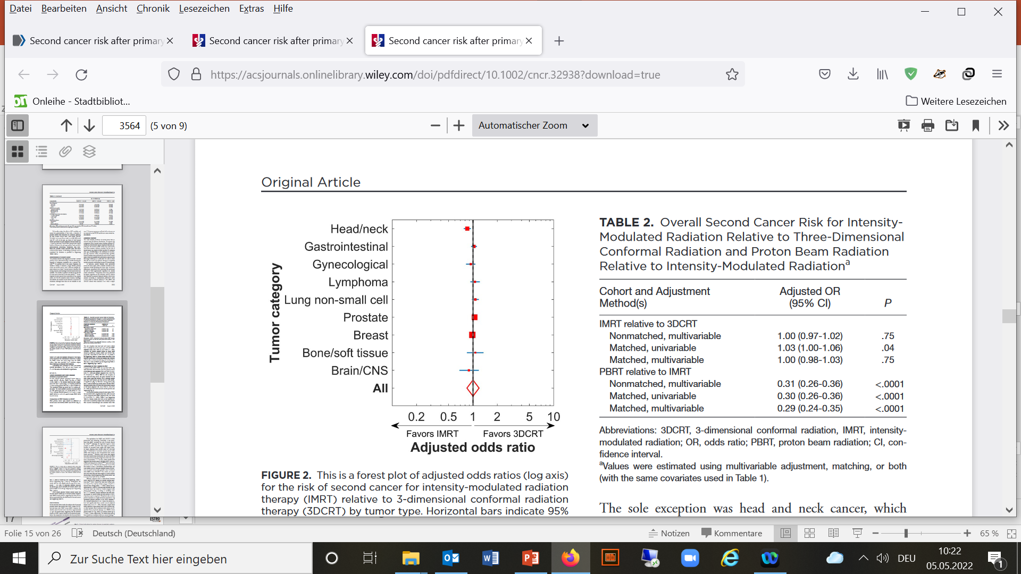
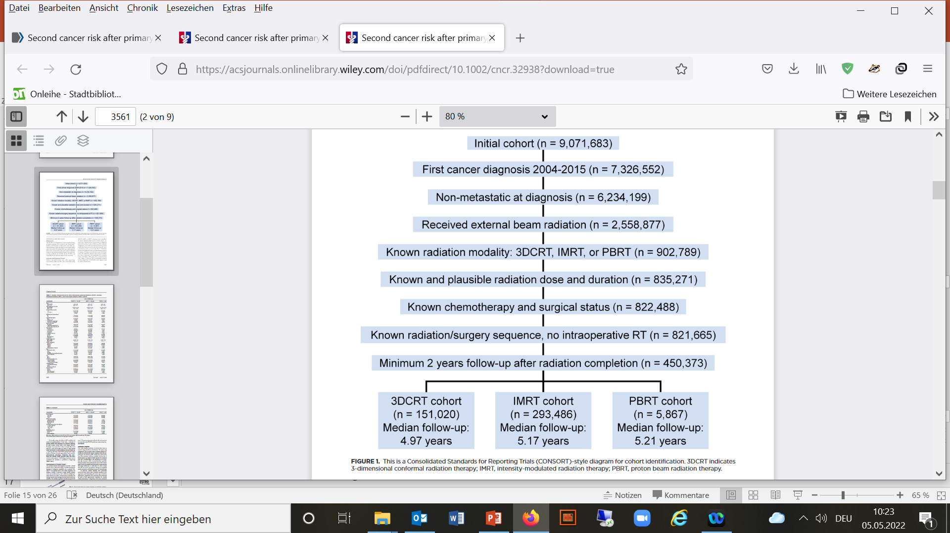
clinical outcome
Evidence for less 2nd malignancies

Slide 12
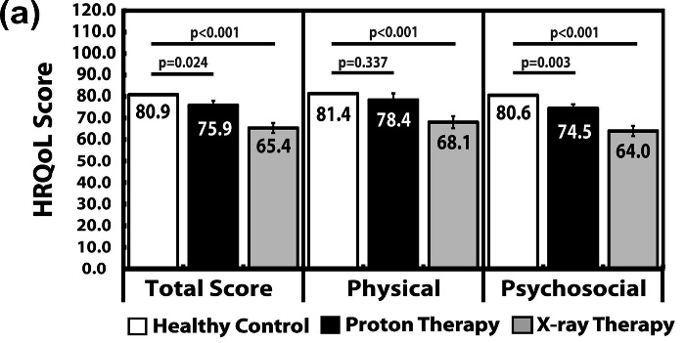
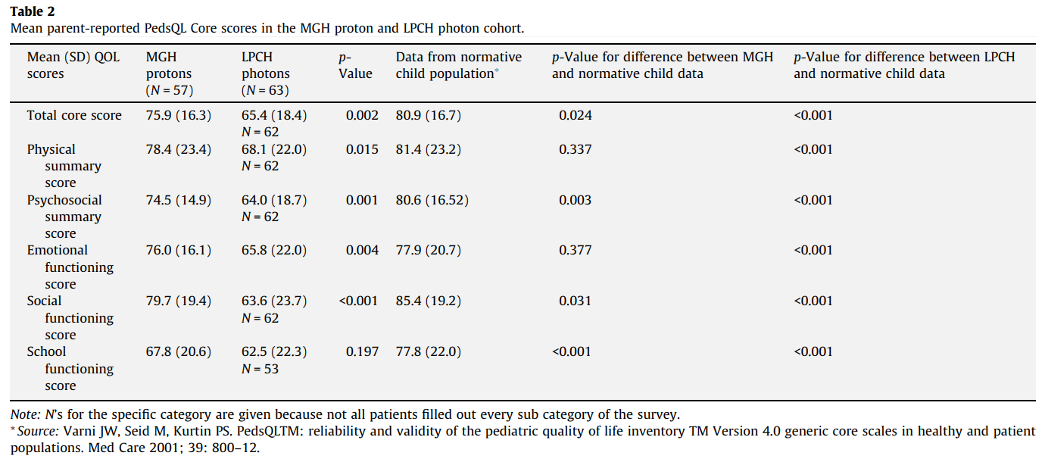
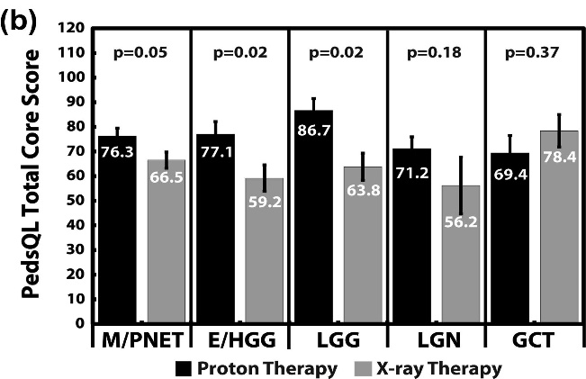
Quality of life outcomes in proton and photon treated pediatric brain tumor survivors
120 patients, PRT or XRT, median age 7 years, HRQoL after 3 years
>50% MDB and HGG, RT dose 50–54Gy, 53–70% CHT
Yock 2014
Notes:
MGH

Slide 13
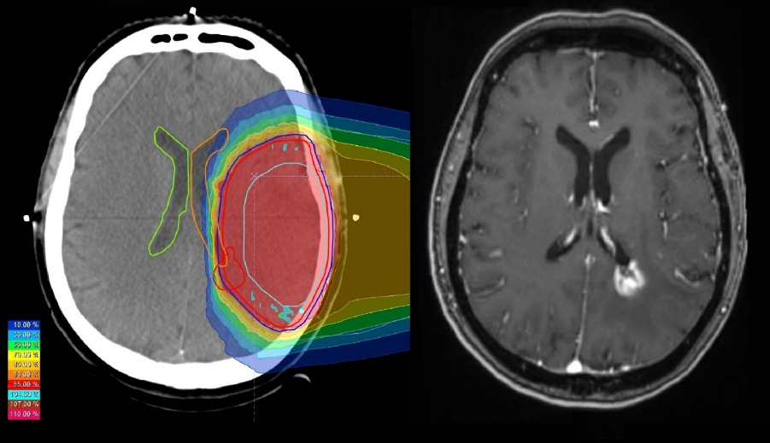
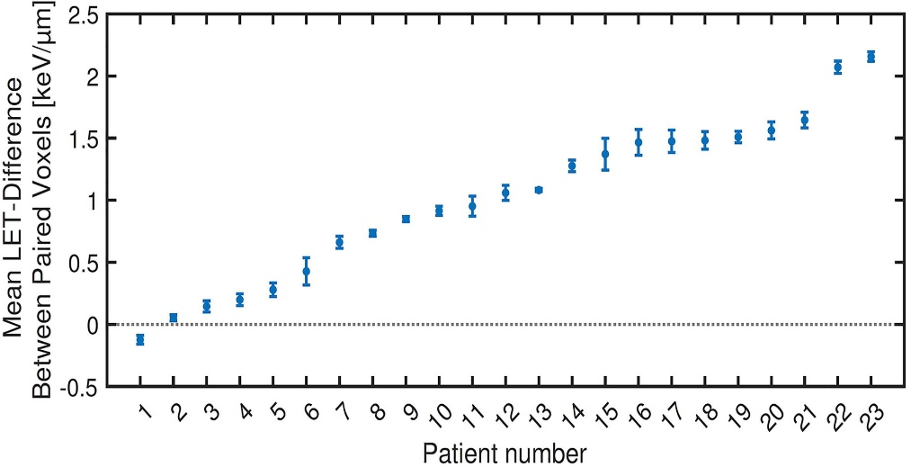
Radiation induced contrast enhancement after proton beam therapy in patients with LGG – How safe are protons?
110 patients with LGG treated with PBT, >1200 MRIs, median f/u 39 months, 7-year-OS 90%
Distinct spatiotemporal pattern of RICE suggests intrinsic radiation sensitivity of ventricular border
Voxel-level based analysis revealed correlation between increased LET and origin of RICE
Findings provide clinical evidence that protons have variable RBE and a fixed factor of 1.1 is inappropriate
Harrabi 2022

Slide 14
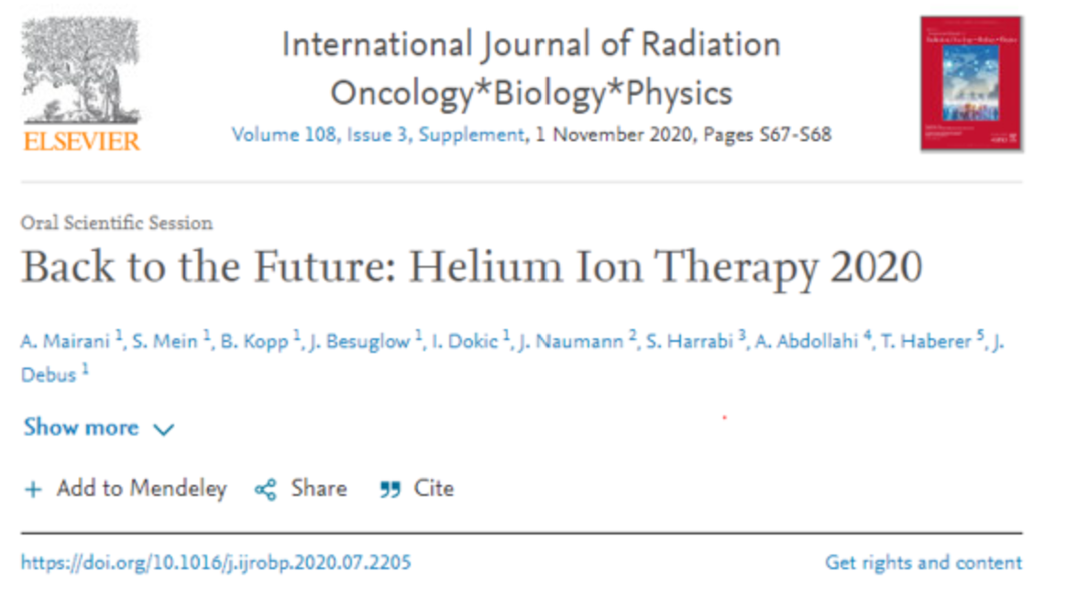
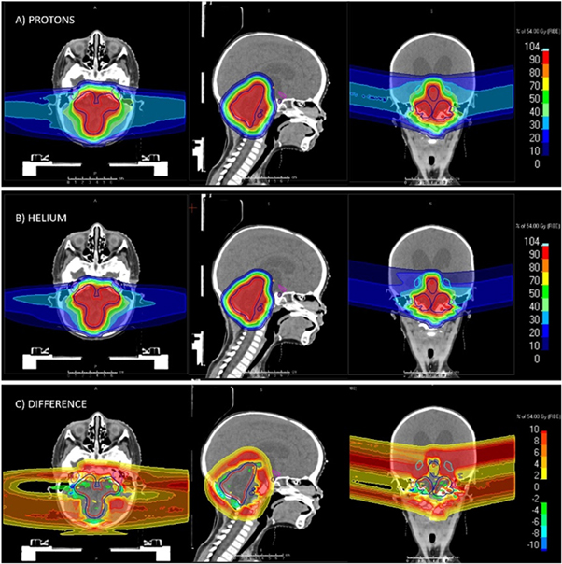
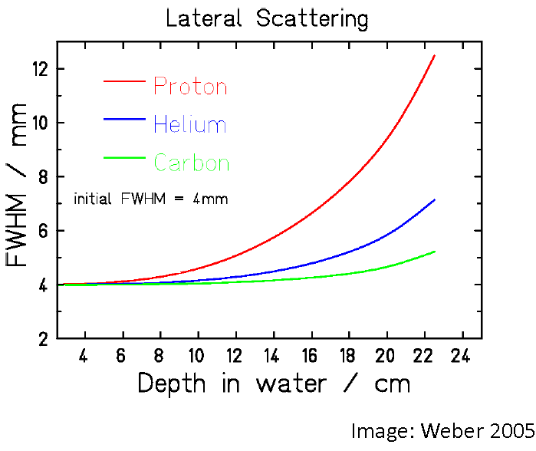
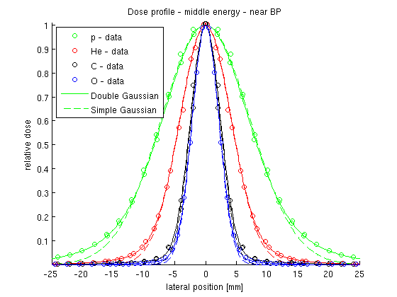

Slide 15
summary
hadron therapy is very important not only for the treatment of pediatric cancer
accepted as standard
alternative to photons
growing evidence of
clinical benefit
increasing availability & use (Europe/worldwide)
different physical properties:
  Steep dose gradient
  Less entry dose
  No or less exit dose
sparing of normal tissue -> less acute and long term toxicity
treatment of otherwise untreatable tumors
dose escalation possible -> improved local control and survival

Slide 16
