Slide 1
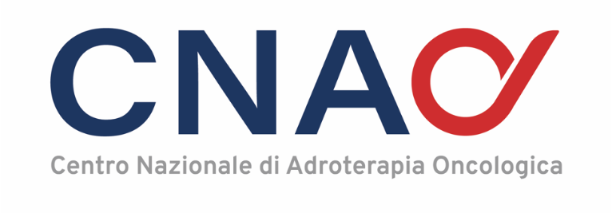
PARTICLE THERAPY EXPERIENCE ON PEDIATRIC PATIENTS
Project meeting and hadrontherapy workshop from innovation to implementation
24-25 MARCH 2025, PODGORICA
Francesca colombo, MD
Radiation oncologist
Fondazione CNAO, Italy
Notes:
Good morning everyone, today I am going to talk to you about particle therapy in paediatric patients.

Slide 2

OVERVIEW
Childhood cancer is a rare disease
It is estimated that in 2022 in Europe:
  > 9 thousand children aged 0 to 14 years were diagnosed with cancer
  > 1.6 thousand died from cancer
  → approximately a quarter of all deaths in children are due to cancer
Eurostat - Being young in Europe today (2020)
ECIS - European Cancer Information System
Notes:
Although paediatric cancers are considered a rare disease, a quarter of all childhood deaths are due to cancer.
It is estimated that in 2022, more than nine thousand children between the ages of 0 and 14 were diagnosed with cancer in Europe and more than 1,600 children died of cancer.

Slide 3
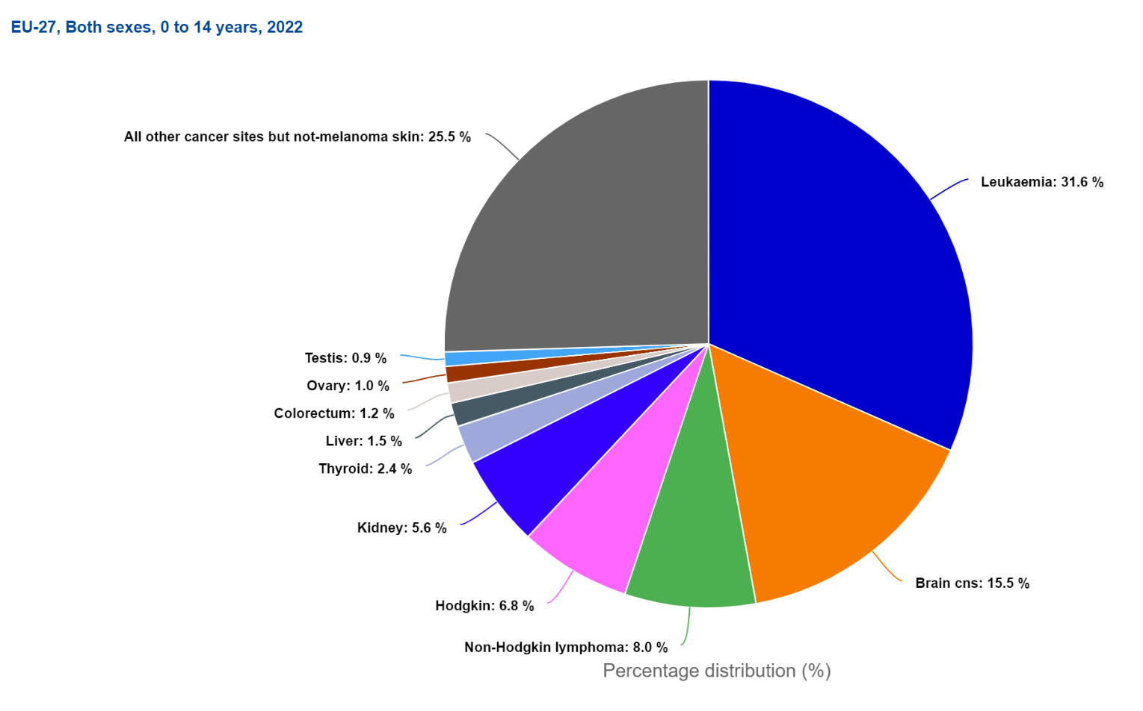
The most common cancer diagnoses among children between 0 to 14 years were:
Leukaemias
cancers of CNS
lymphomas
But there are more than 60 different paediatric malignancies.
Source: ECIS - European Cancer Information System
Notes:
The most commonly diagnosed tumours in children are leukaemias, CNS tumours and lymphomas, but around 40% of deaths are due to CNS tumours.

Slide 4
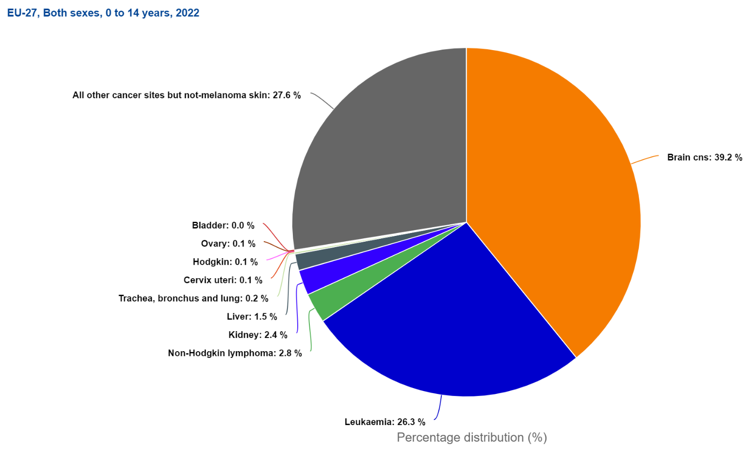
Nearly 40% of cancer deaths were due to CNS tumors.
Source: ECIS - European Cancer Information System

Slide 5
The 5-year survival rate is 81%, an from previous years.
Cure rates range from 99% for retinoblastoma to 60% for CNS tumours.
Increased survival rates lead to an increase in the number of long-term survivors
+ 500,000 childhood cancer survivors in Europe
Greater interest in: LATE TOXICITY and QoL
Neurological deficits
Neurocognitive decline
Endocrinopathies
Growth alterations
Hearing-Visual loss
Vascular deficits
Permanent alopecia
Psycho-social issues
Infertility
Secondary tumours
LATE SIDE EFFECTS
→ The impact of late sequelae not only affects quality of life, but can also influence overall survival
Notes:
Despite everything, these patients have a good outcome, with a 5-year survival rate of 81%, which is higher than in previous years, and with different cure rates depending on histology and site. The improvement in survival rates has led to an increasing number of long-term surviving patients and, consequently, to an increased focus on treatment-related late effects and patients’ quality of life.
The main radiotherapy-related late effects are neurocognitive deficits, growth alterations and endocrinopathies, and depend on the age of the patient at the time of treatment, doses and volumes of radiotherapy and other anticancer treatments.
It is also important to note that the impact of late effects affects not only quality of life, but also overall survival.

Slide 6
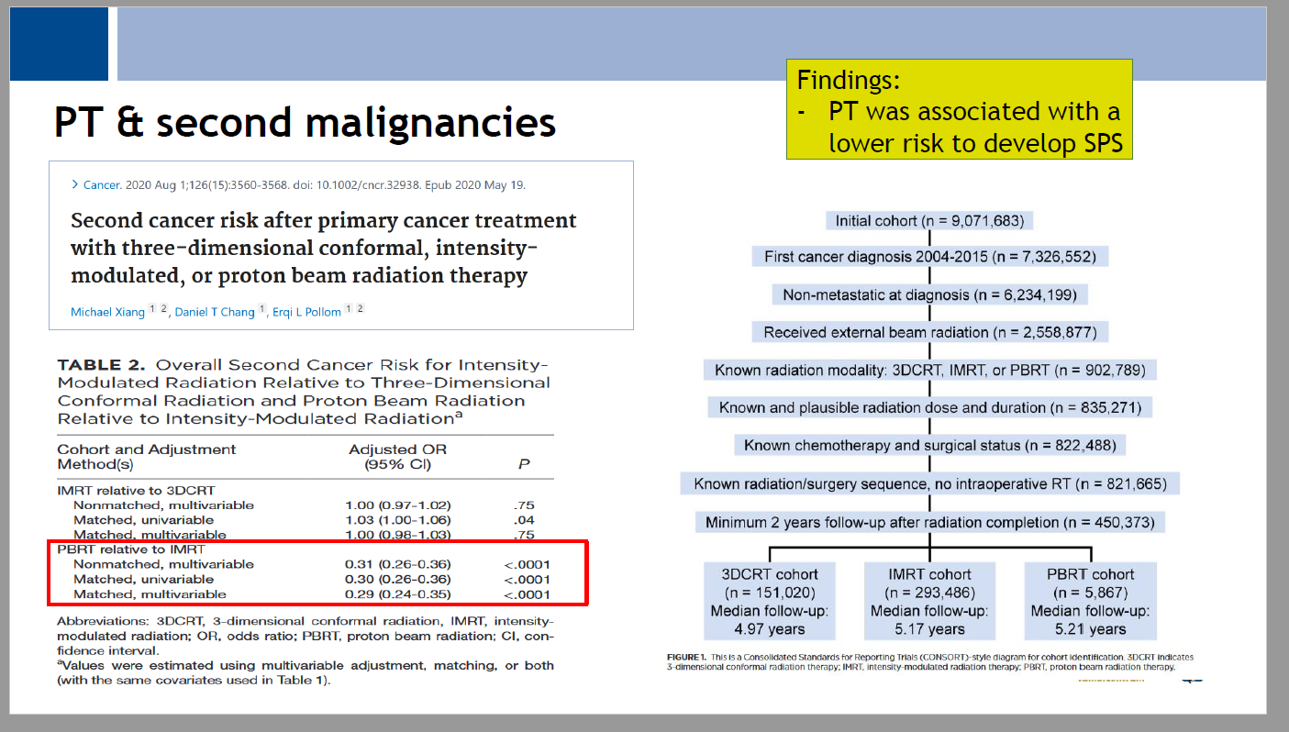
Overall, the incidence of second cancer diagnosis was 1.55 per 100 patient-years.
In a comparison between IMRT versus 3DCRT, there was no overall difference in the risk of second cancer (adjusted odds ratio [OR], 1.00; 95% CI, 0.97-1.02; P = .75).
By comparison, PBRT had an overall lower risk of second cancer versus IMRT (adjusted OR, 0.31; 95% CI, 0.26-0.36; P < .0001).
Notes:
Another important aspect to consider is the risk of second cancers. A study published in 2020 involving more than four hundred and fifty thousand patients treated with 3D, IMRT and protontherapy with a median follow-up of 5.1 years showed that the risk of second cancers was similar between IMRT and 3D, while protontherapy was associated with a lower risk of second cancers.

Slide 7
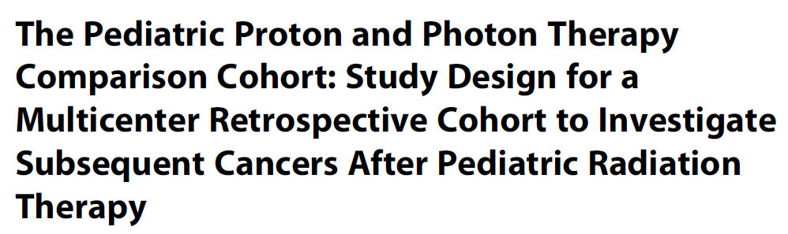
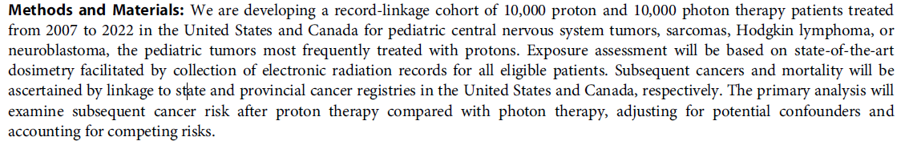
A. Berrington de Gonzalez et al, 2023
Notes:
This is another study involving a very large cohort of patients treated with protons and photons between 2007 and 2022 in the US and Canada. The primary analysis aimed to examine and compare the risk of second cancers in the cohort treated with photons and protons.
We look forward to the results.

Slide 8
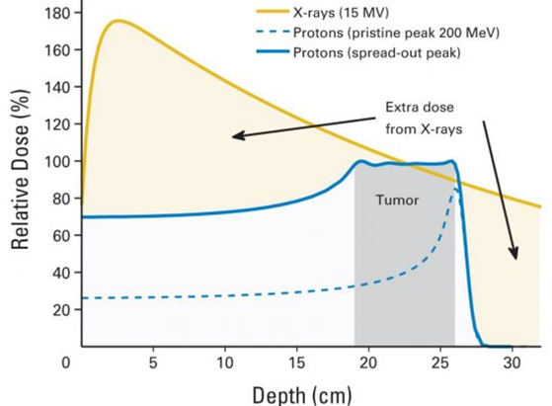
PROTON THERAPY: dosimetric properties and physical selectivity
Dose to OARs
Potential optimization of local tumor probability by increasing dose to the tumor without increasing the dose to OAR.
No changes in dose prescription but reduction of the likelihood of radiation induced toxicity.
Dose escalation to the tumor.
Notes:
I show the Bragg peak only to illustrate that protons, because of their physical and biological properties, allow dose reduction to organs at risk, while maintaining excellent local control of disease and reducing side effects. This can also favour dose escalation to the tumor.

Slide 9
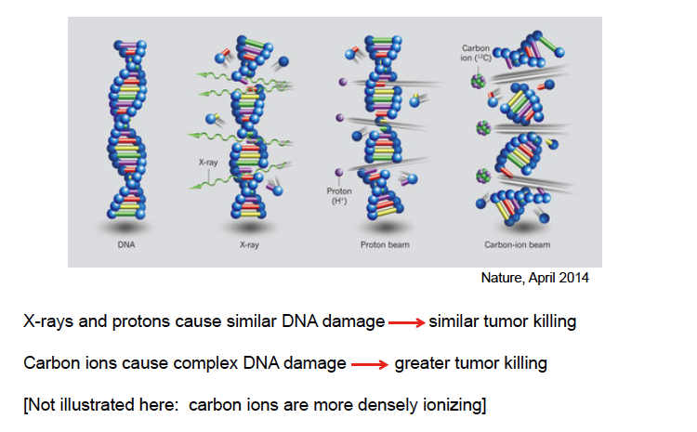
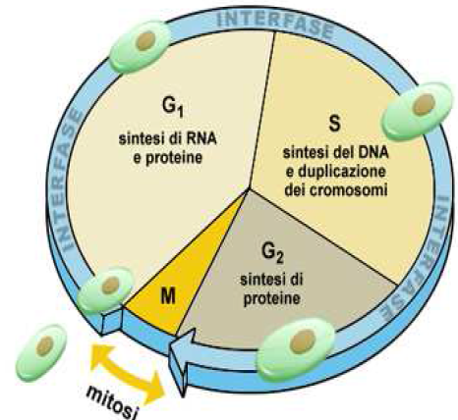
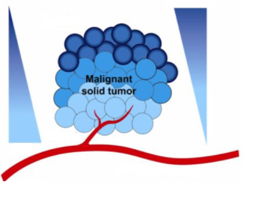
CARBON ION THERAPY: 3Rs (Rare), Radioresistant, Recurrent
1.
C-ions: High Linear Energy Transfer (LET) radiation
X-rays and protons cause similar DNA damage → similar tumor killing → Repair
C-ions cause complex DNA damage → greater tumor killing → No Repair
High radiobiological effectiveness (RBE) → > Effective for radioresistant tumors
2.
Low cell-cycle dependence → increased lethality in the target because cells in radioresistant phase (S) are sensitized
3.
Hypoxia
Low OER → Effective against hypoxic tumor cells
[O₂]
Normoxia
Tinganelli , Cancers, 2020
Notes:
9
In this slide, however, we can see some advantageous features of carbon ions that make it the therapy of choice for rare, radioresistant and recurrent tumours.

Slide 10
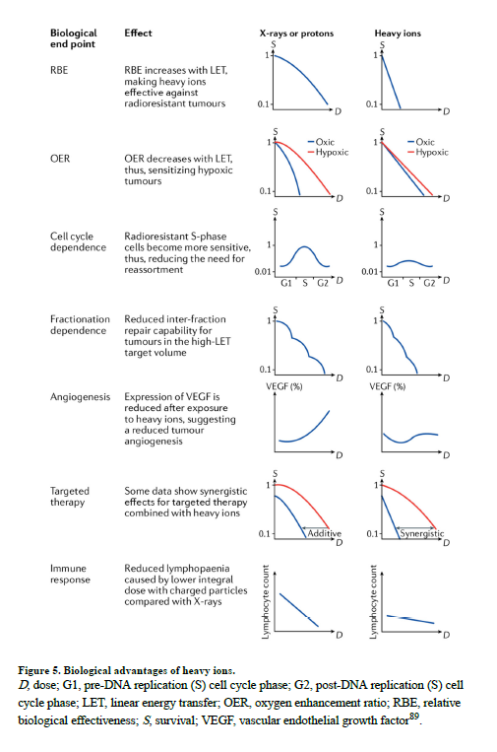
BIOLOGICAL EFFECTS OF PARTICLE THERAPY
The preclinical studies had already demonstrated that, in addition to the increased RBE for cell killing, heavy ions have:
reduced oxygen enhancement ratio (OER),
reduced dependence from the cell cycle phase
reduced dependence on dose rate or fractionation.
More modern observations have shown:
reduced angiogenesis,
as well as synergistic effects in combination with targeted therapy and immunotherapy.
Most of the patients are treated with protons, but heavy ions present additional biological advantages.
Durante M, 2021
Notes:
The characteristics of carbon ion are best described in the publication by Durante et al, who suggest that preclinical studies had already shown that in addition to an increased RBE for cell killing, heavy ions have: reduced oxygen enhancement ratio (OER), reduced dependence on cell cycle phase, reduced dependence on dose rate or fractionation. More recent observations have also shown: reduction of angiogenesis and synergistic effects in combination with targeted therapies and immunotherapy.

Slide 11
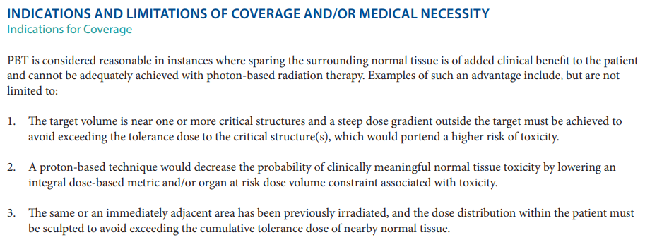
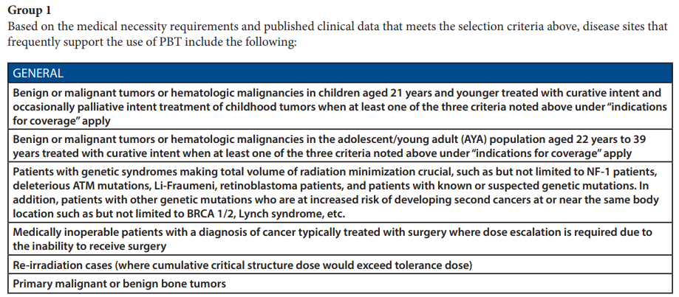
CLINICAL INDICATIONS FOR PARTICLE THERAPY
Consequently, PT is increasingly used worldwide:
for all pediatric cancers
with a high priority for very young children
in curative scenarios
If very high doses are necessary
ASTRO Proton Beam Therapy Model Policy 2022
Notes:
As a result, the use of particle therapy, especially proton therapy, is increasing worldwide for all childhood malignancies, with a higher priority for very young children and with curative intent.
Below you will find the ASTRO indications for which proton therapy is considered reasonable when healthy tissue cannot be adequately spared with photon therapy. Specifically, proton therapy is recommended for the treatment of neoplasms in patients under 21 years of age with curative and occasionally palliative intent, for the curative treatment of neoplasms in young adult patients, in cases where dose escalation is required, and in cases of genetic syndromes or bone tumours.

Slide 12
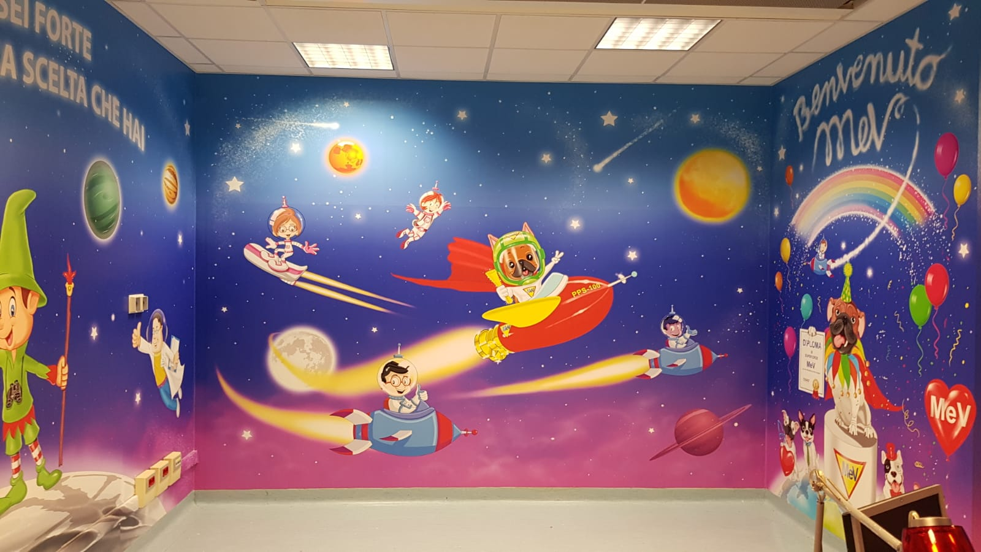
CLINICAL INDICATIONS FOR PROTON THERAPY
An international survey found that in children, PT was most commonly used for treating CNS tumours, followed by extracranial sarcomas, neuroblastomas, and haematopoietic tumours. (N. Journy et al, 2019)
SNC Tumors
  Craniopharyngioma
  Glioma (Low-grade glioma, Optic pathway glioma)
  Germ cell tumors
  Medulloblastoma-PNET
  Ependymoma
  ATRT
  CNS sarcoma
Skull Base Tumors
  Chordoma/chondrosarcoma
Soft tissue and Bone Tumors
  Rhabdomyosarcoma
  Ewing’s tumor
  Osteosarcoma
  NRSTS
Head and Neck Tumours
Retinoblastoma
Neuroblastoma
Lymphoma
Re-RT
Historically radio-resistant tumors
  Increase the proportion of long-term survivors
Tumors that respond favourably to RT → Maintain favourable outcome and improve QoL
CSI → Complex and large volumes
Notes:
On the slide you can see the main indications for proton therapy.
An international survey found that in children, PT was most commonly used for treating CNS tumours, followed by extracranial sarcomas, neuroblastomas, and haematopoietic tumours
Specifically, we will talk about craniopharyngioma, intracranial germ cell tumours, rhabdomyosarcoma and neuroblastoma, which are the most common histologies treated in our centre, and finally we will talk about craniospinal irradiation, which will be one of the main indications.
The slide shows the main indications for proton therapy in paediatrics. Those in bold represent the most common pathologies treated at our centre. The expansion project shown above, with the installation of the gantry, will allow the treatment indications to be further expanded and, in particular, to allow craniospinal irradiation, which is indicated for pathologies with a risk or presence of dissemination at the level of the craniospinal axis and for which, as can be seen in the image, proton therapy has a clear advantage in terms of dose reduction to the organs located anterior to the spine.

Slide 13
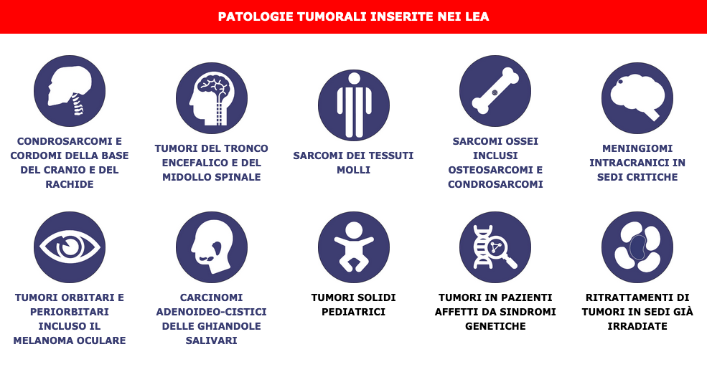
WHAT ABOUT ITALY?
Notes:
In Italy, the treatment of pediatric tumors with hadron therapy is included in the LEA (Essential Levels of Care), which represent the services provided free of charge to all citizens by the National Health Service.

Slide 14
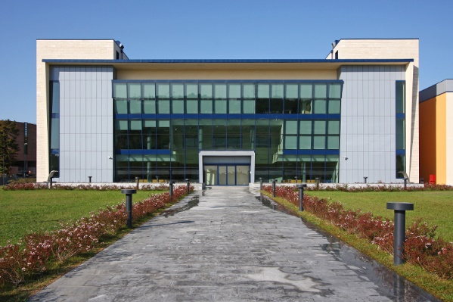
CNAO EXPERIENCE - Paediatric patients
Età media: 11,8 anni (1-29 anni)
Notes:
At CNAO, we have seen an increase in the number of pediatric patients treated over the last 3-4 years. Currently, we treat about 60 patients per year, a quarter of whom undergo treatment under general anesthesia.

Slide 15
Histologies | n°
Neuroblastoma | 5
Neuroblastoma olfattorio | 2
Germinoma | 6
Craniofaringioma | 7
LGG | 5
Rabdomiosarcoma | 9
Carcinoma rinofaringe | 1
Cordoma | 2
Ependimoma | 5
Sarcoma Ewing | 5
ATRT | 1
Sarcoma | 2
Condrosarcoma | 1
MPNST | 2
Pineoblastoma | 1
Meningioma | 1
Total fractions (average): 30 fractions
Total dose (average): 54 Gy
Notes:
The graph shows that the main diseases currently treated are germinoma, rhabdomyosarcoma, craniopharyngioma and neuroblastoma. From next year, with the gantry, a significant increase in central nervous system tumours is expected, particularly medulloblastoma and ependymoma.

Slide 16
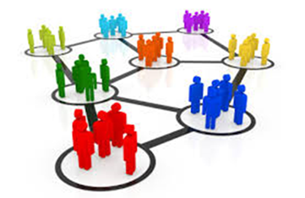
Notes:
We treated patients from all over Italy, especially from the Ospedale Bambino Gesù in Roma and the Istituto Nazionale dei Tumori in Milan, which are the main pediatric oncology centers in Italy.

Slide 17
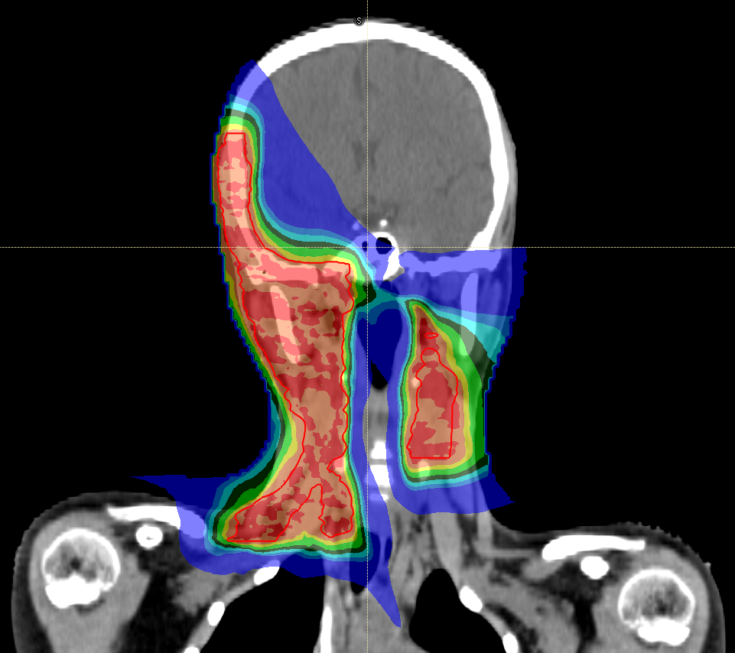
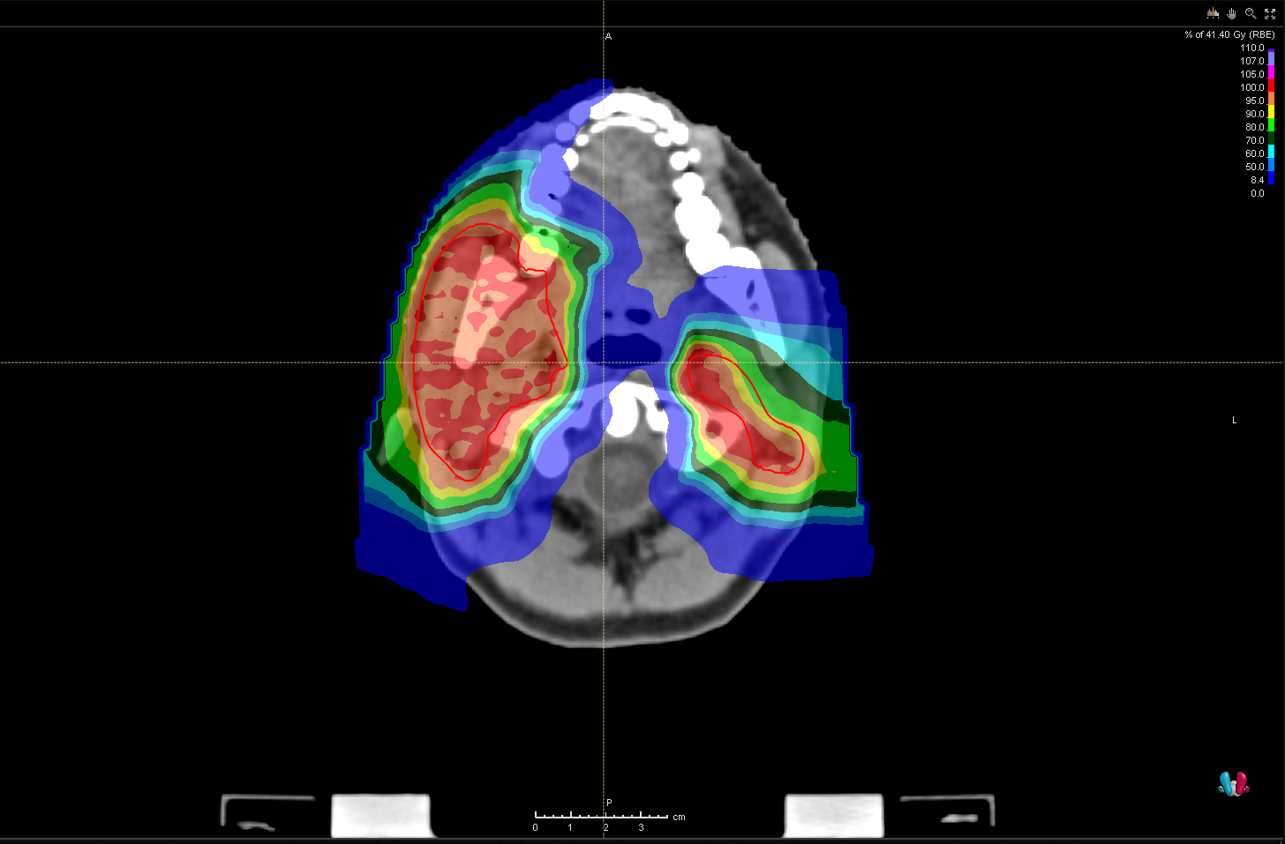
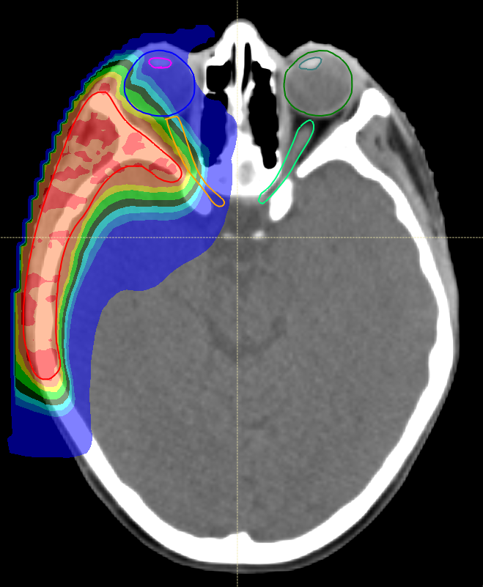
CLINICAL CASE
PM RMS (F, 10yr) treated according to RMS 05 protocol.
RT doses:
41.4 Gy in 23 fractions at the level of positive lymph nodes at diagnosis
sequential boost of 12.6 Gy in 7 fractions at the level of initial diagnosis of disease (T)
sequential boost of 5.4 Gy in 3 fractions for residual disease
Acute tocixity: erythema g1, mucositis g2
Notes:
Below are some clinical cases of patients treated at our centre.
The first case is that of a 10-year-old girl with parameningeal rhabdomyosarcoma treated according to the European RMS 05 protocol. The patient had positive lymph nodes at diagnosis, so we delivered three dose levels using the sequential boost technique, achieving good sparing of organs at risk, particularly the structures of the visual system. The treatment was well tolerated.

Slide 18
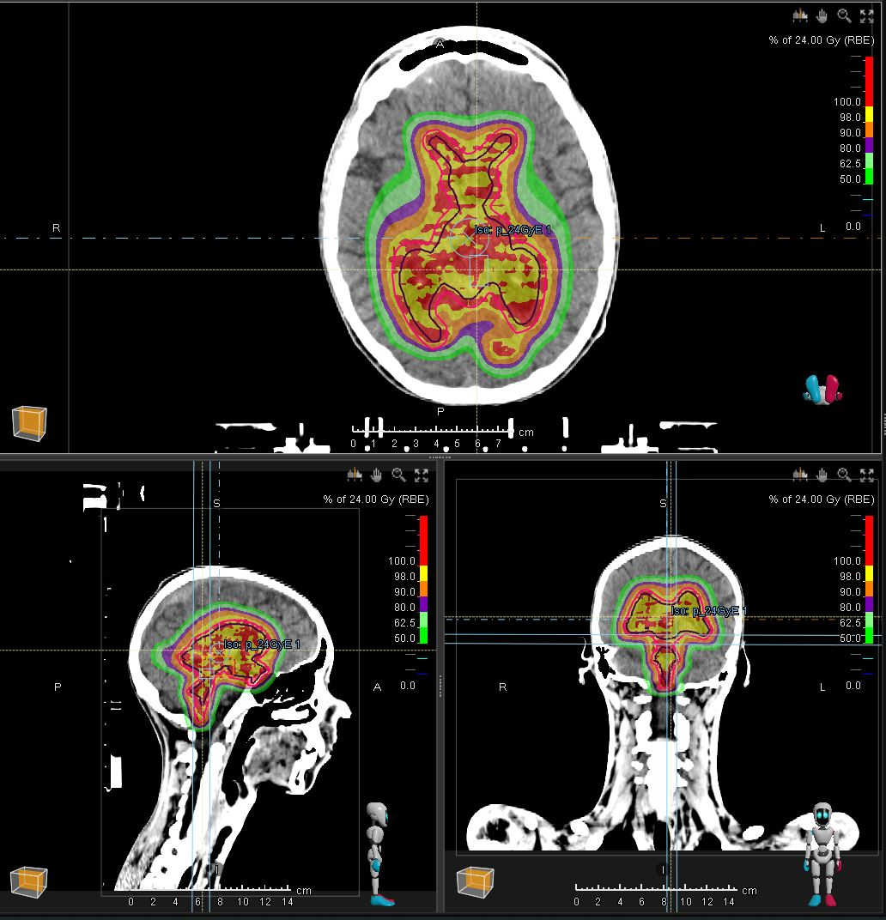
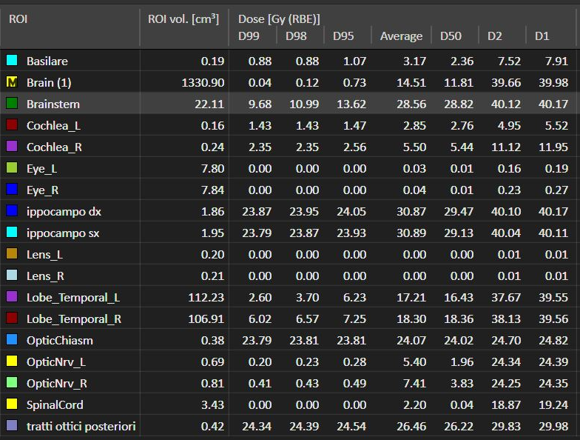
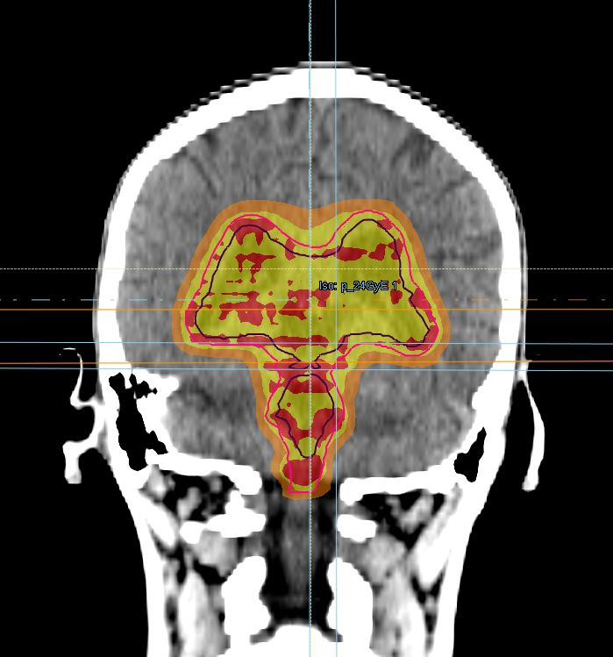
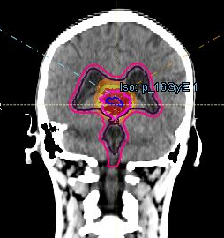
12-year-old boy with Pineal Germinoma
Robust PBS-IMPT dose plan in coronal view; 2 opposing side fields and a vertex field for the WVI, and 2 30-degree inclined fields for the boost
Color wash represents 100% prescription dose (red); 98% (yellow); 90%(orange); 60% (green), 50% (light green)
WVI 24 Gy in 15 fr (1,6 Gy/fr)
WVI
Boost TB 16 Gy
Dose statistics – Sum plan (24 + 16 = 40 Gy)
Notes:
The second is a 12-year-old patient with a pineal gland germinoma who underwent WVI with a dose of 24 Gy and a sequential boost of 16 Gy to residual disease. Despite the large treatment volume, we can see the sparing of healthy brain tissue.

Slide 19
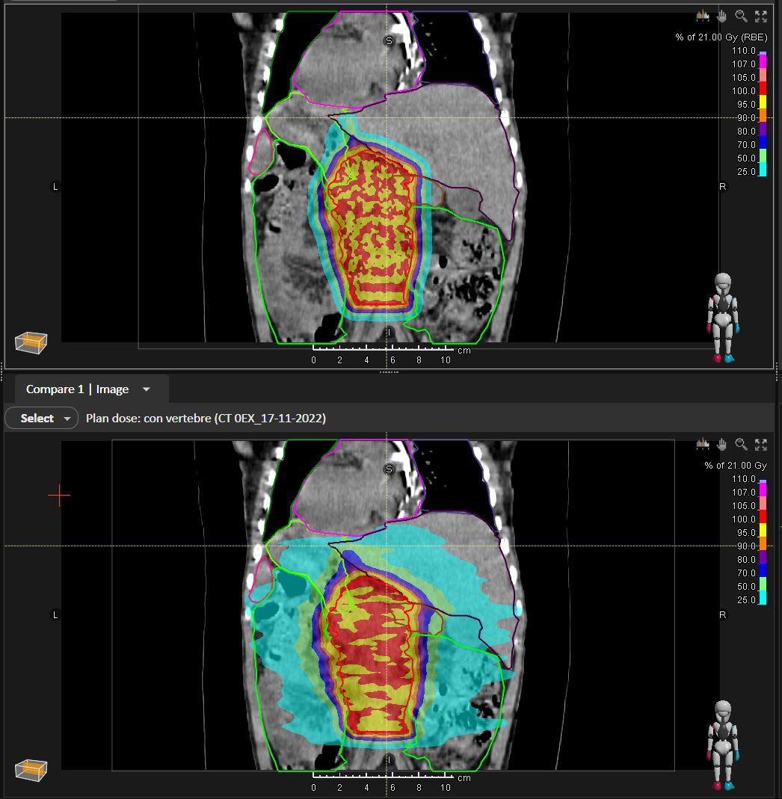
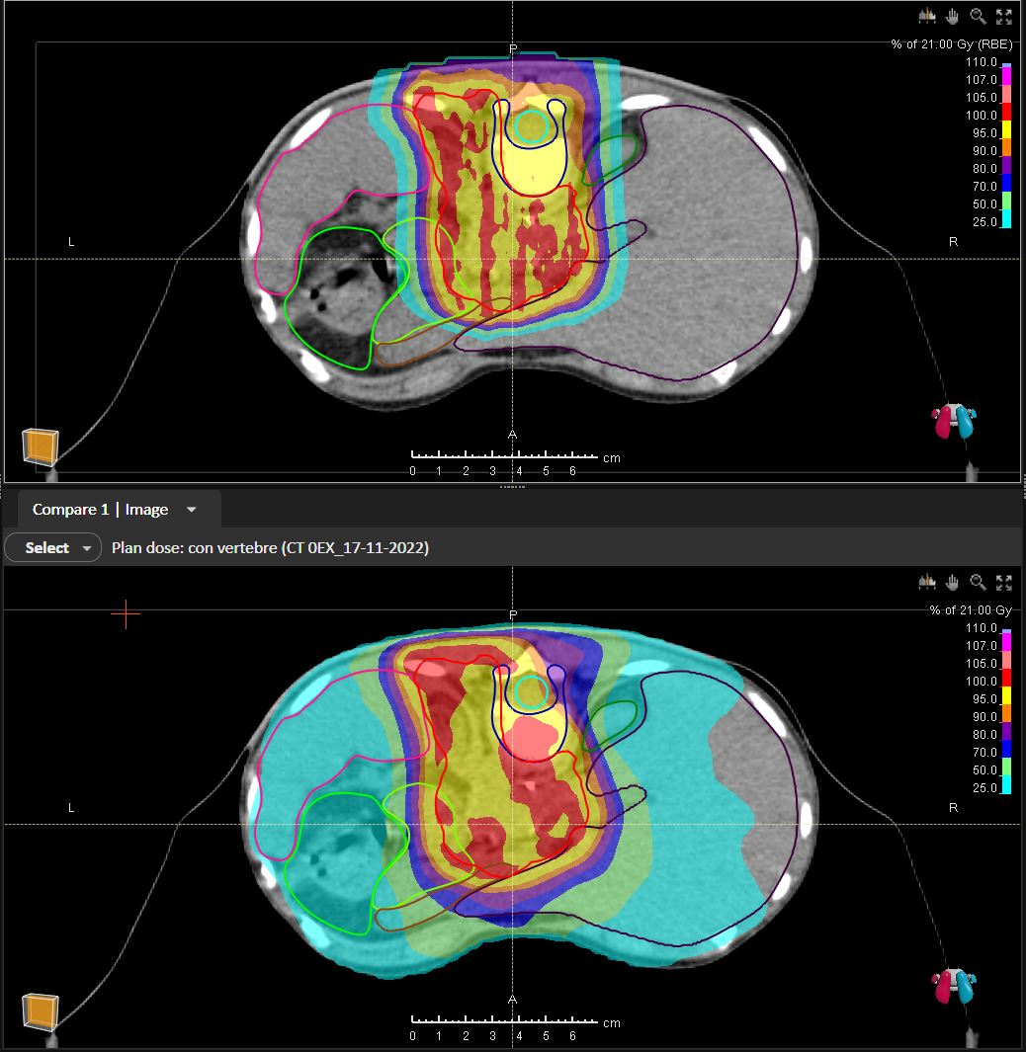
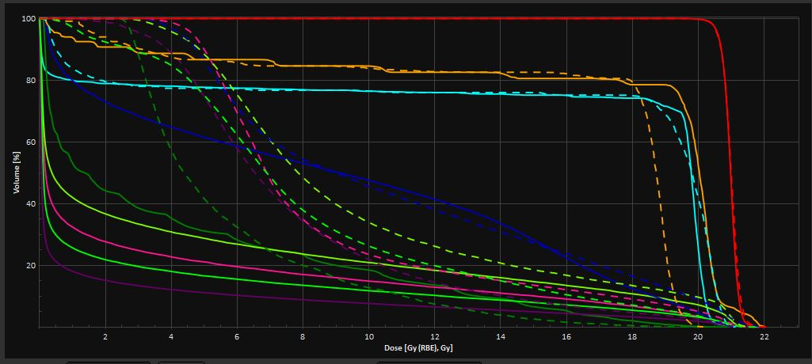
2-year-old patient with abdominal neuroblastoma, stage M, MYCN not amplified, treated according to HR-NBL-1/SIOPEN Protocol.
Dosimetric comparison of proton plane (PBS-IMPT) vs photon plane (IMRT-VMAT) in axial and coronal view.
The data show optimal target coverage with both radiotherapy techniques, and the clear advantage of protons in reducing the dose to all examined OARs.
Major advantage at: Liver, Kidneys, Spleen, Stomach, and Peritoneal cavity
Notes:
This is a proton versus photon dosimetric comparison of a 2-year-old boy with high-risk abdominal neuroblastoma treated with a dose of 21.6 Gy to the preoperative volume and a sequential boost of 14.4 Gy to the residual disease. There is a clear dose sparing to all organs at risk with protons and a greater homogeneity at the vertebral body level.

Slide 20
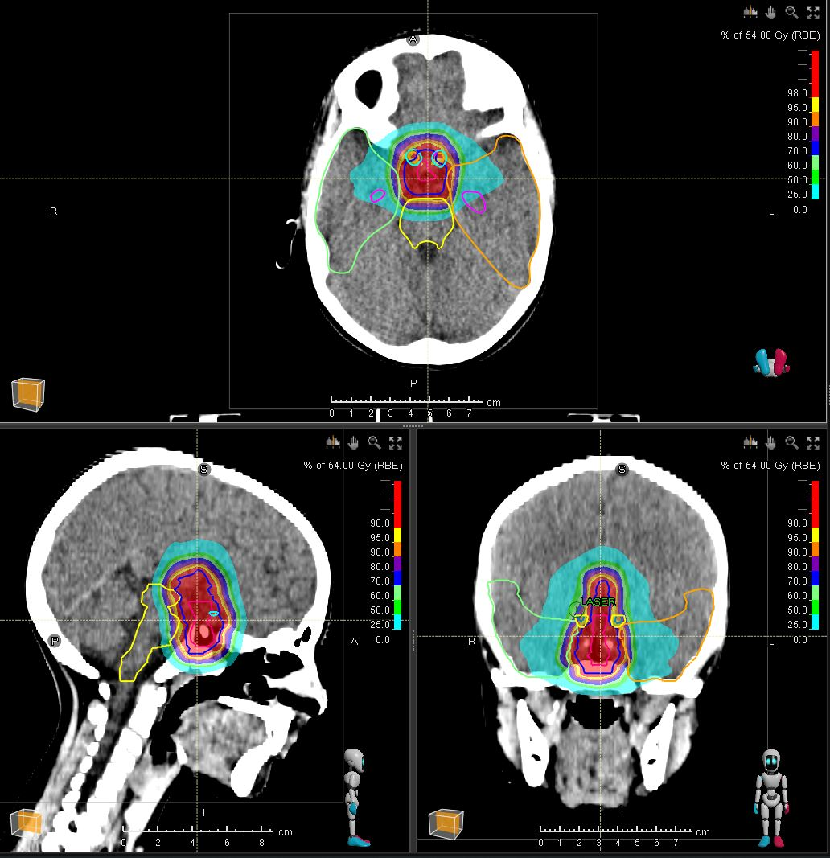
6-year-old girl with Craniopharyngioma
Robust PBS-IMPT dose plan in coronal view; 2 opposing side fields and a vertex field.
Blue contour: CTV 54Gy
GTV = cystic, solid, and calcific components; CTV = GTV + 3-5mm
Color wash represents 100% prescription dose (red); 95% (yellow); 90%(orange); 80% (purple) 70% (blue); 60% (green), 50% (light green) and 25% (light blue) respectively
Notes:
Here we see the treatment plan of a 6-year-old girl with a craniopharyngioma who underwent partial surgery and adjuvant radiotherapy with a dose of 54 Gy. The treatment is well tolerated but requires monitoring of the cystic component by periodic MRI.

Slide 21
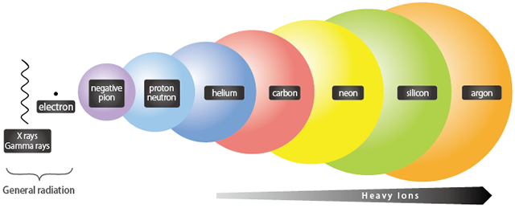
CARBON ION RT IN PAEDIATRIC PATIENTS
Contrary to expectations, there were no high-quality or independently focussed studies on CIRT for paediatric patients.
Carbon ion radiotherapy is most commonly used to treat photon-resistant bone and soft tissue tumours, including:
osteosarcomas,
chordomas,
chondrosarcomas,
chemotherapy-resistant soft tissue sarcomas
re-irradiation
Notes:
There are not many studies on carbon ion therapy in paediatric patients. However, due to its physical and biological properties, carbon ion treatment is commonly used for radioresistant tumours such as: osteosarcomas, chordomas, chondrosarcomas, chemotherapy-resistant soft tissue sarcomas and re-irradiation.

Slide 22
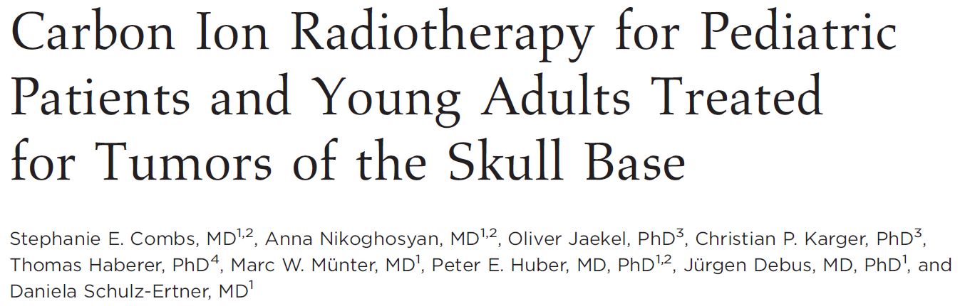
17 patients were aged 6-21 years (median 18 years) treated between 1997 and 2007
  14 pts (82%) primary diagnosis,
  3 pts (18%) recurrent disease
Skull base chordomas (7 pts) and chondrosarcomas (10 pts)
Median total dose of 60 (GyE) (range, 60-66.6 GyE) in a fractionation of 3 GyE (7 days per week) of CIRT
Results:
Median fup 49 months (range 3-112 months)
RT was well tolerated → No severe treatment-related toxicities
Only 1 tumor progression at 60 months after CIRT → LC 94%
SE Combs et al, 2009 - HIT
Notes:
The 2009 German study of 17 patients under 21 years of age with chordoma or chondrosarcoma of the base of the skull treated between 1997 and 2007 with a mean total dose of 60 Gy in 3 Gy/fraction showed good tolerability and excellent local control with only one disease progression at 60 months after radiotherapy.

Slide 23
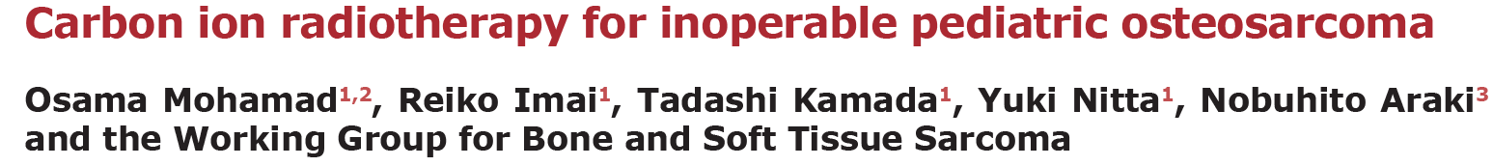
26 patients aged 11–20 years (median 16) treated between 1996 and 2014
inoperable osteosarcoma of the trunk (24 pelvic, 1 mediastinal and 1 paravertebral) without any other lesion at initial examination.
Median CIRT dose was 70.4 Gy RBE delivered in 16 fractions.
Median follow-up was 32.7 months.
Results:
OS was 50.0% and 41.7% at 3 and 5 years.
LC was 69.9% and 62.9% at 3 and 5 years
PFS was 34.6% at 3 and 5 years.
→ Only largest tumor diameter correlated with 5-year OS and LC
There were 4 grade 3-4 CIRT-related late toxicities, 1 case of bone fracture and no treatment-related mortalities. All patients (except 1) were able to ambulate after CIRT.
Mohamad O, 2018 - Japan
Notes:
A more recent Japanese study included 26 patients with an average age of 16 years treated between 1996 and 2014 for inoperable non-metastatic high-grade osteosarcoma with a total dose of 70.4 gy in 16 fractions. The treatment was safe and showed improved survival compared with conventional radiotherapy.
There was one case of grade 3 skin toxicity, one case of grade 4 skin toxicity, and 2 cases of neurologic dysfunction due to nerve injury.

Slide 24
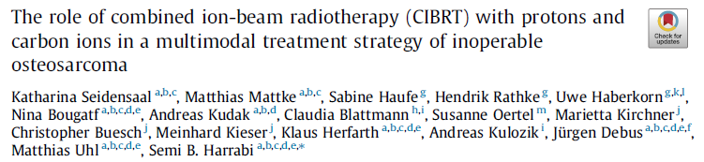
20 pts aged 10.8–49.8 yr (median 20 yr)
Inoperable pelvic (70%) or craniofacial (30%) osteosarcoma
PT 54 GyRBE in 27 fraction and CIRT boost 18 GyRBE in 6 fraction
Results
1yr-PFS was 60% and 1-yr OS was 75%; 2yr-PFS was 45% and 1-yr OS was 68%
Median OS 34 months.
7 in-field local progression (6 in pelvic localization) and 8 distant progression
No acute toxicities > G3
We observed one case of secondary acute myeloid leukemia (AML) seven months after CIBRT for recurrent disease and one case of hearing loss.
Craniofacial localization, lower uptake of FDG in PET/CT and boost plan CTV < median were associated with improved overall survival
K Seidensaal, 2021 - HIT
Notes:
This is another German trial conducted in 20 patients with a median age of 20 years with unresectable pelvic or craniofacial osteosarcoma who underwent treatment with protons at a dose of 54 Gy and carbon ion boost of 18 Gy at 3 Gy/fraction. The study showed a favourable toxicity profile, with no grade 3 toxicity, and promising results in terms of survival, especially in craniofacial localisations. In fact, 6 out of 7 local field progressions occurred in patients with pelvic disease.

Slide 25
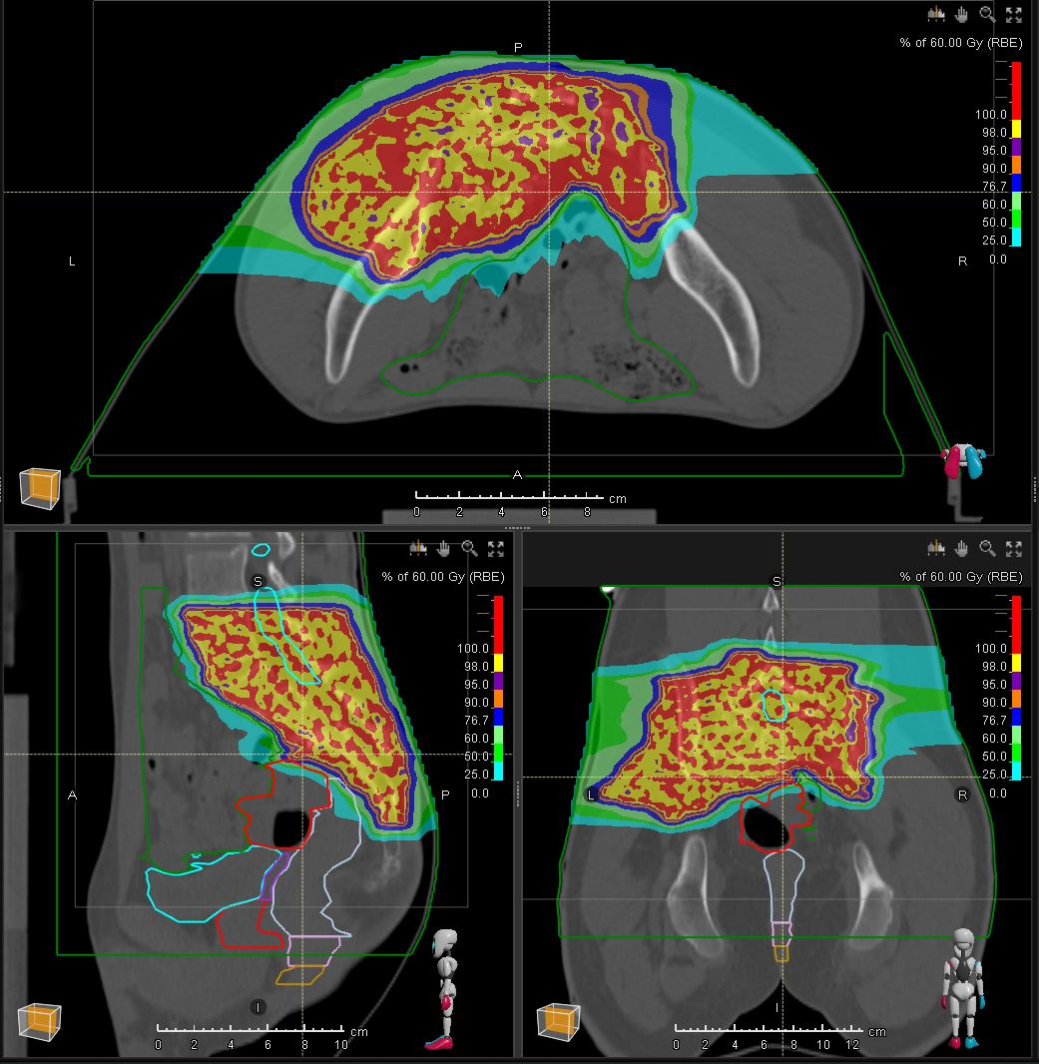
15-year-old boy with local recurrence of osteosarcoma of the pelvis. Previous RT terminated in May 2022.
CIRT 60Gy(RBE) (4Gy(RBE)/fraction, 15 fractions, 4 fractions/week
Well-tolerated treatment. Acute toxicities: erythema G1
Notes:
Below are two clinical cases of carbon ion treatment performed at CNAO. The first is a patient with relapsed osteosarcoma, treated with photons the previous year, who underwent CIRT with a dose of 60 Gy in 15 fractions.The treatment was well tolerated by the patient with no severe toxicity.
Osteosarcoma Carbonio
Prescrizione:
Skin 10cm2≤ 56 Gy(RBE)
Sigma: D1cc ≤ 46 Gy(RBE)
Ossa: no hot spot
Bowel opt: D1cc ≤ 46 Gy(RBE)
Cauda e nervi: no hot spot
Rectum: D1cc < 46 Gy(RBE)

Slide 26
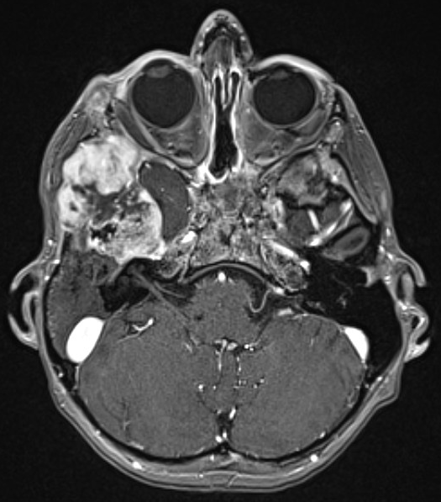
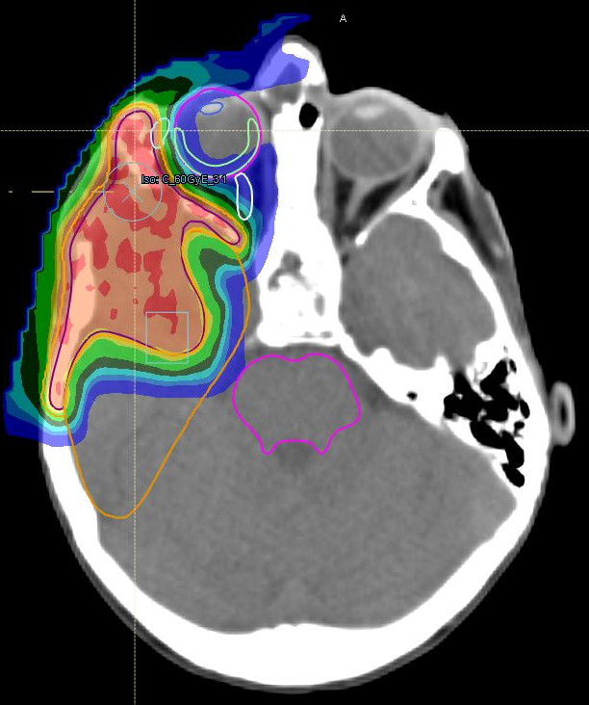
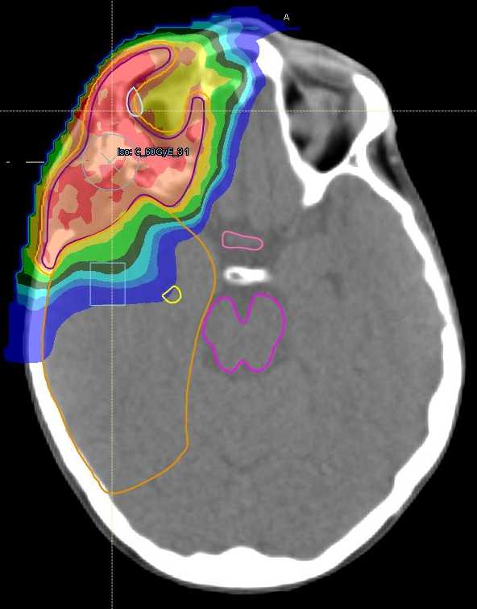
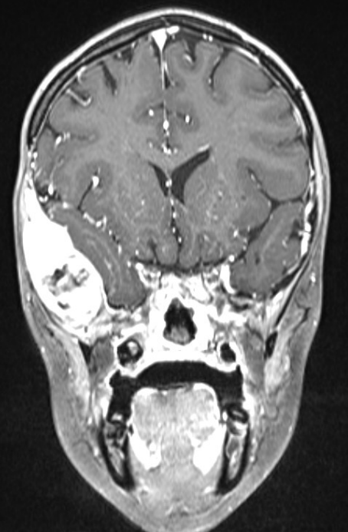
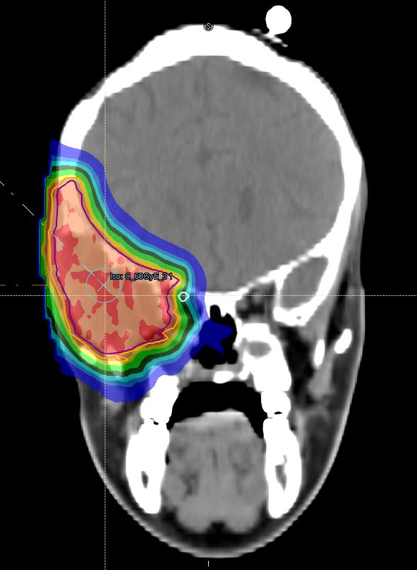
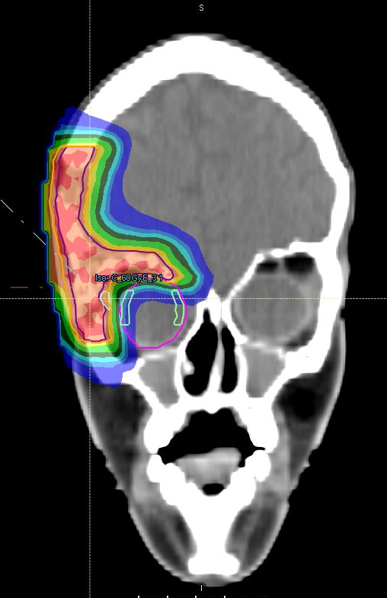
A 15-year-old patient with grade 2 sarcoma of the right temporal region undergoing chemotherapy in a patient with a history of embryonal rhabdomyosarcoma of the skull base treated with chemo-radiotherapy (2013 IMRT 54 Gy).
08/2024 CIRT
60 Gy in 20 fractions (3Gy/fraction) at CTV 2024 (=GTV + 2mm)
Well-tolerated treatment.
Acute toxicities: erythema G1, oedema G2.
Notes:
The second case is of a 15-year-old girl with a radiation-induced sarcoma, treated in 2013 for a parameningeal rhabdomyosarcoma. We delivered radiotherapy with carbon ions at a dose of 60 Gy in 3 Gy/fraction, with a good toxicity profile. The patient is currently in local disease control.

Slide 27
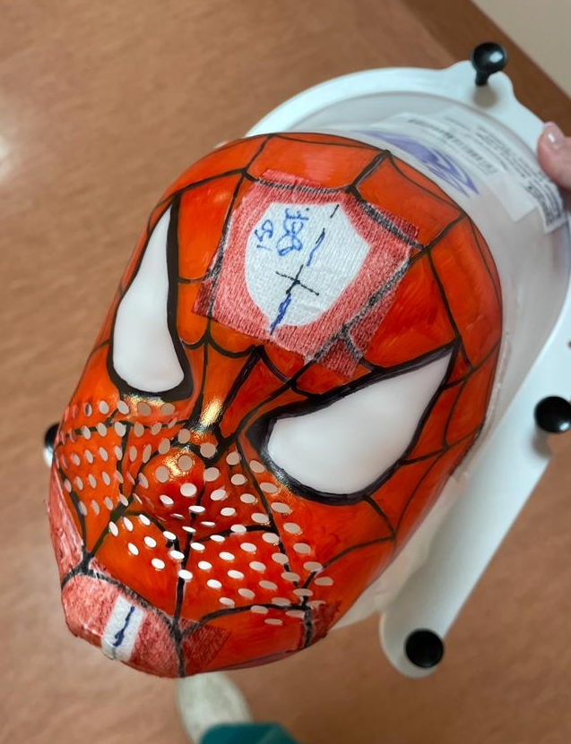
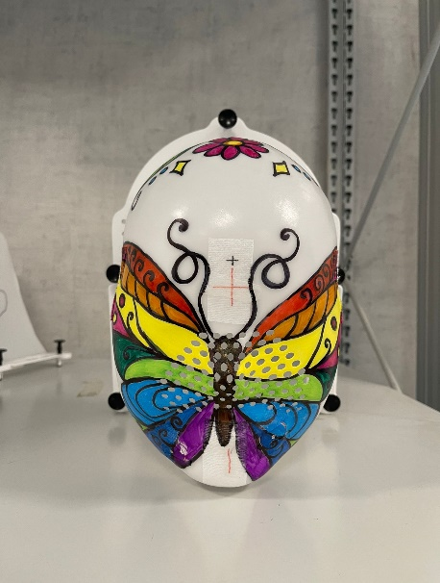
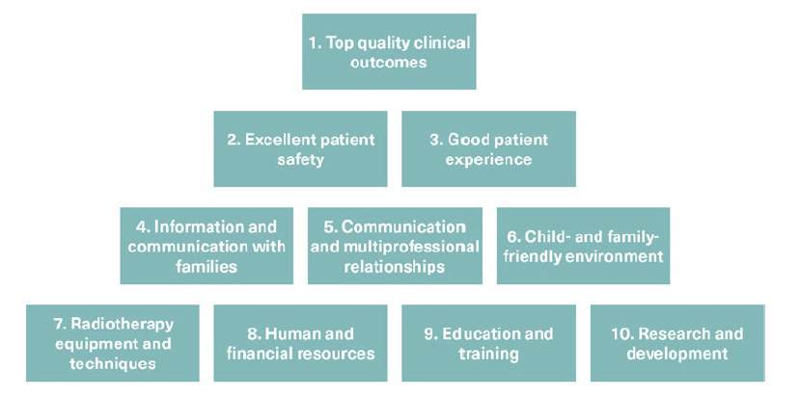
Good Pratice guide for paediatric RT: TEN KEY THEMES
Good practice guide for paediatric radiotherapy, 2° ed, 2018
Notes:
Finally, I would like to share with you the ten key points identified by two British associations that describe the characteristics of a good paediatric radiotherapy centre. We can see that the focus is not only on technical and professional skills to optimise the clinical outcome, but they also recommend the creation of a child- and family-friendly environment, with particular emphasis on the aspect of communication and national and international multidisciplinarity.

Slide 28
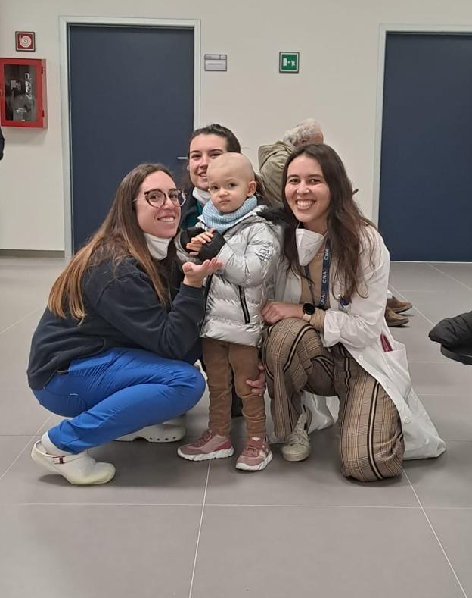
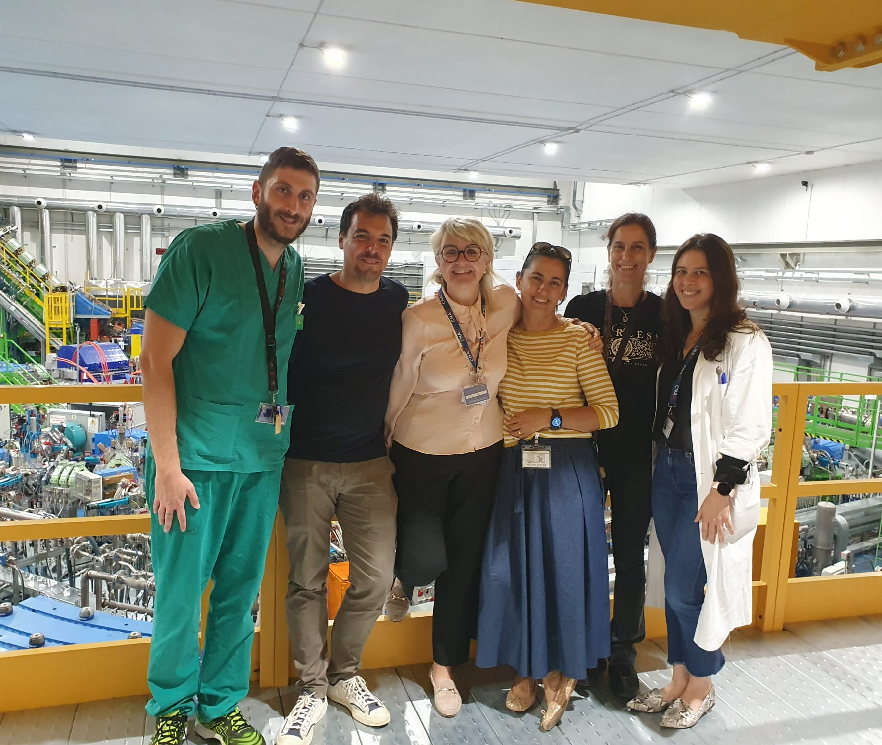
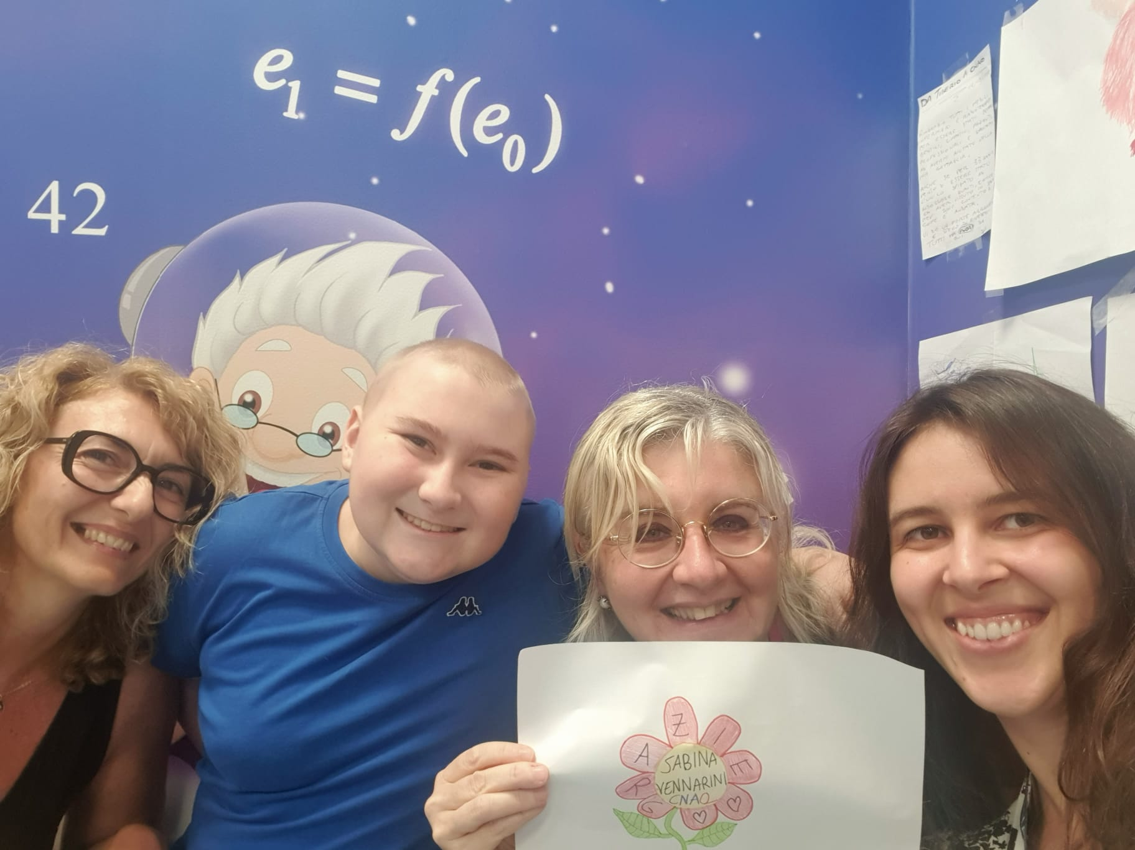
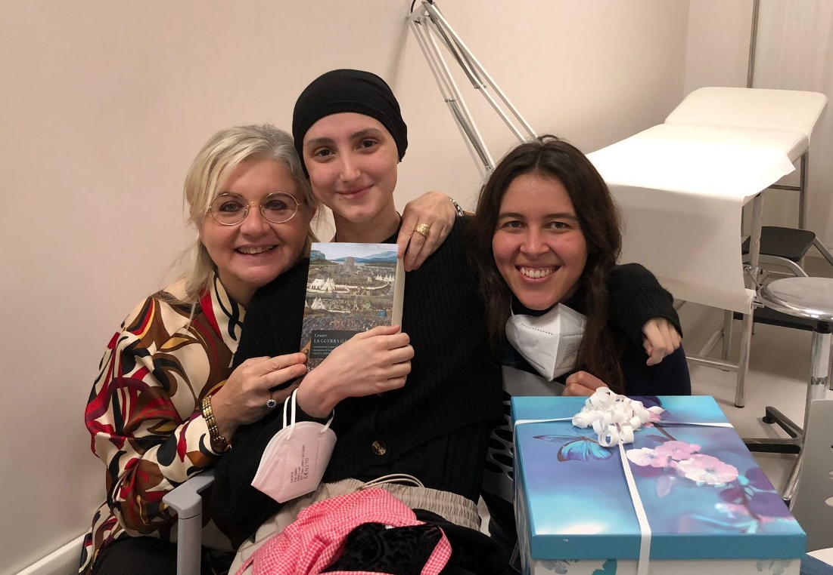
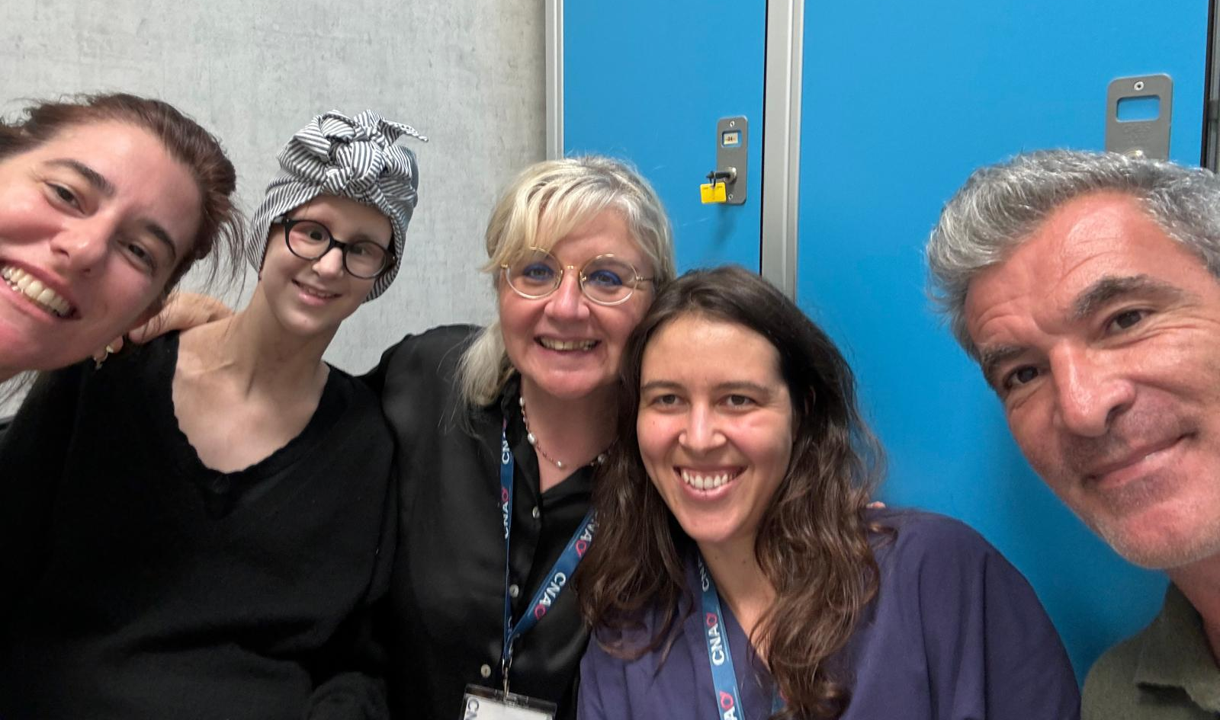
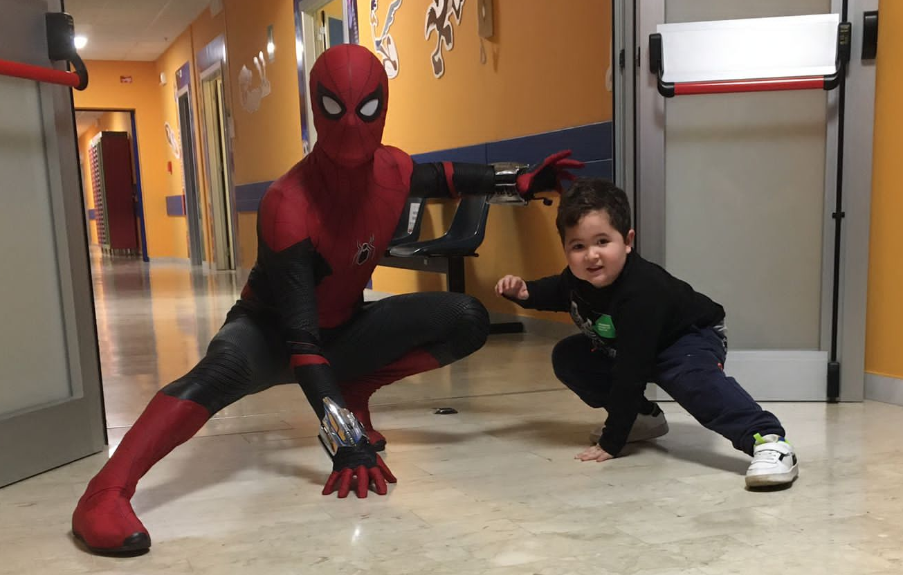
THANKS
Notes:
Thank you all for your attention

