Slide 1
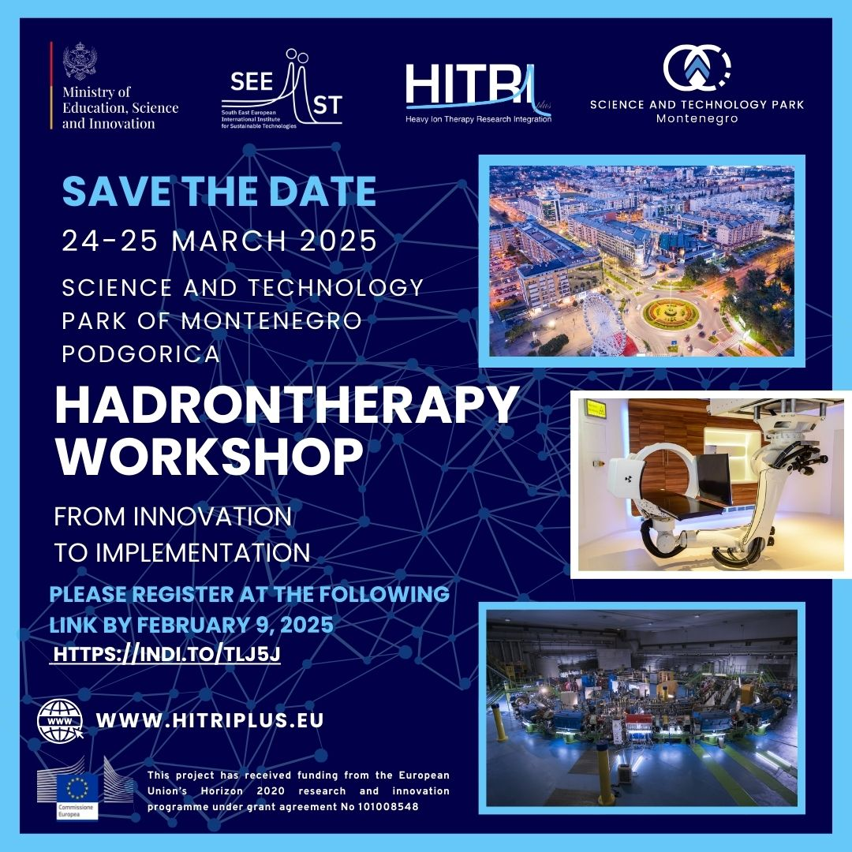

Slide 2
Reirradiations with particles
HADRONTHERAPY WORKSHOP
March 25, 2025
Viviana Vitolo, CNAO

Slide 3
Outline
ReRT: Definition and classification
Advantages of Particle therapy in ReRT (Clinical Outcomes and toxicity) and mail clinical applications
Ongoing clinical studies and future perspective
CNAO experience
Notes:
in glioblastoma, head and neck cancers, and sinonasal tumors.

Slide 4


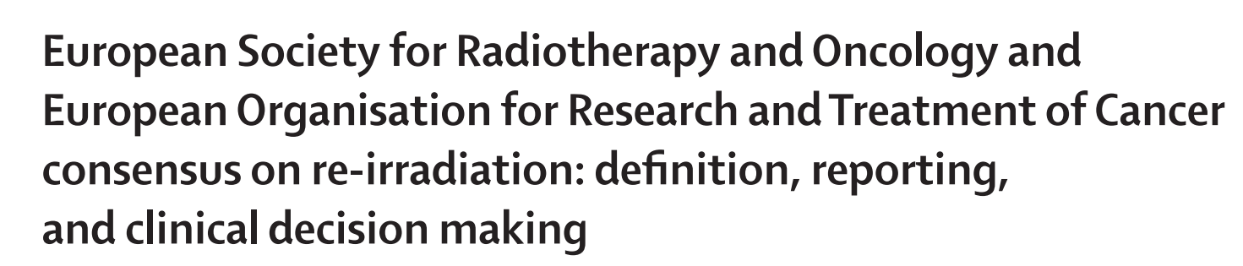
Definition and Classification of Reirradiation
N Andratschke , Lancet Oncology 2022
" New course of Radiotherapy
either in a previously irradiated volume
or where the cumulative dose raises concerns about toxicity."
Type 1: Geometric overlap of irradiated volumes.
Type 2: Concerns about toxicity from cumulative doses, even without geometric overlap.
Notes:
Oulined in the "Lancet Oncology 2022 consensus reRT.pdf" and referenced in "Reirradiation with Particles: Techniques, Toxicity, and Clinical Applications,“
n this Delphi consensus among international experts, endorsed by the European Society for Radiotherapy and
Oncology (ESTRO) and the European Organisation for
Research and Treatment of Cancer (EORTC), we propose
a universally applicable definition of re-irradiation

Slide 5
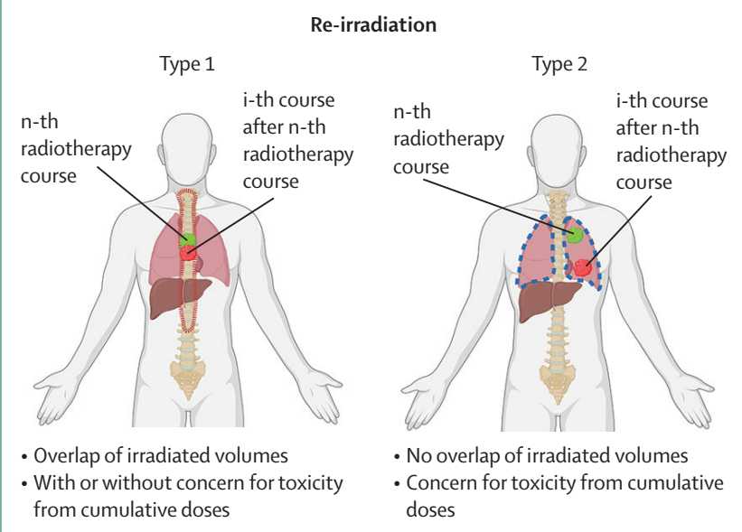
N Andratschke , Lancet Oncology 2022
Notes:
Type 2, no overlap but concerns in terms of cumulative organ toxicity

Slide 6

Reirradiation: key points
Indication: recurrent disease after a previous RT course, not suitable for surgery
Keeping the dose to surrounding pre-irradiated tissue as low as possible
To increase as max as possible the prescription dose since the chances of local control are dose-dependent
Particle therapy: Physical characteristics → superior risk-benefit-profile
Notes:
It is becoming more common over the time in parallel with the technical evolution of RT
In case of tumor relapse or progression of solid tumors after initial radiotherapy treatment options are surgery and re-irradiation, may lead to several sequelae and morbidity
chemotherapy is in many cases a palliative option.
And so RT offers good chances to reach local control

Slide 7

Appropriate Patient selection: KPS, comorbidities, site , prognostic factors
Choice of dose prescription and fractionation: histology, volume of disease
Time interval from previous RT course
Tolerance of the OAR to a second course of RT
Assessment of Risk of potential adverse radiation related effects
Notes:
patient selection,
the optimal radiation dose and fractionation,
tolerance of the brain to a second course of RT,
the risk of adverse radiation effects

Slide 8
Practical need for Radiation Oncologist
Evaluation and re construction of the Previously Delivered Dose
  RT dose, RT plan, RT structures, CT planning images (DICOM)
  In case of lack of DICOM files reconstruction by portals and available docs
  How to manage cases with no availability of previous RT Doc ….

Slide 9
Particle reRT: Literature series

Slide 10
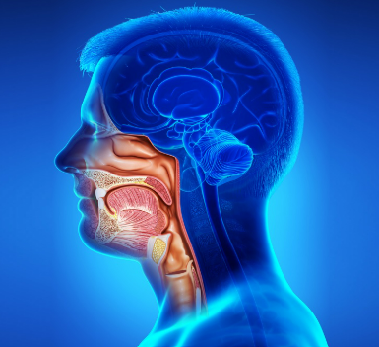
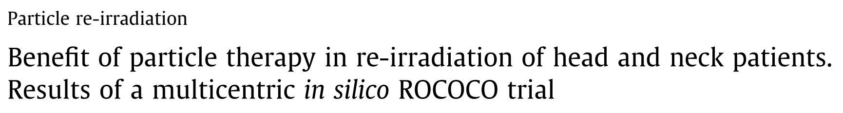
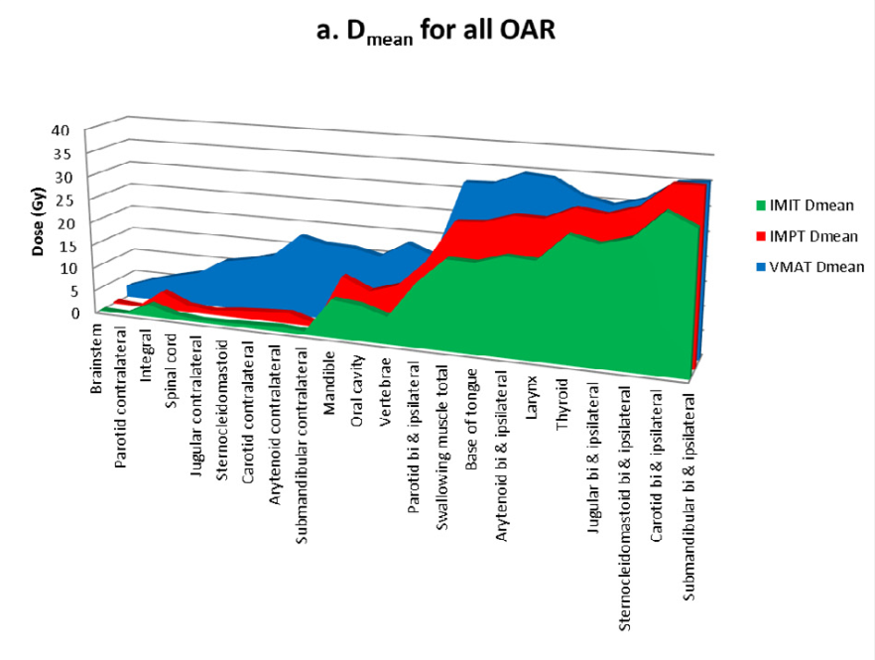
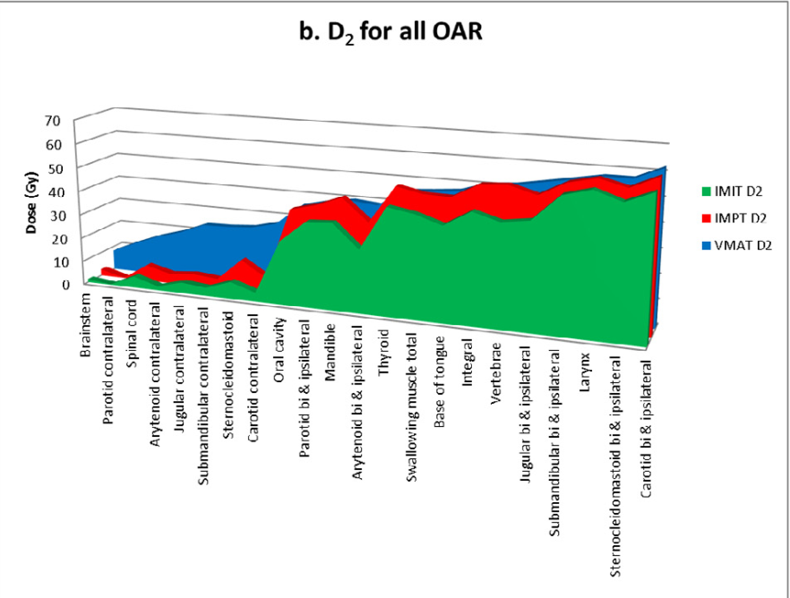
Head and Neck Tumors: reRT
clinicaltrial.gov ID: NCT 02242916
Eekers DBP, Radiother Oncol. 2016
25 patients , SCC, retrospectively replanned ;
Comparison : VMAT vs PT vs CIRT
PT (IMPT and IM CIRT) improve sparing of OAR compared to photon therapy (VMAT)
Notes:
Eekers DBP, Roelofs E, Jelen U, Kirk M, Granzier M, Ammazzalorso F, Ahn PH, Janssens GORJ, Hoebers FJP, Friedmann T, Solberg T, Walsh S, Troost EGC, Kaanders JHAM, Lambin P. Benefit of particle therapy in re-irradiation of head and neck patients. Results of a multicentric in silico ROCOCO trial. Radiother Oncol. 2016 Dec;121(3):387-394. doi: 10.1016/j.radonc.2016.08.020. Epub 2016 Sep 14. PMID: 27639891

Slide 11
Literature series particle reRT: HN PT
Author | study/ n° pts | Tumor type | Prev RT dose (Gy) photons | Median PT dose (GyE) | Median FU (m) | Outcome | Late Toxicity > G3
McDonald, 2016 | 53 | SCC 52% | 64 (43-74) | 70 (36-74) | 15 | 2y OS 32% 2y LC 80% | G3 15.1% (8) B/ST necrosis G4 5.7 % (3) blindness G5 3.8 % (2) brainstem tox
Romesser, 2016 | 92 | SCC 56% | 61.4 (54-69.9) | 60.6 (50-66) | 13.3 | 1y OS 65% LP 34.4 m | G3 skin tox (8.6%), G3 dysphagia (7.1%) G3 gastrostomy tube 9.1% G 5 hemorrhage 2% (2)
Phan, 2016 | 60 | - | 60 Gy (30-70) | 66 (50-70) | 13.6 | 1y LRFS 80.8% 1y PFS 60.1% 1y OS 81.3% | 20% G 3 late toxicity 10% feeding tubes G 5 toxicity 3% (2)

Slide 12
Literature series particle reRT: HN CIRT
Author | study/ n° pts | Tumor type | Prev RT dose (Gy) | PT dose (GyE) | Median FU (m) | Outcome | Late Toxicity > G3
Held, 2019 | 229 | 54% ACC 26% SCC | X or X and CIRT 67.4 (36.5–84) | CIRT 51 (36-66) | 28.5 | 1y LC 60% mPFS: 24.2 m mOS: 26.1 m 1 y OS: 72% | Late toxicity ≥ G3 14.5%
Hu, 2018 | 75 | NPC | IMRT 96%: 70 Gy (66–75.75) | CIRT 57.6 (50-66) | 15.4 | 1y PFS: 82.2% 1y OS: 98.1% | 9.3% mucosal necrosis 1.3% temporal lobe necrosis
Jensen, 2015 | 52 | ACC | 66 | CIRT(93%), X + CIRT 7% 51 3Gy/fr | 14 (1–39) | 1 y LC 70.3% 1y DPFS 72% | CNS G3 3.8% (2) G3 bone necrosis 2 % (1) G4 carotid bo 3.8%(2)
Vischioni, 2020 | 51 | ACC (75%) Other 25% | / | CIRT 60 (45-68.8) | 19 (2-57) | 1y PFS 71% 1y OS 90% | Trismus G3 7% (4) Visual tox G3 5% (3)
Dale, 2017 | 96 (79 CIRT) | ACC 29% SCC 28% Sarcoma 11% Others 32 % | 60 (8-79.2) | CIRT (82%) 60 PT (18%) 54 | 13.4 (1-49) | 1y OS 81.5 % | Carotid Blow out 2.7% (2)

Slide 13
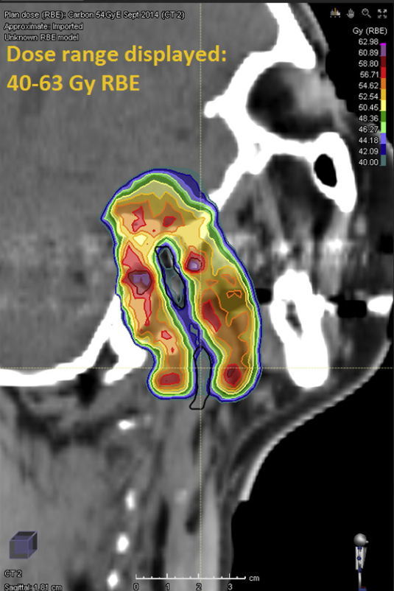
Carotid Blow out Risk
Lowering the risk of carotid toxicity by selectively sparing the dose
to the Carotid Artery
Dale J, Adv in Rad Onc, 2017

Slide 14
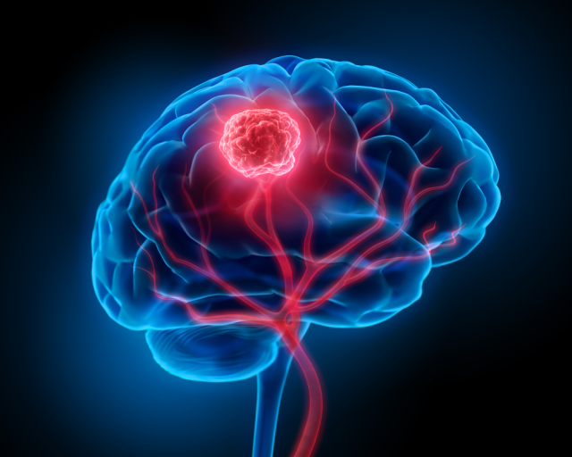
Literature series Particle reRT: BRAIN TUMORS
Author | study/ n° pts | Tumor type | Previous dose Gy | PT dose Gy (RBE) | Median FU (m) | Outcome | Late Toxicity
El Shafie, 2018 | 42 | Meningioma WHO I: 10 WHO II: 25 WHO II: 6 Unknown: 1 | IMRT (n = 16): 52.9 Gy(12–62.4) 3DCRT(n = 16): 54 Gy (50-55,8) SRS (n = 7): 12,1 (12–17) FSRT (n = 1): 58,8 | Protons n = 8 Carbon ion n = 34 51 (15–60) Gy | 49.7 m | 1y PFS 71% 2 y PFS 56.5% 1y OS: 89.6% 2y OS 71.4% | CNS necrosis: No G 4 -G5 3 pts (7%): G3
Eaton, 2015 | 14 | Ependymoma | Protons 85% photons 15% 55.8 (52.5–59.4) | Protons: 50.4 Gy (RBE)(35–55.8) | 37.8 m | 3y PFS 28.1% 3y OS 78.6% | CNS necrosis: 0% G3 3 pts: (21.4%) G2
Eberle 2020 | Retro 30 | Glioma | 60 (37.5–61.2) n= 29 37.5 (2.5 Gy/fr) | CIRT 45 (3 Gy/fr) | 11 m (1-23) | 6 m LC 45% 12 m LC 30% | No G 4 -G5 8 pts (26%): G3 Fatigue (2) dysphasia (1) Seizure (2) emiparesis (1) CNS necrosis (2)
Notes:
6- and 12-month LC rates after
finishing reirradiation were 45% and 30%

Slide 15
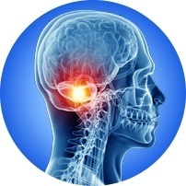
Literature series particle reRT: sarcomas of the skull base & HN
Author | study/ n° pts | Tumor type | Previous dose Gy | PT dose Gy (RBE) | Median FU (m) | Outcome | Late Toxicity > G3
Uhl, 2014 | 25 | Chordoma 20 Chondro 25 | Particles 56%: 60 (42-72) Photons 44%: 66 (38–72.5) | Carbon ions: 51 [45–60) BED (α/β = 2) 63.8 (56.2-75] | 14 m | 2y LPFS 79.3% | G3 bone necrosis 4% (1)
Yang, 2019 | 12 | Head and neck sarcoma | 68 Gy (13–78) | Carbon ions: 60 Gy (RBE) | 15.7 | 1-y OS: 67% | G4 bleeding 8% (1) G5 bleeding 8% (1)

Slide 16
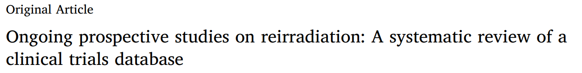
Ongoing Clinical Studies
Willmann J, Radiotherapy and Oncology 2025
99 prospective studies
Site:
CNS 40%
Head and Neck 23%
Pelvis 17%
Radiotherapy techniques:
Stereotactic radiotherapy 17 %
Hypofractionated External Beam Radiotherapy 8 %
Particle therapy (proton or carbon ion therapy) 17 %
41% Studies: RERT + systemic therapies
Notes:
Glioma, head and neck, and prostate cancers dominate ongoing studies,
underrepresented areas such as lung, breast, and gynecological malignancies warrant further investigation.

Slide 17
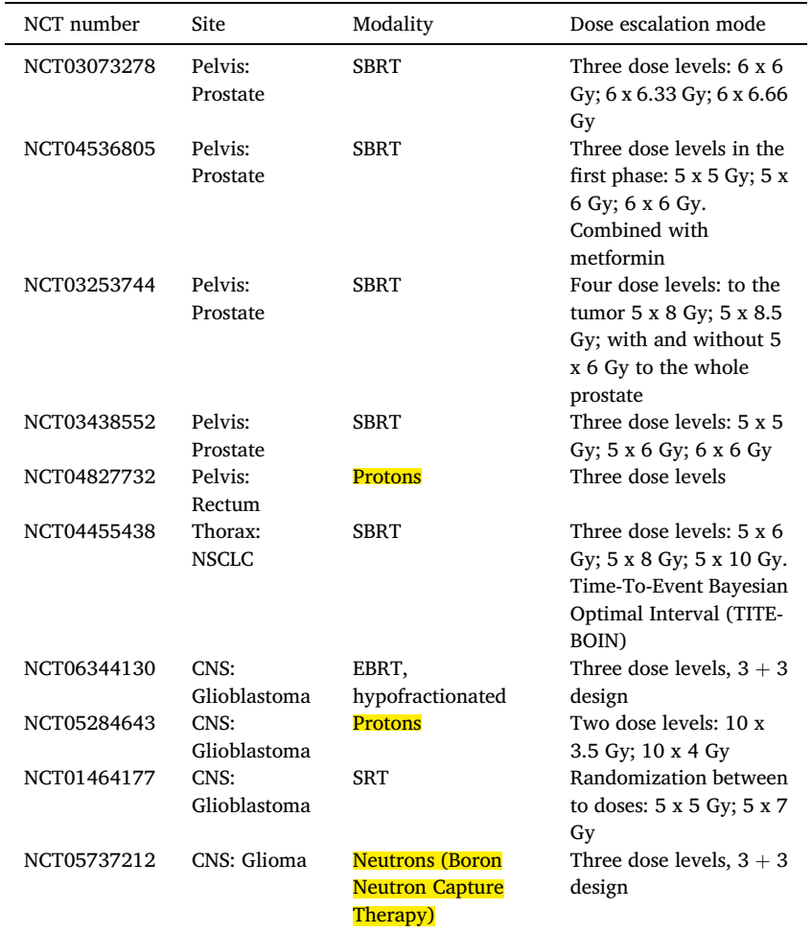
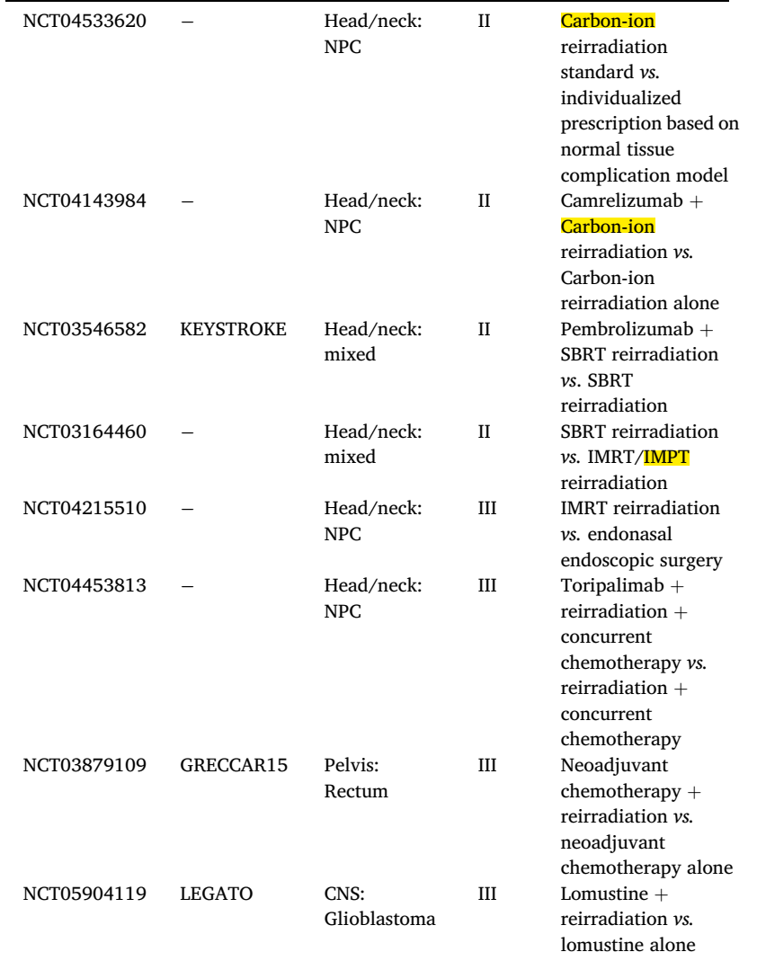
Ongoing Clinical Studies
Willmann J, Radiotherapy and Oncology 2025

Slide 18
Modern RT techniques make Reirradiation feasible, there is the Need of further investigation possibly by randomized control trials
Ongoing studies most frequently focus on CNS, head and neck, and pelvic site
A particular need is for other site not yet well investigated
Lung, breast, and gynecological cancers

Slide 19
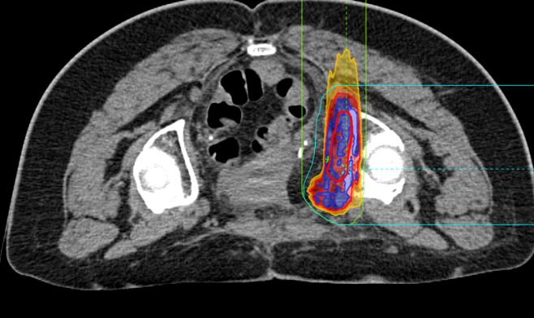
Reirradiation of Gynecological tumors at CNAO
Patient/Tumor hallmaks
Number of patients/lesions | 27 / 28
Age (median, range) | 64.5 years (39-60)
Previous RT dose (median, range) | 52.5 Gy (45-59,4)
Primary tumor
-Cervical carcinoma | 29,60%
-Endometrial carcinomas | 25,90%
-Ovarian Cancers | 22%
-Sarcomas & Melanomas | 22,50%
CTV at Re-RT time (median, range) | 107 cc (15-1381)
Re-RT treatment
  PT (n=12 lesions) →43.5 Gy[RBE] (range:39-60 GyRBE)
  CIRT (n=16 lesions) →48 Gy[RBE] (range:39-68 GyRBE)
  No concomitant systemic therapies during re-RT
Accepted for Poster Discussion @ ESTRO 2025

Slide 20
Re-RT in gynecological tumors at CNAO
  Critelli, Pezzulla et al Gyn Oncol. 2023 → 1y= 74%; 2y=49% G3-G4: 26%
  Pollock et al Adv Radiat Oncol. 2023 → 1y= 83,5% G3: 10%
  Shiba et al Anticancer Research 2017 → 1y= 94% G3-G4 0%
LRFS
All patients
CIRT
Proton
1y 95%
2y 73%
1y 92%
2y 55%
1y-2 y 100%
Radioresistant tumors
Bigger volumes
  3 cases of marginal recurrences after CIRT,
  1 case of Late peripheral neuropathy G2
Accepted for Poster Discussion @ ESTRO 2025

Slide 21
Conclusions & take home messages
Treatment of recurrent disease is challenging
Reirradiation with particles is a valid therapeutic approach and may offer a chance of treatment with curative intent and acceptable toxicity
Literature data are promising but still based on retrospective mono-institutional series
Further prospective studies are necessary to generate evidence and to enlarge clinical indications
Notes:
Treatemnt is tailored on special characteristic of each patients ,
-Several critical aspects to keep in considerations
cumulative dose, the choice of treatment technique, the management of toxicity
-Reirradiation with particles is a valid therapeutic approach for recurrent tumors previously treated with radiotherapy and may offer a chance of treatment with curative intent and acceptable toxicity
- Literature data are promising but still based on retrospective mono-institutional series
Further prospective studies are necessary to generate evidence and to enlarge clinical

Slide 22
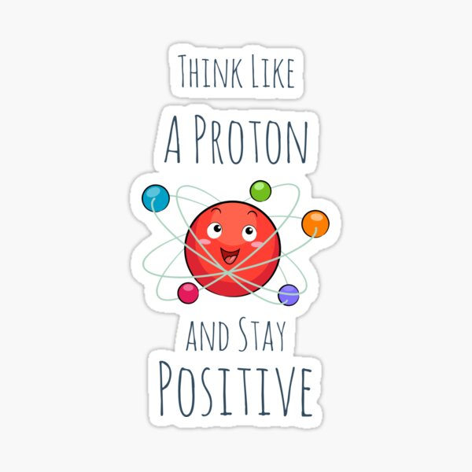
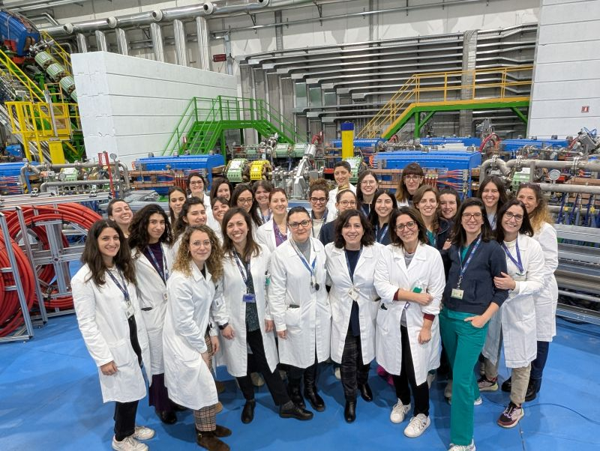
Thanks for your attention!

