Slide 1
The role of control system software in novel Hadrontherapy workflows
Mark Pleško
On behalf of Dominik Peruško

Slide 2



HITRIplus Work Package 11 - Controls and Safety
MS11 Intermediate report on the state-of-the-art treatment room, accelerator control systems, and patient safety systems.
D11.1 Design study on novel treatment room control systems
D11.2 Design study on novel accelerator control systems
D11.3 Design study on novel patient safety systems
Together we are tackling a lot of the challenges, presented today!

Slide 3
Current status of Hadrontherapy
Costly & complex development
Lack of standardization
& interoperability
Legacy pains
Sub-optimal
workflows
Notes:
Based on our experience working with all these different companies, we have the following observations on the current status of radiation therapy:
Development and maintenance of radiation therapy devices is costly, complex, and often underestimated.
Established players have rather old systems with architecture that prevents upgrades for future needs.
Lack of standardization:
Vendors provide silos with custom interfaces and protocols, ending up in hospitals having multiple non-connected silos
Higher costs
Lower quality
Prevents advancements and introduction of new technology
New radiation therapy manufacturers experience these bottle-necks when developing their systems and bring innovation to the market
Difficult supply management (vague split of responsibilities)
Difficult upgrades and maintenance
The increased total cost of ownership
Consequently, in the end, patients are getting sub-optimal treatments

Slide 4
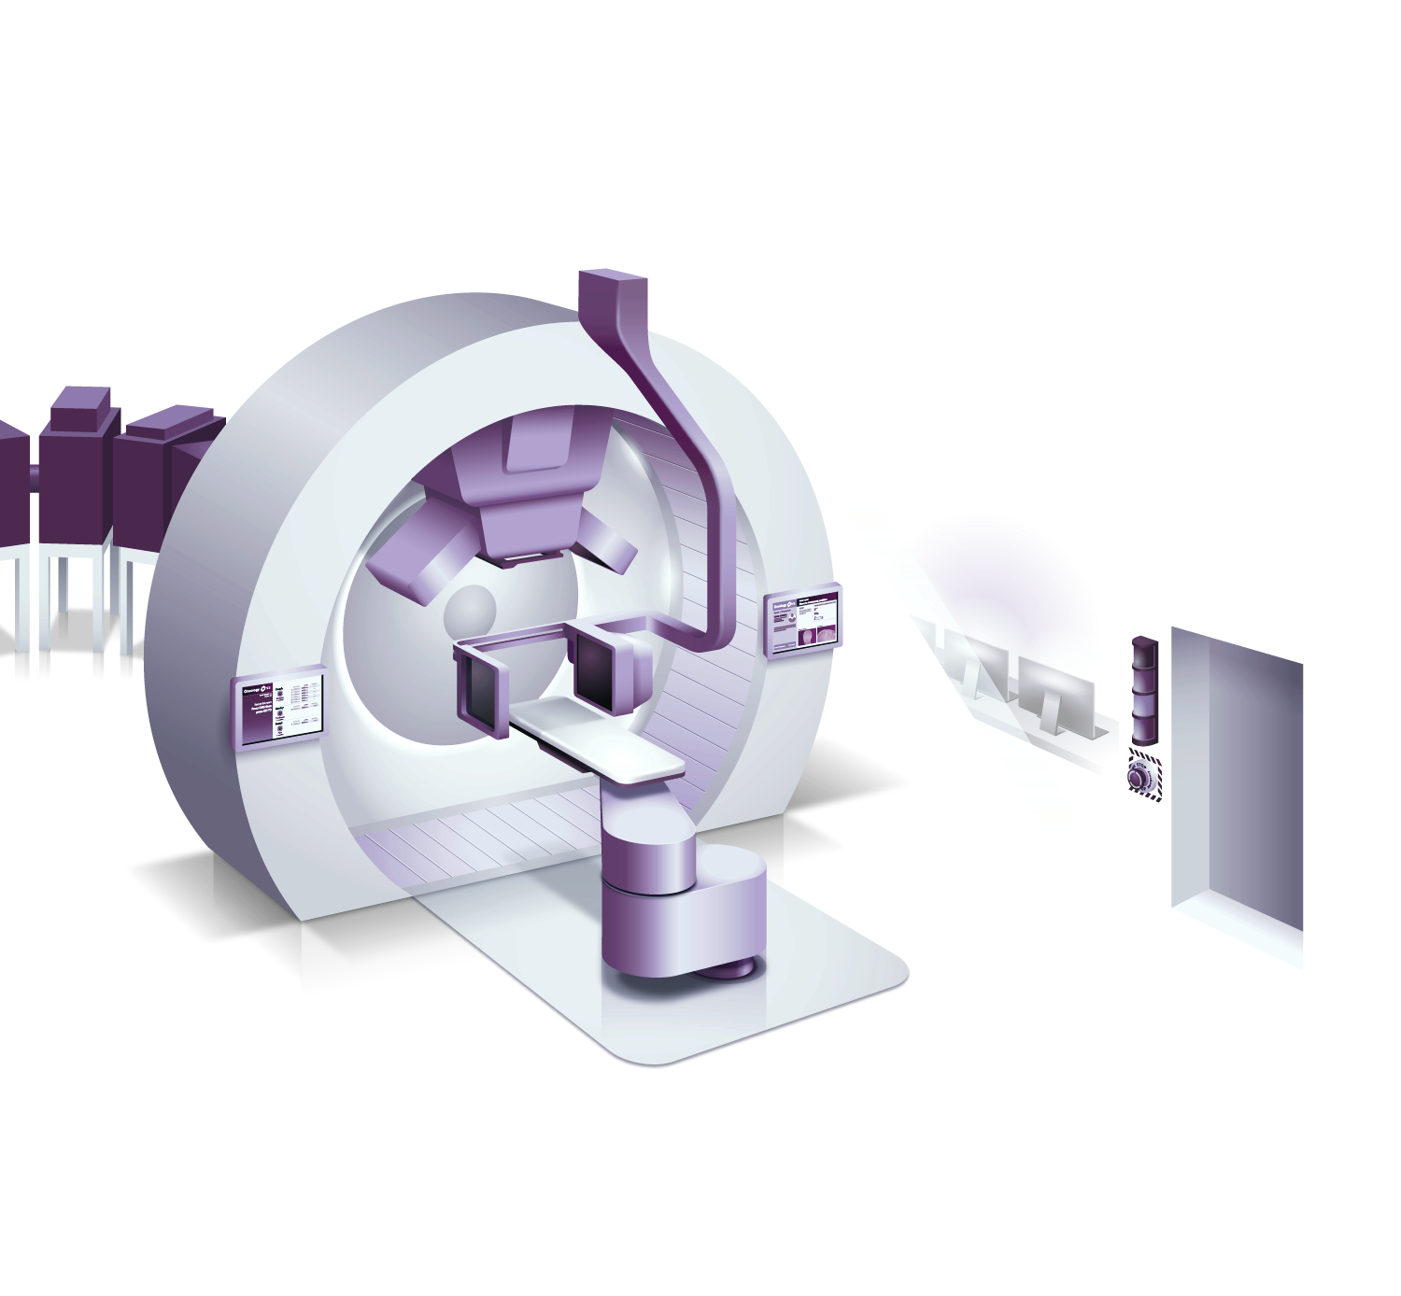
Software is in every part of the machine
4
3
5
7
8
1. Treatment Control System
2. Patient Positioning and Motion Management
3. Image Guidance and Patient Position Verification
4. Dose Delivery
5. Accelerator Control System
6. Safety System
7. Proton Imaging
8. Workflow management
6
1
2
Notes:
Use this one for PT customers

Slide 5
Software is in every part of the oncology workflow
Diagnosis &
Choice of Tx
Cancer boards, Insurance
Simulation & Contouring
CT, MRI, PET
Tx Prescription & Planning
Plan approval, QA
Tx Delivery
Machine Control/QA
Post-Treatment Monitoring
Side effects,
Remission status
Software plays a crucial role every step of the way!

Slide 6
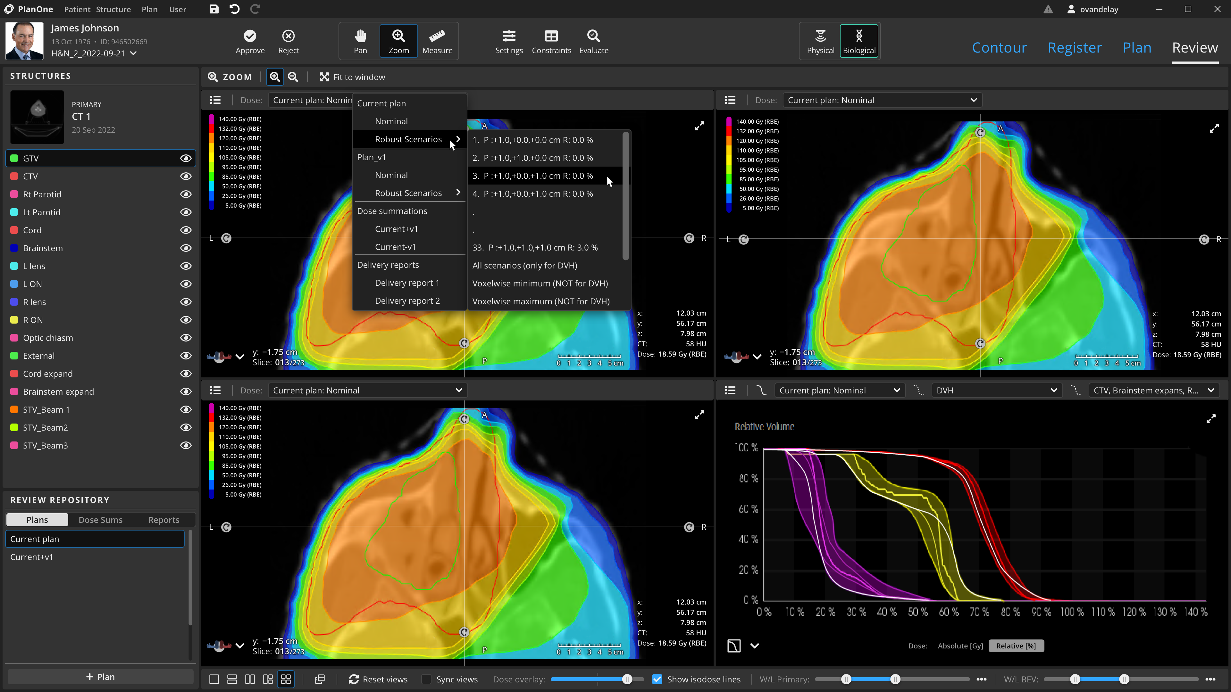
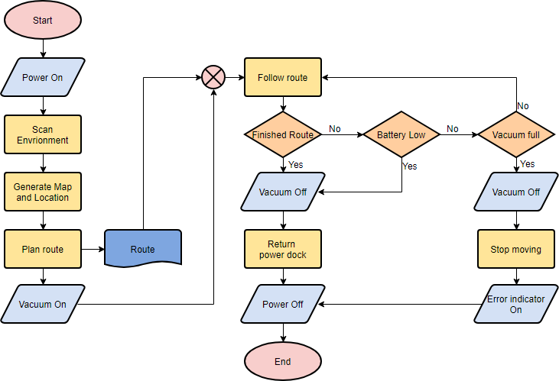

Dilemma: How to show software?
Colourful meaningless screenshots?
Professional incomprehensible flowcharts?
Impressive illegible lines of code?

Slide 7
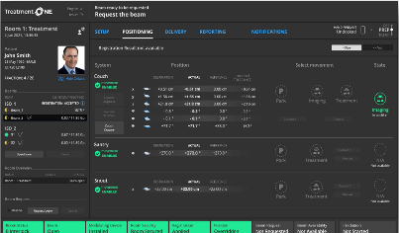
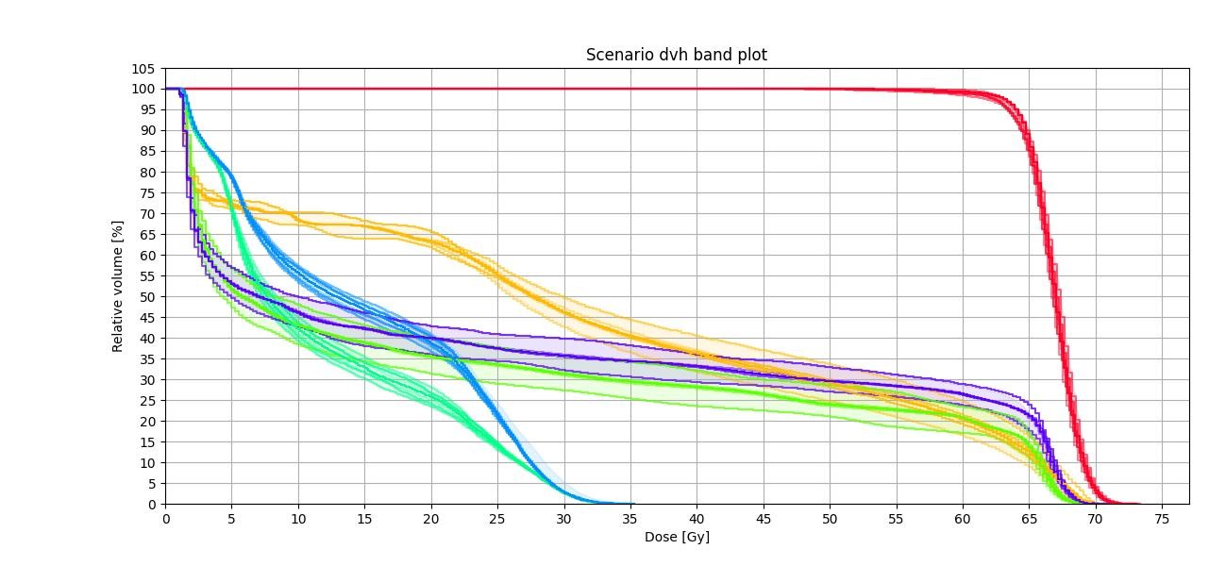
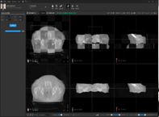
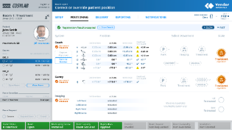
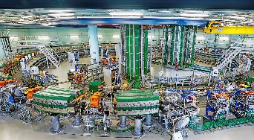

Just name the individual packages?
Information Systems
Treatment prescription, scheduling and follow-up
Treatment Planning System
Patient specific treatment plan
Imaging Software
Diagnosis, Planning and Image Guidance
Treatment Control System
Execution of a Treatment Session
Accelerator Control System
Beam production
Dose Delivery
Pencil bean scanning
.. and more:
Safety Systems (personnel, patient and machine safety)
Patient Positioning (robot/chair control, optical tracking)
ID Verification (personnel, patient, equipment)

Slide 8
Discuss expert software architecture?
Hospital Information Systems
OIS Adapter
Treatment Control System Core
Global Subsystem
Graphical Interfaces Subsystem
Motion Subsystem
Accelerator
Allocator Adapter
Safety Adapter
Systems of Safety
Clinical Subsystem
Health Monitor Subsystem
Imaging & Registration Subsystem
Room Subsystem
Simulators
Treatment Delivery Subsystem
Motion Controllers
Imaging and Registration Adapter
Dose Delivery Adapter
Motion Systems
Imaging and Registration
Dose Delivery Systems

Slide 9
List the thousands of (buzzword compliant) features?
Create the most effective treatment plan for the patient:
  Usage of multi-modality imaging (CT, MRI, PET, proton) – Deformable Image Registration!
  AI Contouring
  Biological optimization (Carbon, FLASH)
  Robust optimization
  Multi-modality planning (comparison, boosts, fallback)
  GPU-powered Monte Carlo dose calculation
  Fast and automatic replanning, based on image of the day – Deformable Image Registration
  Automated Plan QA (machine-file based)
  Real-time tumor tracking – gating, adaptive beam delivery
  …

Slide 10








Whatever, just focus on the patient journey
Nurse
Admin
Rad Onc
MPs
RTTs
HIS
User Home
Treatment Planning
Treatment Scheduling
Treatment (irradiation)
Reports
Billing
Image
Diagnosis
Intent
Protocols
Collect all data
Review
Irradiate
Prostate
  Simulation
  Irradiation
  irradiation
Breast w/ sim. boost
  Simulation
  Irradiation w/ imaging
  irradiation

Slide 11
A few words on „Software Development“
Software cannot be developed in isolation – it‘s connected to everything!!!
  Design top-down, with clinical requirements in mind.
  Standardization of SW interfaces and interoperability is crucial.
  Tight integration with wider hospital software is needed (EHR, hospital information systems).
Hadrontherapy devices are complex and extremely expensive
  It needs to operate and be upgraded for 30+ years – modular and customizable SW design.
  Try to avoid custom software development for each machine separately.

Slide 12
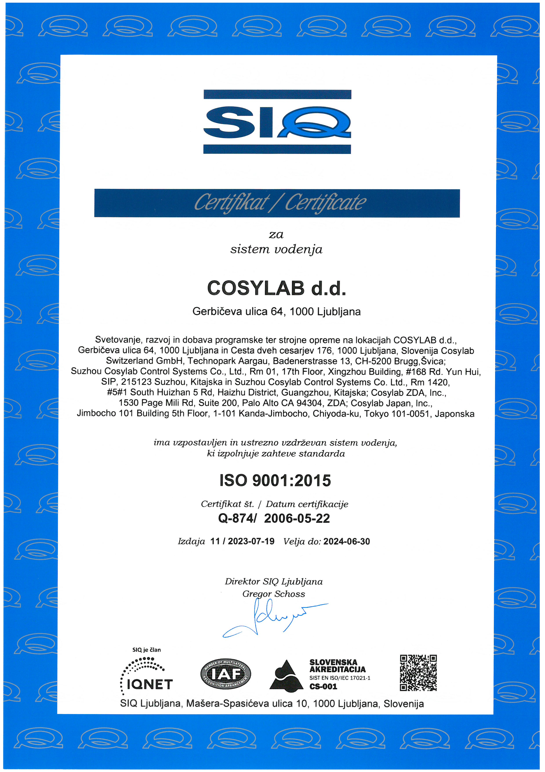
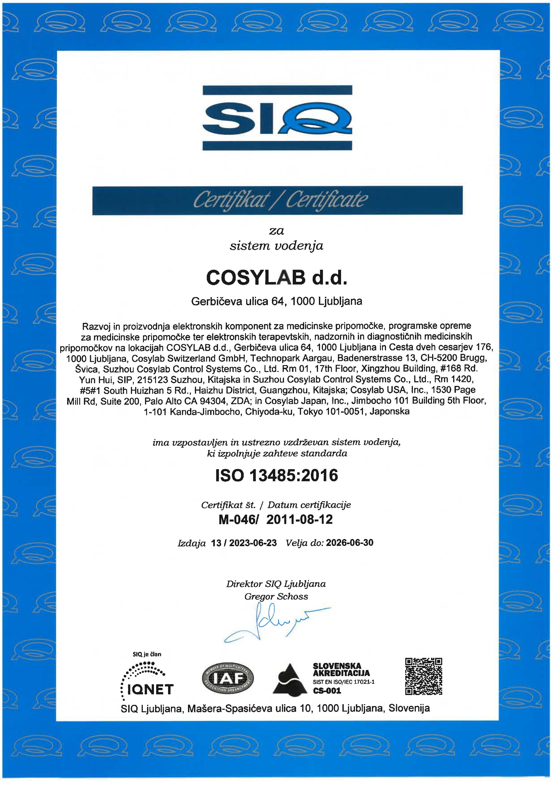
Hadrontherapy software is, or is part of, a Medical Device
Medical device regulations (FDA, MDR, NMPA)
Quality management systems (QMS)
  ISO 9001:2015
  ISO 13485:2016
Software development
  IEC 62304:2006+A1:2015
Usability
  IEC 62366-1:2015+CORR1
Risk management
  ISO 14971:2019
Technical standards (e.g. IEC 60601 family)
Cybersecurity
  ISO 27001:2022
  IEC 81001-5-1:2021
ISO 9001
ISO 13485
Notes:
all the medical software documentation necessary for the certification of the whole device (CE, FDA, NMPA),
ISO 13485 certification simplifies supply management process,
Need a proper certified QMS

Slide 13

Vision: Contribute To Fully Automated Cancer Treatment
CT Scan
Software
Patient
Treatment
Cloud
AI
Digitalisation
Automatisation
HW Integration

Slide 14
THANK YOU mark.plesko@cosylab.com

