Slide 1
Upright patient positioning – renewed interest in a promising paradigm for particle therapy
Lennart Volz
Biophysics, GSI, Germany
Co-chair to the Upright Radiotherapy Research Committee

Slide 2
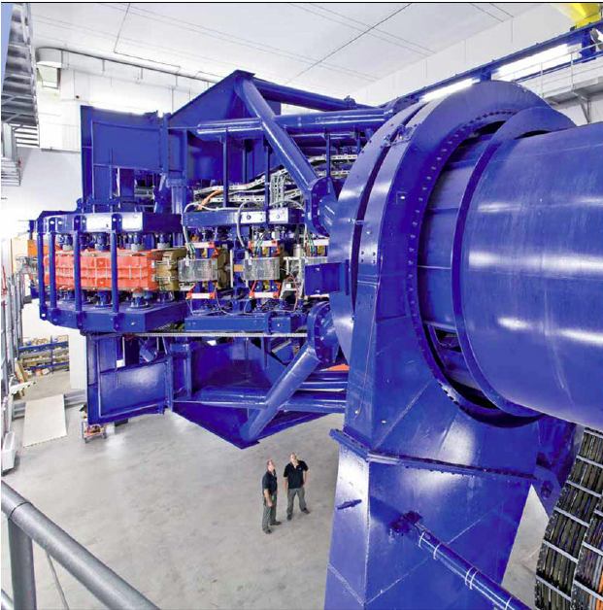
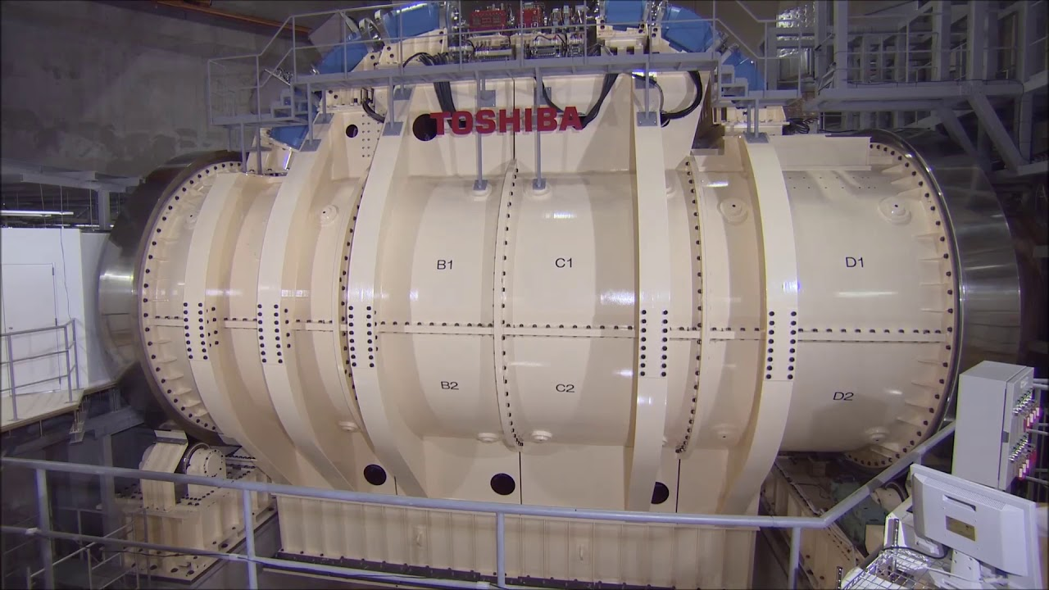
Rationale for upright particle therapy
Challenge particle therapy gantries are large and thus very costly (esp. for heavy ions)
HIT
QST (NIRS)
„System Cost. The simple, yet not widely accepted answer is to eliminate the gantry“
- Jay Flanz, Phys. Med. Biol. 66 (2021)
600t, 25m length
300t, ~10m length

Slide 3
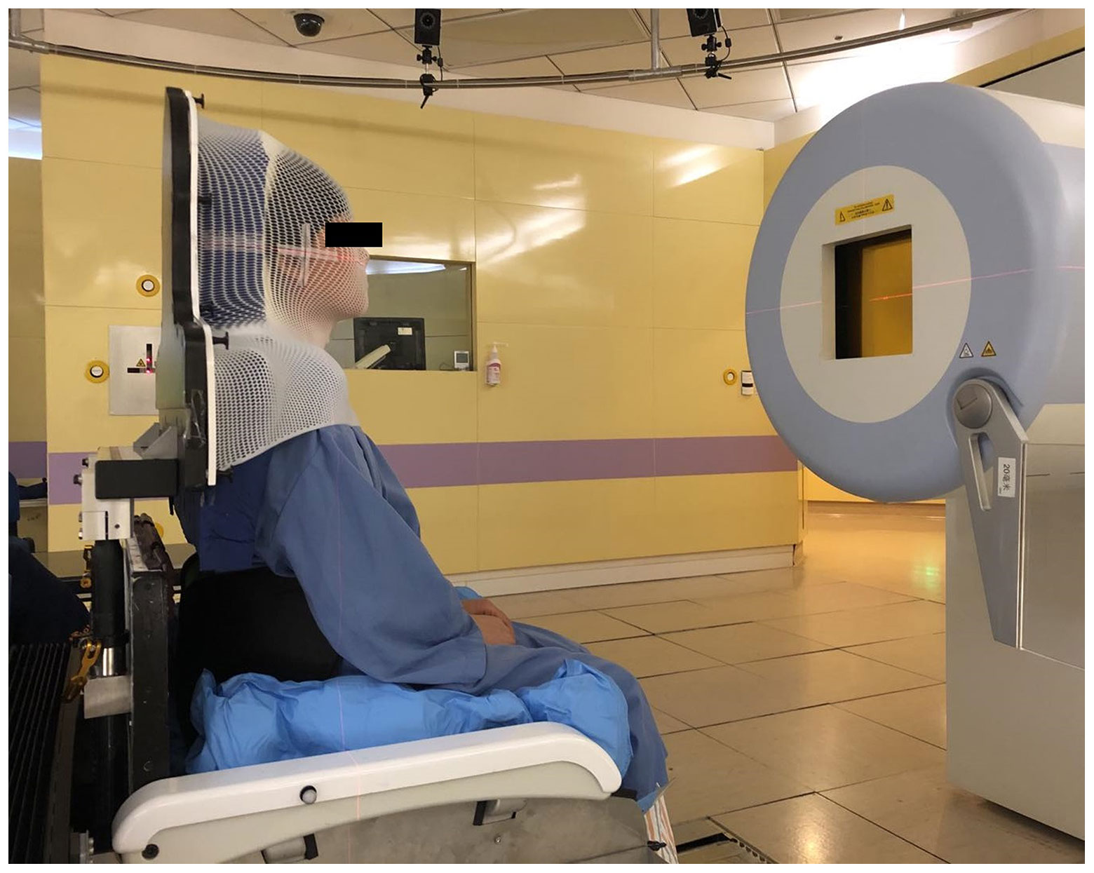
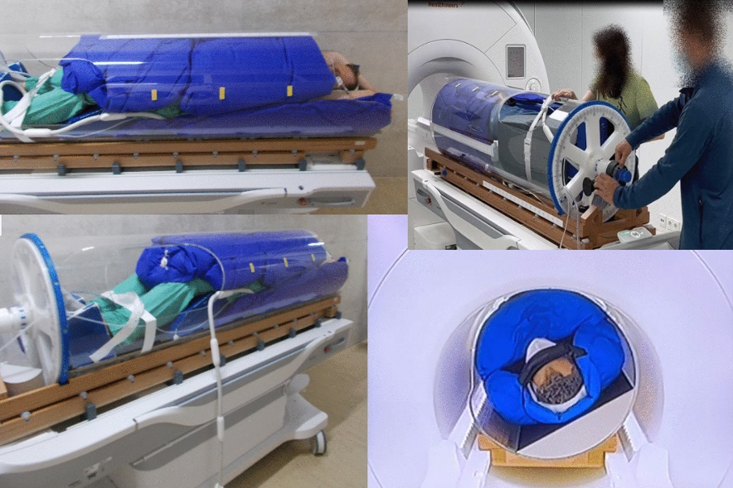
Gantry-less: move the patient, not the beam
Upright
Horizontal rotation
Sun et al. (2021) Front. Oncol.
Beyer et al. (2024) Rad. Oncol.

Slide 4
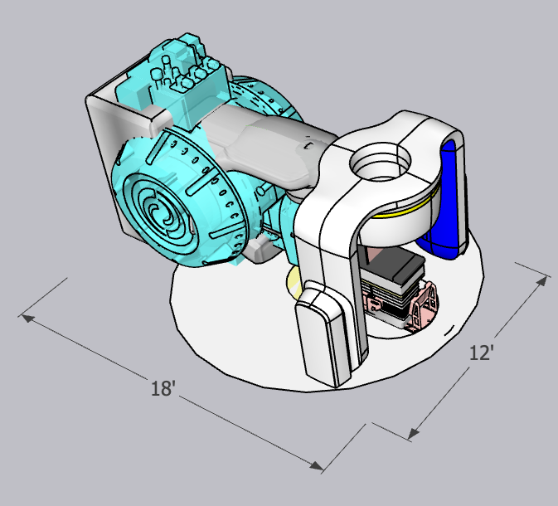
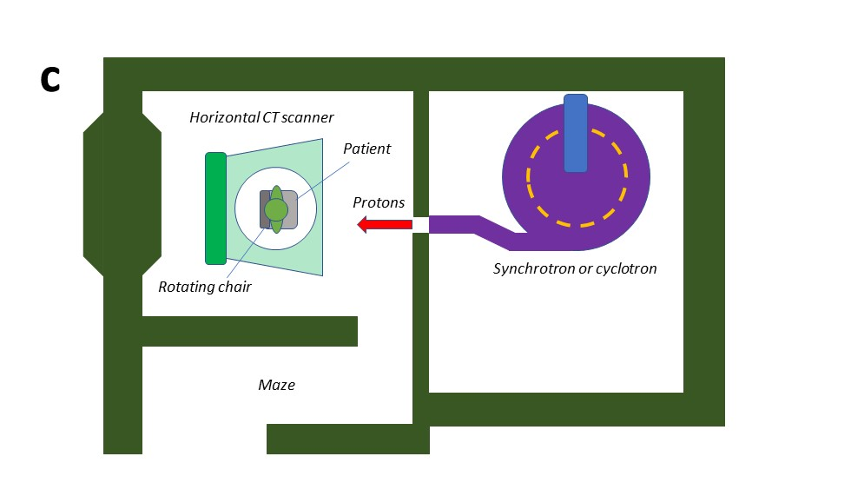
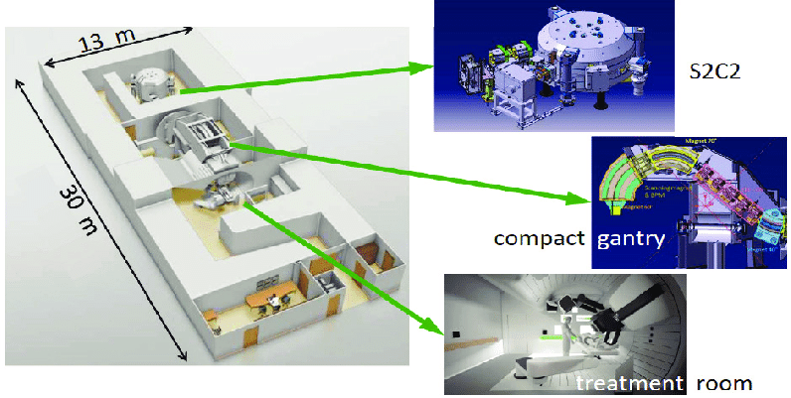
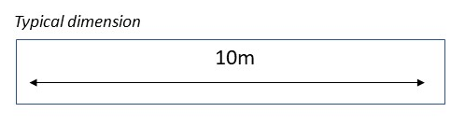
Footprint and room design
U. Amaldi (2015) Modern Physics Letters A 30(17):1540018
Mevion FIT system overlayed on LINAC
Courtesy to N. Schreuder (Leo Cancer Care Ltd.)

Slide 5
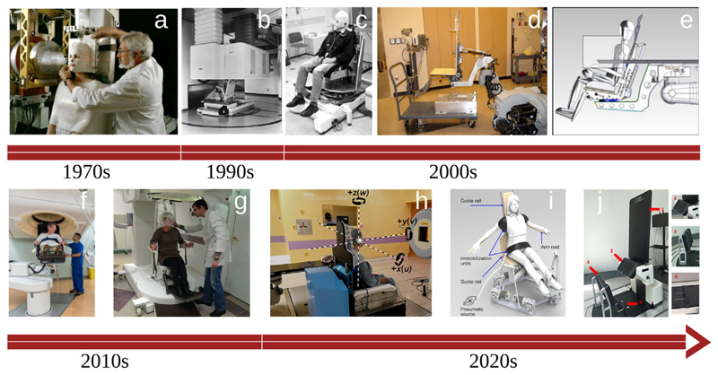
Historical reflection of particle therapy chairs
Currently 5 particle centers with upright positioning (excluding ocular)
SPHIC (CHN), Orsay (FRA), Obninsk (RUS), Chicago (USA), Hadassah (IS)
Graeff, Volz, Durante (2023) PPNP

Slide 6
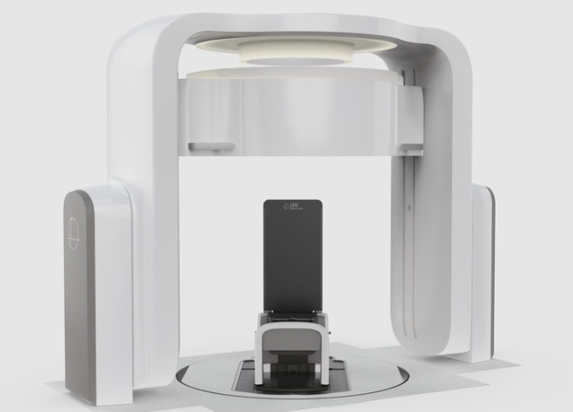
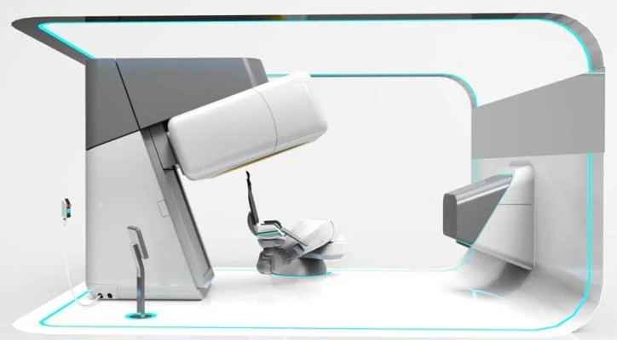
Current main vendors
(To be) set up at:
McLaren Proton Center, Flint, Michigan (US)
UW, Madison Wisconsin
Stanford (US)
CNAO (IT)
Centre Leon Berard (FR)
(To be) set up at:
Chicago Proton Center (US, CT only)
Hadassah Medical Center (IS)
Taian Medical Center, Shandong, (CHN)
Marie TM - Leo Cancer Care upright patient positioning system and CT scanner
P-Cure Ltd., compact 360° gantry-less adaptive proton therapy system

Slide 7
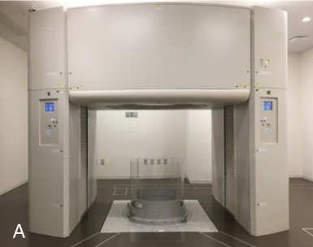
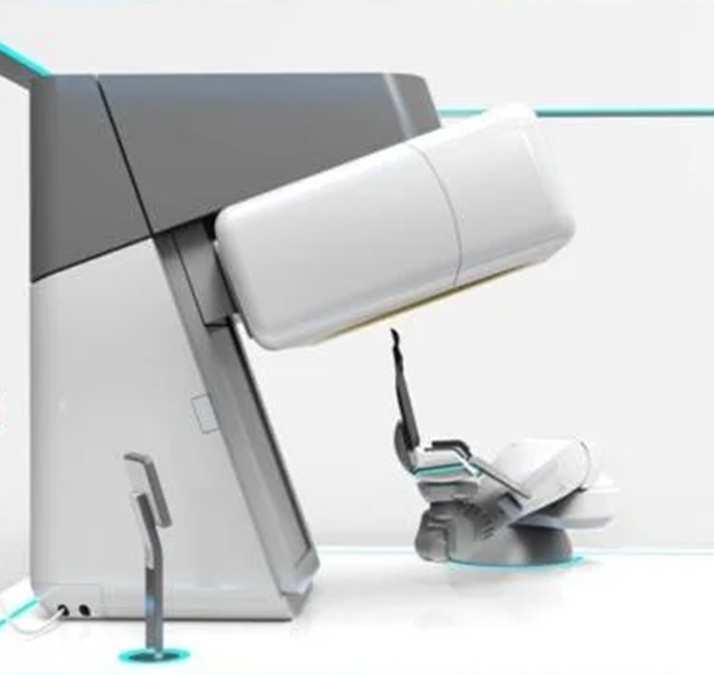
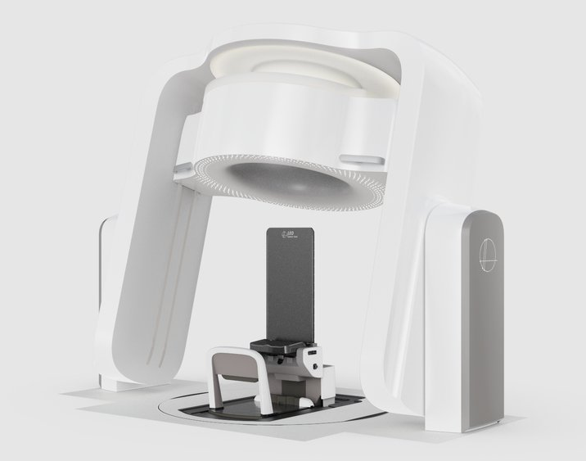
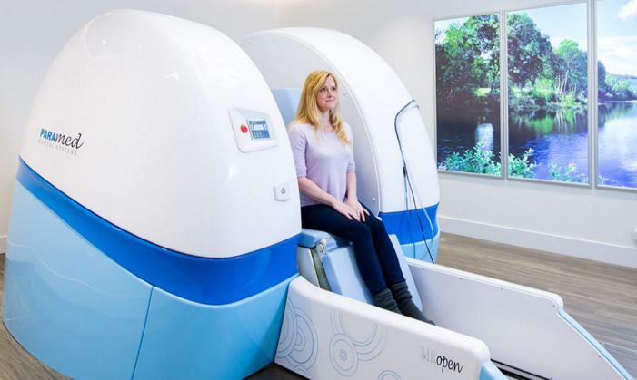
Imaging
Jinsaki et al. (2020) Invest. Radiol.
Canon Medical
P-Cure
Leo Cancer Care
ASG Superconductors
Not yet clear which modalities are essential

Slide 8
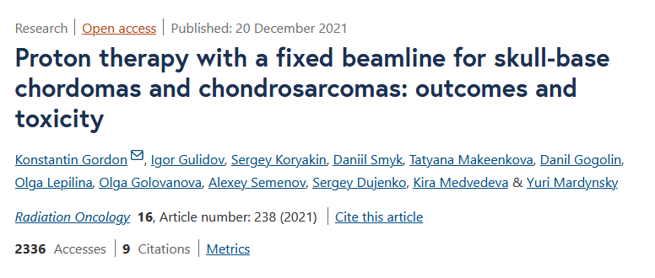
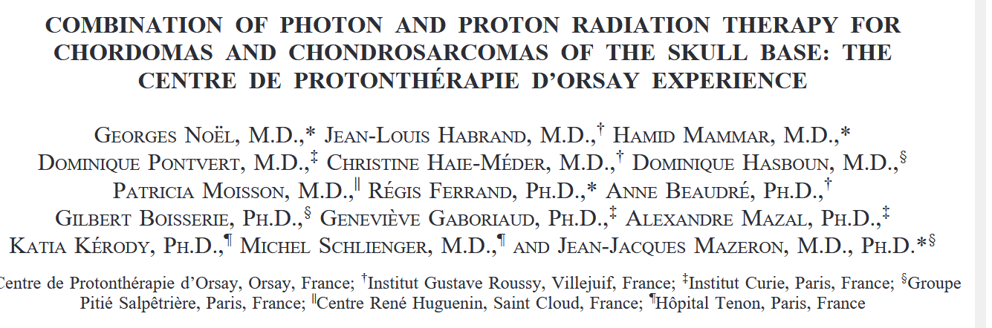
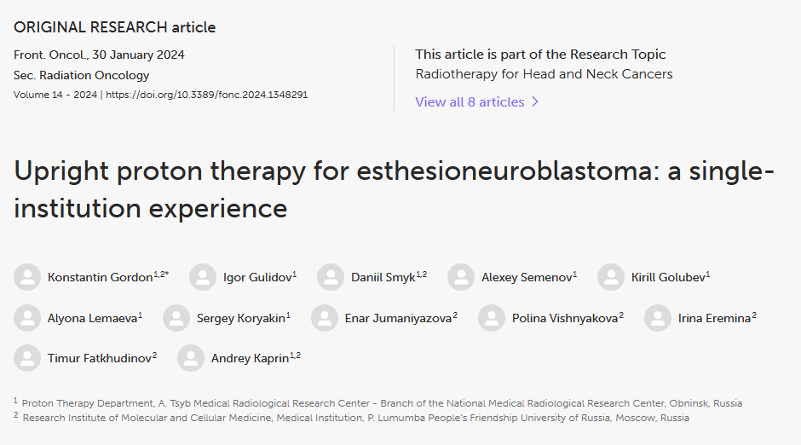
Upright proton therapy for head&neck cancer
Photon combined with upright protons in 2000
Promising results reported in literature for head and neck cancer
Historically, always the first site that is treated, because of simplicity and anatomical stability between positions
Photon combined with upright protons in 2000

Slide 9
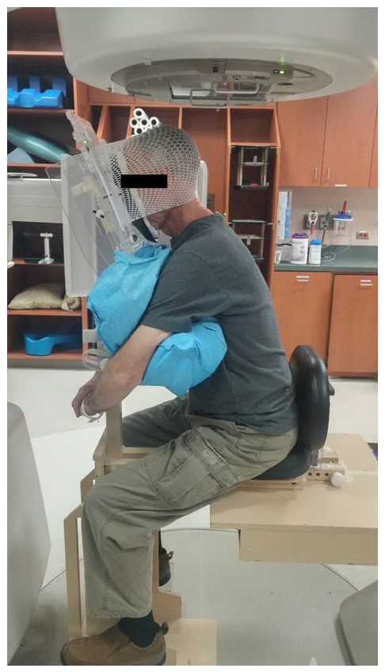
Patient comfort
“…all patients (with lung cancer) experienced the sitting position as more comfortable than the supine position” [1]
“…regarding comfort in the arms during treatment, patients (with HNC cancer) preferred the seated position over the supine position” [2]
“(pelvic) …the scores suggested positively in favour of the upright positioning system or at least similar…patients appreciated the easiness of getting in and out of the chair, they could breathe more easily, and most patients felt more stable in the upright position.” [3]
7 of 9 participants (breast) reported preferring the upright position [4]
[1] Duisters, Cindy, et al. Radiotherapy and oncology 79.3 (2006): 285-287.
[2] McCarroll, Rachel E., et al. JACMP 18.1 (2017): 223-229.
[3] Boisbouvier, S., et al. Technical Innovations & Patient Support in Radiation Oncology 24 (2022): 124-130.
[4] Boisbouvier, S., et al. Frontiers in Oncology 13 (2023): 1250678.
[2]

Slide 10
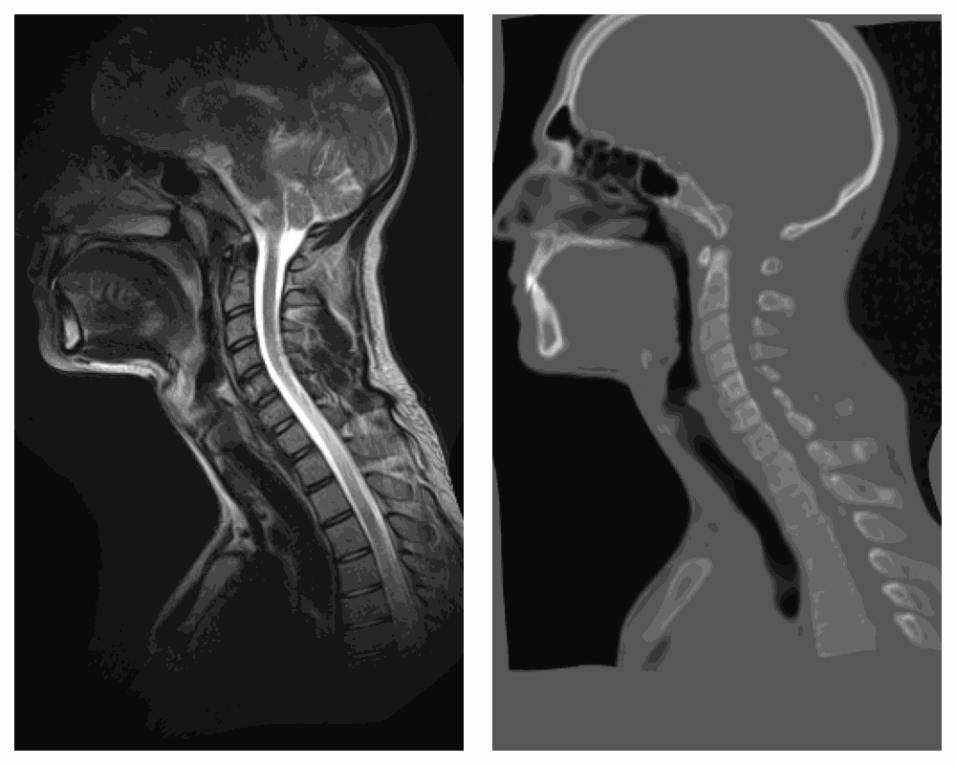

Anatomical differences supine to upright
Change in gravity affects (nearly) all treatment sites
  Sole exception: intracranial and even there, small differences appear e.g. at the optical nerves
Requires suitable robust planning and adaptive/motion mitigation strategies
Courtesy Ye Zhang (PSI) CPT-DIR (xialipku.github.io)
Li et al. (2024) ArXiv

Slide 11
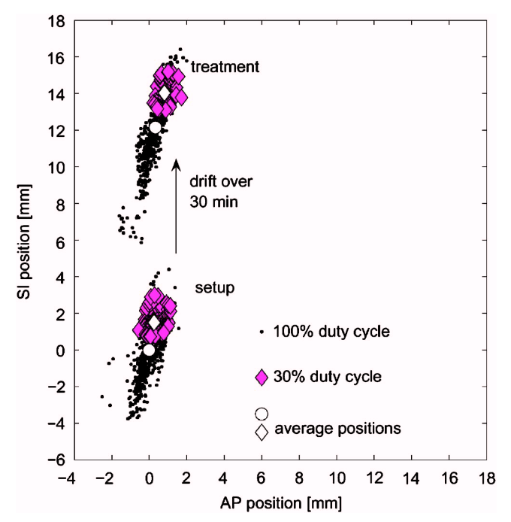
Challenge: anatomical differences between postures
Von Siebenthal (2007) open-bore MRI study:
  Liver drift over 30 of minutes after lying down
  Average position drift of 12mm observed
Inferior shifts in kidney by up to several centimeters
(Reiff et al. 1999, Hayes et al. 2013)
von Siebenthal et al. (2007) Med. Phys

Slide 12
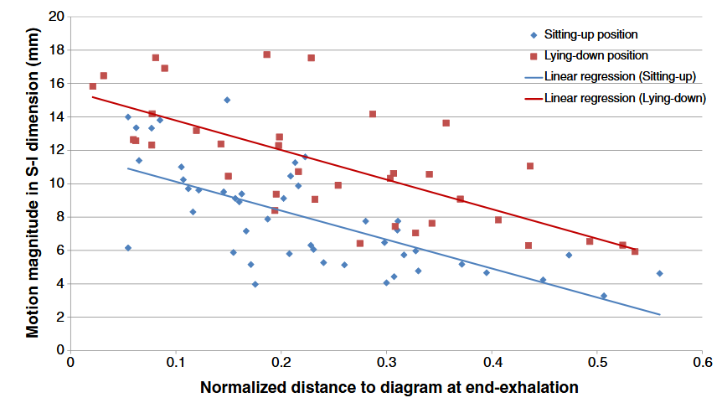
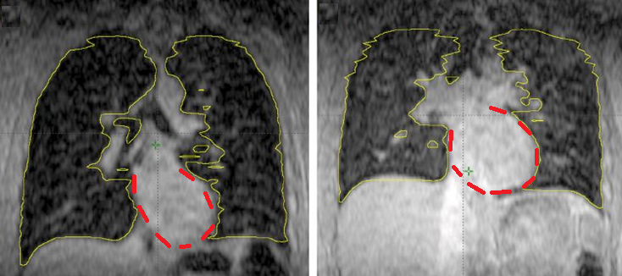
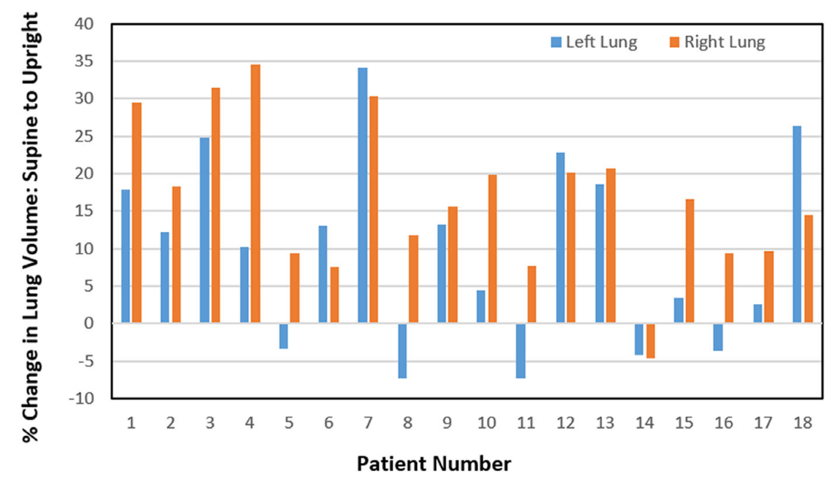
Anatomical differences: Lung
Upright
Supine
Yang et al. (2014) Pract. Radiat. Oncol.:
Increase in lung volume and reduced breathing motion
Marano et al. (2024) J. Appl. Clin. Med. Phys.:
Observed no significant difference in diaphragm motion

Slide 13
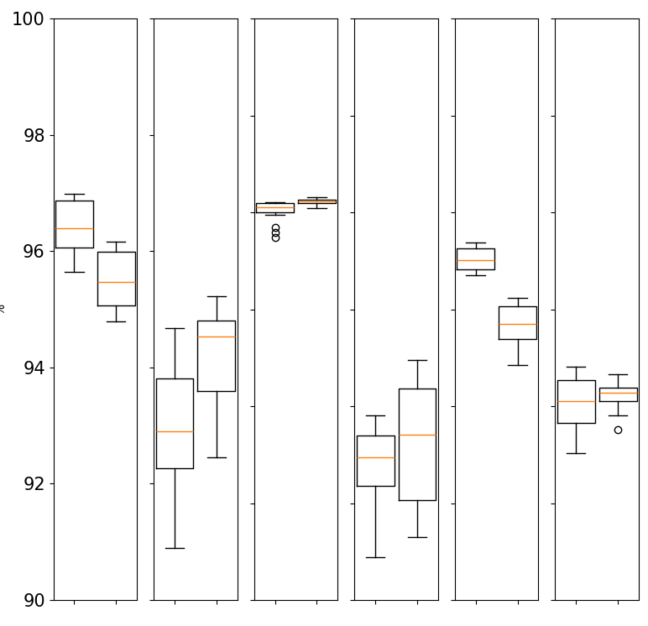
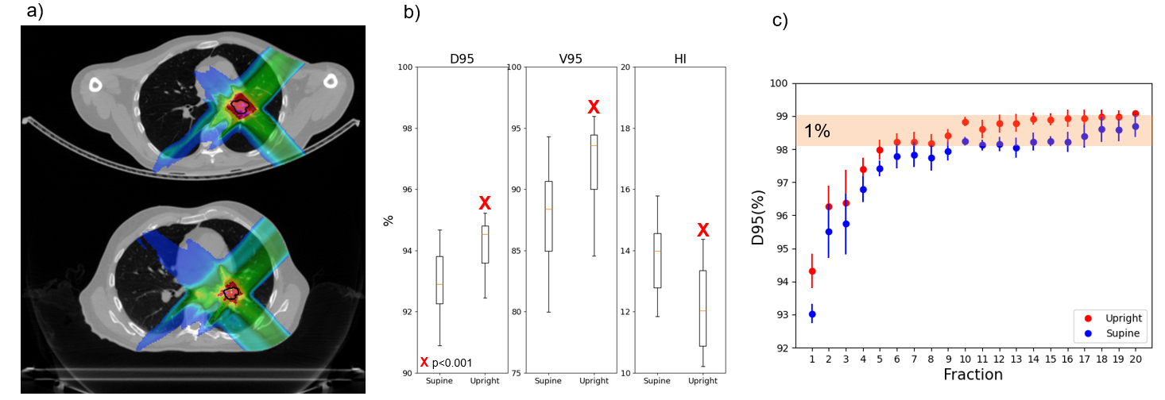
Upright versus Supine Carbon Ion Therapy
Target coverage
X p < 0.05
INTERPLAY EFFECT
P1
P2
P3
P4
P5
P6
Upright (Δmotion=3 mm)
X
X
Statistically significant difference for 3 patient
Supine D₉₅ > Upright D₉₅ for 2 patients
Maximum difference ~ 3%
D95 (%)
X
Supine (Δmotion=6 mm)
S U
S U
S U
S U
S U
S U
M.C. Martire et al., to be submitted
In cooperation with NWCPC

Slide 14
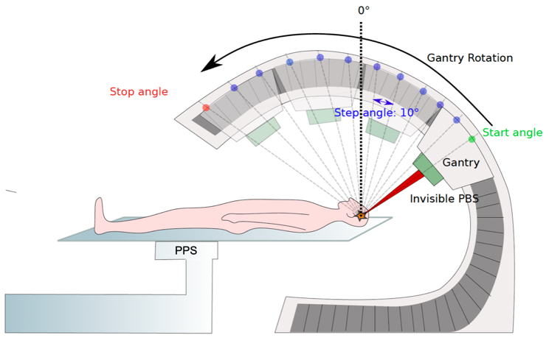
Particle arc therapy: exploiting the upright posture
S. Wuyckens (2024), PhD thesis
Sun et al. (2021) Front. Oncol.

Slide 15
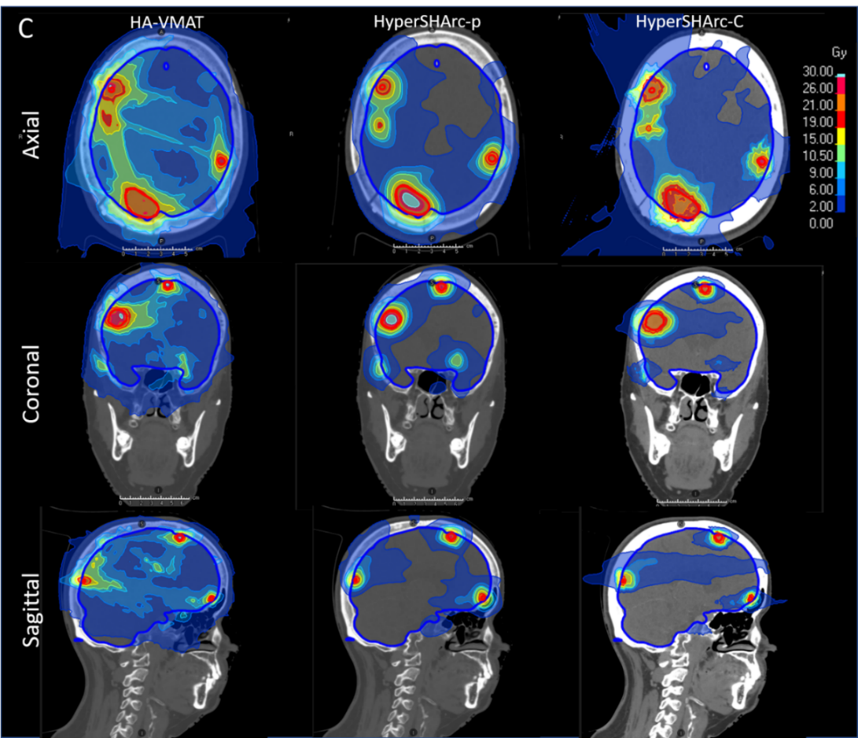
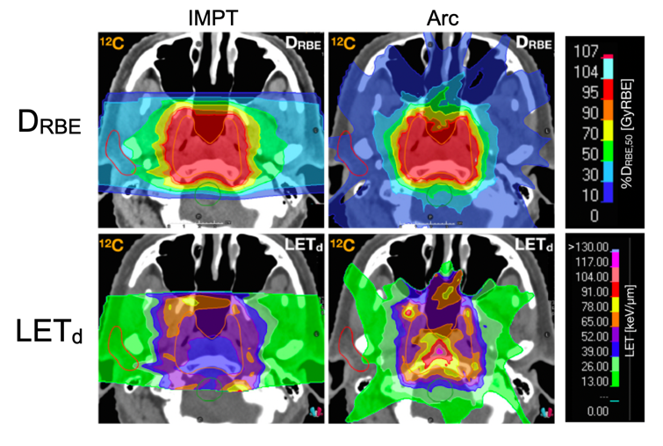
Particle arc therapy: LETd advantage and new treatment options
Ion arcs for patients with multiple brain metastases
L. Volz et al. (2025) Adv. Rad. Onc.
S. Mein et al. (2022) IJROBP

Slide 16
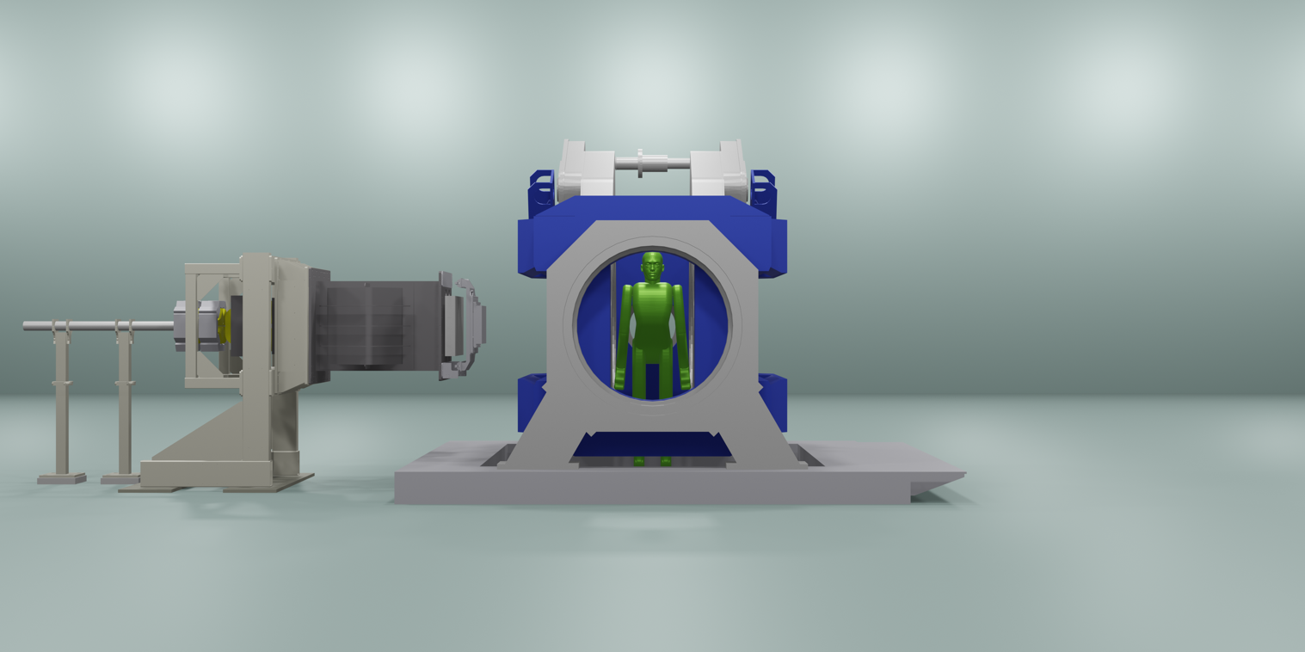
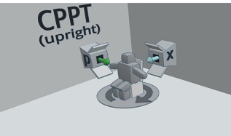
Advanced techniques
In-beam MR-guidance: A. Hoffmann, OncoRay
Combined photon-particle therapy: F. Amstutz et al.
Potential to enable advances techniques for even better dose shaping
Amstutz et al. (2024) Rad. Onc. Volume 190, 109973, January 202
Image courtesy: A. Hoffmann, OncoRay, Dresden, Germany

Slide 17
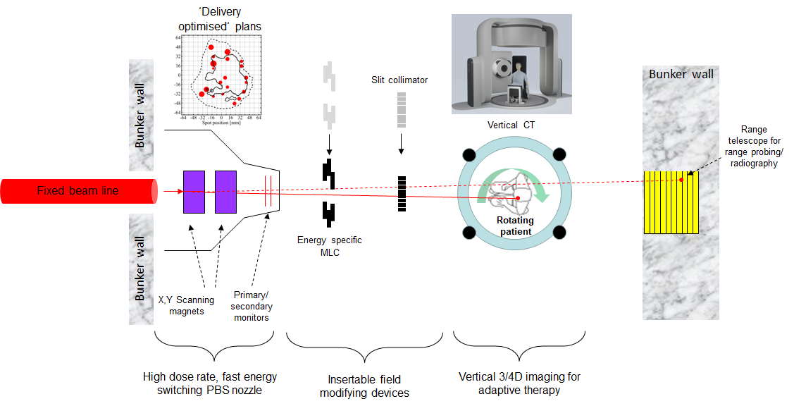
The “Swiss Army knife” of Particle Therapy – Tony Lomax
Courtesy to Tony Lomax (PSI)

Slide 18
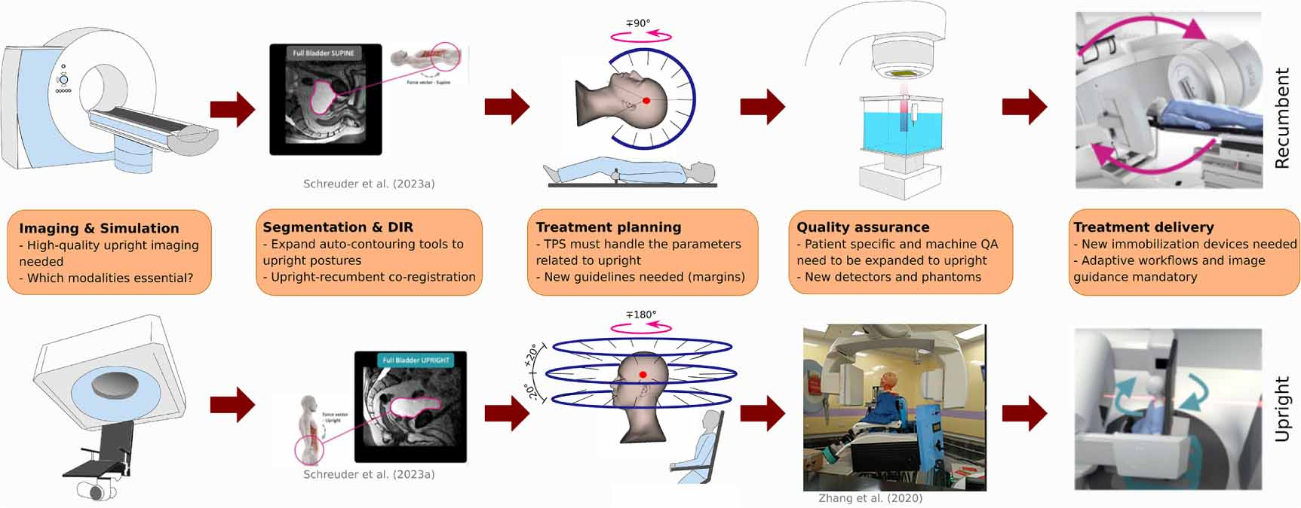
Gantry-less: a paradigm shift
Volz et al. (2024) PMB

Slide 19

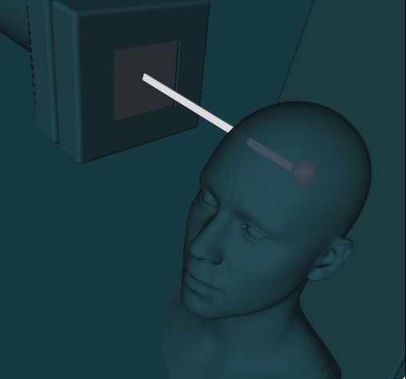


UPLIFT Doctoral network
19 PhD Projects at 15 Supervising Partners
~5M Euro funding
Headed by Christian Graeff at GSI
uplift-project.eu

Slide 21
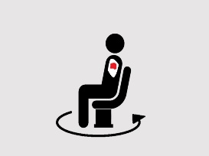
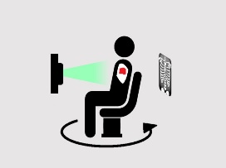
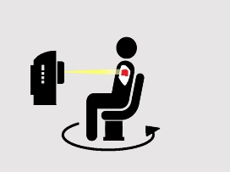
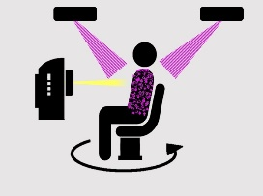
Literature on upright patient positioning
Review of upright photon therapy [1]
Review of upright particle therapy [2]
Commentary on the challenges of upright therapy and some suggested solutions [3]
In-depth review on past and present upright endeavours [4]
[1] Rahim, Sulman, et al. "Upright radiation therapy—A historical reflection and opportunities for future applications." Frontiers in Oncology 10 (2020): 213.
[2] Volz, Lennart, et al. "Considerations for upright particle therapy patient positioning and associated image guidance." Frontiers in Oncology 12 (2022): 930850.
[3] Hegarty, Sarah, et al. "Please Place Your Seat in the Full Upright Position: A Technical Framework for Landing Upright Radiation Therapy in the 21st Century." Frontiers in Oncology 12 (2022): 821887.
[4] Volz, Lennart et al. “Opportunities and challenges of upright patient positioning in radiotherapy” PMB 2024

Slide 22
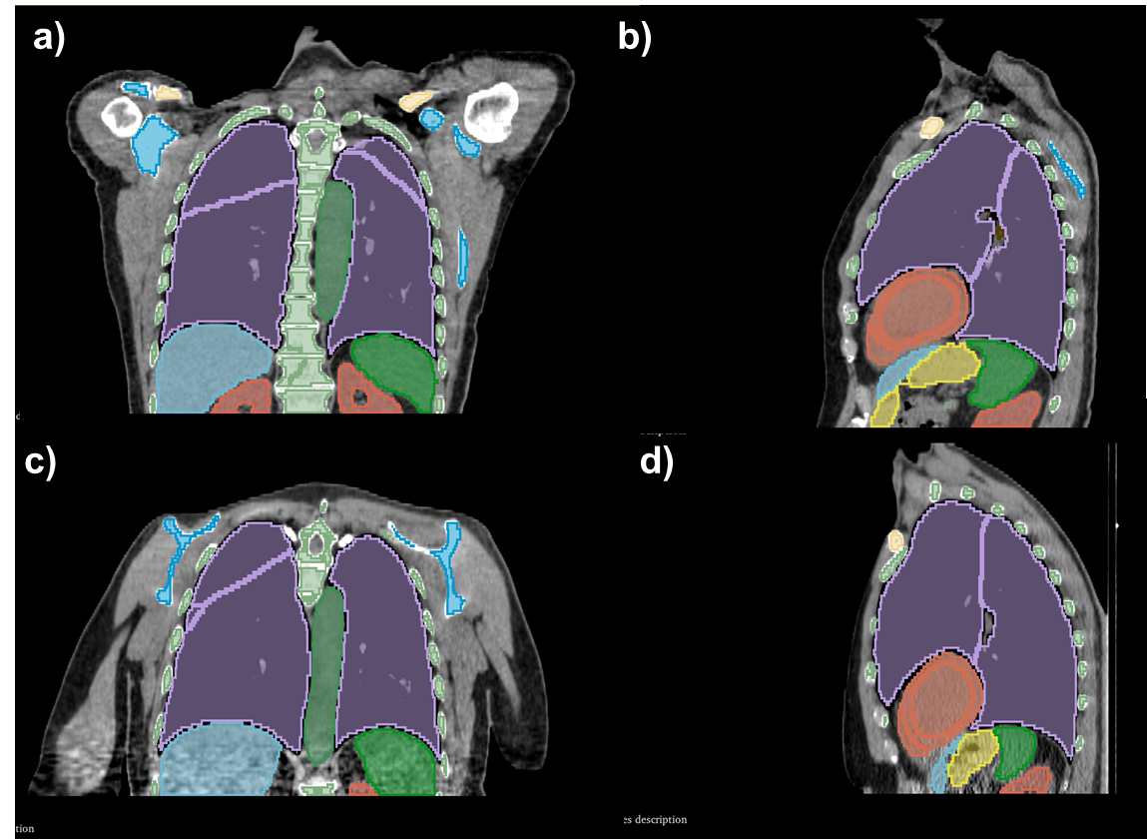
Auto-contouring tools
Auto-contouring tools need to be expanded to upright position
Promising results with supine trained AI segmentation tools (TotalSegmentator, Wassertal et al.)
  Further potential with retraining on limited datasets
Deformable image registration challenged by anatomy differences
Supine
Upright
M.C. Martire, L. Volz et al., to be submitted
In cooperation with NWCPC

Slide 23
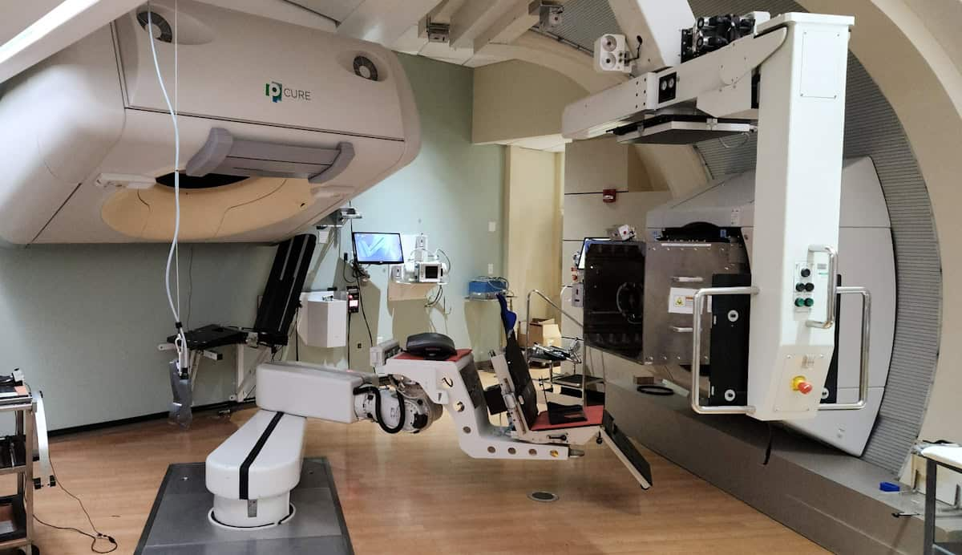
Technical challenge: one-fits-all solution?
At Chicago Proton Center:
Treatment of head&neck (since 2012) and thoracic patients (since 2016)
Two chairs, due to limited workspace and collision issues (robot arm with CT, nozzle)
https://physicsworld.com/a/hope-or-hype-can-upright-treatment-increase-access-to-advanced-radiotherapy/

