Slide 1
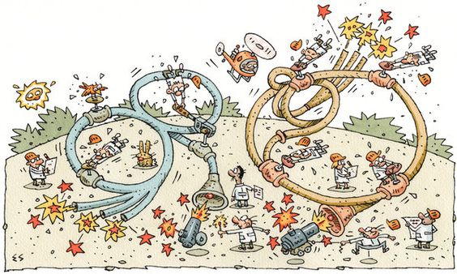
Options and perspectives for future ion therapy accelerator designs
Maurizio Vretenar, CERN
From Innovation to Implementation
Podgorica, 24-25 March 2025
Elwood Smith, NYT

Slide 2
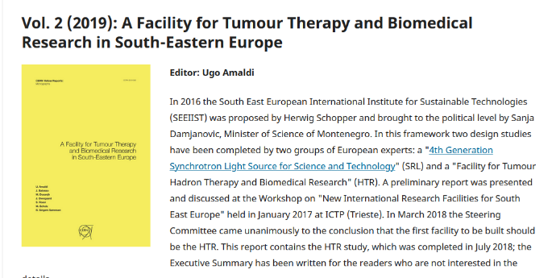
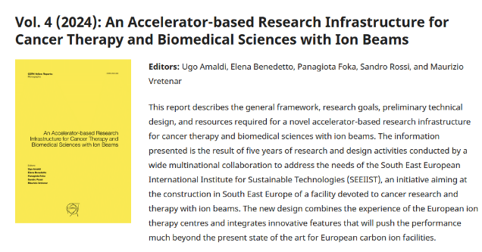
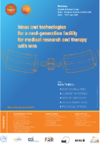
Particle therapy is changing – and we need to change with it
?
Original SEEIIST concept 03/2018 (Yellow report) → Workshop 06/2018 aimed at starting a Technical Design → analysis of different options (therapy and research) → baseline defined, submission to ESFRI in 09/2020 → Yellow Report in 2024.
7 years of work, but in the meantime particle therapy has significantly changed.
The goal of this presentation is to identify the trends that will lead to the therapy accelerators of the future, and the related opportunities in the SEEIIST countries and outside.

Slide 3
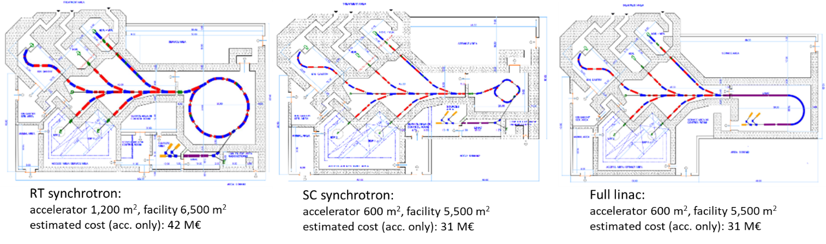
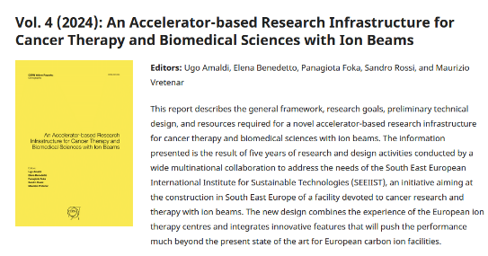
The pathway to the baseline SEEIIST design
Compared 3 accelerator options (conventional, superconducting, linear accelerator)
Baseline design is #1, warm-magnet synchrotron based on PIMMS (CNAO and MedAustron), with novel features. Flexible design, allowing both therapy and research.

Slide 4
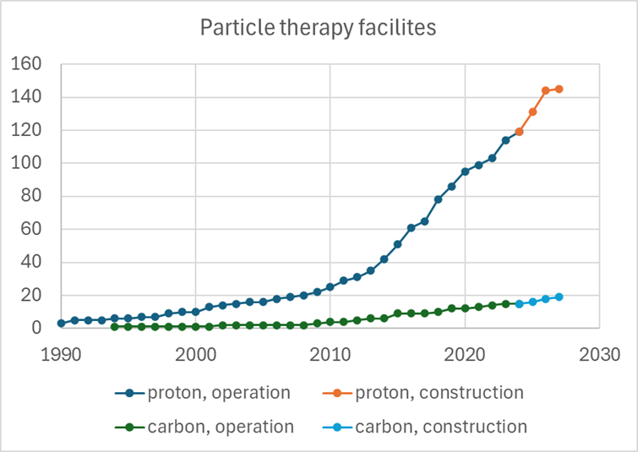
Where is particle therapy nowadays?
Despite all discussions on effectiveness versus cost, the number of particle therapy facilities worldwide is steadily increasing:
Proton therapy: 8.5/year in 2013-26 (decrease of 2021/22 overcome)
Carbon therapy: 0.9/year in 2008-2026
  Proton therapy grows 10 times faster than carbon therapy
Proton therapy is now a mature commercial market with a small number of competing companies.
New initiatives in the field have failed (AVO) because of a) large investments needed to enter a mature market, and b) technical challenges in industrialization.
Carbon therapy is now moving from the pioneering facilities based on scientific design to new industrialised designs.
New options are appearing: FLASH with electrons/ions, other ions, etc.
119 proton and 16 carbon ion therapy facilities in operation worldwide (2024)
(https://www.ptcog.org)

Slide 5
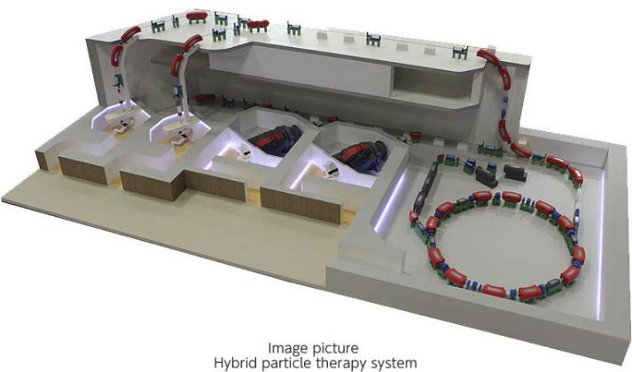
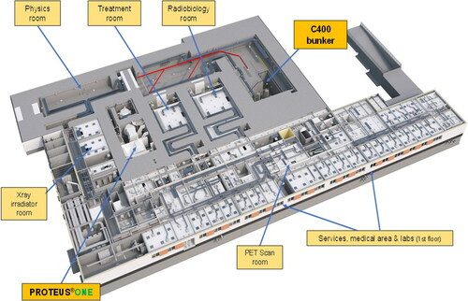
Carbon ion therapy is becoming commercial
Long time to market, >30 years from 1st unit
Mayo Clinic, USA
Cyclhade, France
Chevalier, F. et al., (2022). CYCLHAD: A French Facility Dedicated for Research and Treatment in Hadrontherapy. Nuclear Physics News, 32(2), 27–31.
https://www.hitachi-hightech.com/global/en/products/healthcare/treatment/pbt/hybrid.html
Hybrid particle therapy system from Hitachi (estimated $233M for entire facility incl. protons, X-ray), 19 m diameter over 1 floor
C400 cyclotron from IBA, 7 m diameter over 3 floors (RF, cyclotron, ion sources)
Two carbon ion therapy facilities in construction designed and built by commercial companies: Hitachi for Mayo Clinic (Florida, USA) and IBA for Cyclhade (Normandy, France).
Considering the large investment costs for technical development and medical licensing of a new therapy facility, is there space for a third new design?
Can we justify that this engages local industry and local talents?

Slide 6
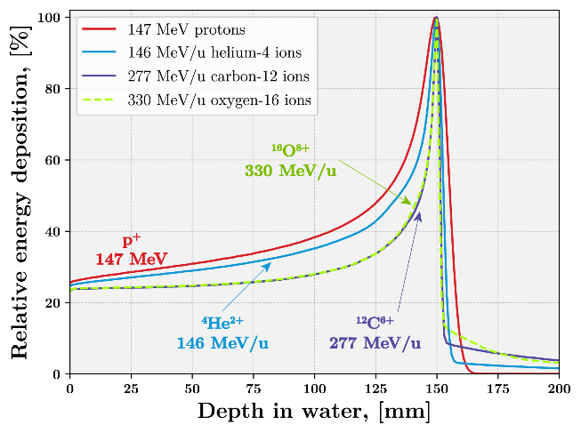
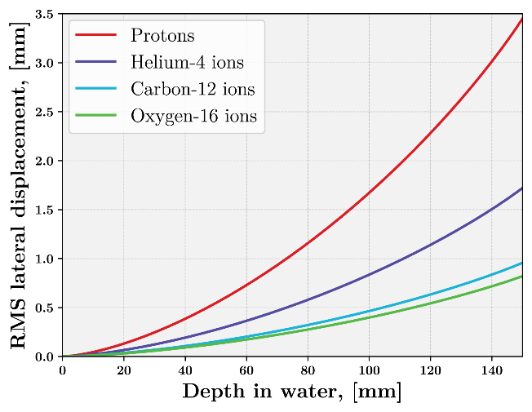
Innovative particles: helium ions
Therapy with helium ions, under development at HIT, may provide at reasonable accelerator cost superior conformality with excellent effectiveness. Ideal for pediatric patients.
Advantages in Physics:
reduced range straggling (longitudinal conformality) compared to protons
reduced penumbra (lateral conformality) compared to protons
reduced nuclear fragmentation tail (distal conformality) compared ¹²C
Advantages in Biology:
increased LET → increased RBE and reduced OER compared to protons
reduced RBE uncertainties and neutron dose compared to ¹²C
First clinical application to patient cohort finalized at HIT
Development by the NIMMS Collaboration at CERN of the design of a helium research and therapy facility → Preliminary Technical Design in a CERN Yellow Report in preparation, to be published in 2025
Courtesy of K. Palskis, Riga Tech. University

Slide 7
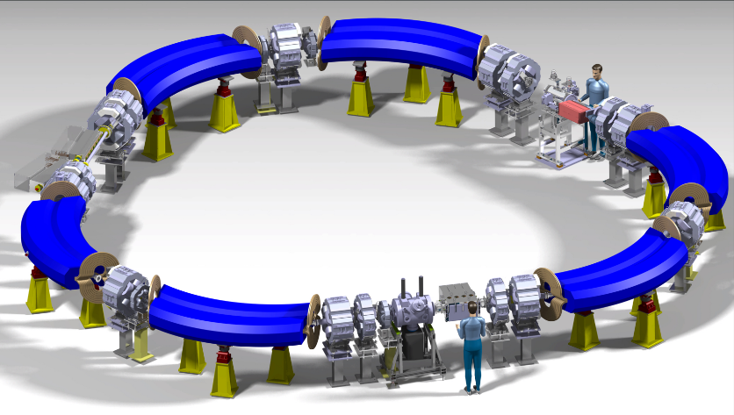
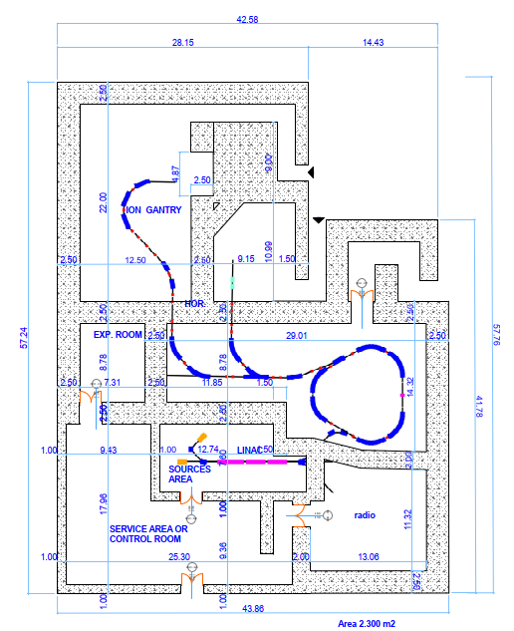
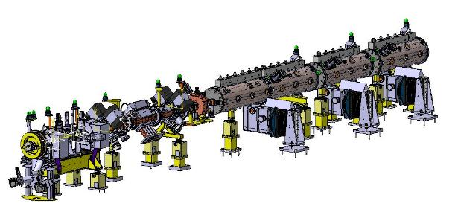
Innovative accelerators: Helium synchrotron (HeLICS)
HeLICS = Helium Light Ion Compact Synchrotron.
Triangular shape with 11 m side dimension.
FLASH extraction (RF phase displacement) under design.
Implementation of the facility in 2,500 m²
Interest from:
A Baltic consortium, for the Advanced Particle Therapy Centre for the Baltic States (APTCB).
TERA-CARE Foundation, for the Clinical Helium Facility for Switzerland (CHeFS)
11 m
Linac injector (8m)

Slide 8

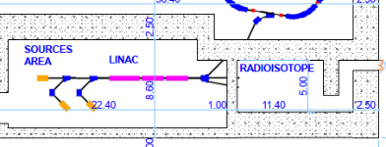
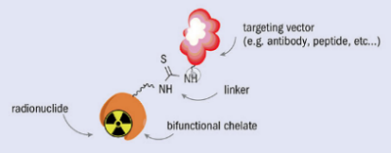
Innovative accelerators: coupling therapy and radioisotopes
The linear injector of a helium therapy synchrotron can be used to produce radioisotopes for imaging and therapy, in parallel to operation for therapy.
Linear accelerators are more efficient and less demanding than conventional cyclotrons for operation with helium ions.
Radioisotope | Usage
Scandium-43, 44 | Diagnostic – PET
Cobalt-57 | Diagnostic – SPECT
Copper-64 | Theranostic (β⁻)
Copper-67 | Theranostic (β⁻)
Indium-111 | Diagnostic – SPECT
Tin-117m | Theranostic (β⁻)
Samarium-153 | Theranostic (β⁻)
Rhenium-186 | Theranostic (β⁻)
Astatine-211 | Therapeutic (α)
synchrotron
radioisotope production target
Courtesy K. Palskis, RTU/CERN
Targeted Alpha Therapy with Astatine 211
211At emits alpha particles (2 protons+2 neutrons) that are the most dangerous radiation (short range and high toxicity). Attached to antibodies and injected to the patient, they can accumulate in the cancerous tissues and selectively deliver their dose.
Image credit: CERN Courier

Slide 9
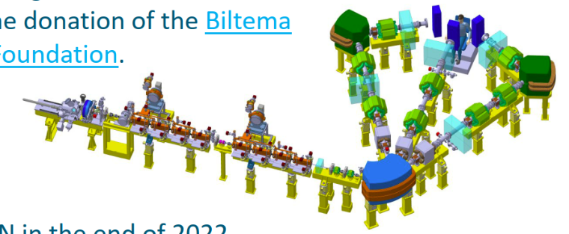
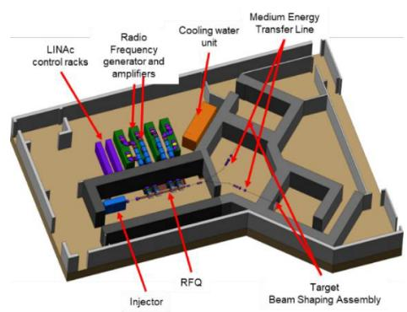
Innovative accelerators: FLASH with electrons, BNCT
Particle therapy in the wider sense is progressing in different directions. Here 2 major examples
Very High Energy Electrons for FLASH therapy
Boron Neutron Capture Therapy
Recent experimental evidence indicates that ultra-high dose rates can spare healthy tissues. Coupled with high-energy electron accelerators, may open a new avenue to cancer treatment.
Treatment of brain and HN cancers with alpha-particles emitted by decay of 10Boron. Patient injected with a tumor-localizing drug containing 10B, which is activated by an external accelerator-produced high-intensity neutron flux.
The DEFT 12 GHz VHEE design (CERN, TERIQ, CHUV)
C. Rossi, Linac24, Chicago
The Anthem BNCT design (INFN-LNL for Caserta (I)
A. Pisent et al., Linacc24, Chicago,
A FLASH electron linear accelerator will have an energy of 100 MeV, for a length of ~10 m.
Different prototype accelerators being developed, at 3 different frequency bands: 12 GHz, 6 GHz, 3 GHz.
A BNCT proton linear accelerator can be RF or DC. It will have an energy of ~5 MeV, for a length of about 5 m

Slide 10
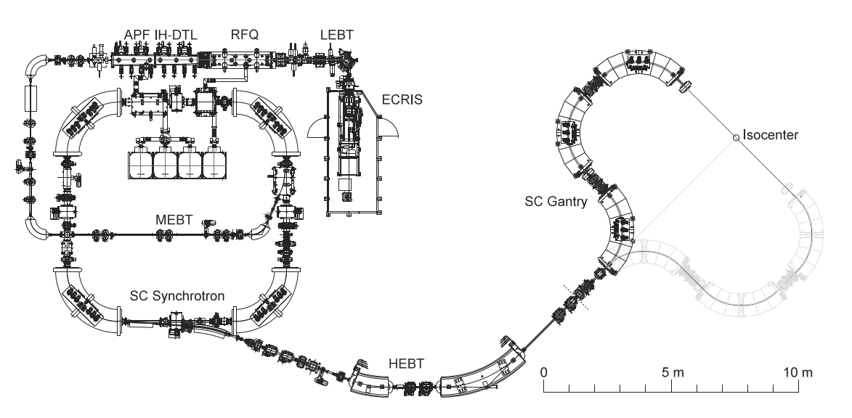
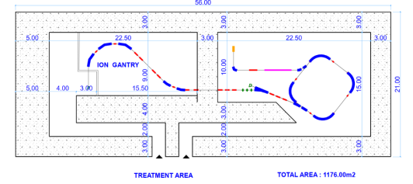
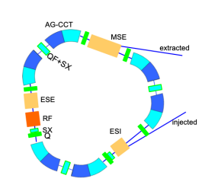
Innovative accelerators: superconducting carbon synchrotron
Compact Carbon Ion therapy facilities based on a superconducting synchrotron
HIMAC (Japan), prototype synchrotron in construction
NIMMS/HITRI+ (EU), demonstrator magnets in construction
Square synchrotron, rep. rate 0.1 Hz, 3 10⁸ pps, 3.5 T dipoles, 30 m circ., 45mx33m w/o shielding
Triangular synchrotron , similar lattice to HeLICS,
rep. rate 0.33 Hz, 3 T dipoles (CCT type), 56mx21m
Y. Iwata et al. , Design of a compact superconducting accelerator for advanced heavy-ion therapy, NIM-A, 1053, 2023
E. Benedetto, M. Vretenar, Innovations in the Next Generation Medical Accelerators for Therapy with Ion Beams, IPAC23, Venice
Compact designs, but:
Limited by magnet ramp rate to <1 Hz operation
Limited advantages in power consumption (small duty cycle)

Slide 11


Innovative accelerators: the impact of AI
The new generation of compact accelerators must be optimized and controlled by Machine Learning and Artificial Intelligence – significant efforts ongoing in the particle accelerator community, small accelerators are the ideal test bed for new software.
Can AI change the business model of commercial particle therapy accelerators?
So far, companies producing commercial particle therapy accelerators make their profit via expensive operation and maintenance contracts. The accelerator is operated by personnel provided by the company, and the local staff has no access to the accelerator. Besides costs, this makes impossible using the accelerator for development of new treatment modalities.
In a not-so-far future, the operation of the accelerator could become completely AI-driven. The goal is that the accelerator becomes a simple button, to be operated by the clinical control room.

Slide 12
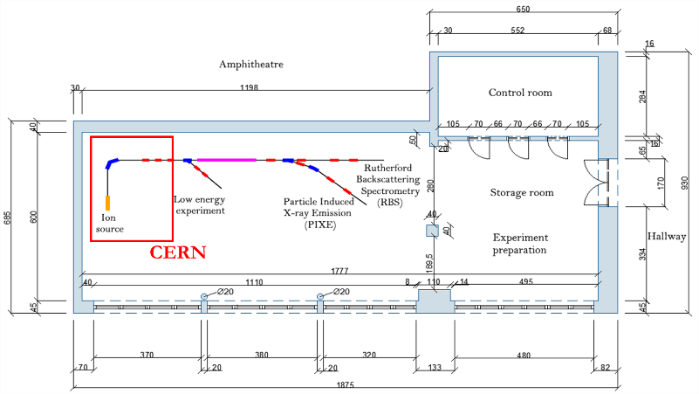
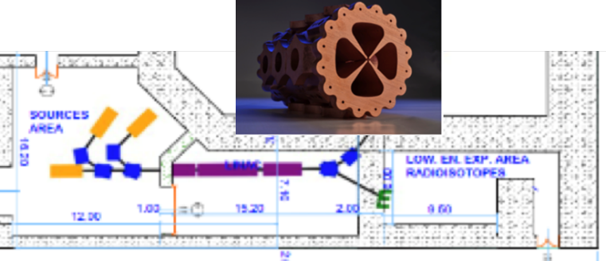
Some conclusions: from innovation to implementation
We have already (too) many designs to choose from, what we miss is a clear path to implementation:
Select the accelerator technology: an emerging technology requires more time (and cost?) to implement but has an impact on regional industry and training – and on science. Avoid the costs and risk of competing with companies already present in a mature commercial market.
Develop a learning curve: start small and advance in stages, to progressively build capacity and competence – and to demonstrate accountability.
Build collaborations and associate industry at the earliest possible stage - to develop a design that can be easily industrialized and reproduced.
Sarajevski Akcelerator Jona (SARAI)
UNSA-CERN-JSI-GSI-COSYLAB-PANTECH.-CIEMAT, 3 Physicists Foundation (3PF) + Ministarstvo Nauke Kantona Sarajevo
2
examples
IFIGENEIA: Excellence Hub HORIZON WIDERA Innovative Facility for Isotope GENeration with Efficient Ion Accelerator : AUTH + 21 partners (GR, CY, SL)

Slide 13
Thank you for your attention
Elwood Smith, NYT

