Slide 1




Advancements in Superconducting Magnet Design for Carbon Ion Therapy
HITRIplus WP8 – Superconducting Magnet Design
Ernesto De Matteis (wp8 coordinator)
4th Project meeting and Hadrontherapy Workshop - From Innovation to Implementation
25 MARCH 2025, Podgorica, Montenegro
On behalf of my wp8 hitriplus colleagues

Slide 2
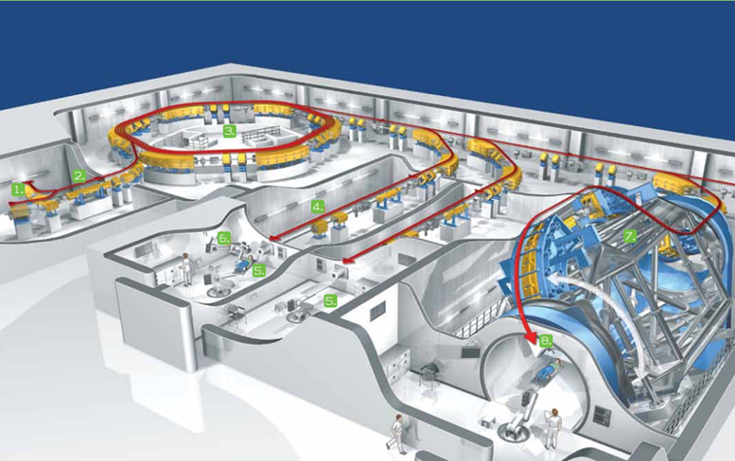
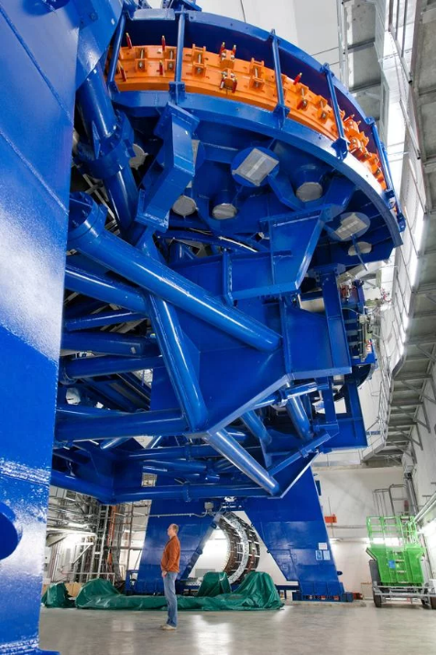
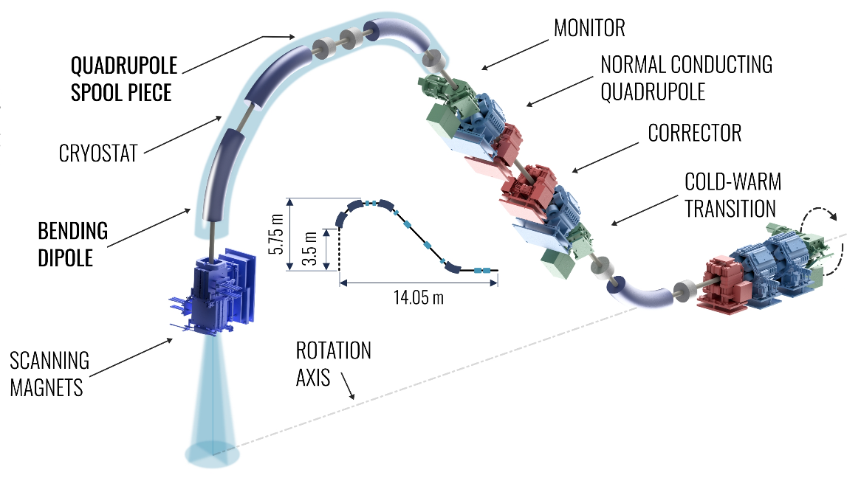
Superconductivity can reduce the footprint of medical facilities
HIT - Heidelberg Ion Beam Therapy Center
Accelerator hall → standard resistive magnet synchrotron vs SC magnets
Resistive dipoles 1.5 T
Curvature radius of about 4.5 m
Courtesy of E. Benedetto (TERA, SEEIST study)
Four 90 degree dipoles at 3.5 T
Curvature radius of about 2 m
Heavy Ion Therapy Rotating Gantry
Footprint and cost reduction;
Reduce the power consumption;
25 m long
13 m diameter
600 tons rotation
670 tons total
Courtesy of E. Felcini (CNAO)
23 May 2024
E. De. MaTTeis - Advancements in Superconducting Magnet Design for Carbon Ion Therapy – 4th HITRIplus Project meeting
2

Slide 3
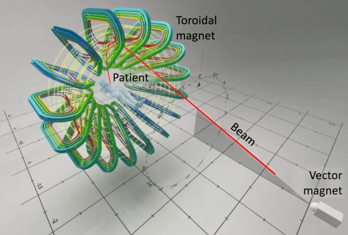
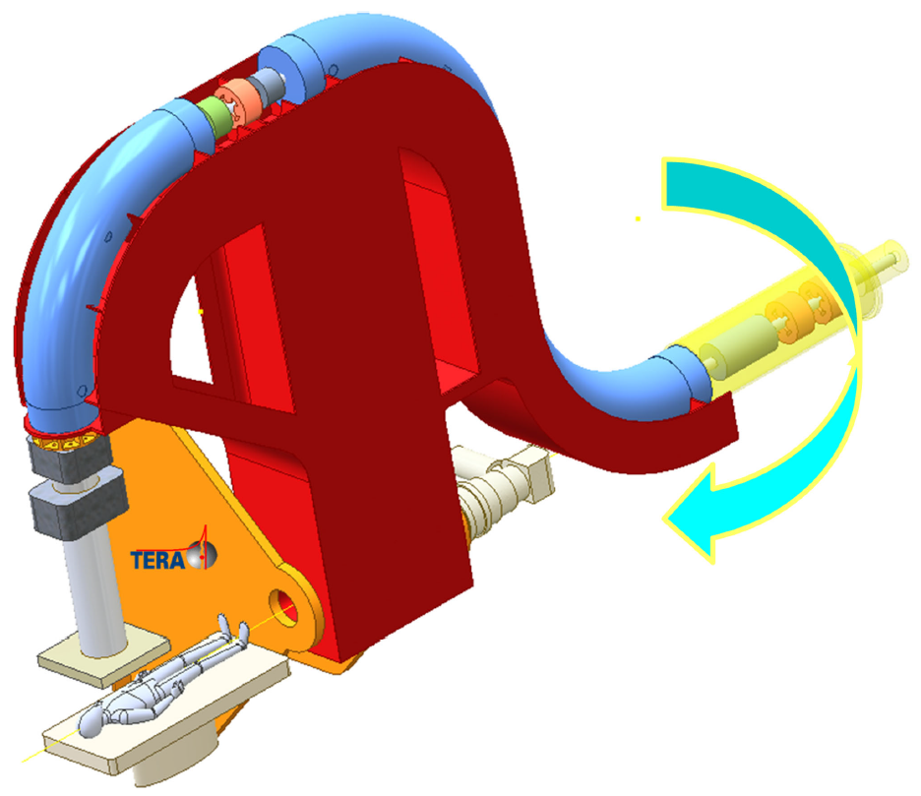


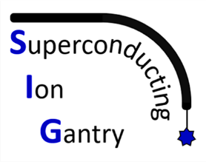

Superconducting magnet technology: EU initiatives
Application of the Superconducting magnet technology for size and cost reduction (energy saving)
EU initiatives started by CERN in 2018-2020:
1) Concept of GaToroid (CERN);
2) Concept of compact rotatable gantry SIGRUM(TERA, CERN);
End 2020: review to decide between GaToroid and Sigrum rotatable gantry→ decision to explore more in detail rotatable gantry and continue the study on the Gatoroid;
2021: setting up of the HITRIplus and IFAST projects with WPs for accelerator and gantry based on superconducting magnets (CCT dipoles);
2022: setting up of INFN call SIG, then EUROSIG, focused on the study of a rotatable superconducting gantry based on Curved CosTheta magnet.
GATOROID
SIGRUM
25 March 2025
E. De. MaTTeis - Advancements in Superconducting Magnet Design for Carbon Ion Therapy – 4th HITRIplus Project meeting
3

Slide 4


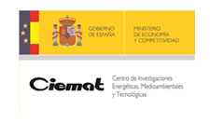







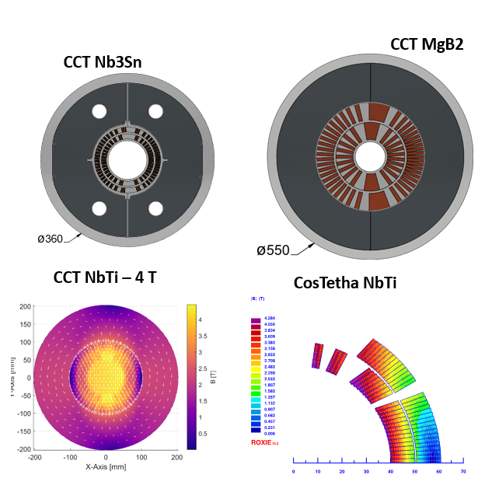
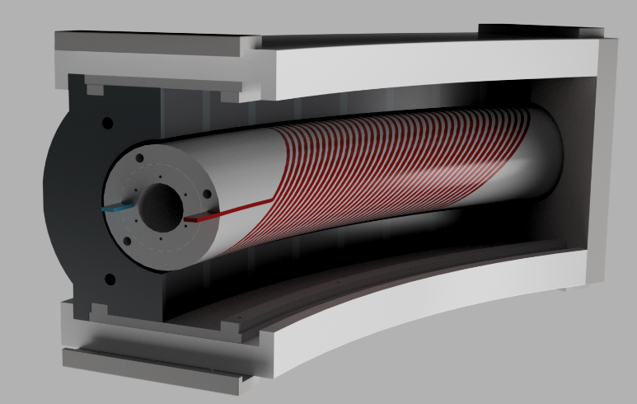
HITRIplus WP8 – Superconducting magnet design
First technical and financial assessment of various magnet designs: Canted cosine theta and Cosine theta layouts with several superconductors (NbTi, Nb3Sn and HTS);
Preliminary engineering design for the new concept of accelerator magnets and innovative gantry magnet;
Construction and test of a small demonstrator for feedback useful for accelerator as well as gantry final magnet design.
Comparison of various magnet designs
Final magnet design
The decision¹ to explore a curved Canted Cosine Theta layout magnet based on NbTi (Low losses strand) and conductor (rope 6+1 strands):
¹E. De Matteis, S. Mariotto, T. Lecrevisse, M. Prioli, S. Sorti, M. Statera, L. Rossi, “Magnet Assessment for SC accelerator and gantry”, HITRIplus WP8 - Deliverable 8.1, Zenodo. https://doi.org/10.5281/zenodo.7875298
25 March 2025
E. De. MaTTeis - Advancements in Superconducting Magnet Design for Carbon Ion Therapy – 4th HITRIplus Project meeting
4

Slide 5
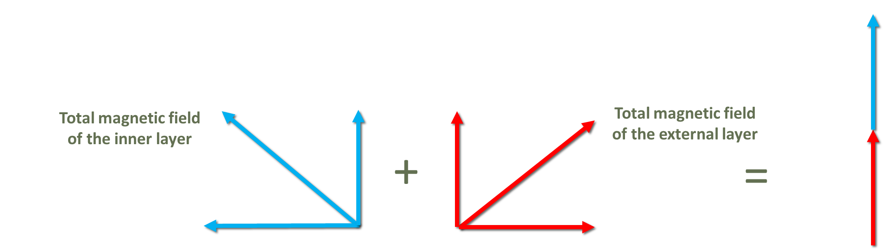
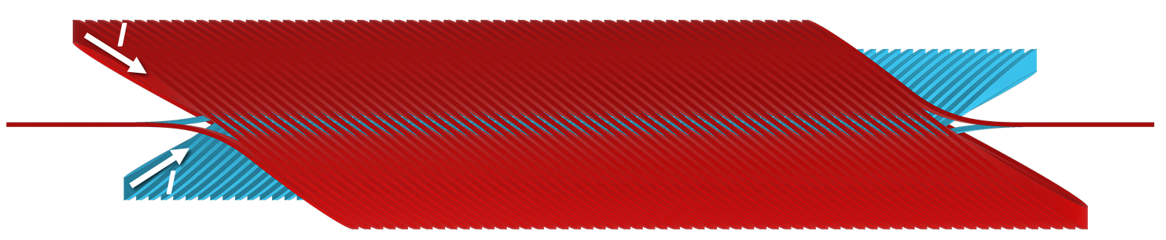
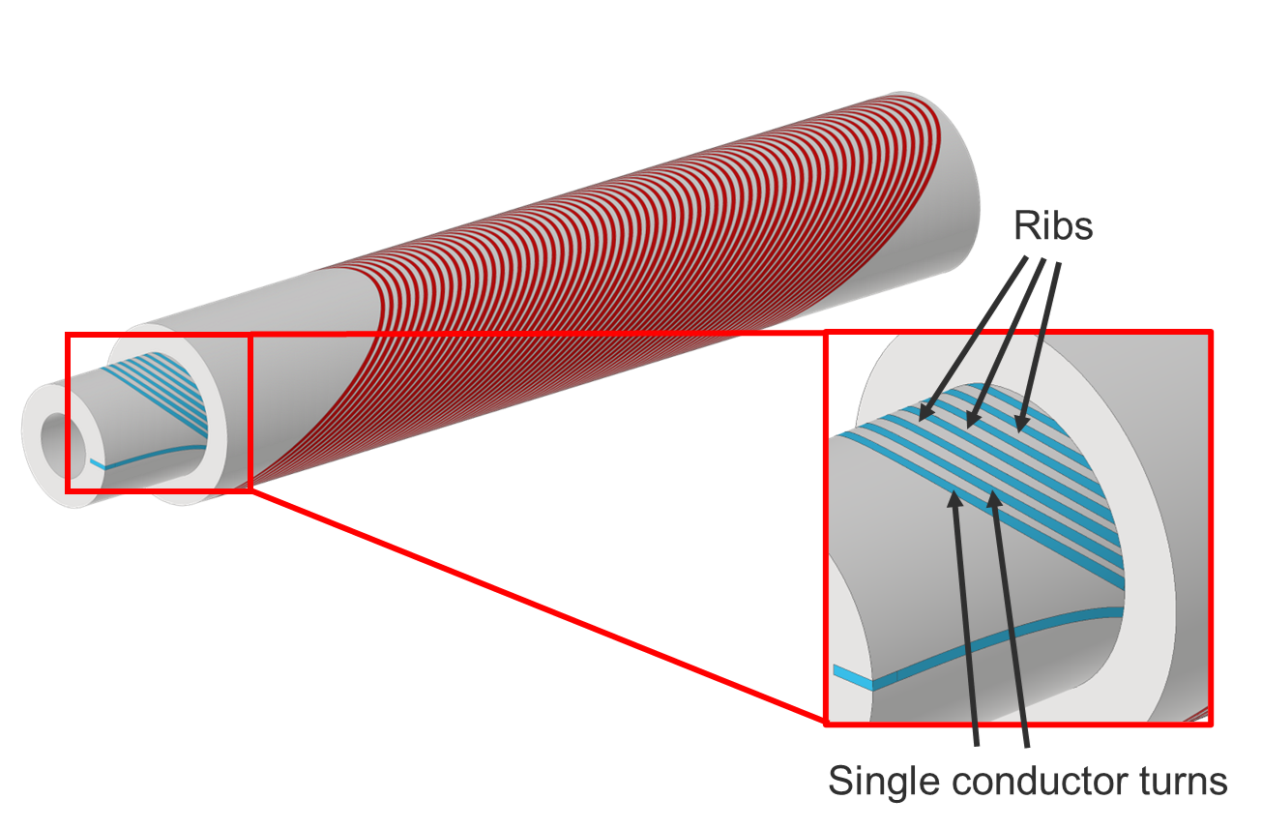
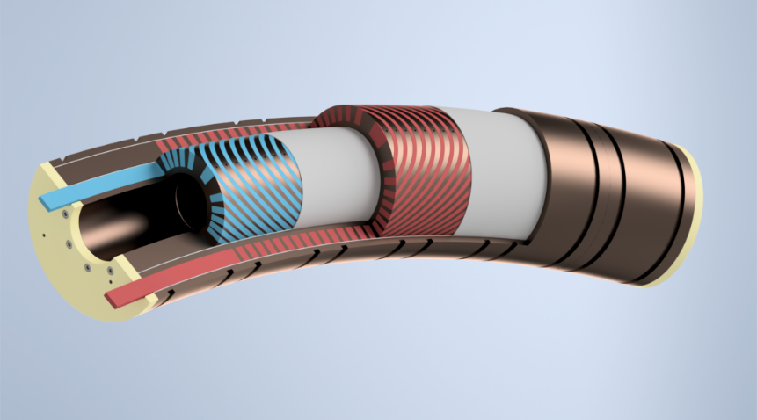
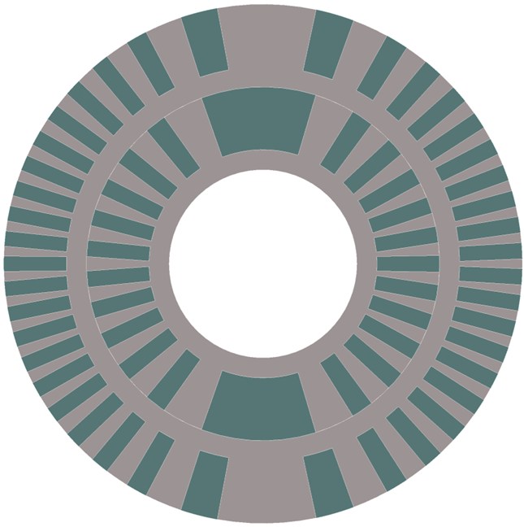
Canted-Cosine-Theta (CCT) Magnet
The CCT design is based on pairs of canted conductor layers:
G. Ceruti – CERN (ex INFN-Milano-LASA)
Current I flows in the two conductors so that the transverse magnetic field components sum and axial field components cancel each other.
Canted Cosine Theta schematics
Straight
Curved CCT
25 March 2025
E. De. MaTTeis - Advancements in Superconducting Magnet Design for Carbon Ion Therapy – 4th HITRIplus Project meeting
5

Slide 6
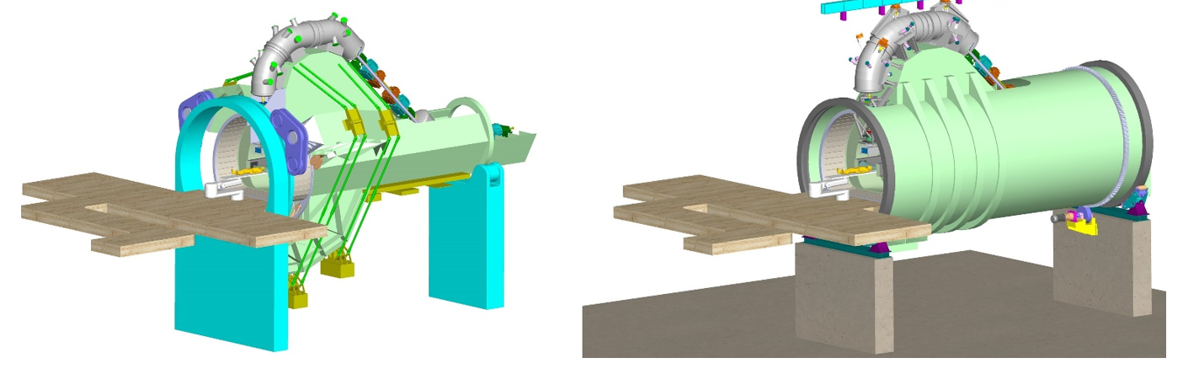
Parameters of demonstrator magnet
Carbon Ion Beam rigidity (6.6 Tm)
Parameters | Values | unit
Magnet type | CCT + Iron | -
Geometry | Curved | -
Central magnetic field B₀ | 4 | T
Curvature radius ρ | 1.65 | m
Bending angle | 30°-45° | degree
Magnetic and physical length | 0.8, 1 | m
Bore diameter | 80 | mm
dB/dt | 0.4 | T/s
Operation temperature | 4.7 | K
Loadline margin (@4.7 K) static | 25 | %
Superconductor | NbTi | -
Superconducting Rotating Gantry
Courtesy of M. Vretenar (CERN) and L. Piacentini (RTU)- WP7 HITRIplus
25 March 2025
E. De. MaTTeis - Advancements in Superconducting Magnet Design for Carbon Ion Therapy – 4th HITRIplus Project meeting
6

Slide 7

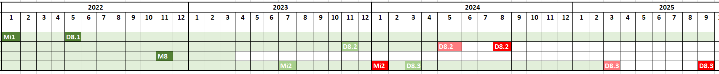
WP8 Timeline – MLS and DLVs
Task 8.1
Task 8.2
Task 8.3
Task 8.4
2026
Deliverables
  D8.1 (05/2022): Magnet Assessment for SC accelerator and gantry (ACHIEVED)
  D8.2 (08/2024): TDR (Technical Design Report) (ACHIEVED)
  D8.3 (03/2025→09/2025→2026): Magnet Demonstrator (we need an additional extension);
    The postponement of the deliverables was necessary due to the difficulty to machine the curved formers.
Milestones:
  Mi1 – Internal (01/2022): Decision on layout of demonstrator magnet (ACHIEVED);
  M8 (11/2022): Magnet Layout decision and Engineering design (ACHIEVED)
  Mi2 – Internal (01/2024): Manufacturing readiness of demonstrator(ACHIEVED):
    Conductor, curved formers and part of the tooling are defined – simplified assembly without Iron yoke.
De Matteis, E., Lecrevisse, T., Mariotto, S., Prioli, M., Sorti, S., Statera, M., & Rossi, L. (2022). Magnet Assessment for SC accelerator and gantry (1.0). Zenodo. https://doi.org/10.5281/zenodo.7875298
Barna, D., Ceruti, G., De Matteis, E., Sorti, S., Felcini, E., & Benedetto, E. (2023). Magnet Layout decision and engineering design report of the curved CCT dipole magnet demonstrator (1.0). Zenodo. https://doi.org/10.5281/zenodo.8096053
25 March 2025
E. De. MaTTeis - Advancements in Superconducting Magnet Design for Carbon Ion Therapy – 4th HITRIplus Project meeting
7

Slide 8
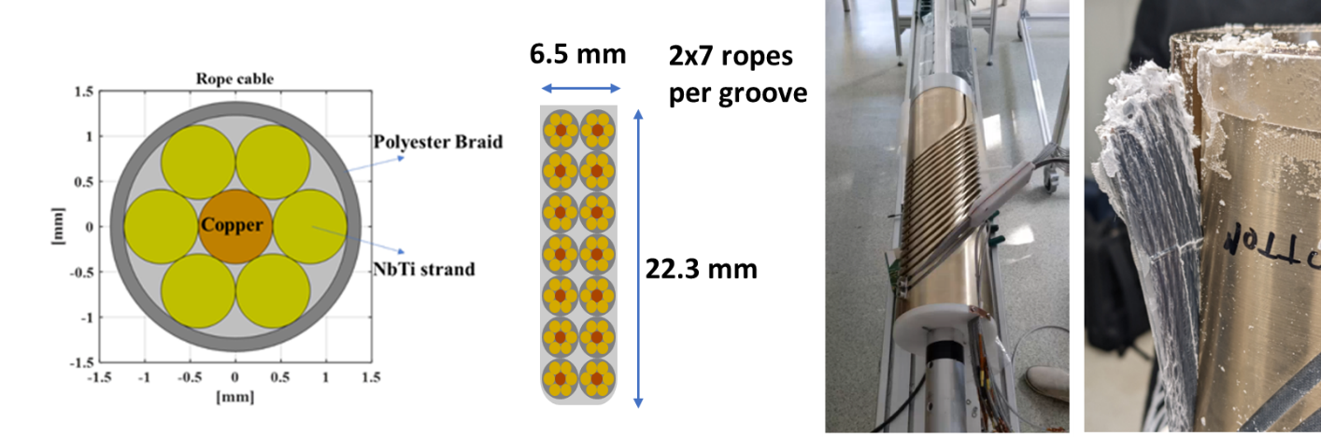
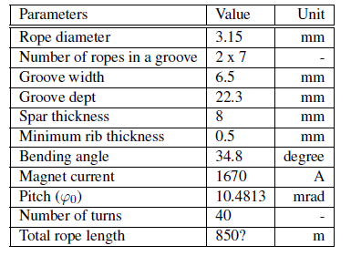
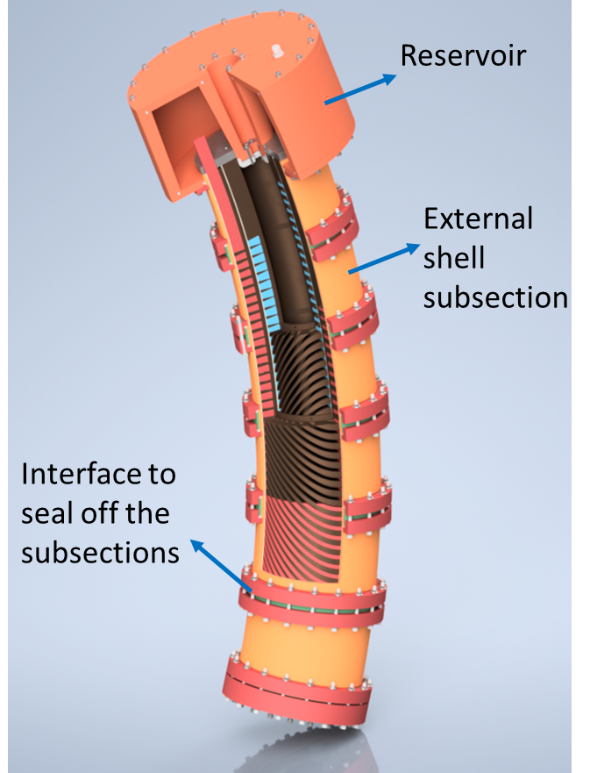
Conductor layout, Materials and Procedures (TDR¹ – D8.2)
Rope Conductor Design
6 NbTi strands + 1 copper core
Double braided polyester insulation
Low-loss NbTi strand
Industrial low-cost cabling
Simplified Manufacturing
Easy winding with minimal tooling
Reduced tool count for fabrication
Wax-Based Impregnation
Magnet structure serves as impregnation mold;
Reversible process – allows recovery of components;
Enables non-quench operation;
Excellent thermal conductivity – ideal for conduction-cooled systems (e.g., gantries).
¹ E. De Matteis, D. Barna, M. Castoldi, N. Ciarchi, G.
Ceruti, S. Sorti, F. Toral (2024). Technical Design Report: Final report on Magnet design for SC synchrotron and SC gantry. to be submitted on Zenodo.
25 March 2025
E. De. MaTTeis - Advancements in Superconducting Magnet Design for Carbon Ion Therapy – 4th HITRIplus Project meeting
8

Slide 9
Magnetic design and field quality (TDR¹ – D8.2)
Yoke Optimization Challenge:
  Coil optimization handles linear sources
  Iron yoke introduces nonlinearities (e.g. sextupole component)
Sextupole Mitigation Strategy:
  Cannot be corrected by coil tuning
  Requires active yoke shaping
Optimization Techniques:
  Insertion of holes in specific yoke regions (e.g. ~60° from midplane)
  Pole shaping as complementary method
Modeling Approach:
  2D asymmetric model with homogenized coils
Results:
  2D optimization: homogeneity ~25 units
  3D model (30° section): final homogeneity <7 units
¹ E. De Matteis, D. Barna, M. Castoldi, N. Ciarchi, G. Ceruti, S. Sorti, F. Toral (2024). Technical Design Report: Final report on Magnet design for SC synchrotron and SC gantry. to be submitted on Zenodo.
25 March 2025
E. De. MaTTeis - Advancements in Superconducting Magnet Design for Carbon Ion Therapy – 4th HITRIplus Project meeting
9

Slide 10
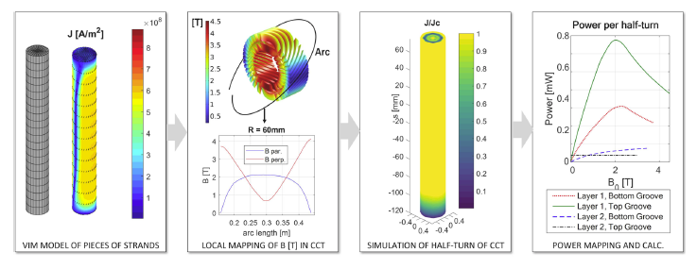

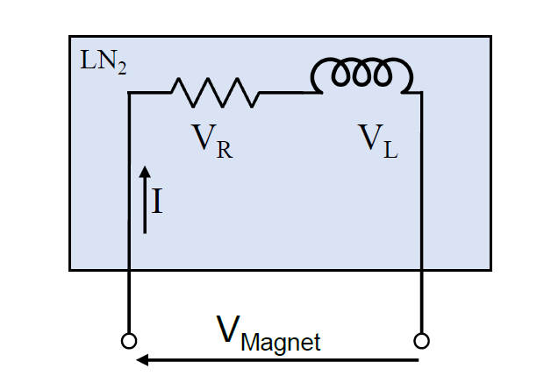
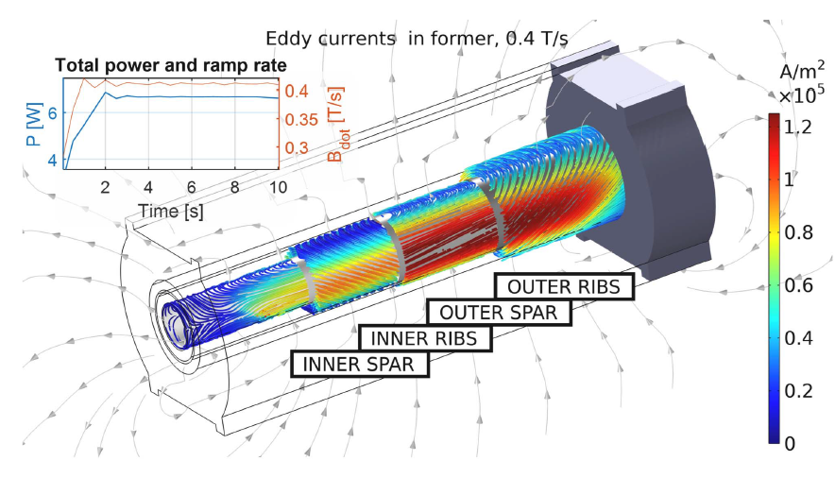
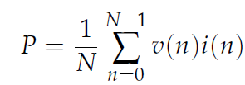

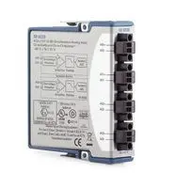
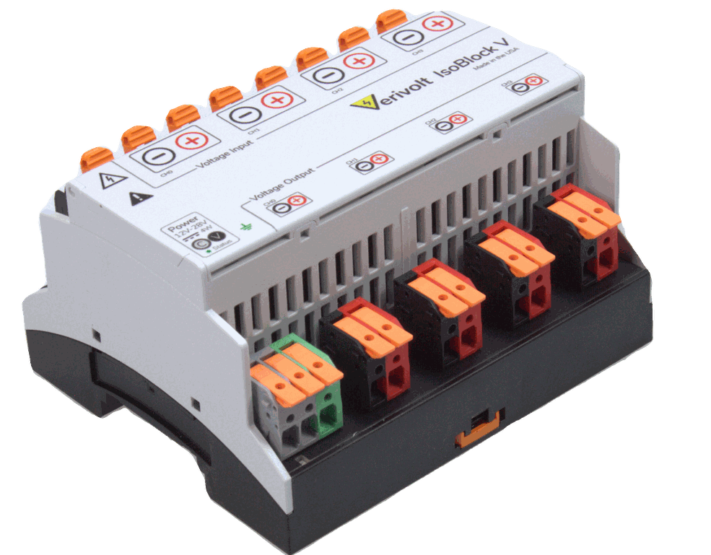
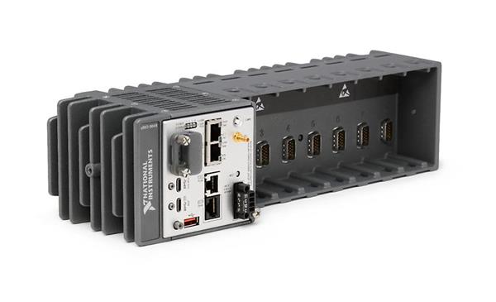
Electromagnetic losses¹ due to fast ramping (0.4 T/s) (TDR – D8.2)
AC Loss Estimation Method:
Based on 3D time-domain FEM simulation in COMSOL 6.1.
Material Considerations:
  Eddy losses ∝ 1/ρ → resistivity sensitivity
  Aluminum-Bronze chosen for the former
Total Estimated Losses:
  ~15–16 W during ramping at 0.4 T/s
Calculation Workflow of interfilament coupling losses in the superconductor
AC losses measurement system (IRIS project)
Power losses due to metallic Al-Br formers
NI-9239
Isoblock
cRIO-9049
¹S. Sorti et al., "Electromagnetic Losses in Fast-Ramped Canted-Cosine-Theta Magnets," in IEEE Transactions on Applied Superconductivity, vol. 34, no. 3, pp. 1-6, May 2024, Art no. 4003506, doi: 10.1109/TASC.2024.3360933.
25 March 2025
E. De. MaTTeis - Advancements in Superconducting Magnet Design for Carbon Ion Therapy – 4th HITRIplus Project meeting
10

Slide 11
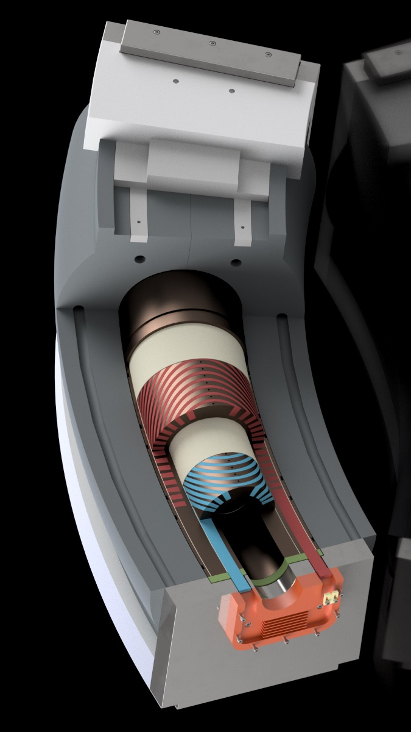
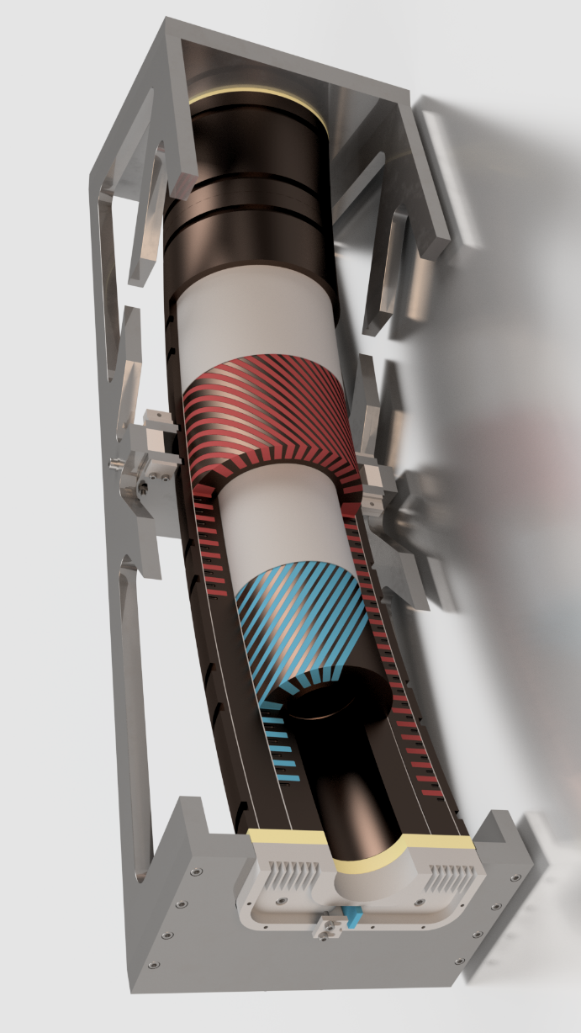
Final and Simplified assembly
Courtesy of N. Ciarchi (INFN-LASA)
Final Assembly of the magnet demonstrator without the Iron Yoke:
The magnet will reach 2.8 T without the iron yoke;
The iron yoke needs resources (funds + R&D);
To reach the target of the deliverable for the HITRIplus project ( D8.3 Magnet demonstrator);
CERN workshop will manufacture the assembly parts;
The R&D of the Iron yoke will continue with the CERN (we have budget available just for a prototype).
25 March 2025
E. De. MaTTeis - Advancements in Superconducting Magnet Design for Carbon Ion Therapy – 4th HITRIplus Project meeting
11

Slide 12
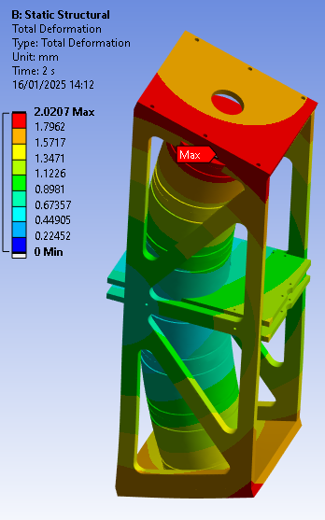
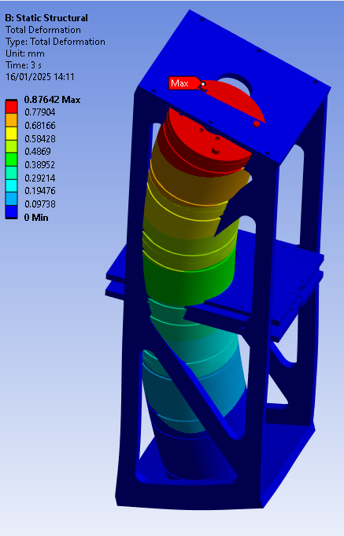
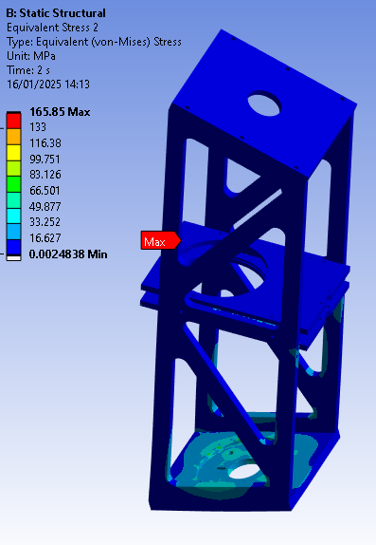
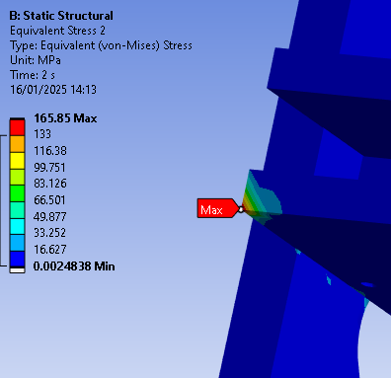
Mechanical study- Assembly magnet
Courtesy of L.Dassa and G. Ceruti (CERN)
FEM Analysis of the CCT structure by Ansys simulations:
Linear models,
Magnet is entirely made in Aluminum Bronze
Structure is entirely made in stainless steel (Rp0.2 = 200 MPa / fadm=200 MPa /1.5= 133 MPa)
Only the bottom face of the magnet is bonded to the structure
Net forces are evaluated for simplicity (conductor is not considered);
A numerical error of the net force due to the asymmetry of the magnet→ solution could be a full 3D simulation (very heavy to run).
Thermal + Energization
Energization
Thermal + Energization
Work in progress!!
25 March 2025
E. De. MaTTeis - Advancements in Superconducting Magnet Design for Carbon Ion Therapy – 4th HITRIplus Project meeting
12

Slide 13
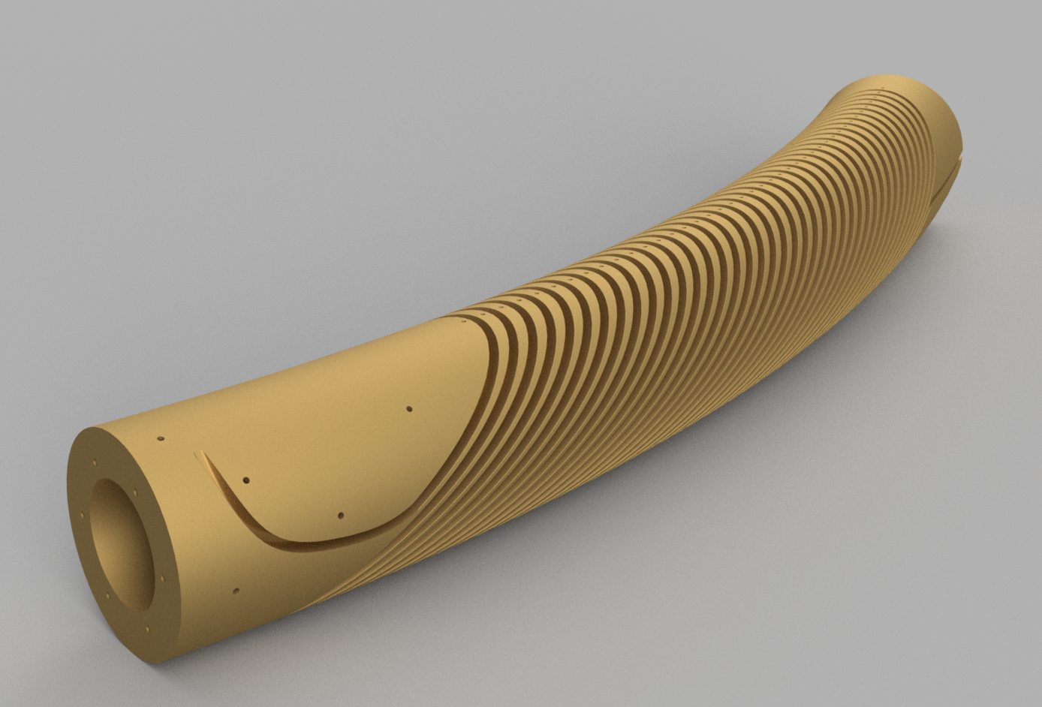
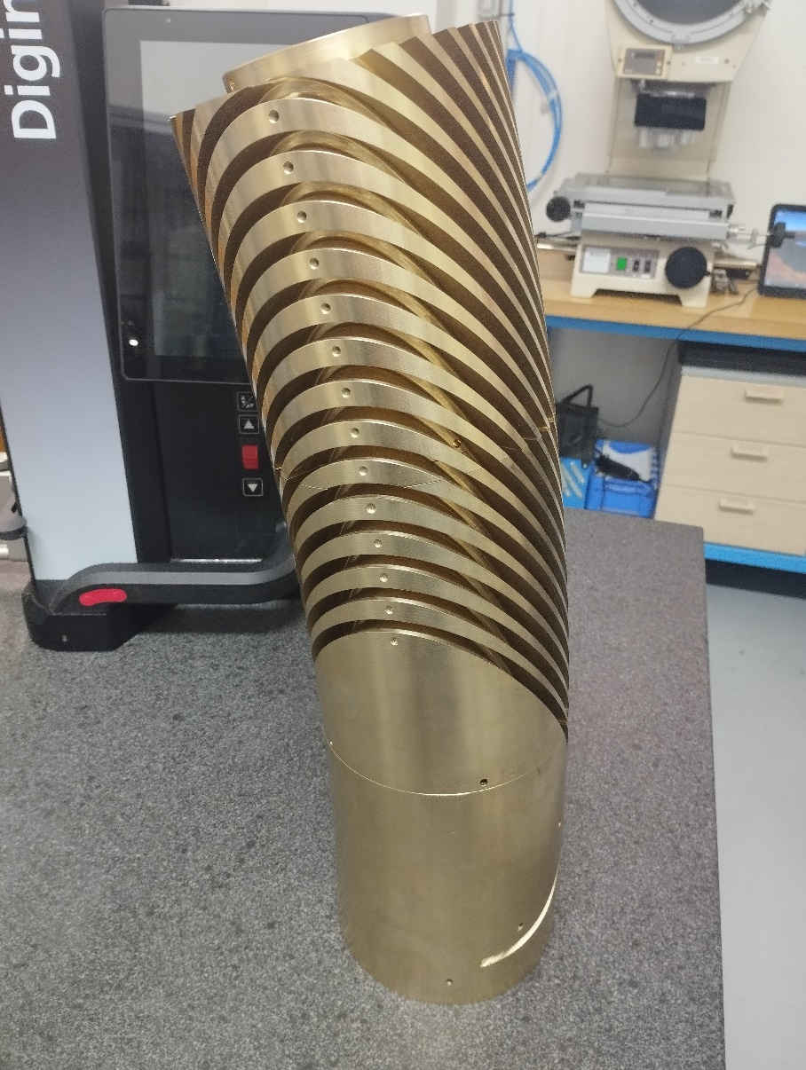
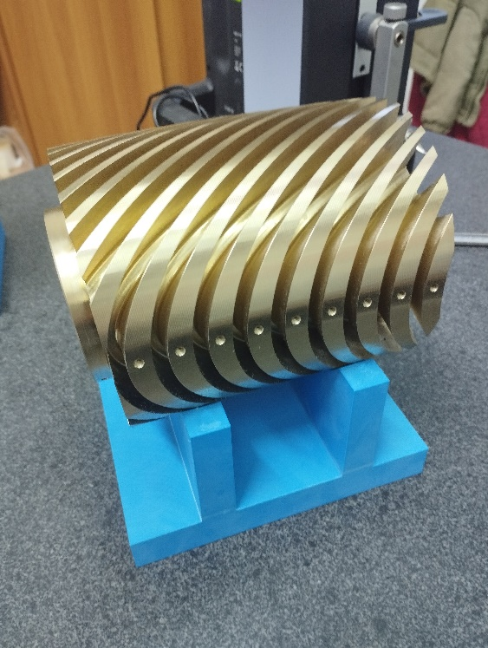
Construction aspects – curved formers (key parts of the magnet)
3D model of the inner former
Assembly of #3 segments (inner former)
Partner Selection Challenge
  Difficulty in finding companies with required expertise;
  Tosti Srl (Castelpiano, Italy) selected after successful prototyping.
Progress Overview
  3D model of curved formers completed
  Technical drawings for first formers delivered
  3 inner former segments produced
    One remade (initially out of tolerance)
    One under correction
Production Insights
  Machining more time-consuming than expected;
  Multiple steps needed to minimize vibrations
  Measurements is not trivial !!
Next Milestones (by July 2025)
  Complete first and second layer formers;
  Final assembly using slotted pins.
One segment on the meas. step
25 March 2025
E. De. MaTTeis - Advancements in Superconducting Magnet Design for Carbon Ion Therapy – 4th HITRIplus Project meeting
13

Slide 14
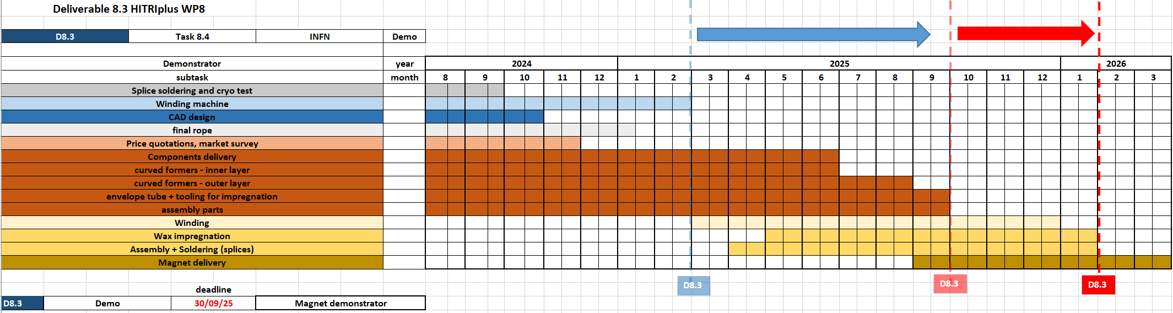
Timeline of D8.3 Magnet demonstrator
Critical points for this magnet are the construction of the curved formers and the overlapping with the construction of the combined function CCT (I.FAST) → both are foreseen at CIEMAT
Additional extension up to March 2026 for finalizing the magnet!!
25 March 2025
E. De. MaTTeis - Advancements in Superconducting Magnet Design for Carbon Ion Therapy – 4th HITRIplus Project meeting
14

Slide 15
Conclusions and next steps
Summary of Progress
  WP8 superconducting magnet design advanced significantly
  TDR – D8.2 highlights presented:
  Conductor design, fabrication procedures
  Magnetic design, field quality, AC losses
  Final assembly without iron yoke (Plan B) due to resource limitations
  CERN workshop will produce assembly components (and R&D of Iron yoke)
Current Status
  Curved formers production delayed – machining more complex than expected
  Extension required to complete magnet construction
Next Steps
  Complete curved formers, envelope tube, and impregnation tooling
  Finalize assembly parts with CERN support
  Final conductor rope delivered by CIEMAT
  Winding & impregnation at CIEMAT – winding machine adaptation ongoing
  Magnetic measurements at warm with Senis (INFN-LASA) – pending
  Cold test at 4.2 K at INFN-LASA (planned for late 2026 – post-HITRIplus)
25 March 2025
E. De. MaTTeis - Advancements in Superconducting Magnet Design for Carbon Ion Therapy – 4th HITRIplus Project meeting
15

Slide 16

Thanks for the attention!!!
email: ernesto.dematteis@mi.infn.it

