Slide 1



Education and Training of Heavy Ion Therapy
25th March 2025
1

Slide 2
Objectives
- Educate and provide hands-on experience to a new generation of researchers
- Allow them to optimally access and exploit the European research infrastructures
- Students, postdocs, technical staff, early stage researchers from multidisciplinary background and not involved in the field, oncology practitioners
- Specialised courses
- Secondments and internships so that they become facility users and learn best practice
WP5 – Education & Training
2

Slide 3
Tasks & Deliverables
Task | Deliverable | Lead | Due Date | % Completed | Status
5.1 | Delivery of Specialised Training Courses | SEEIIST | M30 | 100% | Completed Deliverable submitted
5.2 | Delivery of Masterclasses and train-the-trainer masterclasses | GSI | M47 | 95% | Completed Report being finalised
5.3 | Provision of e-learning courses | UM | M30 | 100% | Completed Deliverable submitted
5.4 | Organisation of secondments and internships: calendar of events | UM | M24 | 100% | Completed Deliverable submitted
M5.1 | Specialised Courses and Masterclass Definition | SEEIIST | M18 | 100% | Completed Deliverable Submitted
WP5 – Education & Training
3

Slide 4
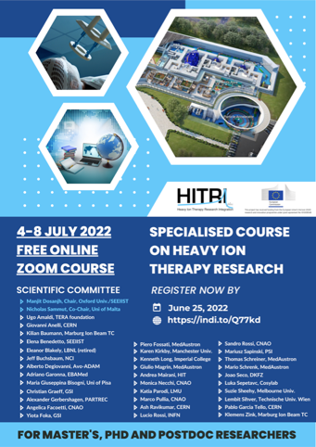
Task 5.1 – Specialised Courses
- 1st course - led by SEEIIST; 4-8 July 2022
- held online limited to 60 participants to maximise student interaction
- targeting advanced masters, Ph.D., postdocs and researchers from close fields
- 36 faculty members, 35 hours of material
- accelerators, magnet tech, biophysics, clinical aspects, radiobiology, treatment planning, simulations, dosimetry, moving targets, arc delivery, imaging, gantry design, beam dynamics, business development, entrepreneurship, certification
- 44 students obtained attendance certificate
- included train the trainer session
- students from 30 countries + 8 through nationality (44 EU, 11 third countries, 4 Balkan,
1 Ukraine)
WP5 – Education & Training
6

Slide 5
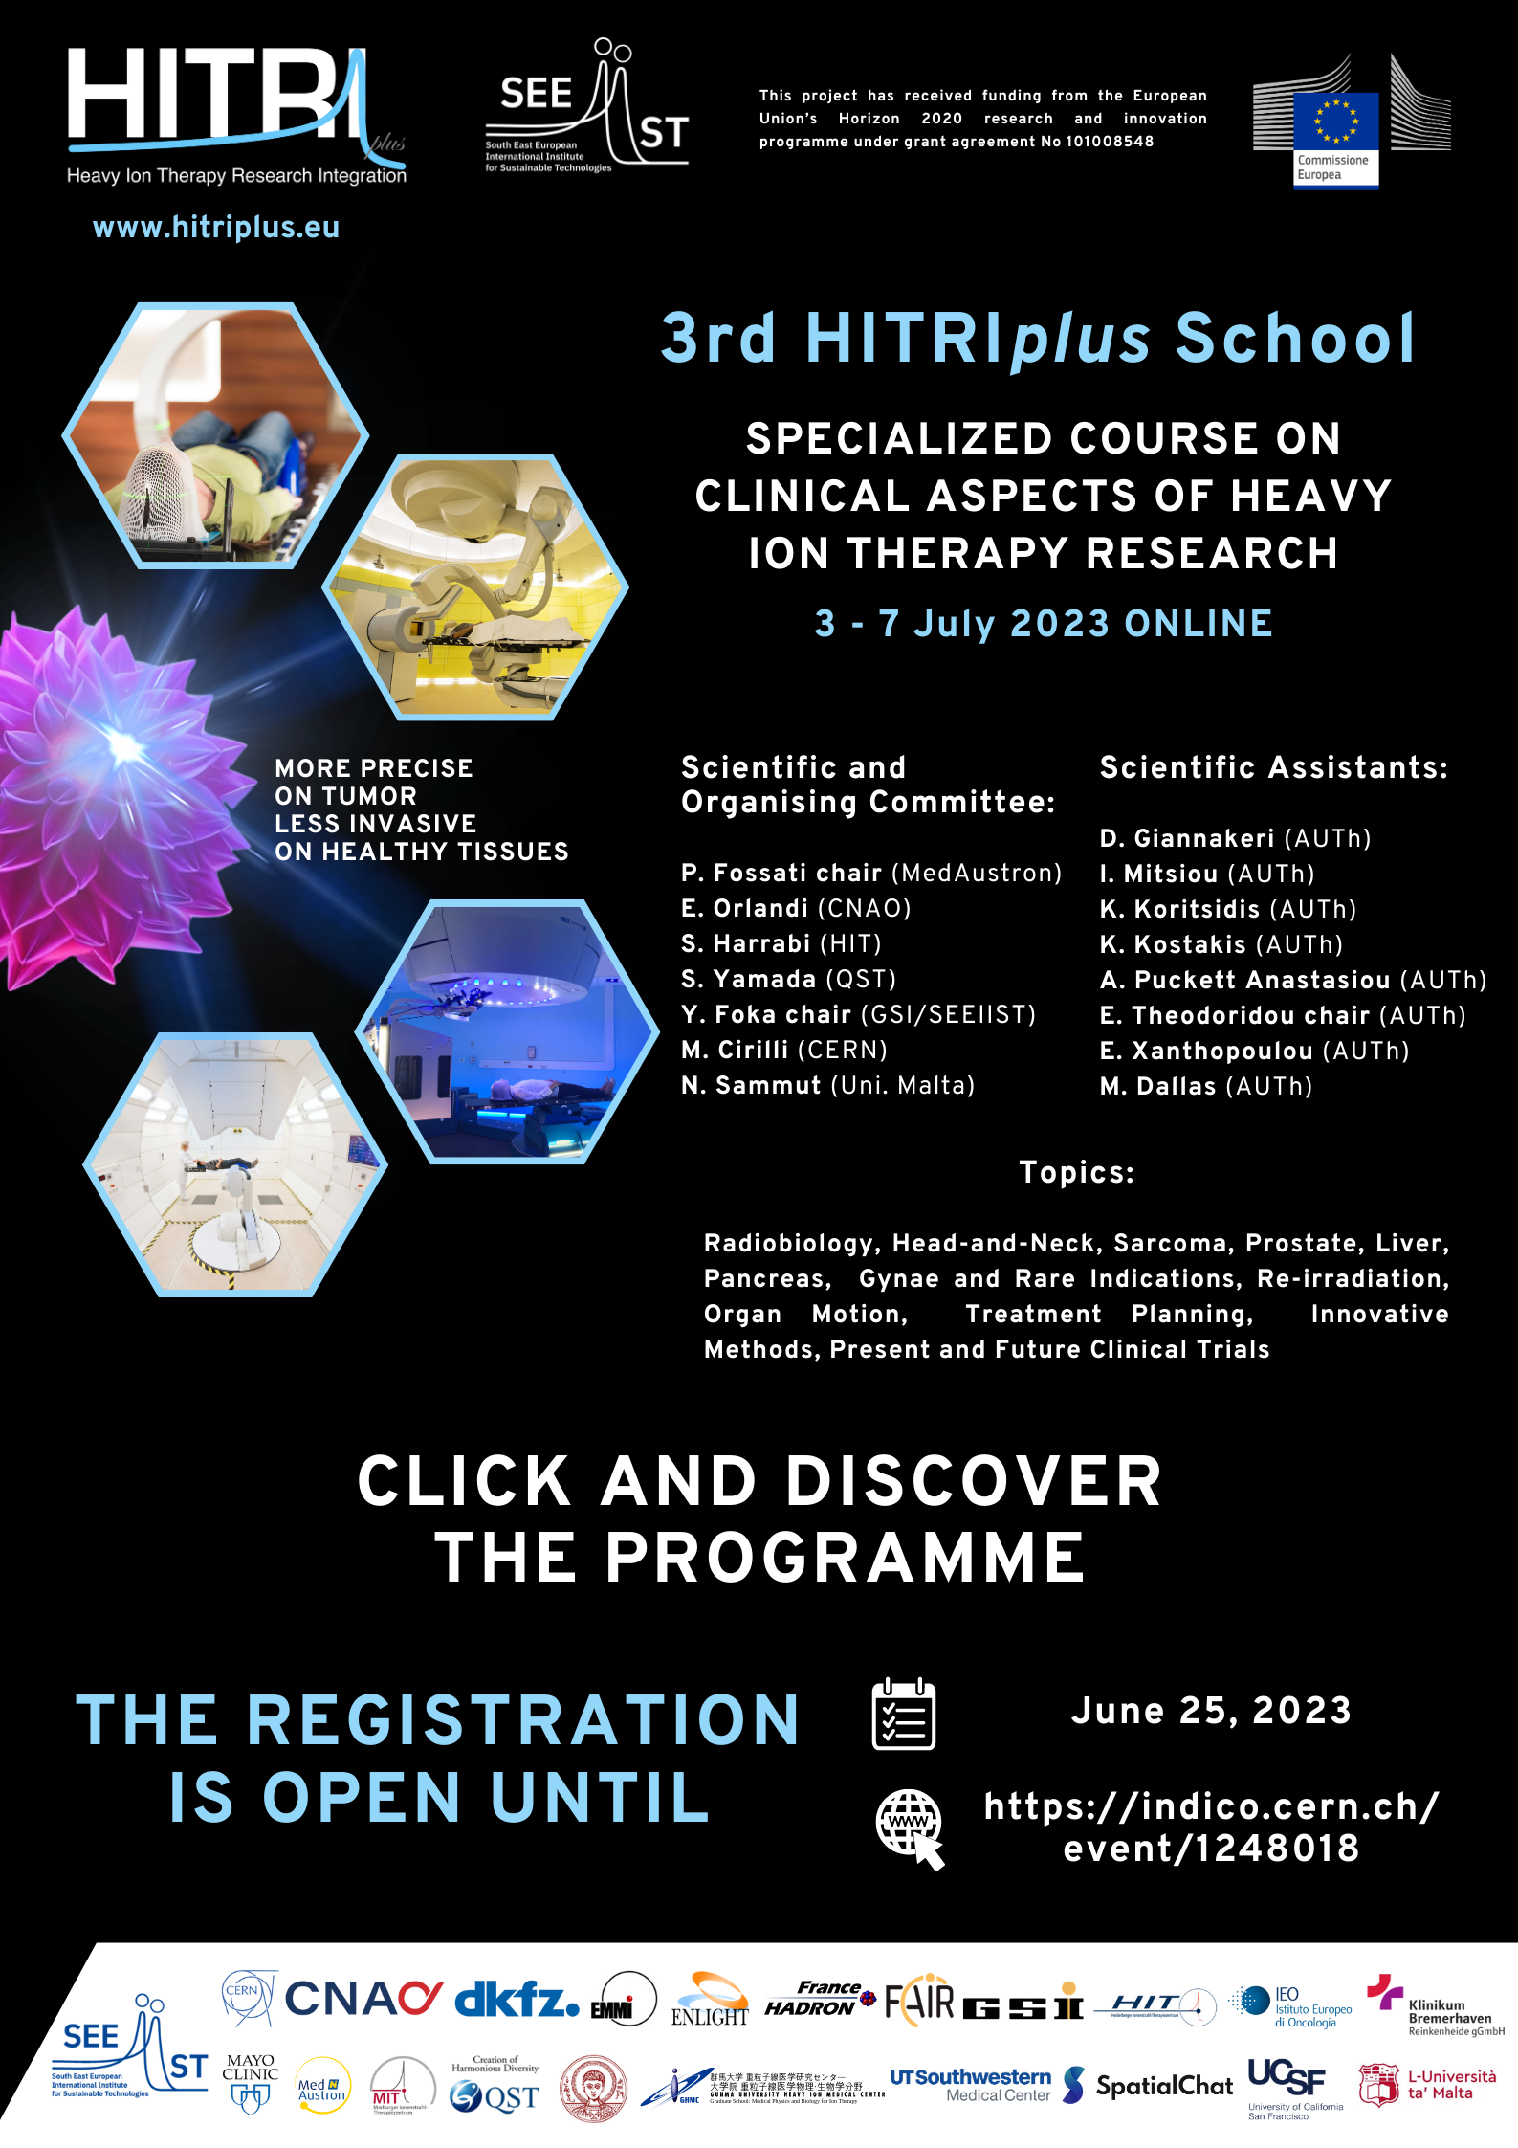
Task 5.1 – Specialised Courses
- 2nd course - clinical aspects - SEEIIST in collaboration with GSI
- held online 3rd to 7th July 2023:
- 557 students registered with 150 to 180 students logged in at any one time
- targeting medical students, clinicians, oncologists
- 39 hours of lectures, 39 faculty members
- head and neck, sarcoma, prostate, liver, pancreas, organ motion, treatment planning,
re-irradiation, gynae and rare indications, innovative methods, present and future clinical trials and radiobiology
- included train the trainer session
- 67 countries world wide; 36% from EU, 17% from SEE, 56% third countries
- 77 students awarded certificate of attendance (80% attendance, 80% of polls); 27 train the trainer mention
- network data (students, specialists, contact institutions used in marketing) inputted into WP2
WP5 – Education & Training
6

Slide 6
Task 5.2 – Masterclass School
- led by GSI – Yiota Foka
- Online 17th - 22nd May 2021
- Report underway
- 36 lecturers (15 female)
- undergrads, masters, PhDs postdocs, researchers from close fields
- 1050 registrants
- 992 attended at some point – average of 600 per day (50% from EU, 12% from Balkan region)
- 158 attendance certificates awarded
- 33 hours of engagement time
WP5 – Education & Training
7

Slide 7
Task 5.4 – Secondments & Internships
- UM in collaboration with CNAO
- 8 opportunities available
- €2000/month for internships; €3000/month for secondments
- 56 applications (40 form EU or Balkan states)
- 25 eligible applications
- 2 internships offered ; Microdosimetry, Accelerator Physics
- 3 secondments offered; Radiation Oncology, Medical Physics, Radiotherapy
- 59 weeks in total
- countries represented: Italy/Palestine, Turkey, Albania, Romania
- All internships and secondments are complete
WP5 – Education & Training
10

Slide 8
Milestone 5.1 – Courses and Masterclass Definition
- Led by UM
- scoping the content and level of current courses in particle therapy
- identifying content that can be adapted to focus on heavy ion therapy
- singling out gaps related to heavy ion therapy
- drawing up a syllabus based on a number of discussions with experts and specialists in the field
- report was submitted in M18
WP5 – Education & Training
10

Slide 9
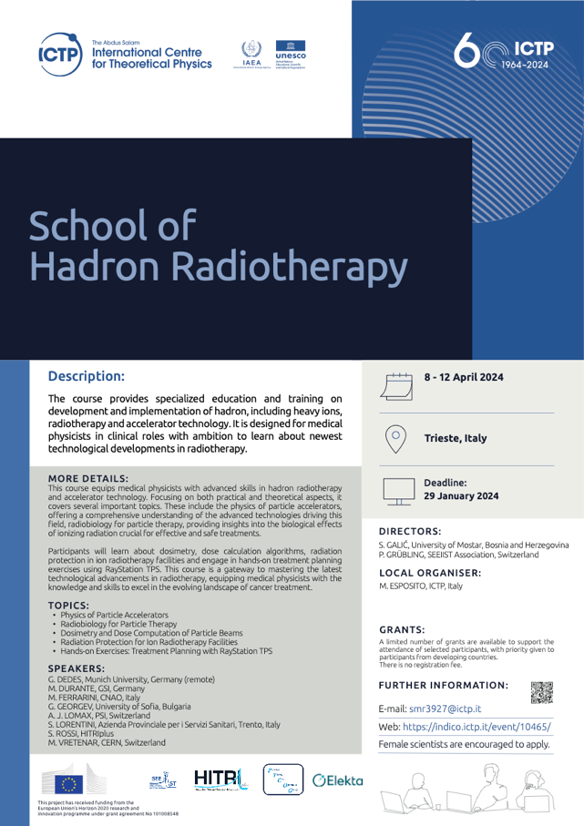
Extra Initiative 1
- School of Hadron Radiotherapy in collaboration with ICTP 8-12 April
- Organised by P. Grubling (SEEIIST), S. Galic (Uni Mostar B&H), M Esposito (ICTP)
- school in-person training + recording
- hadron (including heavy ions) radiotherapy, accelerator technology, radiobiology, dosimetry and dose computation radiation protection, treatment planning
- funded through some SEEIIST savings
- 54 students (48% Third countries, 35% EU, 17% SEE)
- 14 lecturers, 24 hours of lectures
- plan to re-open D5.1 for reporting purposes
WP5 – Education & Training
10

Slide 10
Extra Initiative 2
- 1 train-the-trainer event on 22nd October 2024 (after Hadron Therapy Symposium)
- Focus on Treatment Planning
- In-person in Thessaloniki, Greece
- Organised by Yiota Foka (SEEIIST, GSI)
- Funded by savings made by SEEIIST
- Plan to include in D5.2 reporting
WP5 – Education & Training
10

Slide 11
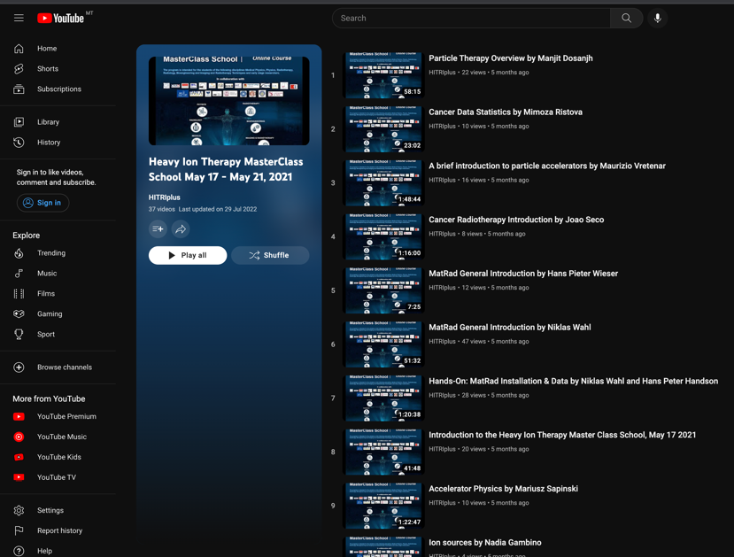
Task 5.3 – e-learning Material
- led by UM
- conversion of task 5.1 and 5.2 into e-learning courses
- editing and cleaning;
- course overview, objectives, learning outcomes; suggested reference books, complementary material
- Task 5.1 1st specialised school recorded and made available online (4,420 views to date)
- Task 5.1 2nd specialised school recorded and made available online (16,672 views to date)
- Task 5.2 masterclass school recorded and made available online (5,079 views to date)
- 1,638 total hours watched by students
WP5 – Education & Training
9

Slide 12

3 Online Courses on Heavy Ion Therapy Research
Treatment Planning
Medical Physics and Engineering
Clinical Aspects
2
E-Learning Courses on Heavy Ion Therapy Research

Slide 13
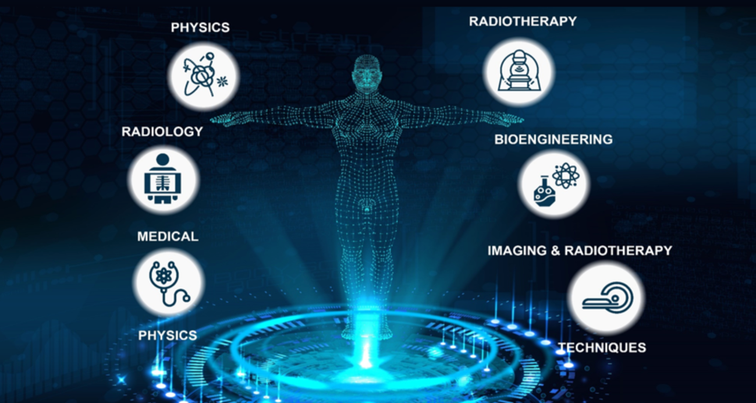
Course 1 – Treatment Planning
Faculty: 36 lecturers
Chair: Yiota Foka (GSI)
Views: circa 5000 to date
Duration: 34 hours
Language: English
Fees: Free
Learning Outcomes:
- underpinning theory, techniques and methods
- design and planning skills
- technical knowledge on the design of heavy ion therapy machines
- analytical, critical and evaluation skills of treatment scenarios
3
E-Learning Courses on Heavy Ion Therapy Research

Slide 14
Course 1 – Treatment Planning
1. Amer Ajanović ICL
2. Elena Benedetto SEEIIST
3. Uta Bilow TU Dresden
4. Giovanni Bisoffi INFN
5. Manuella Cirili CERN
6. Haris Dapo ANKARA Univ./TARLA
7. Mirza Dautbasic UNSA
8. Manjit Dosanjh ENLIGHT/SEEIIST/CERN
9. Ana Đorđević CERN
10. Angelica Facoetti CNAO
11. Yiota Foka GSI/EMMI
12. Piero Fossati MedAustron
13. Nadia Gambino MedAustron
14. Christian Graeff GSI
15. Milkos Jaksic IRB
16. Silvia Meneghello CNAO
17. Uros Mitrović Cosylab JSC
18. Silvia Molinelli CNAO
19. Monica Necchi CNAO
20. Ester Orlandi CNAO
21. Matej Polzelnik Cosylab JSC
22. Marco Pullia CNAO
23. Ash Ravikumar CERN
24. Mimoza Ristova UKIM
25. Mariusz Sapinksi SEEIIST
26. Joao Seco DKFZ
27. Rebecca Taylor ICL
28. Markus Stock MedAustron
29. Dasa Stupica Cosylab JSC
30. Albana Topi GSI
31. Slavisa Tubin MedAustron
32. Vasilis Vlachoudis CERN
33. Maurizio Vretenar CERN
34. Niklas Wahl DKFZ
35. Hans Peter Wieser LMU
4
E-Learning Courses on Heavy Ion Therapy Research
13/04/2021

Slide 15
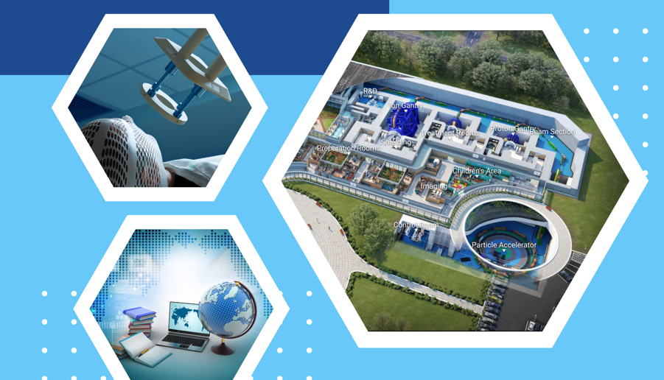
Course 2 – Medical Physics and Engineering
Faculty: 36 lecturers
Chair: Manjit Dosanjh (SEEIIST & Uni Oxford)
Views: circa 4400 to date
Duration: 35 hours
Language: English
Fees: Free
Learning Outcomes:
- underpinning theory, techniques and methods
- specialised medical physics knowledge
- technical expertise in fundamental building blocks
- analytical, critical and evaluation skills of medical physics and engineering
5
E-Learning Courses on Heavy Ion Therapy Research

Slide 16
Course 2 – Medical Physics and Engineering
Organising committee:
Manjit Dosanjh (SEEIIST) (Chair)
Monica Necchi (CNAO)
Angelica Facoetti (CNAO)
Petya Georgieva (SEEIIST/CERN)
Nicholas Sammut (Uni Malta)
Rebecca Taylor (CERN)
Joseph Bateman (Uni Oxford)
Cameron Robertson (Uni Oxford)
Kristaps Palskis (CERN)
Scientific Committee - Manjit Dosanjh (in the chair)
Ugo Amaldi (TERA)
Maurizio Vretenar (CERN)
Elena Benedetto (SEEIIST)
Mariusz Sapinski (PSI)
Kenneth Long (Imperial College)
Klemens Zink (Marburg-MIT)
Eleanor Blakely (Berkeley)
Piero Fossati (MedAustron)
Karen Kirby (INSPIRE - Uni Manchester)
Alex Gerbershagen (Uni Groeningen)
Angelica Facoetti (CNAO)
Monica Necchi (CNAO)
Nicholas Sammut (Uni Malta)
Sandro Rossi (CNAO)
Giovanni Anelli (CERN)
Mario Schrenk (MedAustron)
Thomas Schreiner (MEdAustron)
Yiota Foka (GSI)
Suzie Sheehy (Uni – Melbourne)
Andrea Mairani
Joao Seco (DKFZ)
Anna Subiel (NPL)
Marco Pullia (CNAO)
Lucio Rossi (INFN)
Giusy Bisogni (INFN)
Katia Parodi (Uni Munich)
Steve Myers (ADAM)
Adriano Garonna (EBAMED)
Manuela Cirilli (CERN)
6
E-Learning Courses on Heavy Ion Therapy Research

Slide 17
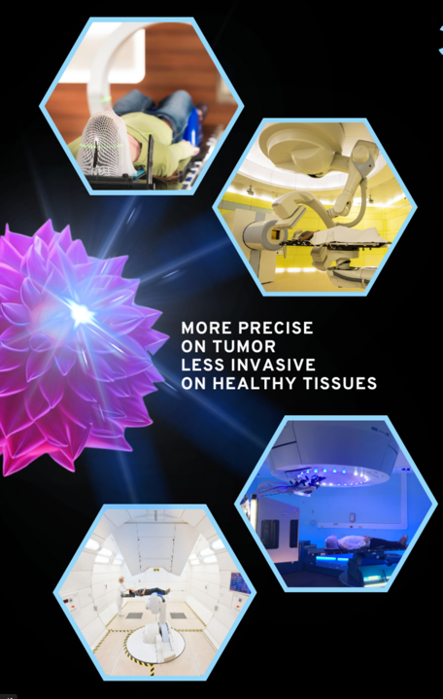
Course 3 – Clinical Aspects
Faculty: 27 lecturers
Chair: Yiota Foka (GSI & SEEIIST) & Piero Fossati (MedAustron)
Views: circa 16,700 to date
Duration: 27 hours
Language: English
Fees: Free
Learning Outcomes:
- underpinning theory, techniques and methods
- specialised clinical knowledge on the design of heavy ion therapy machines
- analytical, critical and evaluation skills of clinical aspects
7
E-Learning Courses on Heavy Ion Therapy Research

Slide 18
Course 3 – Clinical Aspects
Piero Fossati MedAustron
Ester Orlandi CNAO
Semi Harrabi HIT
Yiota Foka GSI/SEEIIST
Manuela Cirilli CERN
Arnold Pompos UTSW
Amelia Barcellini CNAO
Alexander Helm GSI
Barbara Vischioni CNAO
Bradford S. Hoppe Mayo Clinic
Carola Lütgendorf-Caucig MedAustron
Giulia Riva CNAO
Jacques Balosso ARCHADE
Joao Seco DKFZ
Katharina Seidensaal HIT
Maciej Pelak MedAustron
Maria Bonora CNAO
Maria Rosaria Fiore CNAO
Mack Roach UCSF
Niklas Wahl DKFZ
Razvan Galalae Klinikum Bremerhaven
Roberto Orecchia IEO
Rossana Ingargiola CNAO
Silvia Molinelli CNAO
Slavisa Tubin MedAustron
Thomas Held HIT
Walter Tinganelli GSI
8
E-Learning Courses on Heavy Ion Therapy Research

Slide 19




























Top Institutions World-Wide
& Edmond Offermann (Private Sponsor)
9
E-Learning Courses on Heavy Ion Therapy Research

Slide 20
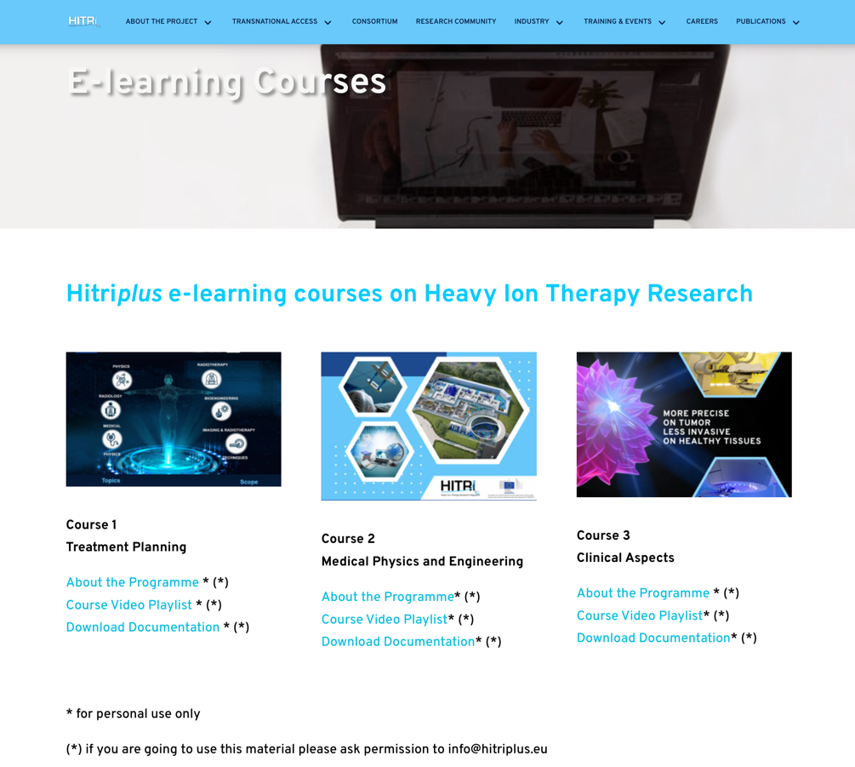
Snapshot
10
E-Learning Courses on Heavy Ion Therapy Research

Slide 21
Snapshot
11
E-Learning Courses on Heavy Ion Therapy Research

Slide 22
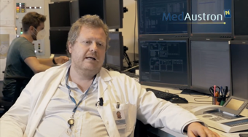
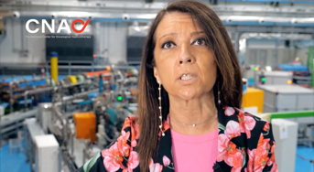
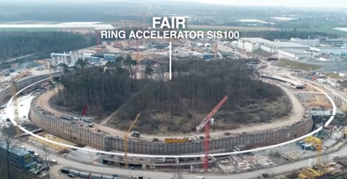
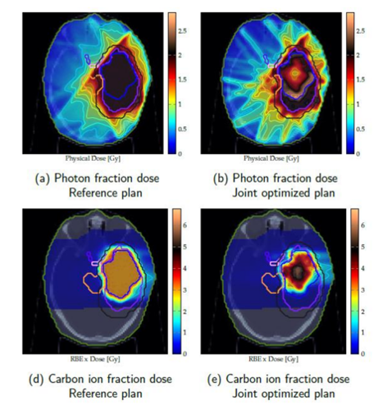
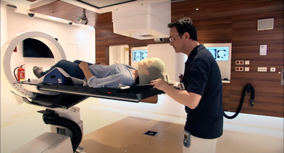
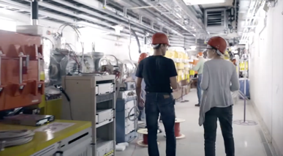
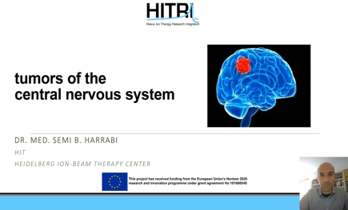
A Few Snapshots
12
E-Learning Courses on Heavy Ion Therapy Research

Slide 23
Link
https://www.hitriplus.eu/
Look for Training and Events from the
Top Navigation bar and select E-Learning Courses
13
E-Learning Courses on Heavy Ion Therapy Research

Slide 24
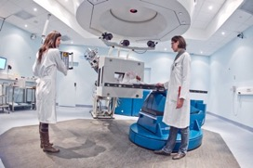
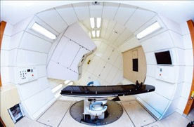
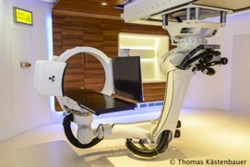
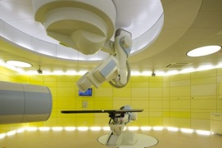
WP5 – Education & Training
12

