Slide 1
European Registries for oncology
Annalisa trama
Fondazione IRCCS Istituto Nazionale Tumori – Milano- Italy

Slide 2
Population-based cancer registries
Hospital-based/clinical cancer registries
New approaches

Slide 3


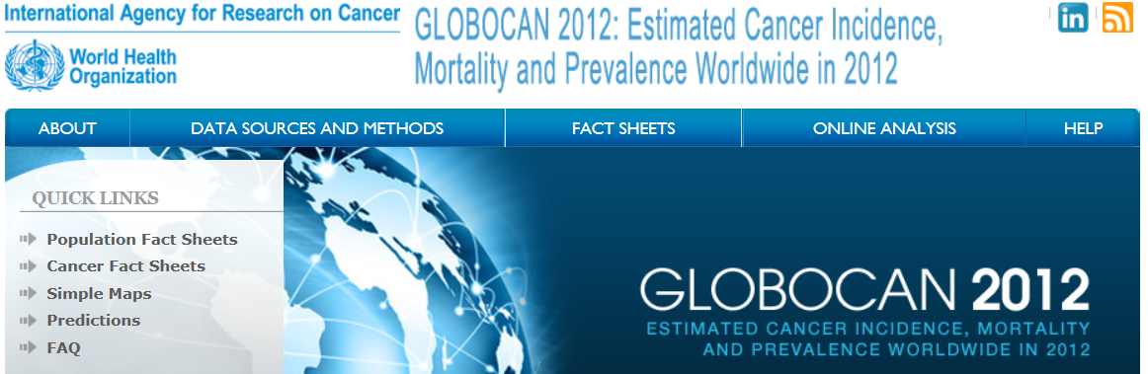
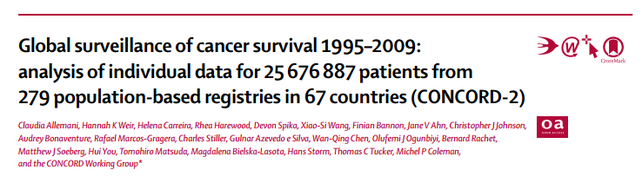
Population-based cancer registries

Slide 4
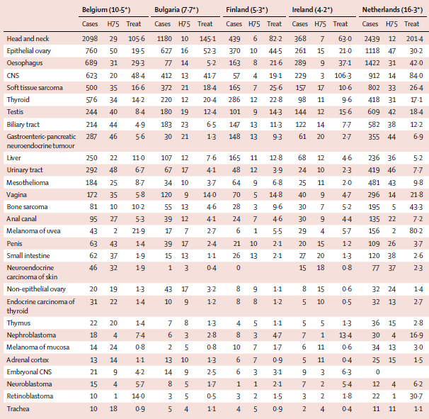
Burden and centralised treatment of rare tumors: results of RARECAREnet – a populaiton-based study
doi: 10.1016/S1470-2045(17)30445-X

Slide 5
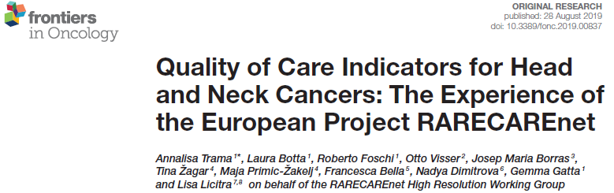
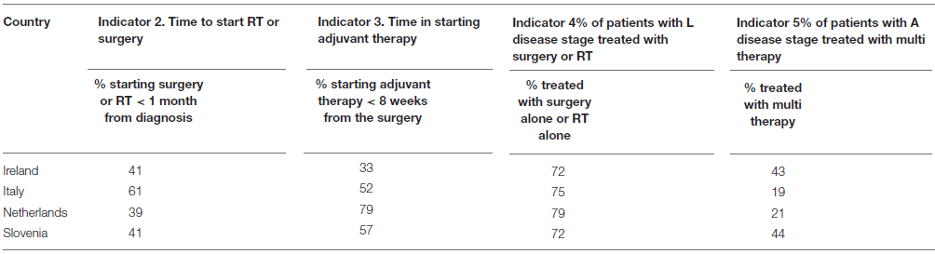
Quality of care for head and neck cancers

Slide 6
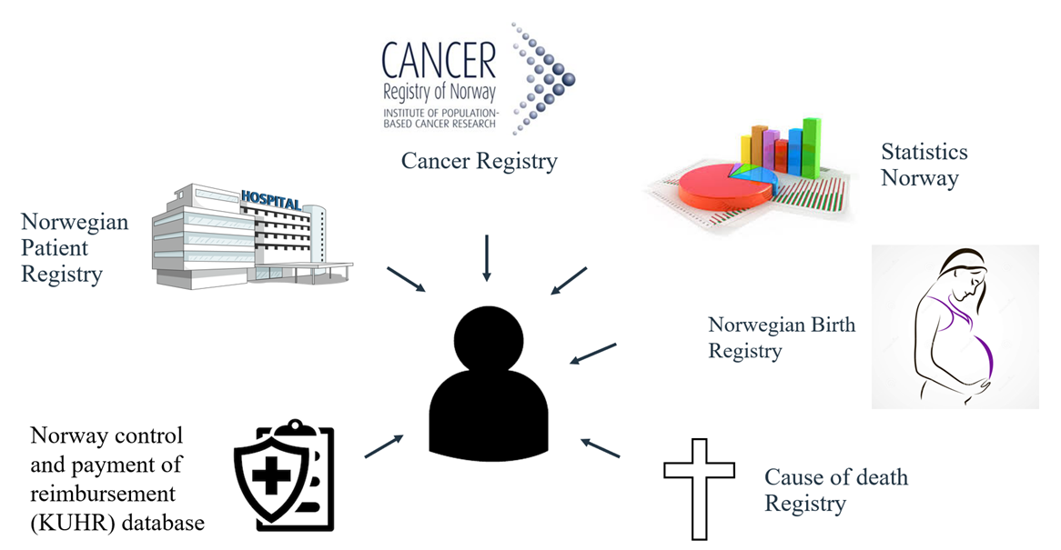
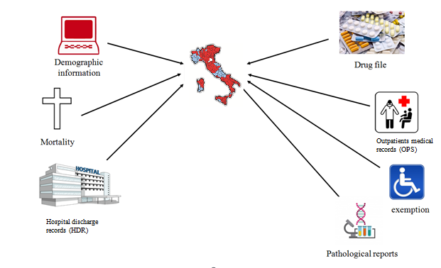
Population-based registries… enrichments
Pros
Unbiased
High number of cases
Rare events
Long-term follow-up
Cons
Diagnostic uncertainty
Missing clinical details
Heterogeneity in measurements of treatment outcomes

Slide 7
Clinical cancer registry
“an organized system that uses observational study methods to collect uniform data
(clinical and other) for a population defined by a particular disease, condition, or exposure, and that serves one or more predetermined scientific, clinical, or policy purposes”
Gliklich RE, DreyerNA.Registries fo rEvaluating Patient Outcomes: A User’s Guide(2nded.).Rockville,MD:AgencyforHealthcareResearch and Quality,2010.

Slide 8
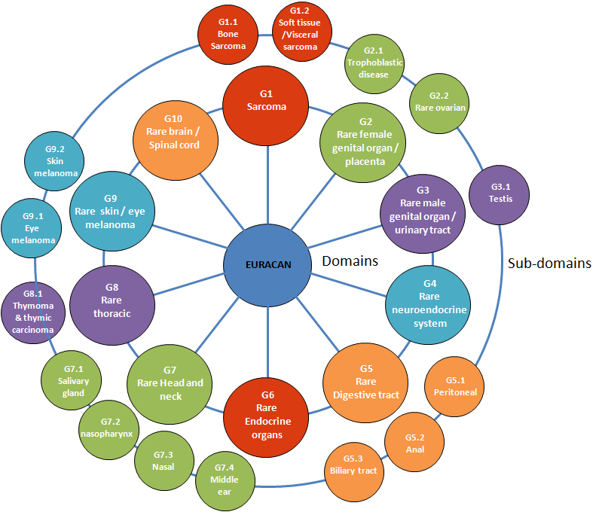
EURACAN registry
Head & neck cancers
Sarcomas
Digestive rare cancers
Neuroendocrine tumours
Rare thoracic cancers
Endocrine gland tumours
Central nervous system tumours
Rare female genital cancers
Rare urological and male genital tumours
Rare skin cancers & non-cutaneous melanoma

Slide 9
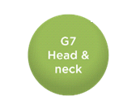
Registry objectives
ClinicalTrials.gov Identifier: NCT05483374
to help describe the natural history of rare head and neck cancers;
to evaluate factors that influence prognosis (e.g. mortality, survival, progression free survival and treatment response;
to assess treatments effectiveness (systemic, radiotherapy, surgery, target therapy, immunotherapy and possible combinations);
to measure indicators of quality of care (diagnostic and staging procedures, treatment strategies, follow-up etc.).
Virtual bio and imaging bank

Slide 10
Inclusion criteria
Patients with epithelial tumours of the rare head and neck cancers (sinonasal, NPC, salivary gland, middle ear)
  Squamous; Adenocarcinoma; Neuroendocrine; adenosquamous carcinoma, teratocarcinosarcoma, NUT carcinoma (NO sarcoma, melanoma or other histologies)
Adult rare head and neck cancer patients; age ≥ 18 years old (EURACAN vs PaedCan)
Patients with a diagnosis done and/or confirmed by the expert centre contributing data to the registry
Patients entering the hospital for any clinical phase of the disease (diagnosis, treatment of primary localised, of primary local advanced, of primary metastatic, treatment of recurrence).The hospital will collect information on the entire disease regardless of when it started to manage the patient.
Prospective registry

Slide 11
Information available
Demographic and lifestyle (eg, age, sex, education, alcohol, smoking, comorbidities)
Previous cancer and genetic syndrome
Primary cancer (site, histology, EBV, HPV status)
Staging (procedures, cTNM, pTNM)
Treatment (surgey, radiotherapy, systemic: intent, setting, regimen…)
Progression/relapse (local, regional, metastic + treatment)
Adverse events
Life status

Slide 12
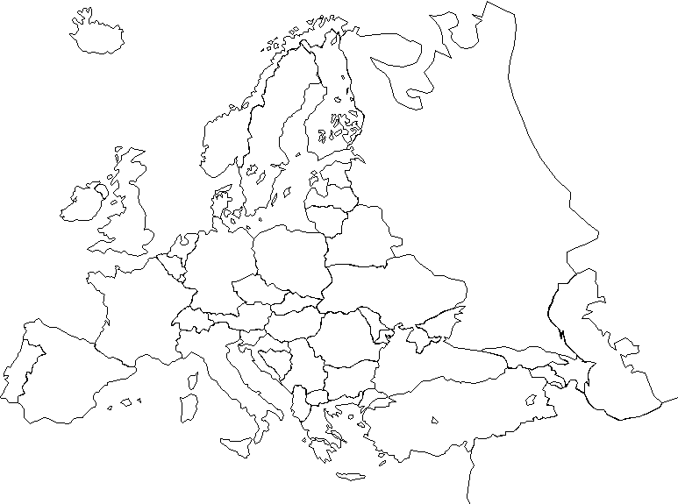






Exploiting what is available
EURACAN
l
l
l
l
l
l
l
l
l
l
UK registry
l
l
l
l
l
l
l
l
l
l
l
l
l
l
l
l
l
l
l
Data collection started in April 2022

Slide 13
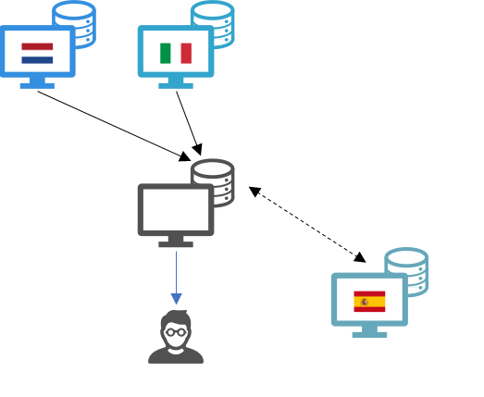
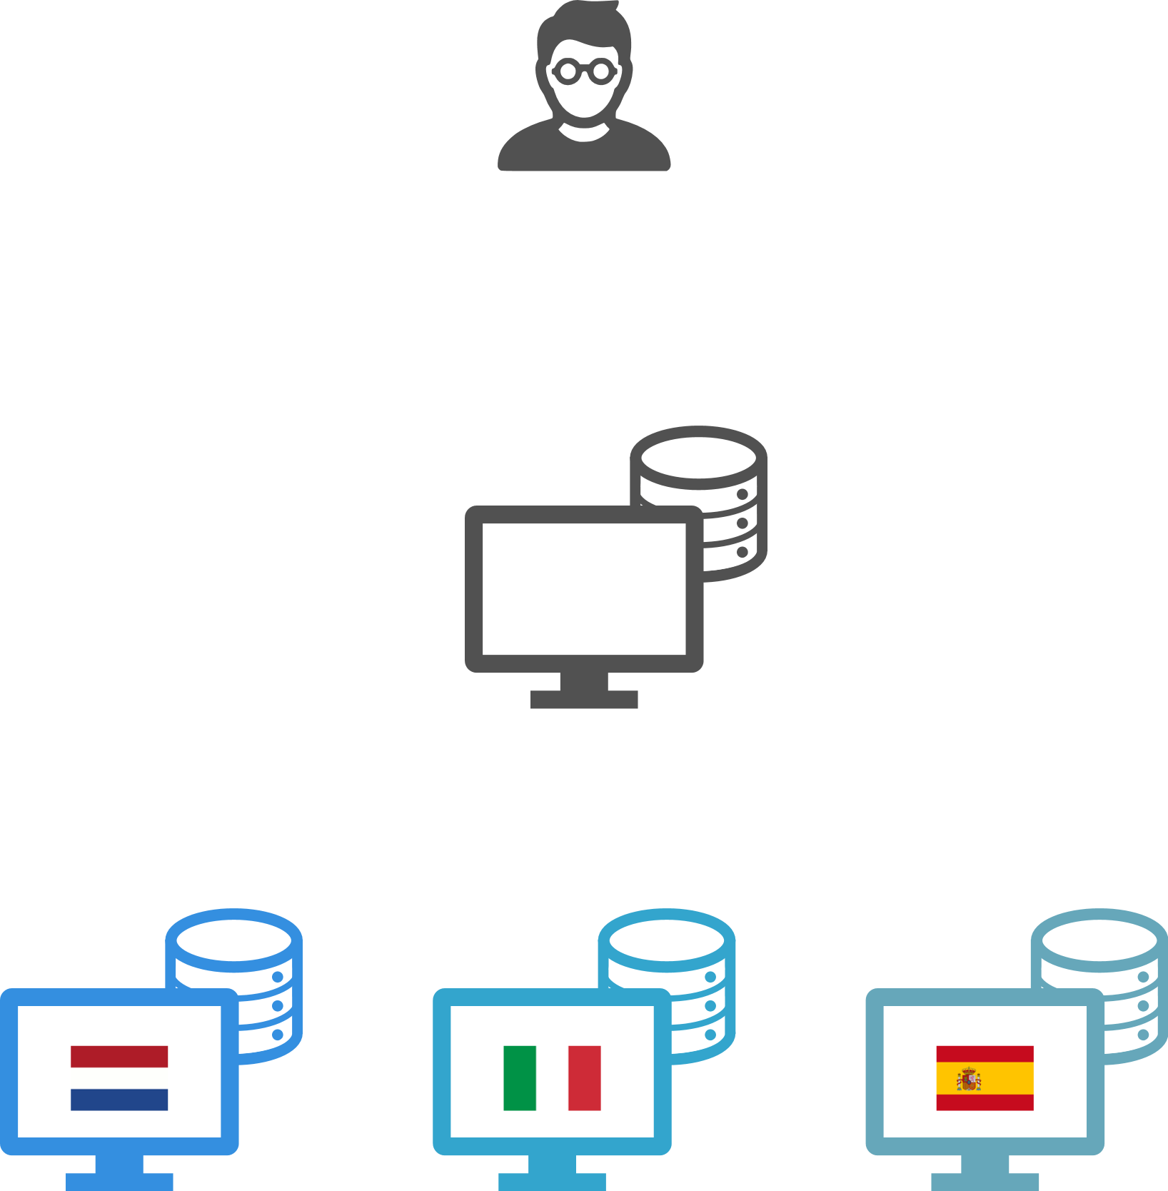
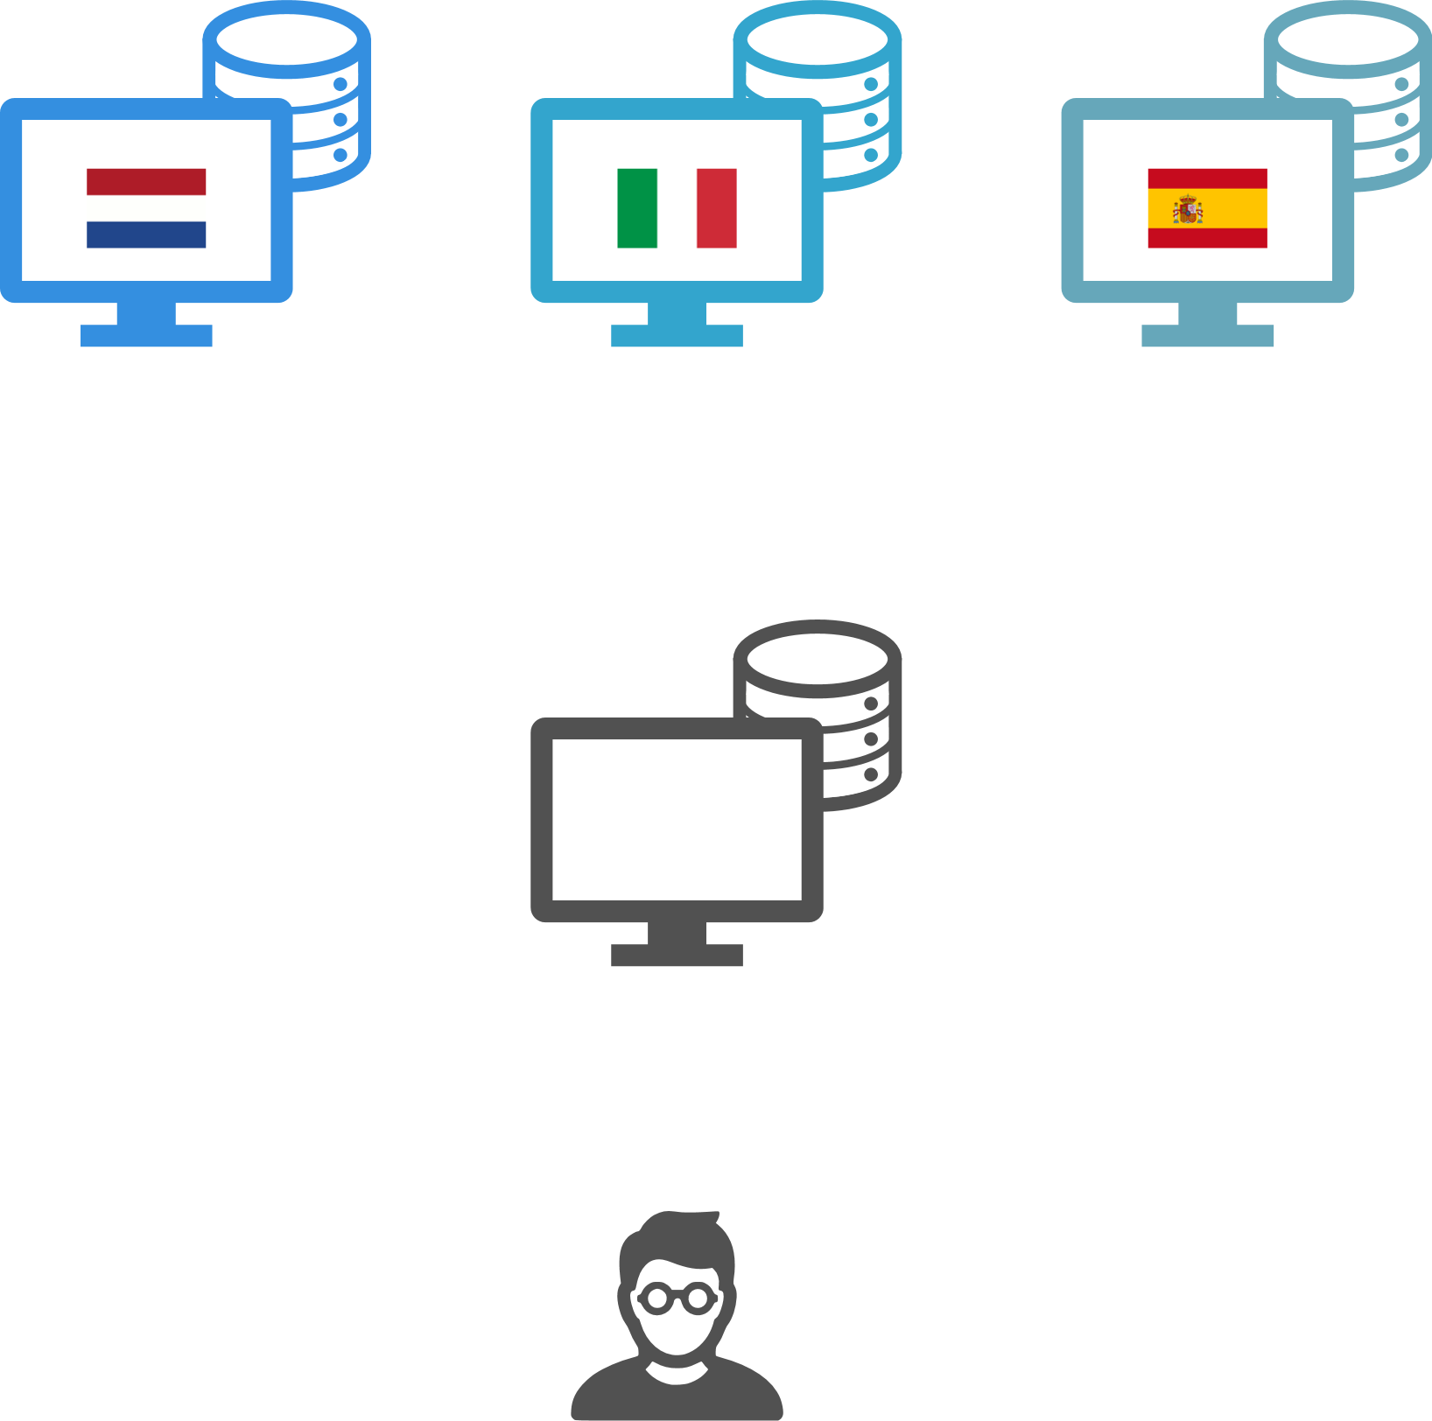

IT infrastructure vs legal framework
Federated
Centralized
Hybrid

Slide 14
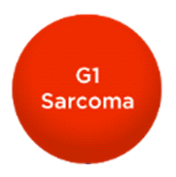

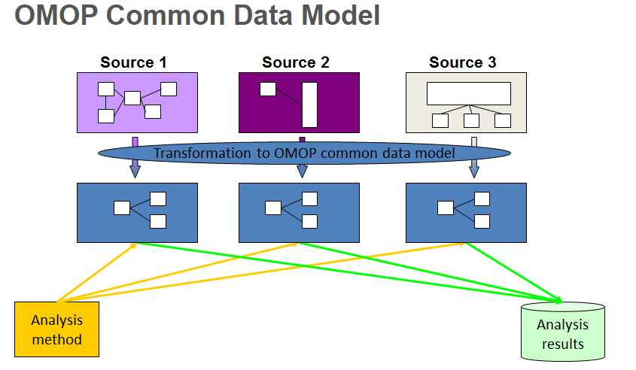
Soft tissue sarcoma registry
Common sarcomas
Core data set
Core data set
Data integration from already available DBs
The Observational Medical Outcomes Partnership (OMOP) Common Data Model
The Observational Medical Outcomes Partnership (OMOP) Common Data Model

Slide 15
Registry quality assurance
Health care provider level
  Automated data quality checks are in place at data entry
  Data quality checks can be run by users
  Training
  Guidelines
Central level
  Centralised data manager monitoring (data quality reports issued, contact with data providers)
  Routine meetings discussing data quality (including data retrieval and data sources)
  Bench mark
  Data checked and accessible for the analyses yearly

Slide 16
Data access rules
Data remain the property of the contributing HCPs or registries
Each HCP or national registry is free to access and use its own data for research purposes
Who can use the registry data (upon the presentation of a study protocol)
each HCP or national registry including data in the EURACAN Registry
third parties (e.g., pharmaceutical companies, patient organisations, competent authorities etc.)
commercial companies, depending on the study, may be asked to contribute funding. Data do not move from the HCPs or national registries and the commercial companies will not access the EURACAN registry federated database.
Review of the study protocol
domain registry working group (RWG), made up of 3 to 5 members including an ePAG, to review the study protocols presented for the domain. Additional expertise may be brought in as required.
HCP/registries agreement

Slide 17
Legal basis: country specific
General Data Protection Regulation
Under Article 9(2) of the GDPR, lawful processing of personal data for scientific research entails:
- the consent of data subjects,
- the pursuing of a substantial public interest,
- the pursuing of a scientific research purpose.
Institutional consent already collecting the consent of the patients for using their data for future research can be used
Ad hoc registry consent (template available in english)

Slide 18
