Slide 1
Laser interferometer GW detectors: current status, latest results and future prospects
Raffaele Flaminio
CNRS/LAPP, Annecy, France
On behalf of the LIGO-Virgo-KAGRA collaboration

Slide 2
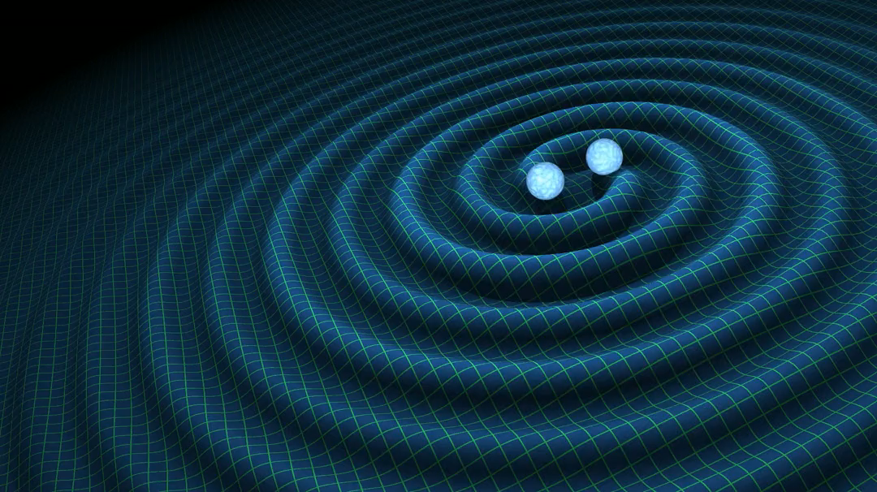
Gravitational wave generation
Gravitational wave generation
  Acceleration of massive, compact and
  relativistic objects
Quadrupolar emission
  Second derivative of the source’s quadrupole
  moment
Typical sources
  Compact binary stars involving black holes
  or neutron stars (BBH, BNS, NSBH)
  Many others are possible
    Rotating neutron stars
    Star core collapses
    …..

Slide 3
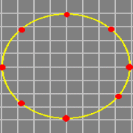
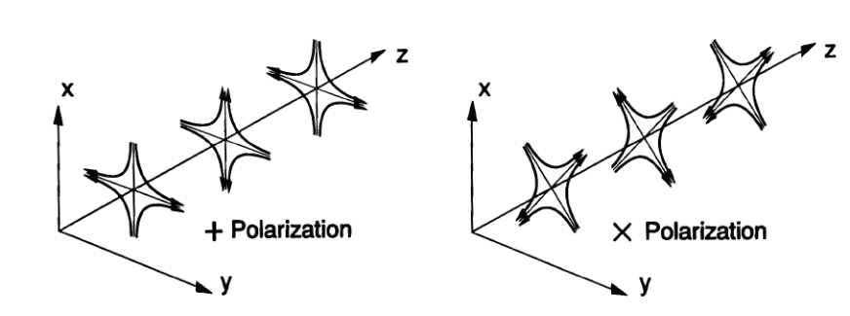

Gravitational wave effect
Oscillations of space-time curvature
  Quadrupolar wave
  Tidal force
  Wave amplitude h
  Two polarizations
$$δL=h L$$

Slide 4
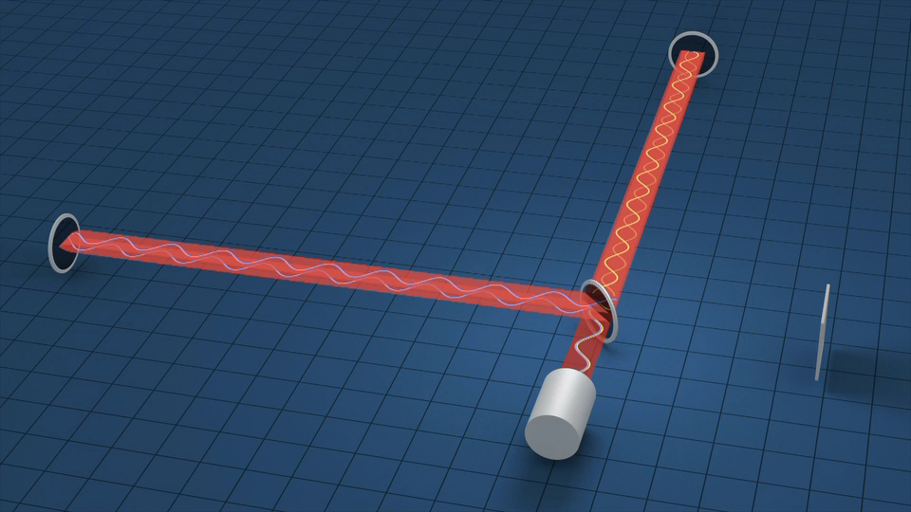
Gravitational wave detection
The principle
  Gravitational wave
  ↓
  Mirror displacement
  ↓
  Light phase shift
  ↓
  Light power variation
The devil is in the details
  Displacement ~10⁻¹⁸ m

Slide 5
The LVK detectors network

Slide 6
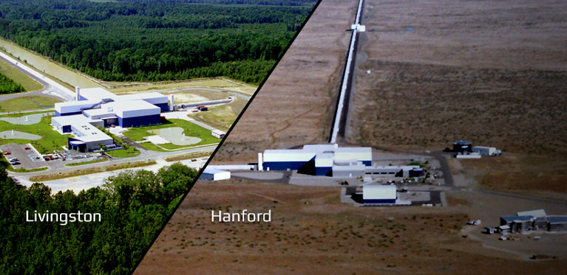
First detection: GW150914

Slide 7
First detection: GW150914
Orbital inspiral and merger of two black holes and ring-down of the final black hole
  Initial black hole masses: 36 M☉ and 29 M☉
  Final black hole mass: 62 M☉
  Energy released: 3 M☉ !!
  At the peak it is brighter than the entire Universe
    Energy flux at Earth larger than full moon

Slide 8
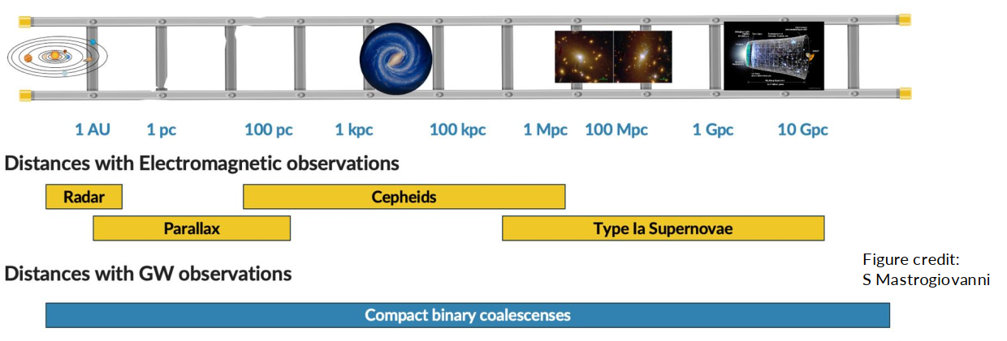
Distance measurement
A new and independent measurement to measure astronomical distances
Can be used to study the d(z) relationship i.e. to do cosmology
Measurement of z requires source identification

Slide 9
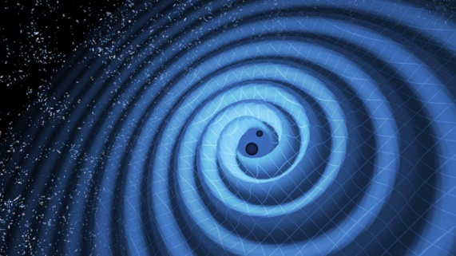

Source localization
The Earth is transparent to gravitational waves
A network of gravitational wave detectors can provide the direction of the source by triangulation
  From the differences in the wave arrival times
  At least three detectors needed

Slide 10

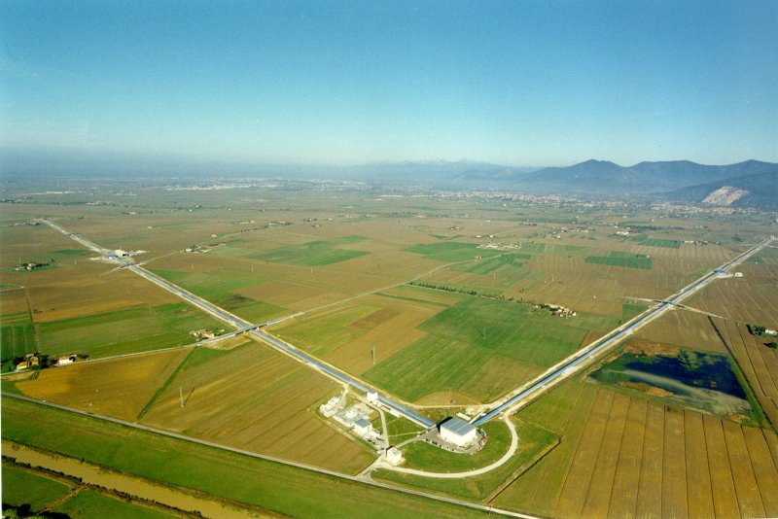
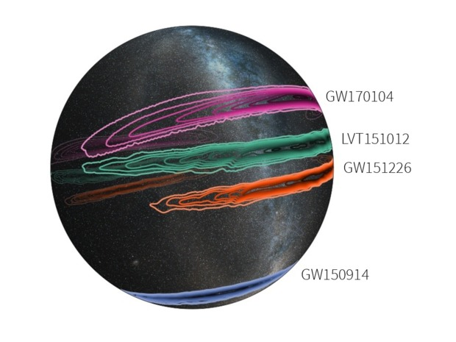
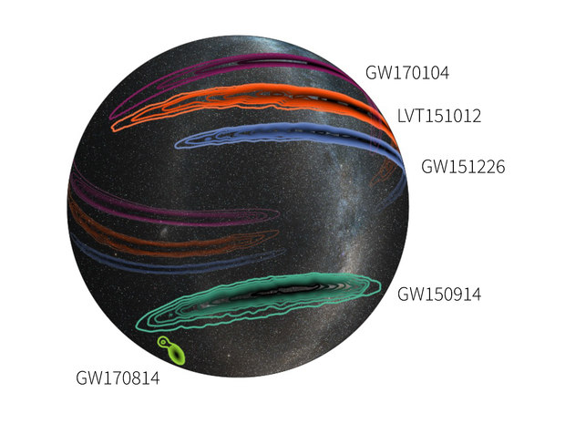
Localization with the Virgo detector
Image: Earth seen
from the North Pole
Localization: before Virgo
Localization: after Virgo
Image credit: LIGO/Leo Singer (Milky Way image: Axel Mellinger)
LIGO Scientific Collaboration and Virgo Collaboration
Phys. Rev. Lett. 119, 141101 (2017)

Slide 11
First Binary Neutron Star detection
Aug 17th, 2017 - GW170817: First detection of gravitational waves from a binary neutron star merger (BNS)
  Coincidence with the detection of a
  short gamma ray burst
  LIGO-Virgo localization
  Subsequent detection of the optical
  counterpart
LIGO Scientific Collaboration and Virgo Collaboration
Phys. Rev. Lett. 119, 161101 (2017)
Map by Google

Slide 12
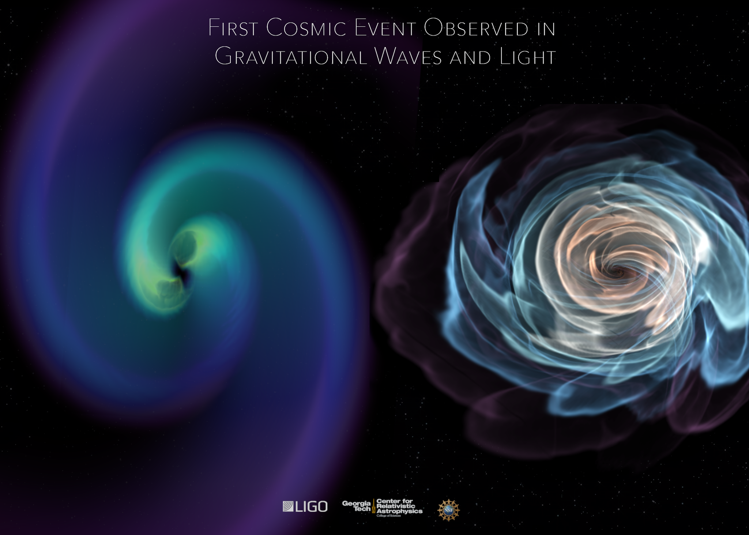
First important consequences
The first combination of gravitational wave data and electro-magnetic observations allowed to gain insights in:
  Fundamental physics
    Speed of gravitational waves
  Astrophysics
    Gamma ray burst engine
    Kilonova, Heavy elements production
  Cosmology
    First Hubble constant measurement
    with GW based distance measurement

Slide 13
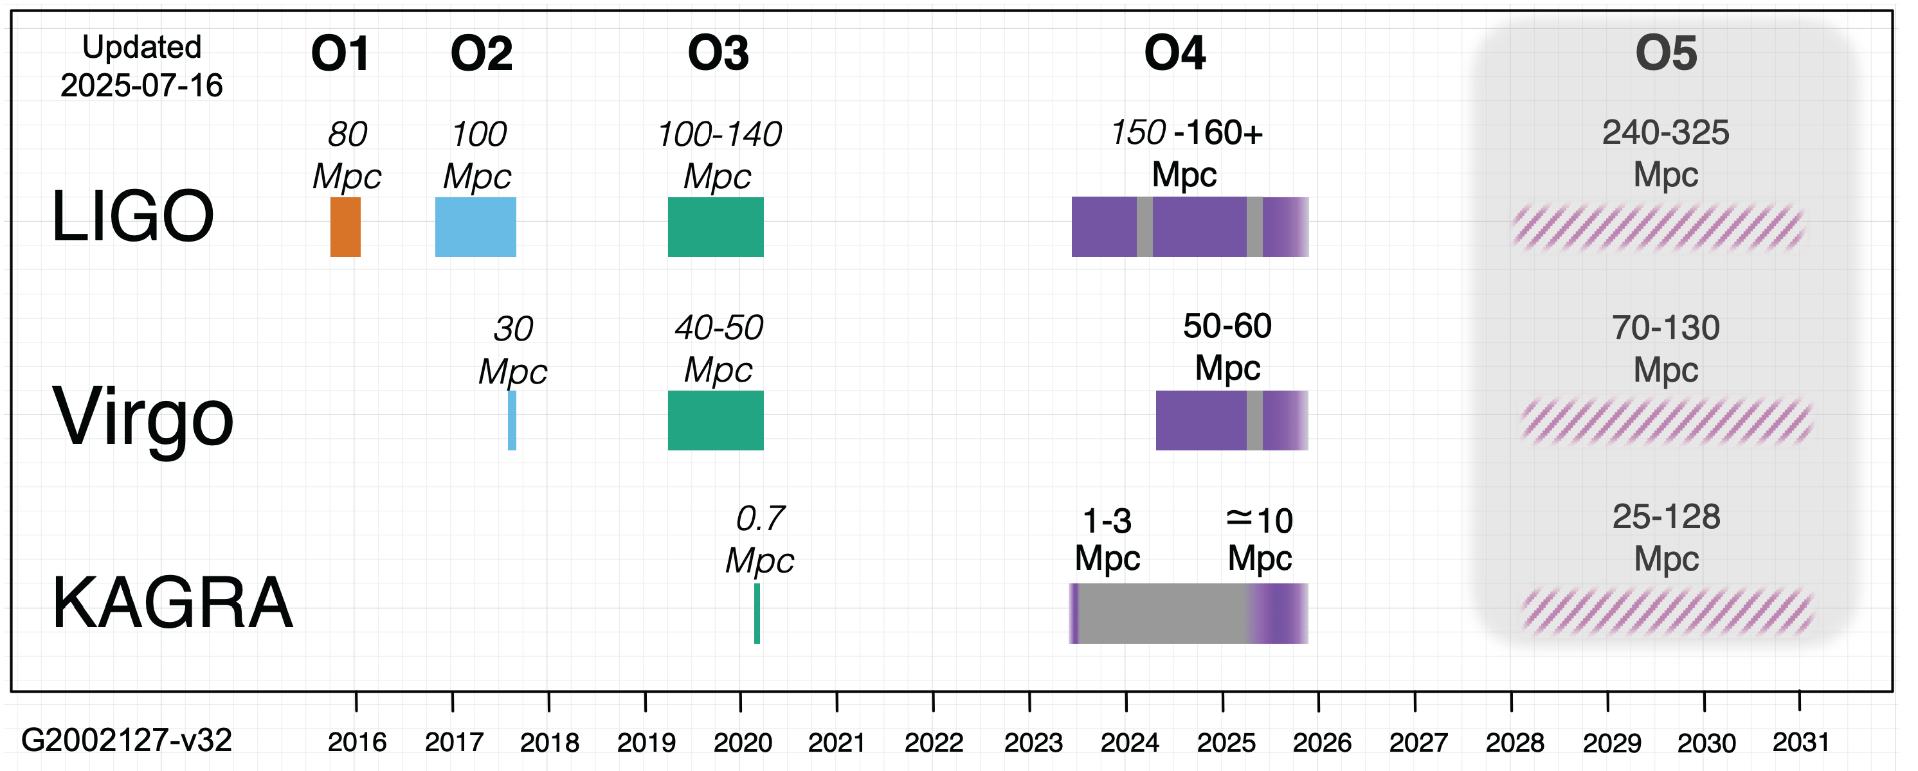
The timeline
First detection
90 sources
Detector upgrades and commissioning
Now: approaching
400 detections
GW170817
https://observing.docs.ligo.org/plan/

Slide 14
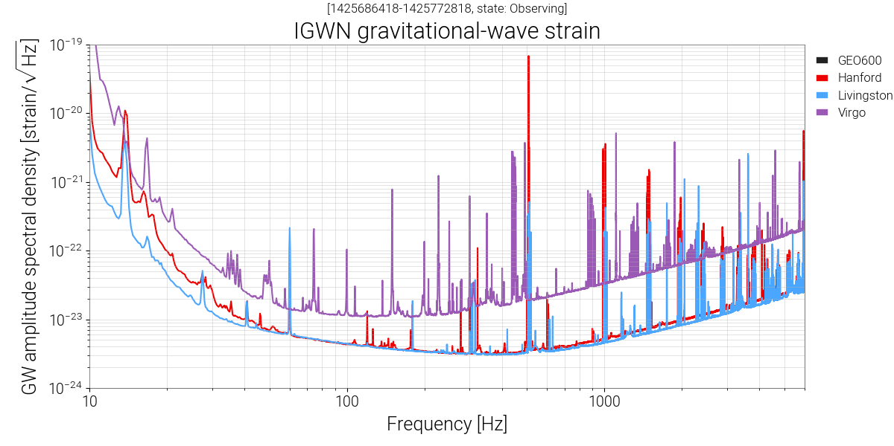
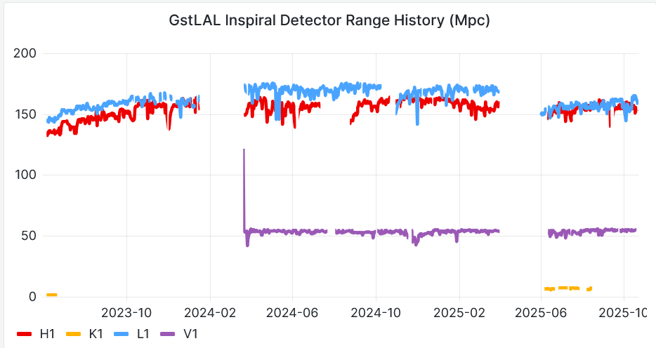
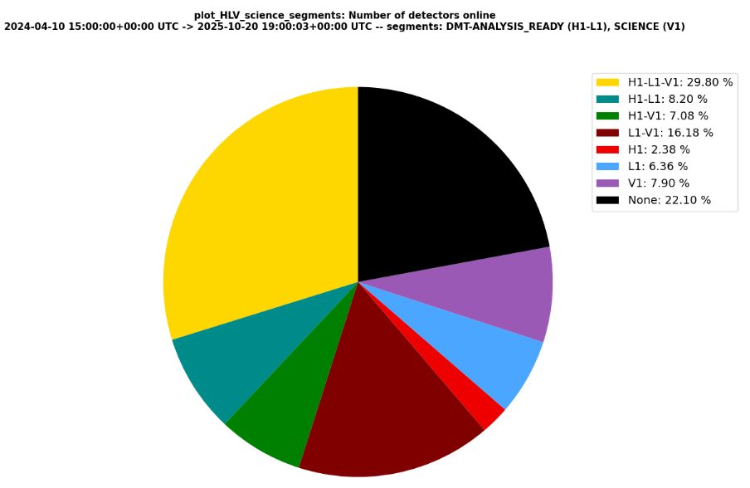
Performances during O4 so far
O4 started on May 2023
  Initially with the two LIGO detectors
  Virgo joined since March 2024
  KAGRA now joining as well

Slide 15
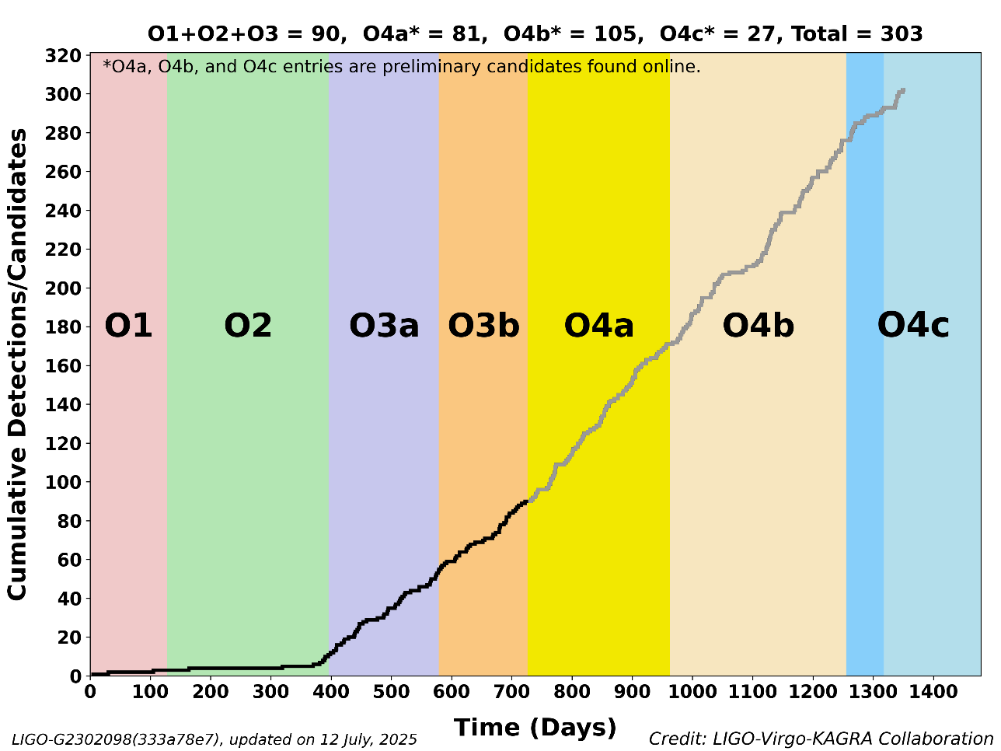
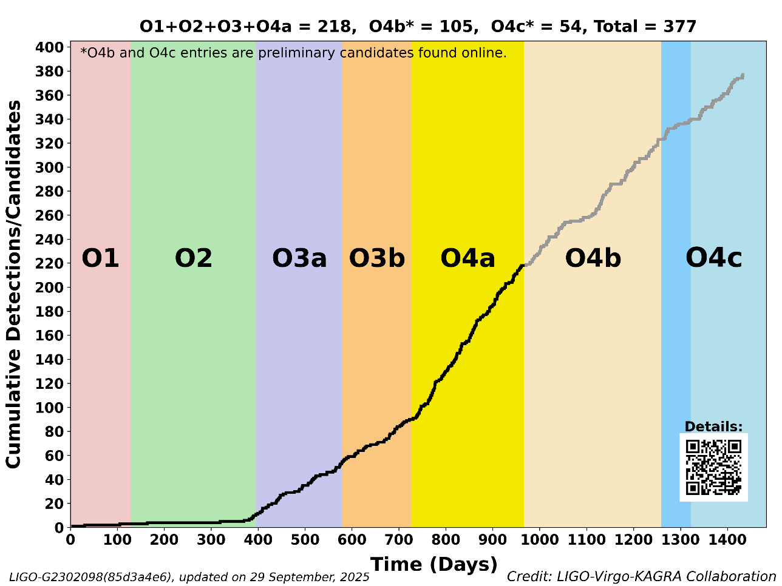
O4: significant alerts statistic
So far 243 significant detection candidates during O4 (272 Total - 29 Retracted)
  See https://gracedb.ligo.org/superevents/public/O4/
  Event rate ~2.5/week, the advantage of upgrading
Information provided
  Timing
  False alarm rate
  Localization/Distance
  Event type
    1 NSBH (55%), BNS (37%) - S250206dm
    1 NSBH (72%), BBH (28%) - S241109bn
    1 NSBH (49%), BBH (48%) - S230627c
    1 NSBH (62%), BNS (31%) - S230529ay
      With BH in the Mass gap
    The others are BBH or most probably BBH
Status
  O4a data released!
  O4 to continue until Nov the 18th

Slide 16
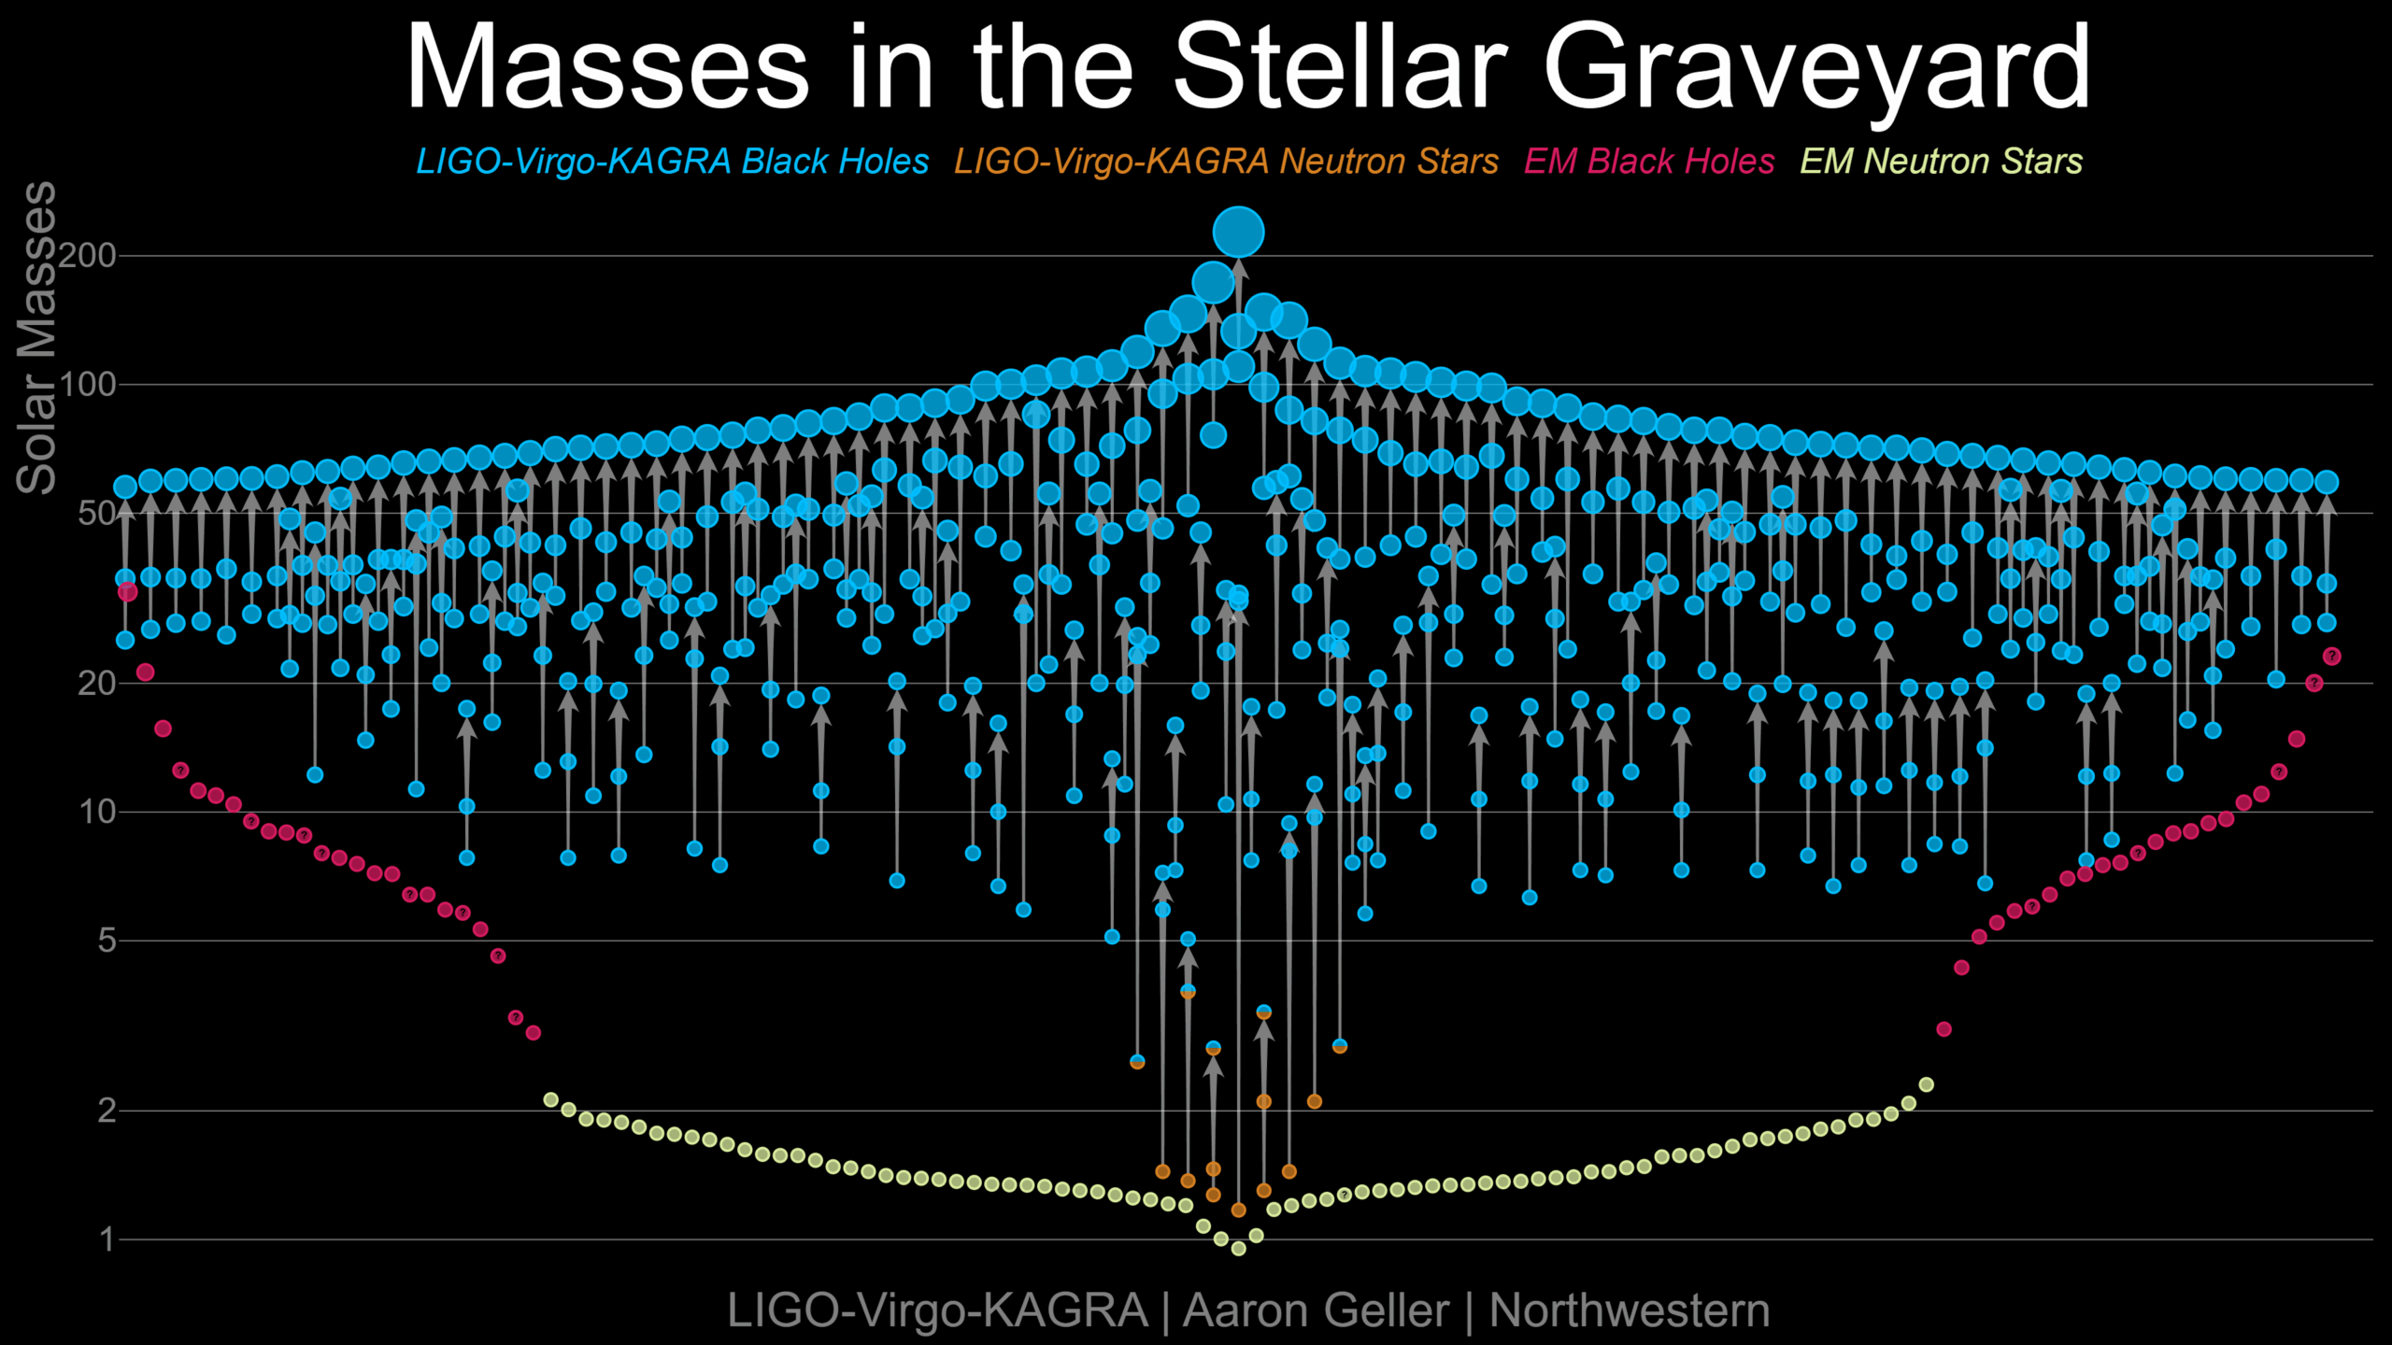
Sources catalog: GWTC-4.0
O1+O2+O3+O4a
  218 events
LIGO Scientific Collaboration, Virgo Collaboration and KAGRA collaboration
arXiv:2508.18082 (2025)

Slide 17
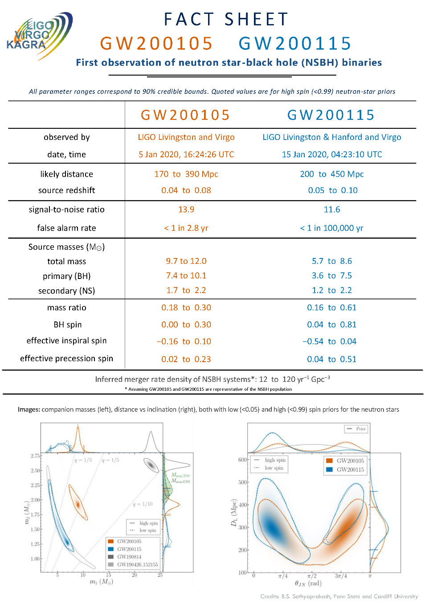
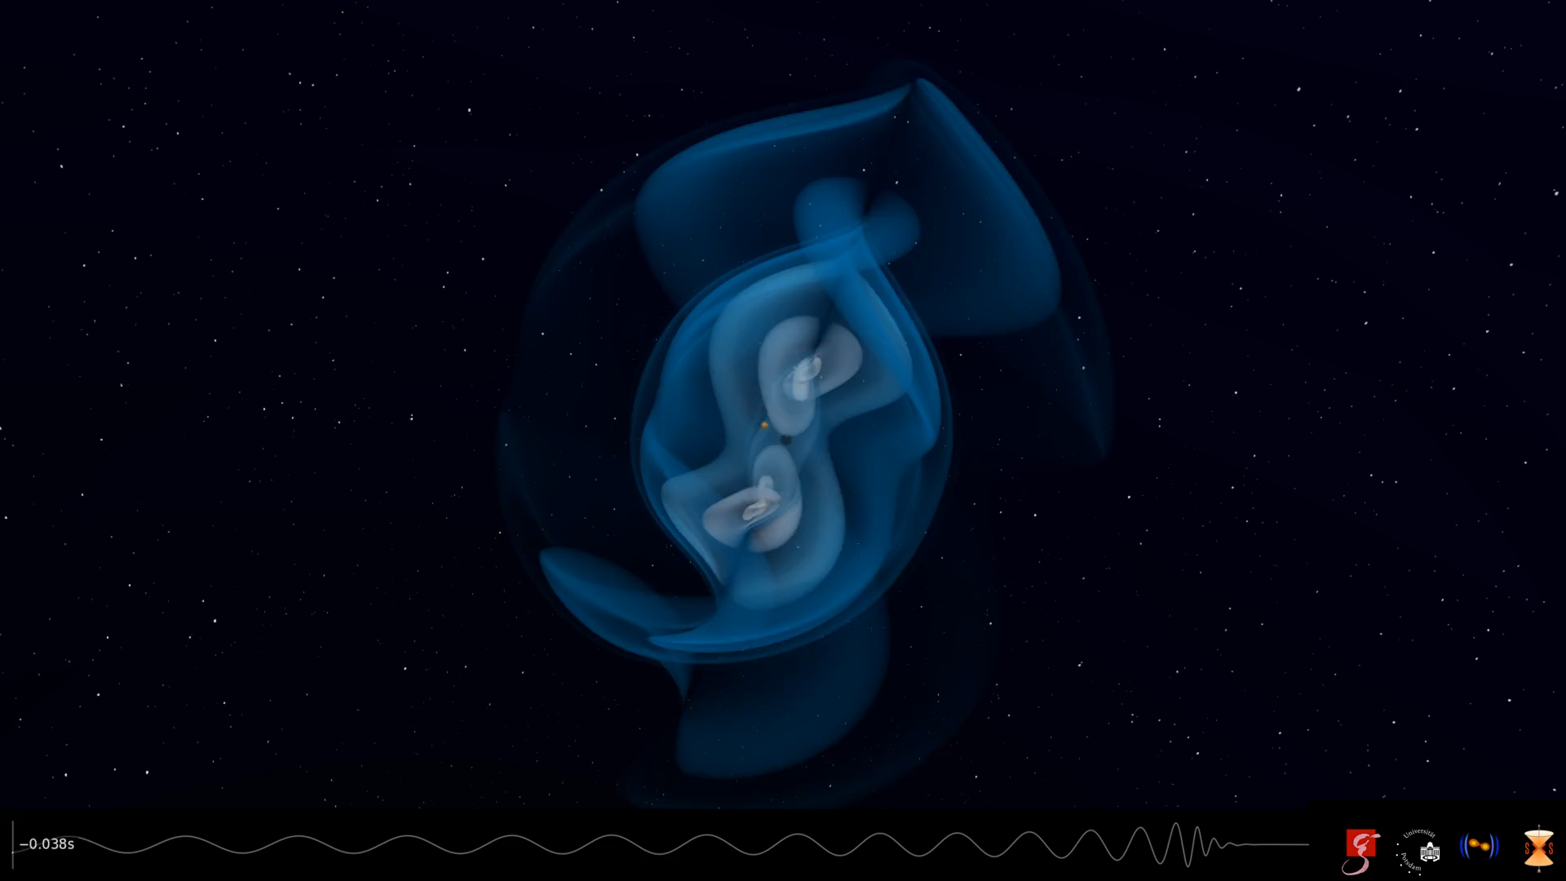
First NS-BH mergers
First neutron star - black hole mergers detected
  GW200105 and GW200115
No optical counterparts
  Relatively far (several 100 Mpc)
  Likely that black hole was massive enough to swallow
  the neutron star as a whole
LIGO Scientific Collaboration and Virgo Collaboration
Astrophys. J. Lett. 915, L5 (2021)

Slide 18
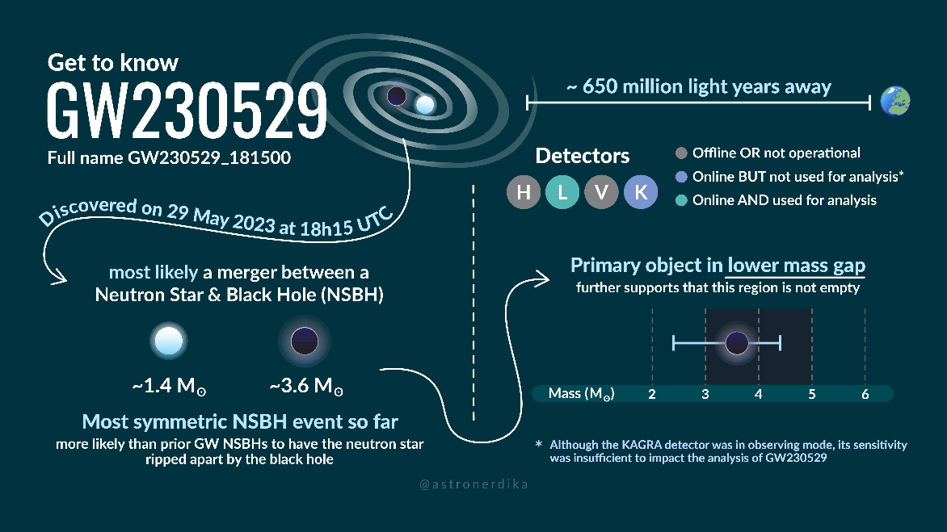
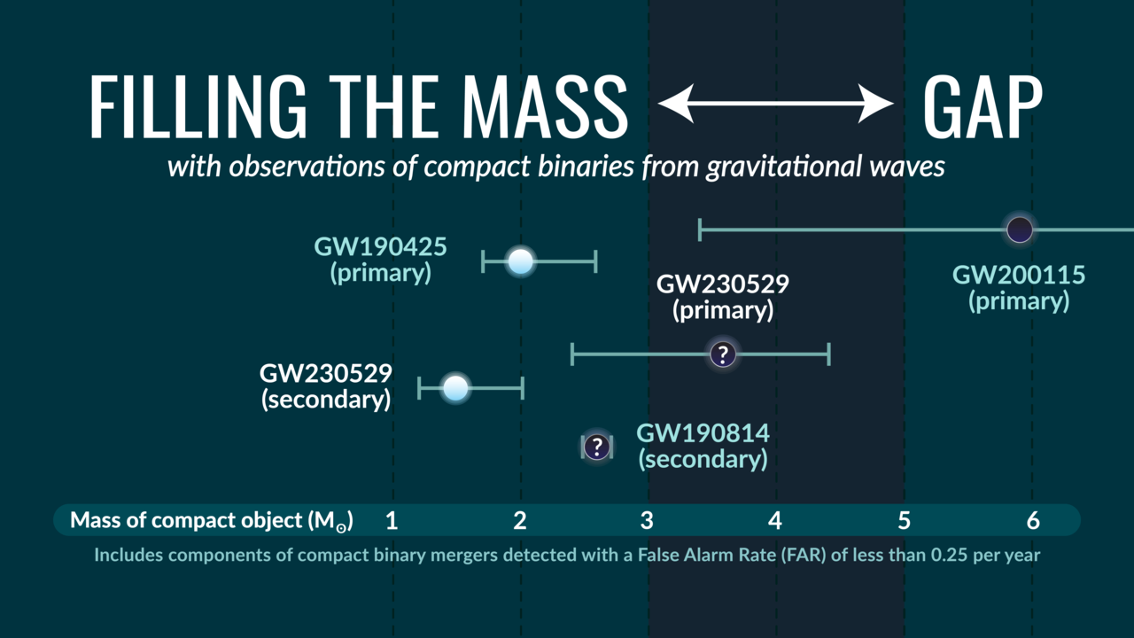
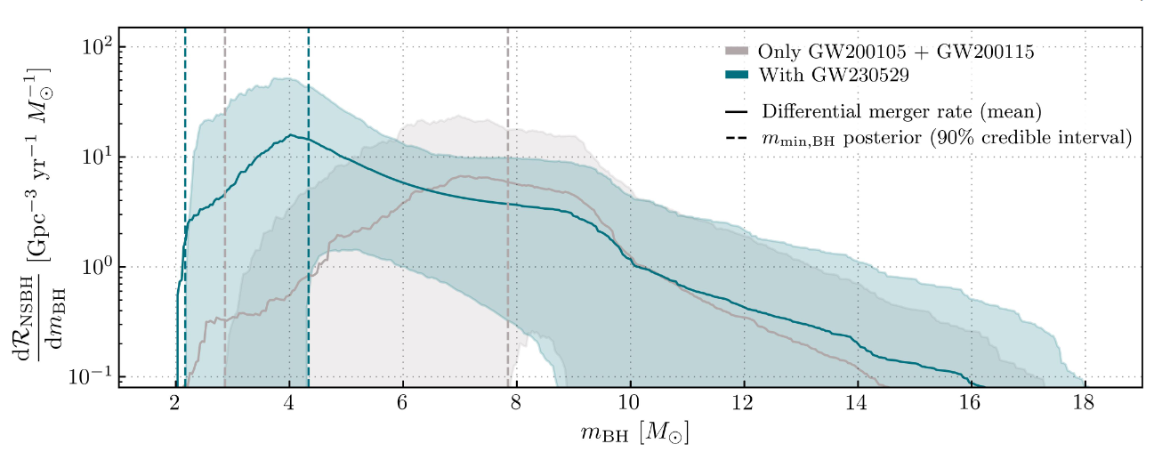
GW230529: an interesting NS-BH
Merger of neutron star with black hole
  Black hole mass between 2.5 M☉ and 5 M☉
    In the so-called mass gap
  First of this type to involve a neutron star as secondary
  component
  Increase estimate of NSBH rate with small black hole
    Interesting for EM emission
The LIGO Scientific Collaboration, the Virgo Collaboration, the KAGRA Collaboration
Astrophys. J. Lett. 970, L34 (2024)

Slide 19
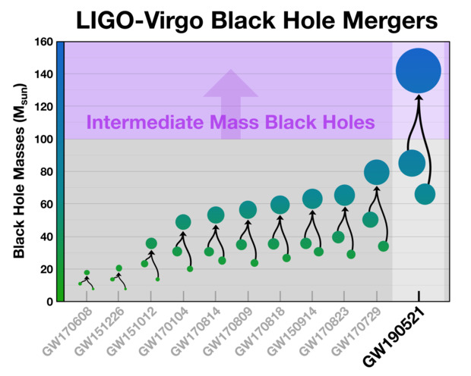
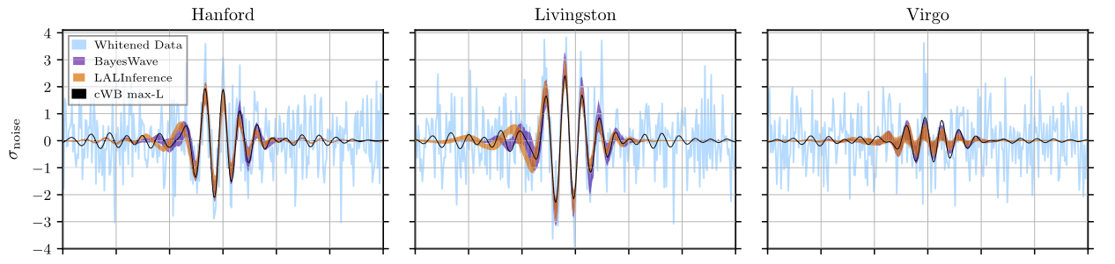
Intermediate mass black holes
Merger of two black holes into a 142 M☉ black hole
  First observation of IMBH
  Primary black hole mass ~85 M☉: in the pair instability mass gap
  Several scenarios considered for its formation
Signal from exotic stars?
  Compatible with head-on collision of two horizonless vector boson stars
  (J.C. Bustillo etr al. Phys. Rev. Lett. 126, 081101)
  Only merger measured
LIGO Scientific Collaboration and Virgo Collaboration
Phys. Rev. Lett. 125, 101102 (2020)

Slide 20
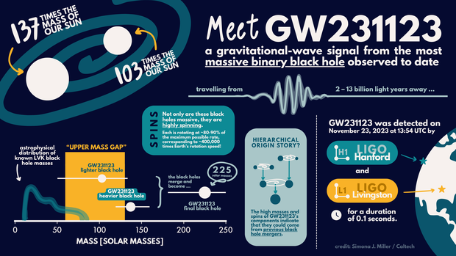
Intermediate mass black holes
Merger of two black holes into a 225 M☉ black hole
The LIGO Scientific Collaboration, the Virgo Collaboration, the KAGRA Collaboration
arXiv:2507.08219 [astro-ph.HE], accepted by ApJL

Slide 21
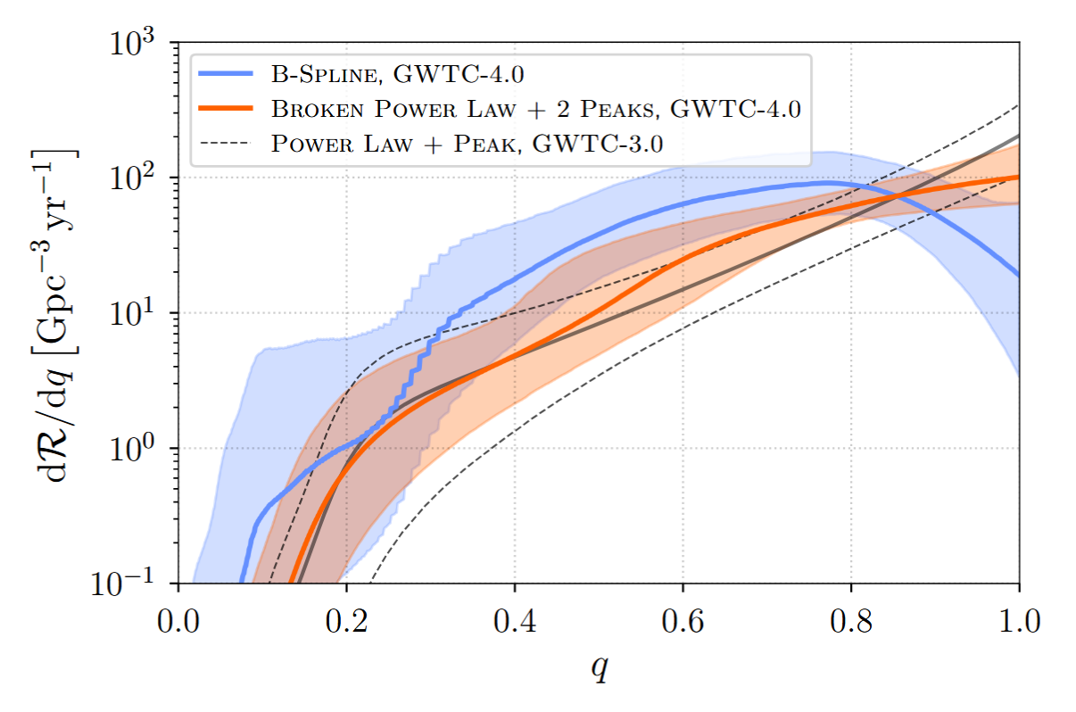
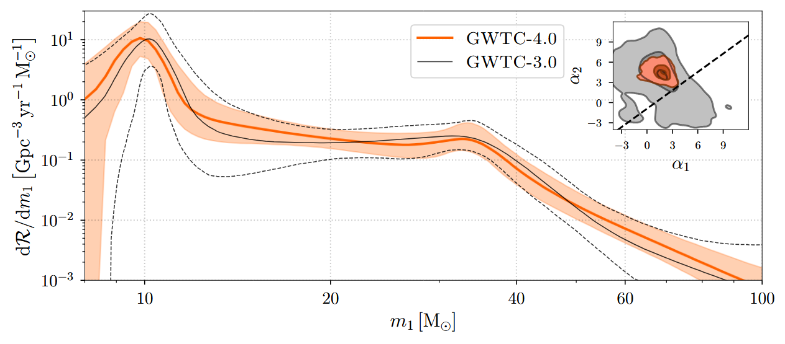
Population studies
Larger number of detection allows population studies
Peaks visible in the black hole mass distribution
Primary mass
Mass ratio
LIGO Scientific Collaboration, Virgo Collaboration and KAGRA collaboration
arXiv:2508.18083 [astro-ph.HE] (2025)

Slide 22
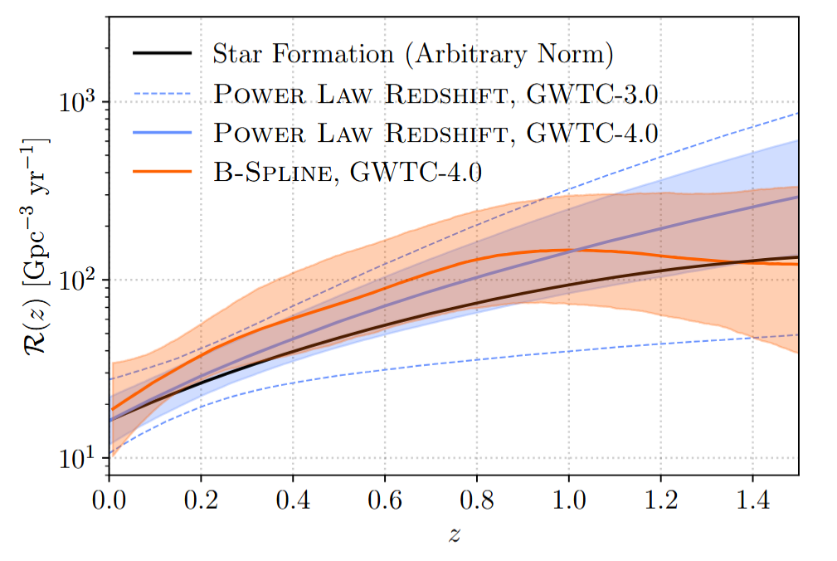
Population studies
Evolution of merger rates with redshift
  Large merger rate at larger redshift
  Consistent with star formation rate
LIGO Scientific Collaboration, Virgo Collaboration and KAGRA collaboration
arXiv:2508.18083 [astro-ph.HE] (2025)

Slide 23
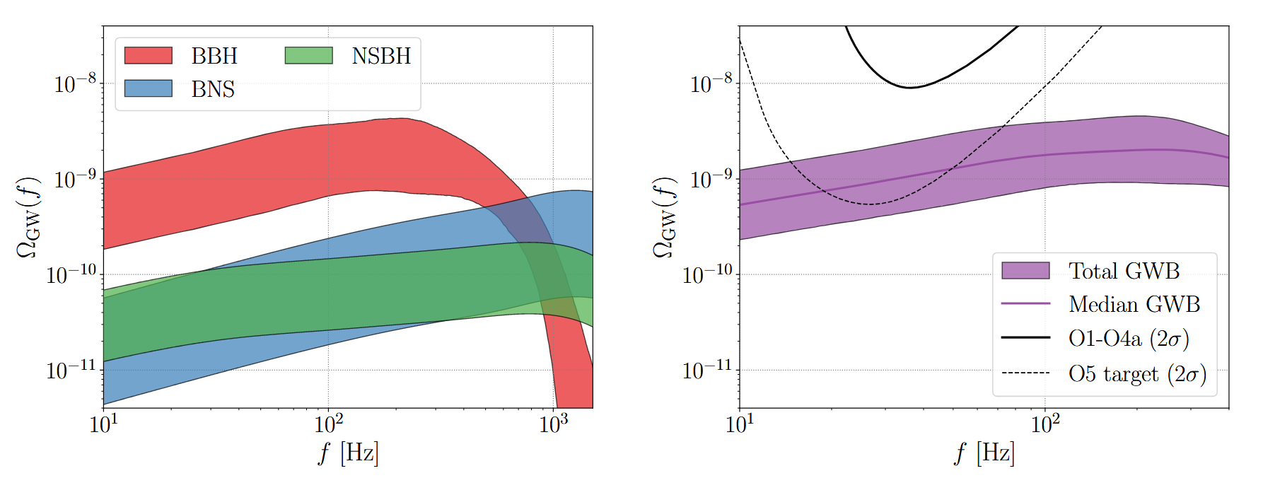
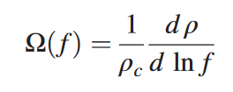
Gravitational wave background?
Upper limits so far
From population studies to expected gravitational wave background due to superposition of all mergers in the Universe
  Accessible to A+/Virgo_nEXT generation
LIGO Scientific Collaboration, Virgo Collaboration and KAGRA collaboration
arXiv:2508.20721 [gr-qc] (2025)

Slide 24
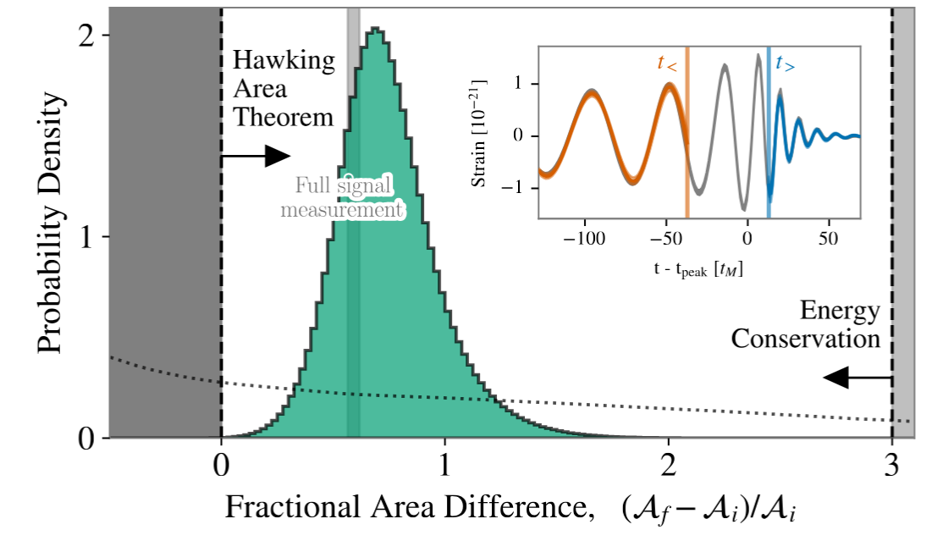
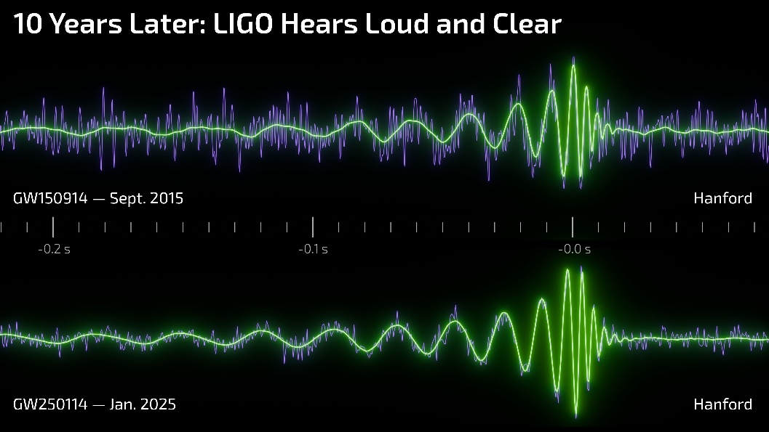
Tests of general relativity
From preliminary tests to precision tests
Example:
  GW250114: Testing Hawking’s Area Law and the Kerr Nature of Black Holes
  Thanks to clean detection of final back hole ringing
LIGO Scientific Collaboration, Virgo Collaboration and KAGRA collaboration
Phys. Rev. Lett. 135, 111403 – Published 10 September, 2025

Slide 25

The timeline: zoom out
Current infrastructures
New infrastructures
LIGO upgrade A#
Cosmic Explorer
Virgo_nEXT
Einstein Telescope
KAGRA upgrade
2030’s
2040’s
Advanced Virgo+
Advanced LIGO+

Slide 26
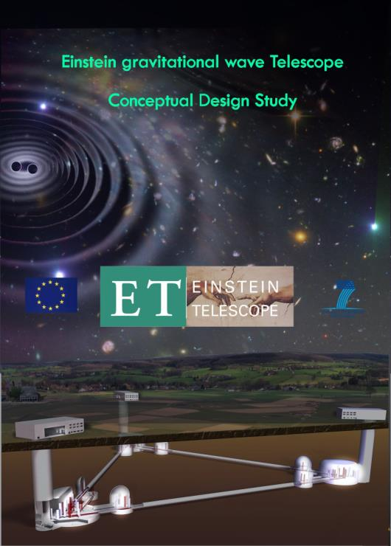
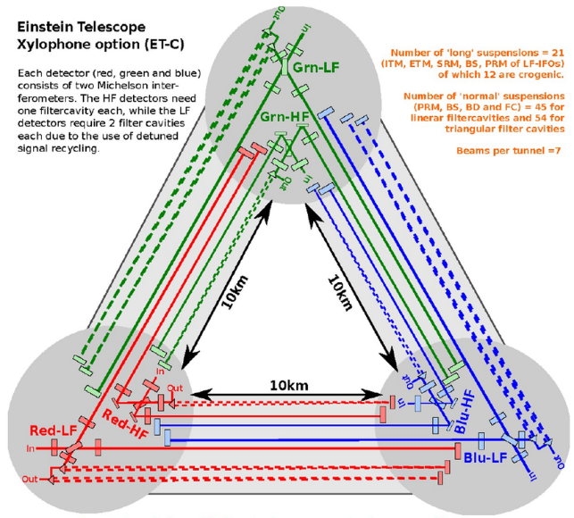
Einstein Telescope (ET)
A new European observatory for gravitational wave astronomy
  Conceptual design established in 2011
  Now part of ESFRI Roadmap (European Strategy Forum for Research Infrastructures)
Main features
  Underground
  Triangular: three nested detectors 10 km long
  Xylophone: two interferometers (one for low frequency and one for high frequency) for each detector
  Cryogenic technology for the low frequency interferometer

Slide 27

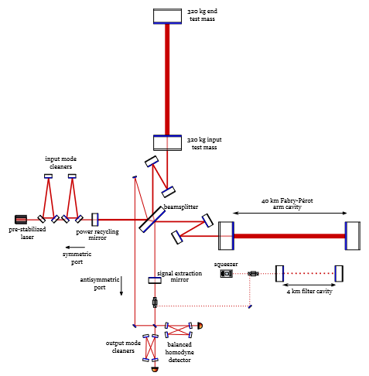
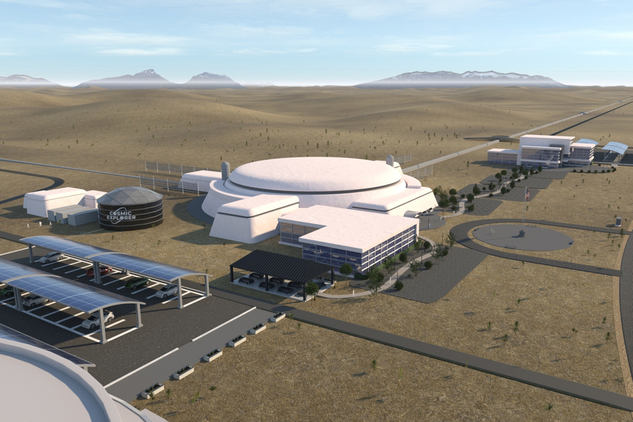
Cosmic Explorer (CE)
A new infrastructure for gravitational wave astronomy in the US
  A horizon study delivered to the NSF in 2021
Main features
  2 L-shape, 40 km and 20 km long interferometers (ITF)
    Alternatives: one 40 km ITF, two 20 km ITF’s
  Based on LIGO technology but larger mirrors and suspensions
    Room temperature, same laser wavelength

Slide 28
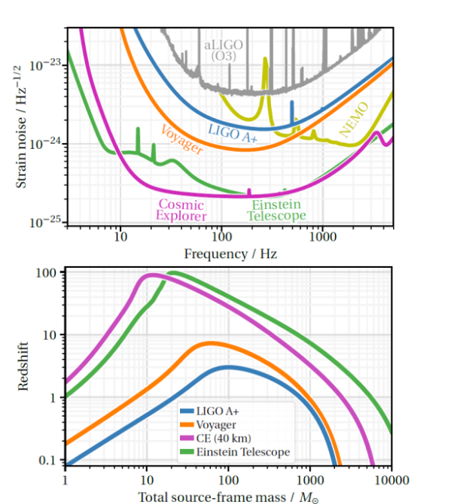
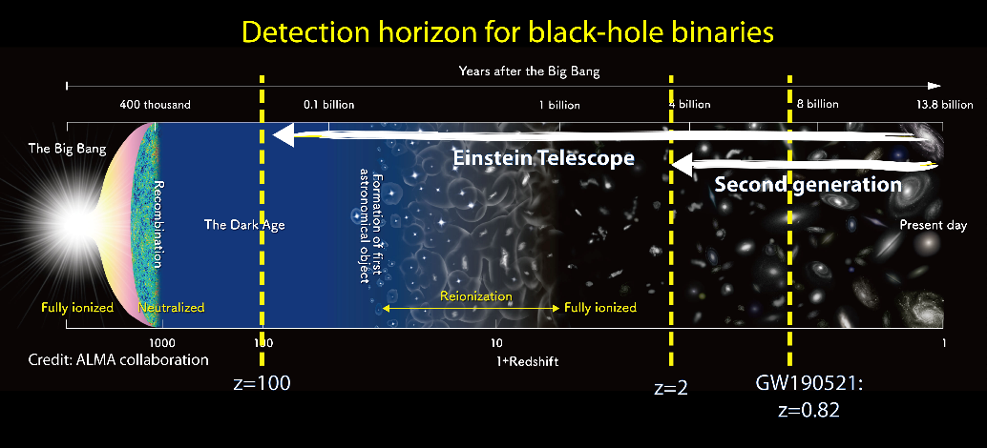
Sensitivity and reach of 3G detectors

Slide 29
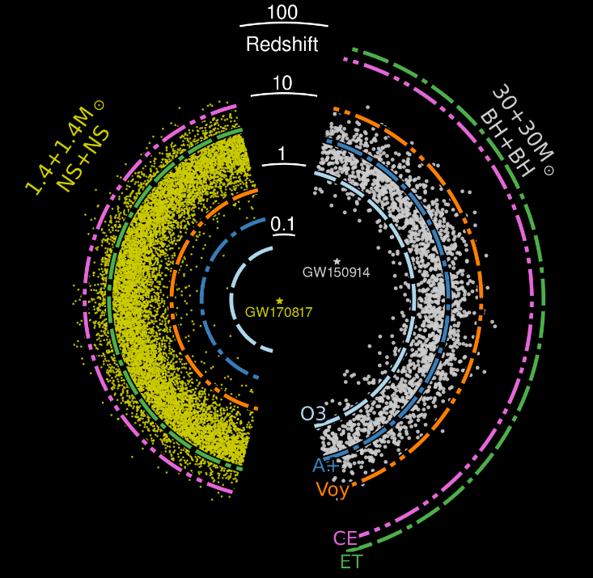
BBH and BNS in 3G detectors
Very high statistics
  Several 10⁵ BBH mergers per year
  10⁵ BNS mergers per year
  Several 10’s of nearby well localized BNS mergers per year
Black Holes and Neutron Stars Throughout Cosmic Time
  Remnants of the First Stars (Pop III)
  Seed Black Holes and Galaxy Formation
  Formation and Evolution of Compact Objects
O3
O5
CE
ET
M. Evans et al. arXiv:2109.09882v2

Slide 30
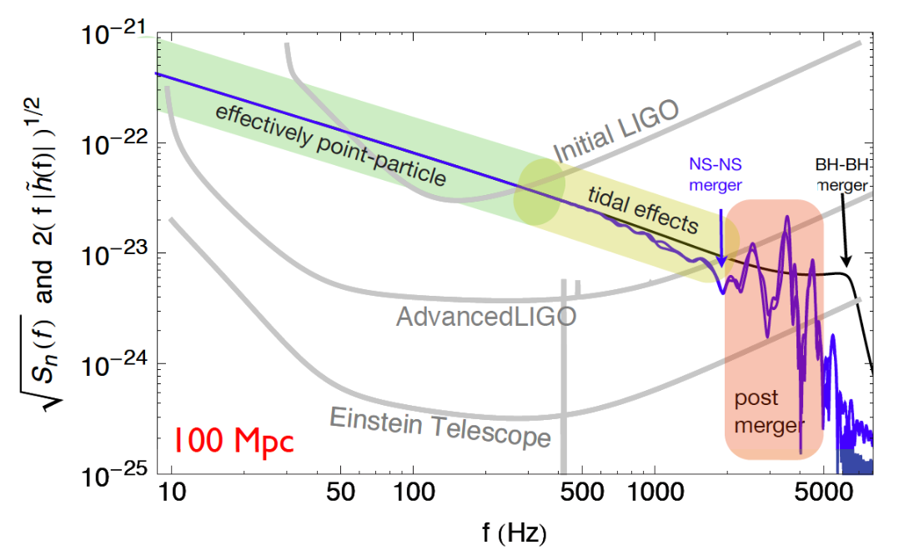
Nuclear Physics with Neutron stars
Dynamics of Dense Matter
  Neutron Star Structure and Composition
    From BNS mergers
    From rotating neutron stars
  New Phases in Quantum Chromodynamics
    From BNS post-merger oscillations
    From supernovae or other burst type events
  Chemical Evolution of the Universe
    From a large number of kilonovae detections
  Gamma-Ray Burst Jet Engine
    From BNS and NSBH orbit inclination measurements
M. Maggiore et al. JCAP 03 (2020) 050

Slide 31
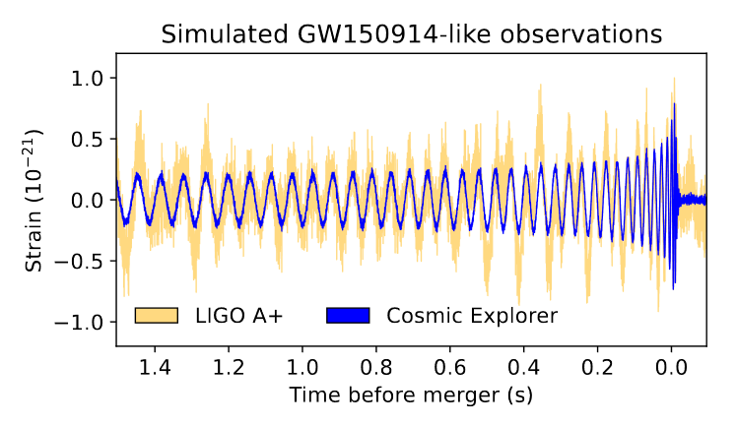
Fundamental physics and cosmology
Fundamental Physics from Extreme Gravity
  Nature of Strong Gravity
    From precision tests of GR
    From search of extra polarizations
    From delays in γ-ray vs GW detections
  Unusual and Novel Compact Objects
    From rare uncommon mergers of BH’s and NS’s
    From exotic compact objects
  Dark Matter and Dark Energy
    From dark matter clouds around BH and NS
    From study of GW propagation
    From GW sources as standard candle
  Early Universe
    From gravitational wave background
M. Evans et al. arXiv:2109.09882v2

Slide 32
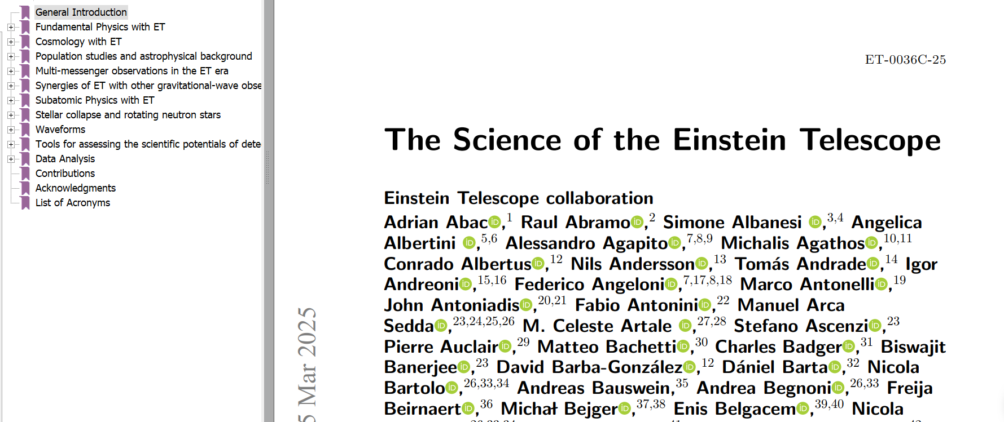
Science with 3G detectors

Slide 33
Conclusions
The first detection of a binary black hole merger open the era of gravitational wave astronomy
The first detection of a BNS merger in coincidence with the electromagnetic observation started the epoch of multi-messenger astronomy
O3&O4 allow first black holes population studies and detection of more rare events
3G detectors will allow very high statistics and very large SNR, enabling the detection of most of the compact binaries mergers in the Universe
Europe and the US have started building a plan for 3G. A 3G detector in another continent will certainly expand the network capability.

Slide 34
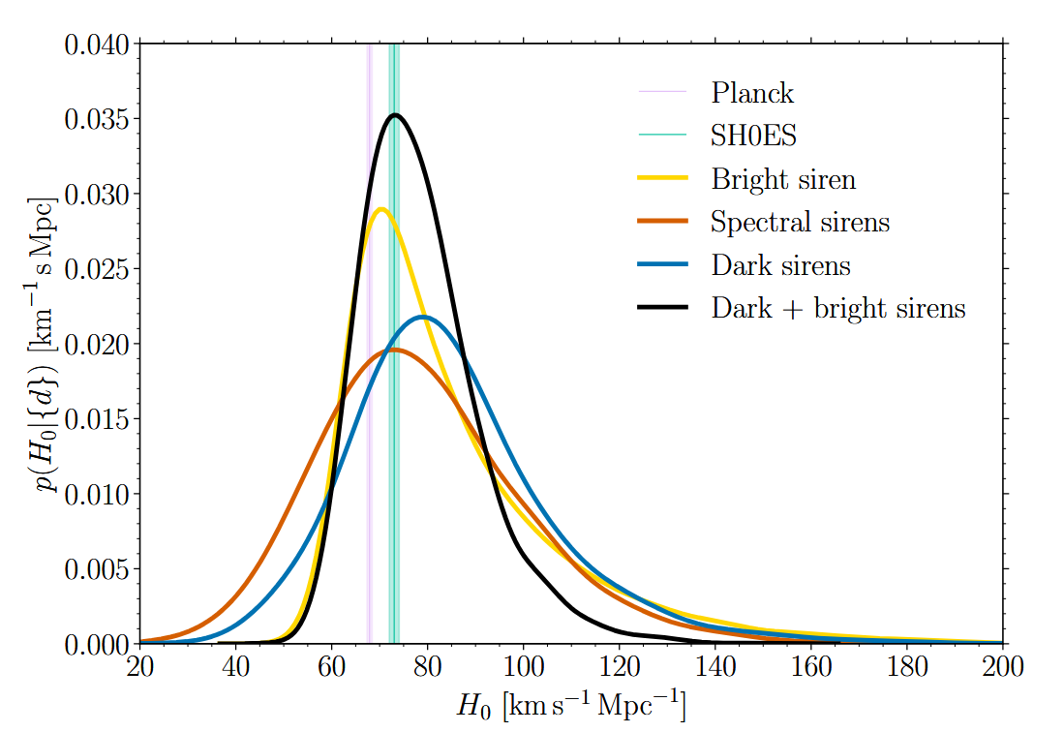
Hubble constant measurement
Use of GW signal to extract source distance
Red-shift from:
  Electromagnetic emission
    “bright siren”
    So far, only GW170817.
  Galaxy catalog
    “dark siren”
  Features in source mass distribution
    “spectral siren”

Slide 35
Dark Matter search
Direct detection
  Dark photon with 10-14 – 10-11 eV
Indirect detection
  Ultralight bosons forming clouds around black holes
  Effects:
    Limit maximum black hole spin due to spin down
    Monochromatic GW emission from the boson clouds
    Evolution of binary black holes frequency chirp

Slide 36
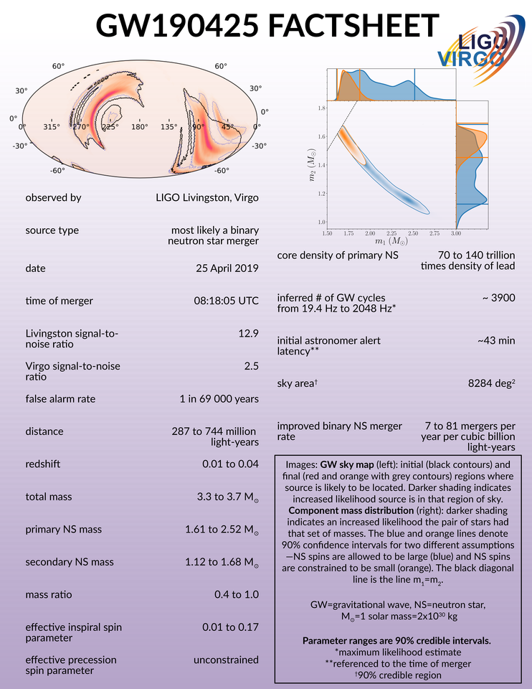
GW190425: Second BNS merger
GW190425: likely a second BNS merger
  But significantly heavier than know galactic BNS
    Total mass between 3.3 and 3.7 M☉
  Tendency confirmed in subsequent detections
  involving neutron stars
Only two detectors on-line
  Poor localization
  No optical counter part identified
LIGO Scientific Collaboration and Virgo Collaboration
Astrophys. J. Lett. 892, L3 (2020)

Slide 37
3G detectors in the 40’s
A world wide network made of O(10 km) scale long detectors
  Cosmic Explorer in the US
    One or two L’s
  Einstein Telescope in Europe
    One triangle or two L’s
  A third long detector in a third continent would improve the
  network capability
Image: Earth seen
from the North Pole

Slide 38
Advanced LIGO detectors
Two laser interferometers in the USA, 3000 km apart.

Slide 39

Advanced Virgo
Three km long interferometer located near Pisa, Italy

Slide 40
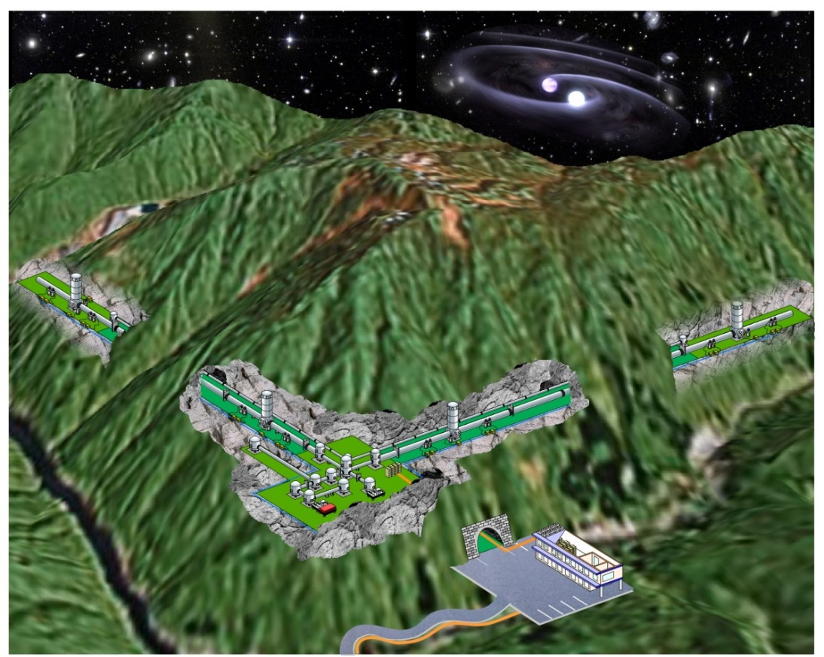
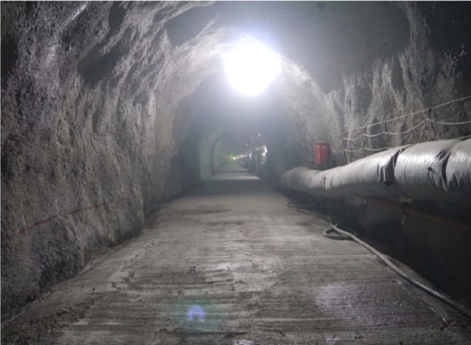
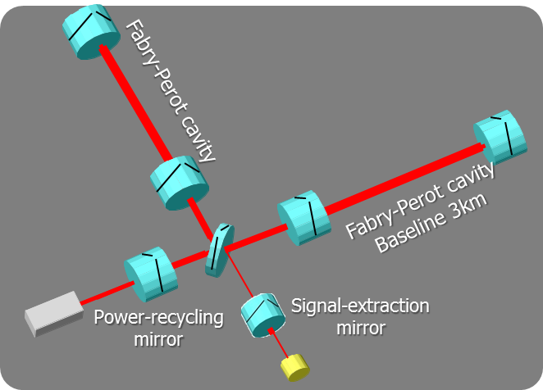

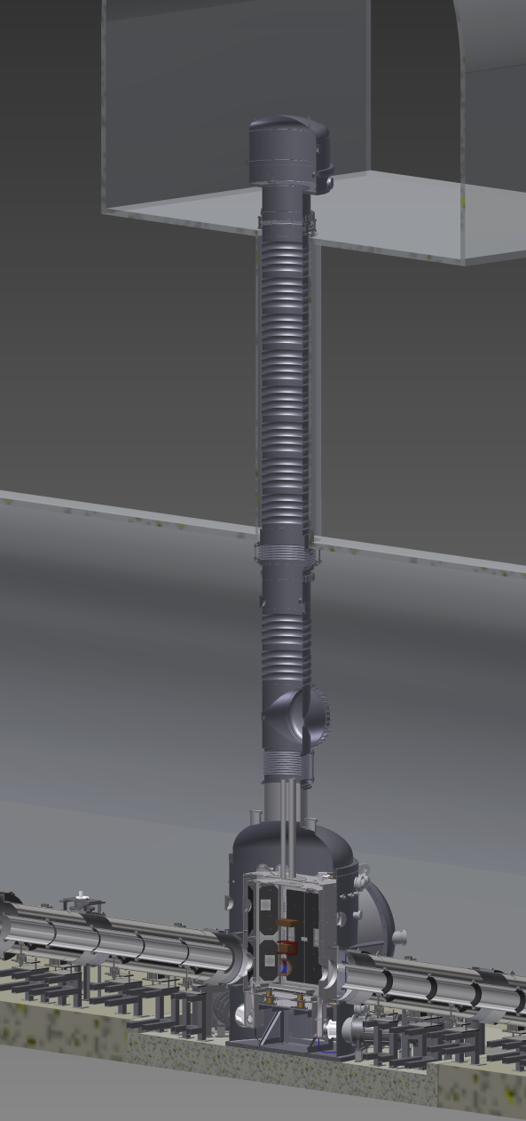
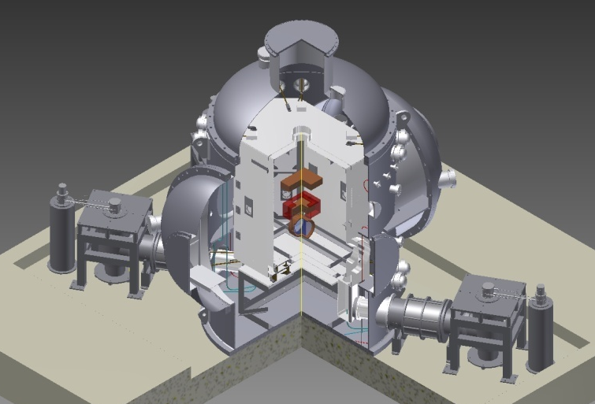
In Japan: KAGRA
Double recycled
interferometer
Underground:
Reduce seismic noise
Two floors cavern
for long
vibration isolation
Cryogenic mirror: -250 C
Reduce thermal noise

Slide 41

Performances during O4 so far
Duty cycle
(since Virgo joined)

Slide 42

Performances during O3

Slide 43

Performances during O3b

Slide 44
Coalescence of two black holes
Orbital inspiral and merger of two black holes and ring-down of the final black hole
  Initial black hole masses: 36 M☉ and 29 M☉
  Final black hole mass: 62 M☉
  Energy released: 3 M☉ !!
  Located at about 400 Mpc from the earth
  At the peak it is brighter than the entire Universe
    Energy flux at Earth larger than full moon

Slide 45
Main results from first detection
Einstein was right!
Signal consistent with general relativity
  Post Newtonian terms compatible with GR
  Upper limits placed on deviation of terms from GR
  Model independent upper bound on graviton mass from lack of dispersion
First measurement of binary black hole merger rate
Prediction of a measurable gravitational wave background originating from all mergers in the Universe

Slide 46
Second detection: GW151226
Signals detected
From the signal shape we deduce the black hole masses
  Initial black holes: 14 M☉, 8 M☉
  Final black hole: 21 M☉
  Release energy: ~ 1 M☉

Slide 47

GW150914 vs GW151226

Slide 48

Localization of the source
Combination of the data from LIGO and Virgo allowed constraining the direction of the source within 30 degrees²
Credit: LIGO/Virgo/NASA/Leo Singer

Slide 49

Localization of the source
One of the best ever localized gravitational wave source

Slide 50
EM follow up: all telescopes pointed there
LIGO and Virgo had an agreement with more than 90 astronomer collaborations (including J-GEM)
Credit: LIGO-Virgo

Slide 51
Discovery of a ‘new star’
Swope telescope after 11 hours
Multi-messenger Observations of a Binary Neutron Star Merger,
The LIGO Scientific Collaboration & The Virgo Collaboration et al.
The Astrophysical Journal Letters, in press (2017).

Slide 52
EM follow up: all telescopes looked there
All electro-magnetic wavelengths explored in the following hours, days and weeks
Multi-messenger Observations of a Binary Neutron Star Merger,
The LIGO Scientific Collaboration & The Virgo Collaboration et al.
The Astrophysical Journal Letters, in press (2017).

Slide 53

Short gamma ray burst
Confirm that binary neutron stars mergers produce short gamma ray bursts
This is the closest gamma-ray burst ever measured
It is very faint: why?
  Source inclination?
  A new population of close and faint gamma ray bursts found?
CREDIT: NSF_LIGO_Sonoma
State University_A. Simonnet
Gravitational Waves and Gamma Rays from a Binary Neutron Star Merger: GW170817 and GRB 170817A,
The LIGO Scientific Collaboration & The Virgo Collaboration & Fermi & INTEGRAL.
The Astrophysical Journal Letters, in press (2017).

Slide 54

Speed of Gravity
Gamma rays arrived 1.7 seconds after the gravitational wave
Exact time of gamma rays emission not known within ~10 seconds
But given the source distance, the “race” lasted 130 million years
Speed of Gravity ~ Speed of Light, within ~0.0000009 m/s
gamma
ray
gravitational
wave
Gravitational Waves and Gamma Rays from a Binary Neutron Star Merger: GW170817 and GRB 170817A,
The LIGO Scientific Collaboration & The Virgo Collaboration & Fermi & INTEGRAL.
The Astrophysical Journal Letters, in press (2017).

Slide 55

Expansion of the Universe
From the gravitational waveform we know the source distance
  New method to measure distances in astronomy
  Result: ${43.8}_{−6.9}^{+2.9} Mpc$
  Precision will improve with more detectors
From the optical observations we know the source velocity
  Assuming it is part of NGC4993
Measurement of the
Hubble constant
  $H_{0}={70.0}_{−8}^{+12} km s^{−1}{Mpc}^{−1}$
‘A standard siren measurement of the Hubble constant with GW170817’
The LIGO Scientific Collaboration & The Virgo Collaboration, et al.
Nature, 16 October 2017.

Slide 56
Alerts process
Event candidates with false alarm rate (FAR) < 2/day are automatically made public.
Event candidates passing the following FAR threshold are significant alerts.
  ~1/months for CBC
    N.B 5 CBC pipelines (gstlal, mbta, pycbc, spiir, and raven) so FAR threshold for each pipeline is 1/(5 months)
  ~1/years for burst,
    N.B. 4 burst pipelines (olib-allsky, cwb-allsky, cwb-bbh, raven) so FAR threshold for each pipeline is 1/(4 years)
As of 31/03/2025 (See https://gracedb.ligo.org/superevents/public/O4/ )
  203 significant detection candidates (228 total - 25 retracted)
  3781 low significance detection candidates

Slide 57
Rapid response team
A joint LIGO-Virgo-Kagra effort, organized in three levels:
  Level-0 (24/7 shifts, 3 time zones).
    “Non-specialists” who respond to public alerts for significant events in real time.
    Perform checks, send out initial Notice/Circular if no issues are found and no “high-profile event”
    Contact Level-1 in case of issues or Level-2 in case of “high-profile”
  Level-1 (on-call)
    Experts of online search pipelines, low-latency infrastructure, data quality and site advocates
  Level-2 = Level-0 + Level-1 + RRT coordinators
    Semi-regular calls and high profile events.
“High profile” events
  Bursts
  Events with NS or remnant
  Sky-localization < 100 deg2

Slide 58

Timeline and latency

Slide 59





Content of alert

Slide 60





Content of alert

Slide 61


Virgo_nEXT and A#
Reach the limit of the present infrastructure
  Ingredients: Larger mirrors (100 kg), Higher power in the arms (1.5 MW), More squeezing (10dB)
Expected best range for binary neutron star mergers: 500 / 600 Mpc

