Slide 1


44th International Symposium on Physics in Collision
Analysis of geomagnetic Pi2 pulsations during solar cycle 24 maximum and minimum regions
Abdelmoamen Ahmed Nosier
Early Creer Researcher at ISSI
October 20-23 ,2025
Cairo-EGYPT
ACAG-CONF.ORG

Slide 2
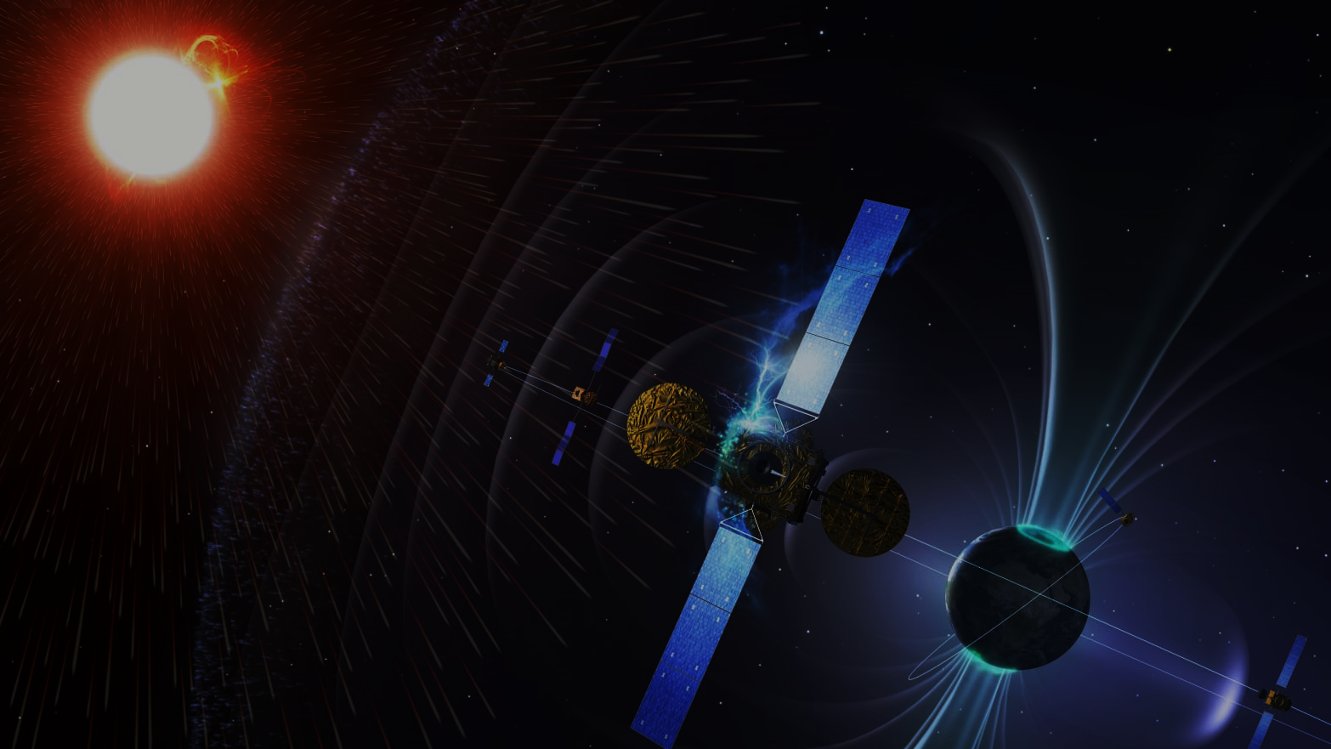

Outlines
Objective
Scientific background.
Brief on Solar Physics.
Pi2 Characteristics
Pi2 mechanisms
Methodology.
Earth geomagnetic stations
Data handling techniques
Work results(Modeling).
Any Questions?

Slide 3
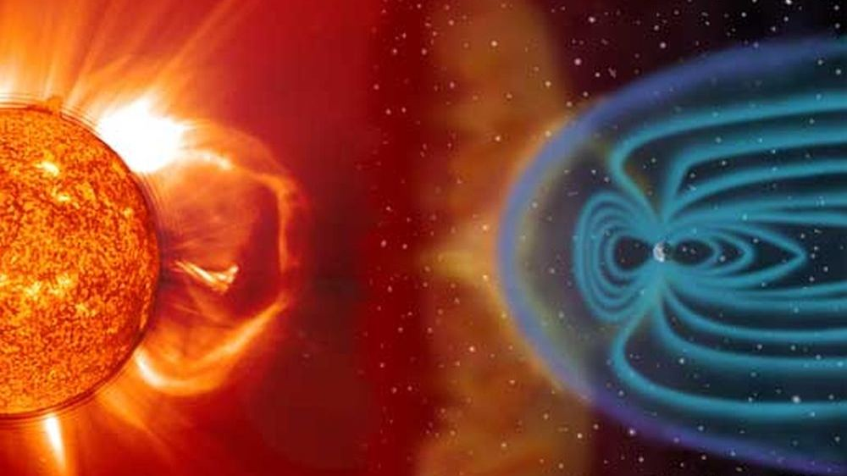
Objective
Study generation mechanism of low-latitude Pi2 pulsations during Solar Cycle 24.
Compare solar minimum (2007) vs solar maximum (2013).
Analyze number of events, intensity (Wp & amplitude), duration and substorm linkage.
Provide automatic detection pipeline and statistics.

Slide 4

Why study 2007 (min) vs 2013 (max)?
2007: solar minimum — lower background solar/geomagnetic activity.
2013: solar maximum — elevated solar wind, more substorms and geomagnetic disturbances.
Hypothesis: Pi2 occurrence/strength/linkage change with solar cycle phase.

Slide 5
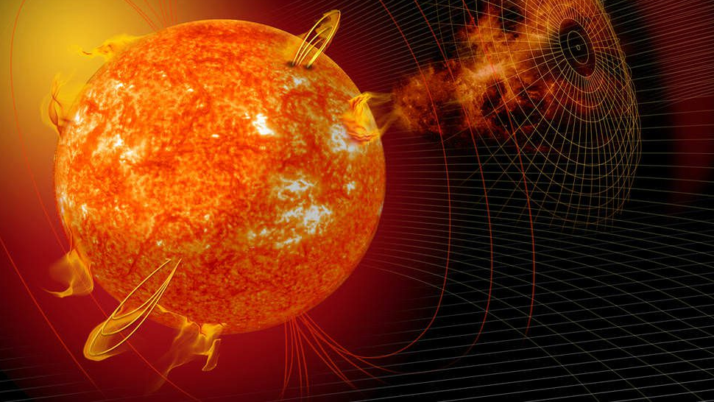
Scientific background

Slide 6
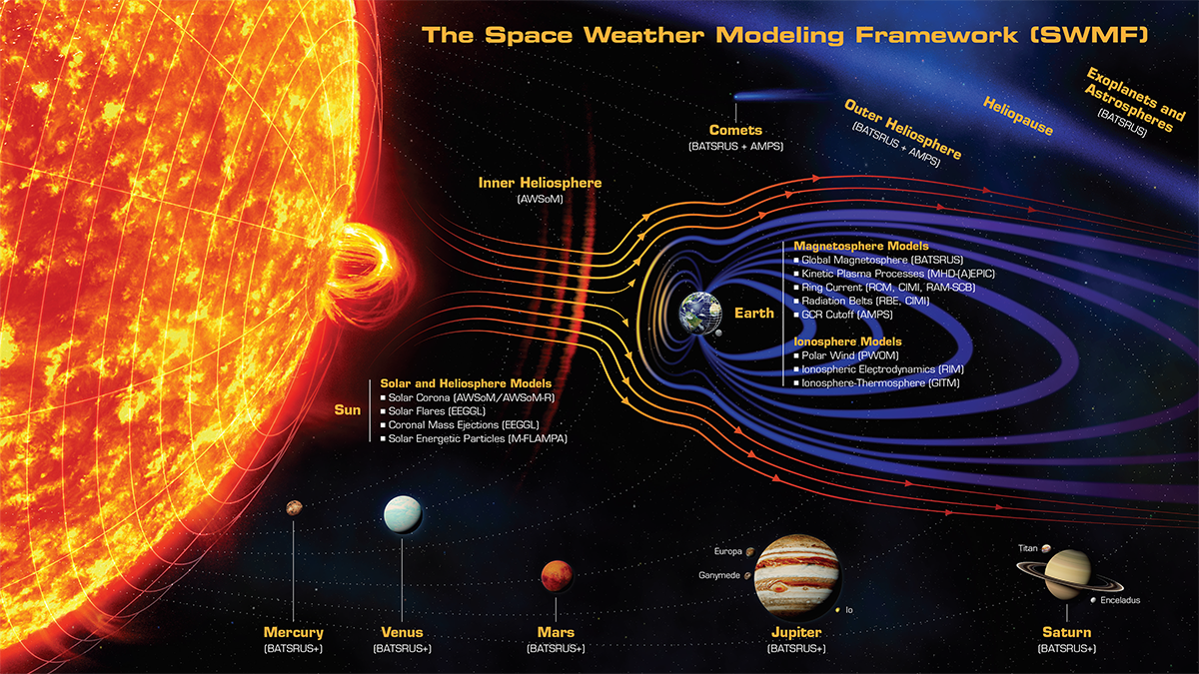
Solar hazards (Solar Wind)

Slide 7
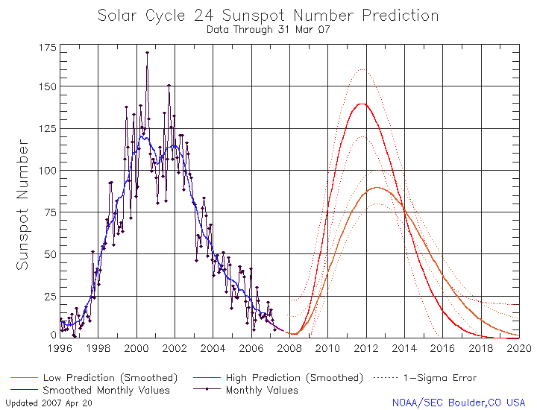
Solar Cycle
Note that :
The Sun has an ~11-year solar cycle that modulates solar activity (sunspots, flares, solar wind).
Solar Cycle 24: 2007–2018 (2007 ~ solar minimum; 2013 ~ solar maximum).
Solar activity influences geomagnetic activity and substorm occurrence on Earth.
https://www.swpc.noaa.gov/content/solar-cycle-24-prediction-updated-may-2009

Slide 8
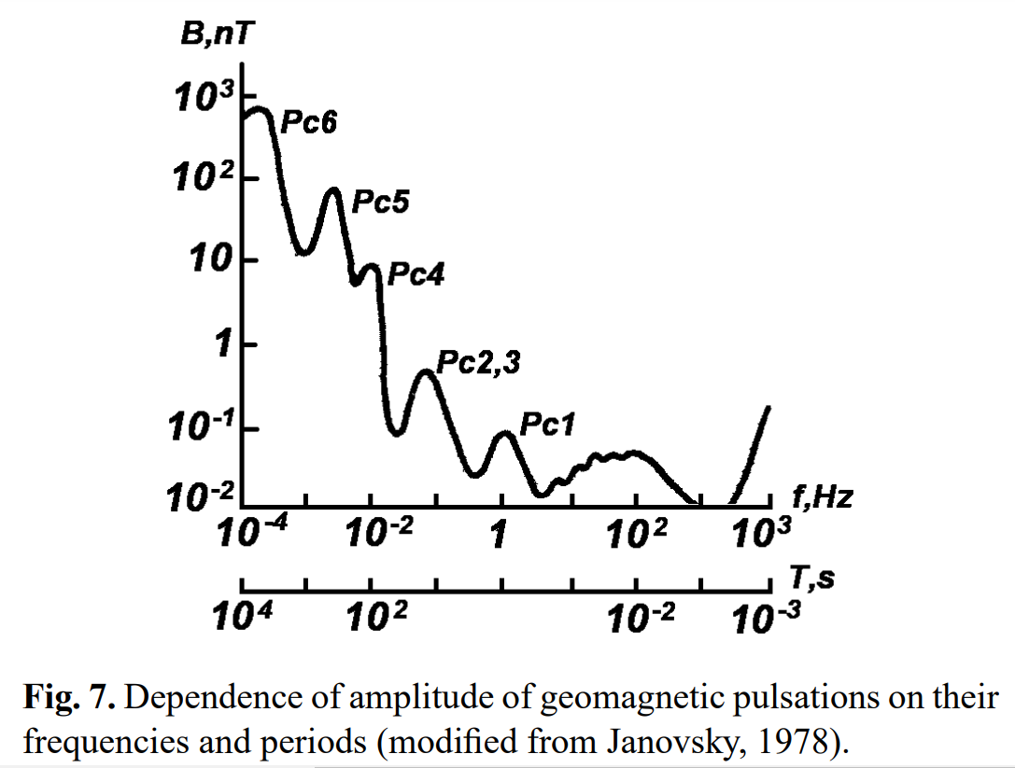
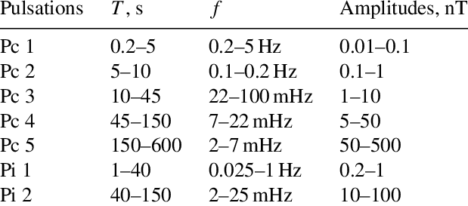
Classification of Magnetic Pulsations
Kozlovskaya et el., 2012

Slide 9
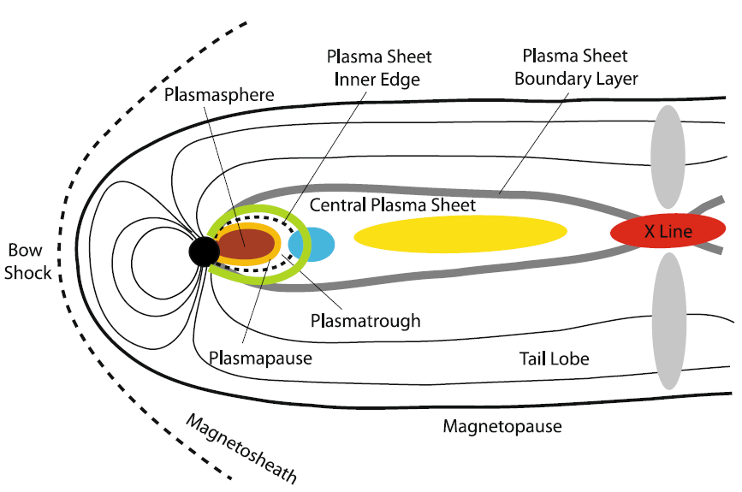
Characteristics of Pi2 pulsations
Pi2 magnetic pulsation is an impulsive nightside ultra-low frequency (ULF) wave and it is considered a sensitive indicator to the onset of the geomagnetic substorms within low- and mid-latitudinal regions. [Baker et al., 1996]
The frequency range of this wave is 7–25 mHz, a period of 40–150 s, with an amplitude of 1–50 nT. [Saito, 1969]
They are typically associated with the onset of magnetospheric substorms, particularly during the expansion phase. [Takahashi et al.,1996]
Their frequencies are typically lower than Pi1 pulsations and other types of continuous pulsations (Pc).
They are typically irregular in both their shape and amplitude. [O. Saka., 2023]
Locations of potential Pi2 source regions (colored brown, orange, green, blue, yellow, red, and gray) inside the Earth’s magnetosphere. A source region is the place where a physical mechanism operates that establishes the Pi2 frequency (Keiling 2011)

Slide 10
Pi2 Autodetection Mechanism

Slide 11
Data and Methodology
Data source: Kakioka (KAK) ground magnetometer, H-component, 1-second resolution.
Signal processing: Bandpass filtering (40–150 s).
Wavelet Analysis: Continuous Morlet wavelet to resolve time-frequency behavior of Pi2.
Wave Power Proxy (Wp): Computed as RMS over 60-second sliding windows.
Geomagnetic indices: AE/AL (WDC Kyoto) and SML/SMU (SuperMAG).
Substorm reference: Ohtani et al. substorm onset list.
Classification: Events divided into Substorm-related and Non-substorm.

Slide 12
Pi2 Detection (detailed)
Pi2 detection steps
Band-pass filter H: Keep periods between 40 and 150 s (Butterworth).
Find local peaks and troughs in filtered signal (prominence threshold).
For consecutive peaks p1,p2 compute period P and require 40s≤P≤150s.
For each peak-trough pair compute amplitude A; require 1nT≤A≤50nT.
Valid waves are appended; adjacent waves with small gaps (MERGE_GAP) merged into events.
Events separated by ≤PACKAGE_GAP considered same package; package onset/offset recorded.
All steps automated (no manual picking).

Slide 13
SML Onset Detection:
The SML (SuperMAG Lower index) is designed to track the strongest negative (westward) deviation of the electrojet.
Onset Detection Process
Change Calculation: The change in SML (ΔSML) is computed by calculating the difference over a short time window:
ΔSML=SML(t+Δt)−SML(t).
Potential Onset Marking: If ΔSML is less than or equal to −50nT (a sudden drop), the time is flagged as a potential substorm onset.
Final Onset Time: The detection algorithm finds the most negative cumulative drop within the time window and identifies the preceding local peak as the final onset time.

Slide 14
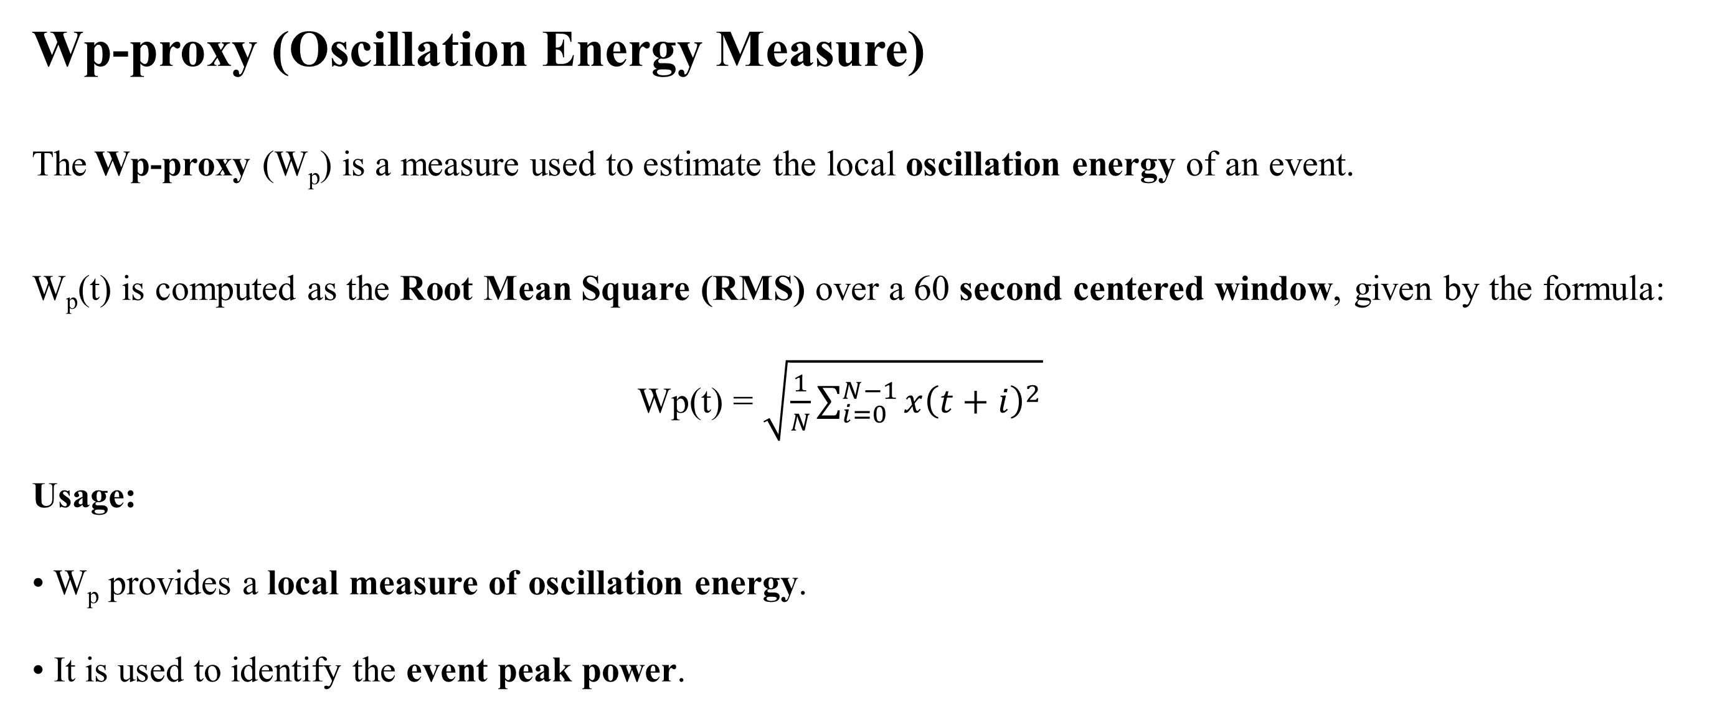
Wp-proxy (Oscillation Energy Measure)
The Wp-proxy (W_{p}) is a measure used to estimate the local oscillation energy of an event.
W_{p}(t) is computed as the Root Mean Square (RMS) over a 60 second centered window, given by the formula:
$\text{Wp}\text{(}\text{t}\text{) = }\sqrt{\frac{1}{N}\sum_{i=0}^{N−1}{x{\left(t+i\right)}^{2}}}$ ​
Usage:
W_{p} provides a local measure of oscillation energy.
It is used to identify the event peak power.

Slide 15


Wavelet scale–frequency relation
Definitions:
• s: wavelet scale
• f_{c}: central frequency of the chosen wavelet (e.g., Morlet)
• f: target frequency (1/period)
Interpretation:
Maps wavelet scales to physical frequency/periods (used to select 40–150 s).
Wavelet Power (Wp-proxy)
Definitions:
• x(t): H-component (filtered)
• N: number of samples in the RMS window (~60 s)
• Wp(t): local RMS proxy (measures local oscillation power)
Interpretation:
RMS over short window to capture local Pi2 energy (useful for intensity/onset).

Slide 16


Amplitude criterion
Definitions:
H_peak: signal peak value
H_trough: signal trough value
A: amplitude = |peak - trough|
A_min, A_max: thresholds (1 nT ≤ A ≤ 50 nT)
Interpretation:
Rejects tiny fluctuations (noise) and extreme outliers or artifacts.
Period criterion
Definitions:
t_{p1}, t_{p2}: sample indices (or times) of successive peaks
F_{s}: sampling frequency (samples/sec)
P: period (seconds), required 40 s ≤ P ≤ 150 s
Interpretation:
Ensures detected oscillations fall in Pi2 band.

Slide 17

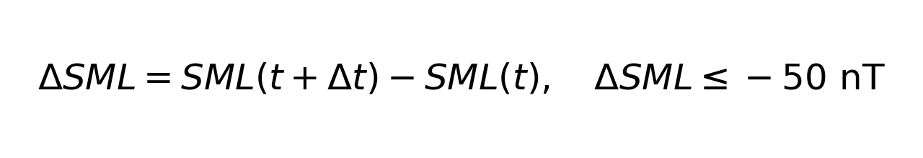
CWT definition (continuous wavelet transform)
Definitions:
• x(t): signal
• ψ: mother wavelet (Morlet here)
• a: scale parameter, b: translation (time)
Interpretation:
CWT gives time–frequency localized power; we compute power to check Pi2 periods.
SML Onset criterion
Definitions:
• SML(t): SuperMAG SML index at time "t"
• Δt: short time interval
• ΔSML: negative drop indicating substorm onset
Interpretation:
A sudden negative drop (≥50 nT) in SML is used to flag substorm onset.

Slide 18

Experimental data Results

Slide 19
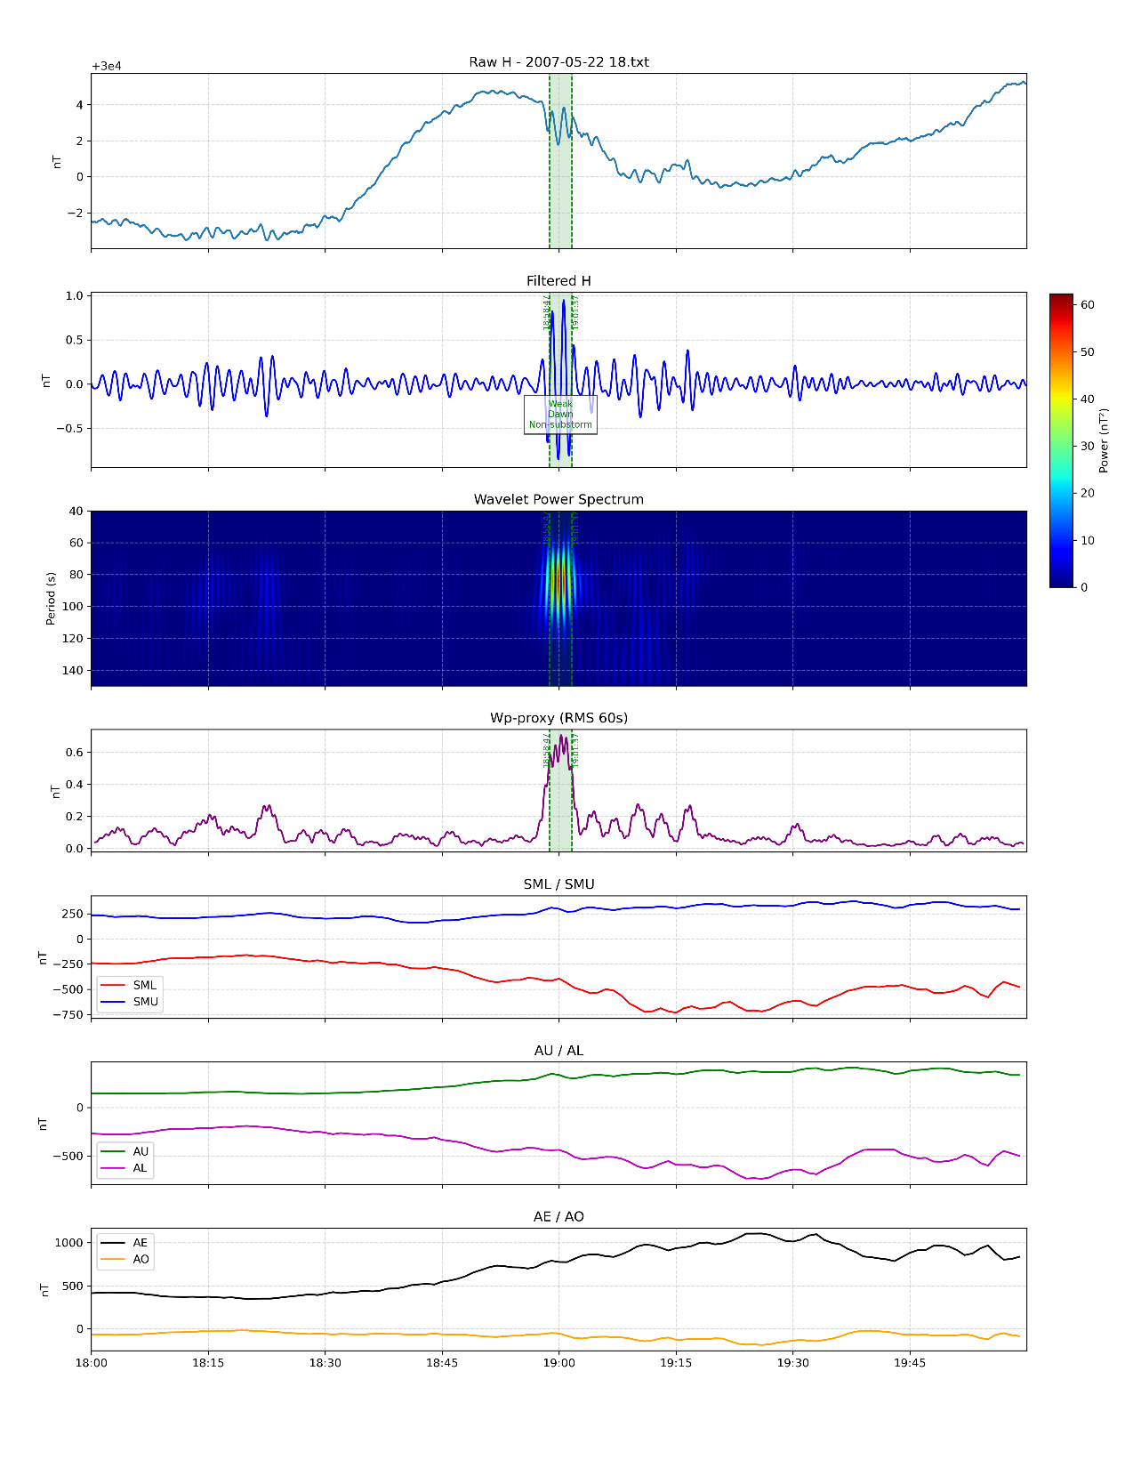
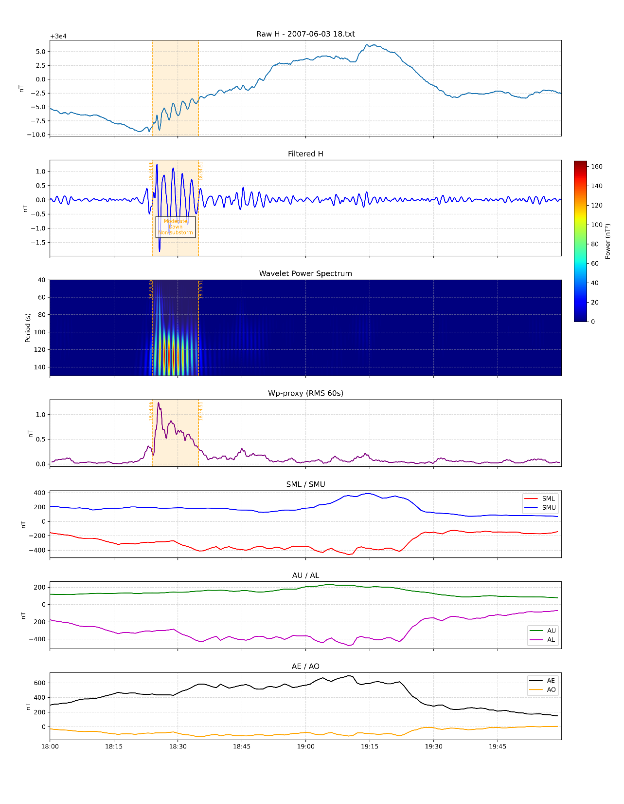
22, May 2007
03, June 2007

Slide 20
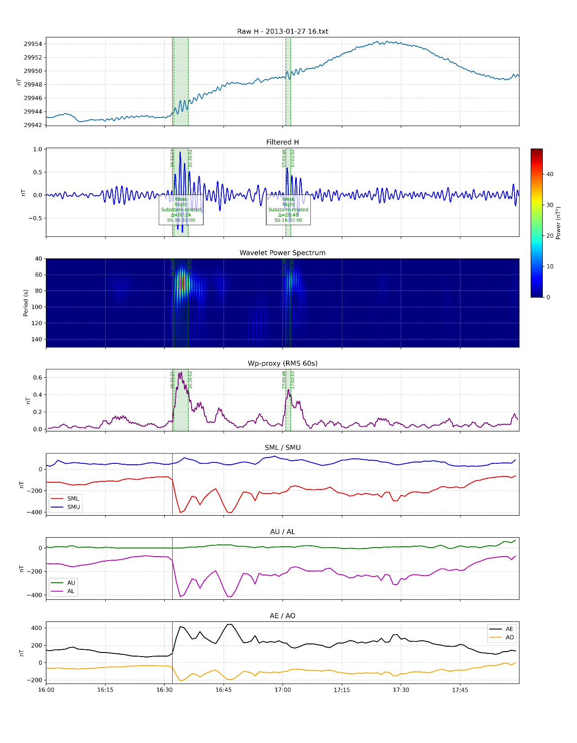
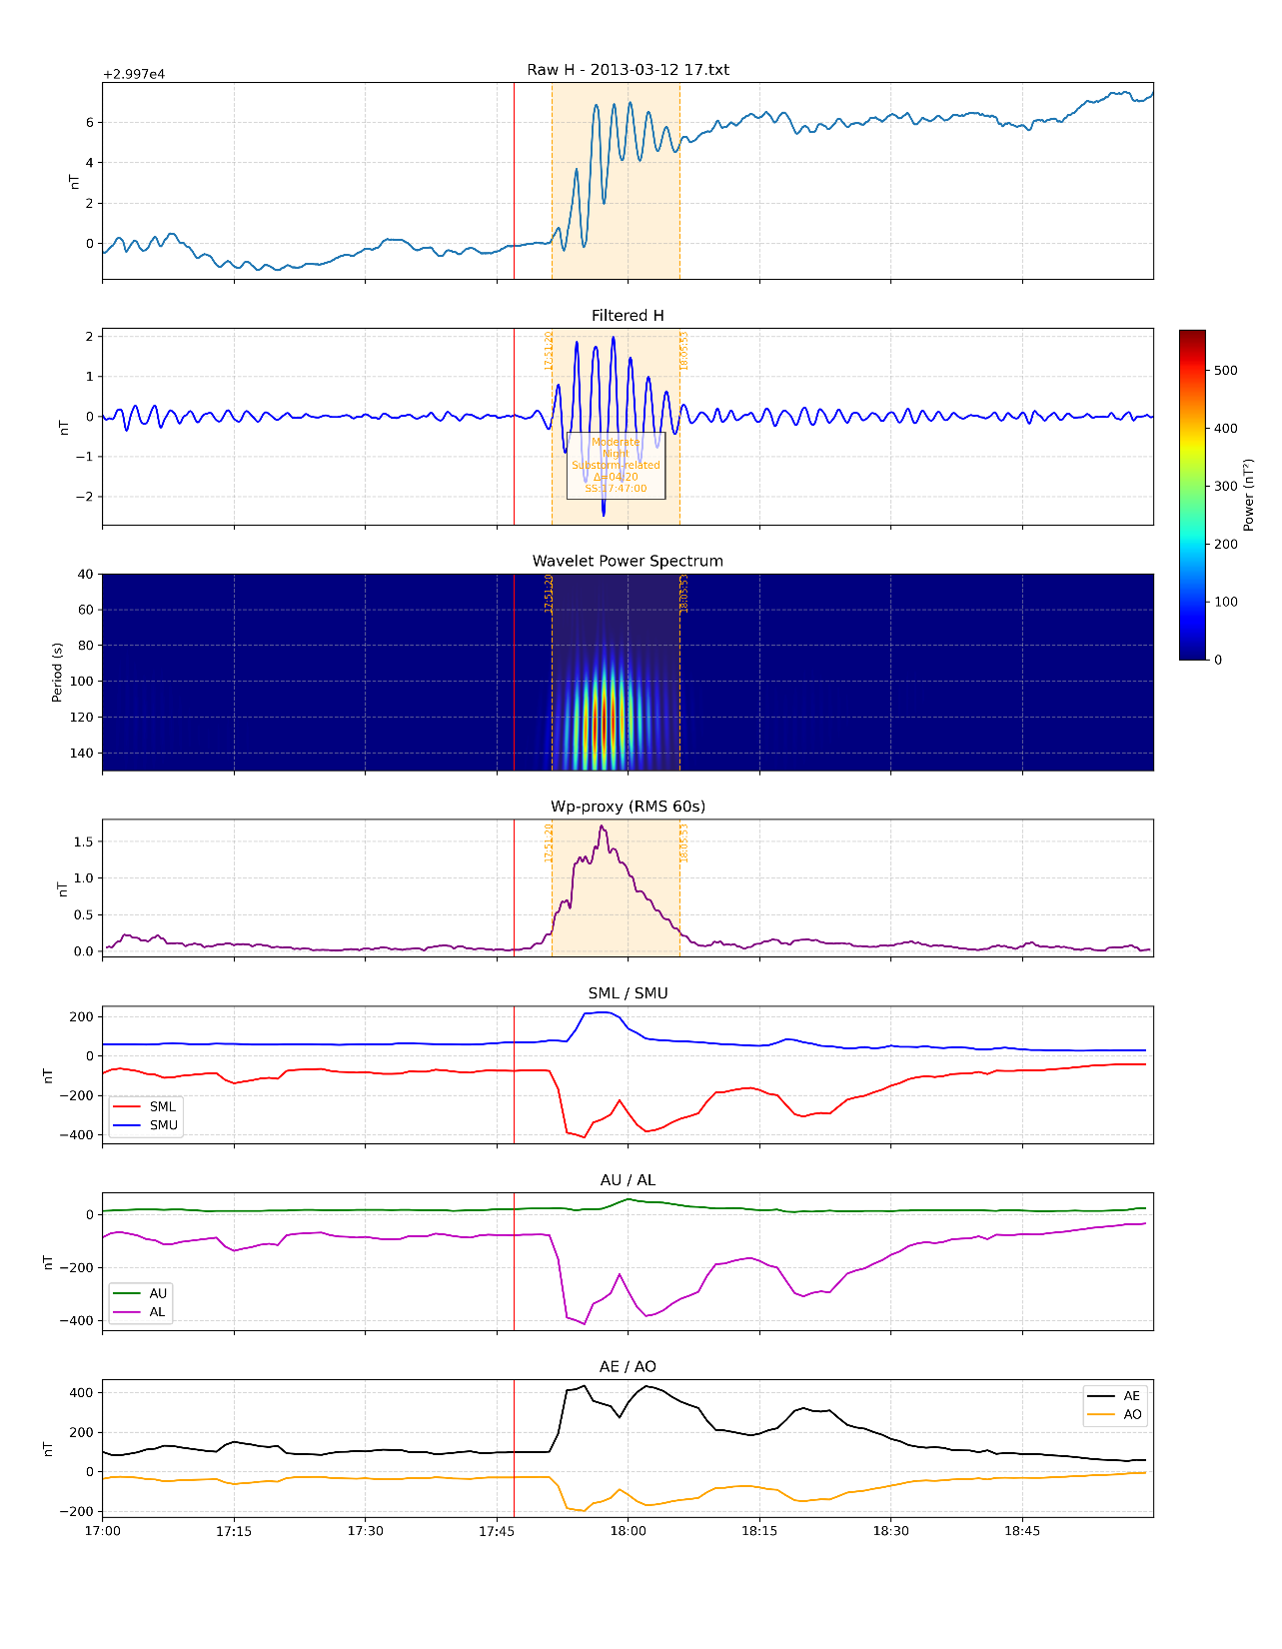
12, March 2013
27, Jan 2013

Slide 21
Pi2 events Data sample for 2007
Date | Onset_UT | Offset_UT | Onset_LT | Duration_s | Num_Waves | Max_Amplitude | Max_Period | Strength | TOD | Wp_Max | Wp_Max_Time | SML_Onset_UT | SML_Peak_UT | Nearest_Substorm_UT | Substorm_Delta_min | Substorm_Linked
2007-01-01 | 2007-01-01 16:55:14 | 2007-01-01 17:02:18 | 2007-01-02 01:55:14 | 424 | 5 | 4.436513 | 78 | Moderate | Night | 1.725227 | 2007-01-01 16:57:19 | 2007-01-01 16:56:00 | 2007-01-01 16:55:00 | 2007-01-01 16:55:00 | +00:14 | Yes
2007-01-01 | 2007-01-01 17:19:37 | 2007-01-01 17:25:43 | 2007-01-02 02:19:37 | 366 | 5 | 4.016867 | 84 | Moderate | Night | 1.666634 | 2007-01-01 17:20:35 | 2007-01-01 17:23:00 | 2007-01-01 17:22:00 | 2007-01-01 16:55:00 | +24:37 | Yes
2007-01-01 | 2007-01-01 17:54:52 | 2007-01-01 17:56:50 | 2007-01-02 02:54:52 | 118 | 2 | 1.629602 | 85 | Weak | Night | 0.64885 | 2007-01-01 17:55:55 | 2007-01-01 17:49:00 | 2007-01-01 17:48:00 |  |  | No
2007-03-15 | 2007-03-15 11:51:18 | 2007-03-15 11:54:50 | 2007-03-15 20:51:18 | 212 | 3 | 1.148397 | 96 | Weak | Dusk | 0.449927 | 2007-03-15 11:52:18 | 2007-03-15 11:54:00 | 2007-03-15 11:53:00 | 2007-03-15 11:51:00 | +00:18 | Yes
2007-03-15 | 2007-03-15 11:58:06 | 2007-03-15 11:58:41 | 2007-03-15 20:58:06 | 35 | 1 | 1.664303 | 71 | Weak | Dusk | 0.64071 | 2007-03-15 11:58:24 | 2007-03-15 12:01:00 | 2007-03-15 12:00:00 | 2007-03-15 11:51:00 | +07:06 | Yes
2007-03-15 | 2007-03-15 12:10:53 | 2007-03-15 12:12:43 | 2007-03-15 21:10:53 | 110 | 2 | 1.659567 | 69 | Weak | Night | 0.619067 | 2007-03-15 12:11:09 | 2007-03-15 12:01:00 | 2007-03-15 12:00:00 | 2007-03-15 11:51:00 | +19:53 | Yes
2007-03-16 | 2007-03-16 00:23:06 | 2007-03-16 00:23:37 | 2007-03-16 09:23:06 | 31 | 1 | 1.483403 | 59 | Weak | Day | 0.536862 | 2007-03-16 00:23:21 | 2007-03-16 00:23:00 | 2007-03-16 00:22:00 |  |  | No
2007-03-16 | 2007-03-16 21:16:31 | 2007-03-16 21:18:19 | 2007-03-17 06:16:31 | 108 | 2 | 1.436271 | 73 | Weak | Day | 0.547229 | 2007-03-16 21:16:50 | 2007-03-16 21:13:00 | 2007-03-16 21:12:00 | 2007-03-16 20:47:00 | +29:31 | Yes
2007-03-17 | 2007-03-17 16:37:41 | 2007-03-17 16:38:17 | 2007-03-18 01:37:41 | 36 | 1 | 1.367884 | 86 | Weak | Night | 0.535685 | 2007-03-17 16:38:00 |  |  | 2007-03-17 16:35:00 | +02:41 | Yes
2007-03-18 | 2007-03-18 11:19:25 | 2007-03-18 11:21:31 | 2007-03-18 20:19:25 | 126 | 2 | 2.0105 | 80 | Weak | Dusk | 0.783806 | 2007-03-18 11:19:44 |  |  | 2007-03-18 12:10:00 | -50:35 | Yes
2007-03-21 | 2007-03-21 11:03:08 | 2007-03-21 11:03:44 | 2007-03-21 20:03:08 | 36 | 1 | 1.180868 | 115 | Weak | Dusk | 0.470398 | 2007-03-21 11:03:25 | 2007-03-21 11:02:00 | 2007-03-21 11:01:00 |  |  | No
2007-03-23 | 2007-03-23 11:18:31 | 2007-03-23 11:20:48 | 2007-03-23 20:18:31 | 137 | 2 | 2.641061 | 86 | Weak | Dusk | 1.058116 | 2007-03-23 11:20:24 | 2007-03-23 11:12:00 | 2007-03-23 11:11:00 | 2007-03-23 11:15:00 | +03:31 | Yes
2007-03-27 | 2007-03-27 17:38:10 | 2007-03-27 17:40:55 | 2007-03-28 02:38:10 | 165 | 3 | 1.770969 | 72 | Weak | Night | 0.758875 | 2007-03-27 17:38:55 | 2007-03-27 17:35:00 | 2007-03-27 17:34:00 |  |  | No
2007-03-28 | 2007-03-28 16:51:18 | 2007-03-28 16:53:20 | 2007-03-29 01:51:18 | 122 | 2 | 1.558334 | 84 | Weak | Night | 0.726682 | 2007-03-28 16:52:19 |  |  |  |  | No
2007-03-28 | 2007-03-28 17:13:52 | 2007-03-28 17:15:36 | 2007-03-29 02:13:52 | 104 | 2 | 1.719145 | 63 | Weak | Night | 0.685385 | 2007-03-28 17:14:40 |  |  |  |  | No
2007-03-31 | 2007-03-31 11:23:42 | 2007-03-31 11:24:17 | 2007-03-31 20:23:42 | 35 | 1 | 1.499814 | 72 | Weak | Dusk | 0.57443 | 2007-03-31 11:24:01 | 2007-03-31 11:20:00 | 2007-03-31 11:19:00 |  |  | No
2007-03-31 | 2007-03-31 14:45:31 | 2007-03-31 14:46:02 | 2007-03-31 23:45:31 | 31 | 1 | 2.036023 | 57 | Weak | Night | 0.758814 | 2007-03-31 14:45:47 |  |  |  |  | No
2007-04-03 | 2007-04-03 16:00:58 | 2007-04-03 16:01:28 | 2007-04-04 01:00:58 | 30 | 1 | 1.272063 | 58 | Weak | Night | 0.471517 | 2007-04-03 16:01:12 | 2007-04-03 15:55:00 | 2007-04-03 15:54:00 | 2007-04-03 16:00:00 | +00:58 | Yes
2007-04-03 | 2007-04-03 16:13:27 | 2007-04-03 16:16:32 | 2007-04-04 01:13:27 | 185 | 4 | 3.109033 | 52 | Moderate | Night | 1.181209 | 2007-04-03 16:14:52 | 2007-04-03 16:00:00 | 2007-04-03 15:59:00 | 2007-04-03 16:00:00 | +13:27 | Yes
2007-04-03 | 2007-04-03 16:40:40 | 2007-04-03 16:41:04 | 2007-04-04 01:40:40 | 24 | 1 | 1.047759 | 47 | Weak | Night | 0.389044 | 2007-04-03 16:41:04 | 2007-04-03 16:41:00 | 2007-04-03 16:40:00 |  |  | No
2007-04-07 | 2007-04-07 01:26:39 | 2007-04-07 01:27:11 | 2007-04-07 10:26:39 | 32 | 1 | 1.200553 | 64 | Weak | Day | 0.449982 | 2007-04-07 01:26:55 | 2007-04-07 01:19:00 | 2007-04-07 01:18:00 | 2007-04-07 01:20:00 | +06:39 | Yes
2007-04-08 | 2007-04-08 15:01:43 | 2007-04-08 15:02:25 | 2007-04-09 00:01:43 | 42 | 1 | 1.255075 | 89 | Weak | Night | 0.5043 | 2007-04-08 15:02:07 | 2007-04-08 14:59:00 | 2007-04-08 14:58:00 | 2007-04-08 15:37:00 | -35:17 | Yes
2007-04-08 | 2007-04-08 15:06:41 | 2007-04-08 15:07:16 | 2007-04-09 00:06:41 | 35 | 1 | 1.1833 | 89 | Weak | Night | 0.49393 | 2007-04-08 15:07:01 | 2007-04-08 14:59:00 | 2007-04-08 14:58:00 | 2007-04-08 15:37:00 | -30:19 | Yes
2007-04-08 | 2007-04-08 15:11:21 | 2007-04-08 15:12:02 | 2007-04-09 00:11:21 | 41 | 1 | 1.231422 | 122 | Weak | Night | 0.490095 | 2007-04-08 15:11:42 | 2007-04-08 14:59:00 | 2007-04-08 14:58:00 | 2007-04-08 15:37:00 | -25:39 | Yes
2007-04-08 | 2007-04-08 15:29:08 | 2007-04-08 15:44:11 | 2007-04-09 00:29:08 | 903 | 8 | 3.450688 | 104 | Moderate | Night | 1.359896 | 2007-04-08 15:39:37 | 2007-04-08 15:35:00 | 2007-04-08 15:34:00 | 2007-04-08 15:37:00 | -07:52 | Yes
2007-04-11 | 2007-04-11 13:18:21 | 2007-04-11 13:19:19 | 2007-04-11 22:18:21 | 58 | 1 | 1.016552 | 121 | Weak | Night | 0.386145 | 2007-04-11 13:18:38 |  |  |  |  | No
2007-04-15 | 2007-04-15 17:17:59 | 2007-04-15 17:20:19 | 2007-04-16 02:17:59 | 140 | 2 | 1.198313 | 91 | Weak | Night | 0.477547 | 2007-04-15 17:19:04 | 2007-04-15 17:20:00 | 2007-04-15 17:19:00 |  |  | No

Slide 22
Pi2 events data sample for 2013
Month | Criteria | Type | File | Date | Onset_UT | Offset_UT | Onset_LT | Duration_s | Num_Waves | Max_Amplitude | Max_Period | Strength | TOD | Wp_Max | Wp_Max_Time | Nearest_Substorm_UT | Substorm_Delta_min | Substorm_Linked
2007-01 | Wp_Max | Strongest | 2007-01-01 16.txt | 2007-01-01 | 2007-01-01 16:55:14 | 2007-01-01 17:02:18 | 2007-01-02 01:55:14 | 424 | 5 | 4.436513 | 78 | Moderate | Night | 1.725227 | 2007-01-01 16:57:19 |  |  | No
2007-01 | Wp_Max | Weakest | 2007-01-01 16.txt | 2007-01-01 | 2007-01-01 17:54:52 | 2007-01-01 17:56:50 | 2007-01-02 02:54:52 | 118 | 2 | 1.629602 | 85 | Weak | Night | 0.64885 | 2007-01-01 17:55:55 |  |  | No
2007-01 | Max_Amplitude | Strongest | 2007-01-01 16.txt | 2007-01-01 | 2007-01-01 16:55:14 | 2007-01-01 17:02:18 | 2007-01-02 01:55:14 | 424 | 5 | 4.436513 | 78 | Moderate | Night | 1.725227 | 2007-01-01 16:57:19 |  |  | No
2007-01 | Max_Amplitude | Weakest | 2007-01-01 16.txt | 2007-01-01 | 2007-01-01 17:54:52 | 2007-01-01 17:56:50 | 2007-01-02 02:54:52 | 118 | 2 | 1.629602 | 85 | Weak | Night | 0.64885 | 2007-01-01 17:55:55 |  |  | No
2013-01 | Wp_Max | Strongest | 2013-01-27 16.txt | 2013-01-27 | 2013-01-27 16:32:44 | 2013-01-27 16:35:42 | 2013-01-28 01:32:44 | 178 | 3 | 1.755732 | 67 | Weak | Night | 0.661654 | 2013-01-27 16:34:16 | 2013-01-27 16:32:00 | +00:44 | Yes
2013-01 | Wp_Max | Weakest | 2013-01-27 16.txt | 2013-01-27 | 2013-01-27 17:01:08 | 2013-01-27 17:01:43 | 2013-01-28 02:01:08 | 35 | 1 | 1.201671 | 71 | Weak | Night | 0.460387 | 2013-01-27 17:01:26 | 2013-01-27 16:32:00 | +29:08 | Yes
2013-01 | Max_Amplitude | Strongest | 2013-01-27 16.txt | 2013-01-27 | 2013-01-27 16:32:44 | 2013-01-27 16:35:42 | 2013-01-28 01:32:44 | 178 | 3 | 1.755732 | 67 | Weak | Night | 0.661654 | 2013-01-27 16:34:16 | 2013-01-27 16:32:00 | +00:44 | Yes
2013-01 | Max_Amplitude | Weakest | 2013-01-27 16.txt | 2013-01-27 | 2013-01-27 17:01:08 | 2013-01-27 17:01:43 | 2013-01-28 02:01:08 | 35 | 1 | 1.201671 | 71 | Weak | Night | 0.460387 | 2013-01-27 17:01:26 | 2013-01-27 16:32:00 | +29:08 | Yes
2013-02 | Wp_Max | Strongest | 2013-02-18 13.txt | 2013-02-18 | 2013-02-18 13:56:02 | 2013-02-18 13:56:31 | 2013-02-18 22:56:02 | 29 | 1 | 1.843294 | 80 | Weak | Night | 0.670489 | 2013-02-18 13:56:17 |  |  | No
2013-02 | Wp_Max | Weakest | 2013-02-24 12.txt | 2013-02-24 | 2013-02-24 13:26:47 | 2013-02-24 13:27:23 | 2013-02-24 22:26:47 | 36 | 1 | 1.03718 | 74 | Weak | Night | 0.402747 | 2013-02-24 13:27:05 | 2013-02-24 14:08:00 | -41:13 | Yes
2013-02 | Max_Amplitude | Strongest | 2013-02-18 13.txt | 2013-02-18 | 2013-02-18 13:56:02 | 2013-02-18 13:56:31 | 2013-02-18 22:56:02 | 29 | 1 | 1.843294 | 80 | Weak | Night | 0.670489 | 2013-02-18 13:56:17 |  |  | No
2013-02 | Max_Amplitude | Weakest | 2013-02-24 12.txt | 2013-02-24 | 2013-02-24 13:26:47 | 2013-02-24 13:27:23 | 2013-02-24 22:26:47 | 36 | 1 | 1.03718 | 74 | Weak | Night | 0.402747 | 2013-02-24 13:27:05 | 2013-02-24 14:08:00 | -41:13 | Yes
2013-03 | Wp_Max | Strongest | 2013-03-12 17.txt | 2013-03-12 | 2013-03-12 17:52:01 | 2013-03-12 18:05:20 | 2013-03-13 02:52:01 | 799 | 7 | 4.228484 | 120 | Moderate | Night | 1.711271 | 2013-03-12 17:56:57 | 2013-03-12 17:47:00 | +05:01 | Yes
2013-03 | Wp_Max | Weakest | 2013-03-23 13.txt | 2013-03-23 | 2013-03-23 13:06:57 | 2013-03-23 13:07:51 | 2013-03-23 22:06:57 | 54 | 1 | 1.01496 | 103 | Weak | Night | 0.374587 | 2013-03-23 13:07:30 | 2013-03-23 13:03:00 | +03:57 | Yes
2013-03 | Max_Amplitude | Strongest | 2013-03-12 17.txt | 2013-03-12 | 2013-03-12 17:52:01 | 2013-03-12 18:05:20 | 2013-03-13 02:52:01 | 799 | 7 | 4.228484 | 120 | Moderate | Night | 1.711271 | 2013-03-12 17:56:57 | 2013-03-12 17:47:00 | +05:01 | Yes
2013-03 | Max_Amplitude | Weakest | 2013-03-16 14.txt | 2013-03-16 | 2013-03-16 14:06:36 | 2013-03-16 14:07:21 | 2013-03-16 23:06:36 | 45 | 1 | 1.007653 | 98 | Weak | Night | 0.404648 | 2013-03-16 14:06:55 | 2013-03-16 13:49:00 | +17:36 | Yes
2013-04 | Wp_Max | Strongest | 2013-04-08 13.txt | 2013-04-08 | 2013-04-08 14:26:16 | 2013-04-08 14:27:01 | 2013-04-08 23:26:16 | 45 | 1 | 1.437314 | 123 | Weak | Night | 0.564264 | 2013-04-08 14:26:39 |  |  | No
2013-04 | Wp_Max | Weakest | 2013-04-08 13.txt | 2013-04-08 | 2013-04-08 13:38:39 | 2013-04-08 13:39:26 | 2013-04-08 22:38:39 | 47 | 1 | 1.303043 | 101 | Weak | Night | 0.510203 | 2013-04-08 13:39:00 |  |  | No
2013-04 | Max_Amplitude | Strongest | 2013-04-08 13.txt | 2013-04-08 | 2013-04-08 14:26:16 | 2013-04-08 14:27:01 | 2013-04-08 23:26:16 | 45 | 1 | 1.437314 | 123 | Weak | Night | 0.564264 | 2013-04-08 14:26:39 |  |  | No
2013-04 | Max_Amplitude | Weakest | 2013-04-08 13.txt | 2013-04-08 | 2013-04-08 13:38:39 | 2013-04-08 13:39:26 | 2013-04-08 22:38:39 | 47 | 1 | 1.303043 | 101 | Weak | Night | 0.510203 | 2013-04-08 13:39:00 |  |  | No
2013-05 | Wp_Max | Strongest | 2013-05-31 14.txt | 2013-05-31 | 2013-05-31 14:26:57 | 2013-05-31 14:29:40 | 2013-05-31 23:26:57 | 163 | 2 | 2.409667 | 106 | Weak | Night | 0.830004 | 2013-05-31 14:28:25 | 2013-05-31 14:35:00 | -08:03 | Yes

Slide 23
Statistical data Results

Slide 24
Substorm Linkage

Slide 25
Events by Time of Day (TOD)

Slide 26
Events by Time of Day attached Substorm Linkage

Slide 27
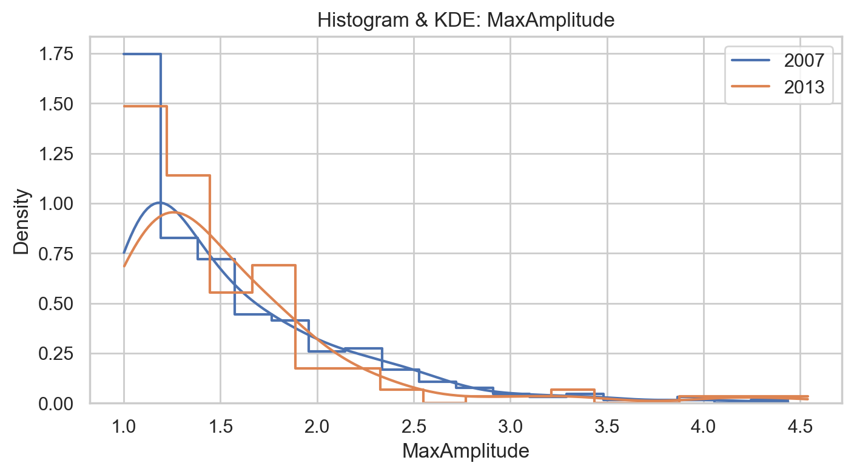
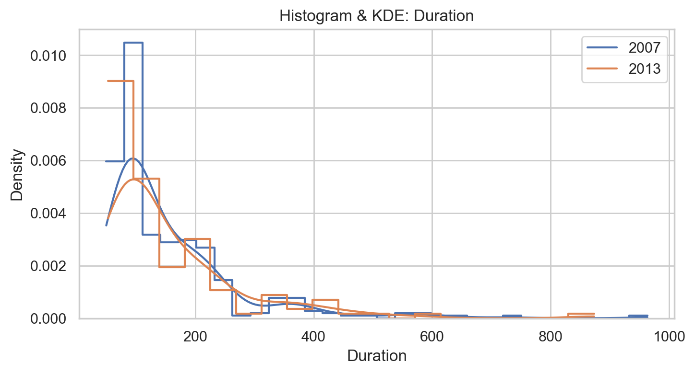
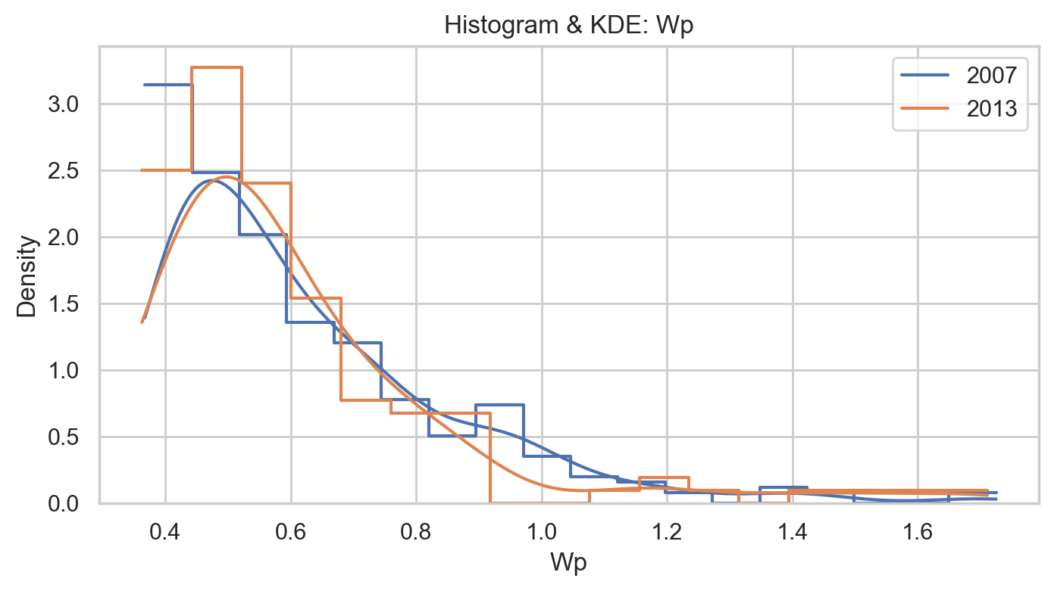
Histograms

Slide 28
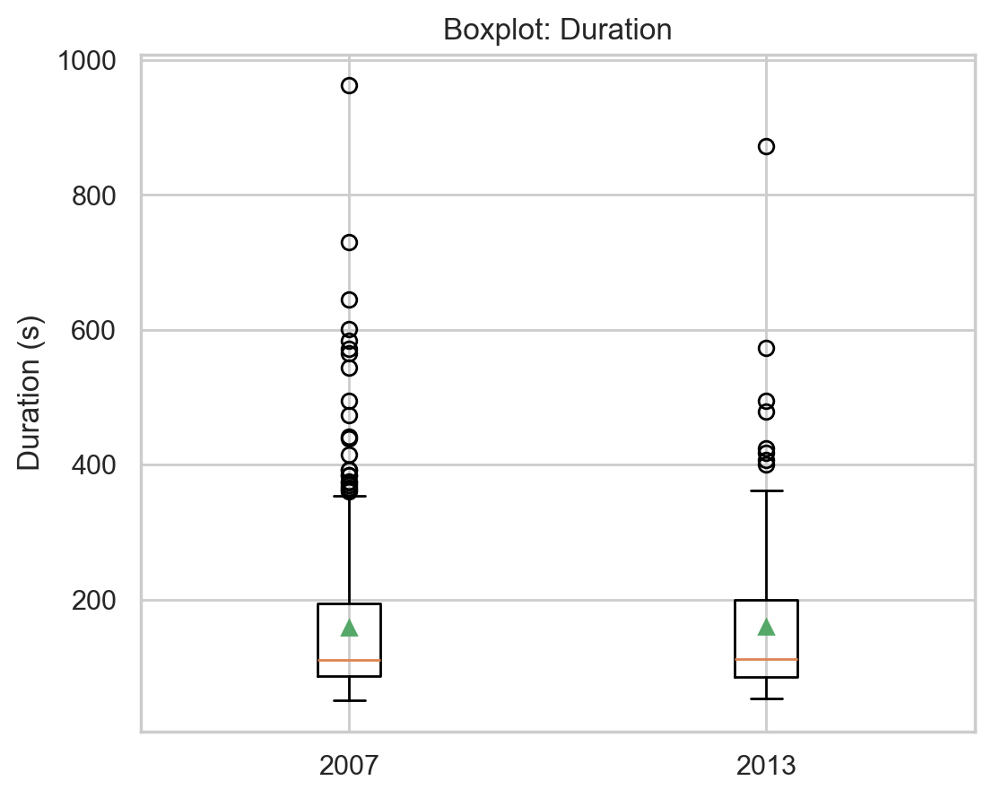
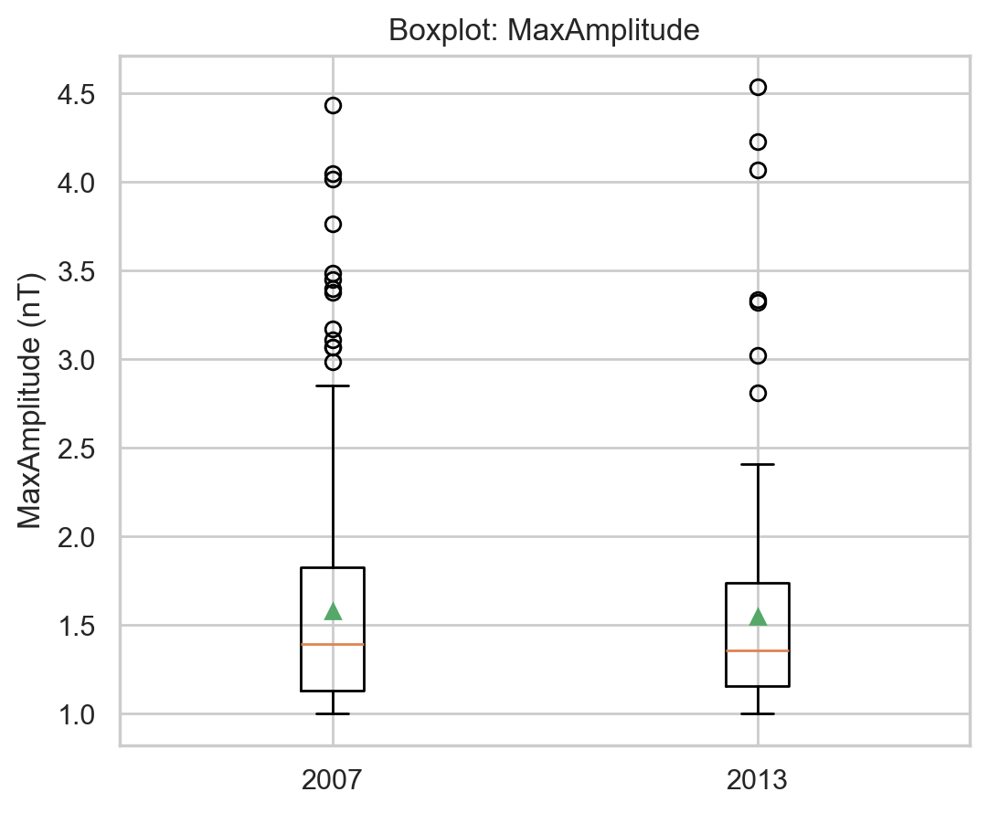
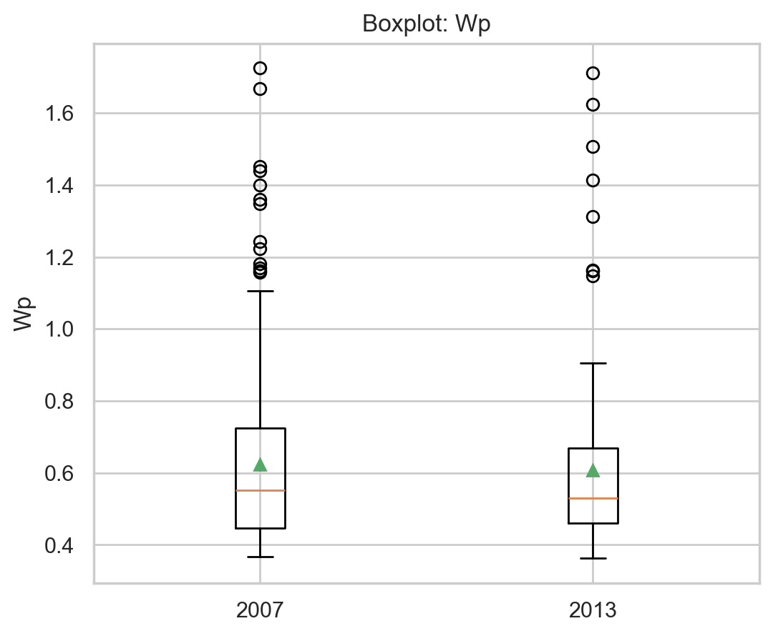
Stander deviation

Slide 29
Conclusion and Discussion
Pi2 occurrence shows a clear inverse relationship with solar activity — more frequent during solar minimum.
Around 30–35% of Pi2s are substorm-related; the rest likely arise from plasma-spheric cavity oscillations.
Most Pi2s are weak (<2 nT) and have short durations (60–200 s) — typical for low-latitude stations.
Wavelet analysis effectively characterizes Pi2s and distinguishes energy levels using Wp as an energy proxy.
Statistical methods (Shapiro–Wilk, Mann–Whitney, Spearman) confirm significant year-to-year variation.
Results support the view that Pi2 activity reflects inner magnetospheric resonance dynamics, not just substorm drivers.
Future work: expand to multi-station analysis and include solar wind parameters to refine causality links.

Slide 30

Future Study
Complete
Complete the study of whole Solar cycle no.24
Build
Build a Pi2 map depending on number of earth station cover all earth
Enhance
Enhance a way to autodetect the Pi2 a.

Slide 31

Any Questions

