Slide 1


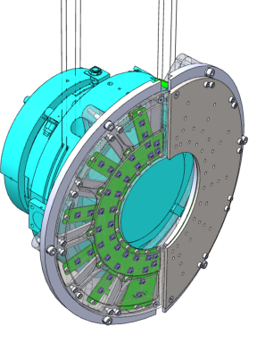
Technology Transfer analysis
Instrumented baffle developed by IFAE
    December 13, 2024 Joan Cano

Slide 2
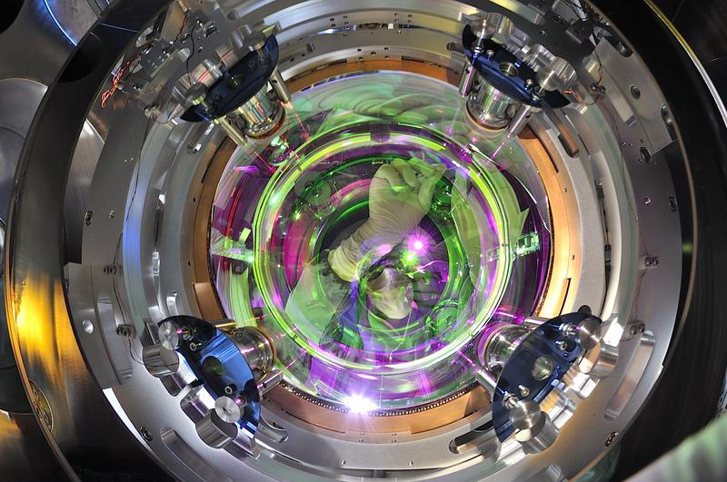

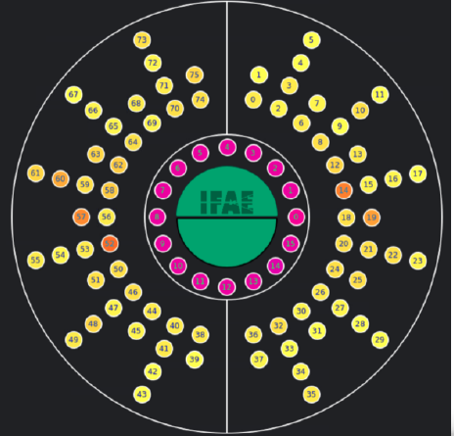




_
Mechanical engineering
_
R&D Team
Gravitational Waves Group
+
Software engineering
Technical Division
_
Electronics engineering
_
Optical engineering

Slide 3

Goals of the technology transfer project
Innovation potential study
-Analysis of novelty and inventive step by screening of existing intellectual property related to the technology
-Definition of the optimal pathway for technology protection and subsequent exploitation
Foster public-private cooperation
-Identify potential licensee companies interested in a pilot and/or a tech transfer agreement
-Connect scientific/entrepreneur team with the most appropriate entrepreneurship / venture builder programme and look for VCs/BAs to reach investment agreements
Identify Market Opportunities
-Define the proper business model by means of searching for industrial applications where innovative solutions can succeed and quantify it.

Slide 4
Innovation potential study
Inventive Step Analysis
Patent Landscape Review
Determining if the innovation is non-obvious and represents a significant improvement over existing solutions.
Examining existing patents and IP rights to identify competitors or potential licensees
Novelty Assessment
IP Strategy Development
Commercialization Potential
Identifying whether the innovation is new and has not been disclosed or implemented in prior art.
Exploring the best protection mechanisms, such as patents, utility model, trademarks, or trade secrets, to safeguard the innovation’s unique value.
Evaluating how the IP uniqueness matches the market trends and needs in order to identify and quantify market segments and technological applications

Slide 5
Innovation potential study
Use of public and private
patent databases for:
Tracking technological trends
Analyzing competitors’ R&D
Identifying market gaps
Mapping intellectual property landscapes.
Forecasting opportunities & guiding strategic investments

Slide 6
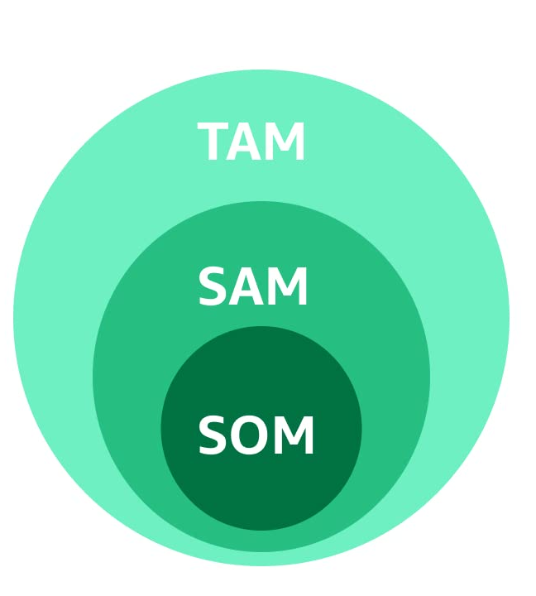
Use case: Laser interferometer market analysis
Total Addressable Market
Market size & trend
Market segmentation
}
Keyplayer analysis
Serviceable Obtainable Market
Chapters 4 and 5 of the Markets&Markets market research report

Slide 7
Specific Market Trends and Opportunities
4.1
Potential markets
5.2
Market evolution
5.2.1
Industrial demands
5.2.3
Future opportunities
5.3
Value Chain analysis

Slide 8



Tech exploitation strategies
Tailormade service
Patent / know-how License agreement
Spin-off creation
Offer the technology as a service with tailormade sizes and especially targeting end users. This would also allow to become an after-sales service provider.
Licensing the technology to a big player in the market, retaining the ownership of the technology, while giving the licensee the permission to commercialize the technology for a compensation
Consider the creation of a spin-off to manufacture and market complete systems or specific pieces related to the invention.
A deep study and the use of a specific market report allows to find the optimal exploitation strategy.

