Slide 1
Possible bunch compression experiments at the SNS
Austin Hoover, Vasiliy Morozov
WP3 Proton Complex Meeting
January 31, 2025
Notes:
This is a preliminary talk

Slide 2
Motivation #1: Experimentally study collective effects at high charge density
Space charge, halo formation, wake fields, electron cloud
Mitigation techniques (phase space painting)
Notes:
1-2-3 are related
General motivation is to probe higher intensity regime in the SNS

Slide 3
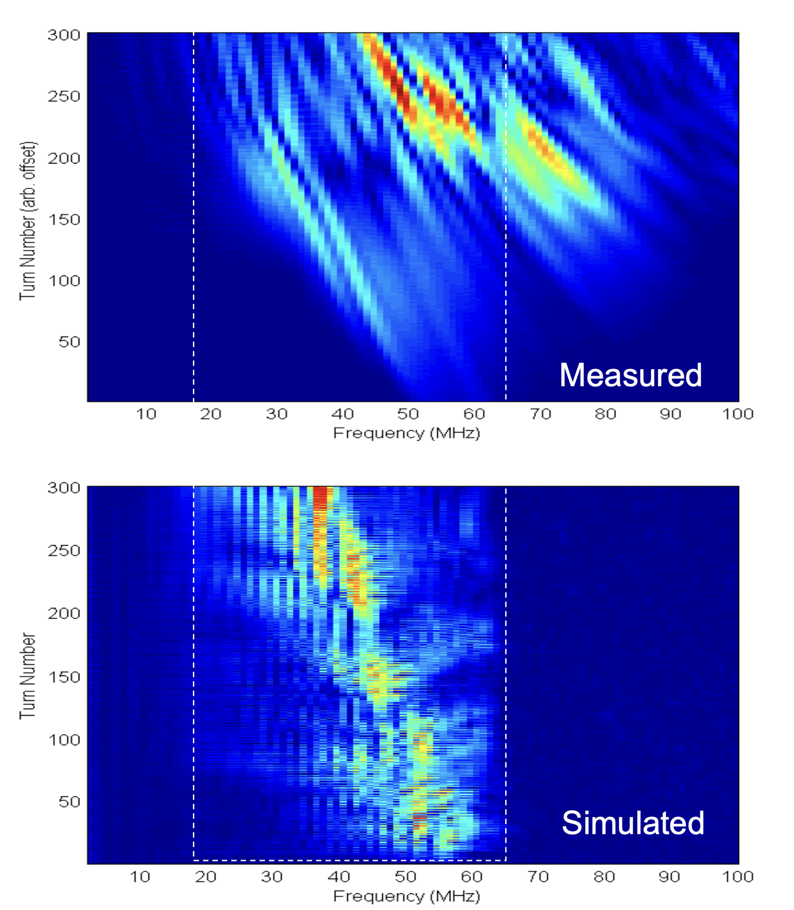
Motivation #2: Benchmark simulation codes
Cousineau et al., ECLOUD 2007

Slide 4
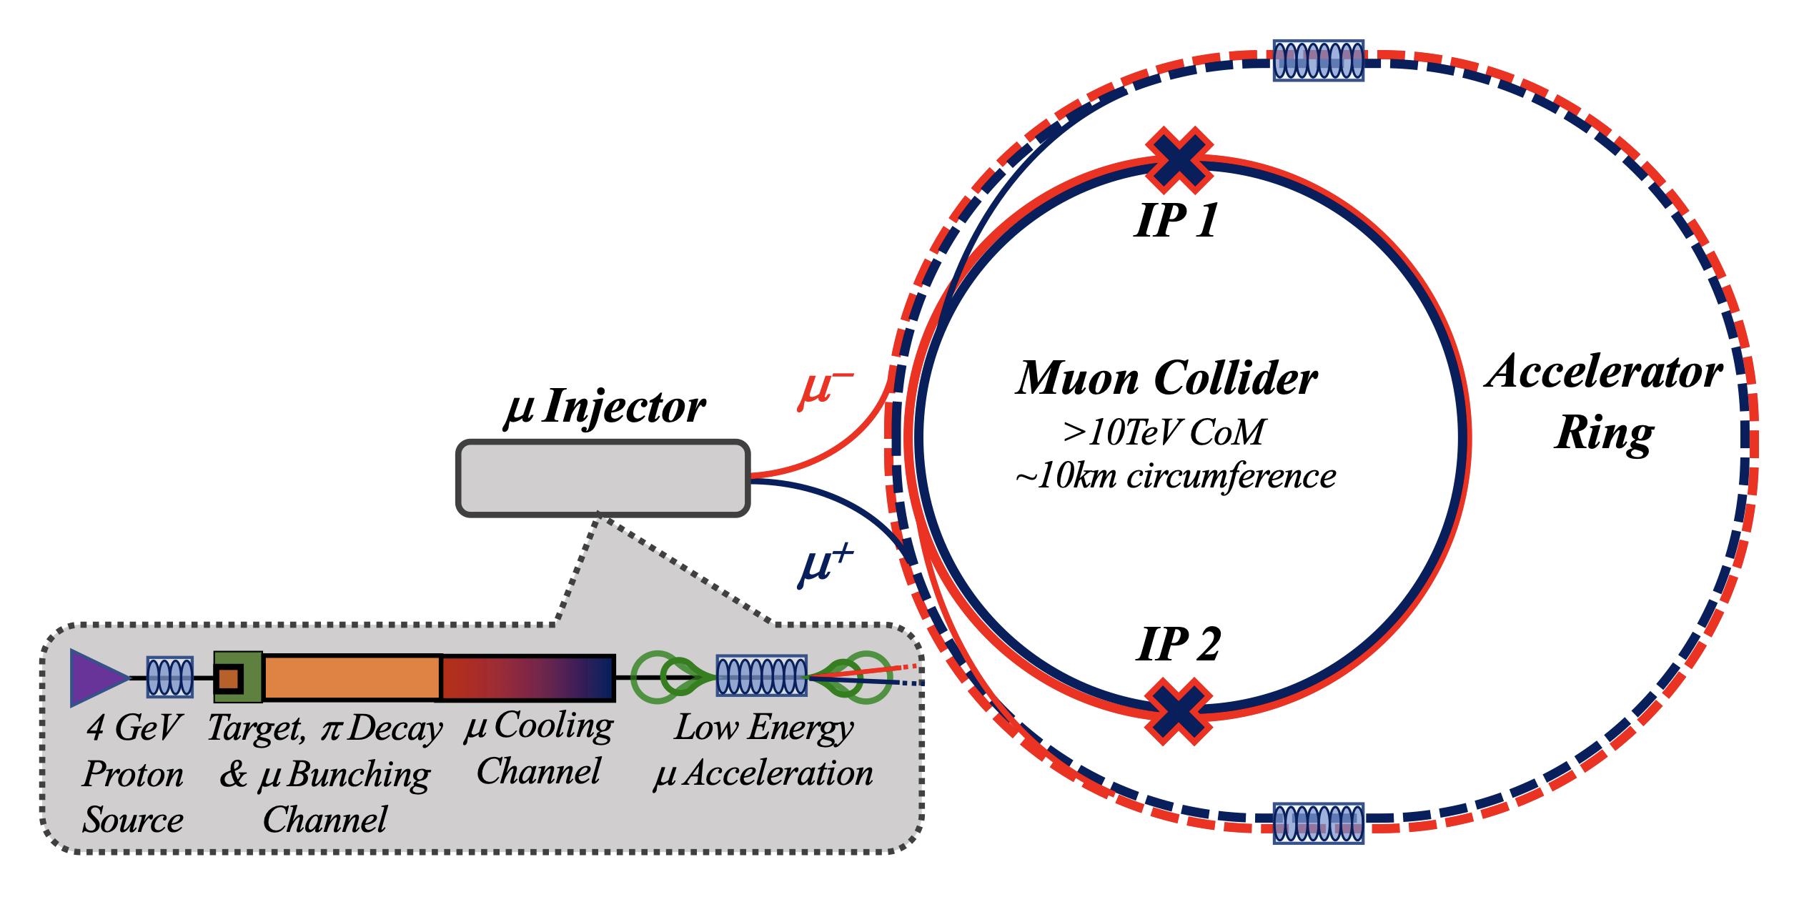
Motivation #3: Contribute to muon collider R&D
https://arxiv.org/abs/2303.08533

Slide 5
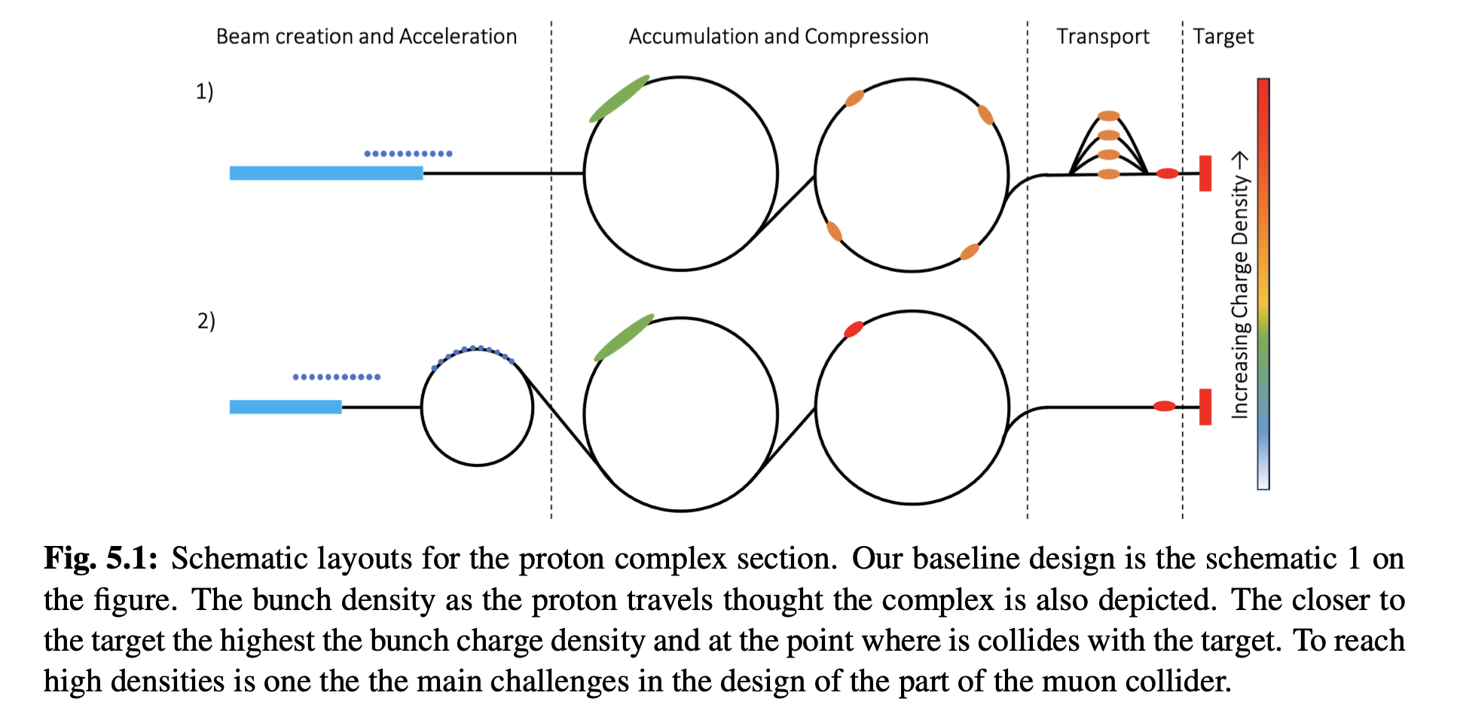
Motivation #3: Contribute to muon collider R&D
https://arxiv.org/abs/2407.12450
Notes:
SNS resembles first part
We're interested in whether SNS studies could be relevant to muon collider R&D

Slide 6
Overview of the SNS accelerator
Notes:
I'll stat with a short overview of the SNS accelerator.
Then I'll describe the relevant parameters for bunch compression.
Then I'll describe the available diagnostics for simulation benchmarking.
Finally, I'll talk about our first round of experiments and simulations.

Slide 7
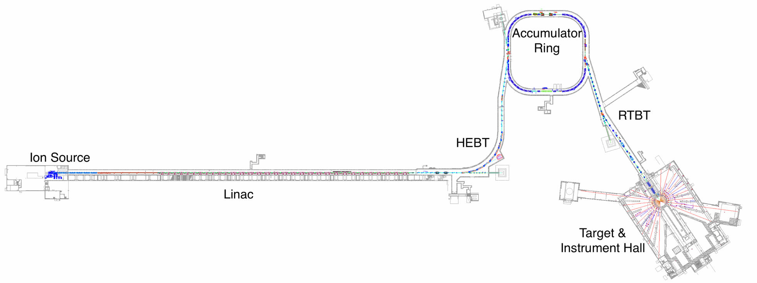

Slide 8
Front end forms 1ms chopped H- beam (~42 mA)
2.5 MeV
RFQ
MEBT
Ion Source

Slide 9


Front end forms 1ms chopped H- beam (~42 mA)
Linac accelerates to 1.3 GeV
2.5 MeV
86.8 MeV
186 MeV
387 MeV
1050 MeV
RFQ
MEBT
DTL
CCL
SRF $β=0.61$
SRF $β=0.81$
Ion Source

Slide 10
Accumulator ring compresses 1 ms pulse to 700 ns
Foil stripping
Front end forms 1ms chopped H- beam (~42 mA)
Linac accelerates to 1.3 GeV
RF (h=1,2)
2.5 MeV
86.8 MeV
186 MeV
387 MeV
1050 MeV
RFQ
MEBT
DTL
CCL
SRF $β=0.61$
SRF $β=0.81$
Ion Source
Notes:
No acceleration in ring; rf maintains extraction gap

Slide 11
Accumulator ring compresses 1 ms pulse to 700 ns
Foil stripping
Front end forms 1ms chopped H- beam (~42 mA)
Linac accelerates to 1.3 GeV
RF (h=1,2)
2.5 MeV
86.8 MeV
186 MeV
387 MeV
1050 MeV
RFQ
MEBT
DTL
CCL
SRF $β=0.61$
SRF $β=0.81$
Ion Source

Slide 12
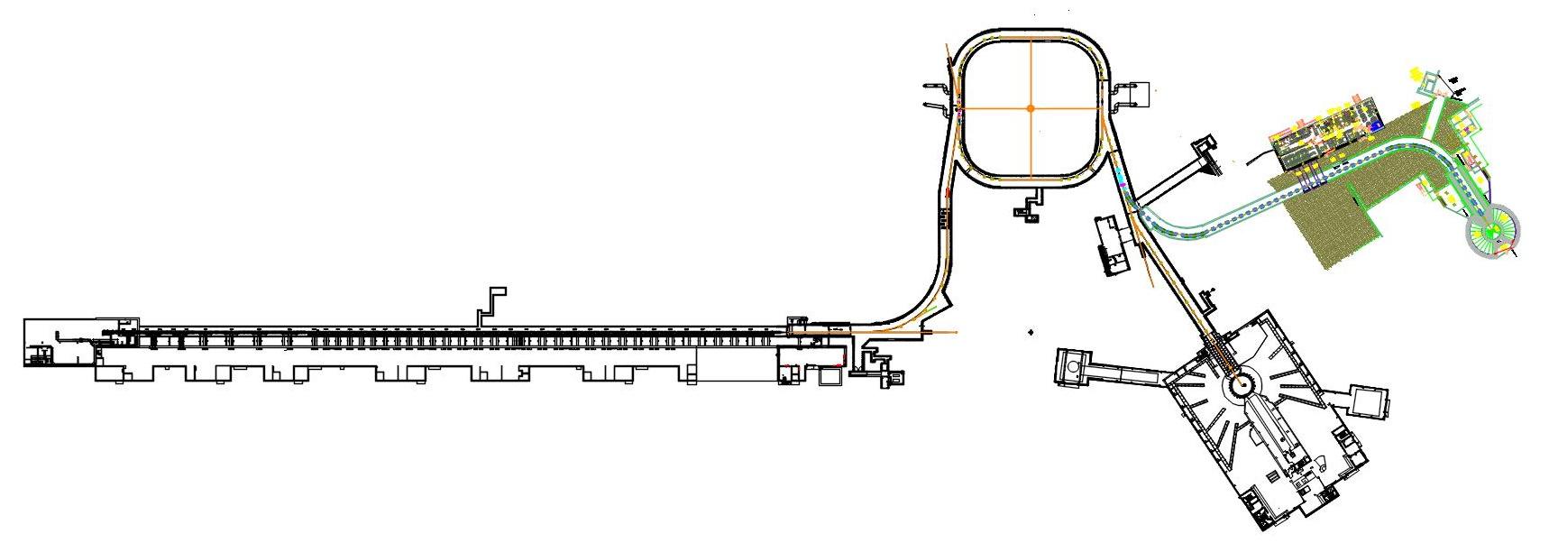

SNS today
650 ns pulse
$1.55×{10}^{14}$ protons
1.7 MW @ 60 Hz

Slide 13

SNS in a couple years (slow power ramp-up)
650 ns pulse
$2.25×{10}^{14}$ protons
2.8 MW @ 60 Hz (capable)
2.0 MW @ 60 Hz (target limit)

Slide 14
SNS in a couple years (slow power ramp-up)
650 ns pulse
$2.25×{10}^{14}$ protons
Experiments possible at full charge (1 Hz)
2.8 MW @ 60 Hz (capable)
2.0 MW @ 60 Hz (target limit)

Slide 15
SNS in 10-15 years (Second Target Station)
650 ns pulse
$2.25×{10}^{14}$ protons
0.7 MW @ 15 Hz
Experiments possible at full charge (1 Hz)
2.0 MW @ 45 Hz

Slide 16
SNS ring has four RF cavities (h=1, h=2)
RF (h=1,2)

Slide 17
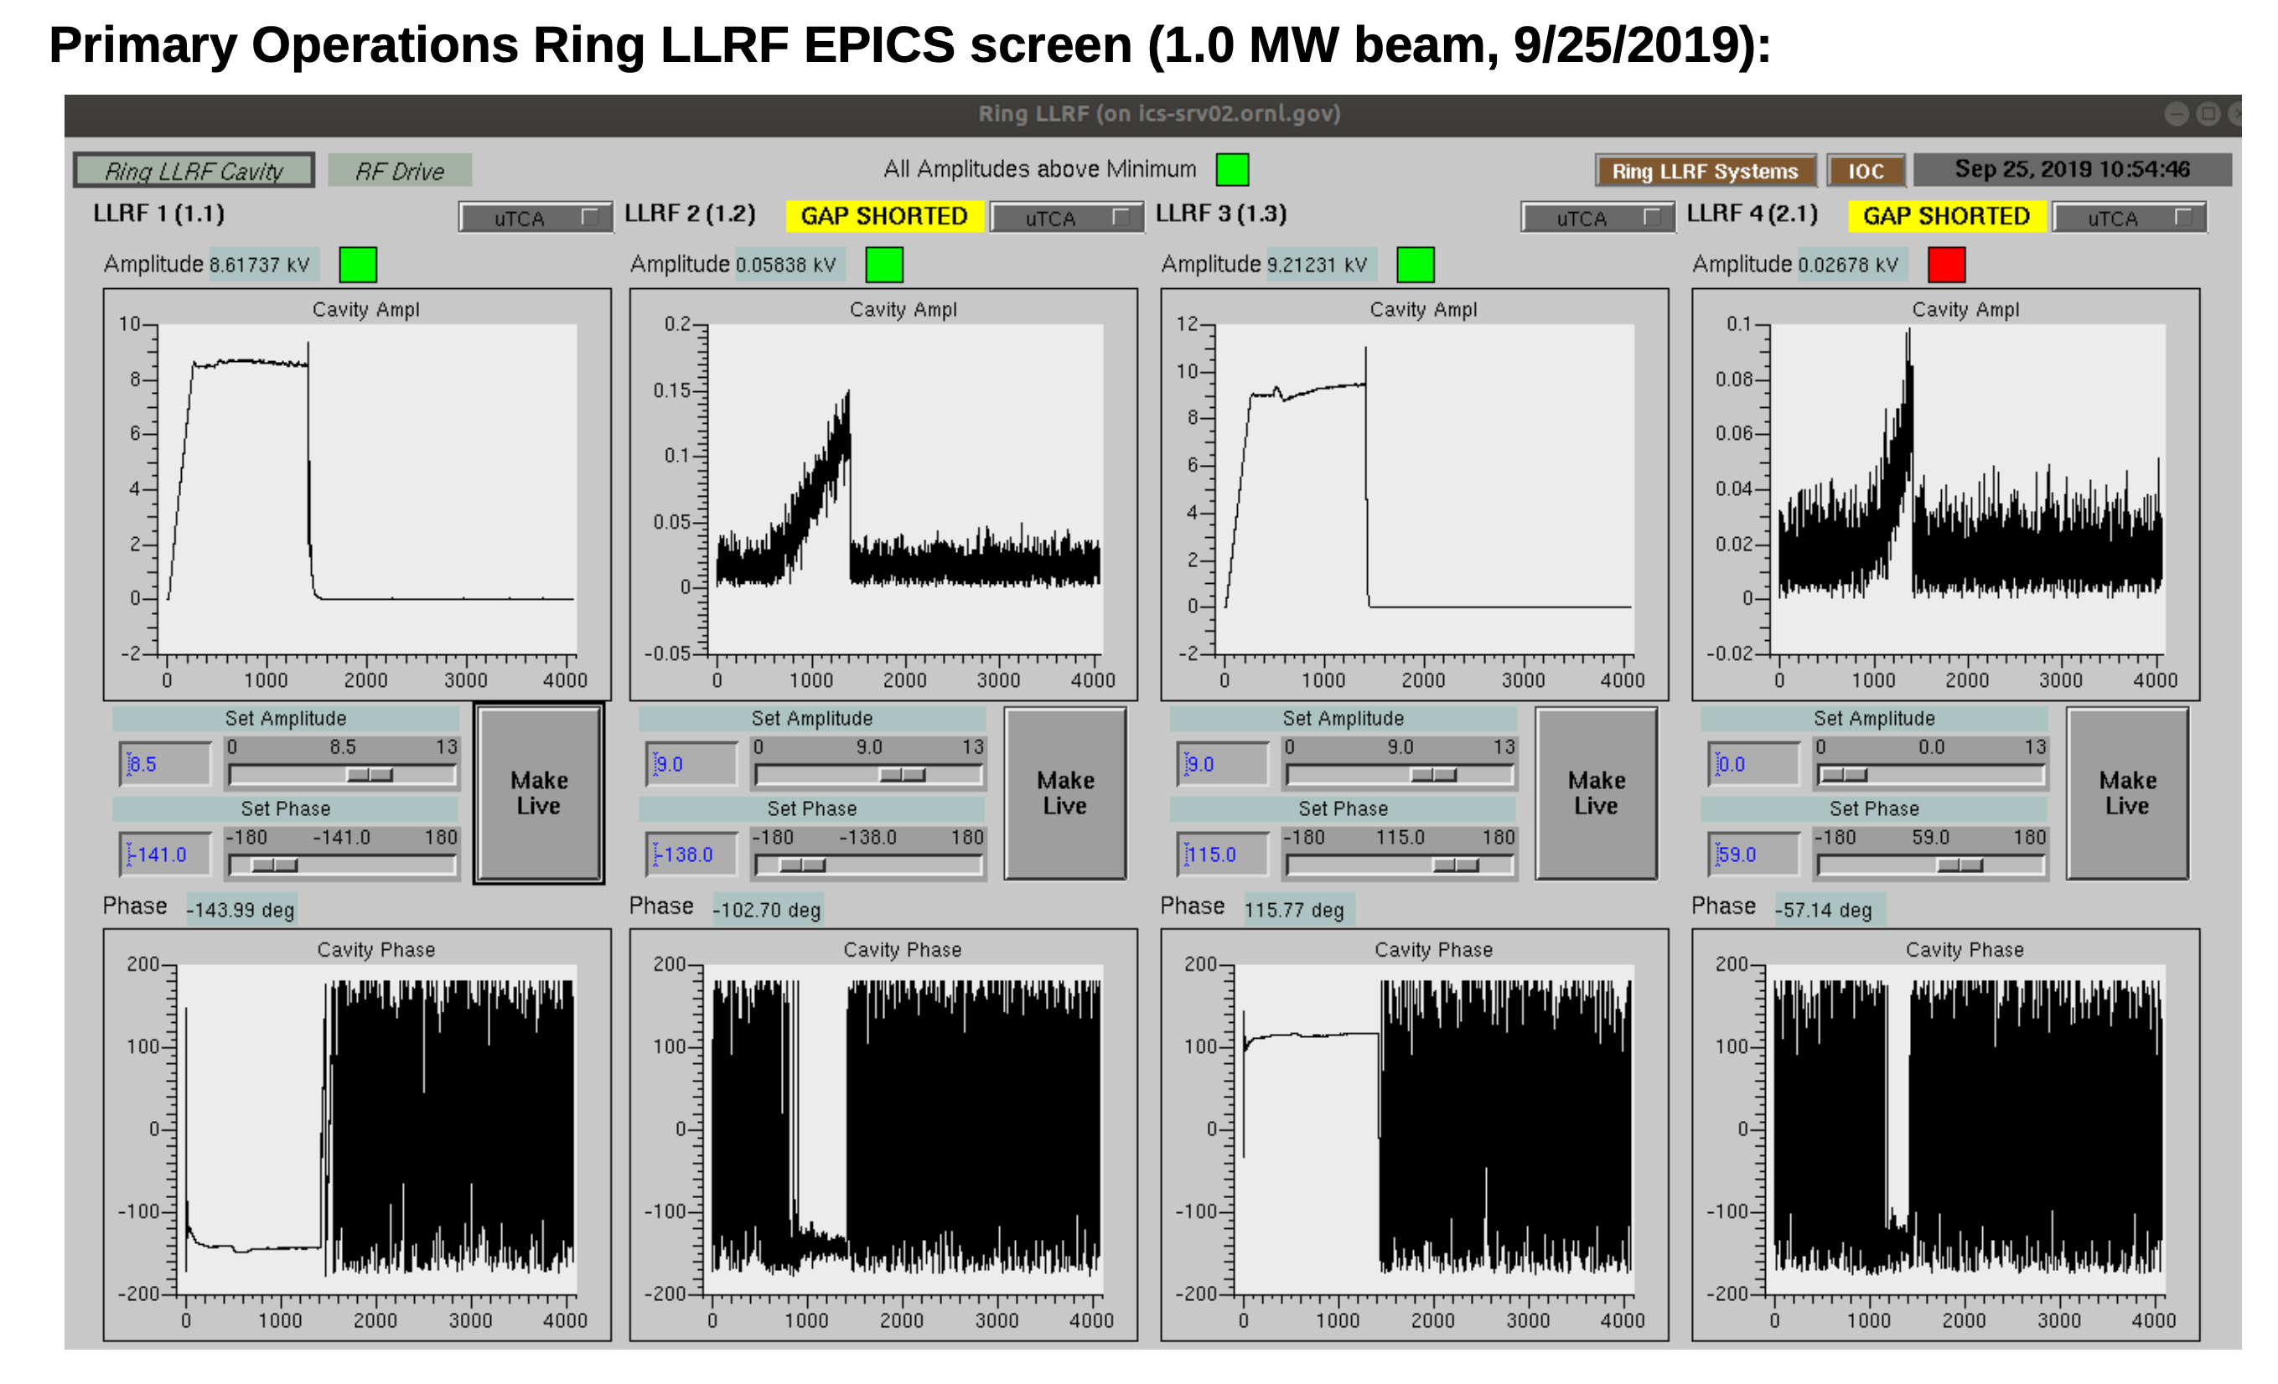
Only two cavities are used in production
Notes:
Original design called for 40 kV h=1
There is unused RF power

Slide 18
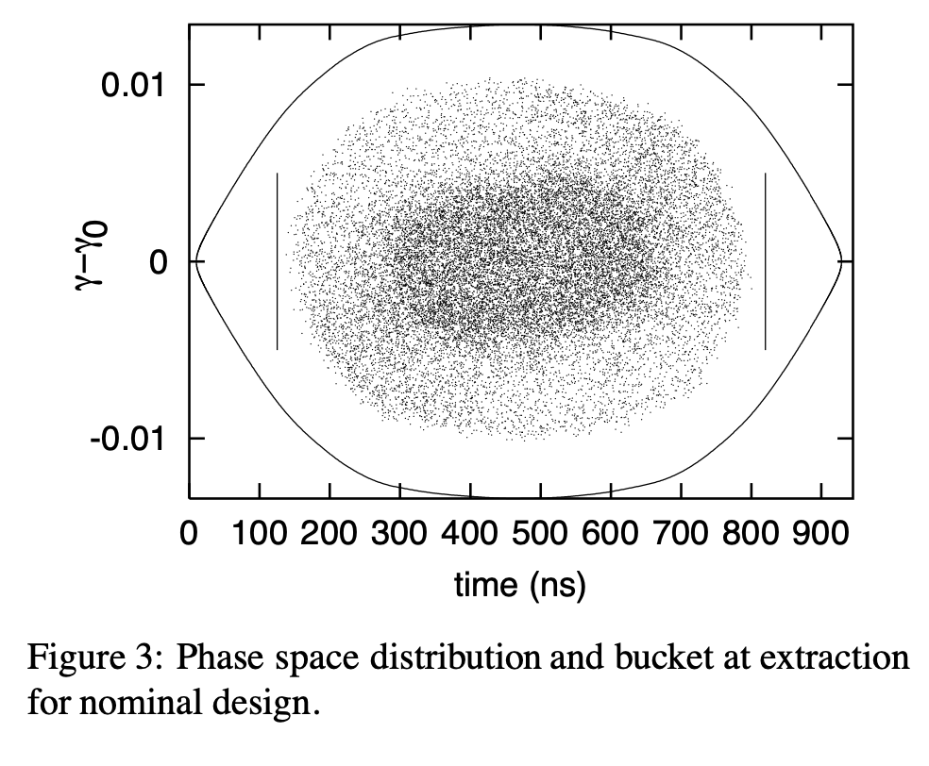
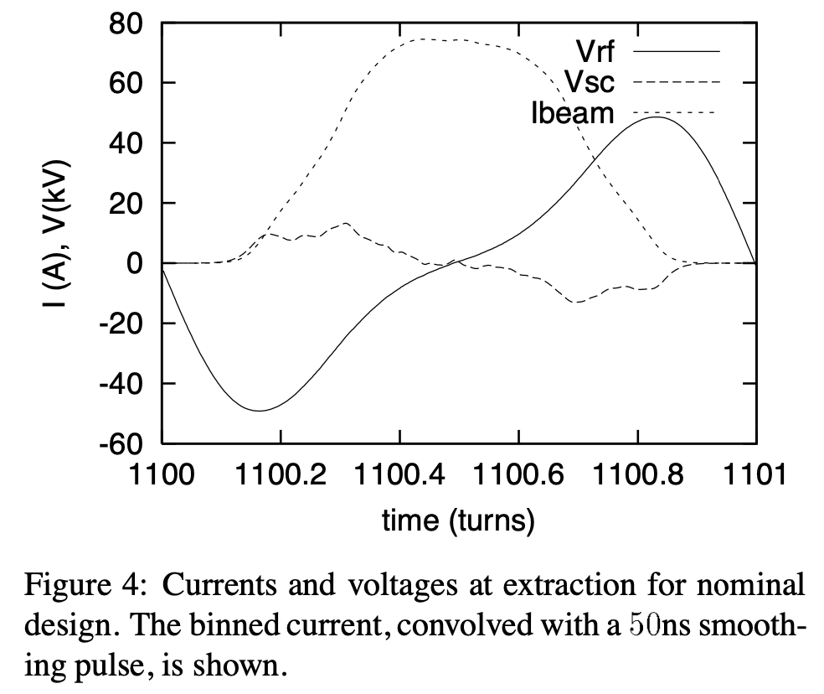
Dual-harmonic waveforms reduce peak density
Blaskiewiczy, RF System for the SNS Accumulator Ring (2001)

Slide 19
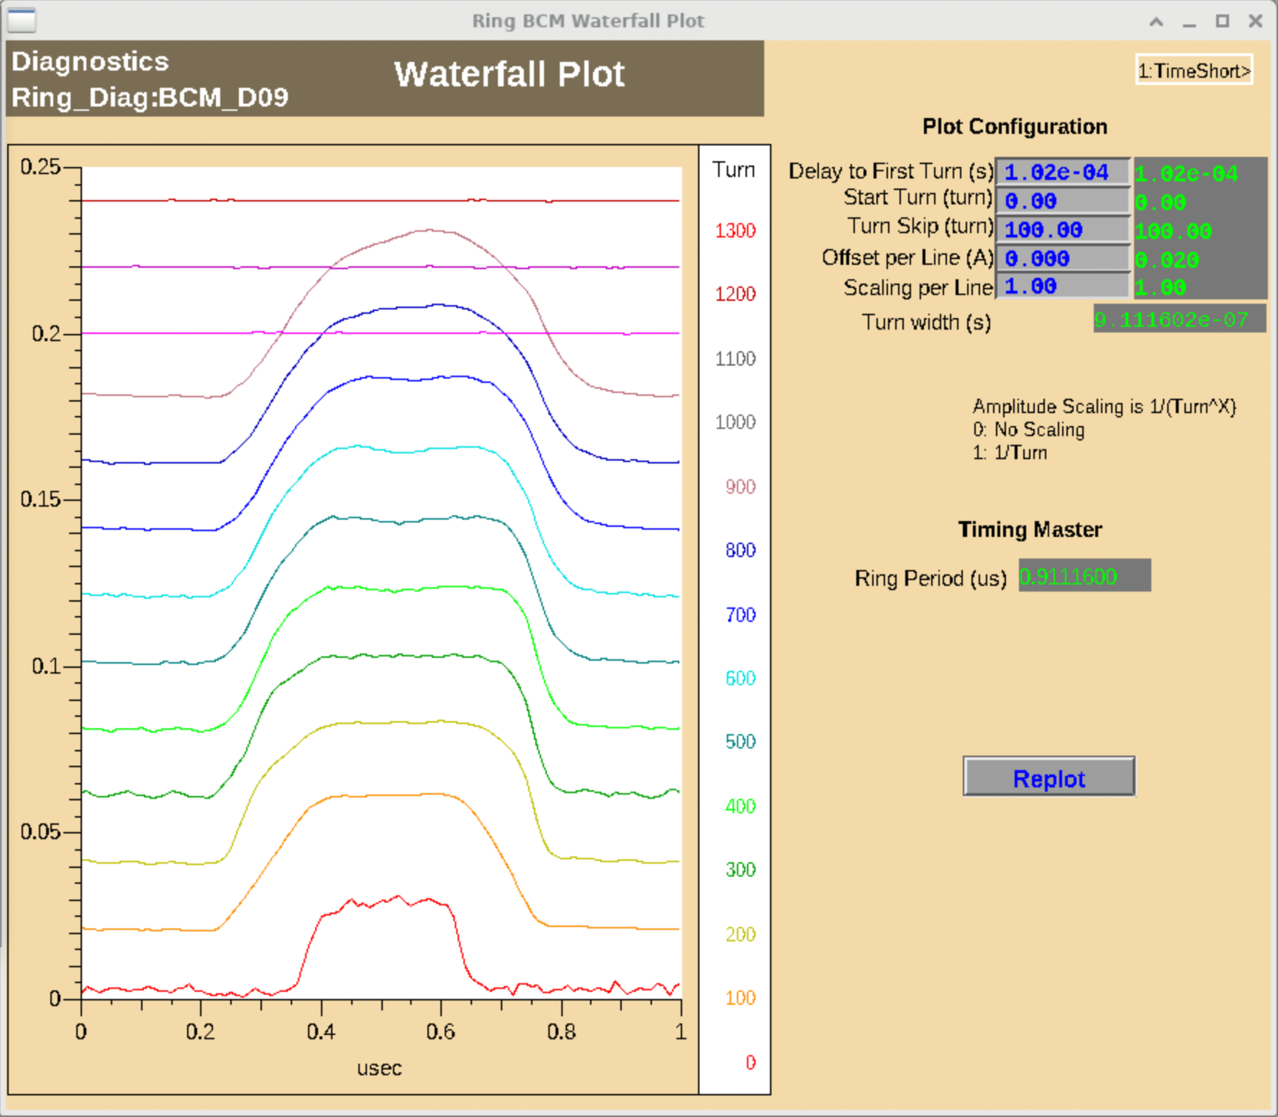

Slide 20
Could we compress the bunch in the SNS accumulator ring?
Notes:
Can we compress the bunch using available RF power?

Slide 21
We do not have a separate compressor ring
Stage 1: accumulation (~1000 turns)
Stage 2: storage + compression (h=1 cavity)
Cavity waveforms must change immediately after accumulation

Slide 22
Goal during storage: ramp h=1 cavity to maximum voltage as fast as possible
Maximum voltage ~20 kV using two cavities
Voltage ramp duration ~200 turns
Synchrotron period ~ 2000 turns at 1.3 GeV
Notes:
The RF during accumulation will determine final compression ration

Slide 23
Goal during accumulation: minimize energy spread and maintain extraction gap
Notes:
E will rotate to z
Extraction gap avoids s-shapke

Slide 24
Goal during accumulation: minimize energy spread and maintain extraction gap
Option 1: production waveforms
Notes:
E will rotate to z
Extraction gap avoids s-shapke

Slide 25
Goal during accumulation: minimize energy spread and maintain extraction gap
Option 1: production waveforms
Option 2: use additional harmonics to approximate barrier waveform (square well)
Notes:
E will rotate to z
Extraction gap avoids s-shapke

Slide 26
Goal during accumulation: minimize energy spread and maintain extraction gap
Option 1: production waveforms
Option 2: use additional harmonics to approximate barrier waveform (square well)
Option 3: turn off cavities
Notes:
E will rotate to z
Extraction gap avoids s-shapke

Slide 27
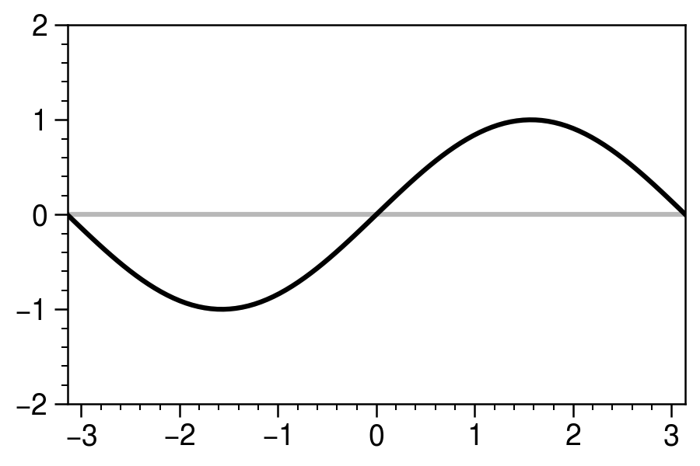
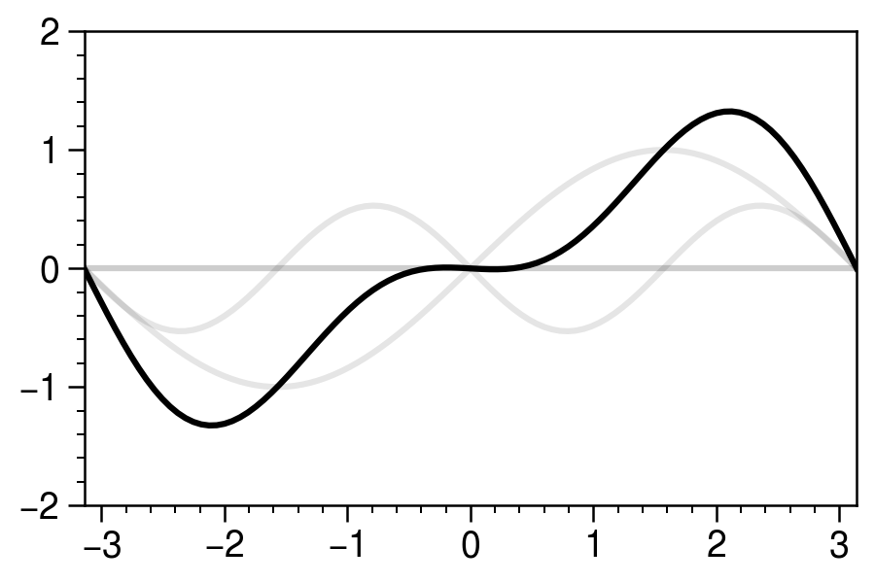
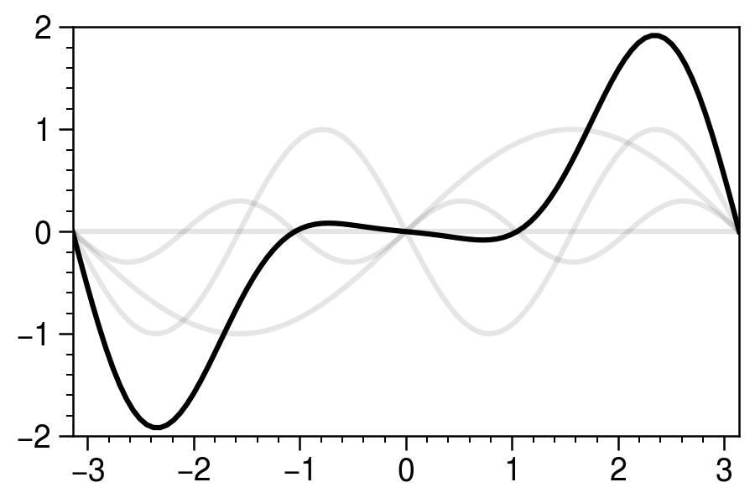
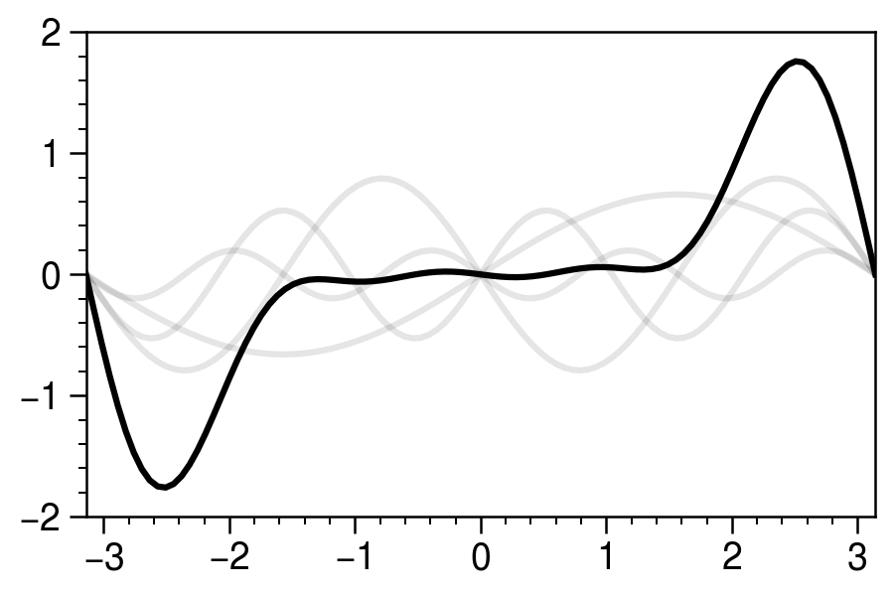
We’ve never tried operating cavities at higher harmonics — should be possible
Notes:
There is probably an exact solution; I found these by messing around with the amplitudes.

Slide 28
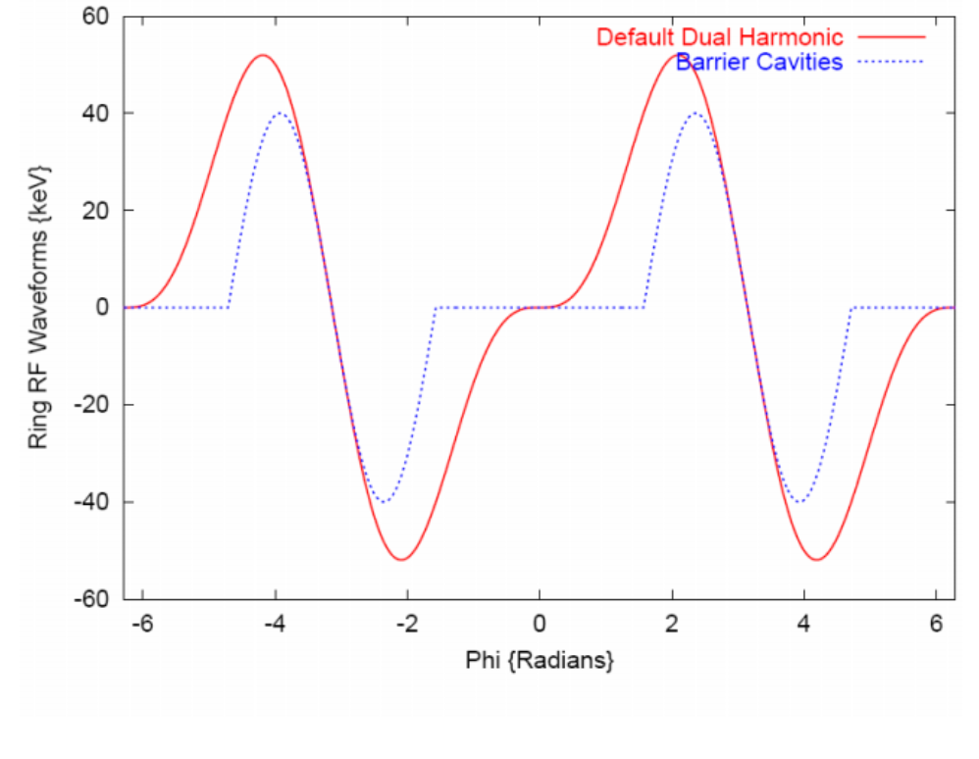
Old simulations show influence of barrier waveforms on longitudinal distribution
Holmes et al., HB 2006

Slide 29
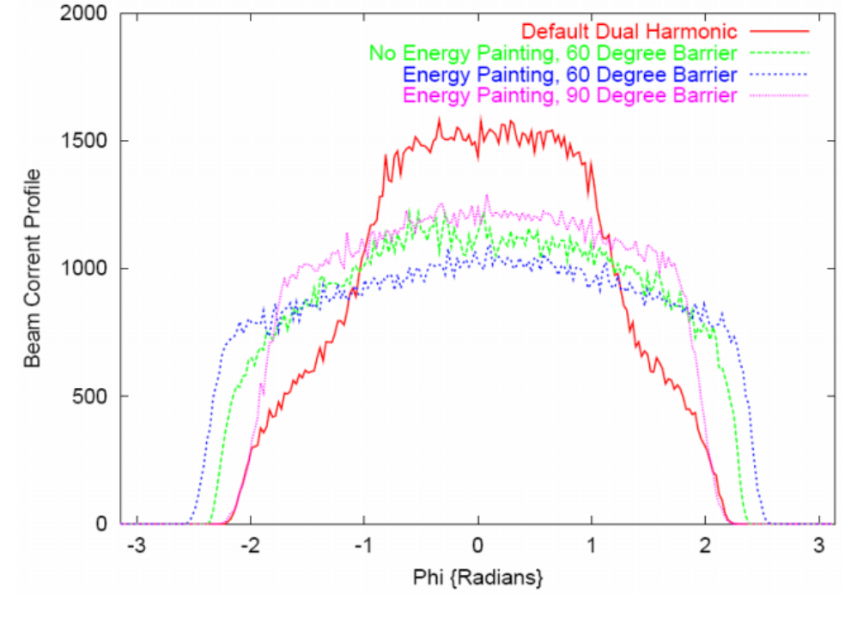
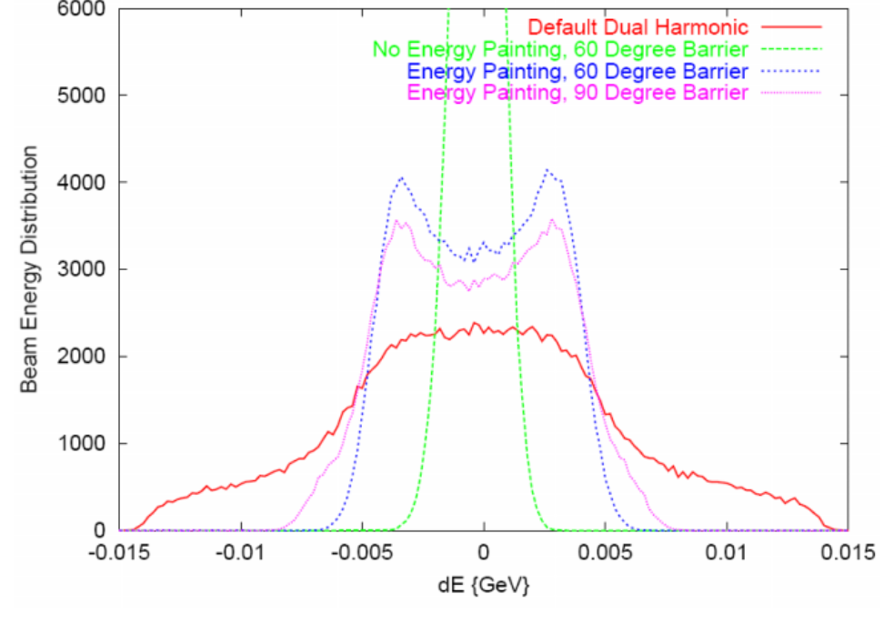


Old simulations show influence of barrier waveforms on longitudinal distribution
$$ρ(φ)$$
$$ρ(E)$$
Holmes et al., HB 2006

Slide 30

Old simulations show influence of barrier waveforms on longitudinal distribution
$$ρ(φ)$$
$$ρ(E)$$
$\sqrt{⟨E^{2}⟩}≈1$ [MeV]
Holmes et al., HB 2006

Slide 31
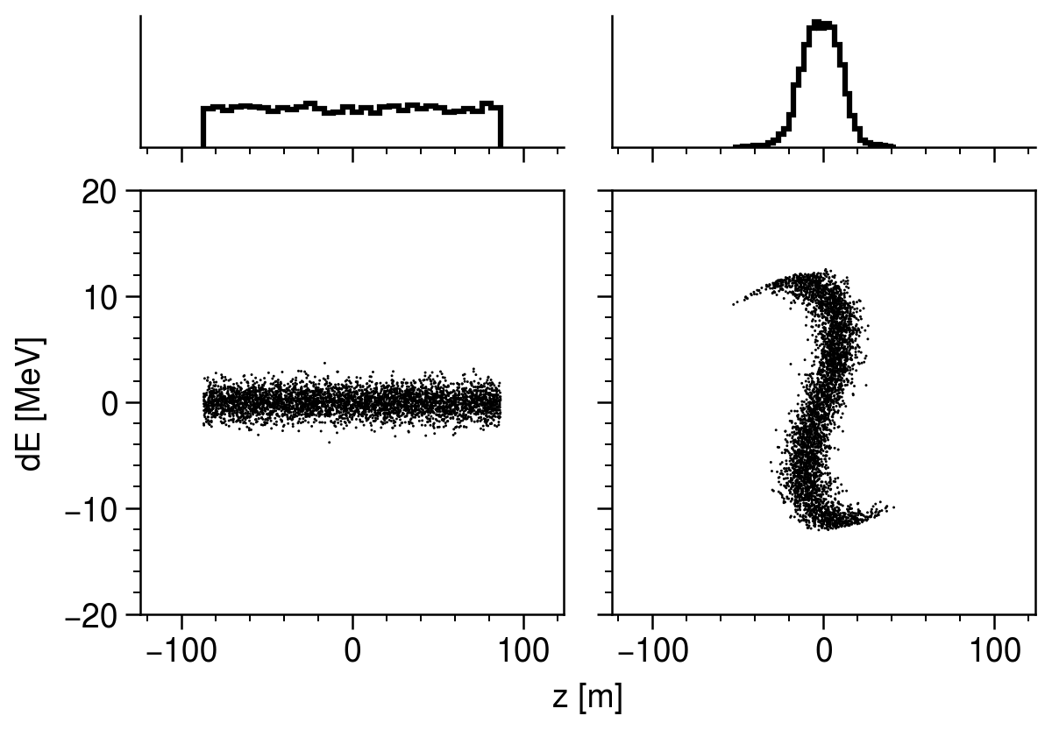
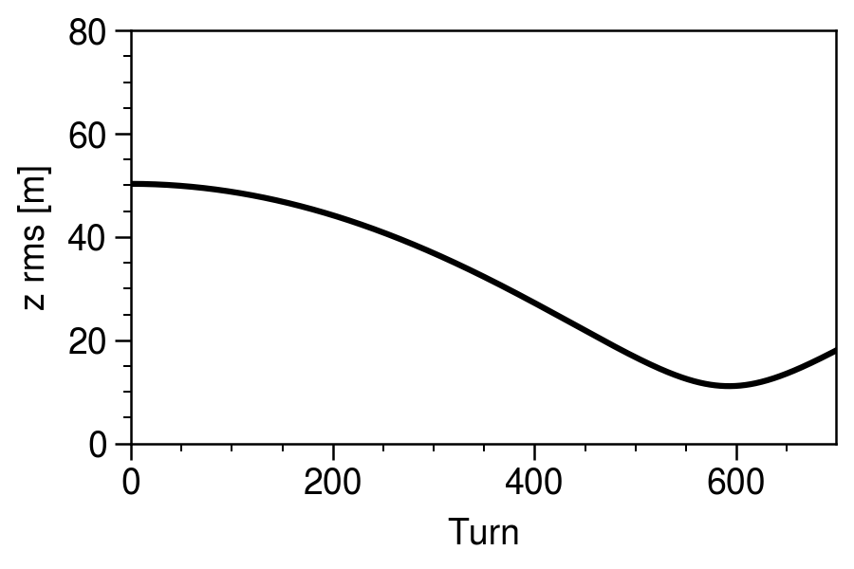

$ΔE$ =1 [MeV]
Notes:
Zero space charge; instant RF ramp; 1.3 GeV beam energy.
[1] Minimum energy spread of 1 MeV from Holmes simulations.
[2] Zero RF voltage during accumulation (not even beam-induced voltage)
[3] Larger energy spread of 3 MeV
Compression factor 5-10 ideal; 2 if nonideal.

Slide 32
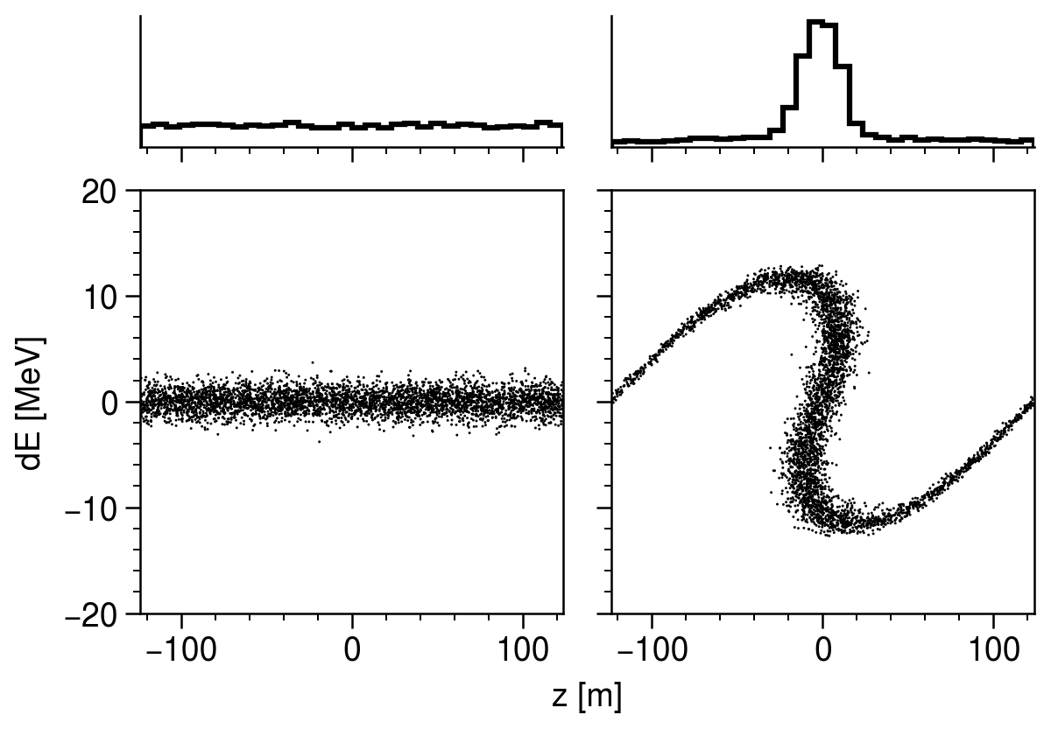
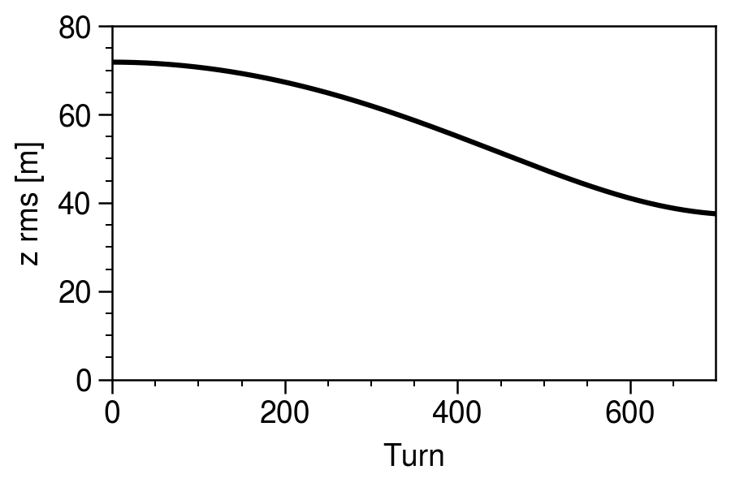
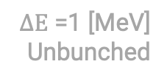
$ΔE$ =1 [MeV]
$ΔE$ =1 [MeV]
Unbunched
Notes:
Zero space charge; instant RF ramp; 1.3 GeV beam energy.
[1] Minimum energy spread of 1 MeV from Holmes simulations.
[2] Zero RF voltage during accumulation (not even beam-induced voltage)
[3] Larger energy spread of 3 MeV

Slide 33
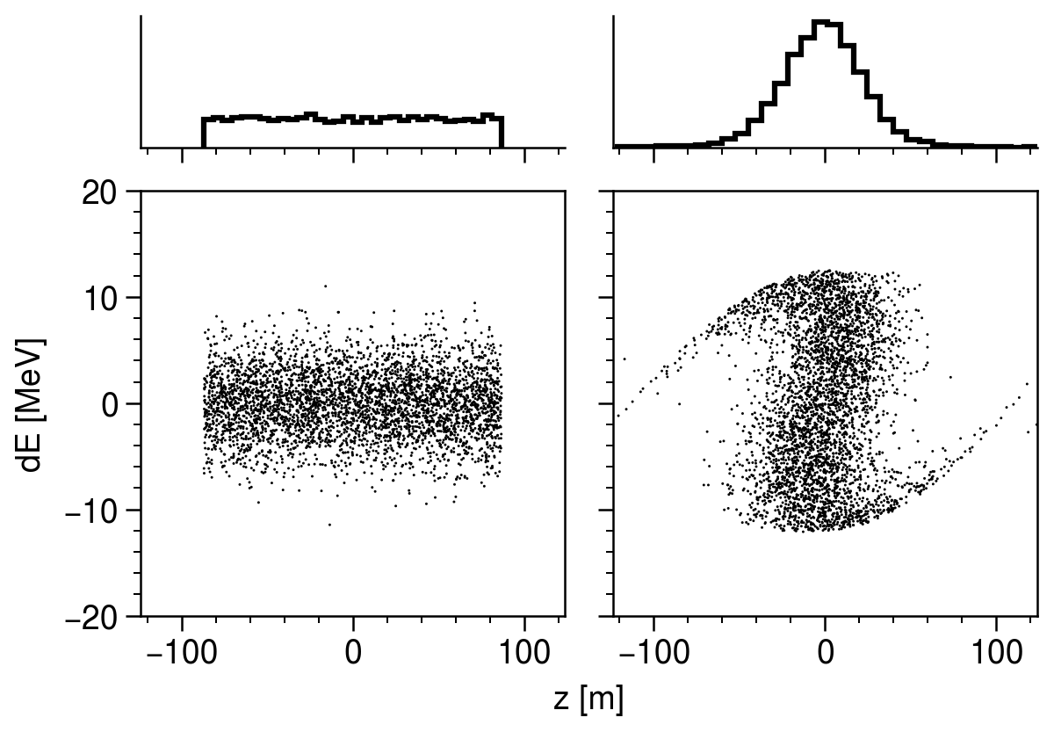
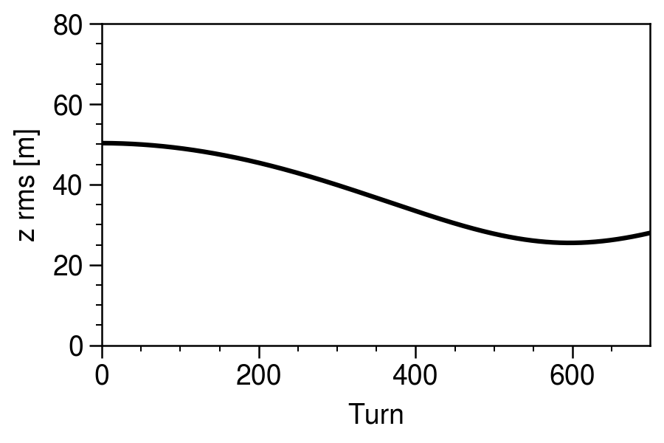

$ΔE$ =1 [MeV]
$ΔE$ =1 [MeV]
Unbunched
$ΔE$ =3 [MeV]
Notes:
Zero space charge; instant RF ramp; 1.3 GeV beam energy.
[1] Minimum energy spread of 1 MeV from Holmes simulations.
[2] Zero RF voltage during accumulation (not even beam-induced voltage)
[3] Larger energy spread of 3 MeV
Conclusion: given the synchrotron tune and expected initial bunch, it could be possible to reach significant compression factor.

Slide 34
Diagnostics and simulation benchmarking

Slide 35
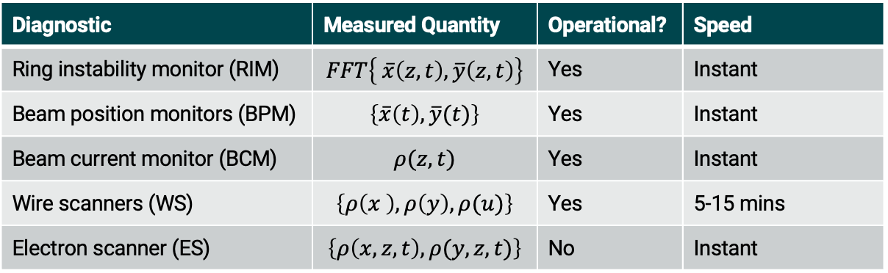
Diagnostics are available to measure turn-by-turn phase space distribution
Diagnostic | Measured Quantity | Operational? | Speed
Ring instability monitor (RIM) | $$FFT\left\{ \overline{x}\left(z,t\right), \overline{y}\left(z,t\right)\right\}$$ | Yes | Instant
Beam position monitors (BPM) | $$\left\{\overline{x}\left(t\right),\overline{y}(t)\right\}$$ | Yes | Instant
Beam current monitor (BCM) | $$ρ(z,t)$$ | Yes | Instant
Wire scanners (WS) | $$\left\{ρ\left(x \right),ρ\left(y\right),ρ(u)\right\}$$ | Yes | 5-15 mins
Electron scanner (ES) | $$\left\{ρ\left(x,z,t\right),ρ(y,z,t)\right\}$$ | No | Instant

Slide 36
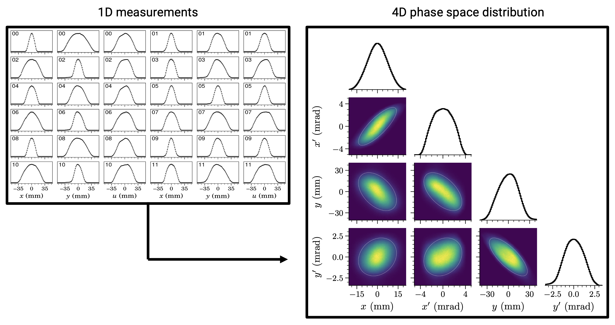
Wire scanners constrain 2D/4D phase space density of extracted bunch
Hoover, Phys. Rev. Accel. Beams 27, 122802 (2024)
Notes:
https://doi.org/10.1103/PhysRevAccelBeams.27.122802
Can measure different turns

Slide 37
Potential to test modeling assumptions against turn-by-turn data
Multiple codes: PyORBIT, Impact-X, X-Suite (PyORBIT-X??)
Space charge during compression (3D slice-by-slice?)
Wake fields — beam-cavity interaction
Electron cloud

Slide 38
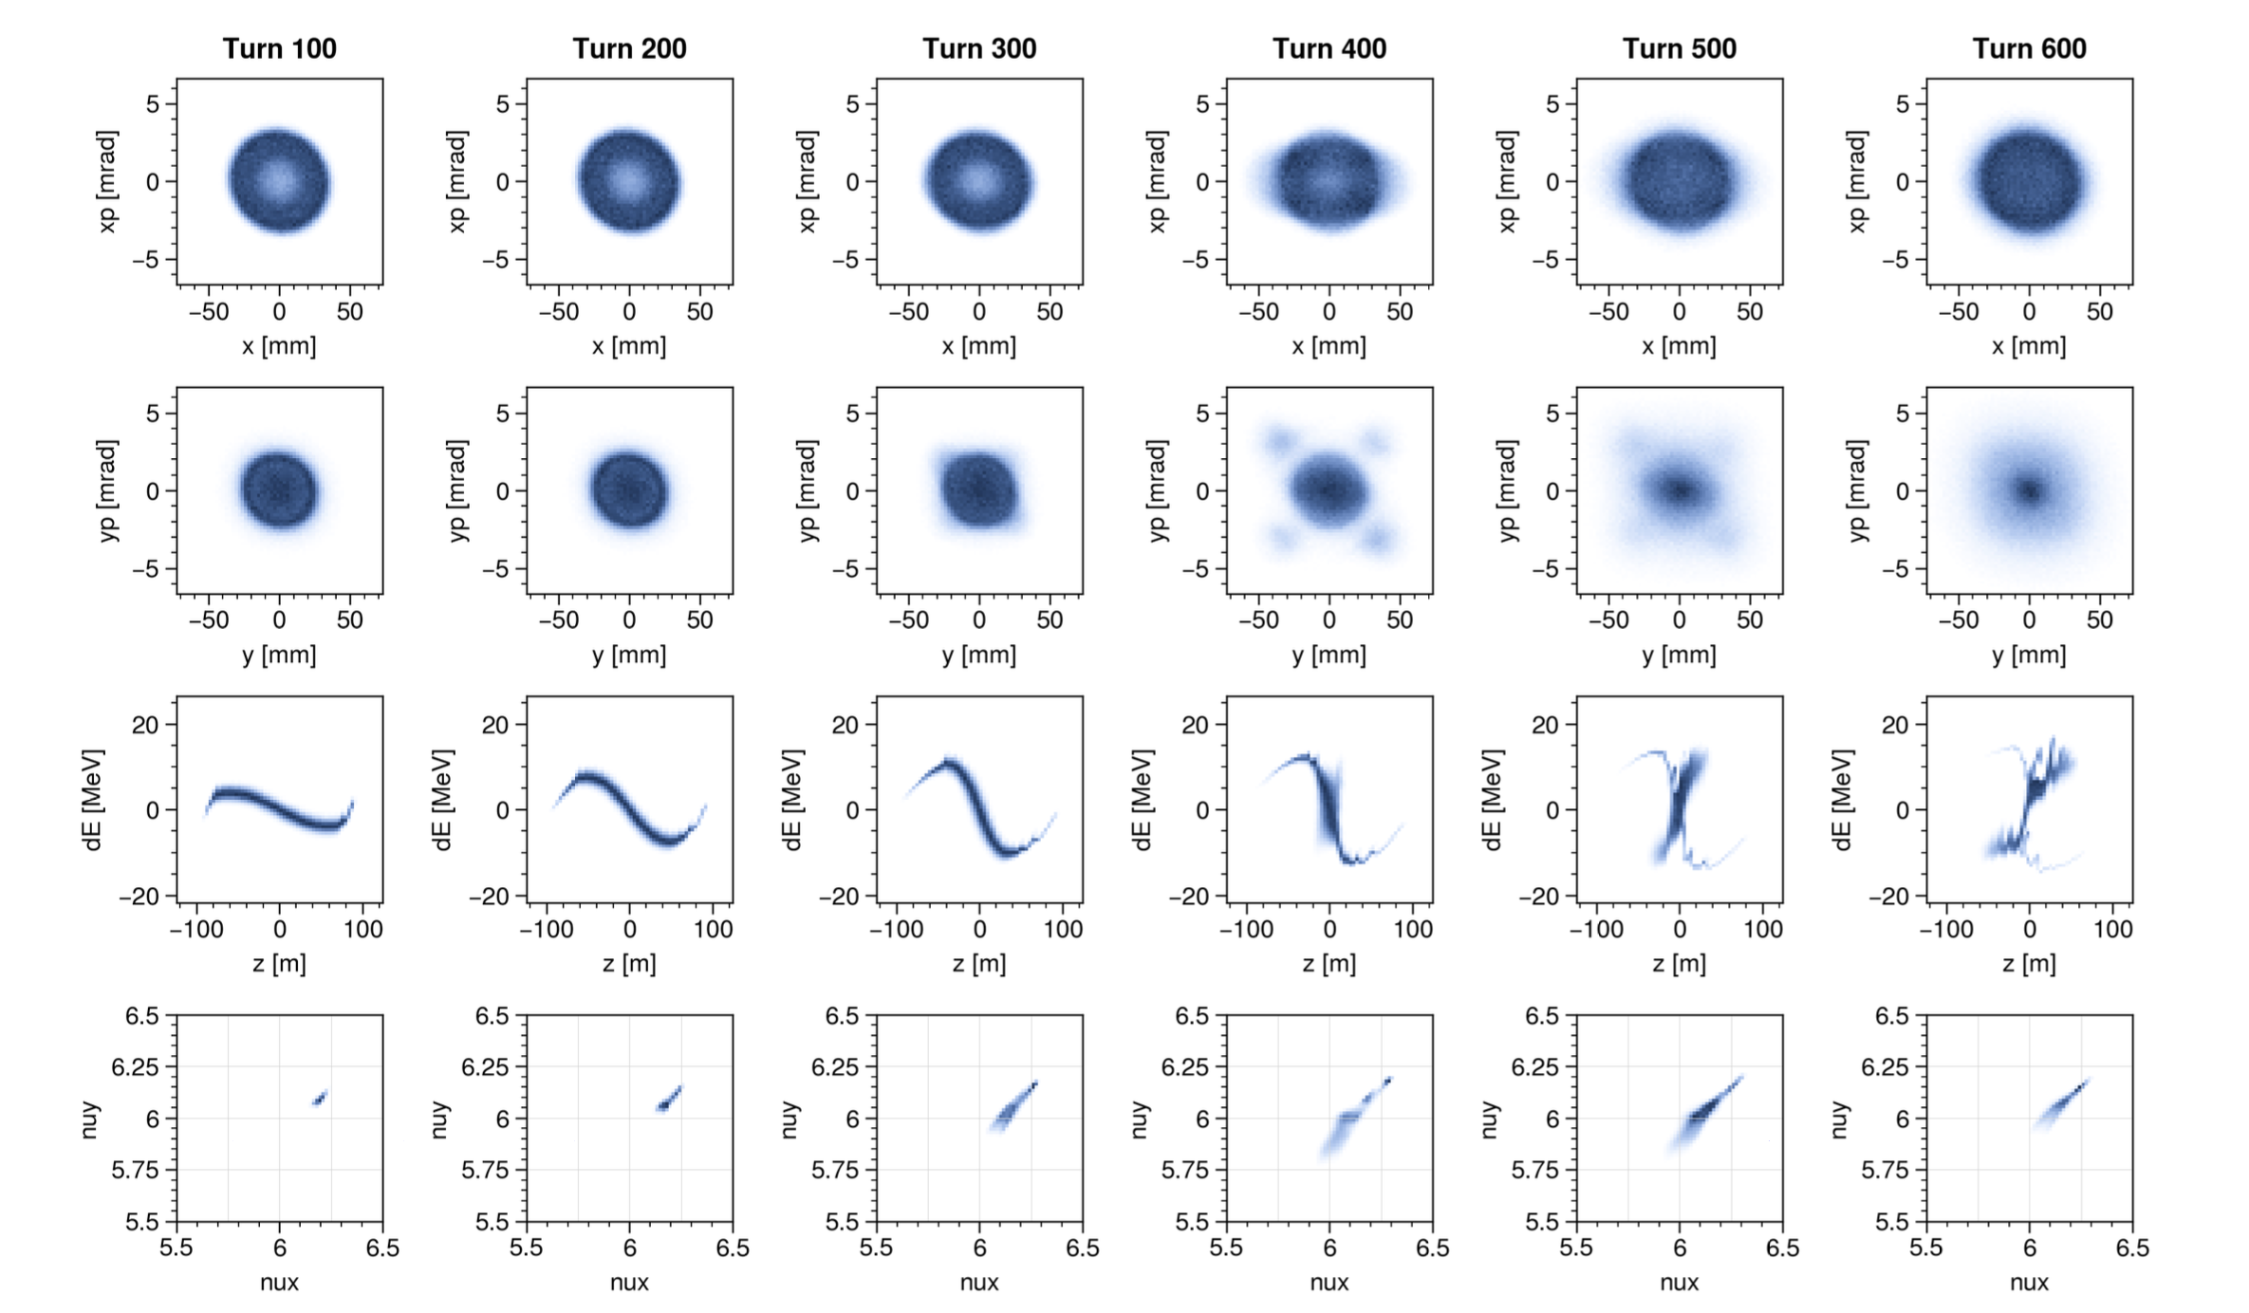
Fourth-order resonance driven by multipoles in space charge potential

Slide 39
Fourth-order resonance driven by multipoles in space charge potential
Measure?

Slide 40
Artificial noise from longitudinal space charge solver
??

Slide 41
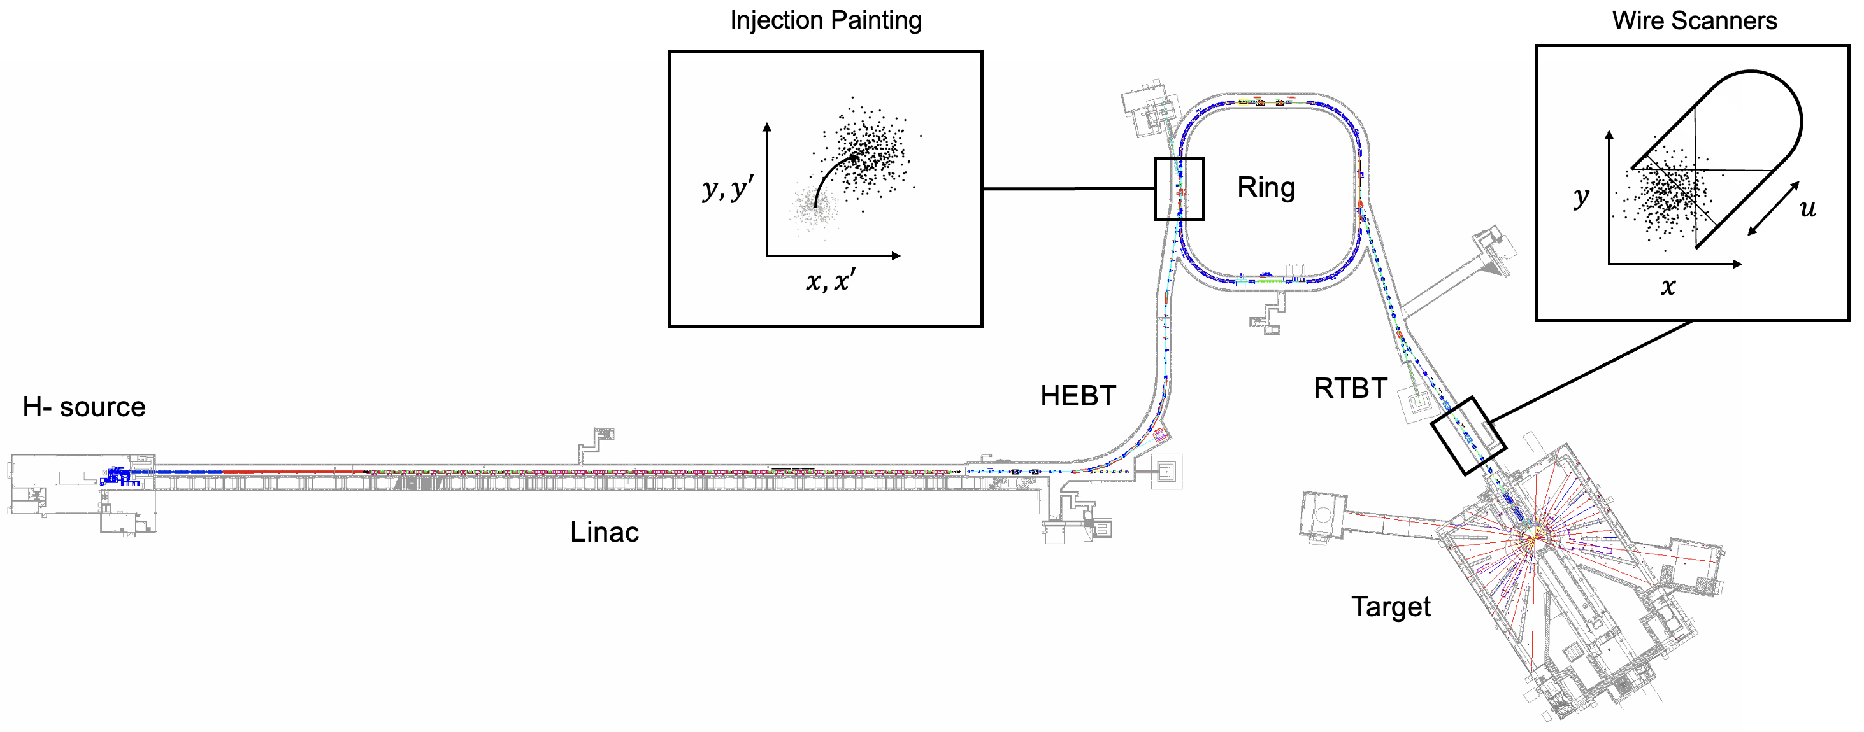
Can amplify collective effects via phase space painting and energy modulation

Slide 42
First experiment

Slide 43
RF system is limited right now
We cannot switch waveforms mid-cycle.
We can ramp the h=1 cavity drive amplitude on a delay (ramp starts after accumulation).
We cannot unshort the cavity mid-cycle. So there will be beam-induced voltage during accumulation.

Slide 44
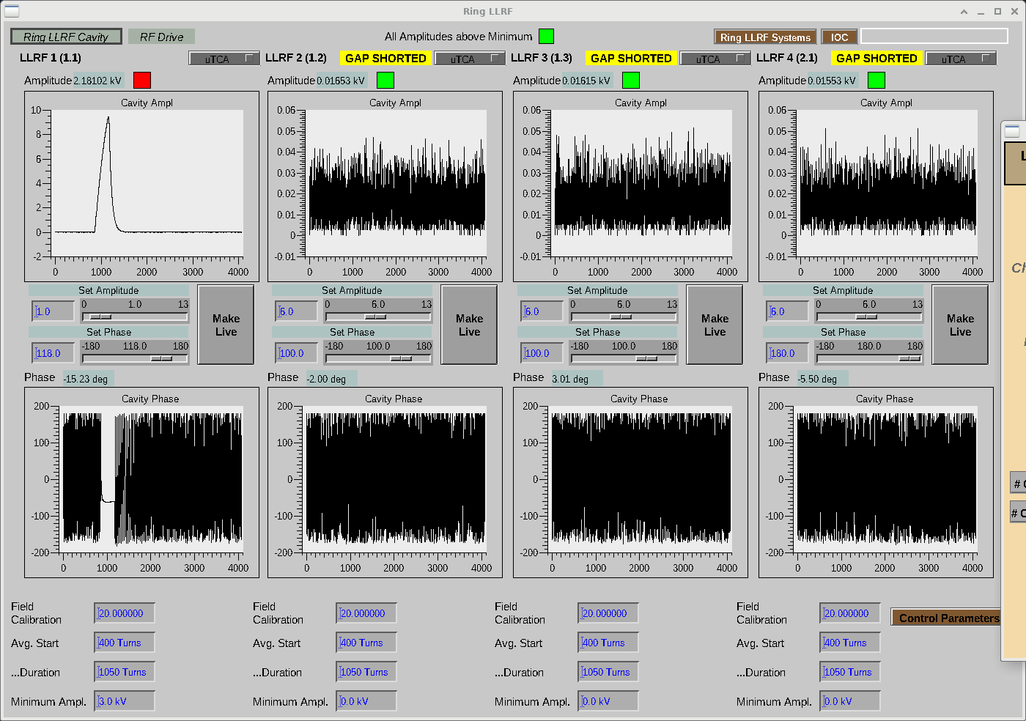
Induced voltage approaches max value after ~300 injected turns

Slide 45
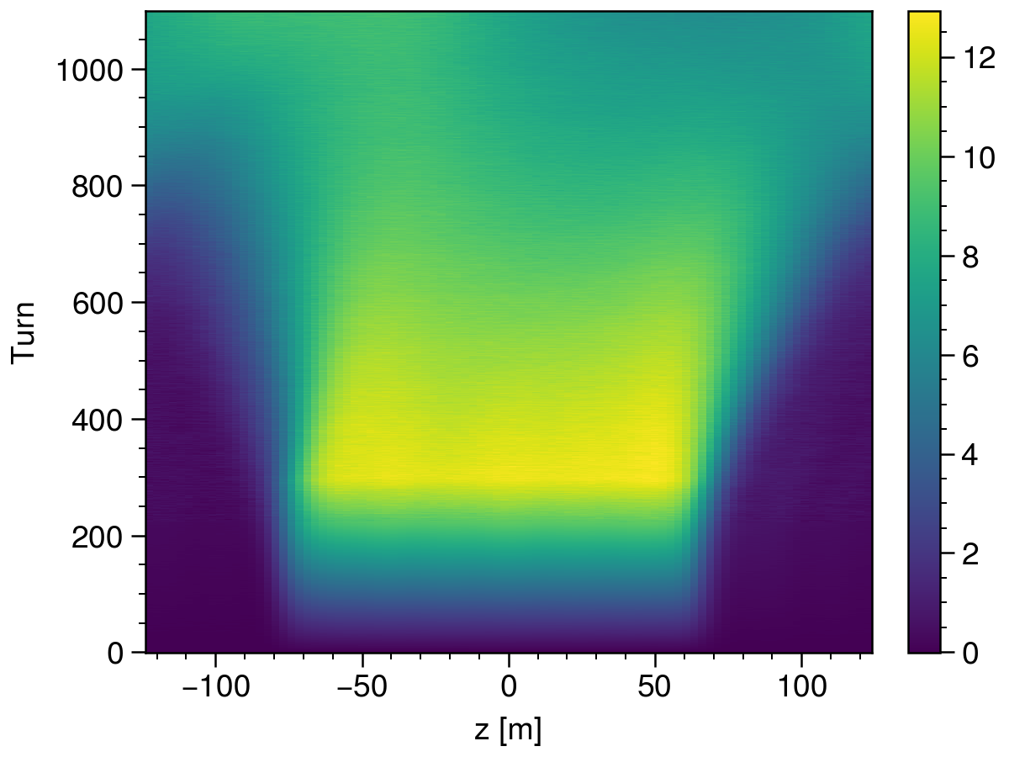
We didn’t see any bunching :(
Constant A
Storage
Ramp A
Accumulation
Zero A

Slide 46
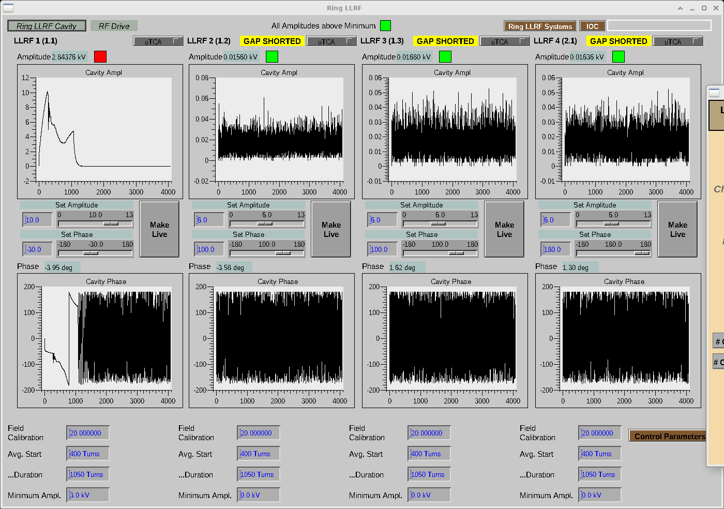

Slide 47
Actual RF phase was probably debunching
RF feedback was unstable at 300 injected turns; we operated without feedback.
Since we operated without feedback, the setpoint phase/amplitude were not equal to the actual values.
Next time, we’ll start at low intensity with feedback on.

Slide 48
Conclusion
Bunch compression in the SNS could be valuable for studying collective effects
Experiments started this month
Success may hinge on ring RF engineering
Thanks for listening!

Slide 50
16.7 ms (1/60 Hz)
Macro-pulse
(ion source)
15.7ms
1ms
945 ns (1/1.059 MHz)
Mini-pulse
(chopper)
645 ns
300 ns
260 micro-pulses
Micro-pulse
(RFQ)
2.4845 ns (1/402.5 MHz)

Slide 51
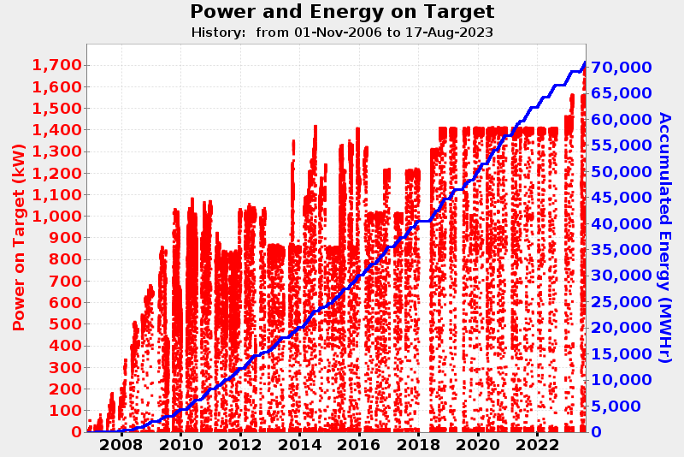

Slide 52
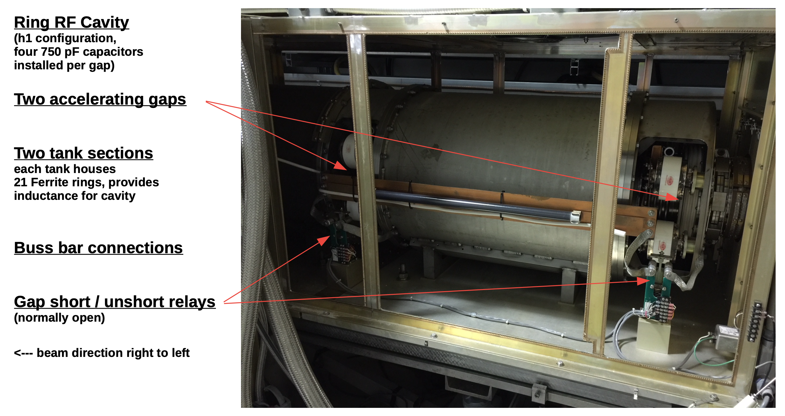
SNS ring has four RF cavities (h=1, h=2)
Notes:
Supplied by Chip Piller (ORNL), RF engineer
I am not an RF engineer and am just starting to learn about the system.

