Slide 2
HI-ECN3 Target complex
13th NBI Workshop - 7-10 October 2024
AYA’s Laboratory, Tokai, Japan
Jean-Louis GRENARD - CERN - on behalf of HI-ECN3 WP4 Target complex

Slide 3
Content
BDF Target complex
Target exchange principle
Service building integration
Service cell
Summary

Slide 4
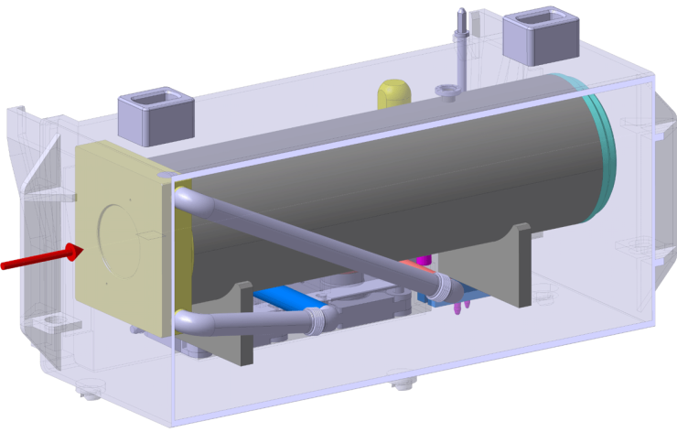
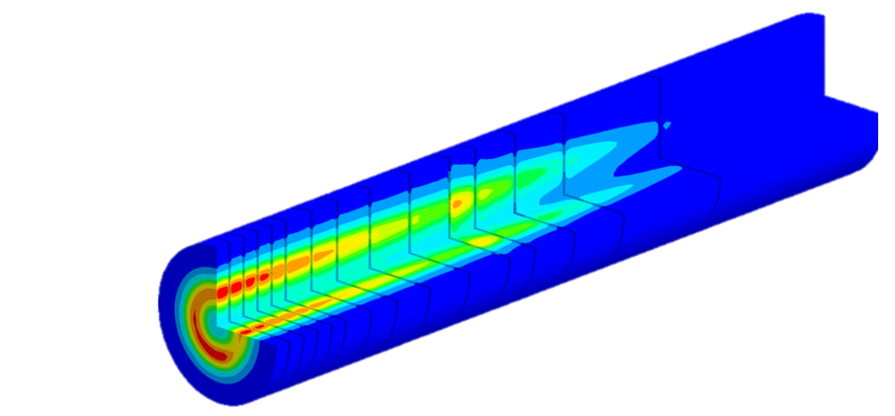
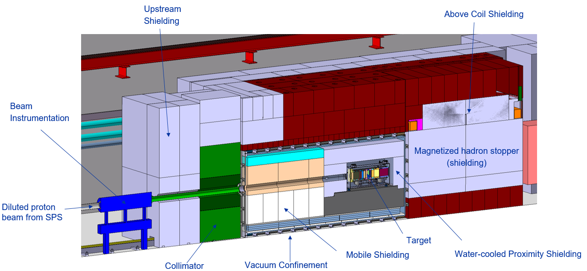
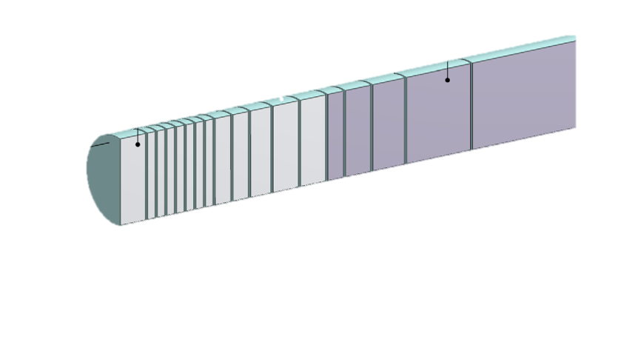
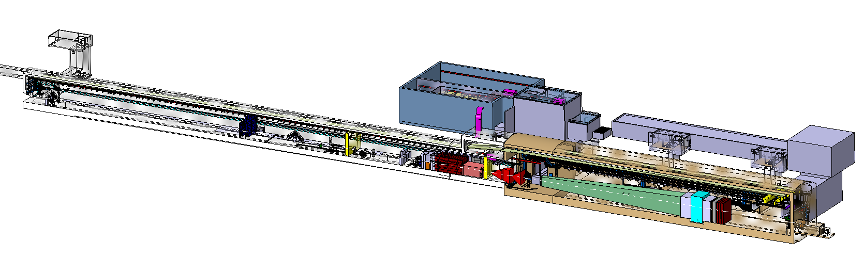

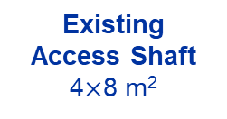
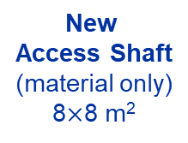
BDF/SHiP Target
Baseline Design → Improvement during TDR
(Rui Franqueira Ximenes)
13 x TZM blocks (580 mm)
5x W blocks (780 mm)
New
Service Building
~ 1000 m²
New
Access Shaft
(material only)
8$×$8 m²
Existing
Access Shaft
4$×$8 m²
B911
B918
Beam Dilution System
TCC8
170m
Also at NBI 2024
The new ECN3 high intensity facility for the BDF/SHiP experiment and high intensity beam transfer (Matthew Fraser)
Radiation protection studies and considerations for the ECN3 high intensity project (Claudia Ahdida)
New Target Complex
containing the Beam Dump Target
ECN3
BDF/SHiP experiment
(Richard Jacobsson)

Slide 5
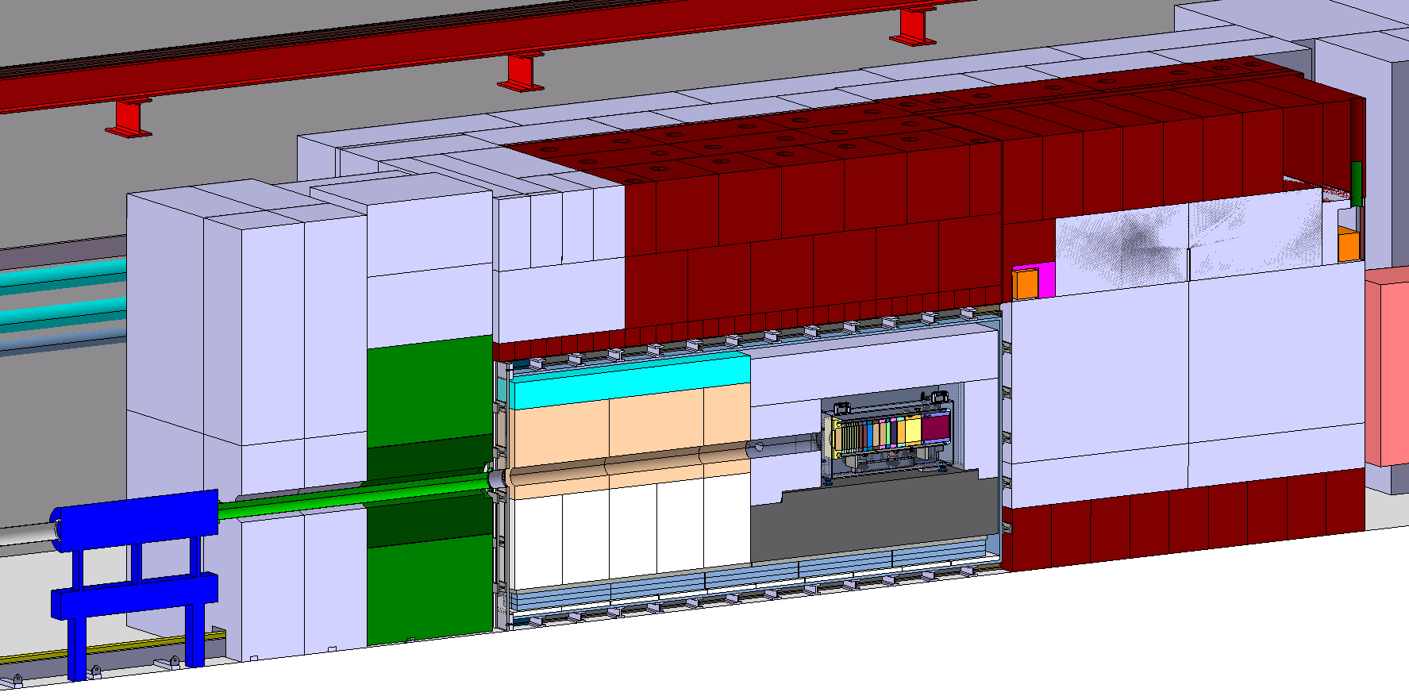
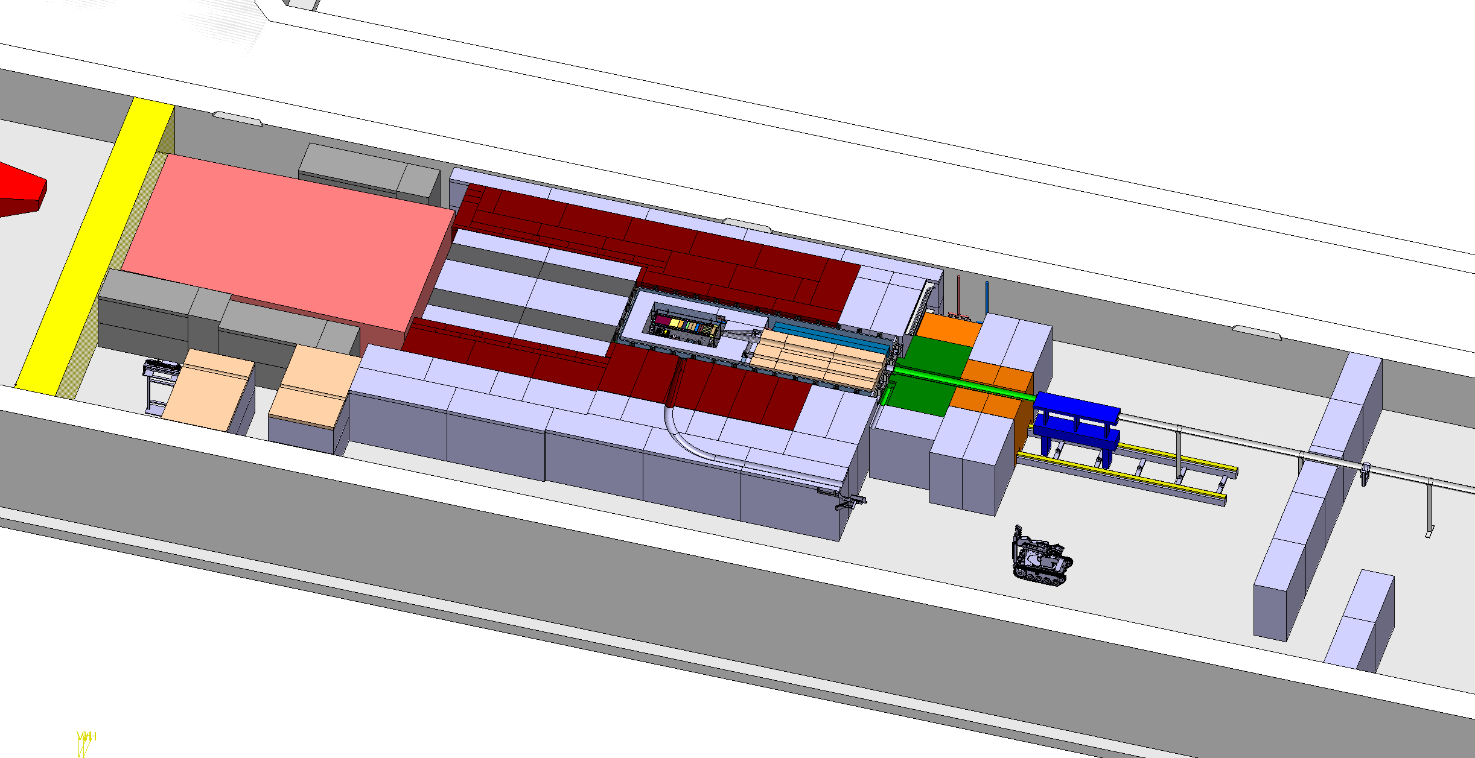
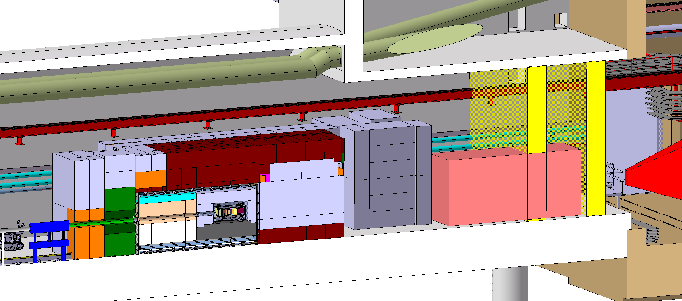
BDF Target complex integration
Upstream Shielding
Above Coil Shielding
Target area
Confinement wall
Magnetized
shielding
Beam instrumentation
Diluted Proton beam from SPS
Water cooled proximity shielding
Mobile Shielding
Vacuum confinement
Target
Collimator
Target station
SHIP experiment
Muon shield magnet
Access chicane
Space for shielding temporary storage

Slide 6
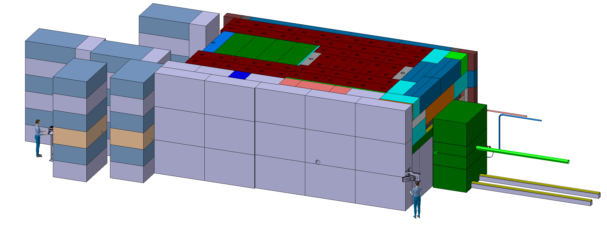
BDF Target complex integration - shielding
~4,8m
~8m
~12m
~ 180 m³ (~1400t) of cast iron + US1010
~ 360 m³ (~800t) of concrete / marble
Now establishing a bill of material to cross check what we will recover from other CERN facilities

Slide 7
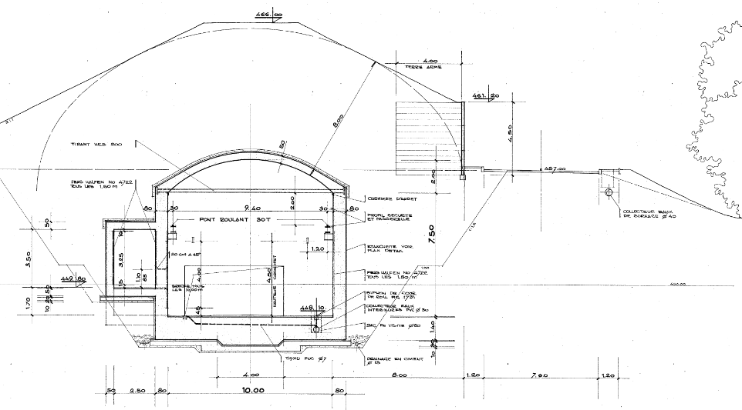
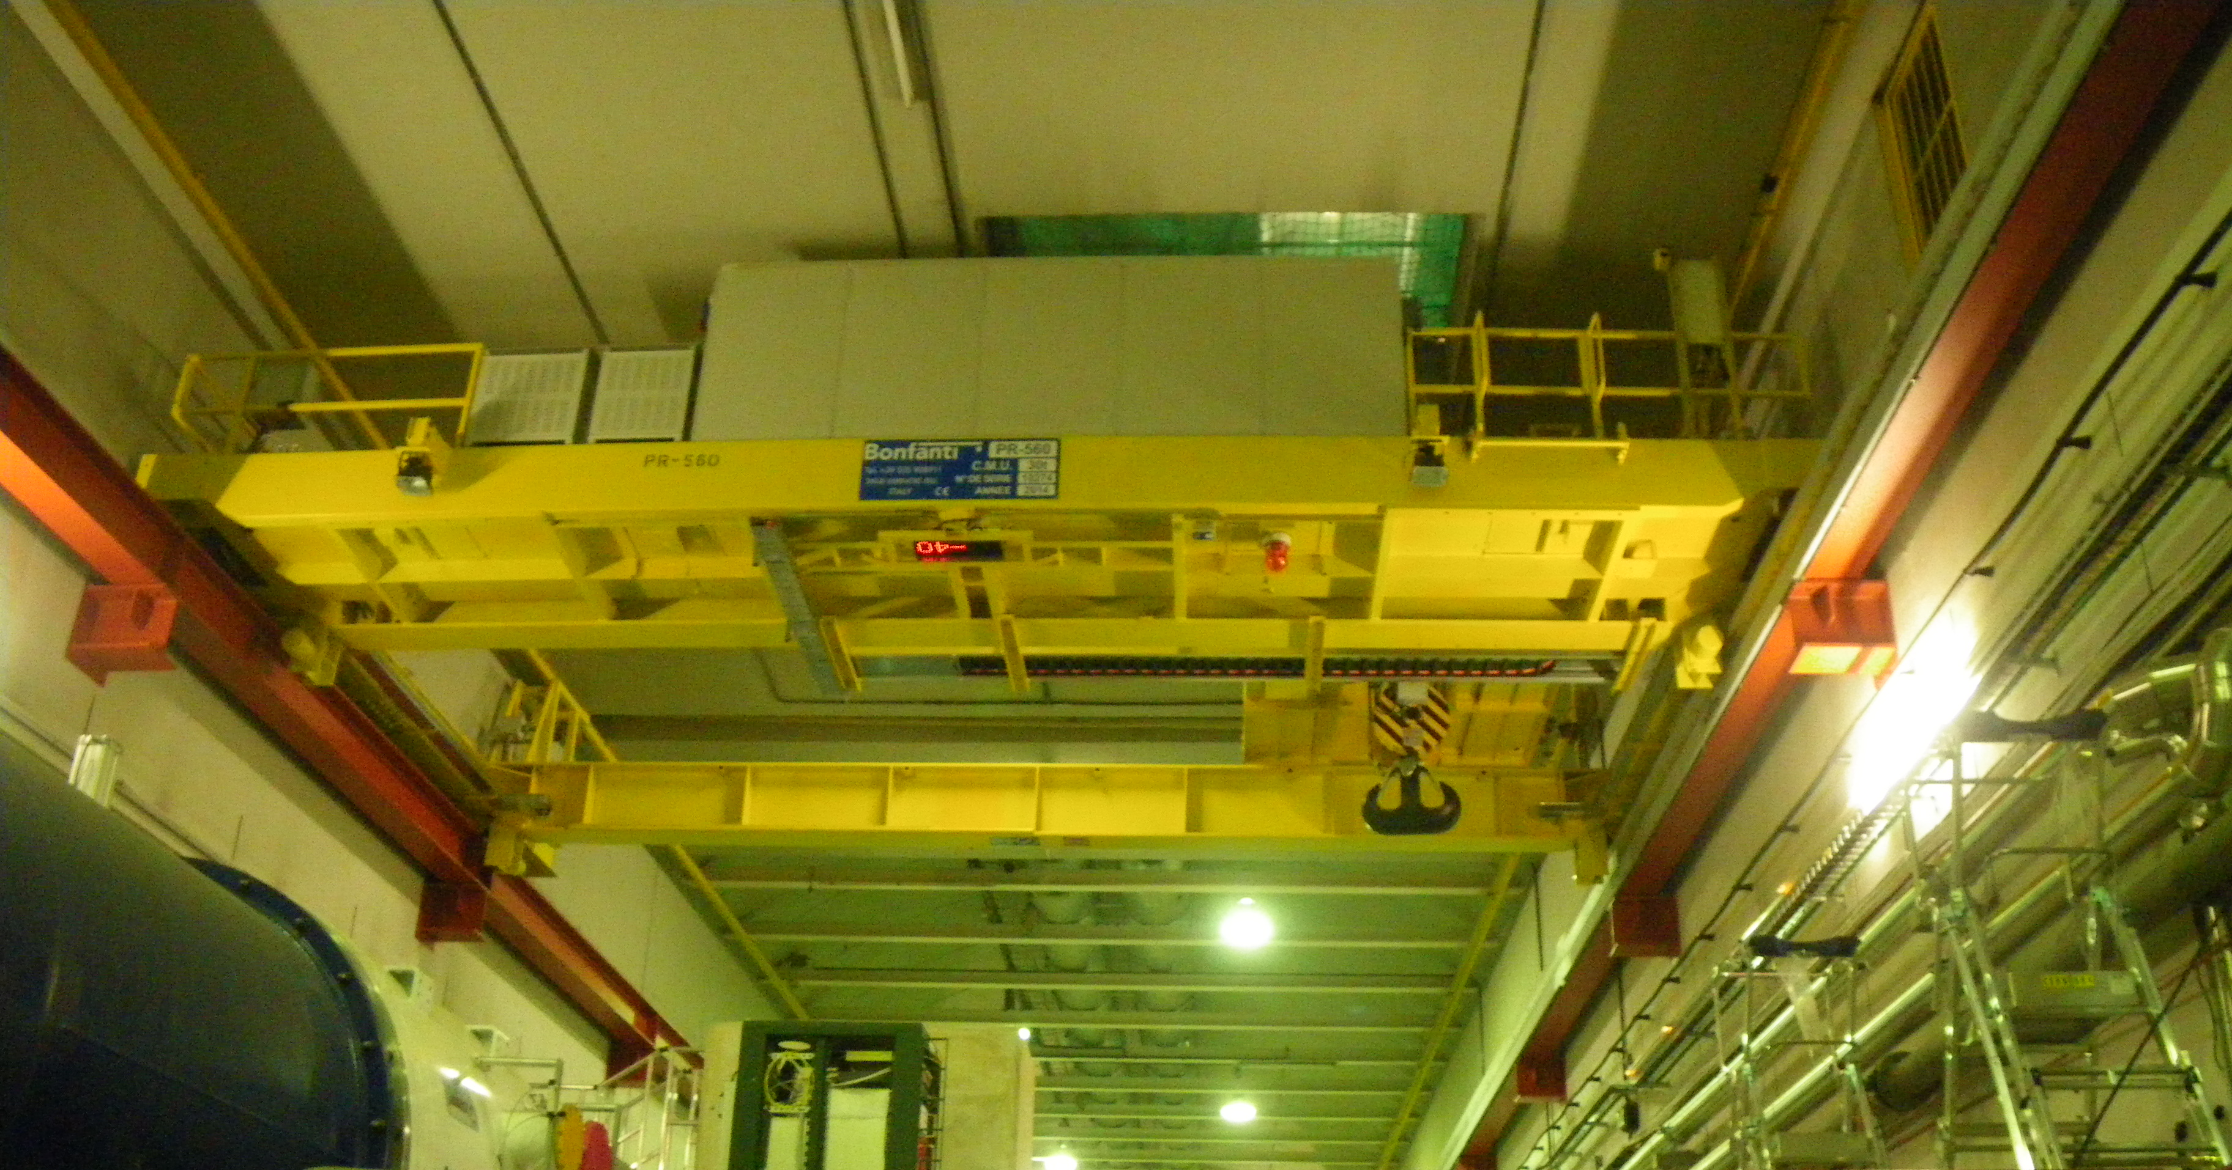
Target Complex in an existing facility
Benefit of being below ground level and having soil on top of the cavern
Existing overhead travelling crane 30t capacity
8m soil
TCC8 cross section (length 170m)

Slide 8
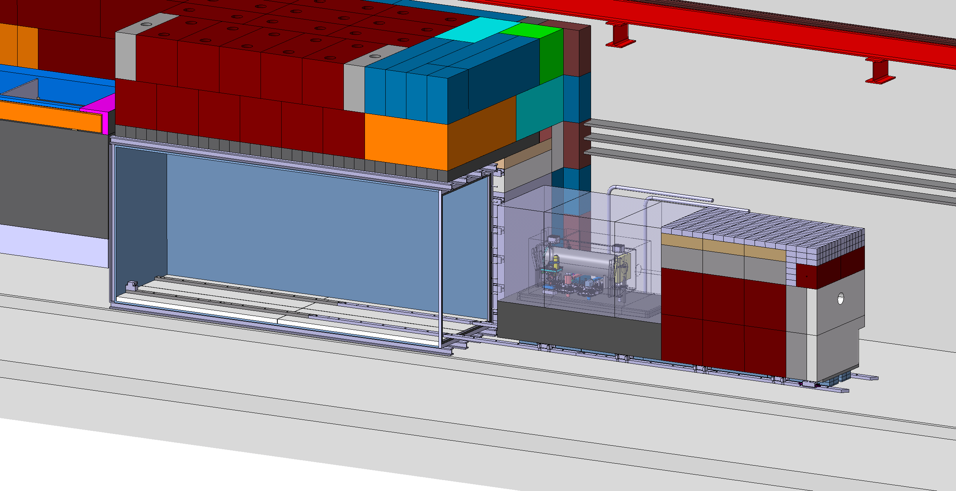
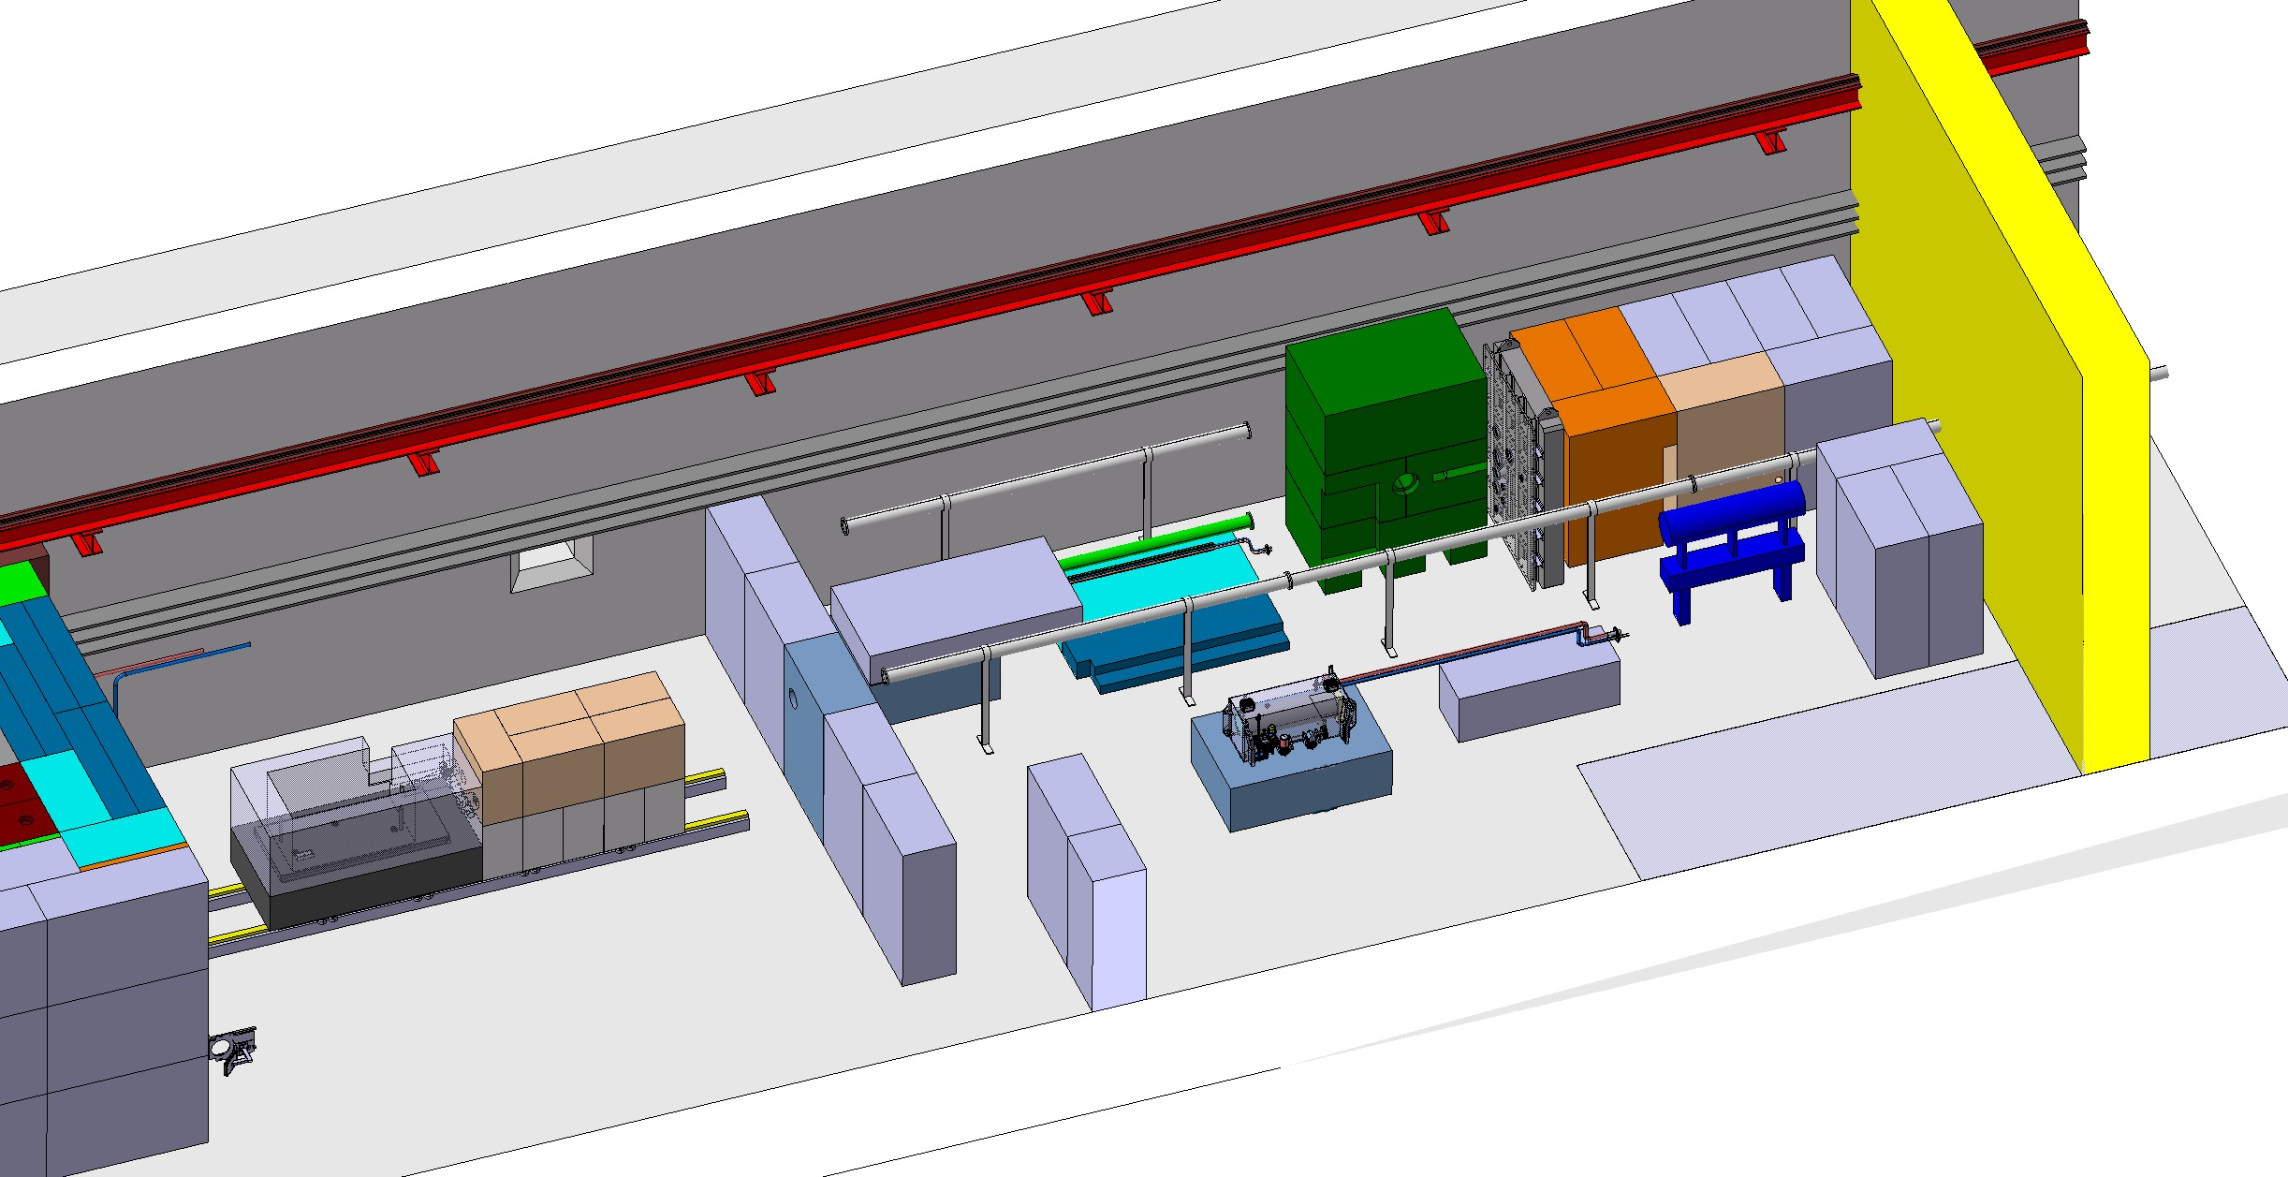
BDF Target complex integration - extraction
~30m

Slide 9
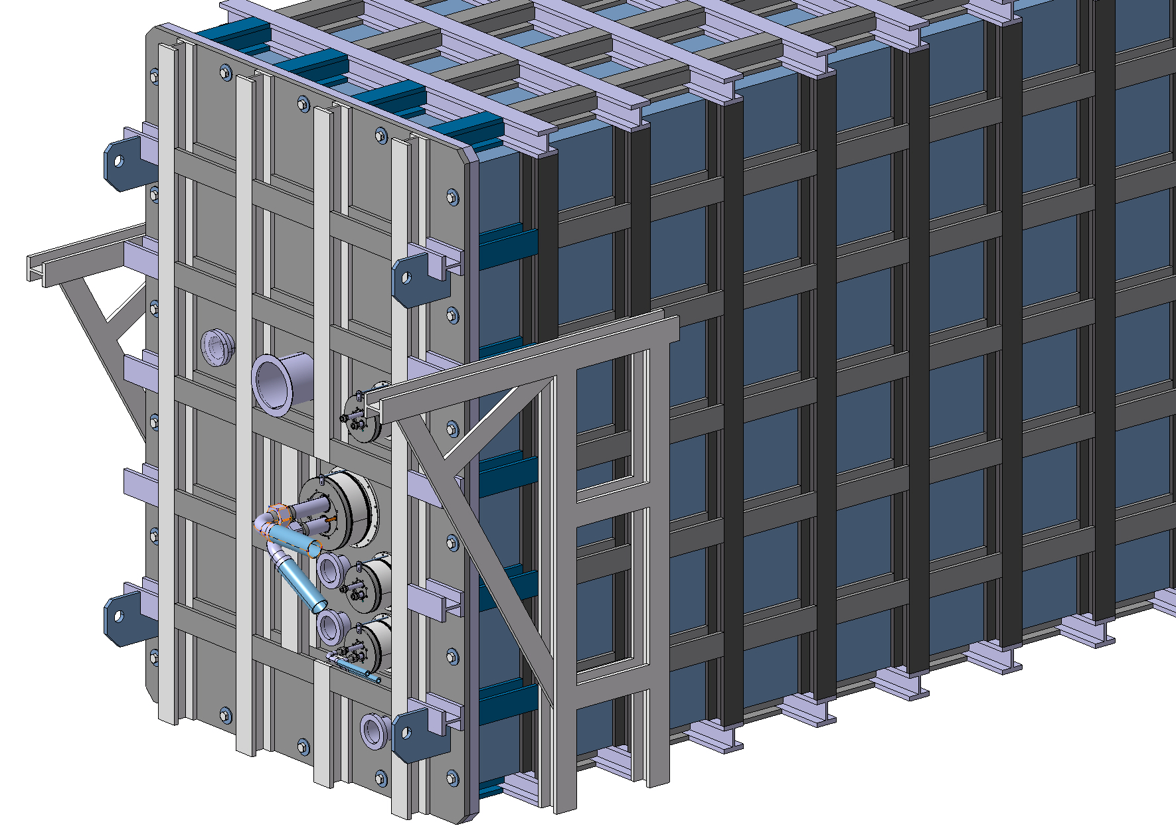
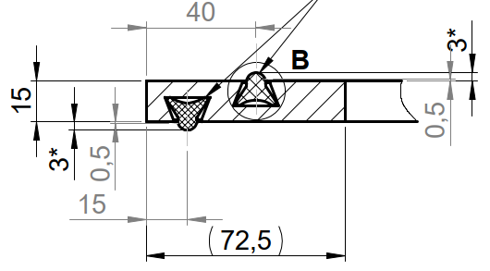
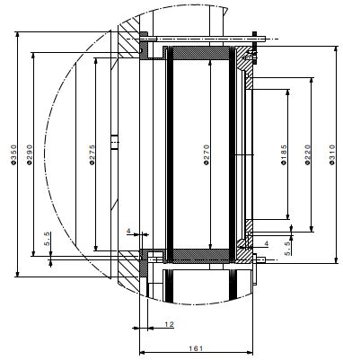
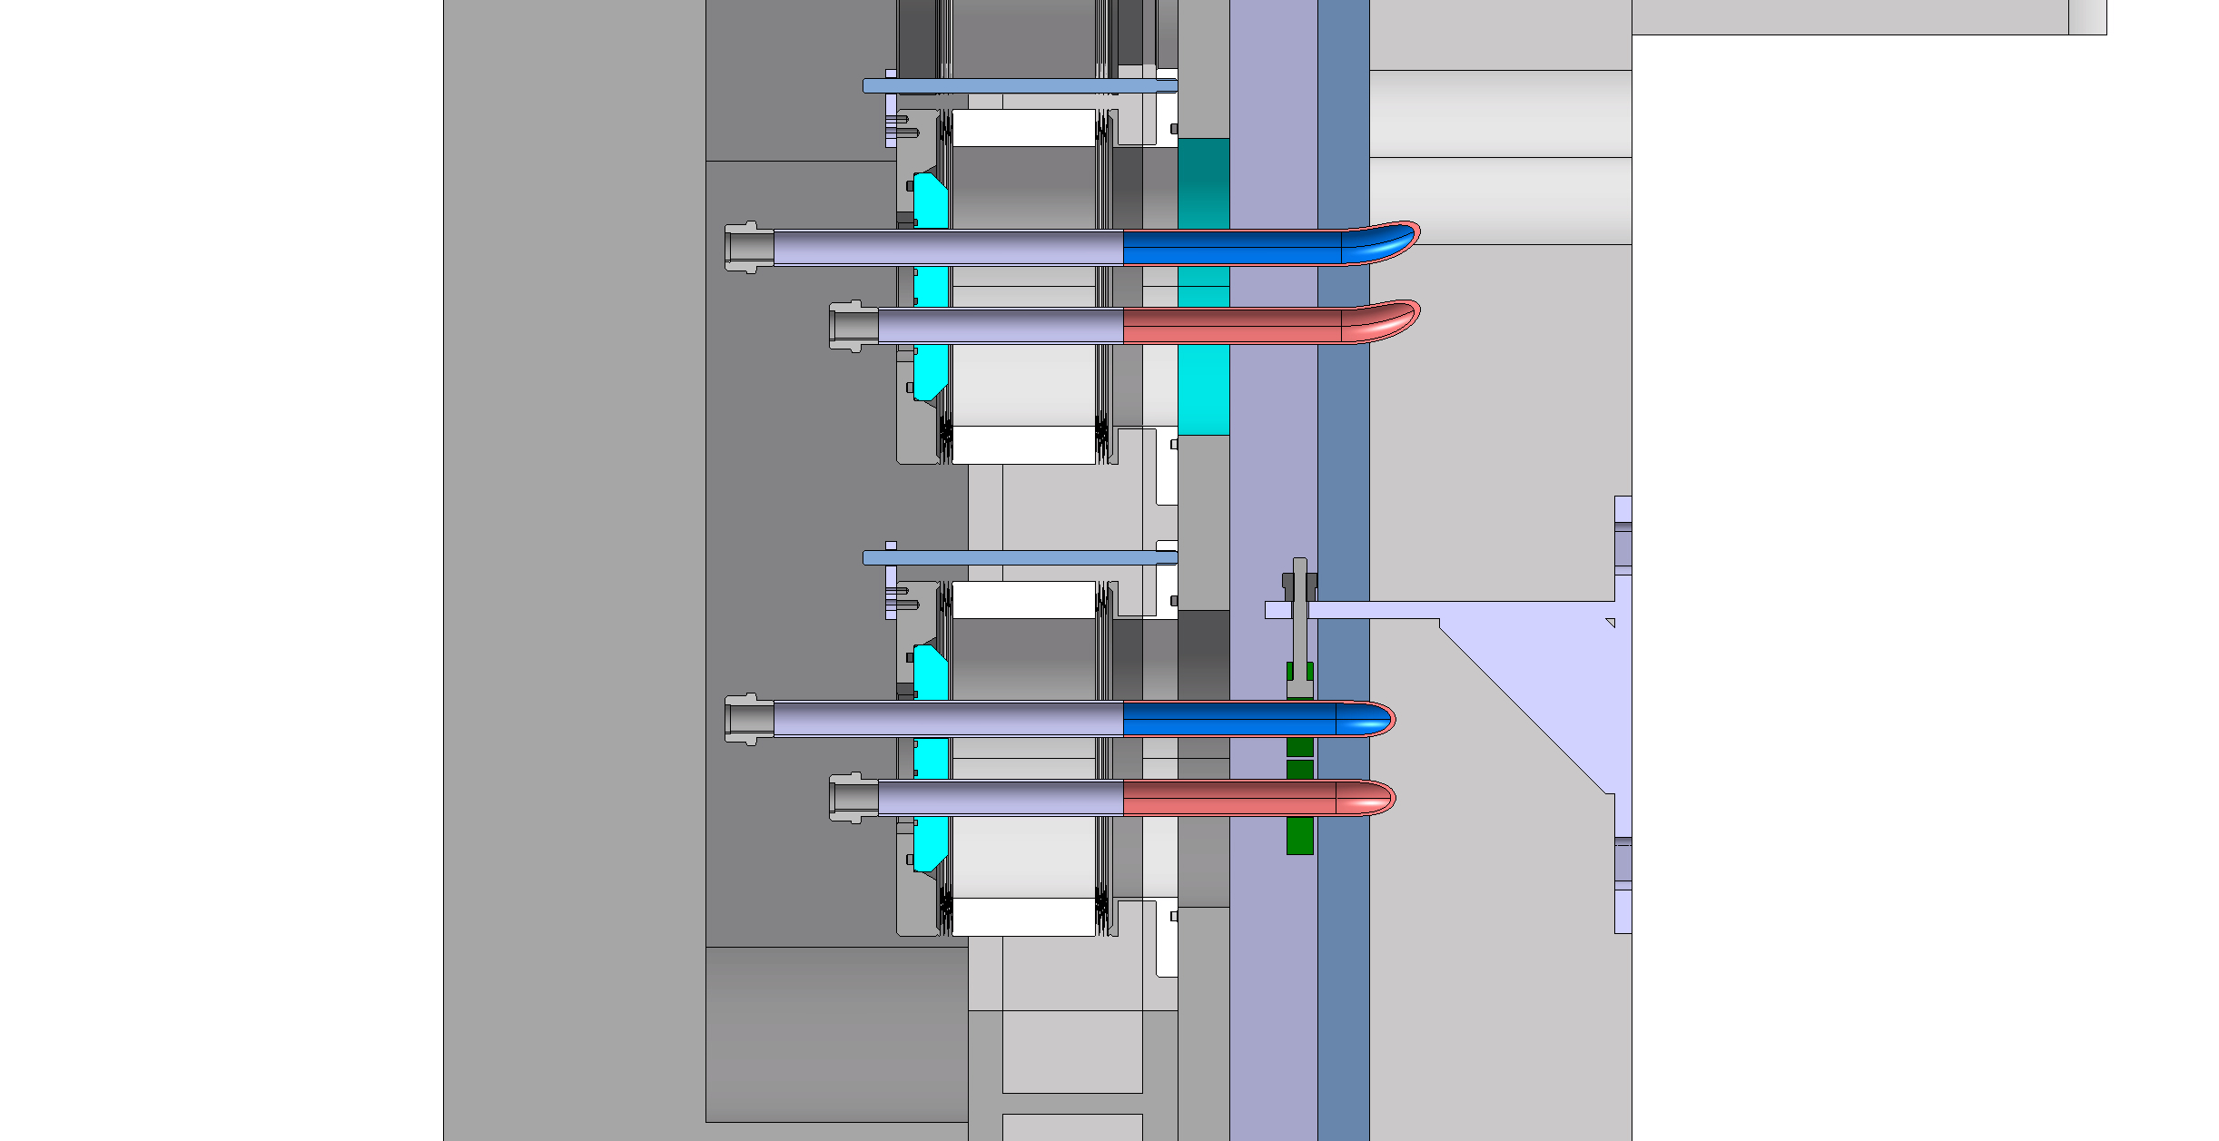
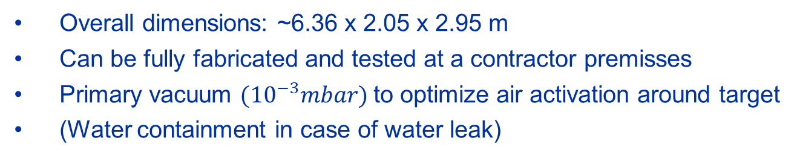
Target station vacuum confinement
Utilities feedthroughs
Mechanical design ready to build a prototype
Design of radiation tolerant gaskets
Decommissioning plan
Overall dimensions: ~6.36 x 2.05 x 2.95 m
Can be fully fabricated and tested at a contractor premisses
Primary vacuum ${(10}^{−3}mbar)$to optimize air activation around target
(Water containment in case of water leak)

Slide 10
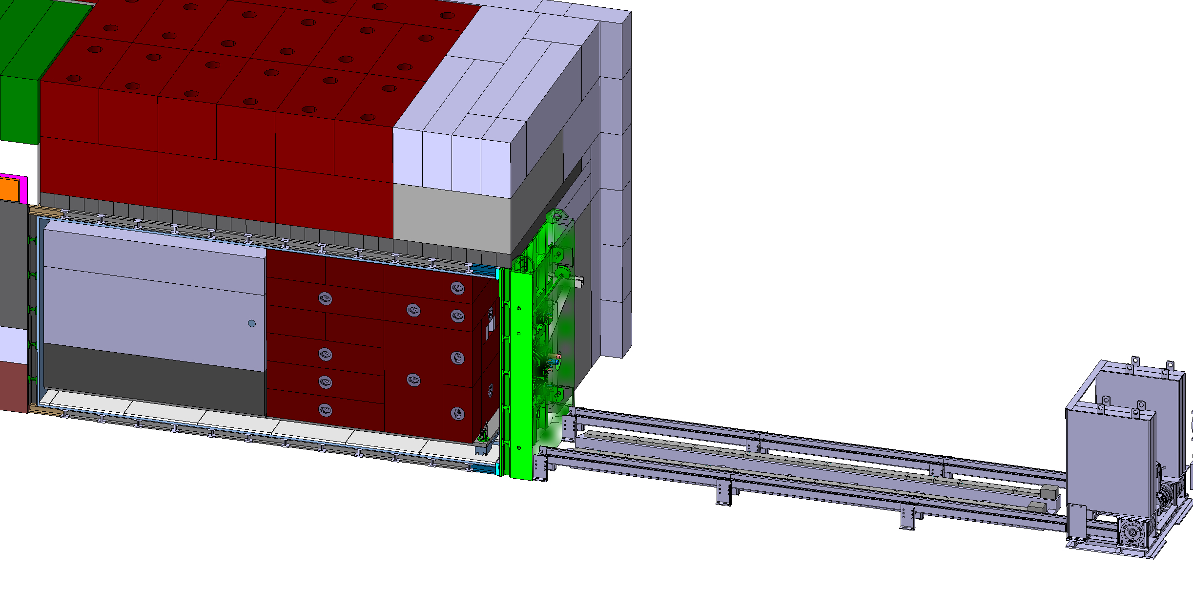
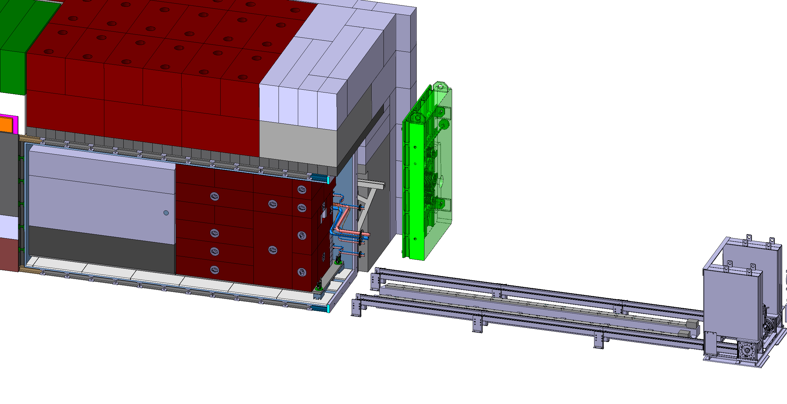
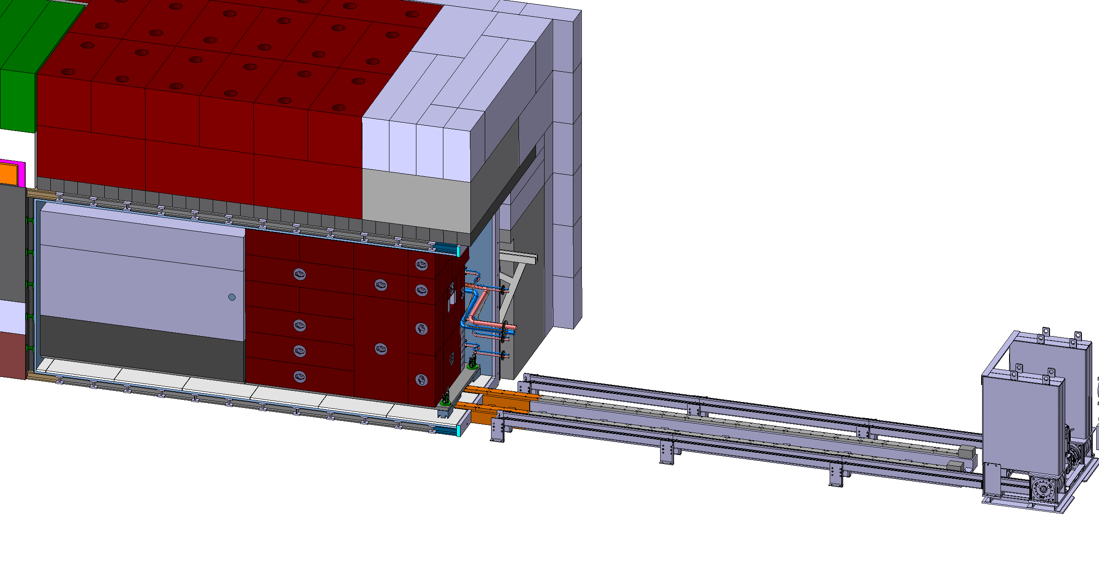
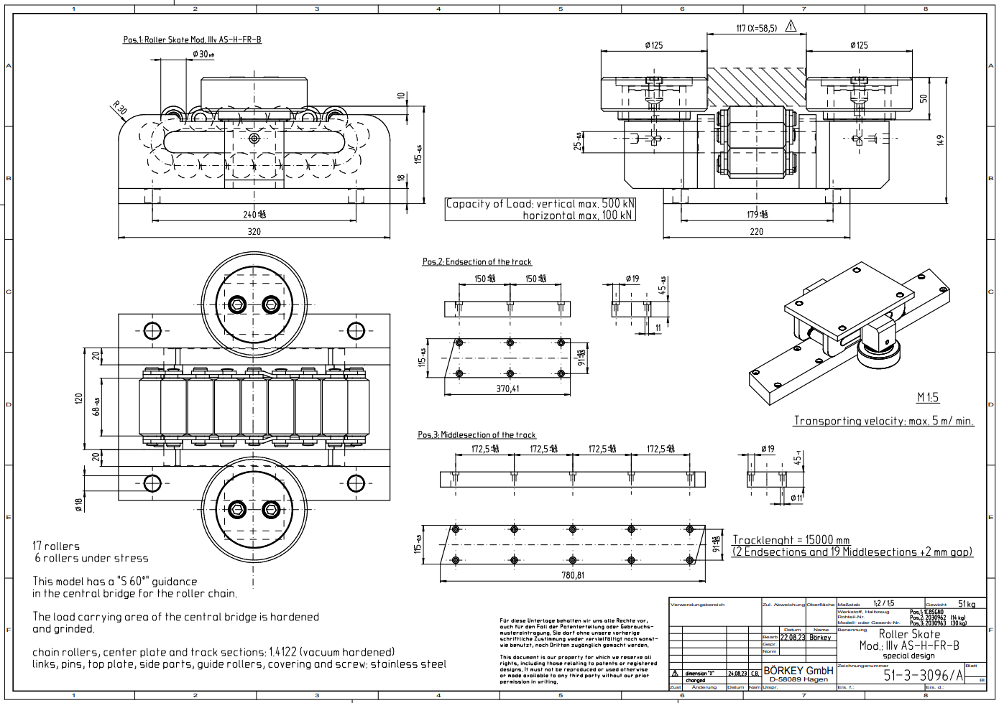

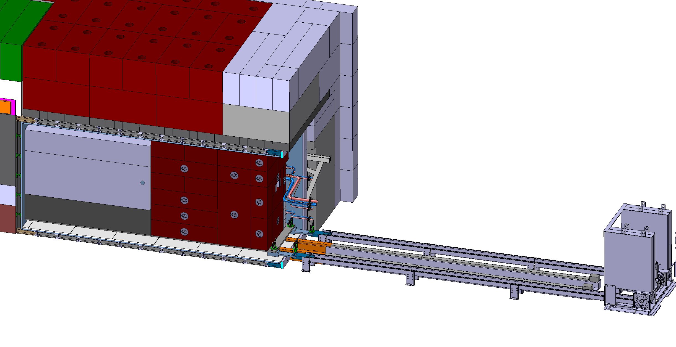
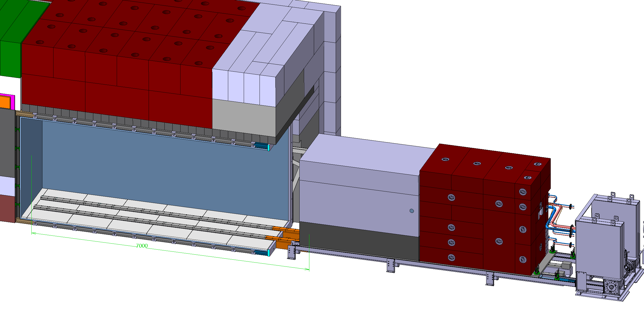
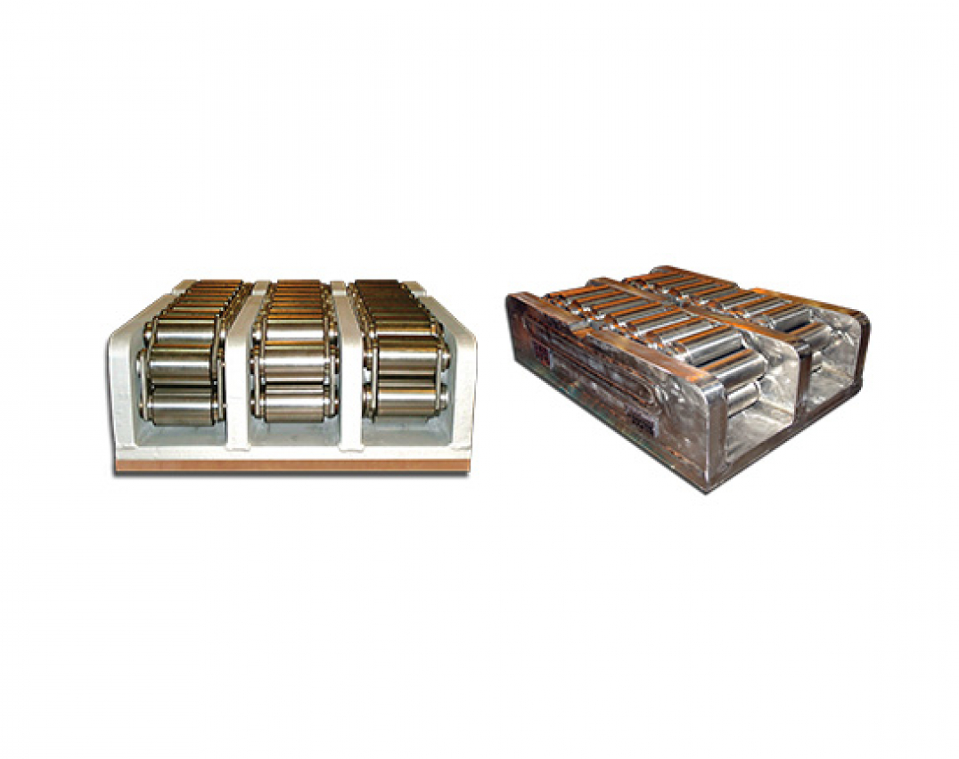
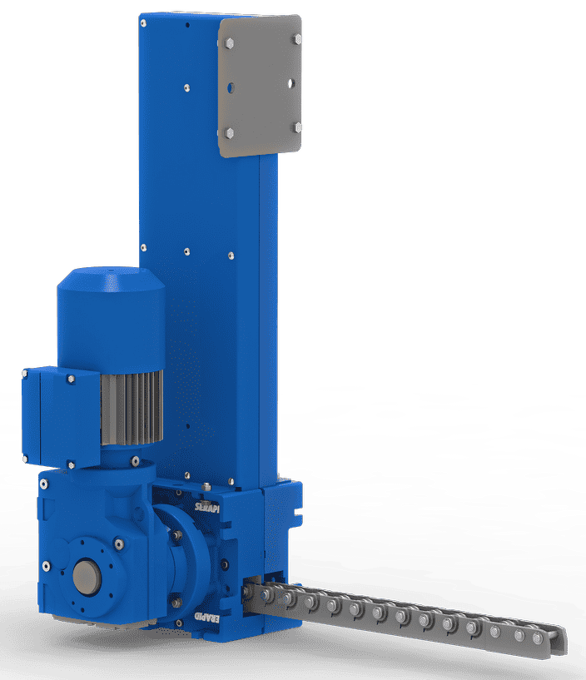
BDF Target complex integration extraction development
Trolley mounted on full stainless steel chain action rollers
Extraction / insertion mechanism based on a motorized rigid chain
Door tooling installation
Door removal
Mobile rails installation
Chains connectors orientation
Chains connectors connection
Trolley extraction

Slide 11
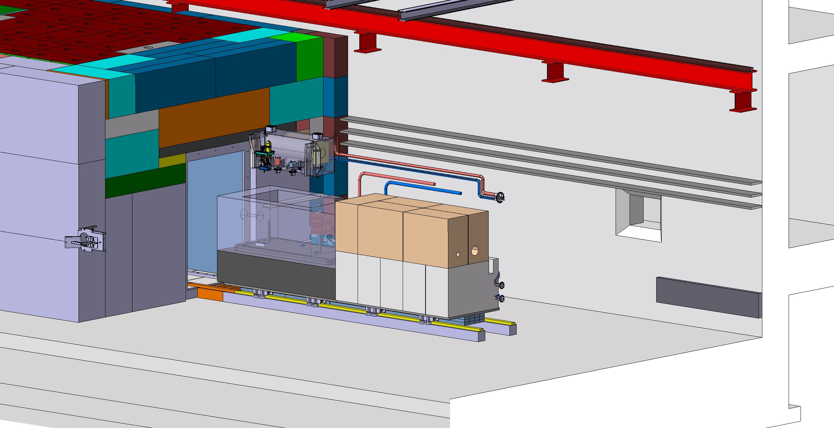
Target handling
Target utilities removed to fit cask

Slide 12
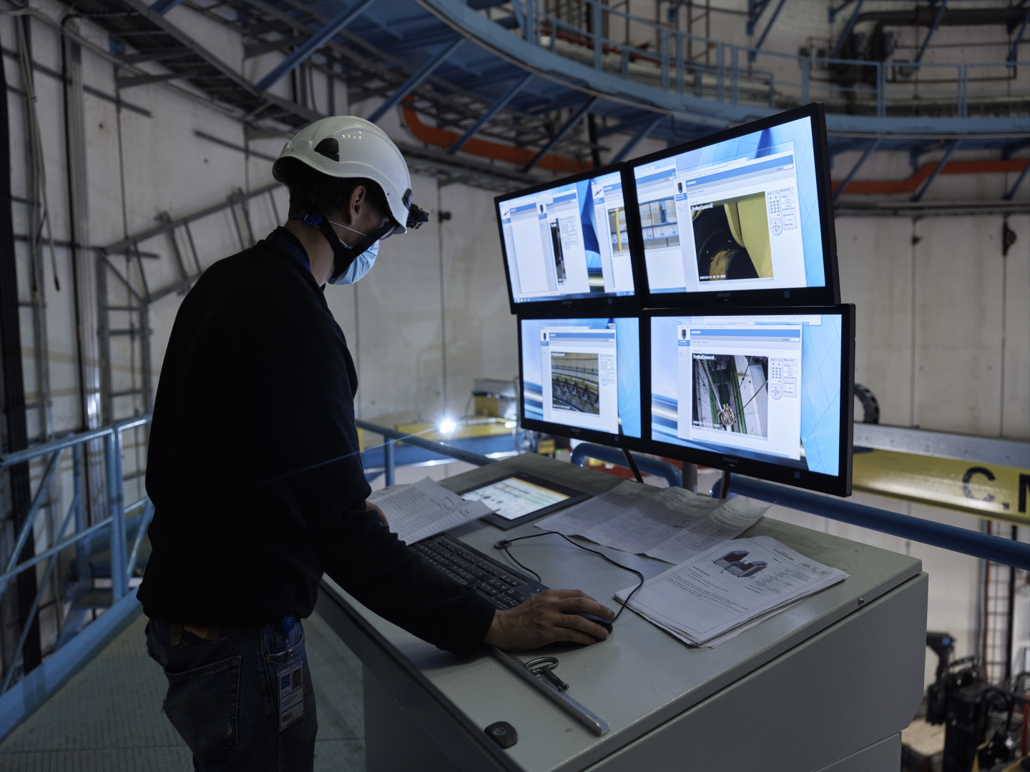
Target Complex handling
Existing overhead travelling crane 30t capacity replaced
  Redundancy on the 3 movements of the crane
  Integration of a video system
  Integration of a positioning system for the 3 movements
  Off-board control cubicles
  Cable festoon routing
  Remote tools connection on the hook
  Auxiliary hoist
  Investigation on possibility to optimize crane size
  Ongoing specification

Slide 13
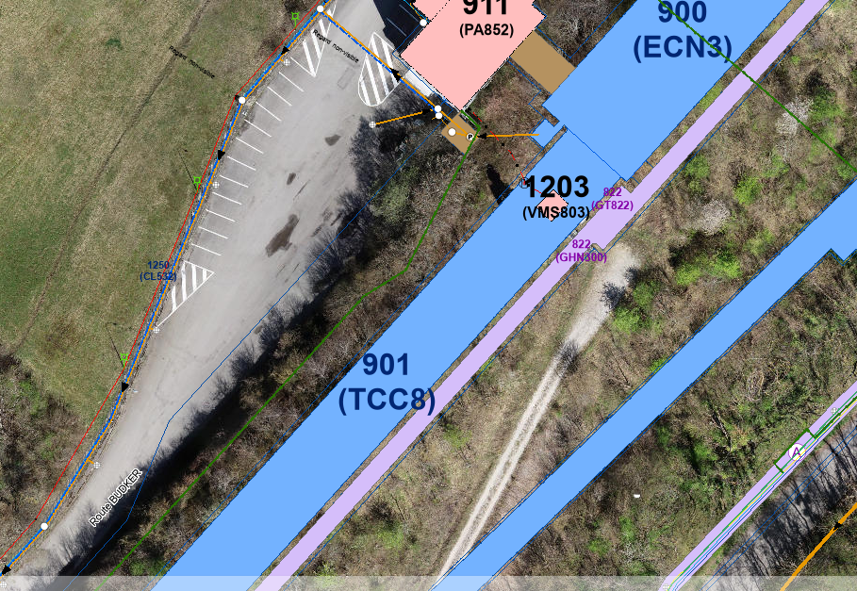
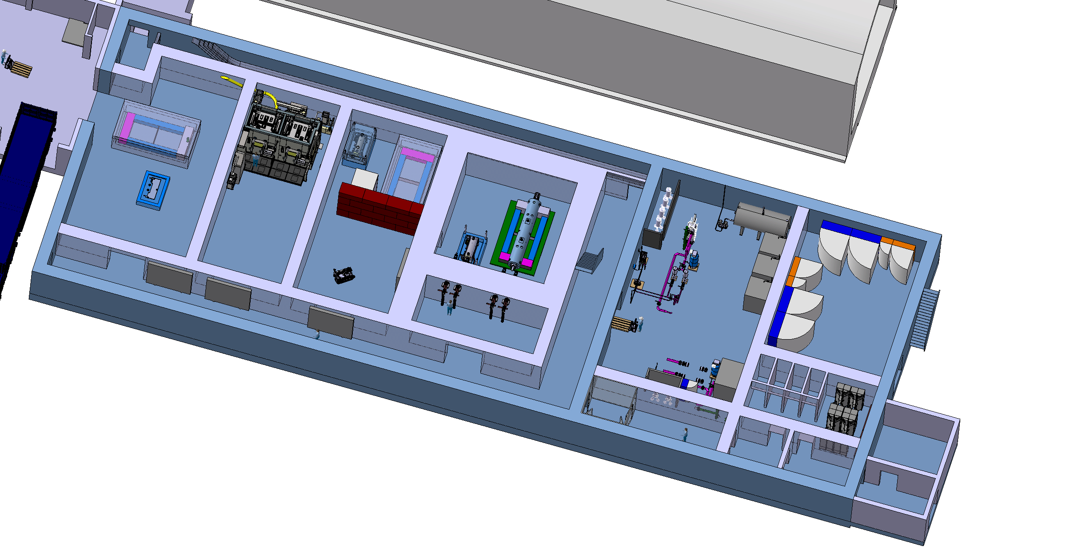
The target service building
Nuclear ventilation system of the target complex
  Air handling units, filters, dehumidifiers (outside)
Target cooling systems
  Pumps, Filters, Heat exchanger, Cooling instrumentation, He circulation system
  Target controls systems
  Target monitoring (sensors), Target control valves, vacuum vessel confinement
  Service cell / hot cell
  Buffer area
Safety systems
Electrical distribution system
Control and safety systems
(Evaporator)
~1000m²

Slide 14
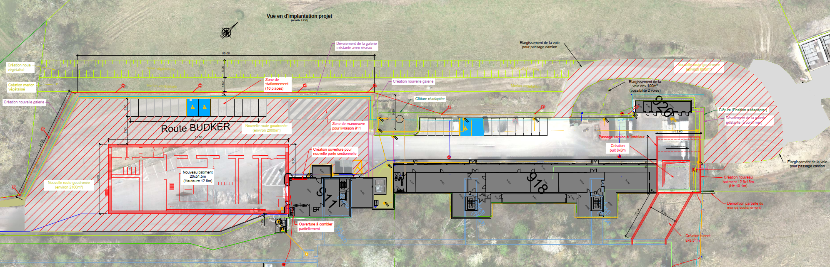
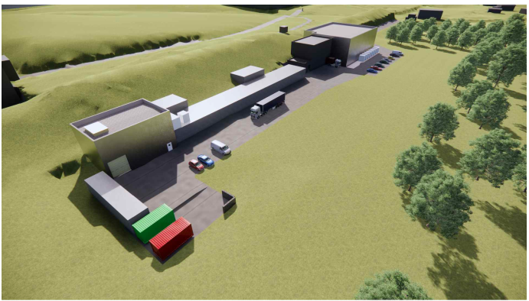
Service building within the BDF/SHiP complex

Slide 15
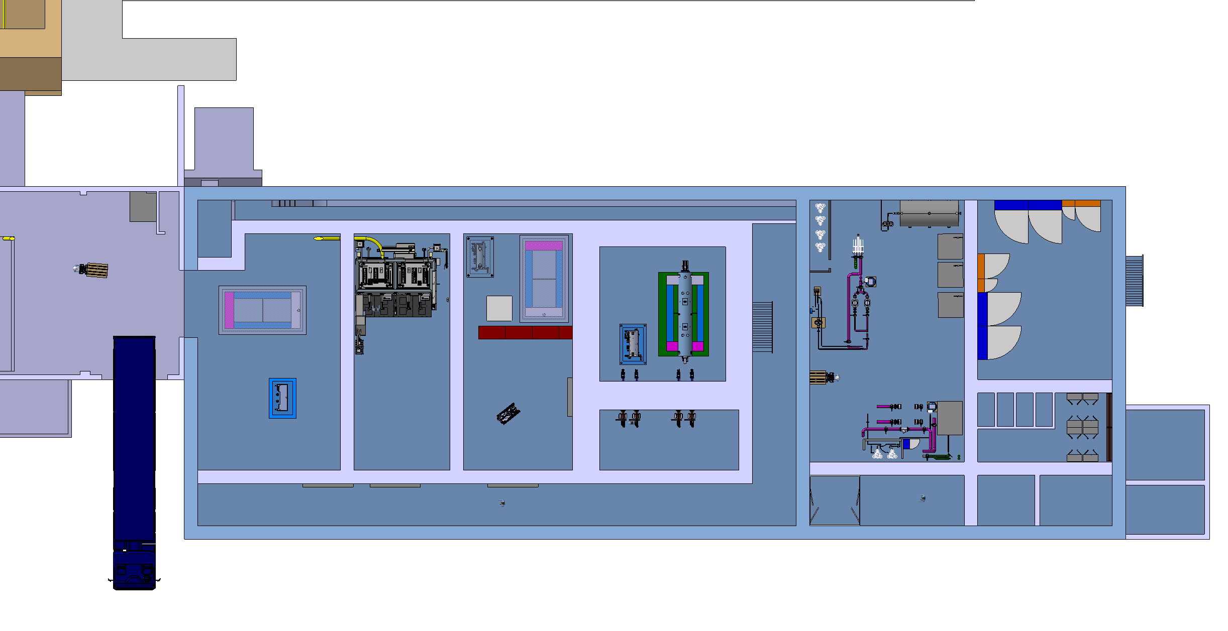
Service building – ground floor
Cooling equipment
Power room
Material access
Access shaft
Lorry access
Personnel access
Shielded buffer zone
HotCell
Service cell (~60m²)
with a movable roof

Slide 16
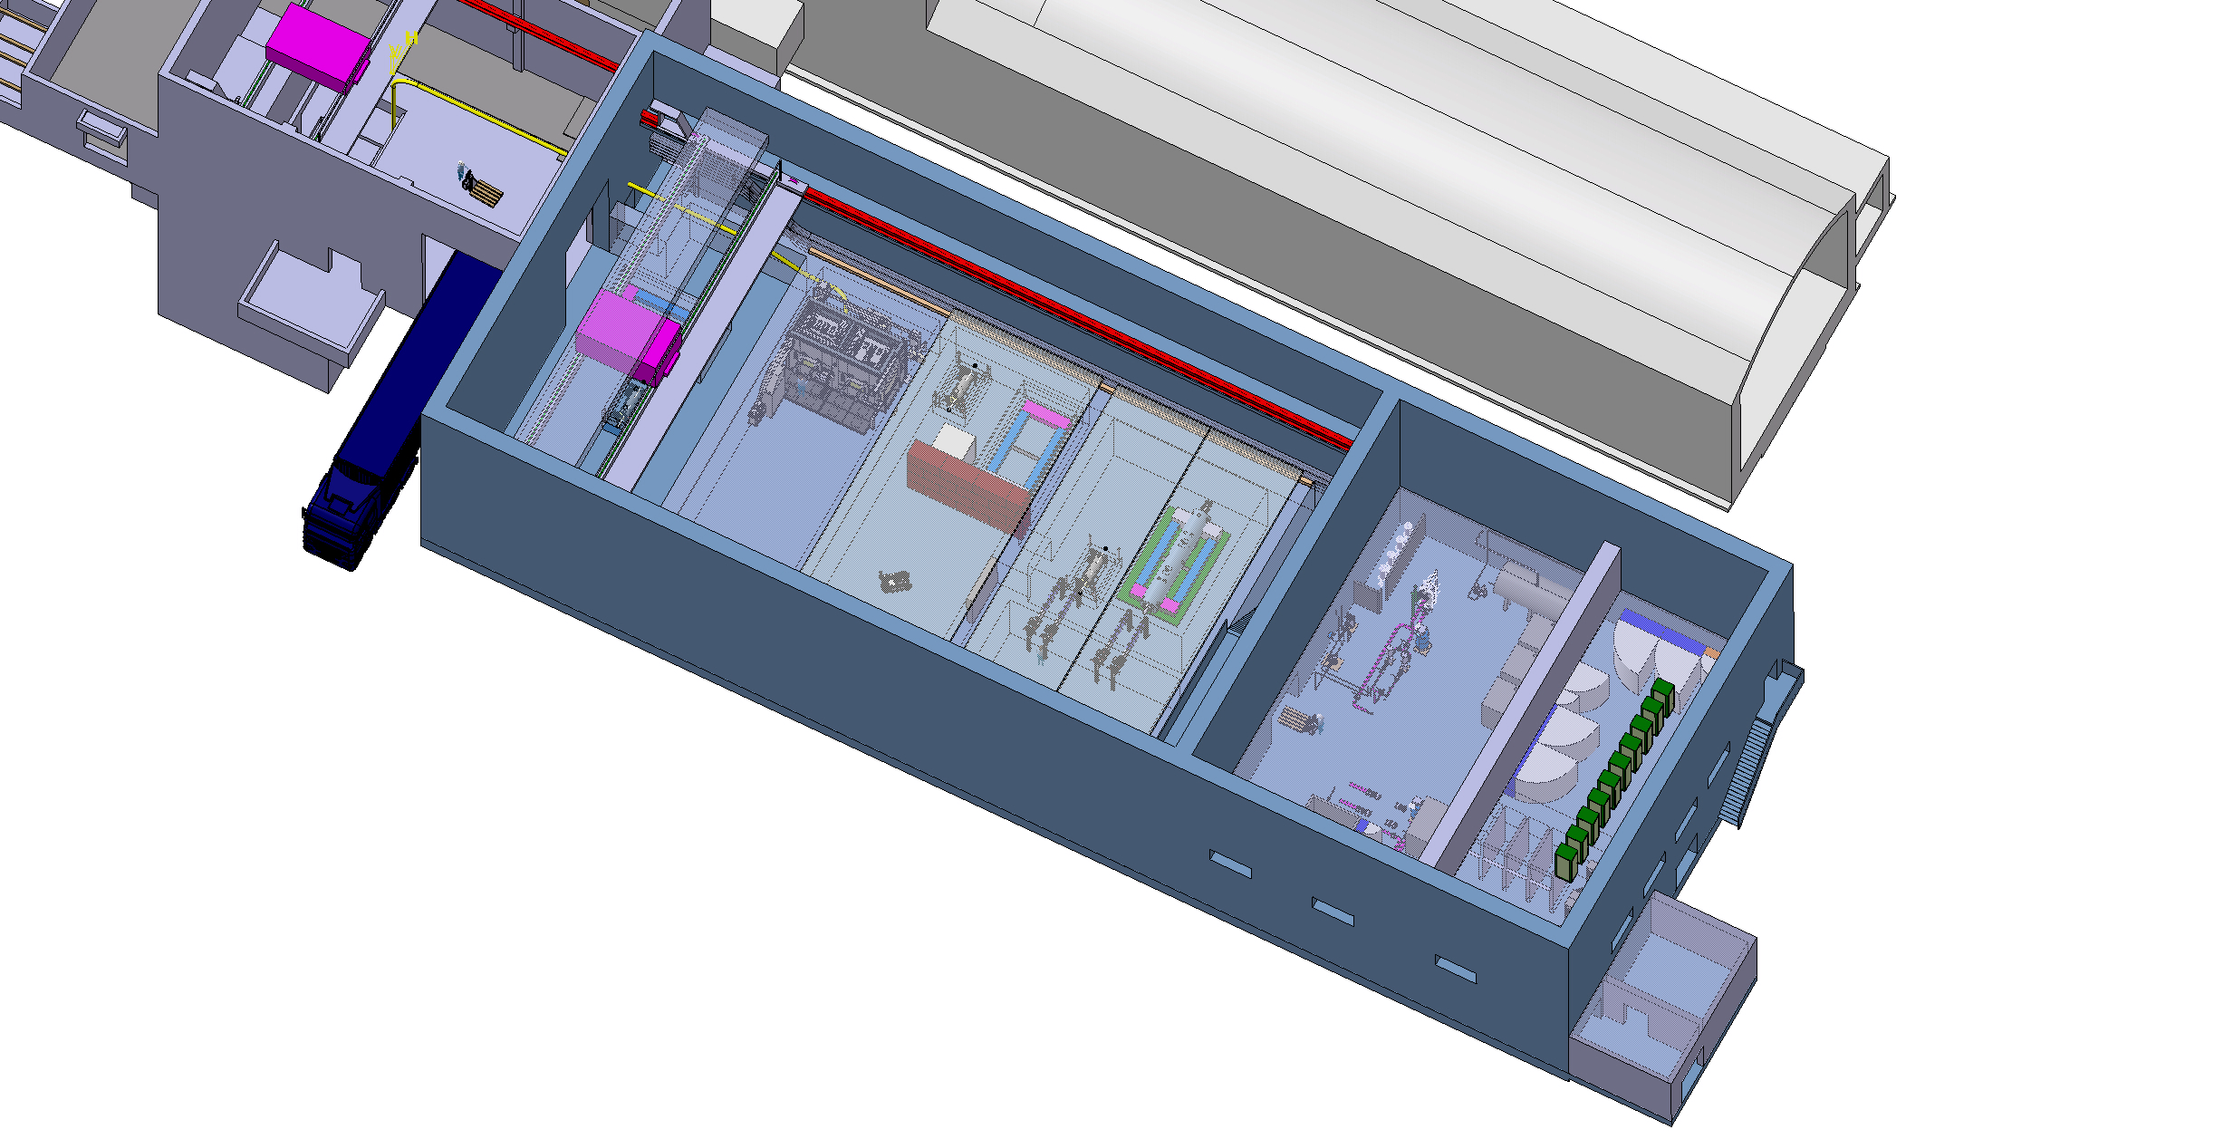
Service building – 1rst level
30t overhead traveling crane
Control racks
Mobile shielded hatches
Definition of the envelops by end of 2024
Filter room

Slide 17
HI-ECN3 service cell - context
HI-ECN3 project need to have a facility to prepare objects for final disposal
  BDF target
  Proximity shielding
  Hadron stopper coil
  Why do we need a specific facility to prepare HI-ECN3 object for final disposal (waste packaging)?
  Level of radiation (~few Sv/h after 1year of cool down)
  Characteristics of materials (W)
  Presence of radiological critical spallation products
  Size and weight of the objects doesn’t fulfil elimination path requirement towards PSI (container size limitation)
  Understanding of failure modes to improve future designs
  Lessons learnt from waste packaging of highly radioactive objects (ISOLDE target, LHC TDE, n_TOF spallation targets)
  Currently such facility does not exist at CERN
Main justification

Slide 18
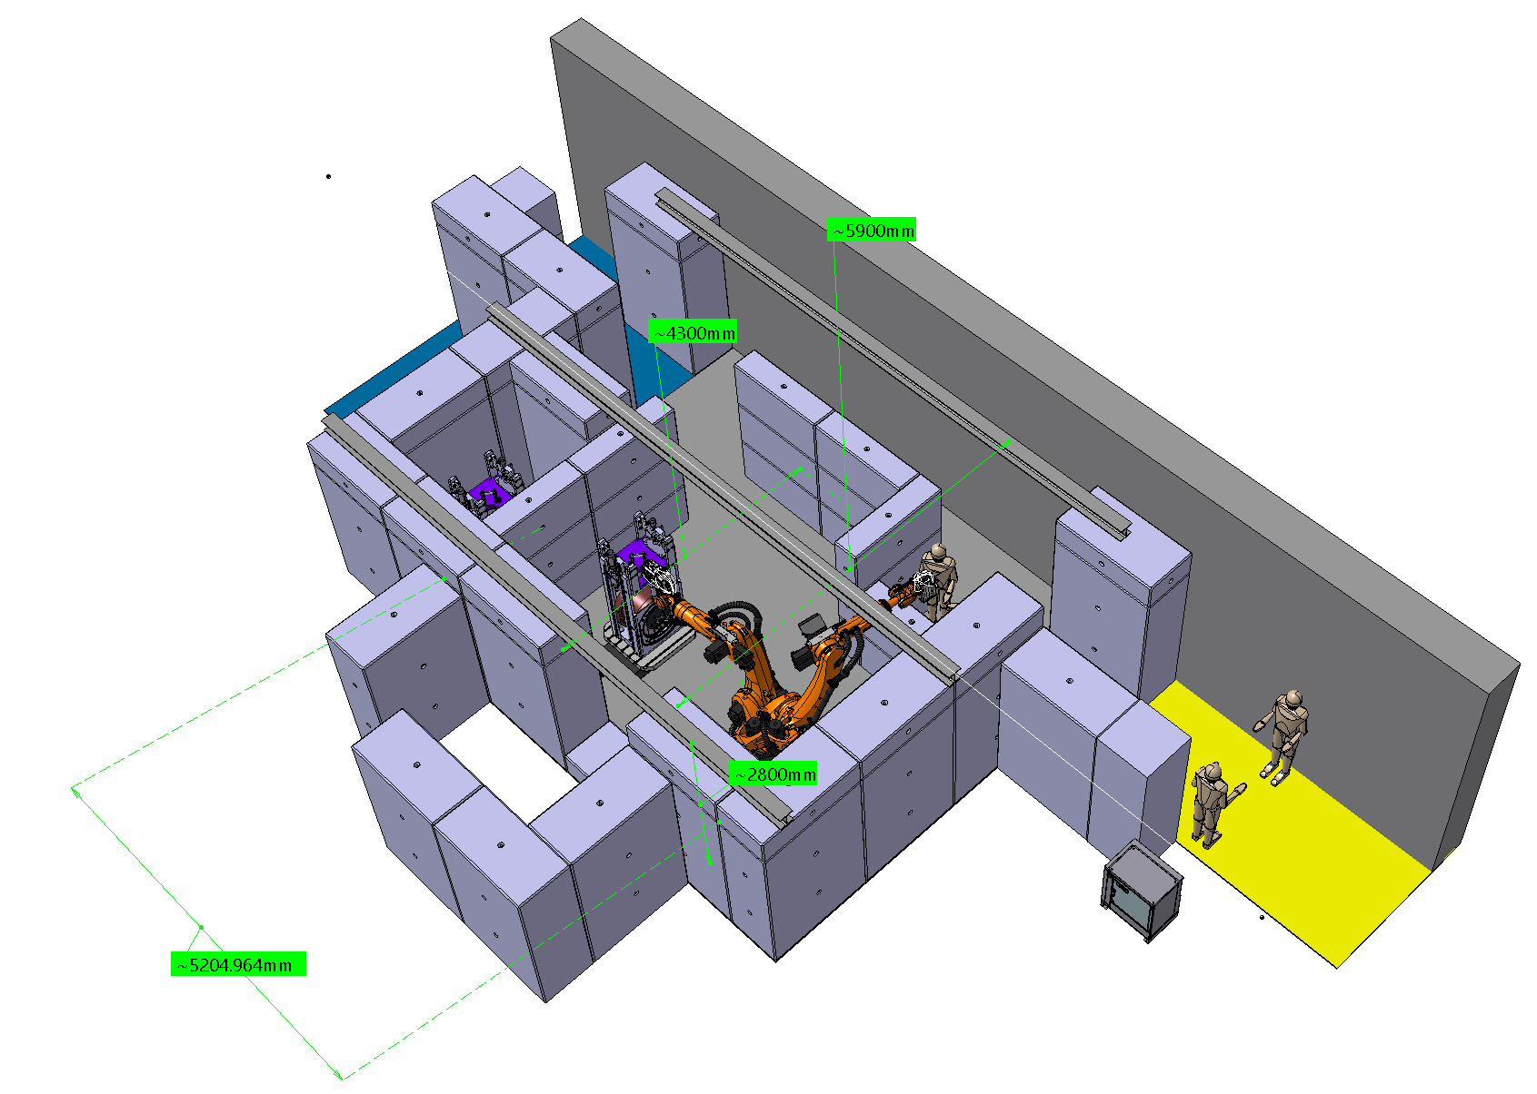
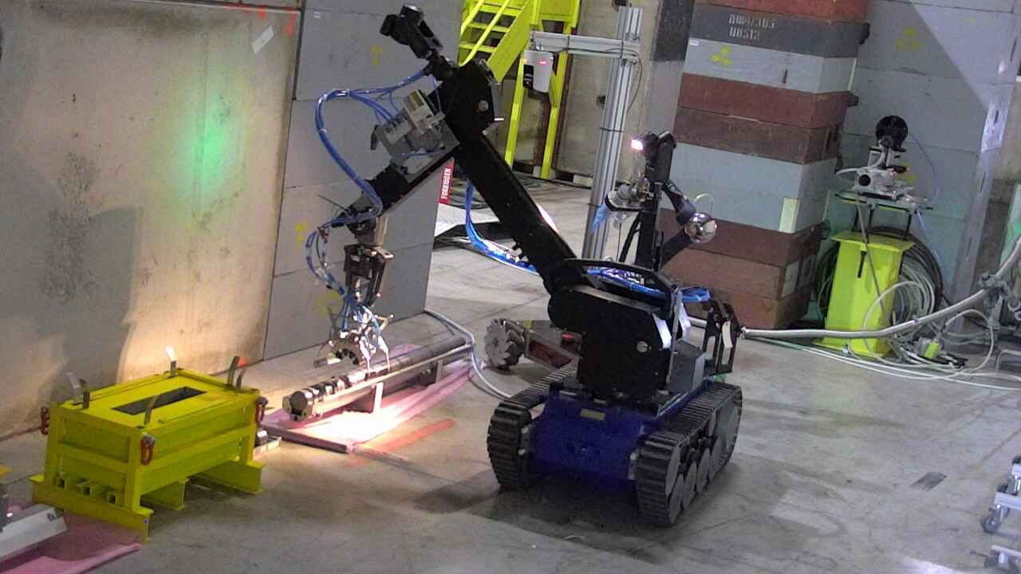
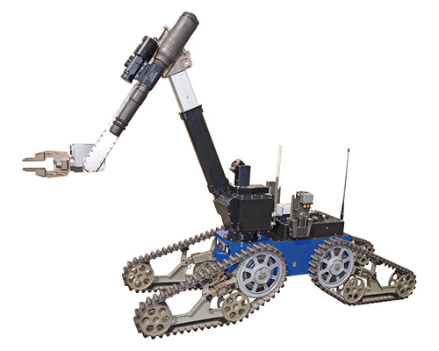
Service building – Service cell
Example of a
possible service cell
internal arrangement
Purpose
  Repair of activated components
  Size reduction and material separation for final disposal to optimize cost using different elimination path
  Post Irradiation Examination
Tools envisaged
  Master-slave manipulators
  Robots (fixed and mobile)
  Custom built machinery

Slide 19
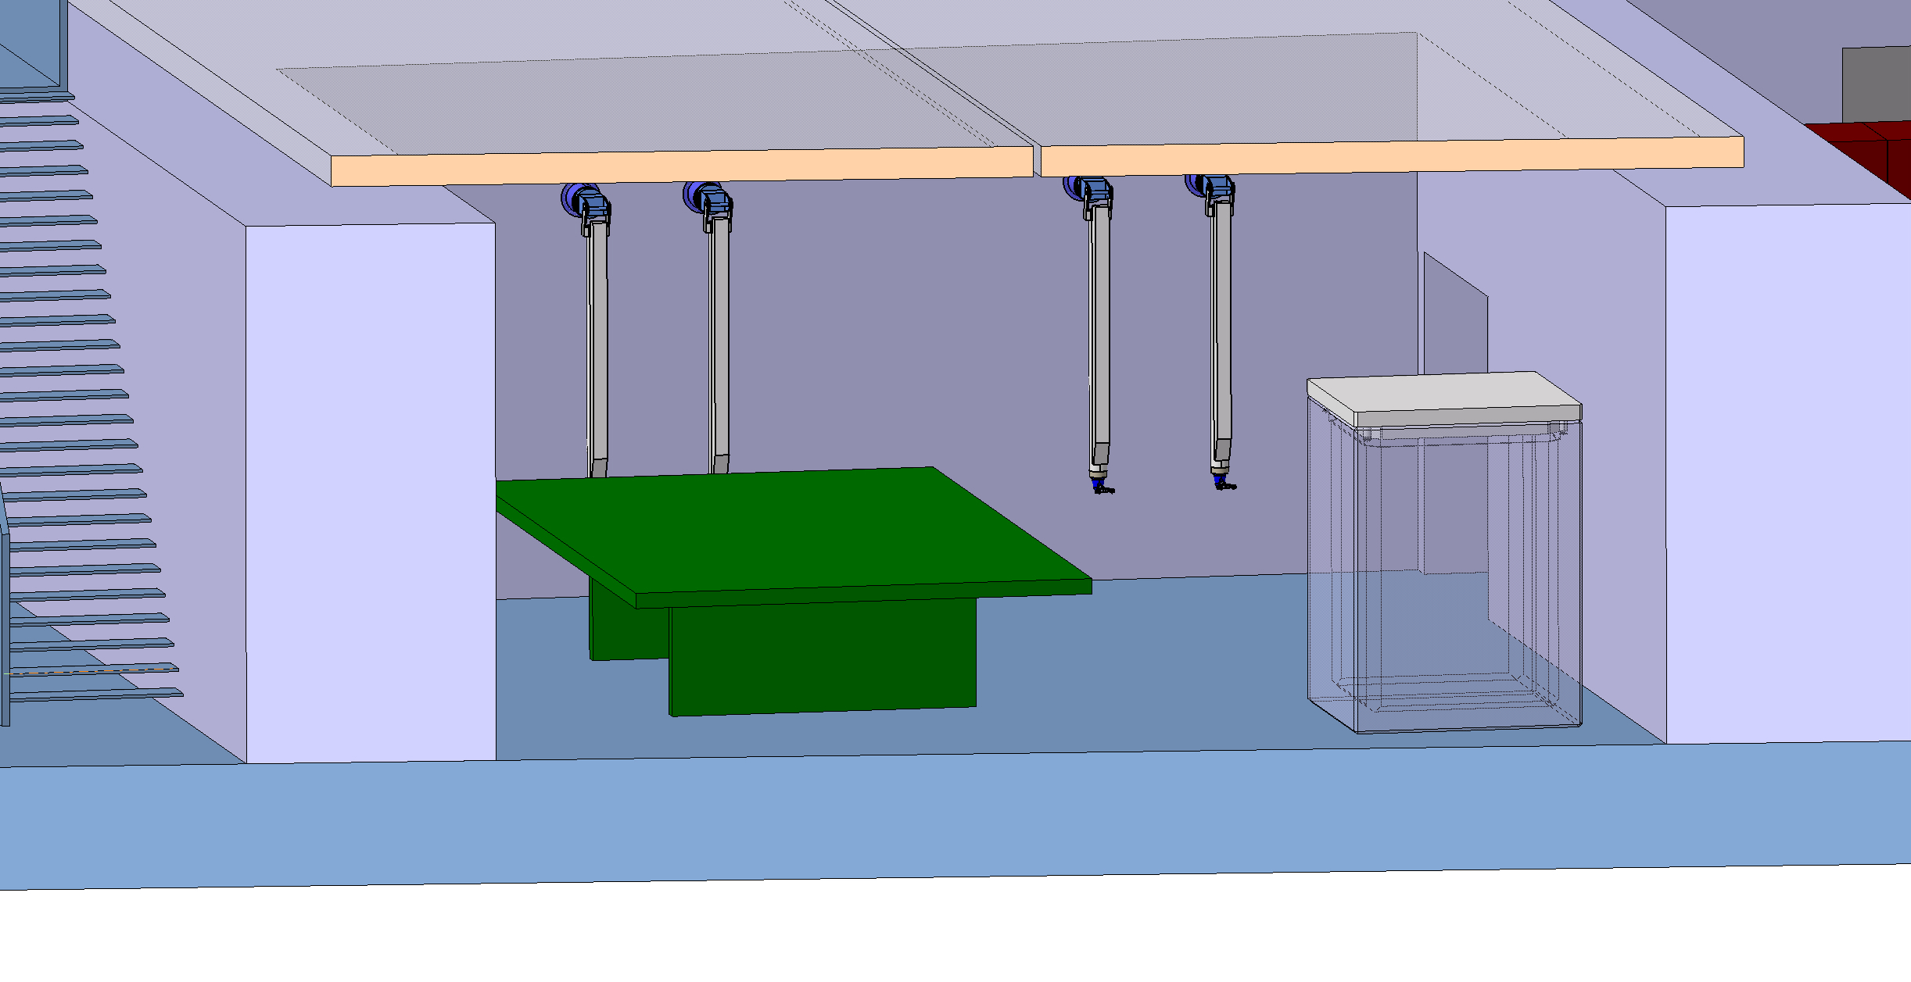
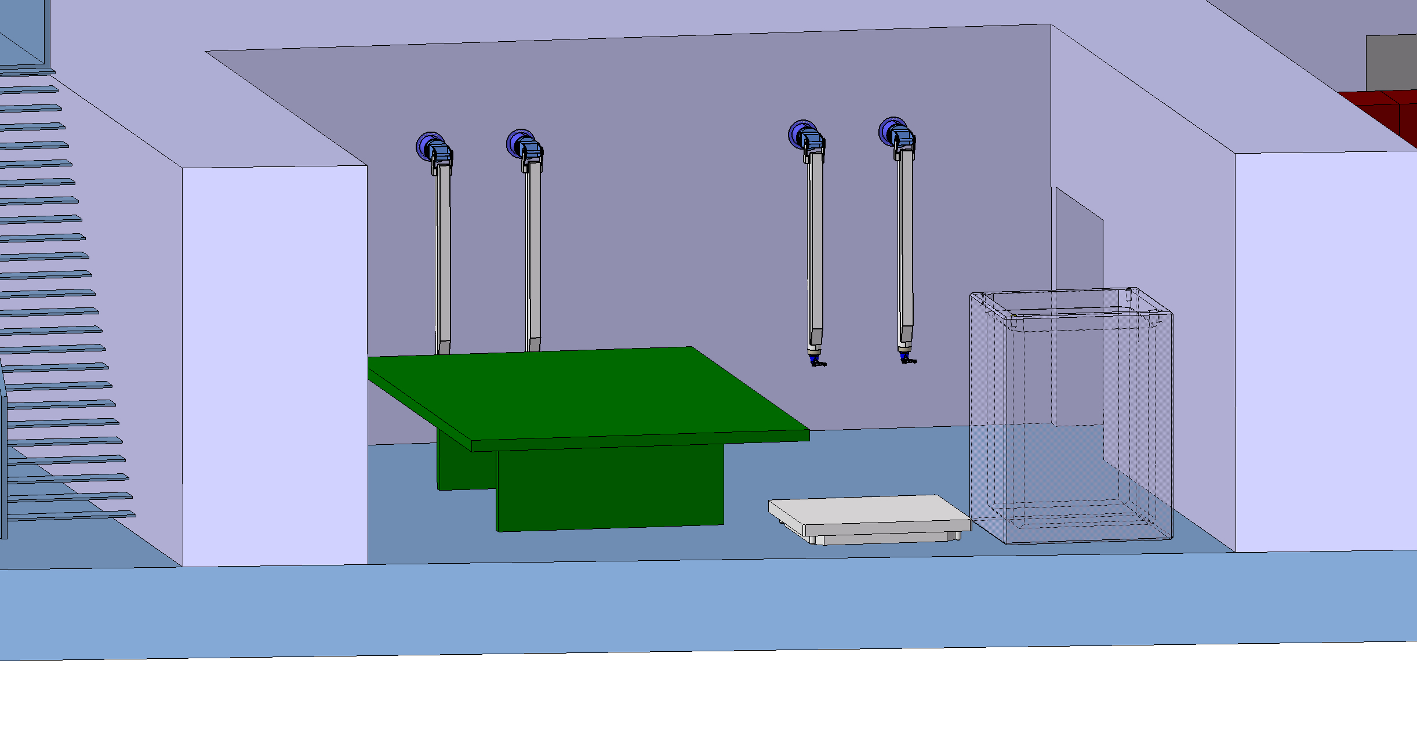
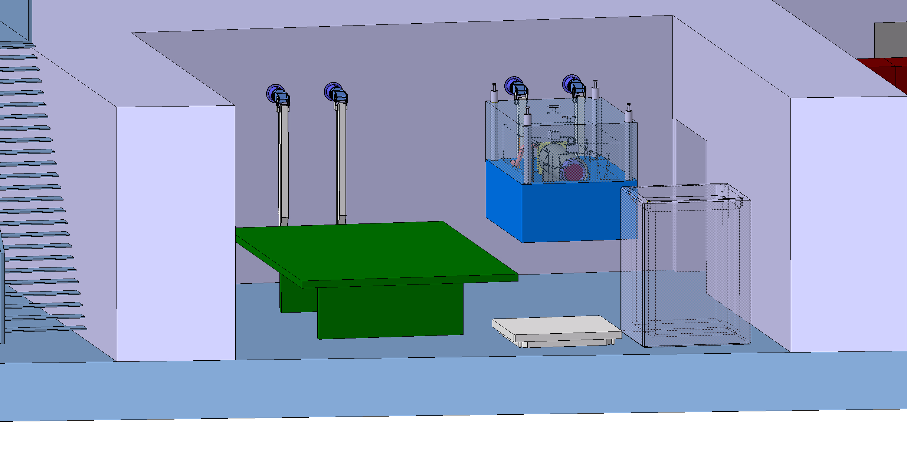
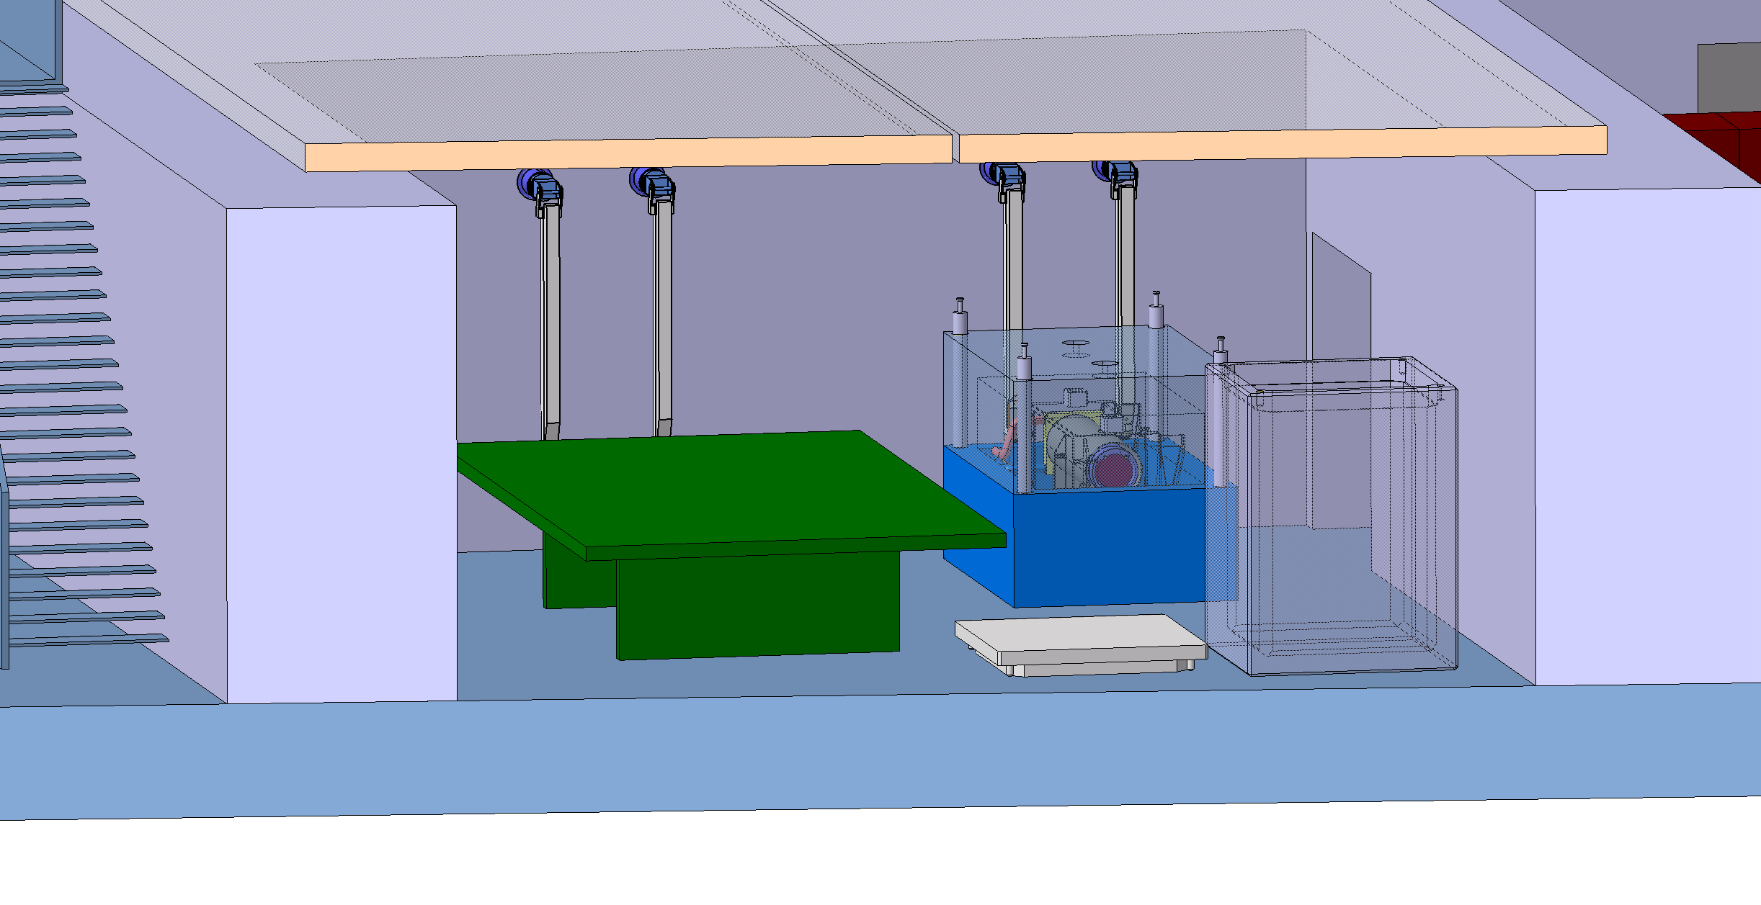
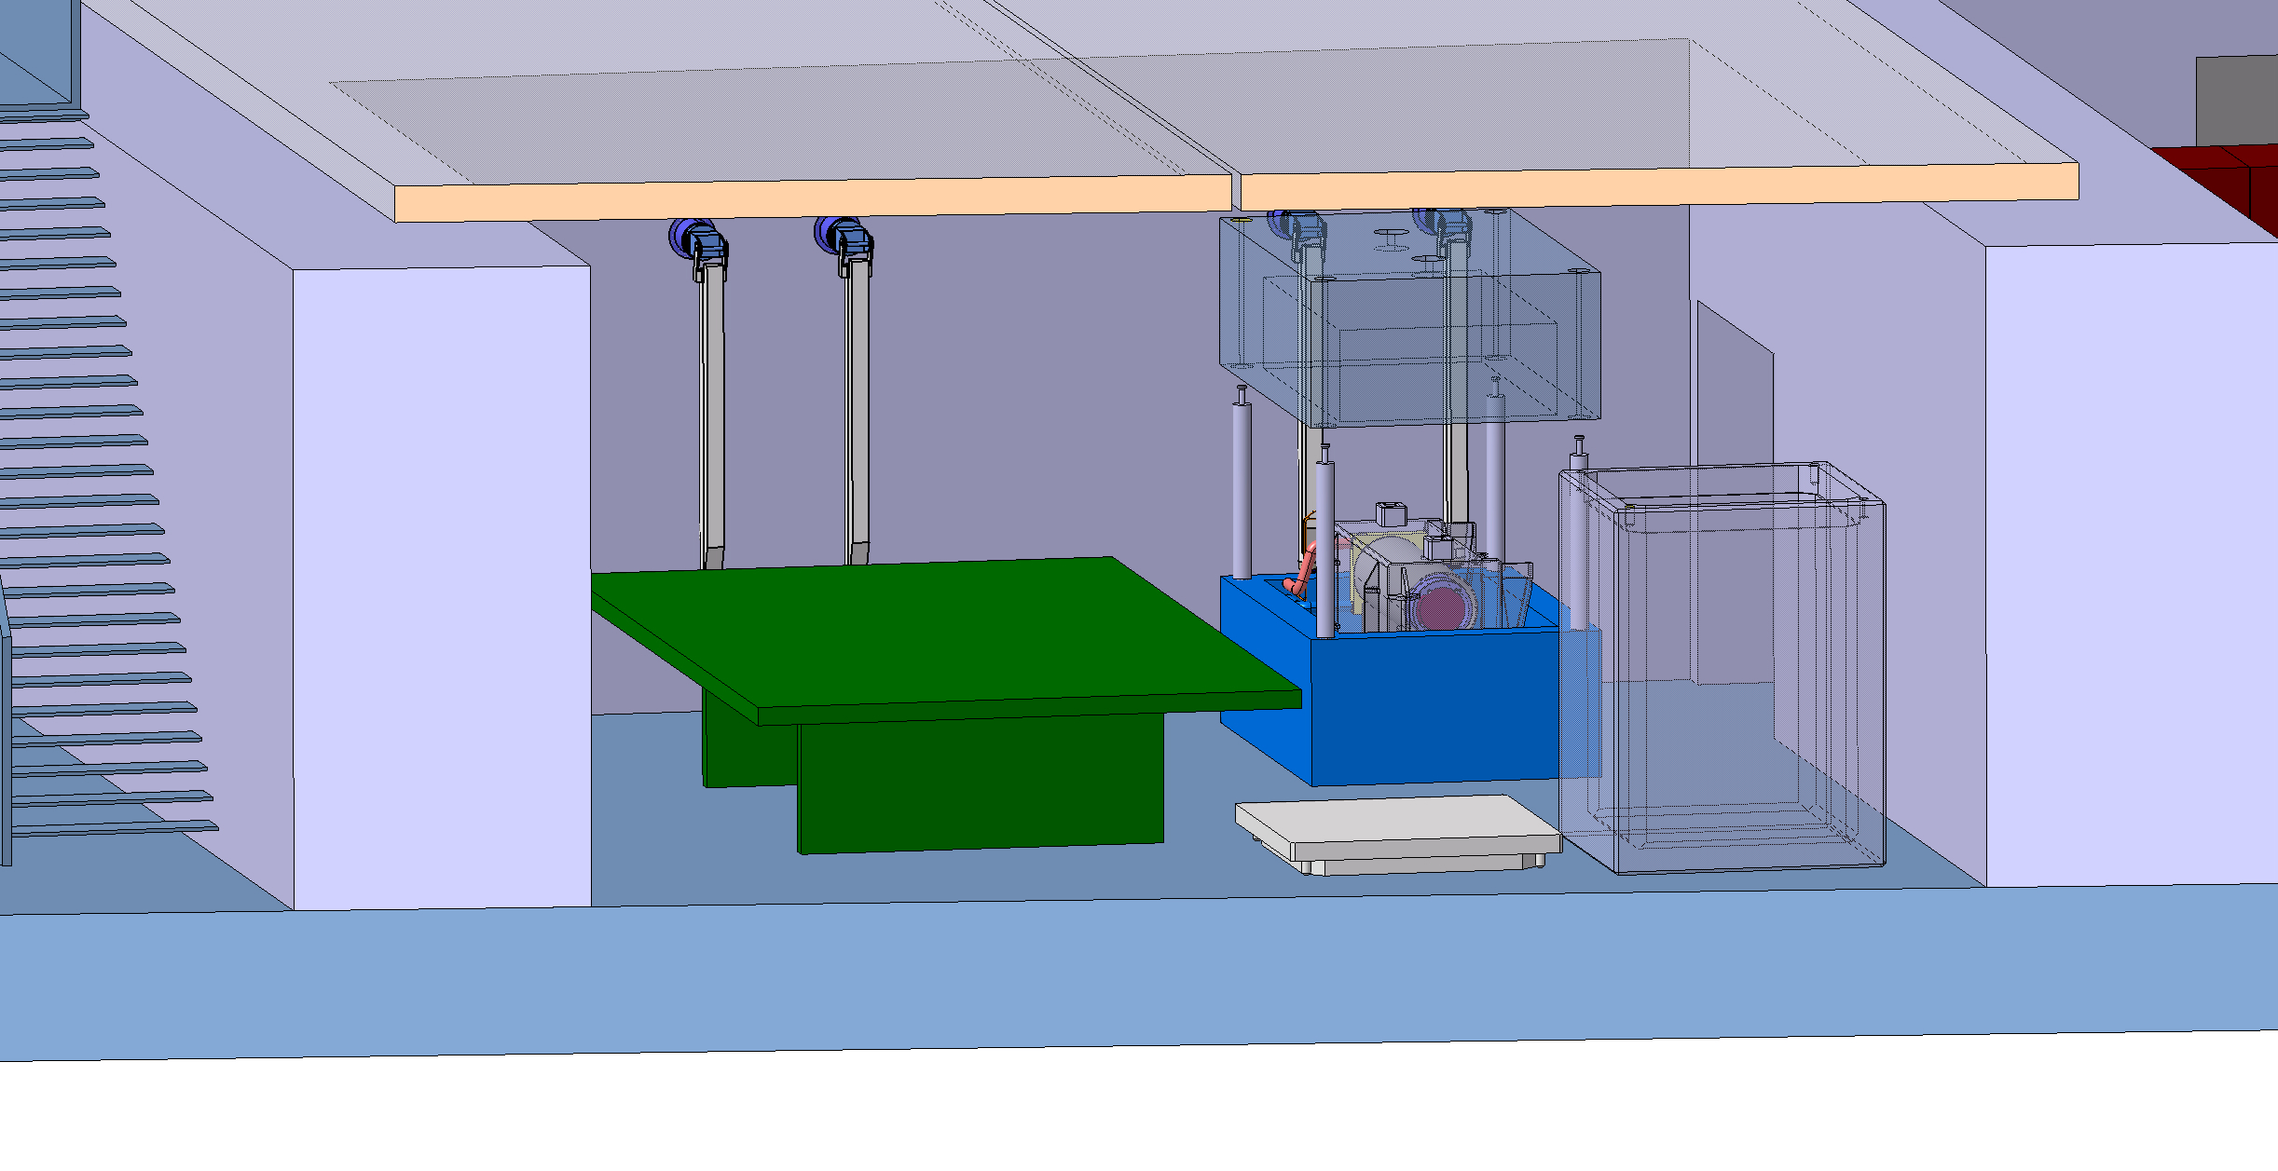
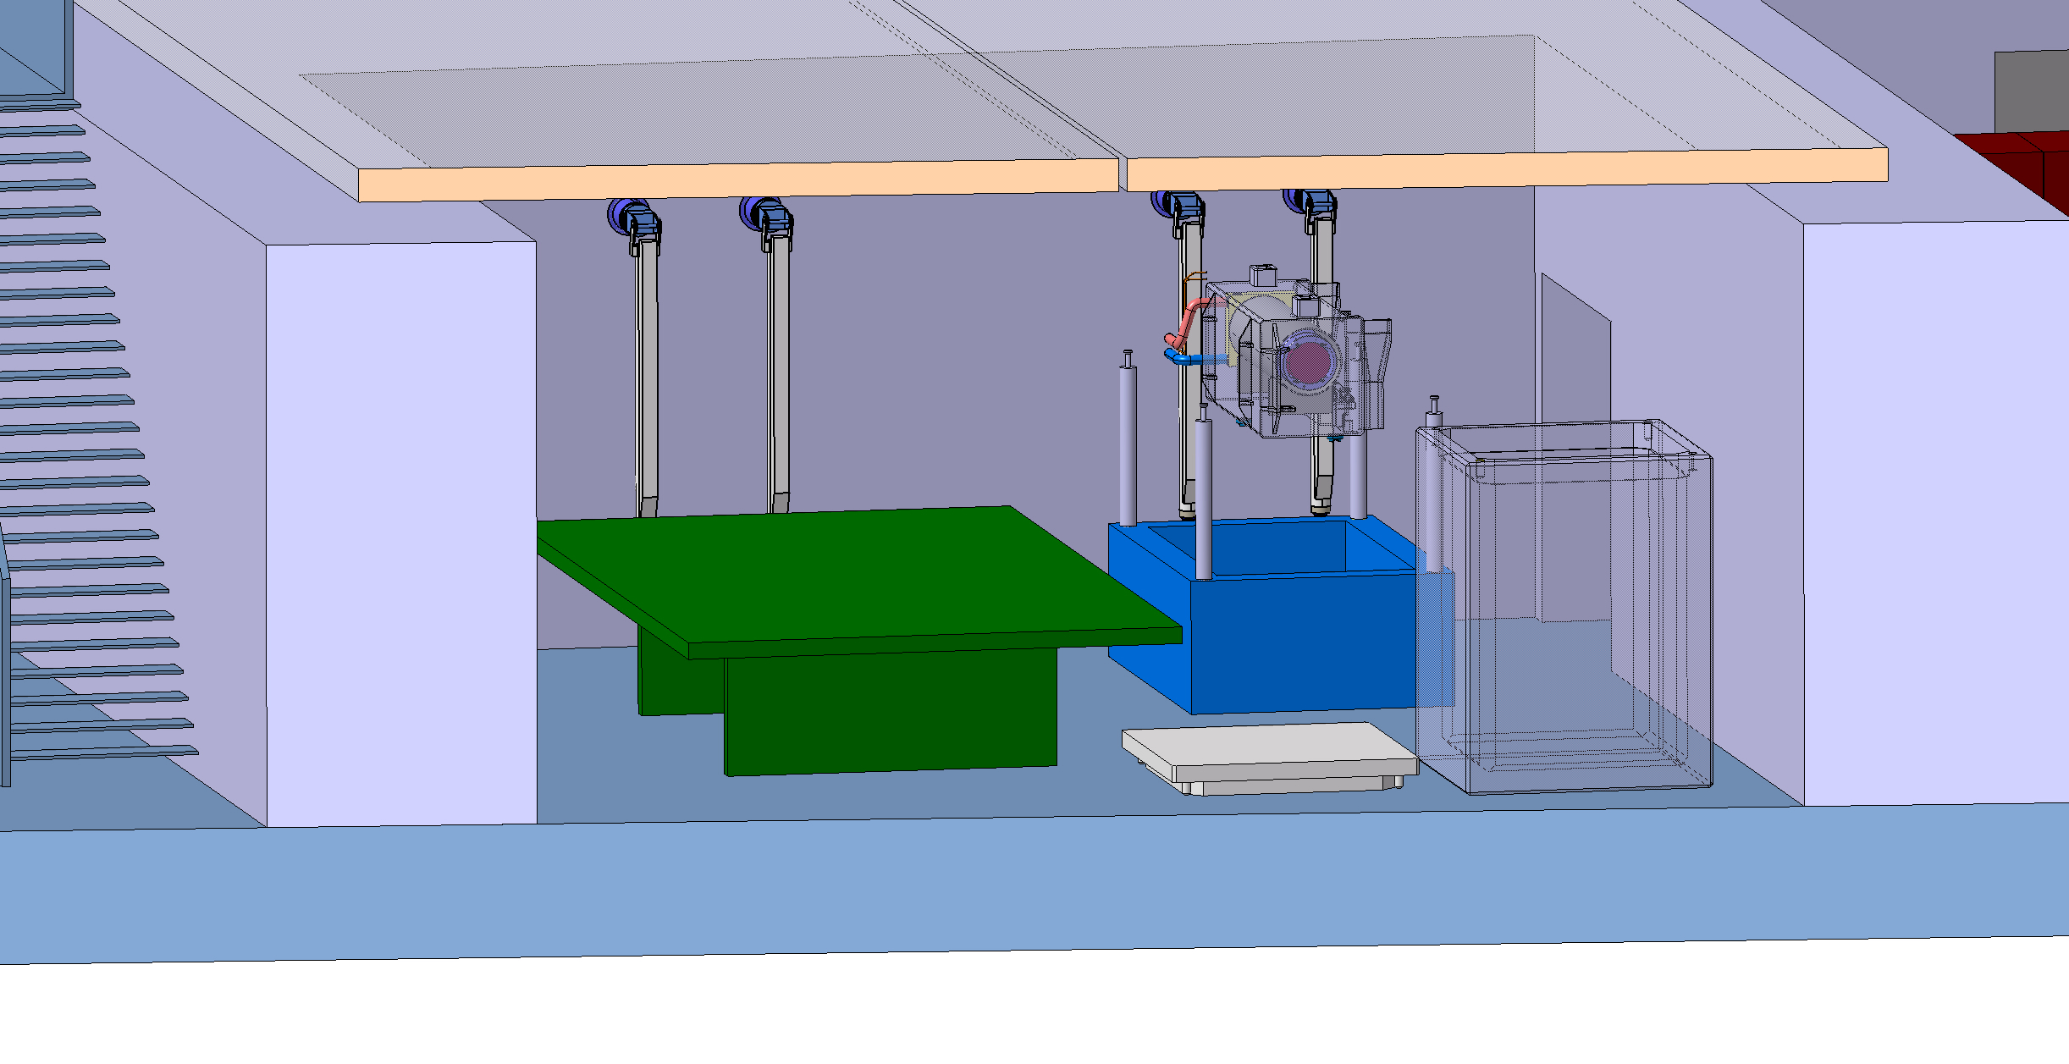
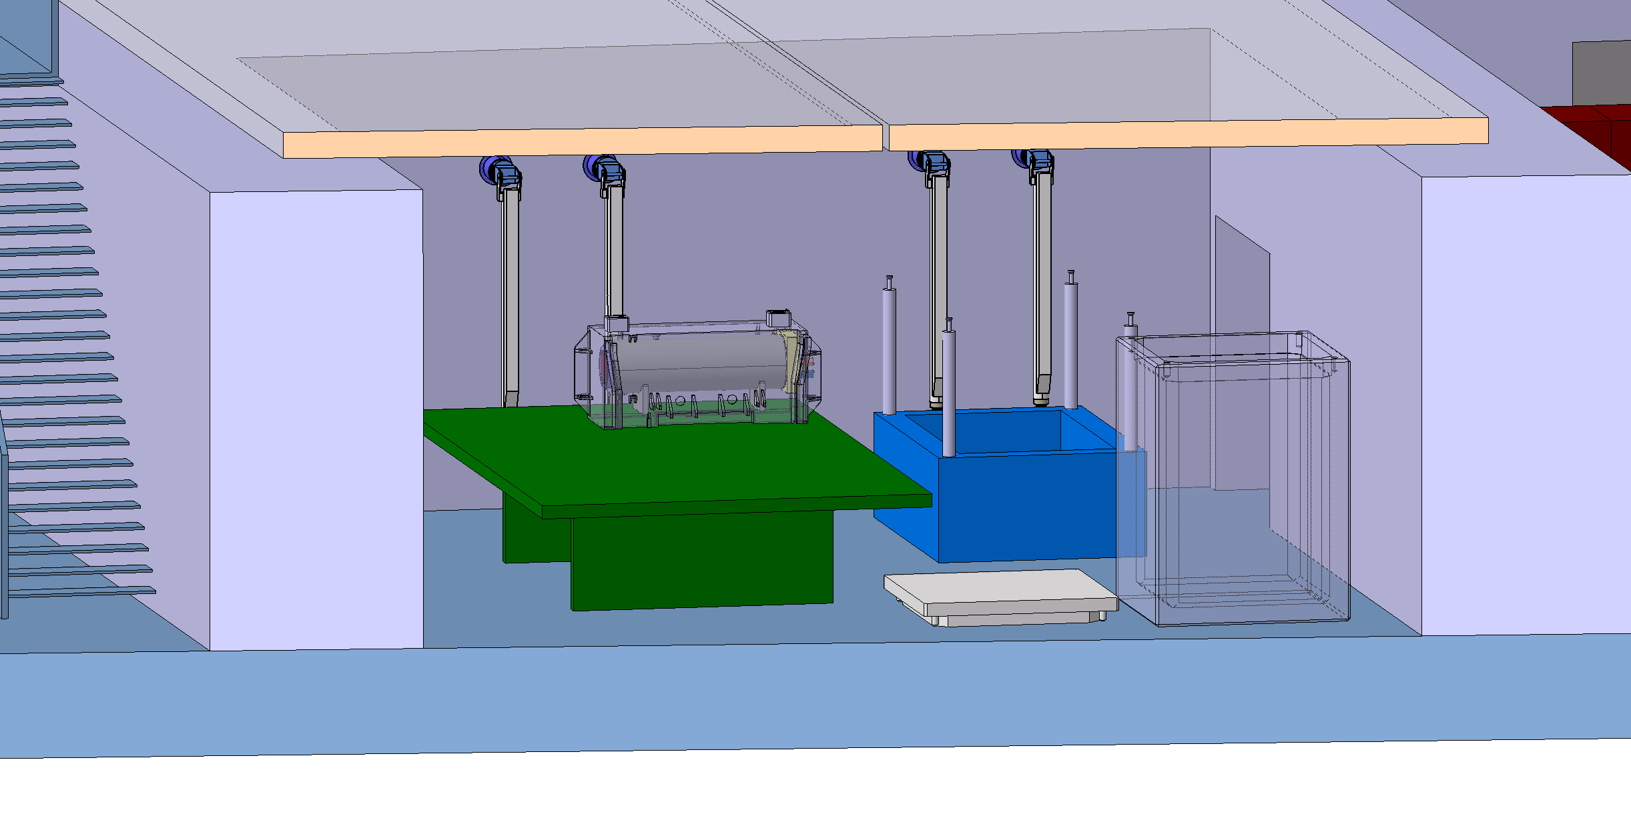
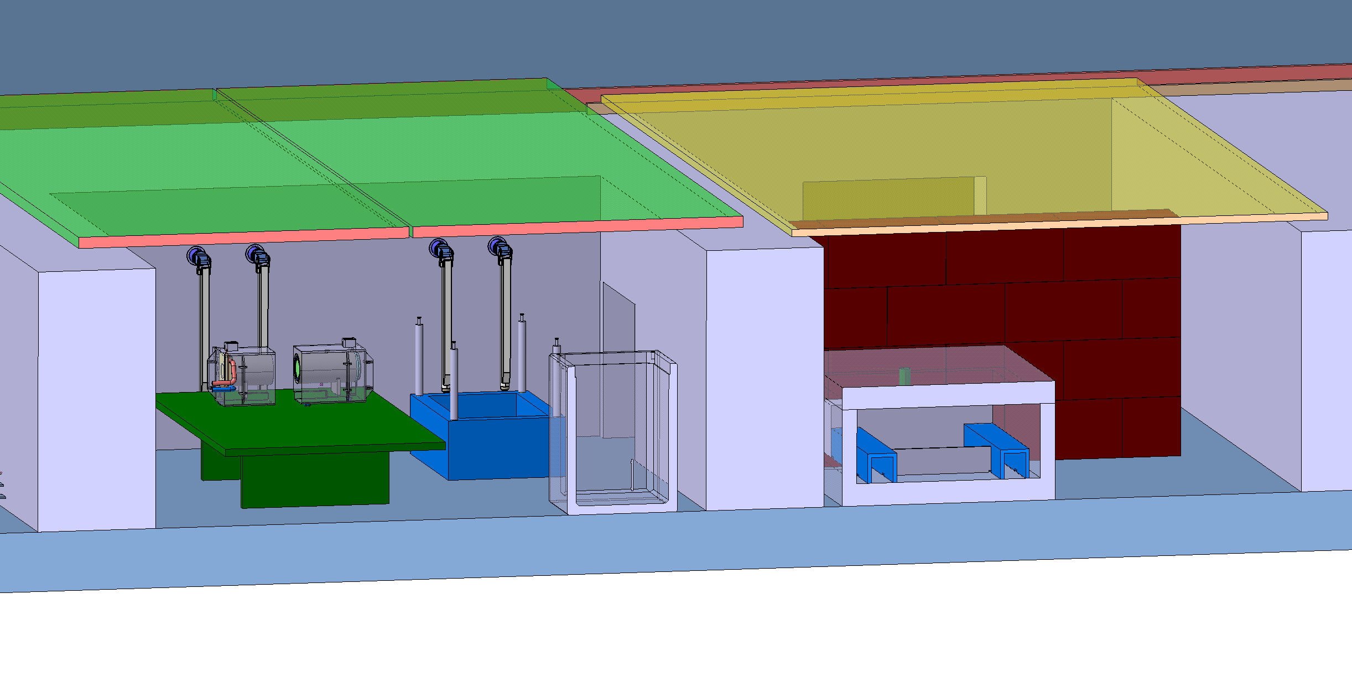
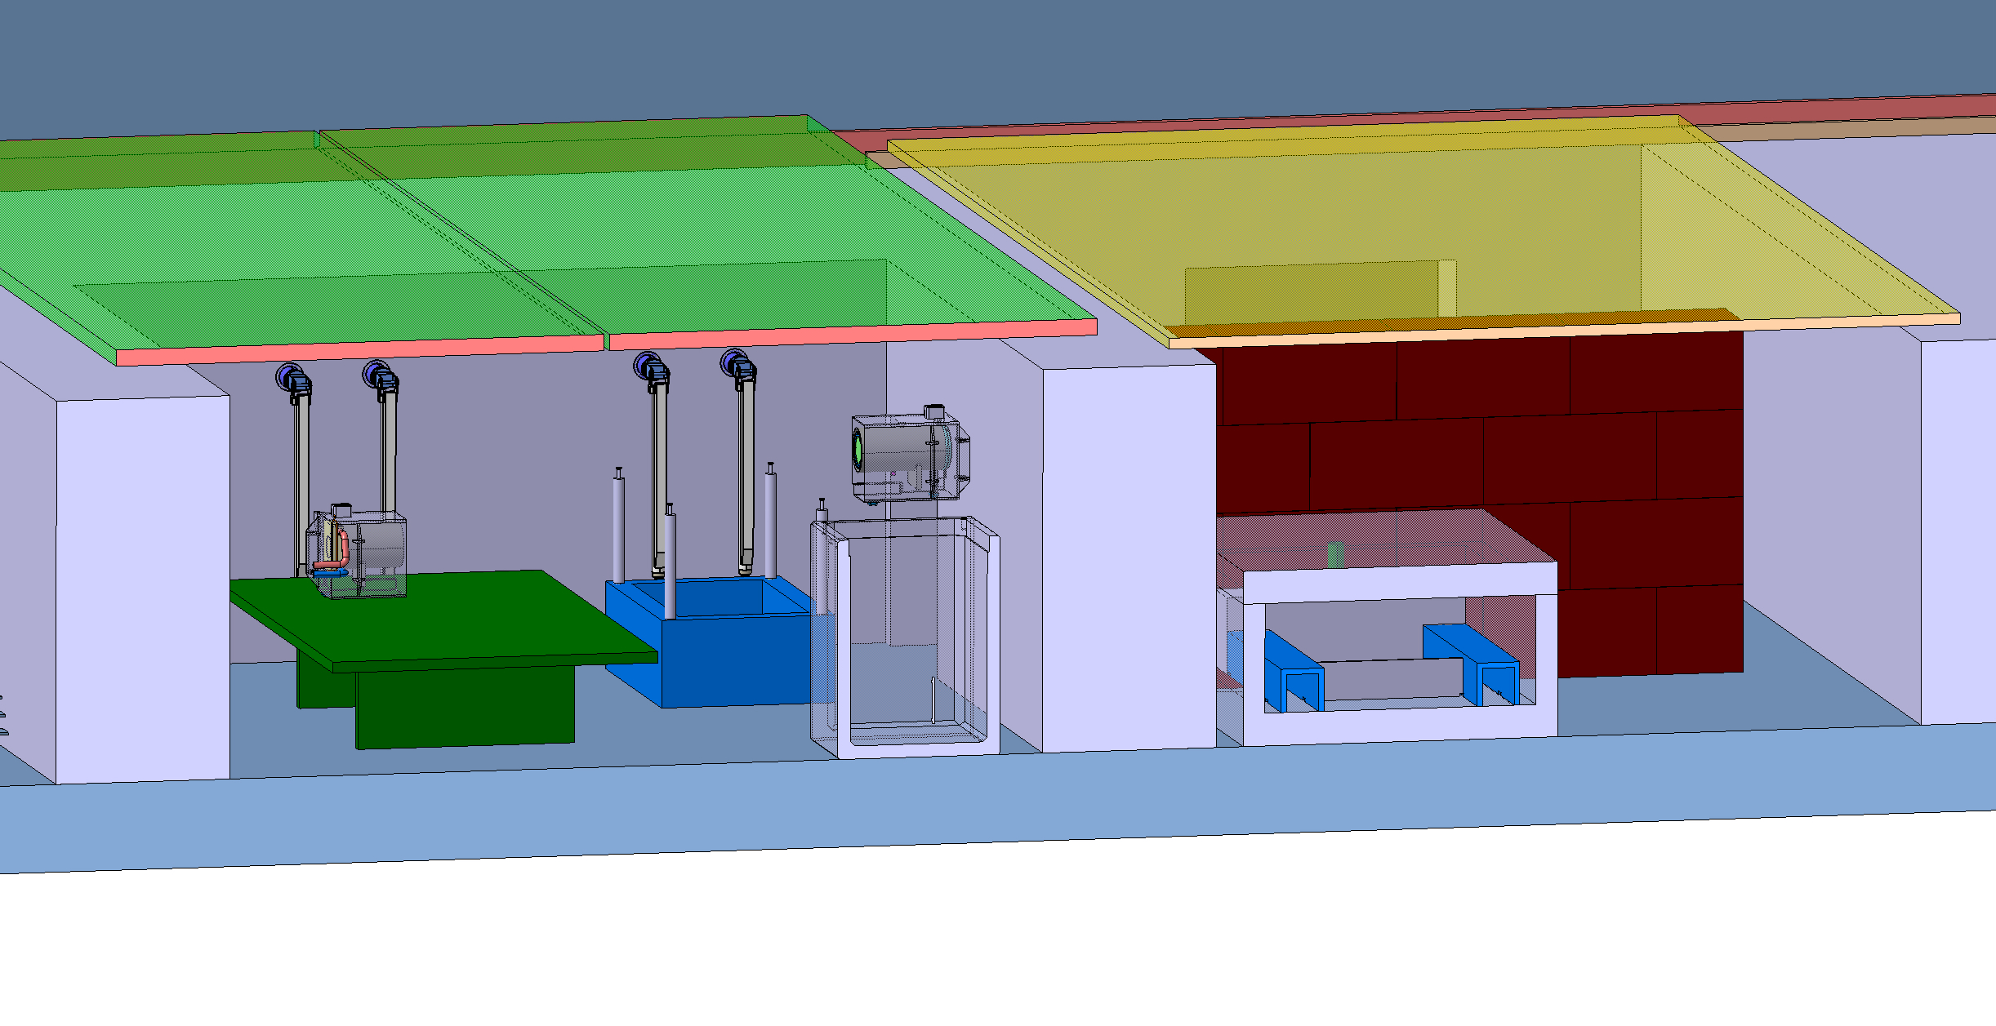


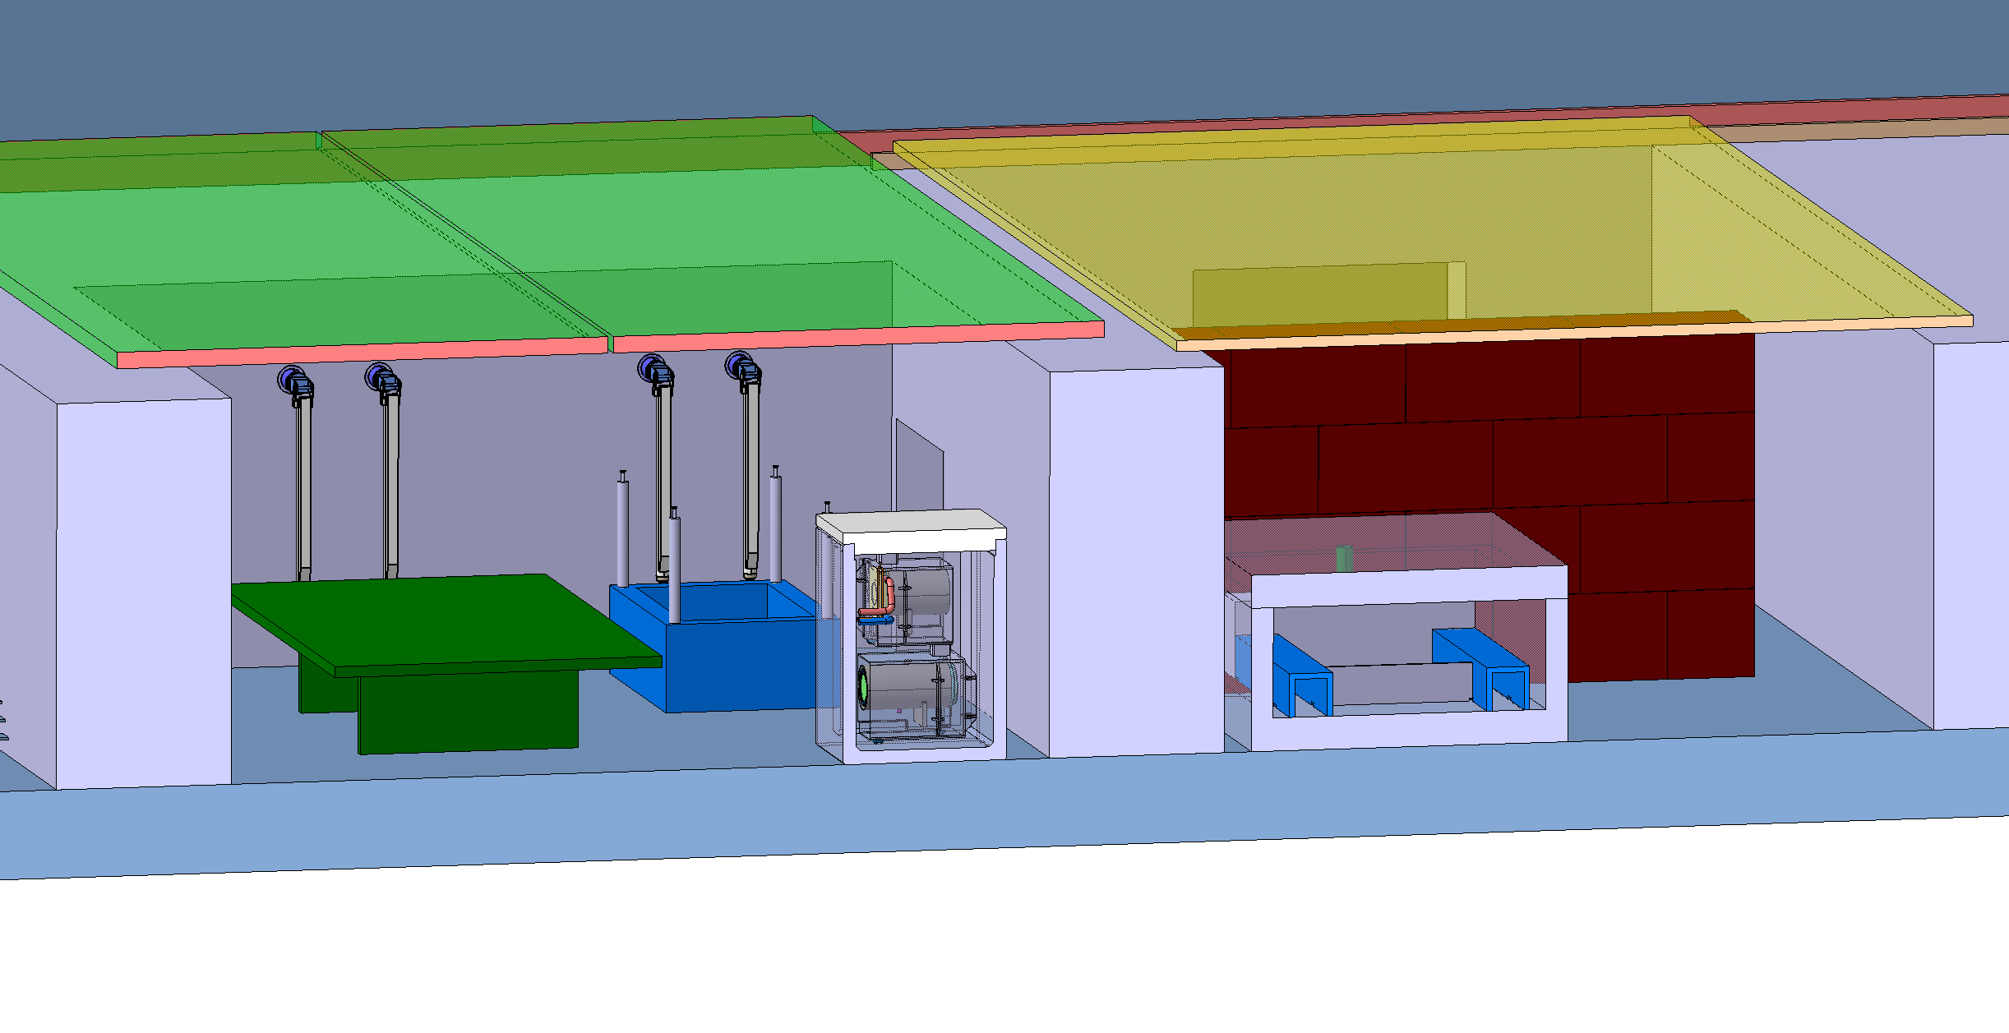
Service cell definition – BDF target disposal draft sequence

Slide 20
Summary
Significant benefit by reusing an existing infrastructure
Preliminary shielding study have been designed and optimized according to radioprotection requirement
TDR is in progress to finalize the design now focused on defining the process to define Civil Engineering aspects
A service building will be implemented to support the target complex
Part of this building will be dedicated to a service cell for size reduction, waste packaging and to perform PIE
A wide range of remote handling technics will be used within the HI-ECN3 target complex taking the benefit of all the recent developed made across various projects at CERN

Slide 21
Thank you

