Slide 2
Radiation Protection Considerations for
HI-ECN3
C. Ahdida, F. Luoni, F. Malacrida, G. Mazzola, O. Pinto, H. Vincke (HSE-RP), HI-ECN3 Project Team
NBI2024 - 13th International Workshop on Neutrino Beams and Instrumentation
AYA'S LABORATORY Quantum Beam Research Center, Japan
October 7th to 10th, 2024

Slide 3
Outline
Overview of RP Challenges at HI-ECN3
Target Complex Design Optimization
Target Studies
Beam Transfer Studies
Dismantling studies

Slide 4
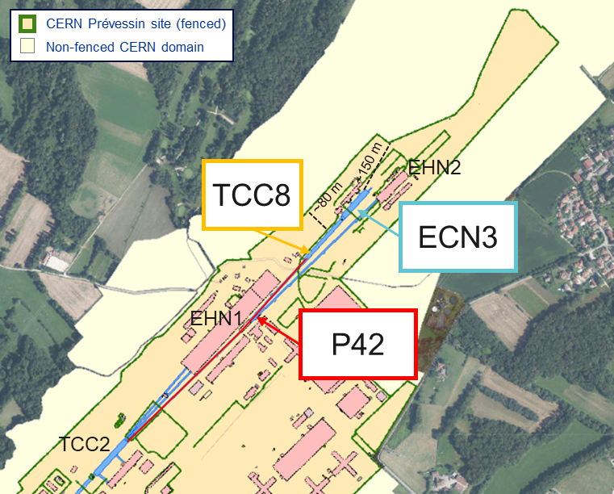
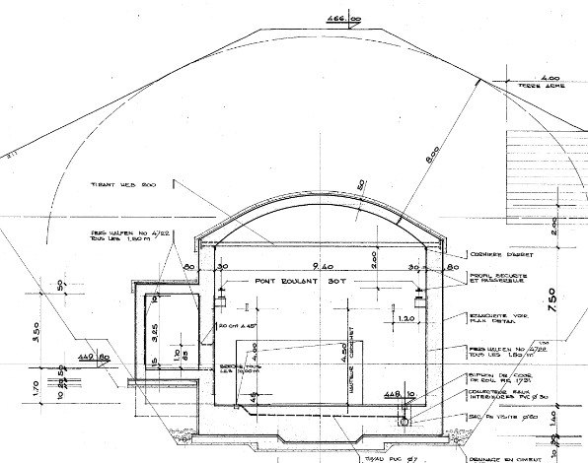
HI-ECN3 at ECN3
See talks about the SHiP experiment by R. Jacobsson and the BDF target station design by J.L. Grenard
CERN’s SPS North Area
TCC8 cross-section
Key beam parameters of BDF/SHiP
 | BDF
Intensity (p/spill) | 4×10¹³
Spill duration (s) | ≥1
Cycle length (s) | ≥7.2
Avg. beam power (kW) | 356
Average intensity (p/s) | ≤5.6×10¹²
Annual POT | 4×10¹⁹
Duration (years) | 15
Total POT | 6×10²⁰
8m soil
400 GeV p⁺ from SPS
High Intensity ECN3 (HI-ECN3) project for a new state-of-the-art high intensity experimental facility housing BDF/SHiP in ECN3
    exploiting the available high intensity SPS 400 GeV/c p⁺ beam
    benefiting from an existing cavern of comfortable size incl. its infrastructure
    using the advantage of the shielding created by the soil
RP challenges
    High beam energy and intensity as well as high POT leading to high prompt radiation and activation levels
    Proximity to surface, experimental and public areas
    High-intensity beam transfer
    Dismantling of current TCC8/ECN3 equipment

Slide 5
Target Complex Optimization

Slide 6


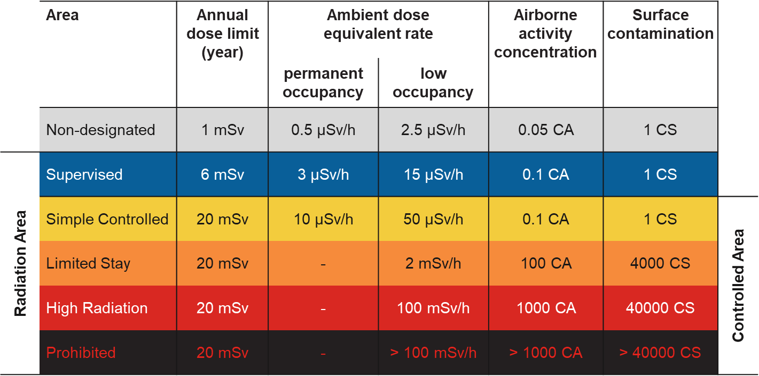
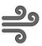

BDF/SHiP design optimization
RP studies based on FLUKA MC simulations were performed for a design optimization of BDF/SHiP@HI-ECN3
ALARA approach
Optimization required to ensure that exposure of personnel to radiation and radiological impact on environment are As Low As Reasonably Achievable
Prompt radiation
Reduce prompt radiation to comply with radiation area classification in the surrounding accessible areas as well as the 1 mSv/y limit at the CERN fence
Radiation area classification
residual radiation
Limit activation of target and experimental area to reduce residual dose rates to be compatible with an adequate area classification
Air and soil activation
Reduce activation of air and its releases into the environmental. Limit soil activation (³H<1000 Bq/kg, ²²Na<50 Bq/kg) and transfer to groundwater
Environmental impact
Reduce environmental impact from prompt radiation and releases of activated air to fulfill CERN’s dose objective for the public of <10 uSv/year

Slide 7
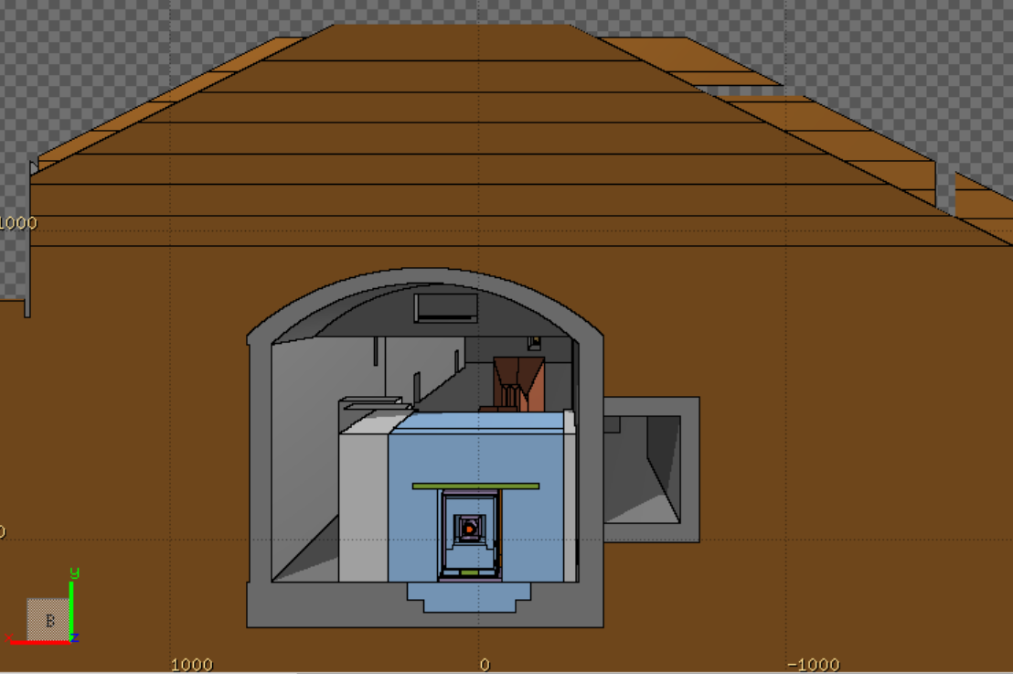
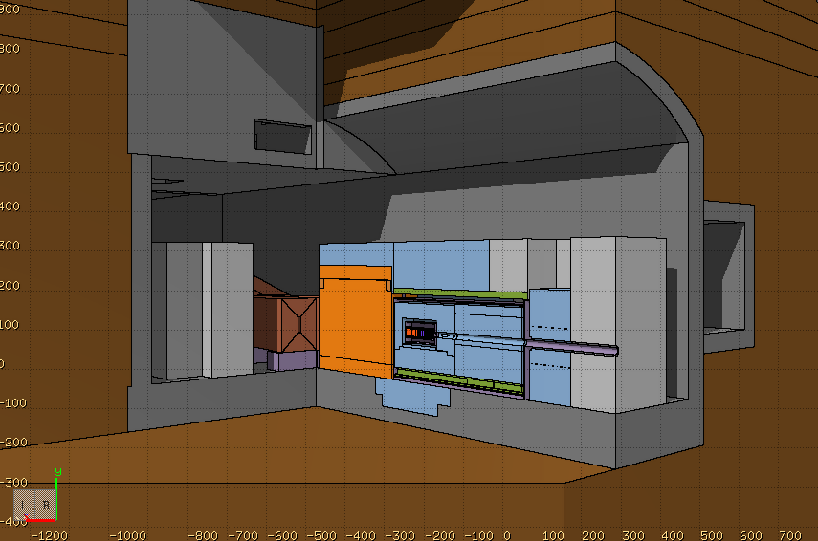
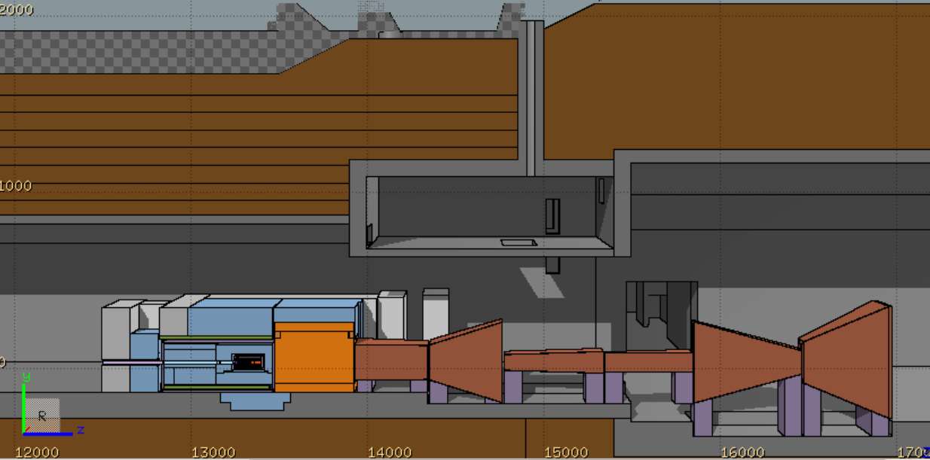
BDF/SHiP FLUKA model
FLUKA hosted by CERN [1-3]
Target complex & muon shield, Created using FLAIR [4]
A detailed BDF/SHiP target complex together with the muon shield was implemented in FLUKA
Optimized BDF dump with reduced shielding and re-use of existing, already activated TCC8/TT7 shielding blocks, while maintaining SHiP physics performance
Shielding embedded in vacuum vessel
FLUKA geometry includes the full underground TCC8/ECN3 cavern and surrounding galleries, tunnels, rooms, etc.
Ground profile data from CERN’s Geographic Information System and technical drawings were used to model the surrounding ground
Moraine
8 m
TCC8
Muon shield
1.7 T
1.6 m
Vacuum vessel
11 m
1.6 m
W-TZM target
4.8 m
Magnetic part of hadron stopper
1.6 T
1 m
Muon shield
ECN3
Floor shielding (13.3 m³)
Stainless steel
US1010
~180 m³ of cast iron + US1010
~360 m³ of concrete
Concrete
Moraine
Cast iron

Slide 8
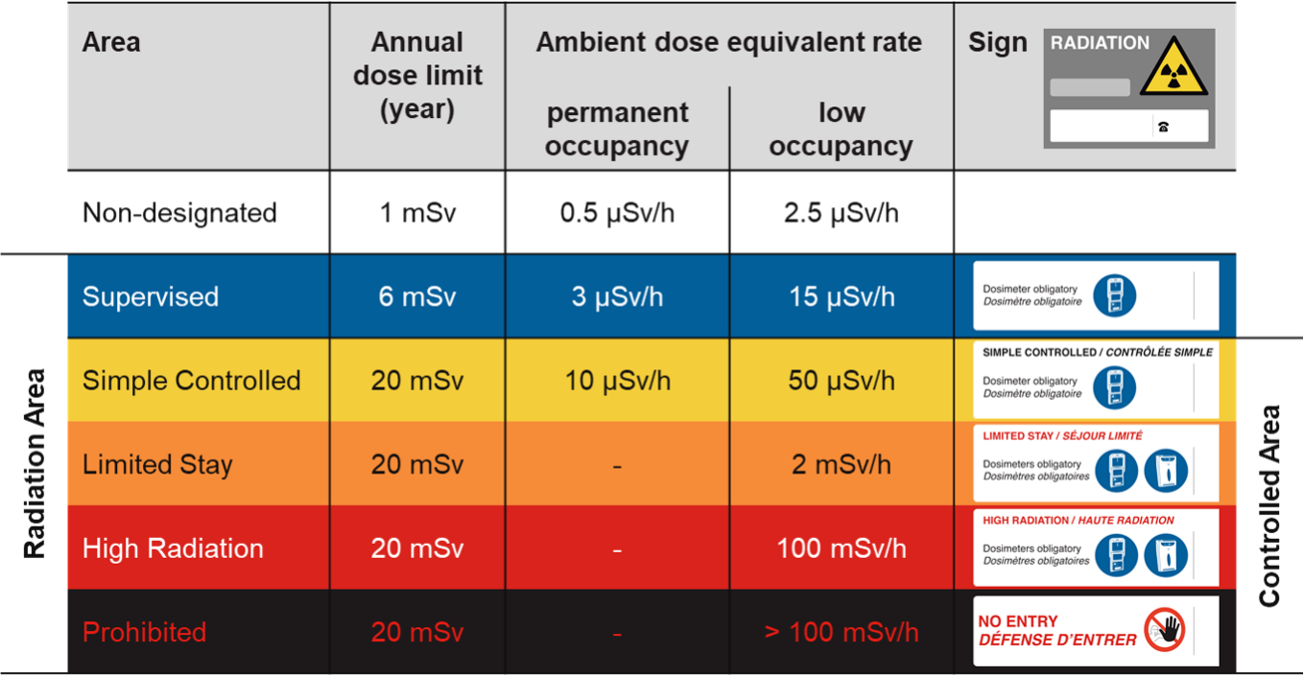
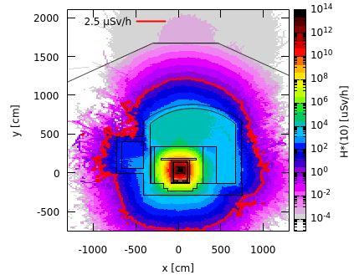
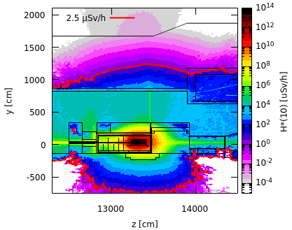
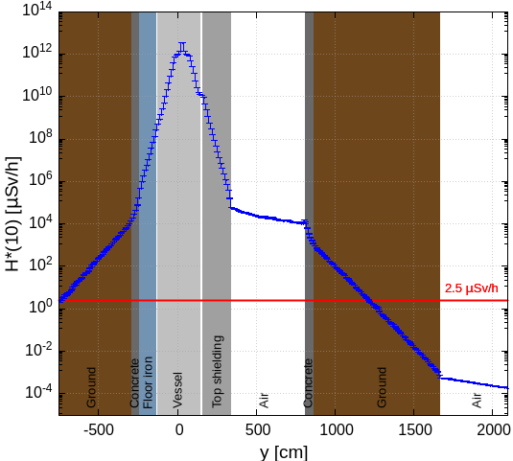
Prompt radiation in target area
Avg. intensity of 5.6×10¹² p/s
Cross-sectional view
Side view
Along y-axis
(-20 cm < x < 80 cm)
(13260 cm < z < 134380 cm)
(13260 cm < z < 13380 cm)
(-20 cm < x < 80 cm)
Shielding design is well optimized for the prompt radiation
Limit of Non-designated Area on CERN domain is by far met
100 rem = 1Sv

Slide 9
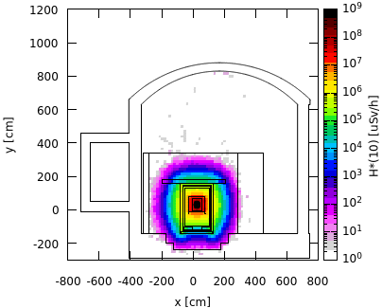
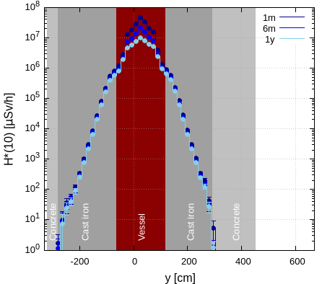
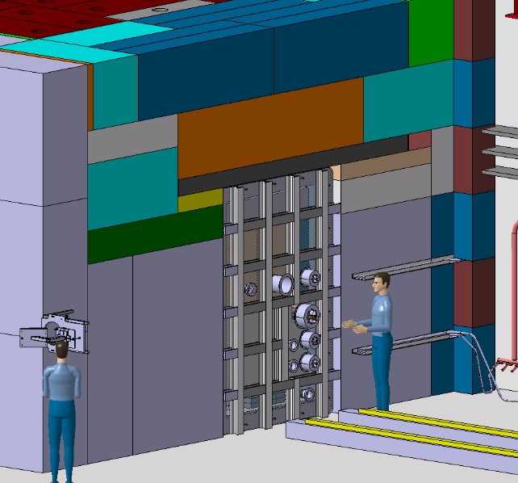
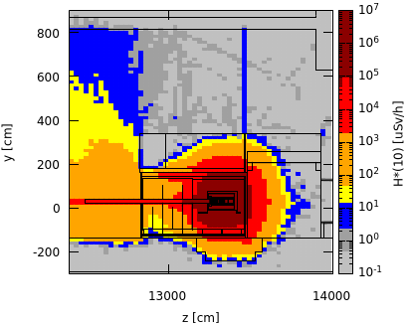
Residual radiation in target area
Total PoT 6×10²⁰
Cross-sectional view, target level
Along x-axis, working height
Upstream of vessel w/o upstream shielding
Preliminary worst case manual intervention scenario
1 month cool-down
1 month
(13240 cm < z < 13390 cm)
(15 cm < y < 45 cm)
(13240 cm < z < 13390 cm)
(-15 cm < x < 80 cm)
Shielding removed
x [0,40]
x_beam = 26 cm
After removal of the shielding upstream of the vessel, residual dose rates of several 100 µSv/h are expected
Supervised Radiation Area on the sides
Further optimization by movable shielding
The shielding design contains well the high residual dose rates reaching in the central target region several 10 Sv/h after 1 month of cool-down
The residual dose rates outside the shielding are < 1 µSv/h
100 rem = 1Sv

Slide 10
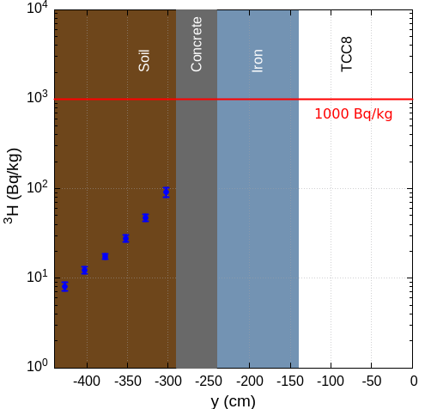
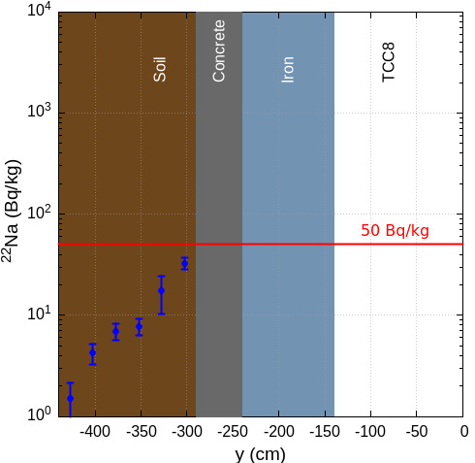
Soil activation
Total PoT 6×10²⁰
Specific activity of ³H and ²²Na in the soil below TCC8 (most critical area)
Most critical area for soil activation
³H
²²Na
¹
1 m
Floor shielding (13.3 m³)
(-120 cm < x < 120 cm)
(13148 cm < z < 13364 cm)
(-120 cm < x < 120 cm)
(13148 cm < z < 13364 cm)
Thanks to floor iron shielding, ³H and ²²Na activity concentrations in the soil are below respective conservative design limits
A hydro-geological study is underway allowing to refine the design limits and possibly allow to reduce the required shielding
100 rem = 1Sv

Slide 11
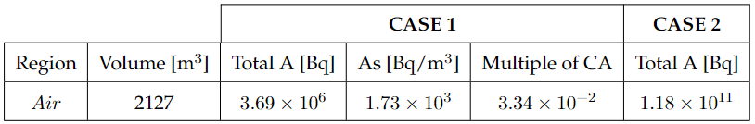
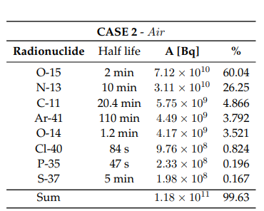
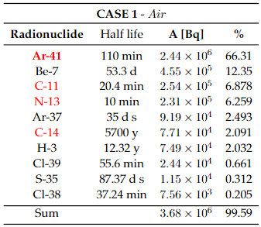
Air activation
PoT 4×10¹⁹ per year
Activation of air in target complex area was studied
Production of radionuclides evaluated with FLUKA in combination with ActiWiz [5]
Two cases were investigated:
CASE 1: build-up of radionuclides during yearly operation without air extraction and 30 min cooldown time before air release
CASE 2: constant immediate release of air (worst-case for upper limit of environmental impact)
Air activation
¹
See talk by H. Vincke
¹
Activities of main radionuclides with % contribution to total activity
Even without any cooldown time, the air activity concentration in the target complex would be compatible with access (< 0.1 CA¹)
Flush of target complex with fresh air before any access
In red main contriubtors to CA (>4%)
¹ Person working 40h/w, 50w/y with standard breathing rate in activated air with CA = 1 receives 20 mSv

Slide 12
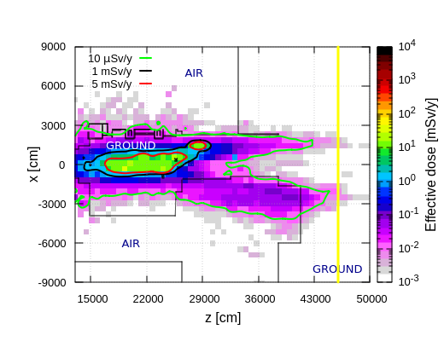
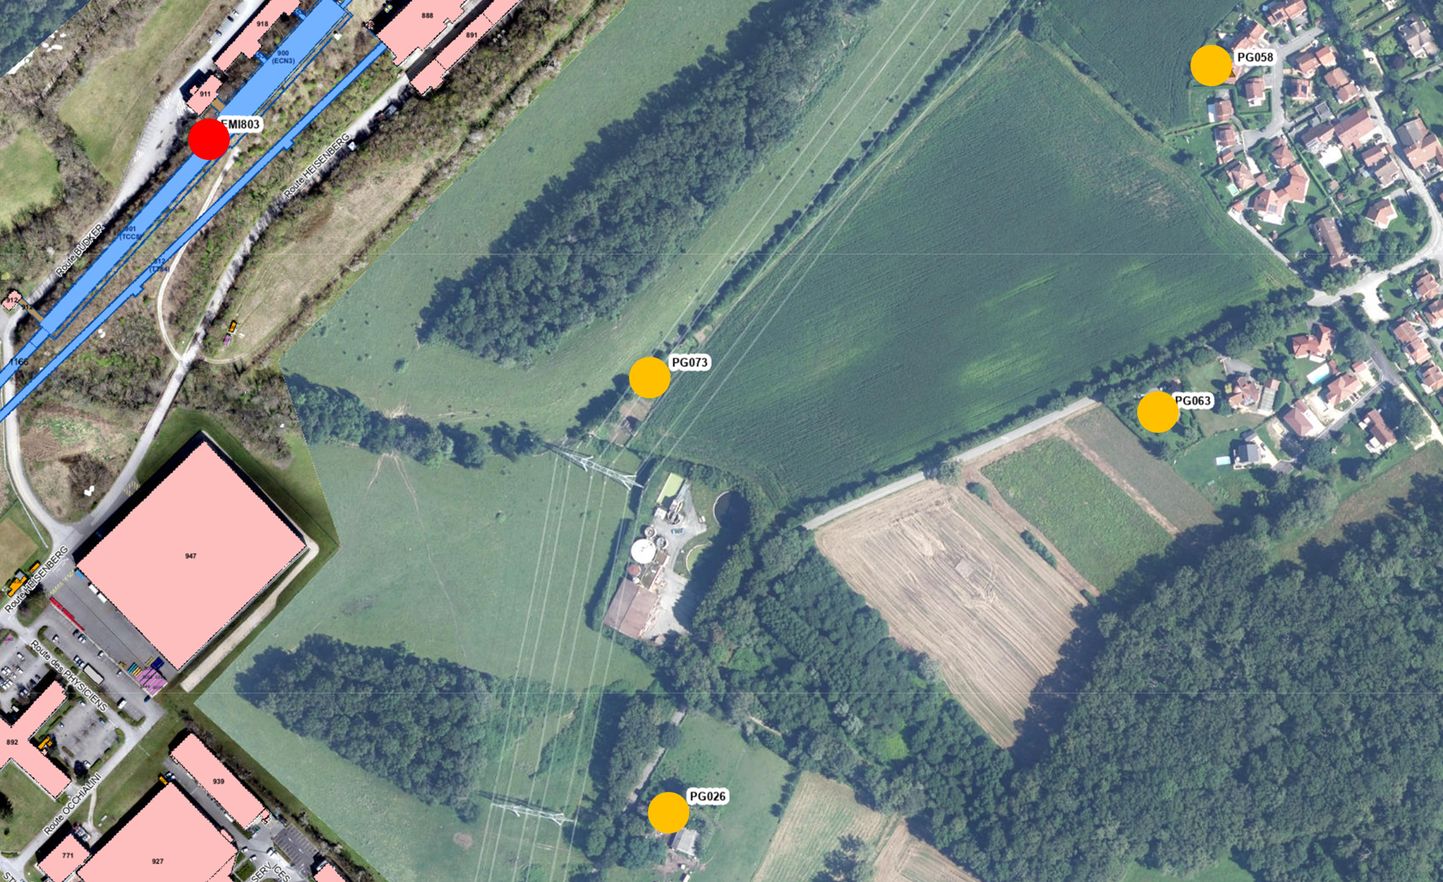
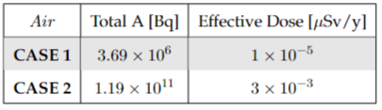
Environmental impact
PoT 4×10¹⁹ per year
Dose from air releases
Dose from stray radiation
Used max. dose coefficients from different age groups [6]
Annual effective dose from muons
Positions of nearby population groups
Effective dose estimates
CERN fence
Release point
Muon prompt radiation aboveground downstream ECN3
H-3 release due to air activation of ~80 kBq
Worst-case immediate air release (CASE 2) yields 3 nSv/year (main contributors: N-13, Ar-41, C-11, O-15) and is thus well below the annual dose objective of CERN
Exposure of members of the public due to air releases is negligible
Annual limit of Non-designated Area on CERN domain and at CERN fence (1 mSv/y) as well as dose objective for members of the public (10 uSv/y) is by far met
100 rem = 1Sv

Slide 13
BDF Target Studies

Slide 14
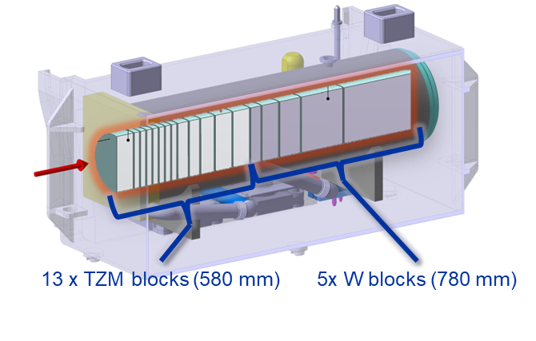
BDF target baseline design
Baseline Design (CDS)
Water-cooled target: TZM (0.08% titanium – 0.05% zirconium – molybdenum alloy) and W blocks cladded with Ta2.5W
Pursued during the comprehensive design phase → C. Ahdida et al., SPS Beam Dump Facility - Comprehensive Design Study, CERN-2020-002
Prototype + test with beam in 2018 + Post irradiation examination
TDR phase for CDS design improvement
Alternatives with pure W and He cooling under investigation
~ 1500 mm
D 250 mm
See talk “Design considerations for the BDF/SHiP production target” by R. Ximenes on Wednesday

Slide 15
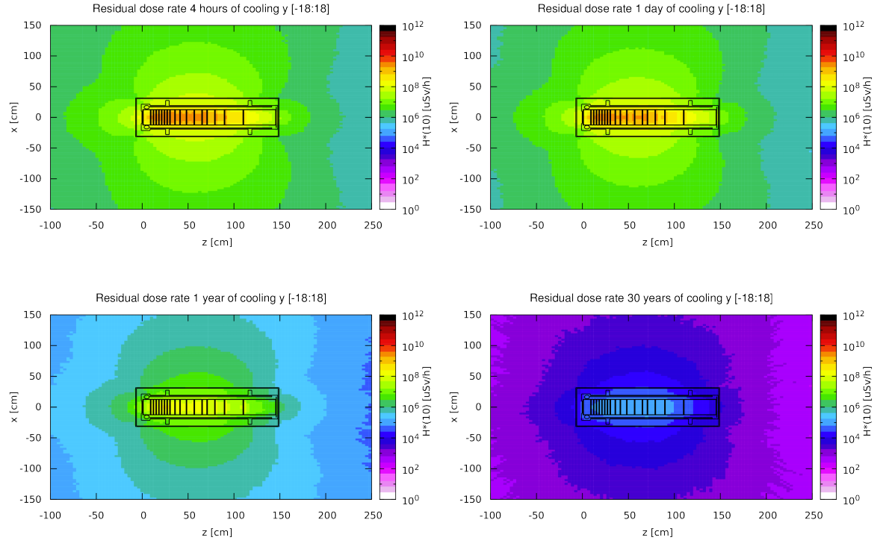
Residual radiation of CDS target
Total PoT 4×10¹⁹ (5 yrs)
Longitudinal cut along the target
The residual dose rates of the target were studied for 5 years of operation and different cool-down times
The highest dose rates are in the order of 100 Sv/h after 4 hours of cooling and a few Sv/h after 1 year
Even after 30 years, dose rates at 40 cm still of the order of a few mSv/h → dedicated storage place in facility for irradiated target
For radioactive transport the max. dose rate level at any point on the external surface of a package shall not exceed 2 mSv/h
Dedicated casks for transportation and storage as well as during handling will be designed
4 hours cool-down
1 day cool-down
1 year cool-down
30 years cool-down

Slide 16
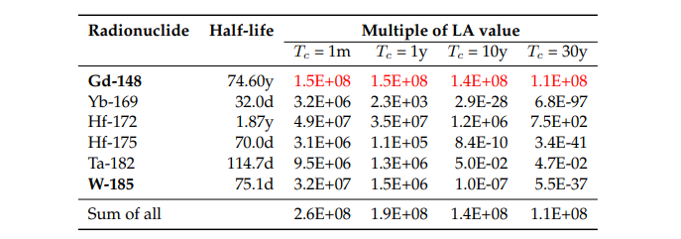
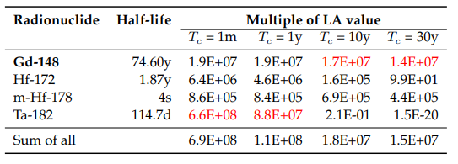
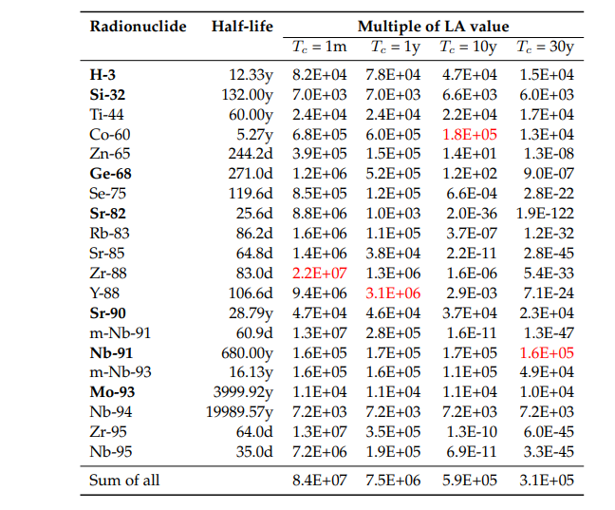
CDS target radionuclide inventories
Total PoT 2×10²⁰ (5 yrs)
LA multiples of BDF target materials,
Main contributors (>1%), sum for all radionuclides
W
Ta
TZM
Pure alpha/beta emitters are shown in bold
Dominant radionuclide is shown in red
Radionuclide inventory of target materials evaluated with FLUKA in combination with ActiWiz → important for radioactive transport and waste considerations (characterization, processing, disposal)
Comparison to Authorization Limits (LA) and Swiss Clearance Limits (LL)

Slide 17
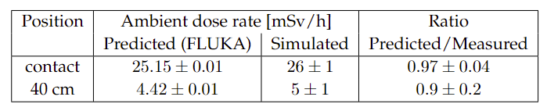
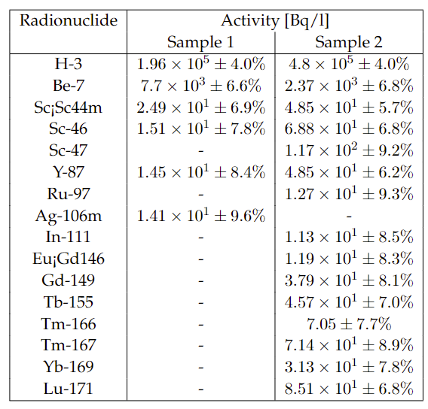
Prototype target tests
Benchmark of residual dose rates (mSv/h)
BDF target prototype w/ in total 14 h irradiation in TCC2, leading to 2.4E16 PoT
Target activation was measured and compared to FLUKA simulations showing excellent agreement
Cooling water activation was estimated w/ FLUKA
Estimated residual dose rate after 1h of cooling at 40 cm from the cartridge is 18.7 mSv/h, while the PMI monitor measured 16.9 mSv/h
Both samples showed the presence of high-Z spallation products some of them could have been produced in the target materials
Water-cooling filter with debris was analysed via EDX
  No peaks were found for Ta, W, Mo or Ti
  Metallic particle (Al, Ca, Fe, Cl, Fe, Cr)
Radionuclides in water samples
Water samples were analysed by liquid scintillation and gamma spectrometry

Slide 18
Beam Transfer Studies
See talk on HI-ECN3 by M. Fraser on Wednesday

Slide 19
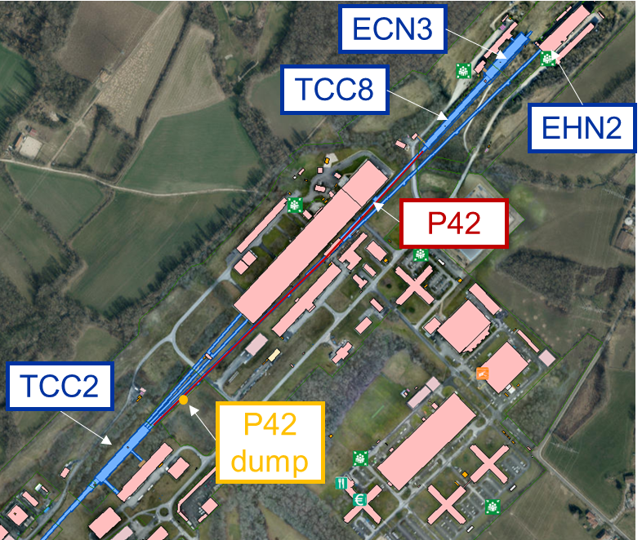
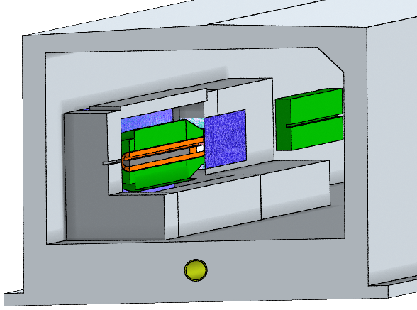
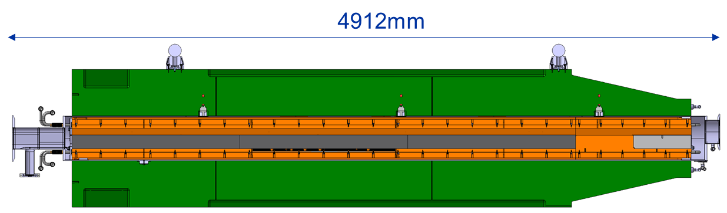
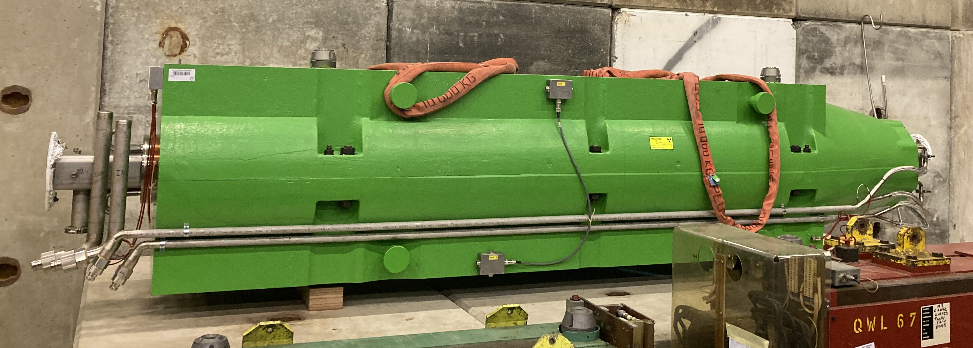
P42 beam dump
FLUKA model of P42 dump
A new beam dump will be installed in the P42 beamline
It shall allow commissioning the most critical part of the dedicated beam transfer (SPS → P42 beamline), while works in TCC8/ ECN3 are ongoing
The former, already activated SPS beam dump is to be reused
Additional shielding is placed around the dump to allow complying with the RP constraints related to prompt radiation, residual radiation, soil and air activation
0.8 m
0.2 m
2.4 m
0.4 m
400 GeV p⁺ from SPS
Iron shielding
Concrete shielding
Key beam parameters of P42 dump
Former SPS beam dump
Intensity (p/spill) | 2.2×10¹²
Cycle length (s) | 7.2
Average intensity (p/s) | 2.8×10¹¹
Operational hours/year | 100
Duration (years) | 3
Total POT | 1.8×10¹⁷
GG20
CuCrZr
Graphite
W
Max. contact dose rate in Apr. 24 amounted to 0.5 mSv/h

Slide 20
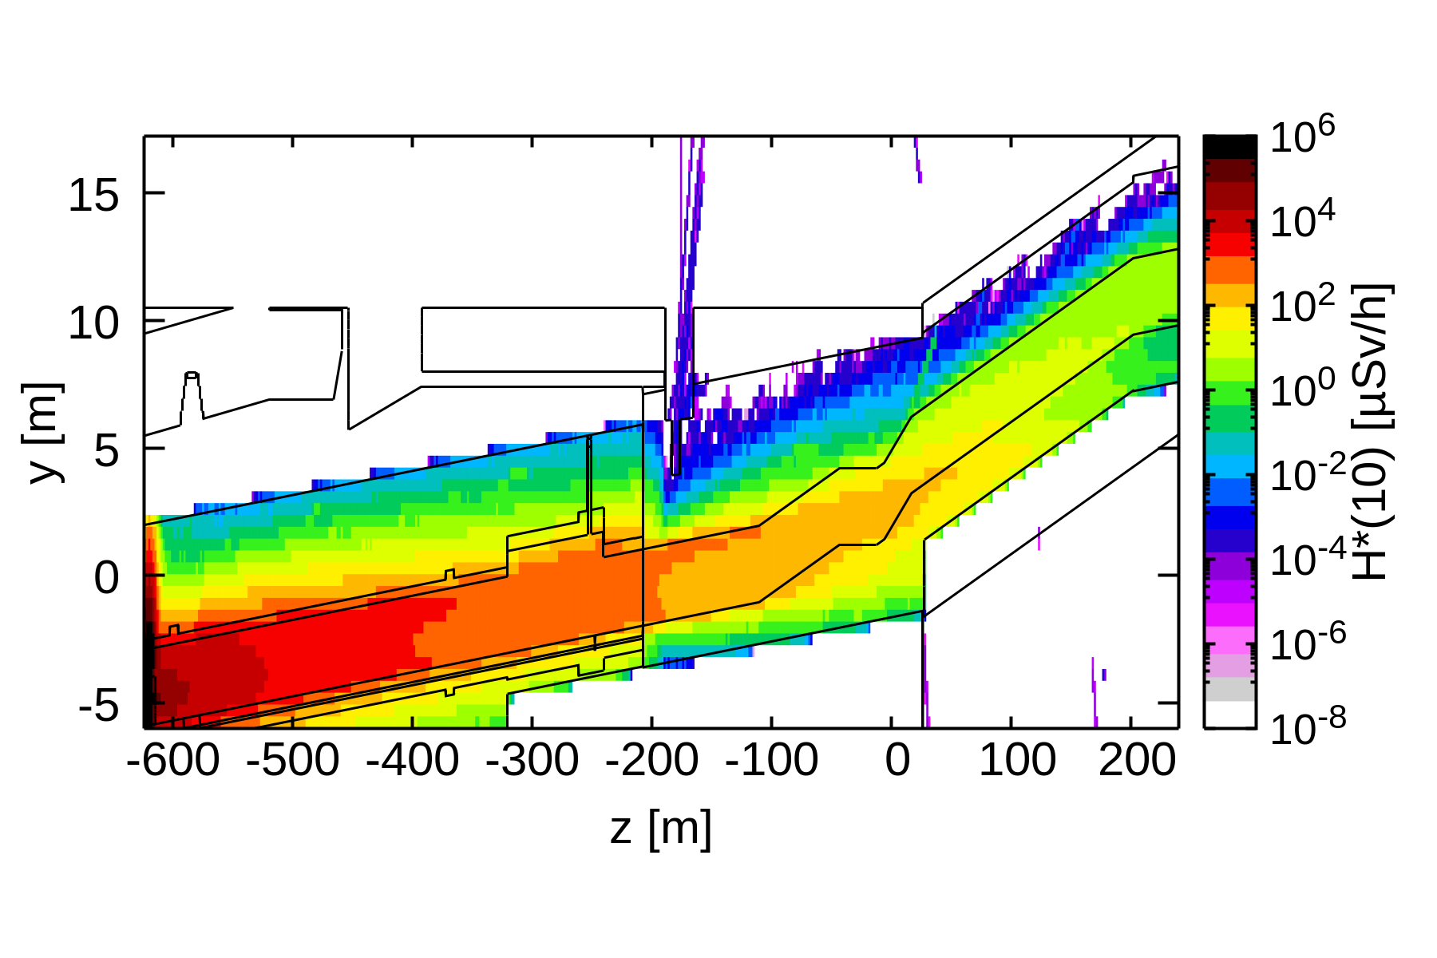
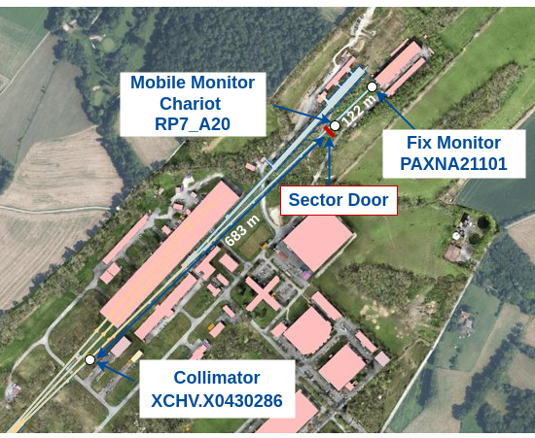
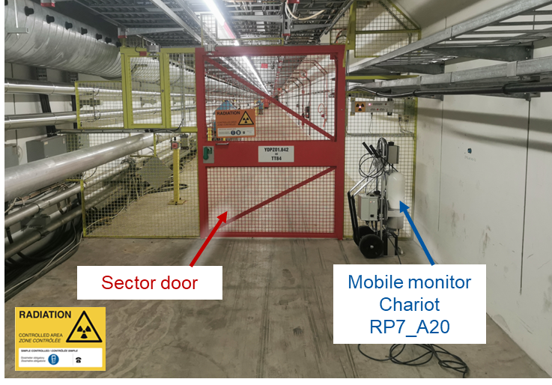
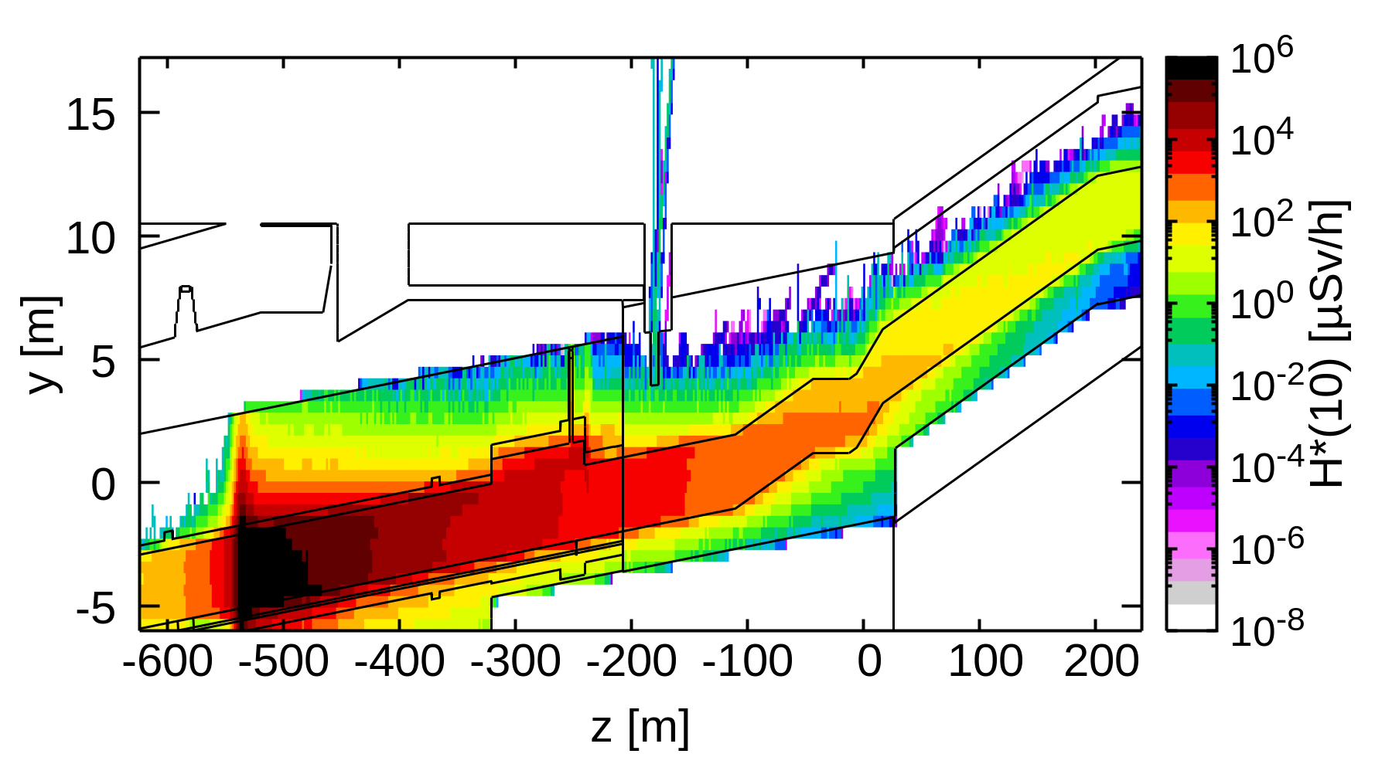
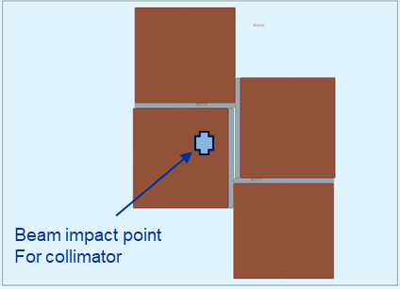
P42 beam dump
Prompt dose rates
Side view, 2.8×10¹¹ p/s
Collimator benchmark
All particles
TT84
Measured dose rate: 27.8 µSv/h
TT83
Prompt dose rates (<30 uSv/h w/ safety factor 3) in the accessible downstream part of TT84 would be compatible with a Simple Controlled Radiation Area (50 uSv/h)
A radiation monitor is in the accessible part of TT84 to monitor the dose rates during access conditions
An additional benchmark of the dose rates measured in TT84 during a deliberate full beam loss on a collimator showed very good agreement with dedicated FLUKA simulations
FLUKA model of collimator Cross-sectional view
Prompt dose rates
Side view, 1.25×10¹⁰ p/s
1 m long
All particles
Simulated dose rate: 22.7 uSv/h

Slide 21
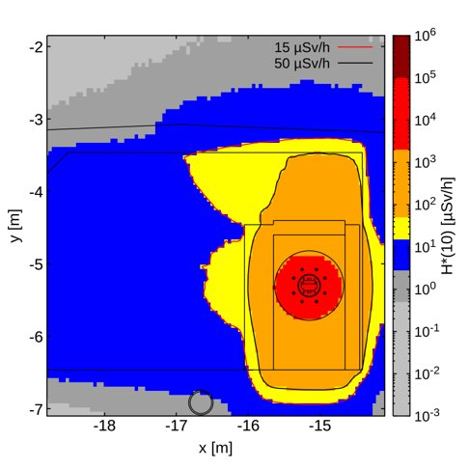
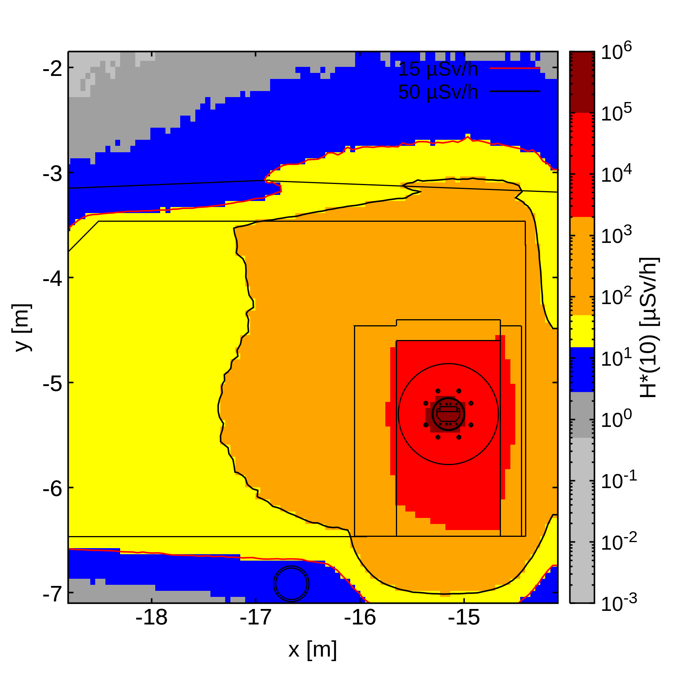
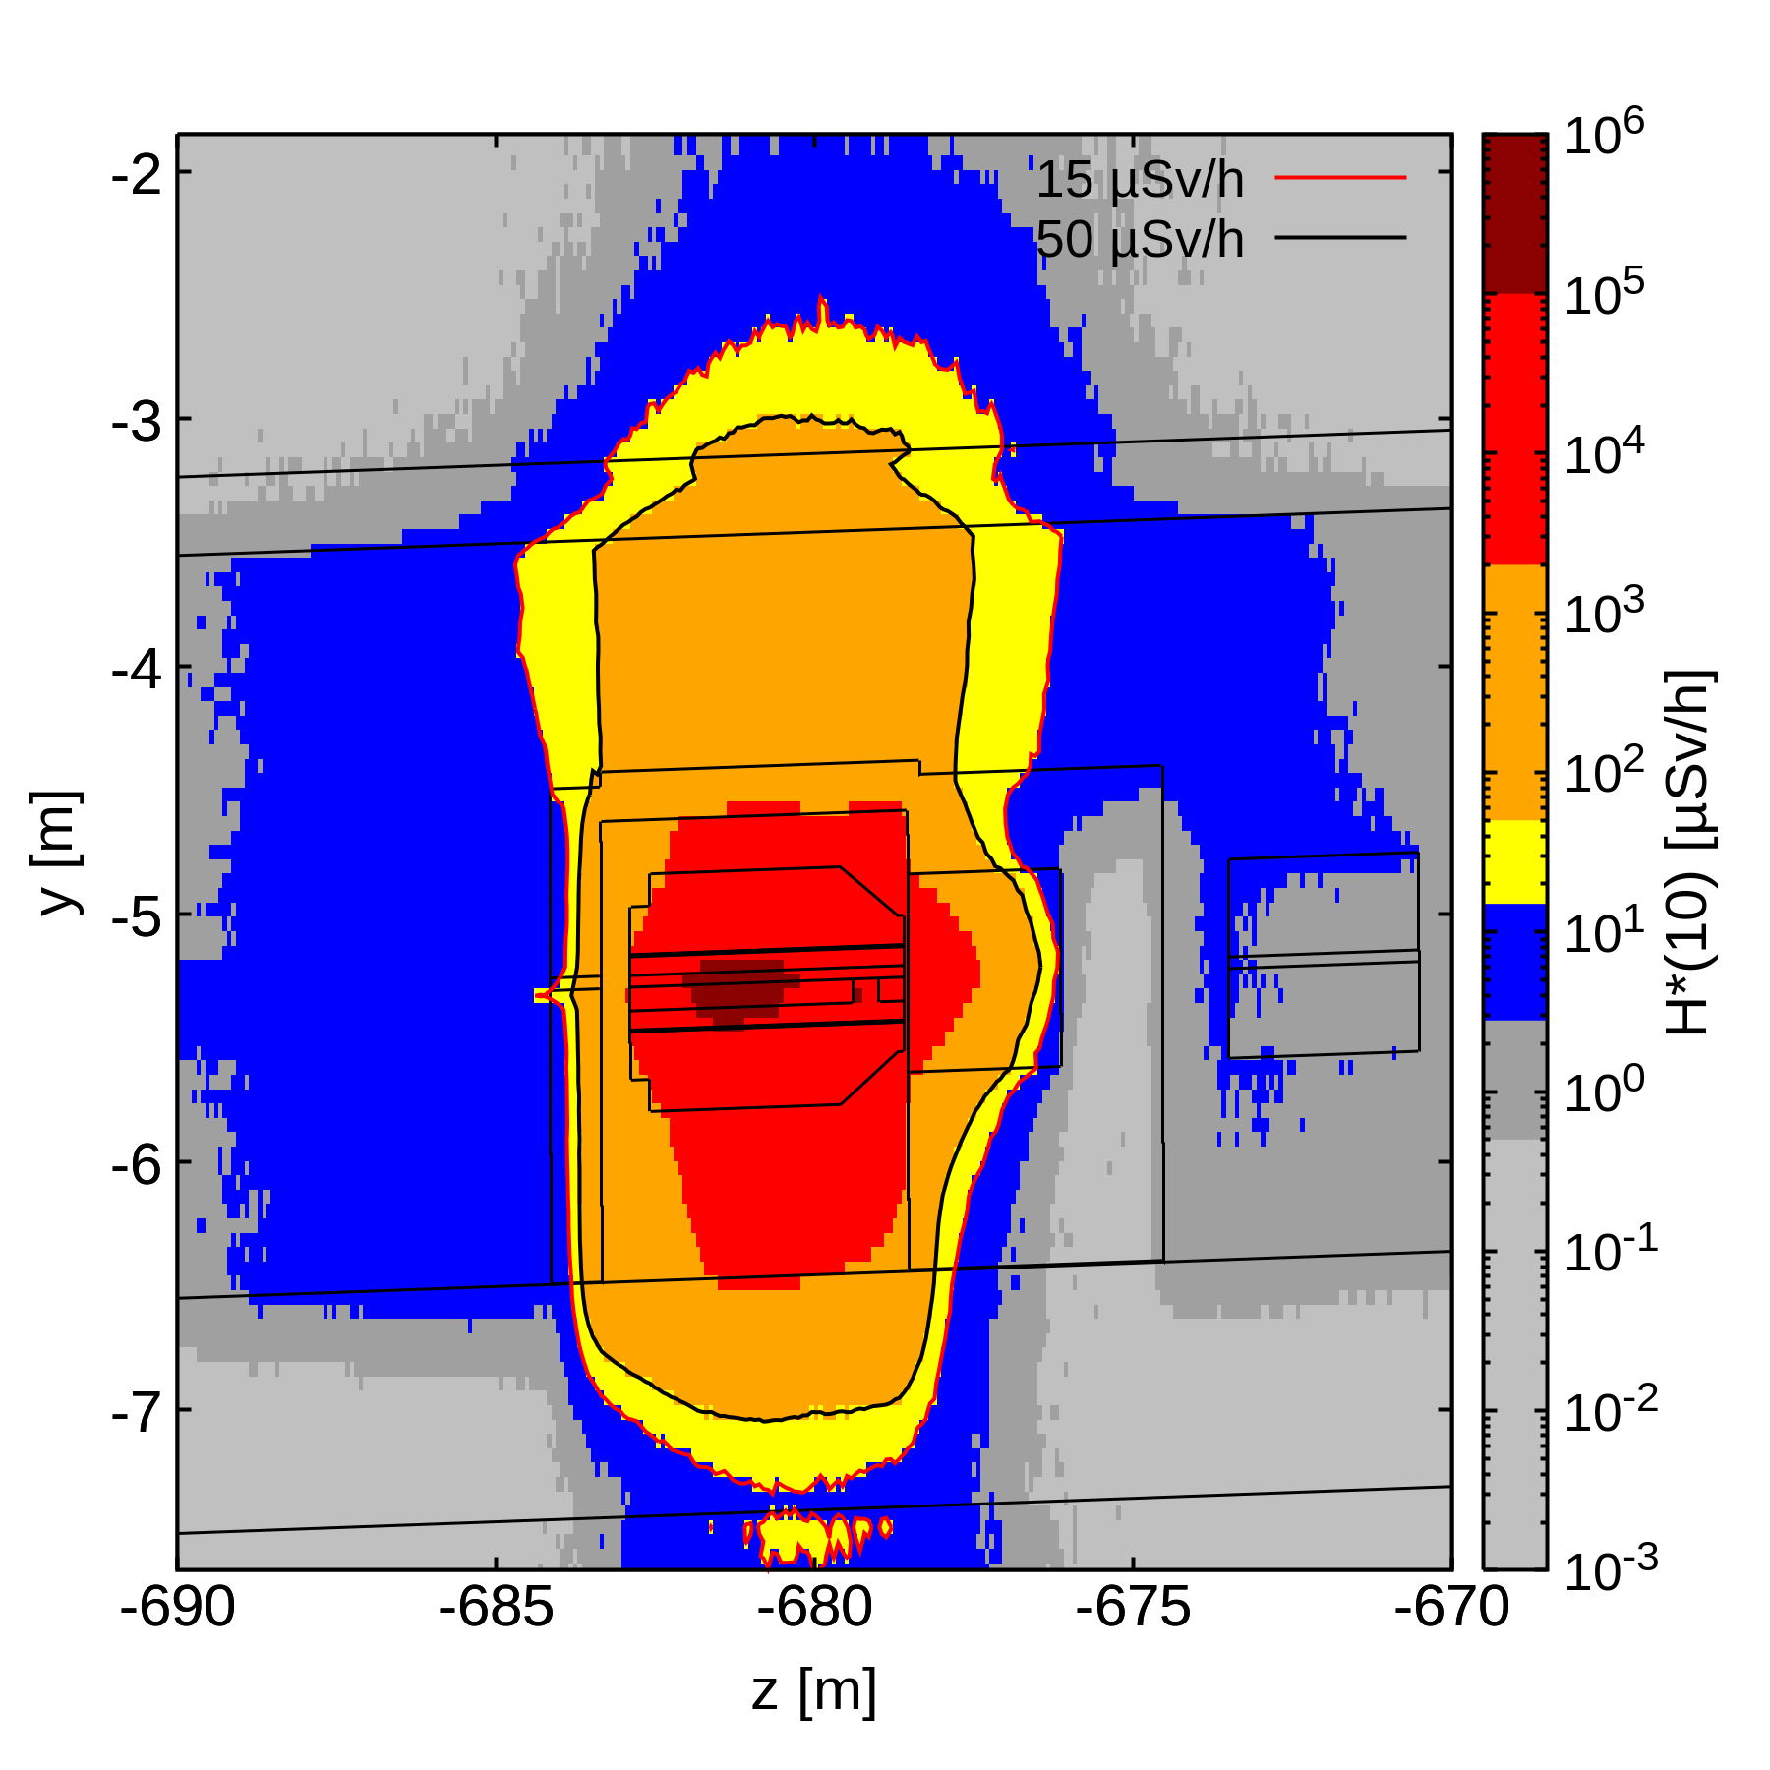
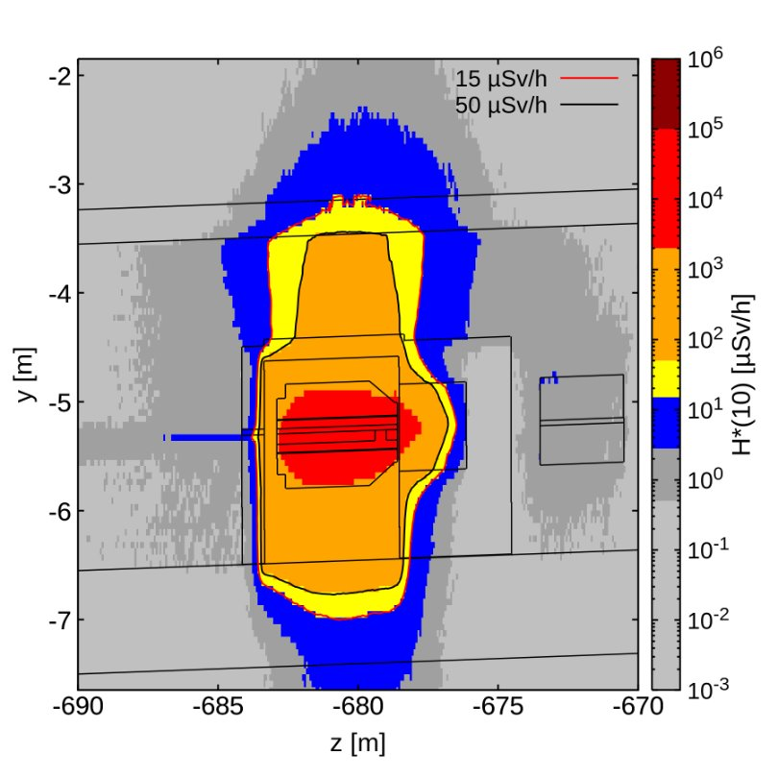
P42 beam dump
Prompt dose rates
Side view, 2.8×10¹¹ p/s
Residual dose rates
1.8×10¹⁷ POT, 1 week cool-down
Soil activation
All particles
1 week
1 month
Soil activation was evaluated for 3 years of operation (1.8×10¹⁷ POT) and found to be acceptable
After 1 week, the residual dose rates close to the dump require a Controlled Radiation Area
After 1 month, most of the accessible area is compatible with a Supervised Radiation Area
Even for unlikely unforeseen accesses to TT83 with 2h cool-down only, the dose for walking past the dump would be acceptable
TT84
TT83
1 week
Air activation
Prompt dose rates (<30 uSv/h w/ safety factor 3) in the accessible downstream part of TT84 would be compatible with a Simple Controlled Radiation Area (50 uSv/h)
A radiation monitor is in the accessible part of TT84 to monitor the dose rates during access conditions
An additional benchmark of the dose rates measured in TT84 during a deliberate full beam loss on a collimator showed very good agreement with dedicated FLUKA simulations
Considering 3 years of operation and 10 min of cool-down the air activation in the tunnel is compatible with a 0.1 CA even without considering additional fresh air injection into the tunnel
The total activity for 5 min of cool-down amounts to 0.2 MBq (N-13, O-15, C-11)
Environmental impact of released air activation is negligible
1 week
1 month

Slide 22
Dismantling Studies

Slide 23
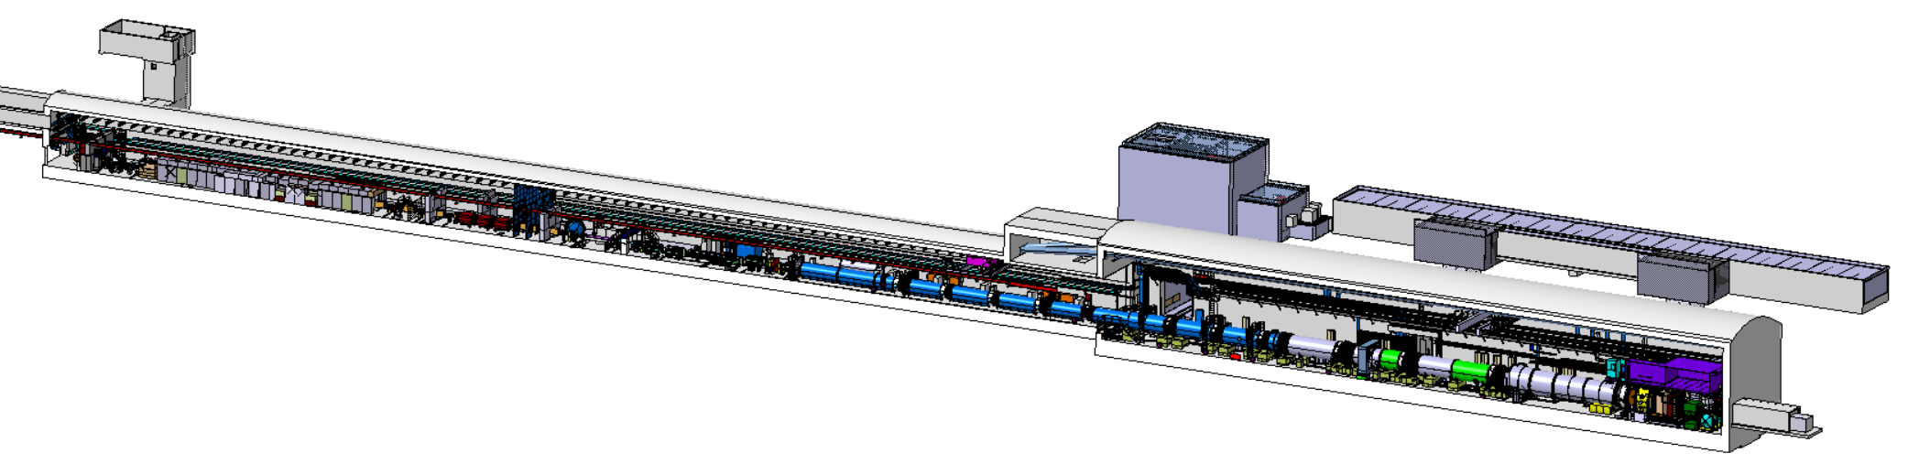
TCC8/ECN3 today
NA62 experiment is currently located in ECN3, while its target area is situated upstream in TCC8
It is in operation since 2009 searching for rare kaon decay modes
NA62 beam parameters
400 GeV p⁺ from SPS
p+ [10¹² /spill] | POT [10¹⁸ / yr] | Exp. tot. POT (2026)
~ 3 | ~0.07 – 2.3 | ~1.4×10¹⁹
B911
B918
TCC8
Be target generates a secondary beam of kaons
ECN3

Slide 24
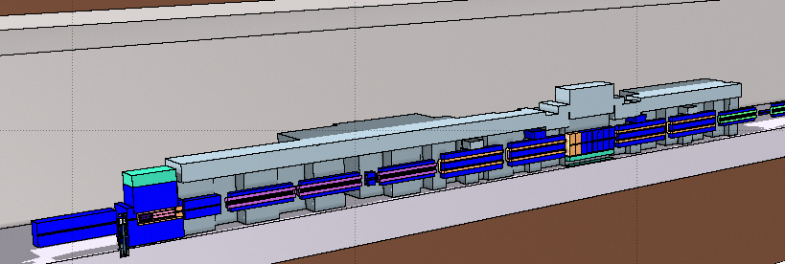
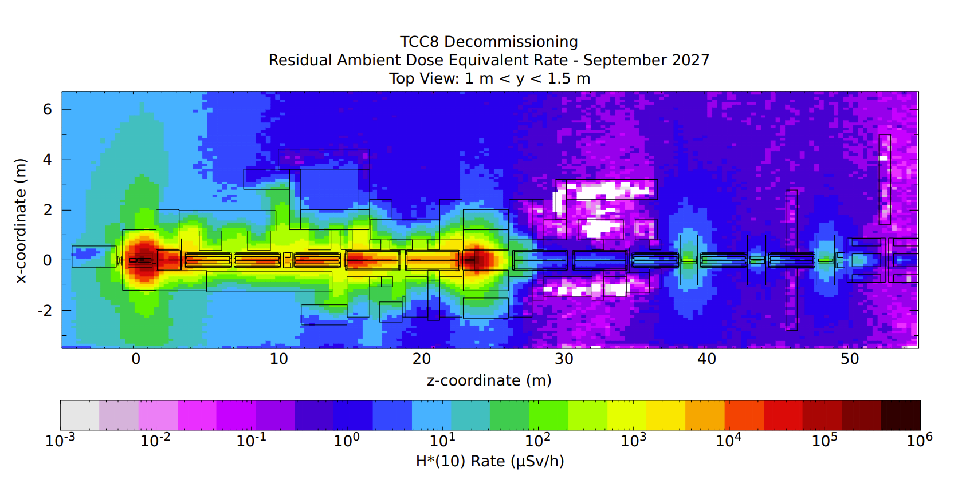
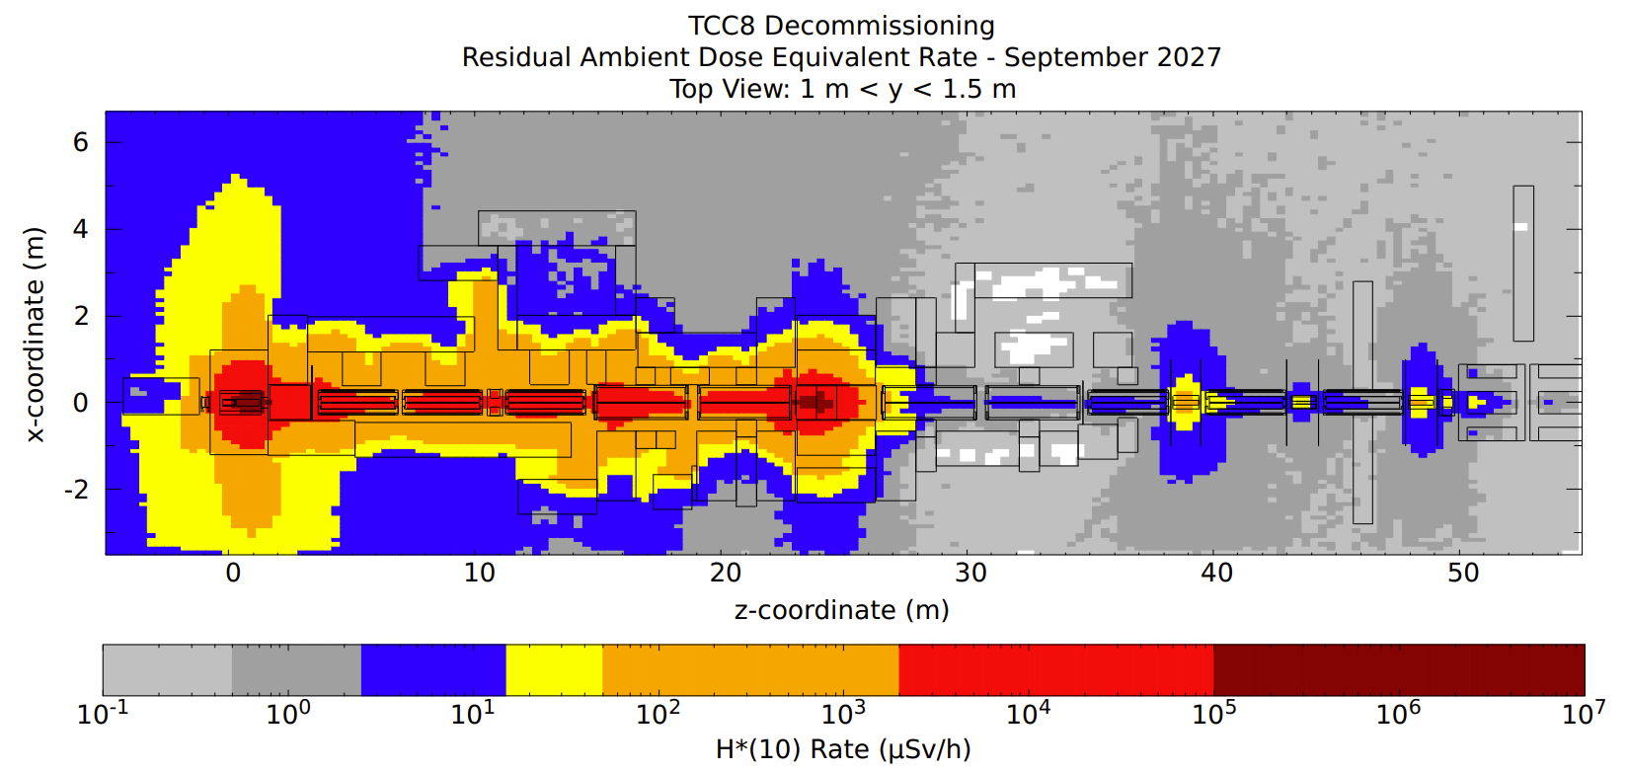
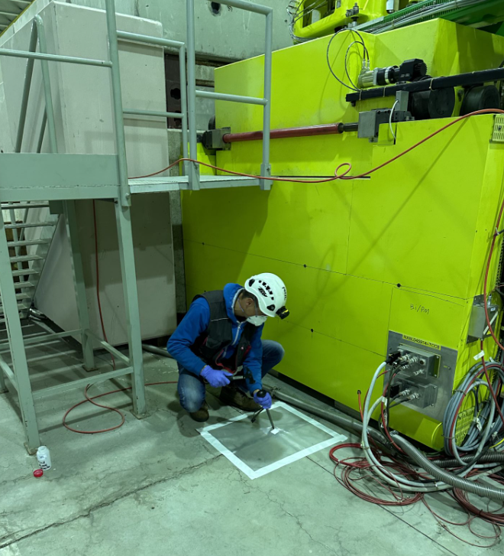
TCC8 dismantling
TCC8 FLUKA model
TCC8 dismantling
Dismantling of the highly radioactive TCC8 target area in 2026
Evaluation of residual dose rates and radio-nuclide inventories for operational RP as well as radioactive transport and waste studies
Residual H*(10) – Sep 2027
Concrete composition studies
Concrete samples were taken and analyzed via gamma spec and XRF measurements
Particle fluences were scored at the given locations via FLUKA, which were then used for subsequent ActiWiz studies to match the measured radionuclide production
Evaluation of refined elemental concrete composition

Slide 25
Summary
Main radiological aspects regarding an implementation of BDF/SHiP in ECN3 were investigated
First shielding design for an optimization of exposure of personnel to radiation and radiological impact on environment
Additional studies for the beam transfer and the TCC8 dismantling were conducted
Further detailed studies and optimization in the Technical Design Phase until 2026 to achieve first beam on target in 2031

Slide 27
Bibliography
[1] Website: https://fluka.cern
[2] C. Ahdida, D. Bozzato, D. Calzolari, F. Cerutti, N. Charitonidis, A. Cimmino, A. Coronetti, G. L. D’Alessandro, A. Donadon Servelle, L. S. Esposito, R. Froeschl, R. García Alía, A. Gerbershagen, S. Gilardoni, D. Horváth, G. Hugo, A. Infantino, V. Kouskoura, A. Lechner, B. Lefebvre, G. Lerner, M. Magistris, A. Manousos, G. Moryc, F. Ogallar Ruiz, F. Pozzi, D. Prelipcean, S. Roesler, R. Rossi, M. Sabaté Gilarte, F. Salvat Pujol, P. Schoofs, V. Stránský, C. Theis, A. Tsinganis, R. Versaci, V. Vlachoudis, A. Waets, M. Widorski, New Capabilities of the FLUKA Multi-Purpose Code, Frontiers in Physics 9, 788253 (2022)
[3] G. Battistoni, T. Boehlen, F. Cerutti, P.W. Chin, L.S. Esposito, A. Fassò, A. Ferrari, A. Lechner, A. Empl, A. Mairani, A. Mereghetti, P. Garcia Ortega, J. Ranft, S. Roesler, P.R. Sala, V. Vlachoudis, G. Smirnov, Overview of the FLUKA code, Annals of Nuclear Energy 82, 10-18 (2015)
[4] V. Vlachoudis, FLAIR: A Powerful But User Friendly Graphical Interface For FLUKA, in Proc. Int. Conf. on Mathematics, Computational Methods & Reactor Physics (M&C 2009), Saratoga Springs, New York (2009)
[5] H. Vincke, C. Theis, ActiWiz – optimizing your nuclide inventory at proton accelerators with a computer code, Progress in Nuclear Science and Technology (2014)
[6] P. Vojtyla, Models for assessing the dosimetric impact of releases of radioactive substances from CERN facilities to the environment – Air, CERN Internal report (2021)

Slide 28
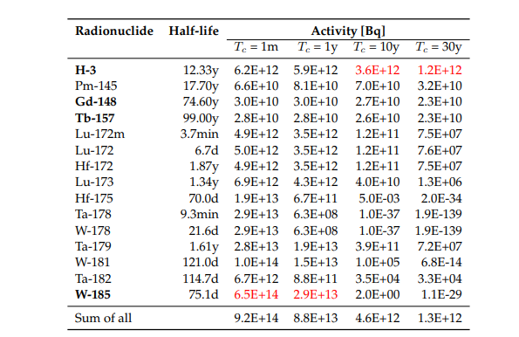
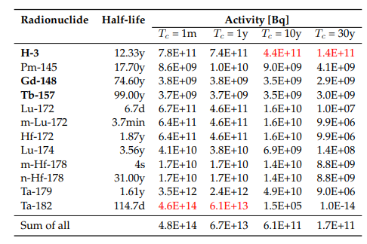

Activities – CDS target
Total PoT 2×10²⁰ (5 yrs)
Activities of BDF target materials
W
Ta
TZM
Pure alpha/beta emitters are shown in bold
Dominant radionuclide is shown in red
Main contributors (>1%), sum for all radionuclides

Slide 29



Multiples of Swiss Clearance Limits (LL)
CDS Target
Total PoT 2×10²⁰ (5 yrs)
LL multiples of BDF target materials
W
Ta
TZM
Pure alpha/beta emitters are shown in bold
Dominant radionuclide is shown in red
Main contributors (>1%), sum for all radionuclides

Slide 30
CDS target radionuclide inventories
Total PoT 2×10²⁰ (5 yrs)
1 month cool-down
Target | Material | Mass [kg] | Multiple LL | Multiple LA | A [Bq]
CDS | W | 695 | 1.9E+08 | 2.6E+08 | 9.2E+14
 | TZM | 271 | 1.1E+09 | 8.4E+07 | 1.8E+14
 | Ta | 28 | 1.7E+11 | 6.9E+08 | 9.8E+14
Ta cladding dominates for 1 month of cool-down due to Ta-182 (τ_{½} - 115 d)
30 years cool-down
For 30 years of cool-down, the LL for Ta and W is dominated by Ba-133 (τ_{½} - 10.5 y), while the LA by Gd-148 (τ_{½} - 74.6 y)
For all materials, the total activity is dominated by H-3 (1.5E12 Bq for TZM, τ_{½} - 12.3 y)
Target | Material | Mass [kg] | Multiple LL | Multiple LA | A [Bq]
CDS | W | 695 | 1.9E+05 | 1.1E+08 | 1.3E+12
 | TZM | 271 | 3.4E+05 | 3.1E+05 | 2.1E+12
 | Ta | 28 | 6.5E+05 | 1.5E+07 | 1.7E+11

Slide 31

Water activation – CDS
Activation of water from cooling circuits was estimated
Shielding estimate around demineralization cartridges was performed assuming Be-7 to be stopped, but no target debris
  → 50 cm cylindrical concrete shielding was foreseen and for the roof of the area 165 cm concrete
Remaining water in circuit mostly contains H-3 with a concentration of around 0.5 GBq/l per year of operation
Due to the high H-3 production in the target (~18 TBq during 5 yrs operation), a significant contribution to the H-3 concentration in the water can come from H-3 out-diffusion from the target disks and subsequent trapping in the cooling water
In case of 1% of out-diffusion every 2 months (guess, currently no data available) and 100% trapping, the H-3 concentration from out-diffusion amounts to ~60 MBq/l every 2 months
The exchange of cooling water (1 m³) in one year would result in ~220 GBq of H-3 activity
PoT 1×10¹⁹ (1 yr)
Total Activity (Bq) for H-3 and Be-7
Results above do not take out-diffusion from target into account

Slide 32


Alternative BDF target design studies
See talk “Design considerations for the BDF/SHiP production target” by R. Ximenes
Baseline Design (CDS) – Water cooled, W + TZM cladded w/ Ta2.5W
Investigation of alternative claddings (Nb, Nb-1Zr, Nb-10Hf-1Ti) → Nb-94 (half-life of 20k yrs) w/ higher waste disposal challenges
Alternative designs currently being studied in the TDR
W Helium cooled Target
Enclosed compact
Cu + W Target
Investigation of radionuclide inventories
Expected to be less critical from a radiological point of view
D = 33 cm, L = 201 cm

Slide 33



Radionuclide inventory of large W target
Tungsten part
Total PoT 2×10²⁰ (5 yrs) + 1 month cool-down
Tungsten – Total Activity (Bq)
Tungsten – Multiple of LL
Tungsten – Multiple of LA
Pure alpha/beta emitters are shown in bold
Dominant radionuclide is shown in red
Main contributors (>1%), sum for all radionuclides

Slide 34
Large W target – LA for short cool-down
Tungsten part
Total PoT 2×10²⁰ (5 yrs)
Tungsten – Multiple of LA
1 hour
1 day
Radionuclide | Halflife | 1h
Hf-178m | 4s | 1.2E+09
Gd-148 | 74.60y | 4.3E+08
W-187 | 23.9h | 3.2E+08
W-185 | 75.1d | 1.9E+08
Hf-172 | 1.87y | 1.5E+08
Ta-182 | 114.7d | 3.8E+07
Sum of all |  | 2.52E+09
Radionuclide | Halflife | 1d
Gd-148 | 74.60y | 4.3E+08
W-185 | 75.1d | 1.9E+08
W-187 | 23.9h | 3.2E+08
Hf-172 | 1.87y | 1.5E+08
Ta-182 | 114.7d | 3.8E+07
Yb-169 | 32.0d | 1.7E+07
Ta-183 | 5.1d | 1.7E+07
Hf-175 | 70.0d | 1.3E+07
Sum of all |  | 1.13E+09
Pure alpha/beta emitters are shown in bold
Dominant radionuclide is shown in red
Main contributors (>1%), sum for all radionuclides
For 1 h of cool-down, Hf-178m is dominant (48%) and wrt. to 1 month of cool-down also W-187 and W185 are relevant (Hf-178m comes from the decay of Ta-178m (2.36h half-life)
For 4 hours of cool-down, the important radionuclides are as for 1 hour
For 1 day of cool-down, Gd-148 becomes most important (38%)

Slide 35

Alternative Claddings
Cladding materials:
  Tantalum –16.6 g/cm3
  Nb (ASTM R04210 – Type 2) – 8.6 g/cm3
  Nb-1Zr (ASTM R04261 – Type 4) – 8.6 g/cm3
  Nb-10Hf-1Ti (ASTM R04295) – 8.86 g/cm3
Total PoT 2×10²⁰ (5 yrs), 1y cool-down
Residual dose rates (uSv/h)
Total PoT 2×10²⁰ (5 yrs)
Includes residual dose rates from surrounding material
Nb-94 half-life of 20300 yrs
Waste classification as FA-MA waste to be disposed of in Switzerland (no open pathway so far for such activation of Ta/Nb)
No difference in the residual dose rates for the various Nb claddings
* LMA: Acceptance Activity Limits, if activity levels < LMA candidate for elimination in France

