Slide 2

Beam Transfer for the High Intensity facility at ECN3 for the Search for Hidden Particles experiment
M. Fraser (SY-ABT-BTP) presenting on behalf of the HI-ECN3 Project Team
13th International Workshop on Neutrino Beams and Instrumentation (NBI2024)
AYA'S LABORATORY Quantum Beam Research Center (AQBRC), Tokai, Japan
7 – 10th October 2024
https://hiecn3.web.cern.ch

Slide 3

Study Project $→$ Approved Project
Upgrade of beam intensity at North Area and SHiP beam-dump (BDF/SHiP) experiment approved recently…
… with ~ 62 MCHF (over 7 years) reserved for the HI-ECN3 project in CERN’s Medium-Term Plan ratified by CERN Council in June 2024.
Approved together with ~ 170 MCHF for consolidation of the North Area (NA-CONS project)
The HI-ECN3 project is a part of CERN’s…
“…broad diverse scientific programme, complementary to the collider and carried out mainly at the injectors: continuously upgraded and expanded (e.g. recently the ECN3 beam intensity upgrade at the North Area).”
Fabiola Gianotti

Slide 4

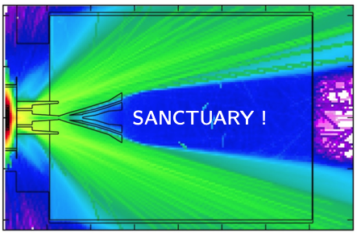
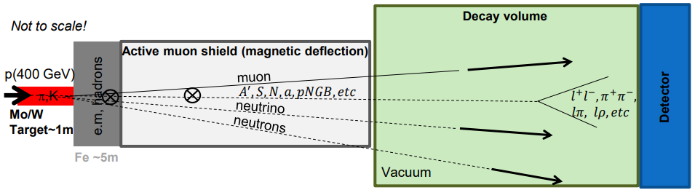


SHiP has a bow wave…
$$μ^{−}$$
$$μ^{+}$$

Slide 5
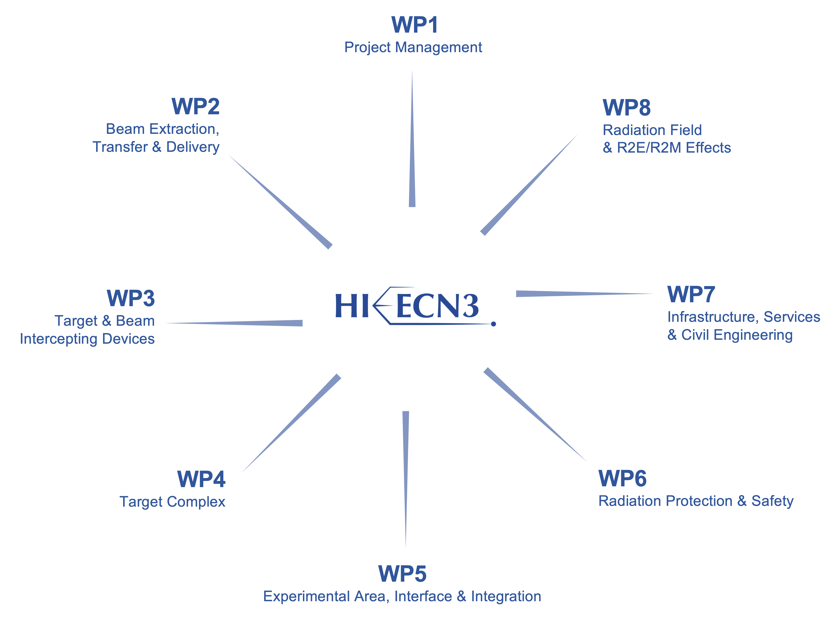
Other HI-ECN3 contributions at NBI 2024
The Search for Hidden Sector experiment and its tau neutrino program
Current & future facilities session: Richard JACOBSSON
Radiation protection studies and considerations for the ECN3 high intensity project
Radiological & safety issues session: Claudia AHDIDA
BDF target station design
Secondary beamline session: Jean-Louis GRENARD
Design considerations for the BDF/SHiP production target
Target and beam window session: Rui Franqueira XIMENES
HI-ECN3 Project Structure
PL: Matthew FRASER
DPL: Claudia AHDIDA
Francesco VELOTTI & Laurie NEVAY
Luigi ESPOSITO
Experiment Project Leader: Richard JACOBSSON
SHiP Experiment Safety Correspondent: Letizia DI GIULIO
Rui FRANQUEIRA XIMENES
Fernando PEDROSA
Jean-Louis GRENARD
Claudia AHIDIDA
Project Safety Officer (PSO): Melania AVERNA
Project & Experiment Safety Support (PESS) Correspondent: Jamie CURRIE
Francois BUTIN

Slide 6
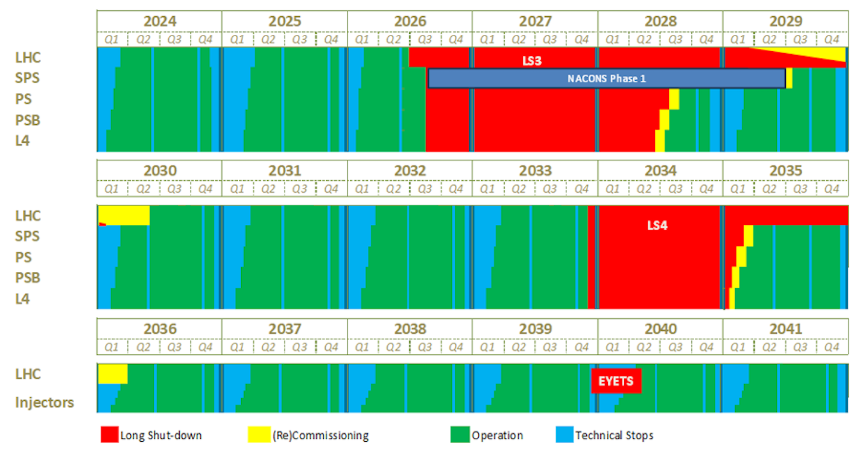
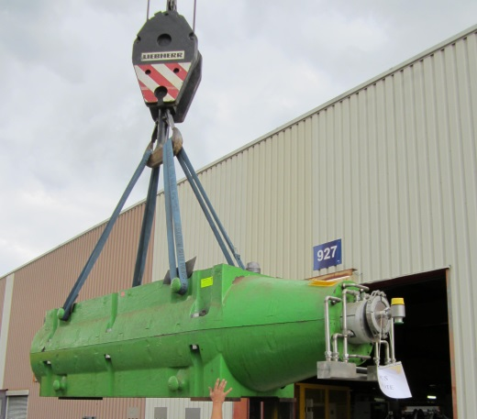
M. Lamont, Updated schedule for CERN’s accelerators, CERN Bulletin, 4 October 2024
CERN Accelerator Schedule
Today
NA available exclusively for EHN1/2 from mid-2029:
Test-beam users & other POT demanding experiments
(e.g. AMBER, MuonE)
ECN3 beam to dump in P42 for commissioning of TCC2
whilst construction ongoing
NA-CONS Phase I
HI-ECN3
Commissioning
HI-ECN3
Operation
NA-CONS Phase II
(TBC)
Operation out to late 2040s:
beyond HL-LHC
(frequency & length of LS’s TBC)
NA-CONS
HI-ECN3 Operation

Slide 7
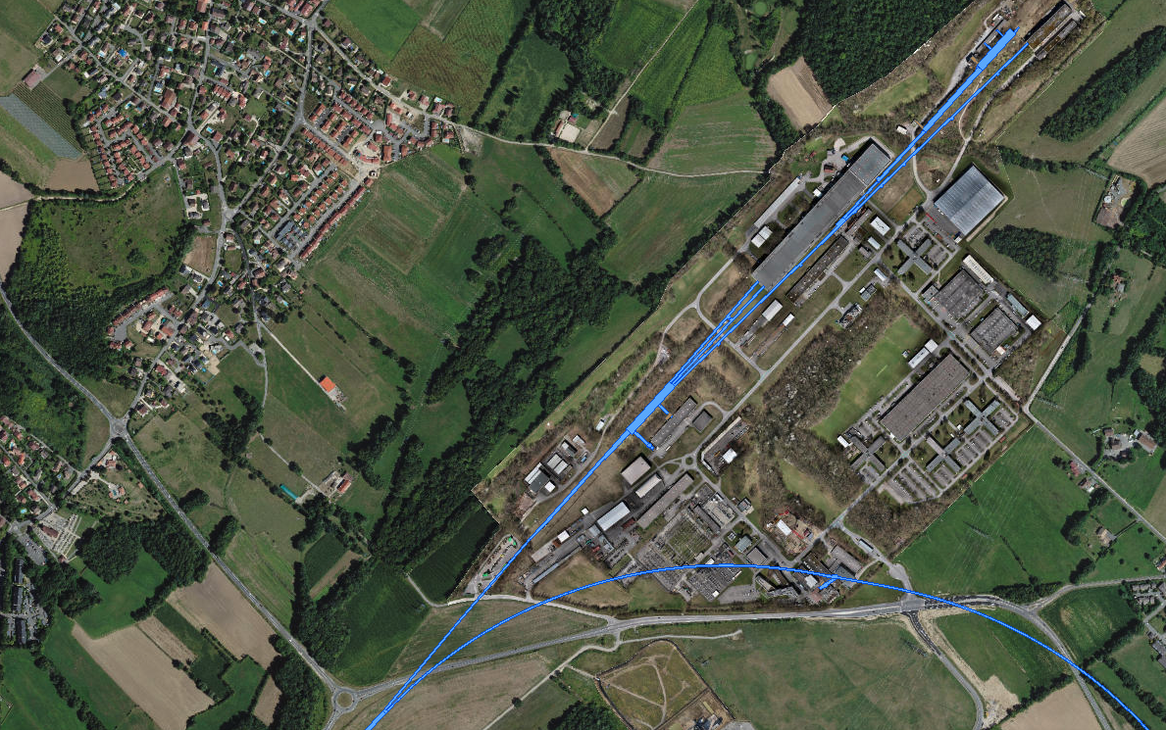
NA-CONS consolidation project
Consolidation & Upgrade
HI-ECN3 project
ECN3
Timeline = completion in LS3 (2026-2029)
Timeline = completion before 2031
TCC8: T10 / TAX
→ BDF
TCC2 Targets:
T2 / T4 / T6
New Beam Dump (TIDVG4)
TDC2: TT20 splitters
~ 1.7 km !
Transfer Tunnel (TT) 20:
inc. TT20 TED
SPS Extraction Straight

Slide 8
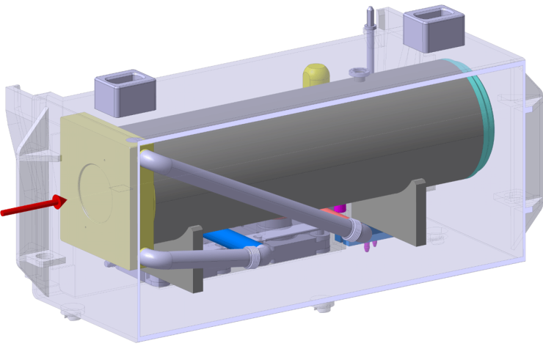
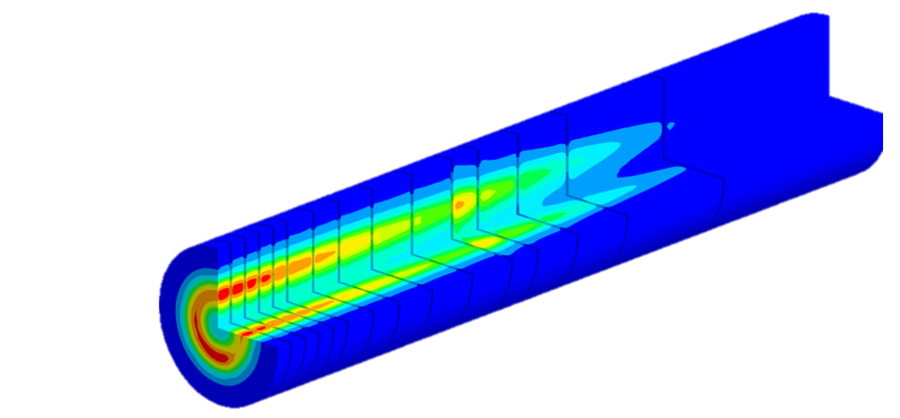
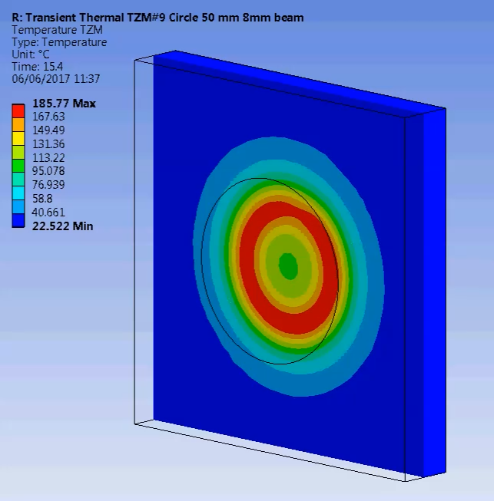
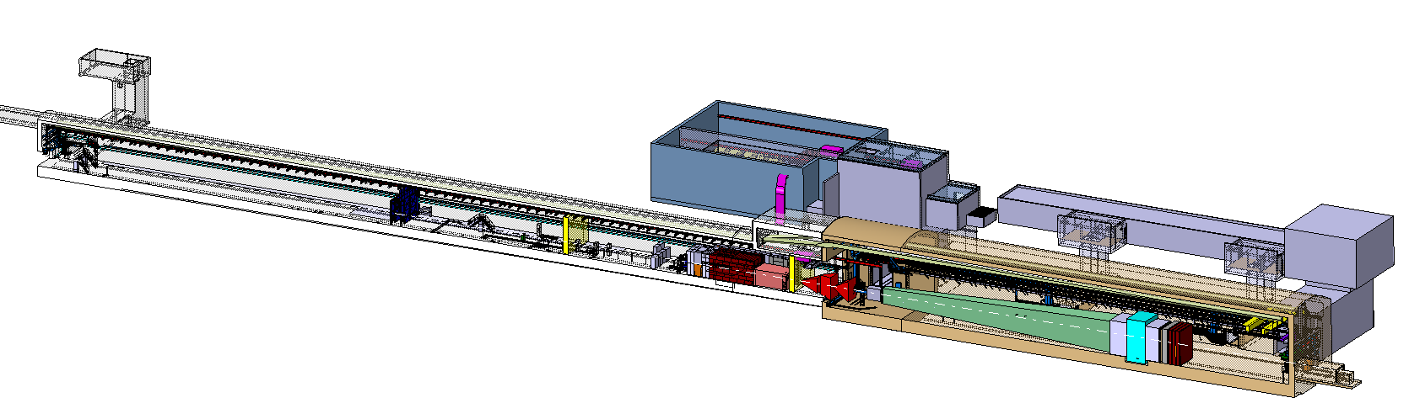
L. Krzempek, BDF-SHiP Integration in ECN3, EDMS #2936008
BDF/SHiP in ECN3
~ 300 kW (avg.)
~ 2.3 MW (spill)
1 second spill
4 Hz sweep
Beam from SPS
New
Access
Shaft
New Target
Service Building
Existing
Access Shaft
B911
B918
Beam Dilution System
TCC8
BDF’s Target Complex
containing a “thick” high-Z target (Mo/W)
ECN3
SHiP experiment

Slide 9
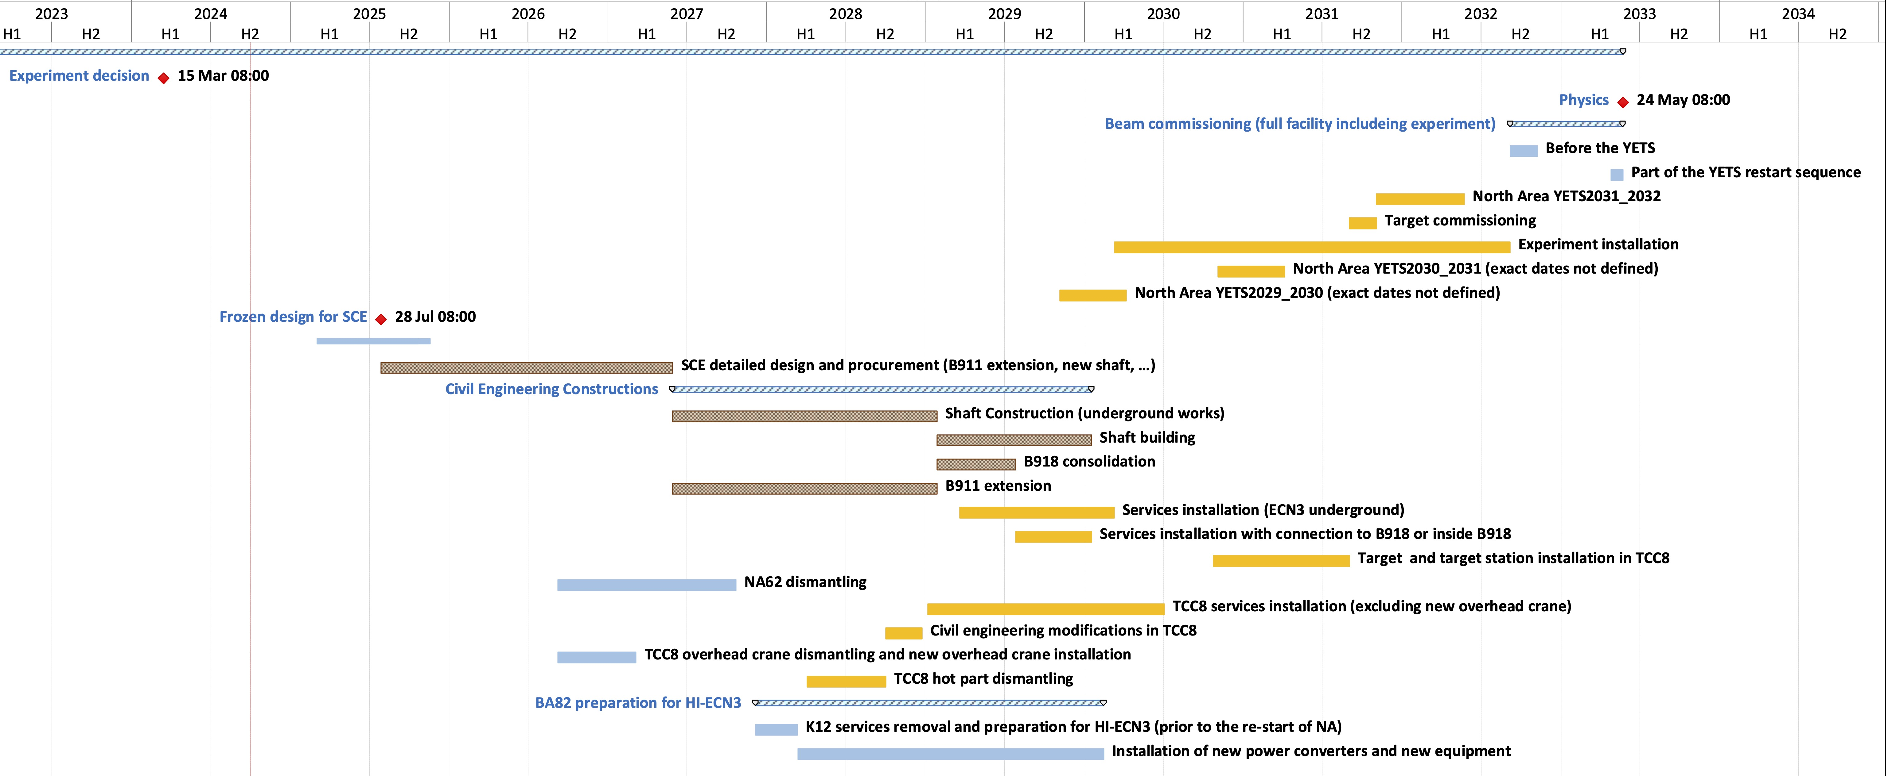
HI-ECN3 Project Timeline
Beam on BDF Target
Long Shutdown 3
Upgrades to NA with NA-CONS
TDR Phase
(Facility)
TDR extension?
Critical path:
CE procurement & works
LS4
Below freezing design for SCE!
(Detailed design for consultant before contractor Invitation to Tender)
July 2026
Dismantling

Slide 10
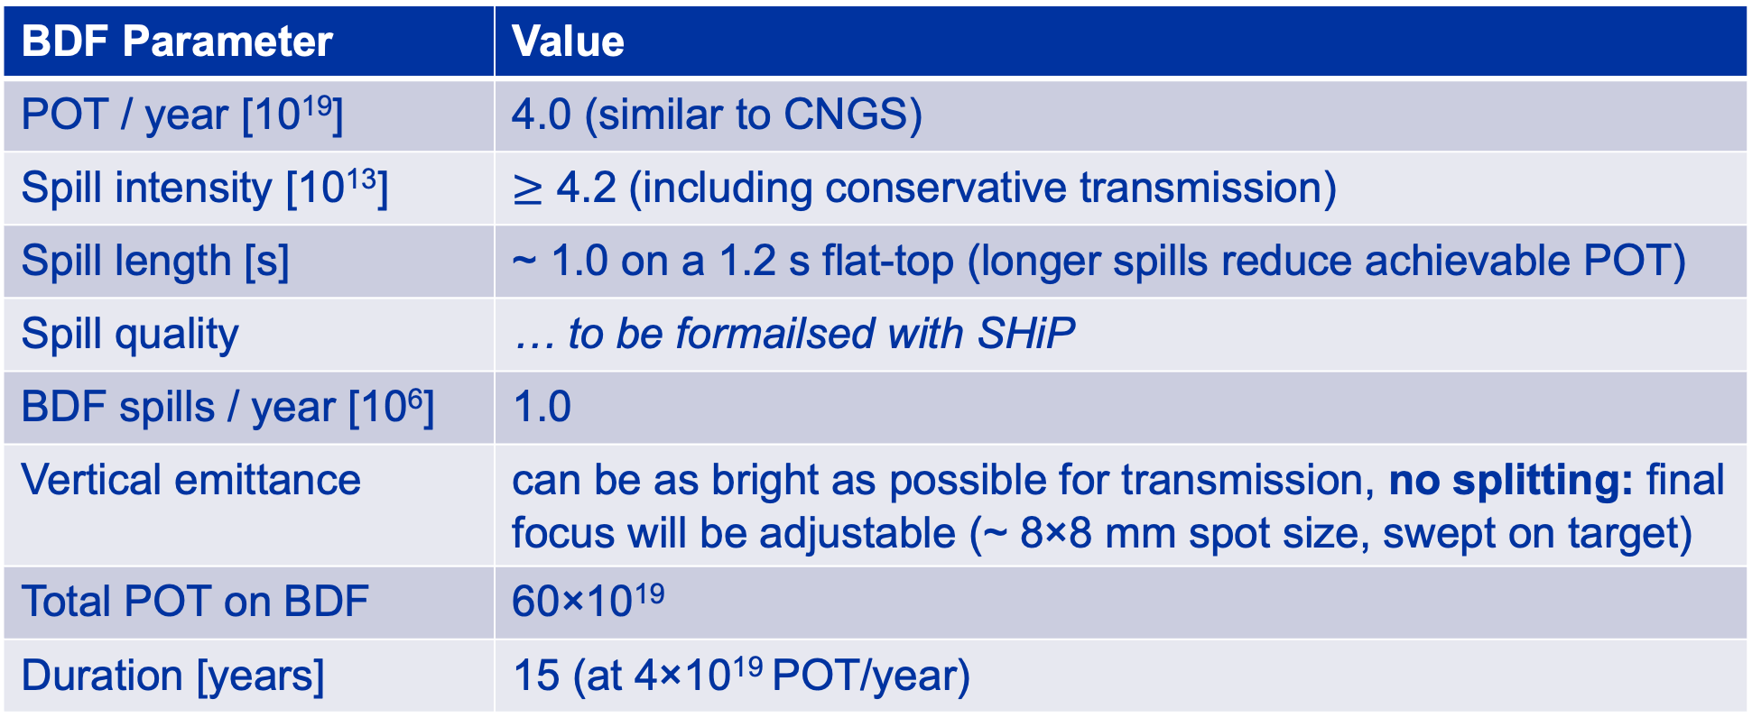
SHiP beam parameter request
BDF Parameter | Value
POT / year [10¹⁹] | 4.0 (similar to CNGS)
Spill intensity [10¹³] | $≥$ 4.2 (including conservative transmission)
Spill length [s] | ~ 1.0 on a 1.2 s flat-top (longer spills reduce achievable POT)
Spill quality | … to be formailsed with SHiP
BDF spills / year [10⁶] | 1.0
Vertical emittance | can be as bright as possible for transmission, no splitting: final focus will be adjustable (~ 8×8 mm spot size, swept on target)
Total POT on BDF | 60×10¹⁹
Duration [years] | 15 (at 4×10¹⁹ POT/year)

Slide 11
Shared Beam Delivery to ECN3
LSS2
TT21
TT22
TT23
T2
H2
H4
SPS
EHN1
H6
TT24
T4
H8
Shared delivery:
splitting
Field-free region
P4
P41, P61
ECN3
TCC8
P42
NA62
Horizontally deflected by the B-field
TT25
T6
M2
EHN2
Continues straight: no B-field
Losses (~5%)
Matthew FRASER | HI-ECN3 Beam Transfer
NBI 2024 AQBRC, Tokai Japan 7 – 10 October 2024
11

Slide 12
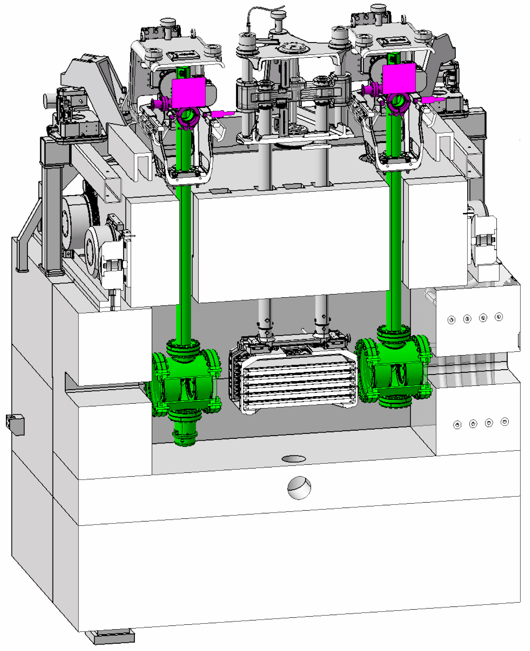

Dedicated Beam Delivery to ECN3: commissioning
LSS2
TT21
TT22
TT23
T2
H2
No splitting
in TDC2
H4
SPS
EHN1
H6
target
T4
TBIU
TBID
TT24
H8
Dedicated delivery:
no splitting
No interaction with TCC2 Target
P4
P4 Beam Dump
ECN3
B
TT25
T6
M2
EHN2

Slide 13
Dedicated Beam Delivery to ECN3
LSS2
TT21
TT22
TT23
T2
H2
No splitting
in TDC2
H4
SPS
EHN1
H6
TT24
T4
H8
No interaction with TCC2 Target
P4
P41, P61
ECN3
TCC8
P42
BDF/SHiP
TT25
T6
M2
EHN2

Slide 14
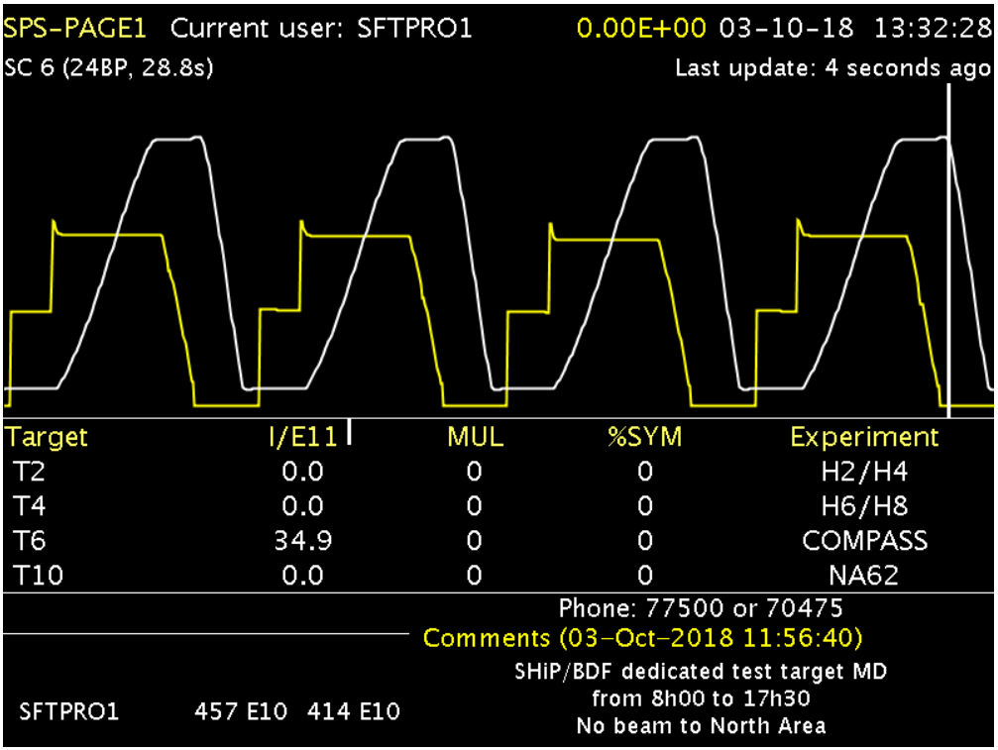
How many protons for BDF / SHiP? (i)
Short CNGS-like 7.2 s SFTPRO cycle with a 1.2 s FT (~ 1 s spill)
SPS Page 1 during BDF prototype target test at T6 in 2018

Slide 15
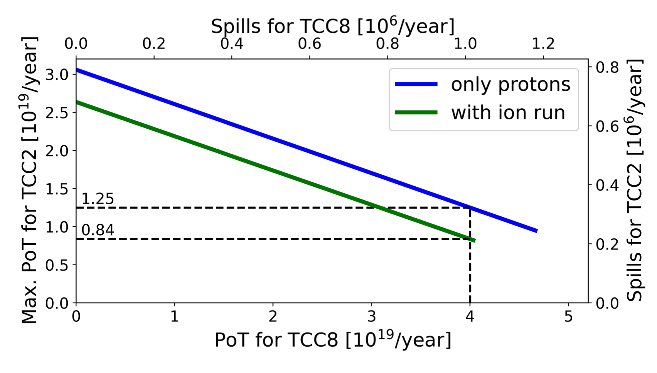
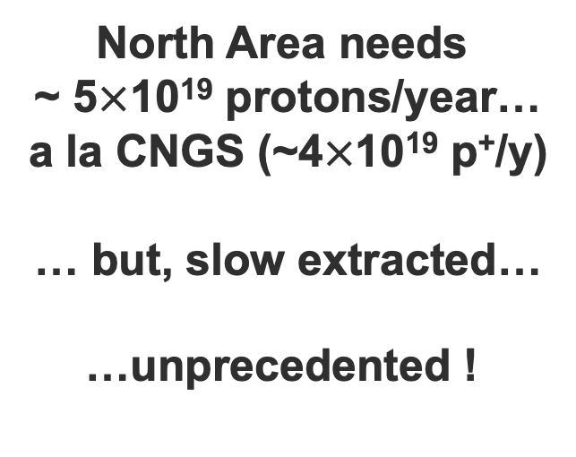
T. Prebibaj et al., SPS Operation and Future Proton Sharing Scenarios for the ECN3 facility, CERN-PBC-Notes-2023-001
How many protons for BDF / SHiP? (ii)
North Area needs
~ 5$×$10¹⁹ protons/year…
a la CNGS (~4$×$10¹⁹ p⁺/y)
… but, slow extracted…
…unprecedented !
Protons to TCC2 (other NA users)
Protons to ECN3 (BDF/SHiP)

Slide 16
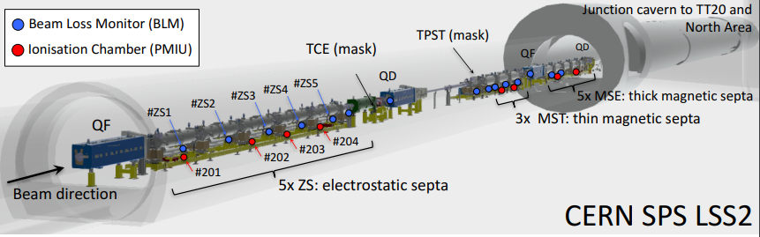
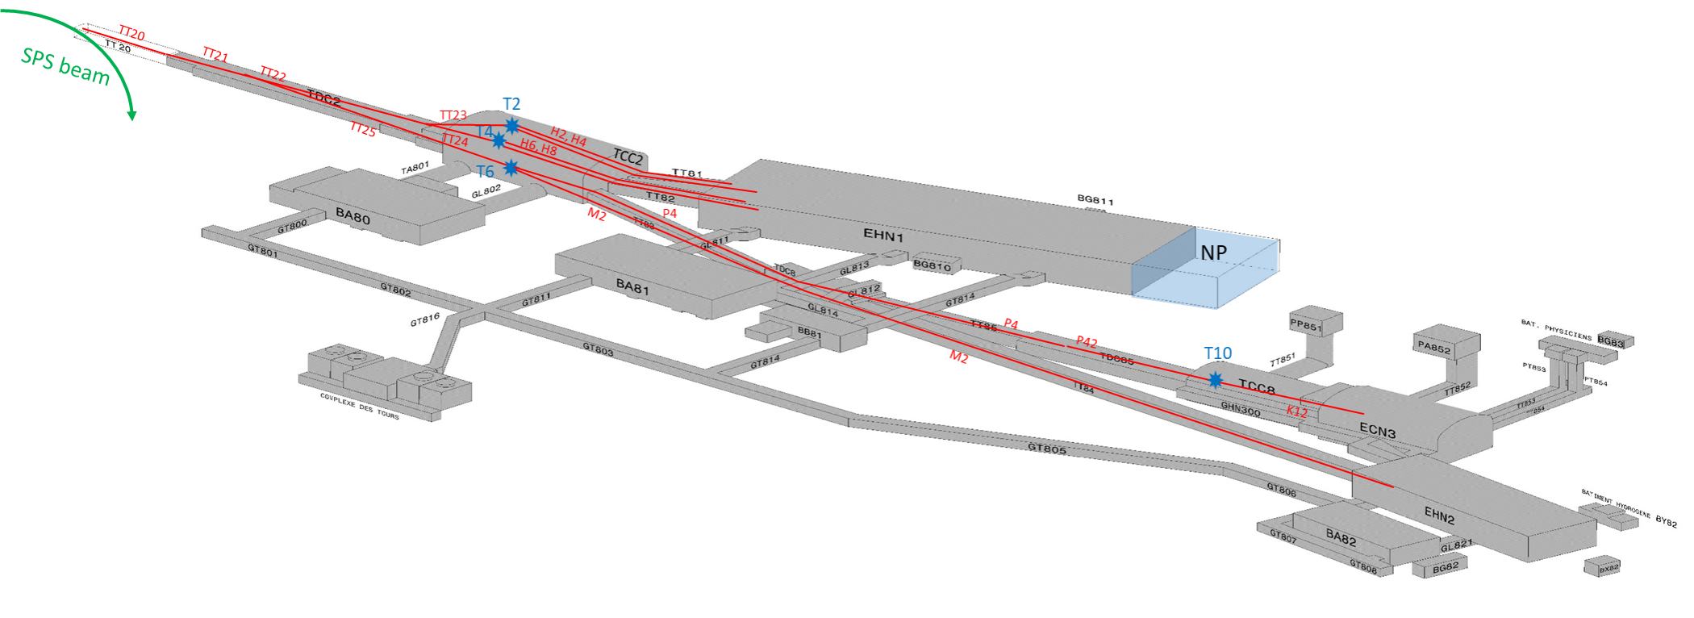
Slow Extraction from LSS2 in SPS

Slide 17
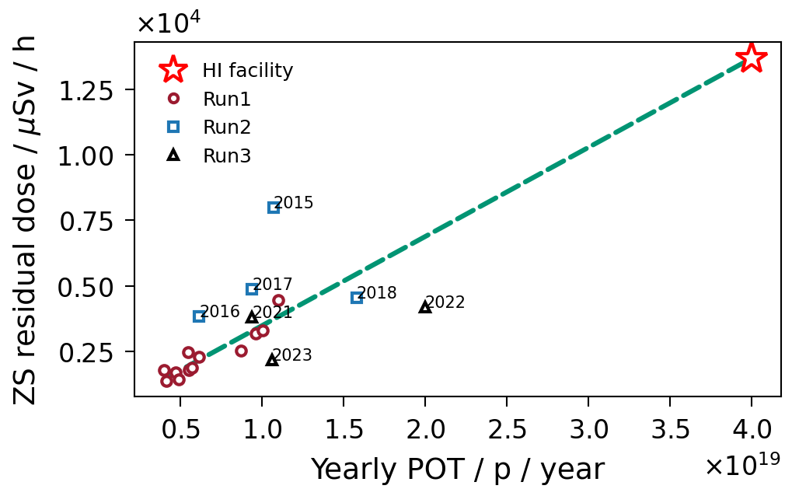
Slow extraction beam loss reduction
Objective: to achieve a beam loss reduction factor of ~ 4 in stable, in long-term operation
Correlation between end of year activation dose rate (peak at electrostatic septum) and annual POT
SY-ABT mandated to investigate losses in 2015
?

Slide 18
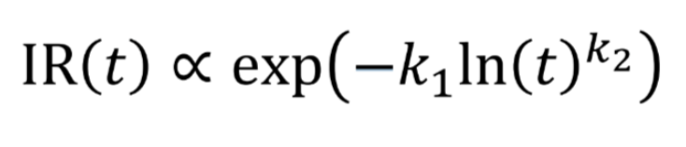
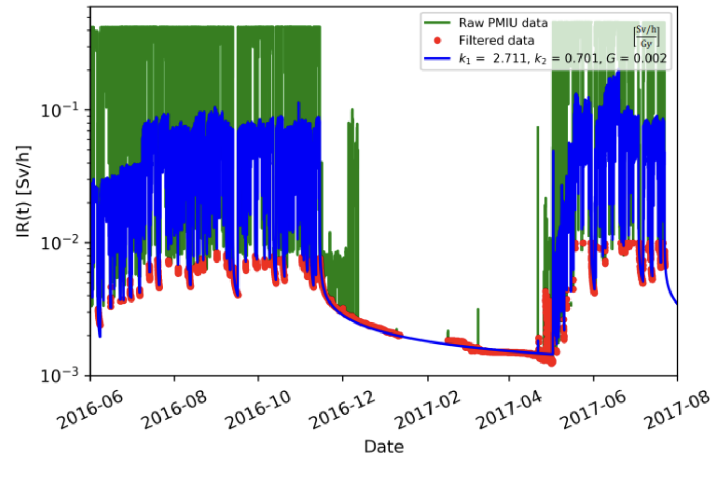
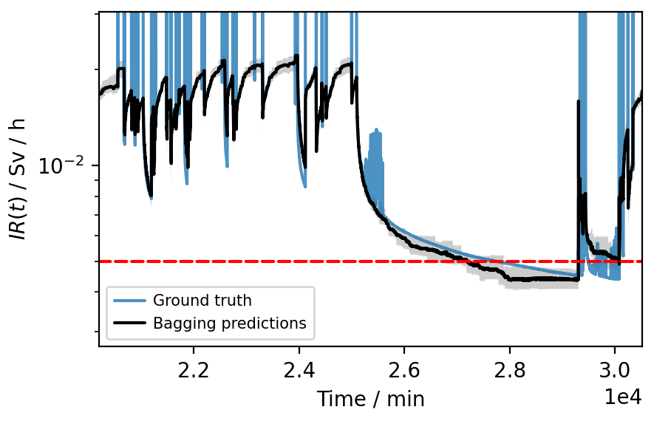
F.M. Velotti, Induced radioactivity predictions from prompt beam loss readings, Slow Extraction Workshop 2024, Wiener Neustadt, February 2024
Modelling induced radioactive in the SPS
Radiation hazards of future operational scenarios can be predicted using data driven models: fit measured prompt beam loss [Gy] & proton flux [p⁺] to RP monitor [Sv/h]
Semi-analytic:
Machine Learning: LightGBM: A Highly Efficient Gradient Boosting Decision Tree
t(function call) ~ minute
t(function call) ~ ms

Slide 19
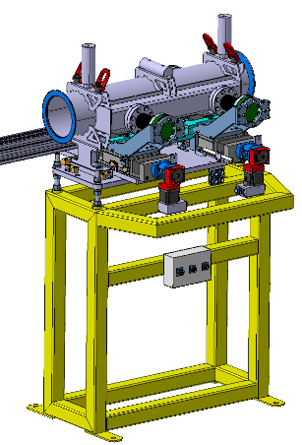
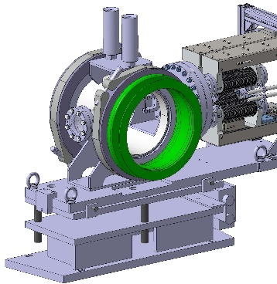
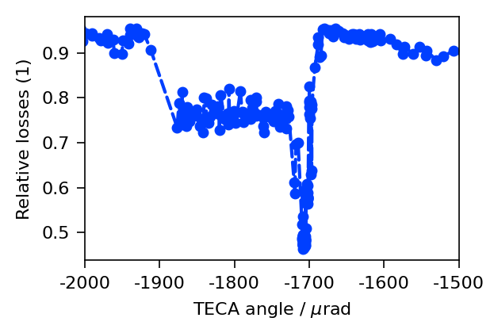


L. Esposito et al., Progress on optimised TECA and MVRA production, SLAWG #76: Crystal shadowing and production, August 2024
F. M. Velotti et al., Phys. Rev. Accel. Beams 22, 093502 (2019)
Crystal Shadowing of electrostatic septa
LSS4 gonio R&D:
~ 55% loss reduction
To be deployed operationally in 2024
LSS2 gonio already operational with 20% loss reduction
TECA (LSS4)
TECS (LSS2)
Unaffected beam
To TT20
deflected
(...)
up
x
Deflected beam
Deflected beam
ZS
circulating
down
s
To SPS
Thin, bent silicon crystal ~ 2 mm thick, 2 mm long

Slide 20
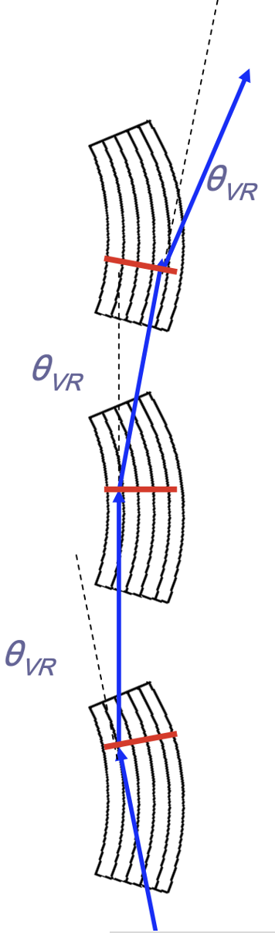
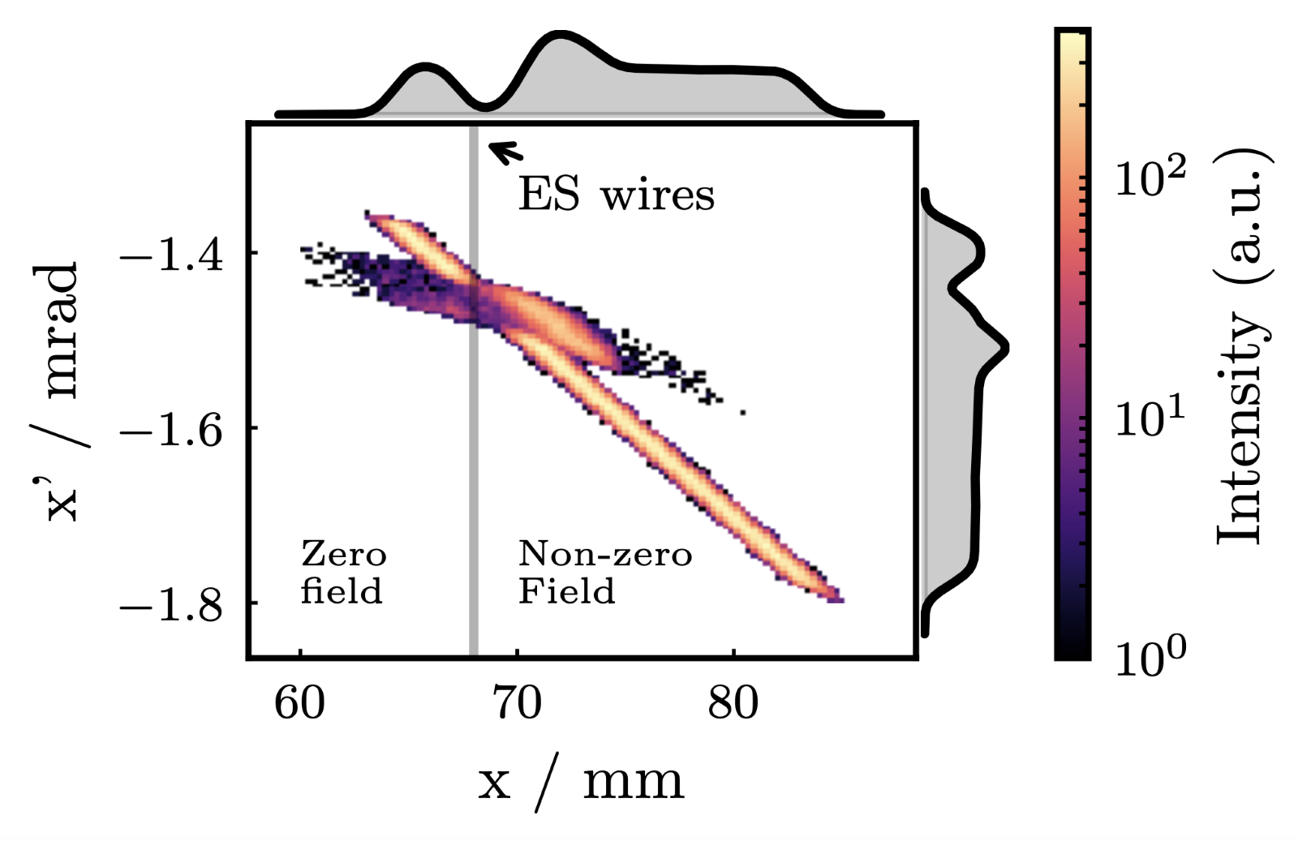
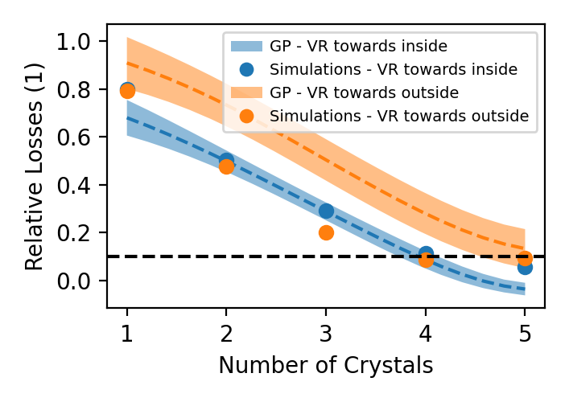
L. Esposito et al., Progress on optimised TECA and MVRA production, SLAWG #76: Crystal shadowing and production, August 2024
F. M. Velotti et al., Phys. Rev. Accel. Beams 22, 093502 (2019)
Crystal Shadowing of electrostatic septa (ii)
Objective: achieve an even higher loss reduction factor (x10?!) with advanced crystal technology (multiple thin, bent crystals aligned for Volume Reflection) installed in SPS
Prototype might be available for tests in 2025 (mechanics developed in-house at CERN)

Slide 21
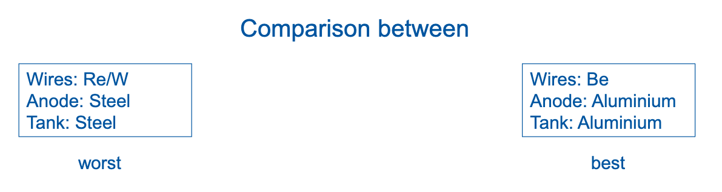
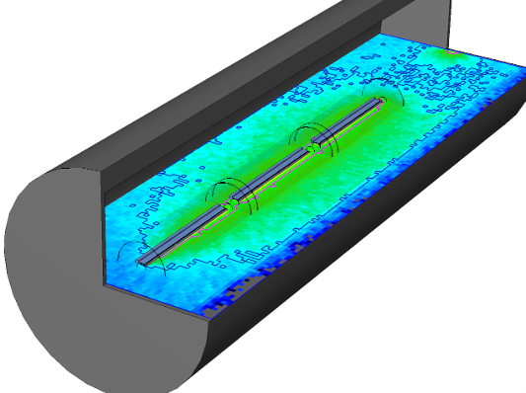
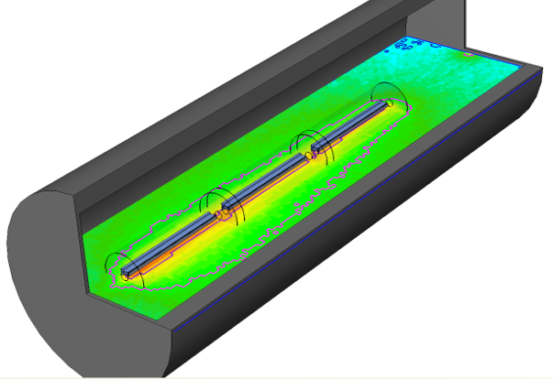

H. Vincke, Radiological impact of the material choice of the ZS element, SLAWG #74, Nov 2023
F. Lackner et al, Improvements of the SPS slow extraction electrostatic septum, TUPC72, IPAC2024
Low-density septa
Today
Dream world
20x reduction!
Residual dose rate after 1 week
Efforts focused on tank material as the best candidate: feasible + factor 2 dose reduction
Selection of alloy → Al 5083
Design of low-Z flanges → Bimetallic flange
Buckling tests → mass reduction of 2.7x w.r.t. current tank
Manufacturing → mock-up + welding tests

Slide 22
TCC2 Upgrades

Slide 23
A. Gorn et al., Optics rematching between TT24 and P42 primary beam lines within the HI-ECN3 study project at CERN 2024, TUPC71, IPAC 2024
L. Dyks, Characterisation of the optics of the TT24 and P42 beamlines in the CERN SPS North Area, IPAC 2024
Beam transfer from SPS to EC3
A huge effort is ongoing to improve understanding of old 1970’s transfer line equipment

Slide 24
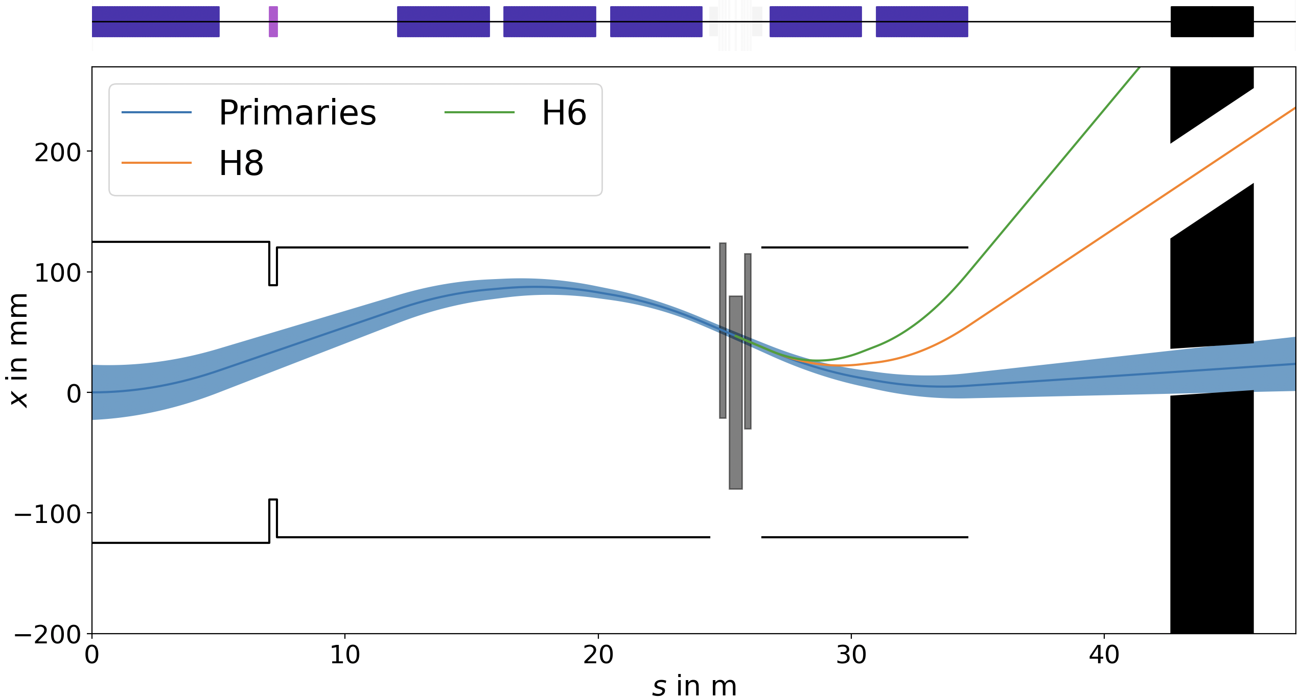

Existing TCC2 Target T4 Region
F. Metzger et al, Beam line and parameters, 30th SHiP collaboration meeting, ALU Freiburg, 1 – 4 October 2024
Today, operation of EHN1 (H6/H8 test beams) is coupled with ECN3 (NA62)
Secondary particles for EHN1 are selected using magnet wobbling system, whilst protons not interacting with the target are transmitted to NA62
To EHN1: H6
To EHN1: H8
To ECN3: NA62
$$μ± 7σ$$
x
T4 Target
s
T4 XTAX

Slide 25
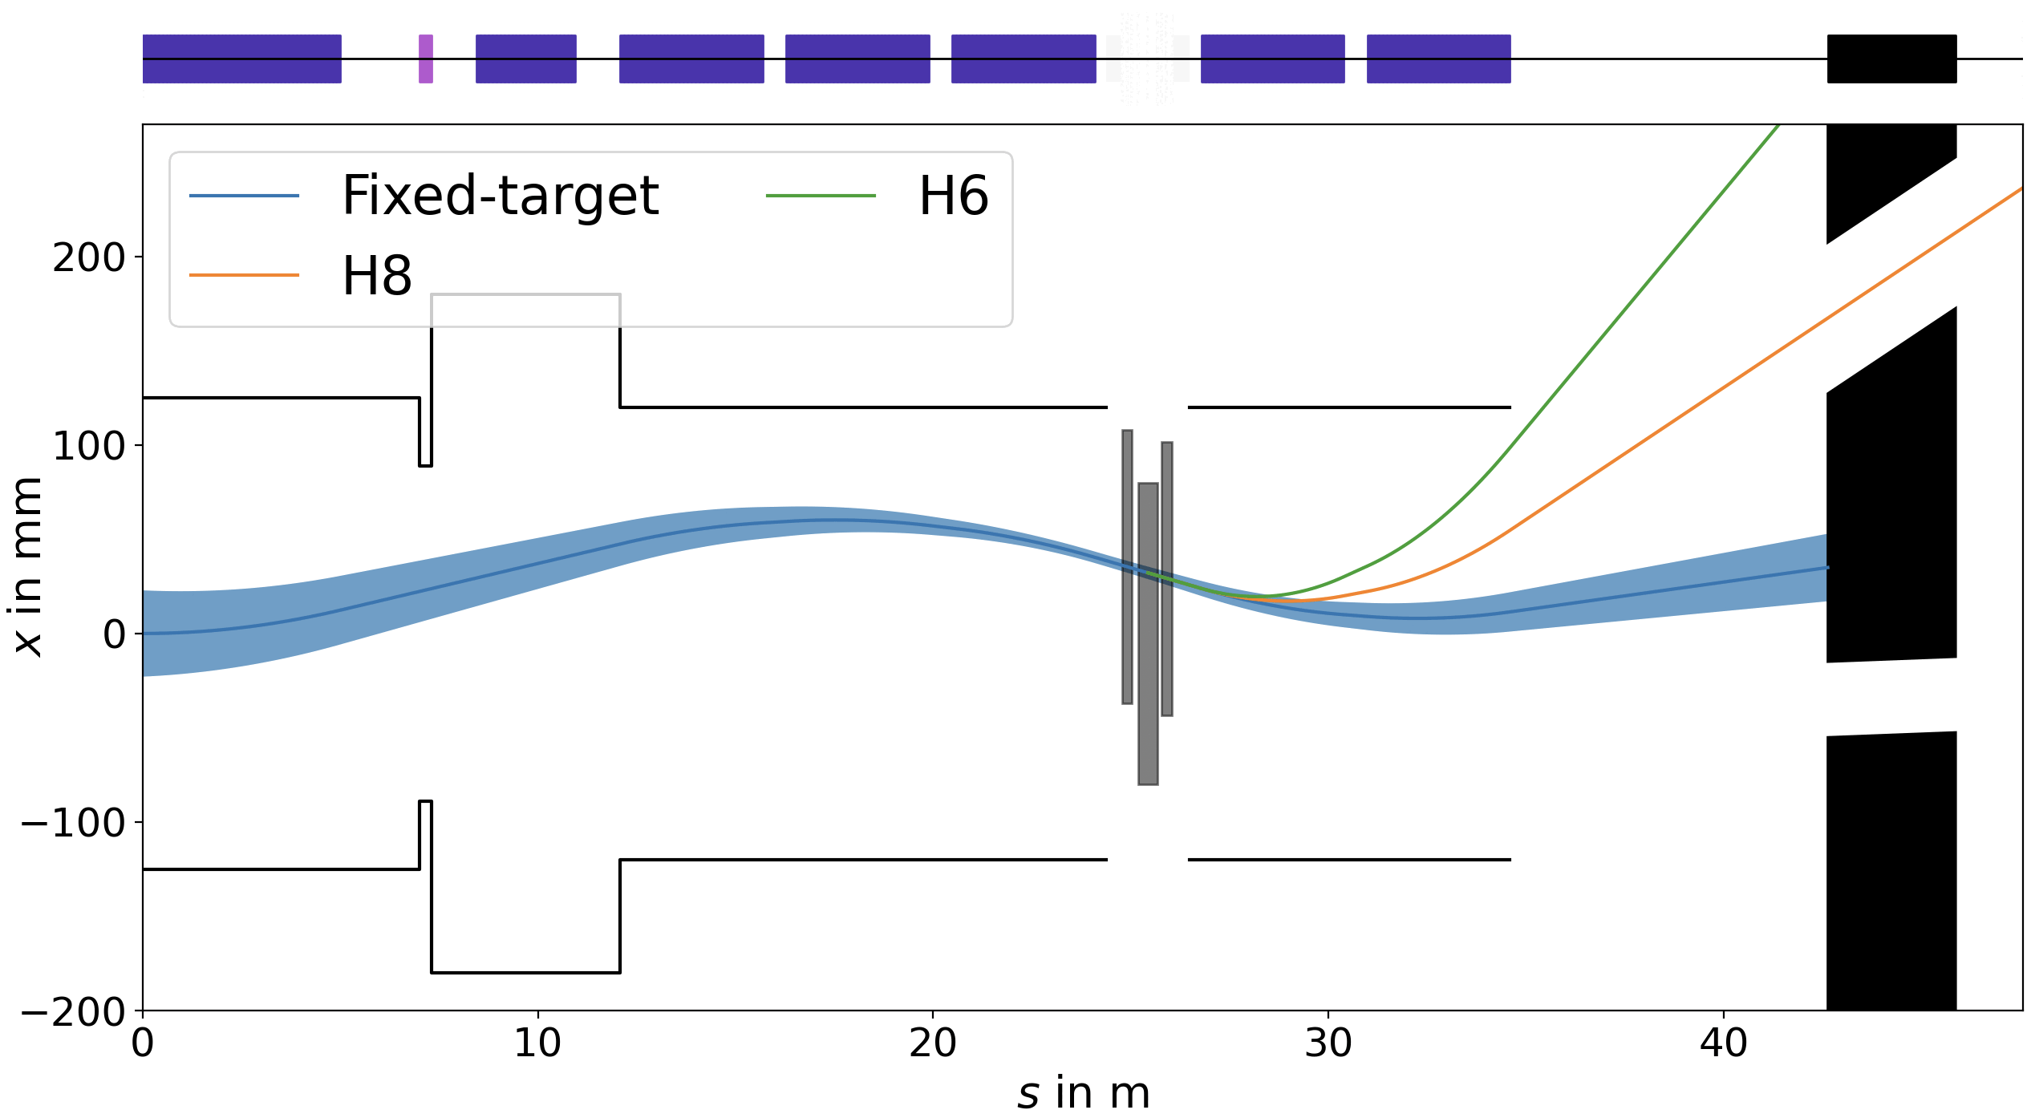
F. Metzger et al, Beam line and parameters, 30th SHiP collaboration meeting, ALU Freiburg, 1 – 4 October 2024
Upgrade for BDF/SHiP
A pulsed magnet allows us to decouple proton beams on the dedicated HI-ECN3 cycle in the horizontal plane (in addition to vertical separation to avoid target)
To EHN1: H6
To EHN1: H8
T4
To ECN3: NA62

Slide 26
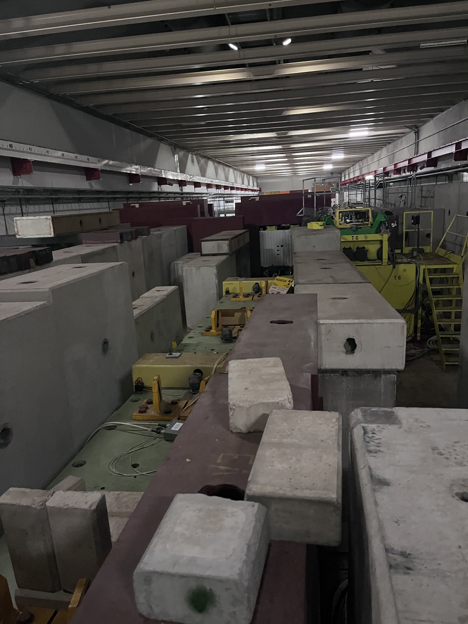
T4 XTAX absorber in TCC2
Looking downstream from on top of T4 target
To ECN3
H8
H6
To avoid scattering BDF/SHiP beam on air the ECN3 side of XTAX will be replaced by a fixed absorber with a vacuum chamber
Urgent design effort ongoing !

Slide 27
TCC2 Target System Upgrade
L. Dyks, Beam loss studies for the P42 beamline at the CERN SPS north area, TUPC73, IPAC 2024
  Reduce beam loss in P42 transfer line to ECN3:
    Putting XTAX under a continuous primary vacuum of ~10⁻³ mbar will reduce the beam loss in the shallow transfer tunnels from TCC2 to ECN3 caused by scattering of BDF/SHiP (by up to a factor ~ 50!)
TCC2: T4
P42 transfer line
TCC8: BDF
Detailed design underway

Slide 28
Dilution

Slide 29
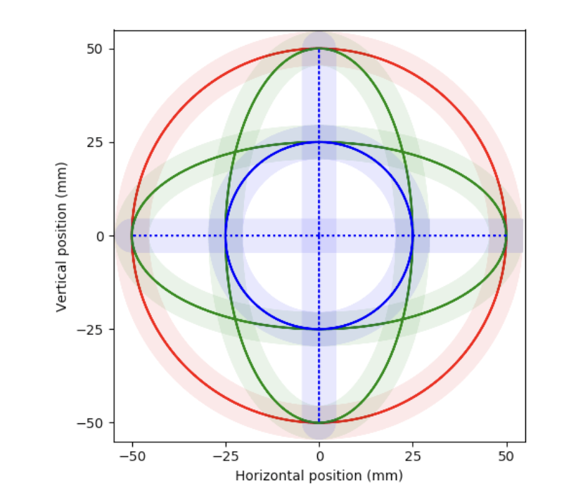
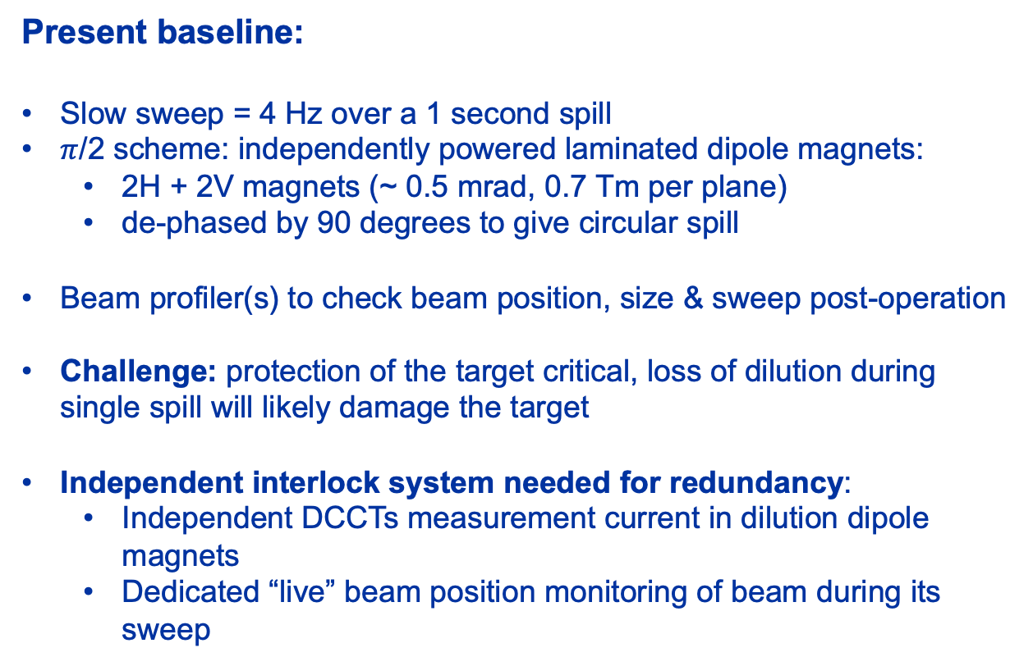
BDF Dilution System
Y. Dutheil, SPS BDF CDS, CERN Yellow Report, CERN-2020-002
Present baseline:
Slow sweep = 4 Hz over a 1 second spill
$π$/2 scheme: independently powered laminated dipole magnets:
  2H + 2V magnets (~ 0.5 mrad, 0.7 Tm per plane)
  de-phased by 90 degrees to give circular spill
Beam profiler(s) to check beam position, size & sweep post-operation
Challenge: protection of the target critical, loss of dilution during single spill will likely damage the target
Independent interlock system needed for redundancy:
  Independent DCCTs measurement current in dilution dipole magnets
  Dedicated “live” beam position monitoring of beam during its sweep
Failure Scenario:
Failure 2H OR 2V
Failure 1H OR 1V
Failure 1H AND 1V

Slide 30
Summary
BDF/SHiP was approved in 2024
CERN has reserved budget in its MTP for a new facility in ECN3 under the project named HI-ECN3
We are under pressure to meet NA-CONS deadlines for Long Shutdown 3 and in the last 6 months we have focused on beam delivery in the North Area
Some ~ 10 years of slow extraction R&D will converge into a Technical Design Report as part of the HI-ECN3 TDR
HI-ECN3 TDR to be published in 2026, aiming at beam on target in 2031 !

